Slide 1

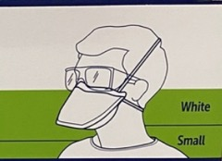

Conserving N95 Masks
CDC approved Method
N95 @ Covenant
Infection Prevention, 3/6/2020
All caregivers requiring use of N95 mask will use ONE mask 5 times. Discard mask after the 5th use or if mask becomes:
  moist or wet
  soiled (dirty)
  Hard to breathe through
When not in use, store the mask in a paper bag with your (the owner) name and the numbers 1, 2, 3, 4, and 5 written on the outside. Keep stored masks in the ante room. If there is no ante room, store in designated drawer
Use N95s in rooms of patients on AIRBORNE (and ONLY Airborne) isolation
  If patient requires Airborne and Contact isolation, discard mask after every use
  DO NOT reuse mask in Aerosolization procedures Ex ( Endo )
Track mask usage by marking through numbers. Discard after 5th use.
The purpose is to conserve N95 masks in preparation of possible increased need in the near future
**Brown bags are in isolation cart or may call equipment distribution**
Please direct your questions to your manager or supervisor
N95 @ Grace
Linda Smith
1 2 3 4 5

