Slide 1
Covenant Health
Presents
Critical Communications: A Weekly Physician Update
January 15, 2021

Slide 2
PHYSICIANS
Accreditation Statement:
The Covenant Health is accredited by the Texas Medical Association (TMA) to provide continuing medical education for physicians.
Credit Designation Statement:
The Covenant Health designates this live CME activity for a maximum of 1.0 AMA PRA Category 1 Credit(s)™. Physicians should claim only the credit commensurate with the extent of their participation in the activity.

Slide 3
Disclosures of Commercial Interest
The speakers and planners of this activity
have no relevant financial interests

Slide 4
Disclosures
This activity is provided by
Covenant Health
No commercial support has been received.
No products will be endorsed.
Speakers will notify the audience if off label drug use will be discussed.

Slide 5
CME Credit was only approved for the Live Teams meeting
To receive credit for this continuing education activity, the participant must:
  Make sure you are logged into your Teams account, if you are signed in with a group provide attendee’s First and Last name(s) in the comments section.
  If you are calling into the Teams meeting you MUST text your First & Last Name to (806) 252-4735. This will ensure you are added to the sign in sheet to receive CME Credit.
  You will receive an email by Wednesday following the call from the CME department with further instructions on claiming your certificate.

Slide 6
Reflection
David Gray, DO

Slide 7
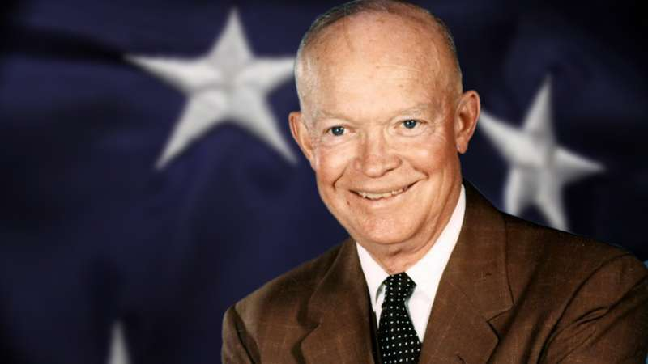
Dwight David Eisenhower
In what military role did Eisenhower serve? In what political position did serve?
Correct answers: Supreme Commander of Allied Forces in Europe during WW2, and for two terms beginning in 1953, President of the United States.
How did he get there? What was special about his background that led to these roles?

Slide 8

Dwight David Eisenhower was born in Denison, Texas on Oct 14, 1890. When he was 2, his family returned to Kansas where extended family lived. His parents held college degrees, but economic times were hard on the Plains. His family had Mennonite roots, but during his childhood they became part of what we know today as Jehovah’s Witnesses, a central tenant of which was pacification.

Slide 9
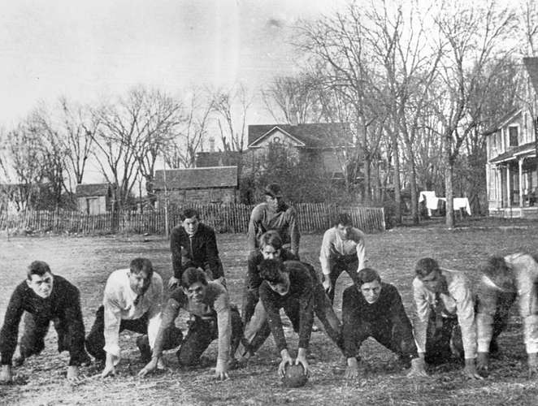
Eisenhower’s childhood was remarkable for avid consumption of his mother’s history books, and he was gifted in mathematics. Because he was unable to afford College, he sought a commission to West Point, where he matriculated in 1911. His mother was understandably disappointed in his embarkation upon a military career but did not intervene.

Slide 10
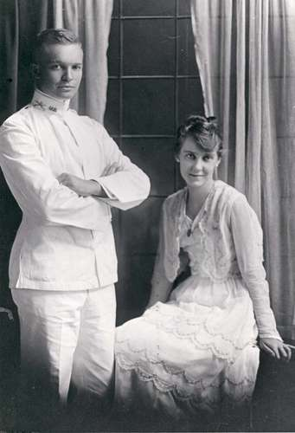
Eisenhower’s time at West Point was remarkable for…
nothing, other than frequent violations of detailed school regulations. He was very good at sports, but repeated knee injuries ended his college sports career during his freshman year. He graduated in the middle of his class, which became known as “the class the stars fell on” because 59 members eventually attained the rank of General.
Eisenhower married Mamie Doud in July of 1916, a date pushed forward by 5 months because of the impending US entry into WW1. Their first son died of Scarlet fever at the age of three (Penicillin wouldn’t be available for more than 2 decades), while their second son went on to a distinguished military career.

Slide 11
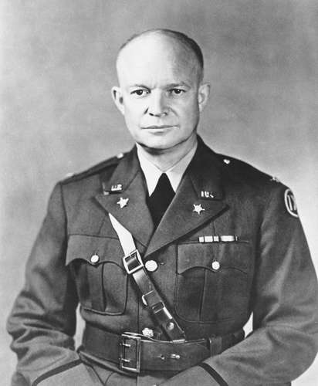
Eisenhower repeatedly requested overseas assignments in his early career, but was instead placed in different training roles in several stateside posts. He became distinguished for his organizational abilities and his ability to accurately assess junior officers’ strengths and make optimal placement of personnel. As the leader of a tank unit, he finally got an assignment to France, but was re-assigned without deployment as WW1 ended one week before his deployment date.
Stay with me here – our story is about to accelerate, but I wanted you to see a string of significant disappointments encountered by the young Eisenhower, through which he continued to learn, grow and apply himself.

Slide 12
In 1920 he began service under a succession of talented generals, including John Pershing, Douglas MacArthur and George Marshall. These men would later describe him as “one of the most capable, efficient and loyal officers I ever met”. Under Douglas MacArthur in the Philippines, Eisenhower distinguished himself in the development of the nascent Philippine National army, but more importantly, learned how to thrive in an atmosphere of disagreement with a highly visible senior officer.
Because of his skills of organization and diplomacy, Eisenhower was tasked with leading America’s first major combat mission in WW2, in spite of never leading soldiers in combat, which represented the passing over of dozens of more senior officers. His path reflected the learning process of the nation as a whole, as we learned the hard way, the hard lessons of world war.

Slide 13
I mentioned at the outset that Eisenhower was the Supreme Commander of Allied Forces in Europe and became President of the US. The point of giving you so much backstory is to encourage us to focus on these three things:
To all of us, think about the following: More than the ease of the opportunities that are laid before us, how we respond to setbacks and heartache will determine the trajectory of our lives. How can we help each other to manage up during these unusually challenging times?
To those with a bit of gray in their hair, think about the following: Without effective mentors, we would not be talking about Eisenhower today. He was not born into opportunities, but was mentored into personal growth and development. How are we mentoring those around us? How can we encourage the development of those around us?
Perhaps especially to those who have not reached their career goals yet, I ask the following: How can we, individually and collectively, answer the call to serve in the roles in which we find ourselves today? How can we diligently, humbly, seek to serve others today and tomorrow?
I hope you will take these thoughts to heart, and may you be a blessing to those around you today!

Slide 14
State Managed Covid-19 Hospital in Lubbock
Walt Cathey, CEO Lubbock Market

Slide 15
The Texas Department of Emergency Management
Looking for facilities in Texas to increase inpatient capacity
Inquired about our recently vacated hospital facility at 50th Street and University
Conducted a site visit of the facility with Covenant/Grace personnel and City officials along with representatives from the third party (ASHBRITT) who will administer/operate/bill for care provided there.
The decision has been reached that the are going to lease the facility from Covenant and begin operations in the next two weeks.
COVID hospitalizations in that facility SHOULD NOT COUNT in our RAC total (that would artificially inflate our percentages)

Slide 16
Racial Disparity and Susceptabilty to
Covid-19
Follow-up from last weeks discussion

Slide 17
Zip Code Origin of Patients that have succumbed to COVID-19 at Covenant
50 Miles
100 Miles
150 Miles
200 Miles

Slide 18
New Physician Screening and Mask Replacement Process for CMC
Reminder

Slide 19
Physician Dining Room Screening Site
Do your daily screenings:
In the Physicians Lounge - New Dots for the next day will be placed in the physician's lounge at 10pm the night before and will be available for self screening 24 hours a day/7 days a week
In the Front Lobby - Between the hours of 5am - 10:30pm, physicians can self screen at the physician table located behind the screener desk in the second cubby on the right.
On the Units - 24/7 access

Slide 20
Reprocess or Replace N-95s
On the Units - 24/7 Access
In the Front Lobby - between the hours of 5am - 10:30pm - Check in with our screener who is greeting and taking temperatures.
This should give you greater accessibility to receive or reprocess masks by being available 7 days a week and for extended hours each day, increasing availability by 100 hours a week.
Type 2 Masks and shields will be available on nursing units and the physician table in the front lobby.
For any questions or concerns, reach out to Lauren Orta (254-855-2117) or Shannon Charlton (806)723-9623.

Slide 21
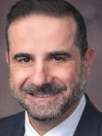
Procedures Review Committee
Sammy Deeb, MD

Slide 22
Formation and Structure
Formed in March 2020 in response to Gov. Abbott executive order GA-9
We were tasked with optimizing care for all Procedural areas under COVID restrictions while accommodating evolving recommendations.

Slide 23
Peri Procedural COVID Committee Structure
Dr. Jason Strefling / Adrew orr (Cardiology / Cath lab)
Dr. Matt Soape / Connie Gonzales (Gastroenterology / GI lab)
Dr. Sammy Deeb / Kristy Flores (Surgery / OR)
Dr. Brian Eppright (Anesthesia services)
Lashelle Doss (Interventional Radiology)
Daniel Hronek (Executive Director of Operative Services)
Teresa Clifford / Dedra Wilson (Bed board)
Janet Vines / Tobin Rasco (Perioperative Services)

Slide 24
What Do WE Do?
Meet Daily
Review all procedures for the upcoming 24 and 48 hours.
Assure compliance of procedures with current laws / restrictions.
Assure Compliance of our patients with the latest testing recommendations.
Educate our providers with the latest recommendations and address their concerns regarding their patients care.

Slide 25
Factors to Consider
Demand on inpatient beds/resources (e.g. cancel / triage cases that require admission)
Current COVID census and trend
Community prevalence trends
Stratifying patients by risk (avoiding patients at high risk for morbidity/mortality)
Staff shortages (many OR staff are quarantined at home due to exposure at work or positive test)
Day of the week (moving cases from mid-week to Monday or Friday to reduce patient throughput bottlenecks)
Capacity to isolate COVID patients who need surgery
Cancellations at nearby facilities/local coalitions
Supply shortages, including PPEs
Testing capacity
Government/regulatory mandates

Slide 26
Our latest recommendations for scheduling surgeries for patients undergoing COVID vaccinations
Recommendation | Rationale
Vaccinations should not be required for scheduling surgeries | The additional challenges of vaccinating the general public should not be a barrier against receiving necessary surgical care
Vaccinated patients should still be tested for COVID preop as per previous recommendations | The effect of vaccines on transmissibility and preventing Covid related complications is unclear at this time
For patients receiving the two-dose vaccine, surgeries should be scheduled after both doses have been completed. | Scheduling a surgery between the doses may create a risk for delaying the second dose as well as clinical and logistical difficulties (e.g. how to manage “half-protected” patients, potential for disrupting the immune response).
Patients should be free of all side-effects of vaccination prior to their procedures. Patients should be screened for COVID related symptoms as per previous recommendations. | Side-effects of the vaccine can vary in timing and intensity. It is important to distinguish side effects from other infections or post-operative symptoms. Vaccinated patients are still at risk for a Covid infection.
Consider waiting one week after completion of vaccination to schedule surgeries. | Two main factors for waiting are 1) side effects and 2) effective immune response. Traditionally, clinicians have recommended waiting 2 weeks after vaccinations prior to surgeries to ensure a full, uninterrupted immune response prior to subjecting patients to physiologic stressors. However, there is no evidence that simply waiting until vaccine side effects subside (usually 2-3 days) is unsafe. One week may be a reasonable compromise.

Slide 27
Suggested wait times from the date of COVID-19 diagnosis to surgery
ASA and APSF Joint Statement on Elective Surgery and Anesthesia for Patients after COVID-19 Infection, 12/8/2020
Four weeks for an asymptomatic patient or recovery from only mild, non-respiratory symptoms.
Six weeks for a symptomatic patient (e.g., cough, dyspnea) who did not require hospitalization.
Eight to 10 weeks for a symptomatic patient who is diabetic, immunocompromised, or hospitalized.
Twelve weeks for a patient who was admitted to an intensive care unit due to COVID-19 infection.
(These timelines should not be considered definitive; each patient’s preoperative risk assessment should be individualized, factoring in surgical intensity, patient co-morbidities, and the benefit/risk ratio of further delaying surgery.)
https://www.asahq.org/about-asa/newsroom/news-releases/2020/12/asa-and-apsf-joint-statement-on-elective-surgery-and-anesthesia-for-patients-after-covid-19-infection

Slide 28
CMC COVID Procedure Committee Recommendation (updated)
Previously positive patients : As more and more patients recover from COVID, the population segment of recovered COVID patients who need elective surgeries will become significant. For these patients we recommend the following:
  For most patients, schedule surgeries a minimum of 30 days after first positive test if asymptomatic, or 30 days after onset of symptoms, if symptomatic.*
  NEW: Consider ASA/APSF guidelines to customize wait period by disease severity or comorbidities.
  Previously positive patients should not be tested again for 90 days after the initial positive test. (This is consistent with CDC recommendations. Due to residual inactive RNA particles that may persist for weeks, a positive test within the 90 days cannot be accurately interpreted as active infection.)
  NEW: A positive COVID test after 90 days should be considered a new or re-infection, regardless of symptoms.
*(The CDC recommendation of 10-20 days is meant to define when a patient is no longer infectious, but it does not address whether a patient is actually healthy enough after a COVID infection. The Task Force felt that a minimum of 30 days to optimize patients prior to surgery is consistent with current best practice)

Slide 29
Post-COVID patient testing and surgery timeline
0 10d 30d 60d 90d
No repeat tests
Test <72 hrs preop
No Surgery
Surgery with risk assessment
Isolate
Note: Day 0 is date of first positive test (if asymptomatic) or onset of symptoms (if symptomatic).
These are general recommendations for patients who have recovered from Covid or previously tested positive. The urgency of surgery and severity of Covid illness should be considered for each patient.

Slide 30
Current Regional Covid-19 Census

Slide 31
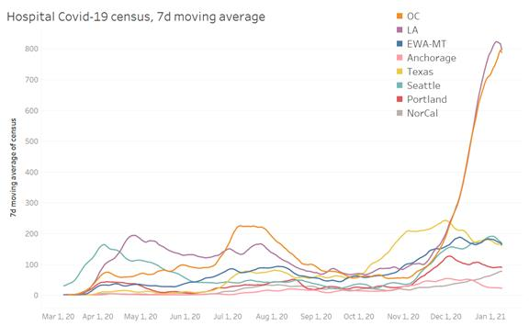
Providence

Slide 32
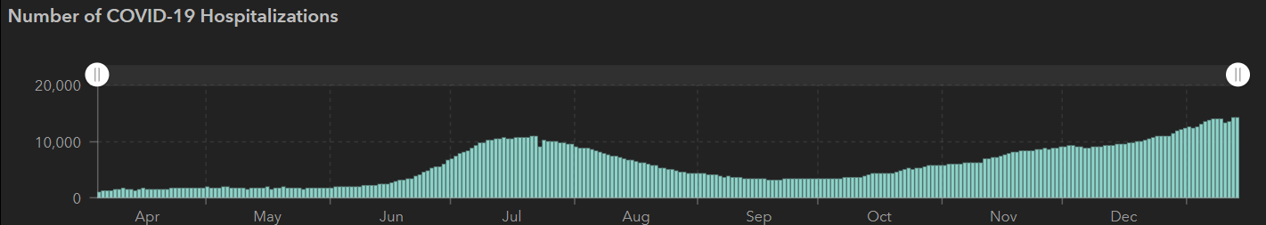
STATE Inpatients
12/2 | 12/16 | 12/28 | 1/4 | 1/6
1,200,674 | 1,367,965 | 1,490,479 | 1,598,713 | 1,646,238
21,756 | 24,394 | 26,521 | 27,969 | 28,545
9,109 | 9,053 | 9,528 | 12,961 | 13,628
NEW RECORD
14,281
1/12
 | 11/30 | 11/16 | 11/04 | 10/21 | 10/5 | 9/23 | 9/9 | 8/26 | 8/12 | 7/29 | 7/15 | 7/1
Cases | 1,168,111 | 1,027,889 | 926,400 | 838,809 | 769,303 | 719,599 | 645,791 | 592,137 | 506,820 | 403,307 | 282,365 | 168,062
Deaths | 21,379 | 19,579 | 18,320 | 17,210 | 16,033 | 15,129 | 13,692 | 11,805 | 9034 | 6190 | 3432 | 2481
Hospitalized | 8900 | 7468 | 5,872 | 4,319 | 3,318 | 3,195 | 3604 | 4806 | 7028 | 9595 | 10,471 | 6904

Slide 33
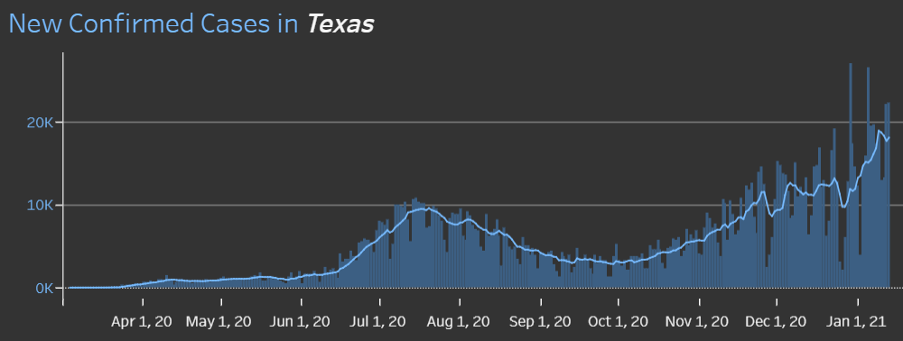
State of Texas
1/13 NEW 22,270

Slide 34
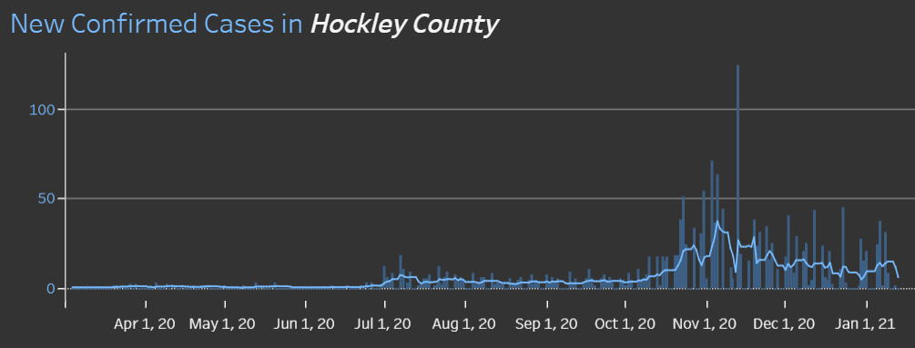
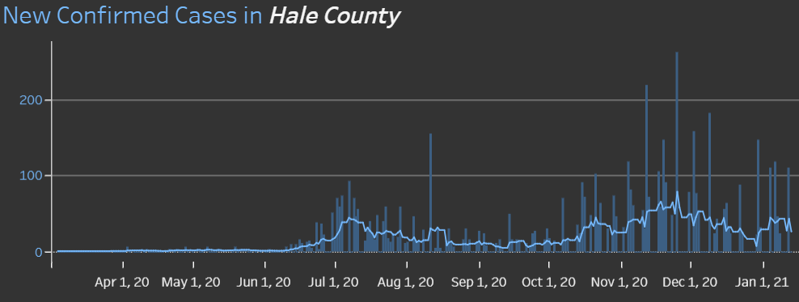
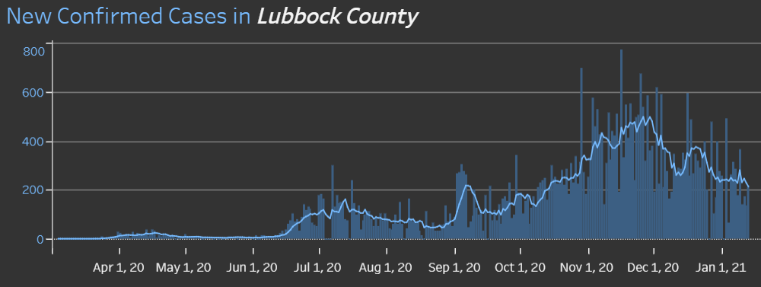
COUNTY
1/11 110 new cases
14.6% positivity rate
1/13 144
14.6 %
Positivity Rate

Slide 35
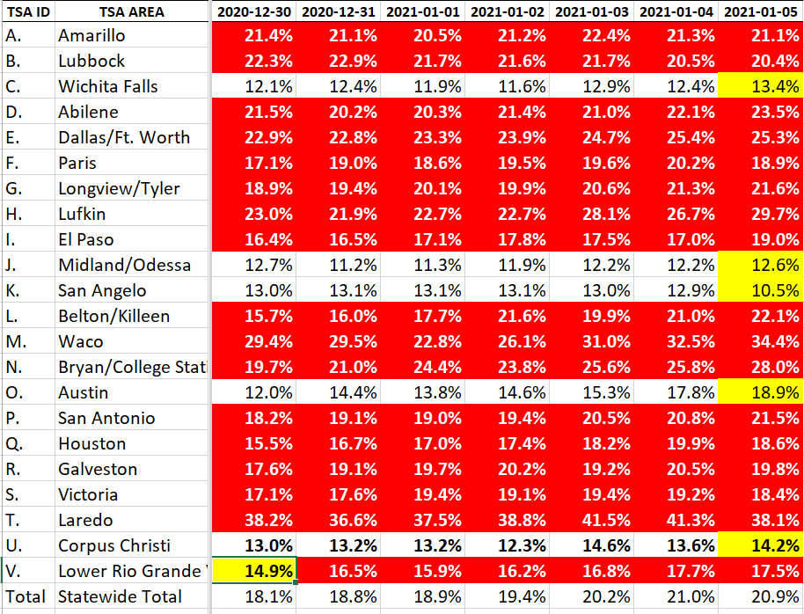
COVID+ HOSPITALIZATIONS BY TSA ID
CONFIRMED COVID+ HOSPITALIZATIONS /HOSPITAL CAPACITY
Last Week

Slide 36
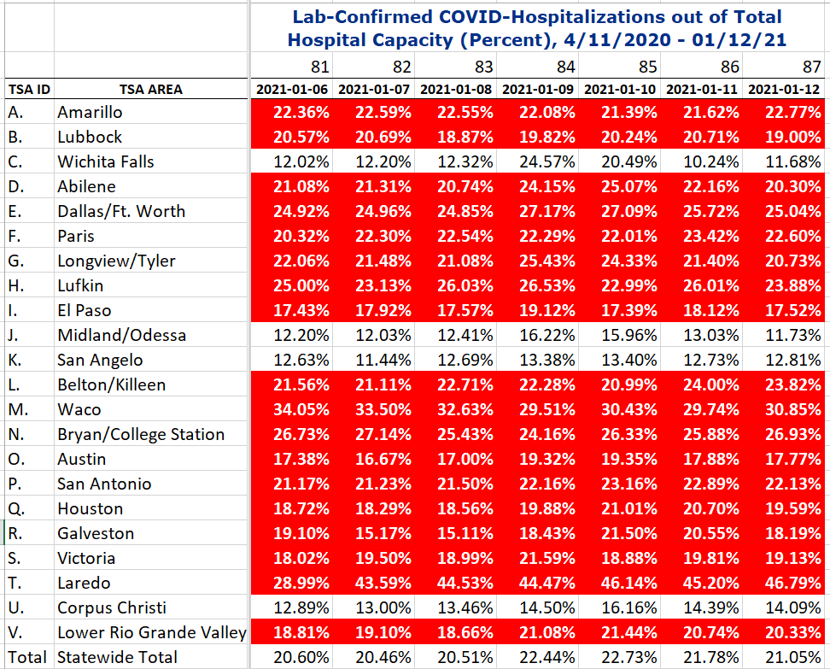
COVID+ HOSPITALIZATIONS BY TSA ID
CONFIRMED COVID+ HOSPITALIZATIONS /HOSPITAL CAPACITY
This Week
TSA – B
87 DAYS > 15%
18 of 22 TSAs are over the limit

Slide 37
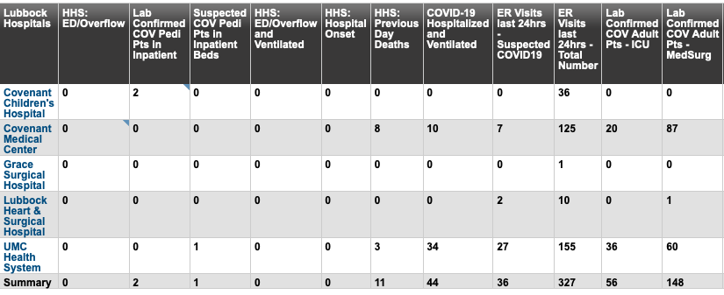
Lubbock This Morning
12/28: 268 Hospitalized in Lubbock – 43 on vents

Slide 38
Surge Plans

Slide 39
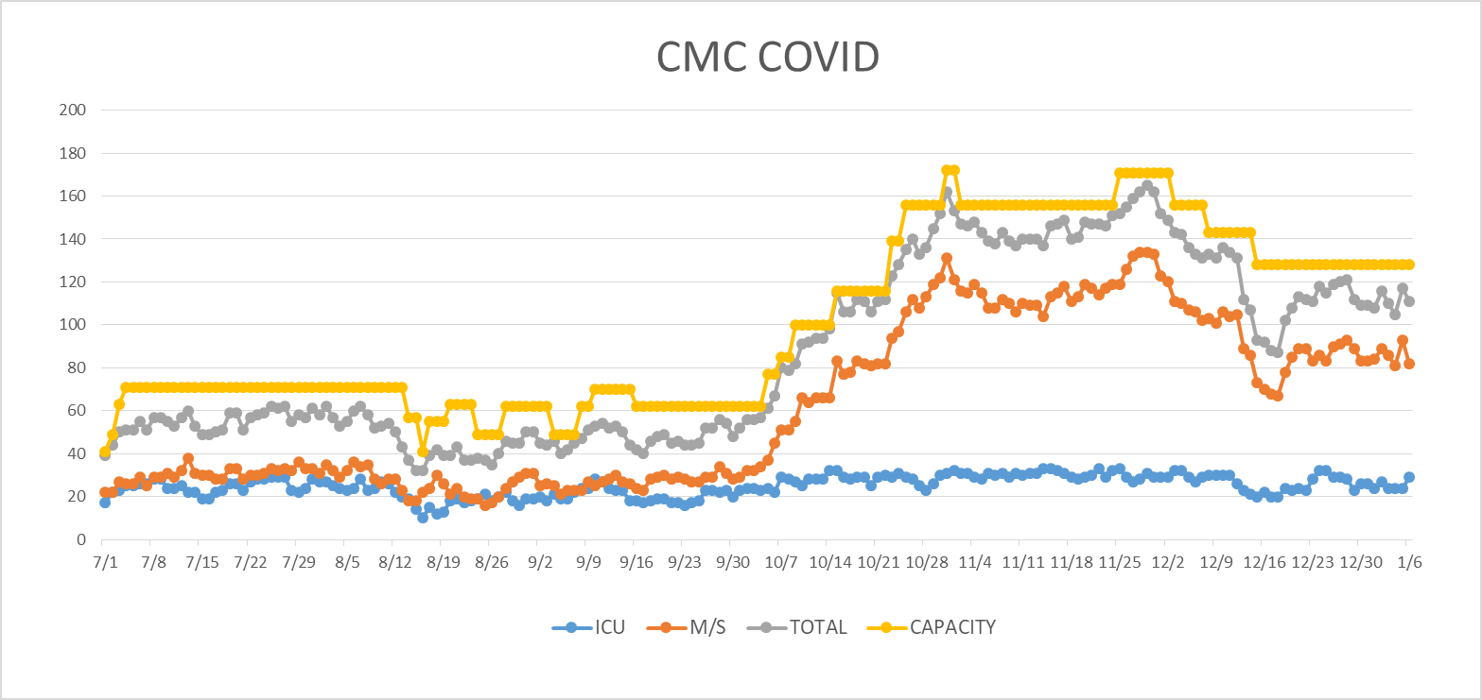
COVID Units - CMC
1/7/2020
UPDATE

Slide 40
Caregiver Update

Slide 41
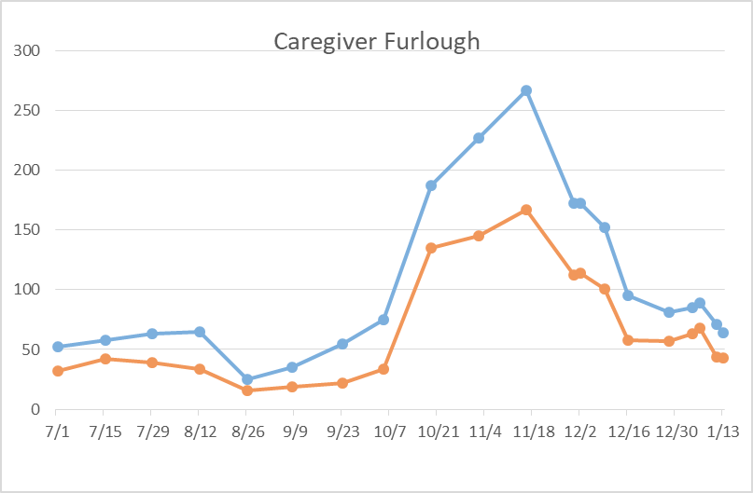
Caregivers
COVID Related Furloughs
67% are positive
Count reflects # furlough (exposed and positive)
Good
Moderate
Critical

Slide 42
Statistics
William Sommer
Clinical Data Analyst
Quality and Clinical Data Analytics
Covenant Health

Slide 43
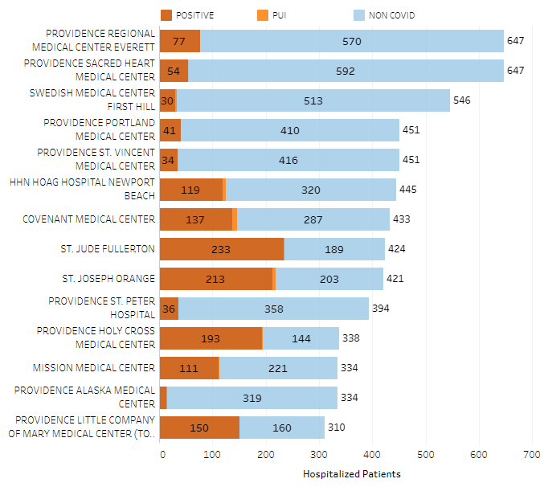
Providence System Hospitalized COVID-19 Cases

Slide 44
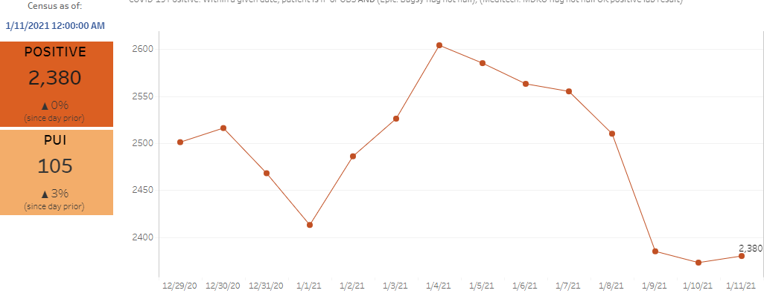
Providence Inpatient COVID-19 Volume

Slide 45
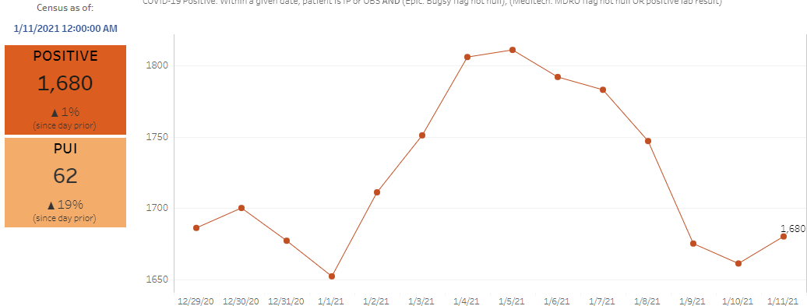
SoCal Inpatient COVID-19 Volume

Slide 46
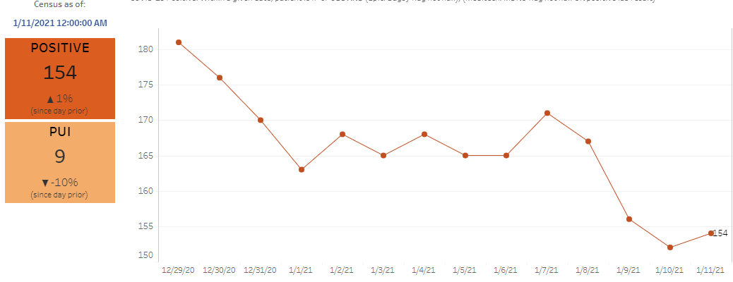
Texas Inpatient COVID-19 Volume

Slide 47
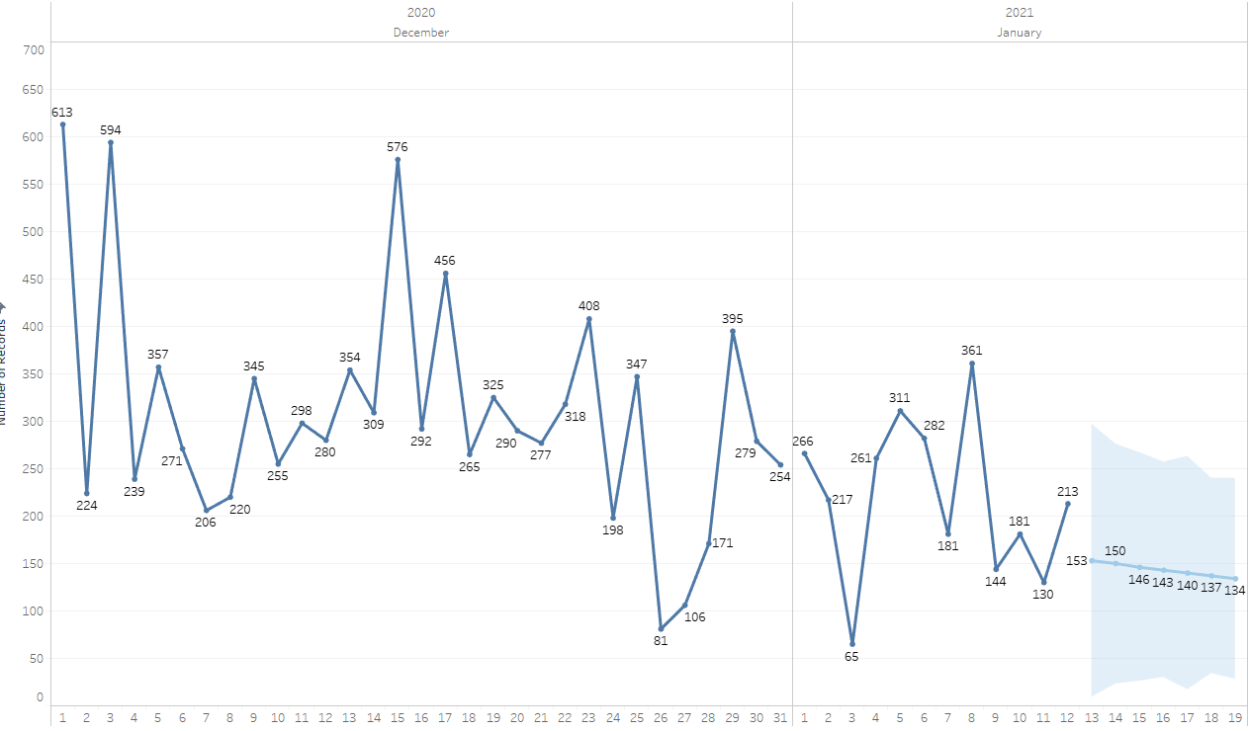

New Covid-19 POSITIVES by Day Trend

Slide 48
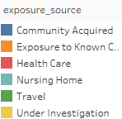
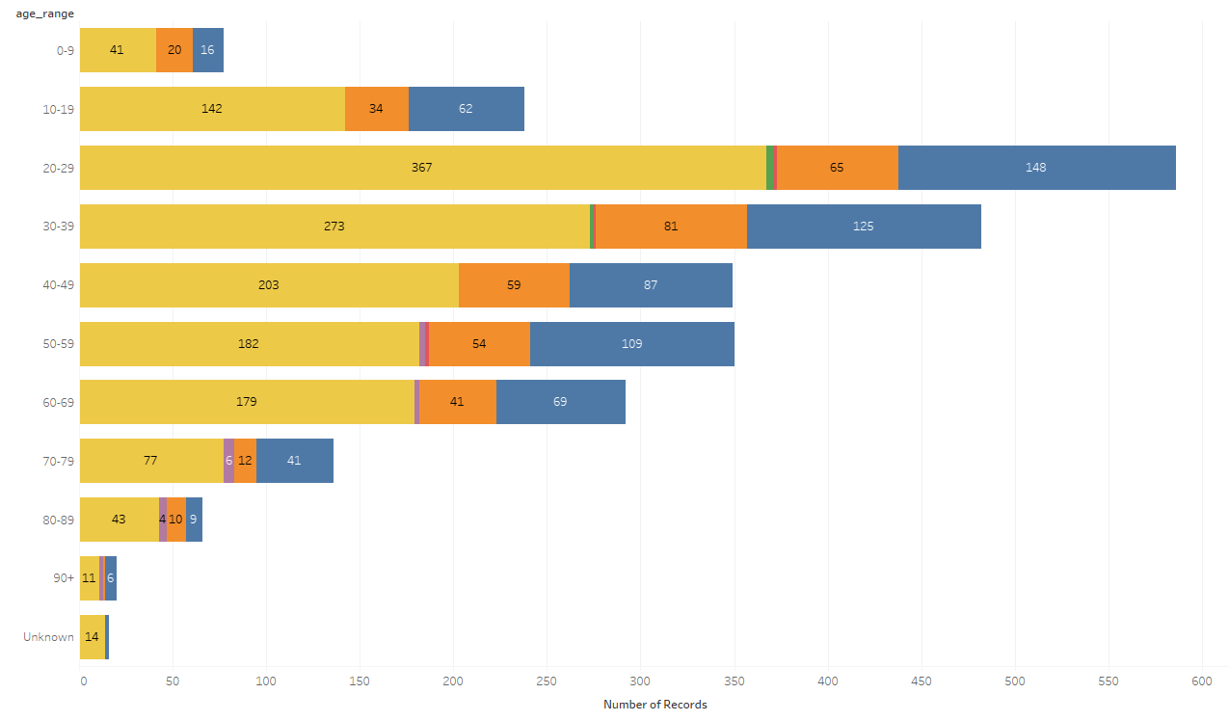
Covid-19 POSITIVES Age Distribution

Slide 49
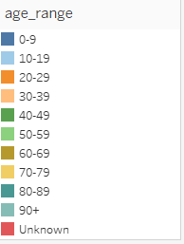
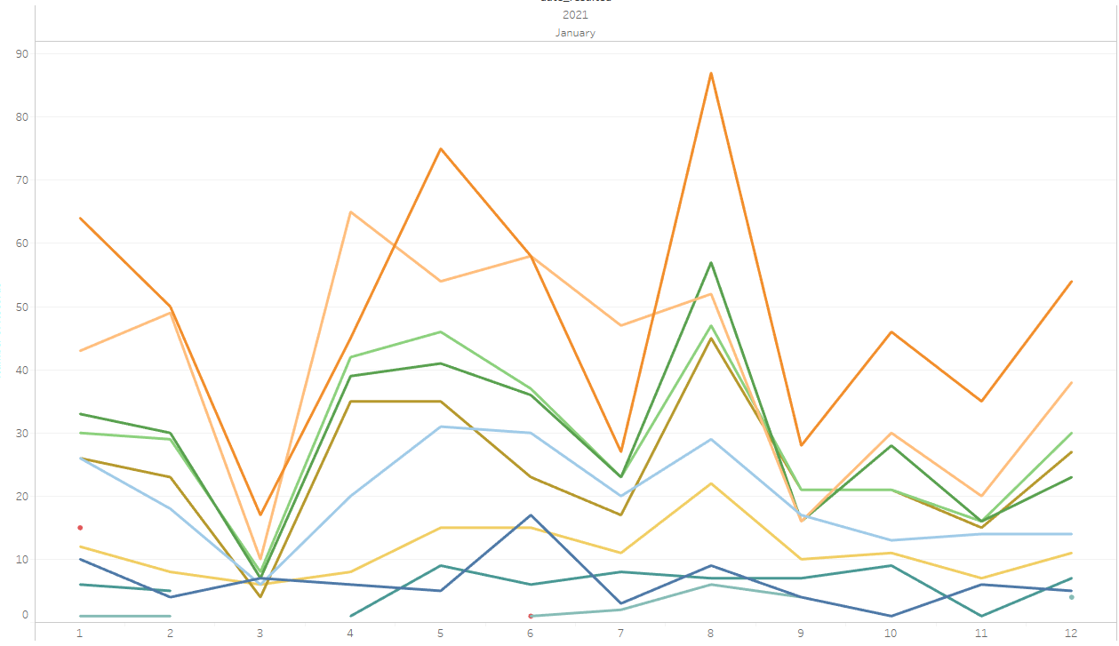
Covid-19 POSITIVES Age Distribution

Slide 50
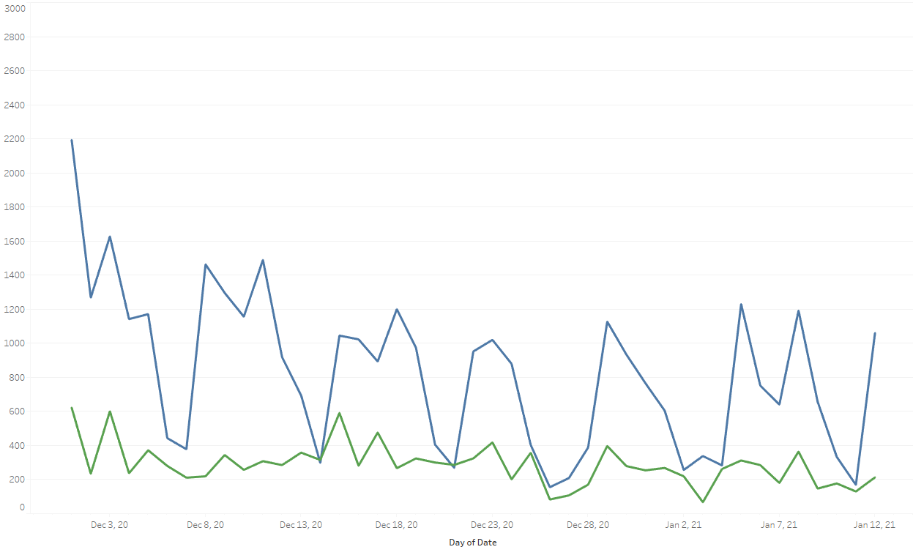

Covid-19 Daily Tests Performed

Slide 51
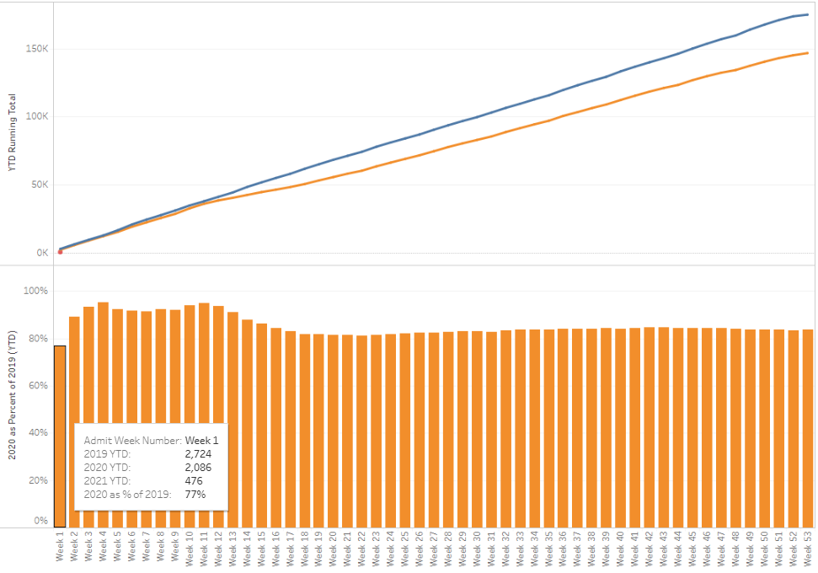

TX/NM Region Weekly Procedures (YOY)

Slide 52
Covenant Outpatient Infusion Center Update

Slide 53
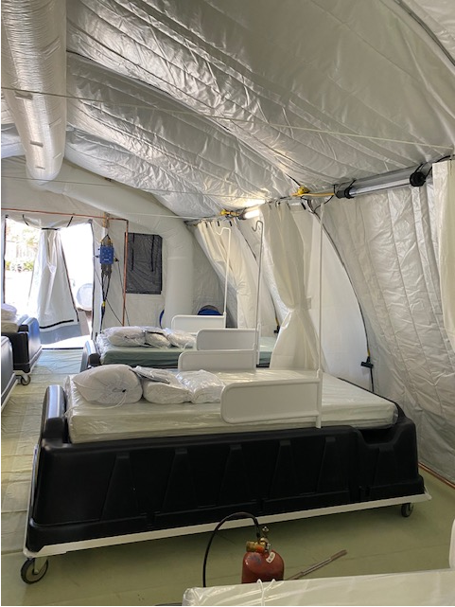
COVID Infusion Center
Status Update
Prakesh Shrestha, MD
Dennis Duriex, MD

Slide 54
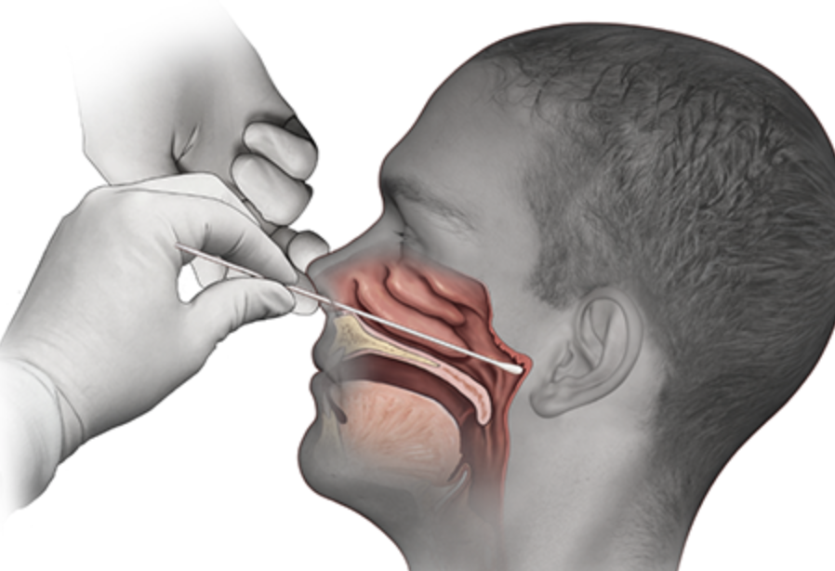
Covid-19 Testing

Slide 55
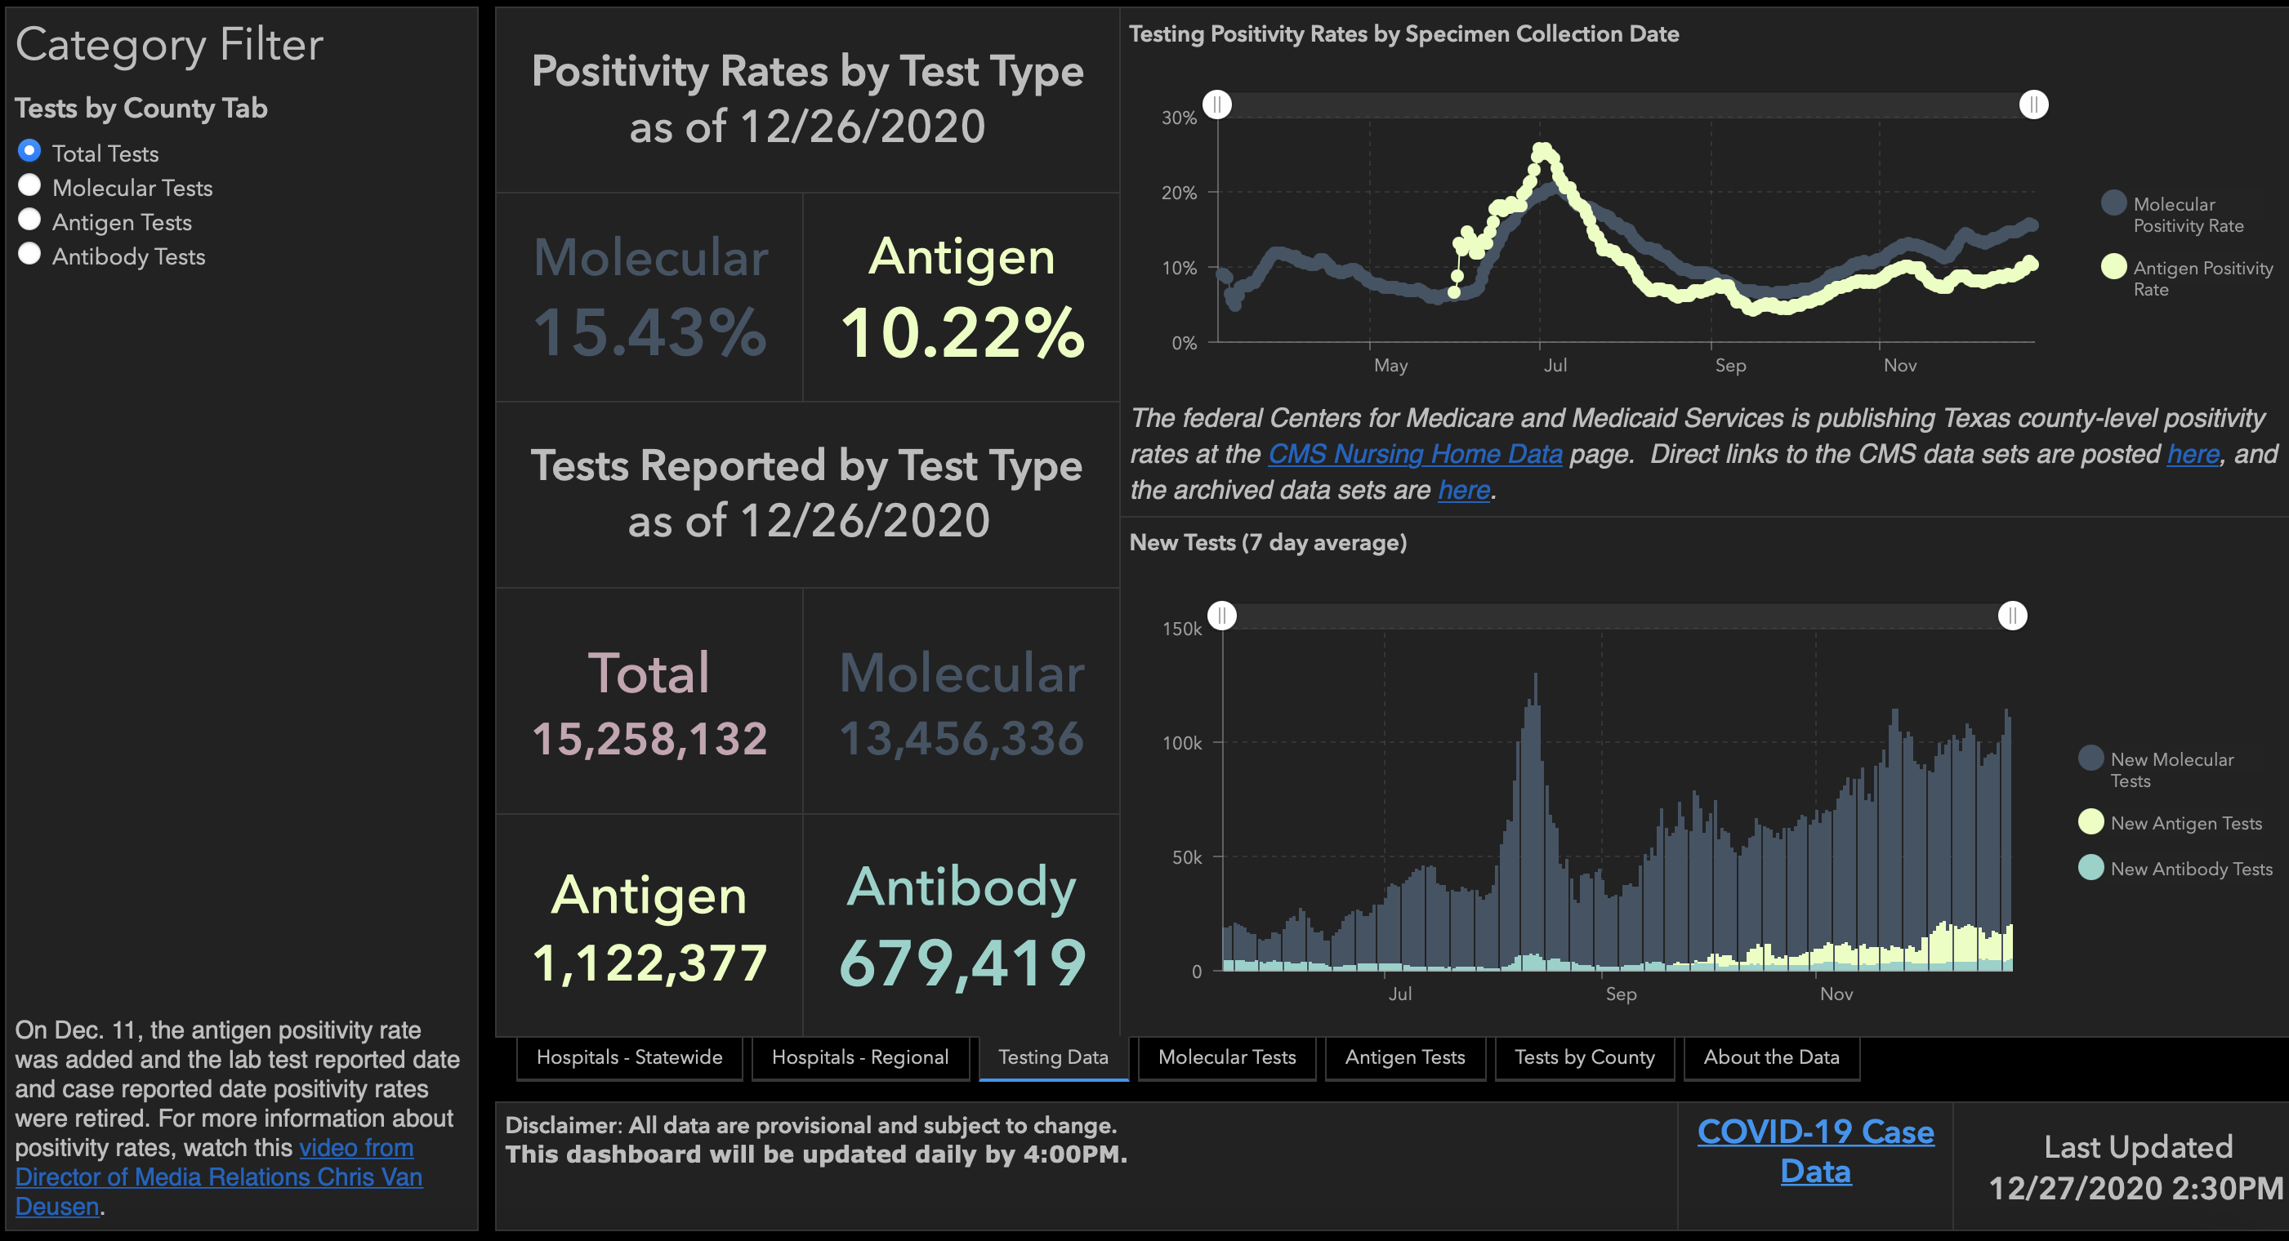

Slide 56
TESTING
 | CMC |  | GMC |  | CMG
 | Rapid | PCR | Rapid | PCR | Rapid
Test Kits
Swabs
VTM
 | CMC |  | GMG/CMG
 | Tests | + | Tests | +
12/21 | 95 | 14 | 24 | 3
12/22 | 239 | 41 | 177 | 48
12/23 | 217 | 33 | 179 | 49
PCR
Rapids
>2000 >750
<2000 <750
<1600 <500
CMC- Alinity back online
GMG- no issues
CMG- no issues

Slide 57
End of Life Issues

Slide 58
Request for CME
The Trauma Section requested standardization and clarification about the appropriate repository for end of life decisions in the EMR
Dr. Ira Byock (an internationally recognized expert) has agreed to provide a CME activity on this issue
Sandy Slaton in Risk Management has also simplified our documentation requirements per Texas Law
What is the pleasure of the group?
  A) An evening 60-90 minute CME program to address these topics (could be counted as ethics) or
  B) Incorporation of this information in 15-20 minute segments during our Friday calls over the next few weeks?
  Please Indicate your preference in the chat window as either ”A” or “B”.

Slide 59
Pharmacy Update
Wesley Wells, PharmD
Regional Pharmacy Director
Covenant Health

Slide 60
Therapeutics Update
Numbers are reported as of January 13 at 11:00 pm
COVID Tent numbers are as of January 12 at 11:00 pm
Medication | Current State |  | Updates/Issues
Remdesivir |  |  | We have dispensed 336 vials to the COVID tent We have treated 71 patients
Bamlanivimab (Lilly) |  |  | No updates
Casirivimab and Imdevimab (Regeneron) |  |  | Working to move Regeneron product to Lubbock
Zanubrutinib | Patients enrolled: 6 | Active patients: 0 | No updates
Regeneron 2066 | Patients enrolled: 3 (4 screened) | Active patients: 0 | No updates
EXIT COVID-19 Trial | Patients enrolled: 9 (10 screened) | Active patients: 4 | Only need 1 more patients for phase 2 trial May increase number to fulfill the full trial enrollment
Ministry | Vials Used on Previous Day | Stock
Covenant Medical Center | 44 | 252
Covenant Children’s Hospital | 1 | 46
Covenant Plainview | 3 | 72
Covenant Levelland | 3 | 36
Home Infusion | 1 | 64
Ministry | Total Doses Infused | Stock
CMC/Home Infusion | 439 | 139
Covenant Plainview | 21 | 72
Covenant Levelland | 9 | 21
Ministry | Total Doses Infused | Stock
CMC/Home Infusion | 106 | 163
Covenant Plainview | 0 | 35

Slide 61
Shortage Update
\]]
Propofol (Diprivan)
  Mostly impacting large vials
    100 ml > 50 ml > 20 ml
  Increase demand corresponding to COVID surge
  Manufacturing cannot meet demand
  Solutions
    Providence unable to get a bulk purchase
    Other sedatives are shorted
    Getting some direct purchases

Slide 62
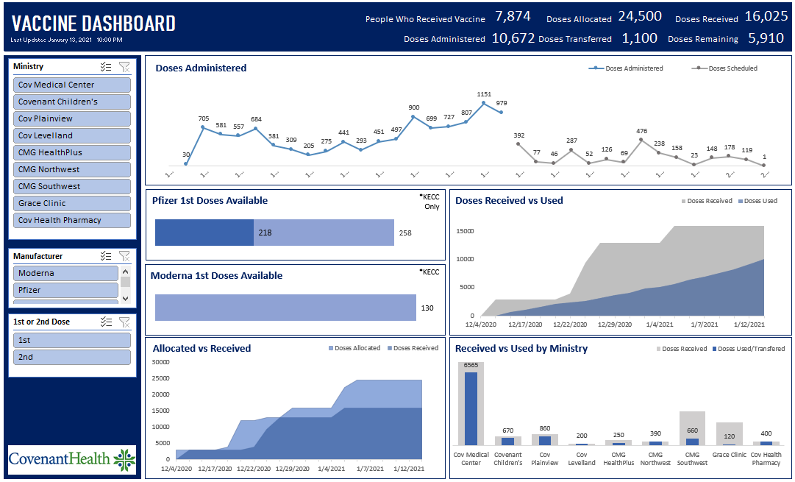
Vaccine Update

Slide 63
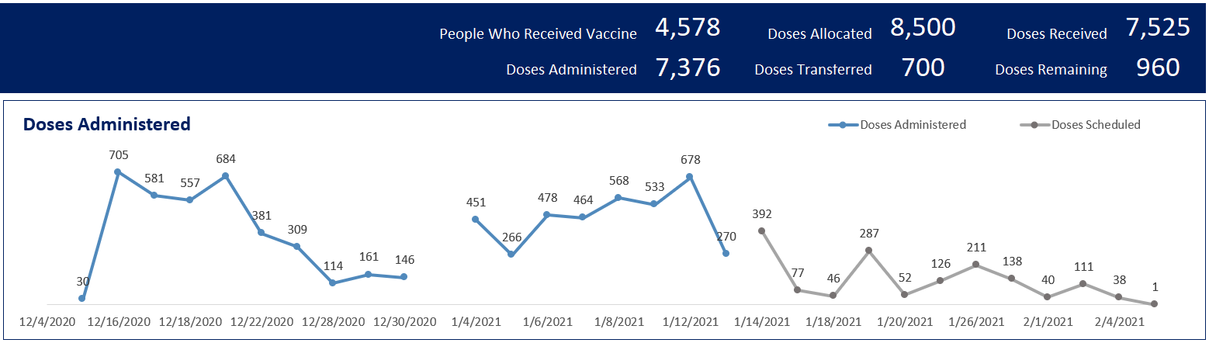
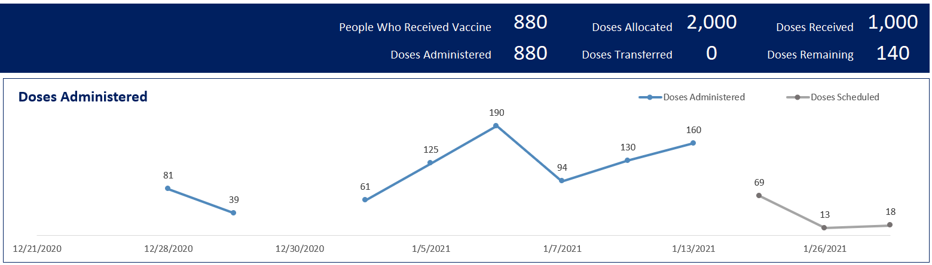
Vaccine Update
Cov Medical Center
Plainview

Slide 64
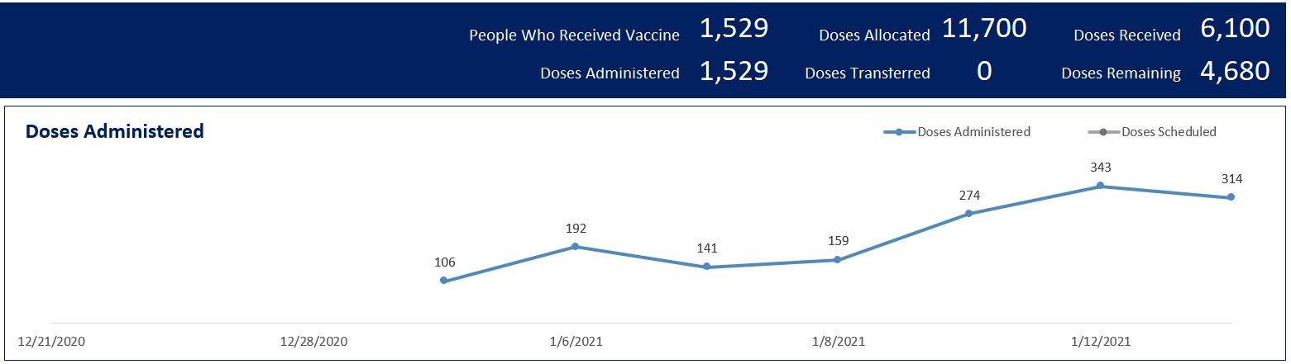
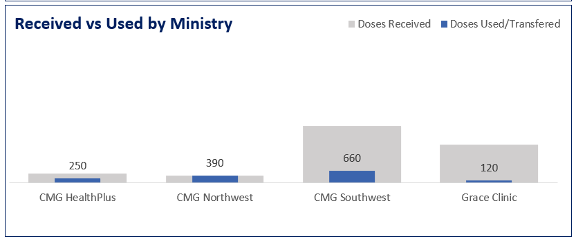
Vaccine Update
Clinics

Slide 65
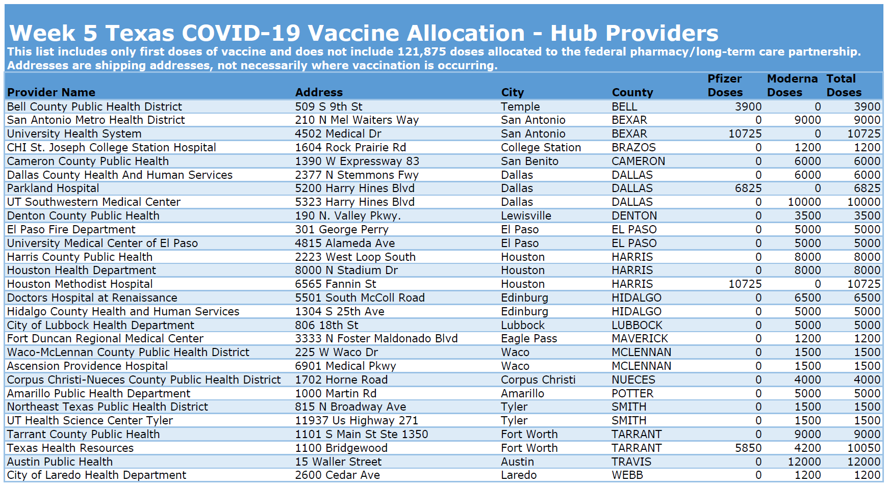
Vaccine Update
Week 5 Allocations
  158,825 doses going to 28 hubs in the state of Texas
  38,300 doses going to 104 counties in Texas
Week 6 Allocations
  Maintaining 28 hub sites
    Hopefully adding other sites
  Submitted survey for mass vaccination in Levelland, Plainview, and Lubbock
    Awaiting response from State/EVAP
  Wrapping up long-term care distribution

Slide 66
Vaccine Update
Trump admin releasing 2nd dose reserves
  Believe manufacturers can keep up
  Waiting on Biden admin approach
  May result in “hoarding” by vaccination locations
Monoclonal Antibody or Convalescent Plasma
  Must wait 90 days after treatment before receiving vaccine
  No indication to restart 2 course regimen
January 21st deadline
  May stop early if stock is unavailable

Slide 67

Texas Demographics

Slide 68
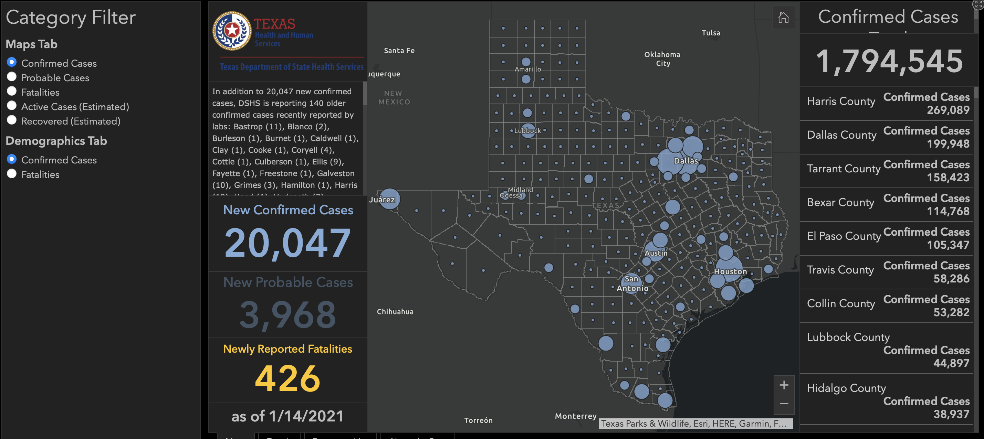

Slide 69
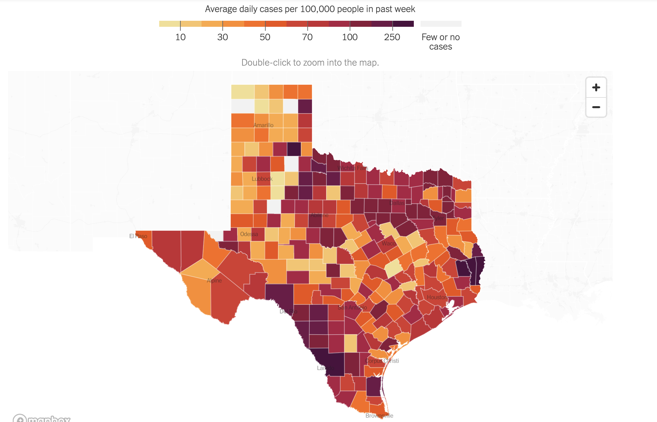

Slide 70
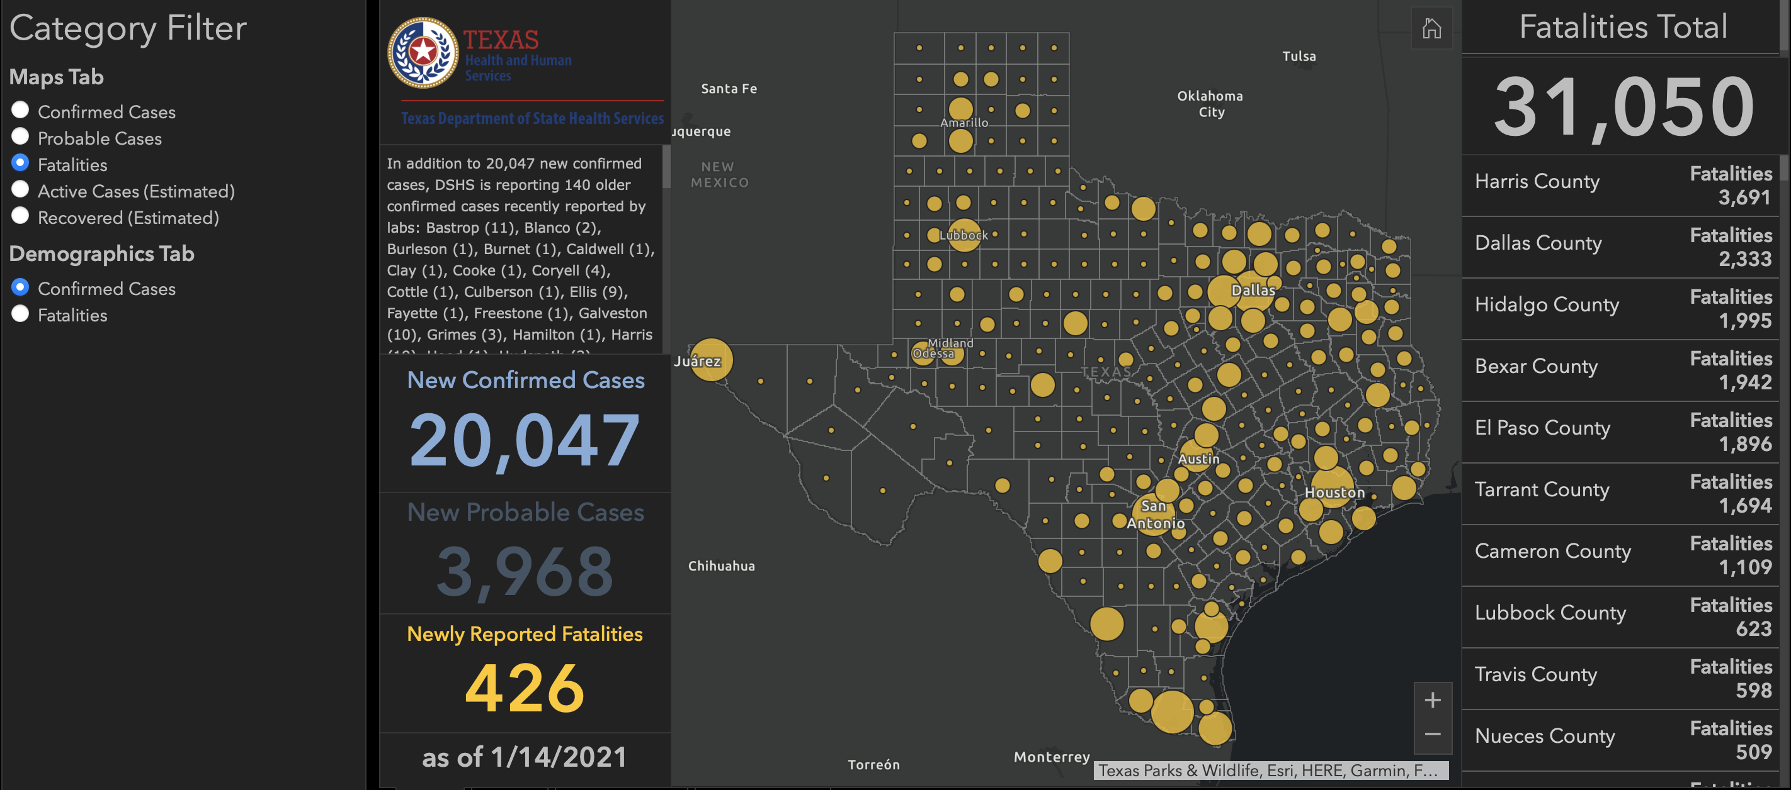

Slide 71
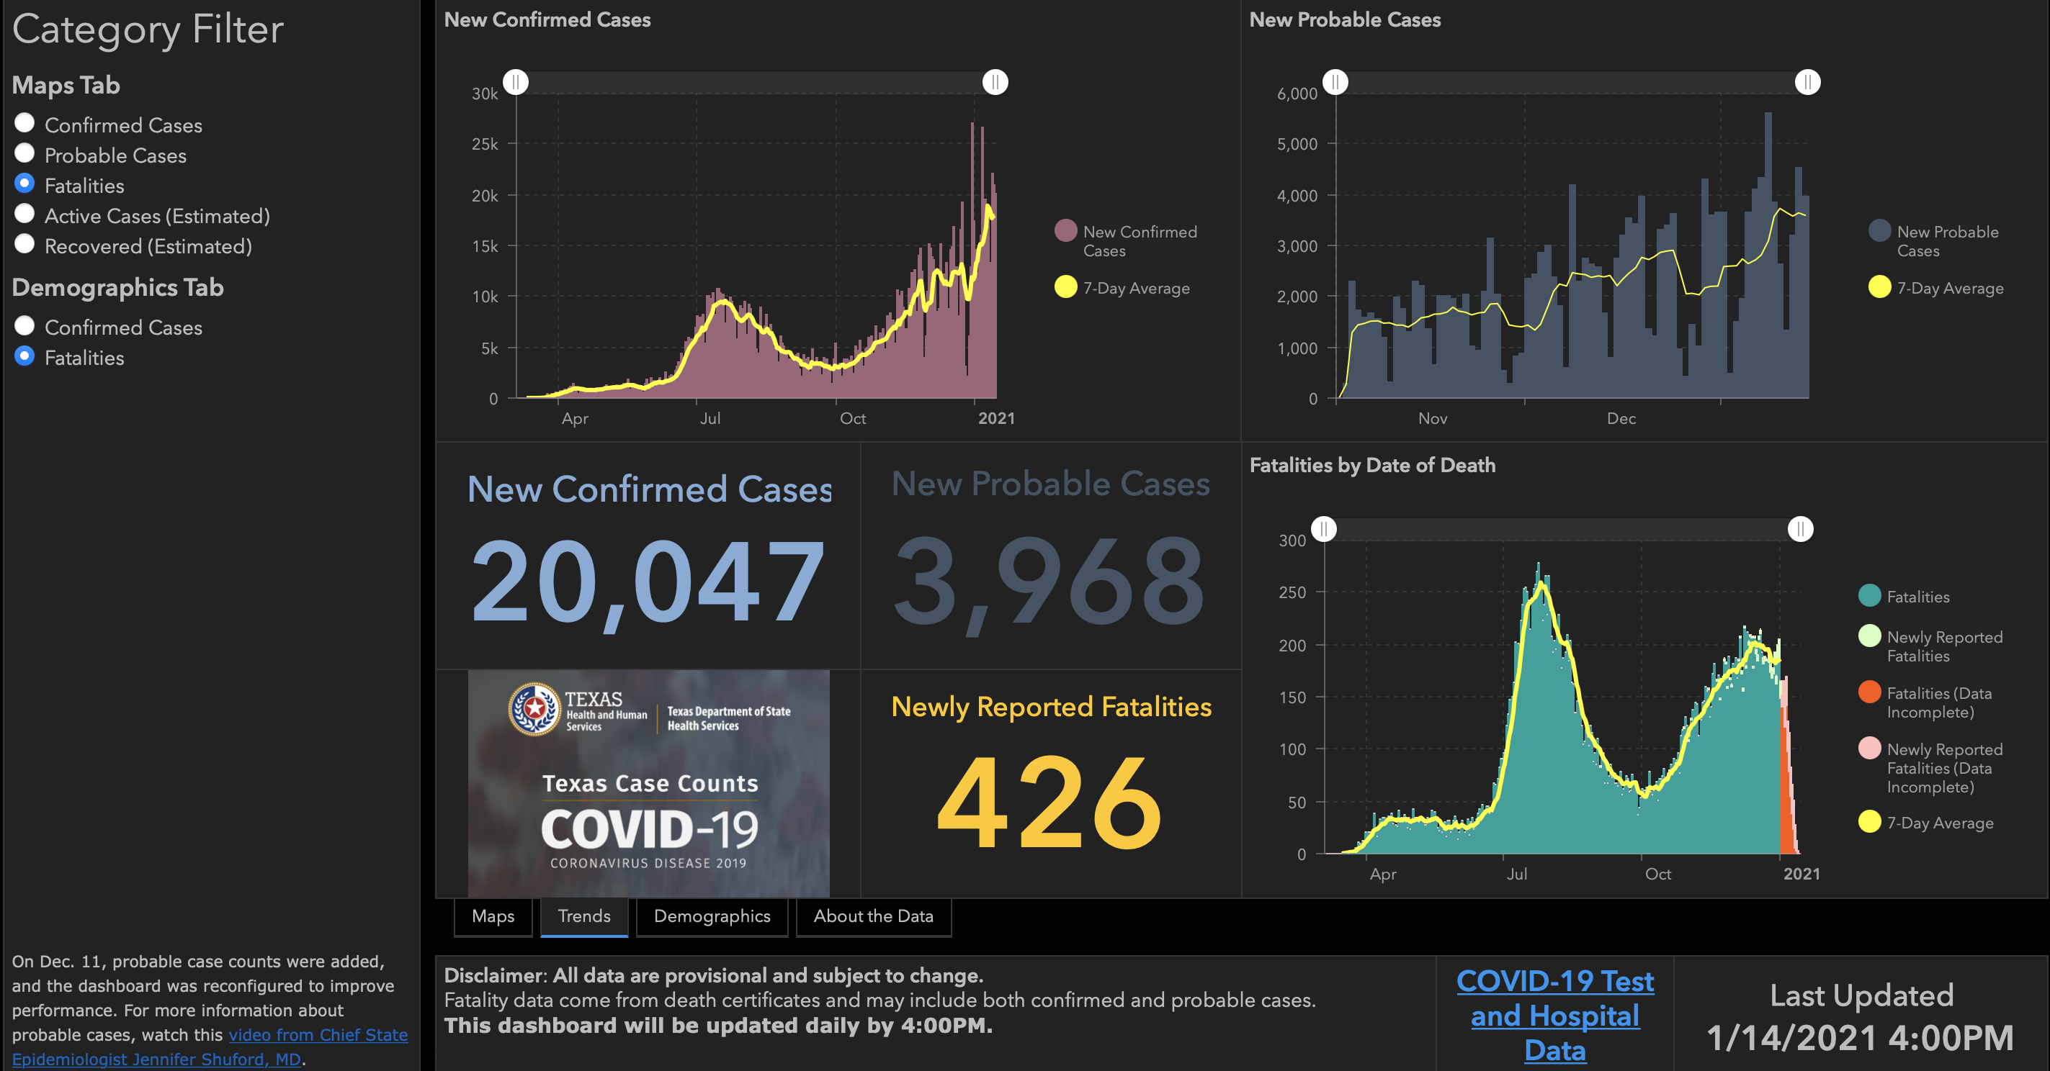

Slide 72
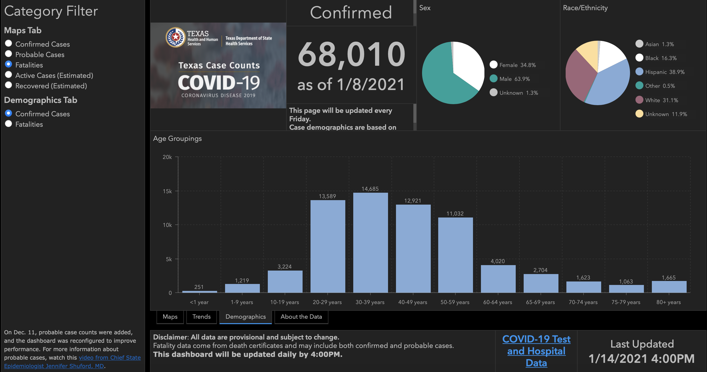

Slide 73
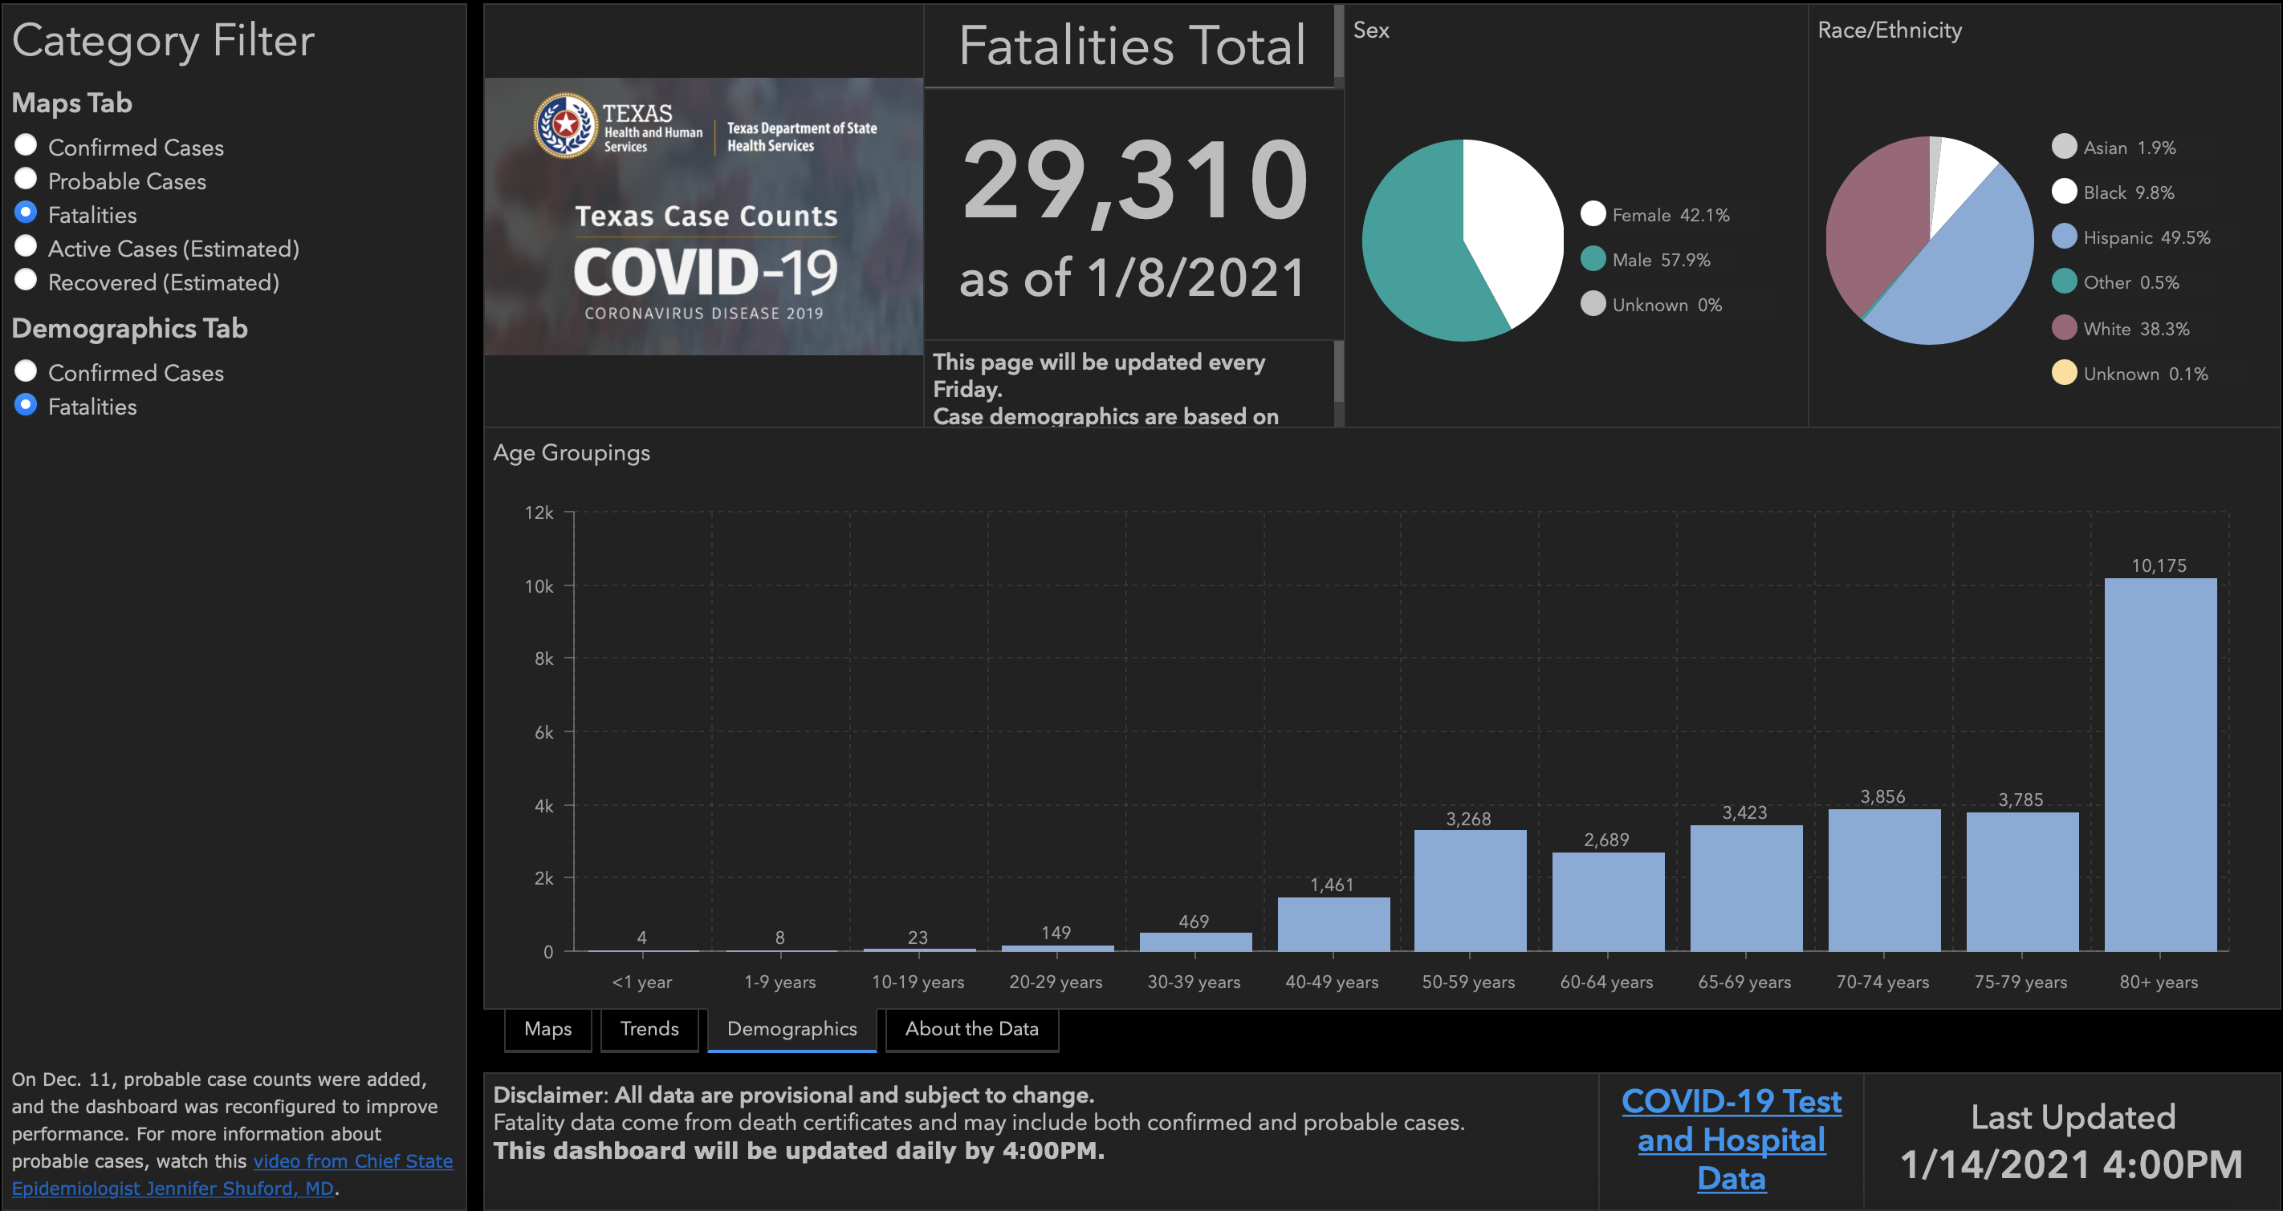

Slide 74
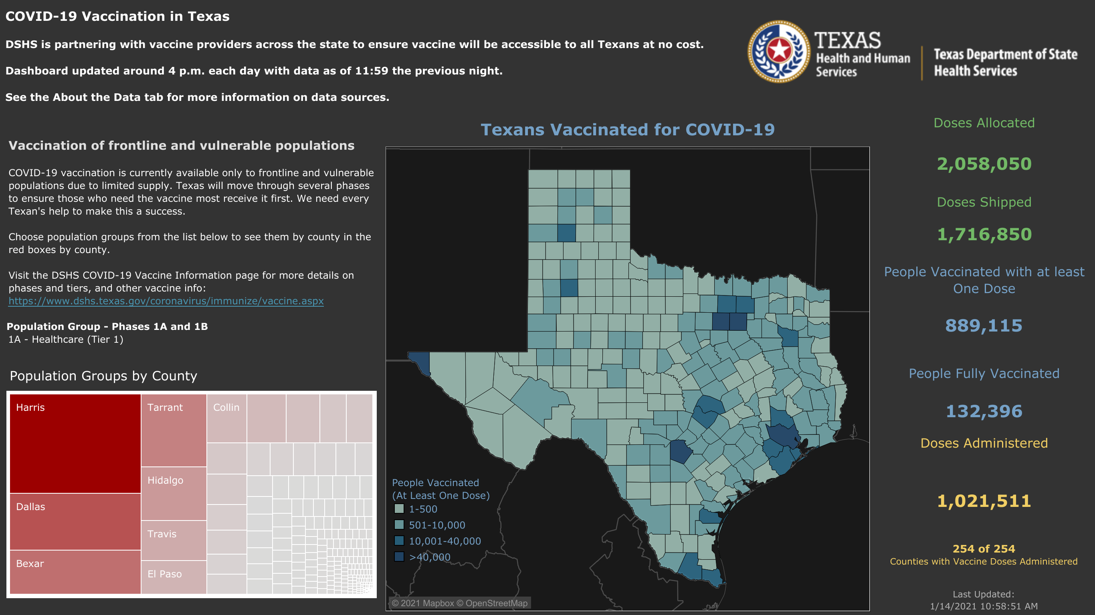

Slide 78
Q & A

Slide 79
CME Credit was only approved for the Live Teams meeting
To receive credit for this continuing education activity, the participant must:
  Make sure you are logged into your Teams account, if you are signed in with a group provide attendee’s First and Last name(s) in the comments section.
  If you are calling into the Teams meeting you MUST text your First & Last Name to (806) 252-4735. This will ensure you are added to the sign in sheet to receive CME Credit.
  You will receive an email by the following Wednesday from the CME department with further instructions on claiming your certificate.

