Slide 1
Covenant Health
Presents
Critical Communications: A Weekly Physician Update
January 22, 2021

Slide 2
PHYSICIANS
Accreditation Statement:
The Covenant Health is accredited by the Texas Medical Association (TMA) to provide continuing medical education for physicians.
Credit Designation Statement:
The Covenant Health designates this live CME activity for a maximum of 1.0 AMA PRA Category 1 Credit(s)™. Physicians should claim only the credit commensurate with the extent of their participation in the activity.

Slide 3
Disclosures of Commercial Interest
The speakers and planners of this activity
have no relevant financial interests

Slide 4
Disclosures
This activity is provided by
Covenant Health
No commercial support has been received.
No products will be endorsed.
Speakers will notify the audience if off label drug use will be discussed.

Slide 5
CME Credit was only approved for the Live Teams meeting
To receive credit for this continuing education activity, the participant must:
  Make sure you are logged into your Teams account, if you are signed in with a group provide attendee’s First and Last name(s) in the comments section.
  If you are calling into the Teams meeting you MUST text your First & Last Name to (806) 252-4735. This will ensure you are added to the sign in sheet to receive CME Credit.
  You will receive an email by Wednesday following the call from the CME department with further instructions on claiming your certificate.

Slide 6
Reflection
Charles V. Bayouth, MD

Slide 7

Be anxious for nothing, but in everything by prayer and supplication with thanksgiving let your requests be made known to God. And the peace of God, which surpasses all comprehension, will guard your hearts and your minds in Christ Jesus.
Philippians 4:6-7

Slide 8
Vaccines throughout the years

Slide 9
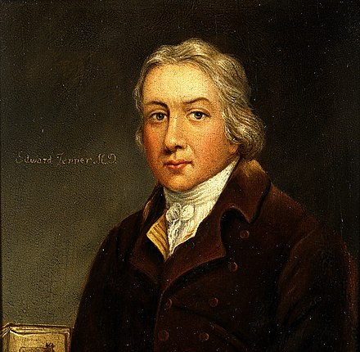
First Vaccine
Smallpox
The terms vaccine and vaccination are derived from Variolae vaccinae (smallpox of the cow), the term devised by Jenner to denote cowpox. 1796-98 Smallpox eradicated in 1980

Slide 10
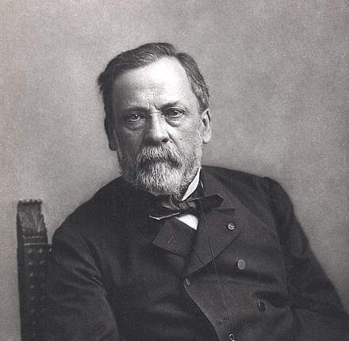
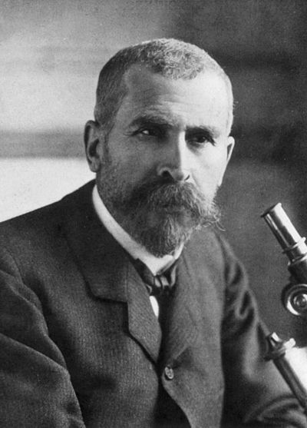
Cholera 1880
Rabies 1885

Slide 11
19th century
1880 – First vaccine for cholera by Louis Pasteur[3][4]
1885 – First vaccine for rabies by Louis Pasteur and Émile Roux[5][6]
1890 – First vaccine for tetanus (serum antitoxin) by Emil von Behring[7]
1896 – First vaccine for typhoid fever by Almroth Edward Wright, Richard Pfeiffer, and Wilhelm Kolle[8]
1897 – First vaccine for bubonic plague by Waldemar Haffkine
20th century
1921 – First vaccine for tuberculosis by Albert Calmette[9][10]
1923 – First vaccine for diphtheria by Gaston Ramon, Emil von Behring and Kitasato Shibasaburō
1924 – First vaccine for scarlet fever by George F. Dick and Gladys Dick
1924 – First inactive vaccine for tetanus (tetanus toxoid, TT) by the French Gaston Ramon, C. Zoeller and P. Descombey
1926 – First vaccine for pertussis (whooping cough) by Leila Denmark
1932 – First vaccine for yellow fever by Max Theiler and Jean Laigret
1937 – First vaccine for typhus by Rudolf Weigl, Ludwik Fleck and Hans Zinsser
1937 – First vaccine for influenza by Anatol Smorodintsev[11]

Slide 12
Late 1940s | Recommended Vaccines
Smallpox
Diphtheria*
Tetanus*
Pertussis*
* Given in combination as DTP

Slide 13
Late 1950s | Recommended Vaccines
Smallpox
Diphtheria*
Tetanus*
Pertussis*
Polio (IPV)
* Given in combination as DTP

Slide 14
Late 1960s | Recommended Vaccines
Smallpox
Diphtheria*
Tetanus*
Pertussis*
Polio (OPV)
Measles
Mumps
Rubella
* Given in combination as DTP

Slide 15
Late 1970s | Recommended Vaccines
Diphtheria*
Tetanus*
Pertussis*
Polio (OPV)
Measles**
Mumps**
Rubella**
* Given in combination as DTP
** Given in combination as MMR

Slide 16
1985 - 1994 | Recommended Vaccines
Diphtheria*
Tetanus*
Pertussis*
Measles**
Mumps**
Rubella**
Polio (OPV)
Hib

Slide 17
1994 - 1995 | Recommended Vaccines
Diphtheria*
Tetanus*
Pertussis*
Measles**
Mumps**
Rubella**
Polio (OPV)
Hib
Hepatitis B
* Given in combination as DTP
** Given in combination as MMR

Slide 18
Important changes to the schedule between 1995 and 2010 included:
New vaccines: Varicella (chickenpox - 1996), rotavirus (1998-1999; 2006, 2008); hepatitis A (2000); pneumococcal vaccine (2001)
Additional recommendations for existing vaccines: influenza (2002); hepatitis A (2006)
New versions of existing vaccines: acellular pertussis vaccine (DTaP ,1997); intranasal influenza (2004)
Discontinuation of vaccine: Oral polio vaccine (2000)

Slide 19
2000 | Recommended Vaccines
Diphtheria*
Tetanus*
Pertussis*
Measles**
Mumps**
Rubella**
Polio (IPV)
Hib
Hepatitis B
Varicella
Hepatitis A

Slide 20
2005 | Recommended Vaccines
Diphtheria*
Tetanus*
Pertussis*
Measles**
Mumps**
Rubella**
Polio (IPV)
Hib
Hepatitis B
Varicella
Hepatitis A
Pneumococcal
Influenza

Slide 21
2010 | Recommended Vaccines
Diphtheria*
Tetanus*
Pertussis*
Measles**
Mumps**
Rubella**
Polio (IPV)
Hib
Hepatitis B
Varicella
Hepatitis A
Pneumococcal
Influenza
Rotavirus
* Given in combination as DTaP
** Given in combination as MMR

Slide 22
Important changes to the schedule:
New vaccines: meningococcal serogroup B vaccine (2014)
Additional recommendations for existing vaccines: HPV (2011 to routinely vaccinate males), intranasal influenza vaccine (2018 again recommended)
Discontinuation of vaccine: intranasal influenza vaccine (2016)

Slide 23
2019 | Recommended Vaccines
Diphtheria*
Tetanus*
Pertussis*
Measles**
Mumps**
Rubella**
Polio (IPV)
Hib
Hepatitis B
Varicella
Hepatitis A
Pneumococcal
Influenza
Rotavirus
* Given in combination as DTaP
** Given in combination as MMR

Slide 24
Vaccines for Adolescents: A new generation of vaccines
New vaccines: Tdap, 2005, meningococcal conjugate (2005), HPV (2006 females, 2009 males), meningococcal serogroup B vaccine (2014)
Additional recommendations for existing vaccines: HPV (2011 to routinely vaccinate males), intranasal influenza vaccine (2018 again recommended)
New versions of existing vaccines: HPV (protecting against 9 types, 2015)
Discontinuation of vaccine: intranasal influenza vaccine (2016)

Slide 25
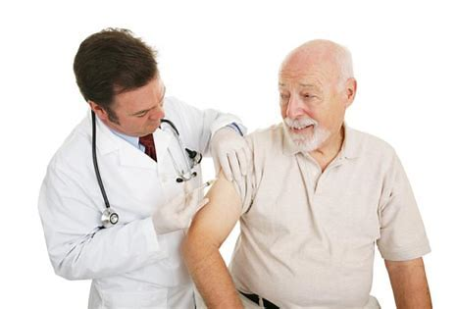
Vaccines for adults — increasing opportunities for health

Slide 26
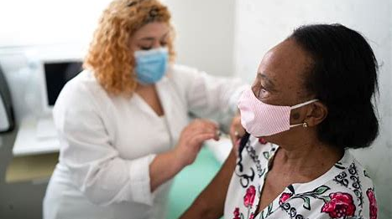
Last but not least COVID

Slide 27
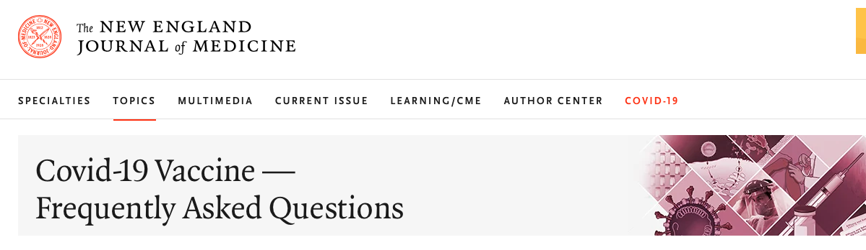
Vaccine Status

Slide 28
VACCINES — MECHANISM, EFFICACY, SAFETY
Paul Sax, M.D., a Professor of Medicine at Harvard Medical School and an infectious disease specialist, provides concise and engaging answers to clinicians’ questions about Covid-19 vaccination and to the questions and concerns patients will raise.
https://www.nejm.org/

Slide 29
How do each of the available Covid-19 vaccines work?
Once the vaccine is injected, the mRNA is taken up by the macrophages near the injection site and instructs those cells to make the spike protein. The spike protein then appears on the surface of the macrophages, inducing an immune response that mimics the way we fight off infections and protects us from natural infection with SARS-CoV-2.
Enzymes in the body then degrade and dispose of the mRNA. No live virus is involved, and no genetic material enters the nucleus of the cells.

Slide 30
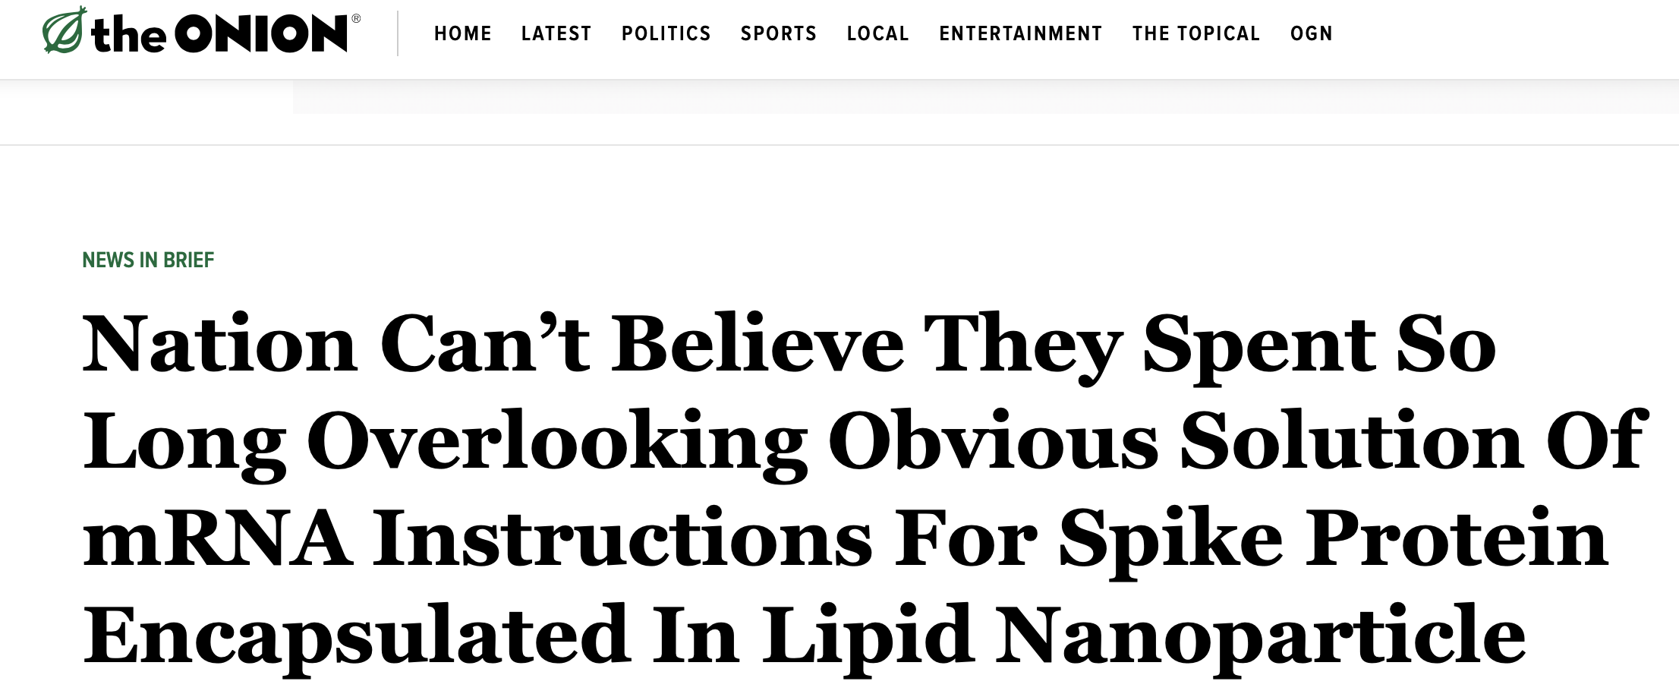
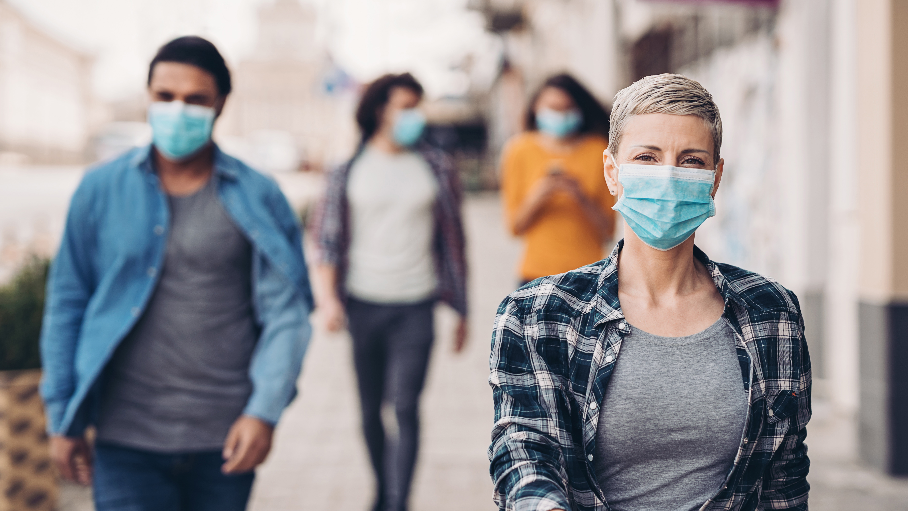
Endorsed by “ The Onion”
Although these are the first mRNA vaccines to be broadly tested and used in clinical practice, scientists have been working on mRNA vaccines for years. And despite this wonderful parody piece saying that the technology is “obvious,” in fact the breakthrough insight that put the mRNA inside a lipid coating to prevent it from degrading is quite brilliant — and yes, this may be the first time the New England Journal of Medicine has referenced a piece in The Onion.

Slide 31
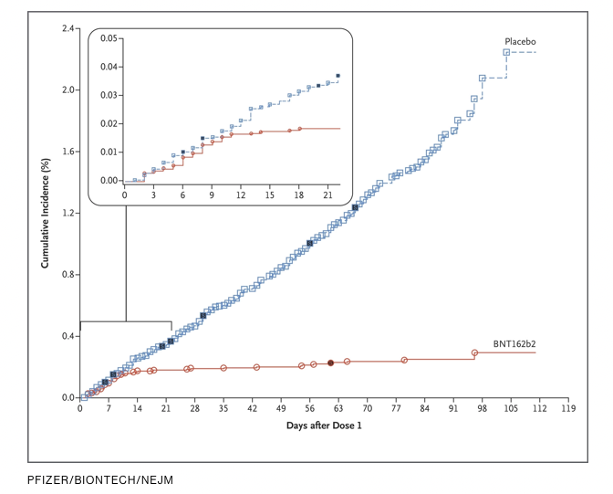
What do we know about each vaccine’s efficacy?
Both vaccines are remarkably effective. In large clinical trials (Efficacy and Safety of the mRNA-1273 SARS-CoV-2 Vaccine by L.R. Baden et al., and Safety and Efficacy of the BNT162b2 mRNA Covid-19 Vaccine by F.P. Polack et al.) that enrolled tens of thousands of people, the vaccines lowered the chance of developing Covid-19 by around 95% as compared with placebo injections.
…Sometimes data are so strong we don’t even have to do a statistical analysis — that’s what happened with both of these clinical trials. The results were that good.

Slide 32
What do we know about each vaccine’s efficacy?
Although we consider data from randomized, placebo-controlled trials to be the strongest form of clinical evidence, additional details make the results even more compelling. First, the vaccines prevented not only any disease due to SARS-CoV-2, but — quite importantly — severe disease. Prevention of severe disease could convert Covid-19 from the global threat it is now into more of a nuisance, like the common cold. Second, the studies enrolled participants who were quite representative of the U.S. population — age, sex, race, and ethnicity all broadly included. Third, while both vaccines are given as two doses, some protection became apparent just 10 to 14 days after the first dose.

Slide 33
What do we know about each vaccine’s efficacy?
The Controversy:
The efficacy noted after the first dose has raised questions about whether we should be vaccinating twice as many people with one dose rather than giving people the full two-dose schedule. However, the 95% vaccine efficacy results come after the second dose, which boosts the immune response and is likely to make it more durable.
For now, in the United States, the Centers for Disease Control and Prevention (CDC) and Food and Drug Administration (FDA) recommend proceeding with the two-dose schedule whenever possible.

Slide 34
What do we know about each vaccine’s efficacy?
Overall, these impressive results put the two mRNA vaccines up there with our most effective vaccines to date — more like measles than influenza vaccines, at least in the short term. The protection is far better than anyone anticipated, which is why many of us specialists in infectious diseases, virology, immunology, and public health become downright giddy when asked to discuss the vaccine’s efficacy.

Slide 35
How long will the vaccines work? Are booster doses required?
Since the vaccines have been tested only since the summer of 2020, we do not have information about the durability of protection. Data from the phase 1 trial of the Moderna vaccine suggested that neutralizing antibodies persisted for nearly 4 months, with titers declining slightly over time.
Given the absence of information on how long the vaccines will be protective, there is currently no specific recommendation for booster doses.

Slide 36
Do the vaccines prevent transmission of the virus to others?
Many commentaries on the results of the vaccine clinical trials cite a lack of information on asymptomatic infection as a limitation in our knowledge about the vaccines’ effectiveness. Indeed, this is a theoretical concern, since up to 40% of people who get infected with SARS-CoV-2 have no symptoms but may still transmit the virus to others.
So, until we know whether the vaccines protect against asymptomatic infection, we should continue to emphasize to our patients that vaccination does NOT allow us to stop other important measures to prevent the spread of Covid-19. We need to continue social distancing, masking, avoiding crowded indoor settings, and regular hand washing.

Slide 37
Do the vaccines prevent transmission of the virus to others?
There are several good reasons to be optimistic about the vaccines’ effect on disease transmission.
First, in the Moderna trial, participants underwent nasopharyngeal swab PCR testing at baseline and again at week 4, when they returned for their second dose. Among those who were negative at baseline and without symptoms, 39 (0.3%) in the placebo group and 15 (0.1%) in the mRNA-1273 group had nasopharyngeal swabs that were positive for SARS-CoV-2 by PCR at week 4. These data suggest that even after one dose, the vaccine has a protective effect in preventing asymptomatic infection.

Slide 38
Do the vaccines prevent transmission of the virus to others?
Second, findings from population-based studies now suggest that people without symptoms are less likely to transmit the virus to others.
Third, it would be highly unlikely in biological terms for a vaccine to prevent disease and not also prevent infection. If there is an example of a vaccine in widespread clinical use that has this selective effect — prevents disease but not infection — I can’t think of one!
Some of my colleagues have now reminded me that certain vaccines (diphtheria, meningitis B, and pertussis) allow asymptomatic colonization, and no doubt this will sometimes be true about the Covid-19 vaccines. Plus, the protective effect will never be 100%, which is why while case numbers are still high, we still recommend the use of social distancing and masking in public. These caveats notwithstanding, the likelihood that these vaccines will reduce the capacity to transmit the virus to others remains excellent.

Slide 39
What do we know about each of the vaccines’ short-term safety?
Overall, both mRNA vaccines are quite safe — that’s the good news, and it should be the dominant message for our patients. But no vaccine (actually, nothing in medicine) is 100% safe.
Before discussing side effects, we need to acknowledge that the safety of Covid-19 vaccines will be in the spotlight for some time — these are new vaccines for a new disease. Rare events will appear in the news, amplifying attention and worry disproportionate to the actual risk.
Our task will be to put these uncommon events into perspective, underscoring that these risks are far lower than the risk of getting sick with Covid-19.

Slide 40
What do we know about each of the vaccines’ short-term safety?
These first two vaccines are classified as “reactogenic” — meaning that they will cause some side effects in most people who receive them, reflective of the brisk immune response they generate. In clinical practice, we should put these vaccines in the same side-effect category as the recombinant shingles vaccine (Shingrix) rather than the annual flu vaccine.
The most common side effect is pain at the injection site, especially in the 12 to 24 hours after administration. Around 1% of participants in the trials categorized the pain as “severe.” Fatigue and headache are other relatively common side effects; high fevers are less common. These side effects generally resolve within a couple of days and are responsive to acetaminophen or a nonsteroidal antiinflammatory drug such as ibuprofen. In general, side effects are more common in younger vaccine recipients than in older ones, with the second shot inducing more side effects than the first.

Slide 41
What do we know about each of the vaccines’ short-term safety?
Bell’s palsy was reported more frequently in vaccine recipients than in controls, but there was not a sufficiently large number of cases to conclude that this was beyond what would naturally be observed in populations of this size by chance. There were no cases of Guillain–Barré syndrome or transverse myelitis.
Although hypersensitivity occurred equally in the placebo and vaccine groups in both trials, after distribution of the vaccines in the United Kingdom and the United States, reports emerged of vaccine recipients experiencing severe allergic reactions (anaphylaxis) shortly after receiving their first dose. The current leading suspect in causing these reactions is polyethylene glycol, a compound present in both vaccines. Because of these rare events, administration of the vaccines includes a period of 15 minutes of observation after vaccination — 30 minutes for those with a history of severe allergic reactions of any sort.

Slide 42
What do we know about each of the vaccines’ short-term safety?
It’s critically important to emphasize that these allergic reactions are uncommon — the current estimate is that anaphylaxis will occur at approximately 1 in 100,000 doses. Although this rate of severe allergic reactions is higher than that with other vaccines, it is substantially lower than the rate reported with penicillin, which is estimated to be 1 in 5000.
But since severe penicillin allergies don’t turn up as news stories, our challenge will be to contextualize this risk.

Slide 43
What do we know about each of the vaccines’ LONG-TERM safety?
The remarkably fast pace of vaccine development means that we have only months, not years, of follow-up. (Both mRNA clinical trials started in the summer of 2020.) But with other immunizations, severe reactions typically occur within days or weeks after administration. Long-term side effects with vaccines are fortunately quite rare, with putative associations later debunked by carefully done population-based studies.
Further safety data on both vaccines will be reported to the Vaccine Adverse Event Reporting System (VAERS). This program is an existing national early warning system that was set up to detect possible safety problems in any licensed vaccine and has been in operation since 1990. In addition, the CDC has its own smartphone-based tool, which uses texting and a Web-based survey to collect information right after patients receive their Covid-19 vaccine.

Slide 44
Vaccine Availability

Slide 45
How and when are the vaccines being made available?
FDA granted both vaccines Emergency Use Authorization (EUA)— the Pfizer/BioNTech vaccine on December 11, 2020, and the Moderna vaccine on December 18
Shipments of the vaccines are sent to the states on the basis of population and are coordinated by the federal government. The states implement a strategy for distributing them, using criteria adapted from guidelines issued by Advisory Committee on Immunization Practices (ACIP).
Vaccine allocations and policies differ from state to state.
“health care personnel” also includes staff in dietary, transport, laundry, engineering, and other services.

Slide 46
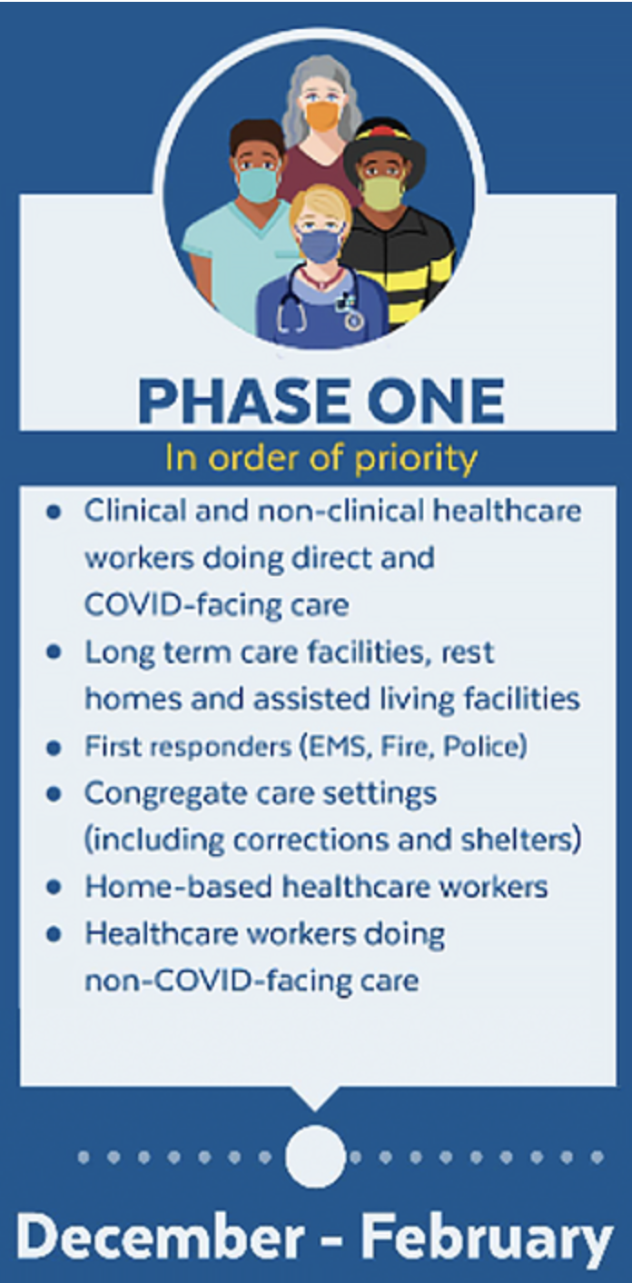
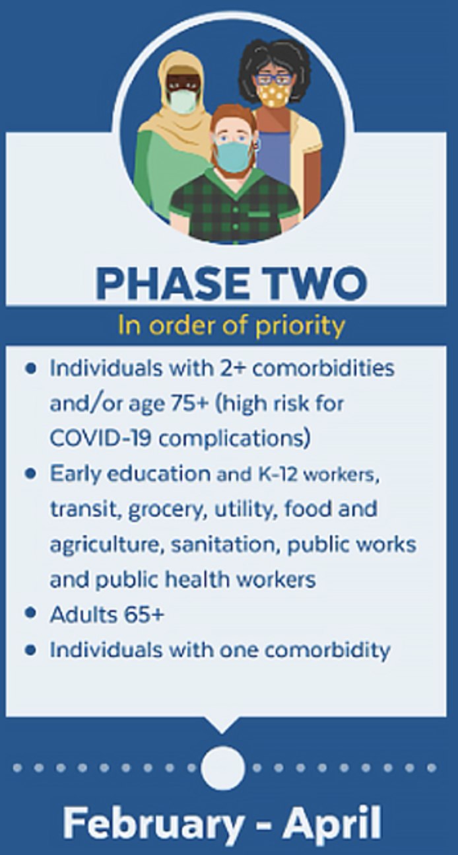
How do I arrange for administration of the vaccine to my patient?
By April, the supply of vaccine should be sufficient for the general population. But again, because policies and distribution of Covid-19 vaccines vary by state, your timeline may differ depending on your site of practice

Slide 47
VACCINATION — WHICH PATIENTS?

Slide 48
Is one vaccine preferable to the other for specific patients?
Pfizer/BioNTech vaccine is authorized for ages ≥16 years
Moderna is authorized for ≥18 years.
Once the vaccine series has started, it should be completed with the same vaccine on the recommended schedule. There are no safety or efficacy data on using one vaccine for the first dose and a different vaccine for the second.
  I can’t think of a reason why this would be problematic if it happens by accident, but it’s not recommended.

Slide 49
Are there contraindications to any of the vaccines?
The only absolute contraindication to these vaccines is known hypersensitivity to the vaccine components. Specific CDC recommendations regarding contraindications list the following:
Severe allergic reaction (e.g., anaphylaxis) after a previous dose of an mRNA Covid-19 vaccine or any of its components
Immediate allergic reaction of any severity to a previous dose of an mRNA Covid-19 vaccine or any of its components (including polyethylene glycol [PEG])
Immediate allergic reaction of any severity to polysorbate (due to potential cross-reactive hypersensitivity with the vaccine ingredient PEG)
Monoclonal antibodies or convalescent plasma for treatment of Covid-19 could theoretically reduce the efficacy of the vaccines. Anyone who has received these treatments should delay receiving the vaccine for at least 90 days

Slide 50
Should immunocompromised patients receive the vaccine?
The CDC considers immunocompromised patients to be at increased risk for severe Covid-19. This is broadly defined as patients with histories meeting the following criteria, which are not 100% inclusive:
Cancer
Bone marrow transplant
Solid-organ transplant
Stem cells for cancer treatment
Genetic immune deficiencies
HIV
Use of oral or intravenous corticosteroids or other medicines called immunosuppressants that lower the body’s ability to fight some infections (e.g., mycophenolate, sirolimus, cyclosporine, tacrolimus, etanercept, rituximab)

Slide 51
Should pregnant or breastfeeding women receive the vaccine?
… CDC advises that pregnant and lactating women should be offered the vaccine and may choose to be vaccinated. This view is shared by the American College of Obstetricians and Gynecologists, and the Society for Maternal–Fetal Medicine.
There is no theoretical reason why mRNA vaccines would be harmful to the mother during pregnancy, to a developing fetus, or to a breastfeeding infant.

Slide 52
Should acetaminophen or nonsteroidal antiinflammatory drugs be taken prior to vaccination to prevent postvaccination symptoms?
Although these drugs could decrease subjective side effects, theoretically they could also blunt immune response and make the vaccines less effective — hence they are not recommended before vaccination. They are useful, however, in diminishing side effects once they occur.
Acetaminophen is preferred for pregnant women.

Slide 53
Is there anything I need to watch for or report after administration of a vaccine? How do I report it?
Anticipated side effects do not need to be reported unless they are so severe that they trigger hospitalization or an emergency department visit.
Clinicians must report severe adverse effects through the Vaccine Adverse Event Reporting System (VAERS). This should be done whether you think the side effect was related to the vaccine or not. The FDA defines a severe adverse effect as one or more of the following:
  Death
  A life-threatening adverse event
  Inpatient hospitalization or prolongation of existing hospitalization
  A persistent or significant incapacity or substantial disruption of normal life functions
  A congenital anomaly or birth defect
  An important medical event that (on the basis of appropriate medical judgment) may jeopardize the person and may require medical or surgical intervention to prevent one of the outcomes listed above
  Multisystem inflammatory syndrome
  Cases of Covid-19 that result in hospitalization or death

Slide 54
After people receive the vaccine, should there be any testing to determine whether the vaccine worked?
People vaccinated with the Covid-19 vaccines develop antibodies to the spike protein of SARS-CoV-2. However, there is currently no recommendation for postimmunization serologic testing.
This may change in the future if results of these tests correlate with protection from infection, especially if they dictate whether booster immunizations are required.
  (It’s important to note that not all available antibody tests assess for anti-spike antibody.)

Slide 55
How does the vaccine affect the evaluation of a patient and diagnostic testing for possible Covid-19?
The Covid-19 vaccines will not influence the results of PCR or antigen testing for the disease.
The vaccines do generate antibodies to SARS-CoV-2, which are directed at the spike protein. Some available serologic assays test for this antibody; others do not. The manufacturers of the individual antibody tests should be able to provide this information, and it is often listed in the package insert.

Slide 56
Racial Disparity and Susceptibility to
Covid-19
Follow-up from last weeks discussion
And
Request for interested spokespersons
Contact Meredith Cunningham

Slide 57
Current Regional Covid-19 Census

Slide 58
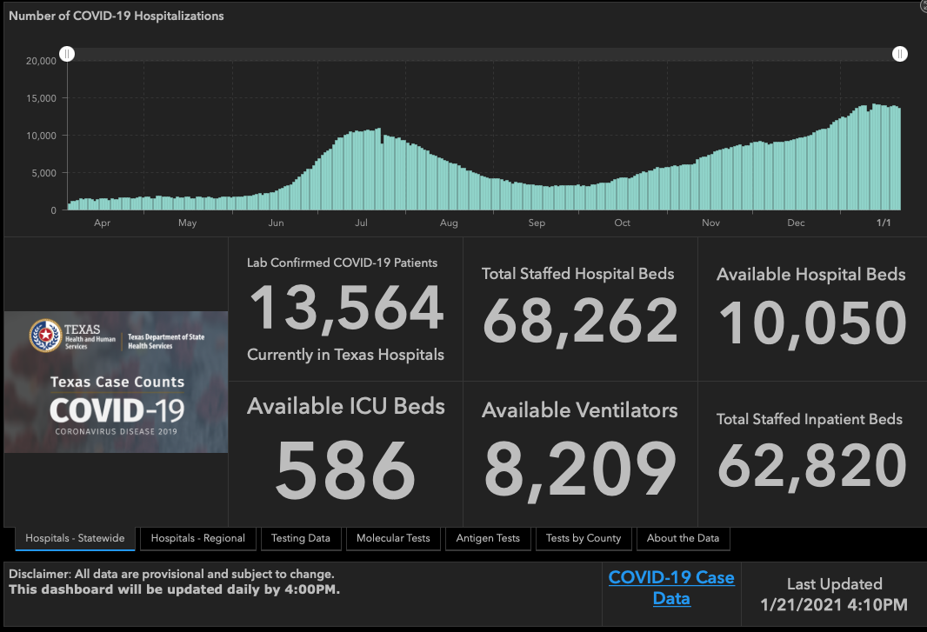

Slide 59
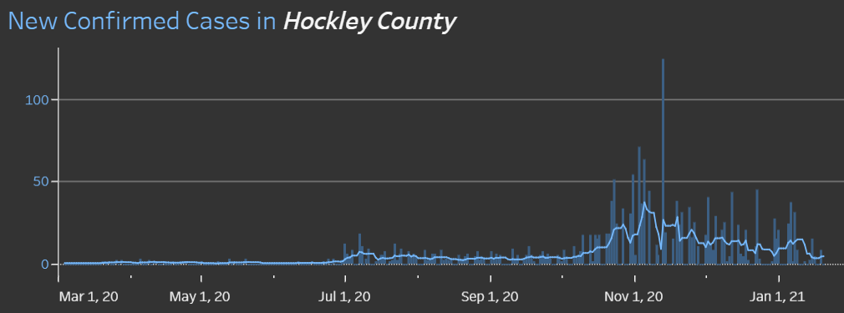
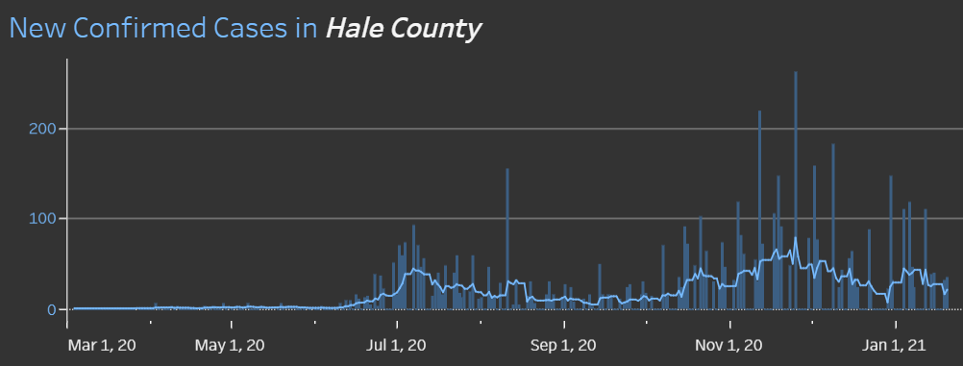
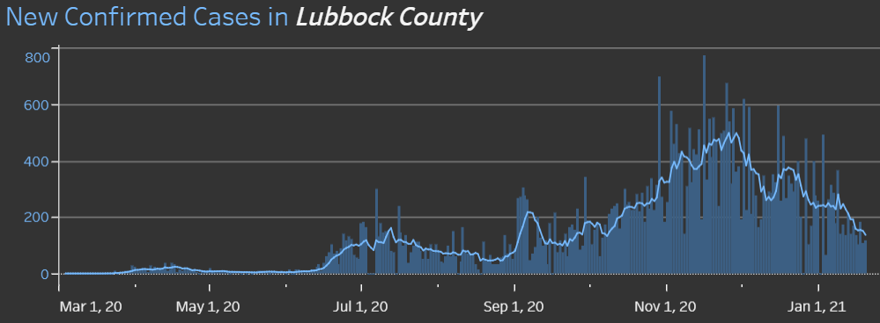
COUNTY
1/11 110 new cases
14.6% positivity rate
14.6 %
Positivity Rate
1/13 144

Slide 60
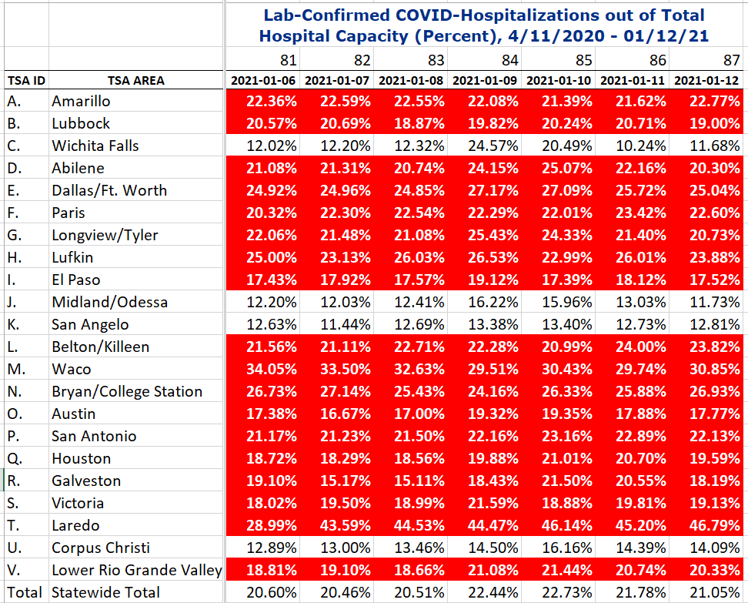
COVID+ HOSPITALIZATIONS BY TSA ID
CONFIRMED COVID+ HOSPITALIZATIONS /HOSPITAL CAPACITY
Last Week
TSA – B
87 DAYS > 15%
18 of 22 TSAs are over the limit

Slide 61
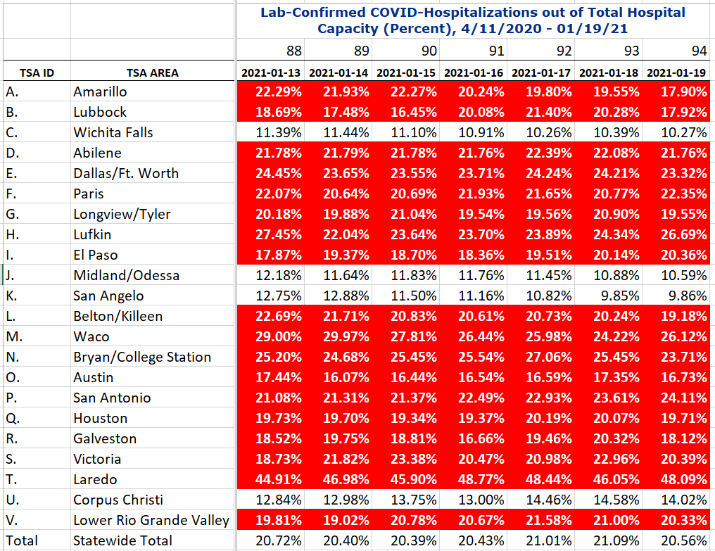
COVID+ HOSPITALIZATIONS BY TSA ID
CONFIRMED COVID+ HOSPITALIZATIONS /HOSPITAL CAPACITY
This Week
TSA – B
94 DAYS > 15%

Slide 62
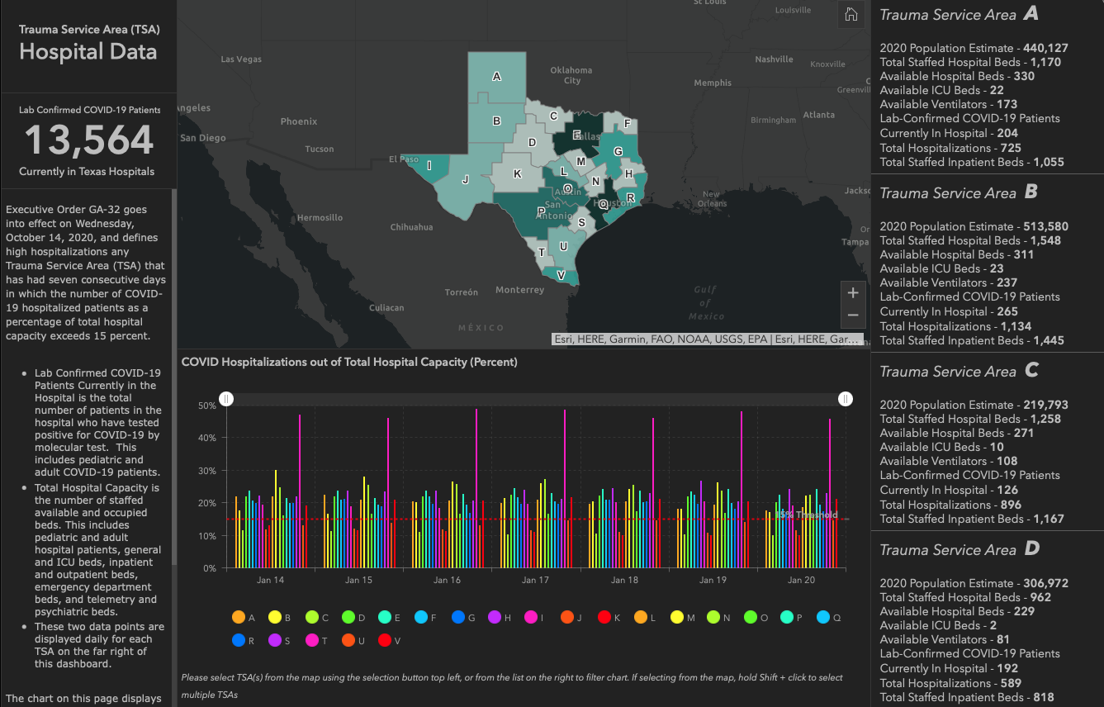

Slide 63
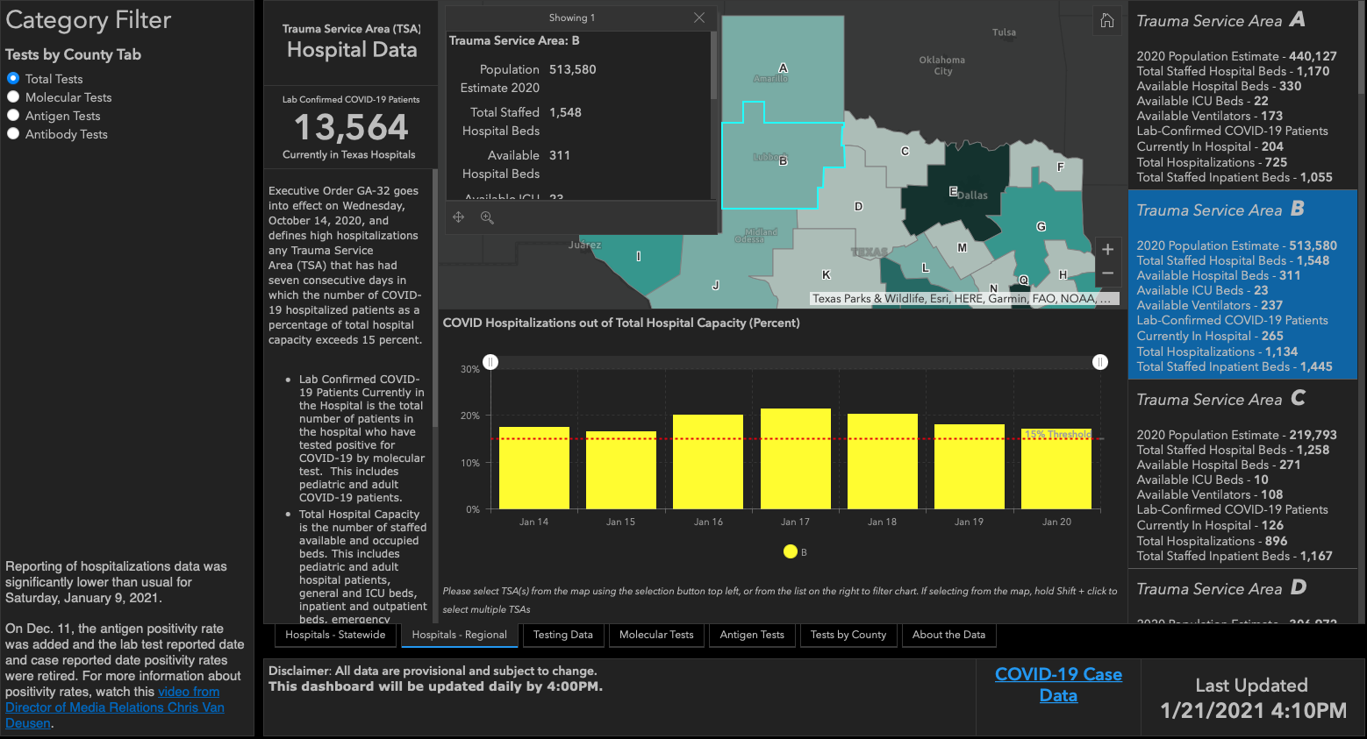
20.08%
21.4%
20.29%
17.92%
17.48%
16.45%
17.12%

Slide 64
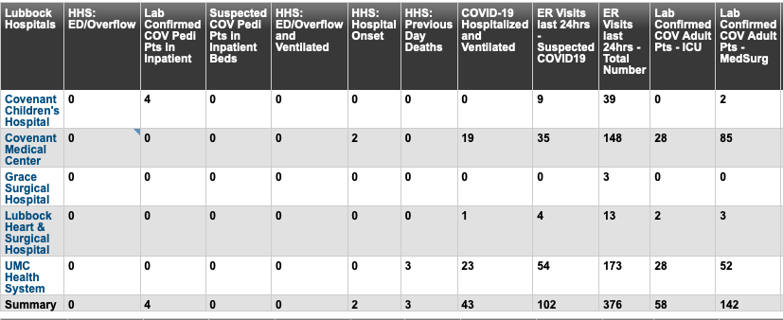
Lubbock This Morning

Slide 65
Surge Plans

Slide 66
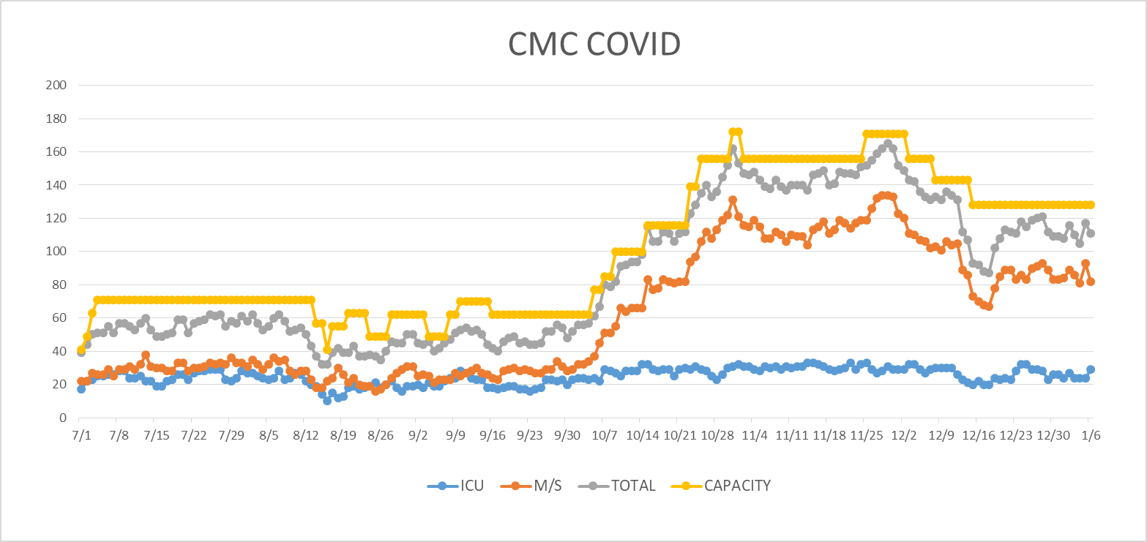
COVID Units - CMC
1/7/2020
UPDATE

Slide 67
Caregiver Update

Slide 68
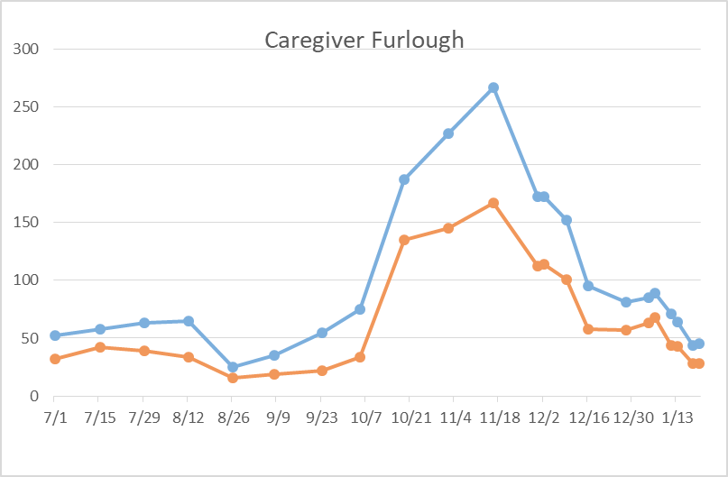
Caregivers
COVID Related Furloughs
Count reflects # furlough (exposed and positive)
Good
Moderate
Critical

Slide 69
Statistics
Sean Glenn
Senior Clinical Data Analyst
Decision Support Services
Covenant Health

Slide 70
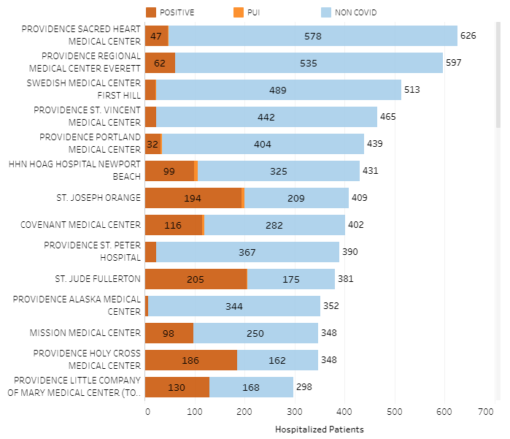
Providence System Hospitalized COVID-19 Cases

Slide 71
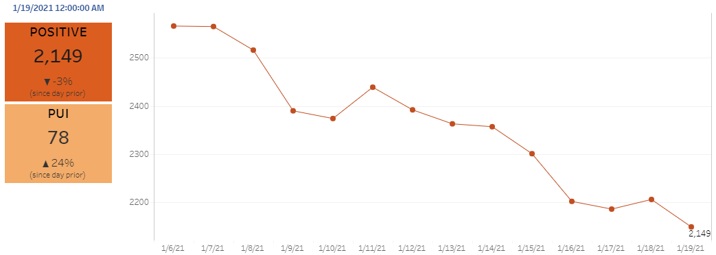
Providence Inpatient COVID-19 Volume

Slide 72
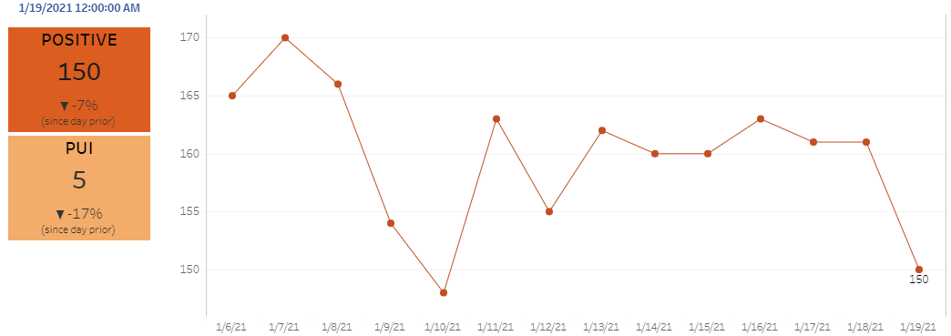
Texas Inpatient COVID-19 Volume

Slide 73
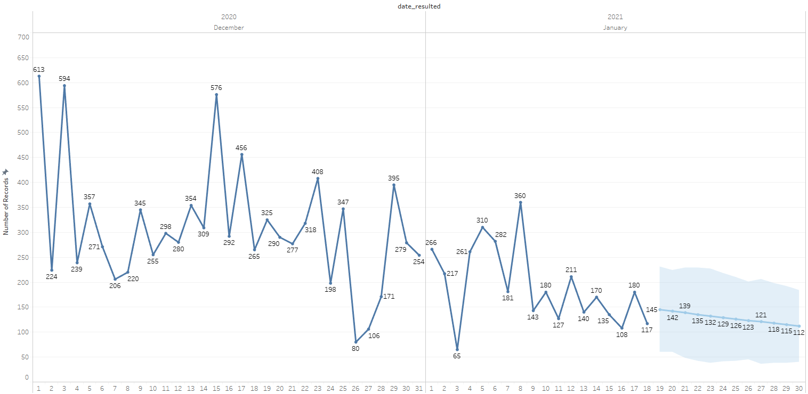

New Covid-19 POSITIVES by Day Trend

Slide 74
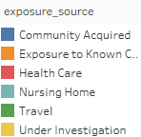
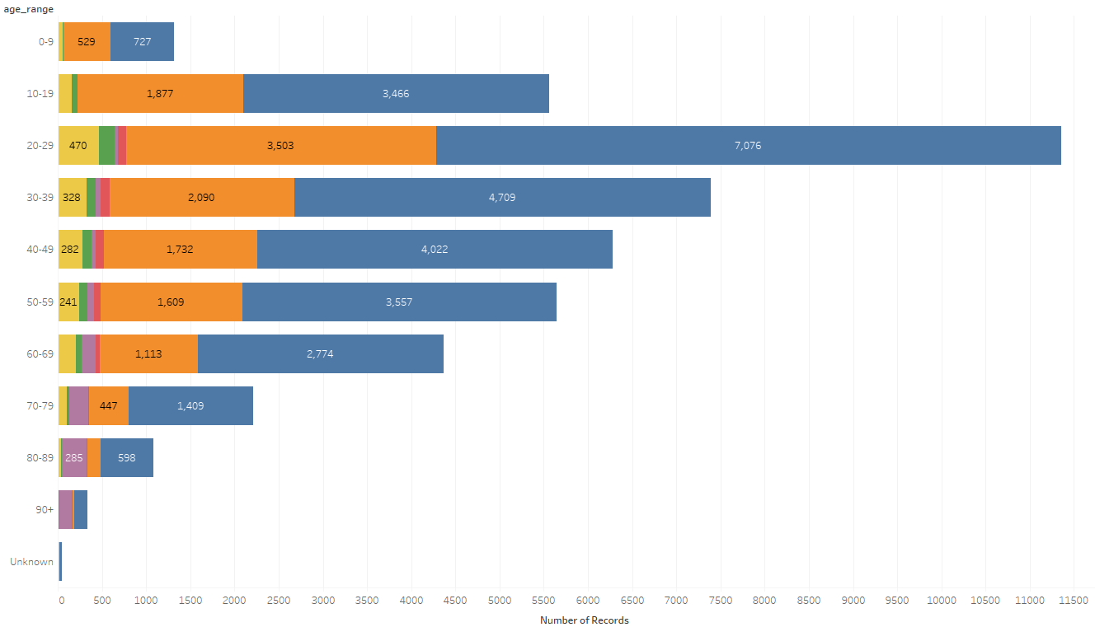
Covid-19 POSITIVES Age Distribution

Slide 75
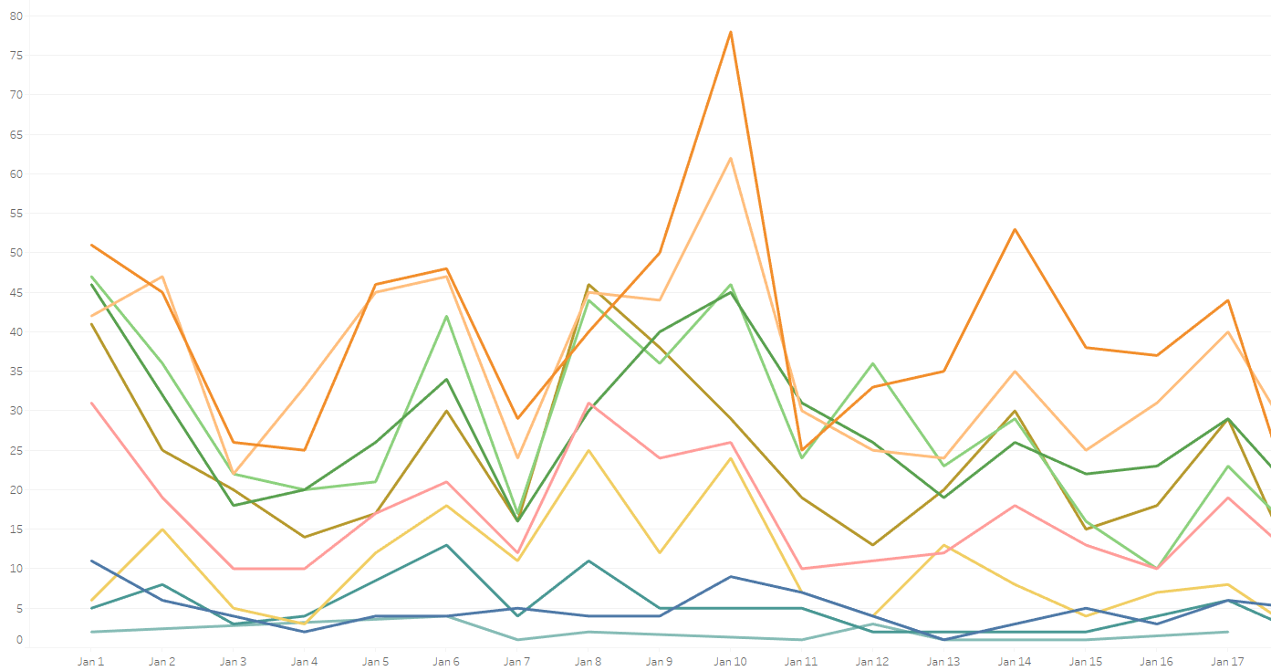
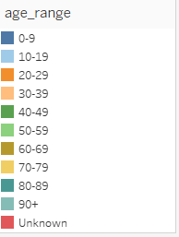
Covid-19 POSITIVES Age Distribution

Slide 76
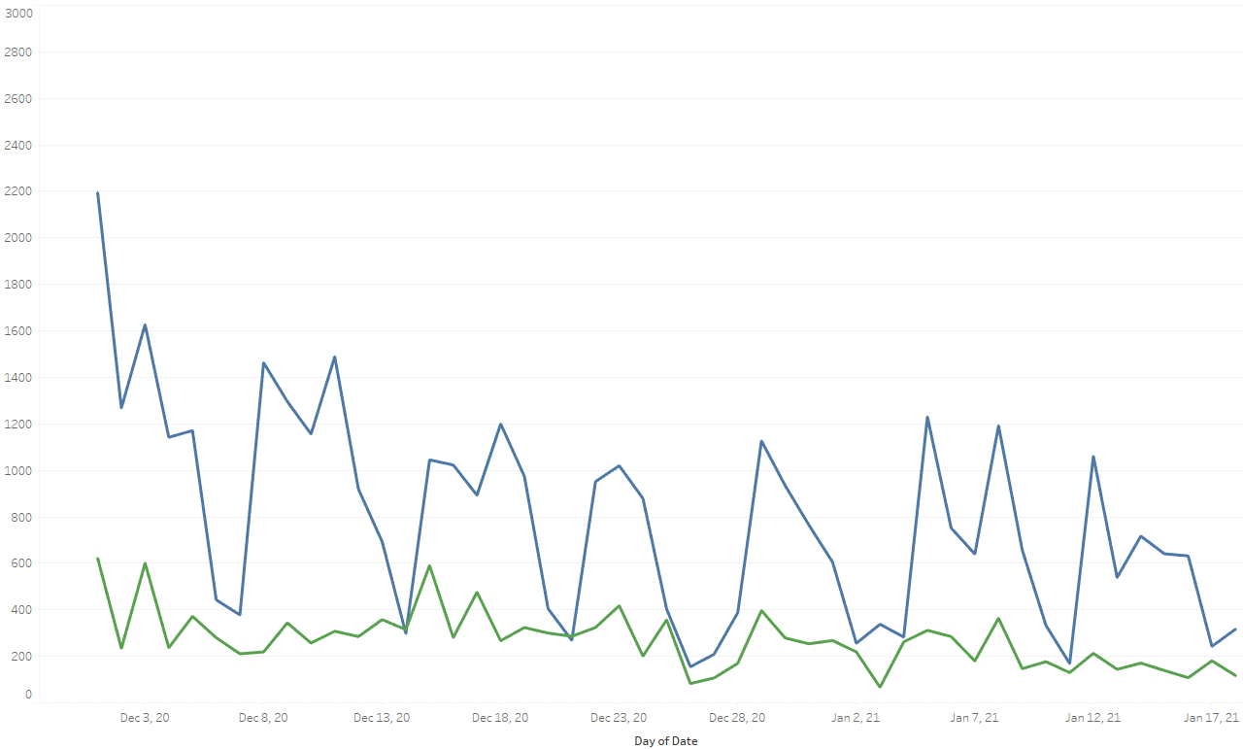

Covid-19 Daily Tests Performed

Slide 77
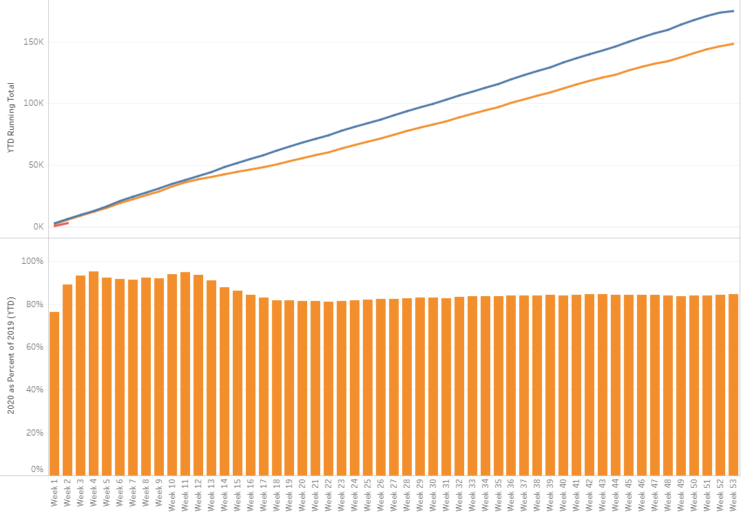

TX/NM Region Weekly Procedures (YOY)

Slide 78
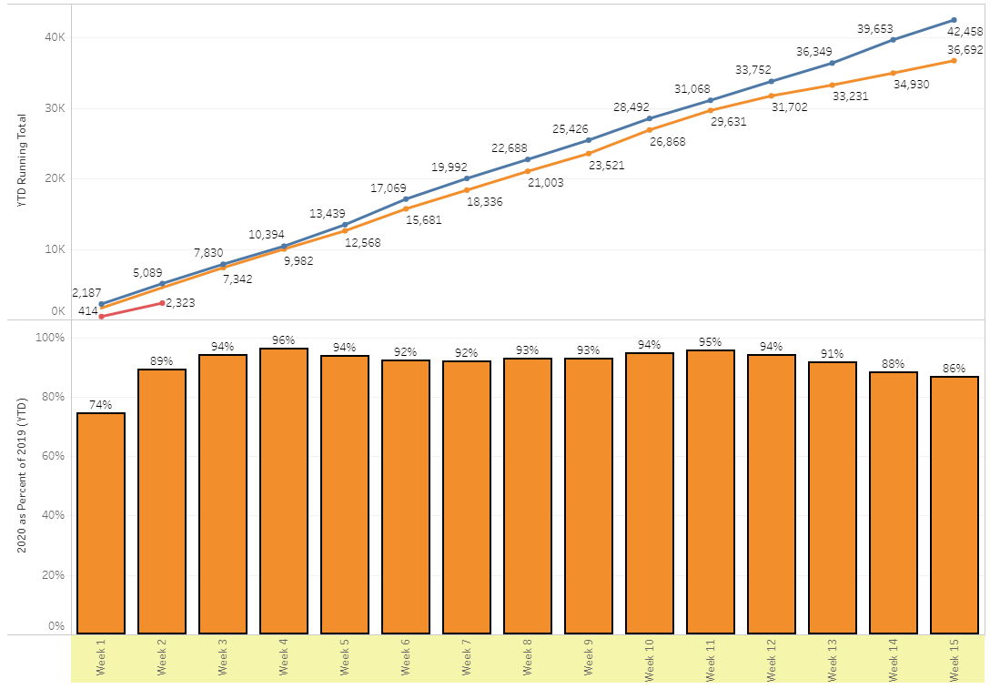
TX/NM Region Weekly Procedures (YOY)

Slide 79
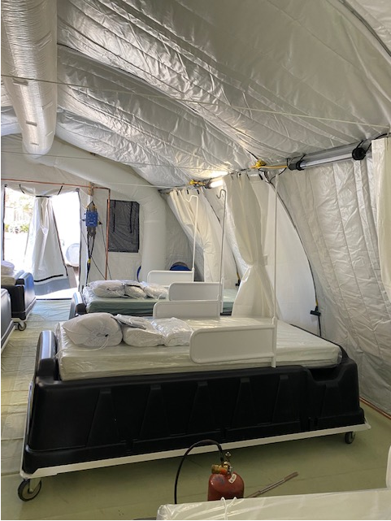
COVID Infusion Center
Status Update
Prakesh Shrestha, MD
Dennis Duriex, MD

Slide 80
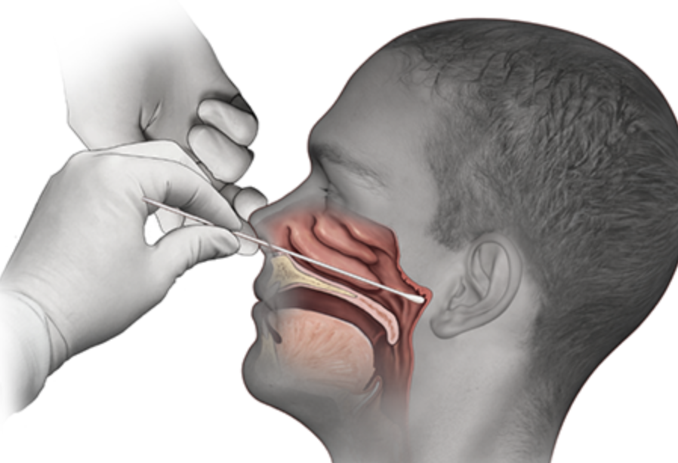
Covid-19 Testing

Slide 81
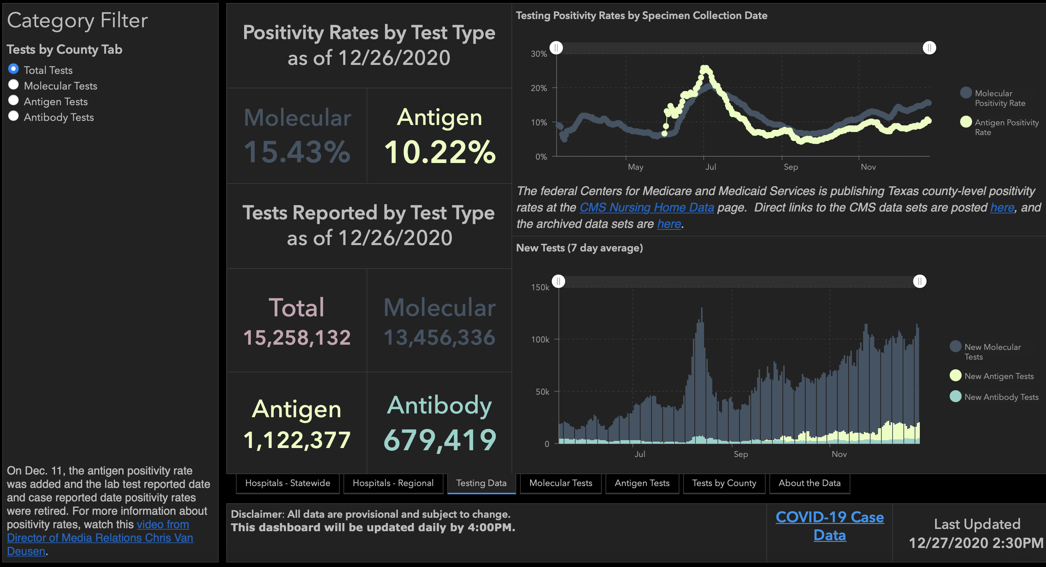

Slide 82
TESTING
 | CMC |  | GMC |  | CMG
 | Rapid | PCR | Rapid | PCR | Rapid
Test Kits
Swabs
VTM
 | CMC |  | GMG/CMG
 | Tests | + | Tests | +
12/21 | 95 | 14 | 24 | 3
12/22 | 239 | 41 | 177 | 48
12/23 | 217 | 33 | 179 | 49
PCR
Rapids
>2000 >750
<2000 <750
<1600 <500
CMC- Alinity back online
GMG- no issues
CMG- no issues

Slide 83
Pharmacy Update
Wesley Wells, PharmD
Regional Pharmacy Director
Covenant Health

Slide 84
Therapeutics Update
Numbers are reported as of January 20 at 11:00 pm
COVID Tent numbers are as of January 19 at 11:00 pm
Medication | Current State |  | Updates/Issues
Remdesivir |  |  | We have dispensed 351 vials to the COVID tent We have treated 76 patients
Bamlanivimab (Lilly) |  |  | Inventory was off on the last report Transferring 25 doses to State Hospital
Casirivimab and Imdevimab (Regeneron) |  |  | Transferring 30 doses to State Hospital
Zanubrutinib | Patients enrolled: 6 | Active patients: 0 | No updates
Regeneron 2066 | Patients enrolled: 3 (5 screened) | Active patients: 0 | No updates
EXIT COVID-19 Trial | Patients enrolled: 10 (11 screened) | Active patients: 1 | Done enrolling patients for phase 2 trial
Ministry | Vials Used on Previous Day | Stock
Covenant Medical Center | 27 | 90
Covenant Children’s Hospital | 0 | 36
Covenant Plainview | 9 | 24
Covenant Levelland | 6 | 5
Home Infusion | 3 | 49
Ministry | Total Doses Infused | Stock
CMC/Home Infusion | 517 | 132
Covenant Plainview | 26 | 67
Covenant Levelland | 13 | 35
Ministry | Total Doses Infused | Stock
CMC/Home Infusion | 117 | 162
Covenant Plainview | 0 | 35

Slide 85
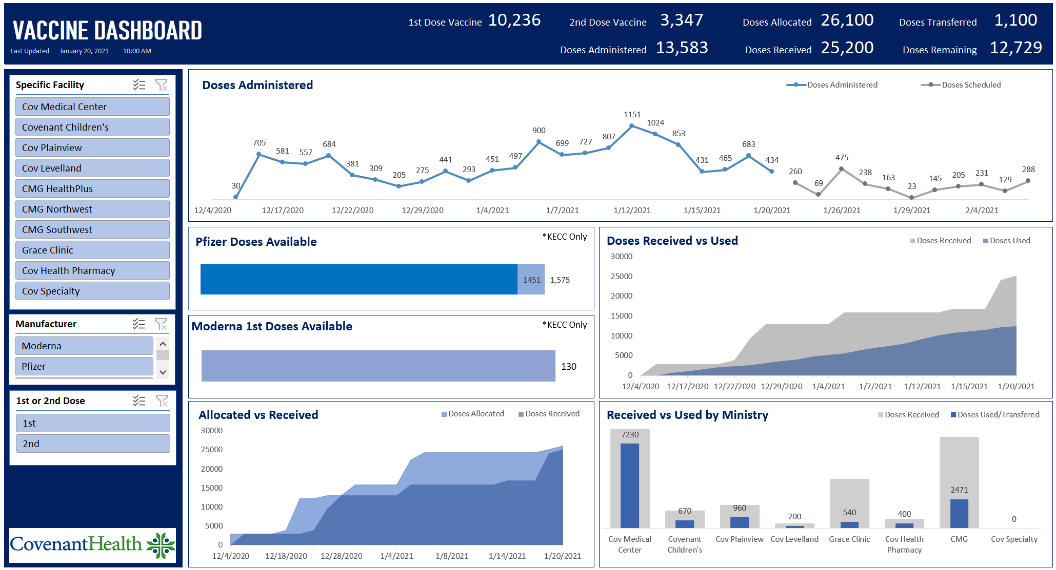
Vaccine Update

Slide 86
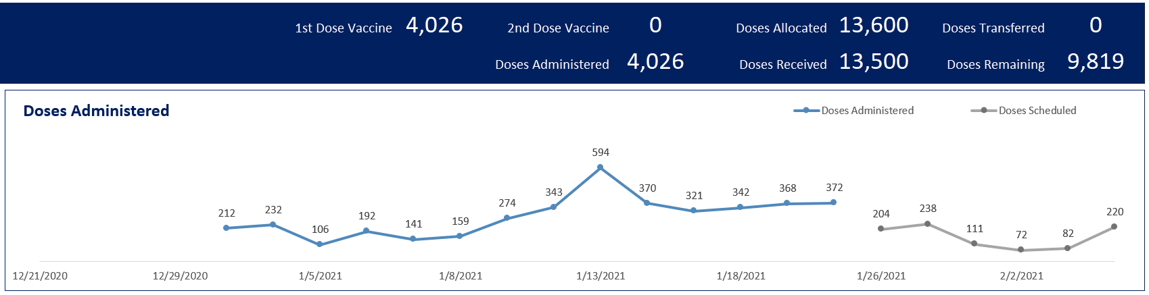
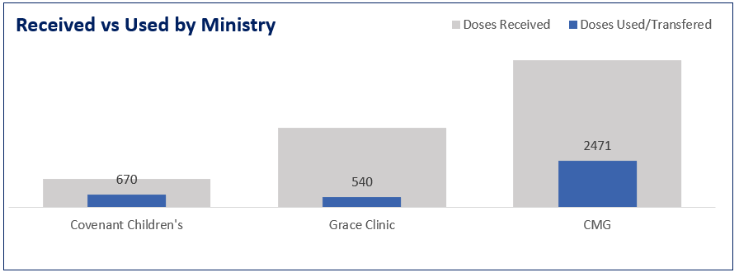
Vaccine Update
Community
and Clinics

Slide 87
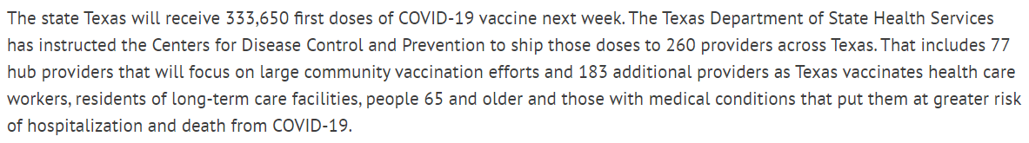
Vaccine Update
Week 6 Allocation
Week 7 Allocation
  Prioritized hub sites, hospitals, local health departments, and dialysis centers
  Prioritized counties which haven’t received previous allocations
  167,100 Moderna doses to allocate and 165,750 Pfizer doses to allocate

Slide 88
Vaccine Updates
Reports of issues with Lot 041L20A
  Reported by California State Department due to increased side effects
  CDC doesn’t recommend health departments stop administering
  California is now allowing administrations
Mass Vaccination with City of Lubbock Health Dept
  City Planning to increase volume of vaccinations at the Civic Center
  Covenant offering to provide manpower to help support
  Specific dates and times TBA

Slide 89
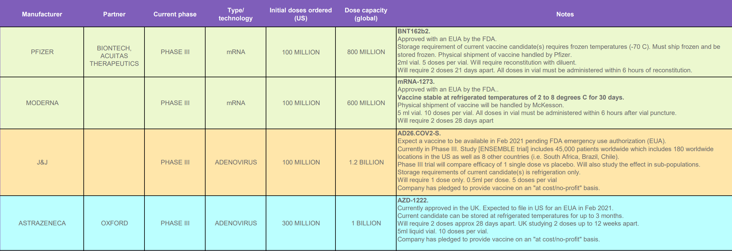
Vaccine Update

Slide 90

Texas Demographics

Slide 91
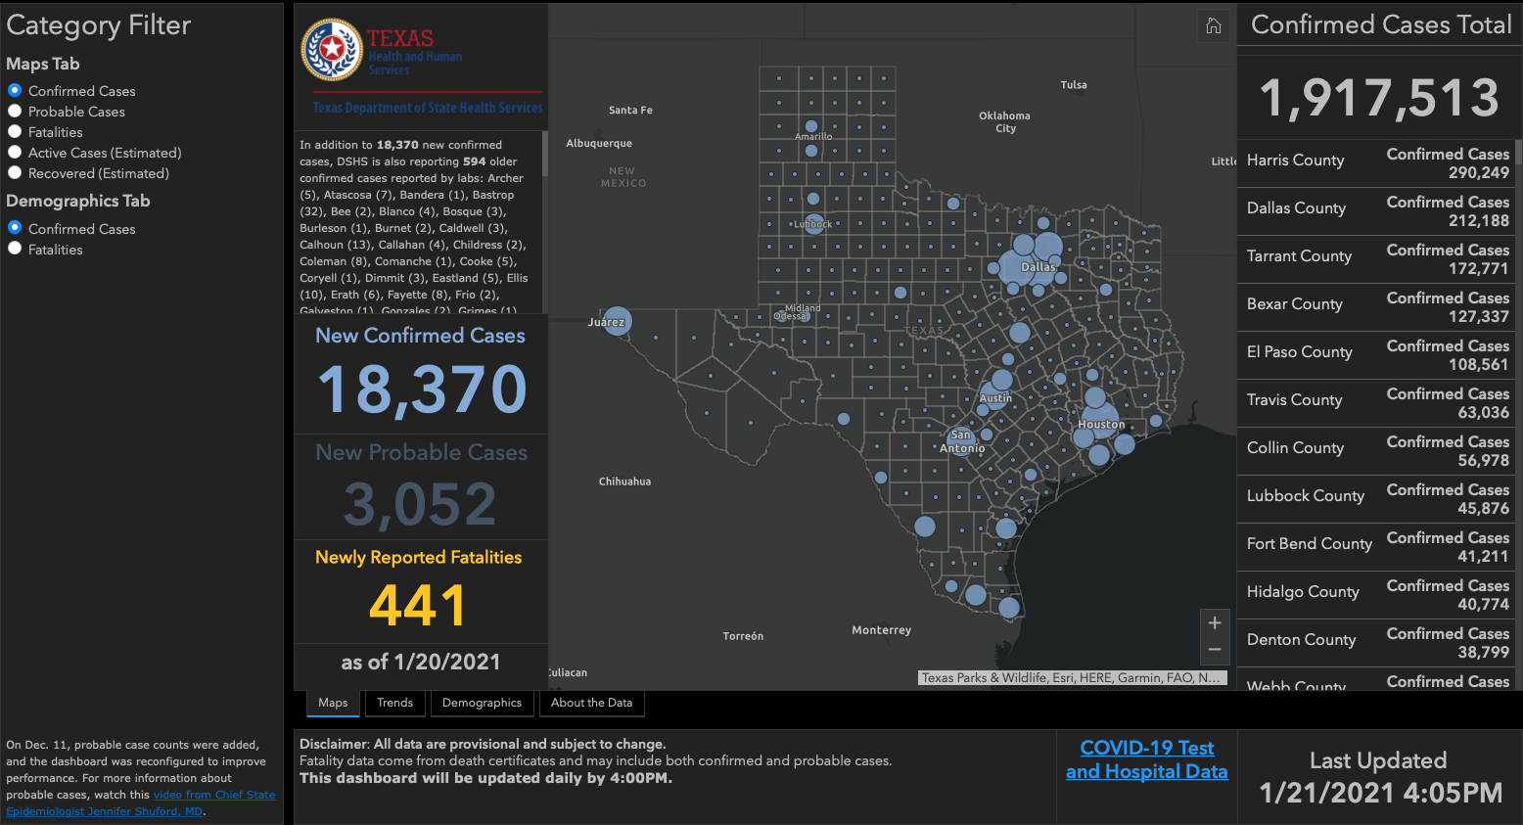

Slide 92
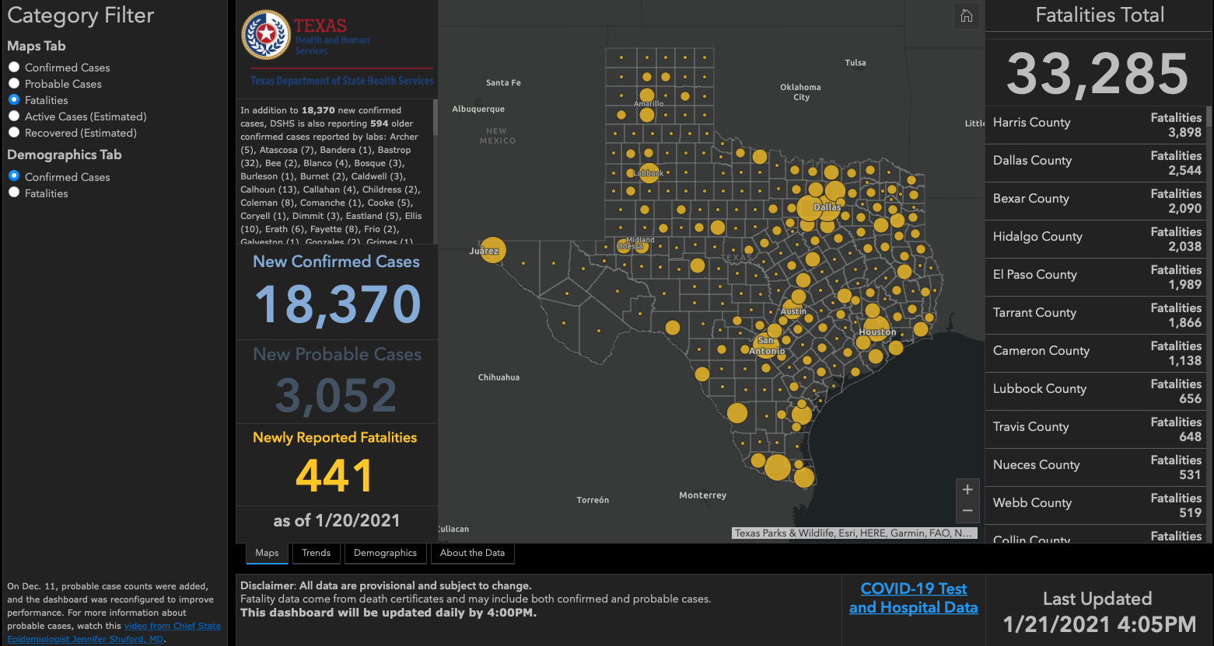

Slide 93
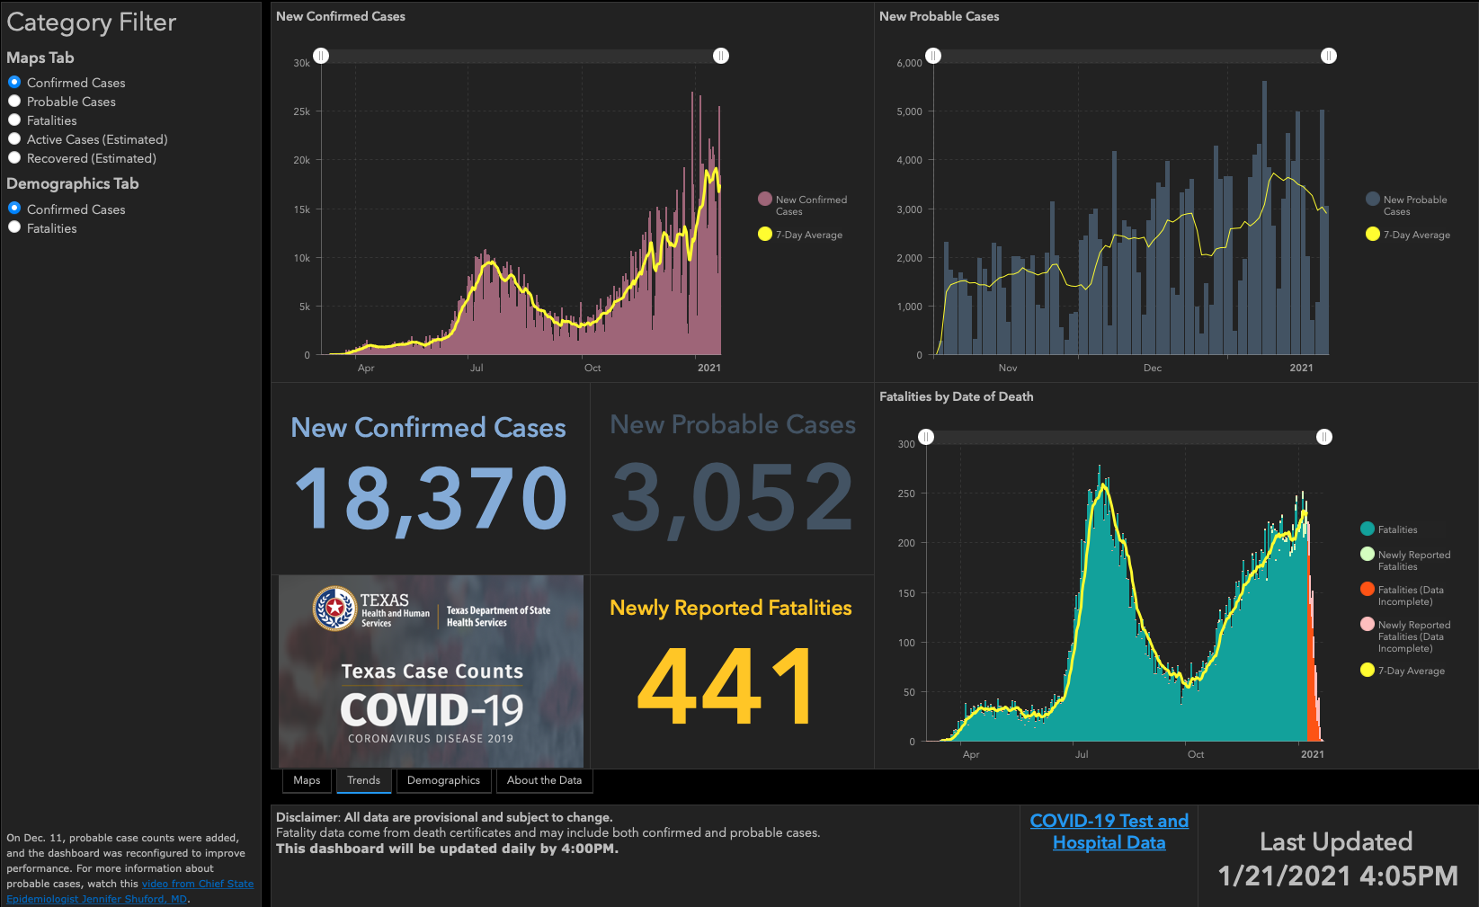

Slide 94
Q & A

Slide 95
CME Credit was only approved for the Live Teams meeting
To receive credit for this continuing education activity, the participant must:
  Make sure you are logged into your Teams account, if you are signed in with a group provide attendee’s First and Last name(s) in the comments section.
  If you are calling into the Teams meeting you MUST text your First & Last Name to (806) 252-4735. This will ensure you are added to the sign in sheet to receive CME Credit.
  You will receive an email by the following Wednesday from the CME department with further instructions on claiming your certificate.

