Slide 1
Covenant Health
Presents
Critical Communications: A Weekly Physician Update
January 29, 2021

Slide 2
PHYSICIANS
Accreditation Statement:
The Covenant Health is accredited by the Texas Medical Association (TMA) to provide continuing medical education for physicians.
Credit Designation Statement:
The Covenant Health designates this live CME activity for a maximum of 1.0 AMA PRA Category 1 Credit(s)™. Physicians should claim only the credit commensurate with the extent of their participation in the activity.

Slide 3
Disclosures of Commercial Interest
The speakers and planners of this activity
have no relevant financial interests

Slide 4
Disclosures
This activity is provided by
Covenant Health
No commercial support has been received.
No products will be endorsed.
Speakers will notify the audience if off label drug use will be discussed.

Slide 5
CME Credit was only approved for the Live Teams meeting
To receive credit for this continuing education activity, the participant must:
  Make sure you are logged into your Teams account, if you are signed in with a group provide attendee’s First and Last name(s) in the comments section.
  If you are calling into the Teams meeting you MUST text your First & Last Name to (806) 252-4735. This will ensure you are added to the sign in sheet to receive CME Credit.
  You will receive an email by Wednesday following the call from the CME department with further instructions on claiming your certificate.

Slide 6
Reflection
Prakash Shrestha, MD
Regional Medical Director
Infection Prevention and Antimicrobial Stewardship Program
Covenant Health

Slide 7
I’ll take care of you
by Prakash Shrestha

Slide 8
Here I’ve Come again to see if you’ve recover;
Has fever gone away, do you feel better ?
Days are so gloomy and endless seems these nights;
Together you and me, one day we’ll win this fight.
Down on my knees I’ll pray for you every morning;
One breath at a time, let the candle of hope Keep burning.
You do your part, let me take care of mine;
Dark clouds will fizzle, Sun will surely shine.
Let’s think of tomorrow when no agony will remain;
This misery will be gone and there isn’t any pain
What will you do when you’ve been all through ?
When you are stronger and you’ll be all new.

Slide 9
Will you once again race with your grandson?
Let him defeat you and watch the joy of little one.
Sitting by the fireside will you pet your dog ?
And early every morning take him for a jog.
Will you feed those birds while your cat stares at you ?
Waiting for the treat that has long been due.
Will you once again take your wife for long drive?
Reminiscing those memories of your beautiful life.
Hang in their my friend, let this storm pass through;
Together you and I, we’ll make all those dream come true.
Battle will be won, that is certainly true;
You trust on me, I’ll take care of you.
--------------------------------xxxxxxxx--------------------------------

Slide 10
Post COVID-19 Syndromes are Emerging

Slide 11
60 Minutes
https://youtu.be/0gLmMPOHDwM

Slide 12
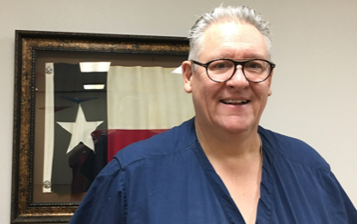
Prolonged Care for Covid-19 “Long-Haulers"
Kerry Hendershot, MD
Covenant Medical Group

Slide 13
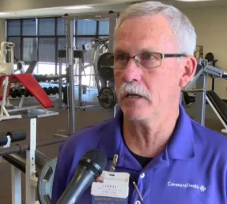
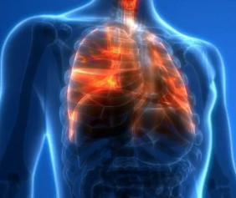

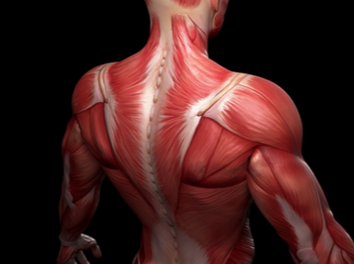
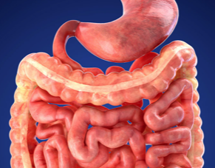
Rehabilitation Programs
Pulmonary Rehabilitation
Cardiac Rehabilitation
Strength Rehabilitation
Nutritional Support
Tommy Parrish
Director of Lifestyle Center

Slide 14
Current Regional Covid-19 Census

Slide 15
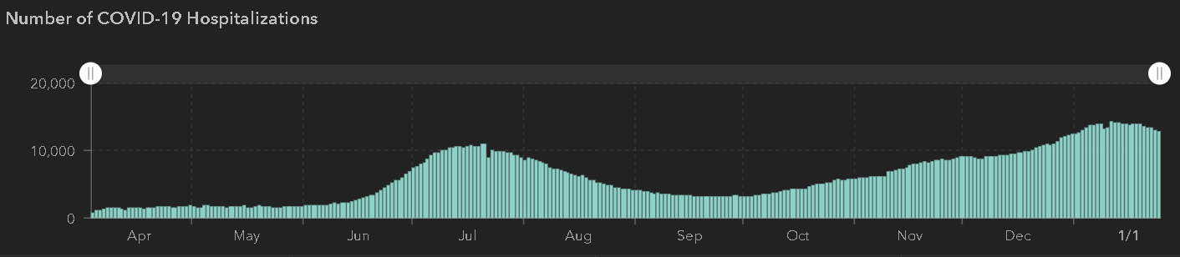
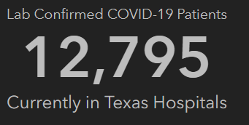
State of Texas Hospitalizations
 | 1/18 | 1/24 | 1/27
Cases | 1,864, 249 | 1,965,585 | 2,003,135
Deaths | 32,084 | 34,394 | 35,168
Hospitalizations | 13,858 | 13,564 | 12,795
STATE

Slide 16
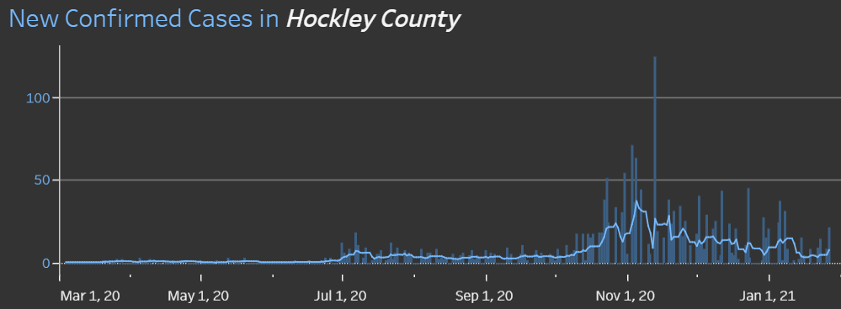
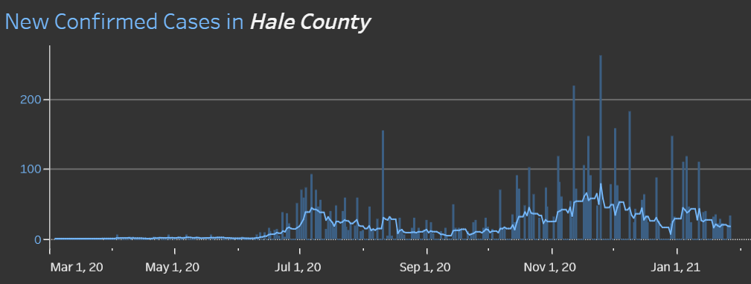
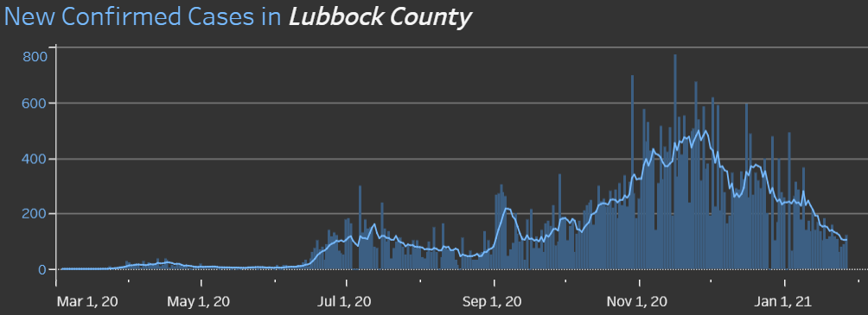
COUNTIES
1/11 110 new cases
14.6% positivity rate
14.5 %
Positivity Rate
1/13 144

Slide 17
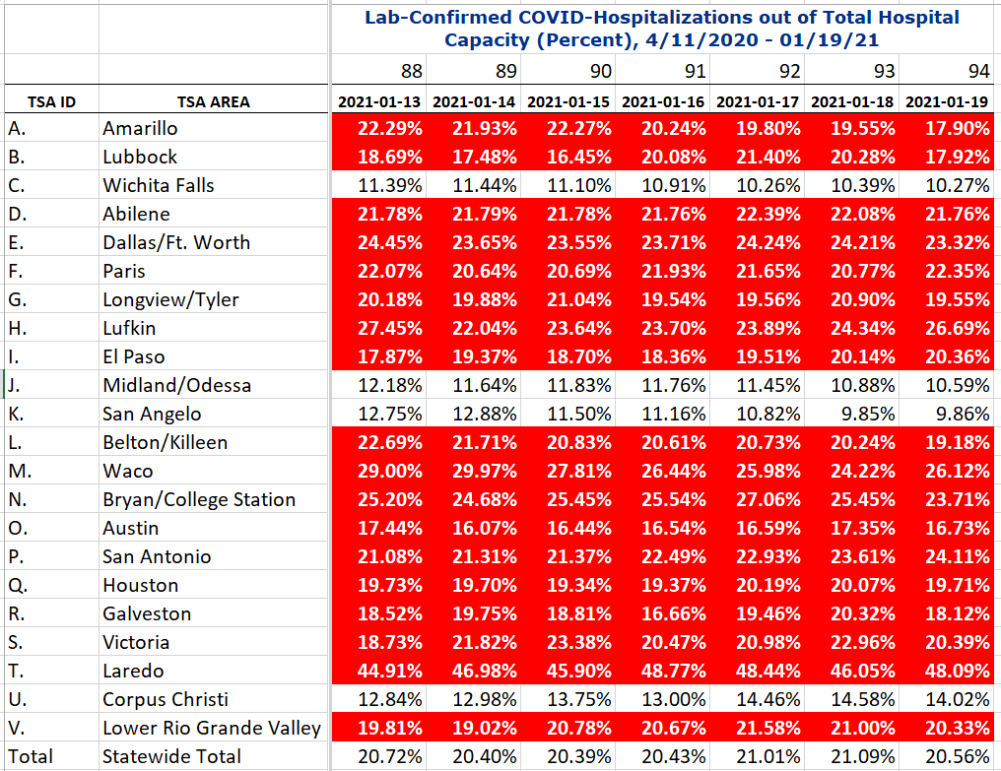
COVID+ HOSPITALIZATIONS BY TSA ID
CONFIRMED COVID+ HOSPITALIZATIONS /HOSPITAL CAPACITY
Last Week
TSA – B
94 DAYS > 15%

Slide 18
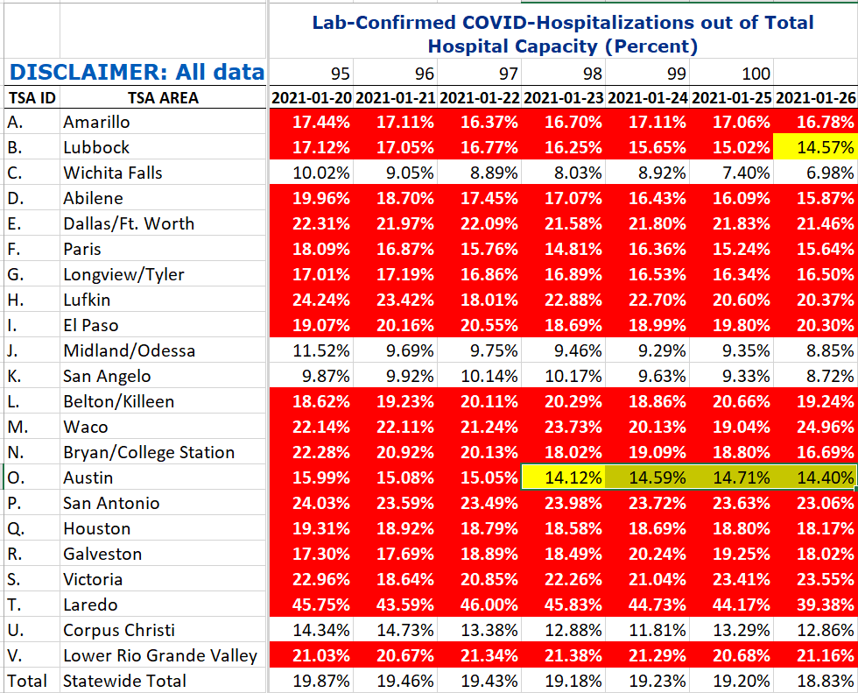
COVID+ HOSPITALIZATIONS BY TSA ID
CONFIRMED COVID+ HOSPITALIZATIONS /HOSPITAL CAPACITY
THIS WEEK
TSA – B
100 DAYS > 15%
1/26 1st day <15%

Slide 19
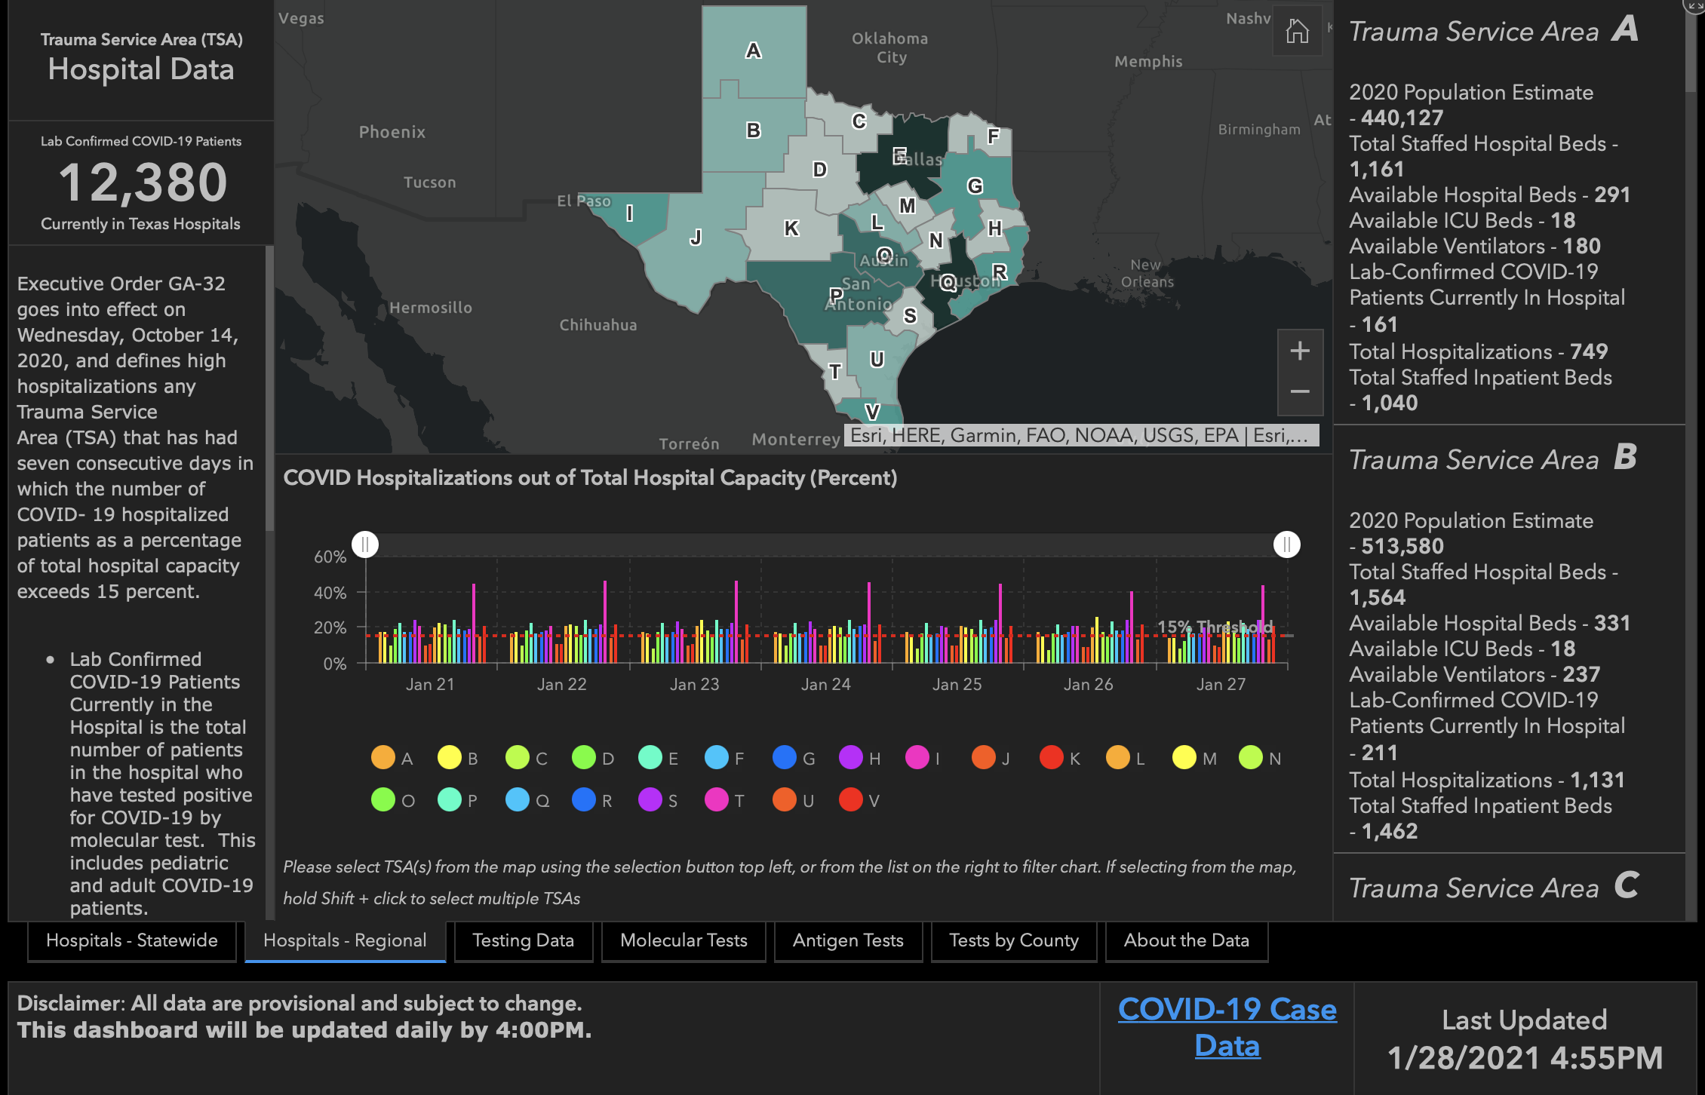

Slide 20
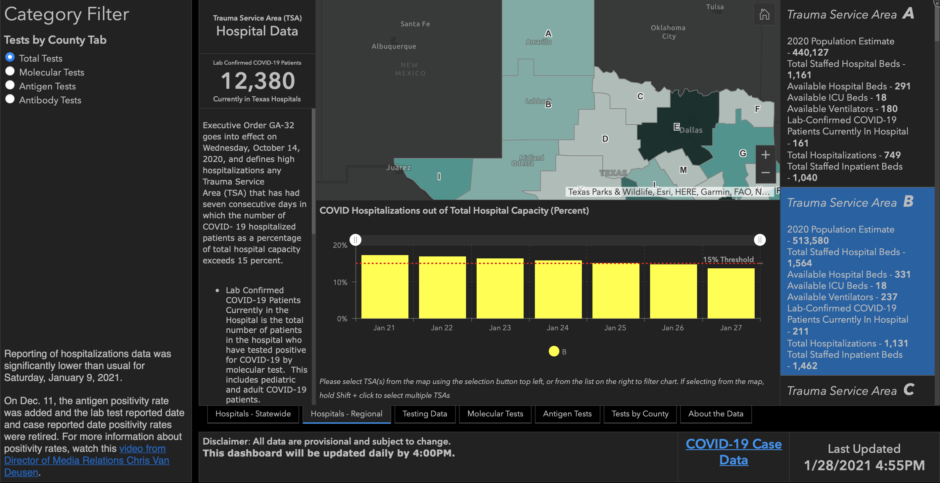
17.05%
16.77%
16.25%
15.65%
15.02%
14.57%
13.49%

Slide 21
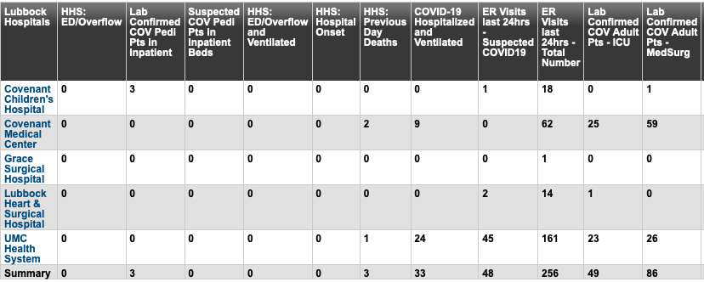
Lubbock This Morning

Slide 22
Surge Plans

Slide 23
Surge Plan
Covenant Medical Center
 | ICU | Med Surg | Total
Phase 1 | 10-CICU |  | 10
Phase 2 | 17-CICU | 10-HC4 | 27
Phase 3 | 17-CICU | 24-HC4 | 41
Phase 4 | 17-CICU | 24-HC4 | 63
Phase 5 | 17-CICU | 24-HC4 15 – S 9 (East) 15-S 10(East) | 71
Phase 6 | 17-CICU 16-MICU 15-S10 | 24-HC4 13-HC6 31 – S 9 (all) | 103
Phase 7 | 17-CICU 16-MICU 15-S 4 15 S10 | 24-HC4 31 – S 9 (all) | 118
Phase 8 | 8-E4 17-CICU 16-MICU 15-S 4 | 24-HC4 13-HC6 31 – S 9 (all) 15 S10 | 139
Currently
Last Month

Slide 24
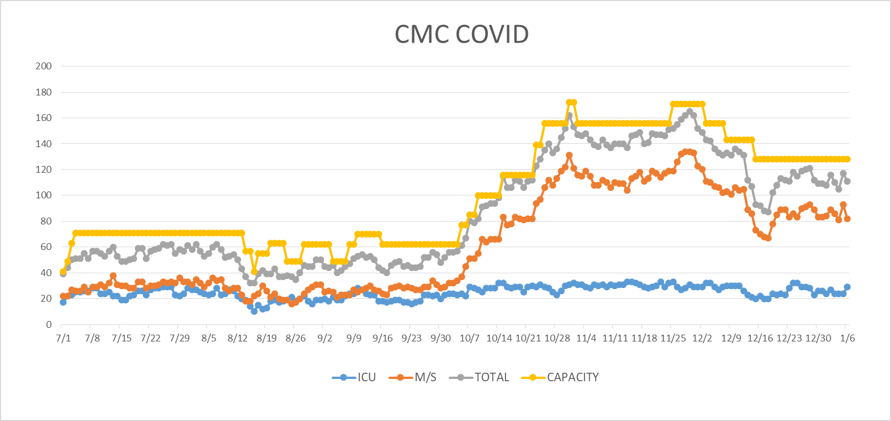
COVID Units - CMC
1/7/2020
UPDATE

Slide 25
Caregiver Update

Slide 26
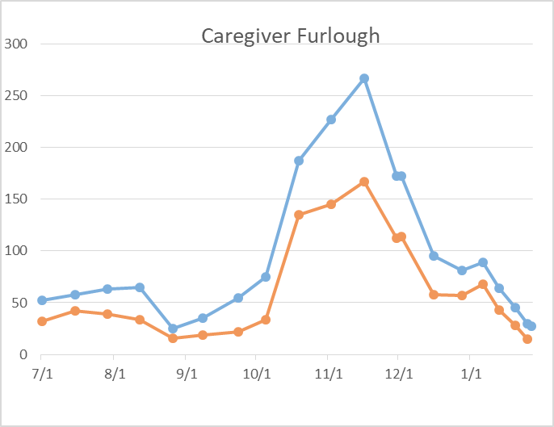

Caregivers
COVID Related Furloughs
Count reflects # furlough (exposed and positive)
Good
Moderate
Critical

Slide 27
Statistics
Cristian Requenez
Clinical Data Analyst
Clinical Analytics
Covenant Health

Slide 28
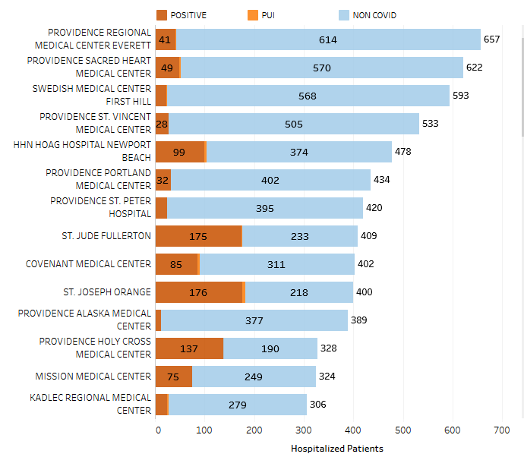
Providence System Hospitalized COVID-19 Cases

Slide 29
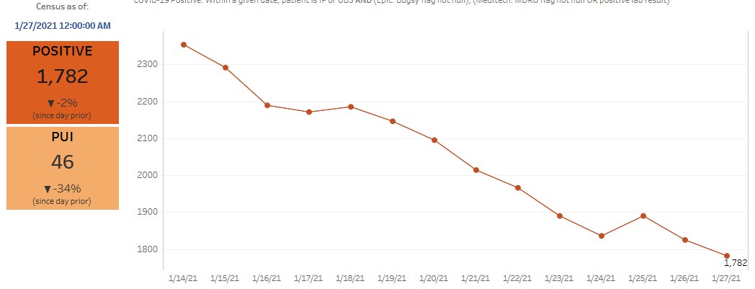
Providence Inpatient COVID-19 Volume

Slide 30
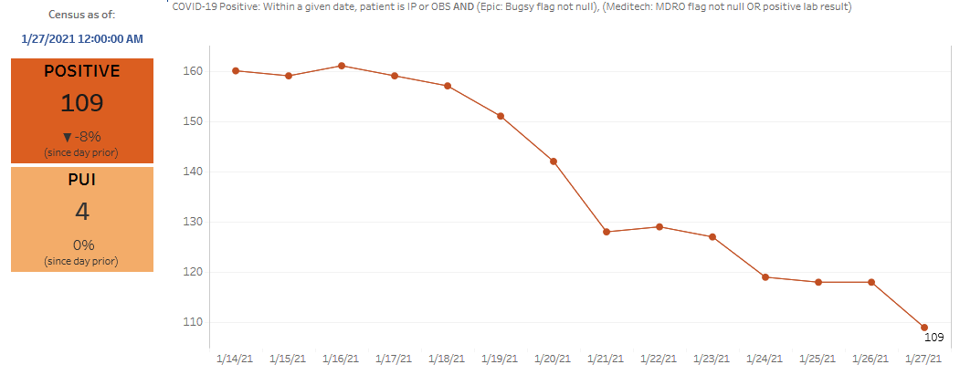
Texas Inpatient COVID-19 Volume

Slide 31
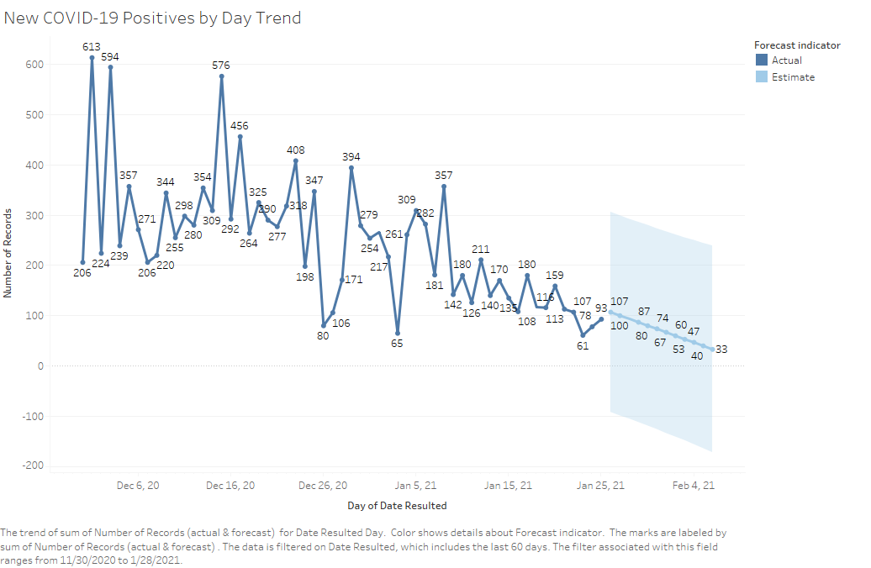
New COVID-19 POSITIVES by Day Trend

Slide 32
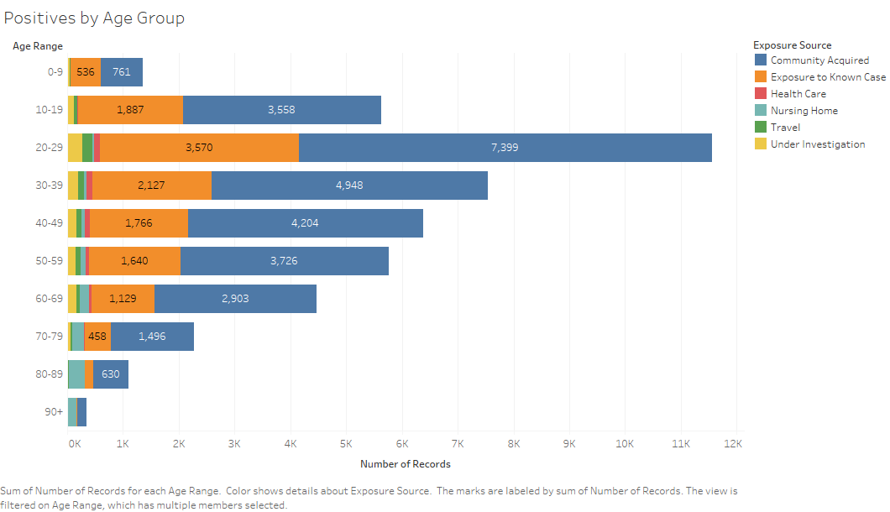
COVID-19 POSITIVES Age Distribution

Slide 33
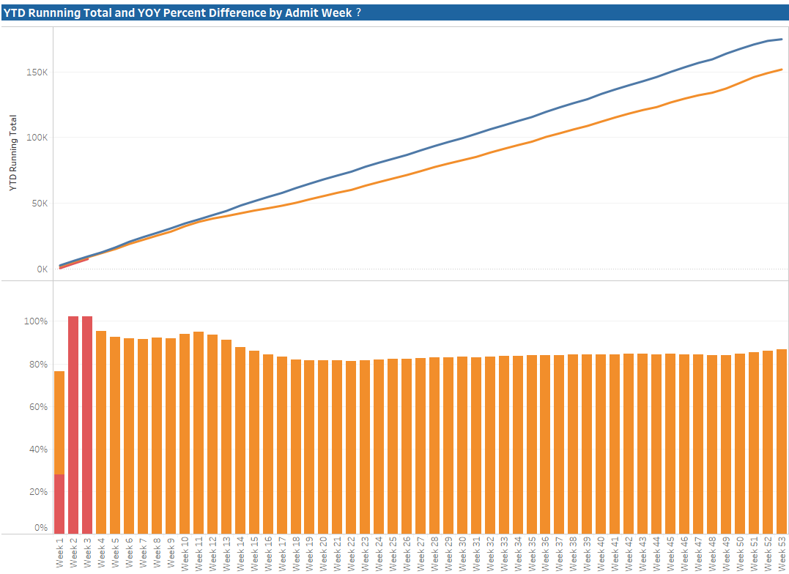
TX/NM Region Weekly Procedures (YOY)

Slide 34
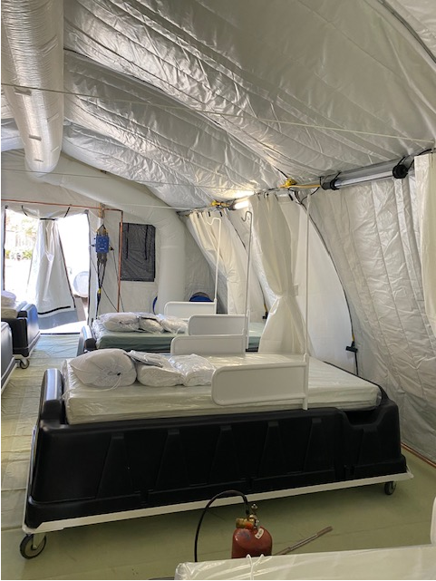
COVID Infusion Center
Status Update
Prakesh Shrestha, MD
Dennis Duriex, MD

Slide 35
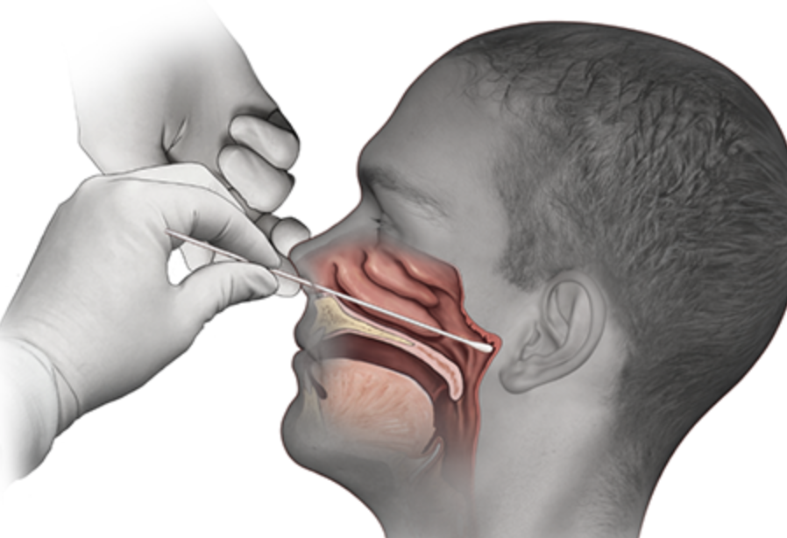
Covid-19 Testing
Jason Loos, MD
Ameripath

Slide 36
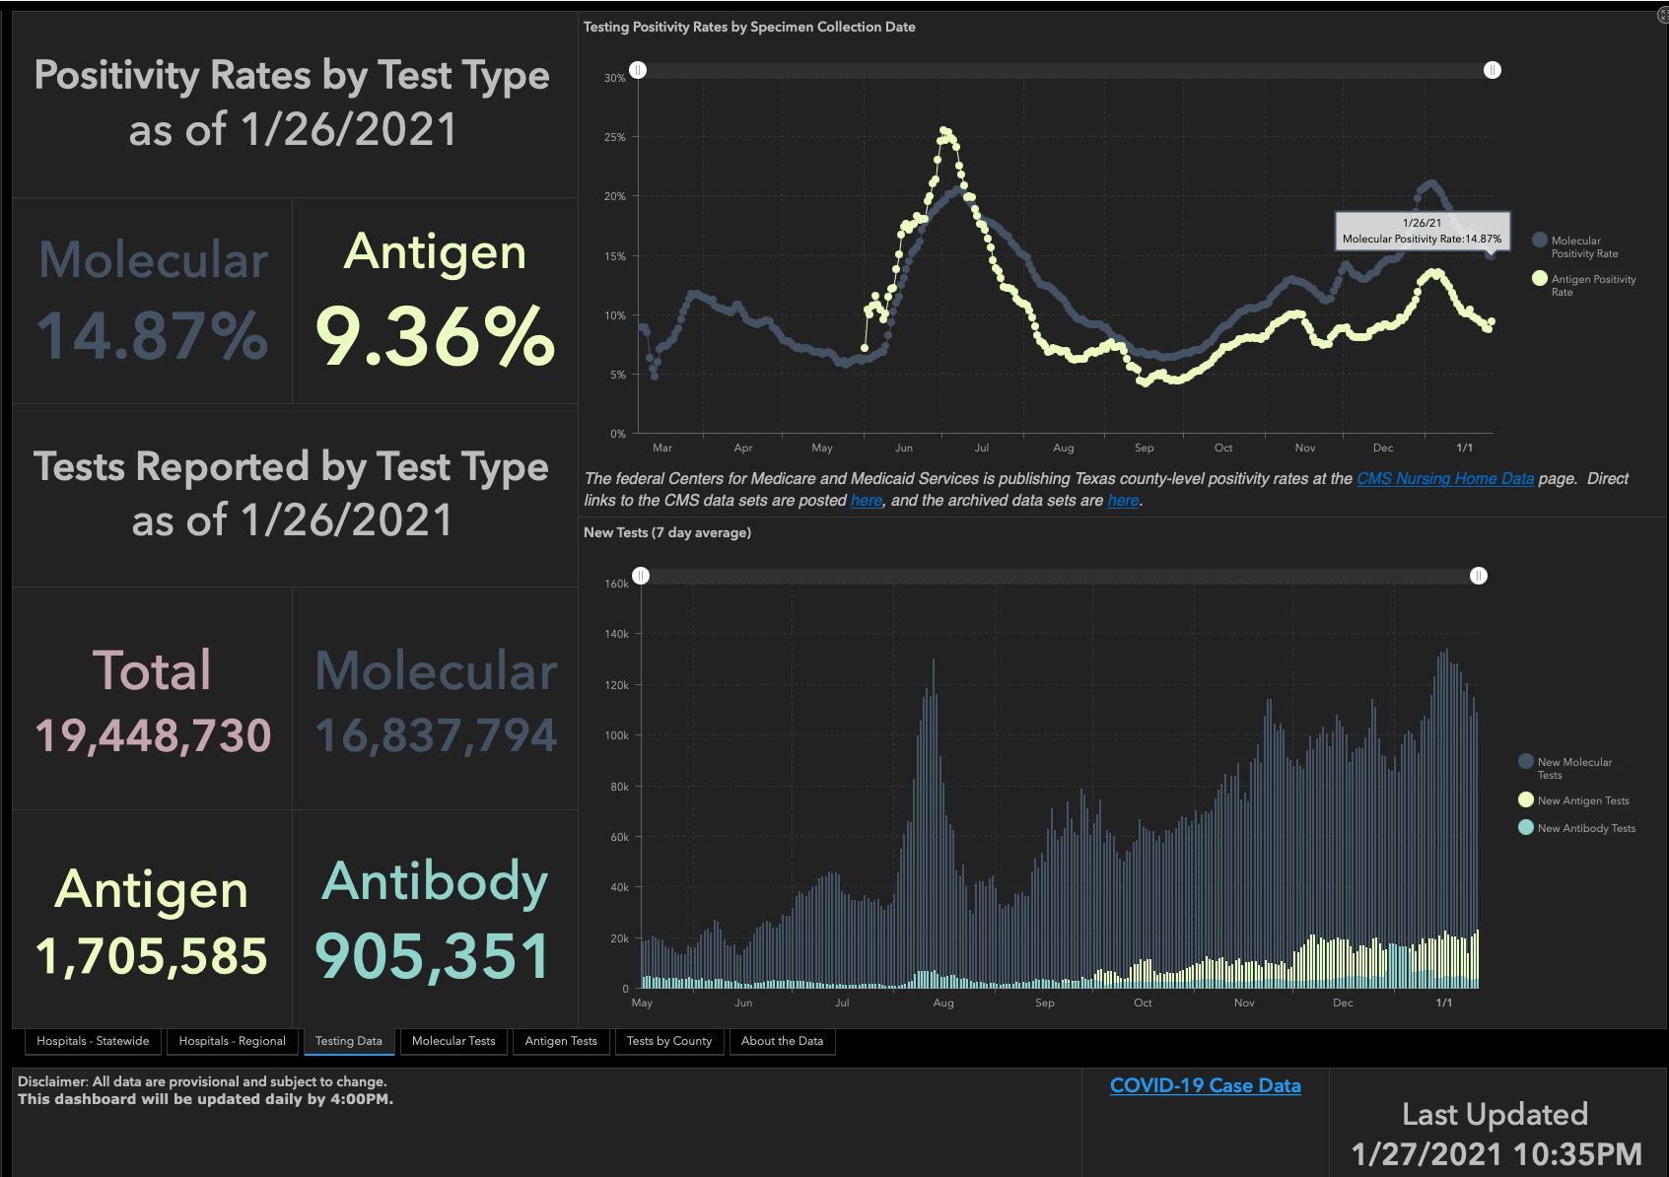

Slide 37
TESTING
 | CMC |  | GMC |  | CMG
 | Rapid | PCR | Rapid | PCR | Rapid
Test Kits
Swabs
VTM
 | CMC |  | GMG/CMG
 | Tests | + | Tests | +
1/25 | 146 | 6 | 19 | 2
1/24 | 111 | 13 | 19 | 1
1/23 | 219 | 24 | 72 | 23
1/22 | 208 | 27 | 75 | 15
1/21 | 311 | 21 | 99 | 20
PCR
Rapids
>2000 >750
<2000 <750
<1600 <500
CMC- no issues
GMG- no issues
CMG- no issues

Slide 38
Pharmacy Update
Wesley Wells, PharmD
Regional Pharmacy Director
Covenant Health

Slide 39
Therapeutics Update
Numbers are reported as of January 27 at 11:00 pm
COVID Tent numbers are as of January 26 at 11:00 pm
Medication | Current State |  | Updates/Issues
Remdesivir |  |  | We have dispensed 355 vials to the COVID tent We have treated 77 patients
Bamlanivimab (Lilly) |  |  | No updates
Casirivimab and Imdevimab (Regeneron) |  |  | No updates
Zanubrutinib | Patients enrolled: 6 | Active patients: 0 | No updates
Regeneron 2066 | Patients enrolled: 3 (5 screened) | Active patients: 0 | No updates
EXIT COVID-19 Trial | Patients enrolled: 10 (11 screened) | Active patients: 0 | No updates
Ministry | 7-Day Average | Stock
Covenant Medical Center | 29 | 366
Covenant Children’s Hospital | 0 | 36
Covenant Plainview | 6 | 59
Covenant Levelland | 1 | 46
Home Infusion | 0.5 | 45
Covenant Hobbs | (5 yesterday) | 49
Ministry | Total Doses Infused | Stock
CMC/Home Infusion | 564 | 123
Covenant Plainview | 28 | 65
Covenant Levelland | 16 | 32
Covenant Hobbs | 6 | 83
Ministry | Total Doses Infused | Stock
CMC/Home Infusion | 137 | 131
Covenant Plainview | 0 | 35
Covenant Hobbs | 0 | 37

Slide 40
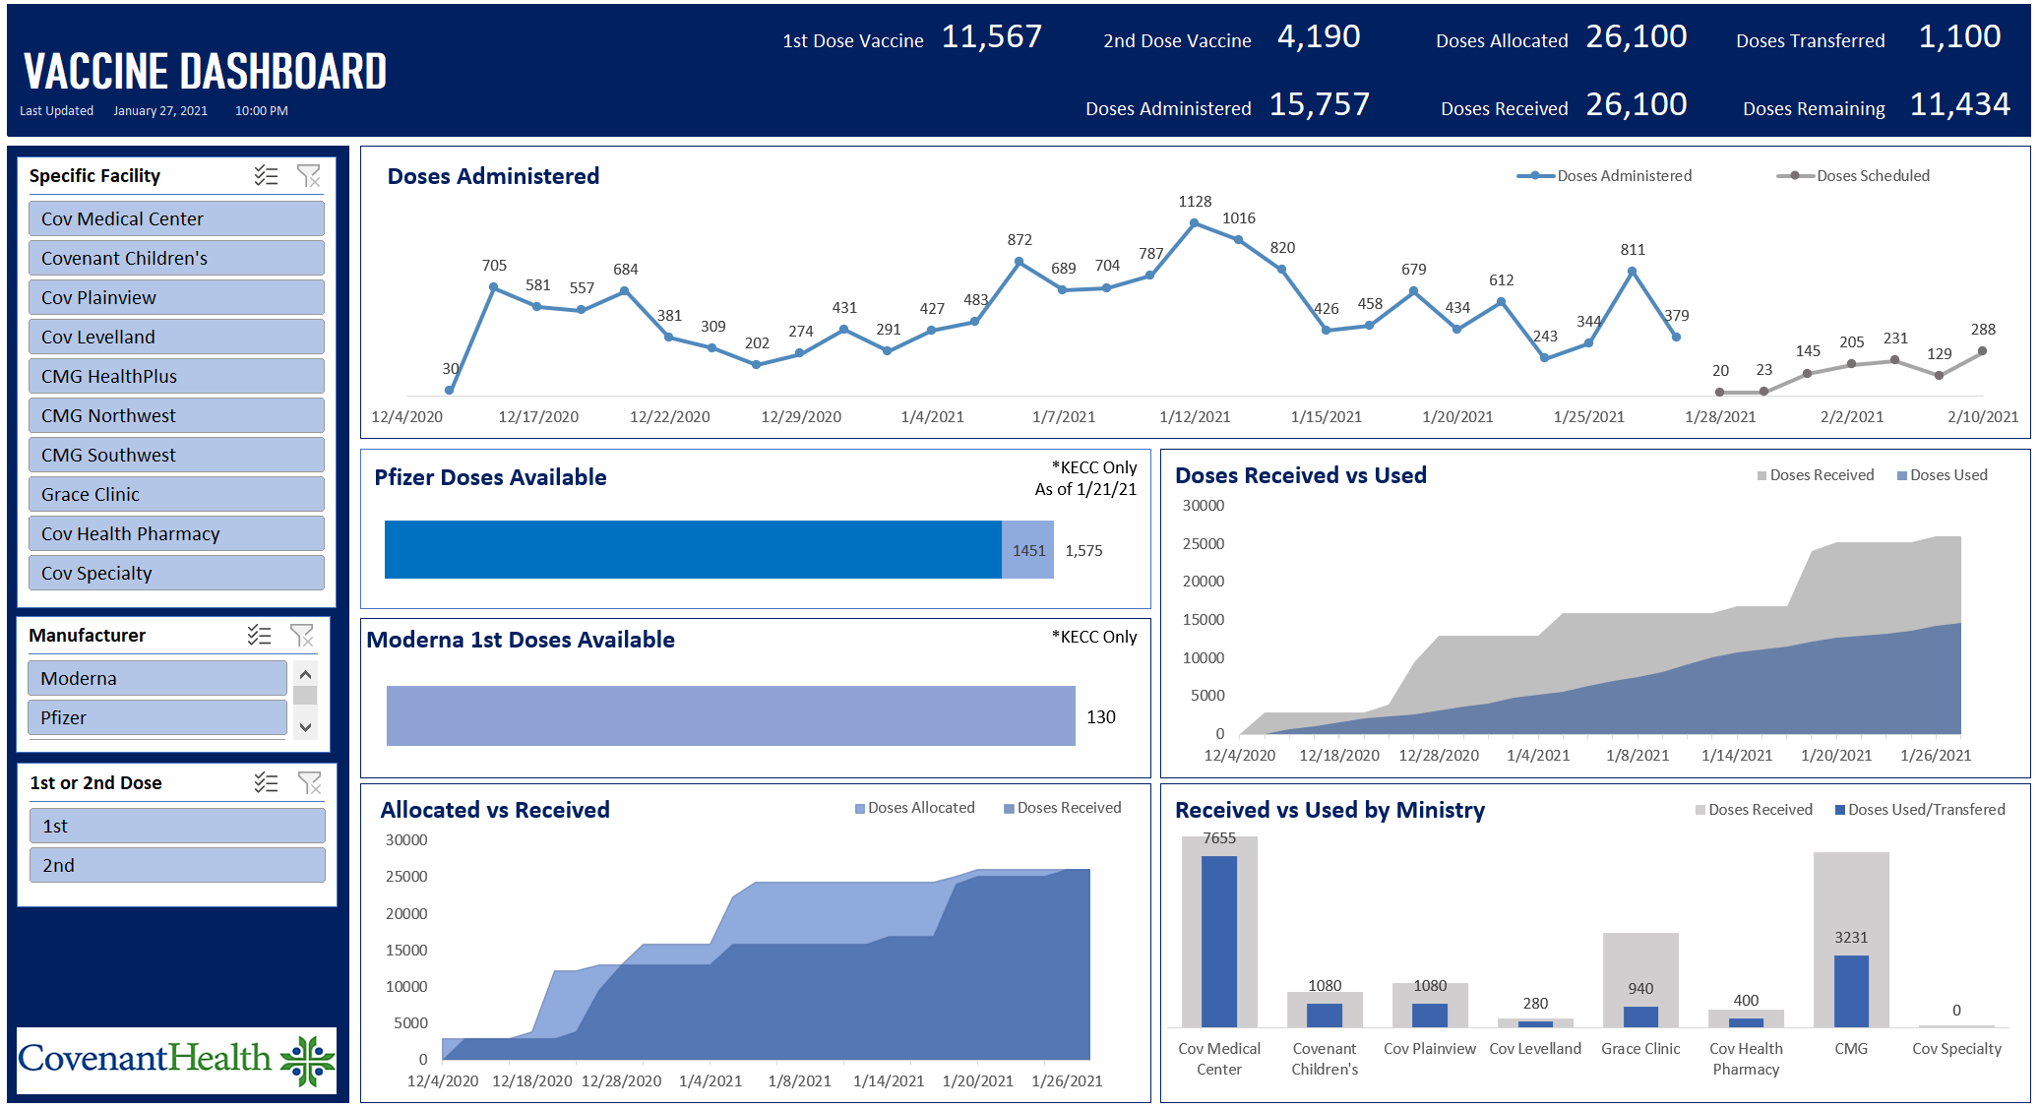
Vaccine Update

Slide 41
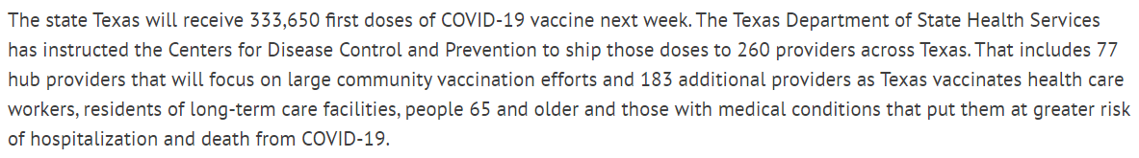
Vaccine Update
Week 6 Allocation
Week 7 Allocation
  Prioritized hub sites, hospitals, local health departments, and dialysis centers
  Prioritized counties which haven’t received previous allocations
  167,100 Moderna doses to allocate and 165,750 Pfizer doses to allocate

Slide 42
Vaccine Update
Overall caregiver reception: 50%
  Rough estimates from Caregiver Health
CDC Updates
  The second dose of Pfizer-BioNTech and Moderna COVID-19 vaccines may be scheduled for administration up to 6 weeks (42 days) after the first dose.
  In exceptional situations in which the first-dose vaccine product cannot be determined or is no longer available, any available mRNA COVID-19 vaccine may be administered at a minimum interval of 28 days between doses

Slide 43
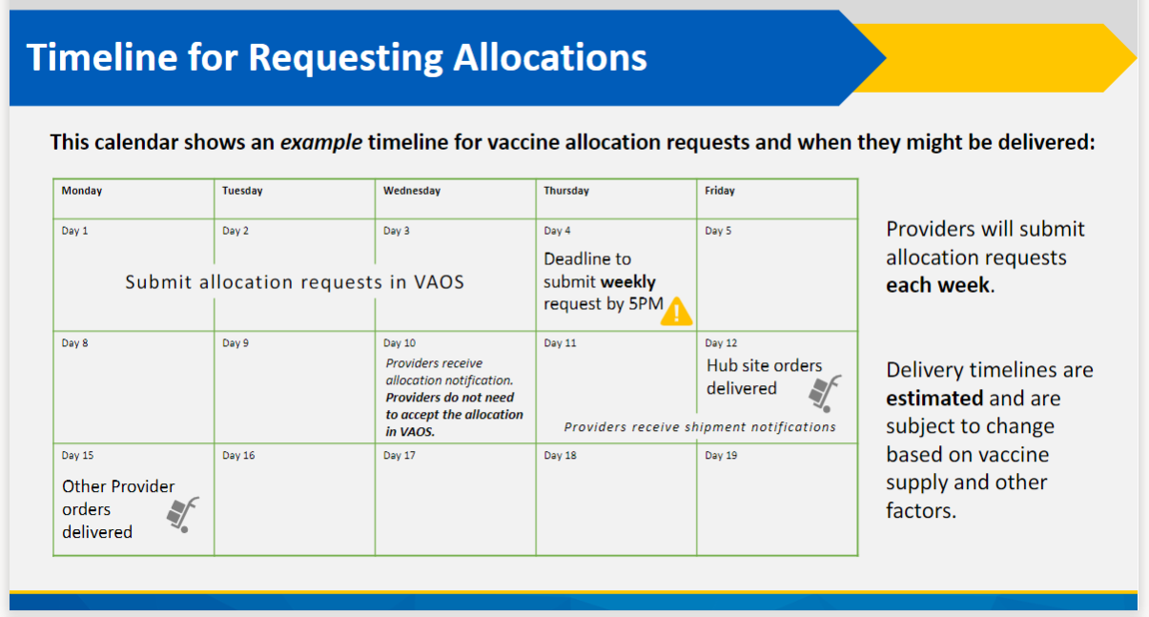
Vaccine Allocation Request

Slide 44
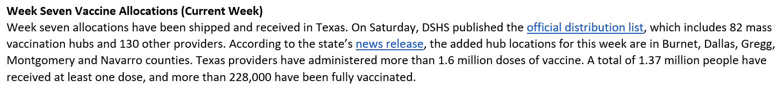
Vaccine Week 7 Allocation

Slide 45
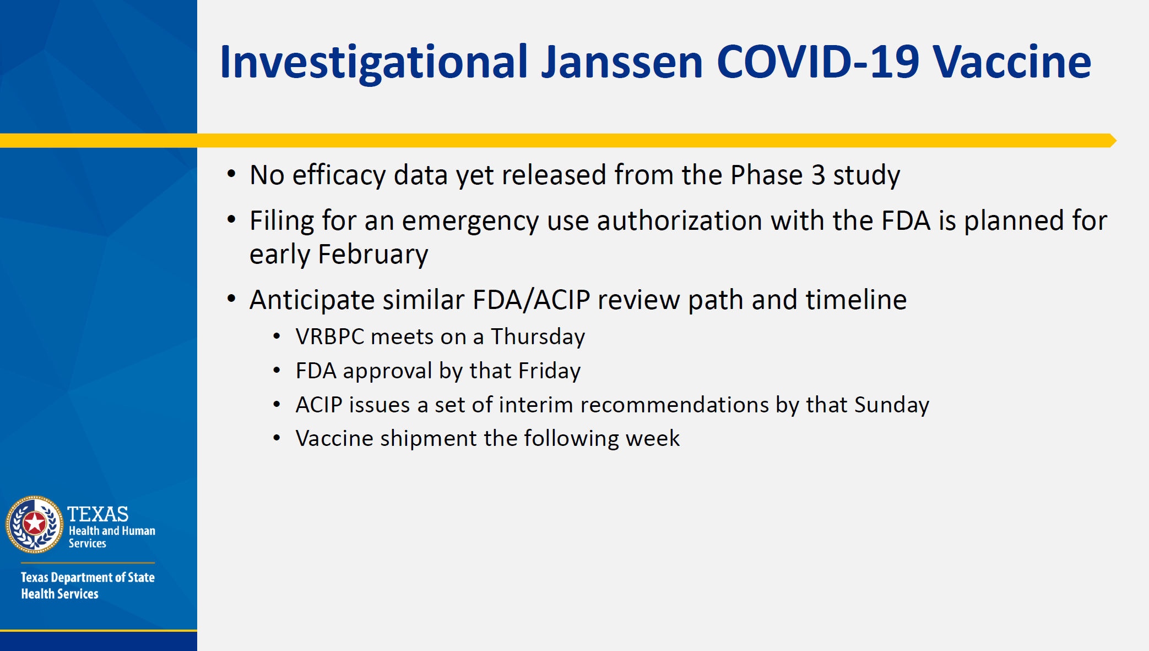
Janssen COVID-19 Vaccine

Slide 46
State Managed Covid-19 Hospital in Lubbock

Slide 47
The Texas Department of Emergency Management
Looking for facilities in Texas to increase inpatient capacity
Inquired about our recently vacated hospital facility at 50th Street and University
Conducted a site visit of the facility with Covenant/Grace personnel and City officials along with representatives from the third party (ASHBRITT) who will administer/operate/bill for care provided there.
The decision has been reached that the are going to lease the facility from Covenant and begin operations in the next two weeks.
COVID hospitalizations in that facility SHOULD NOT COUNT in our RAC total (that would artificially inflate our percentages)

Slide 48
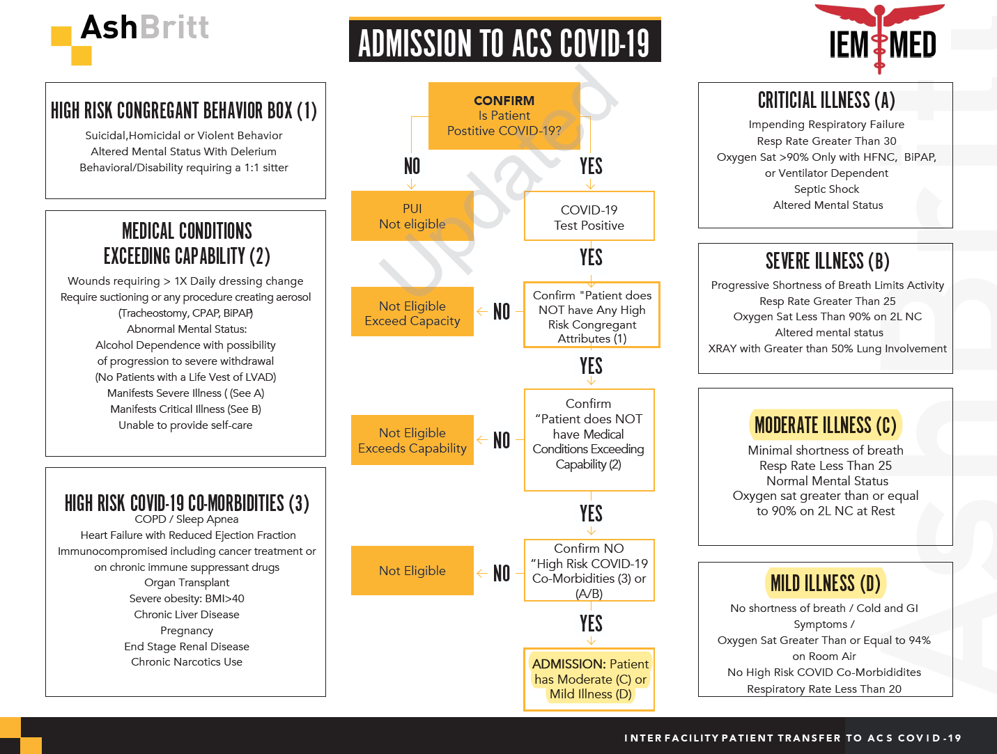
Criteria for Admission to Alternate Care Site

Slide 49

Texas Demographics

Slide 50
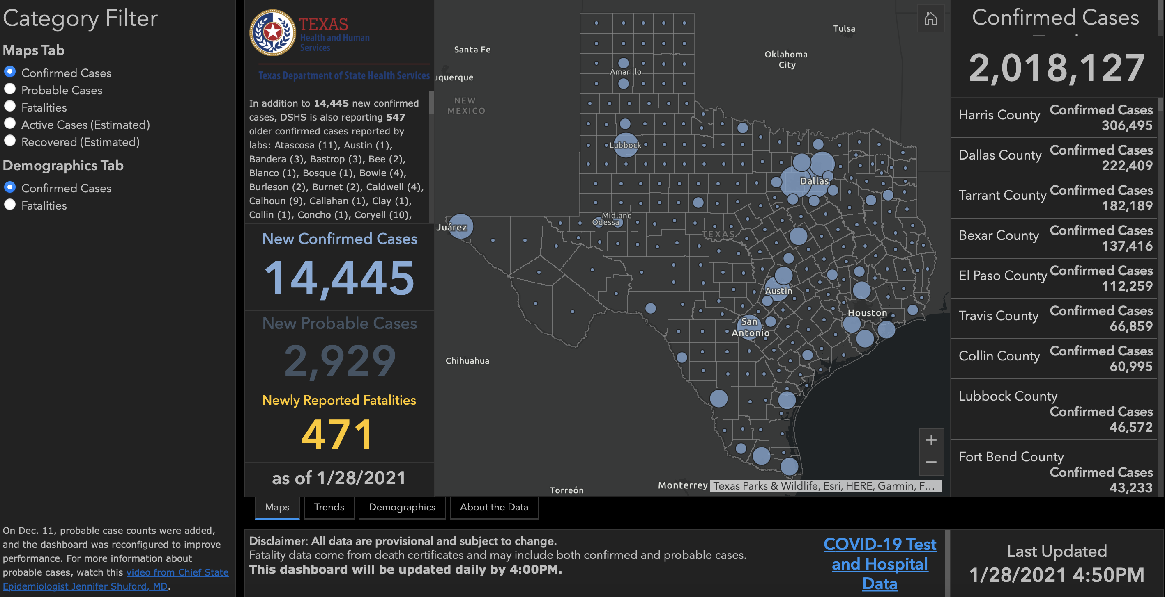

Slide 51
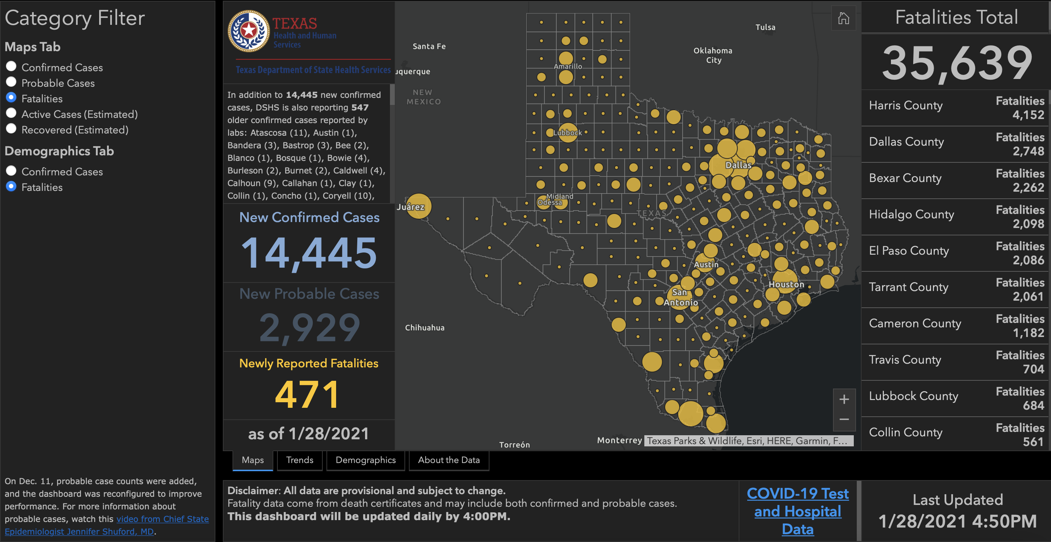

Slide 52
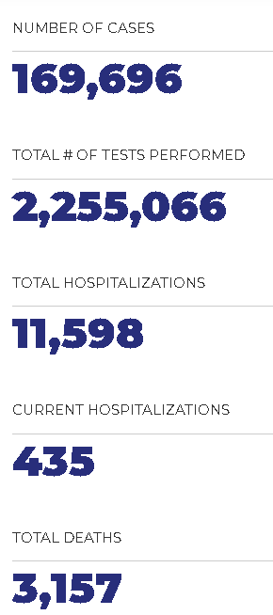
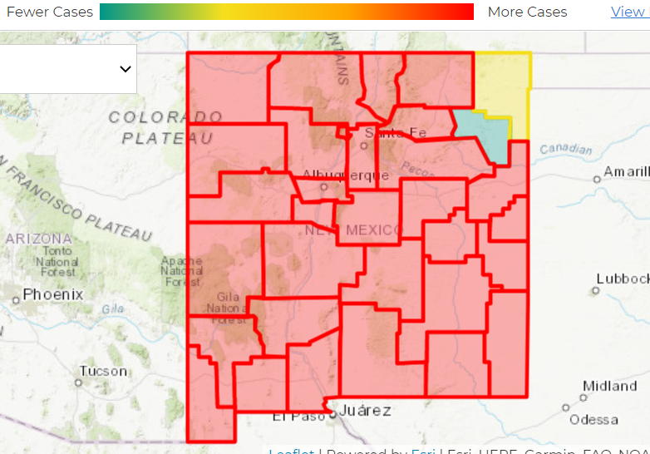
NEW MEXICO

Slide 53
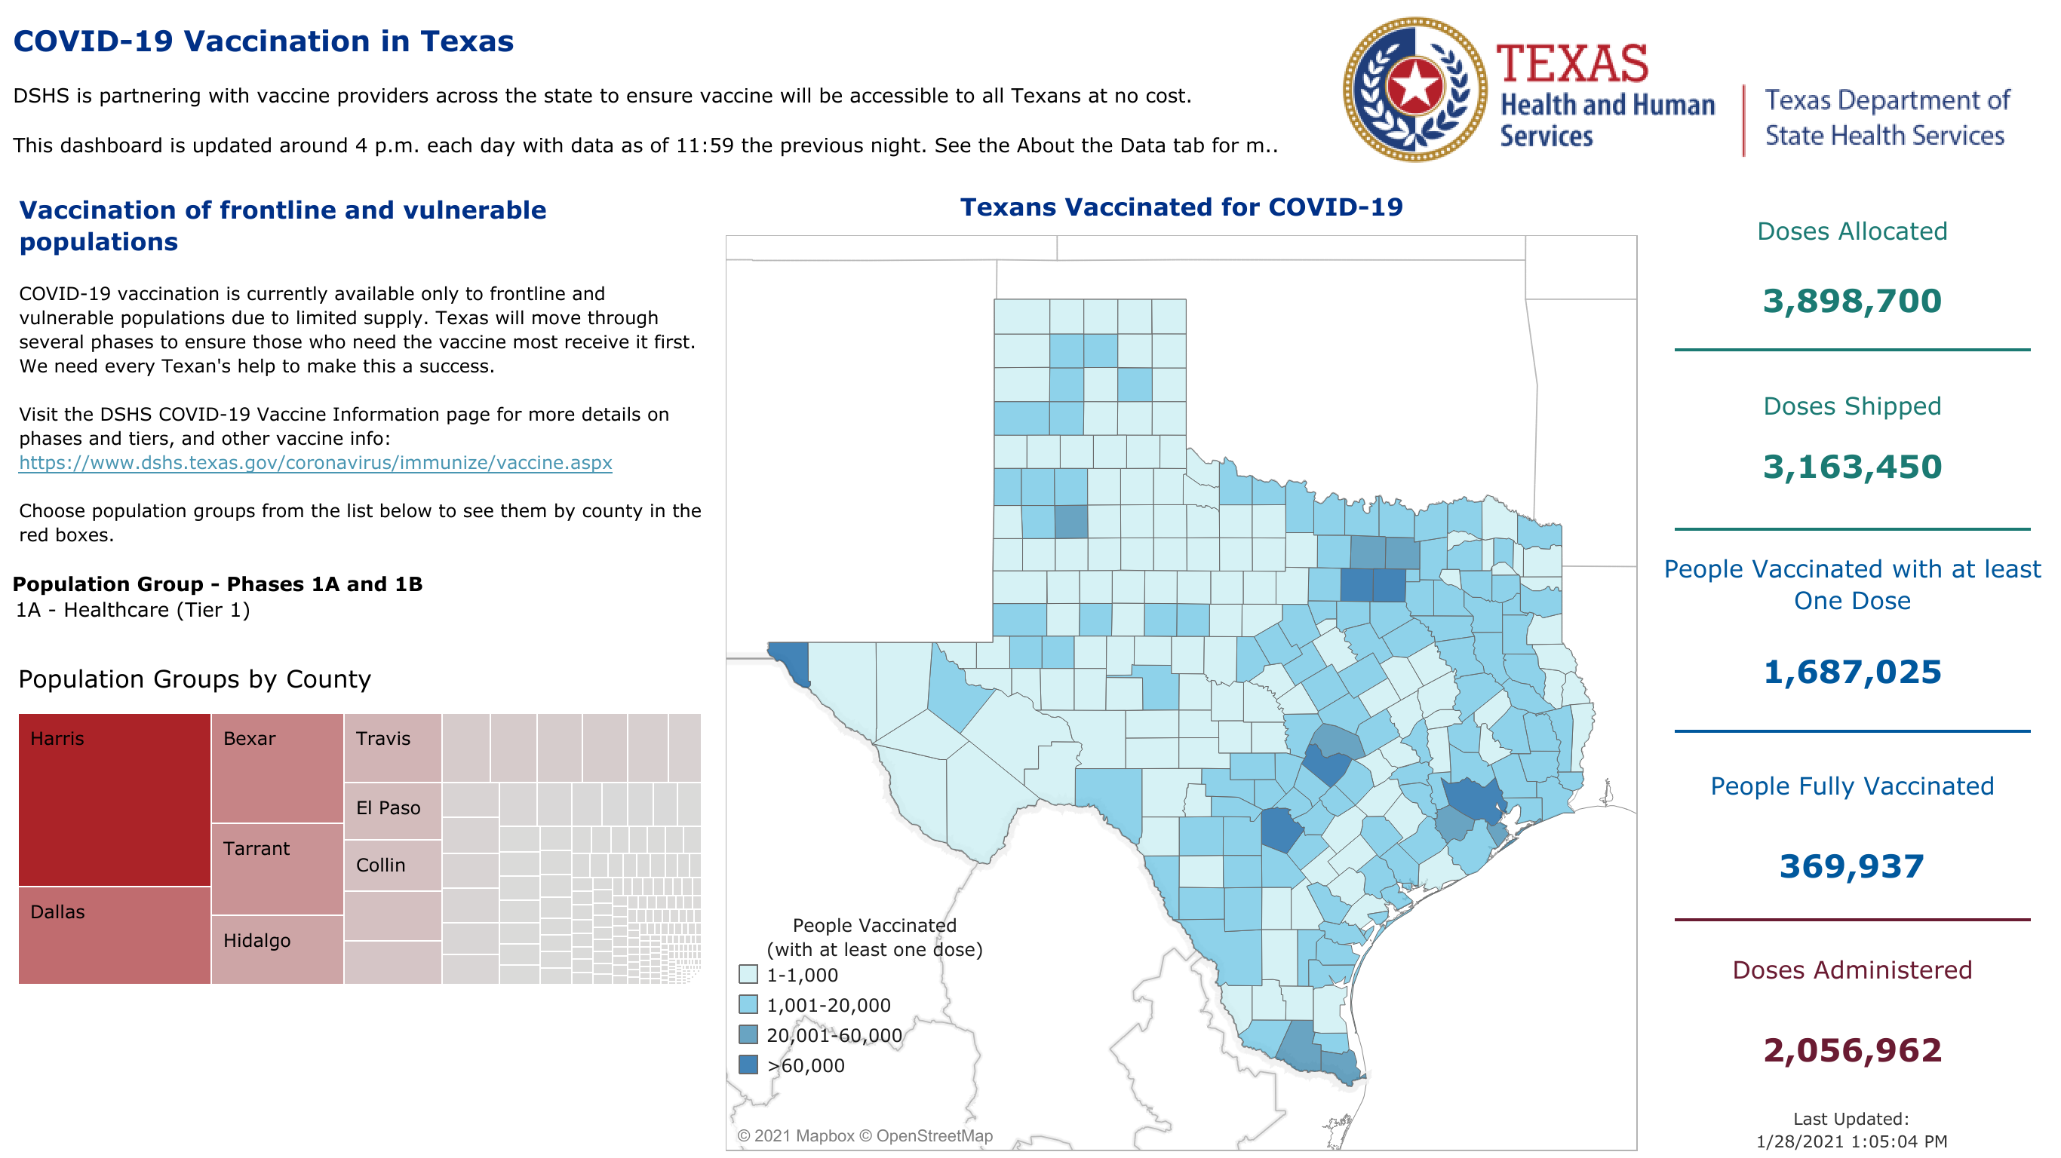

Slide 54
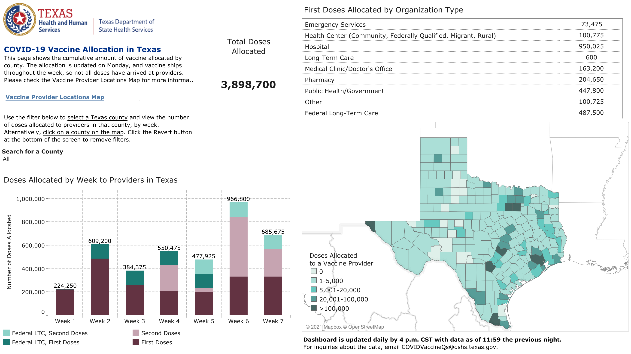

Slide 55
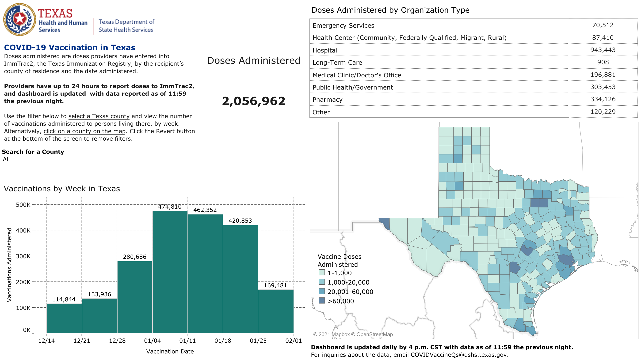

Slide 56
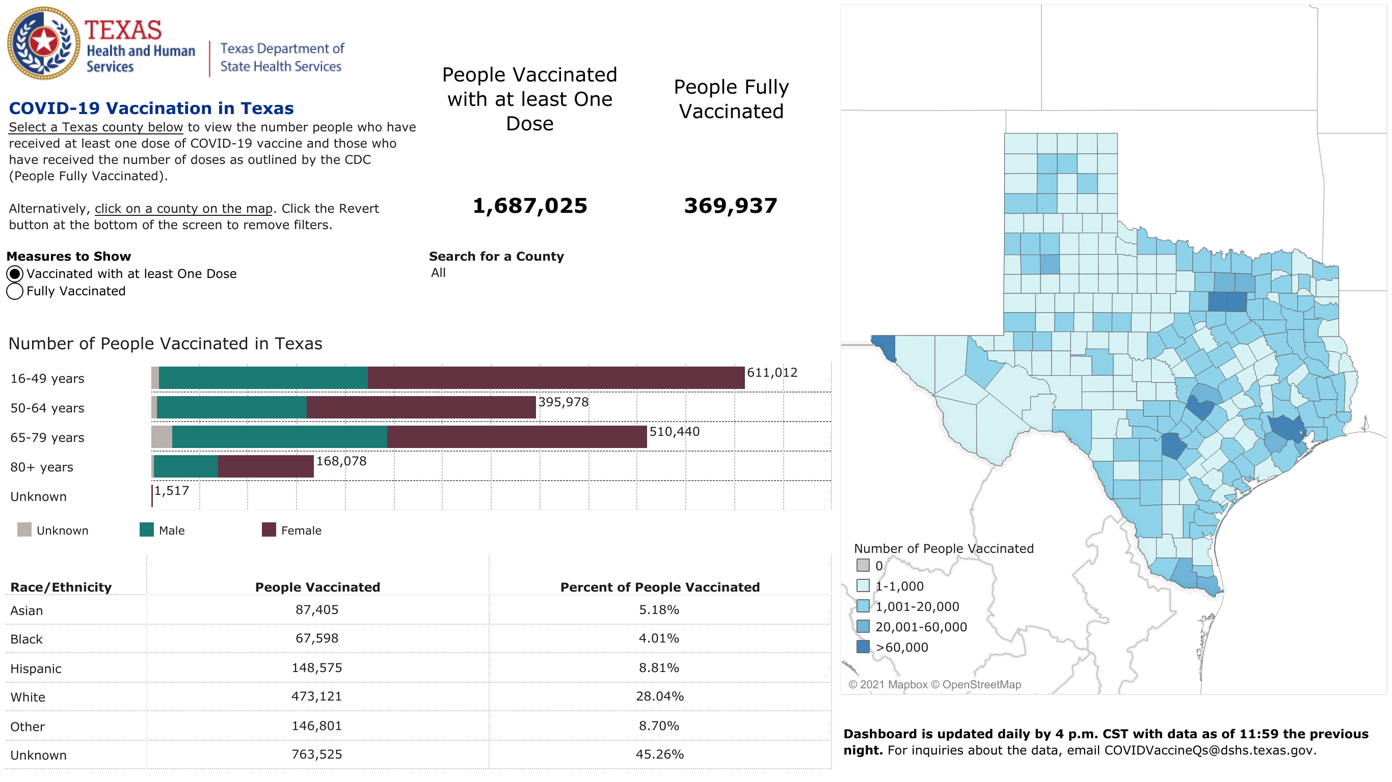

Slide 57
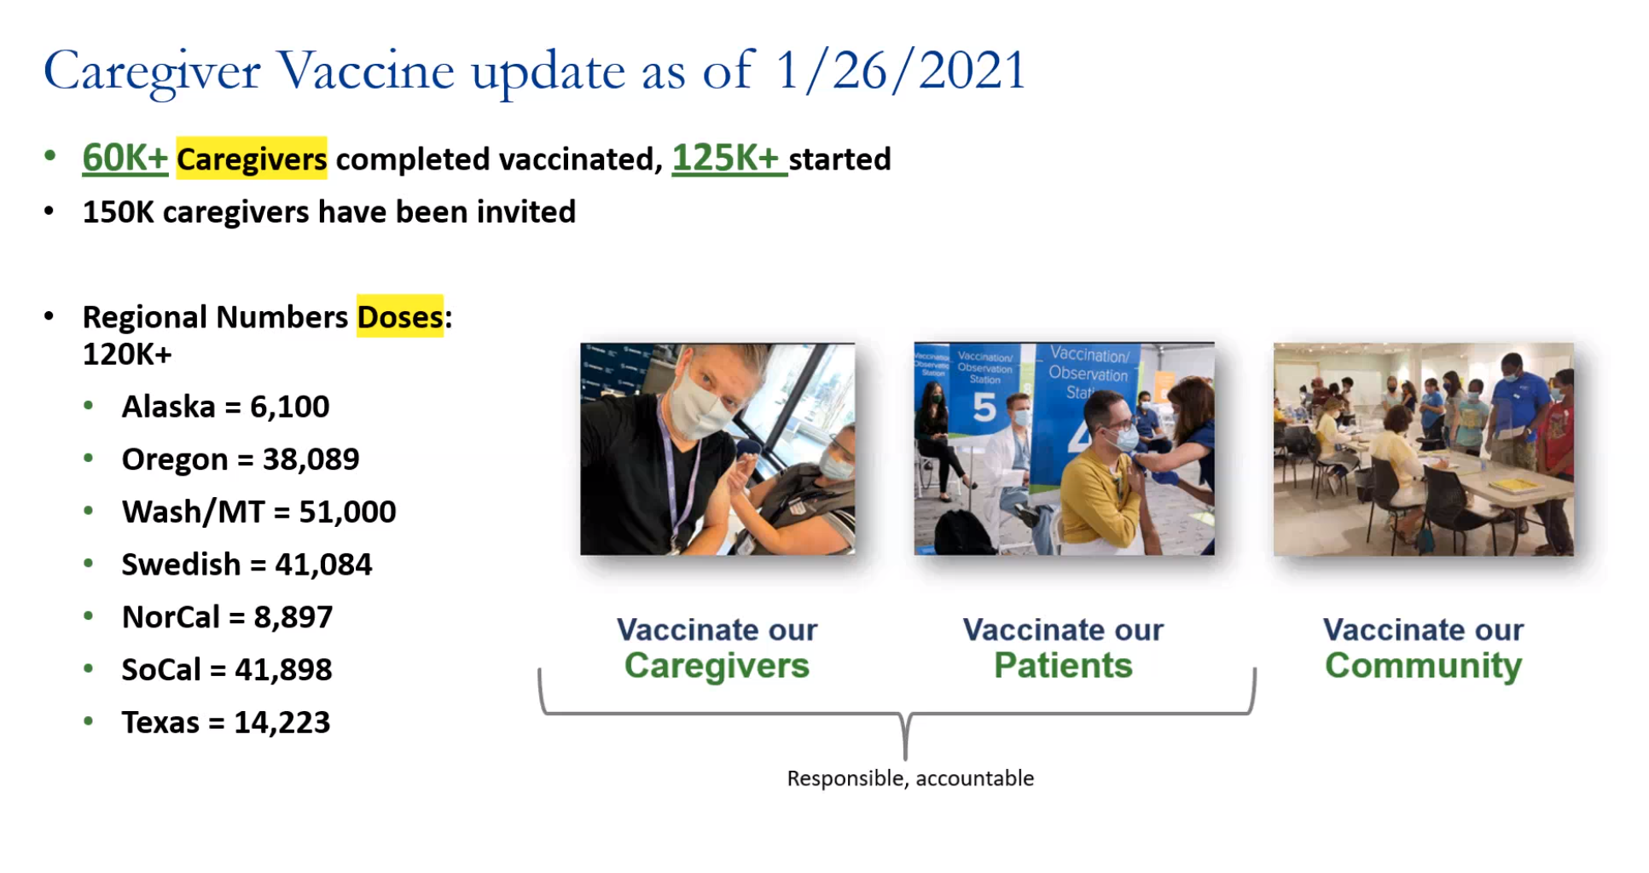

Slide 58
Q & A

Slide 59
CME Credit was only approved for the Live Teams meeting
To receive credit for this continuing education activity, the participant must:
  Make sure you are logged into your Teams account, if you are signed in with a group provide attendee’s First and Last name(s) in the comments section.
  If you are calling into the Teams meeting you MUST text your First & Last Name to (806) 252-4735. This will ensure you are added to the sign in sheet to receive CME Credit.
  You will receive an email by the following Wednesday from the CME department with further instructions on claiming your certificate.

