Slide 1
Covenant Health
Presents
Critical Communications: A Weekly Physician Update
January 8, 2021

Slide 2
PHYSICIANS
Accreditation Statement:
The Covenant Health is accredited by the Texas Medical Association (TMA) to provide continuing medical education for physicians.
Credit Designation Statement:
The Covenant Health designates this live CME activity for a maximum of 1.0 AMA PRA Category 1 Credit(s)™. Physicians should claim only the credit commensurate with the extent of their participation in the activity.

Slide 3
Disclosures of Commercial Interest
The speakers and planners of this activity
have no relevant financial interests

Slide 4
Disclosures
This activity is provided by
Covenant Health
No commercial support has been received.
No products will be endorsed.
Speakers will notify the audience if off label drug use will be discussed.

Slide 5
CME Credit was only approved for the Live Teams meeting
To receive credit for this continuing education activity, the participant must:
  Make sure you are logged into your Teams account, if you are signed in with a group provide attendee’s First and Last name(s) in the comments section.
  If you are calling into the Teams meeting you MUST text your First & Last Name to (806) 252-4735. This will ensure you are added to the sign in sheet to receive CME Credit.
  You will receive an email by Wednesday following the call from the CME department with further instructions on claiming your certificate.

Slide 6
Reflection
David Gray, DO

Slide 7
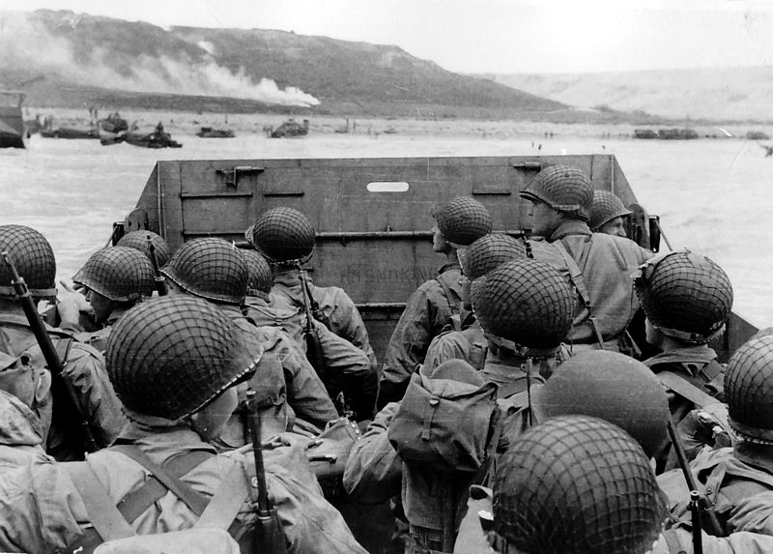
2nd Reflection Dying alone –
Melanie Oblender 1-2021
I was reading an article recently written by an Internist in the Canadian healthcare system about – COVID-19. He was advocating for relaxing visitor restrictions, especially in end of life situations. He never stated what the visitor restrictions are in the Canadian Healthcare system, but described the tremendous psychological toll on caregivers as they attempt to be the bridge between a family and their loved one dying of COVID-19. Their objective is to see that no one dies alone.
You know how your mind can jump from one thing to another to another… Jump with me today.

Slide 8
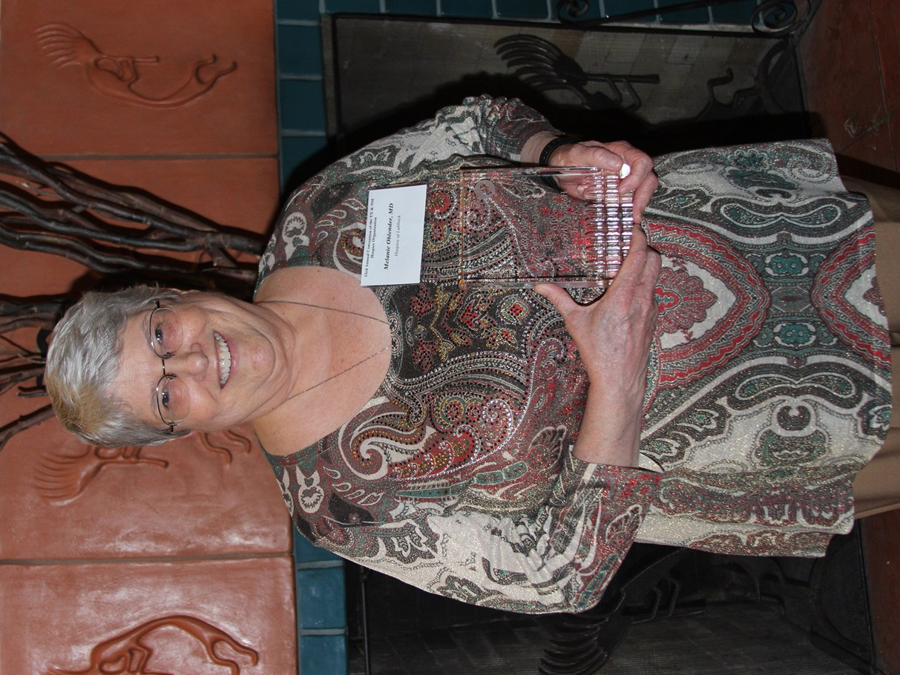
Into the Void
I’m re-reading a 3 volume set on WW2, in part because I’m a firm believer in the adage “Those who do not learn from history are doomed to repeat it”. In that massive war, the one that followed the “War to End All Wars”, millions of people died, civilians as well as fighting men. Those involved in the conflict were struck by the seeming randomness of it all – this boy would die, and that one would not. At times, the fighting was so intense that it was unsafe to collect the wounded, and they were left alone on the battlefield, as the war continued to rage around them. Many, many would die alone.
Sometimes, the fractured men and boys would come home, but would never find healing. In and out of the VA system, often homeless, often without family, many, many of these men would die alone.
Into that void stepped an unlikely hero. In 1995, a Pediatric Heme/Onc specialist moved to Lubbock from Galveston. As a pediatric Heme/Onc specialist, Dr Melanie Oblender was regularly immersed in life and death struggles as her pediatric patients battled cancer. Herself a military veteran, she never lost sight of the veterans who often presented for care in Lubbock alone, and died alone.

Slide 9
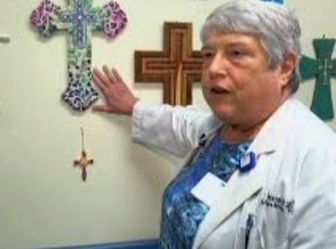
Dr. Melanie Oblender
Dr. Oblender was instrumental in creating our Certified Palliative Care Unit, and bringing Hospice services into a closer working relationship with Pall Med. When she recognized the need for an effective Palliative Care process, she did not receive a warm welcome from the Administration in place at that time – but she did not give up. Because of her persistence, many, many veterans did not die alone, but received focused, compassionate care at the very end of their lives. Because of her legacy, I was able to hold my dad’s hand in our Pall Med unit as he passed away earlier this year.
Why would a Pediatric Hematologist/Oncologist leave such a legacy among adult patients? Because she saw a need and her heart compelled her to address it. She took courses in Palliative care, researched certification in Palliative Care, and persisted until a thriving and sustainable care process was in place. When it was within her power, no veteran ever died alone.

Slide 10
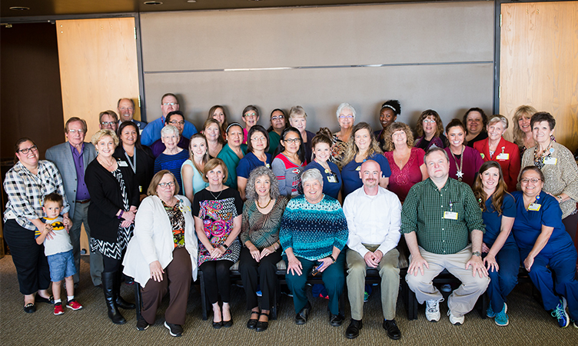
What’s your passion? How can you make a difference for a patient today, this week, this coming year? We are all in this together, this COVID-19 mess. And our collection of extraordinary team mates can make a massive difference in the lives of many, many patients and their families.
I wish blessings for you all, and that you may be a blessing to others in the coming days.

Slide 11
Covid-19 Vaccine

Slide 12
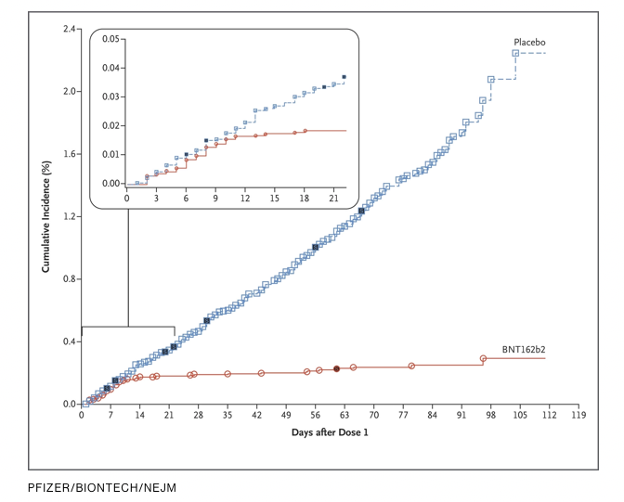
Does the Vaccine Work?

Slide 13
“No comment. This is what vaccines do,” said Florian Krammer, a prominent immunologist, who posted a version of the image to Twitter.
The triumphalism is justified. This is what the researchers have been working toward all year. And the data in this graphic leaves no room for rumors, politics, or uninformed commentary. It’s as plain as day: this vaccine is one of the best we’ve ever seen.

Slide 14
Vaccinations for Office Caregivers
There is a limited availability for your OFFICE STAFF to receive the Covid vaccination at Knipling IF THEY MAKE AN APPOINTMENT
If there is interest, send an email to BARCLAYJL@covhs.org before NOON tomorrow.
Slots are VERY LIMITED and will be first come / first served.
Please DO NOT CALL the MSO or Cynthia Salisbury for this. Emails are easier to track and decreases the potential for error.
Please prioritize staff that deal face to face with your patients.

Slide 15
Racial Disparity in Susceptabilty to Covid-19

Slide 16
Covid Mortality in Texas 2020

Slide 17
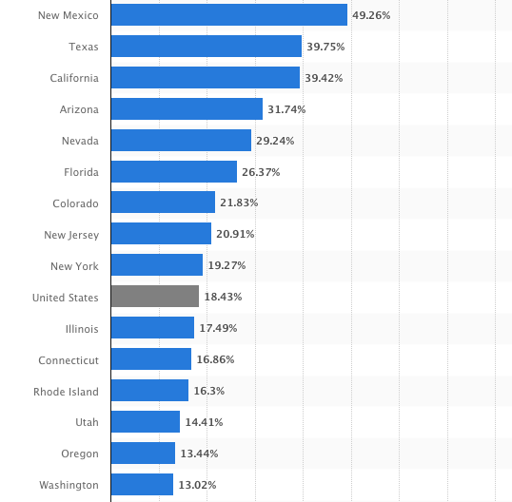
Hispanic Census by State
Compared to the National Norm

Slide 18
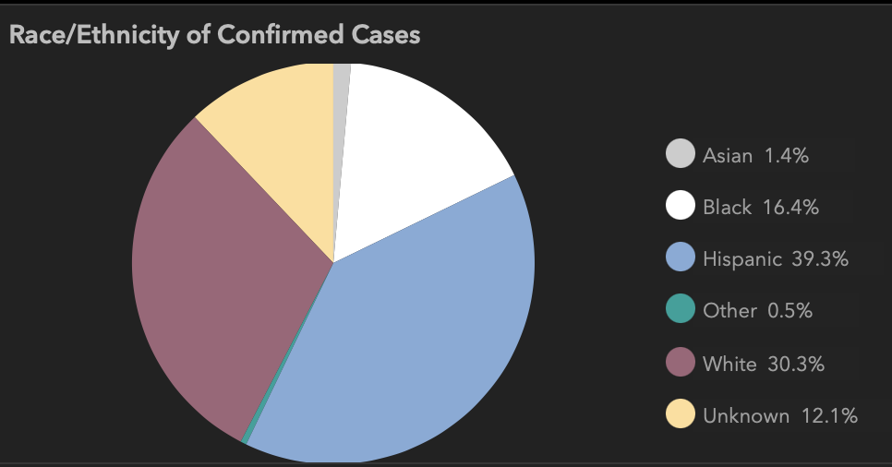
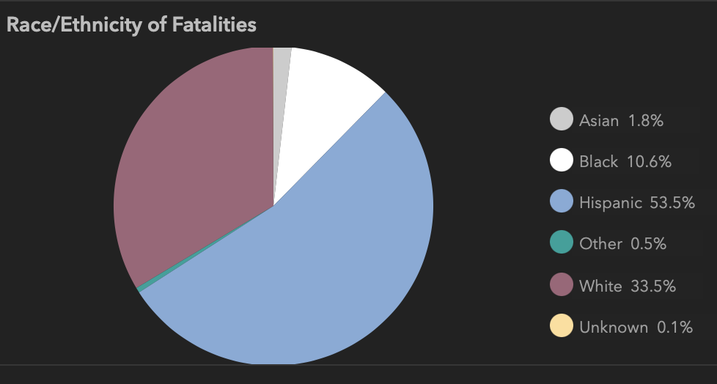
The Hispanic Population has a disproportionate mortality rate.
This has been confirmed in multiple states such as Arizona, Utah, Pennsylvania, New York, Colorado and New Jersey.
The reasons remain unclear.
Texas
New York State Department of Health. Fatalities [as of May 20, 2020]. https://covid19tracker.health.ny.gov/views/NYS-COVID19-Tracker/NYSDOHCOVID-19Tracker-Fatalities?%3Aembed=yes&%3Atoolbar=no&%3Atabs=n. Accessed May 22, 2020.
Despres C. Coronavirus case rates and death rates for Latinos in the United States. Salud America! https://salud-america.org/coronavirus-case-rates-and-death-rates-for-latinos-in-the-united-states/. Accessed May 22, 2020.
Centers for Disease Control and Prevention, National Center for Health Statistics. Weekly updates by select demographic and geographic characteristics. Provisional death counts for coronavirus disease (COVID-19). https://www.cdc.gov/nchs/nvss/vsrr/covid_weekly/. Accessed May 22, 2020.
Texas

Slide 19
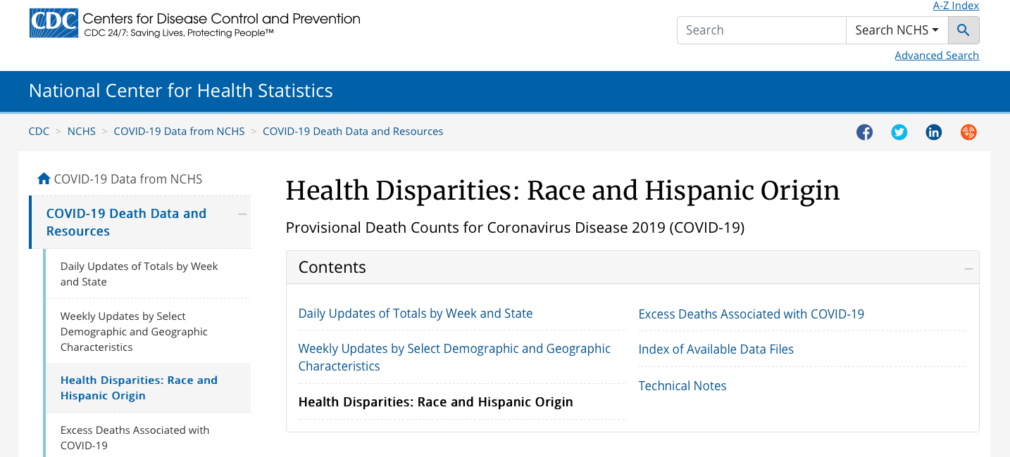

Slide 20
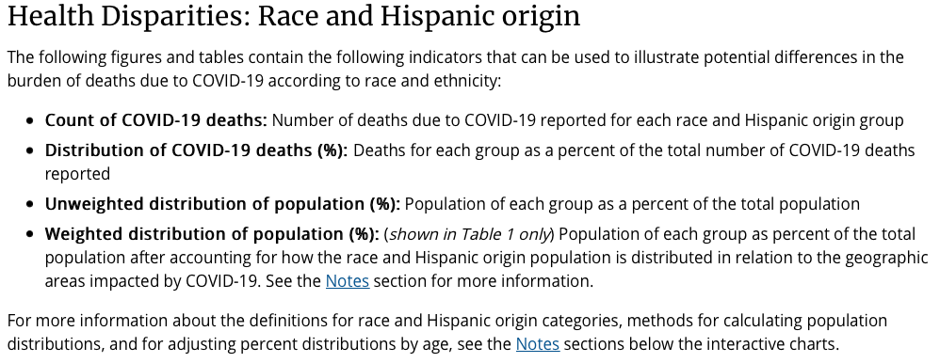

Slide 21
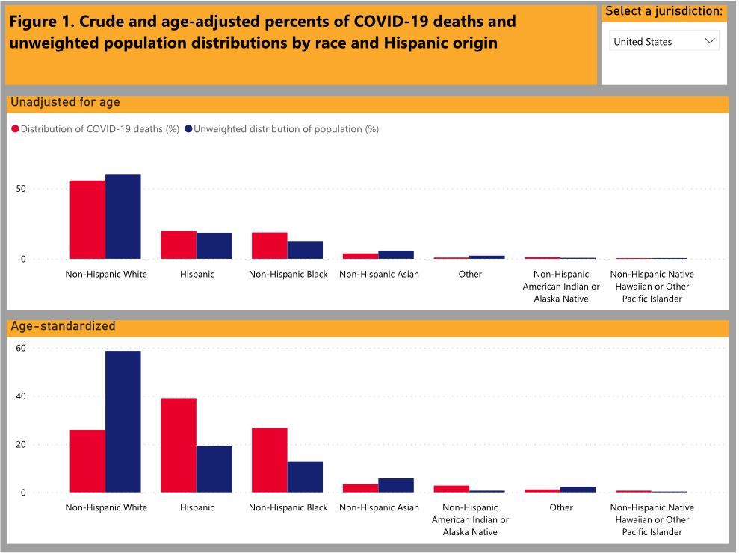
United States

Slide 22
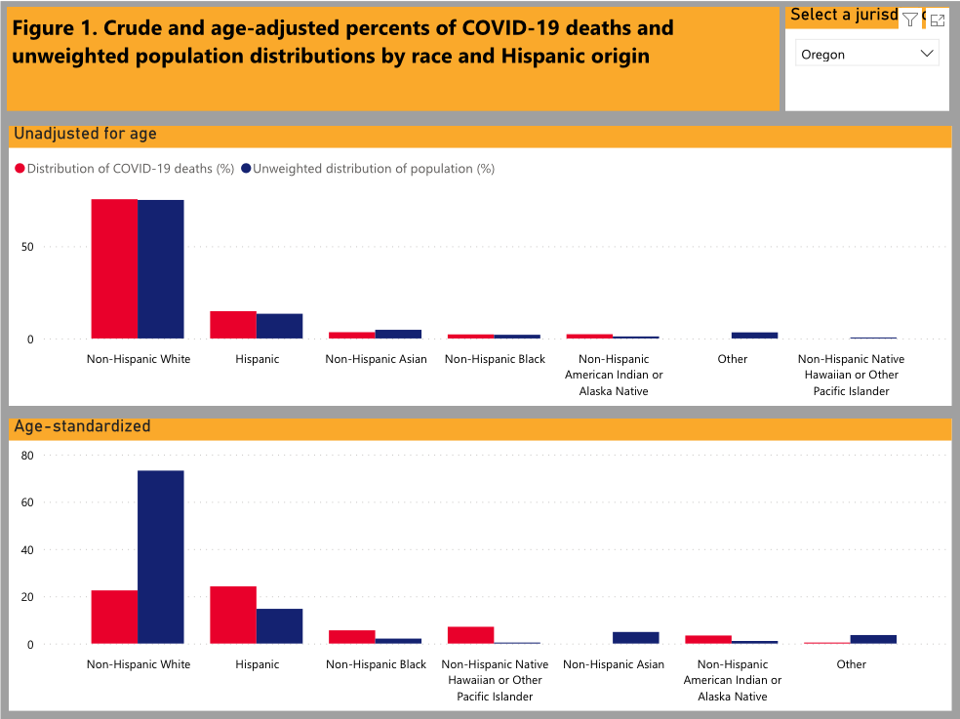
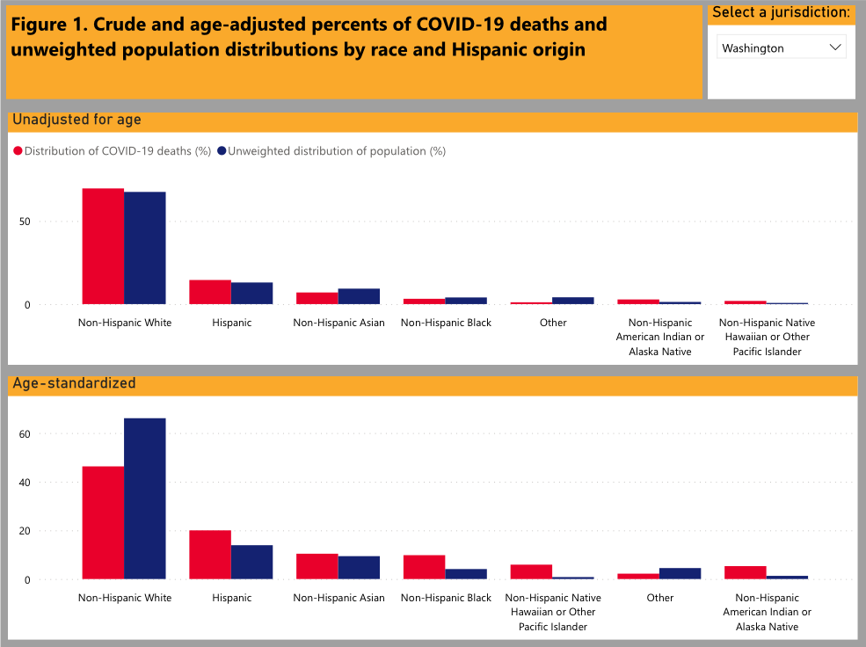
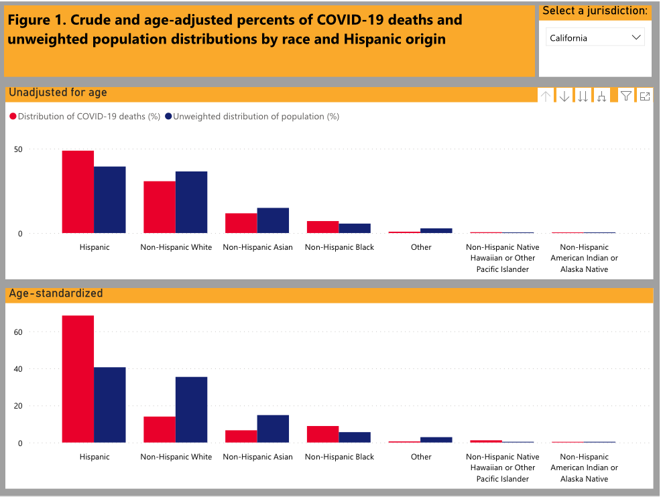
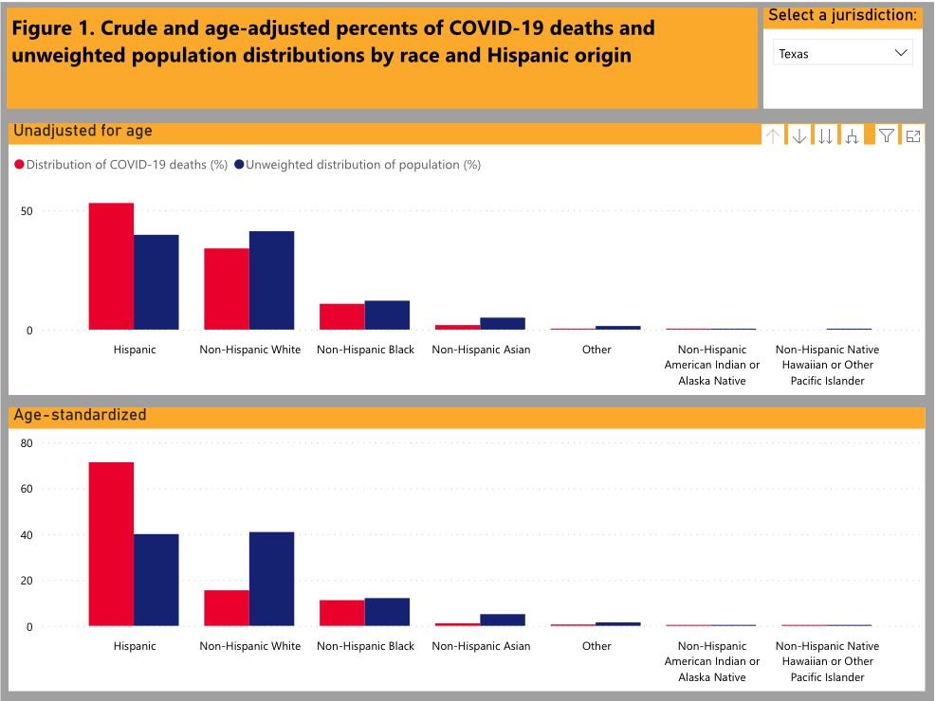
Oregon
Washington
California
Texas

Slide 23
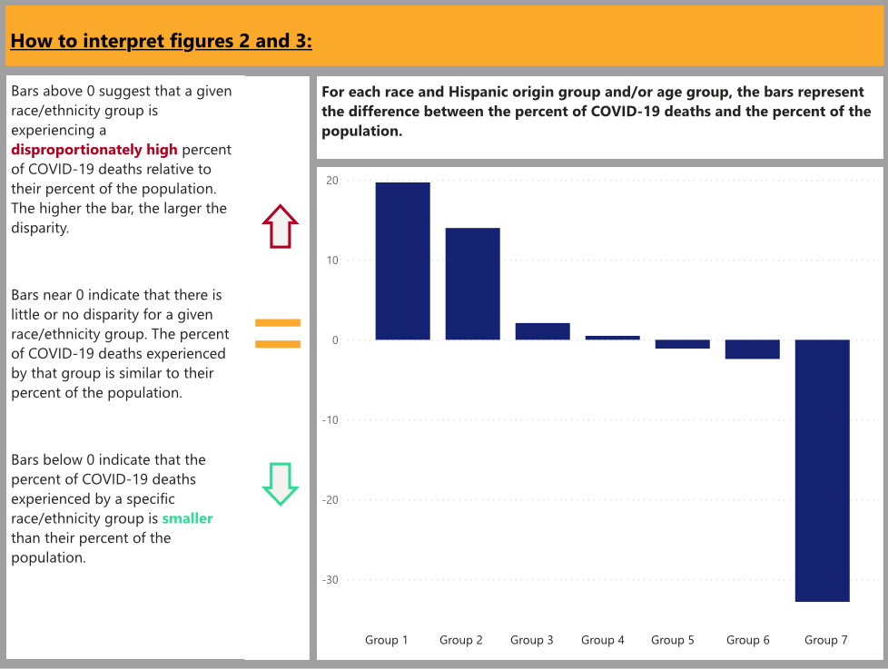

Slide 24
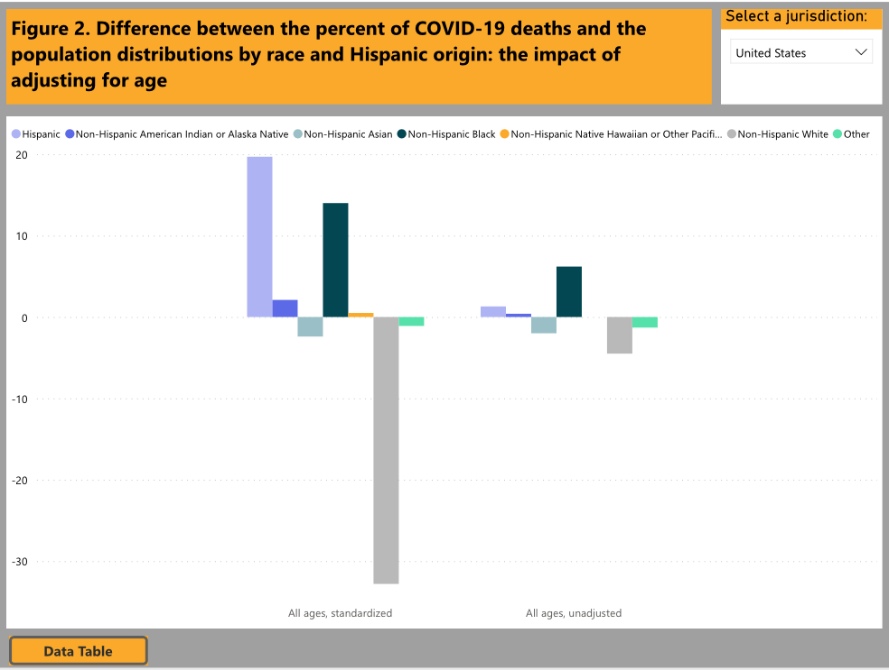
United States

Slide 25
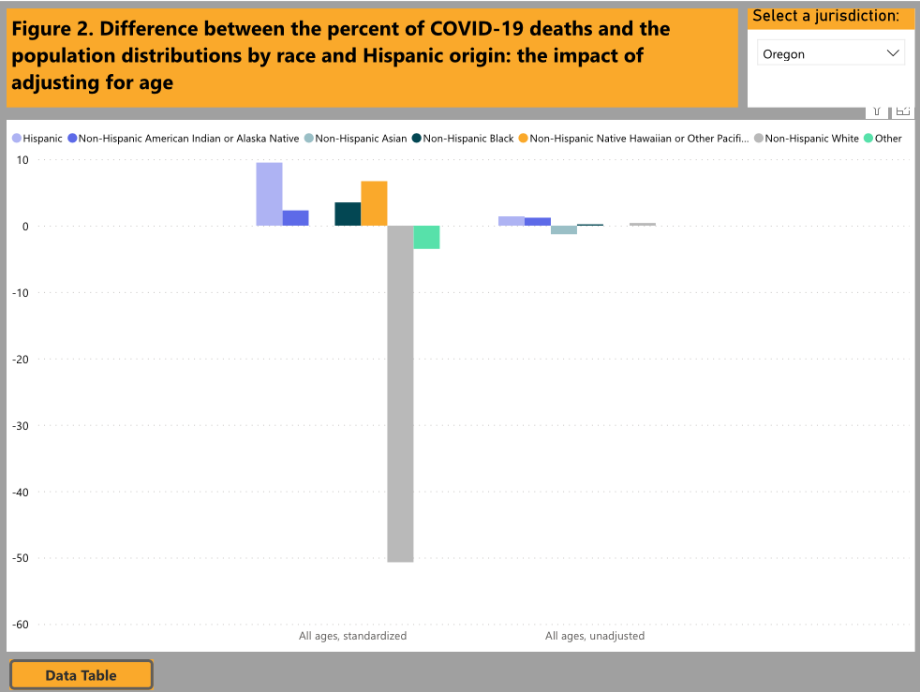
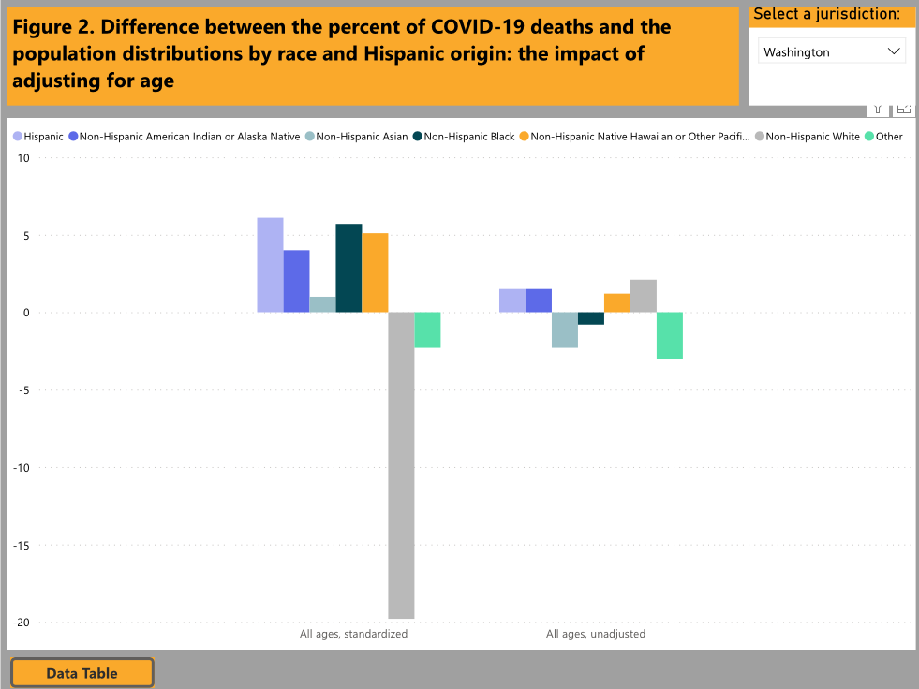
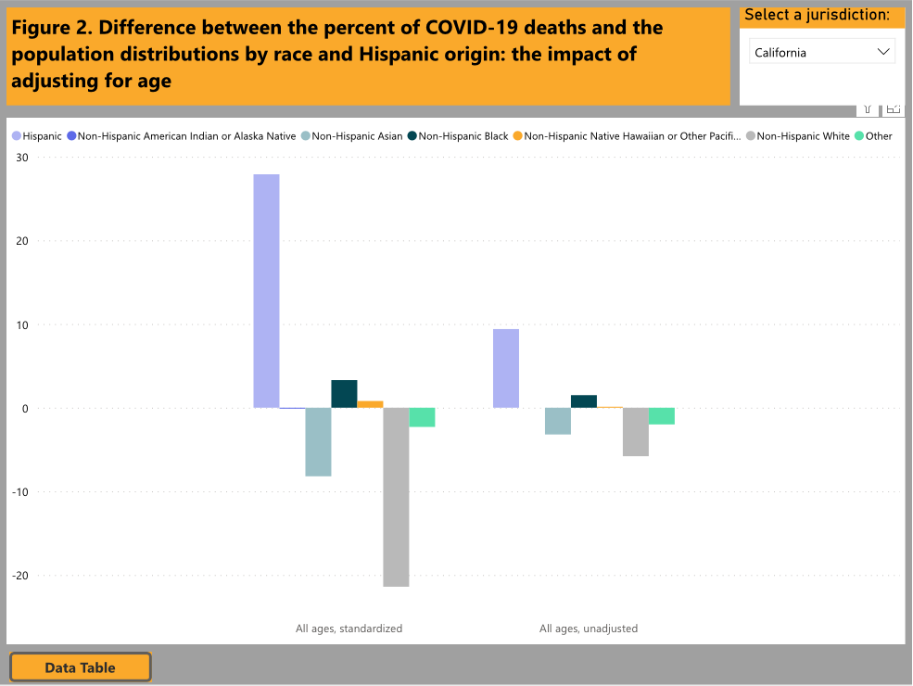
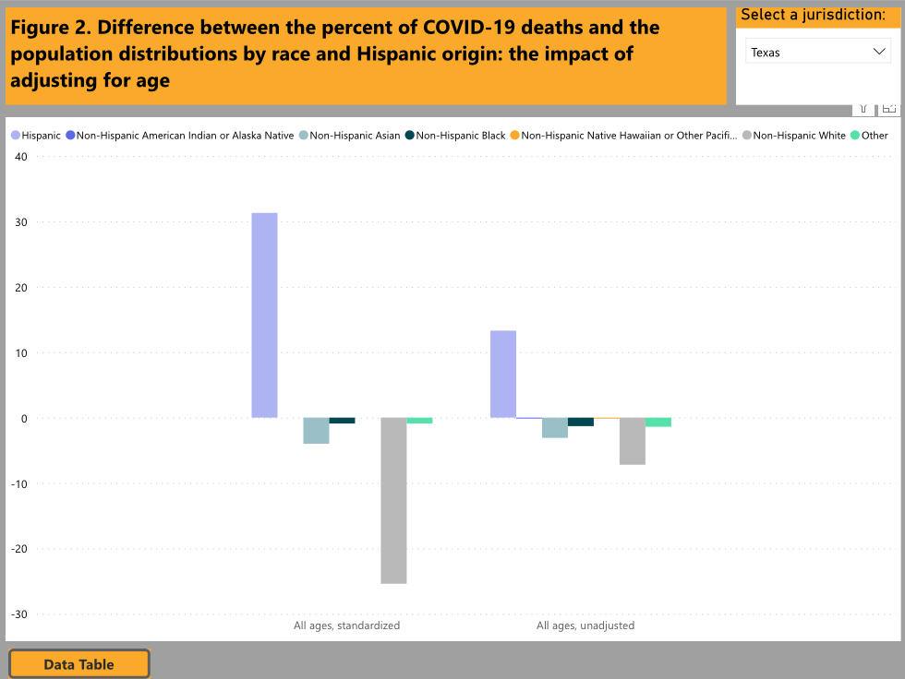
Oregon
Washington
California
Texas

Slide 26
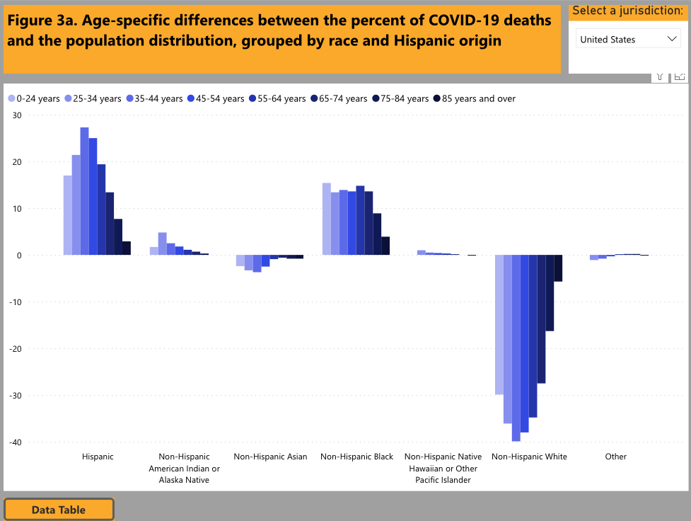
United States

Slide 27
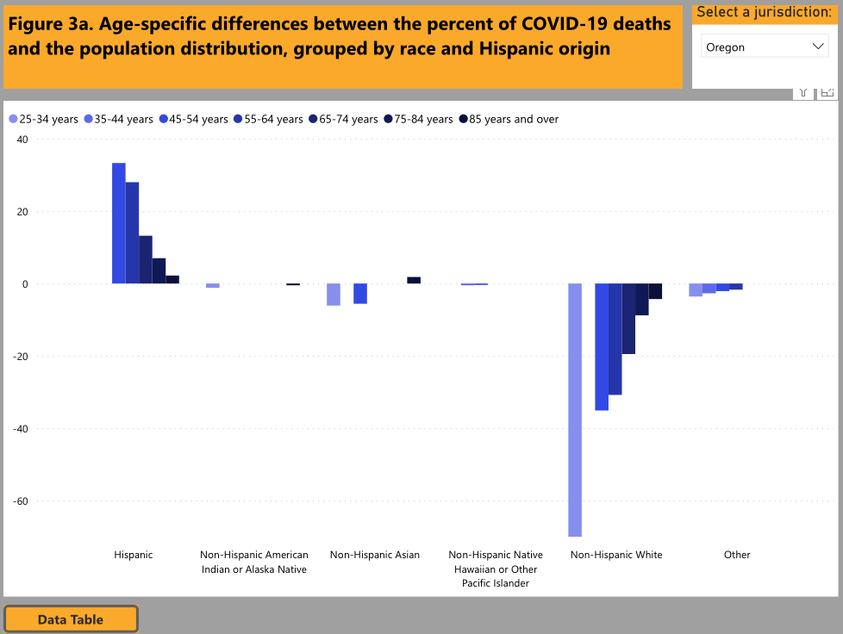
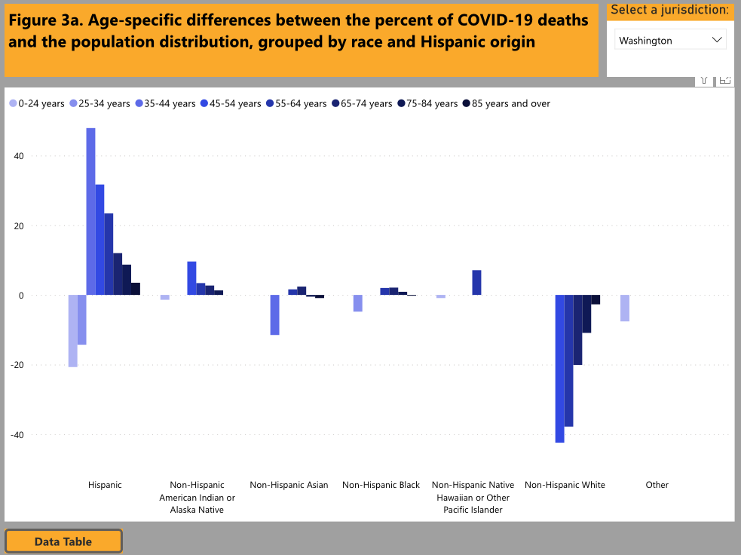
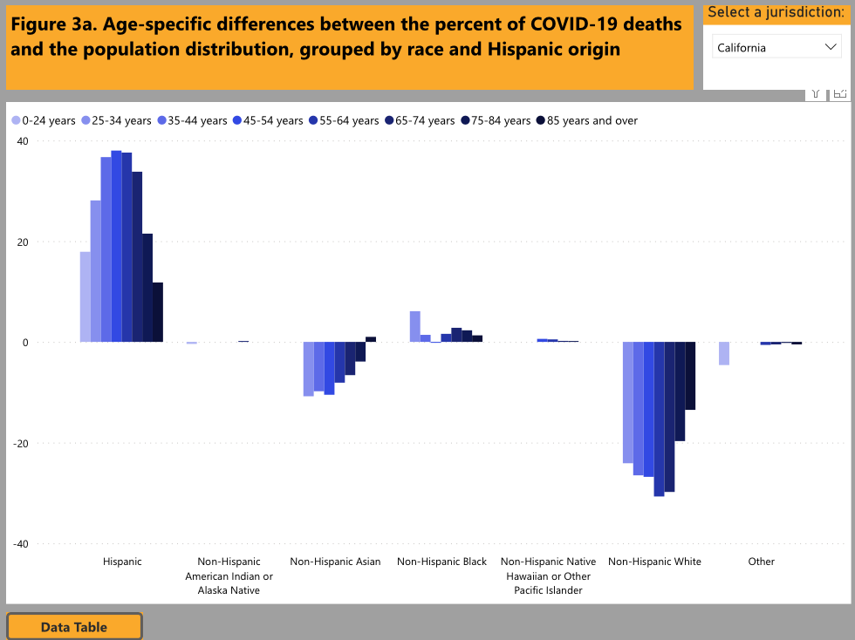
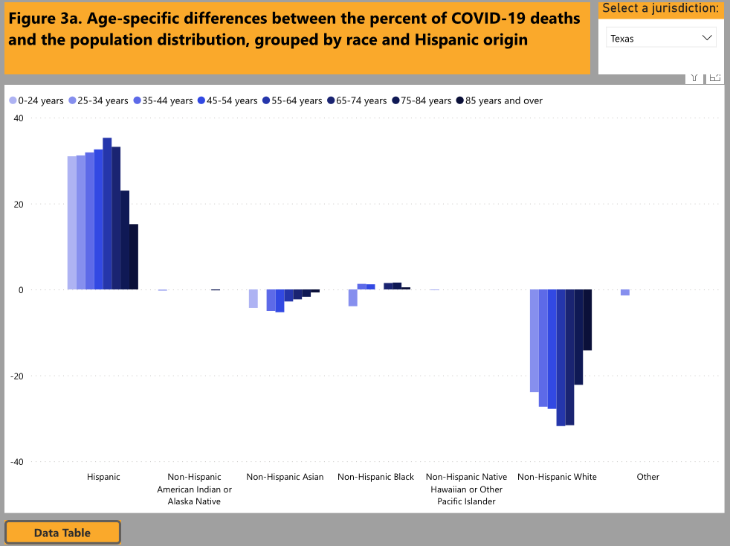
Oregon
Washington
California
Texas

Slide 28
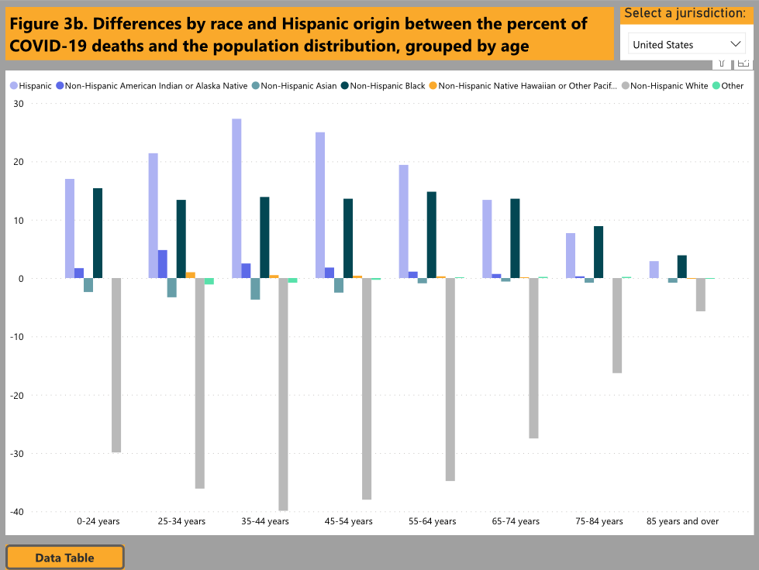
United States

Slide 29
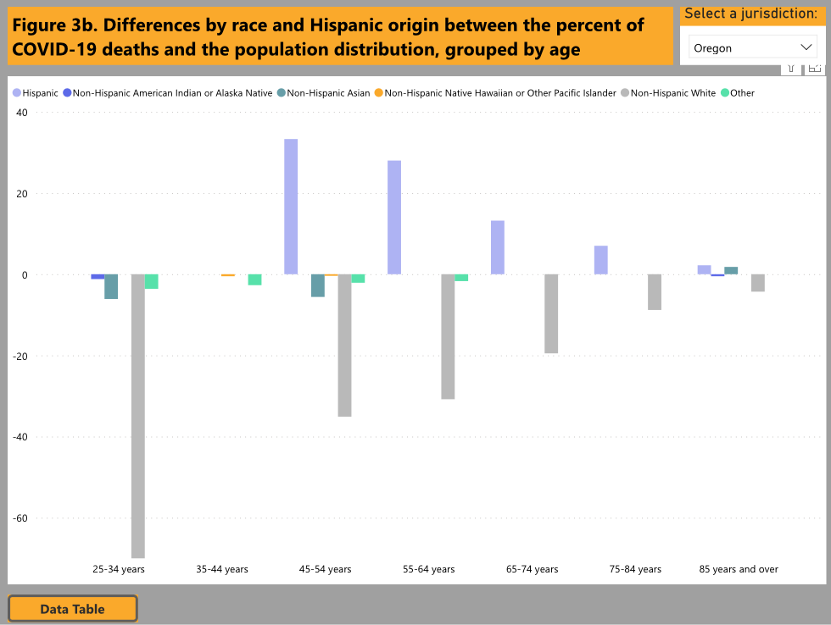
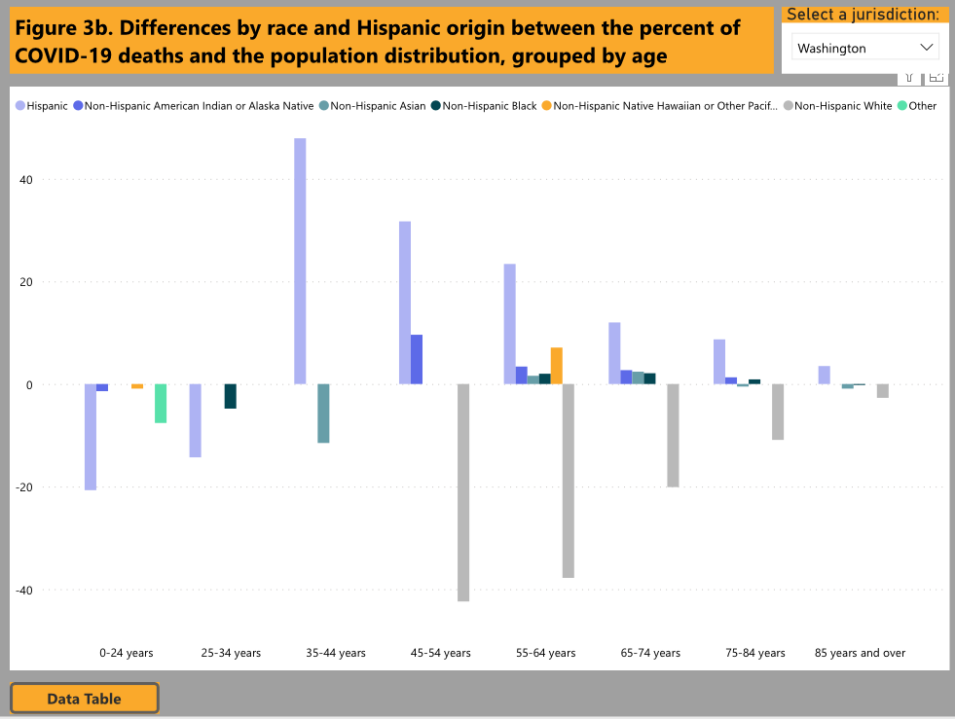
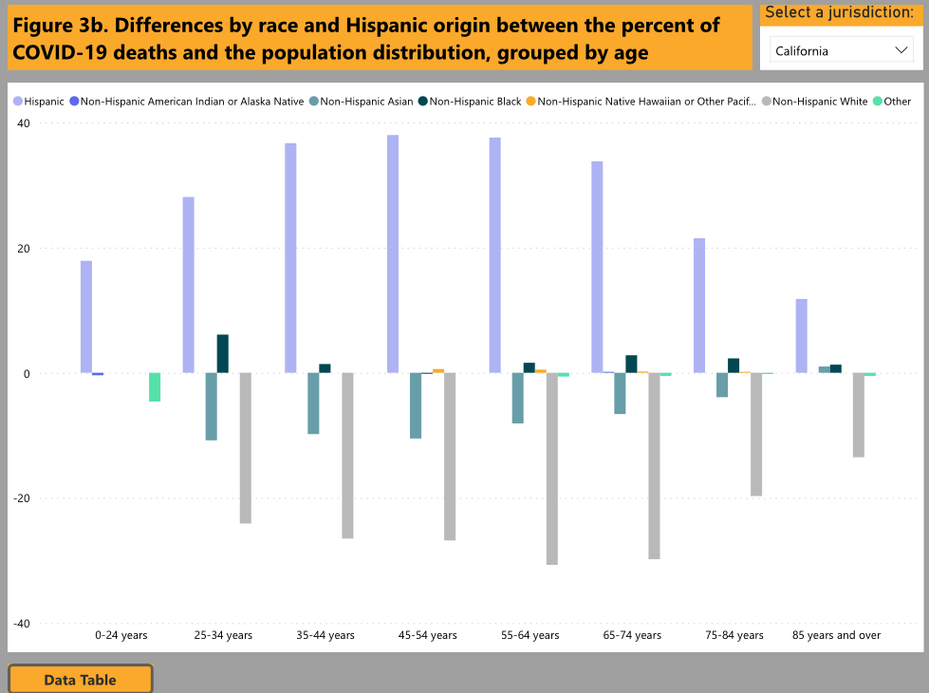
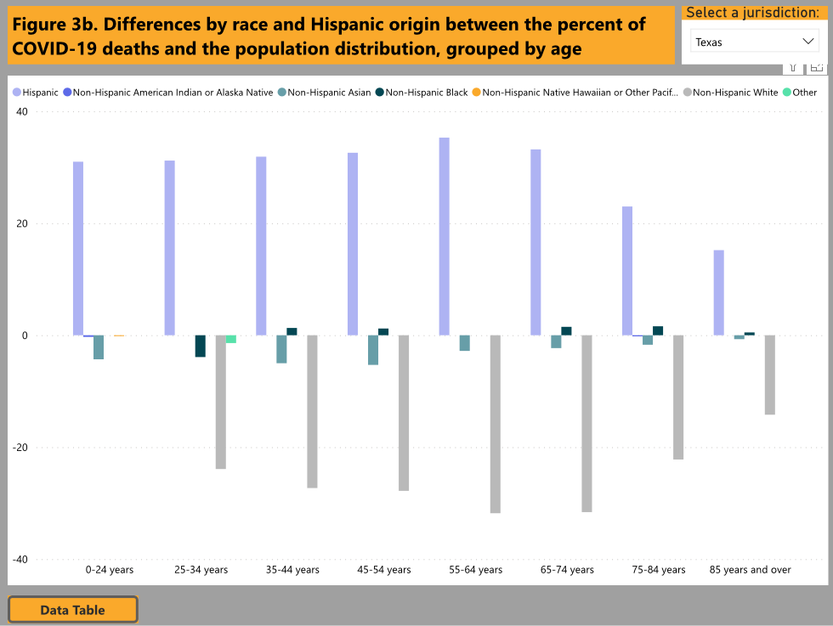
Oregon
Washington
California
Texas

Slide 30
Comparison of Cases, Treatment, and Outcomes Of Covid-19 Patients
at an Academic Medical Center,and at a Covenant Medical Center in Lubbock, Texas
 | University Medical Center |  |  |  | Covenant Medical Center
Med-Surg Floor Patients |  | 1234 |  |  | 1732
ICU Patients |  | 690 |  |  | 443
Ventilated Patients |  | 536 |  |  | 224
Deaths |  | 293 |  |  | 344
Total Number of Covid-19 Patients Treated |  | 1924 |  |  | 2175
% of patients in ICU |  | 35.8 |  |  | 20.36
% of patients on Vents |  | 27.8 |  |  | 10.3
% of Deaths |  | 15.23 |  |  | 15.8
These Figures are through 12-7-2020

Slide 31
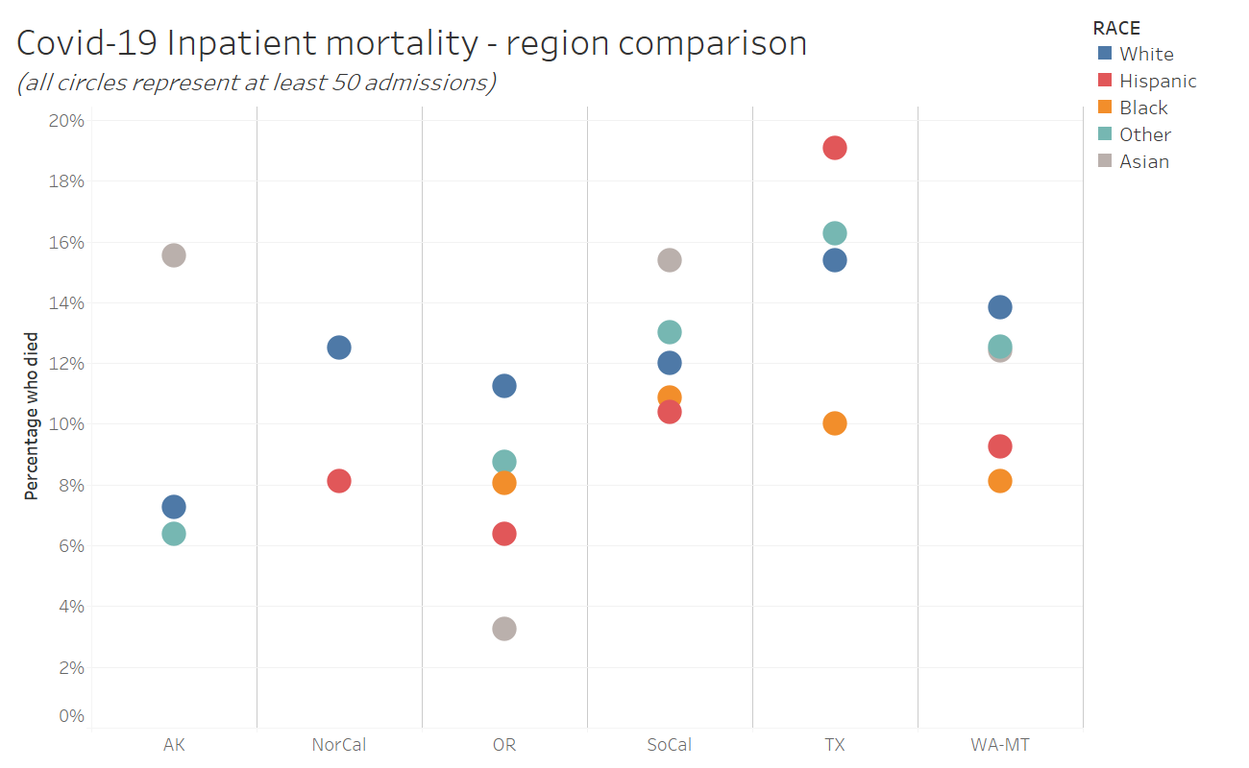
Data from patients admitted through 12.11.2020

Slide 32
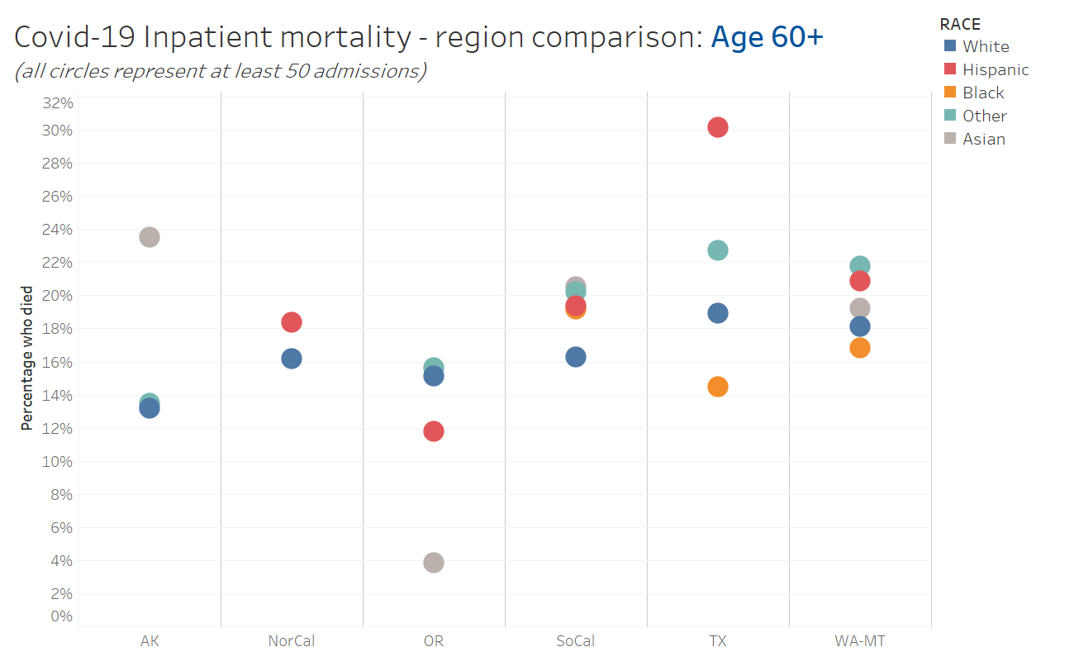
Data from patients admitted through 12.11.2020

Slide 33
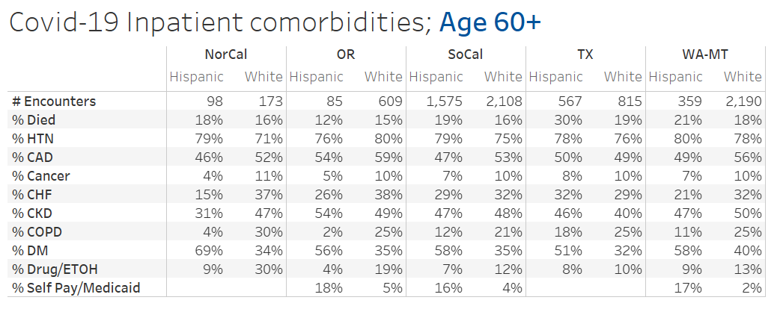
Do Hispanic patients in TX have a different comorbidity profile than in other regions? (Data from patients admitted through 12.11.2020)

Slide 34
Impact for West Texas
We do live in different environment in the South Plains and are receiving patients from vast distances across our area and the rest of Texas
Specialty care in our area (such as the stroke program) demands that patients be transferred to us for complications sustained in other facilities
Comparison of mortality statistics between regions cannot be done equitably without taking these parameters into account.
We do need to be sensitive to the special susceptibility of our Hispanic patients.

Slide 35

Regional Chief Diversity Officer – Kevin McConic

Slide 36
New Physician Screening and Mask Replacement Process for CMC

Slide 37
Physician Dining Room Screening Site
Do your daily screenings:
In the Physicians Lounge - New Dots for the next day will be placed in the physician's lounge at 10pm the night before and will be available for self screening 24 hours a day/7 days a week
In the Front Lobby - Between the hours of 5am - 10:30pm, physicians can self screen at the physician table located behind the screener desk in the second cubby on the right.
On the Units - 24/7 access

Slide 38
Reprocess or Replace N-95s
On the Units - 24/7 Access
In the Front Lobby - between the hours of 5am - 10:30pm - Check in with our screener who is greeting and taking temperatures.
This should give you greater accessibility to receive or reprocess masks by being available 7 days a week and for extended hours each day, increasing availability by 100 hours a week.
Type 2 Masks and shields will be available on nursing units and the physician table in the front lobby.
For any questions or concerns, reach out to Lauren Orta (254-855-2117) or Shannon Charlton (806)723-9623.

Slide 39
Current Regional Covid-19 Census

Slide 40
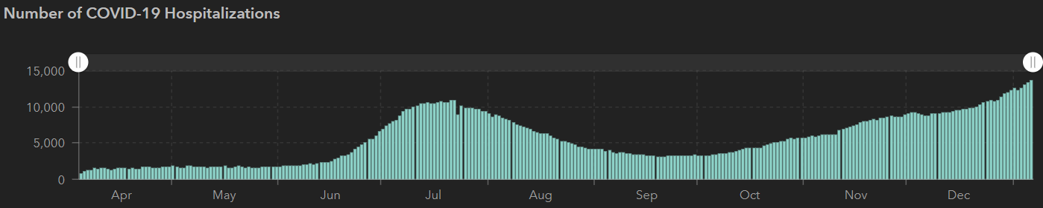
Texas Covid-19 Hospitalizations
12/2 | 12/16 | 12/28 | 1/4 | 1/6
1,200,674 | 1,367,965 | 1,490,479 | 1,598,713 | 1,646,238
21,756 | 24,394 | 26,521 | 27,969 | 28,545
9,109 | 9,053 | 9,528 | 12,961 | 13,628
10,893
7/22
NEW RECORD
13628
 | 11/30 | 11/16 | 11/04 | 10/21 | 10/5 | 9/23 | 9/9 | 8/26 | 8/12 | 7/29 | 7/15 | 7/1
Cases | 1,168,111 | 1,027,889 | 926,400 | 838,809 | 769,303 | 719,599 | 645,791 | 592,137 | 506,820 | 403,307 | 282,365 | 168,062
Deaths | 21,379 | 19,579 | 18,320 | 17,210 | 16,033 | 15,129 | 13,692 | 11,805 | 9034 | 6190 | 3432 | 2481
Hospitalized | 8900 | 7468 | 5,872 | 4,319 | 3,318 | 3,195 | 3604 | 4806 | 7028 | 9595 | 10,471 | 6904

Slide 41
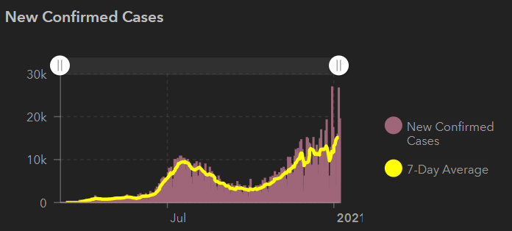
STATE
26,500 new 1/5
19,500 1/6

Slide 42
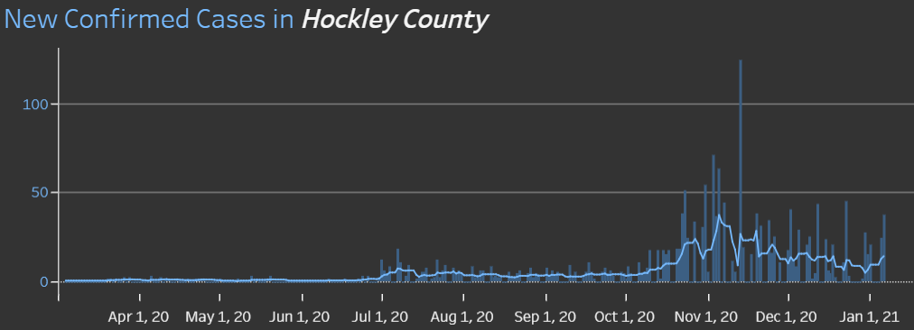
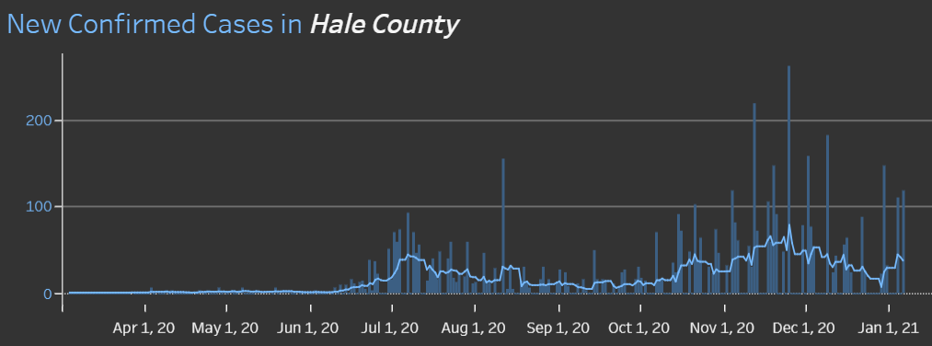
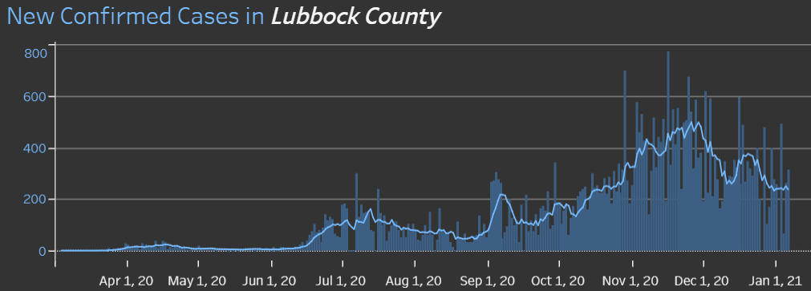
COUNTIES
1/5 118 new cases
1/5 37 new cases
315 new 1/5
14.6 %
Positivity Rate

Slide 43
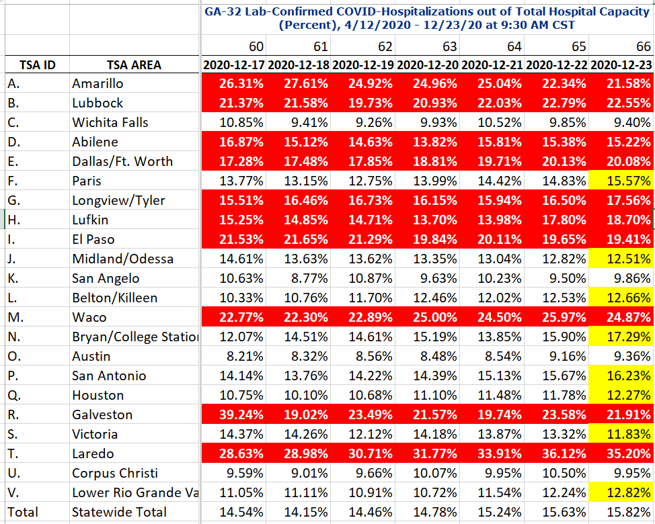
COVID+ HOSPITALIZATIONS BY TSA ID
CONFIRMED COVID+ HOSPITALIZATIONS /HOSPITAL CAPACITY
LAST WEEK

Slide 44
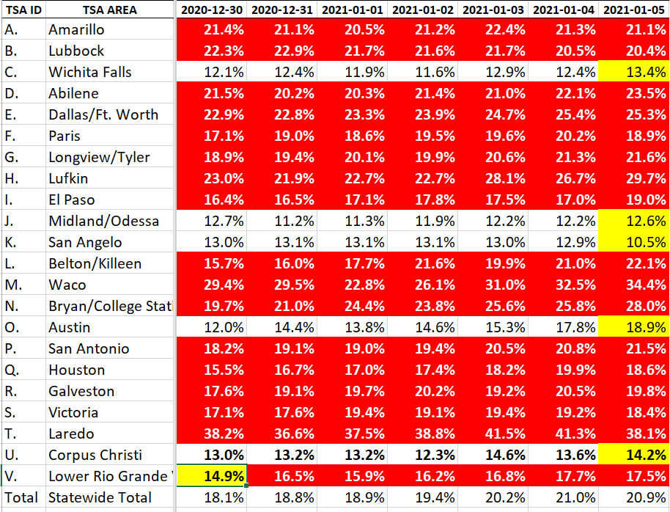
COVID+ HOSPITALIZATIONS BY TSA ID
CONFIRMED COVID+ HOSPITALIZATIONS /HOSPITAL CAPACITY
NOW

Slide 45
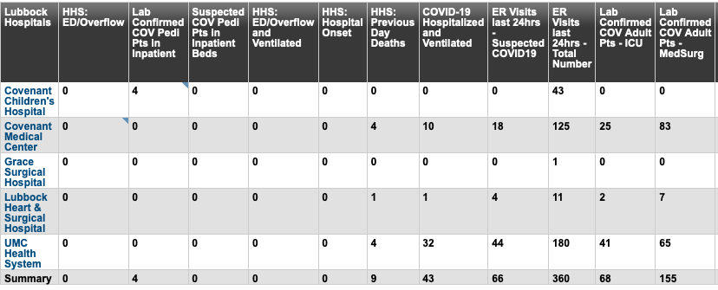
Lubbock This Morning
12/28: 268 Hospitalized in Lubbock – 43 on vents

Slide 46
Surge Plans

Slide 47
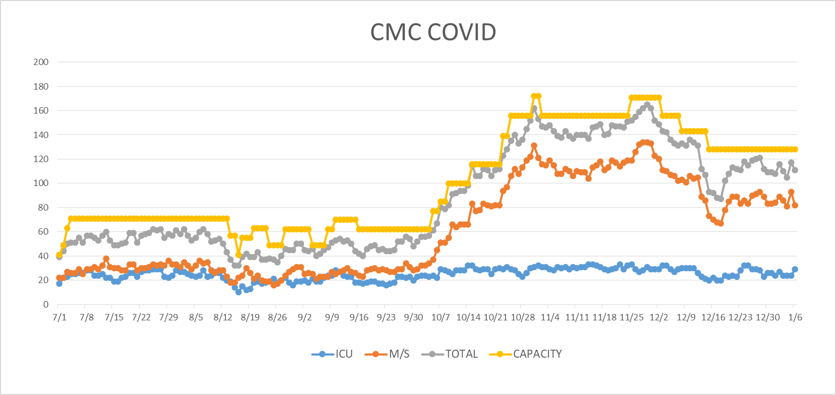
COVID Units - CMC
1/7/2020

Slide 48
Statistics
Cristian Requenez
Clinical Data Analyst
Clinical Analytics
Covenant Health

Slide 49
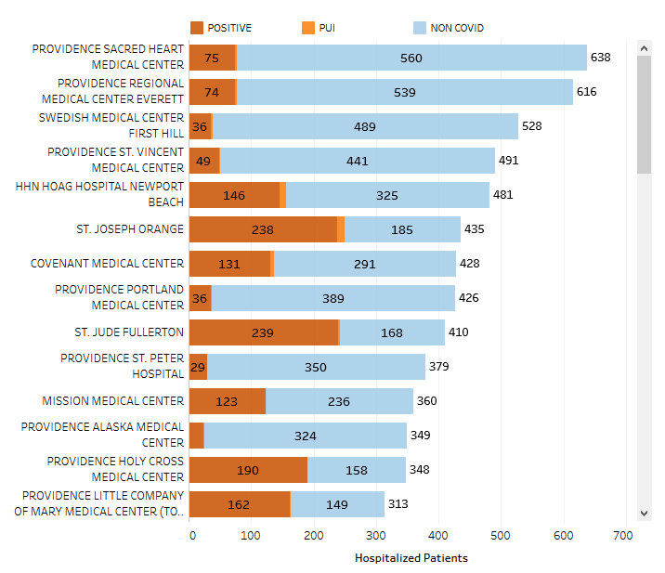
Providence System Hospitalized COVID-19 Cases

Slide 50
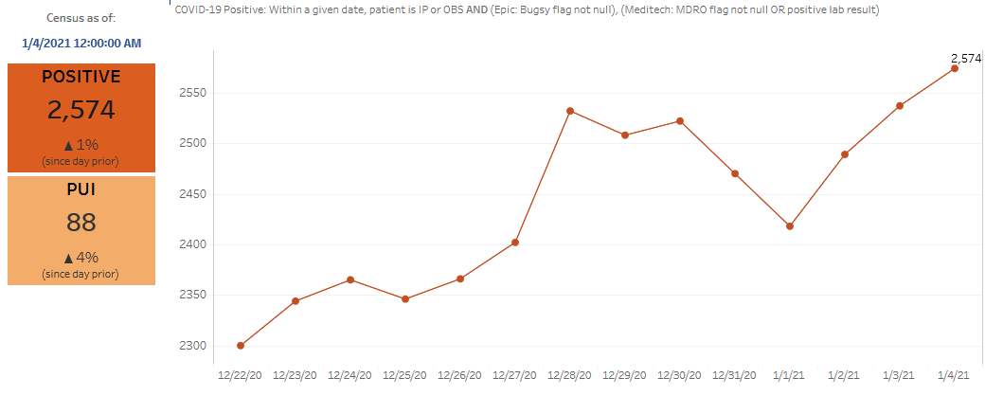
Providence Inpatient COVID-19 Volume

Slide 51
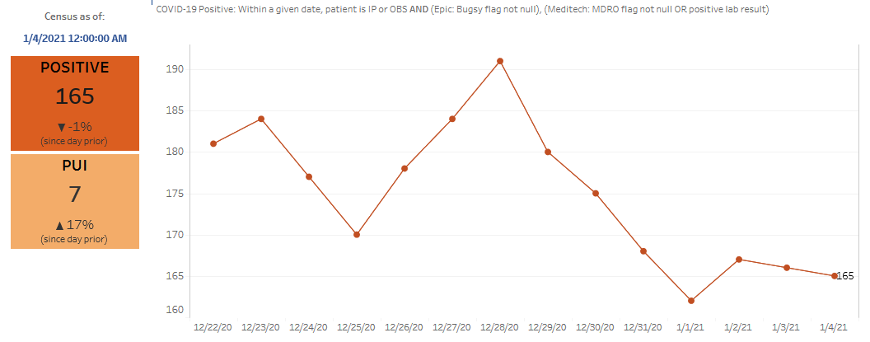
Texas Inpatient COVID-19 Volume

Slide 52
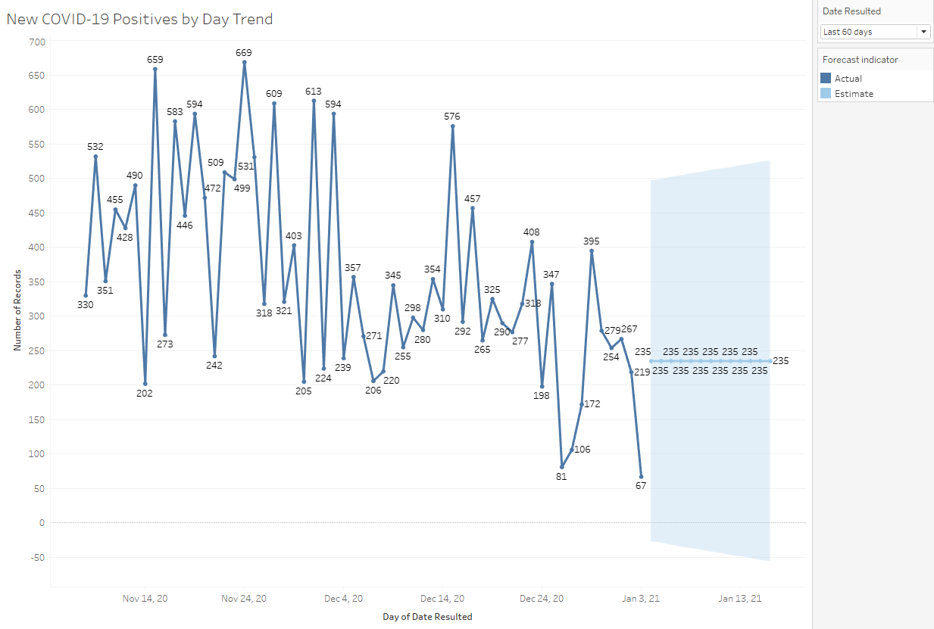
New COVID-19 POSITIVES by Day Trend

Slide 53
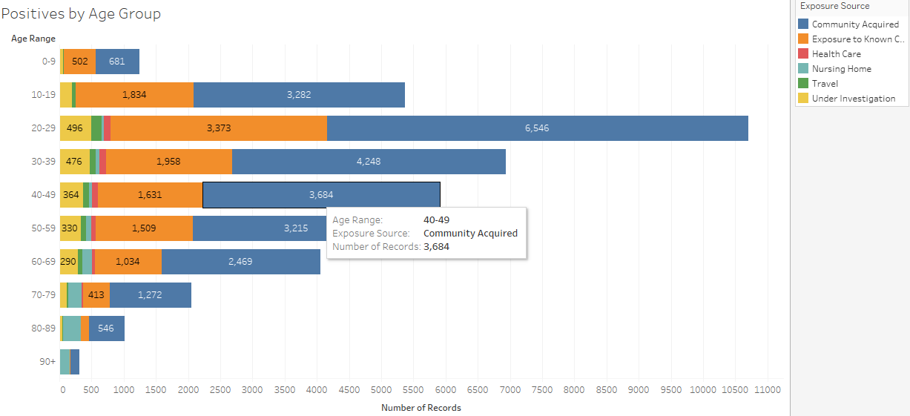
COVID-19 POSITIVES Age Distribution

Slide 54
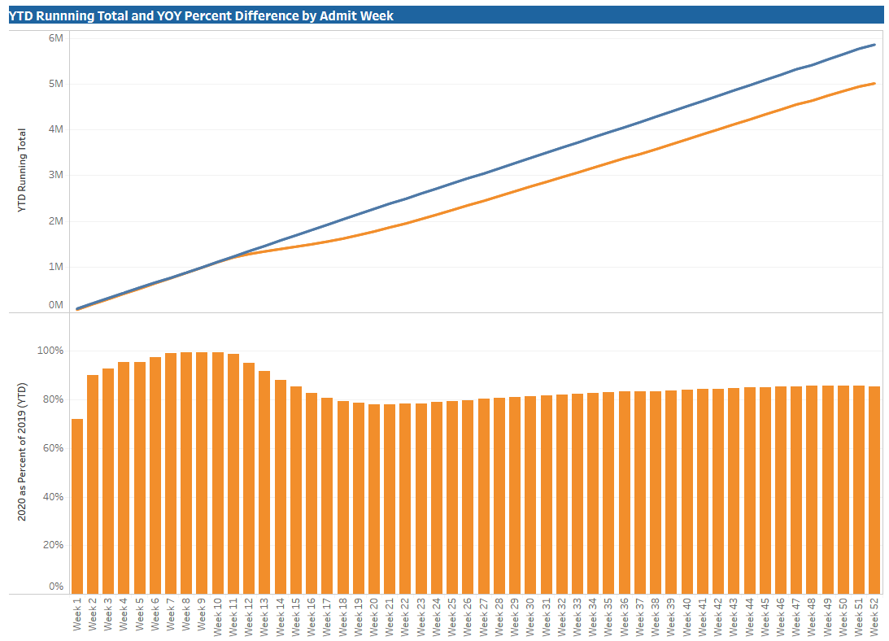
TX/NM Region Weekly Procedures (YOY)

Slide 55
Covenant Outpatient Infusion Center Update

Slide 56
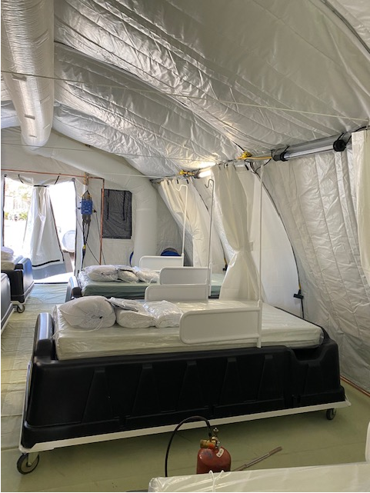
COVID Infusion Center
Status Update
Prakesh Shrestha, MD
  Program successes to date
Dennis Duriex, MD
  Follow-up of infusion patients

Slide 57
Infusion Center Update
Dr Prakash Shrestha

Slide 58
Hours and Capacity
7 weeks - Started on Nov 18th, 2020 – 2 pts
Max no of pts – 30/day

Slide 59
Infusions to Date
  Total – 409 patients received antibody
  Bamlanivimab – 347 pts
  Regeneron- 62 pts
  .

Slide 60
Other Options
  What is the purpose of these treatment ?
  BLAZE (NEJM Oct 28, 2020) – Interim analysis of phase 2 trial
    On day 29, the percentage of patients who were hospitalized was 1.6% in the LY-CoV555 group and 6.3% in the placebo group. In a post hoc analysis that was focused on high-risk subgroups (an age of ≥65 years or a BMI of ≥35), the percentage of hospitalization was 4.2% In the LY-CoV555 group and 14.6% in the placebo group
  Early High-Titer Plasma Therapy to Prevent Severe Covid-19 in Older Adults ( NEJM Jan 6, 2021)
    Early administration of high-titer convalescent plasma against SARS-CoV-2 to mildly ill infected older adults reduced the progression of Covid-19
  Patient selection is key.
  Screening/Approval

Slide 61
Research
Clinical research
  Data analysis on pt receiving ab treatment in UMC and CMC
  Hospitalization/Symptoms relief /Mortality

Slide 62
Remdesivir
Remdesivir
  70 pts
  325 vials
  RDV – Dosed once daily. Approved for inpatient.
  1 dose of RDV ~ 1 hospital bed/day
  325 dose ~ 325 beds in 7 weeks

Slide 63
Converted Covid Unit to Non Covid Unit

Slide 64
Others are watching our success
Among very first hospital in Texas to utilize tent for outpatient treatment of Covid
Very good feedback from pts, providers and State Health
Similar setup in Austin

Slide 65
Request from Dr. Duriex

Slide 66

Covid-19 Testing

Slide 67


Slide 68
TESTING
 | CMC |  | GMC |  | CMG
 | Rapid | PCR | Rapid | PCR | Rapid
Test Kits
Swabs
VTM
 | CMC |  | GMG/CMG
 | Tests | + | Tests | +
12/21 | 95 | 14 | 24 | 3
12/22 | 239 | 41 | 177 | 48
12/23 | 217 | 33 | 179 | 49
PCR
Rapids
>2000 >750
<2000 <750
<1600 <500
CMC- Alinity back online
GMG- no issues
CMG- no issues

Slide 69
Pharmacy Update
Wesley Wells, PharmD
Regional Pharmacy Director
Covenant Health

Slide 70
Therapeutics Update
Numbers are reported as of January 6, 2021 at 11:00 pm
Medication | Current State |  | Updates/Issues
Remdesivir |  |  | Dispensed 320 vials to the COVID tent thru end of January 5. We have treated 70 patients
Bamlanivimab (Lilly) |  |  | No updates
Casirivimab and Imdevimab (Regeneron) |  |  | Plainview is reviewing their vial sizes to look for any possible disparities in dose counting.
Zanubrutinib | Patients enrolled: 6 | Active patients: 0 | No updates
Regeneron 2066 | Patients enrolled: 3 (4 screened) | Active patients: 0 | No updates
EXIT COVID-19 Trial | Patients enrolled 4 (5 screened) | Active patients: 4 | Started first set of patients on Tuesday. Day 4 of treatment will hit over weekend.
Ministry | Vials Used on Previous Day | Stock
Covenant Medical Center | 36 | 247
Covenant Children’s Hospital | 4 | 39
Covenant Plainview | 4 | 63
Covenant Levelland | 0 | 27
Home Infusion | 6 | 40
Ministry | Total Doses Infused | Stock
CMC/Home Infusion | 347 | 236
Covenant Plainview | 18 | 75
Covenant Levelland | 6 | 24
Ministry | Total Doses Infused | Stock
CMC/Home Infusion | 62 | 207
Covenant Plainview | 0 | 37

Slide 71

Vaccine Update

Slide 72


Vaccine Update
CMC
Community

Slide 73


Vaccine Update
Plainview
Levelland

Slide 74
Administration
2-dose series administered intramuscularly 3 weeks apart
Two doses required to achieve high efficacy
  Efficacy after 2nd dose: 95.0%
  Efficacy of a single dose has not been systematically evaluated
How long in-between
  Administration of 2nd dose within 4-day grace period (e.g., day 17-21)
  If >21 days since 1st dose, 2nd dose should be administered at earliest opportunity (but no doses need to be repeated)
  Complete series with same product
Administer alone
  14 days before or after administration with any other vaccines

Slide 75
Who Can Get the Vaccine?
All caregivers, age >= 16 years, regardless of history of prior symptomatic or asymptomatic SARS-CoV-2 infection
  Reinfection uncommon in the 90 days after initial infection, and thus persons with documented acute infection in the preceding 90 days may defer vaccination until the end of this period, if desired
Persons with a known SARS-CoV-2 exposure
  Defer vaccination until quarantine period has ended to avoid exposing healthcare personnel (HCP) or other persons during vaccination visit
Immunocompromised persons may still receive COVID-19 vaccine

Slide 76
Who Can Get the Vaccine
Pregnant/breastfeeding patients may choose to be vaccinated, discussion with healthcare provider can help make an informed decision
  Need to balance risk-benefit
mRNA vaccines are not live and degrade quickly
Routine pregnancy testing is not required
Pregnant women who experience a fever can take acetaminophen

Slide 77

Vaccine Update

Slide 78

Education for Staff

Slide 79
Vaccine Update
LAST DAY for 1st Dose is January 21st
  Will transition to ambulatory side after that date

Slide 80

Texas Demographics

Slide 81


Slide 82


Slide 83


Slide 84
Q & A

Slide 85
CME Credit was only approved for the Live Teams meeting
To receive credit for this continuing education activity, the participant must:
  Make sure you are logged into your Teams account, if you are signed in with a group provide attendee’s First and Last name(s) in the comments section.
  If you are calling into the Teams meeting you MUST text your First & Last Name to (806) 252-4735. This will ensure you are added to the sign in sheet to receive CME Credit.
  You will receive an email by the following Wednesday from the CME department with further instructions on claiming your certificate.

