Slide 1
Covenant Health
Presents
Critical Communications: A Weekly Physician Update
October 16, 2020

Slide 2
PHYSICIANS
Accreditation Statement:
The Covenant Health is accredited by the Texas Medical Association (TMA) to provide continuing medical education for physicians.
Credit Designation Statement:
The Covenant Health designates this live CME activity for a maximum of 1.0 AMA PRA Category 1 Credit(s)™. Physicians should claim only the credit commensurate with the extent of their participation in the activity.

Slide 3
Disclosures of Commercial Interest
The speakers and planners of this activity
have no relevant financial interests

Slide 4
Disclosures
This activity is provided by
Covenant Health
No commercial support has been received.
No products will be endorsed.
Speakers will notify the audience if off label drug use will be discussed.

Slide 5
CME Credit was only approved for the Live Teams meeting
To receive credit for this continuing education activity, the participant must:
  Make sure you are logged into your Teams account, if you are signed in with a group provide attendee’s First and Last name(s) in the comments section.
  If you are calling into the Teams meeting you MUST text your First & Last Name to (806) 252-4735. This will ensure you are added to the sign in sheet to receive CME Credit.
  You will receive an email within 3 business days from the CME department with further instructions on claiming your certificate.

Slide 6
Reflection & Safety Story
Presented by
Cindi Kenady,
Safety Officer
Covenant Medical Center

Slide 7

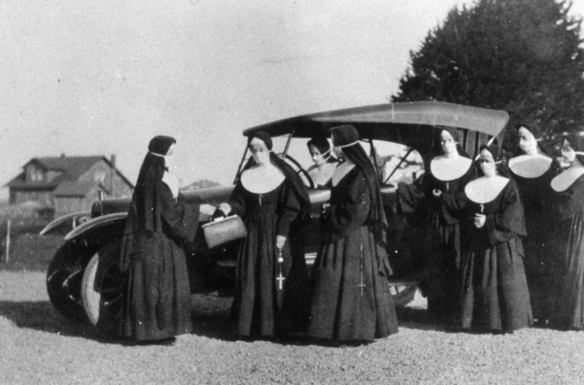

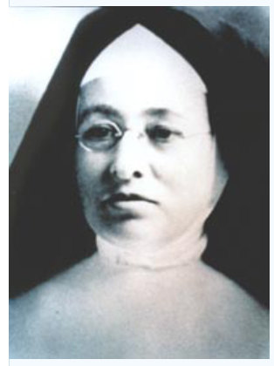

Slide 8
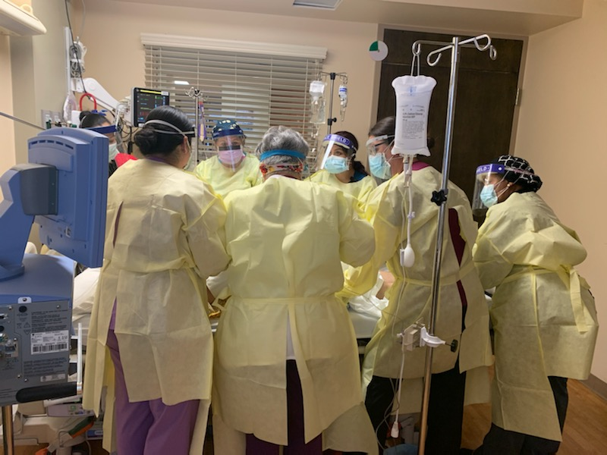
TOGETHER – We can do the IMPOSSIBLE

Slide 9
Now a word from
Richard Parks

Slide 10
Current Regional Covid-19 Census

Slide 11
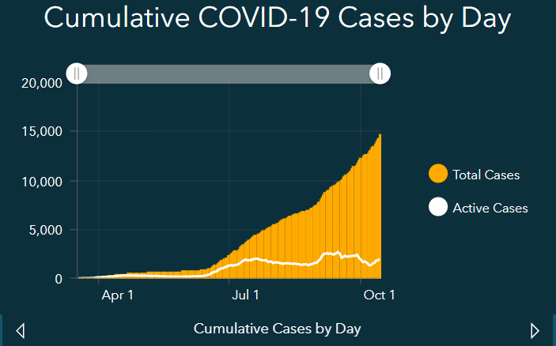
Regional
 | Lubbock |  | TTU |  | Hockley |  | Hale
 | 10/12 | 10/14 | 10/12 | 10/14 | 10/11 | 10/14 | 10/10 | 10/13
Total | 14,165 | 14,675 | 1882 | 1917 | 416 | 433 | 2075 | 2188
Active | 1912 | 2005 | 157 | 137 |  |  | 149 | 218
Deaths | 146 | 152 | 0 | 0 | 11 | 11 | 60 | 60
New | 510 in 2 days |  | 35 |  | 17 |  | 113
Positivity Rate
Lubbock County 11.7%
New cases 311 – record high

Slide 12
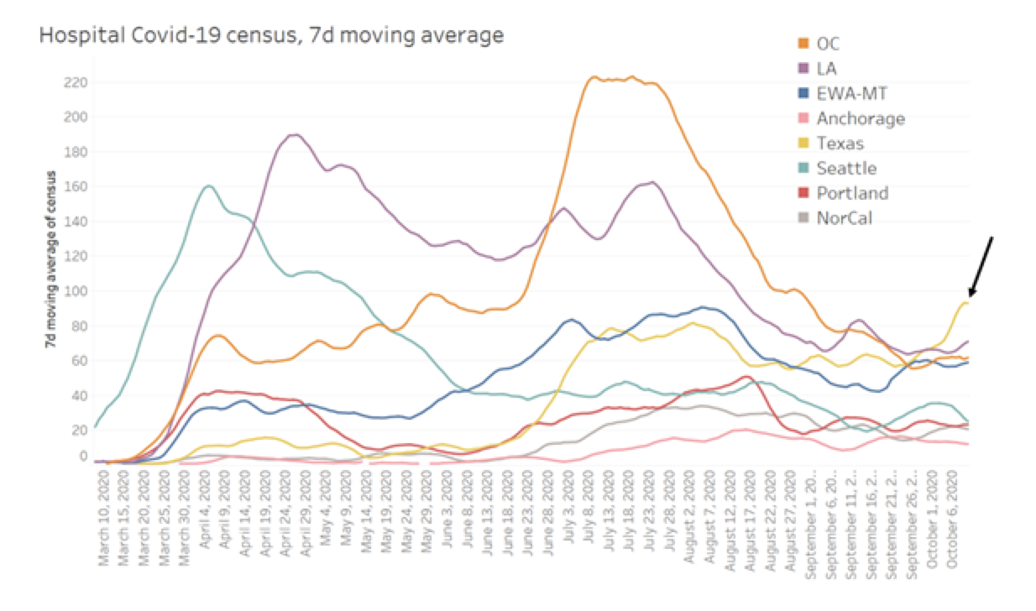

Slide 13
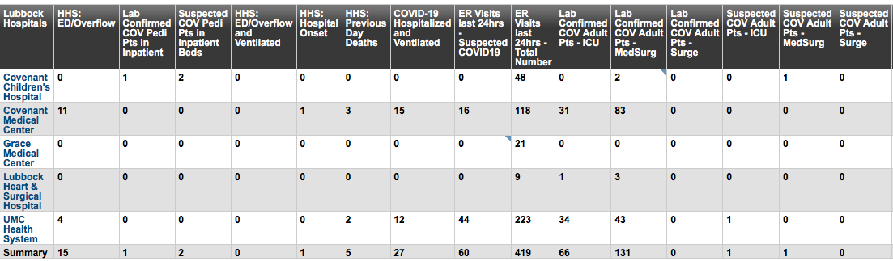
Lubbock

Slide 14
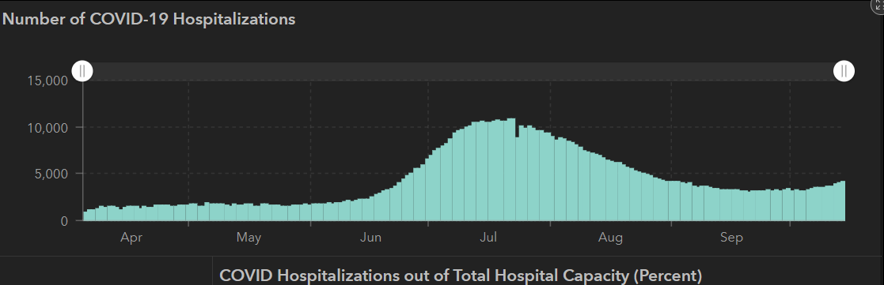
STATE
 | 10/14 | 10/12 | 10/5 | 9/30 | 9/23 | 9/16 | 9/9 | 8/26 | 8/12 | 7/29 | 7/15 | 7/1
Cases | 805,802 | 795,126 | 769,303 | 748,967 | 719,599 | 674,772 | 645,791 | 592,137 | 506,820 | 403,307 | 282,365 | 168,062
Deaths | 16,717 | 16,558 | 16,033 | 15,711 | 15,129 | 14,478 | 13,692 | 11,805 | 9034 | 6190 | 3432 | 2481
Hospitalized | 4,131 | 3,870 | 3,318 | 3,344 | 3,195 | 3249 | 3604 | 4806 | 7028 | 9595 | 10,471 | 6904

Slide 15
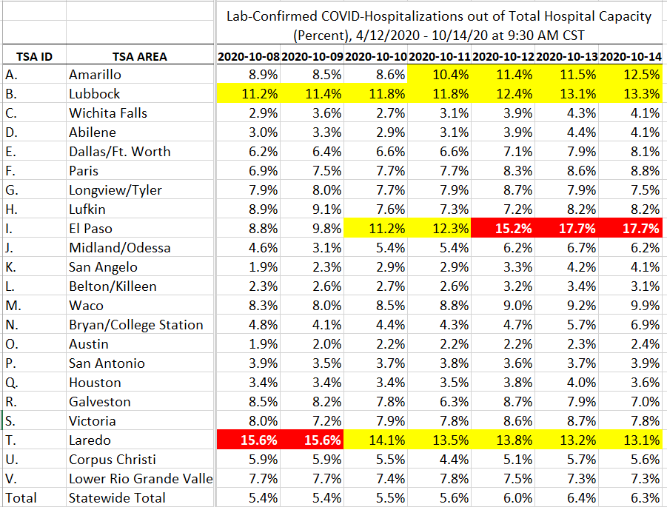
COVID+ HOSPITALIZATIONS BY TSA ID
CONFIRMED COVID+ HOSPITALIZATIONS /HOSPITAL CAPACITY NEW METHOD 10/14

Slide 16
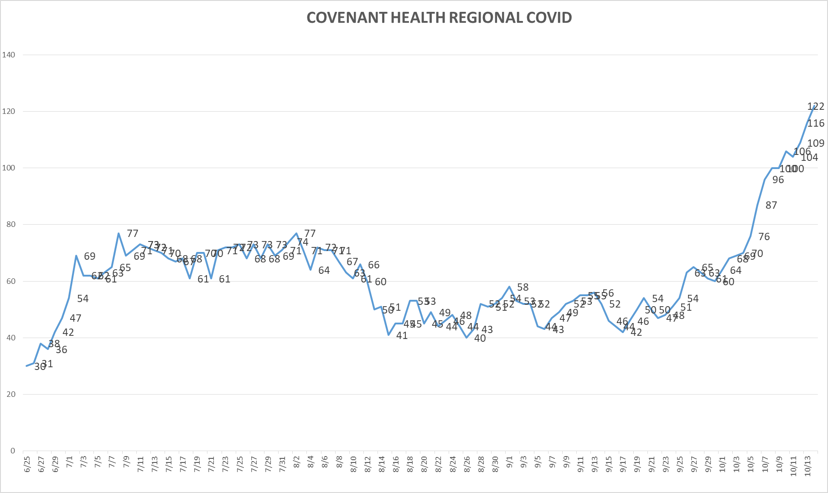
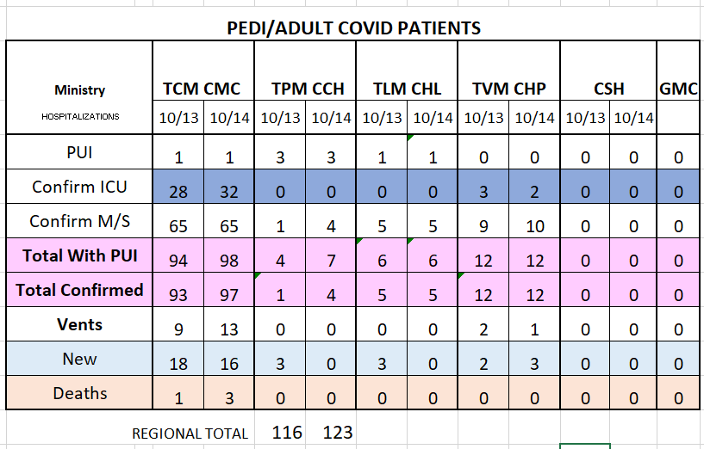
PUI/Confirmed cases-hospitalized
10/14/2020

Slide 17
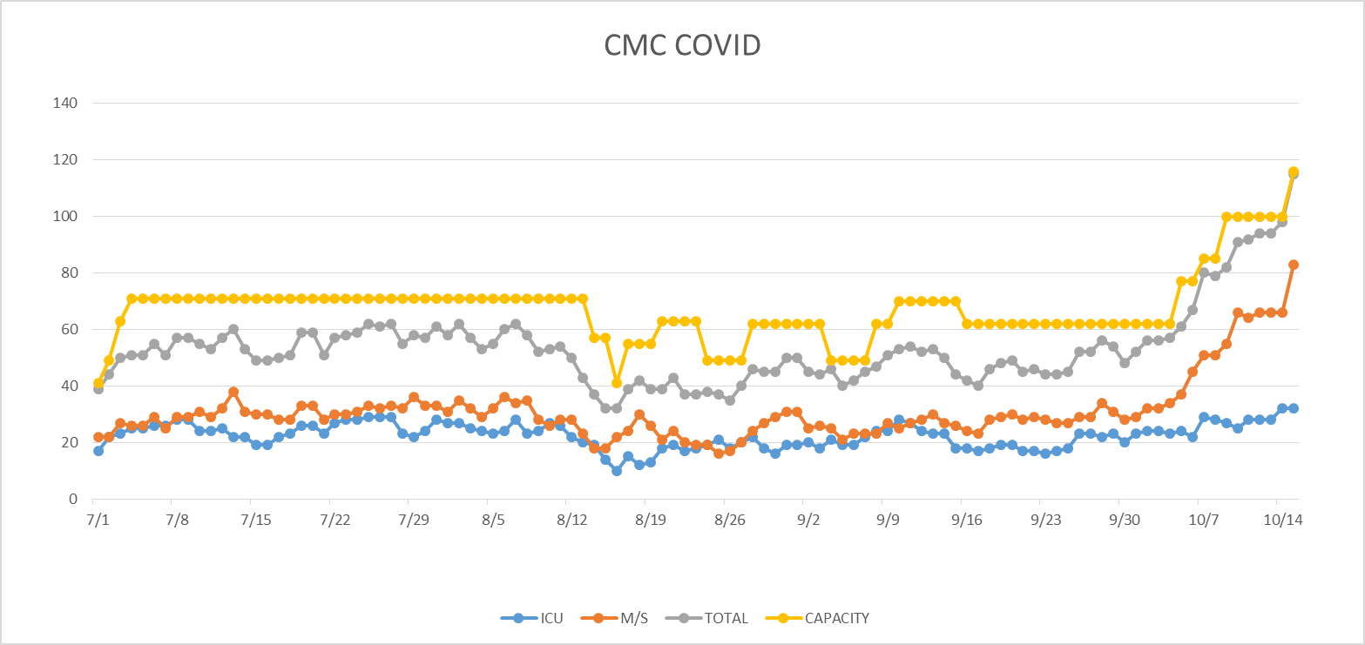
PUI/Confirmed cases-hospitalized
10/15/2020

Slide 18
PUI/Confirmed cases-hospitalized
10/15/2020
 | CICU | MICU | HC4E | HC4W | HC6 | S9E | S9W | S4E
Beds Available | 0 | 1 | 0 | 0 | 0 | 0 | 0 | 0
Total bed available - 1
99.2% Capacity

Slide 19
Surge Plan
Covenant Medical Center
 | ICU | Med Surg | Total
Phase 1 | 10-CICU |  | 10
Phase 2 | 17-CICU | 10-HC4 | 27
Phase 3 | 17-CICU | 24-HC4 | 41
Phase 4 | 17-CICU 8-MICU | 24-HC4 14-Pal Med | 63
Phase 5 | 17-CICU 16-MICU | 24-HC4 14-Pal Med | 71
Phase 6 | 17-CICU 16-MICU 15-S 4 | 24-HC4 13-HC6 15 – S 9 (East) | 100
Phase 7 | 17-CICU 16-MICU 15-S 4 | 24-HC4 13-HC6 31 – S 9 (all) | 116
Phase 8 | 8-E4 17-CICU 16-MICU 15-S 4 | 15-S 10(East) 24-HC4 13-HC6 31 – S 9 (all) | 139
Phase 9 | 16-E4 (all) 17-CICU 16-MICU 15-S 4 | 30 S10 (all) 24-HC4 13-HC6 31 – S 9 (all) | 162
Last Week
Currently

Slide 20
CENSUS
 | 10/5 | 10/6 | 10/7 | 10/8 | 10/9 |  | 10/12 | 10/13 | 10/14 | 10/15 | 10/16
CMC (360) | 332 | 326 | 331 | 327 | 313 |  | 328 | 326 | 343 | 347
Cases (41) | 34 | 30 | 37 | 34 | 24 |  | 29 | 9 | 25
CCH (135) | 72 | 88 | 91 | 87 | 102 |  | 84 | 84 | 91 | 99
Cases (19) | 14 | 13 | 6 | 4 | 11 |  | 10 | 9 | 6
GMC (18) | 2 | 5 | 14 | 13 | 14 |  | 2 | 6 | 16
Cases (20) | 8 | 10 | 13 | 8 | 12 |  | 9 | 13 | 18
CHP (49) | 24 | 34 | 29 | 32 |  |  | 29 | 38 | 38 | 37
Cases (19) | 10 |  | 7 | 16 |  |  | 6 | 3 | 11 | 18
CHL (18) | 8 | 13 | 10 | 14 | 18 | 8 | 7 | 15 | 15 | 13
cases | 0 | 0 | 2 | 0 | 0 |  | 0 | 3 | 1 | 1
CSH (35) | 29 | 30 | 29 | 28 | 26 |  | 23 | 25 | 26 | 26

Slide 21
Statistics
William Sommer
Clinical Data Analyst
Decision Support Services
Covenant Health

Slide 22
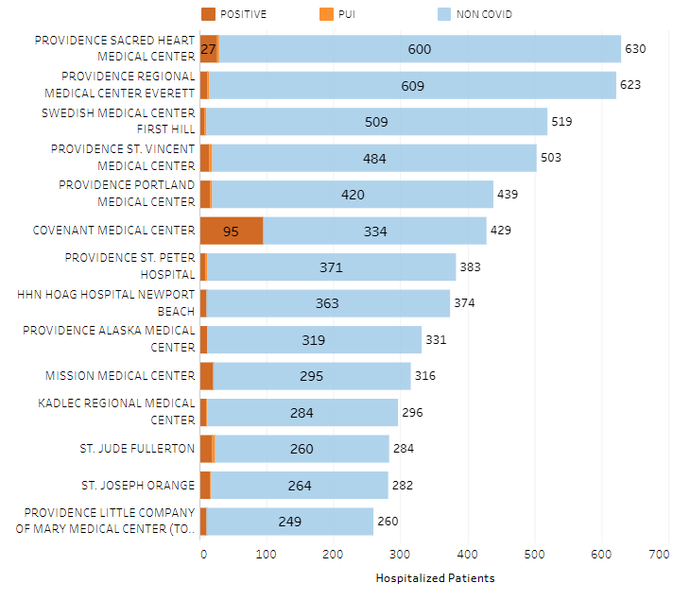
Providence System Hospitalized COVID-19 Cases

Slide 23
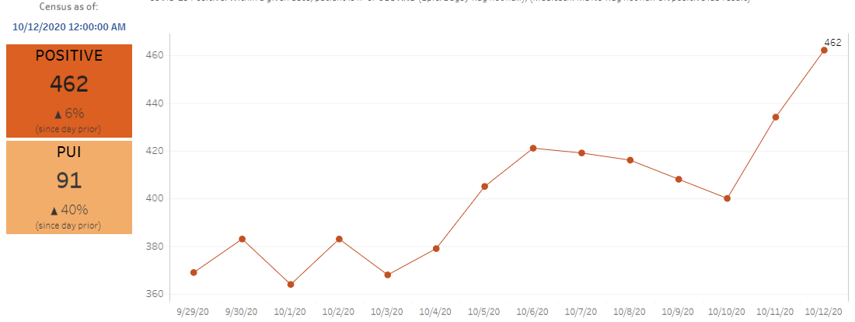
Providence Inpatient COVID-19 Volume

Slide 24
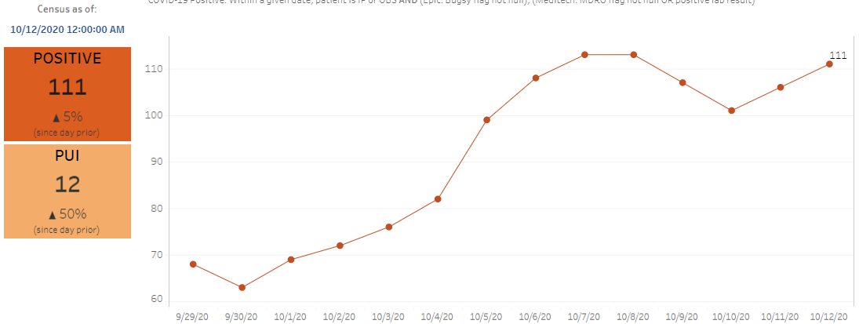
Texas Inpatient COVID-19 Volume

Slide 25
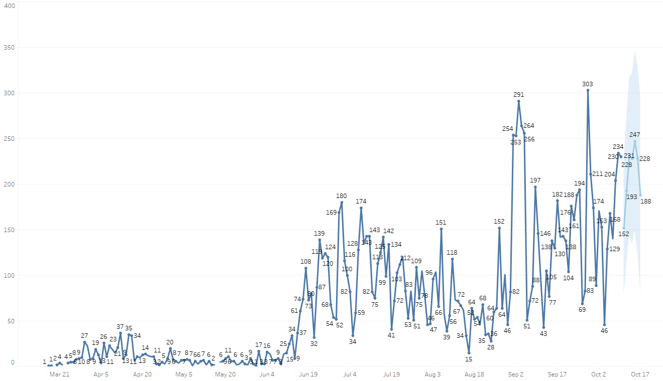

New Covid-19 POSITIVES by Day Trend

Slide 26
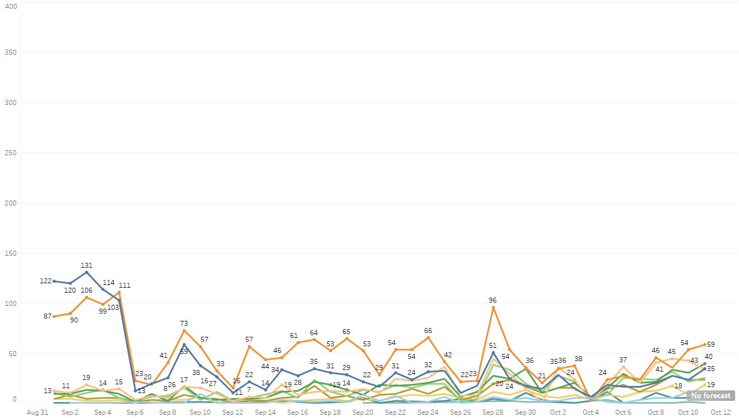
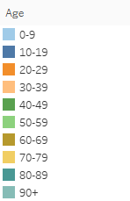
New Covid-19 POSITIVES by Day Age Groups

Slide 27
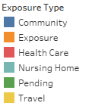
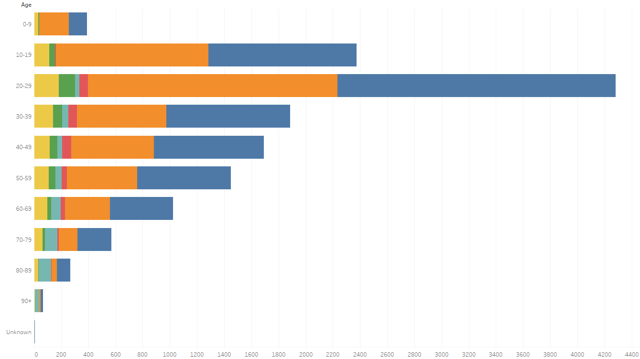
Covid-19 POSITIVES Age Distribution

Slide 28
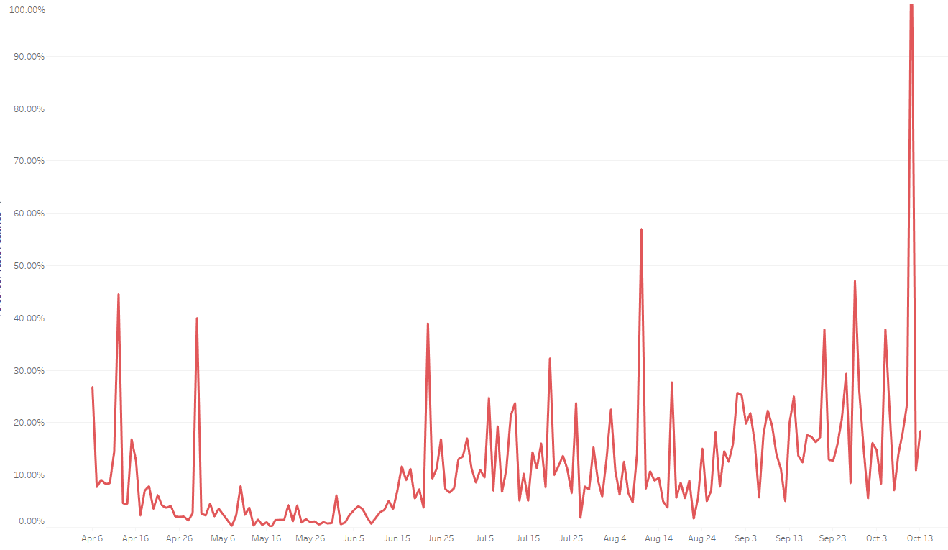

Covid-19 Daily Positive Rate

Slide 29
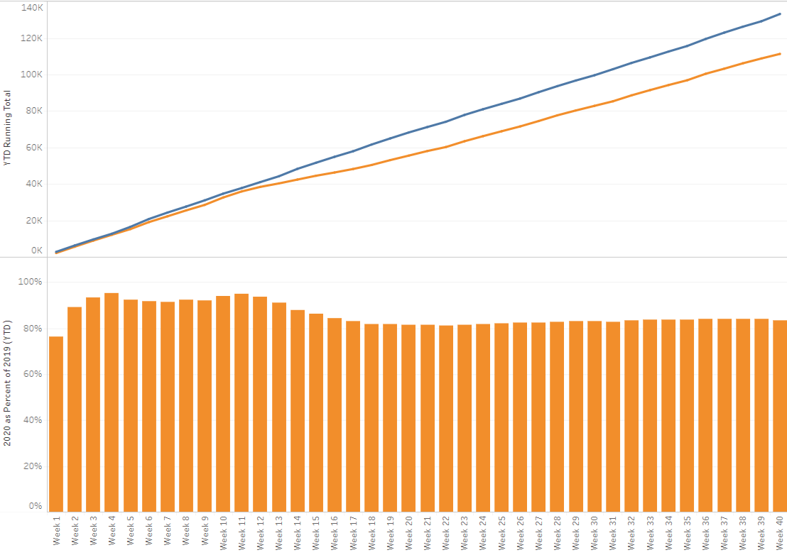

TX/NM Region Weekly Procedures (YOY)

Slide 30
Hot Topics

Slide 31
Hot topics – Dr. Shrestha
Patients within 90 days COVID Recovery
For patients previously diagnosed with symptomatic COVID-19 who have had no symptoms after recovery, retesting is not recommended within 90 days after the date of symptom onset for the initial COVID-19 infection.
  Treat patient as a Non-Covid patient and place on non-covid unit
  No Isolation is required
  DO NOT RETEST as PCR can remain positive for up to 90 days.
For patients developing new symptoms consistent with COVID-19 during the 90 days after the date of initial symptom onset, if an alternative etiology cannot be identified by a provider, then the patient may warrant retesting; consultation with infectious disease or infection control experts is recommended.
  Place patient in COVID isolation if no other etiology is identified
  Retesting if necessary
Serologic testing should not be used to establish the presence or absence of SARS-CoV-2 infection or reinfection.
https://www.cdc.gov/coronavirus/2019-ncov/hcp/duration-isolation.html

Slide 32
Caregiver Update

Slide 33
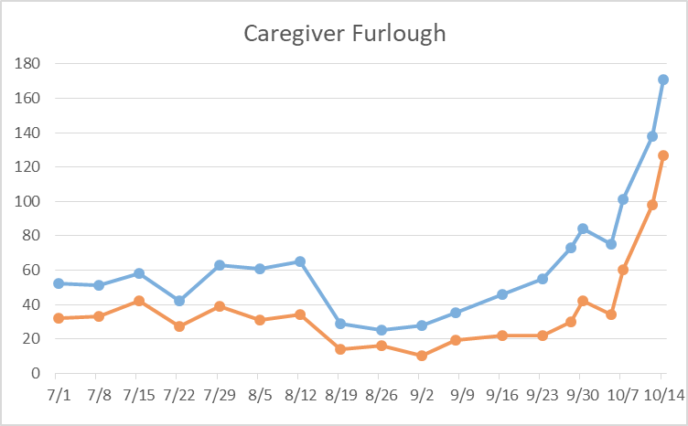
Caregivers
Currently
COVID Related Furloughs
Last Week
74% are positive
Count reflects # furlough (exposed and positive)
Good
Moderate
Critical

Slide 34
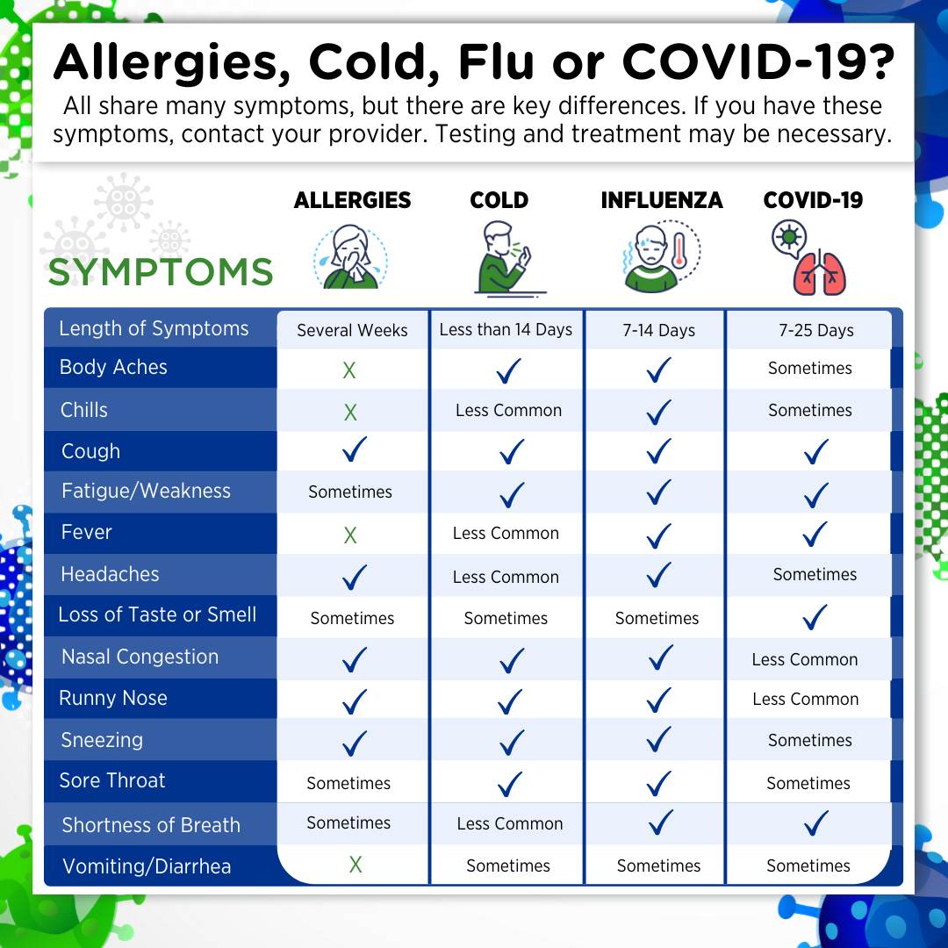
Caregivers
Caregivers with symptoms
Call Caregiver health before shift or immediately when symptoms develop on shift
Check symptoms NOT just temperature

Slide 35

Caregivers
Caregivers wear PPE
Mask ANYTIME you are around other people
Shield when within 6 ft of patient
N-95 and Shield when around aerosol generating procedures or COVID patient

Slide 36
Caregivers
Caregivers who test Positive
Cannot return to work until 10 days after positive test
If receiving oxygen, cannot RTW until 20 days after testing positive
CALL CAREGIVER HEALTH when:
Caregiver tests positive -OR-
Caregiver is exposed to someone who is positive

Slide 37
Caregivers
State Staffing available for B-RAC
  RN’s ICU, Med/Surg, Tele
  Respiratory Therapists
  Must work 100% in COVID area
  Complete STAR Request ICS 215RR And Staffing Request Form
  Send into to city EOC and BRAC
  Contact Cindi Kenady for more direction
We received notice this morning that the State of Texas is sending us
18 Nurses to help with the current situation at Covenant!

Slide 38
Caregivers
Flu Vaccine Update - >3000 given
Messaging to caregivers- “I have to wear a mask – so no need to have the flu shot”
Wrong!

Slide 39
N-95 transition to 8210
Physicians: Starts Next Week
  CCH Physician Dining Room, Tues/Thurs 1100-1300
  CMC PDR, Mon/Tue/Thurs 600-800 and 1500-1700
  Will need to complete Medical Questionnaire if one has not been completed and on file with Caregiver health

Slide 40
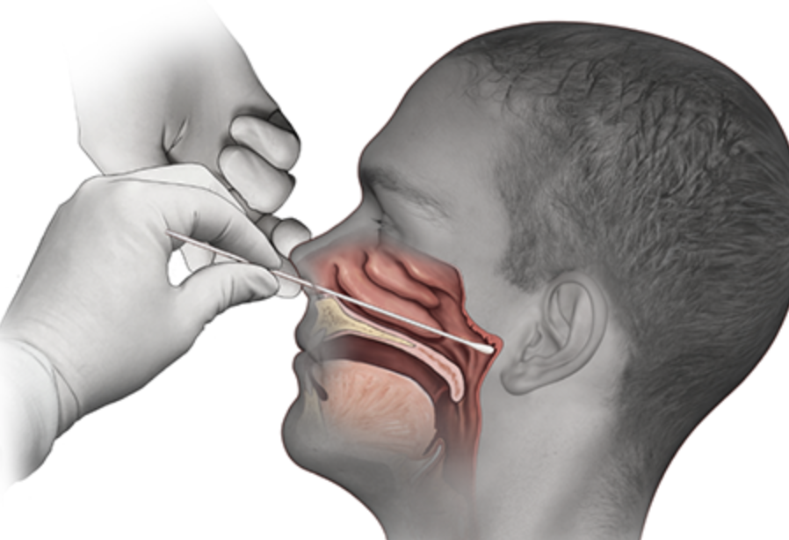
Covid-19 Testing

Slide 41
TESTING
 | CMC | GMC | CMG
Test Kits
Swabs
VTM
 | CMC |  | GMG/CMG
 | Tests | + | Tests | +
10/13 | 356 | 19 | 327 | 87
10/14 | 380 | 31 | 272 | 84
>2000 >750
<2000 <750
<1600 <500
CMC- no issues with allotments
Grace- no change from last week
CMG- no issues

Slide 42
TESTING
Same day surgery tests
Surgeons encouraged to have patients seen at SAS to have pre-procedural testing
Unplanned admission-JACC
If emergency care is needed – go to ED
Not an emergency – treat patient as a PUI until test results received

Slide 43
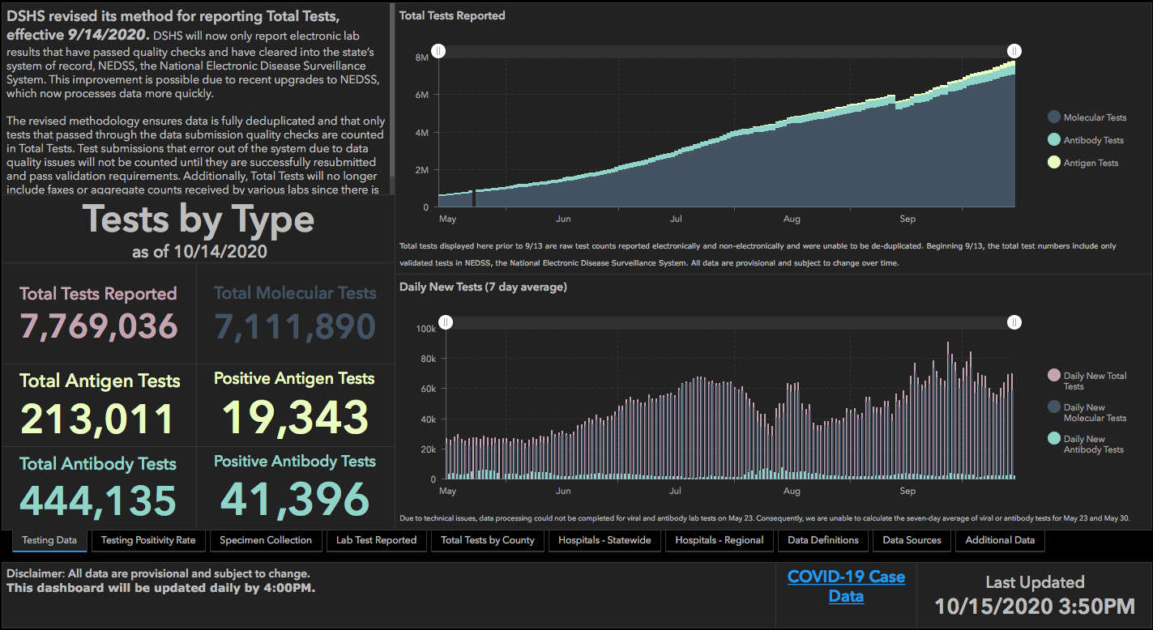

Slide 44
Pharmacy Update
Wesley Wells, PharmD
Regional Pharmacy Director
Covenant Health

Slide 45
Remdesivir
Ministry | Stock | Used Yesterday | Stock Level
Covenant Medical Center | 486 | 49 | Green
Children’s Hospital | 0 | 0 | Green
Covenant Plainview | 151 | 9 | Green
Covenant Levelland | 16 | 2 | Green
“Gate Keeper” system is no longer functional with current census
Expanding utilization to other providers managing COVID patients
  Patient will need to meet certain laboratory criteria
    The patient must maintain an ALT ≤ 5x the upper limit
    The patient must maintain a CrCl ≥30 ml/min
  The ordering provider is responsible for documenting that consent was obtained and that appropriate education

Slide 46
Remdesivir - Consent
I discussed the following with the [patient / legally authorized representative]:
  The patient's clinical condition is consistent with clinical inclusion criteria supporting the emergency use of remdesivir, an investigational drug.
  The FDA has authorized the emergency use of remdesivir, which is not FDA approved, for treatment of COVID-19.
  I informed the patient or legally authorized representative (LAR) that s/he has the option to accept or refuse remdesivir. We discussed alternative options including transitioning to comfort care / hospice (if clinically appropriate).
  Information on available alternative treatments and the risks and benefits of those alternatives.
  Significant and potential risks and benefits of remdesivir, and the extent to which they may occur, is not known at this time.
  The patient/LAR has been provided a Fact Sheet substantially similar to the FDA Fact Sheet.
    FDA Fact Sheet for Patients and Parents/Caregivers
    https://www.fda.gov/media/137565/download
  I provided an opportunity for the patient/LAR to ask questions and discuss any concerns.

Slide 47
Vaccine Preparation Update
Registration
Working to register as vaccinators
Registering with ImmTrac for tracking
Identify Target Population
Planning for phase 1a distribution
Includes high-risk caregivers
Inventory
State expecting 200,000 doses
Will be shipping out 1,000 doses at a time to be administered in 10 days
Storage
Purchased ultra-low freezer for storing Moderna vaccine.
Developing security plans for storage and transport

Slide 48
Shortages
COVID
  Doing well on stock
  Needing to stay on top of allocations due to rapid increase in census
Non-COVID
  Hydralazine 20mg/ml – No ETA
  Enalaprilat vials – No ETA
  Acetazolomide 500mg vials – No ETA
  Neomycin Amps – No ETA
  Valproate Sodium 500mg/5ml – End October
  Propofol 100mg/100ml – No ETA Allocated (Sporadic shipments)
  Clindamycin 600mg/50ml bags – No ETA (Sporadic shipments)
  Nalbuphine 10mg/ml – End of December

Slide 49
Communications Update

Slide 50
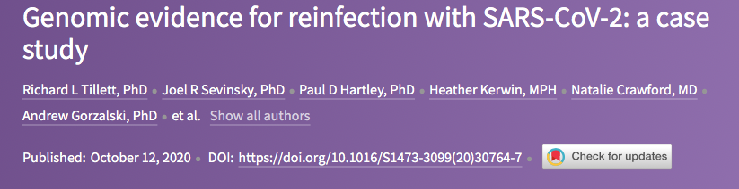
Probable Reinfection Documented

Slide 51
Synopsis
Scientists say they've discovered that a 25-year-old man in Nevada was infected with the novel coronavirus twice, marking the first confirmed case of coronavirus reinfection in the United States, according to a case study published Monday in The Lancet.
The patient first showed symptoms of Covid-19, the disease caused by the coronavirus, on March 25. His symptoms included a sore throat, cough, headache, nausea, and diarrhea. The man on April 18 underwent a reverse transcription polymerase chain reaction (RT-PCR) test for the novel coronavirus as part of a community testing event held by the Washoe County Health District. His test results were positive, and the man self-isolated.

Slide 52
Potential Reinfection (Continued)
The man's symptoms dissipated during isolation. The man reported feeling well from April 27 until May 28, and two "nucleic acid amplification tests" conducted after his symptoms had resolved came back negative for the novel coronavirus, according to the case study.
But on May 31, the patient sought care at an urgent care facility for a fever, headache, dizziness, cough, nausea, and diarrhea. Five days later, on June 5, the patient had low oxygen levels and was admitted to a hospital. While there, the man received a second RT-PCR test for the novel coronavirus, which again came back positive.
the patient's "second infection was symptomatically more severe than the first." For example, during his second infection, the patient "required ongoing oxygen support in hospital and reported symptoms that included myalgia, cough, and shortness of breath,

Slide 53
Potential Reinfection (Continued)
On June 6, the patient underwent a serological test to determine whether he had developed antibodies against the novel coronavirus, and the test showed that he had.
Likely source: his parent that he lived with
The researchers also performed genome sequencing on the strains of the novel coronavirus that were present in samples taken from the patient during each infection period. They determined that the viral strains were different enough that it was unlikely the man experienced "a case of continuous infection entailing deactivation and reactivation."

Slide 54
Questions this case raises:
How many patients have become infected twice?
How long does immunity last after infection?
[Does the] “immune response to the first infection [make]the disease symptoms worse instead of better?
those theories are “very speculative”
"It could be a one in a million event, we don't know," said Iwasaki. "It's possible that the vast majority of people are completely protected from reinfection, but we're not measuring them, because they're not coming to the hospital"

Slide 55
What Does This Mean for a Vaccine?
Iwasaki, however, said cases of reinfection have no bearing on potential coronavirus vaccines, because vaccines deliver a different type of immunity than the body. While the body's immune system can be hampered by proteins deployed by the novel coronavirus, the immune response produced by a vaccine is not as vulnerable to proteins, Iwasaki explained.
"The good thing about a vaccine is that it can induce much better immunity, a much longer lasting immunity, than the natural exposure to the virus"

Slide 56

Texas Demographics

Slide 57
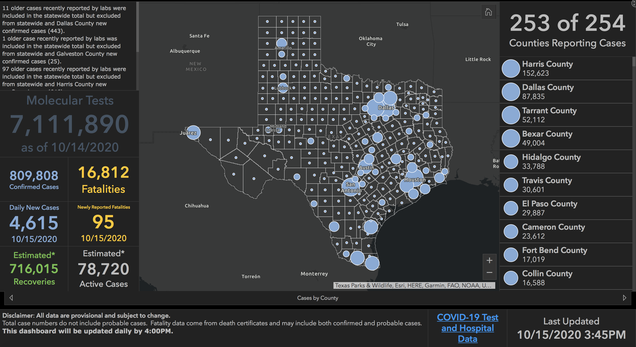

Slide 58
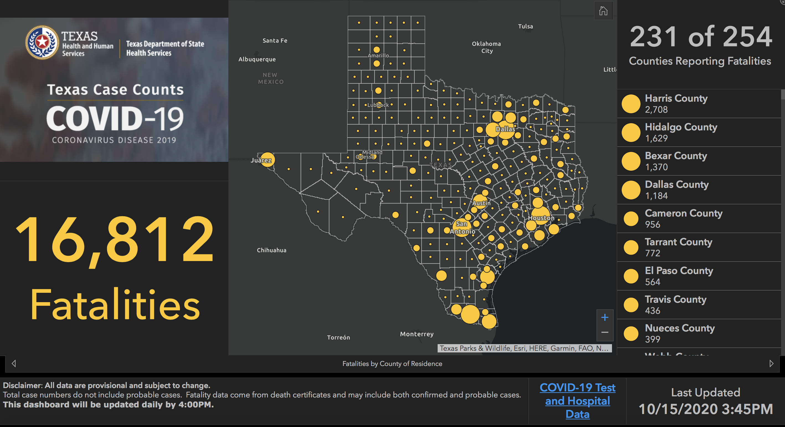

Slide 59
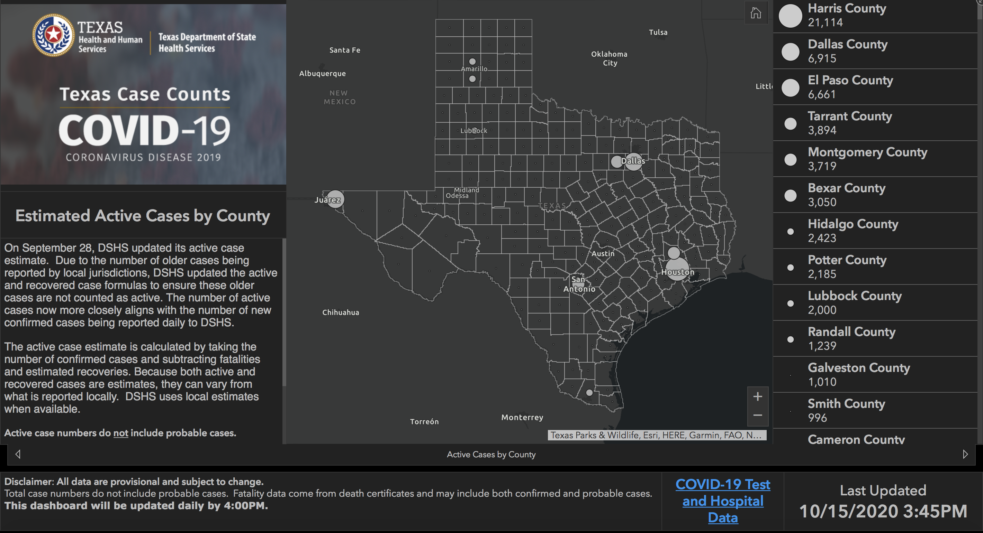

Slide 60
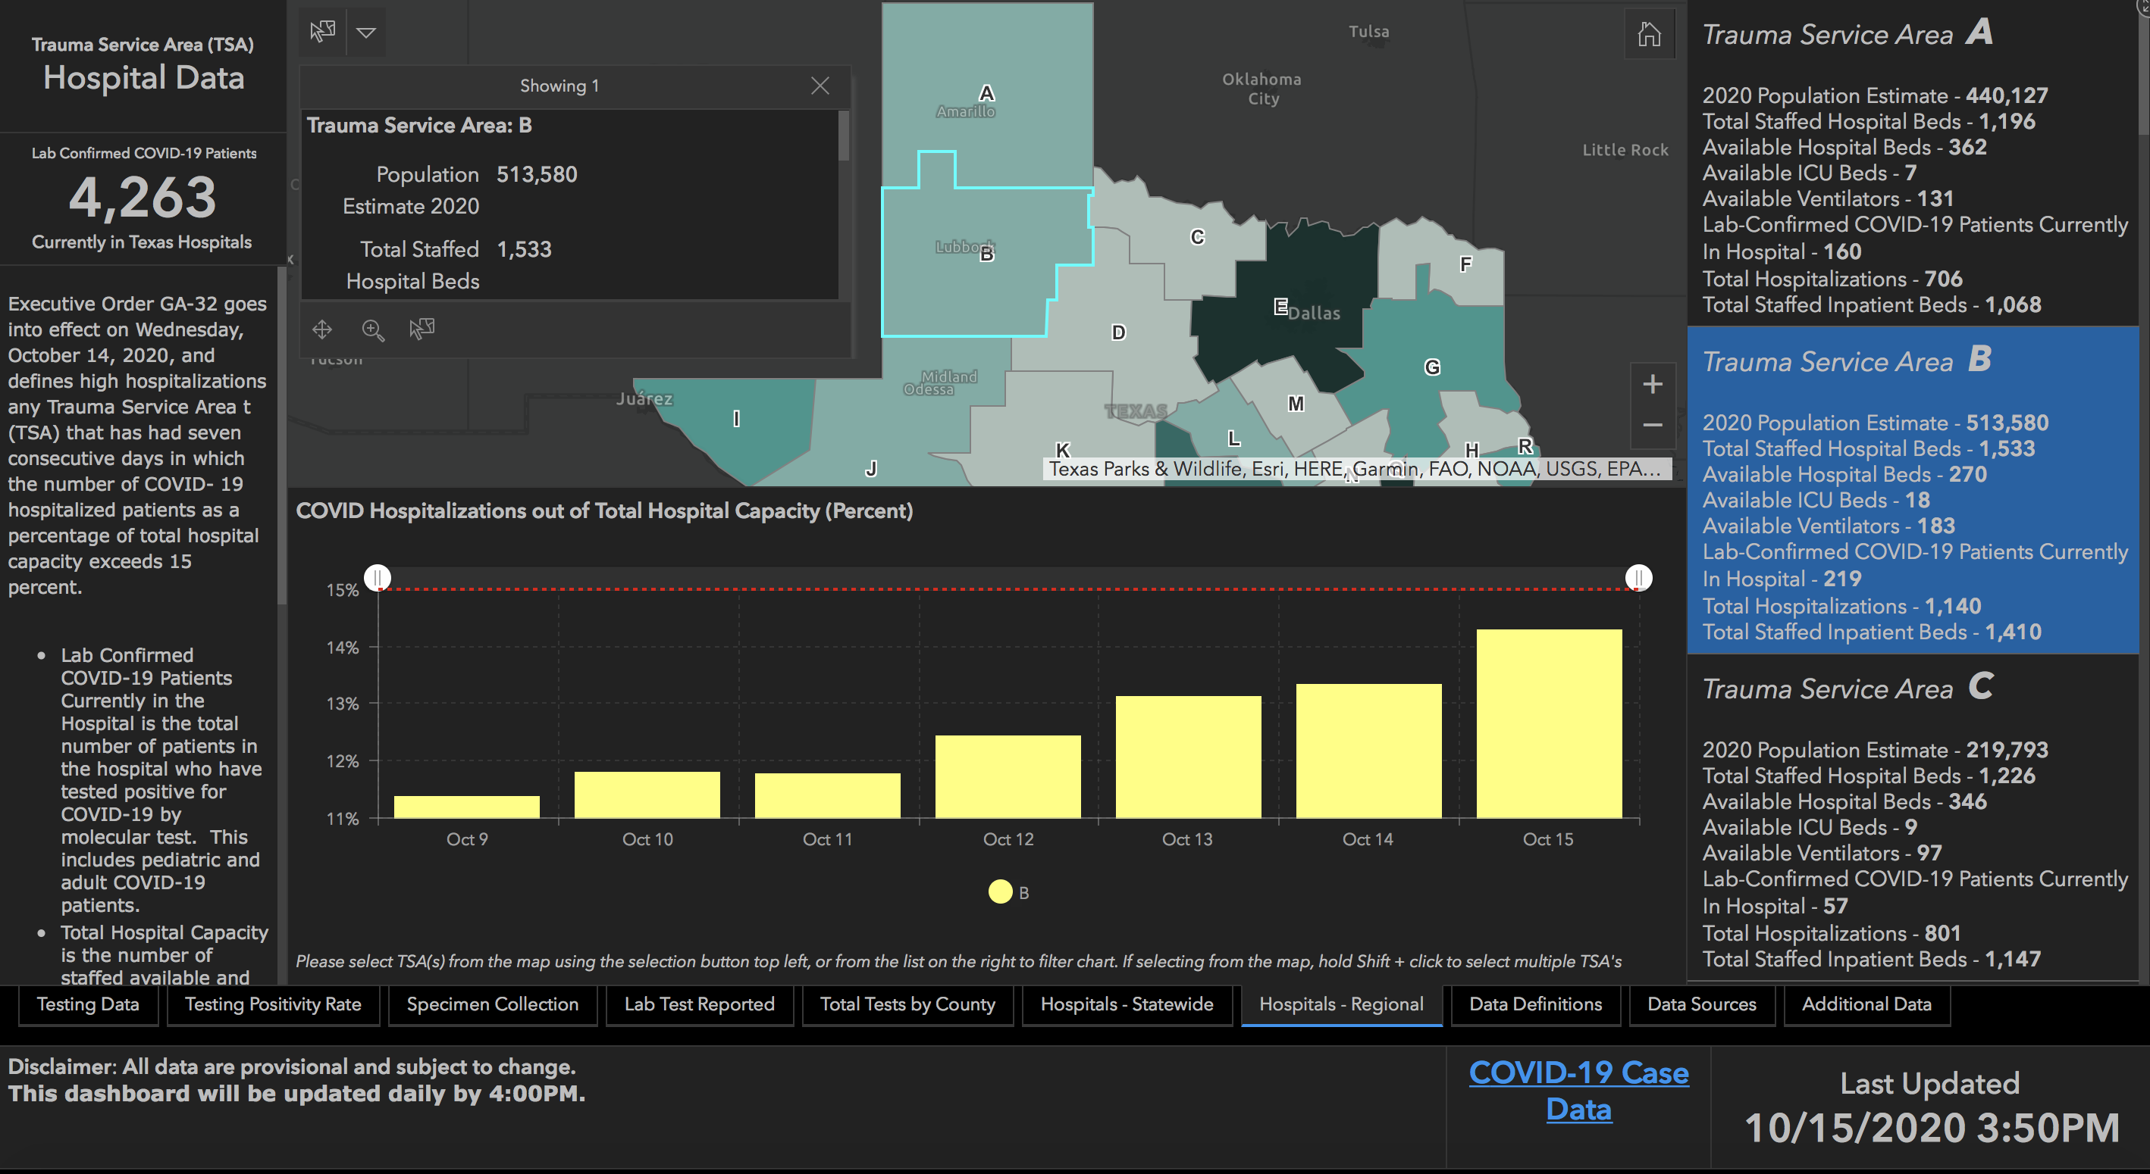
14.29%

Slide 61
New Mexico Demographics

Slide 62
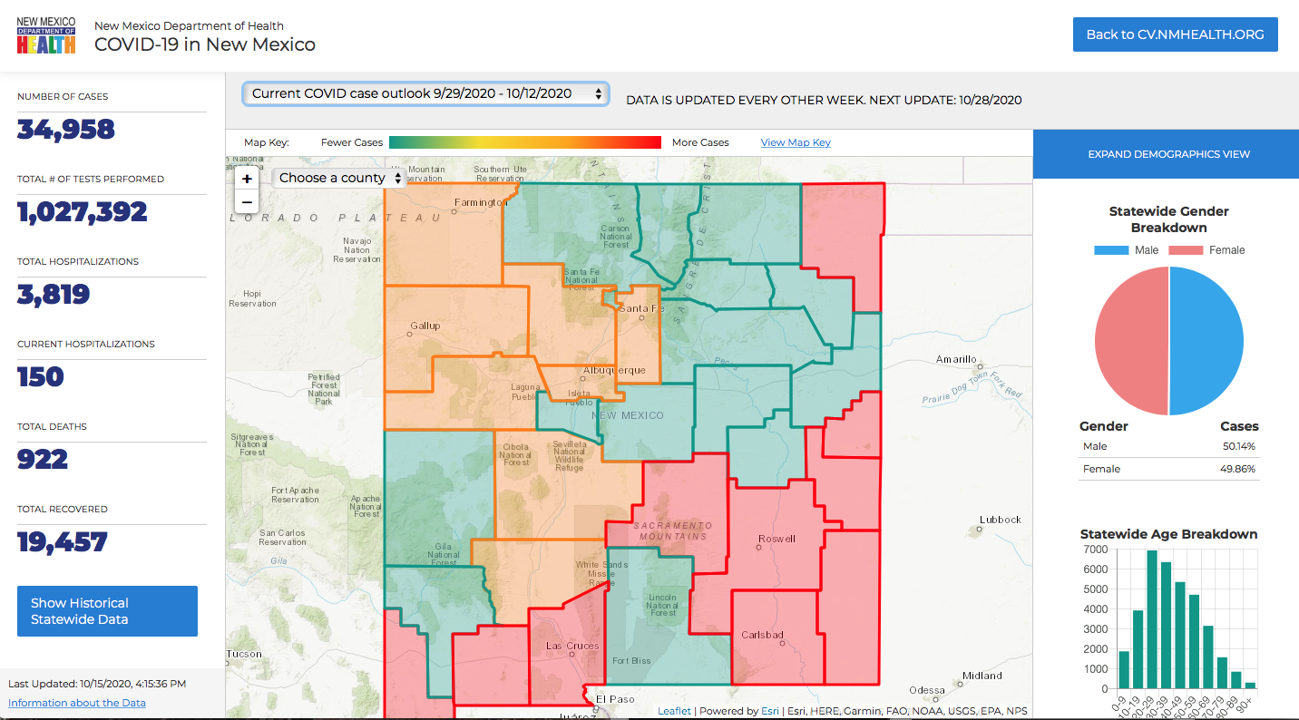

Slide 63
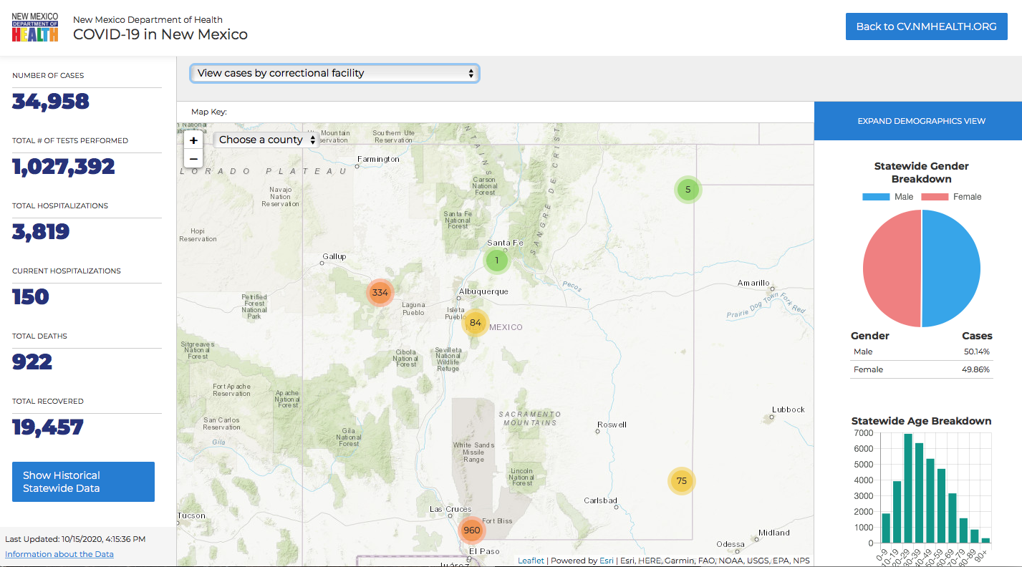

Slide 64
Governmental Affairs

Slide 65
Staffing Assistance From the State
On a call this week with DSHS, state officials indicated they are providing increased staff support to areas experiencing more significant upticks in hospitalizations, including Midland/Odessa, El Paso and Panhandle. Those placements continue to occur through STAR requests. The state also is working to build additional staffing capacity in the event hospitalizations continue to rise. The state is strongly encouraging hospitals in areas that have stabilized in terms of hospitalizations to release state-contracted staff so they can be prepared to shift to other areas as needed. DSHS indicated to THA it will continue to closely watch hospital data and will stay nimble and prepared to redeploy staff wherever they are needed most.

Slide 66
Statewide Huddle, Upward Trends
On a call this week with state leadership and Texas hospitals, DSHS Commissioner Dr. John Hellerstedt underscored the importance of prevention and behavioral choices that help protect people from COVID-19 and outlined that upticks are being detected in areas across the state. DSHS is reporting upswings in the panhandle, El Paso, Midland/Odessa, Dallas/Fort Worth and other areas of north Texas, and Dr. Hellerstedt noted that this trend likely will not stay isolated to only those areas of the state. Hospitals on the call enumerated potential challenges with critical care staffing and other staffing needs as hospitalizations increase, and there is a level of concern about the potential for another suspension of non-essential services. Hospitals in general reported steady supplies of blood, PPE and test kits at this time. On the call, there was discussion about the increases in hospitalizations possibly being linked to “COVID-19 fatigue” and gatherings related to sports and other fall activities. THA and state health officials are encouraging the public to continue prioritizing prevention measures through the flu season and various fall activities. THA is developing new messaging to remind Texans not to let their guard down.

Slide 67
Let the Rumors Begin…

Slide 68


Slide 69
Q & A

Slide 70
CME Credit was only approved for the Live Teams meeting
To receive credit for this continuing education activity, the participant must:
  Make sure you are logged into your Teams account, if you are signed in with a group provide attendee’s First and Last name(s) in the comments section.
  If you are calling into the Teams meeting you MUST text your First & Last Name to (806) 252-4735. This will ensure you are added to the sign in sheet to receive CME Credit.
  You will receive an email within 3 business days from the CME department with further instructions on claiming your certificate.

