Slide 1
Covenant Health
Presents
Critical Communications: A Weekly Physician Update
October 2, 2020

Slide 2
PHYSICIANS
Accreditation Statement:
The Covenant Health is accredited by the Texas Medical Association (TMA) to provide continuing medical education for physicians.
Credit Designation Statement:
The Covenant Health designates this live CME activity for a maximum of 1.0 AMA PRA Category 1 Credit(s)™. Physicians should claim only the credit commensurate with the extent of their participation in the activity.

Slide 3
Disclosures of Commercial Interest
The speakers and planners of this activity
have no relevant financial interests

Slide 4
Disclosures
This activity is provided by
Covenant Health
No commercial support has been received.
No products will be endorsed.
Speakers will notify the audience if off label drug use will be discussed.

Slide 5
CME Credit was only approved for the Live Teams meeting
To receive credit for this continuing education activity, the participant must:
  Make sure you are logged into your Teams account, if you are signed in with a group provide attendee’s First and Last name(s) in the comments section.
  If you are calling into the Teams meeting you MUST text your First & Last Name to (806) 252-4735. This will ensure you are added to the sign in sheet to receive CME Credit.
  You will receive an email within 3 business days from the CME department with further instructions on claiming your certificate.

Slide 6

Reflection
Mac Davis
Jan 21, 1942 - Sept. 29, 2020
Brian Schroeder

Slide 7

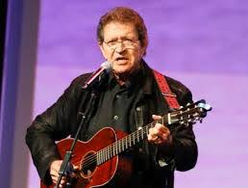
Born in Lubbock, TX; graduated from Lubbock High
Saw Buddy Holly perform locally, decided to pursue show business
Hosted primetime variety show
from 1974-1976
Star on Hollywood Walk of Fame
Recorded 19 studio albums
Of his 38 singles, 30 charted on the U.S. Billboard Hot Country Songs charts between 1970 and 1986
Wrote four hits for Elvis Presley, including “A little Less Conversation” From Ocean’s Eleven
Other artists to record his work include Nancy Sinatra, Dolly Parton, Kenny Rogers…
Weezer & Bruno Mars

Slide 8
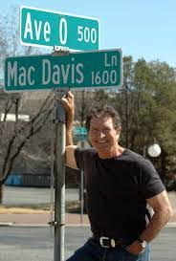
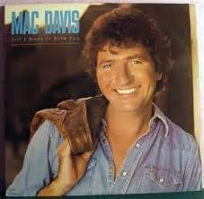
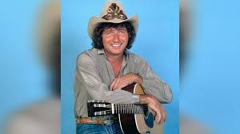
Hey mister, Where you goin’ in such a hurry?
Don’t you think it’s time you realize
There’s a whole lot more to life than work and worry
All the sweetest things in life are free
And they’re right before your eyes?
You’ve got to stop and smell the roses
You’ve got to count your many blessings every day
You’re gonna find your way to heaven is a rough & rocky road
If you don’t stop & smell the roses along the way

Slide 9
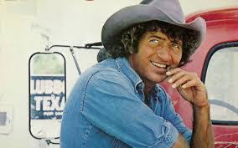
And when I die
You can bury me
In Lubbock Texas
In my jeans

Slide 10
Safety Story
Brian Williams, MD
Pulmonary Associates

Slide 12
Current Regional Covid-19 Census

Slide 13
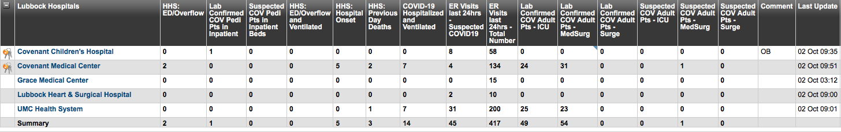
Regional
 | Lubbock |  | TTU |  | Hockley |  | Hale
 | 9/28 | 9/30 | 9/28 | 9/30 | 9/15 |  | 9/25 | 9/29
Total | 11,764 | 12,139 | 1643 | 1689 | 307 |  | 1880 | 1919
Active | 2689 | 2278 | 222 | 260 | 54 |  | 103 | 100
Deaths | 128 | 129 | 0 | 0 | 7 |  | 58 | 58
New | 375 |  | 46 |  |  |  | 39
9/28: 99 Hospitalized in Lubbock – 14 on vents 9/30: 98 Hospitalized in Lubbock – 14 on vents

Slide 14
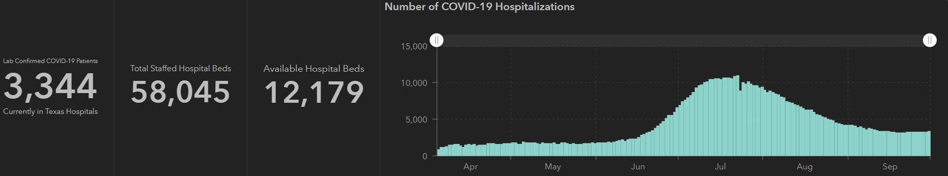
STATE
 | 10/1 | 9/28 | 9/23 | 9/16 | 9/9 | 8/26 | 8/12 | 7/29 | 7/15 | 7/1
Cases | 748,967 | 739,743 | 719,599 | 674,772 | 645,791 | 592,137 | 506,820 | 403,307 | 282,365 | 168,062
Deaths | 15,711 | 15,533 | 15,129 | 14,478 | 13,692 | 11,805 | 9034 | 6190 | 3432 | 2481
Hospitalized | 3,344 | 3,201 | 3,195 | 3249 | 3604 | 4806 | 7028 | 9595 | 10,471 | 6904

Slide 15
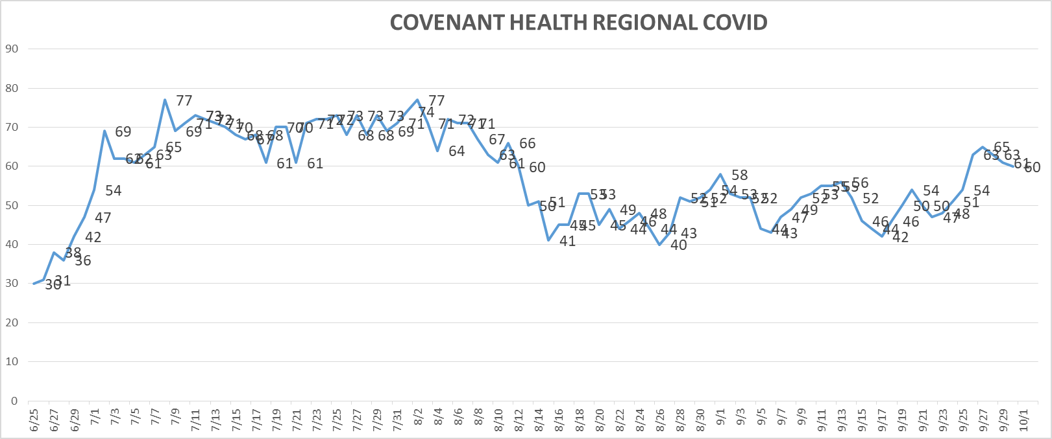
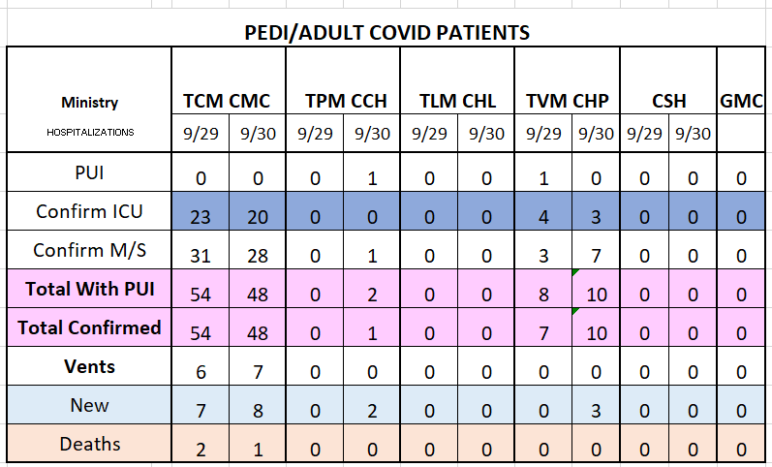
PUI/Confirmed cases-hospitalized
9/30/2020

Slide 16
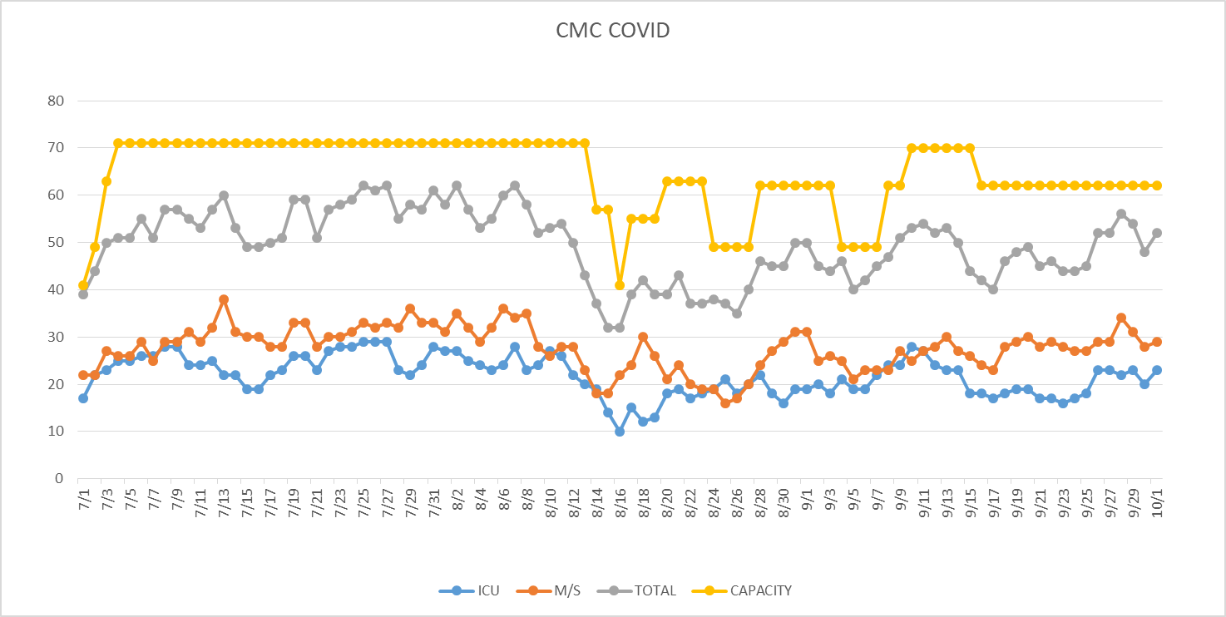
PUI/Confirmed cases-hospitalized
10/1/2020

Slide 17
Surge Plan
Covenant Medical Center
 | ICU | Med Surg | Total
Phase 1 | 10-CICU |  | 10
Phase 2 | 17-CICU | 10-HC4 | 27
Phase 3 | 17-CICU | 24-HC4 | 41
Phase 4 | 17-CICU 8-MICU | 24-HC4 14-Pal Med | 63
Phase 5 | 17-CICU 16-MICU | 24-HC4 14-Pal Med | 71
Phase 6 | 17-CICU 16-MICU 8- SICU 4 (east) | 24-HC4 14-Pal Med 15 – S 9 (east) | 94
Last Week
Currently

Slide 18
Statistics
Sean Glenn
Senior Clinical Data Analyst
Decision Support Services
Covenant Health

Slide 19
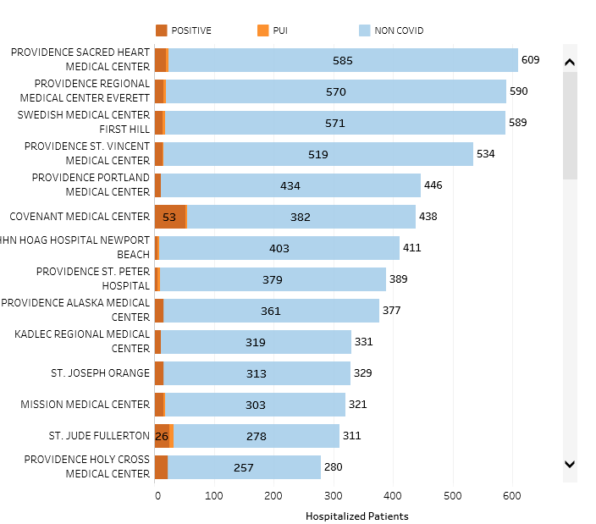
Providence System Hospitalized COVID-19 Cases

Slide 20
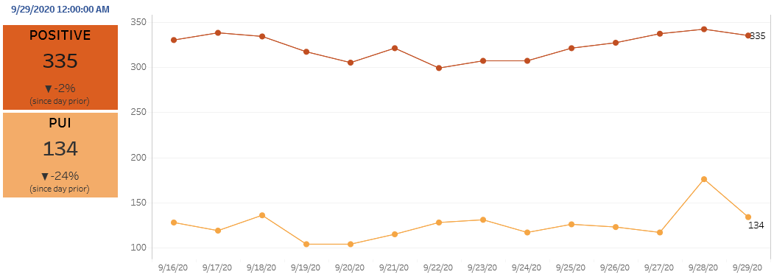
Providence Inpatient COVID-19 Volume

Slide 21
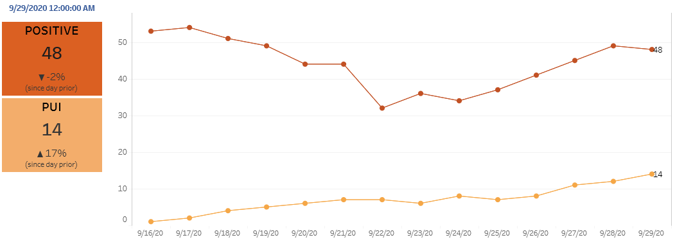
Texas Inpatient COVID-19 Volume

Slide 22

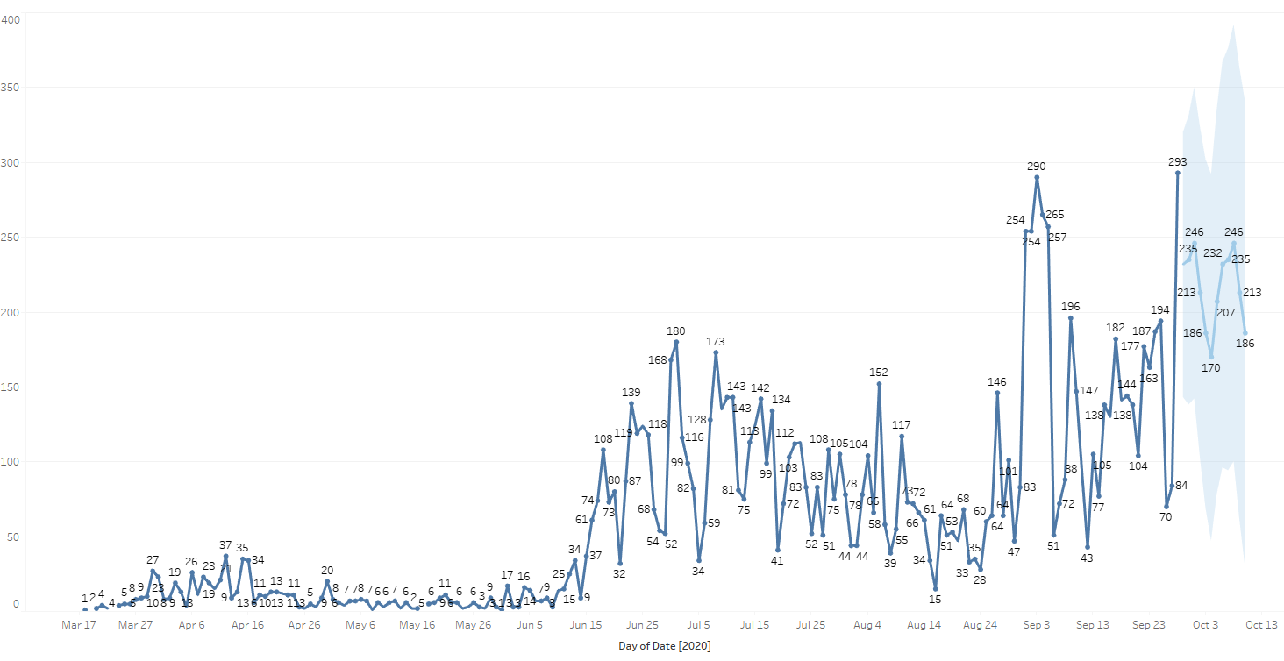
New Covid-19 POSITIVES by Day Trend

Slide 23
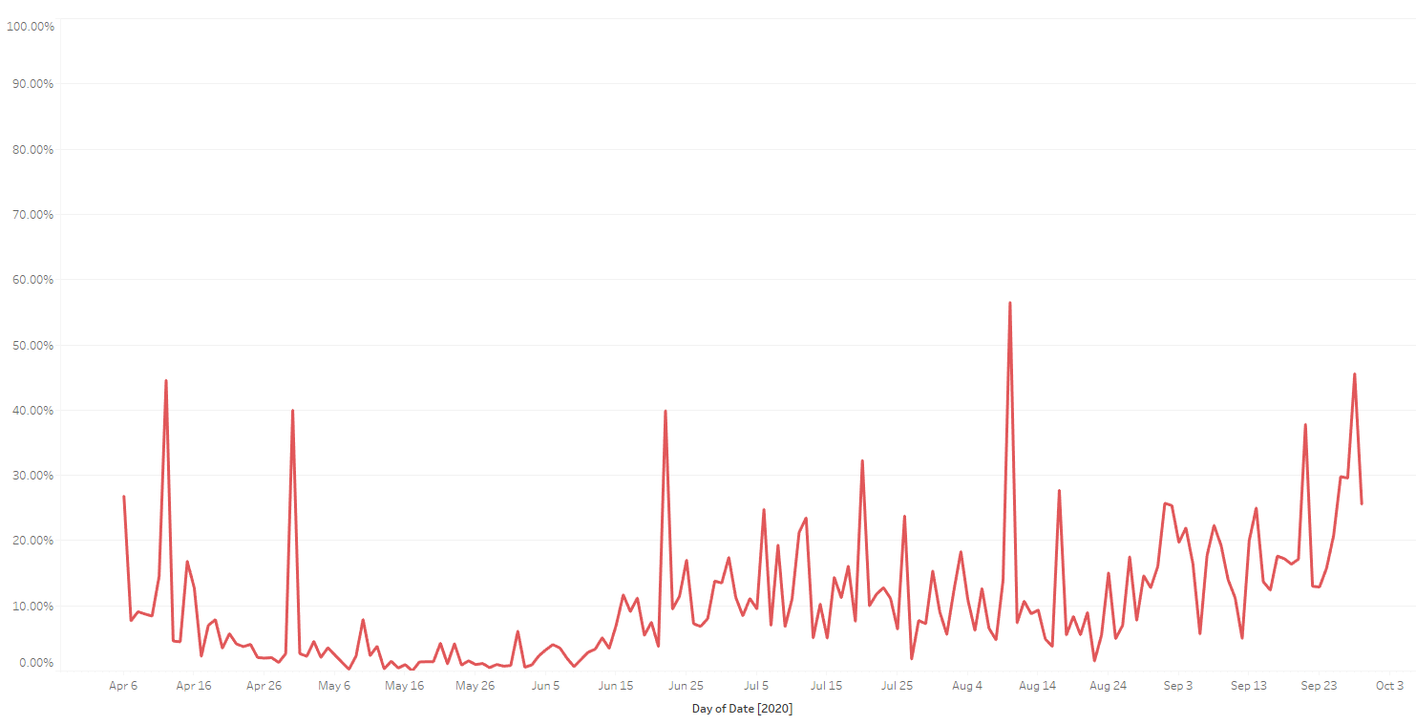

Covid-19 Daily Positive Rate

Slide 24
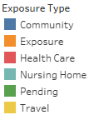
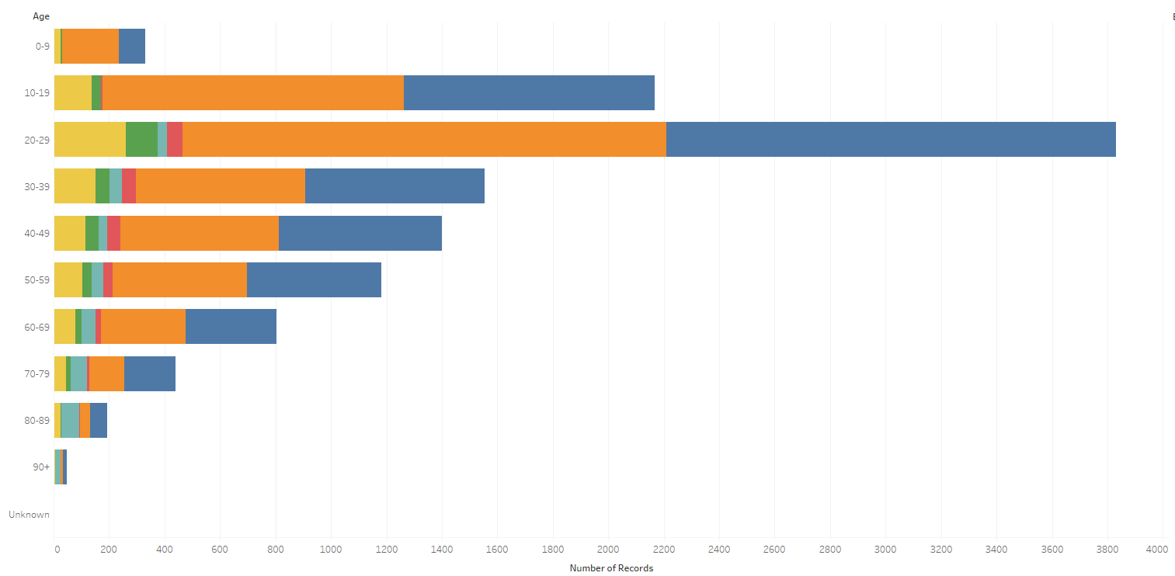
Covid-19 POSITIVES Age Distribution

Slide 25
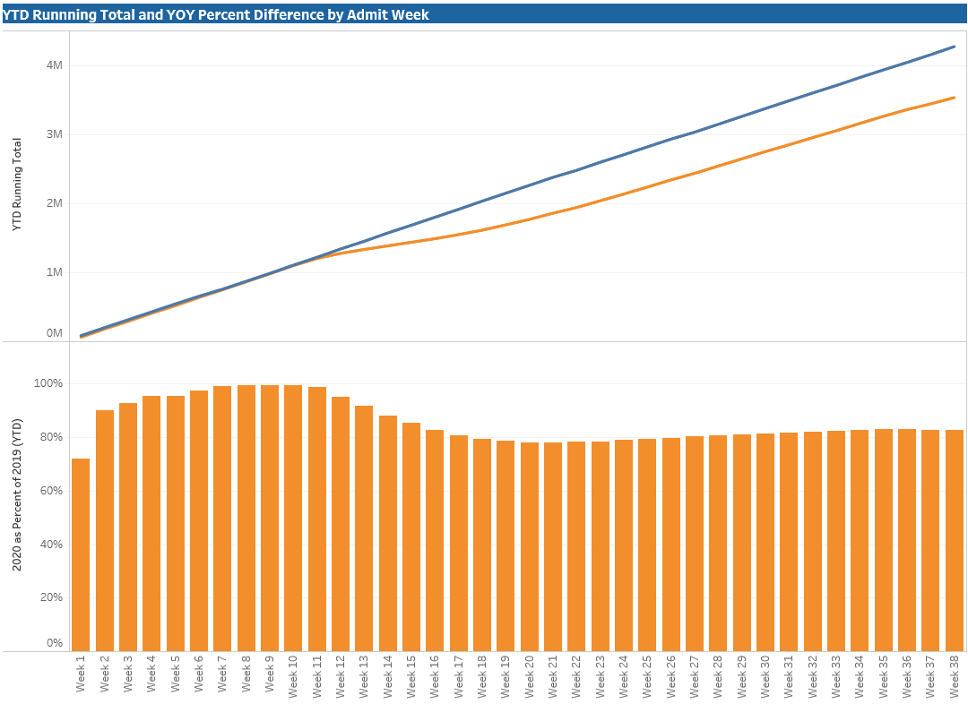

TX/NM Region Weekly Procedures (YOY)

Slide 26
Caregivers

Slide 27
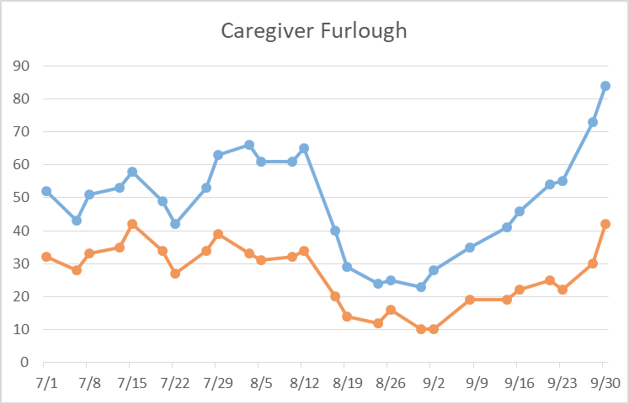
Caregivers
COVID Related Furloughs
Count reflects # furlough (exposed and positive)
Good
Moderate
Critical

Slide 28
Caregivers
Testing Our Heroes (antibody testing)
  Start October 19 (IF all barriers to collection of samples and reporting of results can be accomplished)
  Ordered additional blood collection tubes
  All tests will be processed and performed at CMC
  Caregivers must register on-line
    PRIOR to the blood collection
    AND with Follow My Health to get results of testing

Slide 29
Caregivers
Respiratory Therapists
  2 applications received
  Being reviewed daily by HR
Statewide shortages with agency staff

Slide 30
Covid-19 Testing

Slide 31
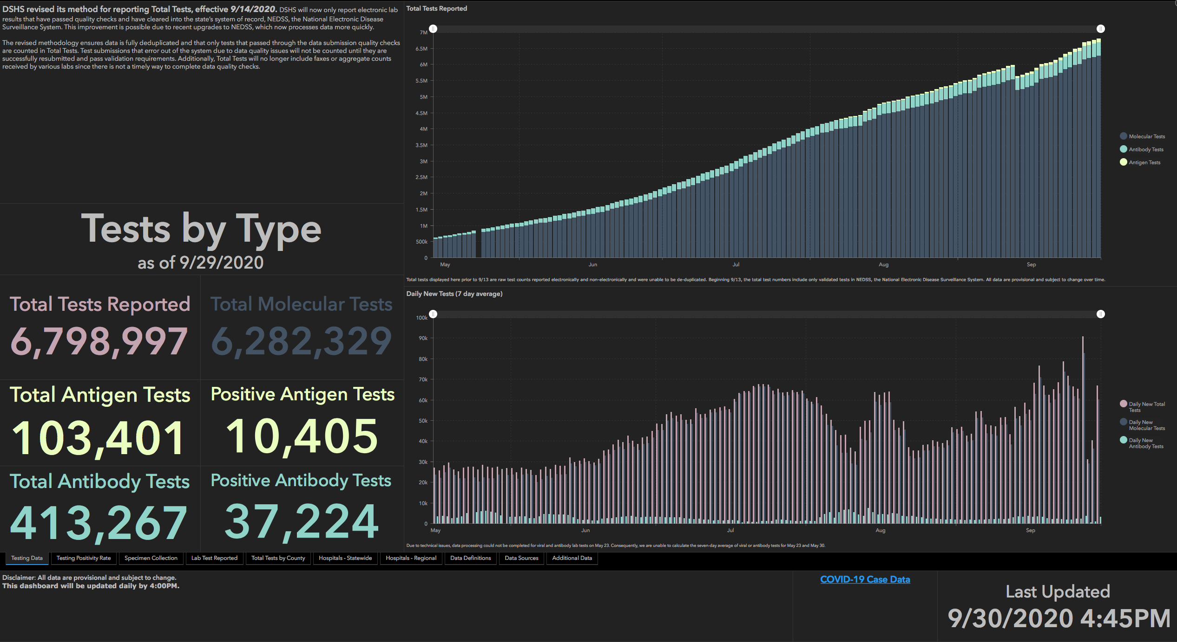

Slide 32
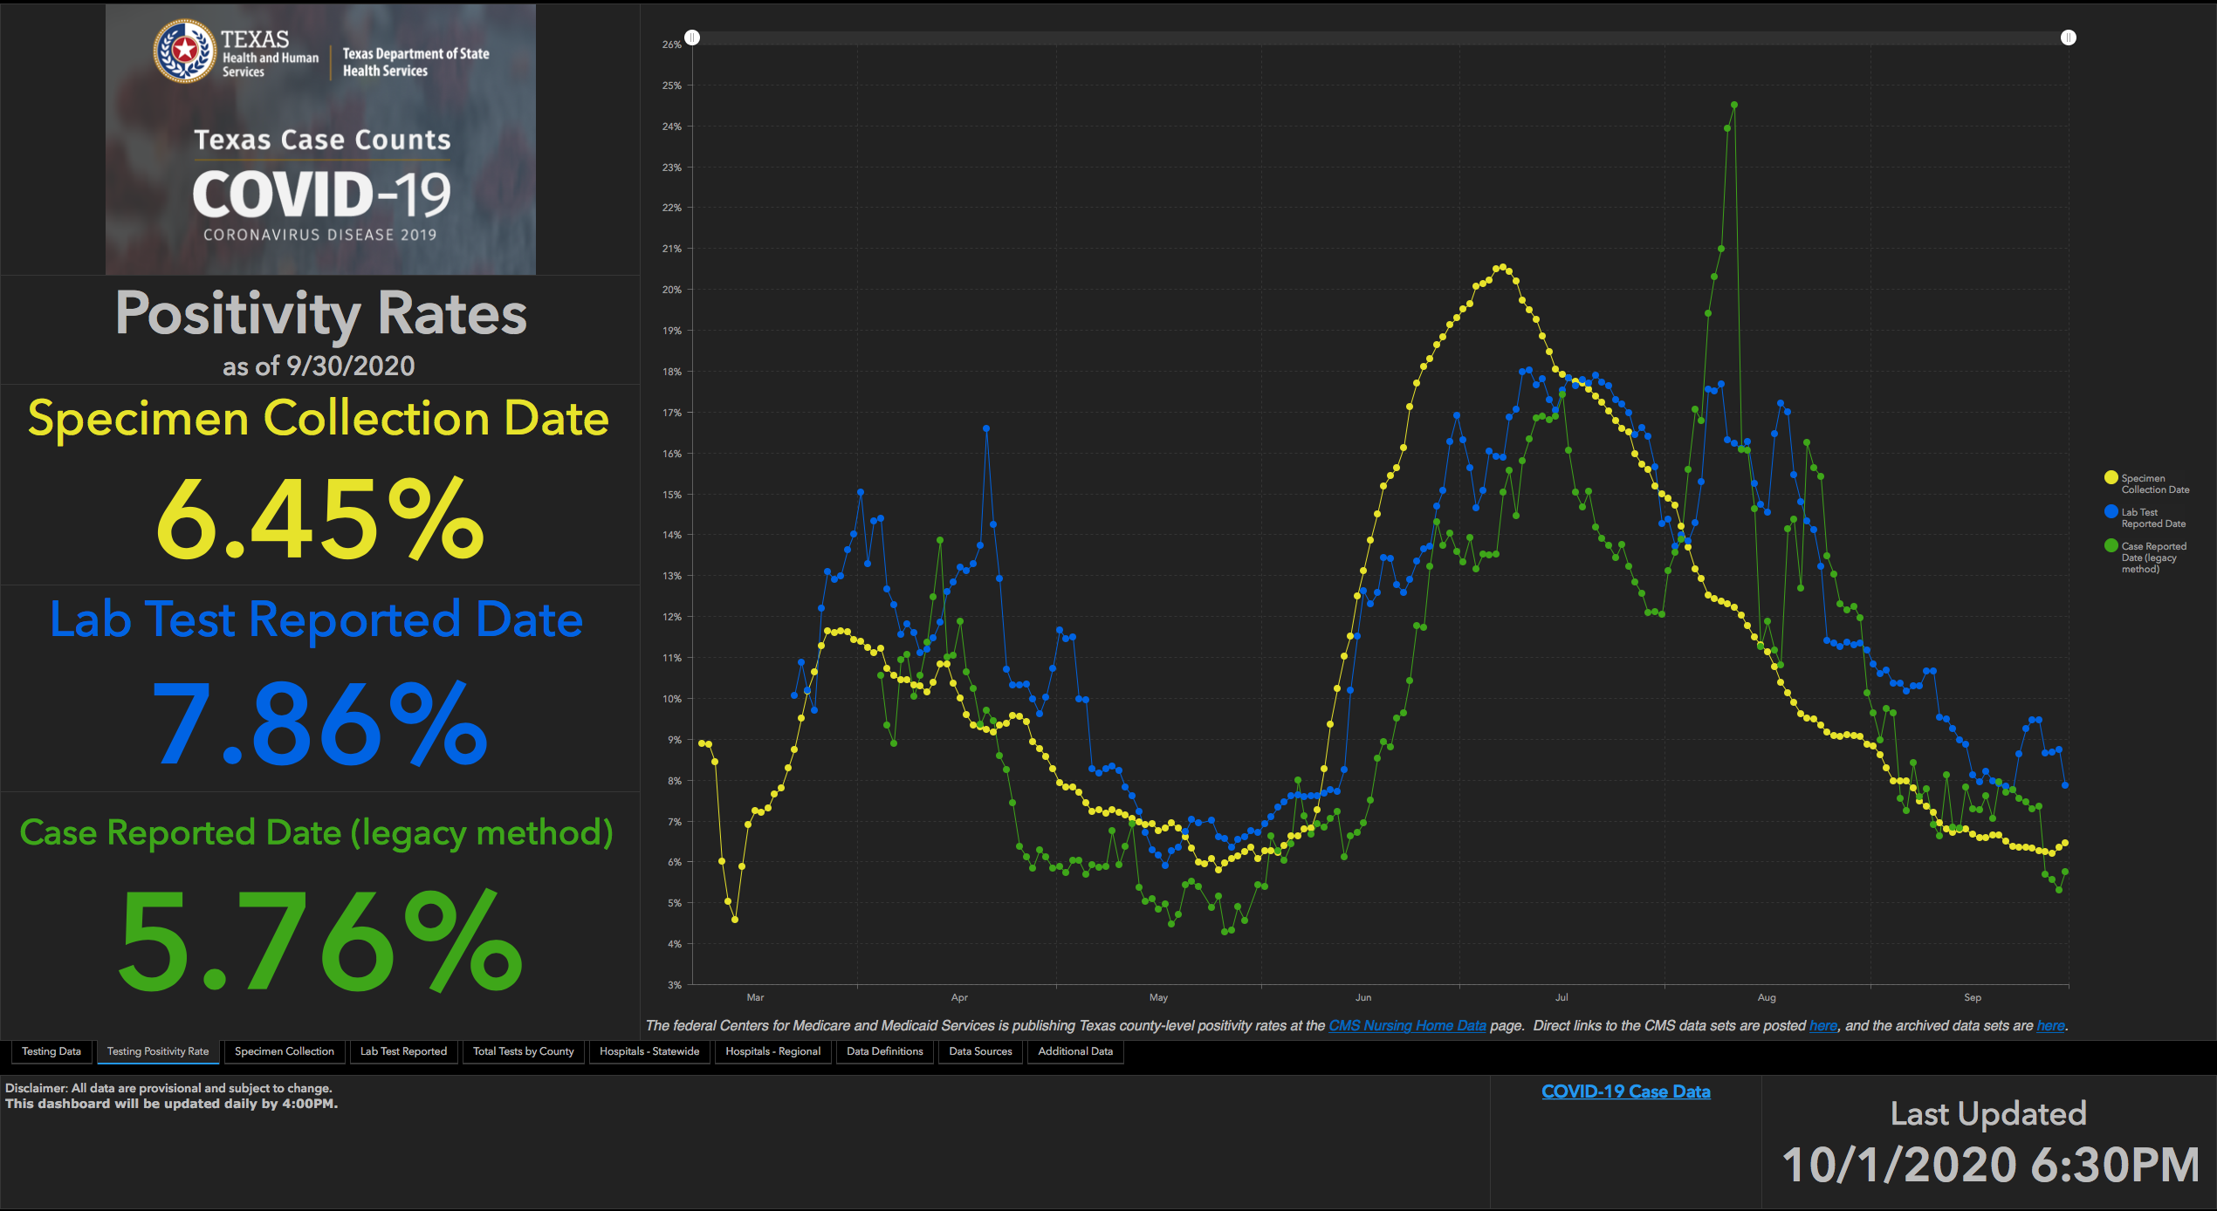

Slide 33
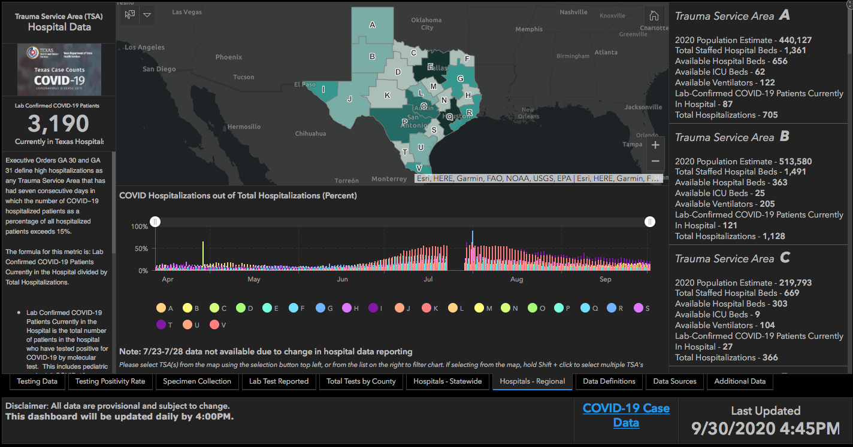
All Texas RACs

Slide 34
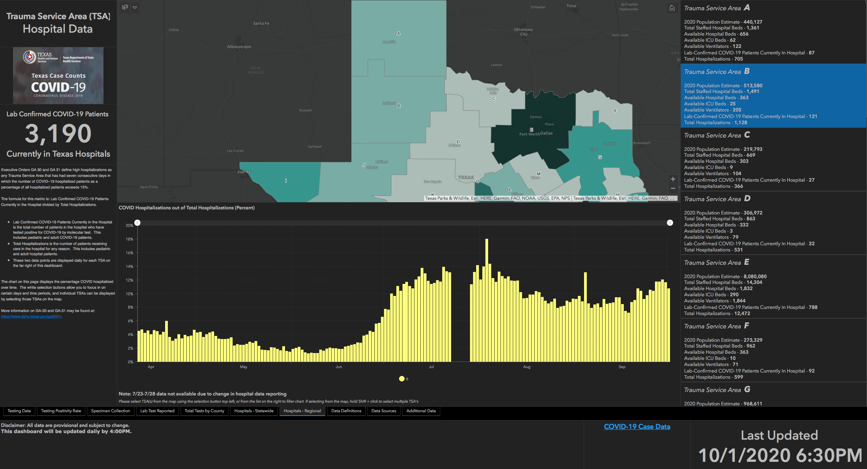
B-RAC Only

Slide 35
TESTING
 | CMC | GMC | CMG
Test Kits
Swabs
VTM
 | CMC |  | GMG/CMG
 | Tests | + | Tests | +
9/28 | 242 | 26 | 22 | 4
9/29 | 347 | 42 | 165 | 27
9/30 | 394 | 47 | 158 | 34
>2000 >750
<2000 <750
<1600 <500
Grace- Continue receive an allotment of BD Kits
CMG- Received their allocation with Abbotts

Slide 36
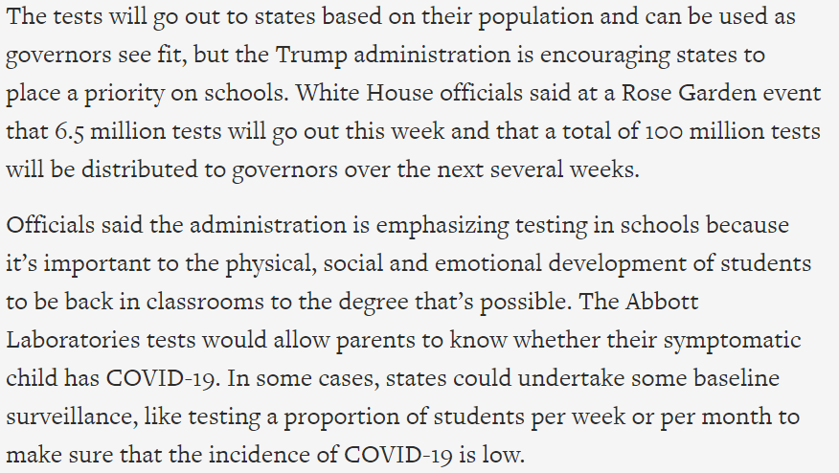
TESTING
Feds to send millions of tests to governors in the next several weeks.
THA call – hospitals voicing concerns with school performing the tests – recommending to DSHS to utilize hospitals – controls reporting and appropriate use of tests

Slide 37

SARS-CoV-2 Reference Panel Comparative Data
NAAT Detectable Units per ml
1800 | Becton, Dickinson & Company (BD) | BioGX SARS-CoV-2 Reagents for BD MAX System
1800 | Quest Diagnostics Infectious Disease, Inc. | Quest SARS-CoV-2 rRT-PCR
5400 | Abbott Molecular | Abbott RealTime SARS-CoV-2 assay
5400 | Cepheid | Xpert Xpress SARS-CoV-2 test
5400 | Becton, Dickinson & Company | BD SARS-CoV-2 Reagents for BD MAX System¹
5700 | Centers for Disease Control and Prevention (CDC) | Influenza SARS-CoV-2 (Flu SC2) Multiplex Assay
18000 | Centers for Disease Control and Prevention (CDC) | CDC 2019-nCoV Real-Time RT-PCR Diagnostic Panel (CDC)
180000 | Laboratory Corporation of America (LabCorp) | COVID-19 RT-PCR Test
300000 | Abbott Diagnostics Scarborough, Inc. | ID NOW COVID-19

Slide 38
Communications Update

Slide 39

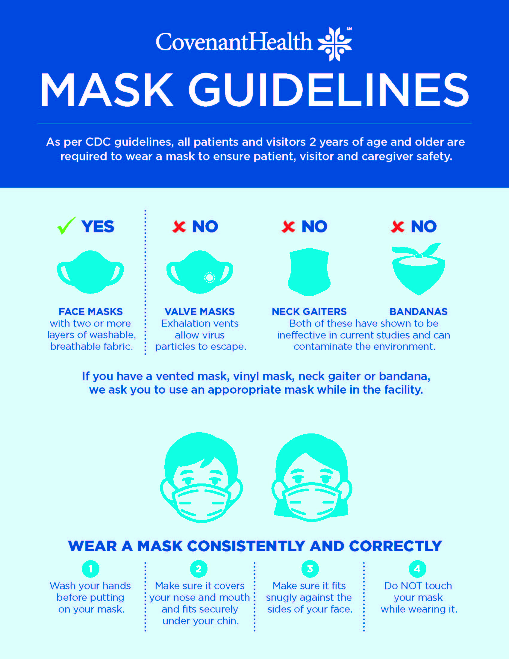
SIGNAGE – patient and visitors
Signage received and sent to Grace, Specialty, CMG and Plainview
Children’s should be in today
CMC ordered yesterday

Slide 40
AGP and N-95
Revisions to Aerosol Generating Procedures
Identifying areas that will need n-95 masks
  Nursing
  EVS
  Therapies
  RT
  Dialysis
  Transportation
  Additional being assessed
Signs arrived – delivered last request to CCH, being picked up by CMC, Who else needs some?
**NOTE: place level 1 mask on patients that are using nasal cannulas.

Slide 41
Aerosol Generating Procedures and N-95 Masks
 | COVID Unit | Isolation Room Non-COVID | Aerosol Generating Procedure Non-COVID
N-95 | YES Wear while on unit; discard at end of day when leaving unit | ONLY IF AIRBORNE ISOLATION Discard when leaving the isolation room | YES Wear with face shield Reprocess at end of day
LEVEL 2 MASK | NO – use n-95 with face shield or CAPR/PAPR | DROPLET OR CONTACT ISOLATION Wear with face shield Discard when leaving the isolation room | NO – use n-95 with face shield

Slide 42
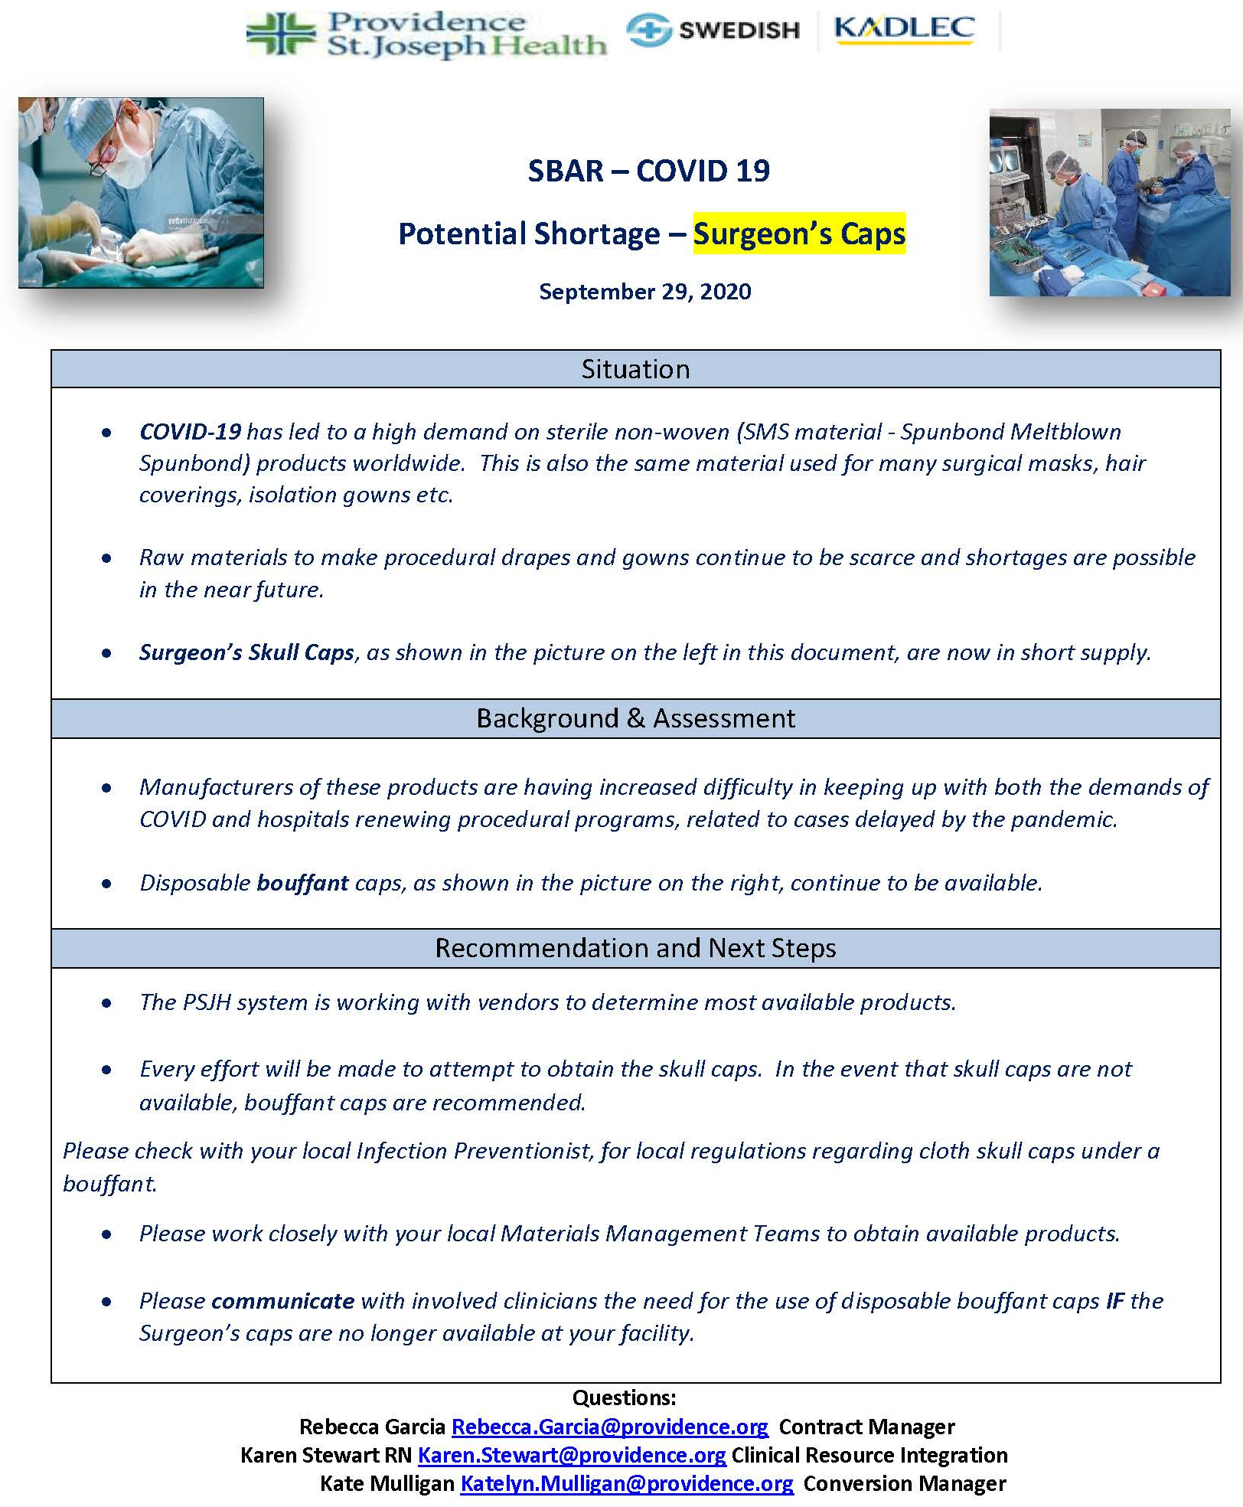

Critical Inventory
SBAR – Surgeon’s Caps Potential Shortage

Slide 43

Covid-19

Slide 44
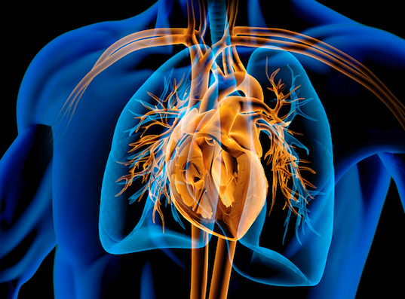
Can COVID-19 affect your heart?
Two new studies show that COVID-19 may cause lasting effects on the heart, even in people who didn't need hospitalization.
While the studies were small, they showed that people who recovered from COVID-19 had structural changes to their hearts.
Two-thirds of the patients studied had a biomarker that usually indicates stress on the heart.
The heart changes seemed to affect otherwise healthy people.
Researchers found that 61% of the patients [who died with Covid-19] had evidence of COVID-19 in their heart tissue. (autopsy findings)

Slide 45
Heart Effects?
“What these studies show is that the heart can be affected by the virus, but the near-term or long-term consequences of that are unknown, particularly in people who are asymptomatic,” says Tyler Gluckman, MD, FACC, a cardiologist at Providence St. Vincent Heart Clinic is Portland, OR. “We need science and time to better understand what the prevalence of this is and what the overall impact will be.”

Slide 46
Separation Anxiety in the Pandemic

Slide 47
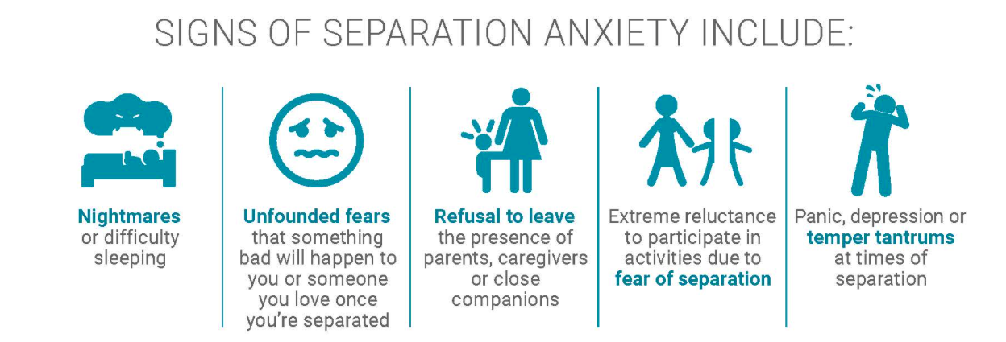
Separation Anxiety?

Slide 48
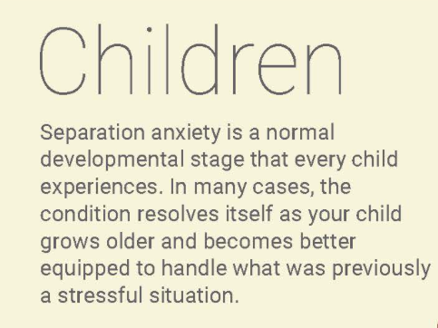
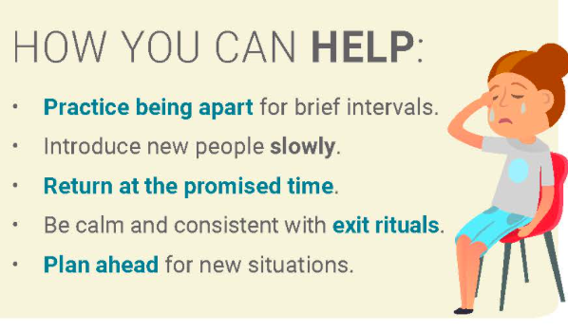
Separation Anxiety in Children

Slide 49
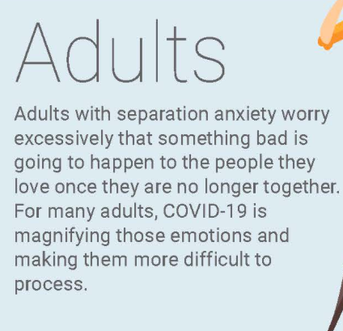
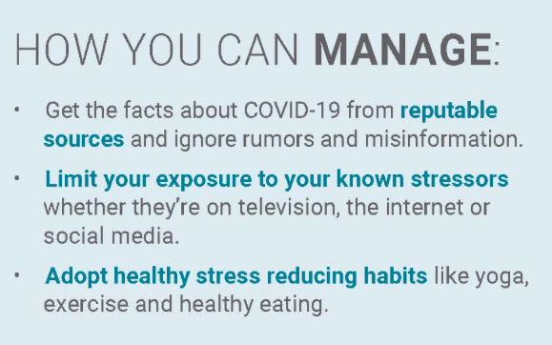
How about the Adults?

Slide 50
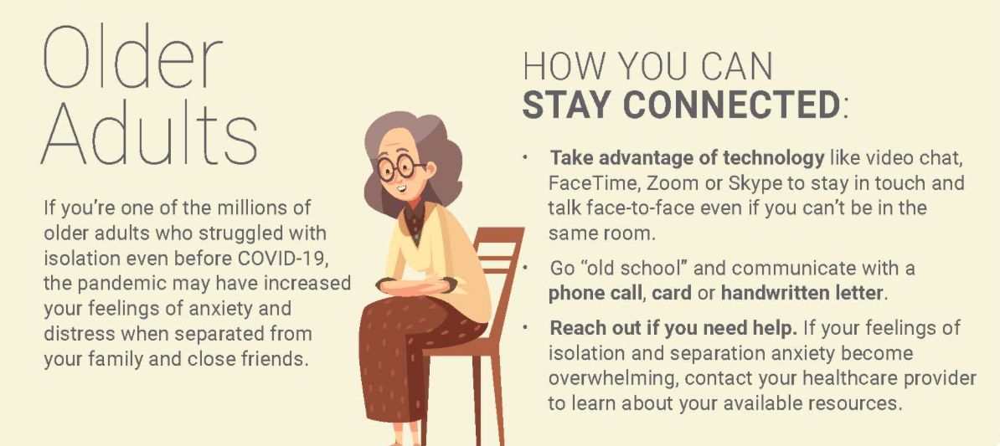
Geriatrics

Slide 51
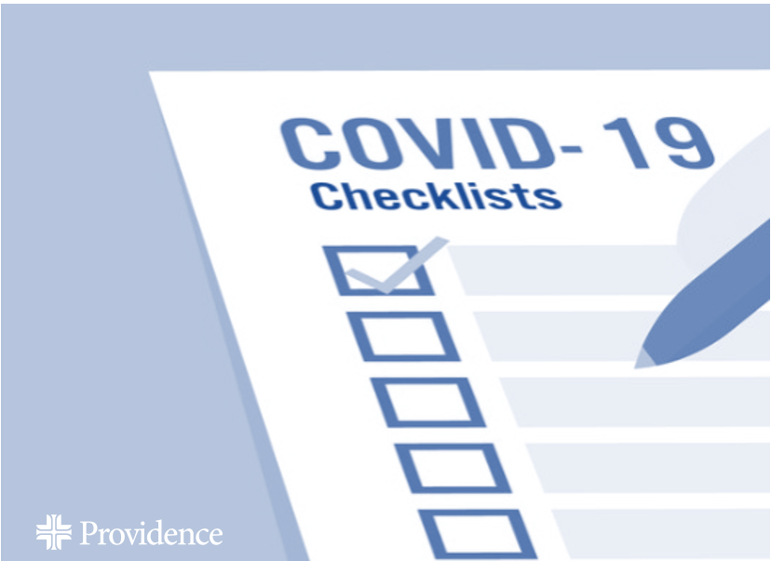
Ramping up for Round II of COVID-19:
10 Key Lessons

Slide 52
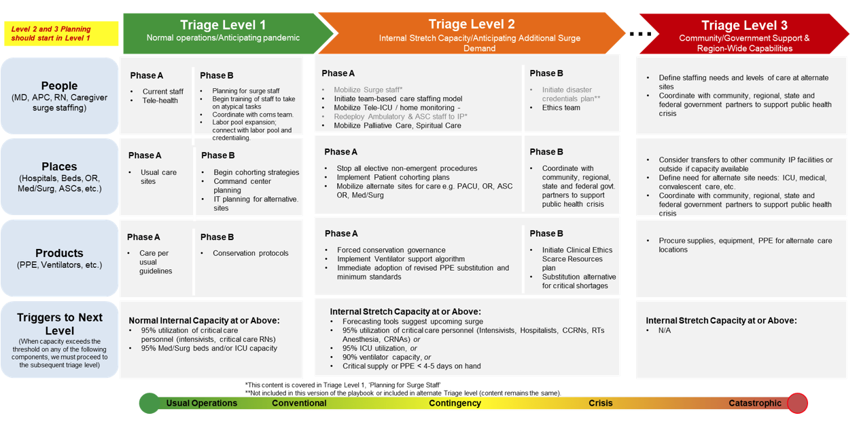

Slide 53

Texas Demographics

Slide 54
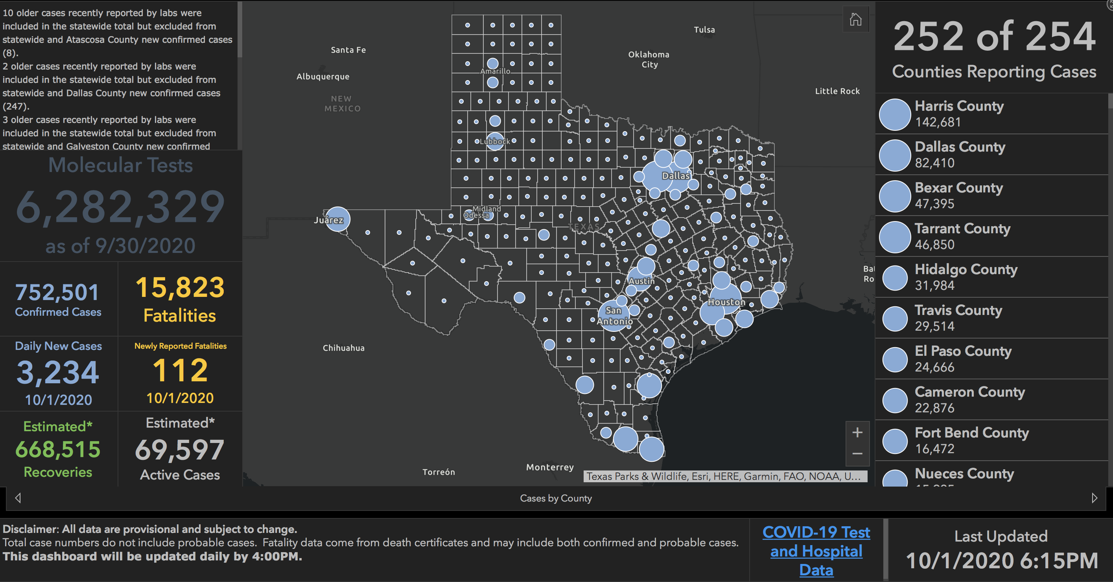

Slide 55
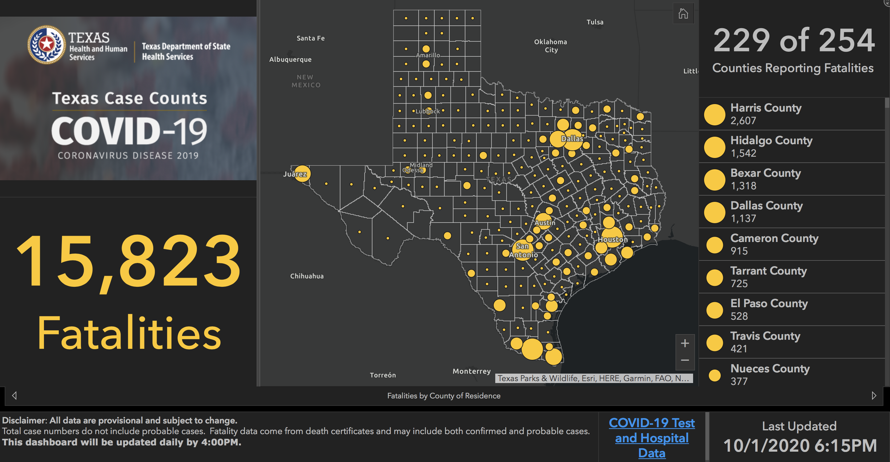

Slide 56
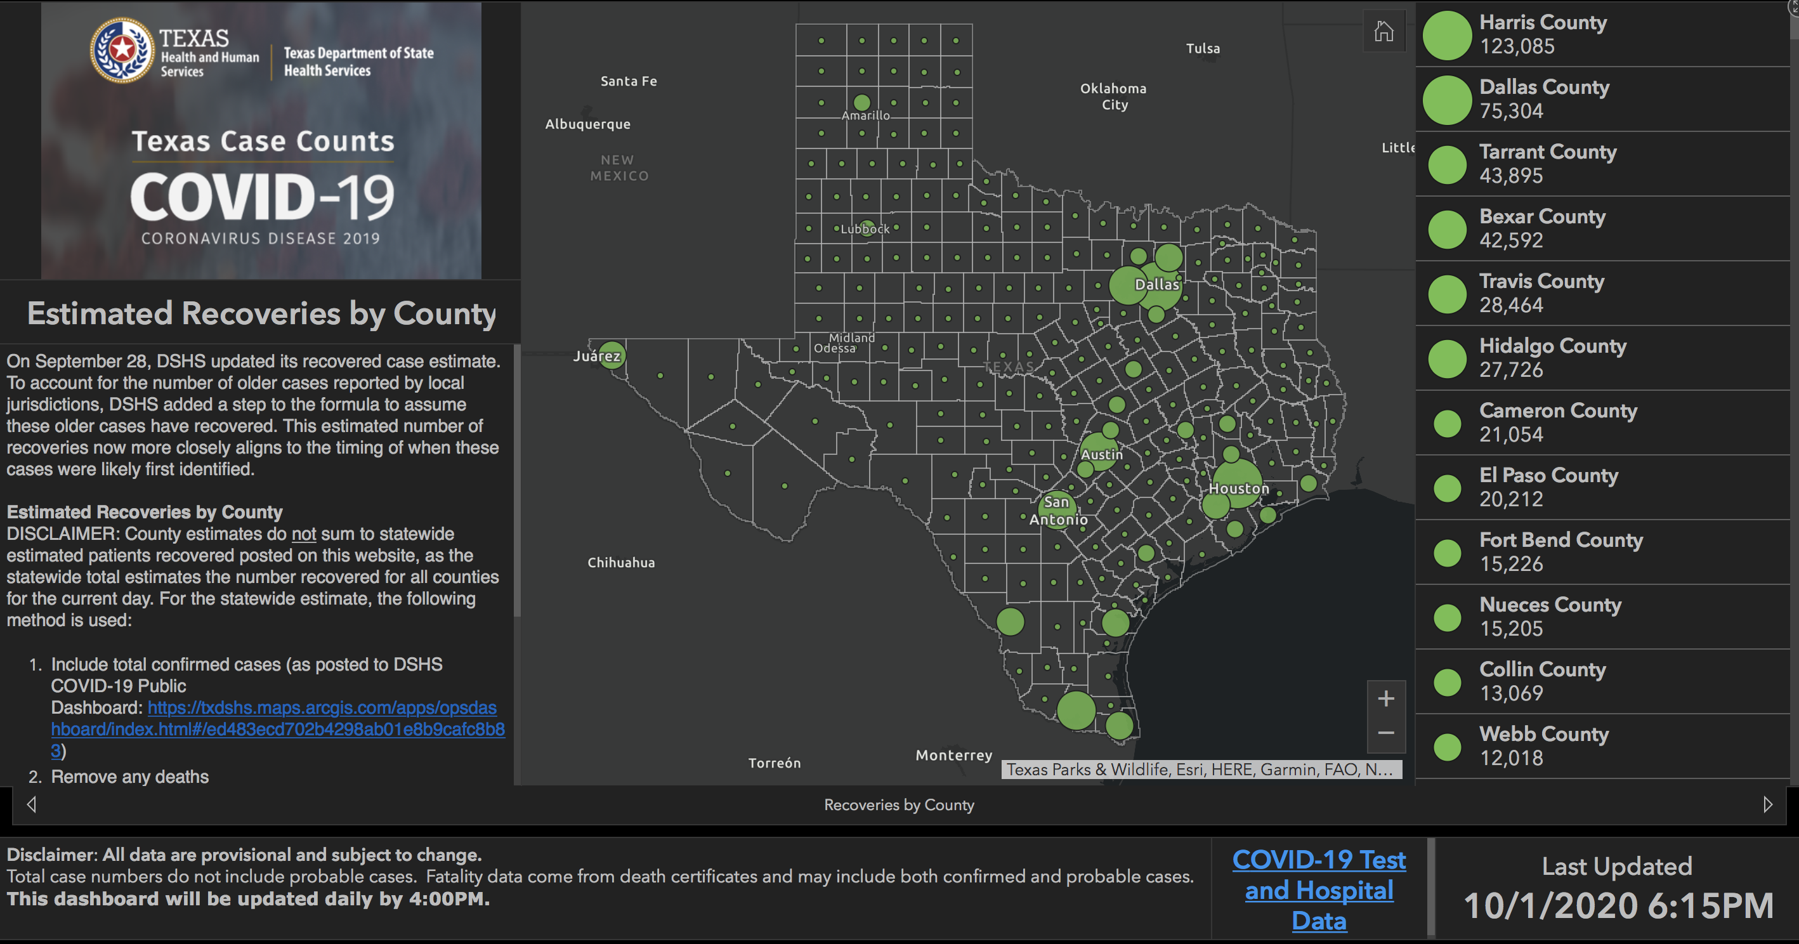

Slide 57
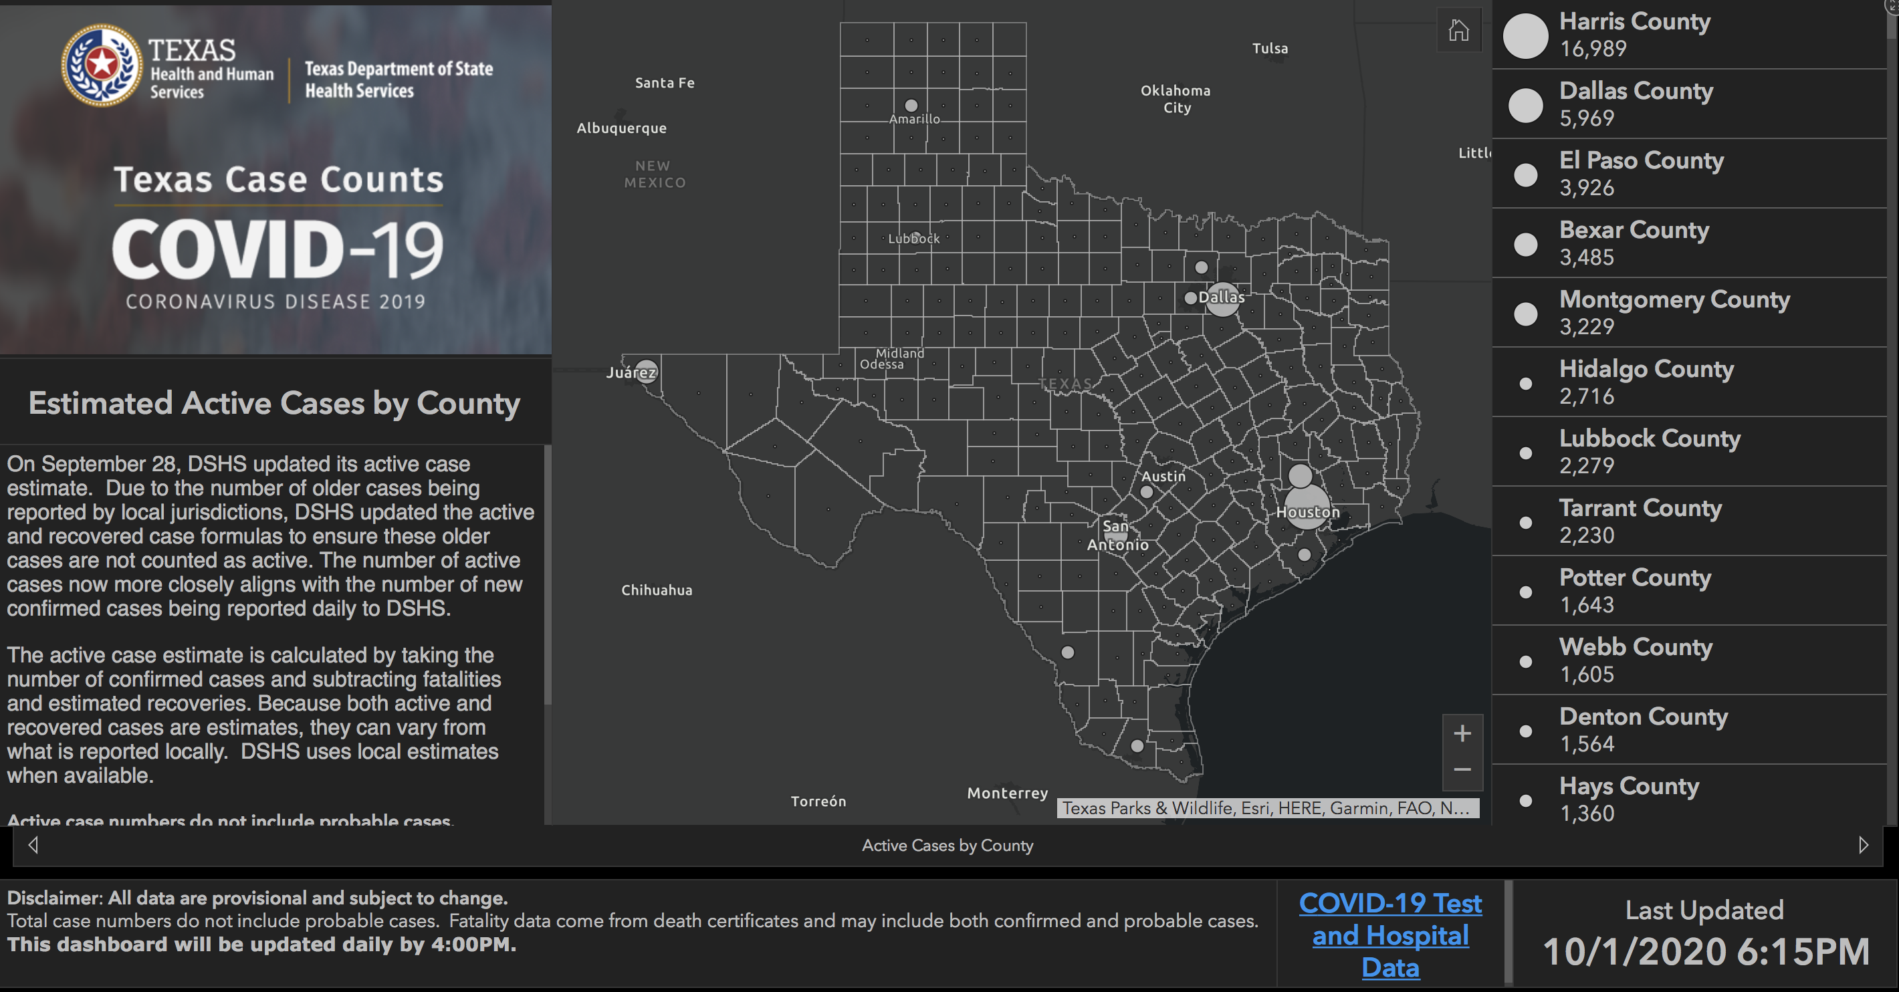

Slide 58
And New Mexico

Slide 59
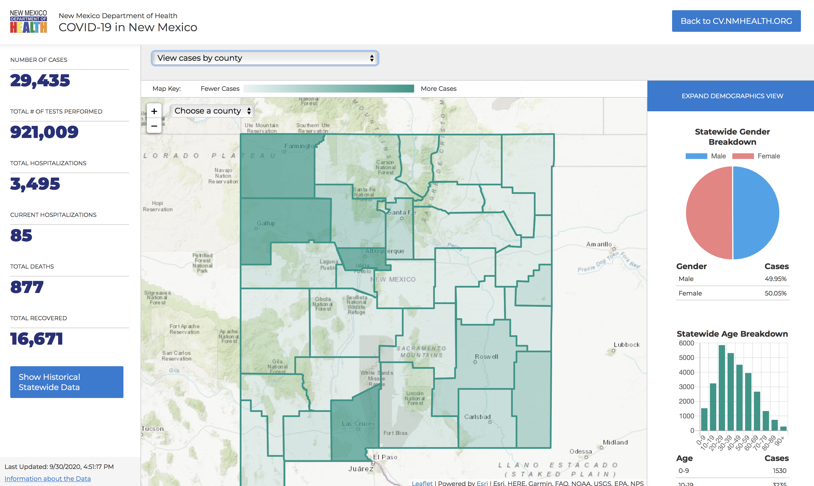

Slide 60
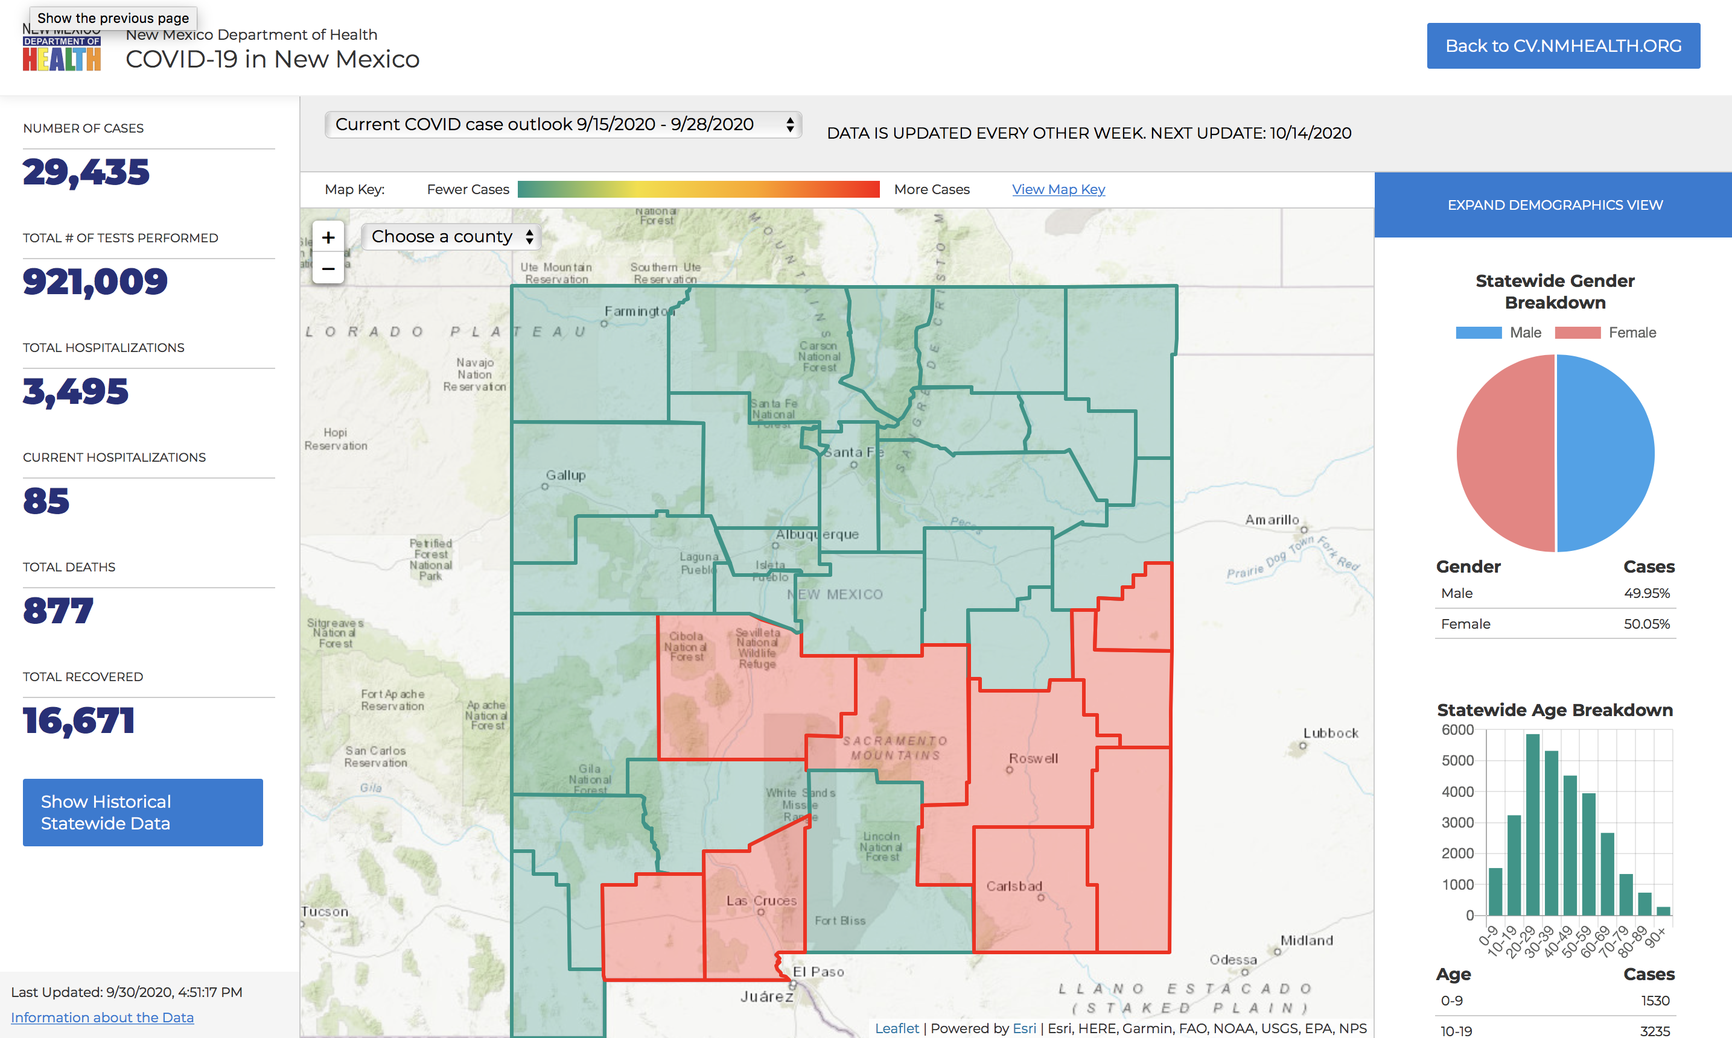

Slide 61
Governmental Affairs

Slide 62
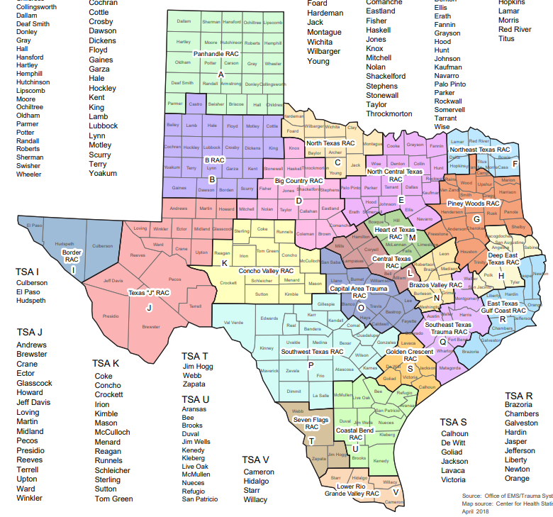
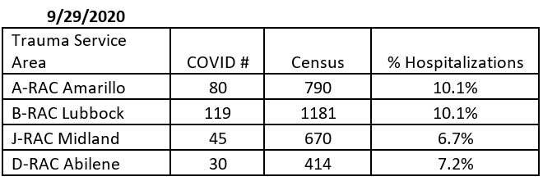
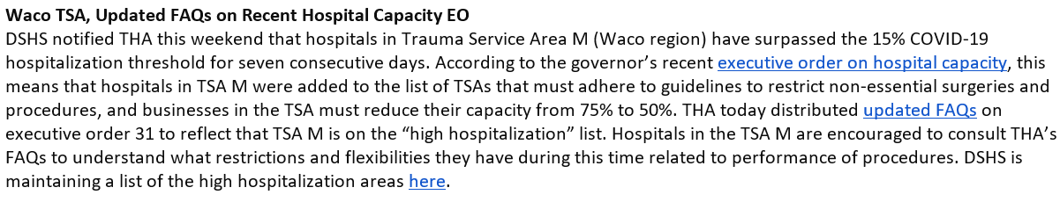
Hospital Capacity - Governor’s Exec order

Slide 63
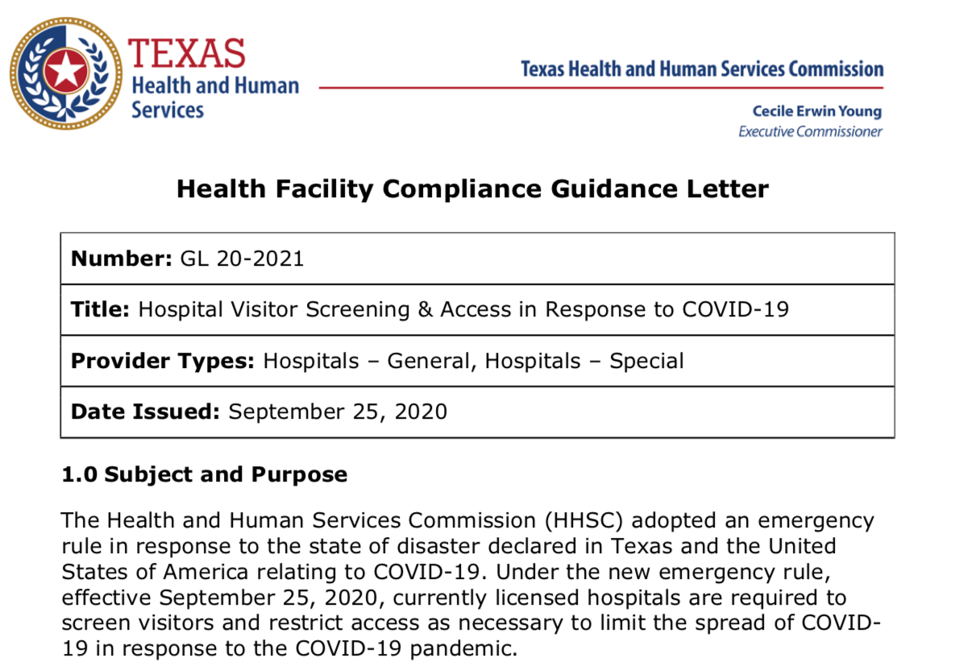

Slide 64
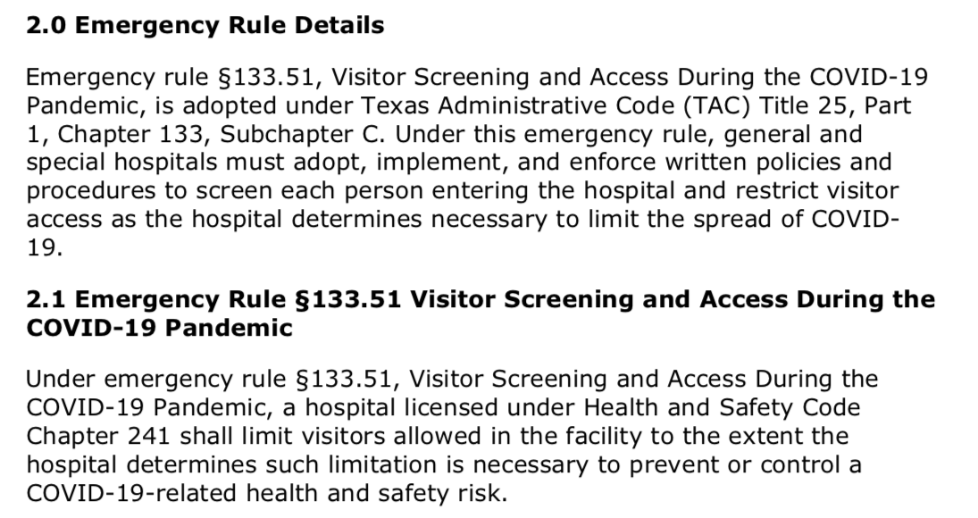

Slide 65
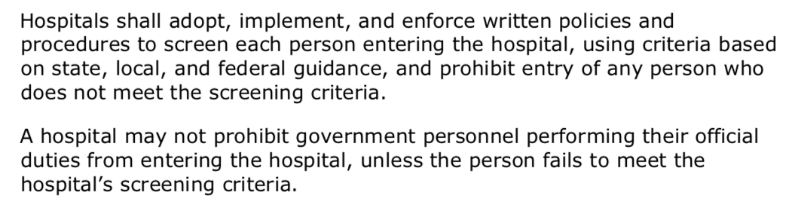

Slide 66


Slide 67
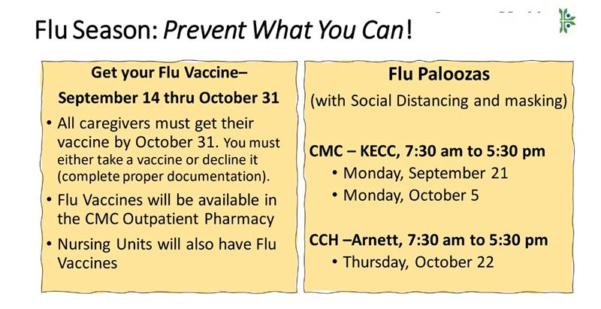
“This might be your most important flu vaccine ever.”

Slide 68
Reminder about E-Prescribing

Slide 69
e-Prescribing of Controlled Substances (EPCS)
State of Texas requirement to use EPCS for all DEA Scheduled drugs (II-V, controlled substances) beginning January 1st, 2021
  Outpatient pharmacies will no longer accept written prescriptions for controlled substances starting on 1/1/21
Meditech allows EPCS via Dr. First
  You must be enrolled in DrFirst to use EPCS
  To enroll in DrFirst contact Clinical Informatics at 806-725-4189
CMS has delayed their requirement for EPCS until 1/1/22
  This does not affect the 1/1/21 Texas State requirement

Slide 70
Remember
You must be enrolled via Dr. First
Waiting until December will be hazardous
  The CI department will be implementing EPIC at Grace Short Stay Surgical Hospital AND at Hospice of Lubbock during that time and will NOT likely have personnel to help enroll you with Dr. First in the last three weeks of December.
To enroll in Dr. First contact Clinical Informatics at 806-725-4189

Slide 71
Q & A

Slide 72
CME Credit was only approved for the Live Teams meeting
To receive credit for this continuing education activity, the participant must:
  Make sure you are logged into your Teams account, if you are signed in with a group provide attendee’s First and Last name(s) in the comments section.
  If you are calling into the Teams meeting you MUST text your First & Last Name to (806) 252-4735. This will ensure you are added to the sign in sheet to receive CME Credit.
  You will receive an email within 3 business days from the CME department with further instructions on claiming your certificate.

