Slide 1
Covenant Health Presents Critical Communications: A Weekly Physician Update October 23, 2020

Slide 2
PHYSICIANS
Accreditation Statement:
The Covenant Health is accredited by the Texas Medical Association (TMA) to provide continuing medical education for physicians.
Credit Designation Statement:
The Covenant Health designates this live CME activity for a maximum of 1.0 AMA PRA Category 1 Credit(s)™. Physicians should claim only the credit commensurate with the extent of their participation in the activity.

Slide 3
Disclosures of Commercial Interest
The speakers and planners of this activity
have no relevant financial interests

Slide 4
Disclosures
This activity is provided by
Covenant Health
No commercial support has been received.
No products will be endorsed.
Speakers will notify the audience if off label drug use will be discussed.

Slide 5
CME Credit was only approved for the Live Teams meeting
To receive credit for this continuing education activity, the participant must:
Make sure you are logged into your Teams account, if you are signed in with a group provide attendee’s First and Last name(s) in the comments section.
If you are calling into the Teams meeting you MUST text your First & Last Name to (806) 252-4735. This will ensure you are added to the sign in sheet to receive CME Credit.
You will receive an email within 3 business days from the CME department with further instructions on claiming your certificate.

Slide 6
Reflection & Safety Story
Presented by
Wesley Wells, PharmD, BCPS, BCPPS
TX-NM Regional Pharmacy Director
Covenant Health

Slide 7
Reflection
Wesley Wells, PharmD
Regional Pharmacy Director
Covenant Health

Slide 8
John Cassis Experience
Notes:
John Cassis is one of our nation’s finest motivational speakers. He told a story recently about a time when he was serving as one of the Chaplain's for the Chicago Bears during their glory years of the 80’s. As John tells it, Mike Ditka was about to deliver a locker room pep talk one day. He looked up and saw defensive tackle William “Refrigerator” Perry. How could he not see him? At 338 pounds the Fridge stood out even in a crowd of pro football players. Ditka gestured to the Fridge. “When I get finished,” he said, “I’d like you to close with the Lord’s Prayer.” Then the coach began his talk. Meanwhile, Jim McMahon, the brash and outspoken quarterback, punched John Cassis. “Look at Perry,” McMahon whispered, “he doesn’t know the Lord’s Prayer.” Sure enough, Perry sat with a look of panic on his face, his head in his hands. He was sweating profusely. “Everybody knows the Lord’s Prayer,” said Cassis to McMahon in disbelief. After a few minutes of watching the Refrigerator leaking several gallons of sweat, McMahon nudged Cassis again. “I’ll bet you 50 bucks Fridge doesn’t know the Lord’s Prayer.” As Cassis tells the story, he stops to reflect on the absurdity of it all: “Here we were sitting in chapel and betting 50 bucks on the Lord’s Prayer.” When Coach Ditka finished his pep talk, he asked all the men to remove their caps. Then he nodded at Perry and bowed his head. It was quiet for a few moments before the Fridge spoke in a shaky voice, “Now I lay me down to sleep. I pray the Lord, my soul to keep…” Cassis felt the tap on his shoulder. It was Jim McMahon. “Here’s the 50 dollars,” McMahon whispered. “I had no idea Perry knew the Lord’s Prayer.”

Slide 9
Safety Story
Wesley Wells, PharmD
Regional Pharmacy Director
Covenant Health

Slide 10
Safety Story
Past
Current

Slide 11
Current Regional Covid-19 Census

Slide 12
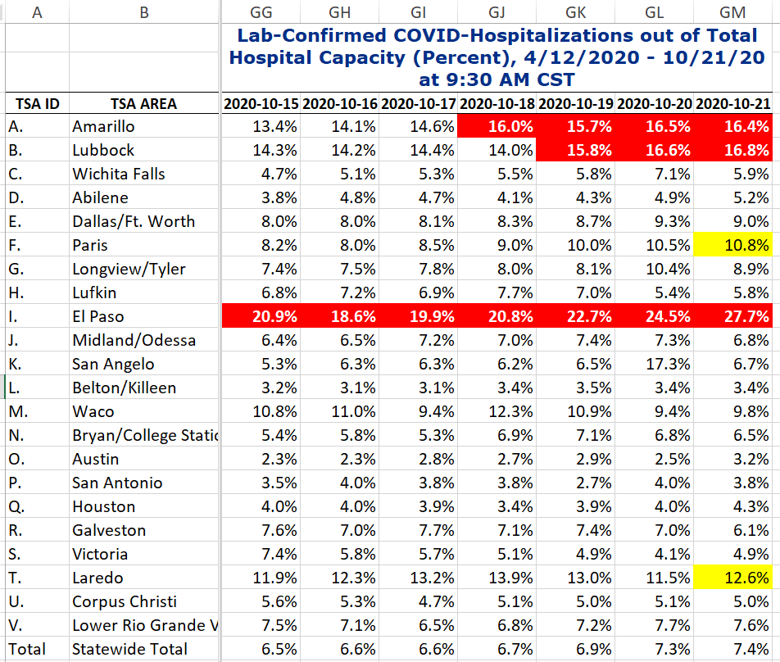
COVID+ HOSPITALIZATIONS BY TSA ID
CONFIRMED COVID+ HOSPITALIZATIONS /HOSPITAL CAPACITY
Governor’s Executive Ordered enforced when there are 7 consecutive days >15% for the TSA

Slide 13
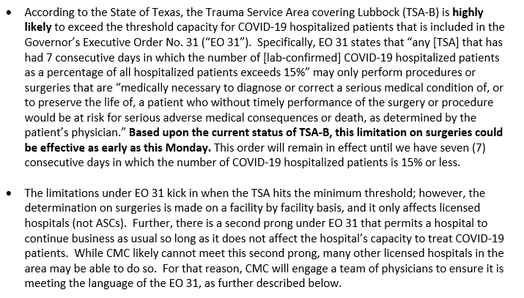
COVID+ HOSPITALIZATIONS BY TSA ID

Slide 14
Hospitalization Data Defined
COVID-19 Patients as a Percentage of Total Hospital Capacity (Effective October 14, 2020)
Executive Order GA-32 defines high hospitalizations as any Trauma Service Area that has had seven consecutive days in which the number of COVID 19 hospitalized patients as a percentage of all hospital capacity exceeds 15%.
The formula for this metric is: Lab Confirmed COVID-19 Patients Currently in the Hospital divided by Total Hospital Capacity.
Lab Confirmed COVID-19 Patients Currently in the Hospital is the total number of patients in the hospital who have tested positive for COVID-19 by molecular test. This includes pediatric and adult COVID-19 patients.
Total Hospital Capacity is the number of staffed available and occupied beds. This includes pediatric and adult hospital patients, general and ICU beds, inpatient and outpatient beds, emergency department beds, and telemetry and psychiatric beds.

Slide 15
DSHS – RAC Meeting
Expectations from hospitals:
Expand surge plans
Allocate beds for COVID
When beds are not available
single rooms to double rooms
utilize other locations onsite and offsite of hospital premises
State provision of staff, supplies, equipment
Hospitals on diversion – concerns on impact to the region
Crisis MODE – what can we do to avoid diversion
WEEKLY CALLS WITH
DSHS and RAC

Slide 16
DSHS – RAC Meeting
Medical Incident Support Team (MIST) plans:
Virtual MIST Team
A and B RAC areas
Manage the transfers, monitor diversion and appropriate requests / denials
Need to log our current requests and reason for denials
Area of Origin | Number of Patients
RAC B (Lubbock Region) | 3
RAC A (Amarillo Region) | 1
RAC J (Midland/Odessa Region) | 1
New Mexico | 4

Slide 17
Regional
 | Lubbock |  | TTU |  | Hockley |  | Hale
 | 10/19 | 10/21 | 10/19 | 10/21 | 10/19 | 10/21 | 10/19 | 10/20
Total | 15,908 | 16,417 | 2020 | 2034 | 483 | 519 | 2259 | 2407
Active | 2488 | 2255 | 188 | 191 |  | 122 |  | 320
Deaths | 157 | 168 | 0 | 0 | 11 | 12 | 60 | 60
New | 509 |  | 14 |  | 36 |  | 148

Slide 18
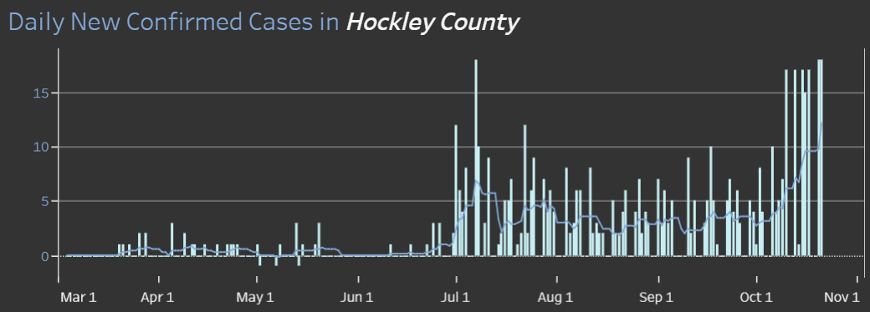
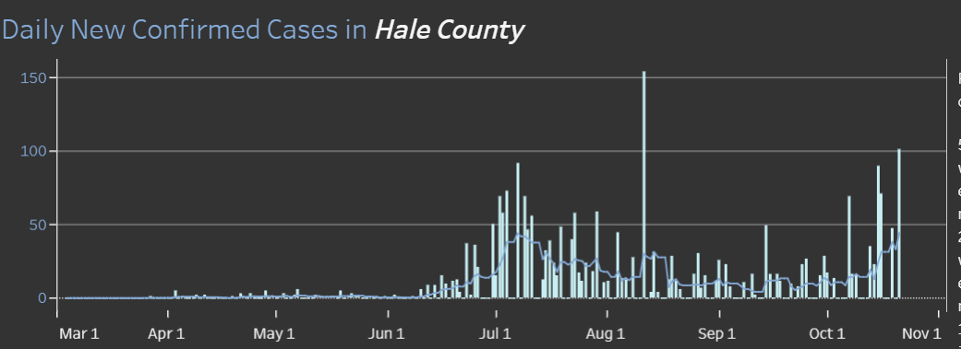
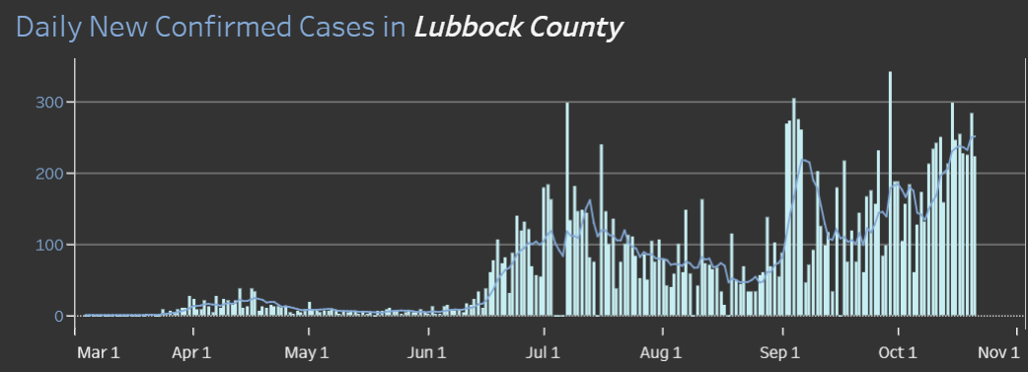
Lubbock, Hale, Hockley Counties
18
101
Positivity Rate
Lubbock County 12.1%

Slide 19
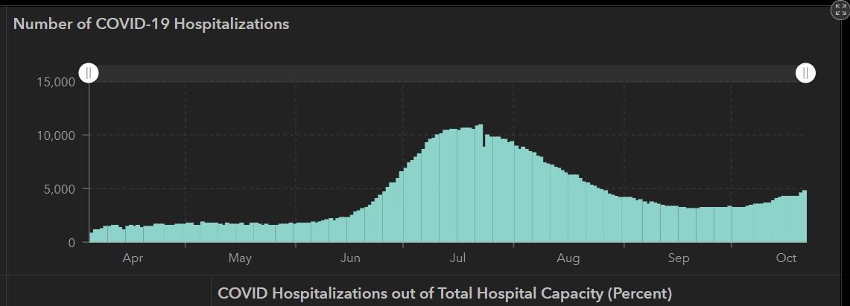
STATE
 | 10/21 | 10/19 | 10/14 | 10/12 | 10/5 | 9/23 | 9/9 | 8/26 | 8/12 | 7/29 | 7/15 | 7/1
Cases | 838,809 | 828,527 | 805,802 | 795,126 | 769,303 | 719,599 | 645,791 | 592,137 | 506,820 | 403,307 | 282,365 | 168,062
Deaths | 17,210 | 17,022 | 16,717 | 16,558 | 16,033 | 15,129 | 13,692 | 11,805 | 9034 | 6190 | 3432 | 2481
Hospitalized | 4,782 | 4,319 | 4,131 | 3,870 | 3,318 | 3,195 | 3604 | 4806 | 7028 | 9595 | 10,471 | 6904

Slide 20
Lubbock This Morning
10/23: 229 Hospitalized in Lubbock – 27 on vents

Slide 21
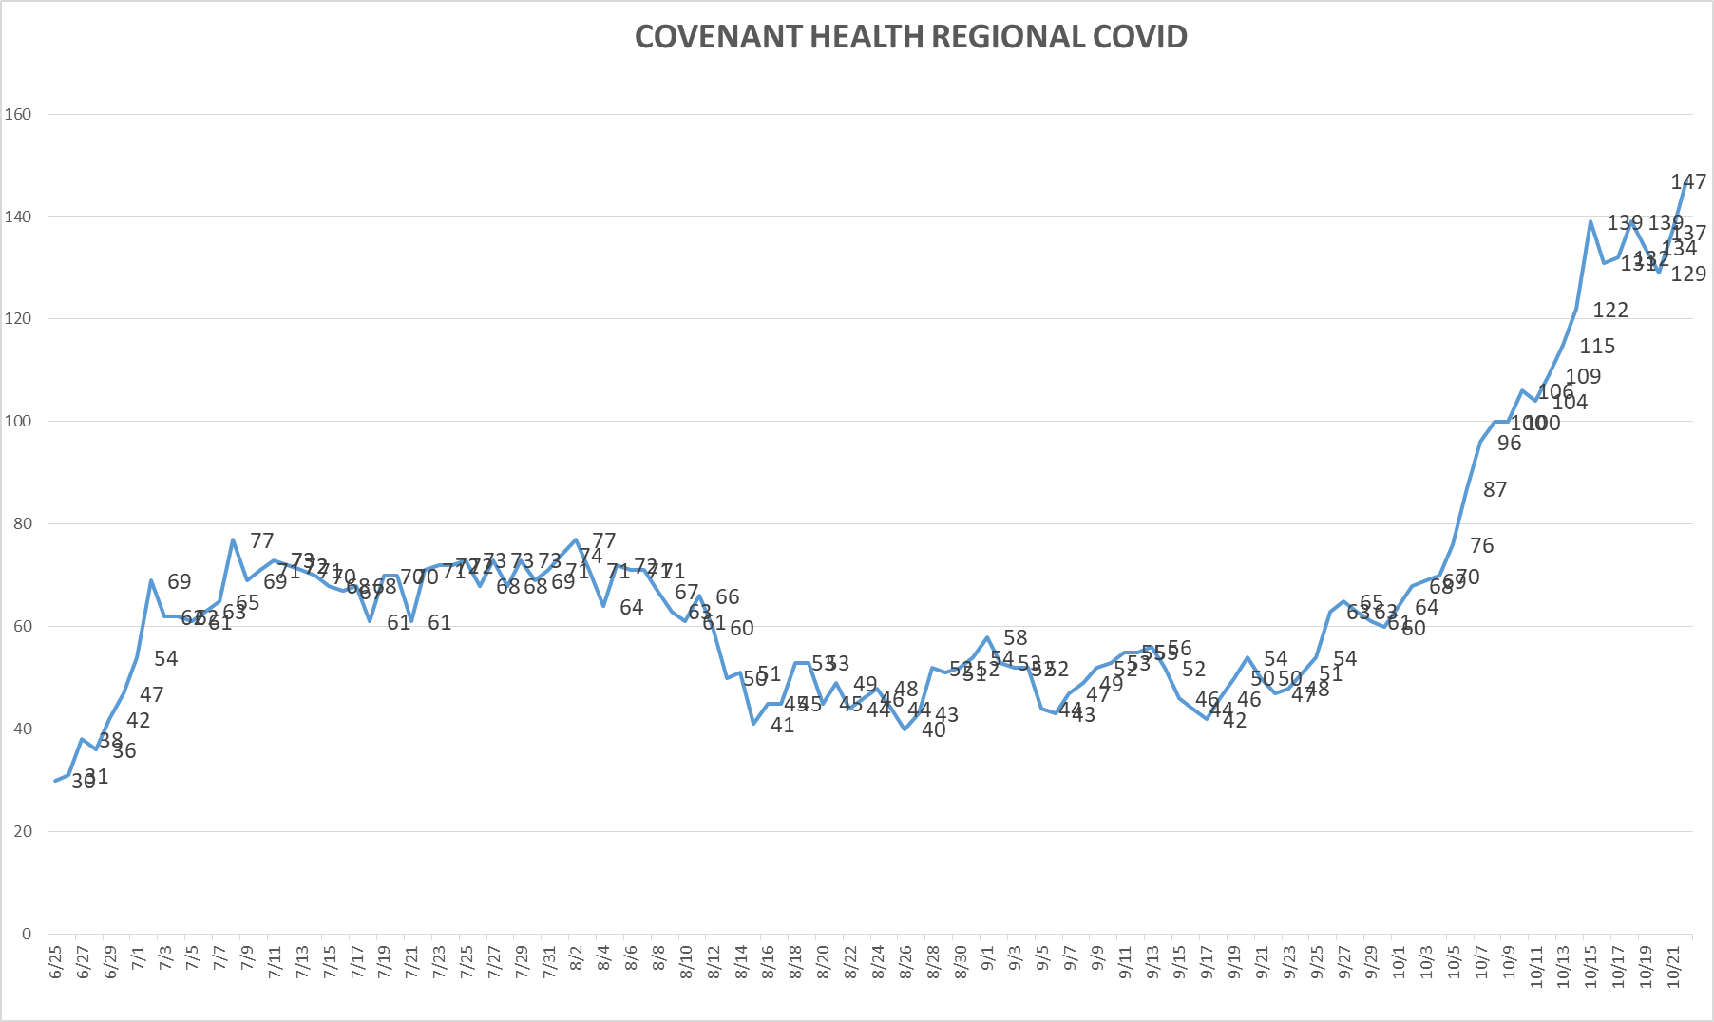
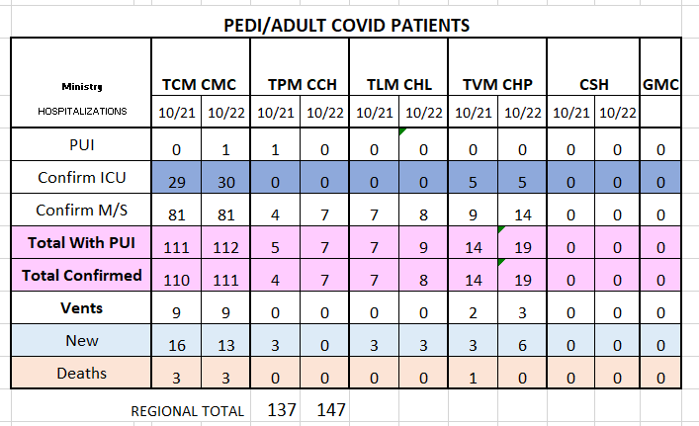
PUI/Confirmed cases-hospitalized
10/22/2020

Slide 22
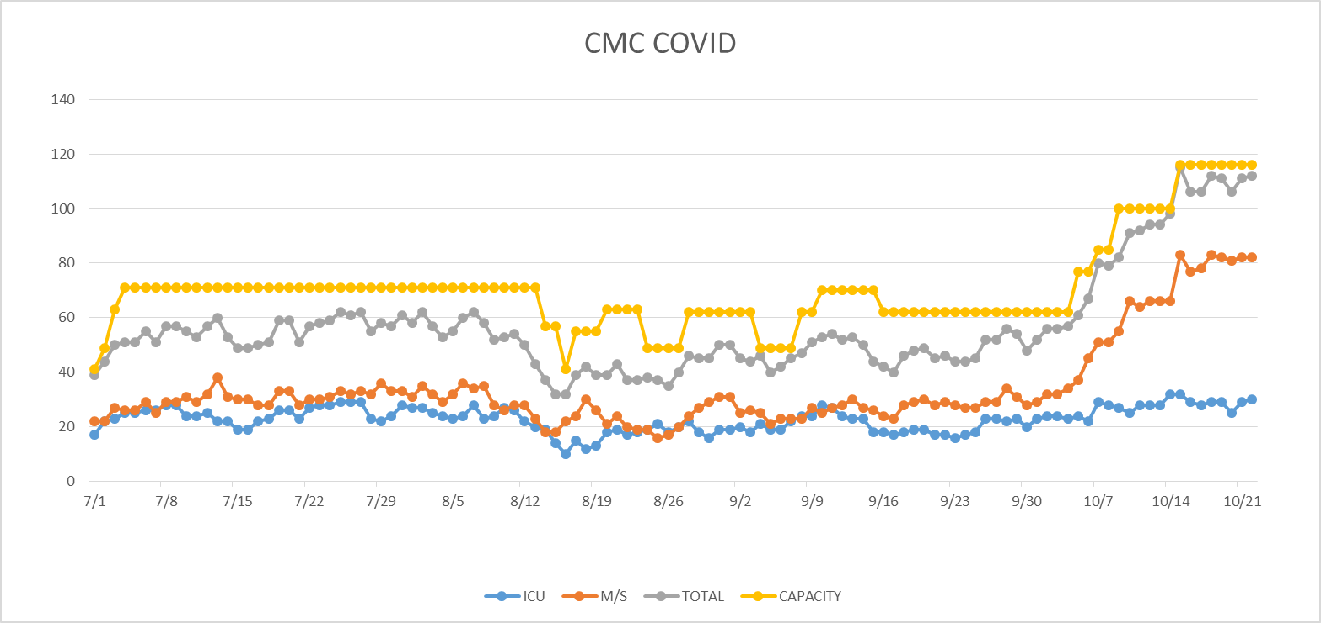
PUI/Confirmed cases-hospitalized
10/22/2020
ED HOLDS - 7

Slide 23
Surge Plan
Covenant Medical Center
 | ICU | Med Surg | Total
Phase 1 | 10-CICU |  | 10
Phase 2 | 17-CICU | 10-HC4 | 27
Phase 3 | 17-CICU | 24-HC4 | 41
Phase 4 | 17-CICU 8-MICU | 24-HC4 14-Pal Med | 63
Phase 5 | 17-CICU 16-MICU | 24-HC4 14-Pal Med | 71
Phase 6 | 17-CICU 16-MICU 15-S 4 | 24-HC4 13-HC6 15 – S 9 (East) | 100
Phase 7 | 17-CICU 16-MICU 15-S 4 | 24-HC4 13-HC6 31 – S 9 (all) | 116
Phase 8 | 8-E4 17-CICU 16-MICU 15-S 4 | 15-S 10(East) 24-HC4 13-HC6 31 – S 9 (all) | 139
Phase 9 | 16-E4 (all) 17-CICU 16-MICU 15-S 4 | 30 S10 (all) 24-HC4 13-HC6 31 – S 9 (all) | 162
Last Week
Currently

Slide 24
CENSUS
 | 10/12 | 10/13 | 10/14 | 10/15 | 10/16 |  | 10/19 | 10/20 | 10/21 | 10/22 | 10/23
CMC (360) | 328 | 326 | 343 | 347 | 332 |  | 319 | 327 | 336 | 337
Cases (41) | 29 | 9 | 25 | 38 |  |  | 34 | 29 | 23
CCH (135) | 84 | 84 | 91 | 99 | 120 |  | 71 | 90 | 82 | 81
Cases (19) | 10 | 9 | 6 | 13 | 12 |  | 12 | 10
GMC (18) | 2 | 6 | 16 | 13 | 6 |  | 3 | 9 | 17 | 21
Cases (20) | 9 | 13 | 18 | 11 | 0 |  | 14 | 12 | 12 | 9
CHP (49) | 29 | 38 | 38 | 37 | 17 |  | 35 | 38 | 39 | 44
Cases (19) | 6 | 3 | 11 | 18 | 18 |  | 11 | 7 | 11 | 16
CHL (18) | 7 | 15 | 15 | 13 | 15 |  | 14 | 16
cases | 0 | 3 | 1 | 1 | 0 |  | 0 | 1
CSH (35) | 23 | 25 | 26 | 26 | 27 |  | 27 | 27 | 25 | 26
Capacity Status RED Square

Slide 25
Statistics
Cristian Requenez, MS
Clinical Data Analyst
Clinical Excellence
Covenant Health

Slide 26
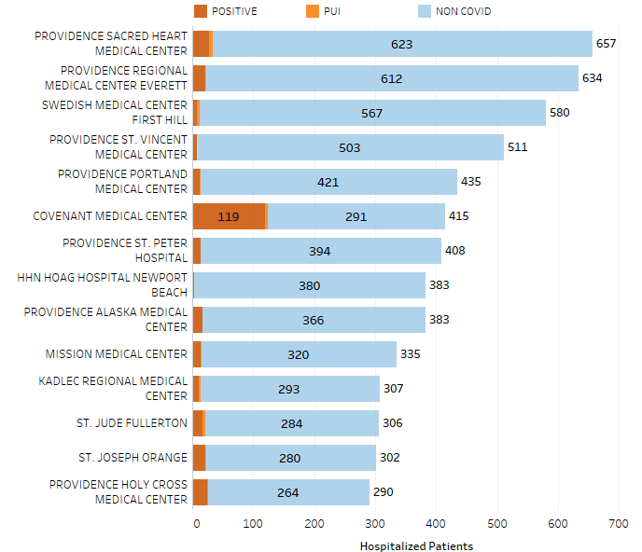
Providence System Hospitalized COVID-19 Cases

Slide 27
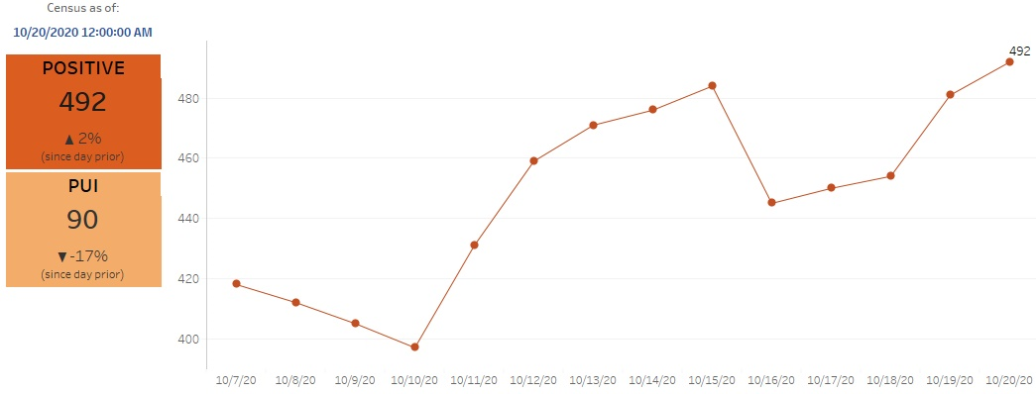
Providence Inpatient COVID-19 Volume

Slide 28
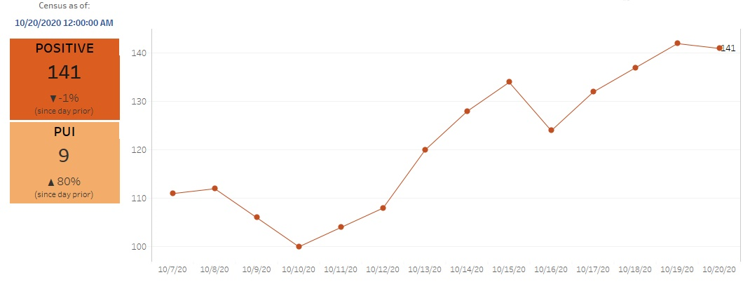
Texas Inpatient COVID-19 Volume

Slide 29
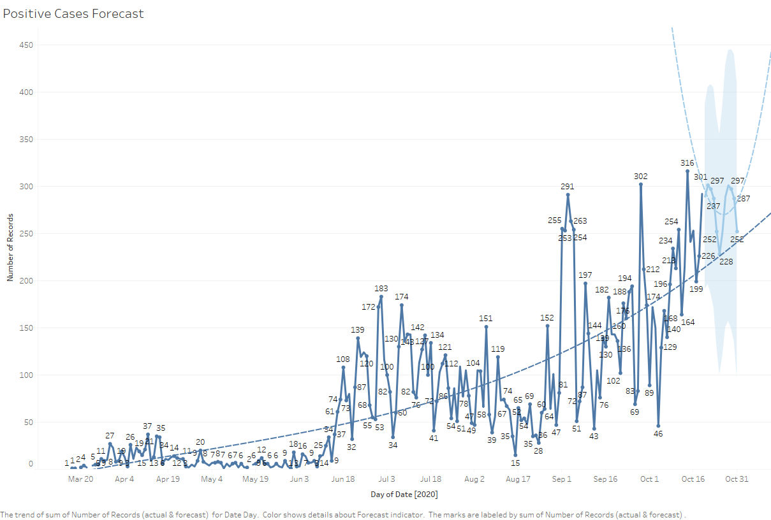
New COVID-19 POSITIVES by Day Trend

Slide 30
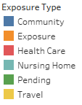
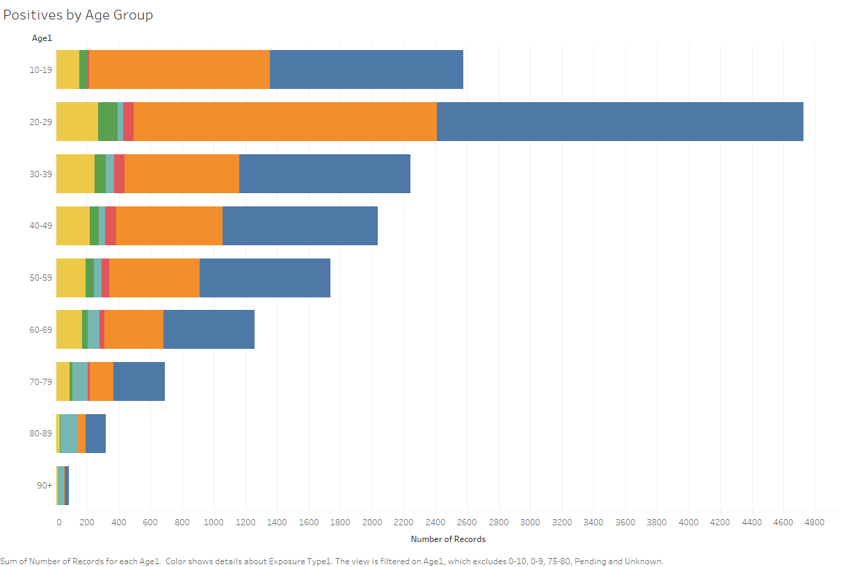
COVID-19 POSITIVES Age Distribution

Slide 31
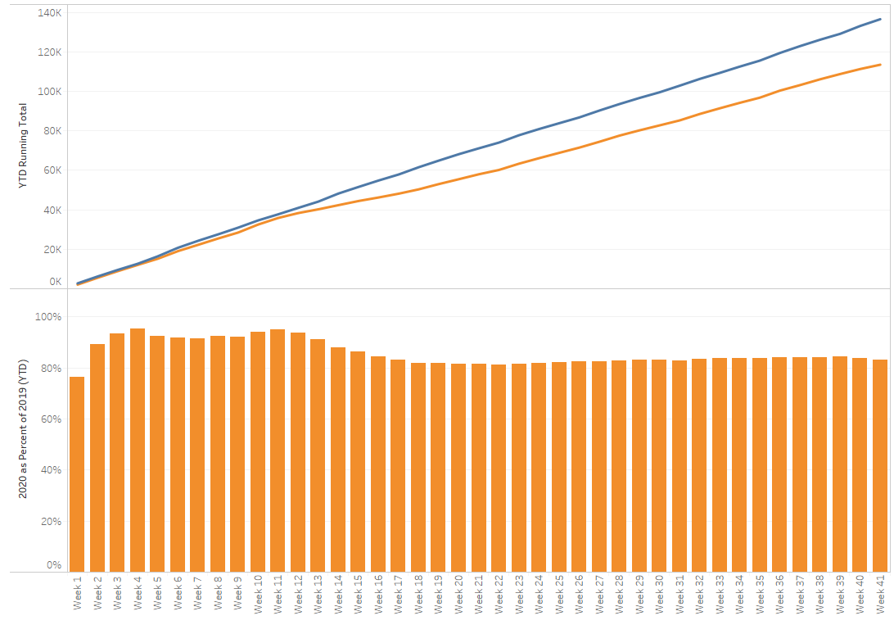
TX/NM Region Weekly Procedures (YOY)

Slide 32
Caregiver Update

Slide 33
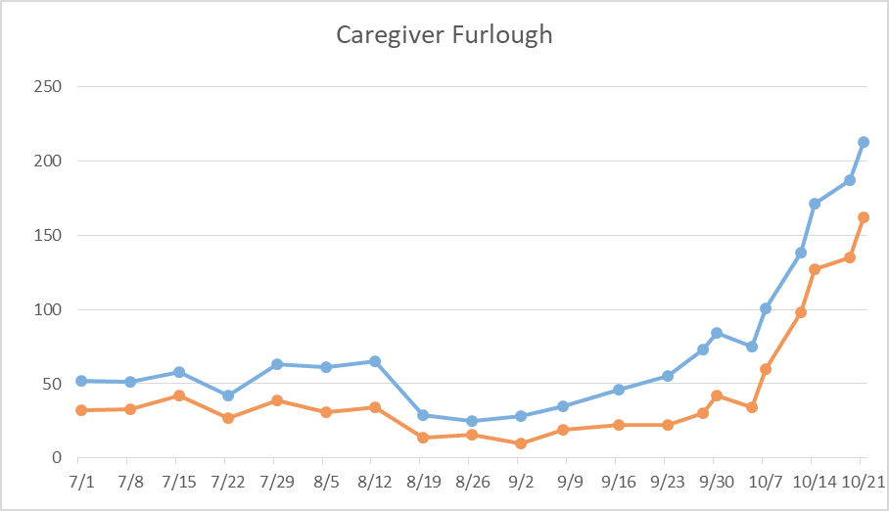
Caregivers
COVID Related Furloughs
76% are positive
Count reflects # furlough (exposed and positive)
Good
Moderate
Critical

Slide 34
Caregivers
STAR Requests
CMC – RT’s day and night shifts
Levelland – RN’s day and night shifts
Plainview – RN’s ICU day and night shift
MUST ONBOARD and have boots on the ground to treat patients in 24 hours

Slide 35
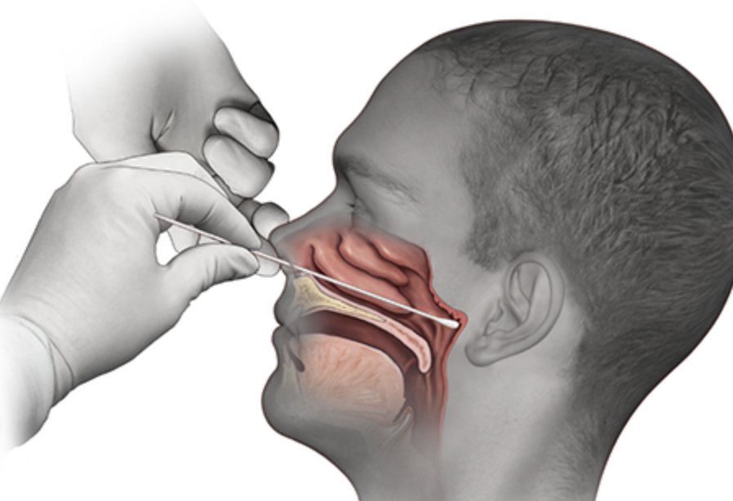
Covid-19 Testing

Slide 36
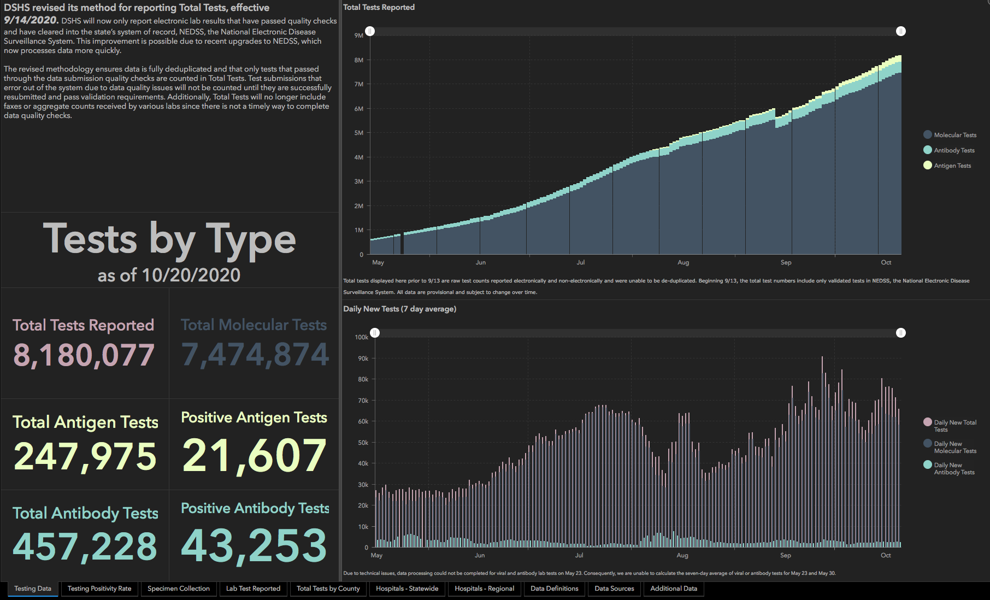

Slide 37
TESTING
 | CMC | GMC | CMG
Test Kits
Swabs
VTM
 | CMC |  | GMG/CMG
 | Tests | + | Tests | +
10/20 | 381 | 33 | 248 | 77
10/21 | 320 | 49 | 254 | 55
>2000 >750
<2000 <750
<1600 <500
CMC- no issues with allotments
Grace- BD will be increasing their allotments
CMG- no issues

Slide 38
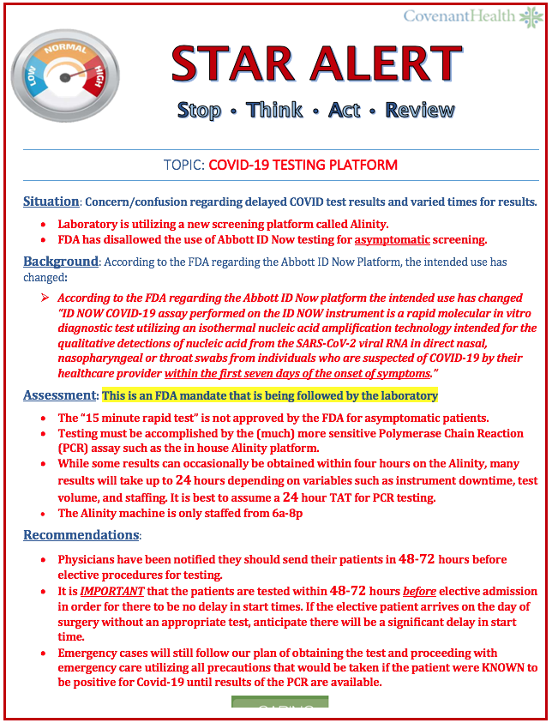
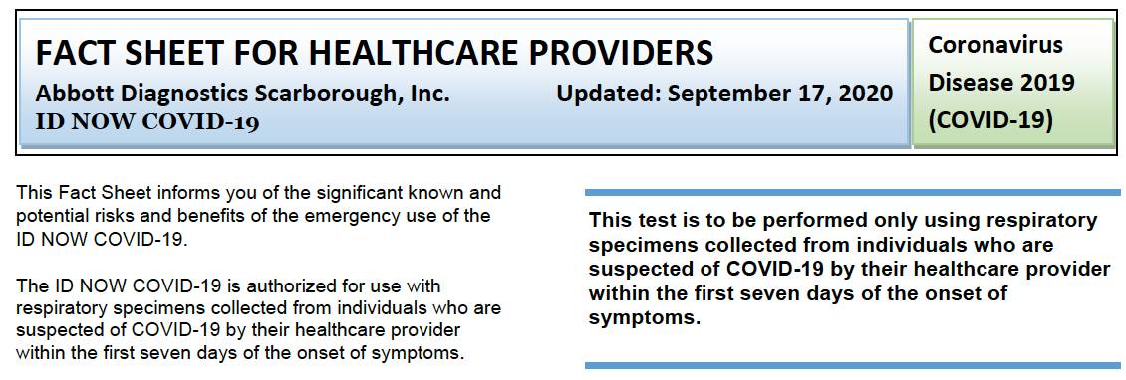
New FDA Guidelines

Slide 39
Testing – L & D
Expectant Moms
Rapid testing with Abbott ID with asymptomatic patients is prohibited by the FDA
Expectant moms will not be able to receive this test now
Need plan for testing and appropriate bed placement for expectant moms

Slide 40
Caregivers
Testing Our Heroes (antibody testing)
CMC 10/26 – 10/30 7:30 AM – 5:00 PM Main Lobby by Piano
CCH 11/2 – 11/6 7:30 AM – 5:00 PM Arnett Room
Levelland 10/27 and 10/28 8:00 AM – 5:00 PM Atrium
Plainview 10/26 and 10/28 8:00 Am – 5:00 PM, Lab
Specialty go to the Texas Cardiac Center 3710 21st St 10/26 – 11/6 8:00 AM – 5 PM extended hours Tu/Thu 7:30 AM to 6 PM

Slide 41
Caregivers
Testing Our Heroes (antibody testing)
Grace Clinic 10/26 – 11/6 8:00AM – 5:00 PM
Grace Medical Center – go to Grace clinic or other clinic locations
CMG Clinics 11/2 – 11/6 8:00 AM to 5 PM
Northwest Clinic 611 North Frankford Ave
Southwest Clinic 9812 Slide Road
Health Plus 7601 Quaker
Memphis Place Mall 3801 50th Street

Slide 42
Caregivers
Testing Our Heroes
Online Registration
Providence.lumedic.id
This will lead the person to Redcap
Registration will start

Slide 43
Pharmacy Update
Larry Pineda, PharmD
Clinical Pharmacist – AMS
Covenant Health

Slide 44
COVID19-Hot Topics
Remdesivir
Beigene Zanubrutinib Trial
Placebo controlled
Dose: 4 capsules PO daily x 28 days
Ministry | Patients Receiving Treatment | Stock (vials)
Covenant Medical Center | 44 | 363
Covenant Children’s Hospital | 0 | 0
Covenant Plainview | 7 | 108
Covenant Levelland | 1 | 15
Last updated: 10/21/20 at 0600
Active Patients | Total Patients
1 patient | 4 patients
Last updated: 10/21/20 at 0600

Slide 45
COVID19-Hot Topics
Regeneron 2066 Trial
Currently underway in Oregon and other sites
Phase 3 trial plans to enroll 1350 patients
Monoclonal antibody that prevents the binding of virus to cells
3 treatment arms
High-dose IV infusion over 1 hour
Low-dose IV infusion over 1 hour
Placebo IV infusion over 1 hour
Awaiting training meeting from Regeneron
COVID Vaccine
Plan to have meeting with local team next week

Slide 47
SOLIDARITY Design
Adaptive, simple, multi-country, open-label, randomized trial
Hundreds of potentially over-stressed hospitals so no form-filling was required, and trial procedures were minimal but rigorous
Placebos were not used
Randomized in equal proportions between control (local standard-of-care) and study drugs locally available (remdesivir, hydroxychloroquine, lopinavir, and interferon-β1a)
Hydroxychloroquine and lopinavir were dropped early for futility, interferon ceased 10/16/20
Remdesivir 200 mg x 1, 100 mg x 9
Primary endpoint: in-hospital mortality (ie, mortality during the original episode of hospitalization; follow-up ceased at discharge)
Secondary outcomes: initiation of ventilation and hospitalization duration
Notes:
Placebos were not used
Remdesivir continuing
Open label (truly RDV + SOC?), patients who would be considered fit for discharge might be kept in somewhat longer just because they were being given a study drug

Slide 48
SOLIDARITY
Study period: March 22 to October 4, 2020
11,330 patients from 405 hospitals in 30 countries
Geographic location:
Europe or Canada 22%
Latin America 17%
Asia and Africa 61%
For comparison, ACTT-1:
North America 79.8%
Europe 15.3%
Asia 4.9%
Notes:
Enrollment for ACTT-1 began on February 21, 2020, and ended on April 19, 2020
Standards of care have changed dramatically over time. ie. at the start of the pandemic, doctors had little to offer patients and were quick to intubate people

Slide 49
Baseline Demographics: ACTT-1 vs SOLIDARITY
Characteristic | ACTT-1 | SOLIDARITY
N | 1062 (RDV = 541) | 11,266 (RDV = 2743, C = 2708)
Age | ~58.9 | 35% <50, 45% 50-69, 19% 70+
Male sex | 64.4% | 62%
White race | 53.3% | n/a
Median time from symptom onset | 9 days (IQR 6-12) | n/a, prior days in hospital 2+ 38%
Diabetes | 30.6% | 25%
Hypertension | 50.7% | n/a, heart dz 21%
Obesity | 45.4% | n/a
Hospitalized, no O2 | 13% | 28%
Hospitalized, requiring O2 | 41% | 63% (low and high flow)
Hospitalized, high flow or NIV | 18.2% | n/a
Hospitalized, invasive ventilation | 26.8% | 8%
Notes:
Prior days in hospital 0 = 29%, 1 = 33%

Slide 50
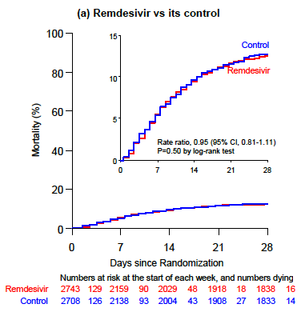
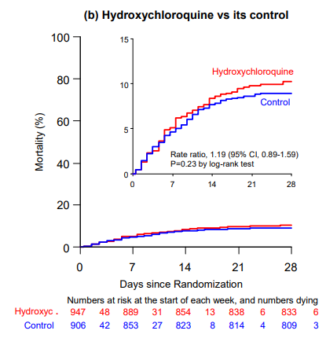
Survival Curve

Slide 51
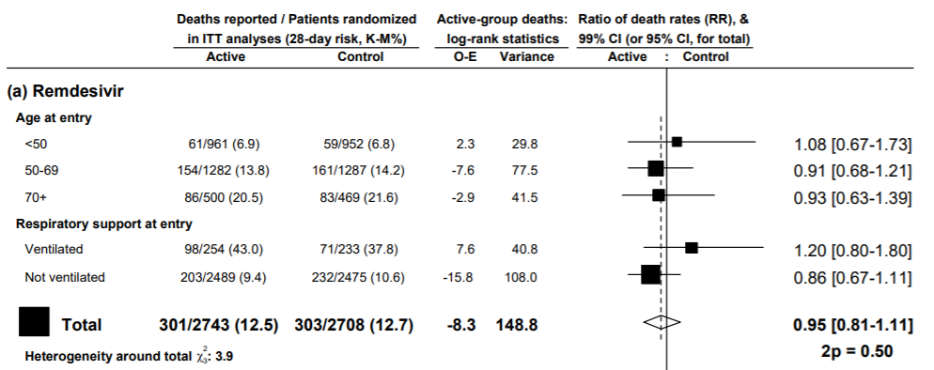
Rate Ratio – Any Death
Notes:
Take away – RDV is not for everyone, but we already knew that

Slide 52
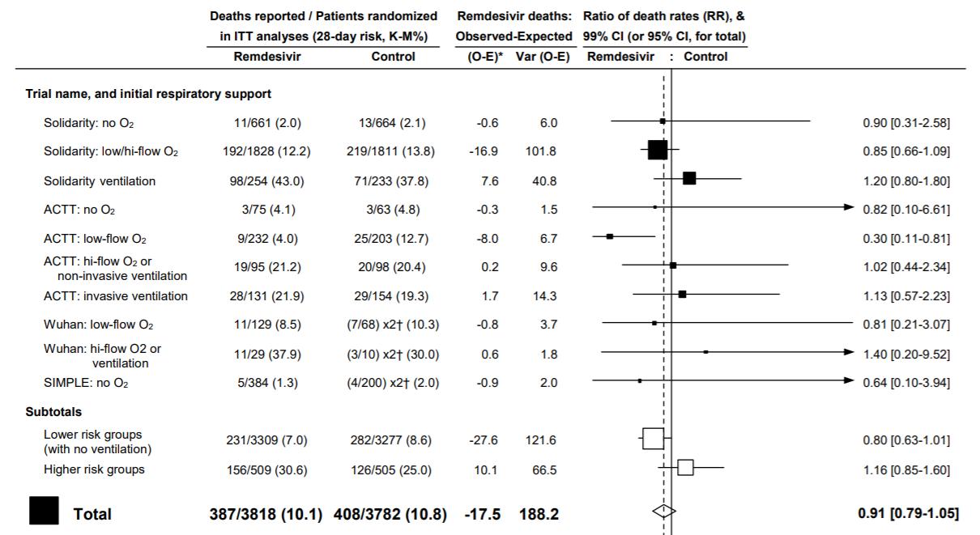
SOLIDARITY Meta-Analysis
Notes:
No study drug appreciably reduced initiation of ventilation in those not already ventilated

Slide 53
SOLIDARITY Limitations
Currently not peer reviewed
Interim analysis
No placebo (impact on hospital duration)
With the simple design and many sites it is difficult to account for differences in standard of care
Criteria for hospitalizing patients might have differed also
Missing critical piece of information
Symptom onset to randomization
Not limitations but worthy observations:
Different patient population from ACTT
Benefit seen in ACTT may be masked by grouping of O2 requirement
Notes:
Symptom onset to randomization
No placebo – if no study drug (shorter duration?)

Slide 54
So Does Remdesivir Work?
“A cautious maybe. Sometimes. For some people.”
— Paul E. Sax, MD
NEJM HIV and ID Observations 10/20/20
Notes:
It is complicated.
We can’t explain the discordant results found in these 2 RCTs b/c they have different study designs and populations.
Given the absence of anything else right now and its low toxicity, means I’d still recommend it for most hospitalized people with COVID-19 — with the hope of giving it sooner rather than later, especially for those on oxygen at high risk for disease progression.
But if we can learn anything from the mental gyrations required to square these conflicting study results, it’s that we definitely need more effective options.

Slide 55
Communications Update

Slide 56
ASK IP
Infection Prevention presents….

Slide 57
COVID-19 LUCIDOC--> CHS COVID
Discontinuation of Transmission Based Precautions for COVID19
Guidelines for determining when a patient is recovered from COVID and no longer infectious yet still needs hospitalization in a non-COVID unit,
Position Statement AGP Definition and List Final Approved
Defines what procedures are considered Aerosol Generating Procedures (AGPs) and will require use of a N95 mask.
Position Statement Rationale for Extended Use Reuse Recommendations
Explanation of why we are extending the use of PPE when there are shortages
Position Statement Visitation Final Approved
Hospital Visitation restrictions during COVID pandemic
Position Statement AGP in Procedural Settings
Lists procedural areas where AGPs are likely to be performed
Position Statement Asymptomatic COVID Screening Combined (1)
Combines COVID screening (testing for COVID) of asymptomatic patients prior to procedures (including Surgeries) that are likely to include AGP and precautions to follow when asymptomatic patients are COVID positive
Position Statement. Bouffants and Shoe Covers final (004)
These items are is short supply and will only be worn in OR and where required, NOT required PPE while caring for patient with COVID+
Position Statement Patient Masks Final Approved
Details mask requirements for all patients inside and outside of their room
Position Statement Personal PPE Use Final Approved
Personal PPE like cloth masks cannot be worn when caring for patients. May be worn in common areas like cafeteria, elevator…
Position Statement Respirator Conservation Final Approved
Guidelines for conserving N95 and other protective masks- use PAPRs and CAPRs as much as possible to conserve mask utilization
Practice Alert - Universal Masking - COVID
Everyone (all caregivers, visitors…) must wear masks covering nose and mouth in all public areas. No gaiter or vented masks may be used
Patient Transportation-Airway-PPE Practice Alert
Details what PPE to wear while transporting positive patients with different resp status
Recovered COVID Transport-final
Instructions for transporting and receiving patients that have recovered from COVID (no longer infectious)
Novel Respiratory Precautions COVID-19-1
General Policies not otherwise specified…waste management, post-mortem care, donning/doffing CAPR/PAPR
Position Statement Short Description

Slide 58
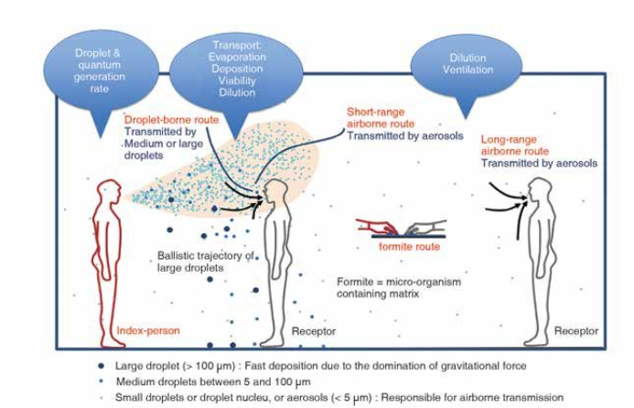
Droplet vs Aerosol
O-6 feet Lingers in the Air with AGP
AEROSOL
VS
DROPLET
Size matters

Slide 59
AGPs = Aerosol-Generating Procedures
Position Statement: AGPs in Procedural Settings

Slide 60
High Risk Areas wearing N95 daily due to elevated risk of AGP
Extended use of N95 /CAPRS - Definition of Extended use is to wear all day due to high risk patients on AGP. Removal only for breaks/lunch and wear for rest of day.
Reprocess N95 masks If not with a + COVID pt. or other isolation.
Critical Care areas ( all ICU) PICU, NICU, CICU, SICU, MICU
ED Due to high % of infectivity rate in Lubbock
All Resp Therapist
LTAC Caregivers
All Surgery in the OR rooms
All Units housing COVID patients

Slide 61
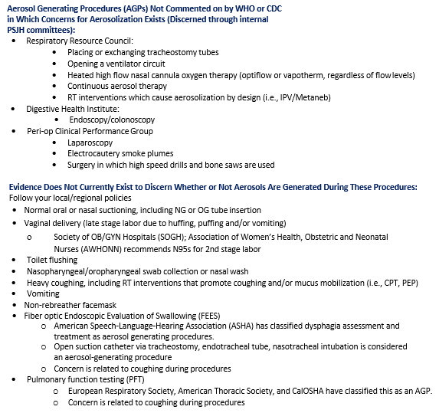
AGPs = Aerosol-Generating Procedures
Position Statement: Defining and Identifying AGPs

Slide 62
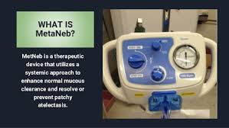
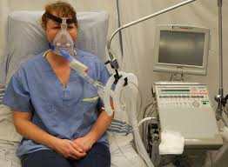
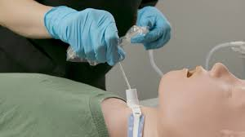
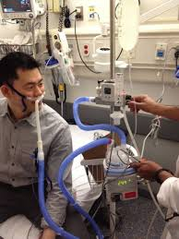
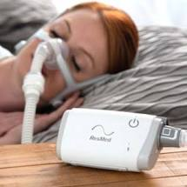
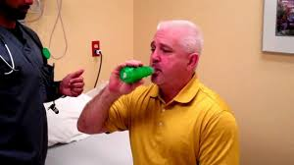
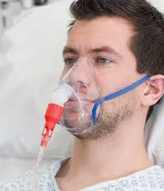
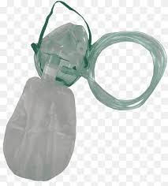
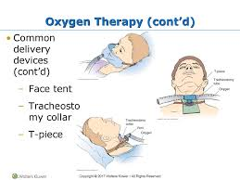
Most Common Examples of AGPs Resp Therapist Subject Expert
MetaNeb or Hand Neb
Open Trach Suctioning
BIPAP
High Flow Nasal Cannula
Acapella
CPAP Sometimes used for sleeping
Can be Nasal or Face Mask CPAP
Colored attachment Venturi Mask Non Re-breather Mask
Face Tent/ T Piece Continuous O2

Slide 63
Alert Sign Do not enter room without a fit tested N95 mask Patient care nurse places sign on Door when AGP ordered Respiratory Therapist will be 2nd pair of eyes to validate while doing treatments.

Slide 64
 | COVID Unit No Reprocess of Mask | Isolation Room Non-COVID No Reprocess of Mask | Aerosol Generating Procedure Non-COVID No Isolation Reprocess N95 Mask
N-95 | YES Wear while in COVID Room; discard at end of day when leaving unit | Yes: Wear N95 in AIRBORNE Isolation OR any AGP Isolation Discard N95 when leaving the isolation room | YES Wear N95 with face shield Reprocess at end of day
LEVEL 2 MASK | In pt room only – use n-95 with face shield or CAPR/PAPR In the Covid unit hallway Level 2 mask | DROPLET OR CONTACT ISOLATION Wear Level 2 mask and with face shield Discard mask when leaving the isolation room and clean shield | AGP…. use n-95 with face shield Reprocess at end of day
N95 Masks

Slide 65
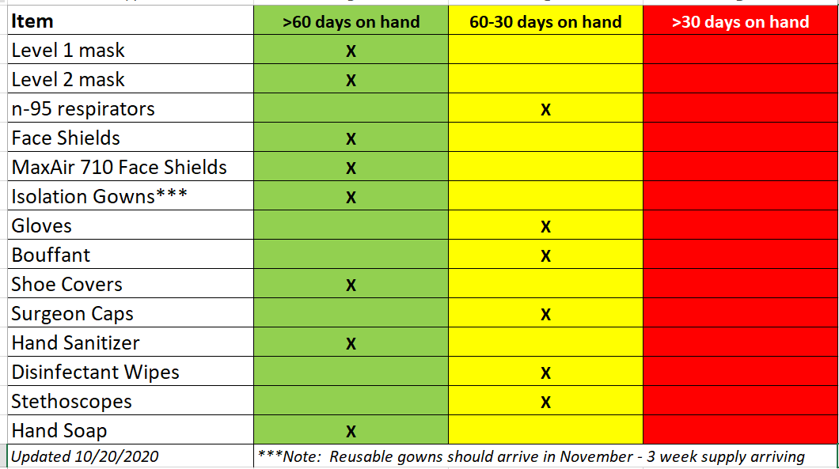

Slide 66
Infection Preventionist On Call (806) 252-1762
QUESTIONS?

Slide 67
Texas Demographics

Slide 68
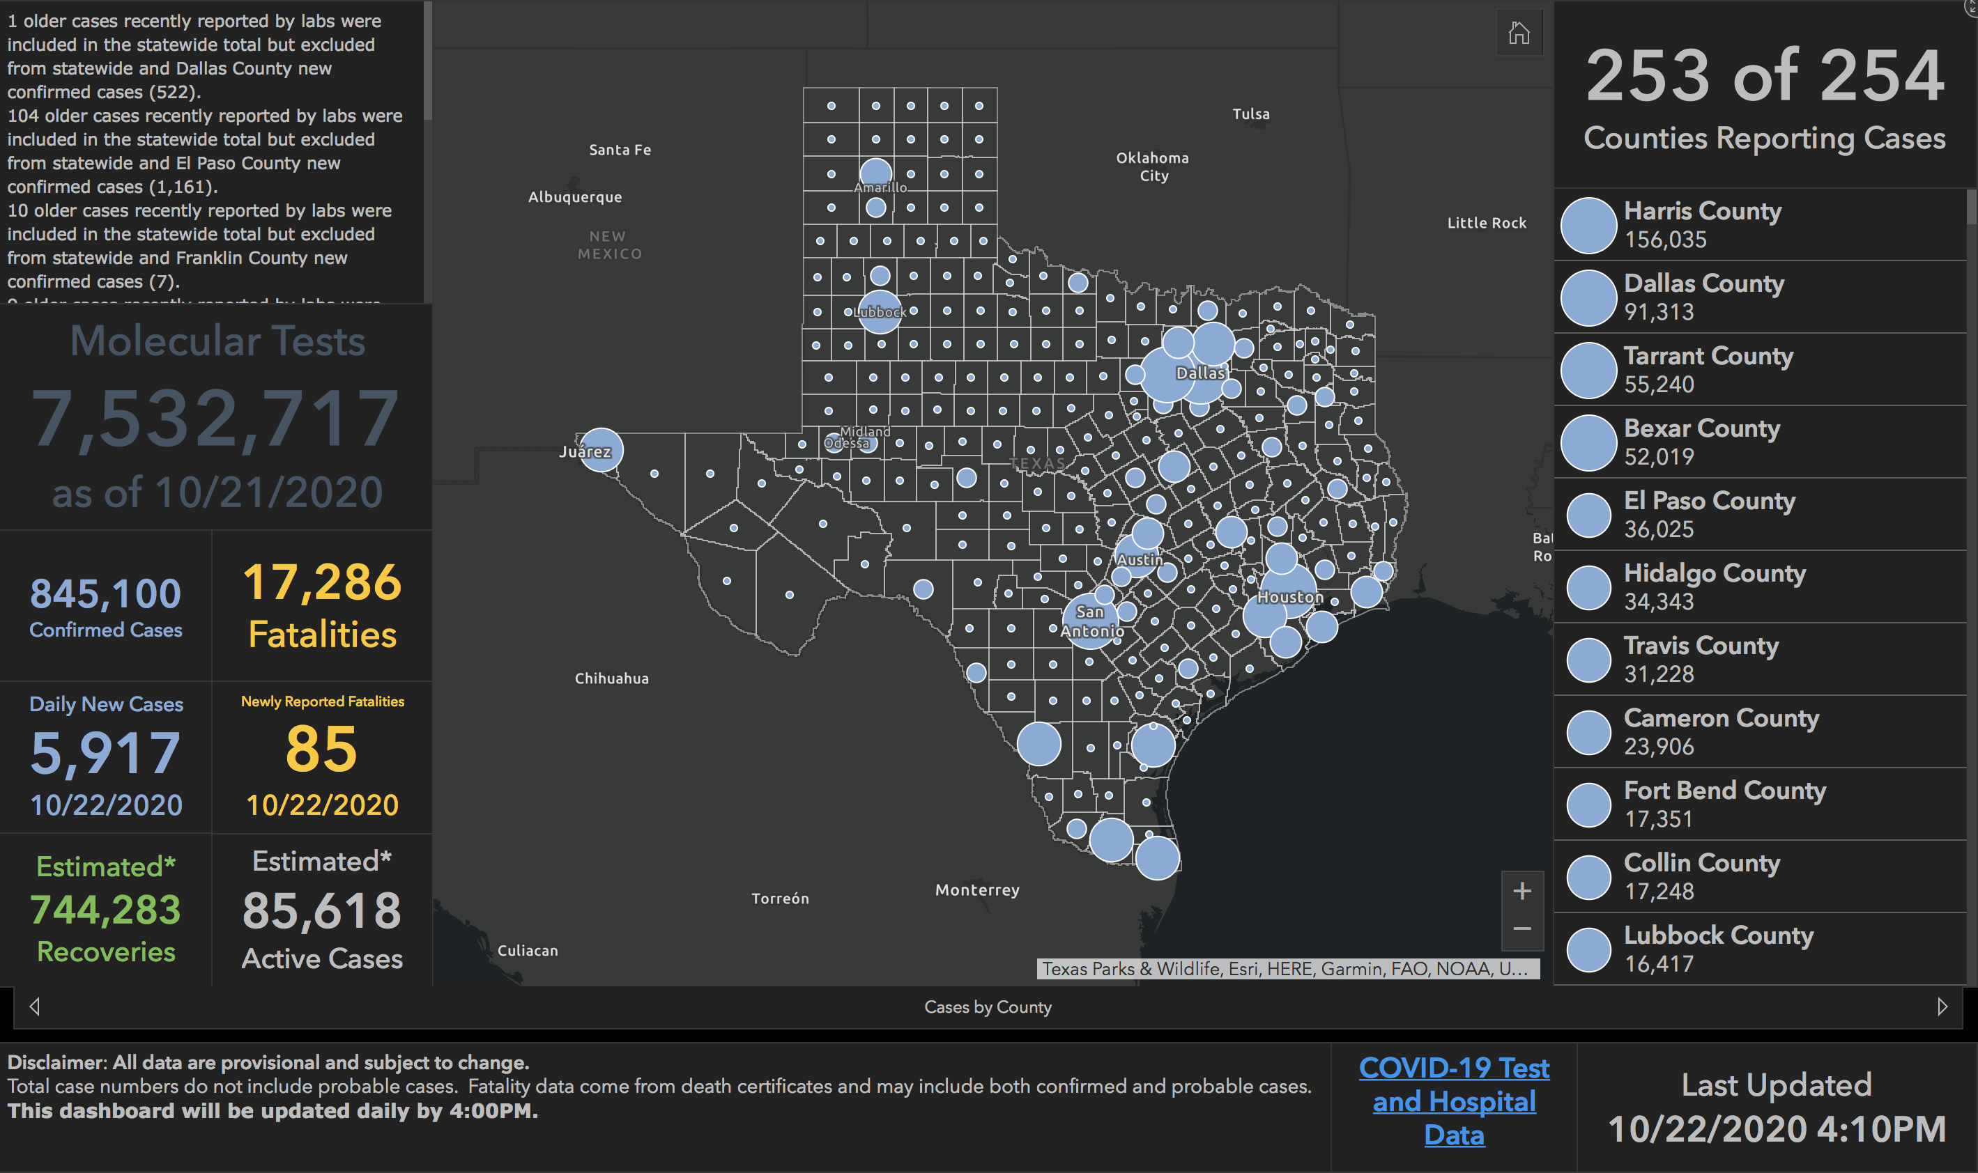

Slide 69
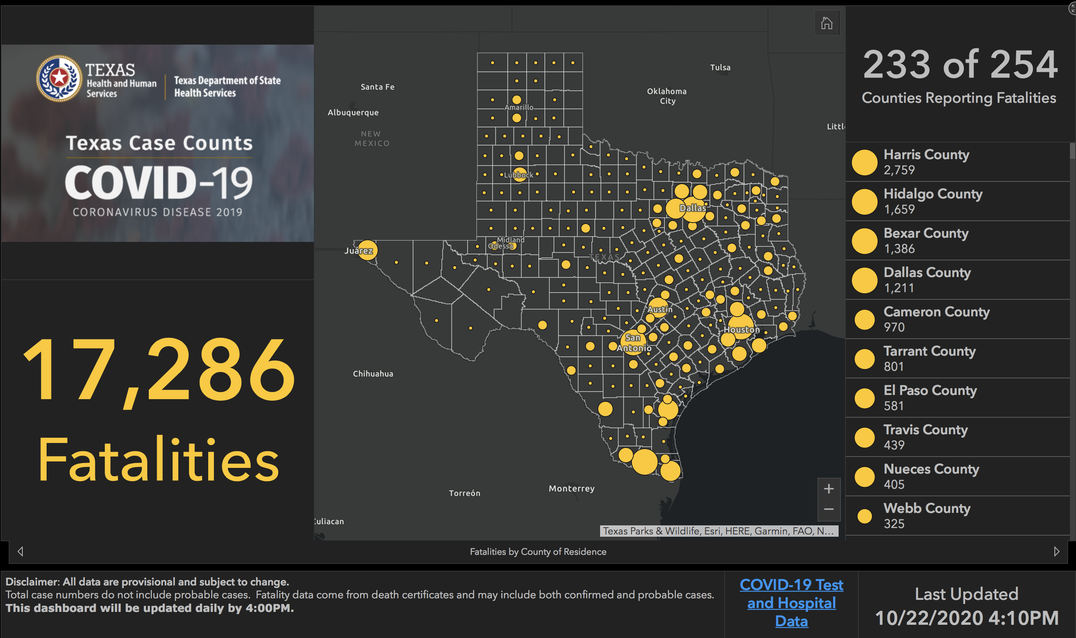

Slide 70
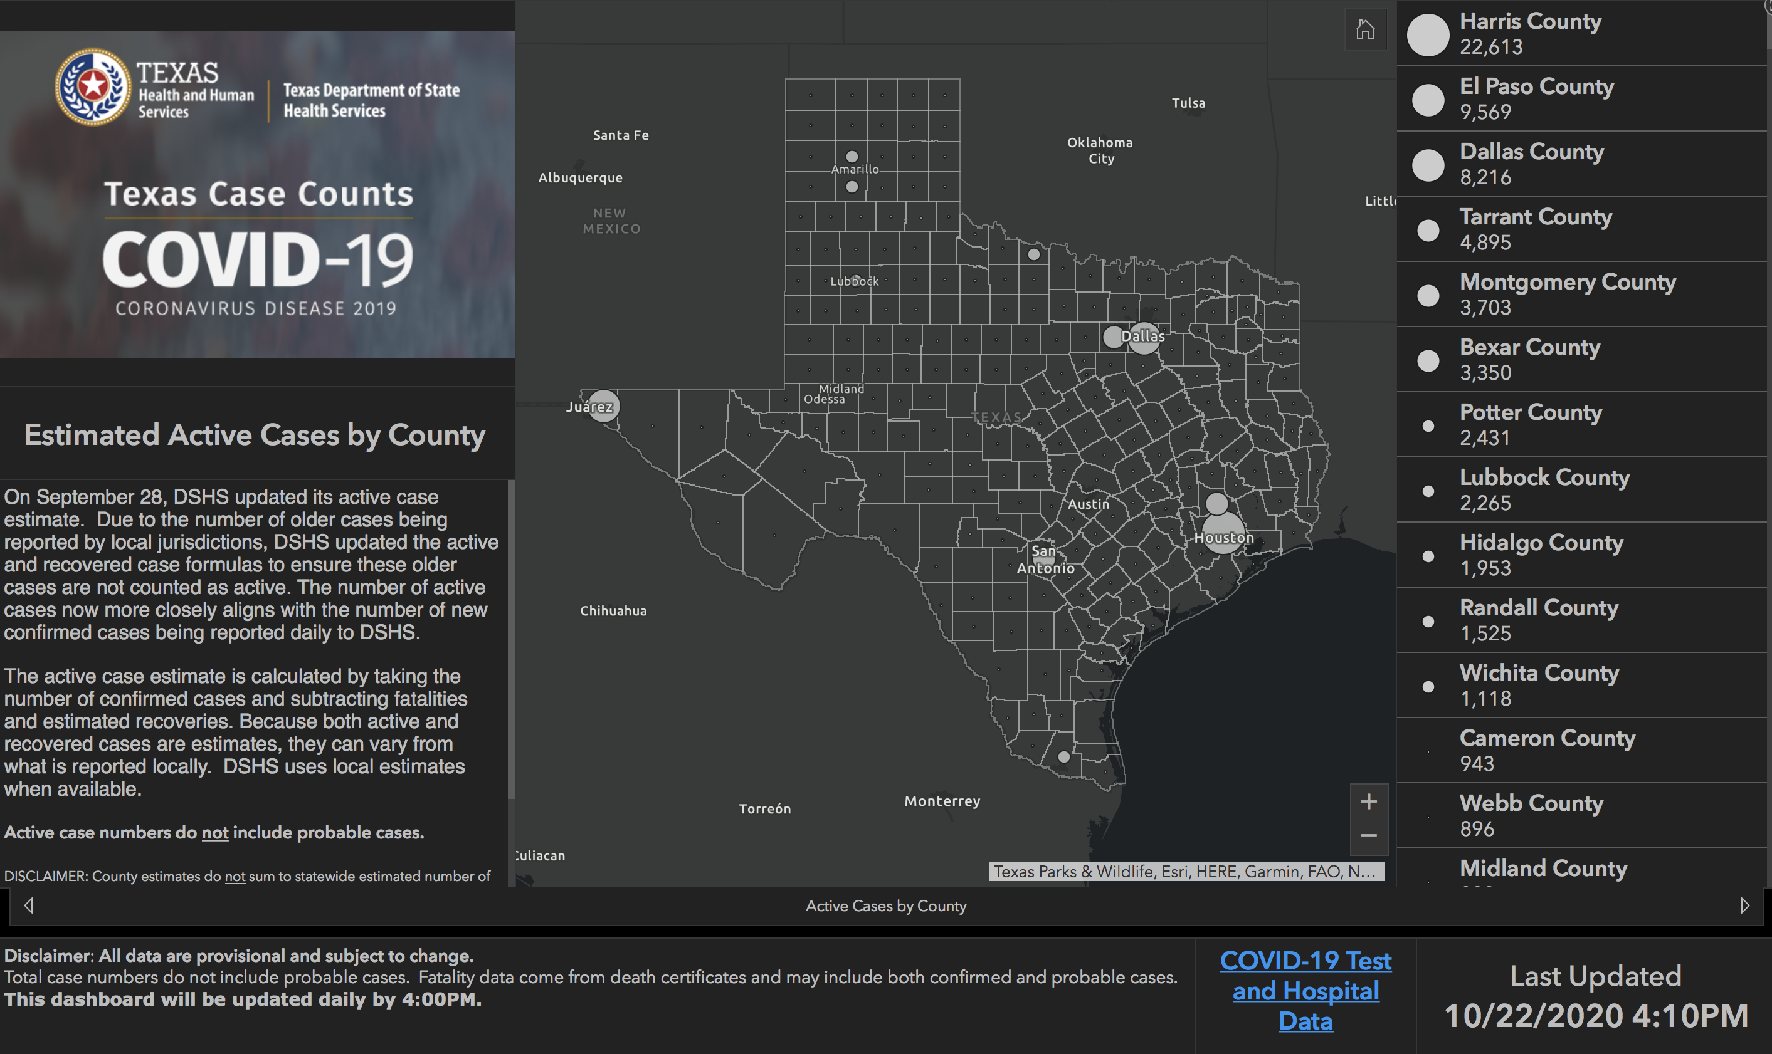

Slide 71
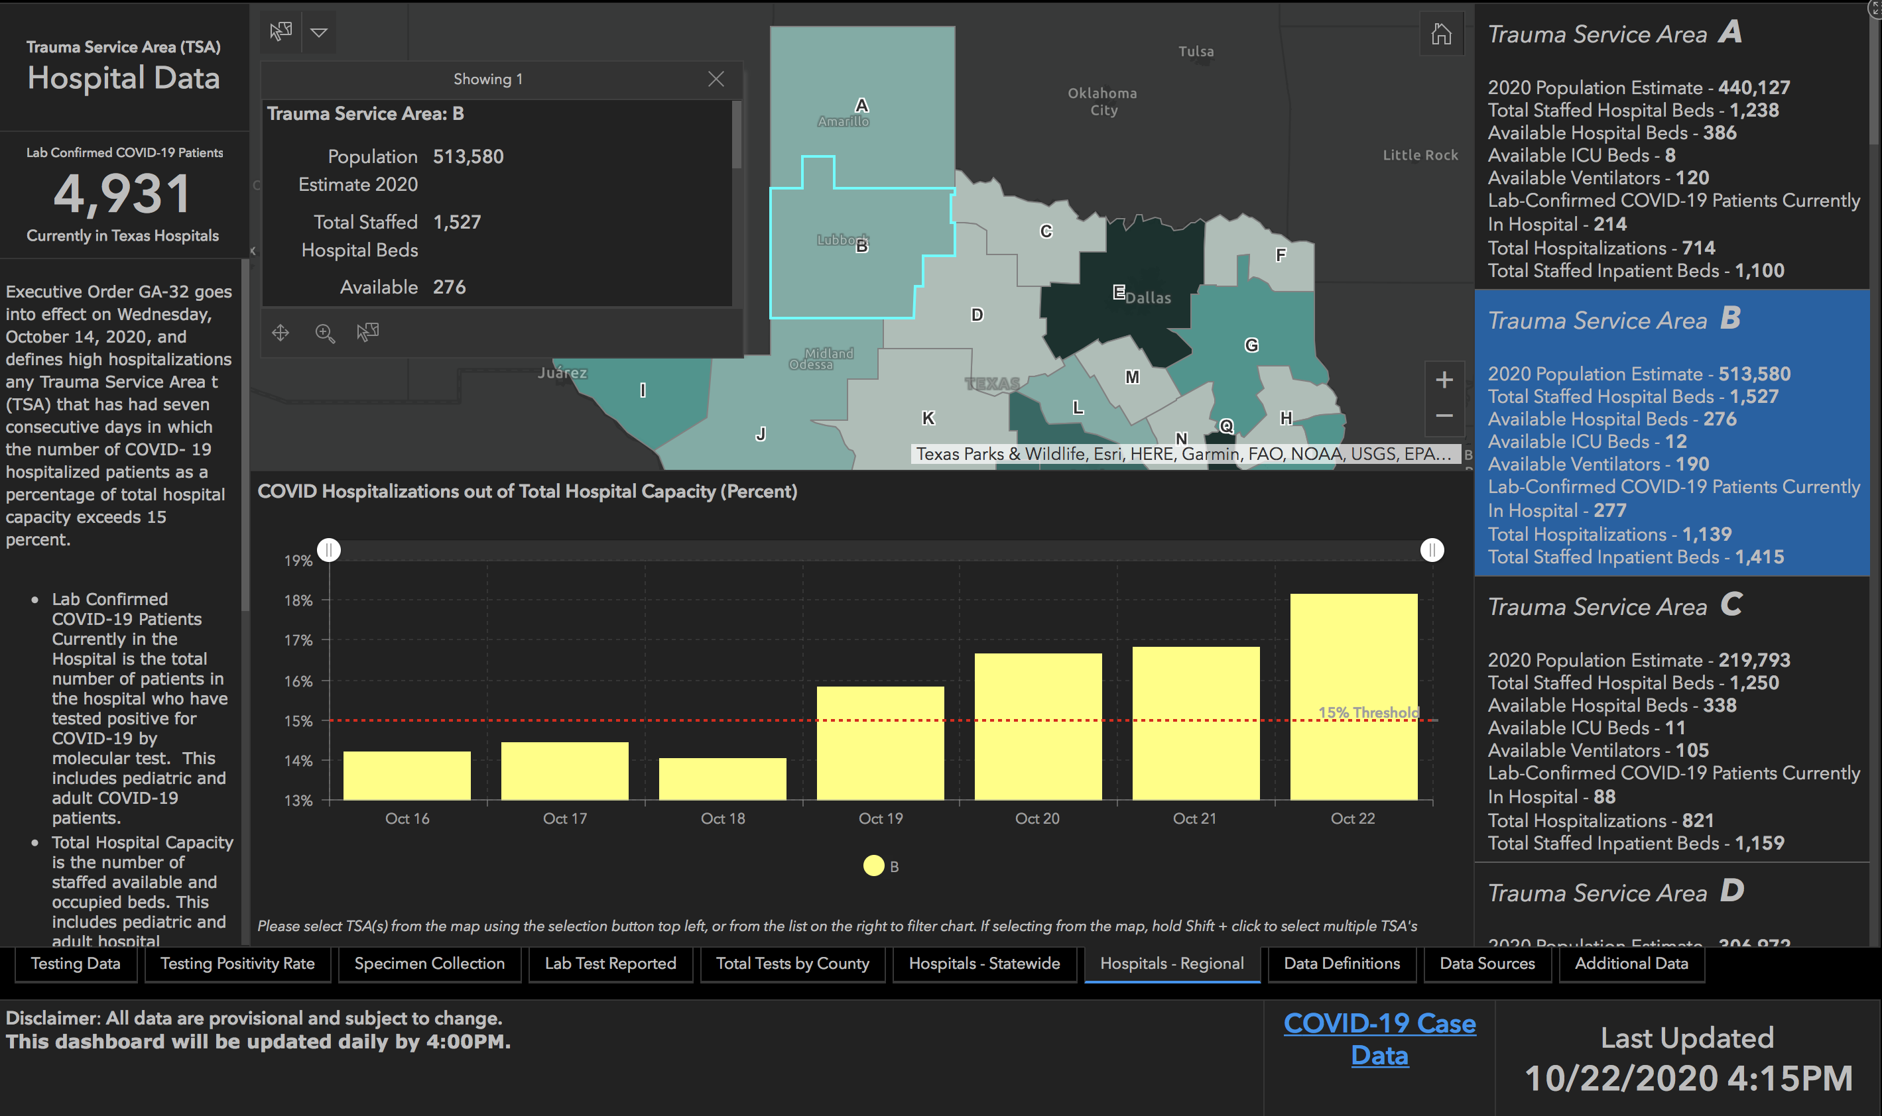

Slide 72
New Mexico Demographics

Slide 73
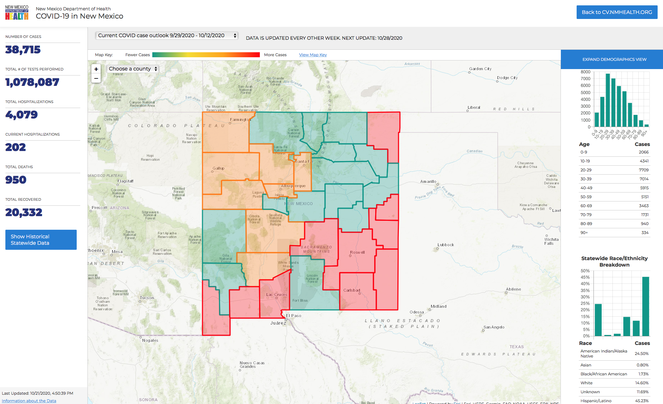

Slide 74
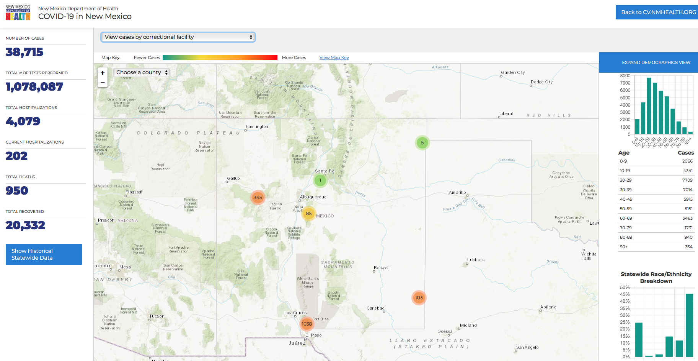

Slide 75
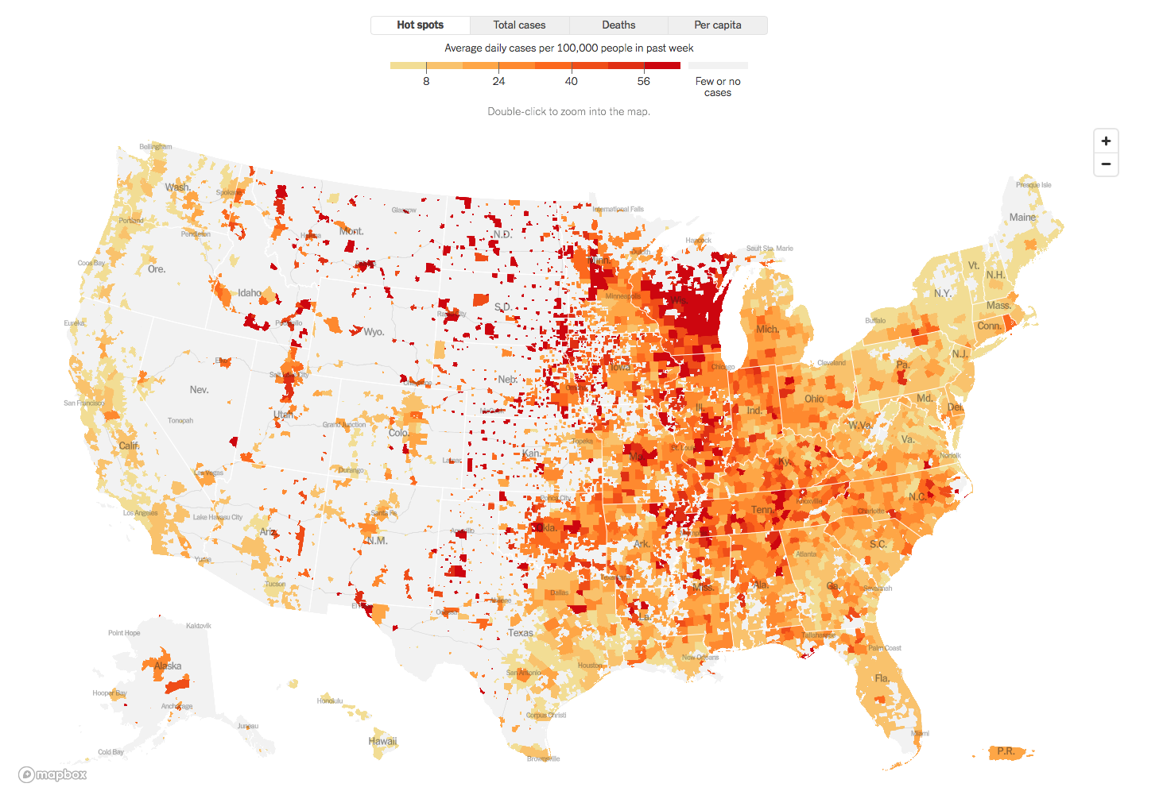

Slide 76
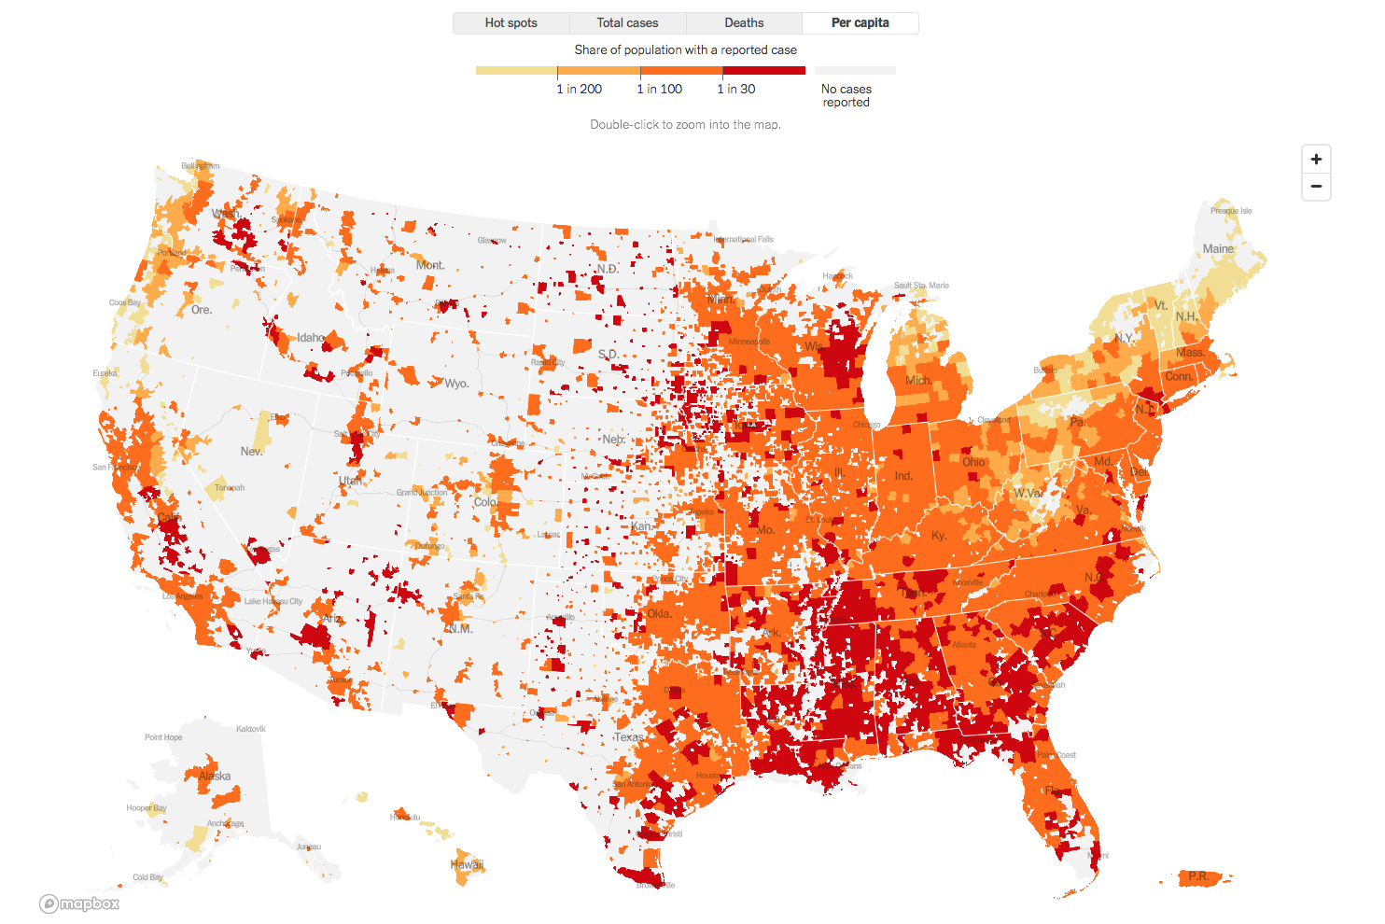

Slide 77
Q & A

Slide 78
CME Credit was only approved for the Live Teams meeting
To receive credit for this continuing education activity, the participant must:
Make sure you are logged into your Teams account, if you are signed in with a group provide attendee’s First and Last name(s) in the comments section.
If you are calling into the Teams meeting you MUST text your First & Last Name to (806) 252-4735. This will ensure you are added to the sign in sheet to receive CME Credit.
You will receive an email within 3 business days from the CME department with further instructions on claiming your certificate.

