Slide 1
Covenant Health
Presents
Critical Communications: A Weekly Physician Update
October 30, 2020

Slide 2
PHYSICIANS
Accreditation Statement:
The Covenant Health is accredited by the Texas Medical Association (TMA) to provide continuing medical education for physicians.
Credit Designation Statement:
The Covenant Health designates this live CME activity for a maximum of 1.0 AMA PRA Category 1 Credit(s)™. Physicians should claim only the credit commensurate with the extent of their participation in the activity.

Slide 3
Disclosures of Commercial Interest
The speakers and planners of this activity
have no relevant financial interests

Slide 4
Disclosures
This activity is provided by
Covenant Health
No commercial support has been received.
No products will be endorsed.
Speakers will notify the audience if off label drug use will be discussed.

Slide 5
CME Credit was only approved for the Live Teams meeting
To receive credit for this continuing education activity, the participant must:
  Make sure you are logged into your Teams account, if you are signed in with a group provide attendee’s First and Last name(s) in the comments section.
  If you are calling into the Teams meeting you MUST text your First & Last Name to (806) 252-4735. This will ensure you are added to the sign in sheet to receive CME Credit.
  You will receive an email within 3 business days from the CME department with further instructions on claiming your certificate.

Slide 6
Reflection & Safety Story
Presented by
Shannon Turnbow, MD
Pulmonary Intensivist
Covenant Medical Group

Slide 7
Safety Story
Shannon Turnbow, MD
Pulmonary Intensivist
Covenant Medical Group

Slide 8
Current Regional Covid-19 Census

Slide 9
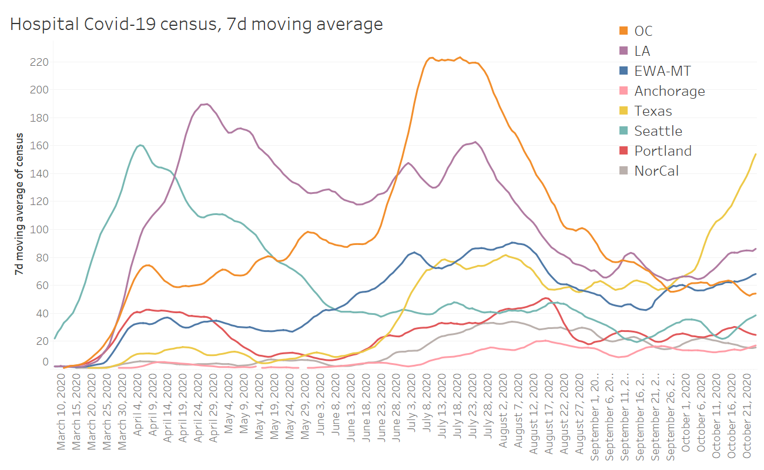

Slide 10
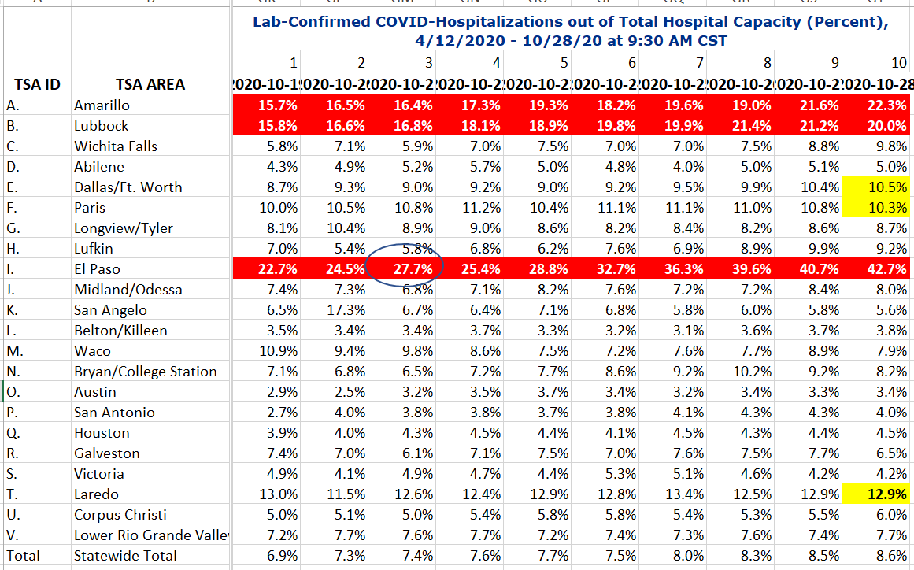
COVID+ HOSPITALIZATIONS BY TSA ID
CONFIRMED COVID+ HOSPITALIZATIONS /HOSPITAL CAPACITY

Slide 11

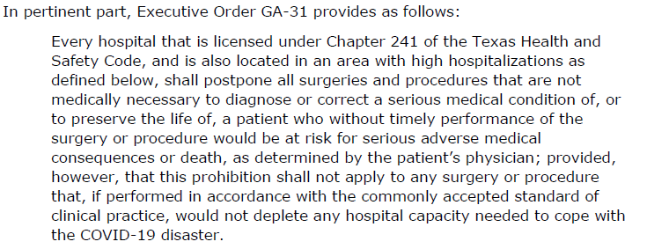
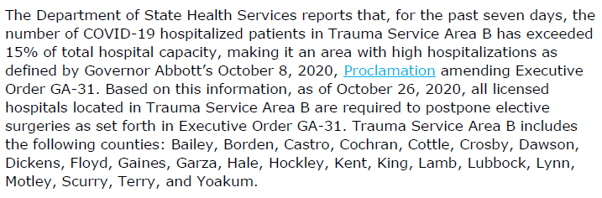
COVID+ HOSPITALIZATIONS BY TSA ID
GA-31 TSA B receives cease letter from Texas-HHS

Slide 12
DSHS – RAC Meeting
Medical Incident Support Team (MIST) plans:
Virtual MIST Team
  A and B RAC areas
  Manage the transfers, monitor diversion and appropriate requests / denials
Need to log our current requests and reason for denials
Area of Origin | Number of Patients
RAC B (Lubbock Region) | 3
RAC A (Amarillo Region) | 1
RAC J (Midland/Odessa Region) | 1
New Mexico | 4

Slide 13
Regional
 | Lubbock |  | TTU |  | Hockley |  | Hale
 | 10/26 | 10/28 | 10/26 | 10/28 | 10/25 | 10/27 | 10/26 | 10/28
Total | 17,703 | 18,712 | 2160 | 2165 | 632 | 665 | 2537 | 2632
Active | 2759 | 3298 | 222 | 197 | 122 |  |  | 301
Deaths | 184 | 195 | 0 | 0 | 14 | 14 | 63 | 65
New | 1009 |  | 5 |  | 33 |  | 95
673 highest reported
Lubbock County
Partially due to backlog of tests from day prior
Positivity Rate
Lubbock County 12.5%

Slide 14
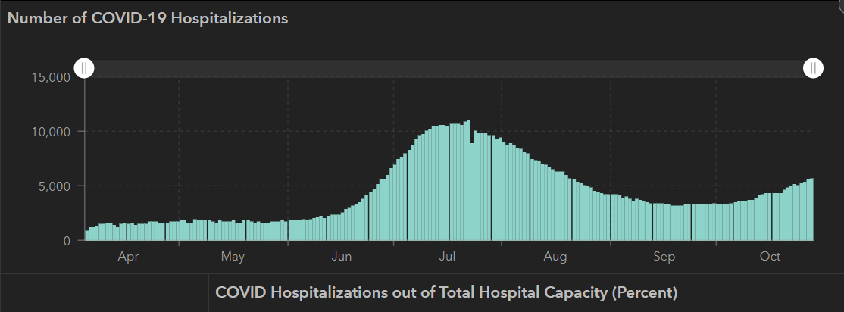
STATE
 | 10/28 | 10/26 | 10/21 | 10/14 | 10/5 | 9/23 | 9/9 | 8/26 | 8/12 | 7/29 | 7/15 | 7/1
Cases | 879,994 | 867,065 | 838,809 | 805,802 | 769,303 | 719,599 | 645,791 | 592,137 | 506,820 | 403,307 | 282,365 | 168,062
Deaths | 17,700 | 17,514 | 17,210 | 16,717 | 16,033 | 15,129 | 13,692 | 11,805 | 9034 | 6190 | 3432 | 2481
Hospitalized | 5,659 | 5,278 | 4,319 | 3,870 | 3,318 | 3,195 | 3604 | 4806 | 7028 | 9595 | 10,471 | 6904

Slide 15
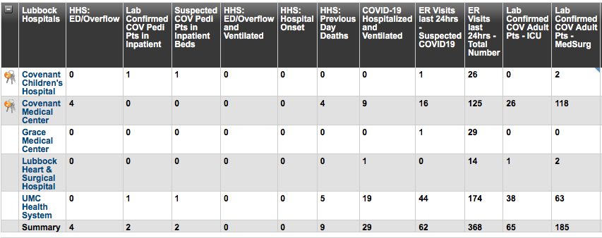
Lubbock This Morning

Slide 16
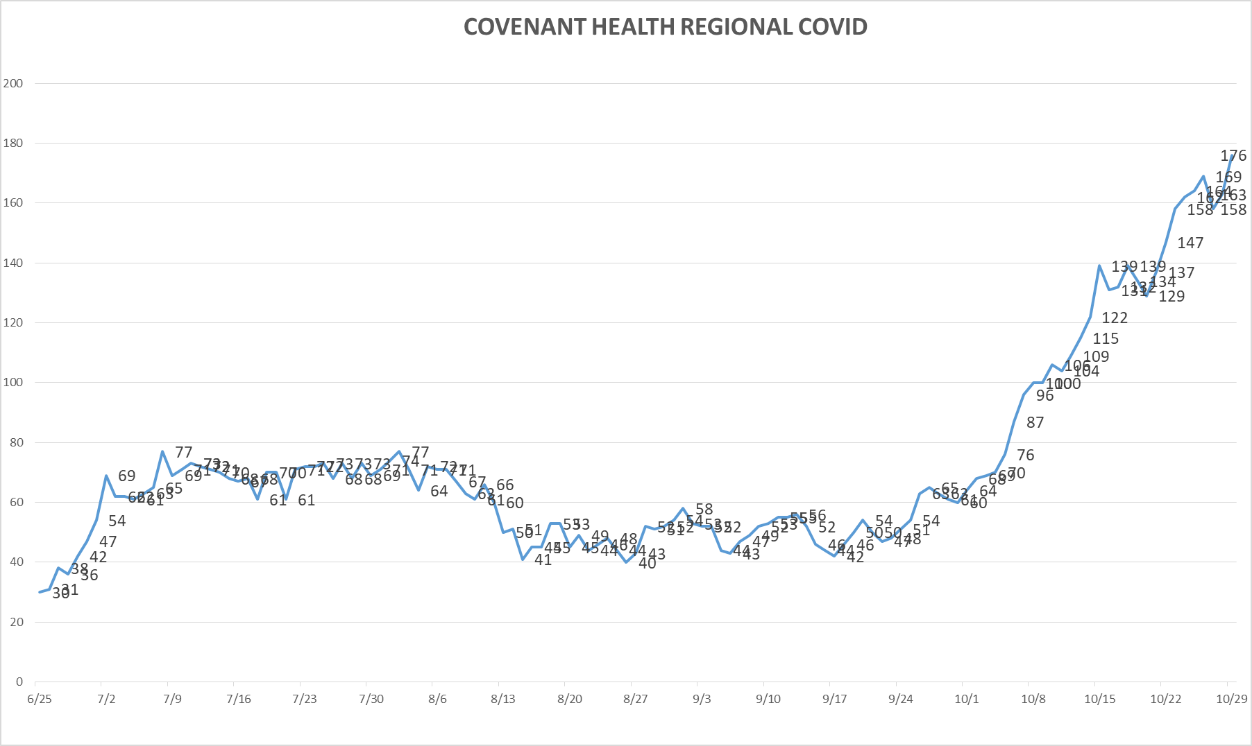
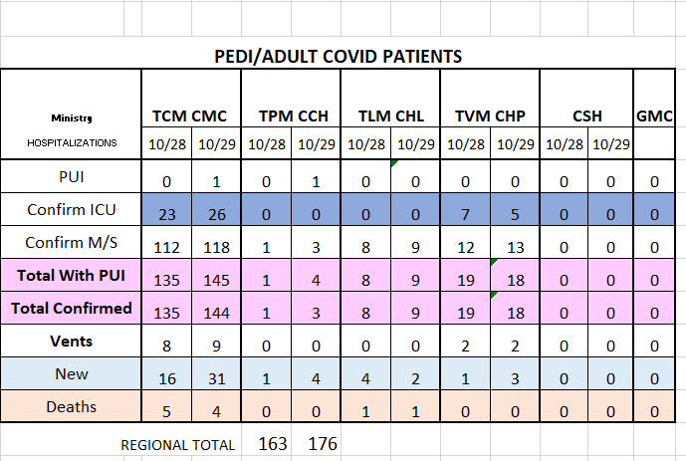
PUI/Confirmed cases-hospitalized
10/29/2020

Slide 17
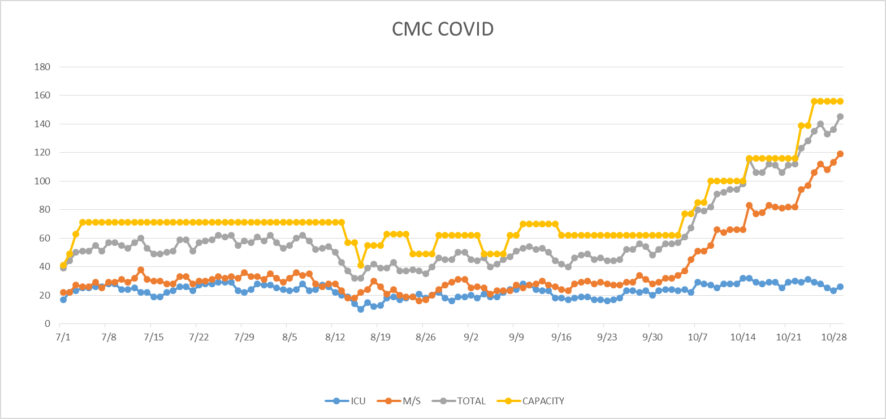
PUI/Confirmed cases-hospitalized
10/29/2020

Slide 18
Surge Plan
Covenant Medical Center
 | ICU | Med Surg | Total
Phase 1 | 10-CICU |  | 10
Phase 2 | 17-CICU | 10-HC4 | 27
Phase 3 | 17-CICU | 24-HC4 | 41
Phase 4 | 17-CICU 8-MICU | 24-HC4 14-Pal Med | 63
Phase 5 | 17-CICU 16-MICU | 24-HC4 14-Pal Med | 71
Phase 6 | 17-CICU 16-MICU 15-S 4 | 24-HC4 13-HC6 15 – S 9 (East) | 100
Phase 7 | 17-CICU 16-MICU 15-S 4 | 24-HC4 13-HC6 31 – S 9 (all) | 116
Phase 8 | 8-E4 17-CICU 16-MICU 15-S 4 | 15-S 10(East) 24-HC4 13-HC6 31 – S 9 (all) | 139
Phase 9 | 16-E4 (all) 17-CICU 16-MICU 15-S 4 | 30 S10 (all) 24-HC4 13-HC6 31 – S 9 (all) | 162
Last Week
Currently

Slide 19
CENSUS
 | 10/19 | 10/20 | 10/21 | 10/22 | 10/23 |  | 10/26 | 10/27 | 10/28 | 10/29 | 10/30
CMC (360) | 319 | 327 | 336 | 337 | 328 |  | 343 | 344 | 336 | 351
Cases (41) | 34 | 29 | 23 |  | 23 |  | 26 | 21 | 18
CCH (135) | 71 | 90 | 82 | 81 | 86 |  | 74 | 80 | 104 | 92
Cases (19) | 12 | 10 | 8 |  | 12 |  | 12
GMC (18) | 3 | 9 | 17 | 21 | 13 |  | 4 | 4 | 9 | 5
Cases (20) | 14 | 12 | 12 | 9 | 8 |  | 3 | 6 | 12 | 0
CHP (49) | 35 | 38 | 39 | 44 | 45 |  | 37 | 46 | 40 | 44
Cases (19) | 11 | 7 | 11 | 16 | 11 |  | 11 | 5 | 3 | 13
CHL (18) | 14 | 16 |  | 17 |  | 8 |  | 8 | 9 | 16
cases | 0 | 1 |  | 1 |  |  |  | 4 | 0 | 1
CSH (35) | 27 | 27 | 25 | 26 | 17 |  | 29 | 29 | 33 | 33

Slide 20
Statistics
Cristian Requenez, MS
Clinical Data Analyst
Clinical Excellence
Covenant Health

Slide 21
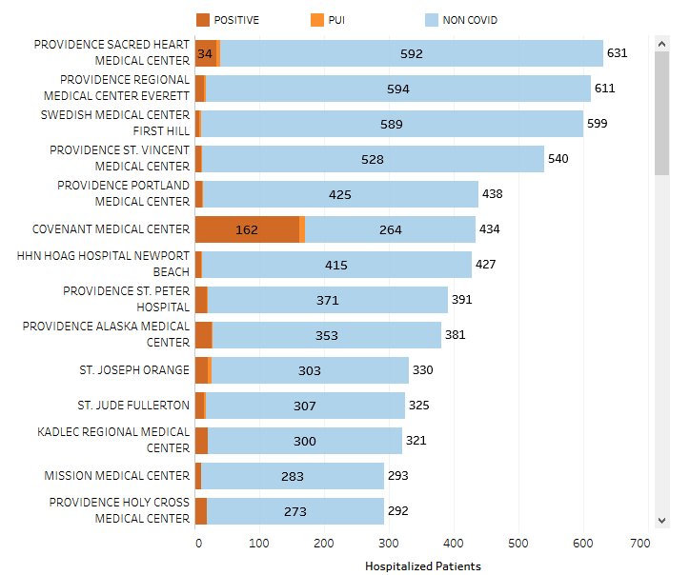
Providence System Hospitalized COVID-19 Cases

Slide 22
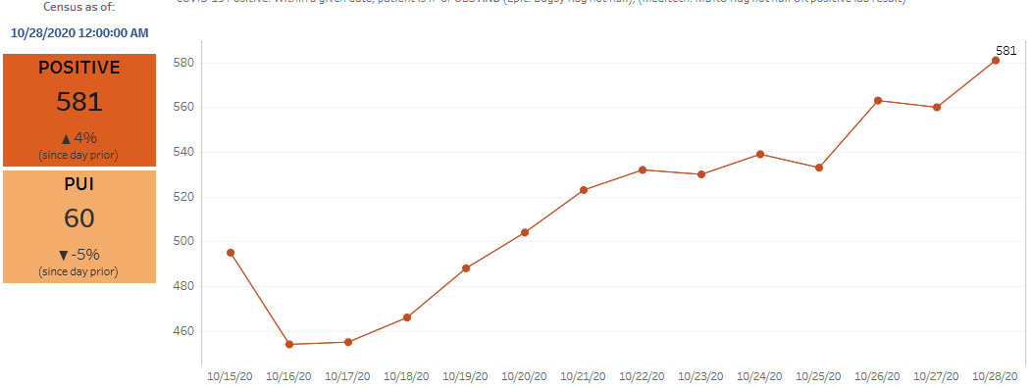
Providence Inpatient COVID-19 Volume

Slide 23
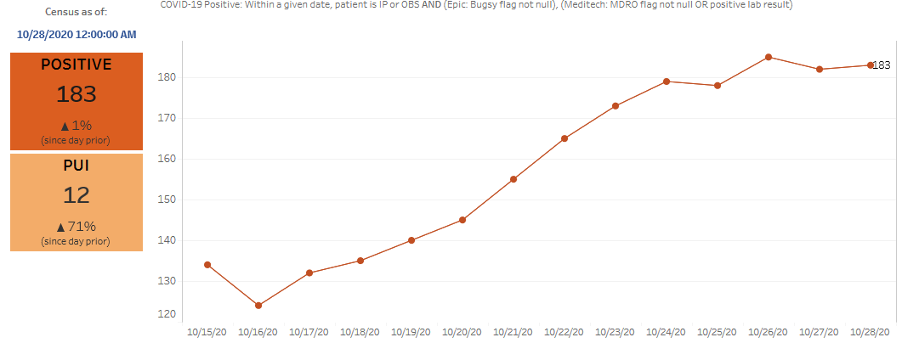
Texas Inpatient COVID-19 Volume

Slide 24
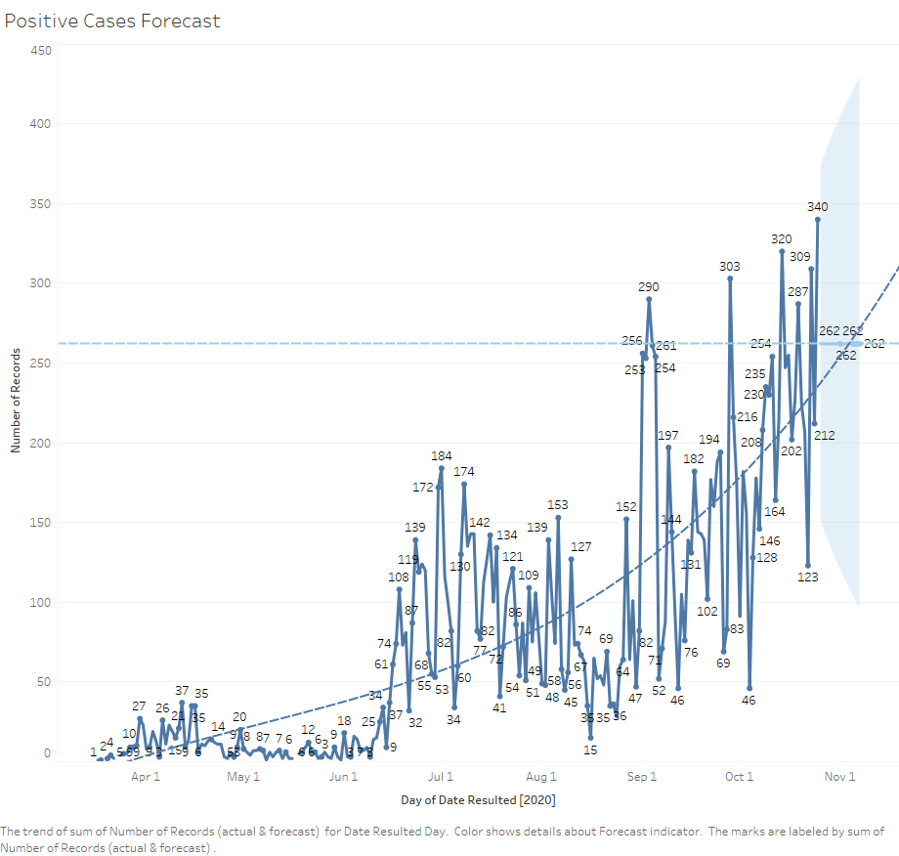
New COVID-19 POSITIVES by Day Trend

Slide 25
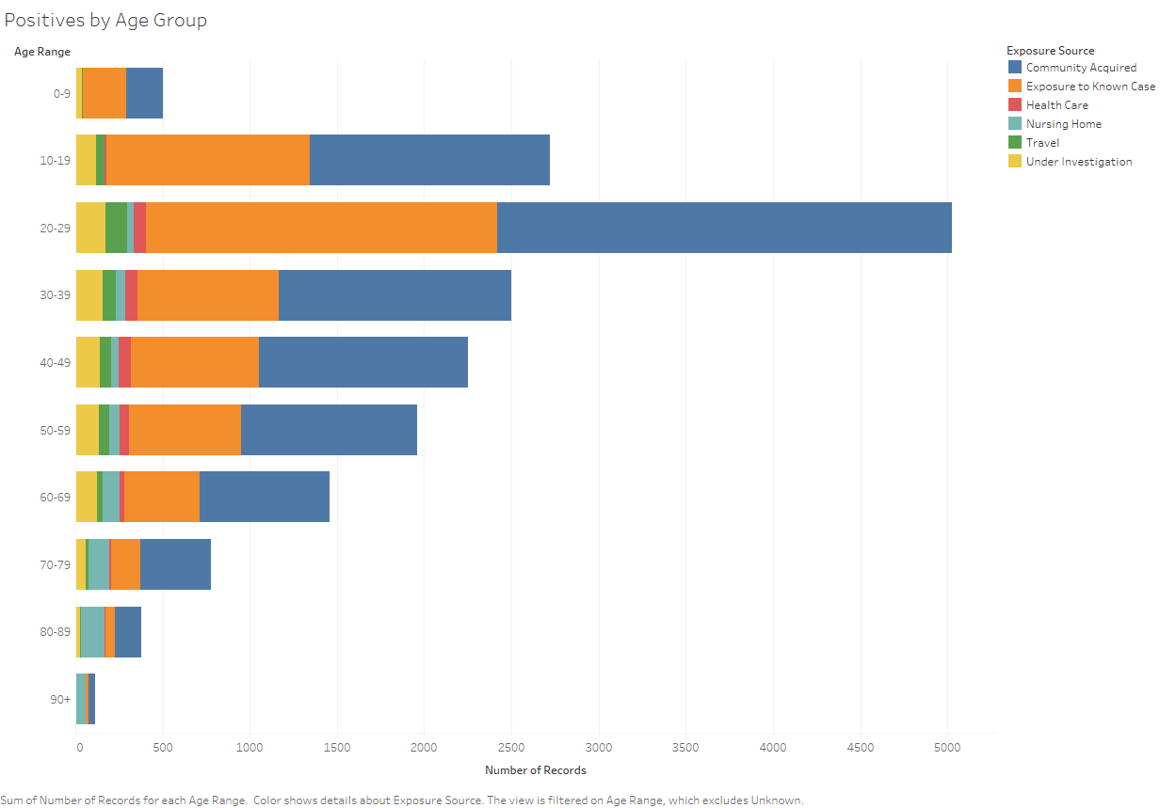
COVID-19 POSITIVES Age Distribution

Slide 26
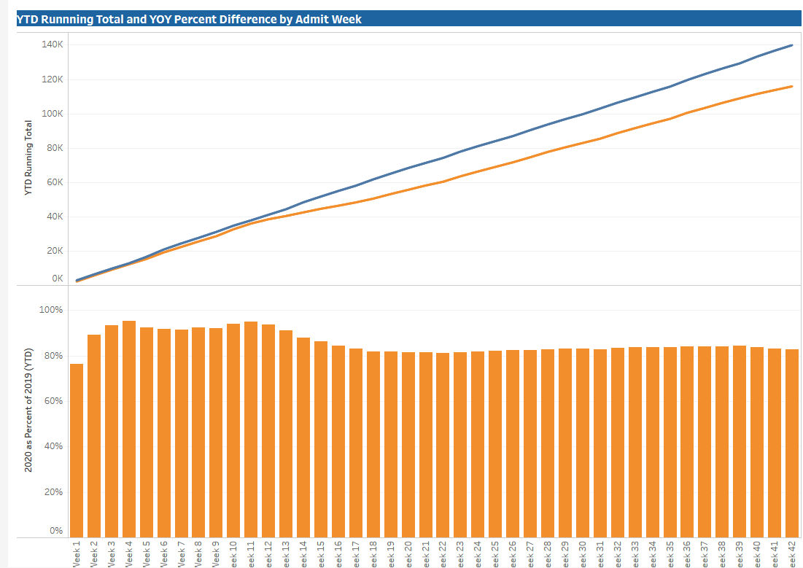
TX/NM Region Weekly Procedures (YOY)

Slide 27
Caregiver Update

Slide 28
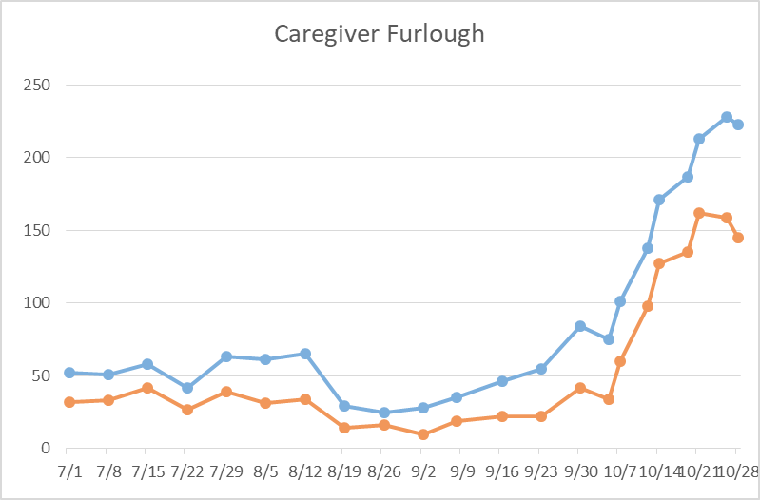
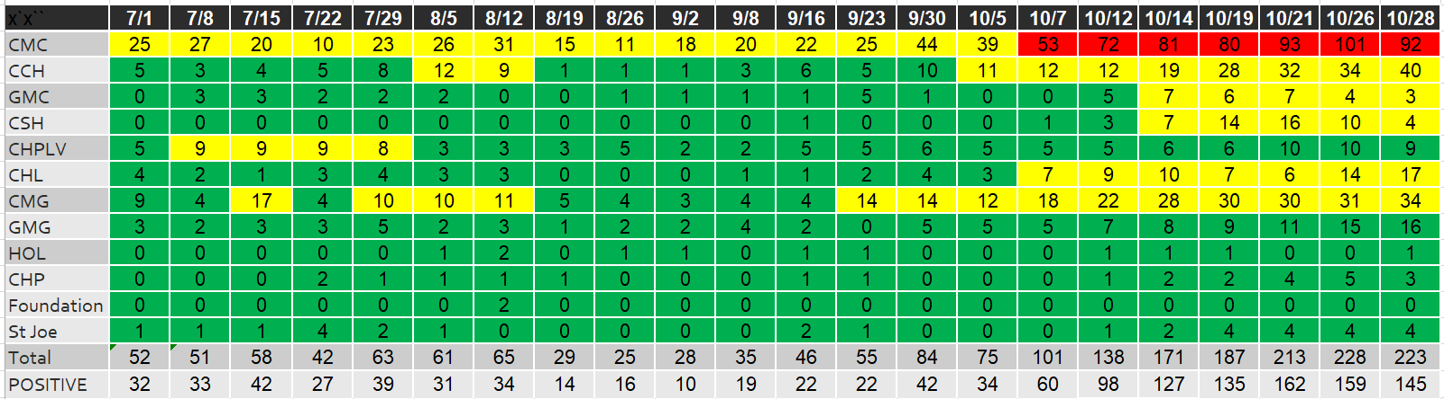
Caregivers
COVID Related Furloughs
65% are positive
Count reflects # furlough (exposed and positive)
Good
Moderate
Critical

Slide 29

STAR Requests for staffing
10-30-20
We received notice THIS MORNING that we will receive an additional 50 caregivers today and (possibly 6 more tomorrow) Distribution TBD

Slide 30
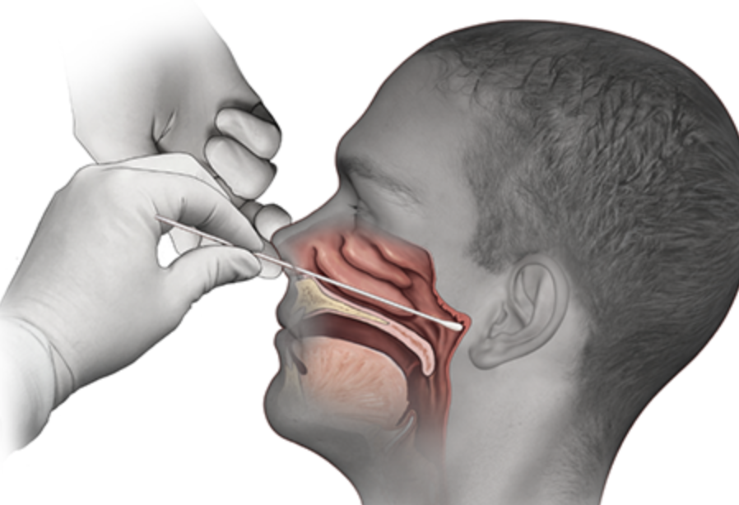
Covid-19 Testing
Jason T. Loos, MD
Ameripath

Slide 31
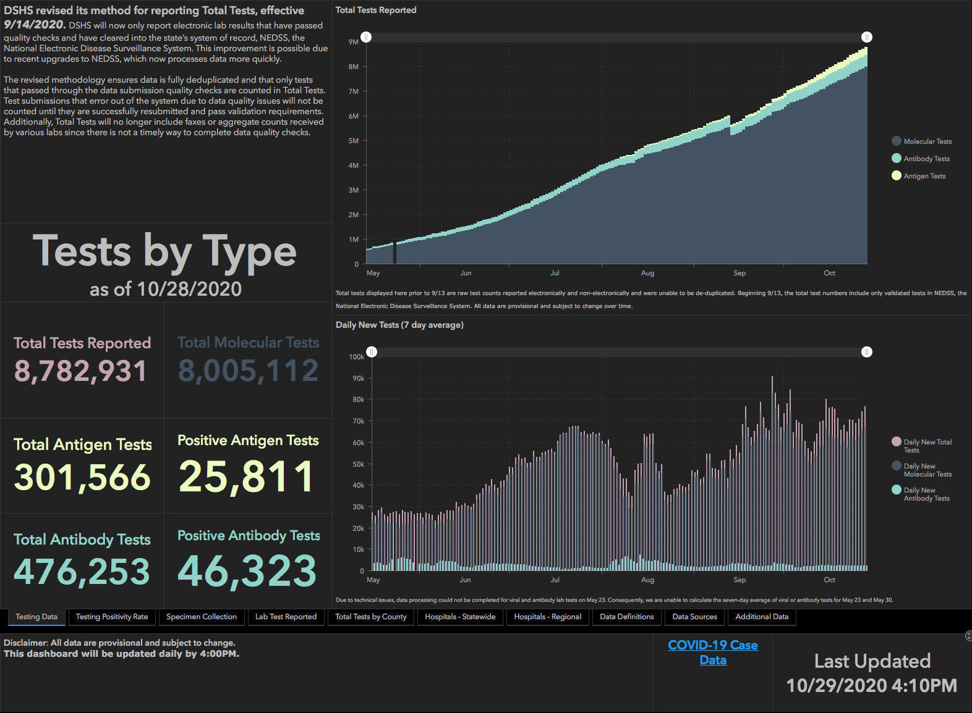

Slide 32
TESTING
 | CMC |  | GMC |  | CMG
 | Rapid | PCR | Rapid | PCR | Rapid
Test Kits
Swabs
VTM
 | CMC |  | GMG/CMG
 | Tests | + | Tests | +
10/23 | 197 | 45 | 294 | 83
10/24 | 314 | 46 | 259 | 39
10/25 | 379 | 91 | 44 | 17
10/26 | 116 | 52 | 60 | 17
10/27 | 97 | 21 | 268 | 92
10/28 | 69 | 14 | 262 | 91
>2000 >750
<2000 <750
<1600 <500
CMC- Alinity down, Technician onsite

Slide 33
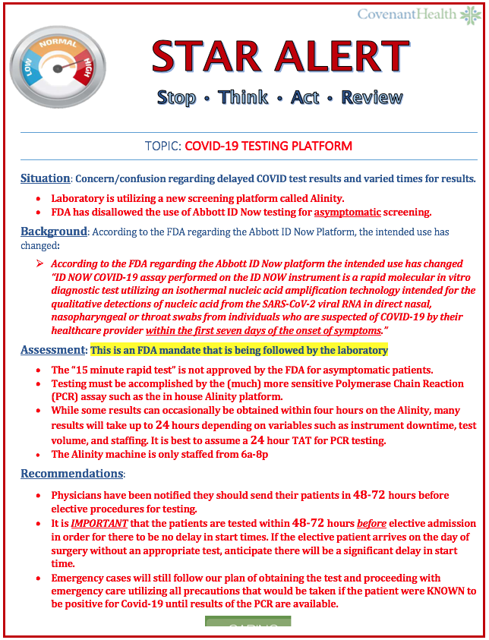
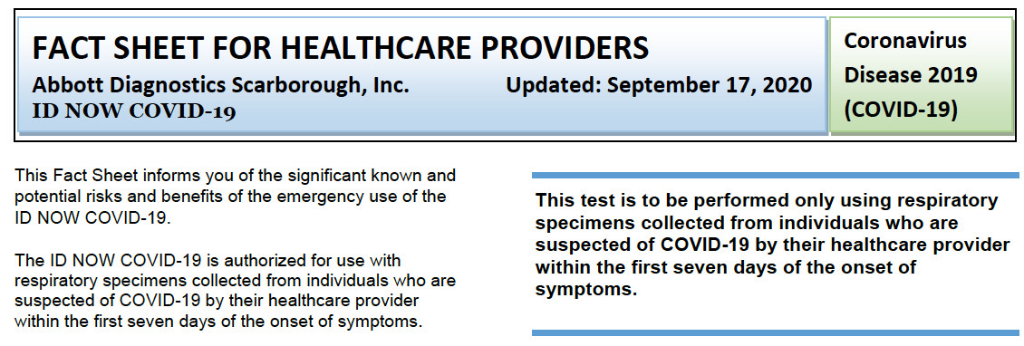
New FDA Guidelines

Slide 34
Clarification on Testing
The Abbott ID Now Platform has been our WORKHORSE for testing patients that are symptomatic and suspected of having Covid-19. NOTHING HAS CHANGED IN THIS REGARD!
It is only the ASYMPTOMATIC Patients that the FDA has required us not to use this platform.

Slide 35
Pre-op Testing of Asymptomatic Patients
Covenant has recently responded to an FDA announcement, affecting pre-op testing, resulting in a change of our protocols
Given the high rate of false negative results in asymptomatic patients, the FDA will no longer permit the use of the rapid (15-min) Abbott ID Now test for pre-procedure evaluation
  Positive test results for COVID-19 indicate that RNA from SARS-CoV-2 was detected, and therefore the patient is infected with the virus and presumed to be contagious
  Negative tests DO NOT rule out COVID-19 and should not be used as the sole basis for treatment or management decisions
    Negative results should be treated as presumptive, and if inconsistent with sign/symptoms, patients should be retested with an alternate assay
    It is possible to test the patient too early or too late during COVID-19 infection to make an accurate diagnosis
Covenant has no control over this change. We strive to provide you the resources necessary for the most effective care of your patients. Thank you for your understanding
https://www.cdc.gov/coronavirus/2019-ncov/symptoms- testing/symptoms.html

Slide 36
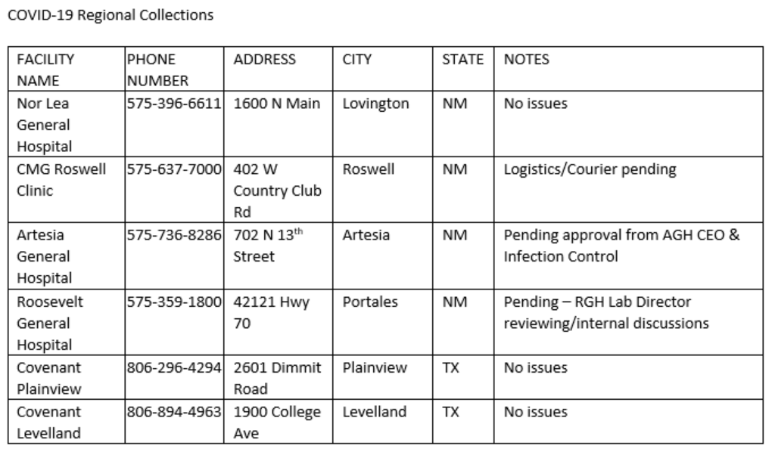

Muleshoe
Dimmitt (Plains Memorial)
Tahoka (Lynn Co)
Denver City (Yoakum Co)
Big Springs (Scenic Mtn)
Seminole (Seminole Memorial)
Snyder (Cogdell Memorial)

Slide 37
Testing our Heroes

Slide 38
Caregivers
Testing Our Heroes (antibody testing)
  CMC 10/26 – 10/30 7:30 AM – 5:00 PM Main Lobby by Piano
  CCH 11/2 – 11/6 7:30 AM – 5:00 PM Arnett Room
  Levelland 10/27 and 10/28 8:00 AM – 5:00 PM Atrium
  Plainview 10/26 and 10/28 8:00 Am – 5:00 PM, Lab
  Specialty go to the Texas Cardiac Center 3710 21st St 10/26 – 11/6 8:00 AM – 5 PM extended hours Tu/Thu 7:30 AM to 6 PM

Slide 39
Caregivers
Testing Our Heroes (antibody testing)
  Grace Clinic 10/26 – 11/6 8:00AM – 5:00 PM
  Grace Medical Center – go to Grace clinic or other clinic locations
  CMG Clinics 11/2 – 11/6 8:00 AM to 5 PM
    Northwest Clinic 611 North Frankford Ave
    Southwest Clinic 9812 Slide Road
    Health Plus 7601 Quaker
    Memphis Place Mall 3801 50th Street

Slide 40
Caregivers
Testing Our Heroes
  Online Registration
    Providence.lumedic.id
    This will lead the person to Redcap
    Registration will start after you click on “Region/Service Area” and Select Texas

Slide 41
Pharmacy Update
Larry Pineda, PharmD
Clinical Pharmacist – AMS
Covenant Health

Slide 42
Remdesivir Inventory
Ministry | Patients Receiving Treatment | Stock (vials)
Covenant Medical Center | 51 | 360
Covenant Children’s Hospital | 0 | 0
Covenant Plainview | 10 | 111
Covenant Levelland | 1 | 40
Last updated: 10/29/20

Slide 43
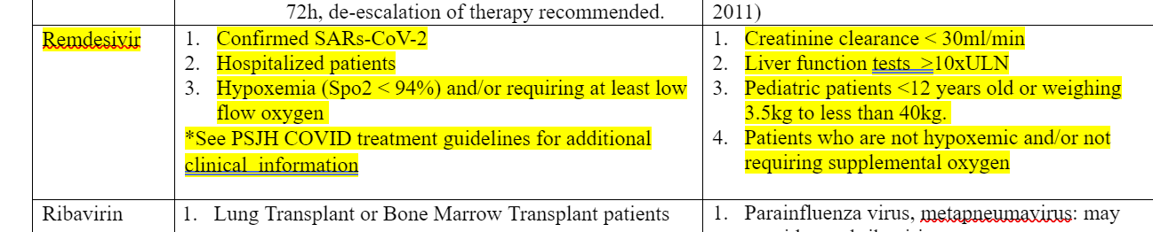
PSJH Formulary Recommendation
Tier 2: Reserved antiinfective
Note: pediatric use = EUA (consent required)

Slide 44
PSJH AMS COVID-19 Subgroup
Notes:
invasive mechanical ventilation or ECMO:RDVplus DEX(CIII)

Slide 45
Communications Update

Slide 46
ASK IP
Infection Prevention presents….

Slide 47
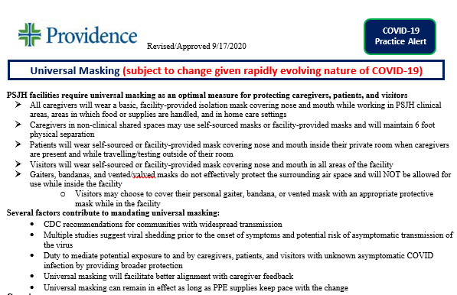
COVID-19
LUCIDOC-->
CHS COVID
Universal Masking

Slide 48
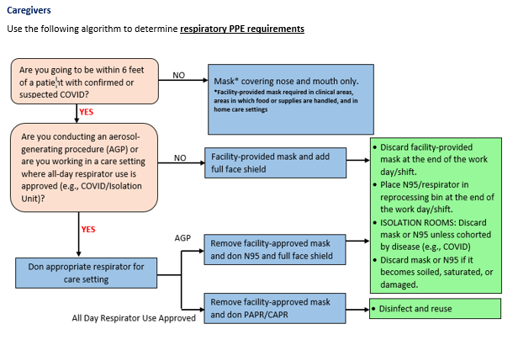
LUCIDOC→
CHS COVID
Universal Masking

Slide 49
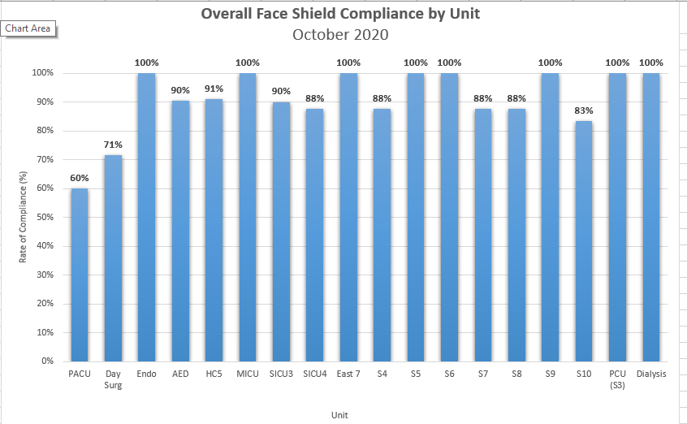
October
Face Shield when with patient care

Slide 50
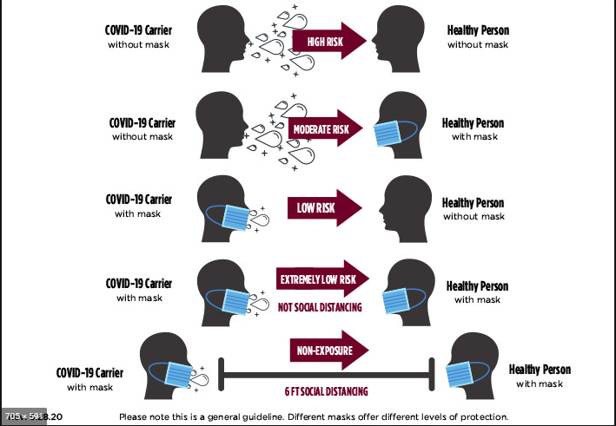
How do masks help prevent the spread of COVID?
Masks Reduce the Level of Risks for Exposure from Caregivers and Patients

Slide 51
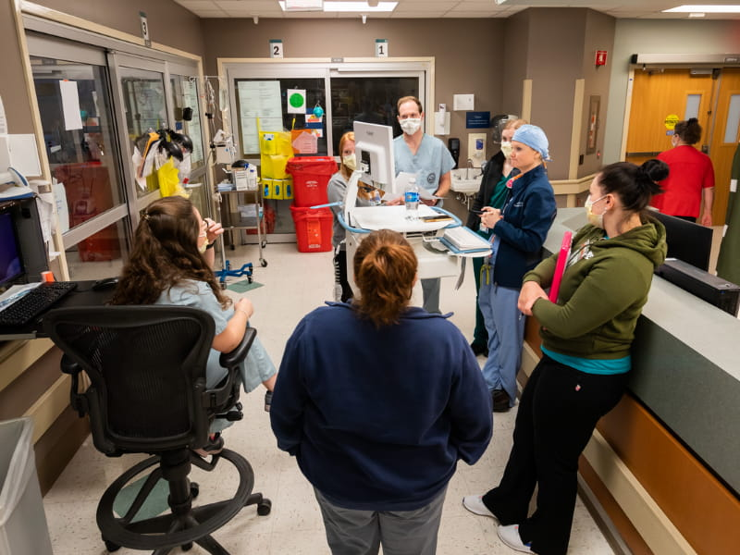

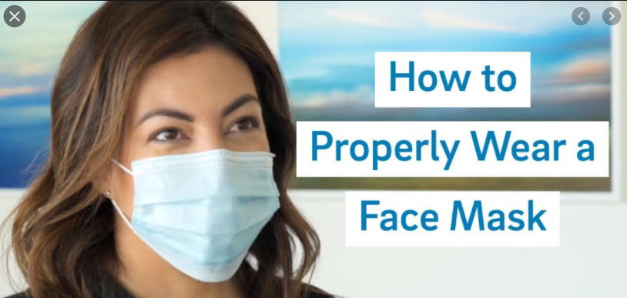
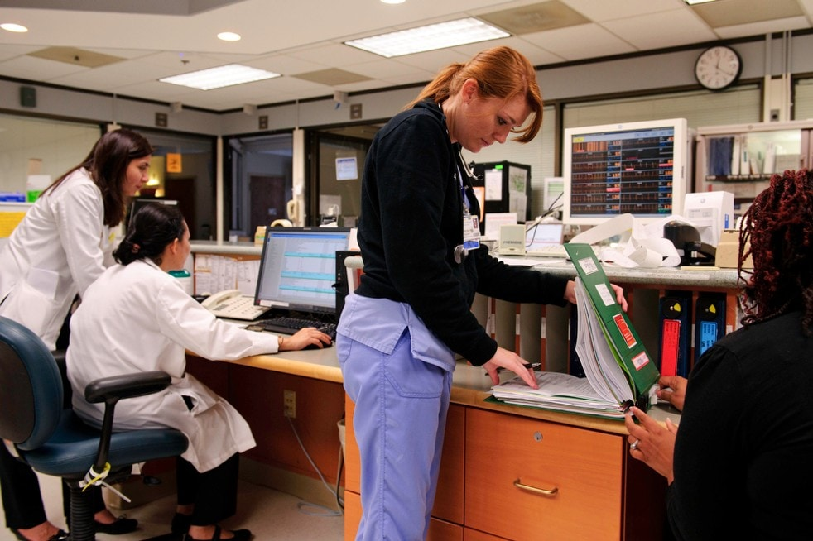
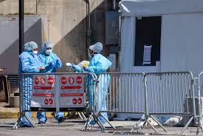
Are you wearing your mask correctly in all encounters at work

Slide 52

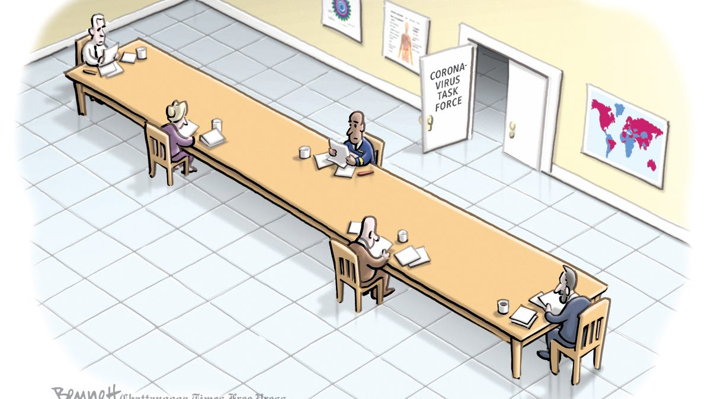
Social distancing while eating No mask

Slide 53
Infection Preventionist On Call
(806) 252-1762
Questions?

Slide 54

Texas Demographics

Slide 55
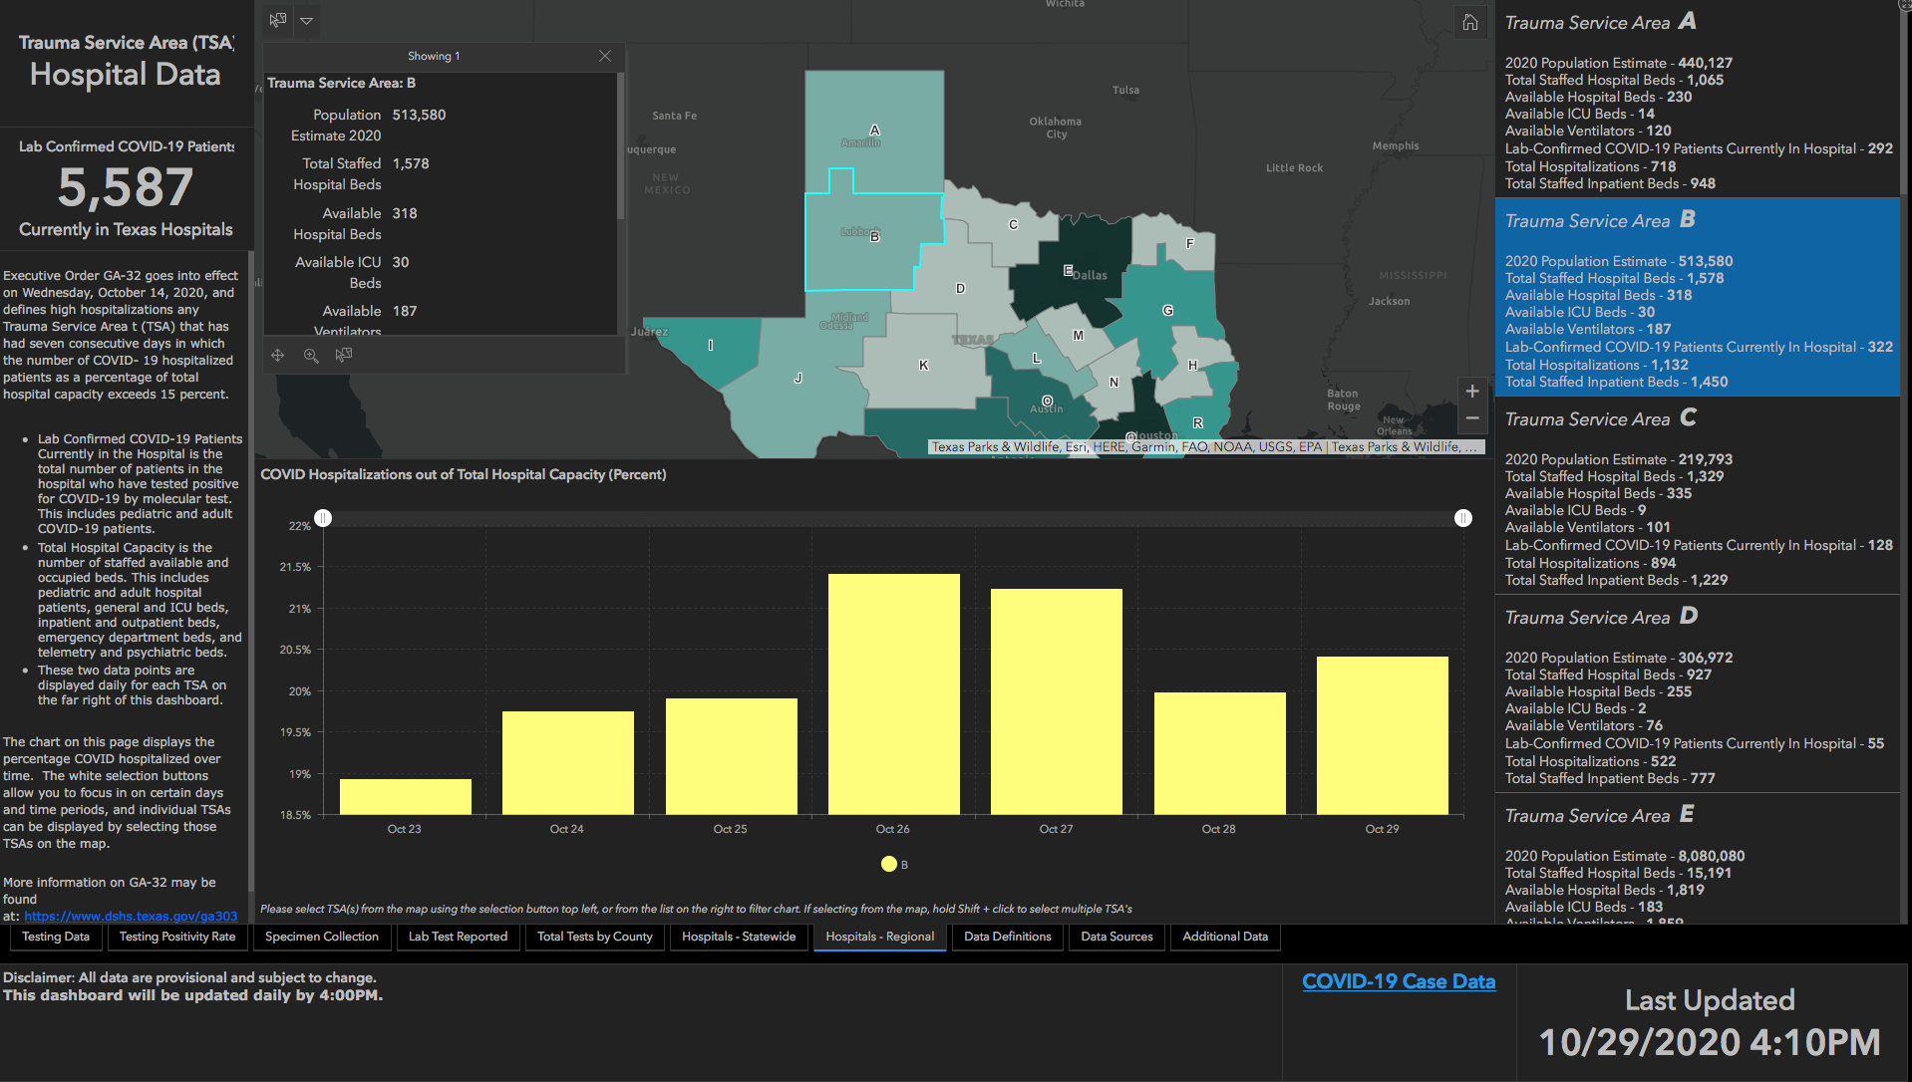
21.41%
21.23%
20.41%
19.9%
19.97%
19.75%
18.93%

Slide 56
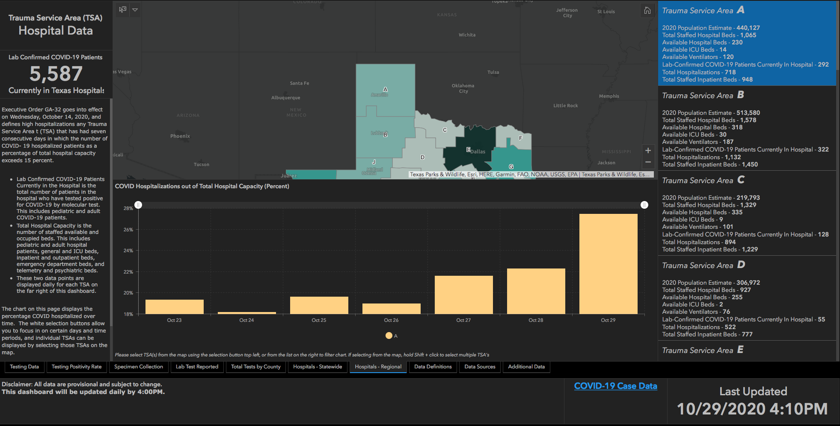
27.42%
21.59%
22.29%
19.31%
19.62%
18.17%
18.99%

Slide 57
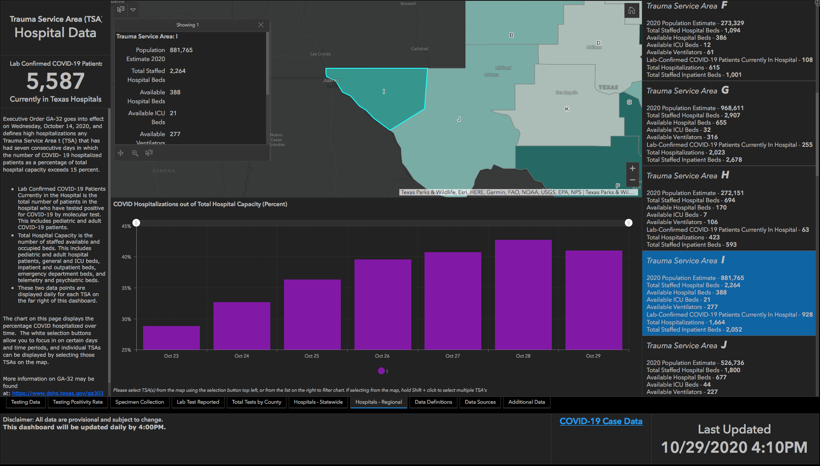
42.7%
40.99%
39.58%
40.72%
36.32%
32.68%
28.82%

Slide 58
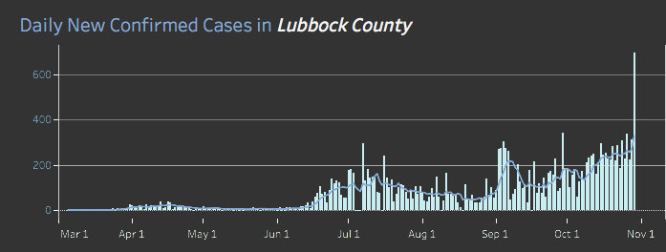
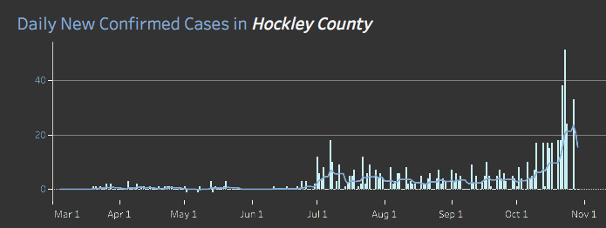
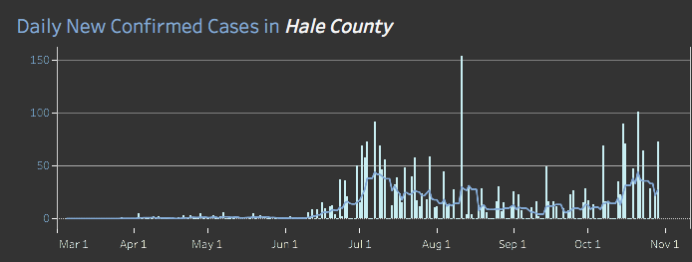
Daily New Confirmed Cases For Our Area

Slide 59
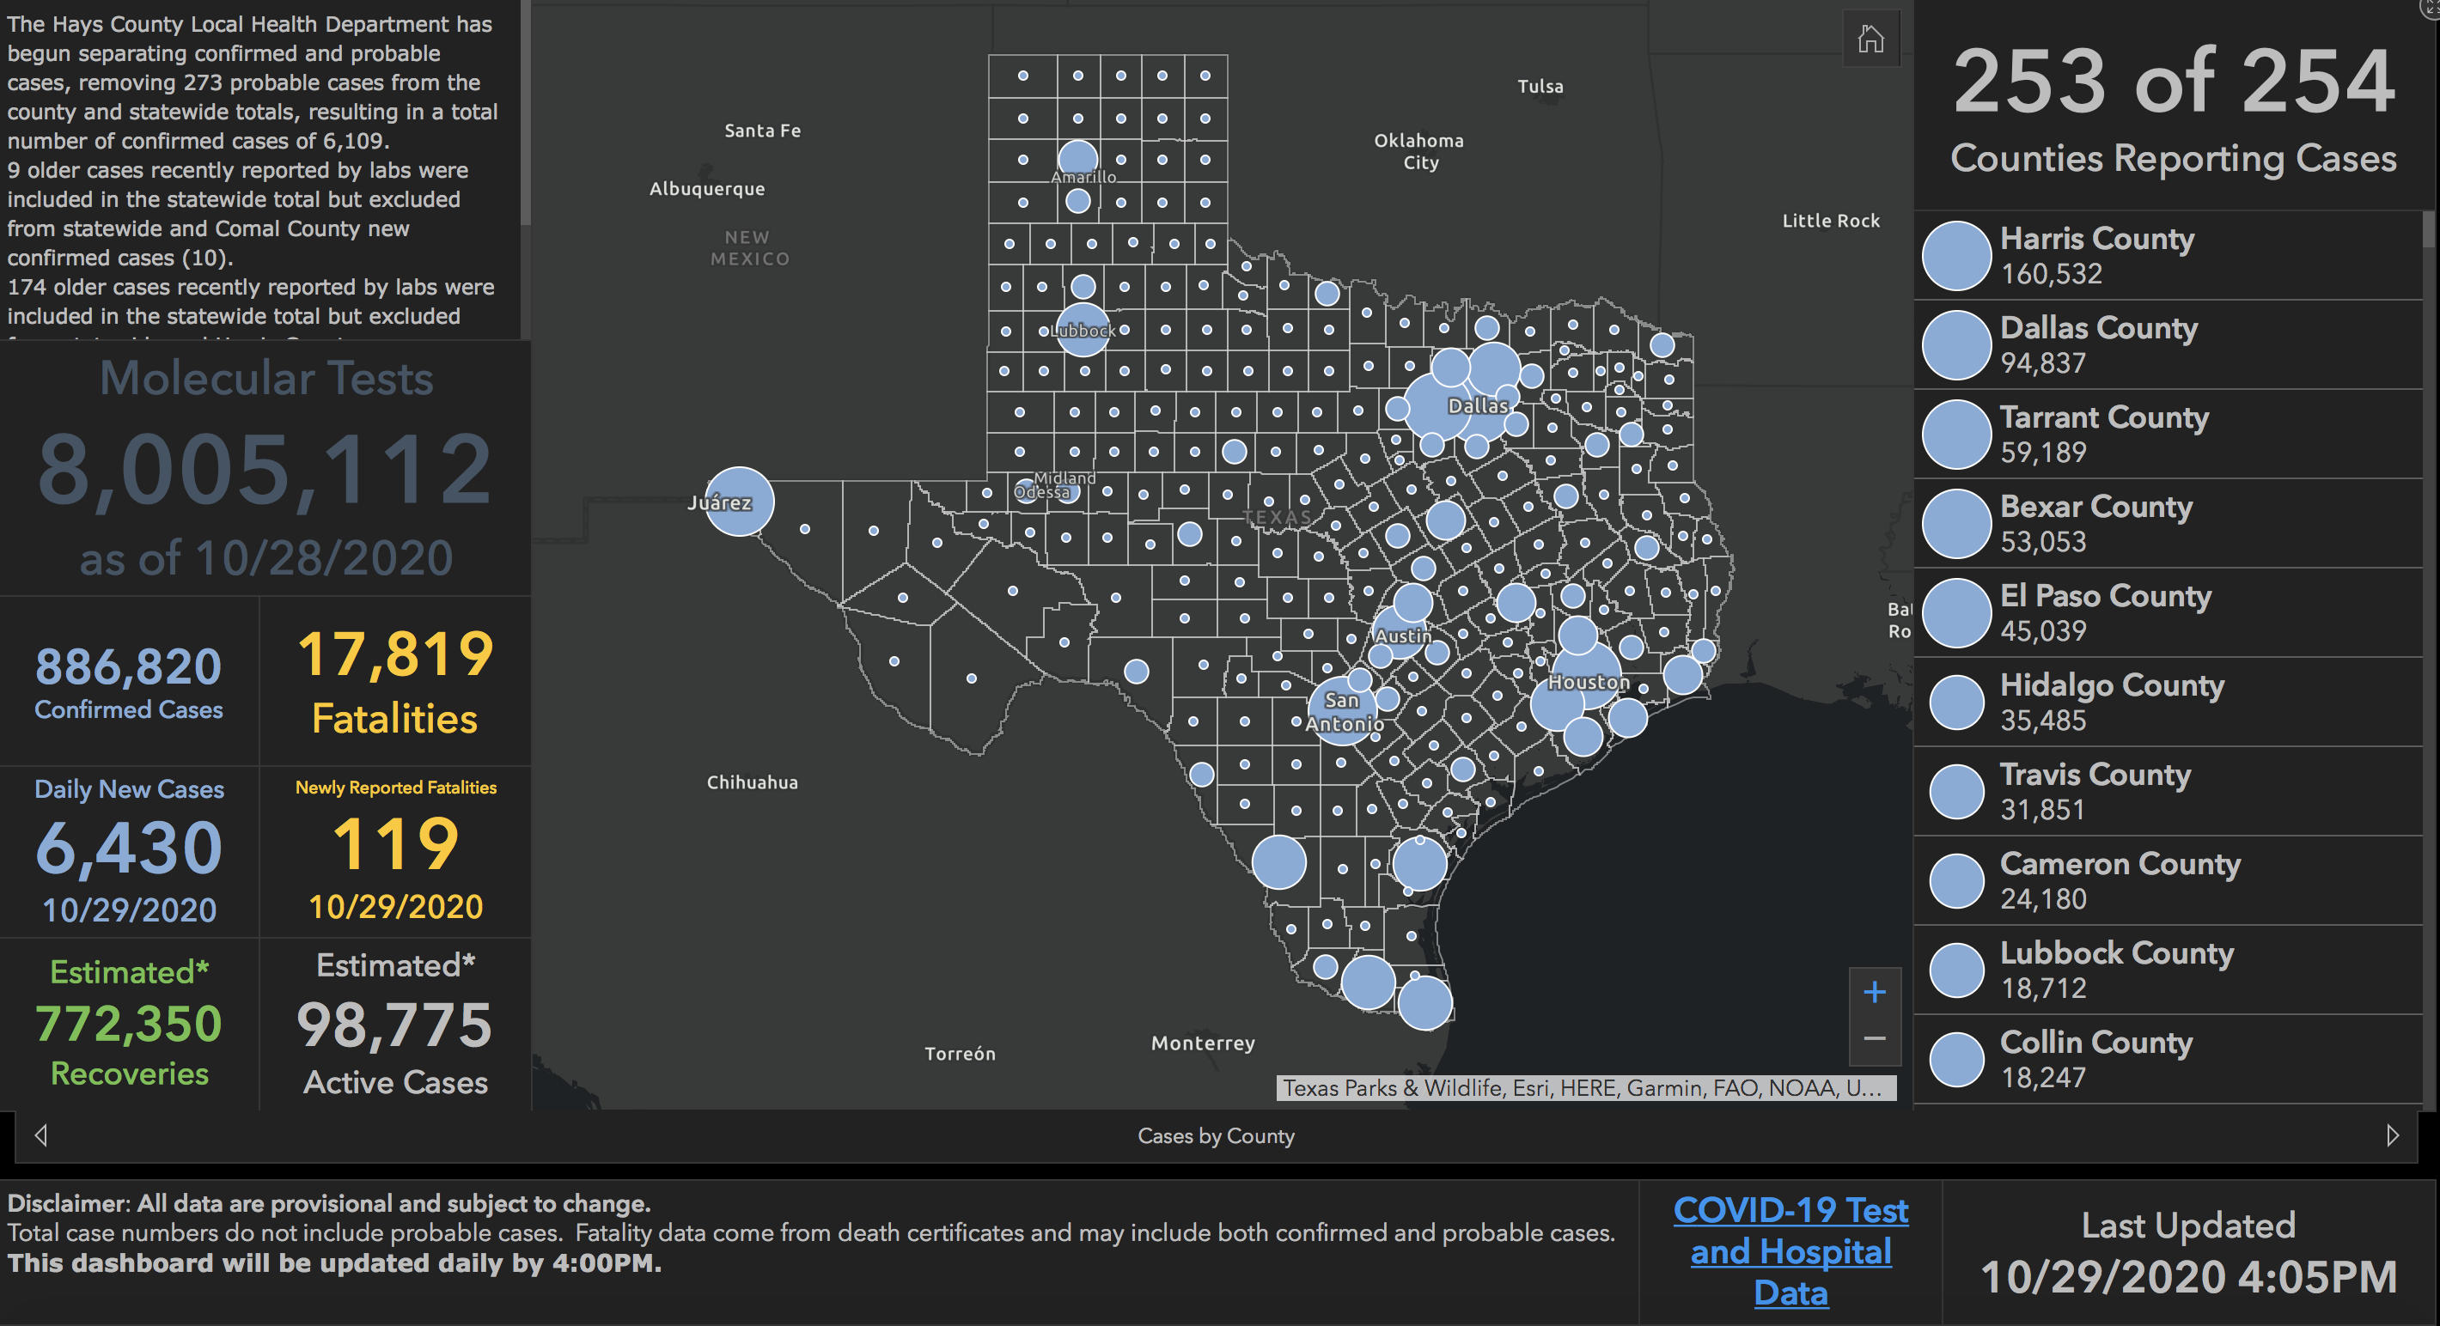

Slide 60
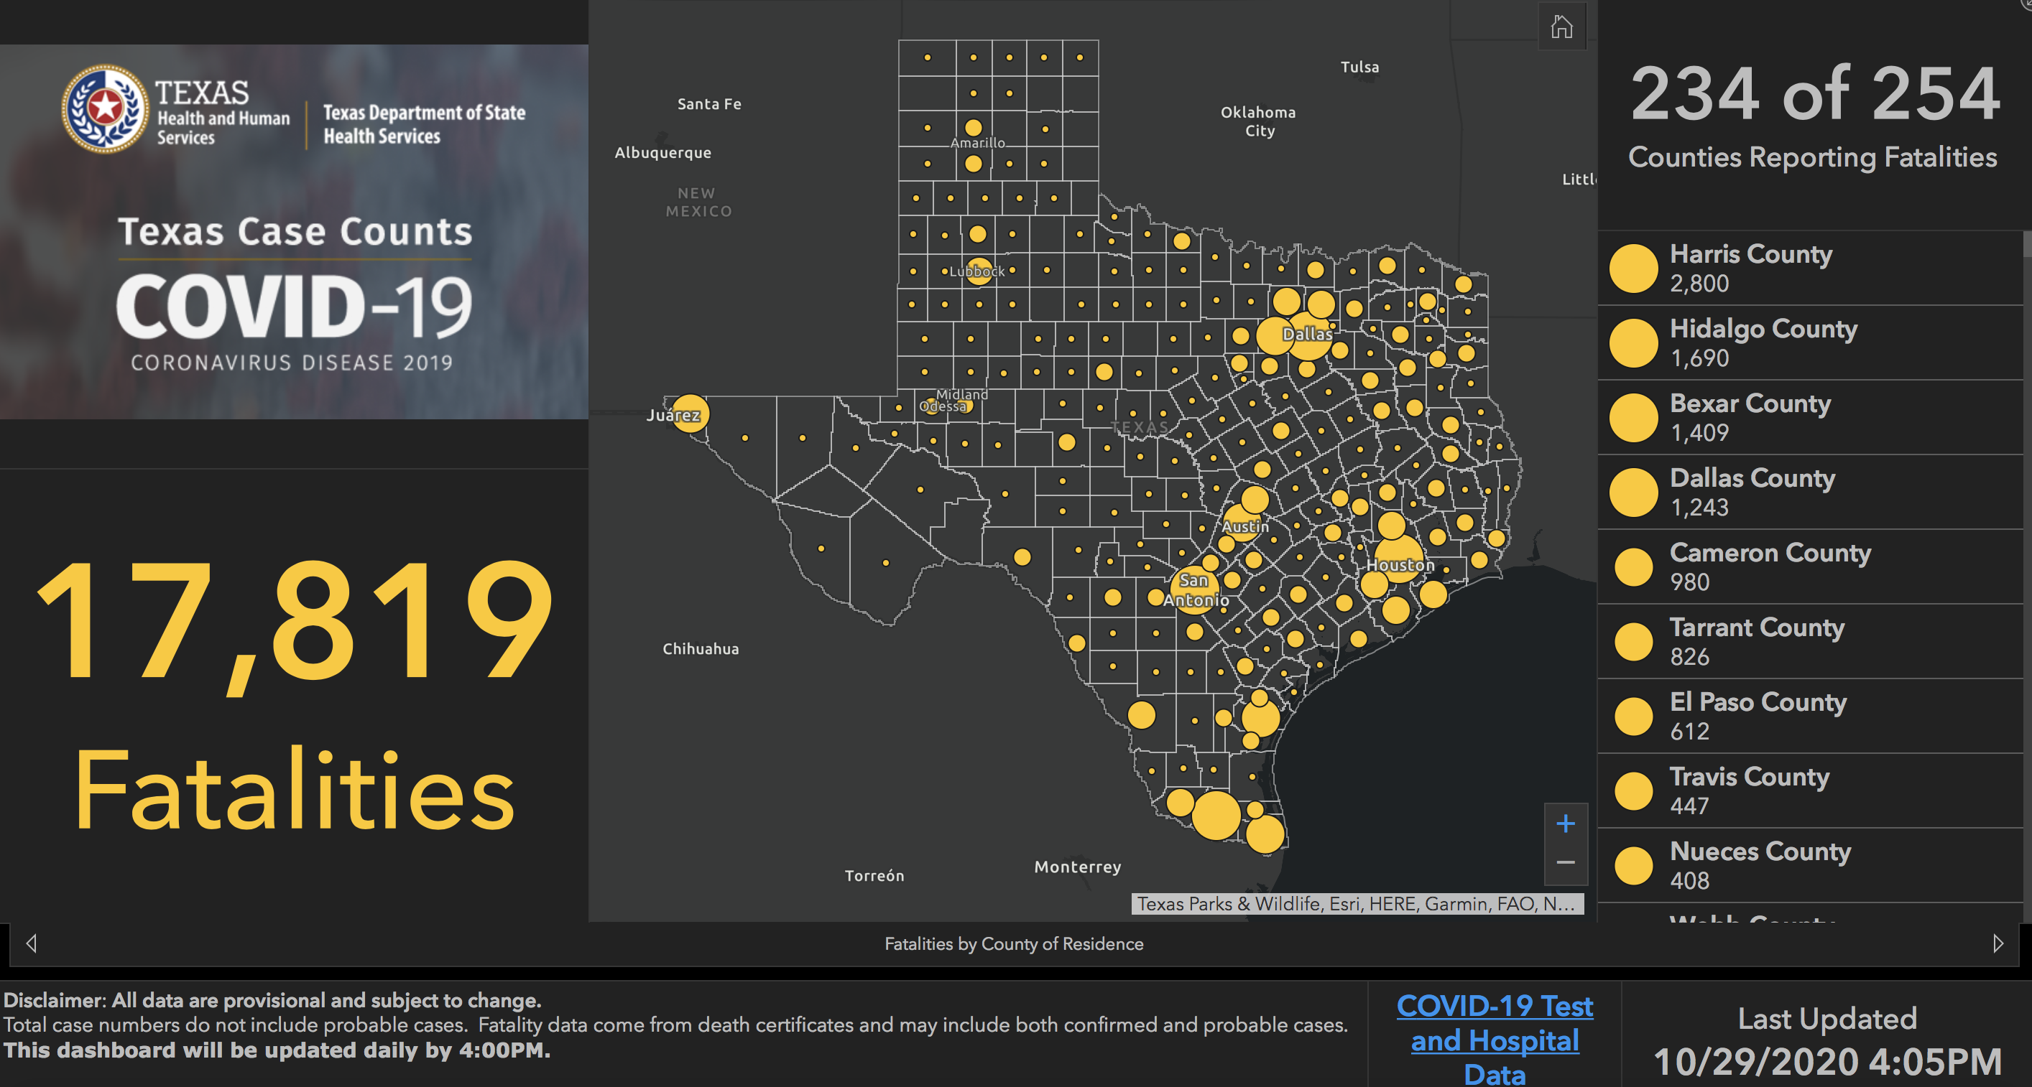

Slide 61
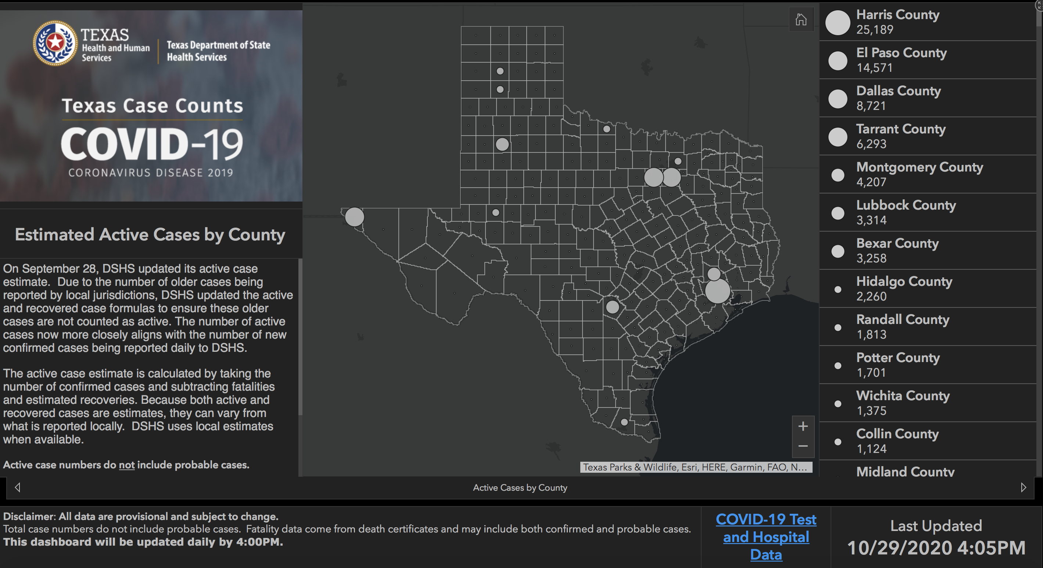

Slide 62
New Mexico Demographics

Slide 63
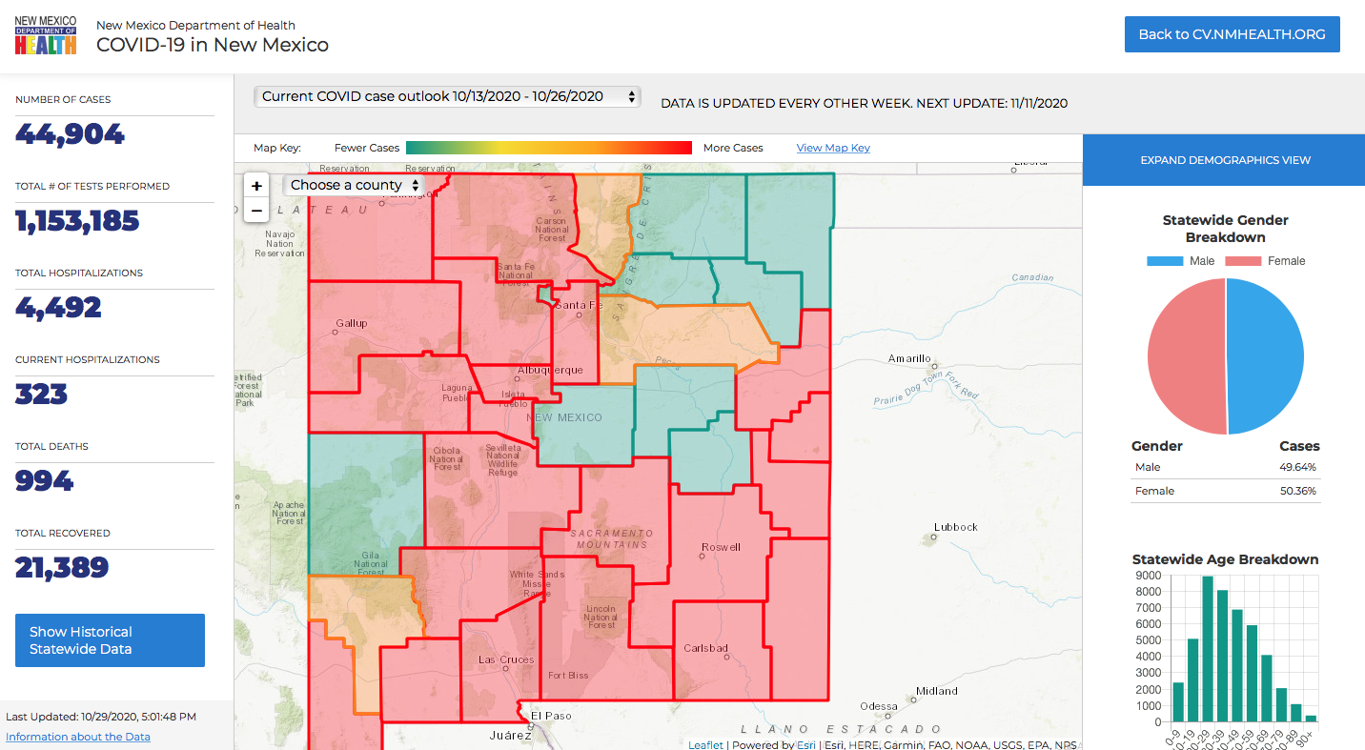

Slide 64
Special Thanks

Slide 65
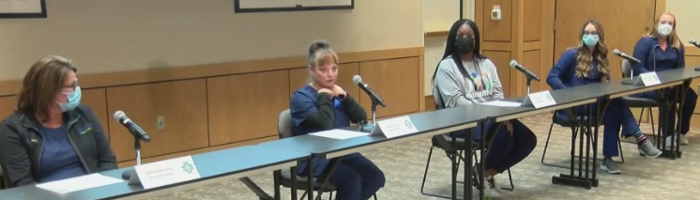
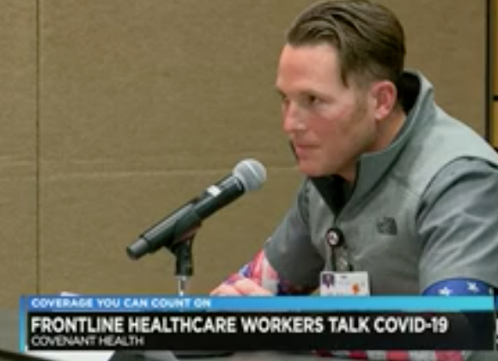
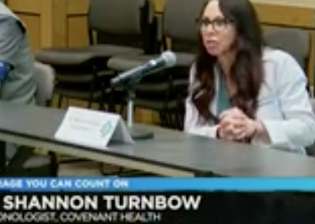
Press Conference Stars!!
Connie Gonzales
Brooklyn Fleming
Lona Ashley
Geri Butler
Denise Christianson
Dr. Turnbow
Dr. Williams

Slide 66
“These are REAL PEOPLE,
Not just numbers”

Slide 67
Q & A

Slide 68
CME Credit was only approved for the Live Teams meeting
To receive credit for this continuing education activity, the participant must:
  Make sure you are logged into your Teams account, if you are signed in with a group provide attendee’s First and Last name(s) in the comments section.
  If you are calling into the Teams meeting you MUST text your First & Last Name to (806) 252-4735. This will ensure you are added to the sign in sheet to receive CME Credit.
  You will receive an email within 3 business days from the CME department with further instructions on claiming your certificate.

