Slide 1
Covenant Health
Presents
Critical Communications: A Weekly Physician Update
October 9, 2020

Slide 2
PHYSICIANS
Accreditation Statement:
The Covenant Health is accredited by the Texas Medical Association (TMA) to provide continuing medical education for physicians.
Credit Designation Statement:
The Covenant Health designates this live CME activity for a maximum of 1.0 AMA PRA Category 1 Credit(s)™. Physicians should claim only the credit commensurate with the extent of their participation in the activity.

Slide 3
Disclosures of Commercial Interest
The speakers and planners of this activity
have no relevant financial interests

Slide 4
Disclosures
This activity is provided by
Covenant Health
No commercial support has been received.
No products will be endorsed.
Speakers will notify the audience if off label drug use will be discussed.

Slide 5
CME Credit was only approved for the Live Teams meeting
To receive credit for this continuing education activity, the participant must:
  Make sure you are logged into your Teams account, if you are signed in with a group provide attendee’s First and Last name(s) in the comments section.
  If you are calling into the Teams meeting you MUST text your First & Last Name to (806) 252-4735. This will ensure you are added to the sign in sheet to receive CME Credit.
  You will receive an email within 3 business days from the CME department with further instructions on claiming your certificate.

Slide 6
Reflection & Safety Story
Presented by
Dr. Brian D. Schroeder, CMO, Covenant Medical Center
Colonel, USAF, Medical Corps, Flight Surgeon

Slide 7

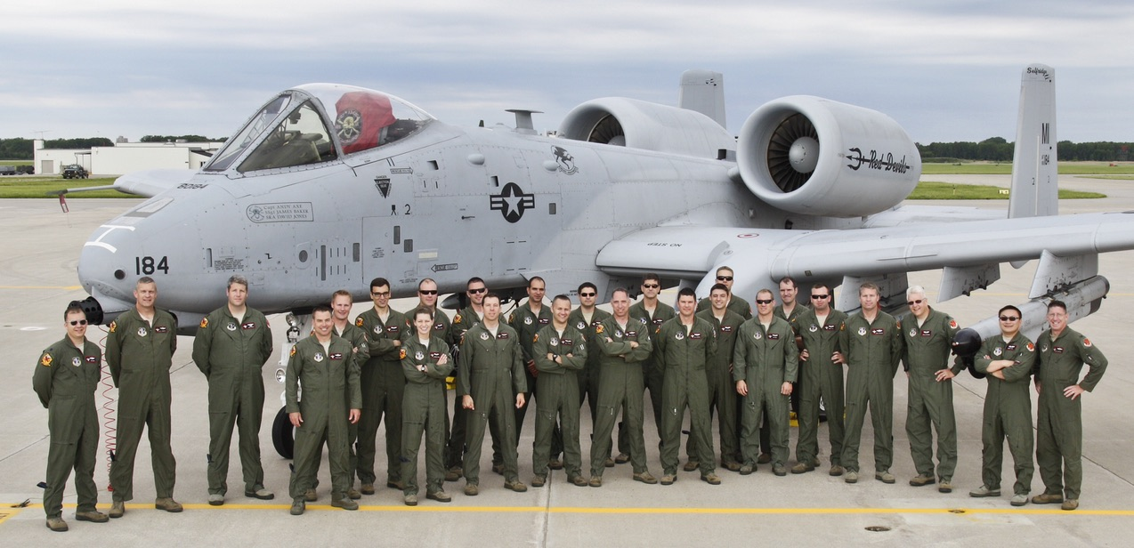
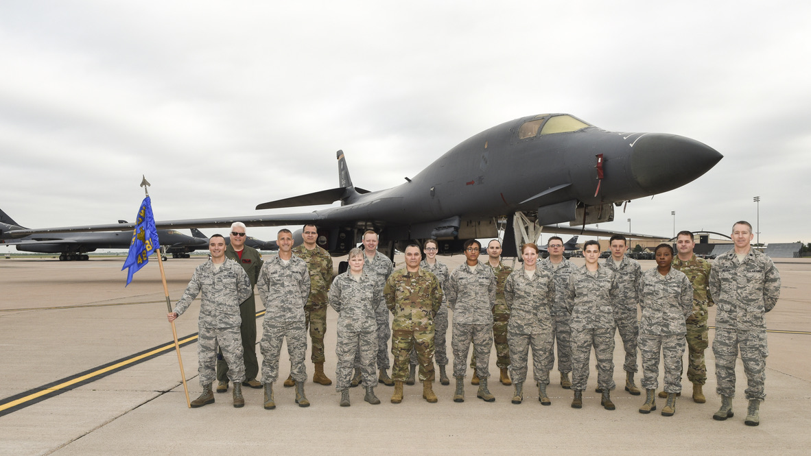
As Veteran’s Day approaches…
From this day to the ending of the world,
But we in it shall be remembered-
We few, we happy few, we band of brothers;
For he today that sheds his blood with me
Shall be my brother.
William Shakespeare, Henry V

Slide 8


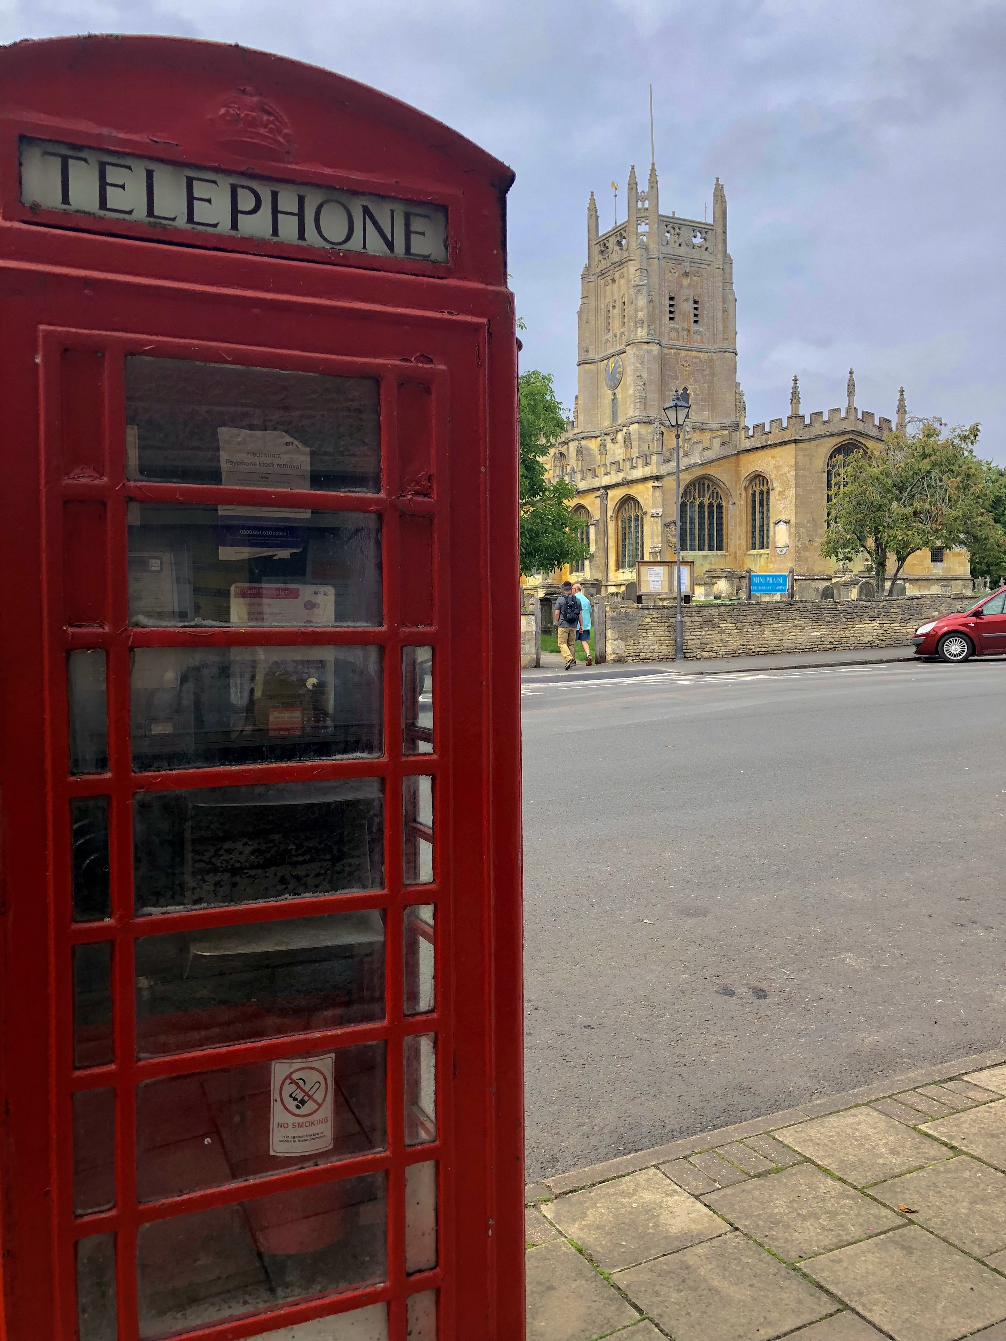

Operation Ample Strike, RAF Fairford, Sept, 2018

Slide 9

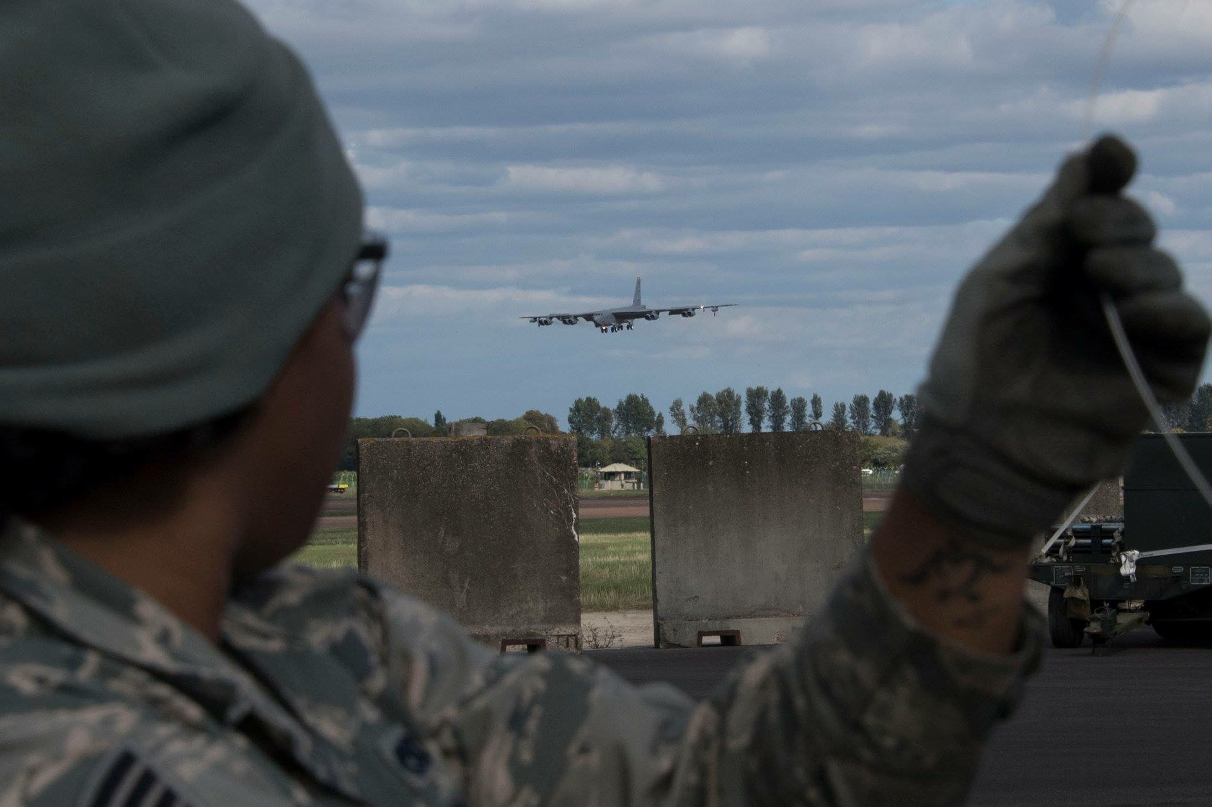
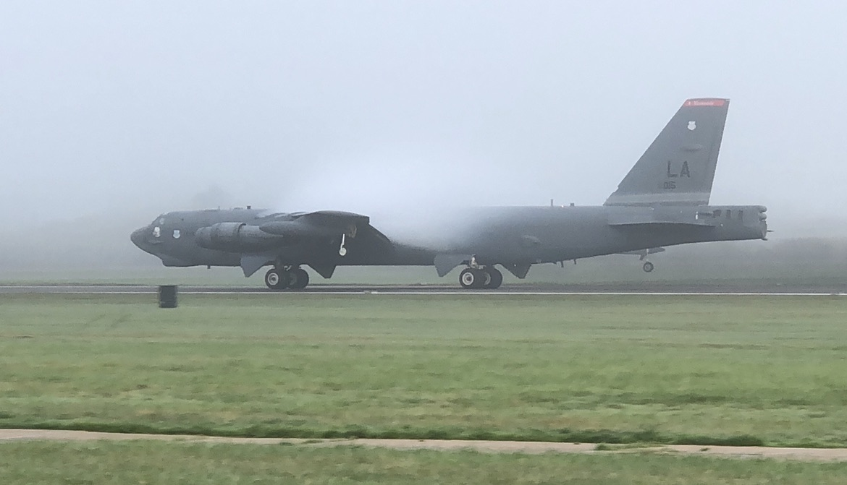
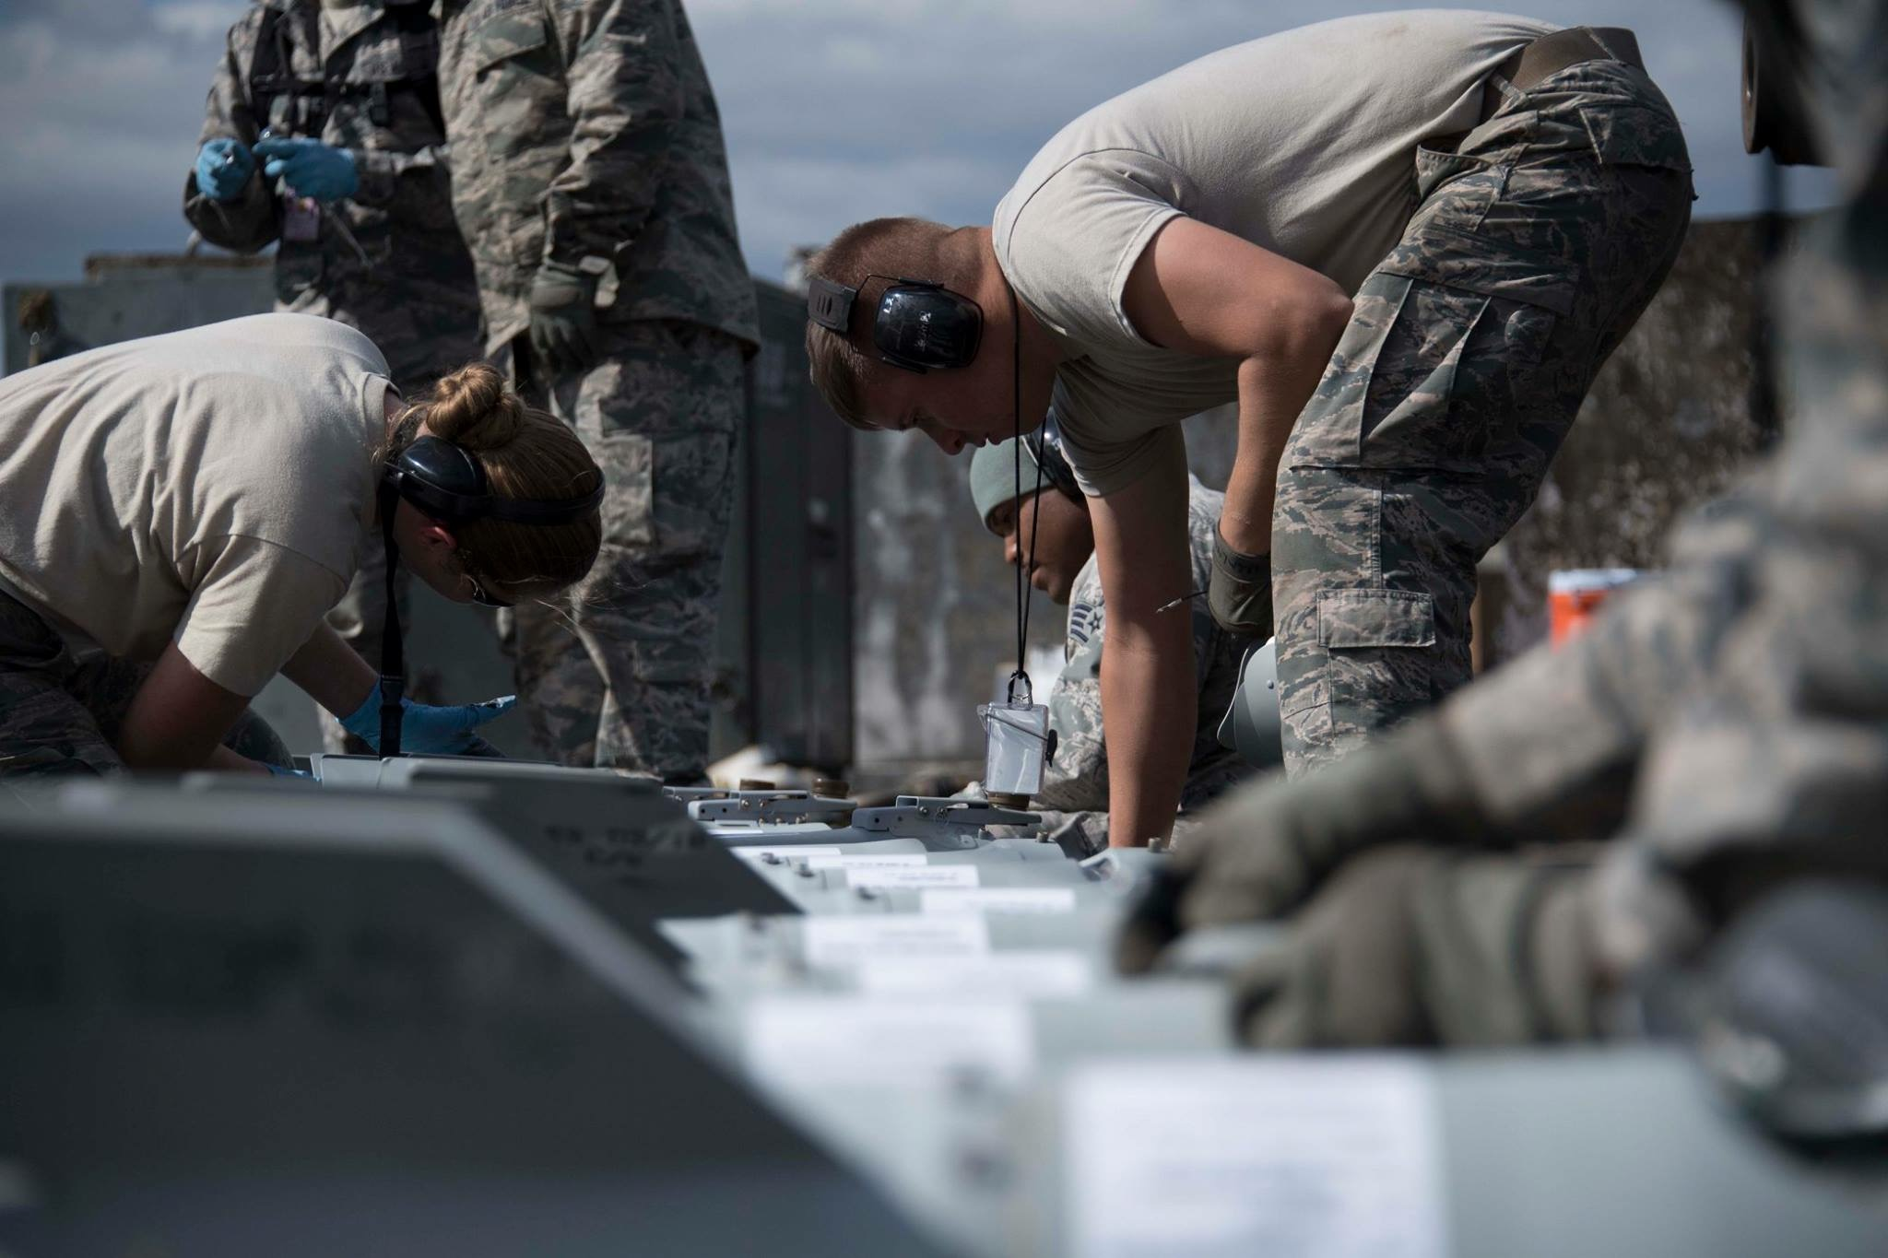
3 weeks; 160 Airmen

Slide 10
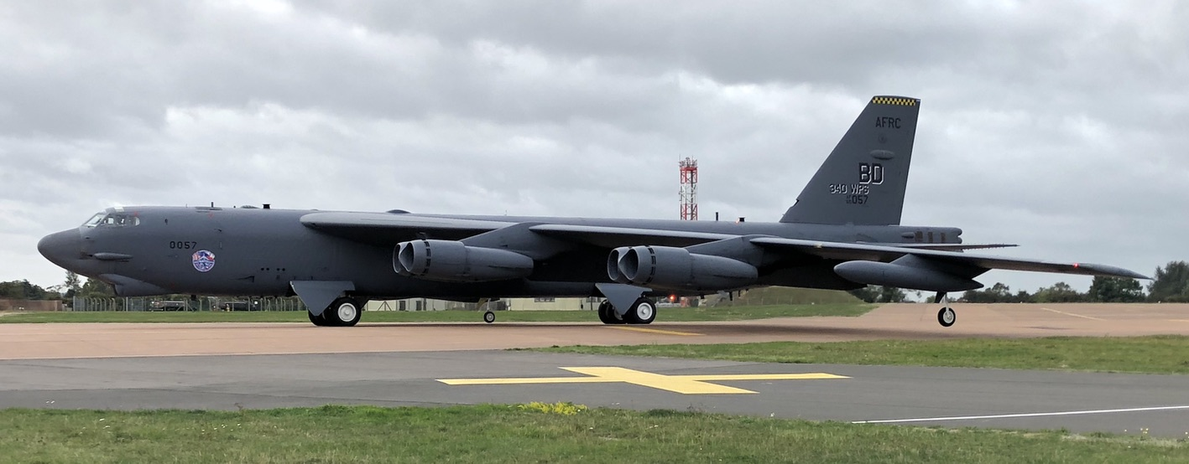


The B-52, aka. “The BUFF”

Slide 11



Airman “Jessica”
20 year old female Airman, stationed in Northern England, on temp duty at Fairford, working in Food Service
Headed to work, steps off curb “wrong”, “hears a snap”, goes to ground
Pain, displacement of malleolus, inability to move foot
EMS Called—ha!
Transported to hospital by private auto, accomp. by another airman
Treated and released

Slide 12
Fairford Hospital & Great Western Hospital, Swindon

Slide 13
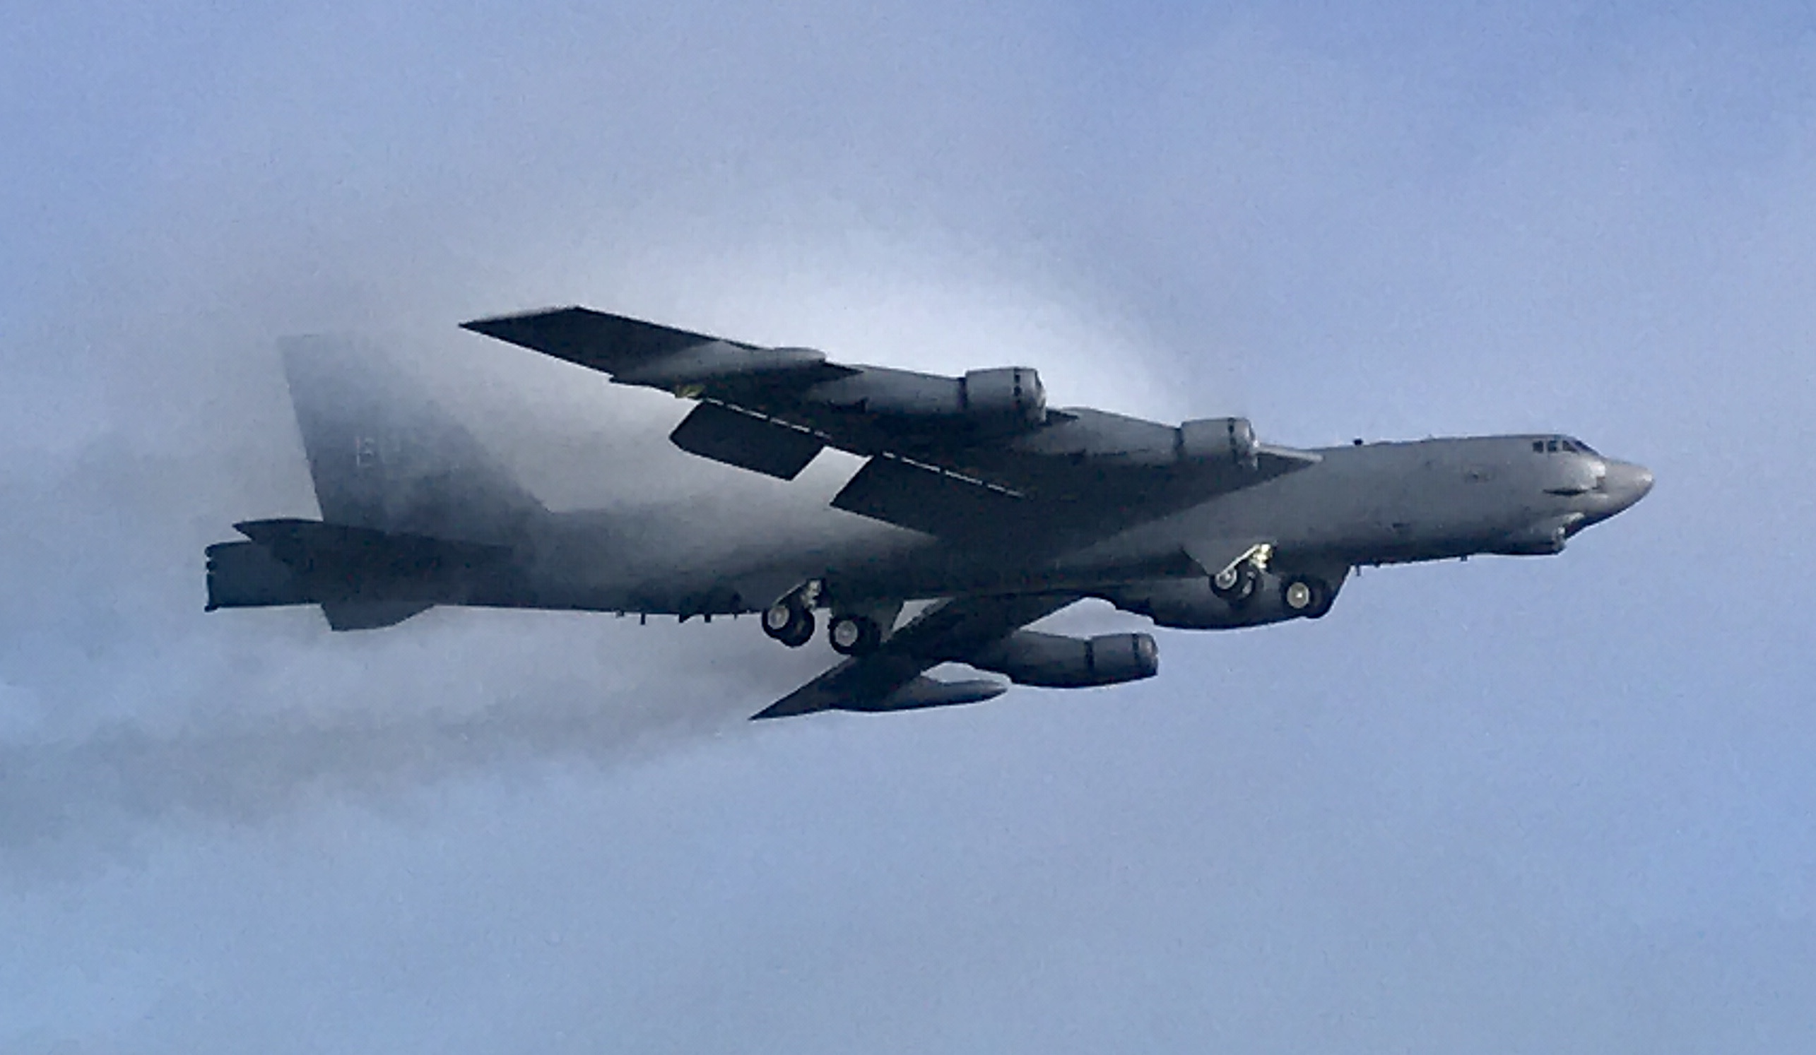

Not the care we are used to
Nearest hospital 30 miles away
Trauma & Burn center in Oxford, 40 miles away
Treated and released
  No ACE wrap
  No Crutches
  Grudgingly given equivalent to Tylenol #3 and ACE
Returned to her home base
  told to follow up with PCP

Slide 14
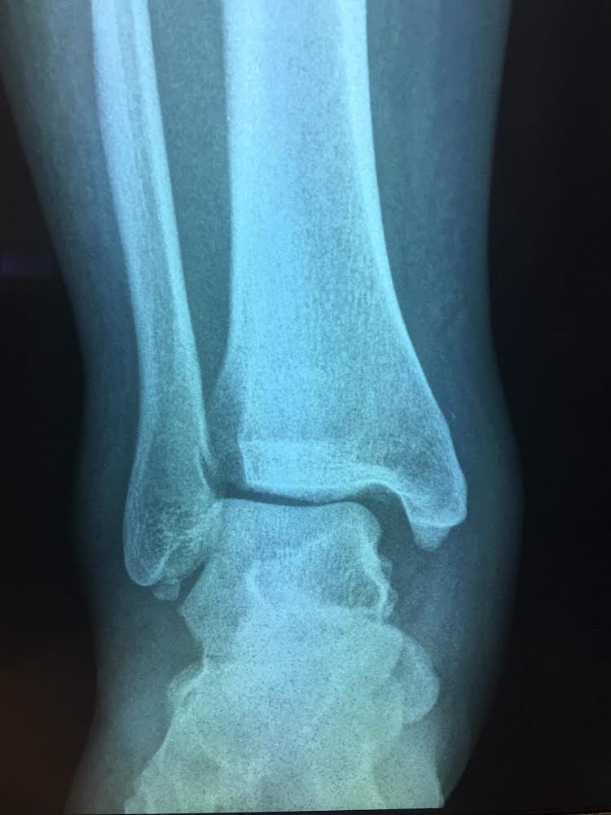
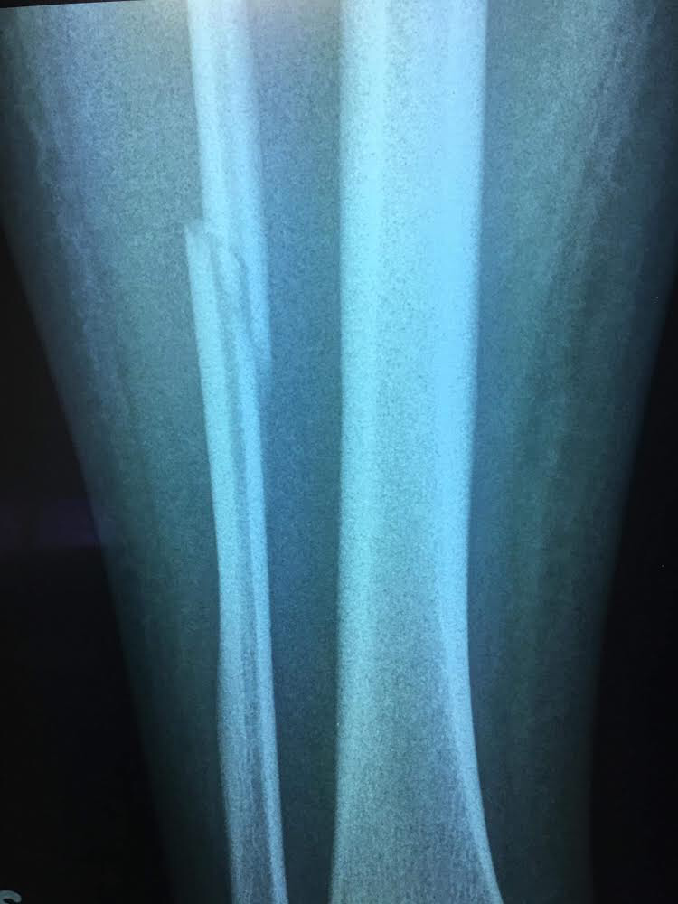
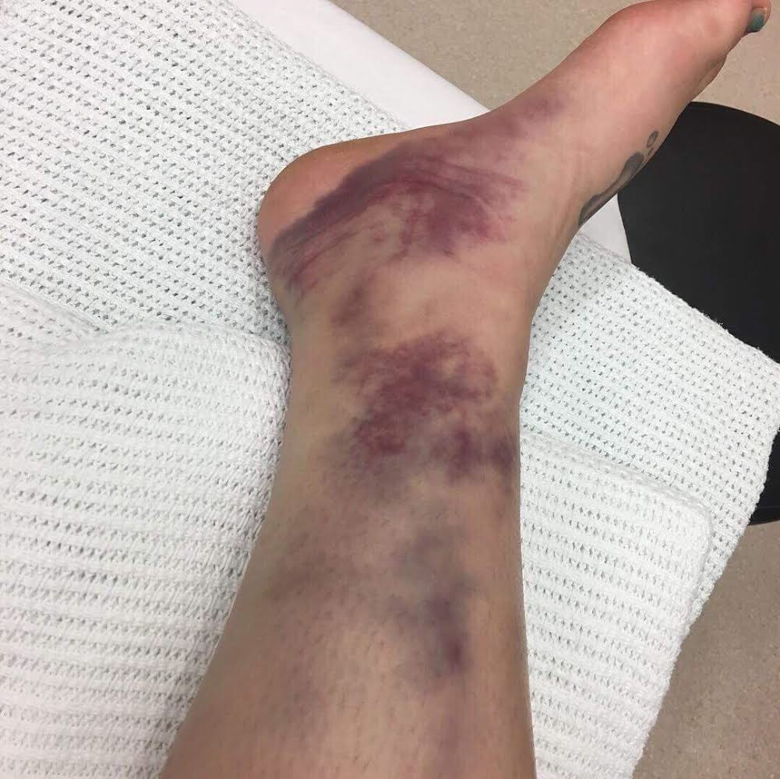
The next day…

Slide 15
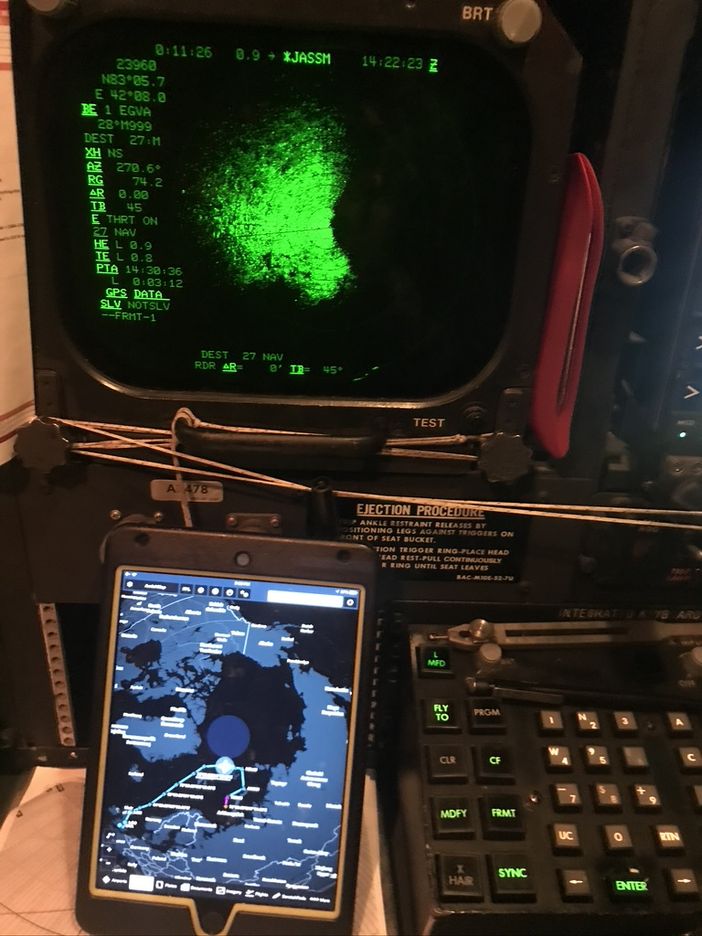
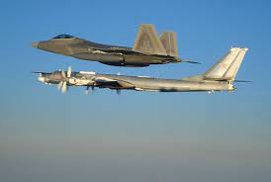
After Action Report
My medic couldn’t get over this…
  Just how BAD is the National Health Service?
  Is THIS what we can expect from
  “nationalized health care”?
Actually, there’s more to the story…

Slide 16
Lessons Learned
Patient Safety is an INTERNATIONAL issue!
Use of two patient identifiers is NOT just a “Providence” thing!
Learn the tools of High Reliability!
  Pay attention to detail!
  Communicate clearly!
  Have a questioning attitude!
  Speak up for safety!
  Operate as a team--
    As a band of brothers!

Slide 17

Any questions?

Slide 18
Current Regional Covid-19 Census

Slide 19
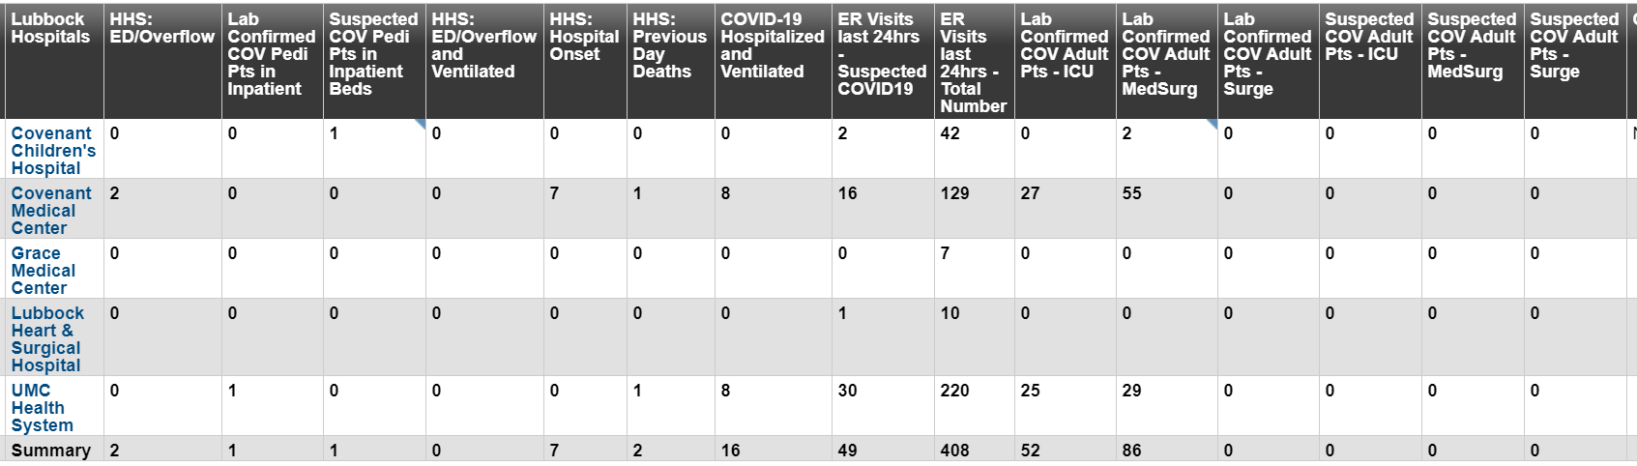
Regional
 | Lubbock |  | TTU |  | Hockley |  | Hale
 | 10/7 | 10/8 |  | 10/8 | 10/6 | 10/7 | 10/6 | 10/7
Total | 13,070 | 13,283 |  | 1799 | 383 | 392 | 2009 | 2025
Active | 1472 | 1501 |  | 156 |  |  | 117 | 128
Deaths | 135 | 137 |  | 0 | 9 | 9 | 58 | 58
New | 213 |  |  |  | 9 |  | 16
10/7: 136 Hospitalized in Lubbock – 17 on vents 10/9: 138 Hospitalized in Lubbock – 16 on vents

Slide 20
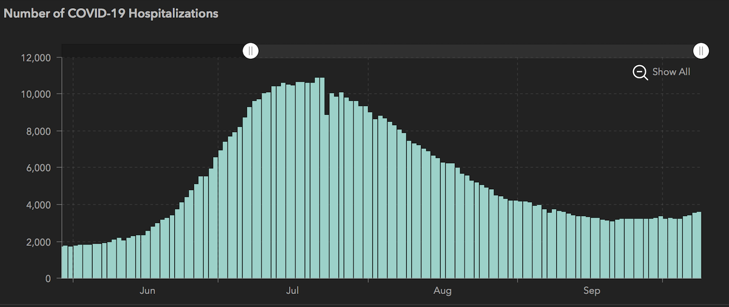
STATE
 | 10/8 | 10/7 | 10/5 | 9/30 | 9/23 | 9/16 | 9/9 | 8/26 | 8/12 | 7/29 | 7/15 | 7/1
Cases | 781,749 | 777,556 | 769,303 | 748,967 | 719,599 | 674,772 | 645,791 | 592,137 | 506,820 | 403,307 | 282,365 | 168,062
Deaths | 16,334 | 16,230 | 16,033 | 15,711 | 15,129 | 14,478 | 13,692 | 11,805 | 9034 | 6190 | 3432 | 2481
Hospitalized | 3,556 | 3,519 | 3,318 | 3,344 | 3,195 | 3249 | 3604 | 4806 | 7028 | 9595 | 10,471 | 6904

Slide 21
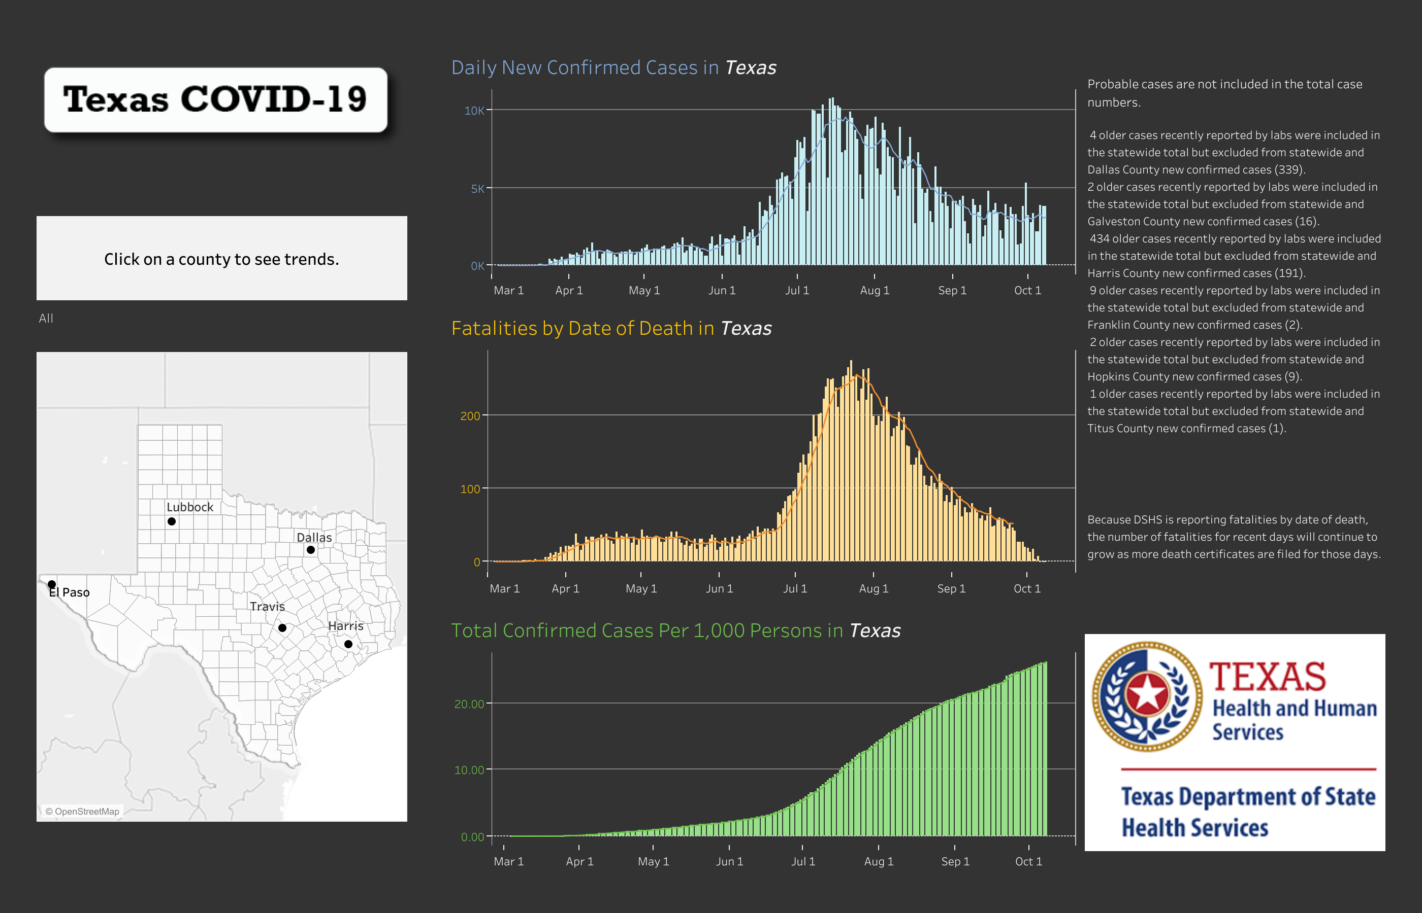
26.3

Slide 22
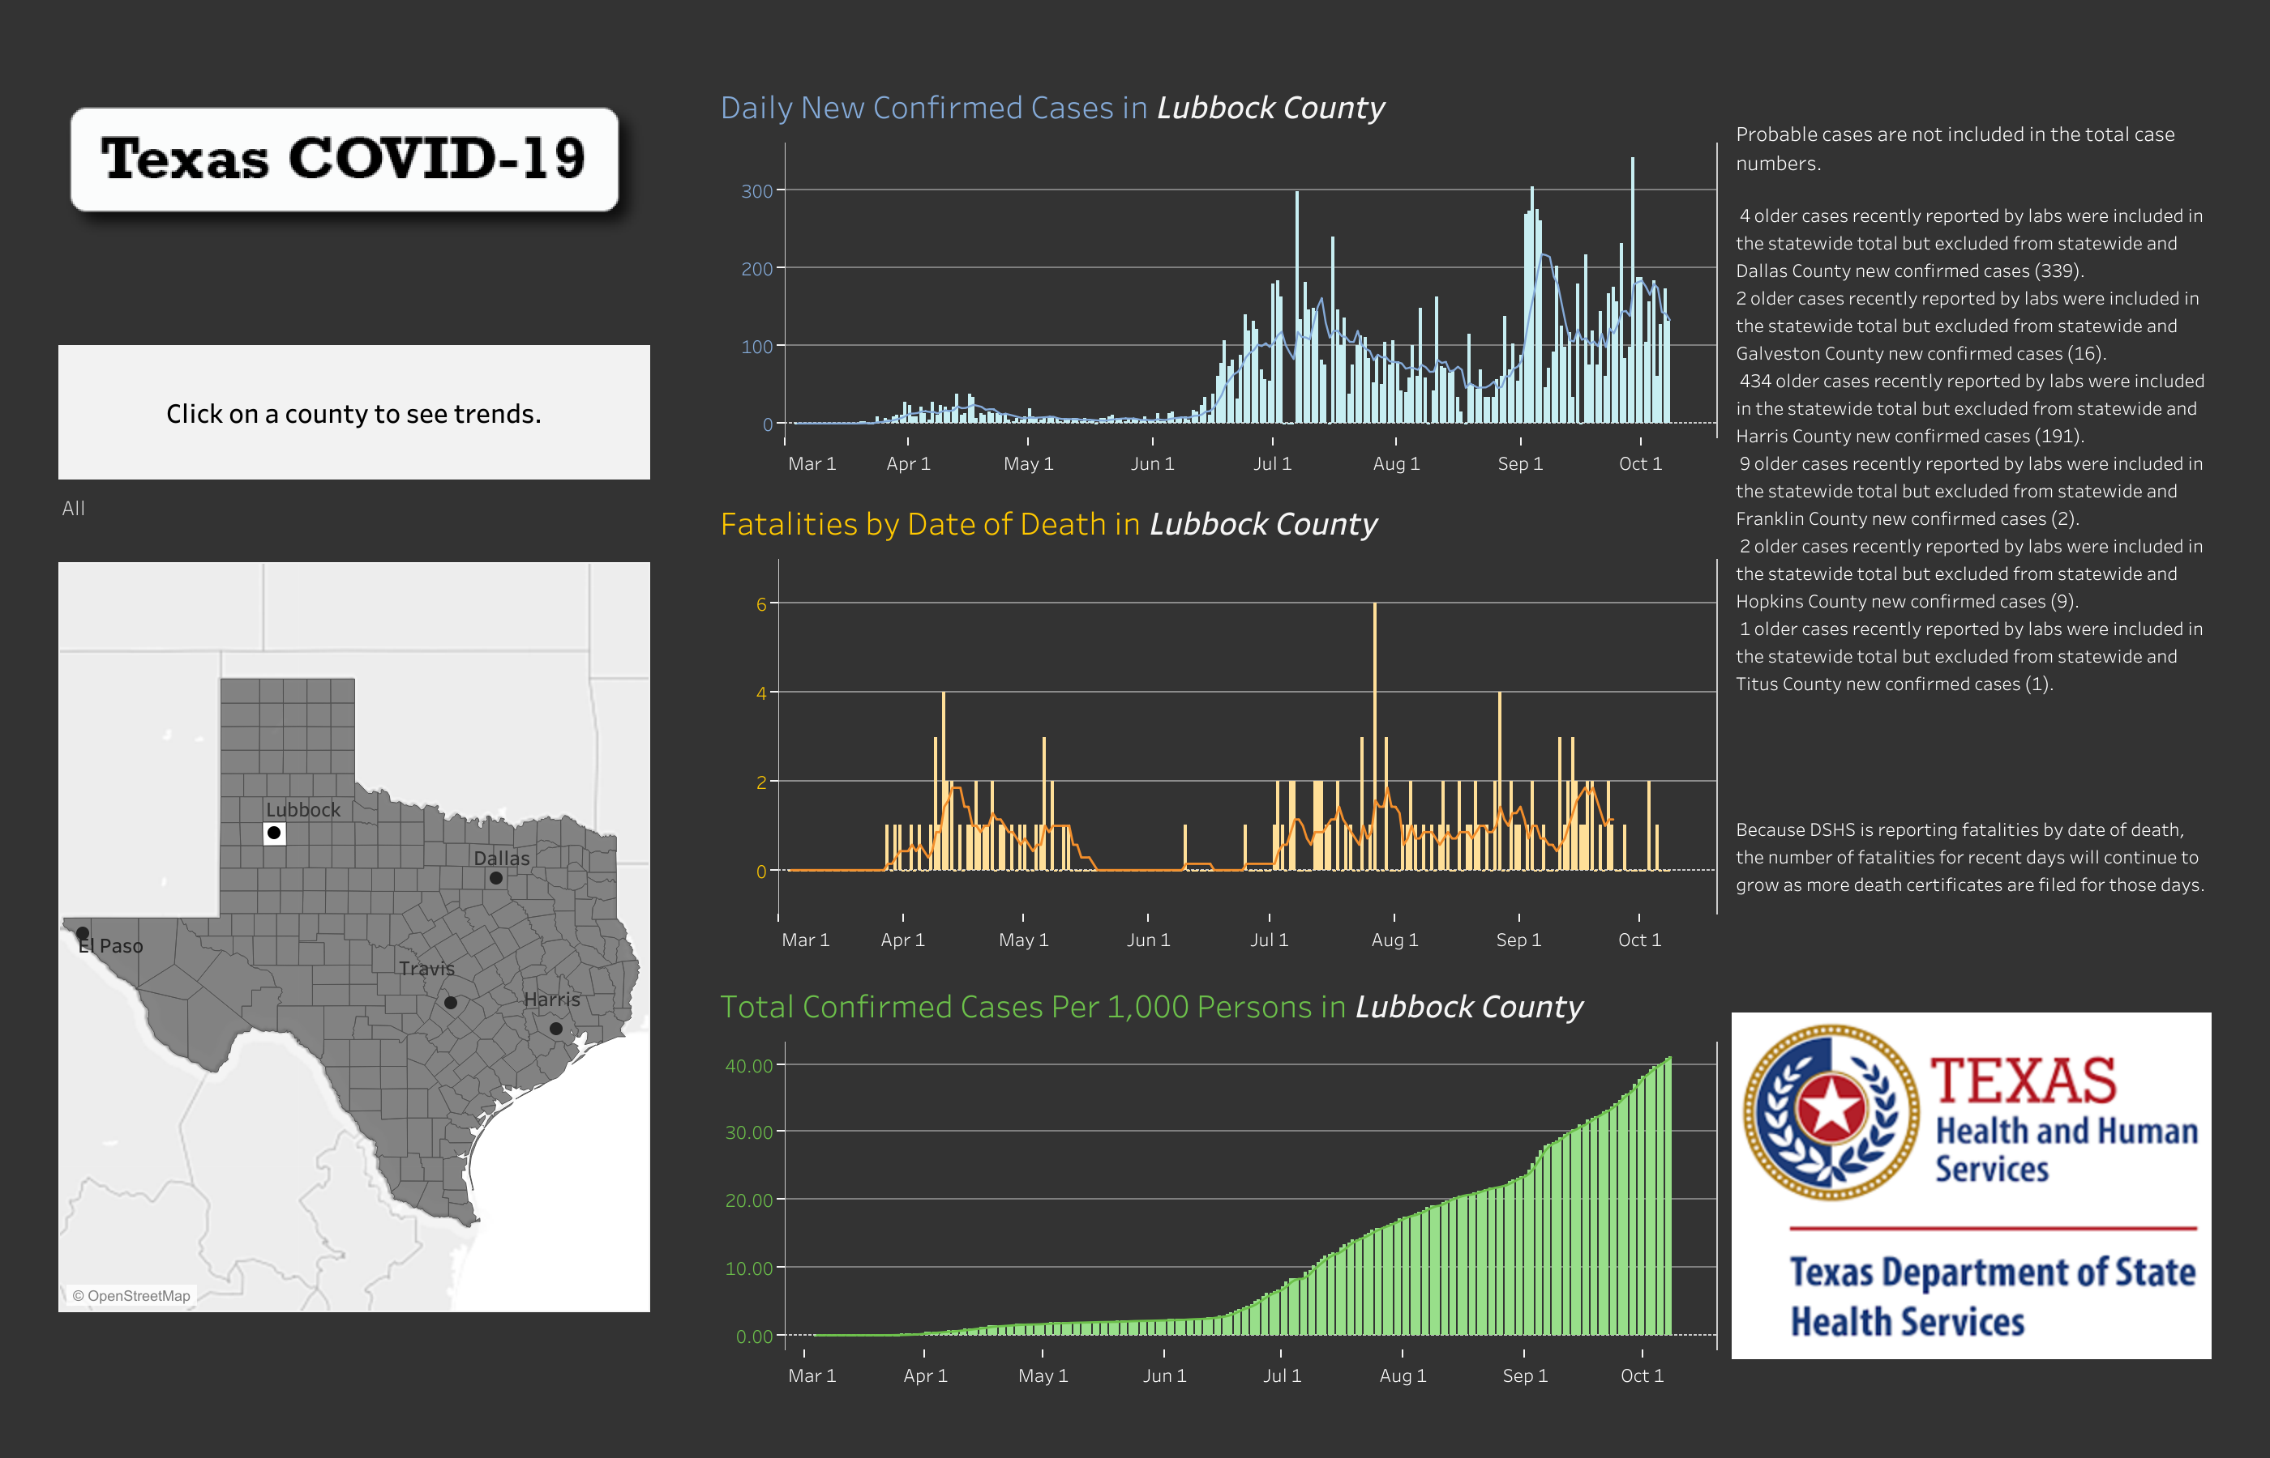
41.2

Slide 23
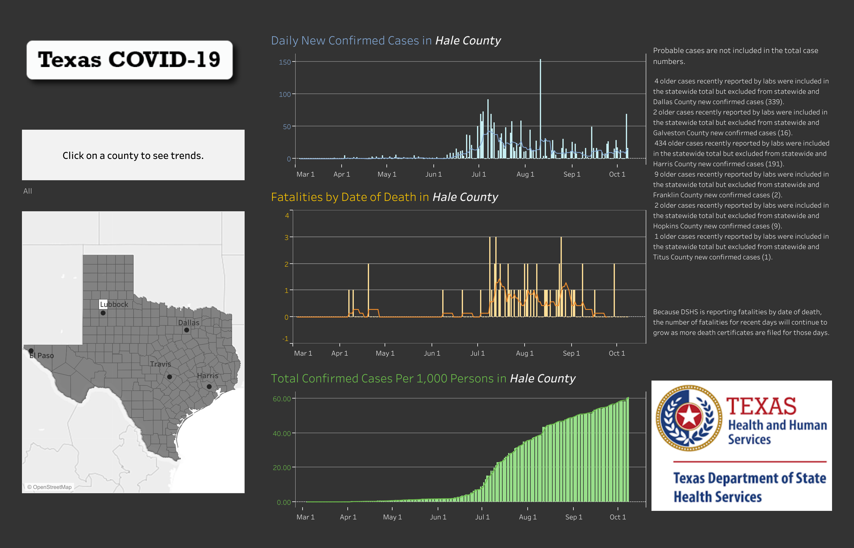
60.99

Slide 24
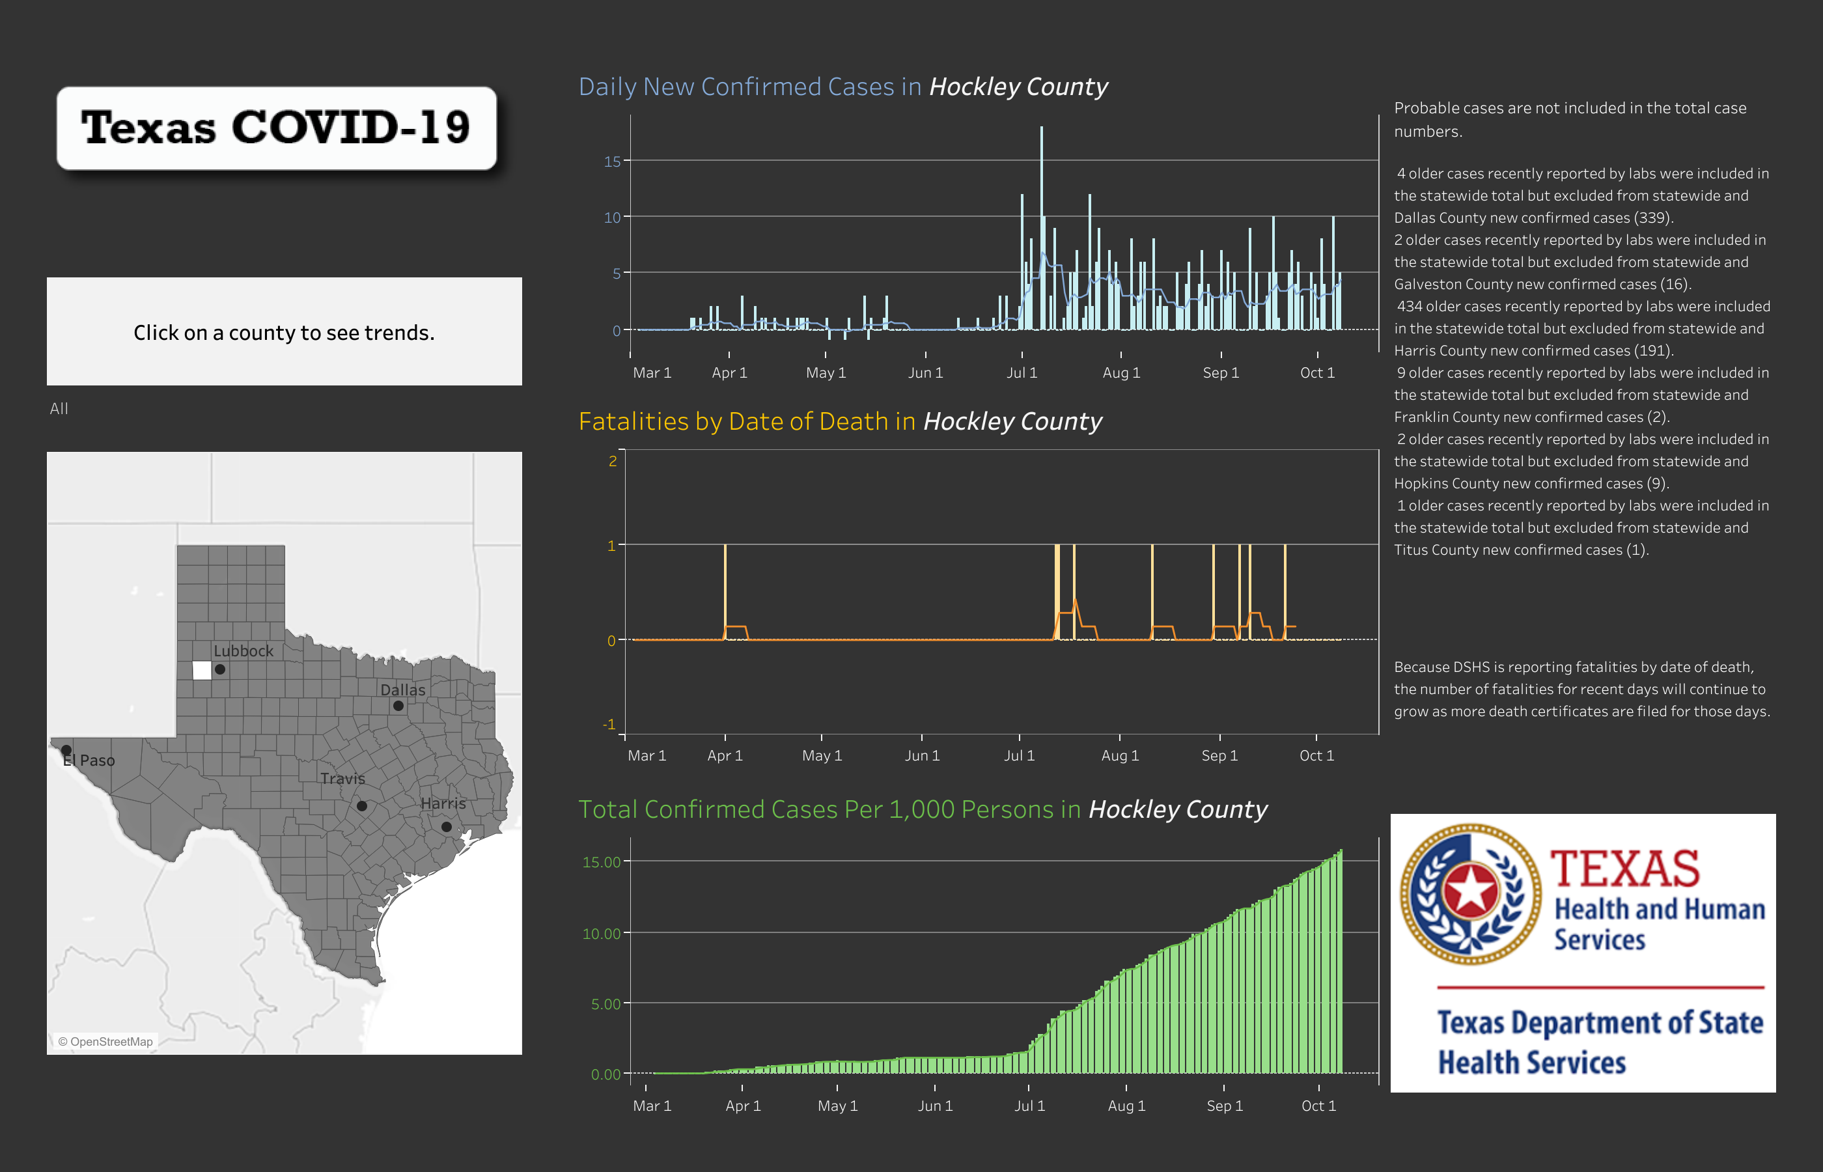
15.91

Slide 25
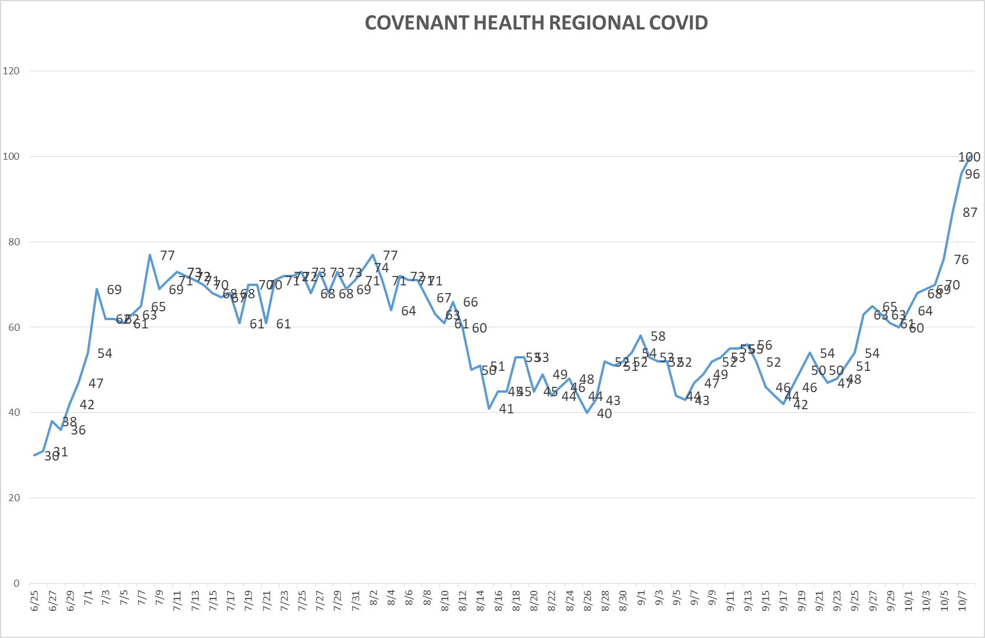
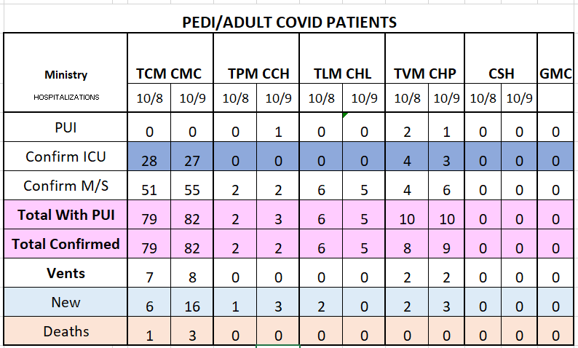
PUI/Confirmed cases-hospitalized
10/9/2020

Slide 26
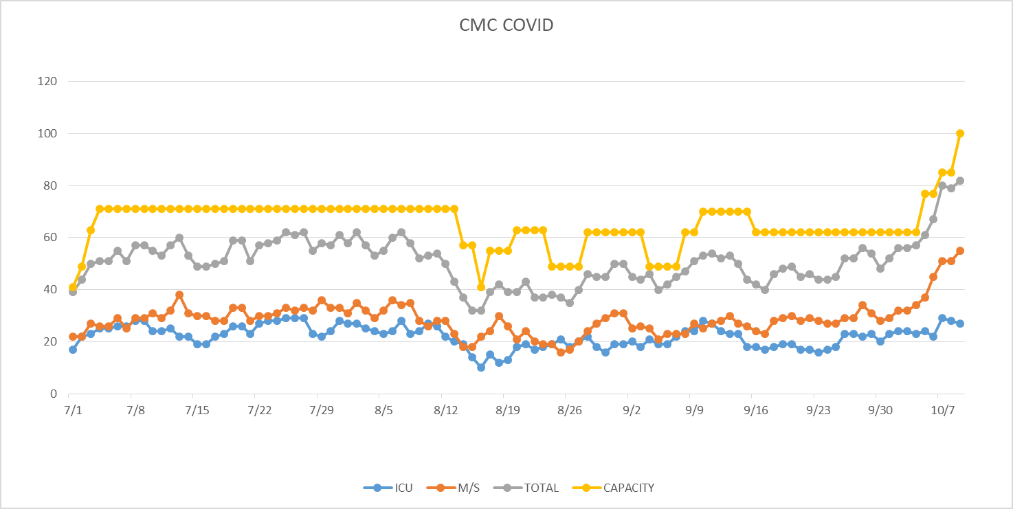
PUI/Confirmed cases-hospitalized
10/9/2020
MICU added 8 beds 10/6, S4 added 15 beds 10/9

Slide 27

HOT SPOTS
Nursing Homes
Lubbock: Heritage Oaks and Windmill;
84 residents in NH COVID positive
Levelland: Hickory Place
CMC- 5 NH COVID
CHL- 3 NH COVID

Slide 28
Surge Plan
Covenant Medical Center
 | ICU | Med Surg | Total
Phase 1 | 10-CICU |  | 10
Phase 2 | 17-CICU | 10-HC4 | 27
Phase 3 | 17-CICU | 24-HC4 | 41
Phase 4 | 17-CICU 8-MICU | 24-HC4 14-Pal Med | 63
Phase 5 | 17-CICU 16-MICU | 24-HC4 14-Pal Med | 71
Phase 6 | 17-CICU 16-MICU 15-S 4 | 24-HC4 13-HC6 15 – S 9 (east) | 100
Last Week
Currently

Slide 29
CENSUS
Capacity Status RED Square
 | 9/28 | 9/29 | 9/30 | 10/1 | 10/2 |  | 10/5 | 10/6 | 10/7 | 10/8 | 10/9
CMC (360) | 333 | 344 | 346 | 346 | 345 |  | 332 | 326 | 331 | 327 | 313
Cases (41) | 36 | 28 | 35 | 40 | 26 |  | 34 | 30 | 37 | 34
CCH (135) | 74 | 76 | 92 | 92 | 100 |  | 72 | 88 | 91 | 87 | 102
Cases (19) | 14 | 17 | 6 | 11 | 10 |  | 14 | 13 | 6
GMC (18) | 6 | 9 | 14 | 13 | 7 |  | 2 | 5 | 14 | 13 | 14
Cases (20) | 47 | 9 | 12 | 11 | 8 |  | 8 | 10 | 13 | 8 | 12
CHP (49) | 14 | 39 | 42 | 24 | 32 |  | 24 | 34 | 29 | 32
Cases (19) | 5 | 3 | 3 | 7 | 3 |  | 10 |  | 7 | 16
CHL (18) | 4 | 4 | 6 | 5 | 7 | 8 | 8 | 13 | 10 | 14
cases | 0 | 0 | 1 | 1 | 1 |  | 0 | 0 | 2 | 0
CSH (35) | 29 | 28 | 28 | 27 | 29 |  | 29 | 30 | 29 | 28 | 26

Slide 30
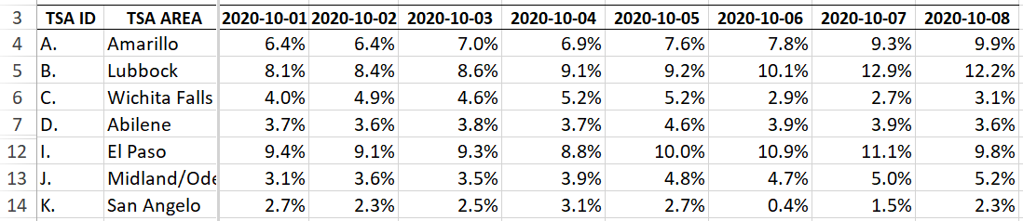
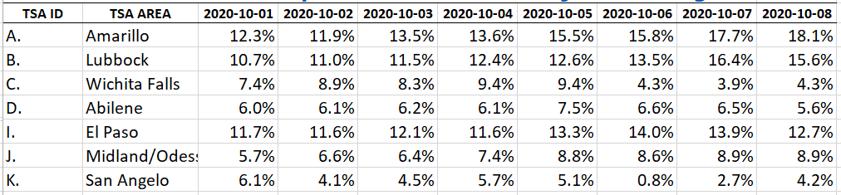
COVID+ HOSPITALIZATIONS BY TSA ID
CONFIRMED COVID+ HOSPITALIZATIONS/HOSPITAL CAPACITY – NEW METRIC
CONFIRMED COVID+ HOSPITALIZATIONS/TOTAL HOSPITALIZATIONS – OLD

Slide 31
Statistics
Cristian Requenez, MS
Clinical Data Analyst
Clinical Excellence
Covenant Health

Slide 32
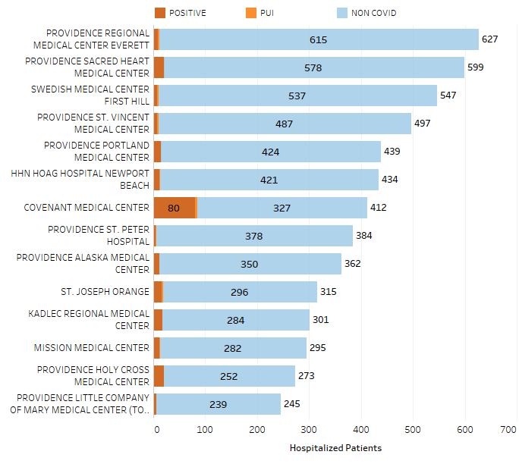
Providence System Hospitalized COVID-19 Cases

Slide 33
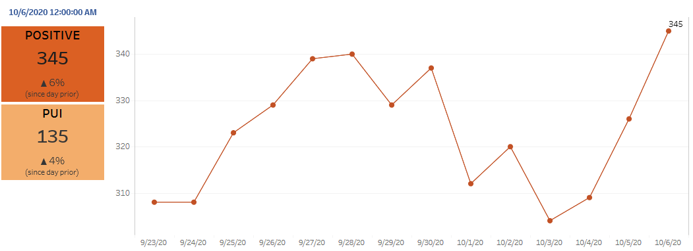
Providence Inpatient COVID-19 Volume

Slide 34
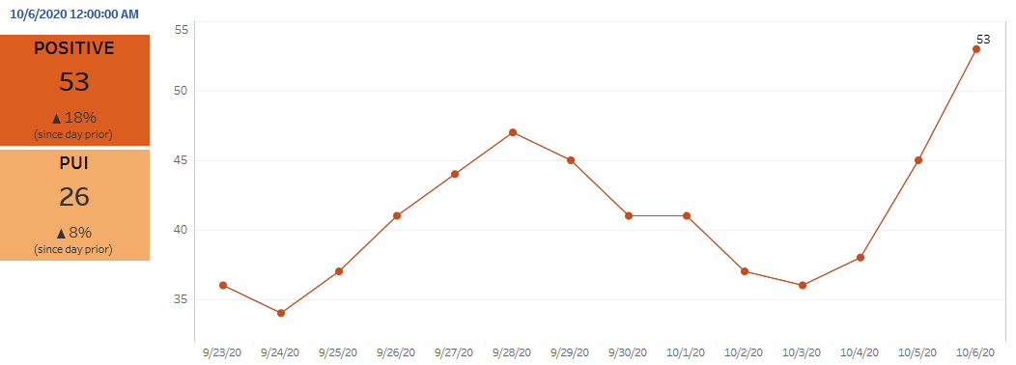
Texas Inpatient COVID-19 Volume

Slide 35
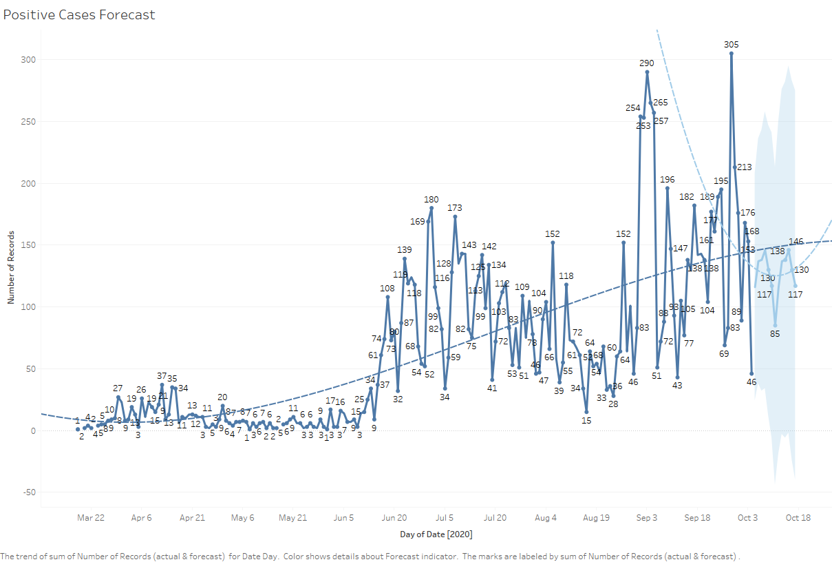
New COVID-19 POSITIVES by Day Trend

Slide 36
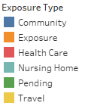
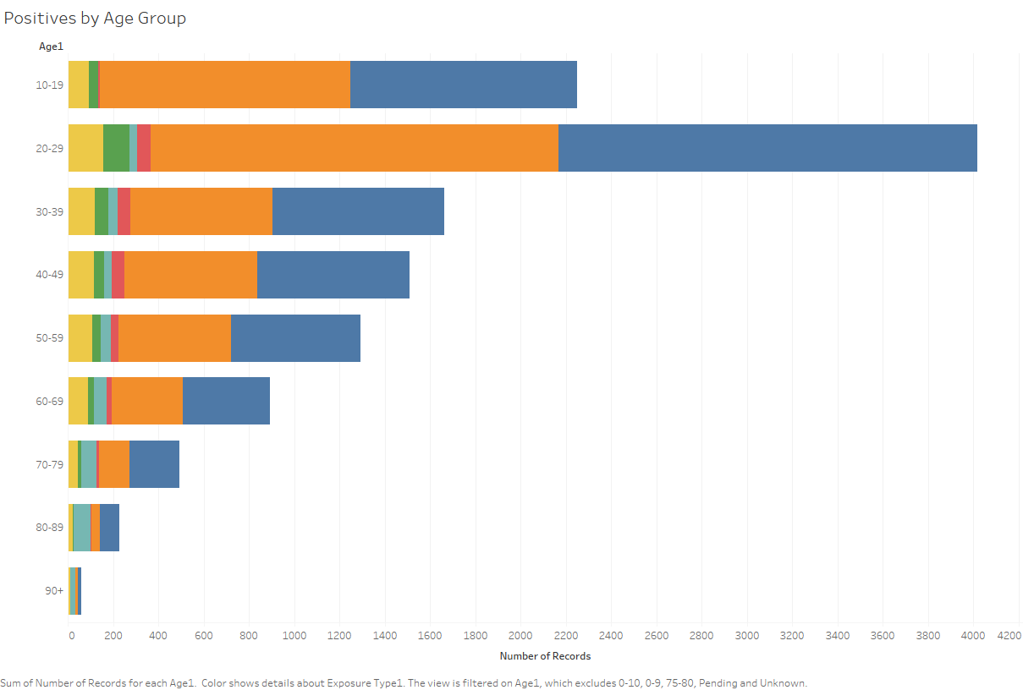
COVID-19 POSITIVES Age Distribution

Slide 37
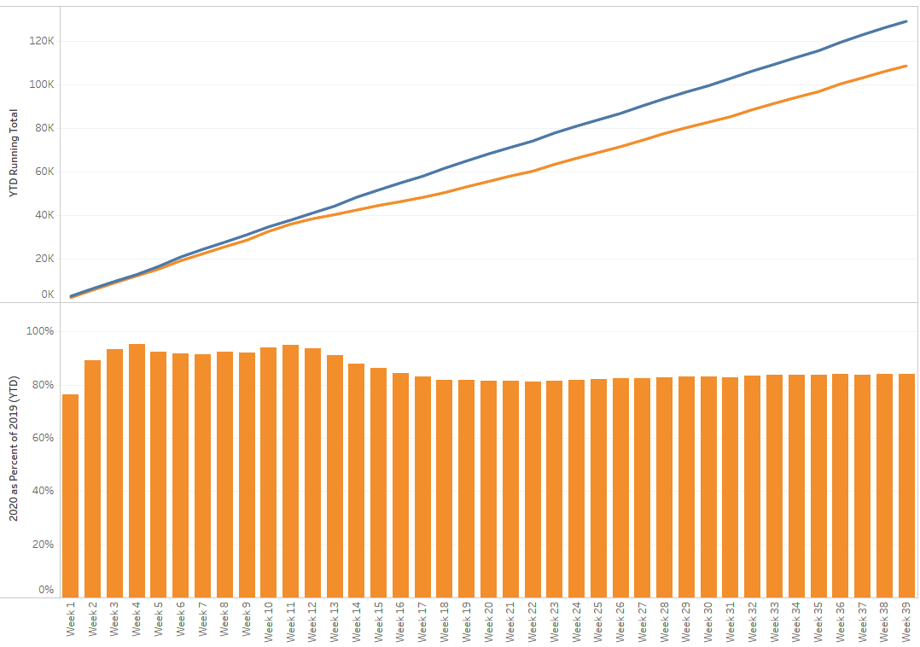
TX/NM Region Weekly Procedures (YOY)

Slide 38
Caregivers

Slide 39
CENSUS
 | 9/28 | 9/29 | 9/30 | 10/1 | 10/2 |  | 10/5 | 10/6 | 10/7 | 10/8 | 10/9
CMC (360) | 333 | 344 | 346 | 346 | 345 |  | 332 | 326 | 331 | 327
Cases (41) | 36 | 28 | 35 | 40 | 26 |  | 34 | 30 | 37
CCH (135) | 74 | 76 | 92 | 92 | 100 |  | 72 | 88 | 91 | 87
Cases (19) | 14 | 17 | 6 | 11 | 10 |  | 14 | 13 | 6
GMC (18) | 6 | 9 | 14 | 13 | 7 |  | 2 | 5 | 14 | 13
Cases (20) | 47 | 9 | 12 | 11 | 8 |  | 8 | 10 | 13 | 8
CHP (49) | 14 | 39 | 42 | 24 | 32 |  | 24 | 34 | 29 | 32
Cases (19) | 5 | 3 | 3 | 7 | 3 |  | 10 |  | 7 | 16
CHL (18) | 4 | 4 | 6 | 5 | 7 | 8 | 8 | 13 | 10 | 14
cases | 0 | 0 | 1 | 1 | 1 |  | 0 | 0 | 2 | 0
CSH (35) | 29 | 28 | 28 | 27 | 29 |  | 29 | 30 | 29 | 28
Capacity Status RED Square

Slide 40
COVID HOSPITALIZATIONS BY TSA

Slide 41
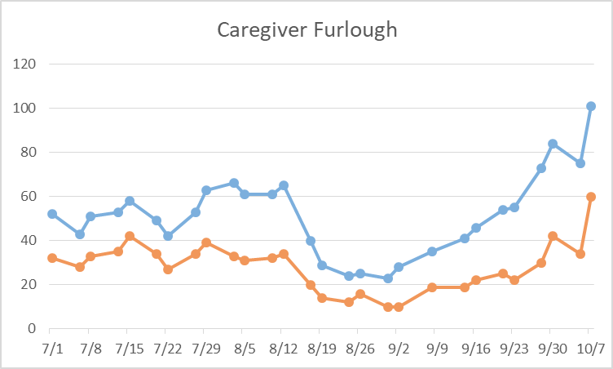
Caregivers
COVID Related Furloughs
10/8 Update: 117 Caregivers furloughed
Count reflects # furlough (exposed and positive)
Good
Moderate
Critical

Slide 42
Caregivers
Testing Our Heroes (antibody testing)
  Start October 26
  Ordered additional blood collection tubes
  All tests will be processed and performed at CMC
  Caregivers must register on-line
    PRIOR to the blood collection
    Red Cap Database will collect the results and send each provider an email to access their results in that database

Slide 43


Caregivers
Respiratory Therapists
  2 applications received
  Being reviewed daily by HR
Statewide shortages with agency staff
Radiology Technicians (Especially MRI) Significant shortages exist
When ordering an MRI, especially if the patient is COVID positive, consider if the exam is essential and if that is the best modality. If you are unsure, please consult a radiologist.

Slide 44
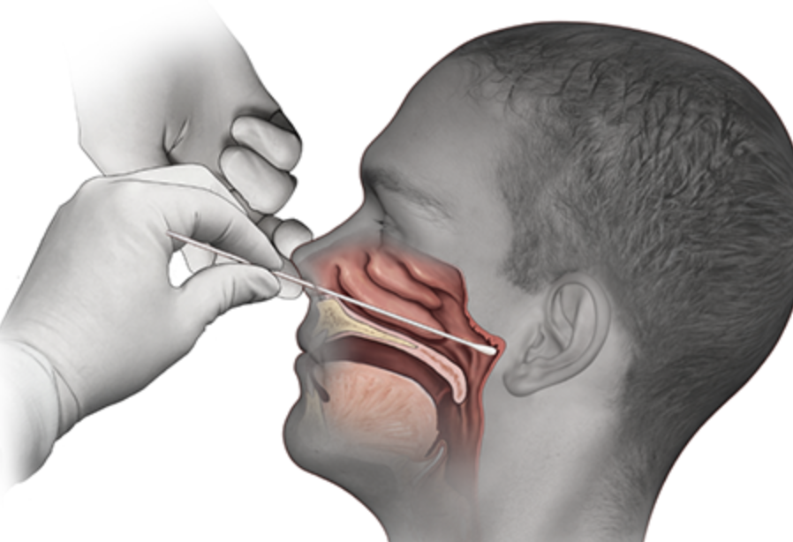
Covid-19 Testing

Slide 45
TESTING
 | CMC | GMC | CMG
Test Kits
Swabs
VTM
 | CMC |  | GMG/CMG
 | Tests | + | Tests | +
10/5 | 138 | 27 | 27 | 6
10/6 | 351 | 15 | 281 | 63
10/7 | 292 | 34 | 325 | 93
>2000 >750
<2000 <750
<1600 <500
CMC-2 weeks of testing with Alinity, no issues with allocation
Grace- slowly receiving from BD
CMG- received all previous orders; 5000 rapids in

Slide 46
TESTING
Patients who test positive
Will not be retesting, false positives are not common
Abbott ID – rapid test use
Use on symptomatic patients

Slide 47
TESTING
Same Day Surgery
Test in advance
Delay any non urgent procedures
Expect a several hour turn around because we must use the higher sensitivity testing platforms

Slide 48
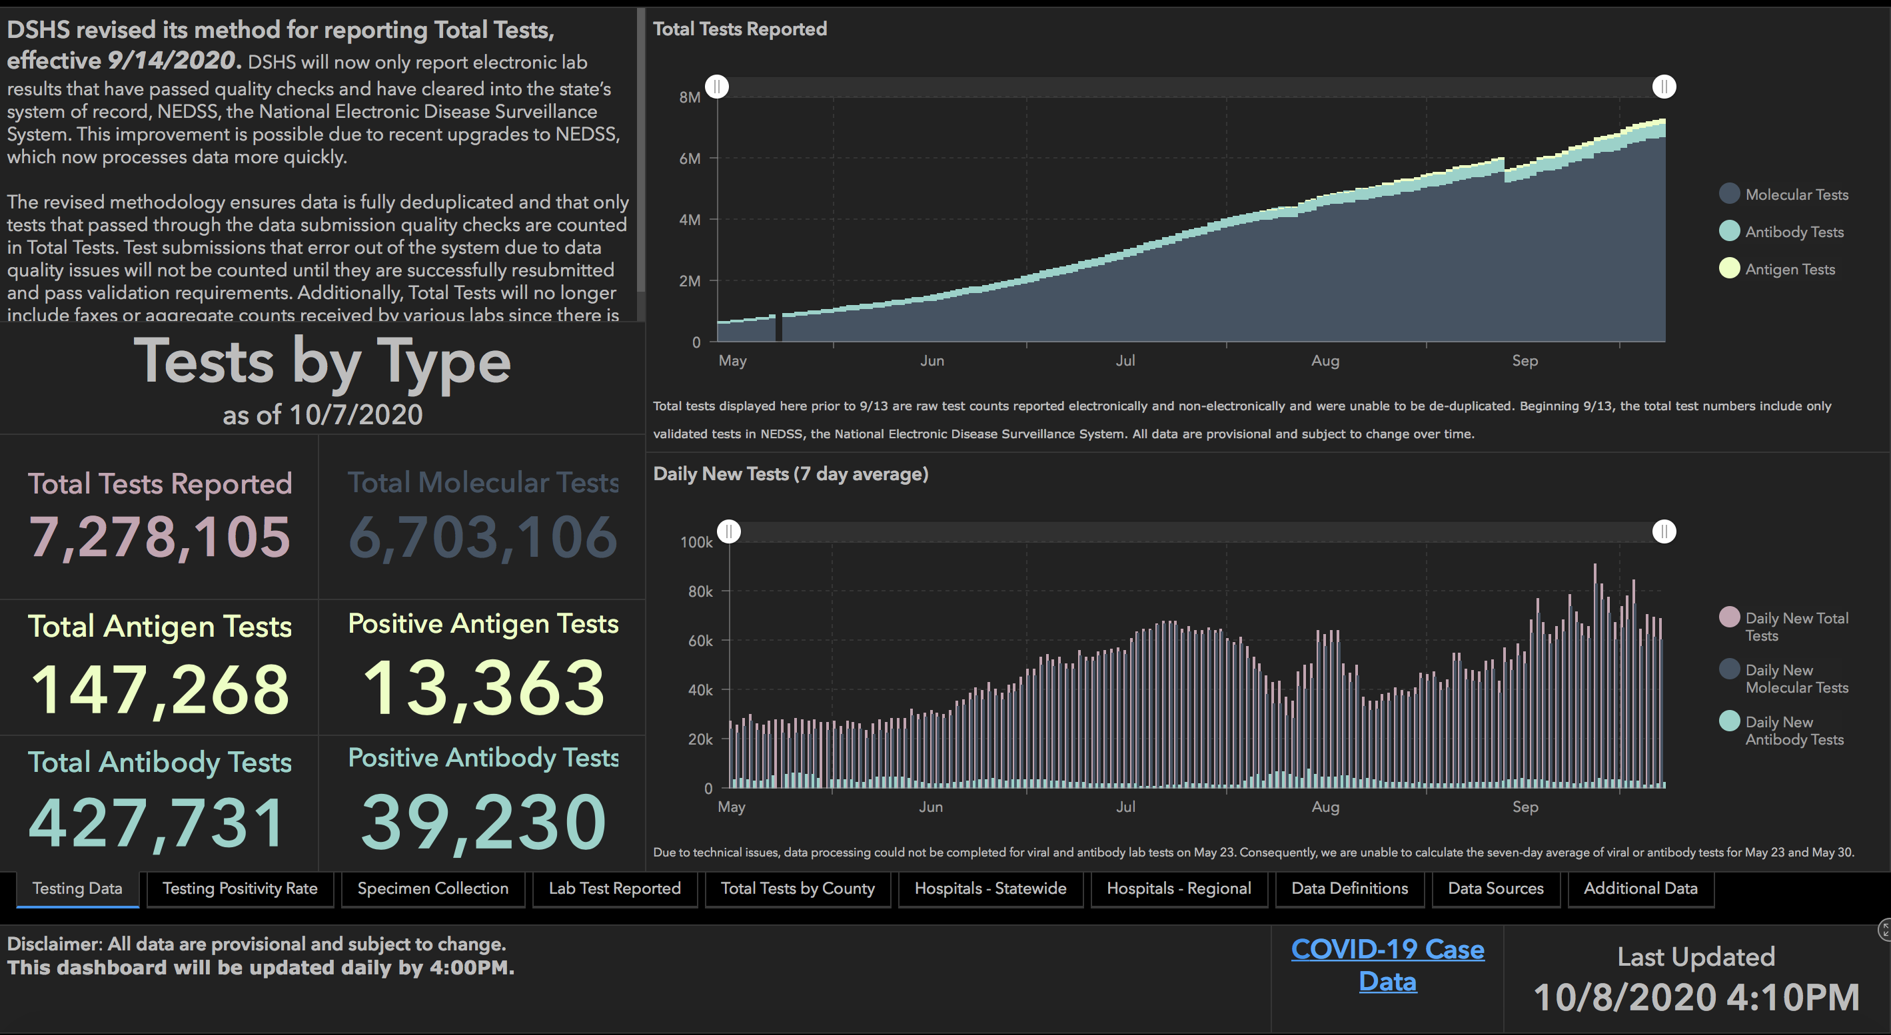

Slide 49
Pharmacy Update
Larry Pineda, PharmD
Clinical Pharmacist – AMS
Covenant Health

Slide 50
CHS Remdesivir Inventory
Ministry | Stock | On Treatment | Min PAR | Max PAR
Covenant Medical Center | 330 | 30 | 480 | 640
Children’s Hospital | 0 | 0 | 0 | 6
Covenant Plainview | 200 | 4 | 80 | 120
Covenant Levelland | 14 | 0 | 0 | 6

Slide 51
Corticosteroids
Clinical Trial Data

Slide 52
NIH Guidelines
Recommend using dexamethasone 6 mg per day for up to 10 days or until hospital discharge, whichever comes first, for the treatment of COVID-19 in hospitalized patients who are mechanically ventilated (AI) and in hospitalized patients who require supplemental oxygen but who are not mechanically ventilated (BI)
Recommend against using dexamethasone for the treatment of COVID-19 in patients who do not require supplemental oxygen (AI)
If dexamethasone is not available, recommend using alternative glucocorticoids such as prednisone, methylprednisolone, or hydrocortisone (AIII)
Notes:
Background text from NIH guidelines for reference:
Both beneficial and deleterious clinical outcomes have been reported with use of corticosteroids (mostly prednisone or methylprednisolone) in patients with other pulmonary infections. In patients with Pneumocystis jirovecii pneumonia and hypoxia, prednisone therapy reduced the risk of death;² however, in outbreaks of other novel coronavirus infections (i.e., Middle East respiratory syndrome [MERS] and severe acute respiratory syndrome [SARS]), corticosteroid therapy was associated with delayed virus clearance.^{3,4} In severe pneumonia caused by influenza viruses, corticosteroid therapy appears to result in worse clinical outcomes, including secondary bacterial infection and death.⁵
Corticosteroids have been studied in critically ill patients with acute respiratory distress syndrome (ARDS) with conflicting results.⁶⁻⁸ Seven randomized, controlled trials that included 851 patients evaluated use of corticosteroids in patients with ARDS.⁷⁻¹³ A meta-analysis of these trial results demonstrated that, compared with placebo, corticosteroid therapy reduced the risk of all-cause mortality (risk ratio 0.75; 95% CI, 0.59–0.95) and duration of mechanical ventilation (mean difference, -4.93 days; 95% CI, -7.81 to -2.06 days).^{14,15}
Whether use of other corticosteroids (e.g., prednisone, methylprednisolone, hydrocortisone) for the treatment of COVID-19 provides the same benefit as dexamethasone is unclear. The total daily dose equivalencies for these drugs to dexamethasone 6 mg (oral or intravenous [IV])²⁰ are:
Prednisone 40 mg
Methylprednisolone 32 mg
Hydrocortisone 160 mg

Slide 53
Observational Data, China
Study | Type | Size | Corticosteroid | Outcomes
Wu C, et al. JAMA IM 2020 | Retrospective | N = 201, 84 with ARDS | Methylprednisolone (no data on dose/duration) | Death: HR, 0.38; 95% CI, 0.20-0.72; p=0.003
Lu X, et al. Crit Care Open Access 5/2020 | Retrospective | N = 244 Critically ill (ARDS or sepsis with acute organ dysfunction) N = 62 Propensity score matched (PSM) | Methylprednisolone 40 mg/day or equivalent dexamethasone x 8 days | 28 day mortality, no difference Multivariate analysis: aOR, 1.05; 95% CI, 0.15-7.46 28 day mortality in PSM: 39% vs 16% of control group; p=0.09
Wu J, et al. J Clin Endocrinol Metab 9/2020 | Retrospective | N = 1514 severe, 249 critical | 40 mg/day methylprednisolone or equivalent x 6 days | In-hospital mortality: increased risk Severe: HR=1.77, 95% CI: 1.08-2.89, p=0.023 Critical: HR=2.07, 95% CI: 1.08-3.98, p=0.028
Notes:
Wu C, et al. JAMA Intern Med. 2020;180(7):934-943. 201 patients, of which 84 developed ARDS
Evaluated clinical characteristics associated with the development of acute respiratory distress syndrome (ARDS) and progression from ARDS to death. Among patients with ARDS, treatment with methylprednisolone decreased the risk of death (HR, 0.38; 95% CI, 0.20-0.72)
Lu X, et al. Crit Care 2020 open access. Adjusted for differences in baseline characteristics by propensity score. Multivariate logistic regression revealed corticosteroid treatment was not associated with reduced 28-day mortality. Additionally, higher doses were associated with more death (every 10-mg increase in dosage was associated with additional 4% mortality risk)
Wu J et al. J Clin Endocrinol Metab. 2020 Sep 3. Compared to non-corticosteroid group, systemic corticosteroid use was not associated with beneficial effect in reducing in-hospital mortality in both severe cases (HR=1.77, 95% CI: 1.08-2.89, p=0.023), and critical cases (HR=2.07, 95% CI: 1.08-3.98, p=0.028)

Slide 54
Observational Data, Other
Study | Type | Size | Corticosteroid | Outcomes
Cruz AF, et al. | Retrospective, Spain | N = 463 PSM, ARDS and/or hyperinflammatory syndrome | 1 mg/kg/day methylprednisolone or equivalent, unclear duration | In-hospital mortality: 55/396 (13.9%) vs 16/67 (23.9%); HR 0.51; 95% CI, 0.27-0.96, p=0.044
Nelson BC, et al. CID 08/2020 | Retrospective, US | N = 84 PSM, mechanically ventilated | Methylprednisolone 1 mg/kg/day x 5 days | Ventilator-free days: 6.21 vs 3.14; p=0.044 Ventilator-free days, multivariate analysis: aOR, 4.11; 95% CI, 0.83-7.40 Extubation: 45% vs 21%; p=0.021 Mortality: 19% vs 36%; p=0.087
Salton F, et al. Preprint | Retrospective, Italy | N = 173 Severe COVID-19 MP (n=83) vs control (n=90) | Methylprednisolone 80 mg/day ~ 14 days | Composite endpoint (ICU, intubation, or death): 19 vs 40 aHR, 0.41; 95% CI 0.24-0.72 Transfer to ICU: 18.1% vs 30%; p=0.07 Need for invasive MV: 16.9% vs 28.9%; p=0.10 Days off invasive MV: 24 days vs 17.5 days; p=0.001 Death: aHR, 0.29; 95% CI 0.12-0.73)
Notes:
Cruz et al. In-hospital mortality was lower in patients treated with steroids than in controls (13.9% [55/396] versus 23.9% [16/67]; hazard ratio [HR], 0.51 [95% confidence interval, 0.27 to 0.96]; P = 0.044).
Nelson et al. Mean ventilator-free days were significantly higher in patients treated with methylprednisolone (6.21 ± 7.45 vs 3.14 ± 6.22; P = .044). The probability of extubation was also increased in patients receiving methylprednisolone (45% vs 21%; P = .021), and there were no significant differences in mortality (19% vs 36%; P = .087). In a multivariable linear regression analysis, only methylprednisolone use was associated with a higher number of ventilator-free days (P = .045).
time to steroid treatment from symptom onset varied among all studies. Mortality lower, but not significant

Slide 55
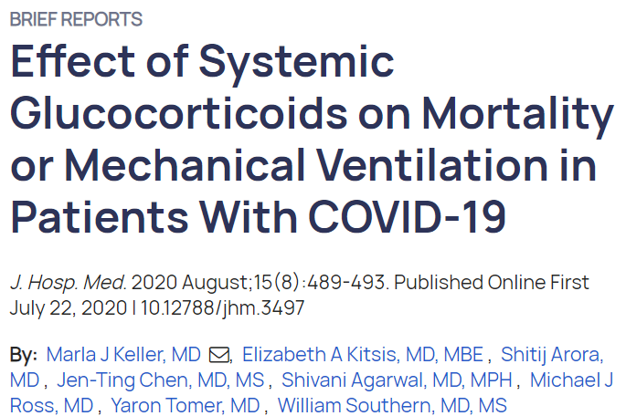
Observational Data
1806 patients
  140 with systemic corticosteroids (dexamethasone, hydrocortisone, methylprednisolone, prednisone) within the first 48 hours of admission
  Dosage not included
Primary outcome: composite mortality or mechanical ventilation
  No association with composite or separate
However, early steroid use if initial CRP > 20 mg/dL significantly reduced risk of mortality
  CRP < 10 mg/dL was associated with significantly increased risk of mortality
Notes:
The efficacy of glucocorticoids in COVID-19 is unclear. This study was designed to determine whether systemic glucocorticoid treatment in COVID-19 patients is associated with reduced mortality or mechanical ventilation. This observational study included 1,806 hospitalized COVID-19 patients; 140 were treated with glucocorticoids within 48 hours of admission. Early use of glucocorticoids was not associated with mortality or mechanical ventilation. However, glucocorticoid treatment of patients with initial C-reactive protein (CRP) ≥20 mg/dL was associated with significantly reduced risk of mortality or mechanical ventilation (odds ratio, 0.23; 95% CI, 0.08-0.70), while glucocorticoid treatment of patients with CRP <10 mg/dL was associated with significantly increased risk of mortality or mechanical ventilation (OR, 2.64; 95% CI, 1.39-5.03). Whether glucocorticoid treatment is associated with changes in mortality or mechanical ventilation in patients with high or low CRP needs study in prospective, randomized clinical trials

Slide 56

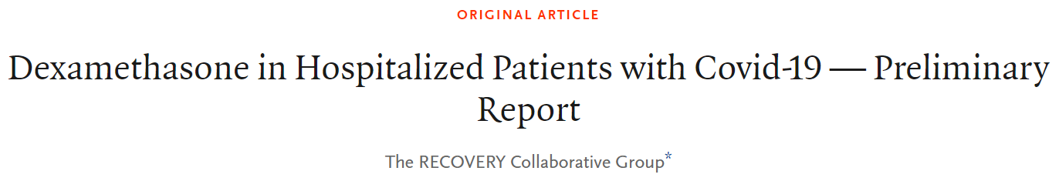
RECOVERY Trial
Design: open-label, multi-center, randomized control trial in UK
Intervention: dexamethasone PO/IV 6 mg daily up to 10 days (median, 7 days)
Patients:
  2104 assigned to receive dexamethasone
  4321 to receive usual care
Primary outcome: 28-day mortality

Slide 57
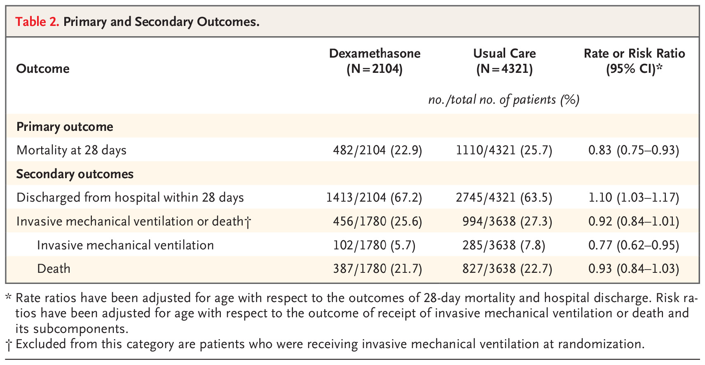
RECOVERY Trial
Notes:
Overall, 482 patients (22.9%) in the dexamethasone group and 1110 patients (25.7%) in the usual care group died within 28 days after randomization (age-adjusted rate ratio, 0.83; 95% confidence interval [CI], 0.75 to 0.93; P<0.001). The proportional and absolute between-group differences in mortality varied considerably according to the level of respiratory support that the patients were receiving at the time of randomization. In the dexamethasone group, the incidence of death was lower than that in the usual care group among patients receiving invasive mechanical ventilation (29.3% vs. 41.4%; rate ratio, 0.64; 95% CI, 0.51 to 0.81) and among those receiving oxygen without invasive mechanical ventilation (23.3% vs. 26.2%; rate ratio, 0.82; 95% CI, 0.72 to 0.94) but not among those who were receiving no respiratory support at randomization (17.8% vs. 14.0%; rate ratio, 1.19; 95% CI, 0.91 to 1.55).

Slide 58
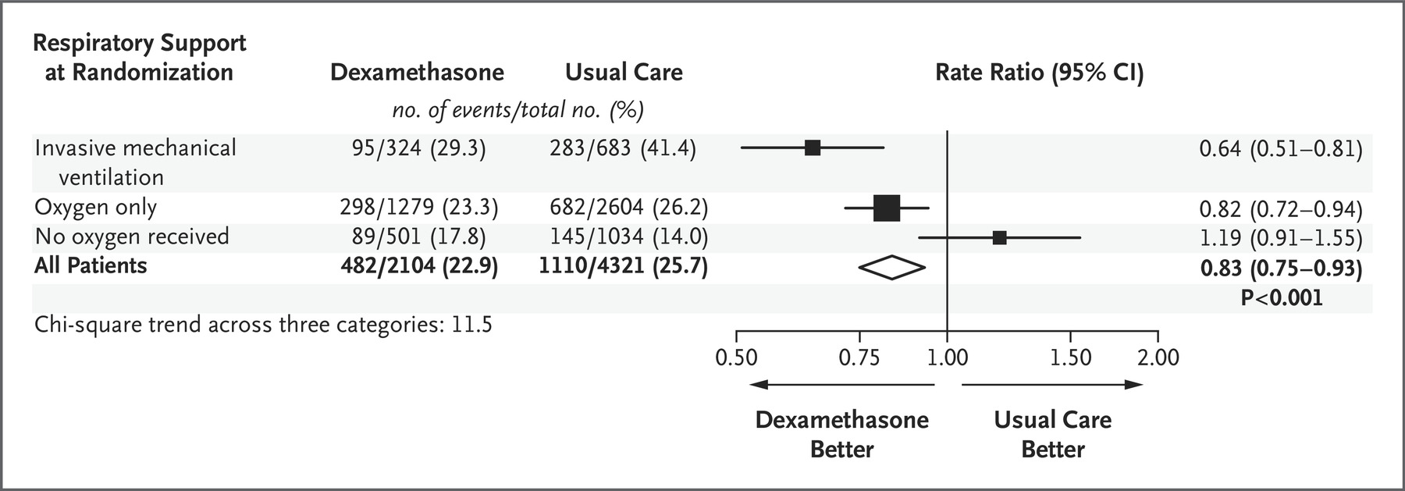
RECOVERY Trial

Slide 59

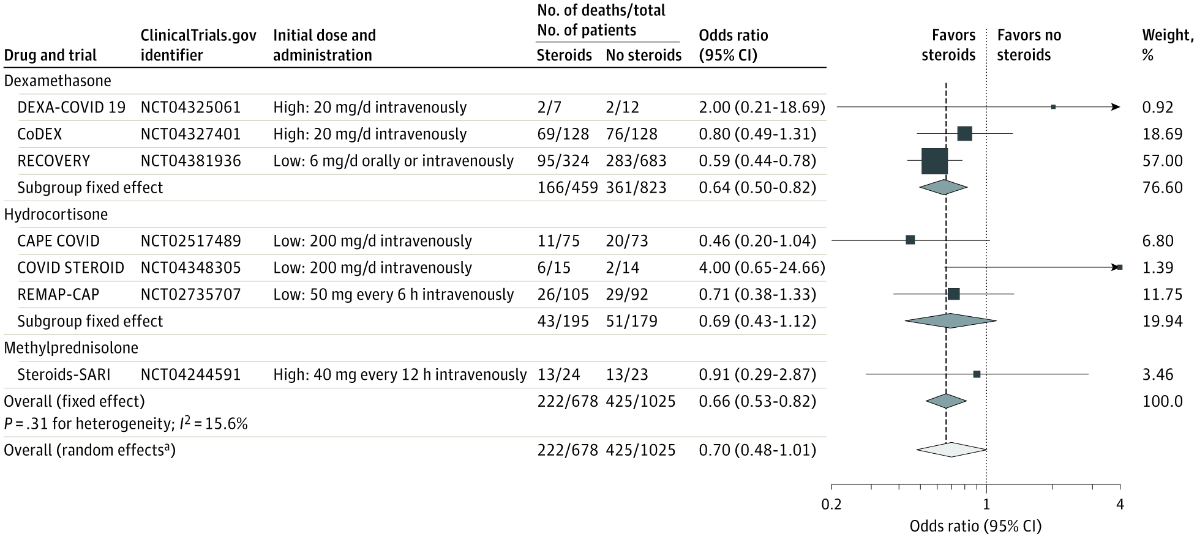
From: Association Between Administration of Systemic Corticosteroids and Mortality Among Critically Ill Patients With COVID-19: A Meta-analysis
JAMA. 2020;324(13):1330-1341. doi:10.1001/jama.2020.17023
Notes:
9/2/2020 JAMA
Association Between Corticosteroids and 28-Day All-Cause Mortality in Each Trial, Overall, and According to Corticosteroid DrugThe area of the data marker for each trial is proportional to its weight in the fixed-effect meta-analysis. The Randomized Evaluation of COVID-19 Therapy (RECOVERY) trial result is for patients who were receiving invasive mechanical ventilation at randomization. CAPE COVID indicates Community-Acquired Pneumonia: Evaluation of Corticosteroids in Coronavirus Disease; CoDEX, COVID-19 Dexamethasone; COVID STEROID, Hydrocortisone for COVID-19 and Severe Hypoxia; DEXA-COVID 19, Efficacy of Dexamethasone Treatment for Patients With ARDS Caused by COVID-19; REMAP-CAP, Randomized, Embedded, Multifactorial Adaptive Platform Trial for Community-Acquired Pneumonia; Steroids-SARI, Glucocorticoid Therapy for COVID-19 Critically Ill Patients With Severe Acute Respiratory Failure.
ªThe random-effects analysis estimates both the average and variability of effects across studies. The 95% CI for the average effect (shown here) is wide because there is a small number of studies, some of which have very small sample size. The prespecified primary analysis was the fixed-effect analysis, which should be used to guide clinical interpretation of the results.

Slide 60
Inhaled Corticosteroids
In-vitro data suggesting inhibition of viral proliferation
Case series from Japan observed possible clinical benefit of ciclesonide in 3 patients with mild/moderate disease
  No control group, spontaneous improvement?
No published studies specifically evaluating use of inhaled corticosteroids in patients with COVID-19
RCTs needed to assess benefit/risk
  Several ongoing trials listed on ClinicalTrials.gov

Slide 61
Take Away
Beneficial effect of glucocorticoids is dependent on selection of the right dose, at the right time, in the right patient
Strongest evidence with dexamethasone (RECOVERY)
Unclear if benefit is “class effect”
Unknown if inhaled corticosteroids are beneficial/harmful
Notes:
Metcovid
CoDeX
REDMAP CAP
CAPE COVID
Metaanalysis in JAMA

Slide 62
Communications Update

Slide 63

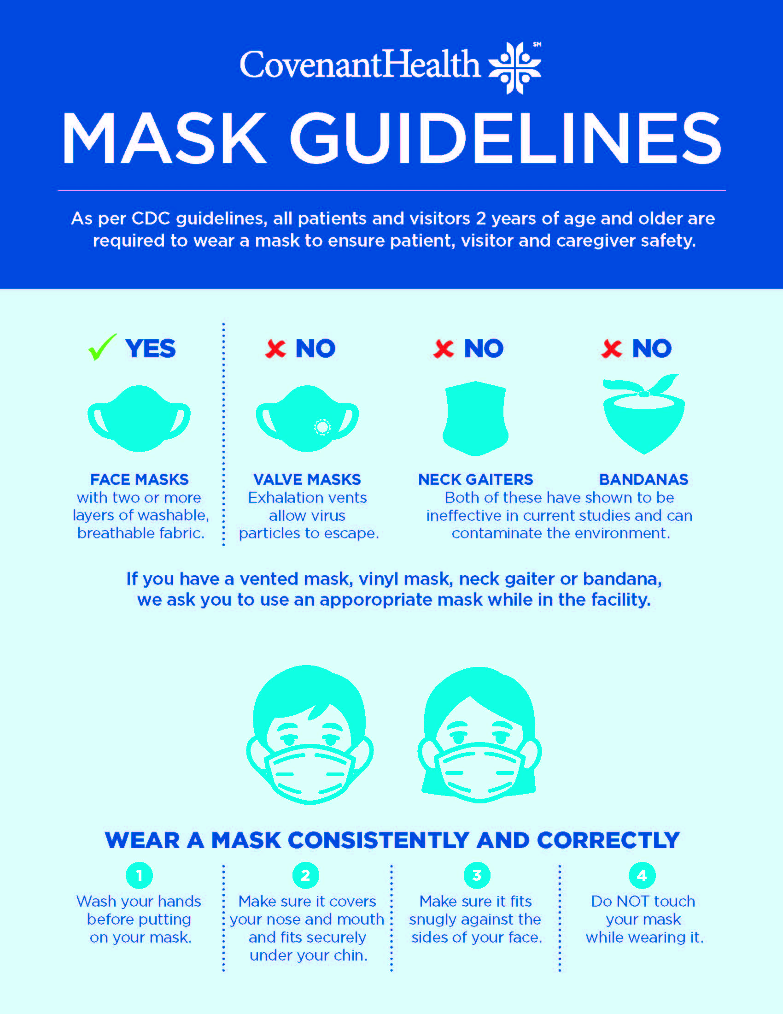
SIGNAGE – patient and visitors
Signage received and sent to Grace, Specialty, CMG and Plainview
Children’s should be in today
CMC ordered yesterday

Slide 64
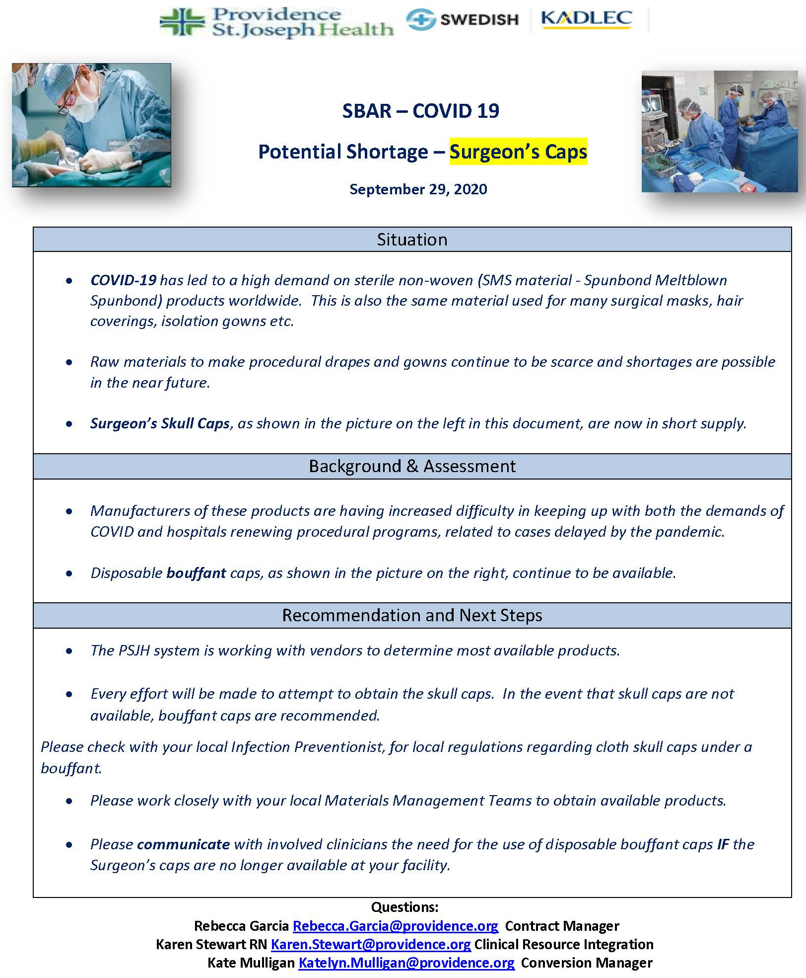
Critical Inventory
OR Attire Policy Change
Surgeons Caps and Bouffants
Allowing cloth coverings – washed daily, discard if it becomes contaminated with blood, body fluids, or other potentially infectious materials
Dr. Deeb to take this to MEC for approval at CMC

Slide 65

Texas Demographics

Slide 66
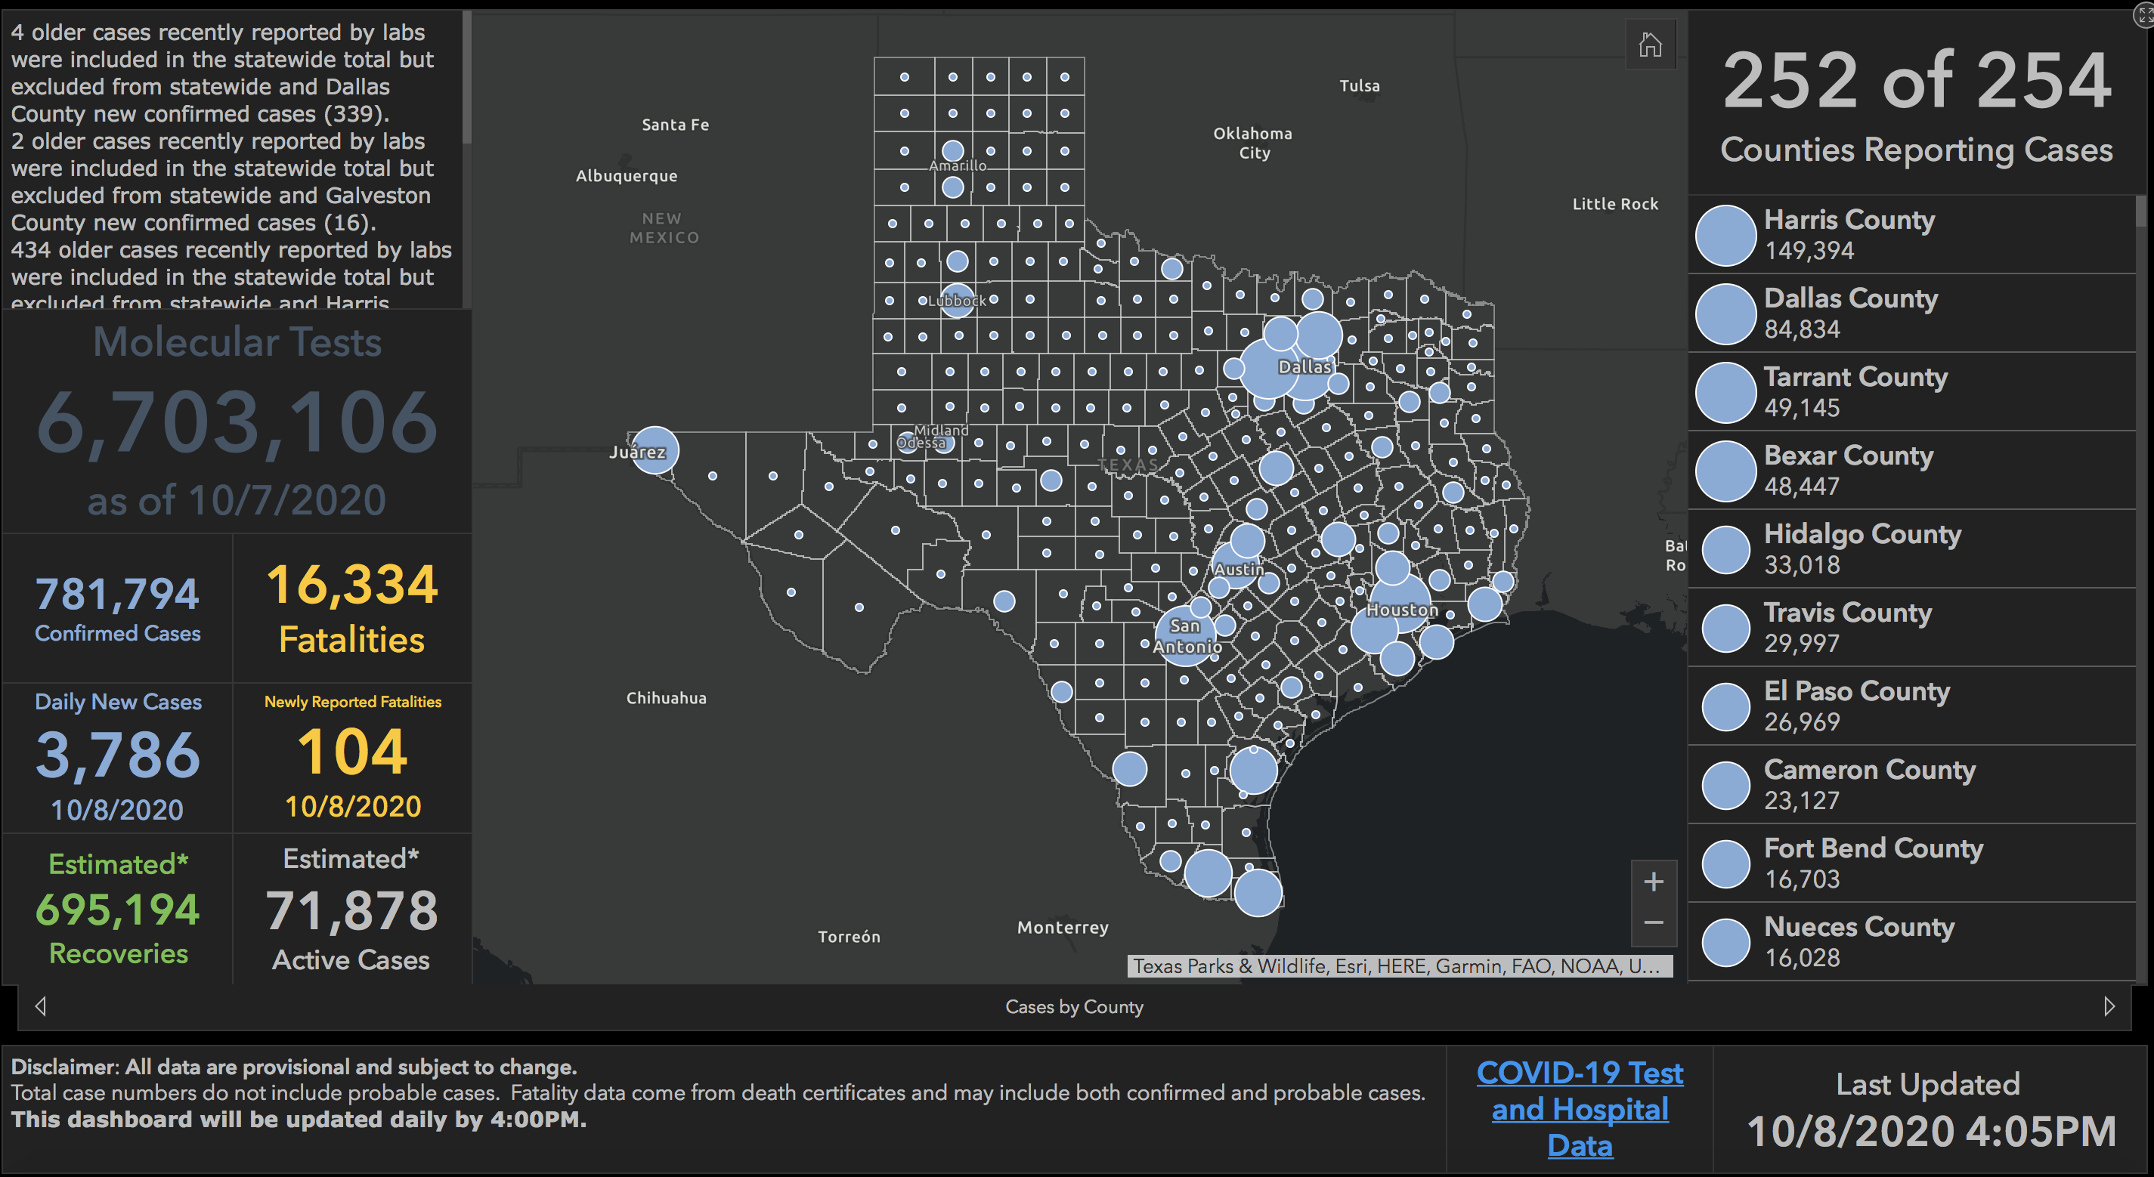

Slide 67
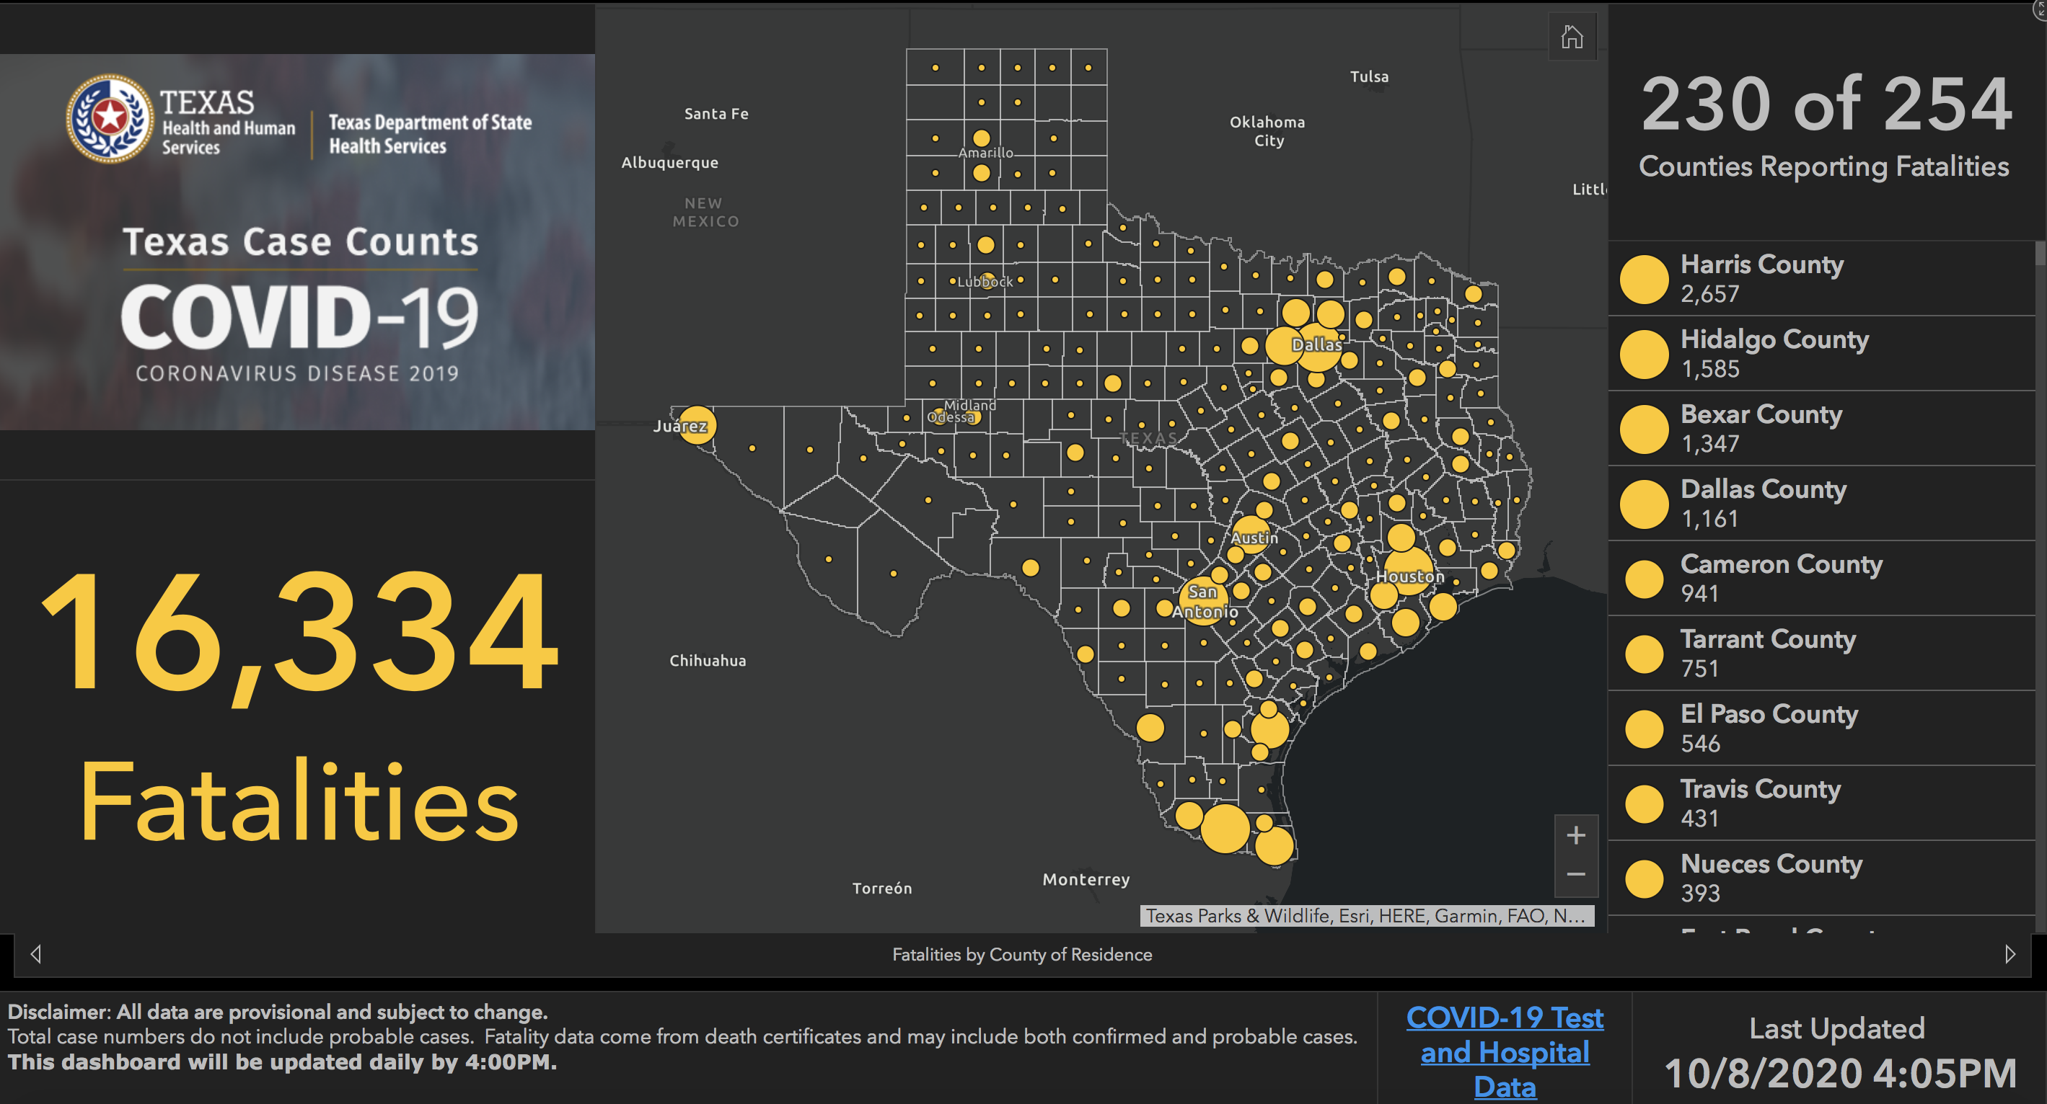

Slide 68
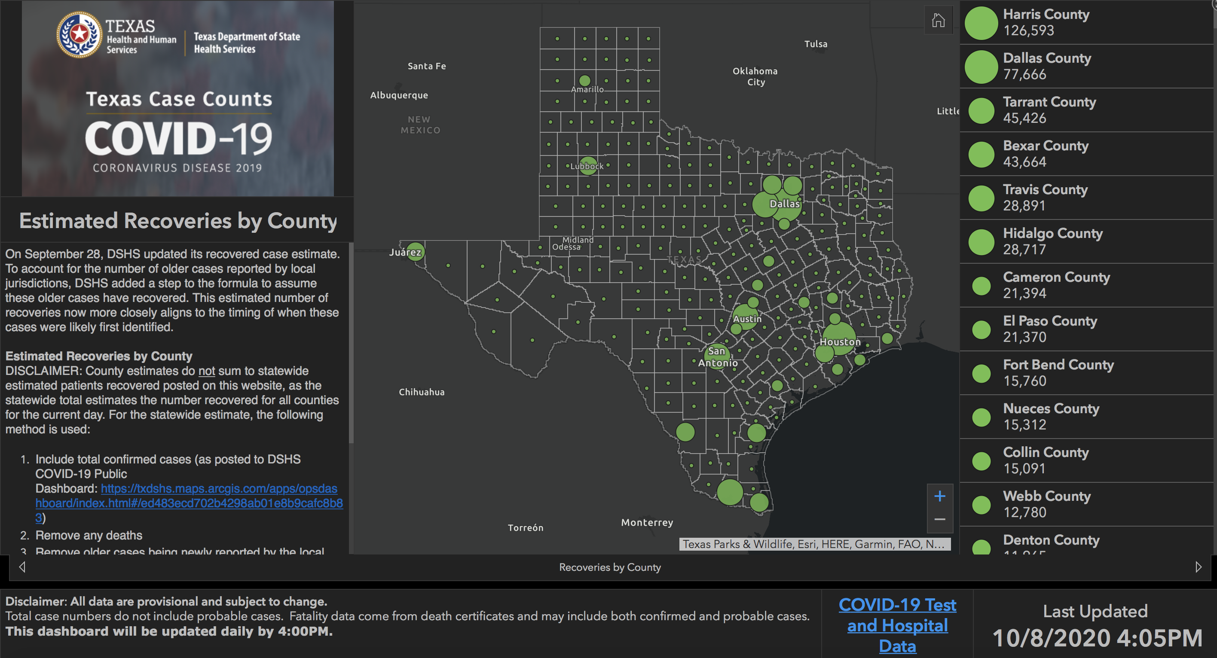

Slide 69
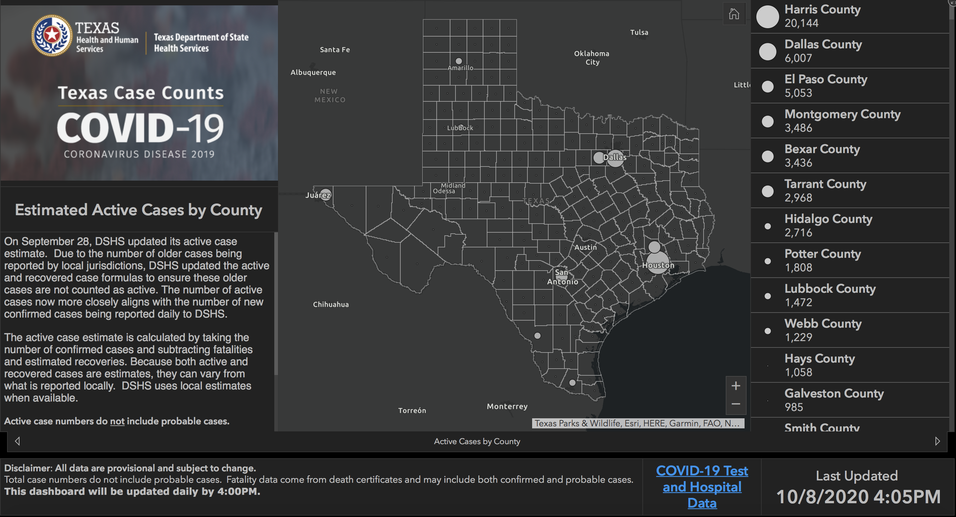

Slide 70
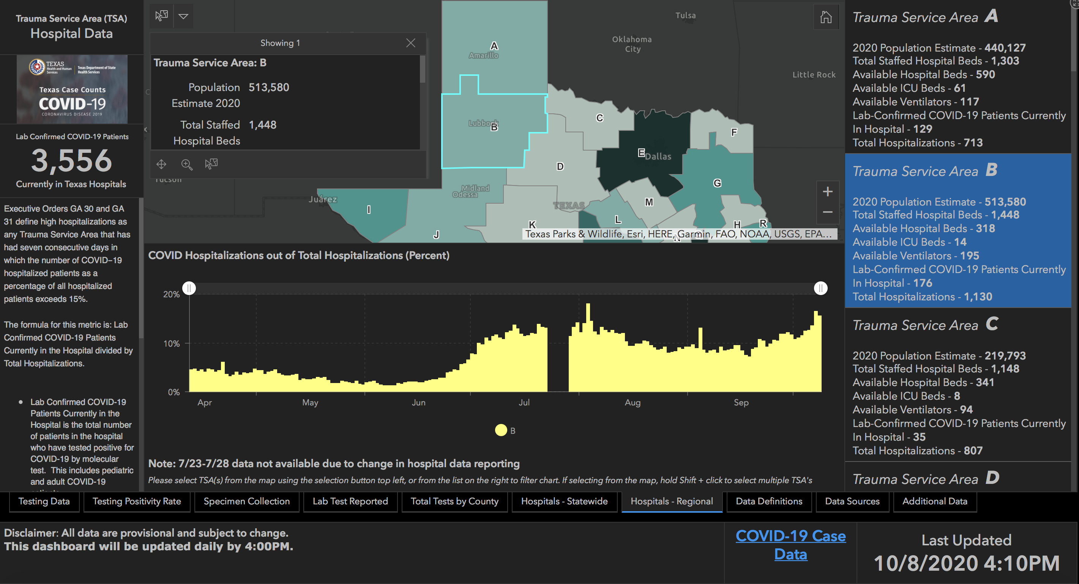

Slide 71
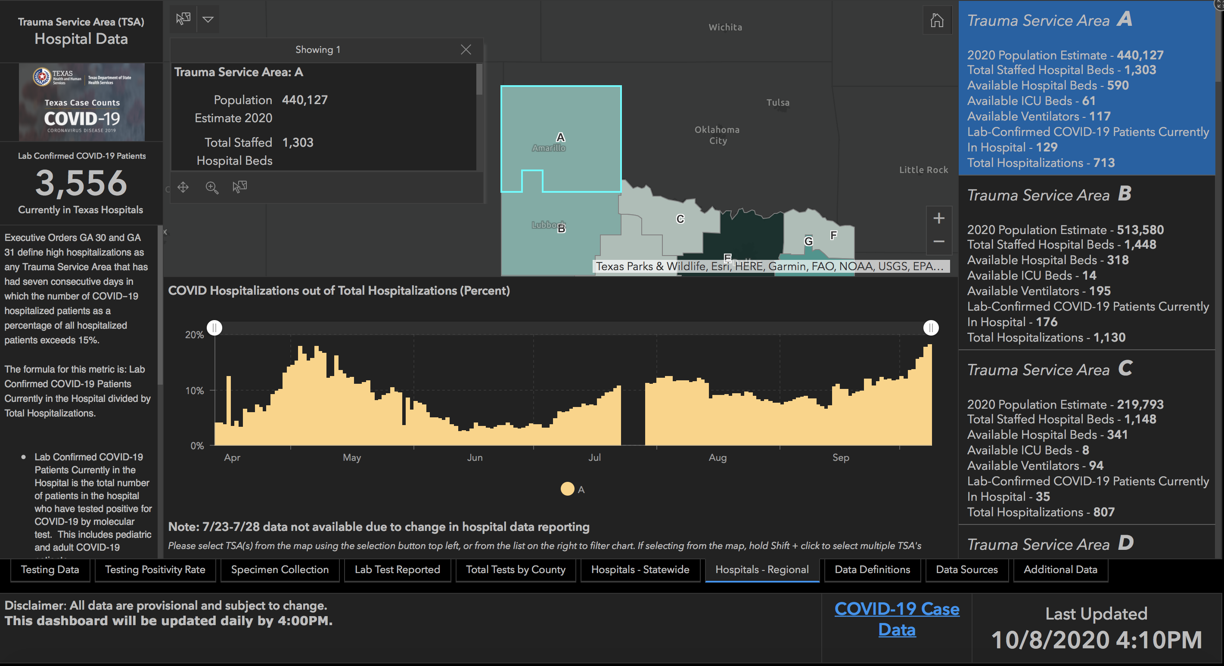

Slide 72
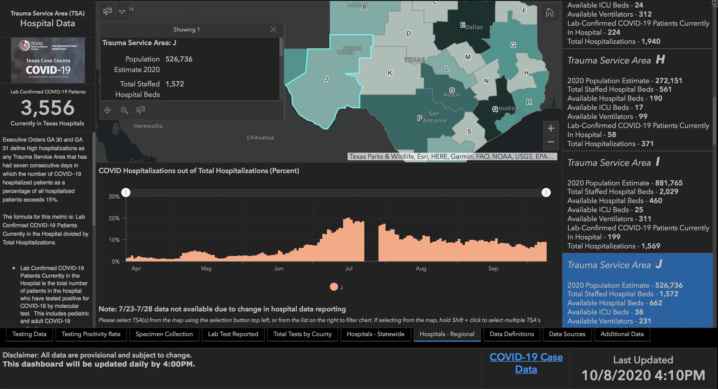

Slide 73
Governmental Affairs

Slide 74
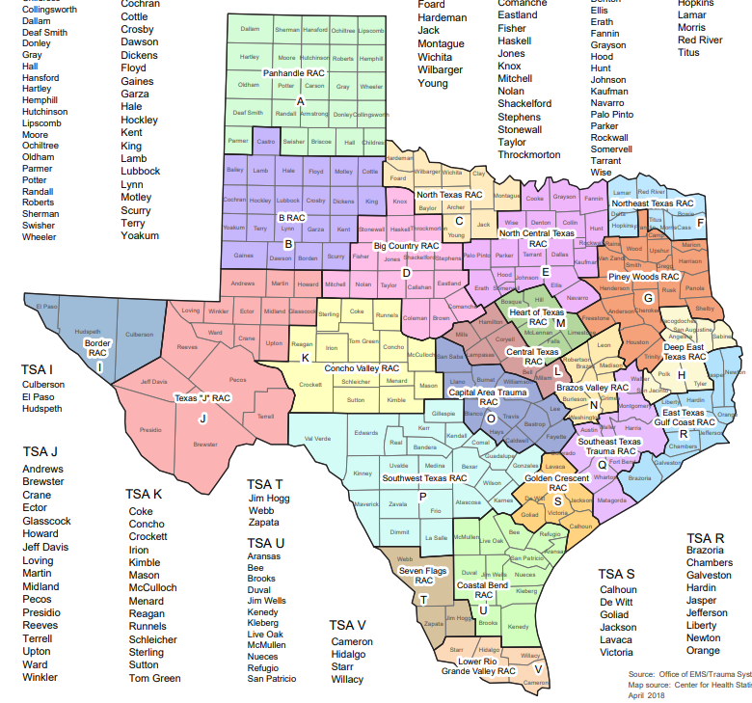
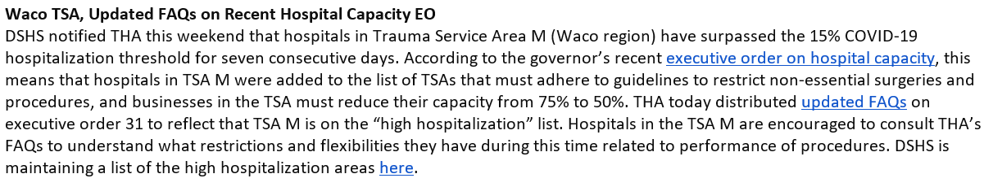
Hospital Capacity - Governor’s Exec order

Slide 75

GOVERNMENT AFFAIRS

Slide 76

Recognition of Great Nurses on the South Plains

Slide 77





South Plains Great 25 Nurses
Congratulations to our Wonderful Covenant Nursing Caregivers who were selected as
“South Plains Great 25 Nurses” for 2020:
Raye Nell Hanna
Daniel Hronek
Krystina Beard

Slide 78




South Plains Great 25 Nurses
Charlotte Wheeler
Lauren Johnston
Kelsey Sawyer
We are so proud of your outstanding example of our Mission, Vision & Values!

Slide 79
Reminder about E-Prescribing

Slide 80
e-Prescribing of Controlled Substances (EPCS)
State of Texas requirement to use EPCS for all DEA Scheduled drugs (II-V, controlled substances) beginning January 1st, 2021
  Outpatient pharmacies will no longer accept written prescriptions for controlled substances starting on 1/1/21
Meditech allows EPCS via Dr. First
  You must be enrolled in DrFirst to use EPCS
  To enroll in DrFirst contact Clinical Informatics at 806-725-4189
CMS has delayed their requirement for EPCS until 1/1/22
  This does not affect the 1/1/21 Texas State requirement

Slide 81
Remember
You must be enrolled via Dr. First
Waiting until December will be hazardous
  The CI department will be implementing EPIC at Grace Short Stay Surgical Hospital AND at Hospice of Lubbock during that time and will NOT likely have personnel to help enroll you with Dr. First in the last three weeks of December.
To enroll in Dr. First contact Clinical Informatics at 806-725-4189

Slide 82
Q & A

Slide 83
CME Credit was only approved for the Live Teams meeting
To receive credit for this continuing education activity, the participant must:
  Make sure you are logged into your Teams account, if you are signed in with a group provide attendee’s First and Last name(s) in the comments section.
  If you are calling into the Teams meeting you MUST text your First & Last Name to (806) 252-4735. This will ensure you are added to the sign in sheet to receive CME Credit.
  You will receive an email within 3 business days from the CME department with further instructions on claiming your certificate.

