Slide 1
Covenant Health
Presents
Critical Communications: A Weekly Physician Update
November 20, 2020

Slide 2
PHYSICIANS
Accreditation Statement:
The Covenant Health is accredited by the Texas Medical Association (TMA) to provide continuing medical education for physicians.
Credit Designation Statement:
The Covenant Health designates this live CME activity for a maximum of 1.0 AMA PRA Category 1 Credit(s)™. Physicians should claim only the credit commensurate with the extent of their participation in the activity.

Slide 3
Disclosures of Commercial Interest
The speakers and planners of this activity
have no relevant financial interests

Slide 4
Disclosures
This activity is provided by
Covenant Health
No commercial support has been received.
No products will be endorsed.
Speakers will notify the audience if off label drug use will be discussed.

Slide 5
CME Credit was only approved for the Live Teams meeting
To receive credit for this continuing education activity, the participant must:
  Make sure you are logged into your Teams account, if you are signed in with a group provide attendee’s First and Last name(s) in the comments section.
  If you are calling into the Teams meeting you MUST text your First & Last Name to (806) 252-4735. This will ensure you are added to the sign in sheet to receive CME Credit.
  You will receive an email by Wednesday following the call from the CME department with further instructions on claiming your certificate.

Slide 6
Reflection
Presented by
Brian Schroeder, MD FACP
CMO Covenant Medical Center

Slide 7
Current Regional Covid-19 Census

Slide 8
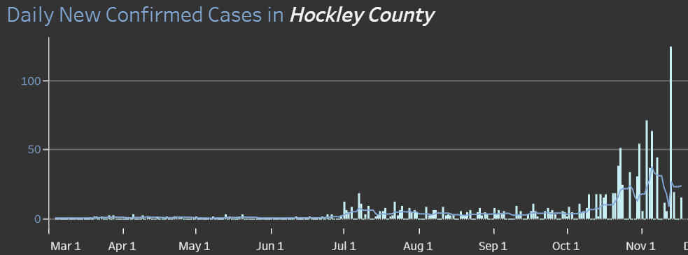
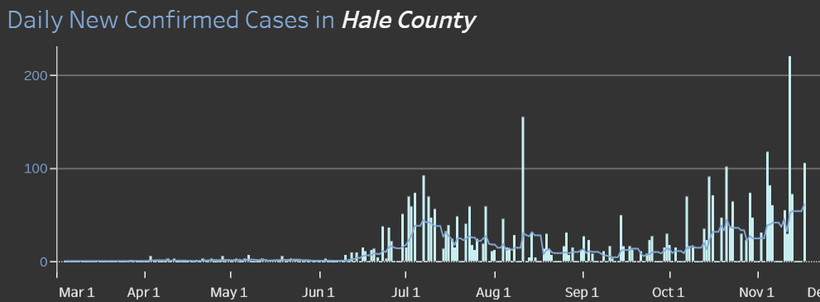
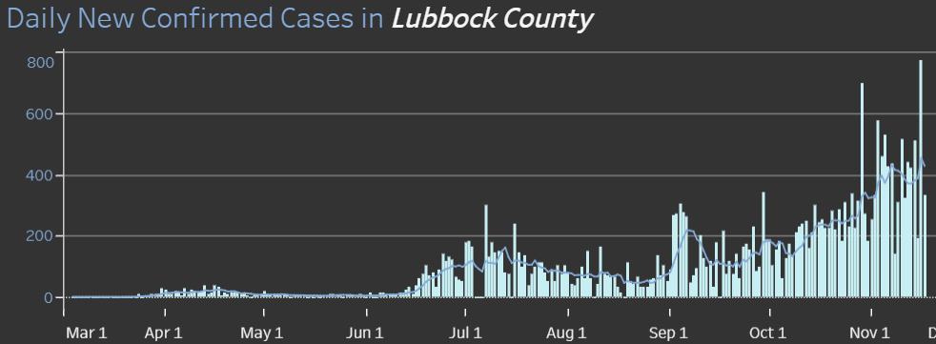
COUNTY
124 on 11/13
219 on 11/12
105 on 11/17
449 on 11/18
13.6 %
Positivity Rate

Slide 9
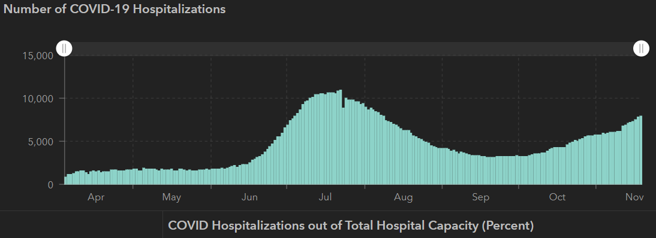
STATE
11/09 | 11/16 | 11/18
963,019 | 1,027,889 | 1,048,383
18,769 | 19,579 | 19,883
6103 | 7468 | 7958
10,893
7/22
 | 11/04 | 10/28 | 10/21 | 10/14 | 10/5 | 9/23 | 9/9 | 8/26 | 8/12 | 7/29 | 7/15 | 7/1
Cases | 926,400 | 879,994 | 838,809 | 805,802 | 769,303 | 719,599 | 645,791 | 592,137 | 506,820 | 403,307 | 282,365 | 168,062
Deaths | 18,320 | 17,700 | 17,210 | 16,717 | 16,033 | 15,129 | 13,692 | 11,805 | 9034 | 6190 | 3432 | 2481
Hospitalized | 5,872 | 5,659 | 4,319 | 3,870 | 3,318 | 3,195 | 3604 | 4806 | 7028 | 9595 | 10,471 | 6904

Slide 10
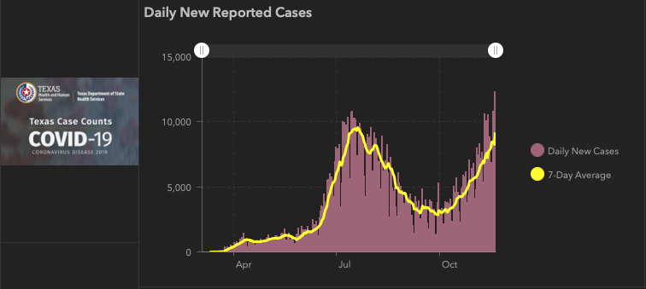

Slide 11
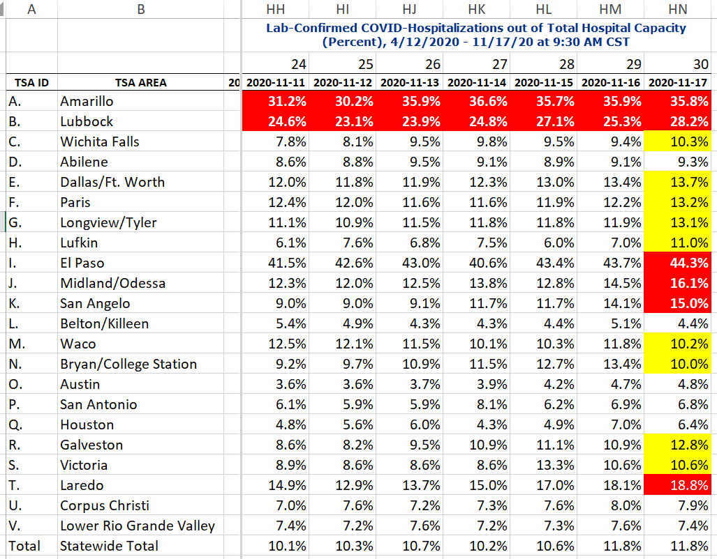
COVID+ HOSPITALIZATIONS BY TSA ID
CONFIRMED COVID+ HOSPITALIZATIONS /HOSPITAL CAPACITY

Slide 12
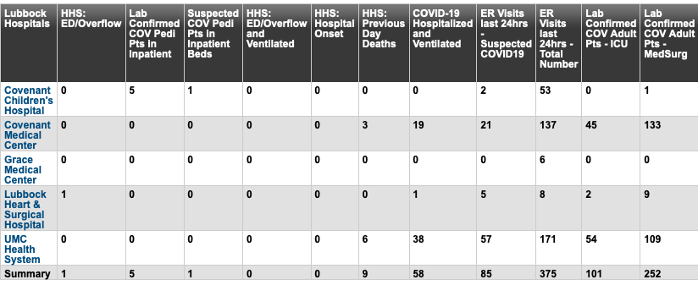
Lubbock This Morning
11/20: 359 Hospitalized in Lubbock – 58 on vents

Slide 13
RAC-DSHS
Medical Incident Support Team (MIST)
MIST Demobilized last week
Transfer management back to the local level
Rural hospitals concerned as they were support to facilitate transfers to locations outside of the RAC
Hospitals in surrounding areas and states not able to take patients

Slide 14
Transfers
Amarillo VA Hospitals
Taking non-veteran COVID patients
Have taken 12 patients from the region

Slide 15
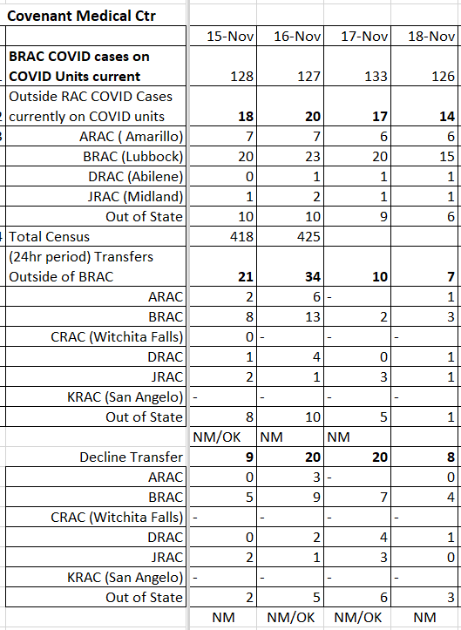
TRANSFERS
COVID UNITS
ALL UNITS

Slide 16
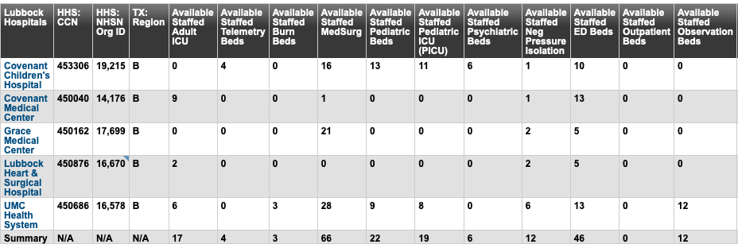
BRAC – bed availability this morning

Slide 17
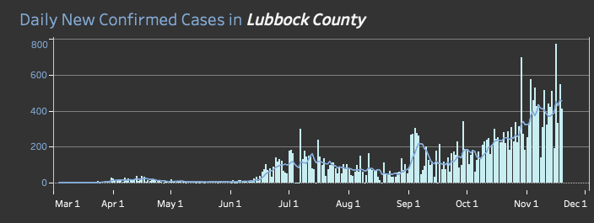
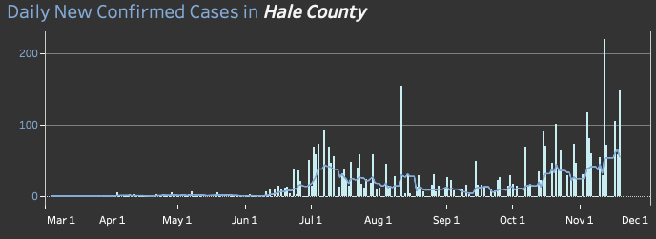
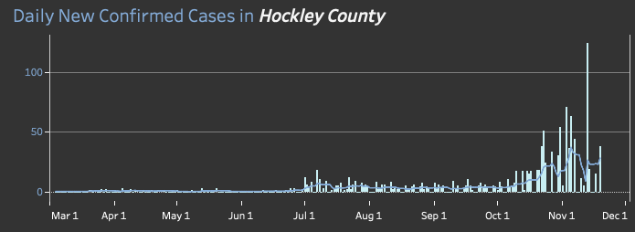
Daily New Confirmed Cases for our area
326 on 11/10
446 on 11/11
13.4 %
Positivity Rate

Slide 18
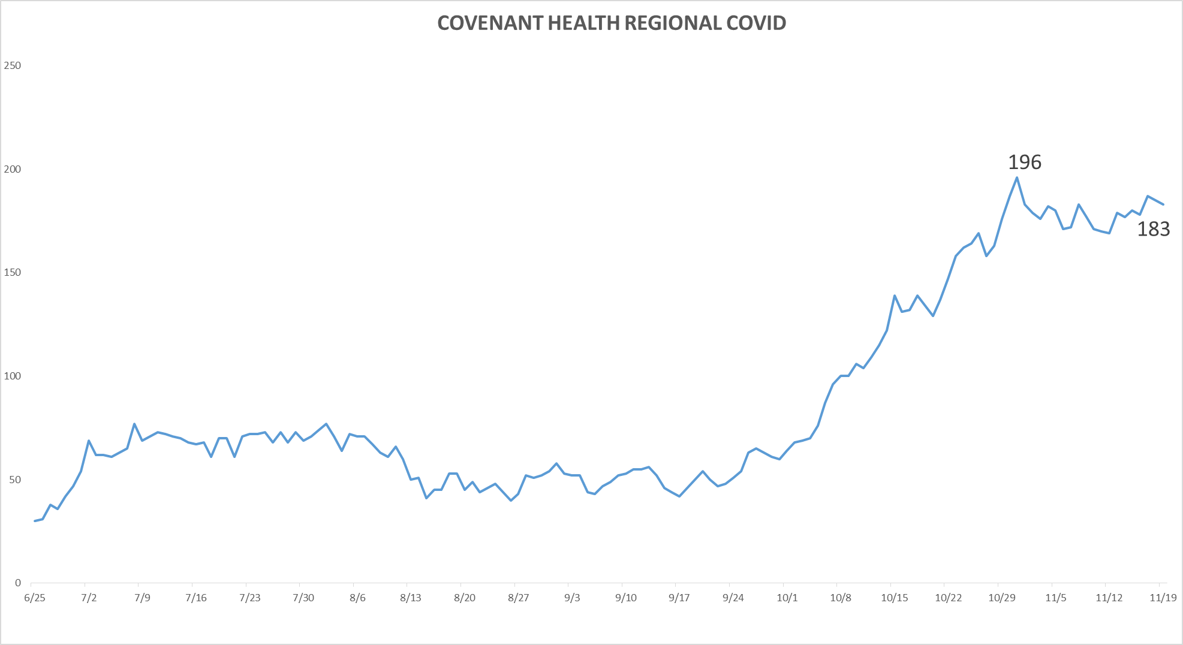
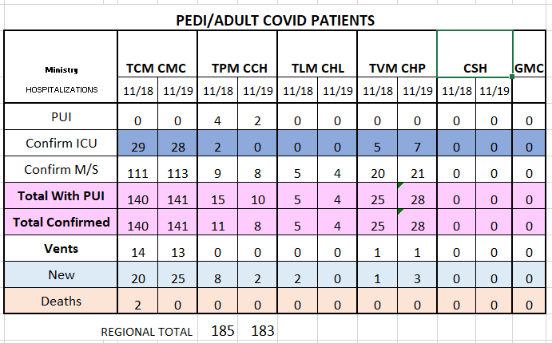
PUI/Confirmed cases-hospitalized COVID UNITS
11/19/2020

Slide 19
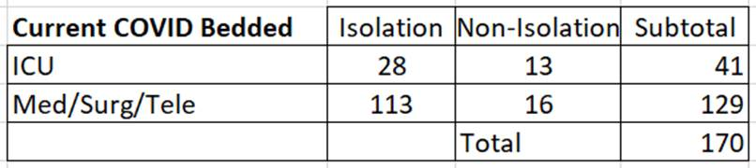
TOTAL COVID on ALL UNITS on CMC

Slide 20
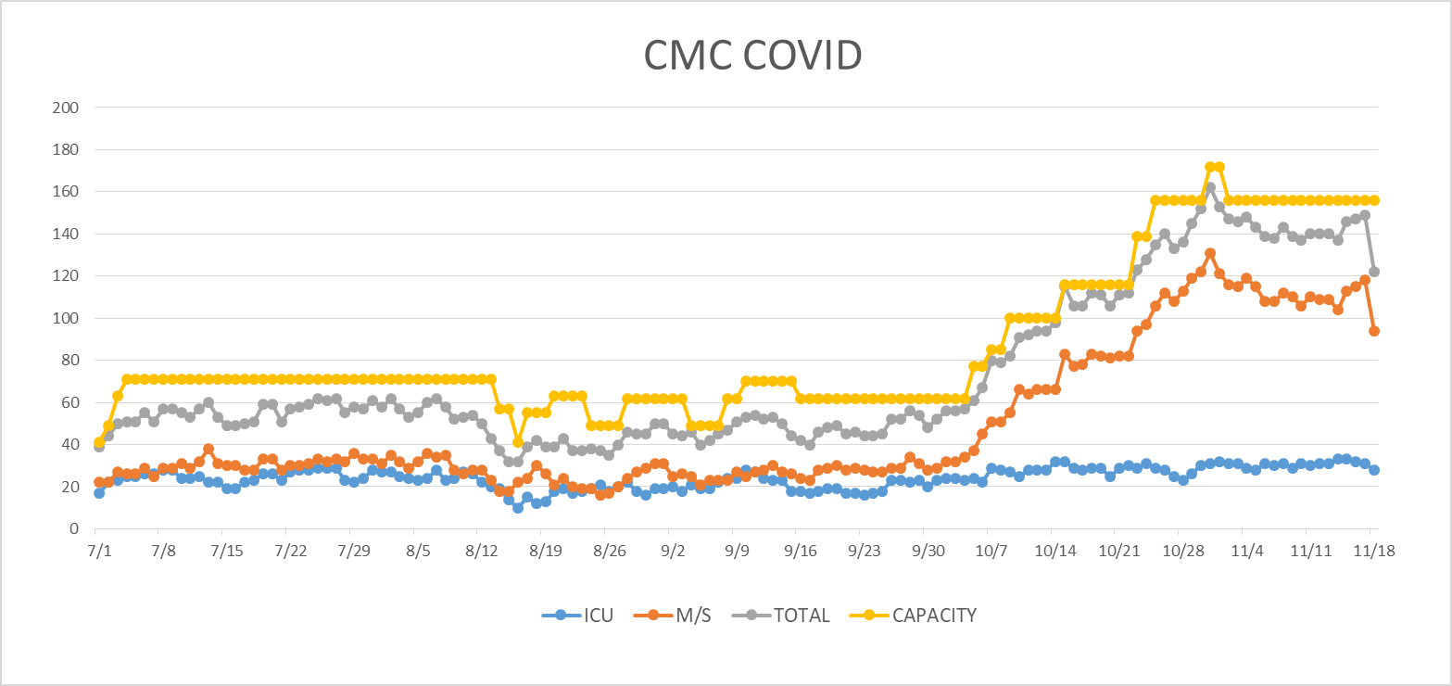
COVID Units - CMC
11/19/2020

Slide 21
Surge Plans

Slide 22
Surge Plan
Covenant Medical Center
 | ICU | Med Surg | Total
Phase 1 | 10-CICU |  | 10
Phase 2 | 17-CICU | 10-HC4 | 27
Phase 3 | 17-CICU | 24-HC4 | 41
Phase 4 | 17-CICU 8-MICU | 24-HC4 14-Pal Med | 63
Phase 5 | 17-CICU 16-MICU | 24-HC4 14-Pal Med | 71
Phase 6 | 17-CICU 16-MICU 15-S 4 | 24-HC4 13-HC6 15 – S 9 (East) | 100
Phase 7 | 17-CICU 16-MICU 15-S 4 | 24-HC4 13-HC6 31 – S 9 (all) | 116
Phase 8 | 8-E4 17-CICU 16-MICU 15-S 4 | 15-S 10(East) 24-HC4 13-HC6 31 – S 9 (all) | 139
Phase 9 | 16-E4 (all) 17-CICU 16-MICU 15-S 4 | 30 S10 (all) 24-HC4 13-HC6 31 – S 9 (all) | 162
Last Week
Currently

Slide 23
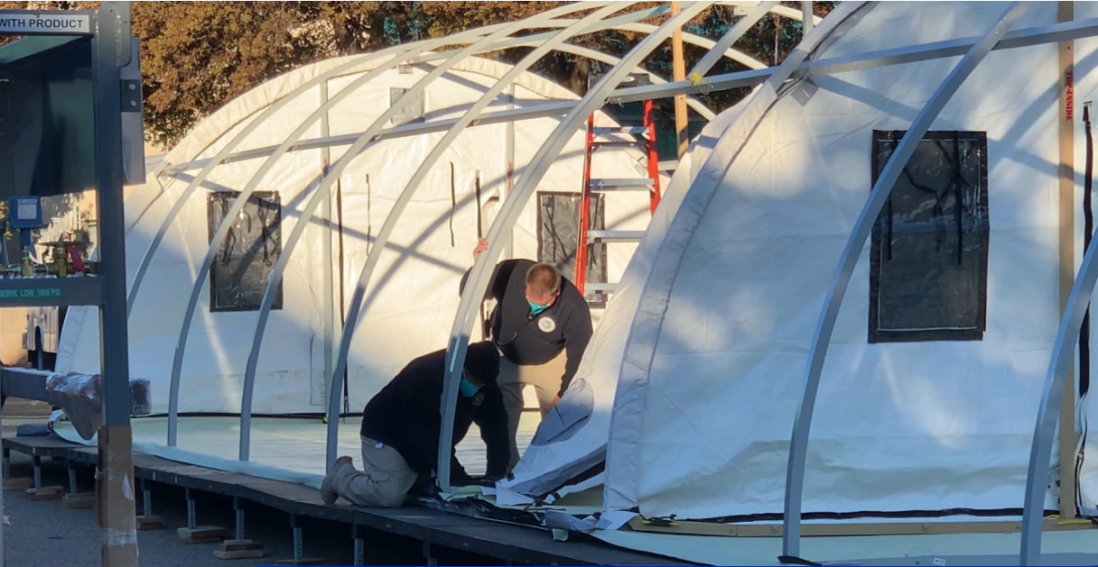
STATE PROVIDED BLUE MEDICAL TENTS
Covenant 1 tent
Tentative Go Live: Tuesday 11/17
Tent setup complete 11/12
  Security fencing up
  LPD has location on an assigned route
First pts 11/18
11/19: 8 pts treated
UMC 3 tents
Tentative Go Live: TBA
Emergency Room Overflow
Observation
TRACKING COSTS FOR FEMA REIMBURSEMENT

Slide 24
1 South Overflow at Children’s
Planning Phase
Beds- 28 beds
Patient type: South 9 - hospitalist
Staff requested: RN, Monitor Tech, Respiratory
Equipment: Mobile Tele system, IV modules, defibrillator, medical suction
Med Gases: RM 101-113 O2/Vacuum RM 116-128 O2/Vacuum/ Med Air
Working on Physician Coverage
Rooms to be ready: 11/16
Go Live: When volume exceeds capacity at CMC

Slide 25
Statistics
Cristian Requenez, MS
Clinical Data Analyst
Clinical Excellence

Slide 26
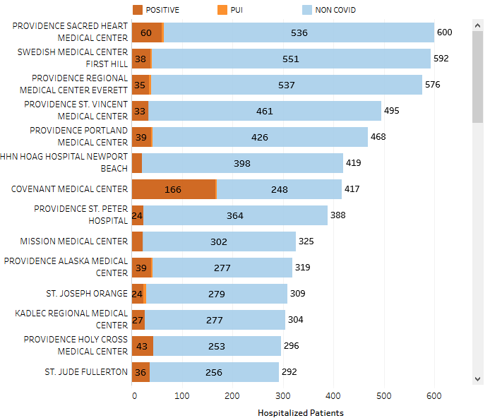
Providence System Hospitalized COVID-19 Cases

Slide 27
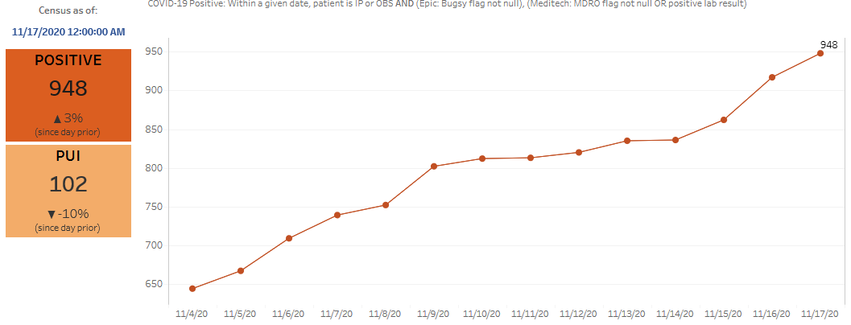
Providence Inpatient COVID-19 Volume

Slide 28
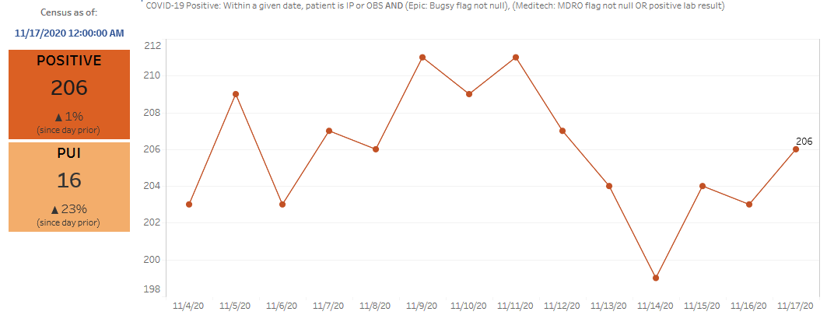
Texas Inpatient COVID-19 Volume

Slide 29
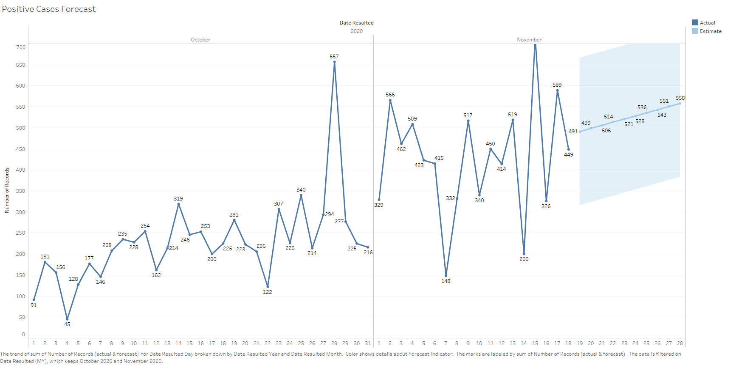
New COVID-19 POSITIVES by Day Trend

Slide 30
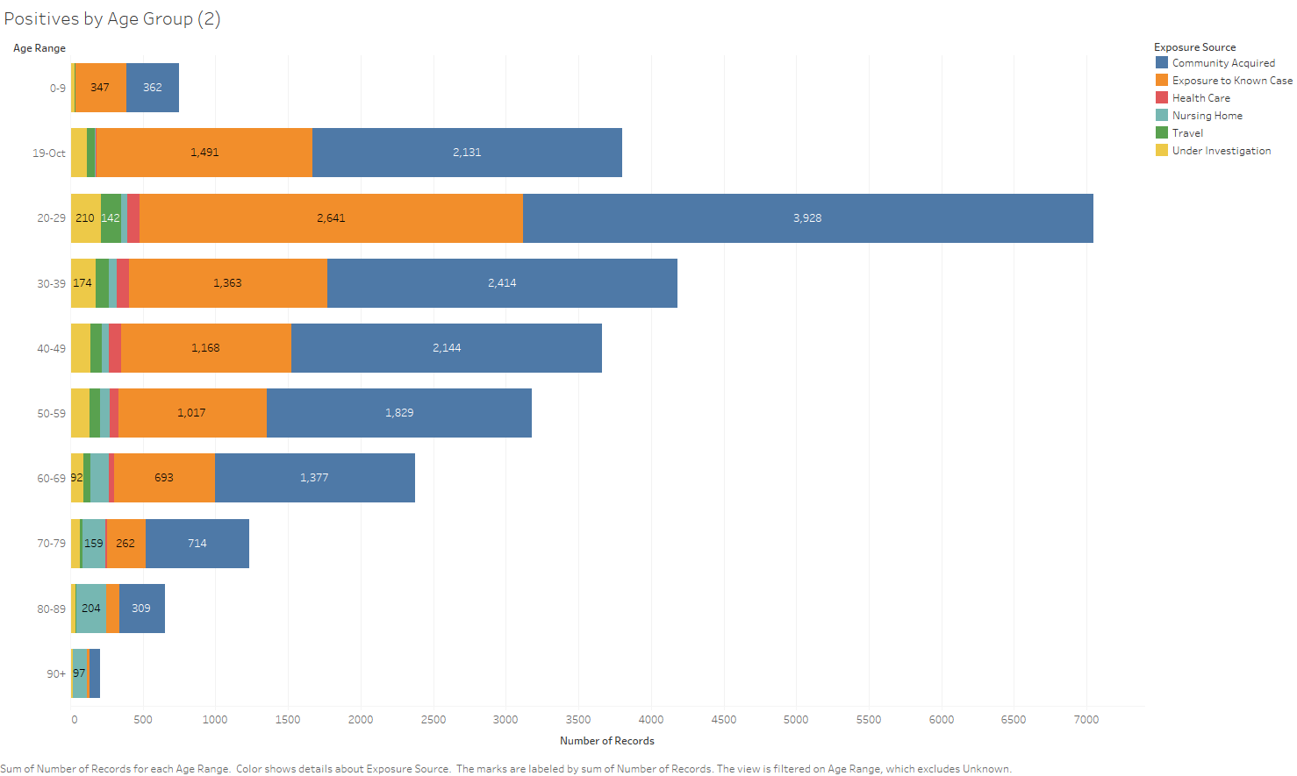
COVID-19 POSITIVES Age Distribution

Slide 31
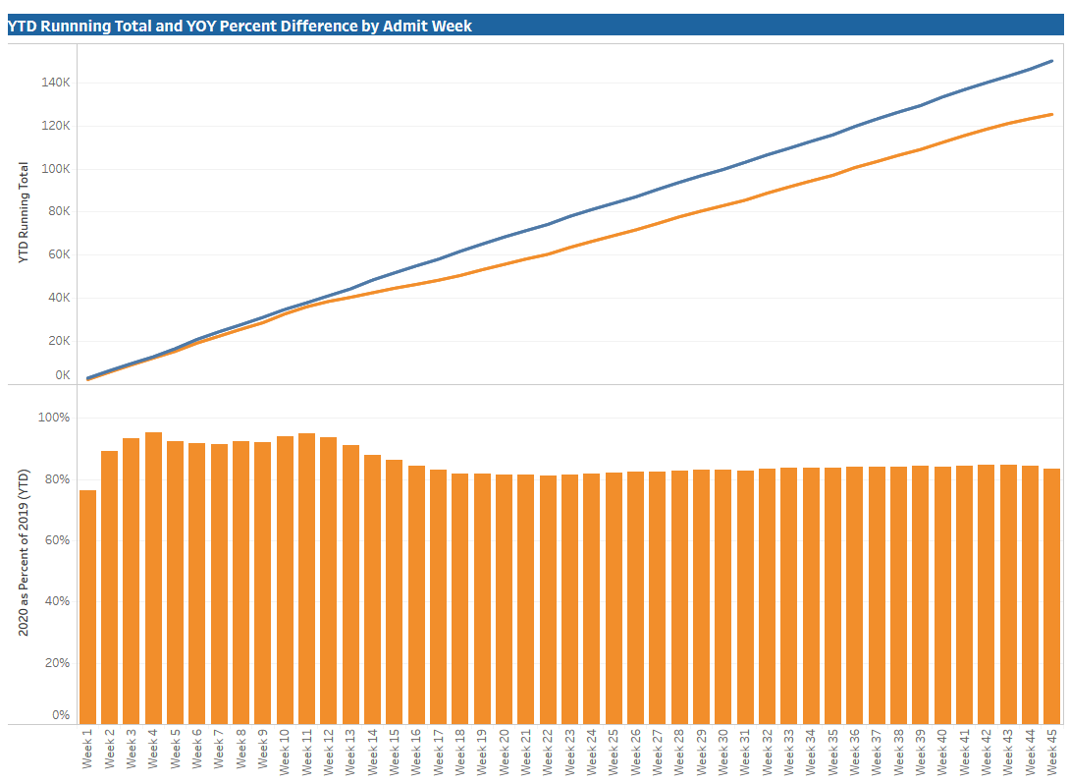
TX/NM Region Weekly Procedures (YOY)

Slide 32
Caregiver Update

Slide 33
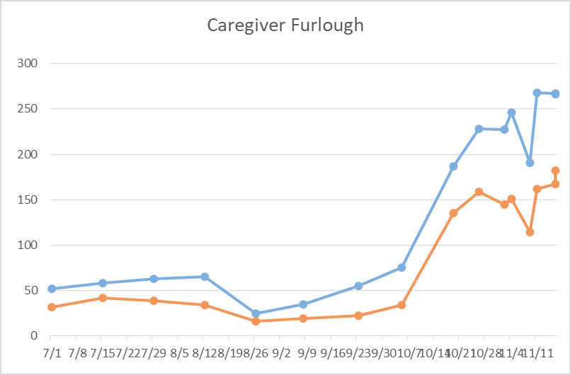
Caregivers
COVID Related Furloughs
68.4% are positive
11/18
Count reflects # furlough (exposed and positive)
Good
Moderate
Critical

Slide 34
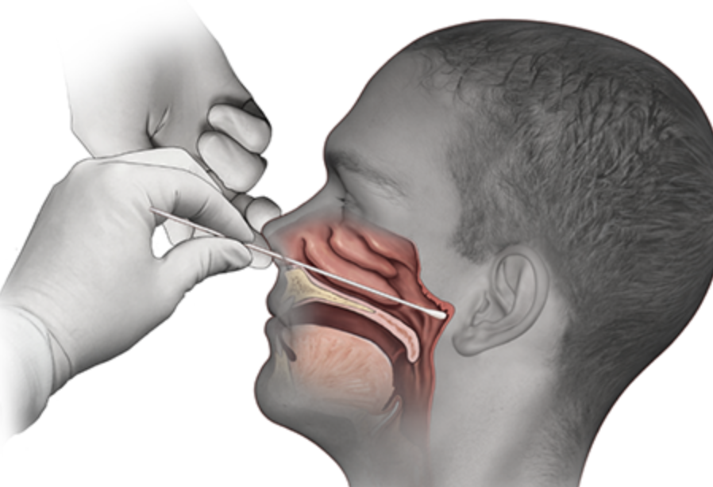
Covid-19 Testing
Jason T. Loos, MD
Ameripath

Slide 35
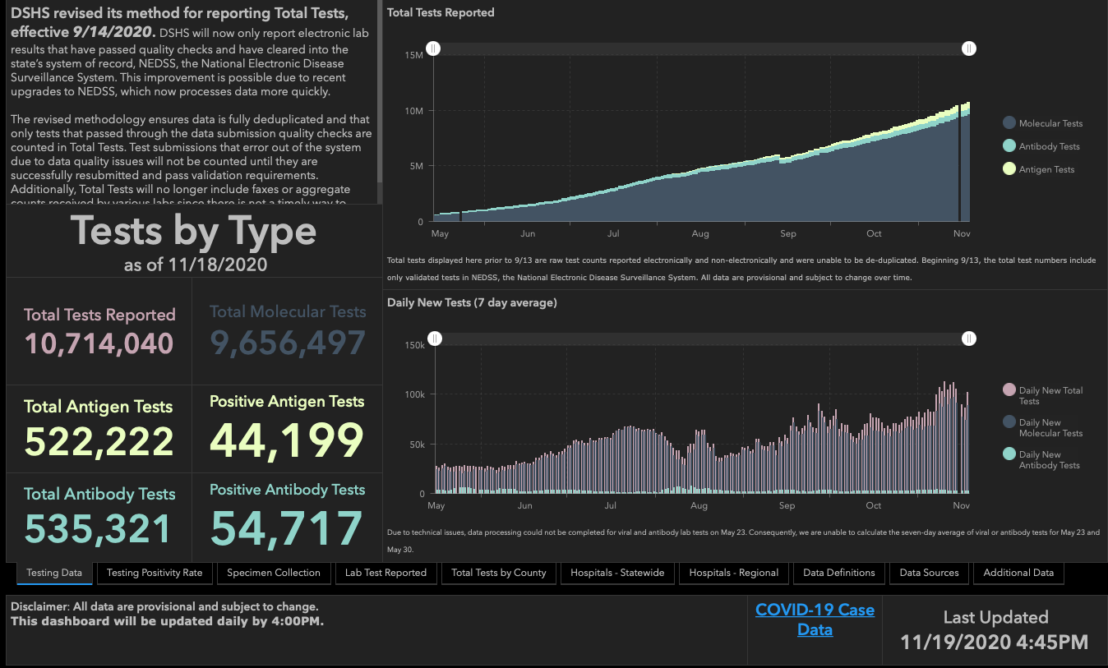

Slide 36
TESTING
 | CMC |  | GMC |  | CMG
 | Rapid | PCR | Rapid | PCR | Rapid
Test Kits
Swabs
VTM
 | CMC |  | GMG/CMG
 | Tests | + | Tests | +
11/10 | 209 | 117 | 220 | 80
11/11 | 94 | 36 | 199 | 75
PCR
Rapids
>2000 >750
<2000 <750
<1600 <500
CMC- Alinity update
GMG-Received shipment but high utilization
CMG-

Slide 37
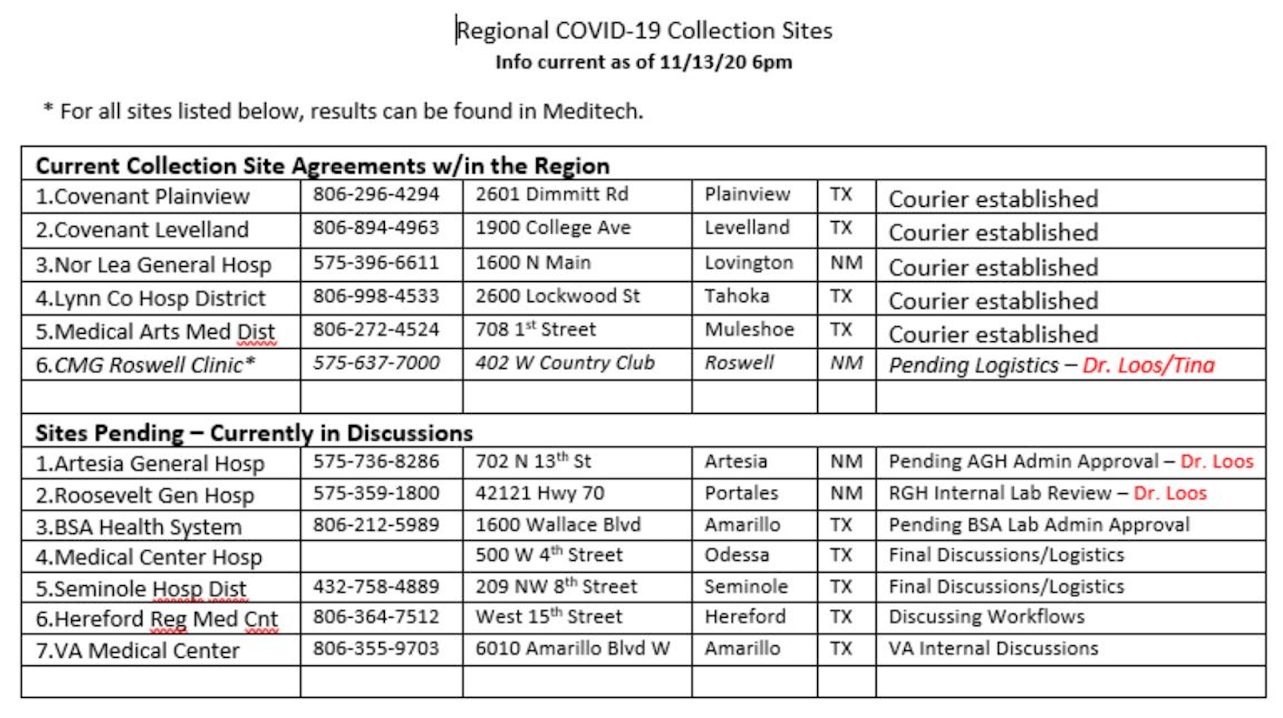

Slide 38
Pharmacy Update
Vaccine Update
Wesley Wells, PharmD
Regional Pharmacy Director
Covenant Health

Slide 39
Operation Warp Speed (OWS)
Ensuring that every American who wants to receive a COVID-19 vaccine can receive one, by delivering safe and effective vaccine doses to the American people beginning January 2021
Four essential components to strategy
  Distribution, Administration, Monitoring, Education

Slide 40
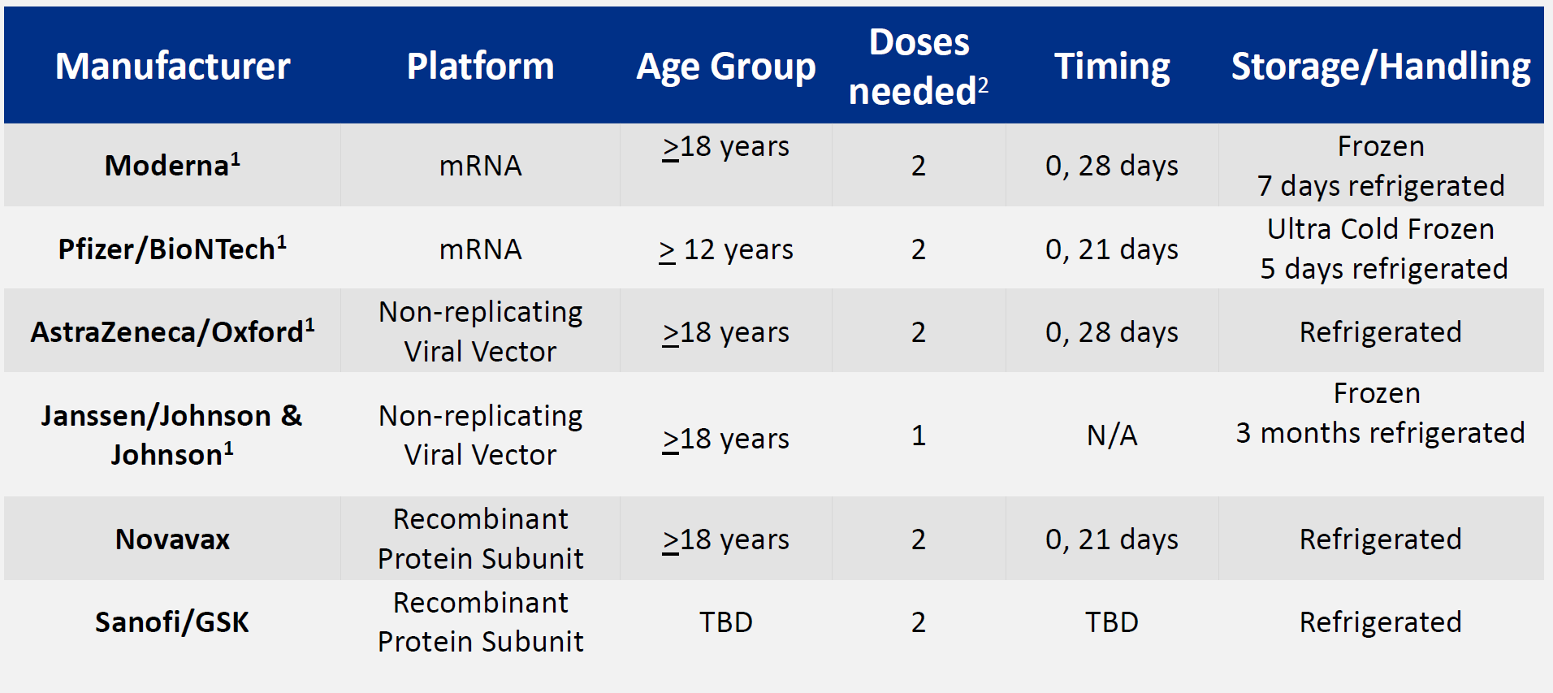
Possible Candidates

Slide 41
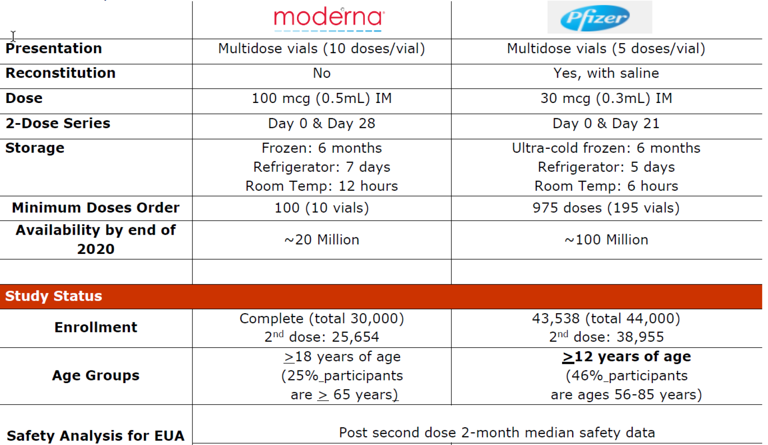
Comparison of Products
30 days

Slide 42
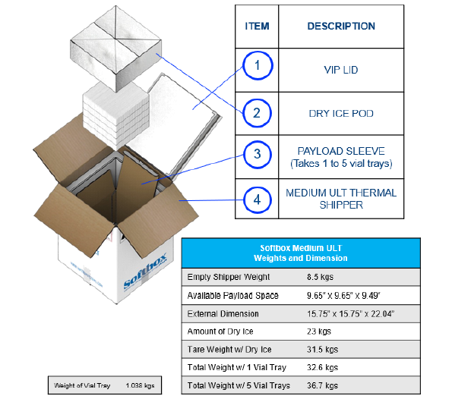
Pfizer Vaccine Packaging
Packaged in Pfizer’s Ultra-Low Temperature Thermal Shipper
Up to five trays (pizza boxes) per shipper
Tray and vial quantities:
  One vial = 5 doses
  One tray = 195 vials
  975 doses per tray: the minimum order
  Five trays = 4,875 doses: the maximum
  per shipper
Recharge every 5 days, opening shipper
only twice per day
  Return shipper to Pfizer within 10-20 days

Slide 43
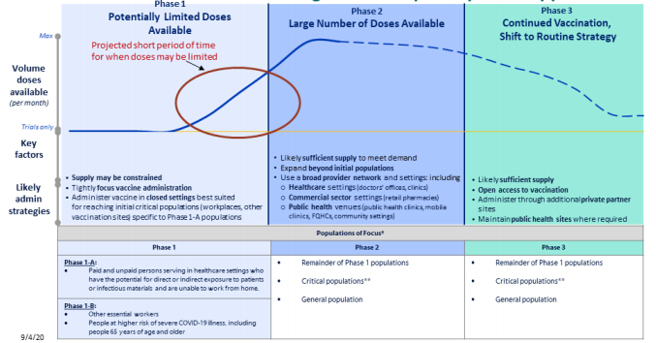
COVID Vaccination Phased Distribution

Slide 44



Distribution Models
Model 1: Ship-to-Site
  Ship directly to site of administration
  Eliminates additional cold-chain requirements
  Draw backs
    Limited distribution in sites that have limited number of target caregivers
    Shortened shelf life depending on storage conditions
    Requires coordination on data entry requirements

Slide 45
Distribution Models
Model 2: Hub-and-Spoke
  Ship to a central location and distribute out
  CMC has a 25 cu ft Ultra-Low Freezer
    Have also invested in portable cooler and thermometer
  Draw back
    Additional registration
    Maintain cold-chain on transport
    Security on transport

Slide 46
Timeline of Distribution
EXAMPLE TIMELINE
Dec. 11
Pre-Position Sites
Begin Vaccination
Dec. 7
Dec. 10
Pre-EUA/Pre-ACIP
EUA
Post-ACIP (Recommendations
We are here
Nov. 30
Dec. 8 or 9
Shipments Sent to
Other Sites
Ancillary Supplies
Delivery to Pre-Positioned Sites
Vaccine delivery to Pre-Positioned Sites

Slide 47
Next Steps by Team
Currently 2 vaccines lead the pack of candidates
  Each requires 2 doses
  Unique storage of each – preparing for both
  Closely monitoring EUA approval process
Planning for phase 1a distribution
  Guided by state and system analysis
Preparing for various allocation methods
  Most storage conditions have been planned for
This is a fluid situation – need to be prepared but flexible

Slide 48
Pharmacy Update
Bamlanivimab
Wesley Wells, PharmD
Regional Pharmacy Director
Covenant Health

Slide 49
Bamlanivimab
Investigational monoclonal antibody therapy
  Binds to spike protein preventing virus entry into host cells
For the treatment of mild-to-moderate COVID-19 in patients greater than 12 years and 40 kilograms
  Outpatients who do not require oxygen
  Do not have an increase in oxygen need if previously on supplemental oxygen
Is distributed by Amerisource Bergen
  Will follow a similar process to the Remdesivir EUA
  CMC is expecting about 97 vials, UMC is expecting 82-85 vials

Slide 50
Bamlanivimab
Shown in clinical trials to reduce COVID-19-related hospitalization or emergency room visits in high-risk patients
Use of medication is supported by Governor Abbott and his team
NIH and IDSA do not recommend its routine use
  May have a role in select high-risk patients
Being released by the state but still a scarce resource
Coordinated a criteria for use with UMC

Slide 51
Bamlanivimab
CRITERIA FOR USE
Must be administered within 5 days of positive COVID test and within 10 days of symptom onset No exclusion criteria: Hospitalized due to COVID Requiring supplemental oxygen therapy due to COVID Requiring an increase in baseline supplemental oxygen due to COVID
AND
Immunocompromised condition Solid organ transplant Blood or bone marrow transplant Primary Immune deficiencies HIV with a low CD4 cell count HIV not on treatment Prolonged use of corticosteroids Use of other immune weakening therapies | OR | Patient is greater than or equal to 65 years AND 2 of the following: BMI greater than 35 kg/m2 CKD stage 3 or 4 Uncontrolled diabetes Last A1C is greater than 7%

Slide 52
Government Affairs
Monoclonal Antibody –
next shipment to the state will be substantially higher than first allotment (5700 doses)
Governor Abbott had a press conference on Thursday 11-19 in Lubbock to discuss MA and City’s response to COVID

Slide 53
Communications Update

Slide 54

Texas Demographics

Slide 55
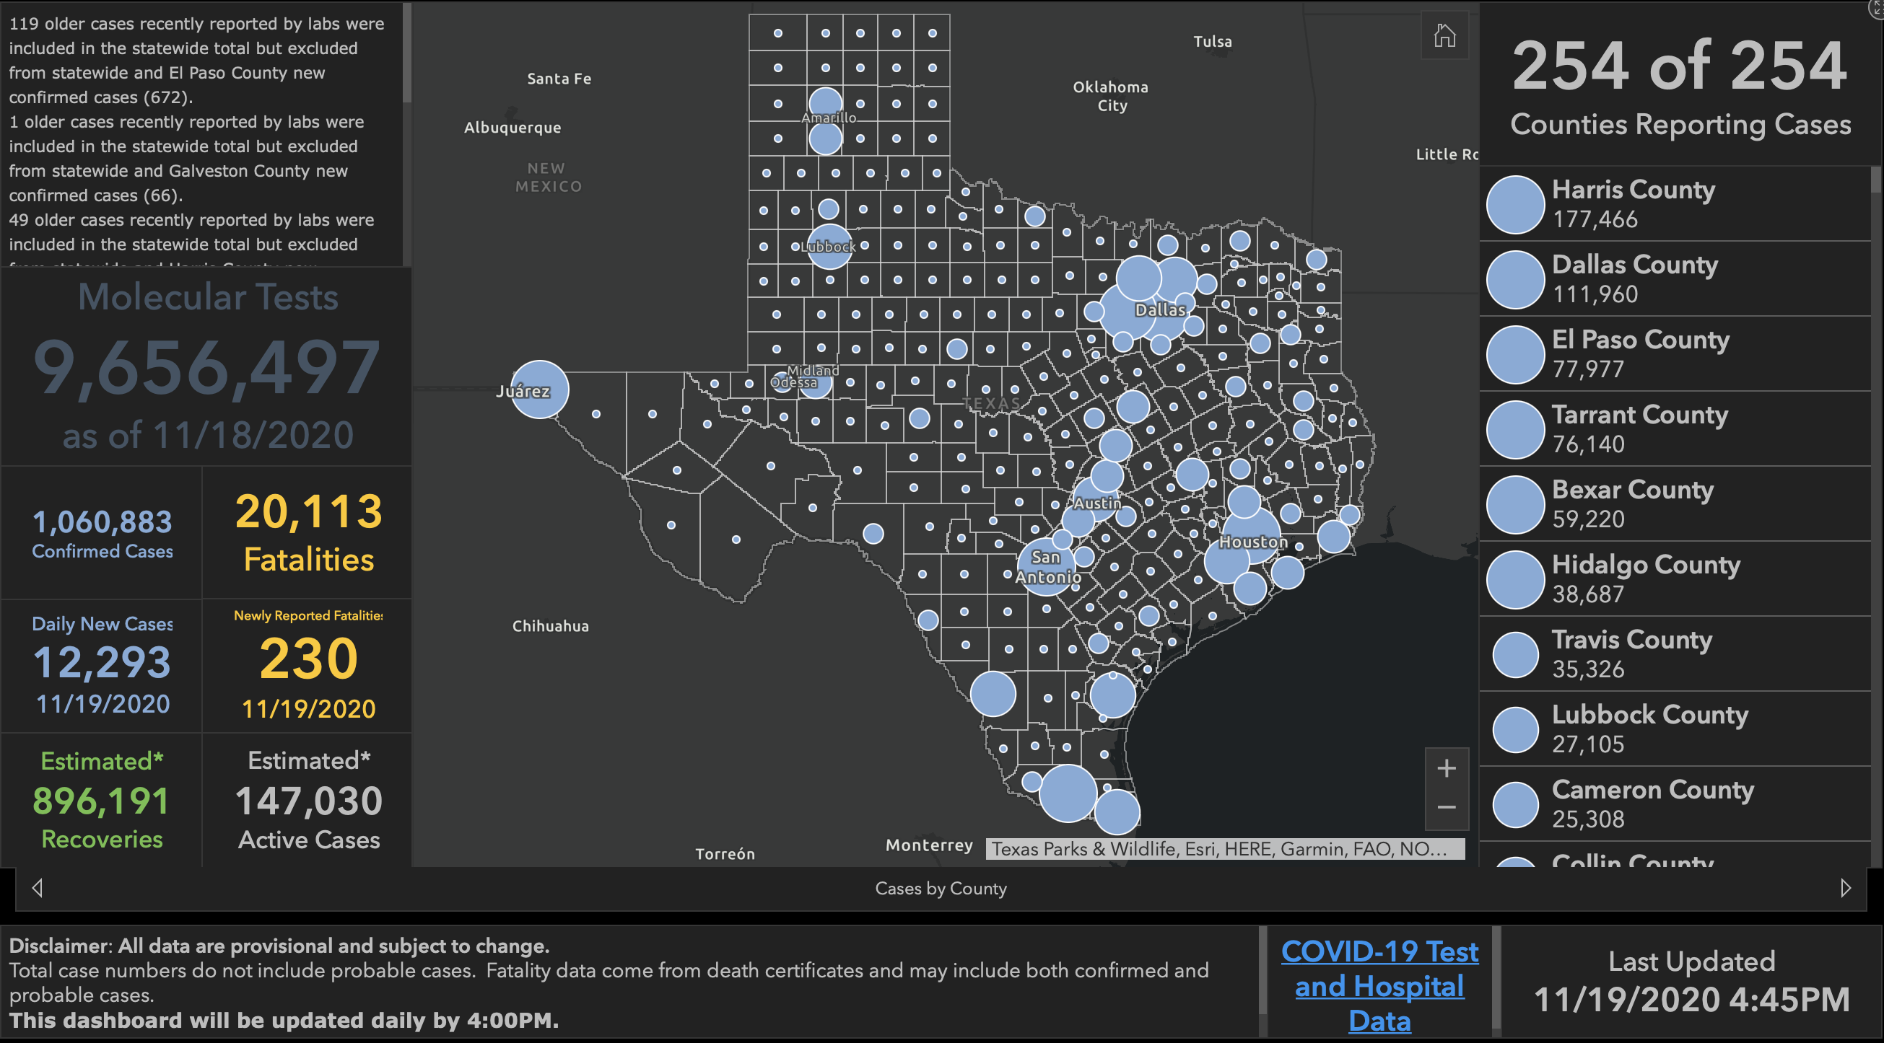

Slide 56
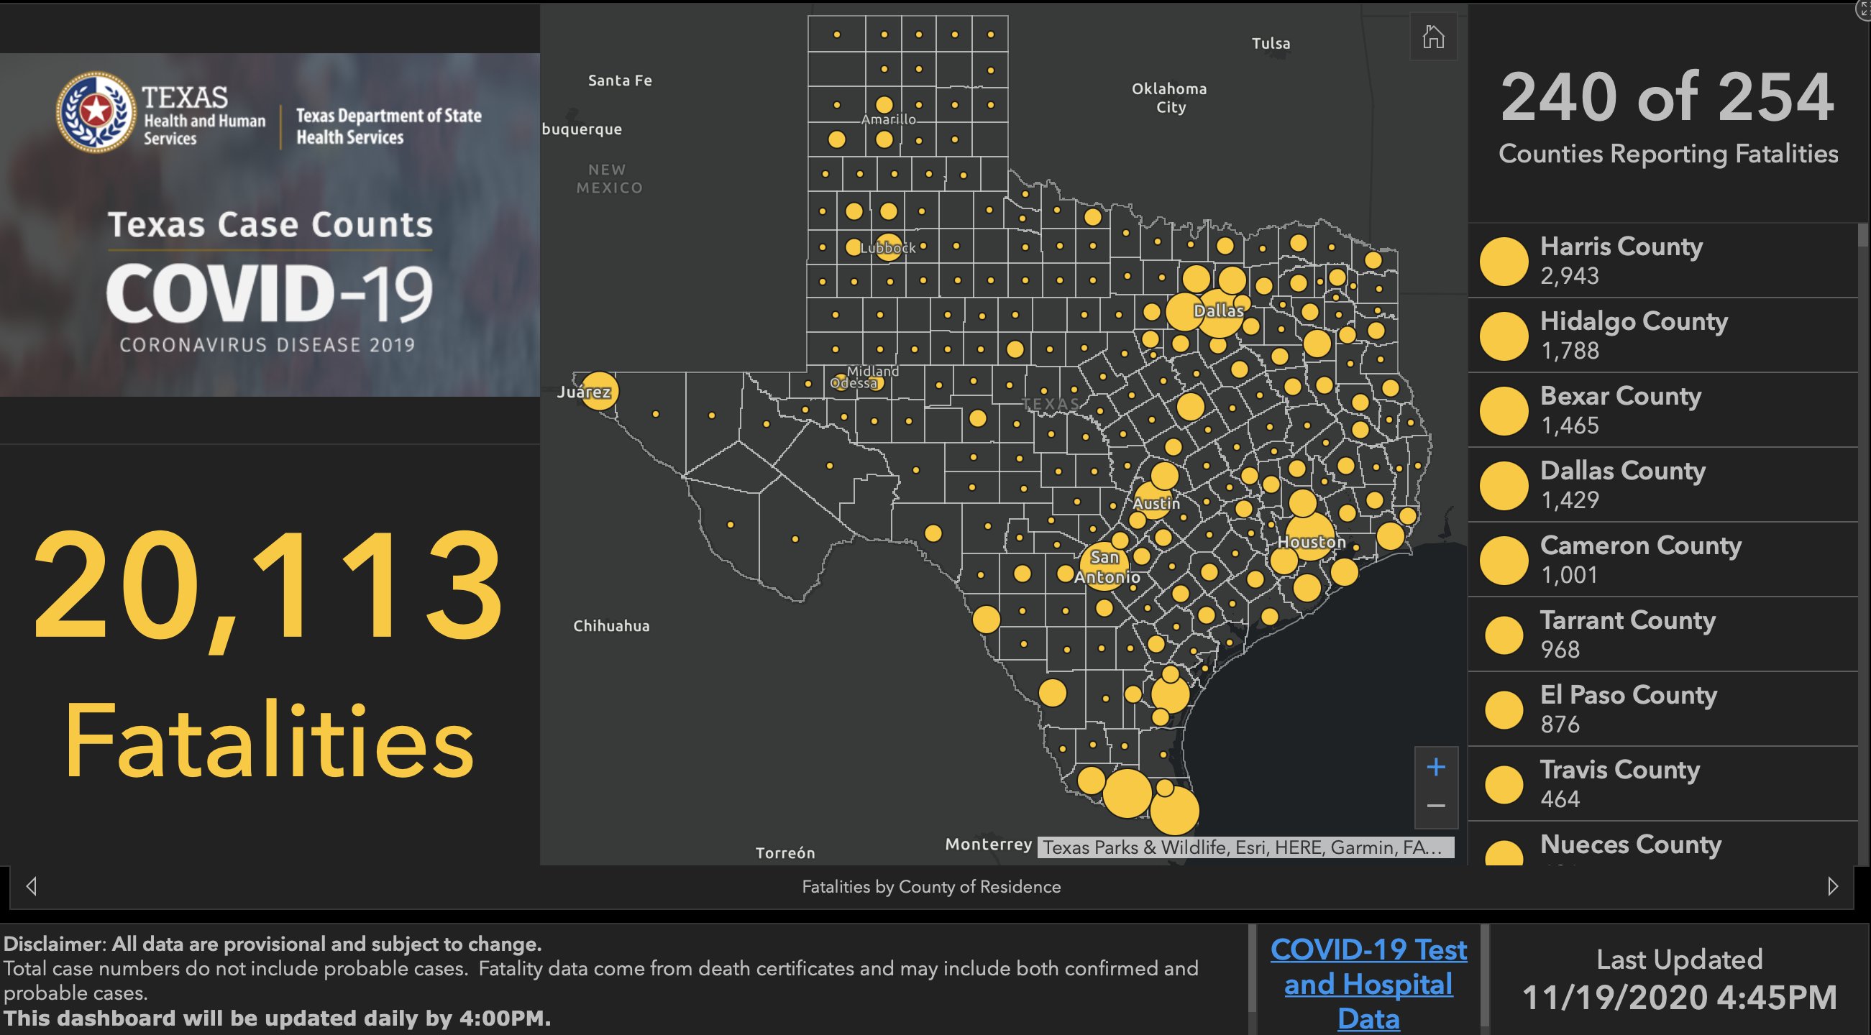

Slide 57
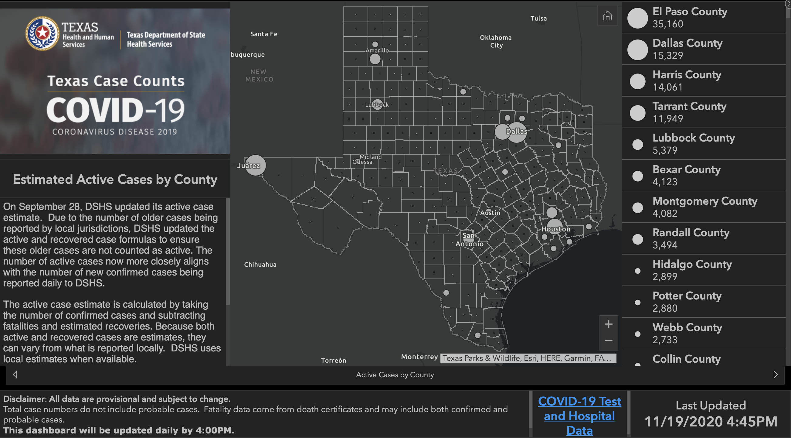

Slide 58
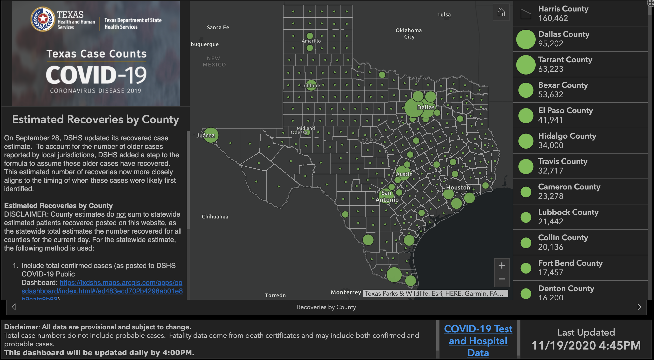

Slide 59
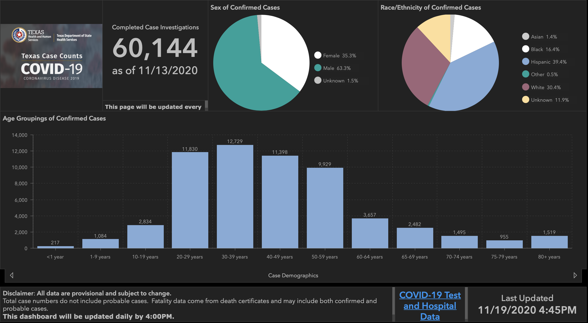

Slide 60
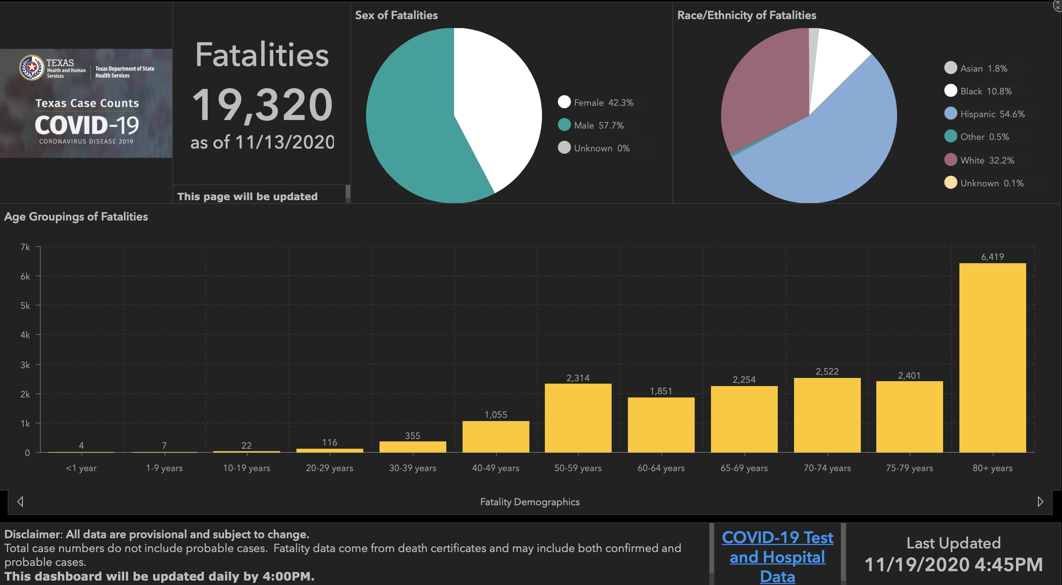

Slide 61
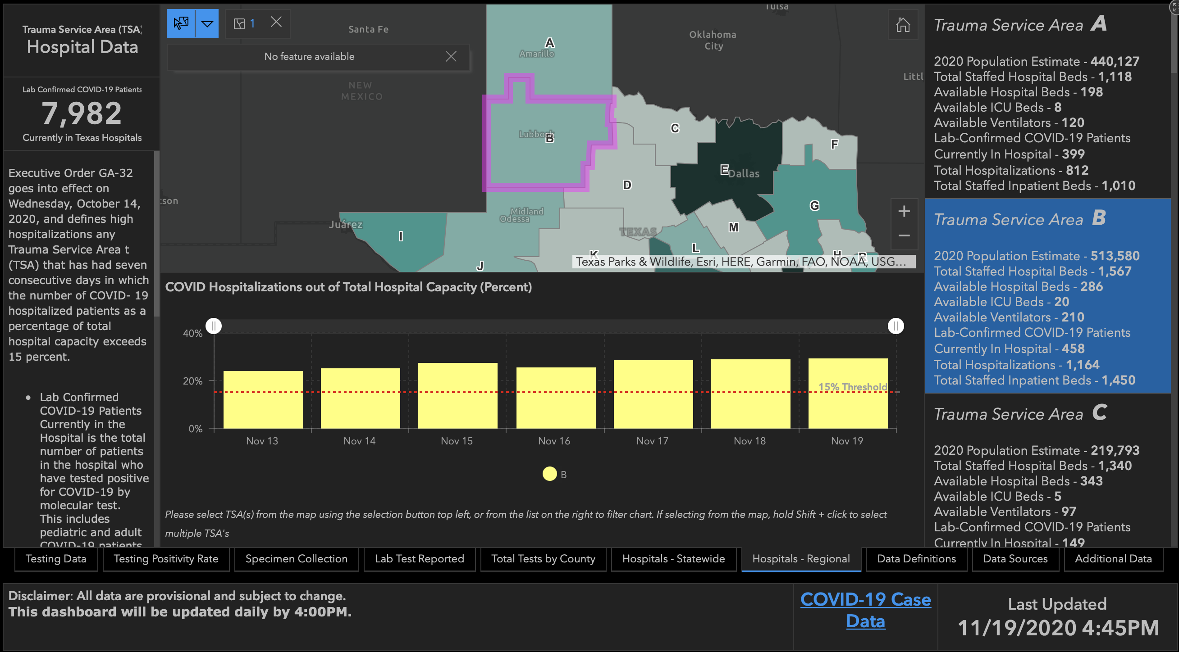
23.87%
24.81%
27.1%
25.27%
28.2%
28.71%
29.23%

Slide 62
Reminder:
NO Call next week, due to Thanksgiving.
Celebrate safely, enjoy time your loved ones, and be grateful for all that we’ve been given.

Slide 63
Q & A

Slide 64
CME Credit was only approved for the Live Teams meeting
To receive credit for this continuing education activity, the participant must:
  Make sure you are logged into your Teams account, if you are signed in with a group provide attendee’s First and Last name(s) in the comments section.
  If you are calling into the Teams meeting you MUST text your First & Last Name to (806) 252-4735. This will ensure you are added to the sign in sheet to receive CME Credit.
  You will receive an email by the following Wednesday from the CME department with further instructions on claiming your certificate.

