Slide 1
Covenant Health
Presents
Critical Communications: A Weekly Physician Update
December 11, 2020

Slide 2
PHYSICIANS
Accreditation Statement:
The Covenant Health is accredited by the Texas Medical Association (TMA) to provide continuing medical education for physicians.
Credit Designation Statement:
The Covenant Health designates this live CME activity for a maximum of 1.0 AMA PRA Category 1 Credit(s)™. Physicians should claim only the credit commensurate with the extent of their participation in the activity.

Slide 3
Disclosures of Commercial Interest
The speakers and planners of this activity
have no relevant financial interests

Slide 4
Disclosures
This activity is provided by
Covenant Health
No commercial support has been received.
No products will be endorsed.
Speakers will notify the audience if off label drug use will be discussed.

Slide 5
CME Credit was only approved for the Live Teams meeting
To receive credit for this continuing education activity, the participant must:
  Make sure you are logged into your Teams account, if you are signed in with a group provide attendee’s First and Last name(s) in the comments section.
  If you are calling into the Teams meeting you MUST text your First & Last Name to (806) 252-4735. This will ensure you are added to the sign in sheet to receive CME Credit.
  You will receive an email by Wednesday following the call from the CME department with further instructions on claiming your certificate.

Slide 6

Reflection
Brian D. Schroeder, MD, MBA, FACP
CMO, Covenant Medical Center

Slide 7
Current Regional Covid-19 Census

Slide 8
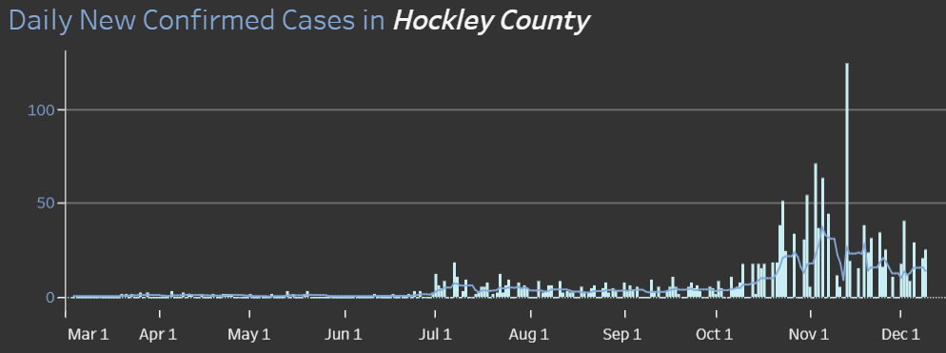
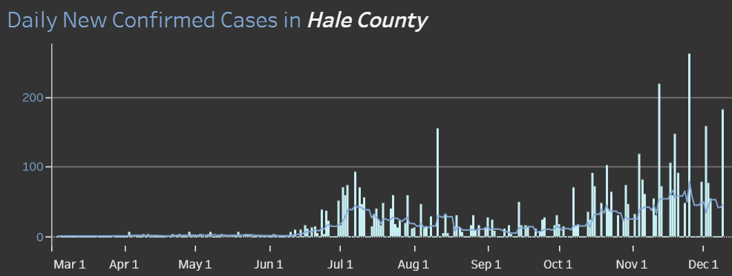
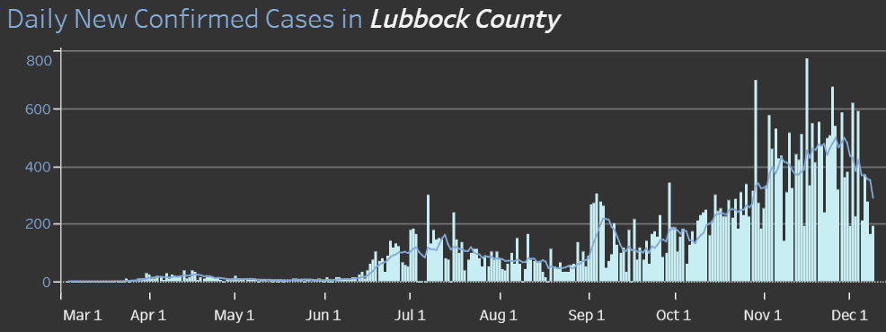
COUNTIES
158 new 12/1
344 new 12/9
14.3 %
Positivity Rate

Slide 9
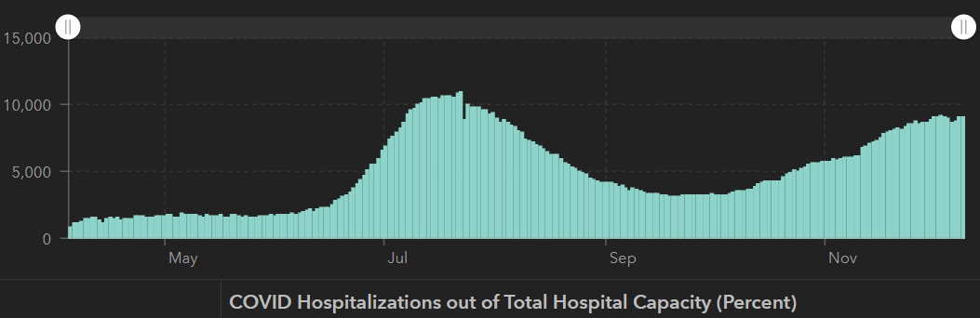
STATE
12/2 | 12/7 | 12/19
1,200,674 | 1,258,214 | 1,283,674
21,756 | 22,627 | 23,081
9,109 | 8,790 | 9,053
10,893
7/22
9,053
12/9
 | 11/30 | 11/16 | 11/04 | 10/21 | 10/5 | 9/23 | 9/9 | 8/26 | 8/12 | 7/29 | 7/15 | 7/1
Cases | 1,168,111 | 1,027,889 | 926,400 | 838,809 | 769,303 | 719,599 | 645,791 | 592,137 | 506,820 | 403,307 | 282,365 | 168,062
Deaths | 21,379 | 19,579 | 18,320 | 17,210 | 16,033 | 15,129 | 13,692 | 11,805 | 9034 | 6190 | 3432 | 2481
Hospitalized | 8900 | 7468 | 5,872 | 4,319 | 3,318 | 3,195 | 3604 | 4806 | 7028 | 9595 | 10,471 | 6904

Slide 10
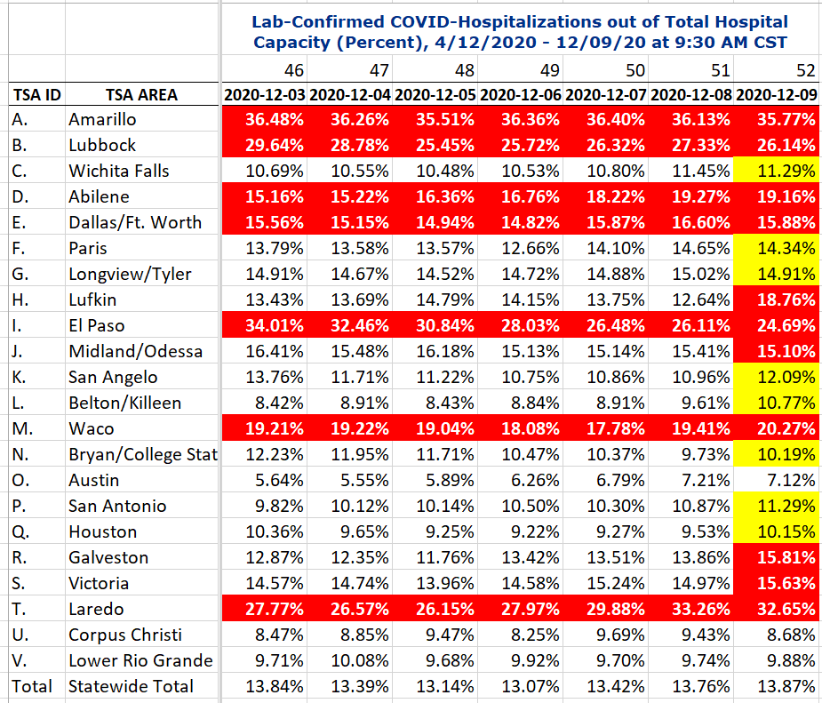
COVID+ HOSPITALIZATIONS BY TSA ID
CONFIRMED COVID+ HOSPITALIZATIONS /HOSPITAL CAPACITY

Slide 11
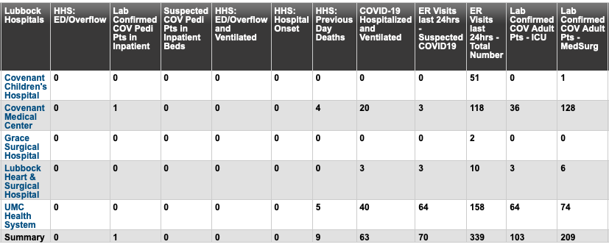
Lubbock This Morning
11/20: 312 Hospitalized in Lubbock – 63 on vents

Slide 12
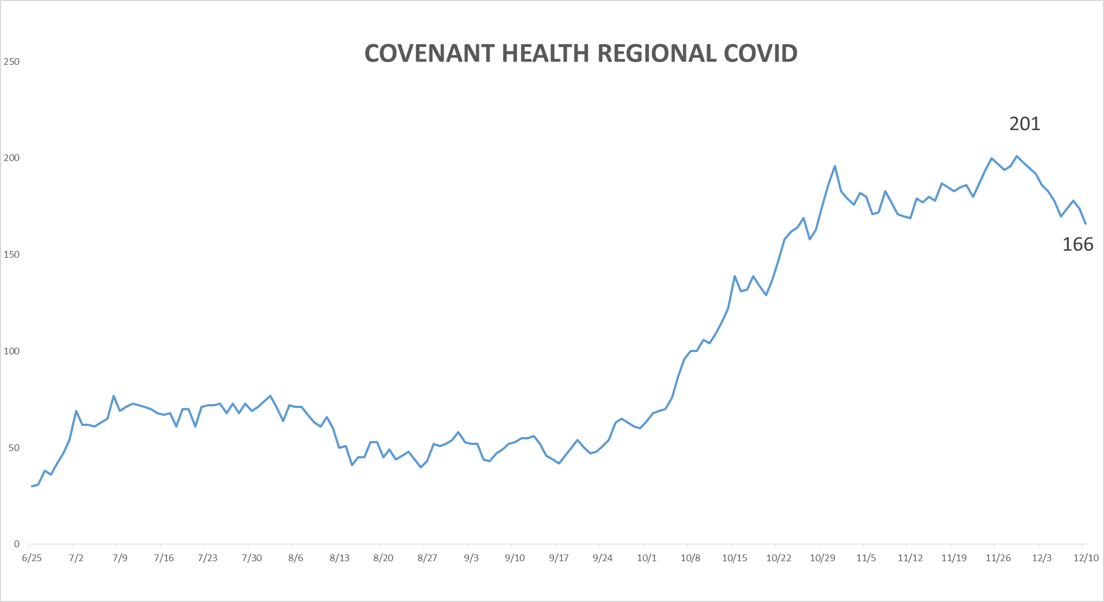
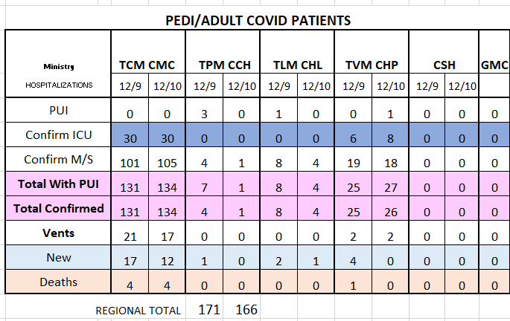
PUI/Confirmed cases-hospitalized COVID UNITS
12/10/020

Slide 13
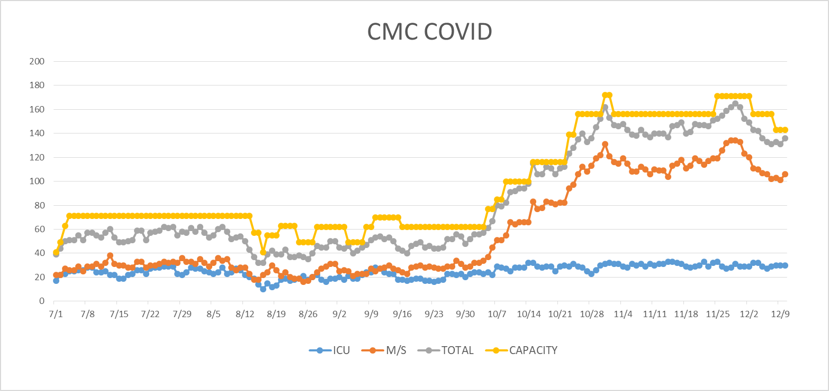
COVID Units - CMC
12/10/2020

Slide 14
Surge Plans

Slide 15
Surge Plan
Covenant Medical Center
 | ICU | Med Surg | Total
Phase 1 | 10-CICU |  | 10
Phase 2 | 17-CICU | 10-HC4 | 27
Phase 3 | 17-CICU | 24-HC4 | 41
Phase 4 | 17-CICU 8-MICU | 24-HC4 14-Pal Med | 63
Phase 5 | 17-CICU 16-MICU | 24-HC4 14-Pal Med | 71
Phase 6 | 17-CICU 16-MICU 15-S 4 | 24-HC4 13-HC6 15 – S 9 (East) | 100
Phase 7 | 17-CICU 16-MICU 15-S 4 | 24-HC4 13-HC6 31 – S 9 (all) | 116
Phase 8 | 8-E4 17-CICU 16-MICU 15-S 4 | 15-S 10(East) 24-HC4 13-HC6 31 – S 9 (all) | 139
Phase 9 | 16-E4 (all) 17-CICU 16-MICU 15-S 4 | 30 S10 (all) 24-HC4 13-HC6 31 – S 9 (all) | 162
Currently
Last Week

Slide 16
1 South Overflow at Children’s
Operational Phase
Opened Thursday 12/10
Beds- 24 beds
Patient type: Observation and Med-Surg acuity
Staff requested: RN, Respiratory Therapy
Will add Telemetry once VISI is installed
  Will accept tele patients from 7AM – 7PM
  Tuesday 12-15 VISI will be installed
Telehealth Coverage will be implemented within 2 weeks
Staff has been requested from the state to supplement our staff

Slide 17
Statistics
Sean Glenn
Senior Clinical Data Analyst
Decision Support Services
Covenant Health

Slide 18
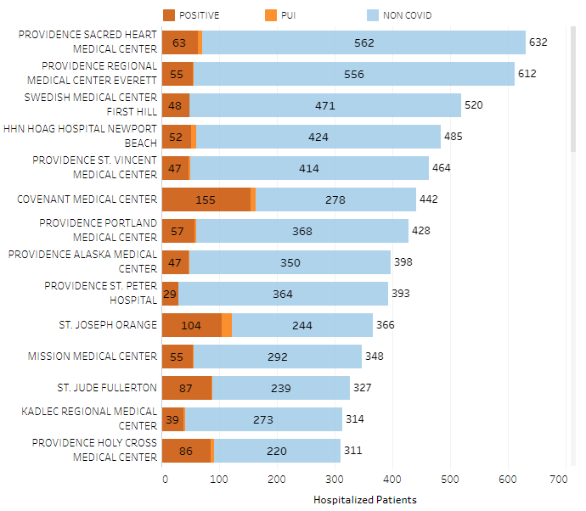
Providence System Hospitalized COVID-19 Cases

Slide 19
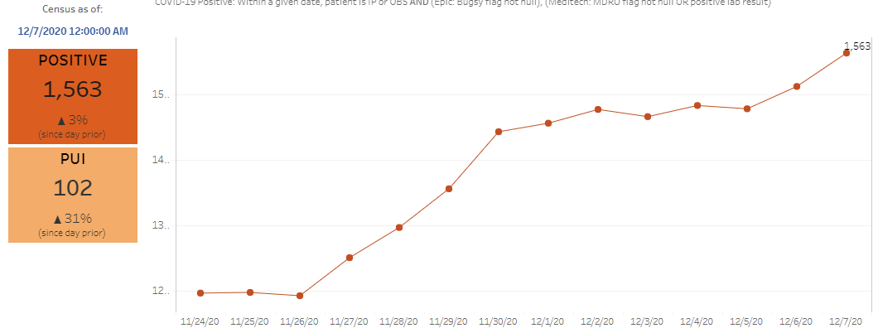
Providence Inpatient COVID-19 Volume

Slide 20
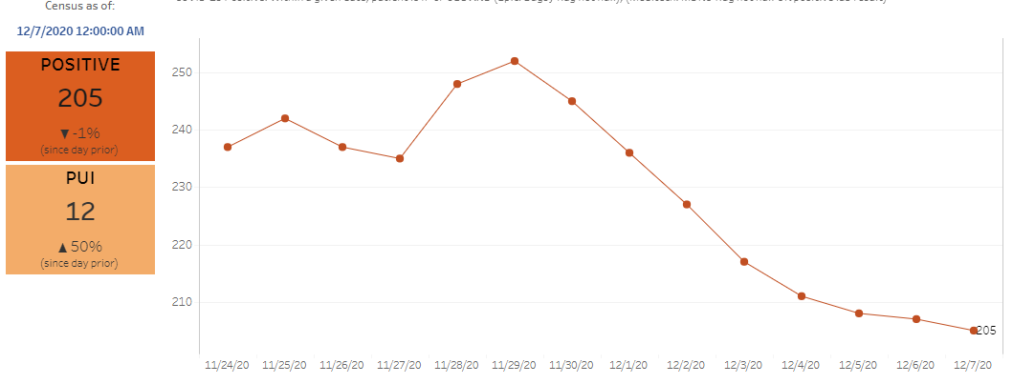
Texas Inpatient COVID-19 Volume

Slide 21
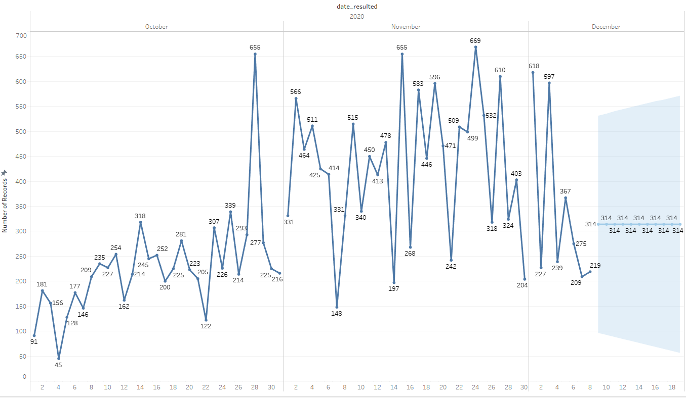

New Covid-19 POSITIVES by Day Trend

Slide 22
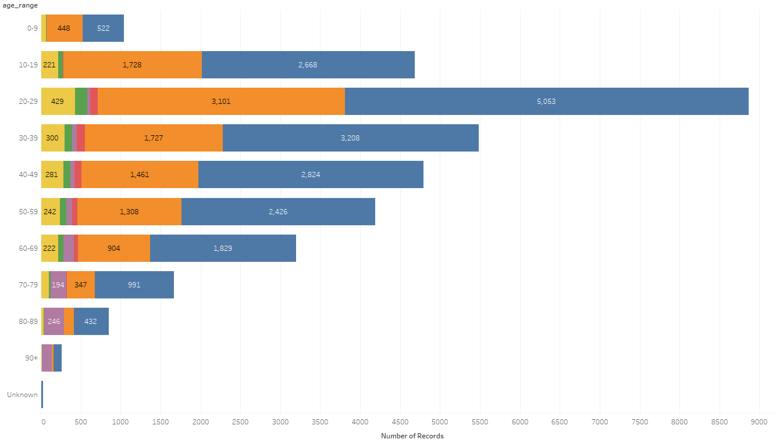
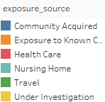
Covid-19 POSITIVES Age Distribution

Slide 23
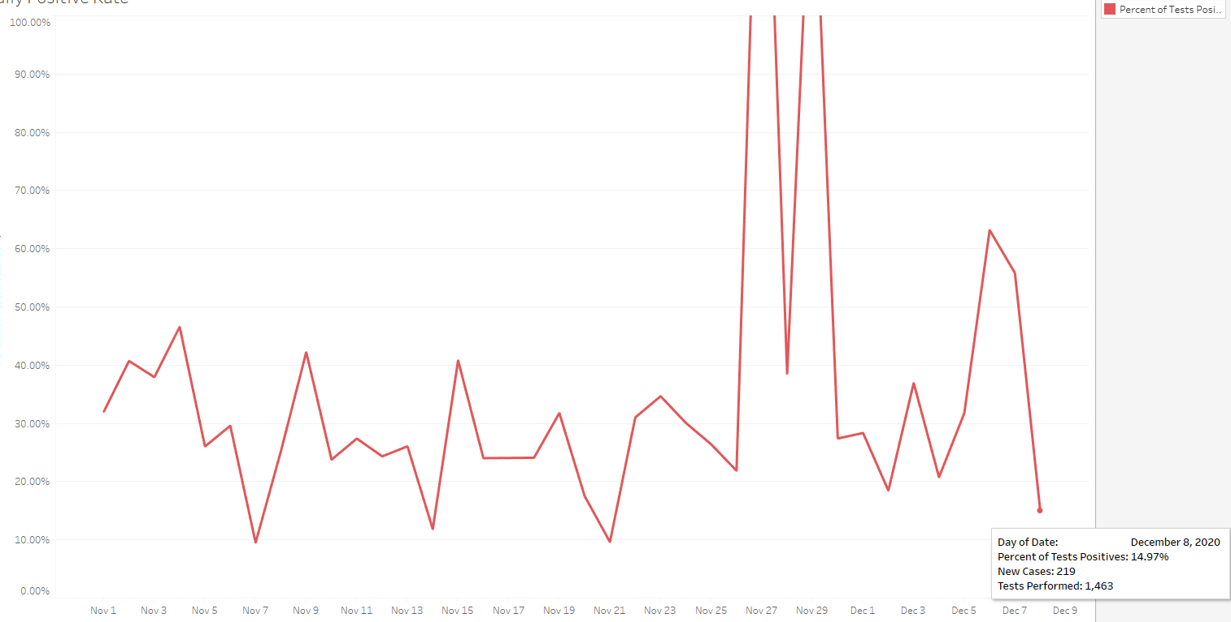
Covid-19 Daily Positive Rate

Slide 24
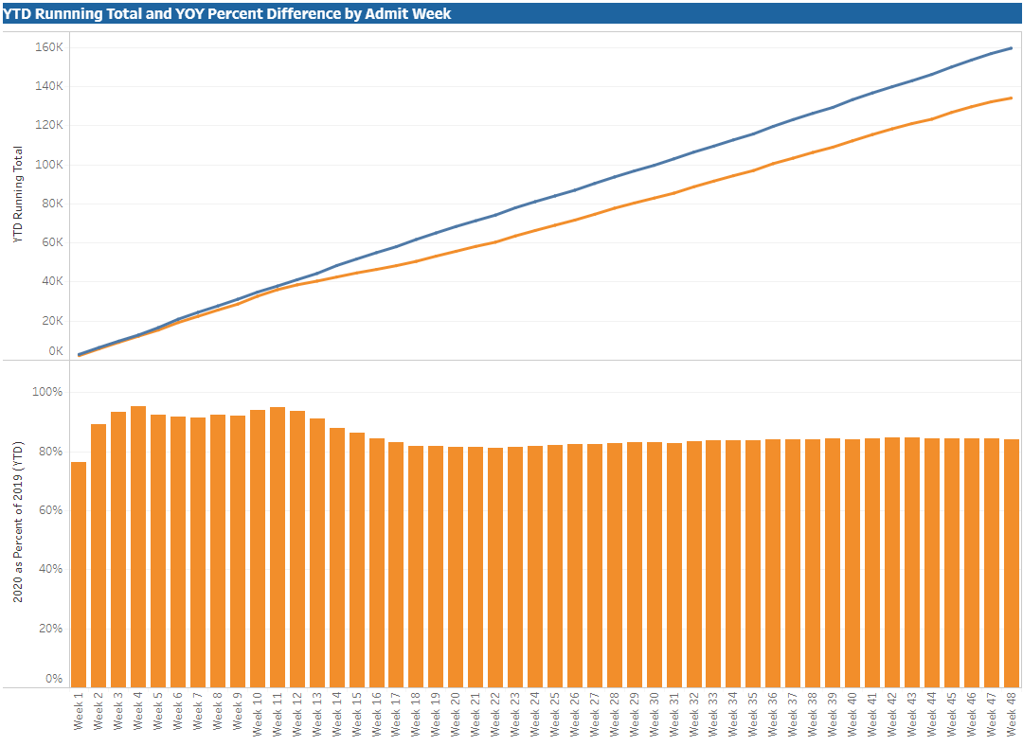

TX/NM Region Weekly Procedures (YOY)

Slide 25
Caregiver Update

Slide 26
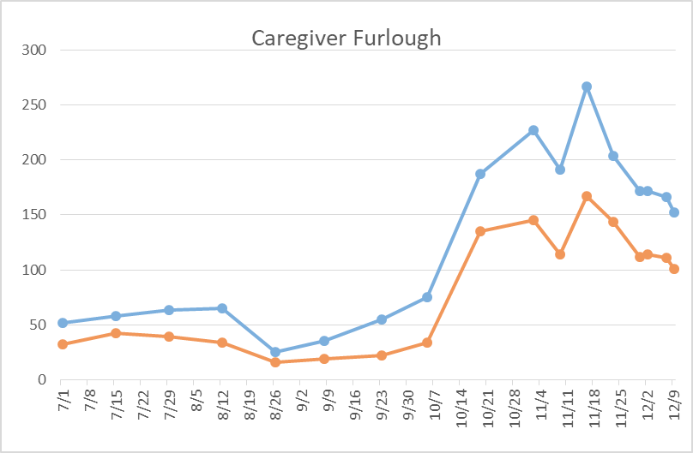
Caregivers
COVID Related Furloughs
66% are positive
Count reflects # furlough (exposed and positive)
Good
Moderate
Critical

Slide 27
COVID Units - CMC
12/10/2020

Slide 28
Covenant Outpatient Infusion Center Update

Slide 29
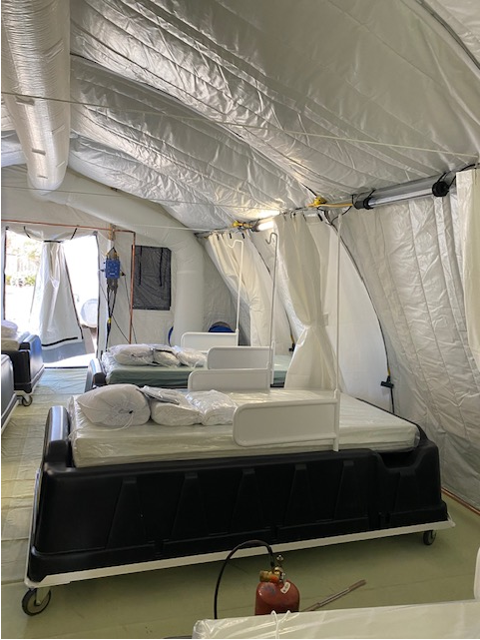
COVID Infusion Center
PCP issues
Working on PCP for those who do not have one through Grace Med Group and CMG
Combest Center for non-insured for PCP
Home Monitoring kits
Twistle has 10-11 patients enrolled
Working with Levelland and Plainview

Slide 30
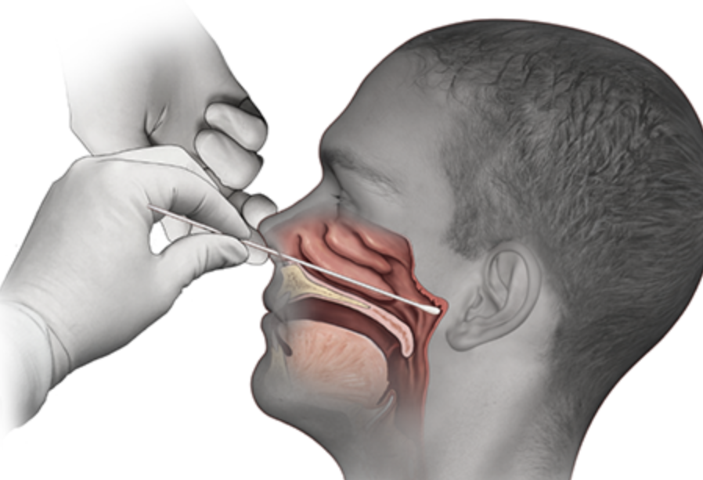
Covid-19 Testing
Jason T. Loos, MD
Ameripath

Slide 31
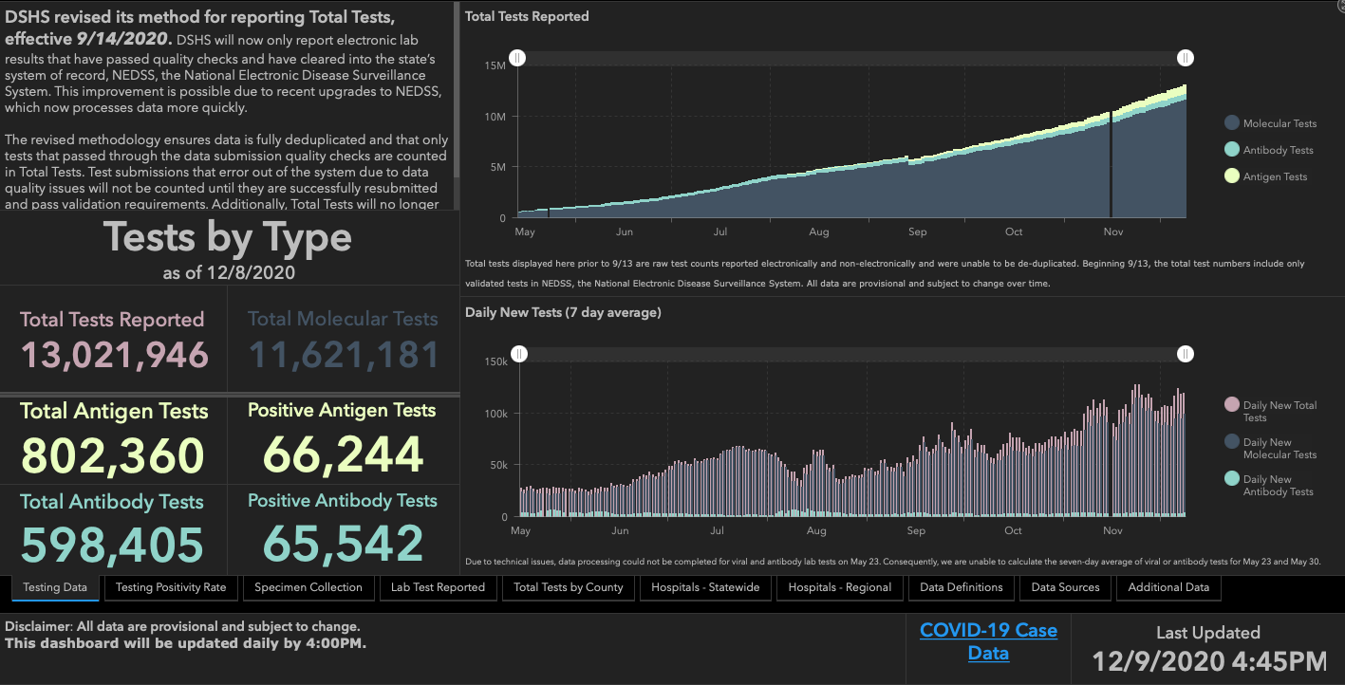

Slide 32
TESTING
 | CMC |  | GMC |  | CMG
 | Rapid | PCR | Rapid | PCR | Rapid
Test Kits
Swabs
VTM
 | CMC |  | GMG/CMG
 | Tests | + | Tests | +
12/8 | 77 | 11 | 130 | 40
12/9 | 93 | 21 | 69 | 23
PCR
Rapids
>2000 >750
<2000 <750
<1600 <500
CMC- Alinity 75% operational
GMG- No issues
CMG- Receiving weekly allocations

Slide 33
Changes in POC test regulation
CMS will temporarily exercise enforcement discretion under CLIA for the duration of the COVID-19 public health emergency for the use of authorized SARS-CoV-2 molecular and antigen POC tests on asymptomatic individuals outside of the test’s authorization. Specifically, CMS will not cite facilities with a CLIA Certificate of Waiver when authorized SARS-CoV-2 molecular or antigen POC tests are performed on asymptomatic individuals outside of the test’s authorization, when done so considering the information in FDA's FAQ. In addition, CMS will not cite nonwaived facilities when modified authorized, cleared or approved SARS-CoV-2 molecular or antigen POC tests are performed in such manner without establishing performance specifications. Updated 12/07/2020

Slide 34
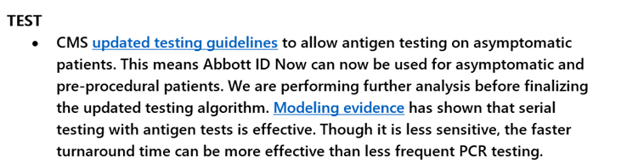
COVID Testing updates
CMS updated testing guidelines
Covenant will continue to use PCR for asymptomatic; utilize rapid test as an option when someone needs a rapid TAT

Slide 35
Pharmacy Update
Wesley Wells, PharmD
Regional Pharmacy Director
Covenant Health
Larry Pineda, PharmD
Antimicrobial Stewardship Pharmacist
Covenant Health
Cynthia Salisbury, RN, MSN
Chief Quality Officer
Covenant Health

Slide 36
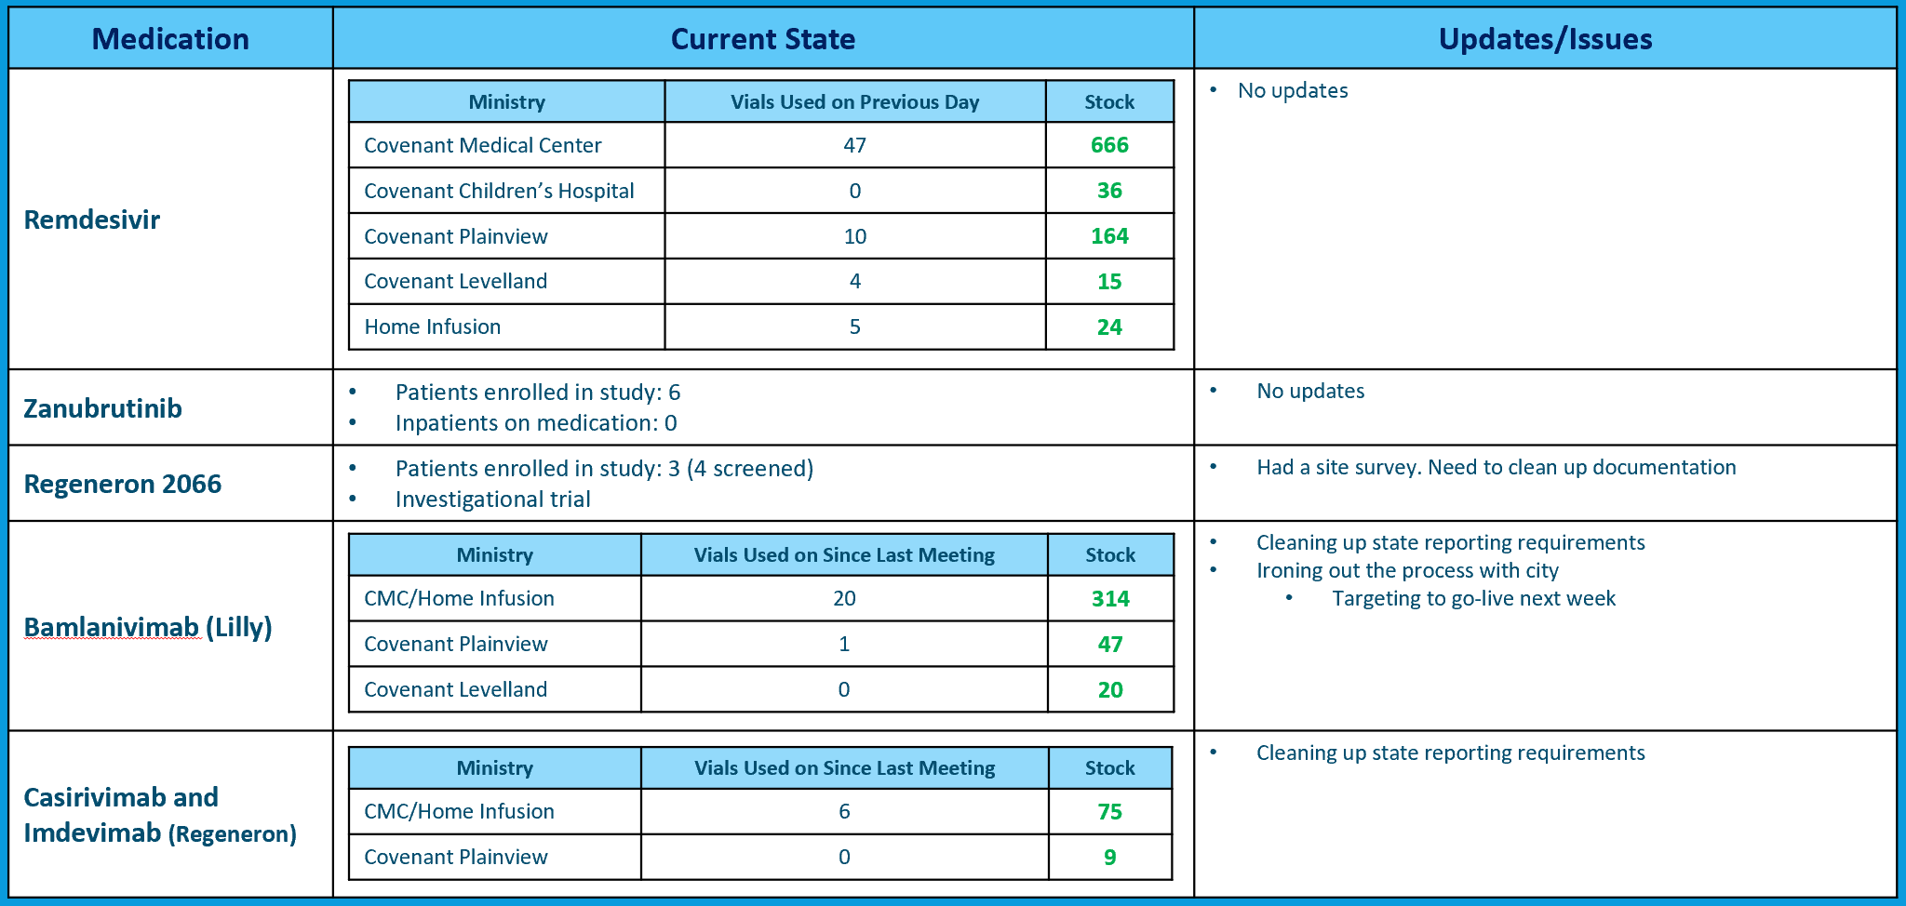
Therapeutic Updates

Slide 37

Vaccine Update
FDA meet on December 10 today to review Pfizer vaccine
Information from FDA supported documents is very supportive
  Several unanswered questions

Slide 38
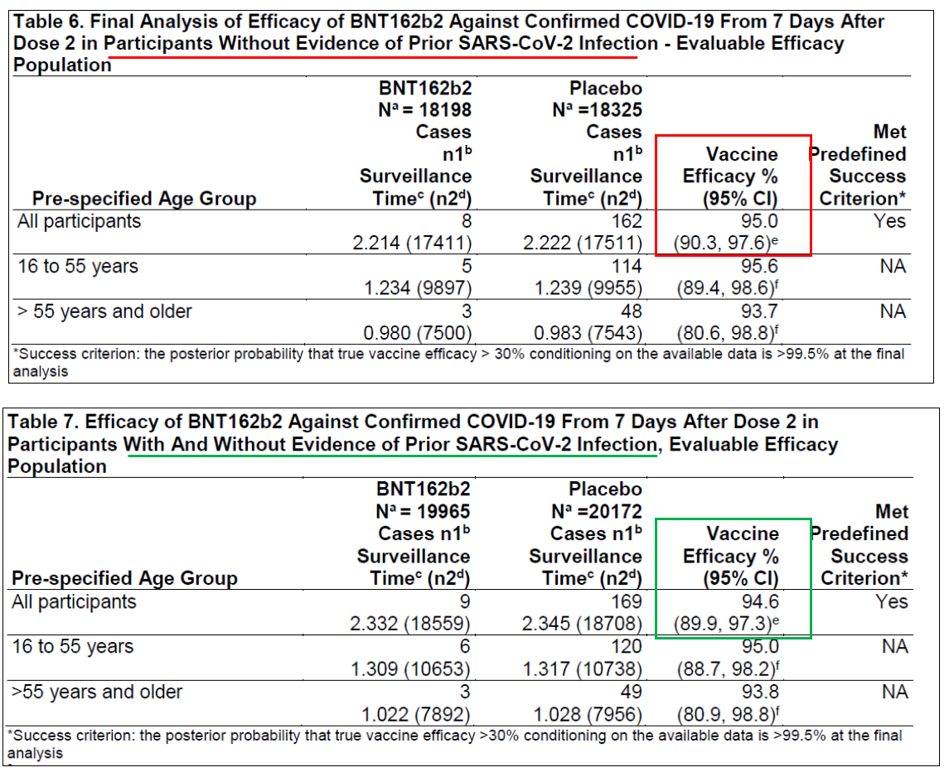
FDA Review

Slide 39
FDA Review
Notes:
Geometric means = means for growth rates

Slide 40
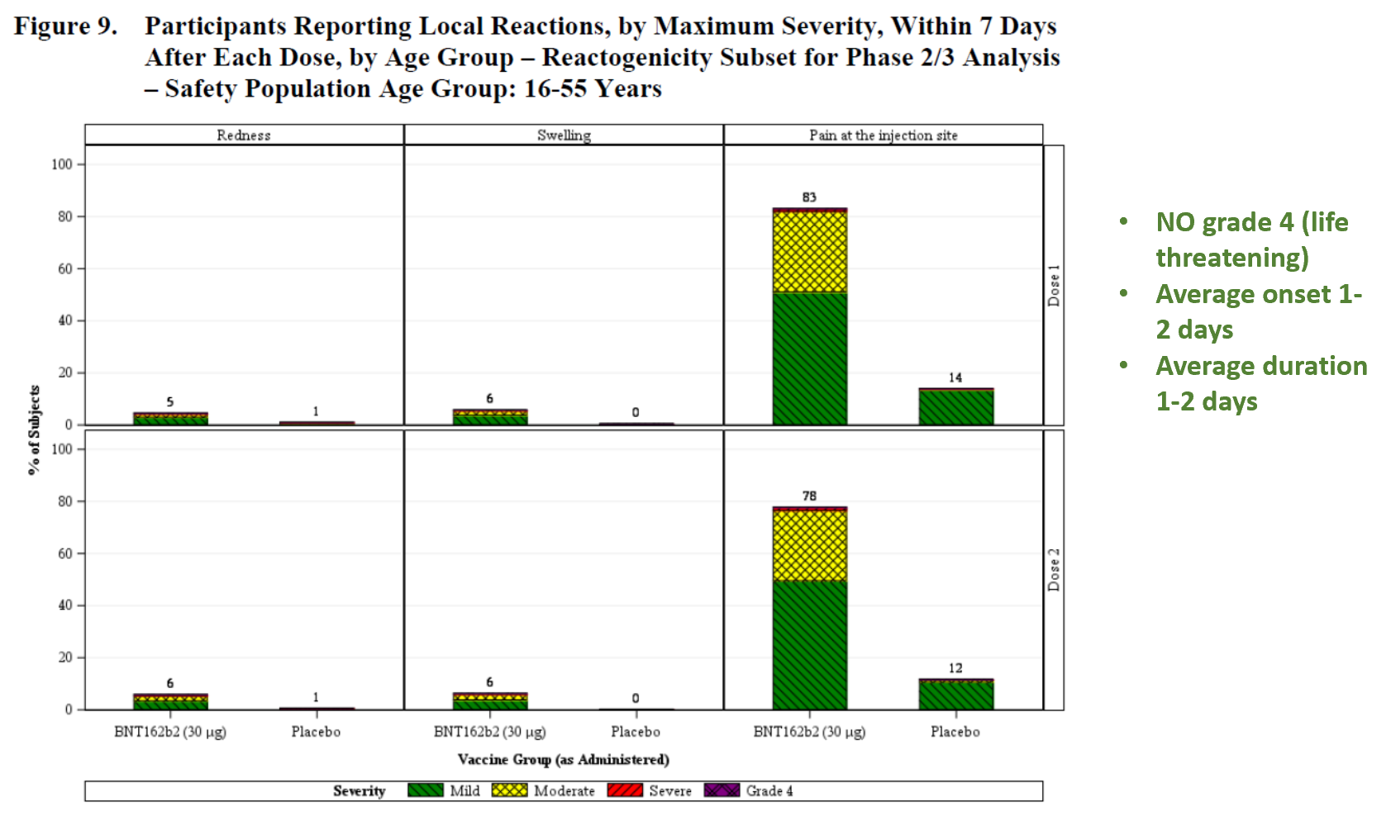
FDA Review
Notes:
Pain redness swelling

Slide 41
FDA Review
Notes:
Mild no interference w daily activity, Mod some interference, Severe prevents daily activity, 4 life threatening
Younger more than older group (more immunogenicity)
More common with 2nd dose
Similar onset and duration as injection site reactions, within 3 days and duration 2-3 days
No life threatening

Slide 42
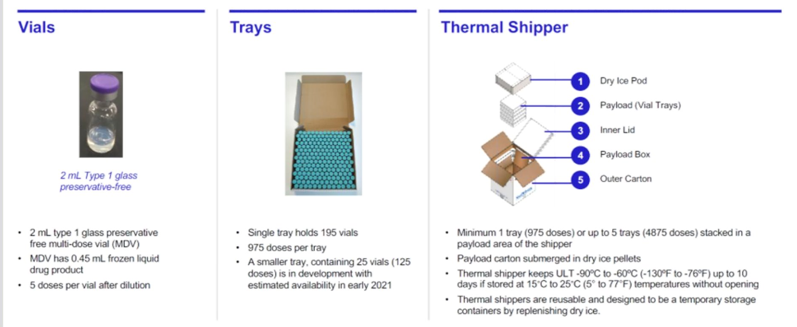
Product Packaging Overview

Slide 43
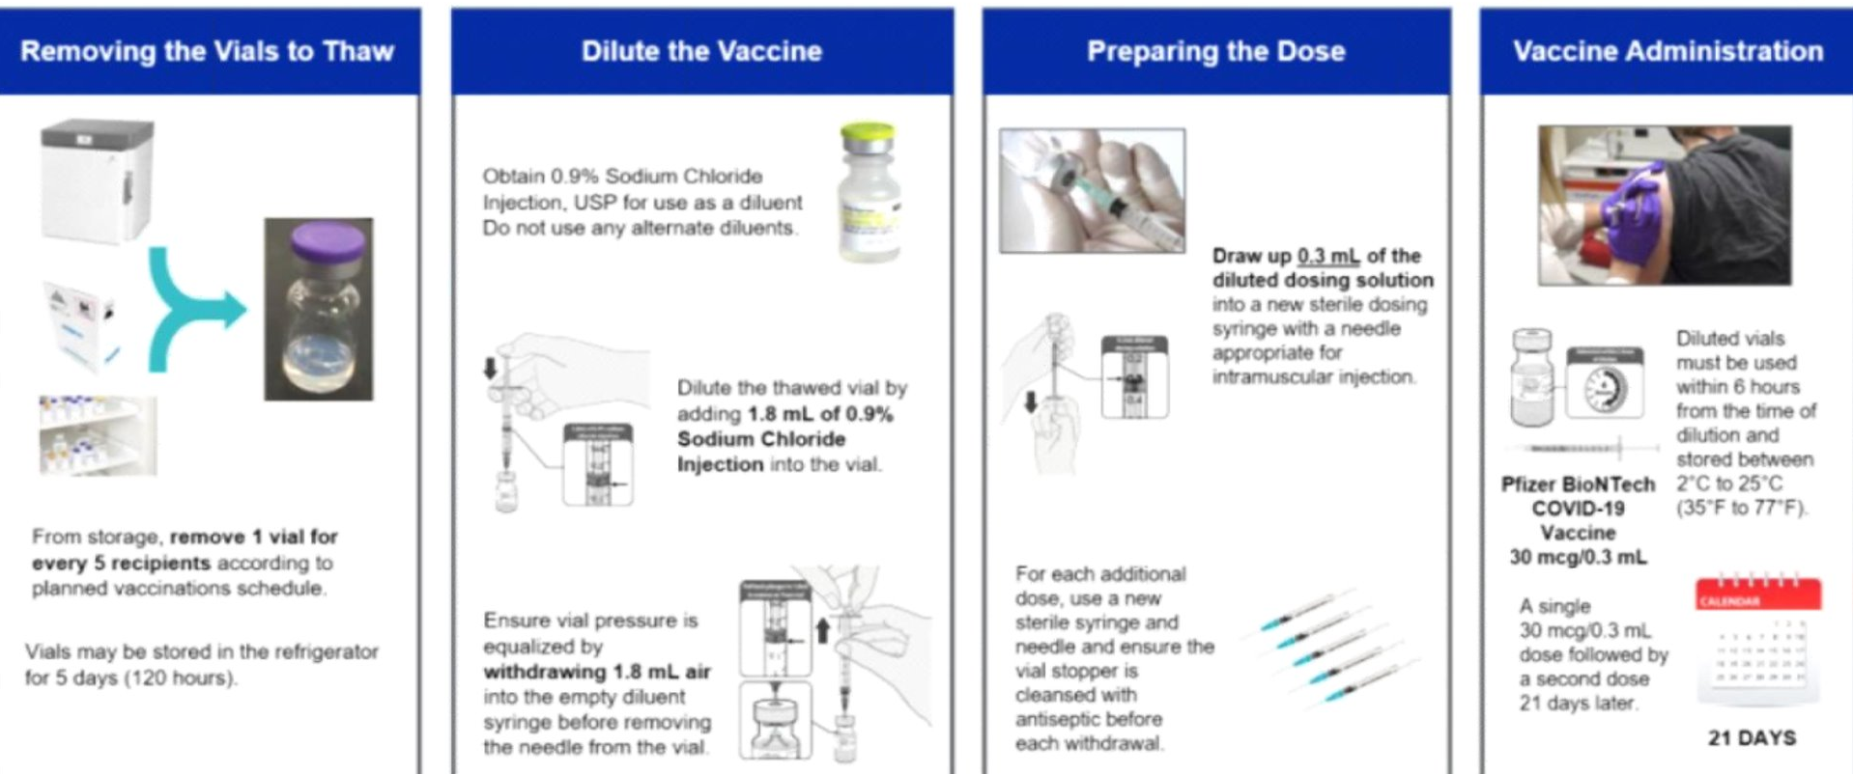
Vaccine Preparation/Administration

Slide 44
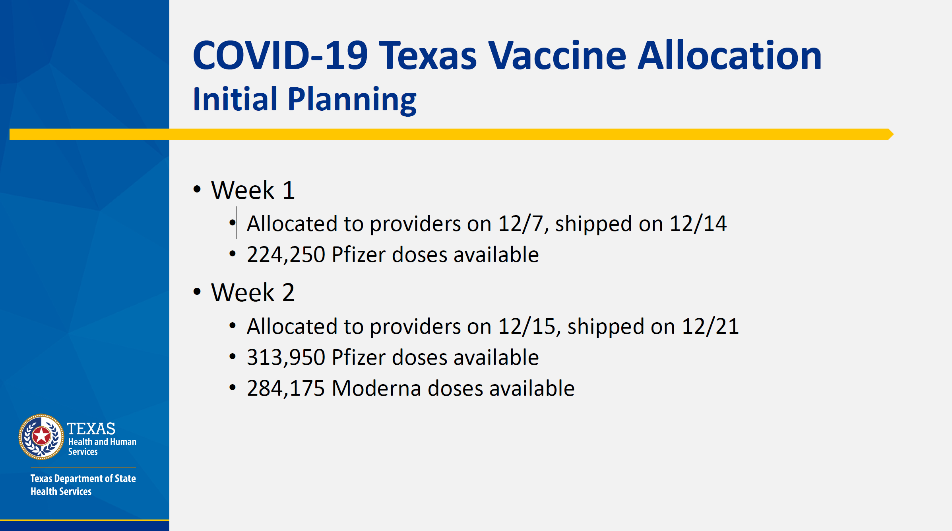
Vaccine Allocation
CMC was allocated 2,925 doses of the Pfizer vaccine
https://dshs.texas.gov/news/updates/COVIDVaccineAllocation-Week1.pdf
Planning to allocate this for Covenant Health, not just CMC
Will evaluate allocations this week for other sites

Slide 45
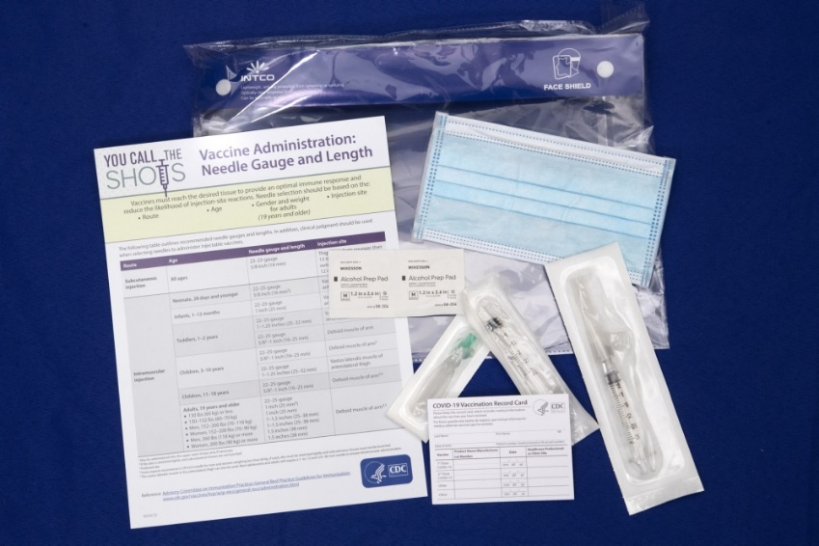
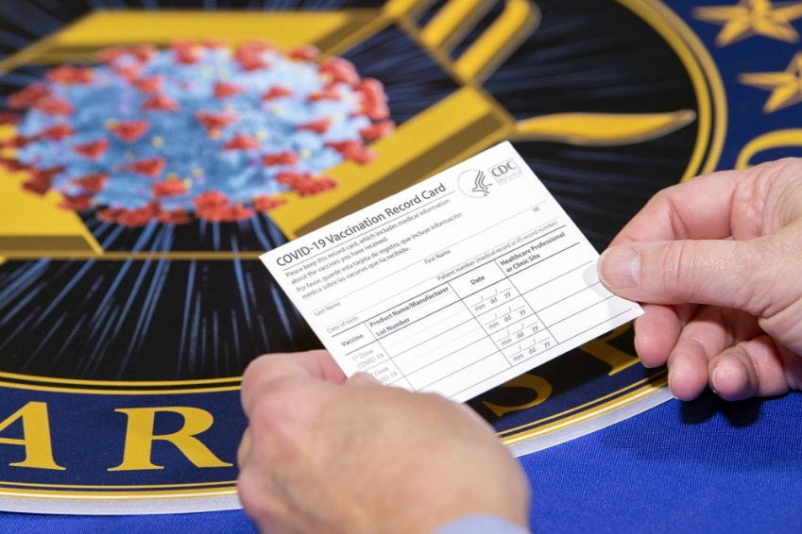
Ancillary Supplies
Expecting ancillary supplies to arrive today
  Syringes, needles, alcohol pads, masks, face shields, diluents, information sheets, vaccination cards
  https://www.dvidshub.net/video/773456/operation-warp-speed-large-ancillary-kit-description

Slide 46
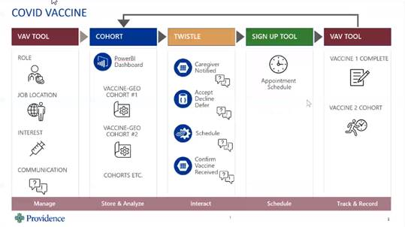
Prioritization and Scheduling

Slide 47
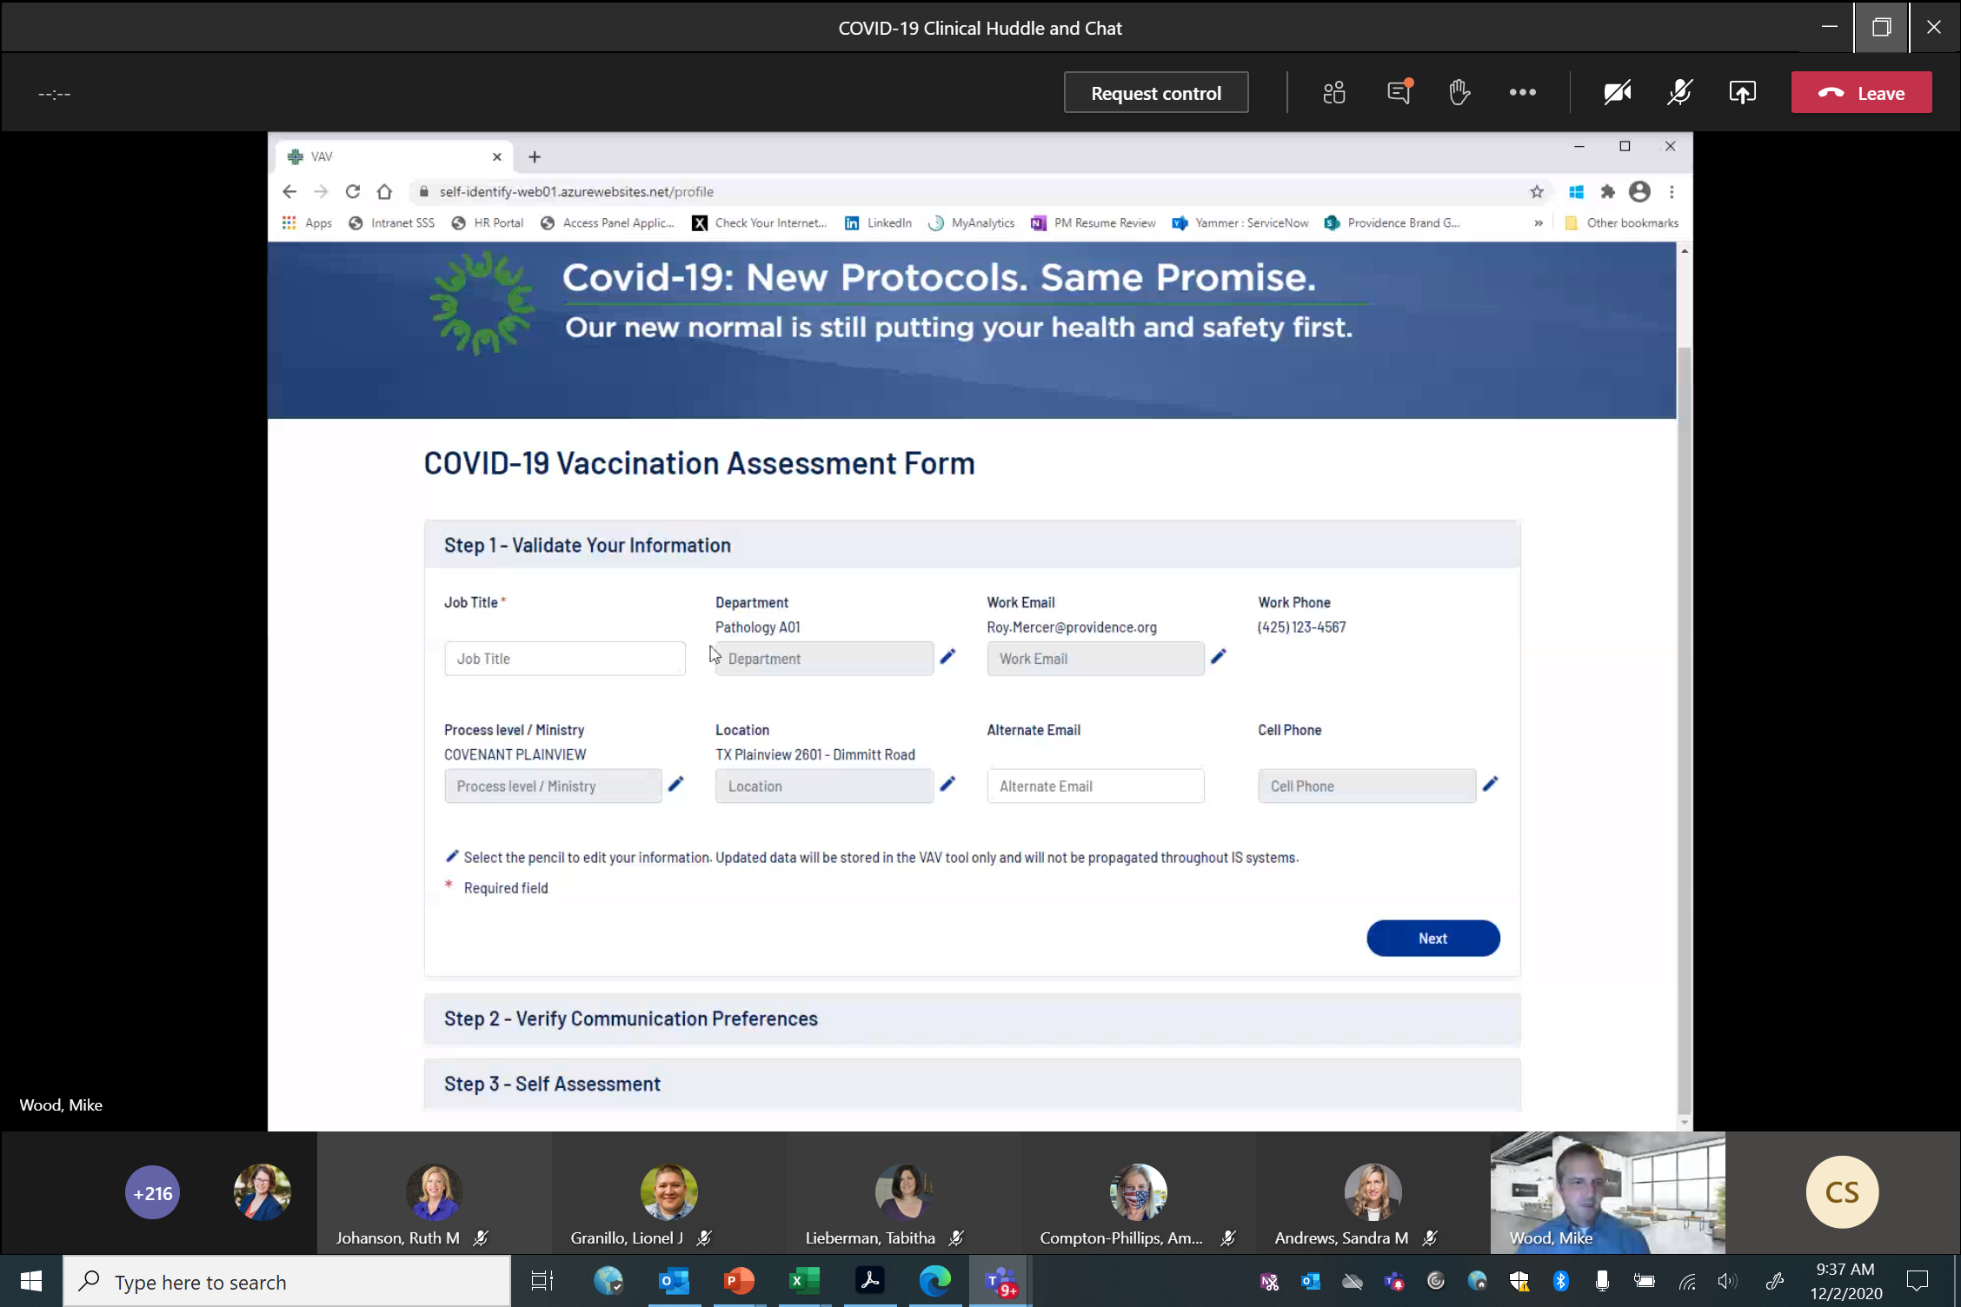

Slide 48
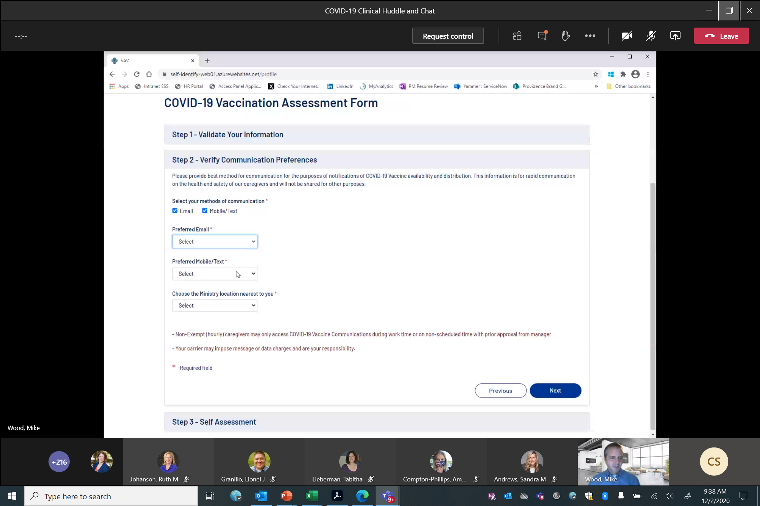

Slide 49
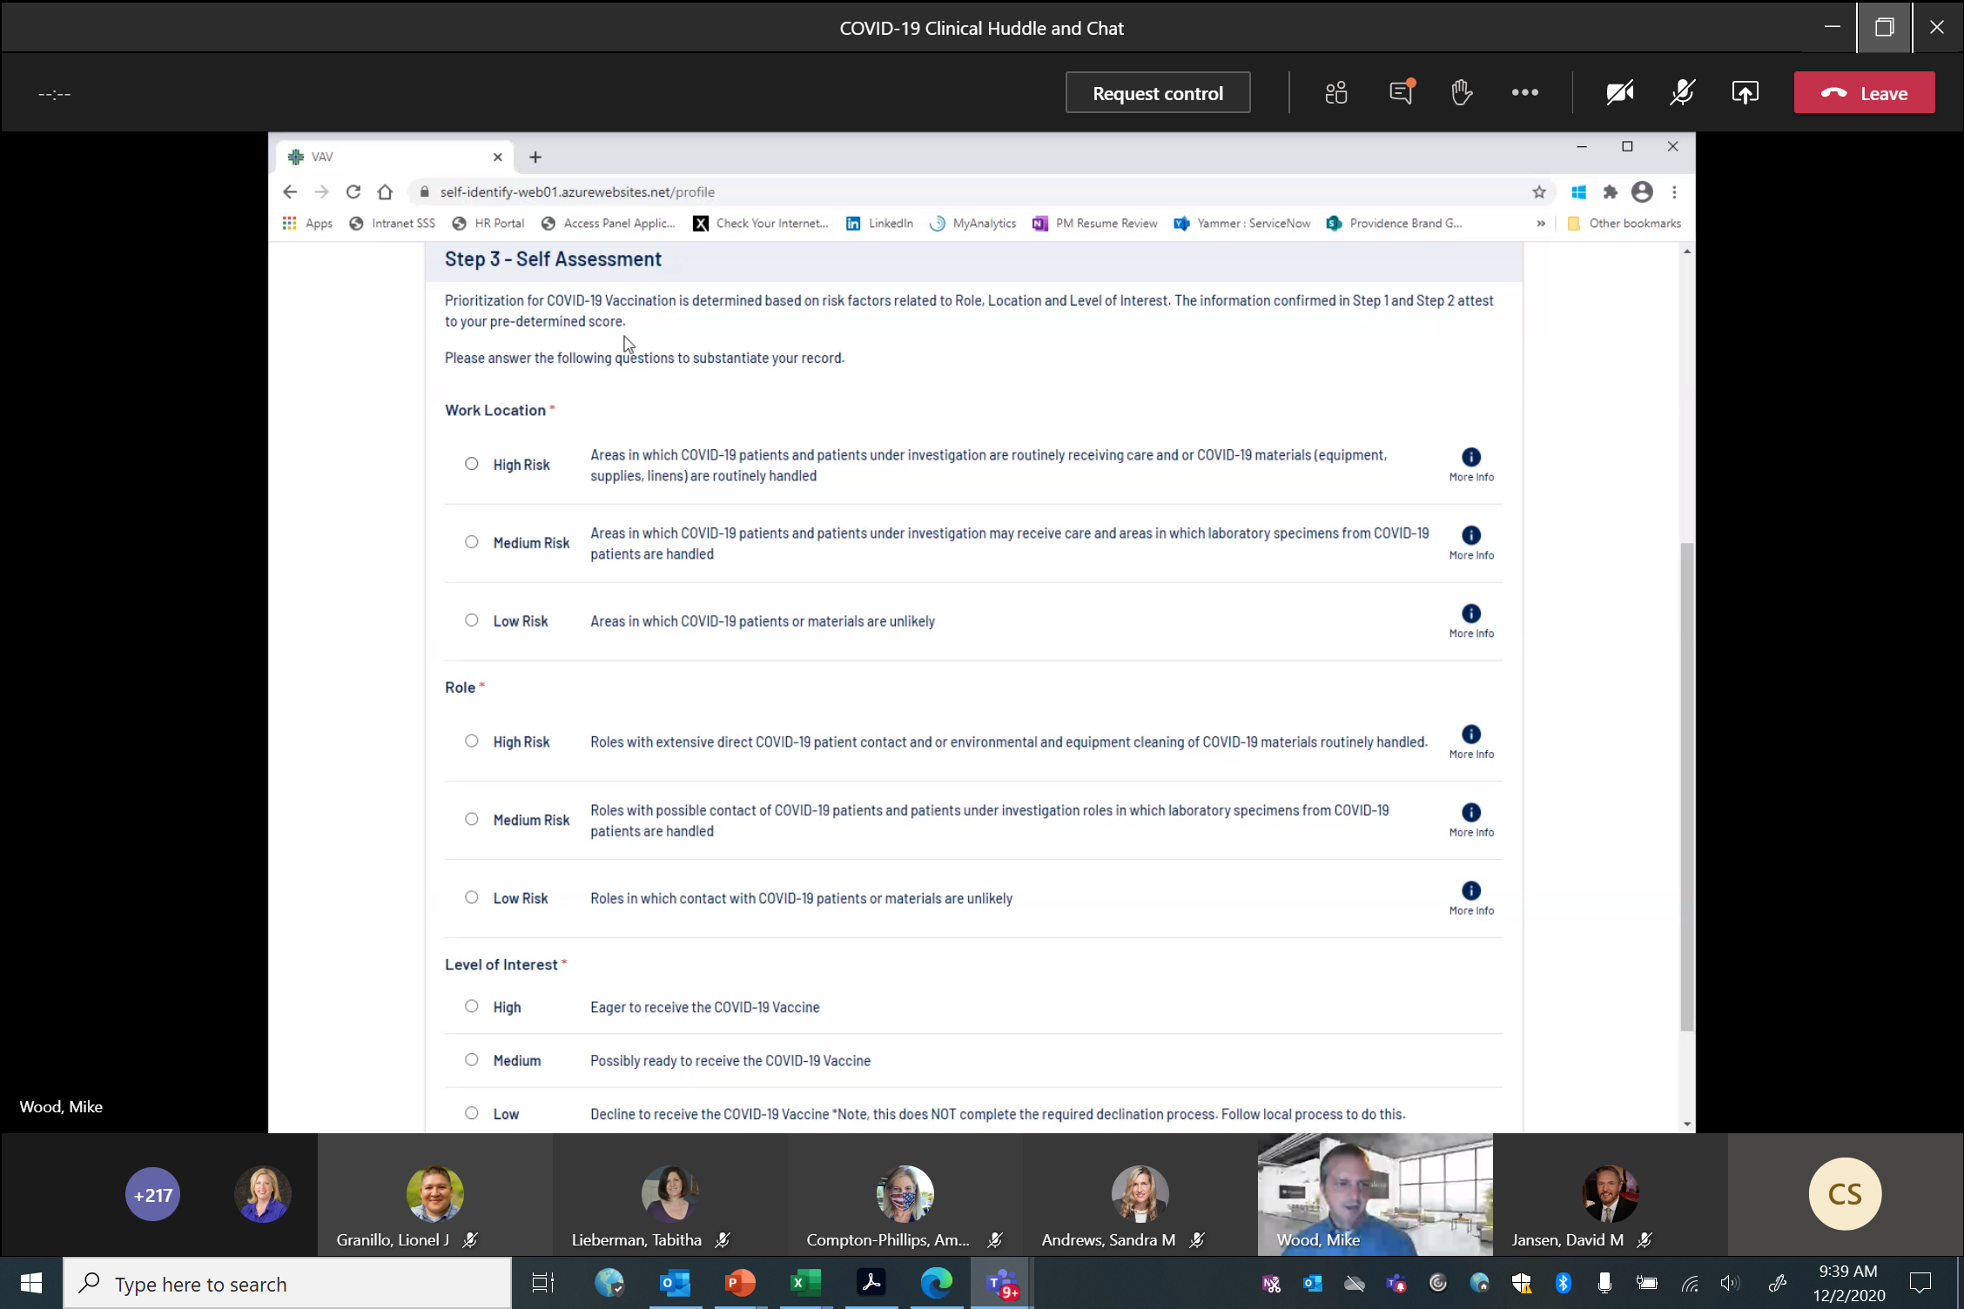

Slide 50
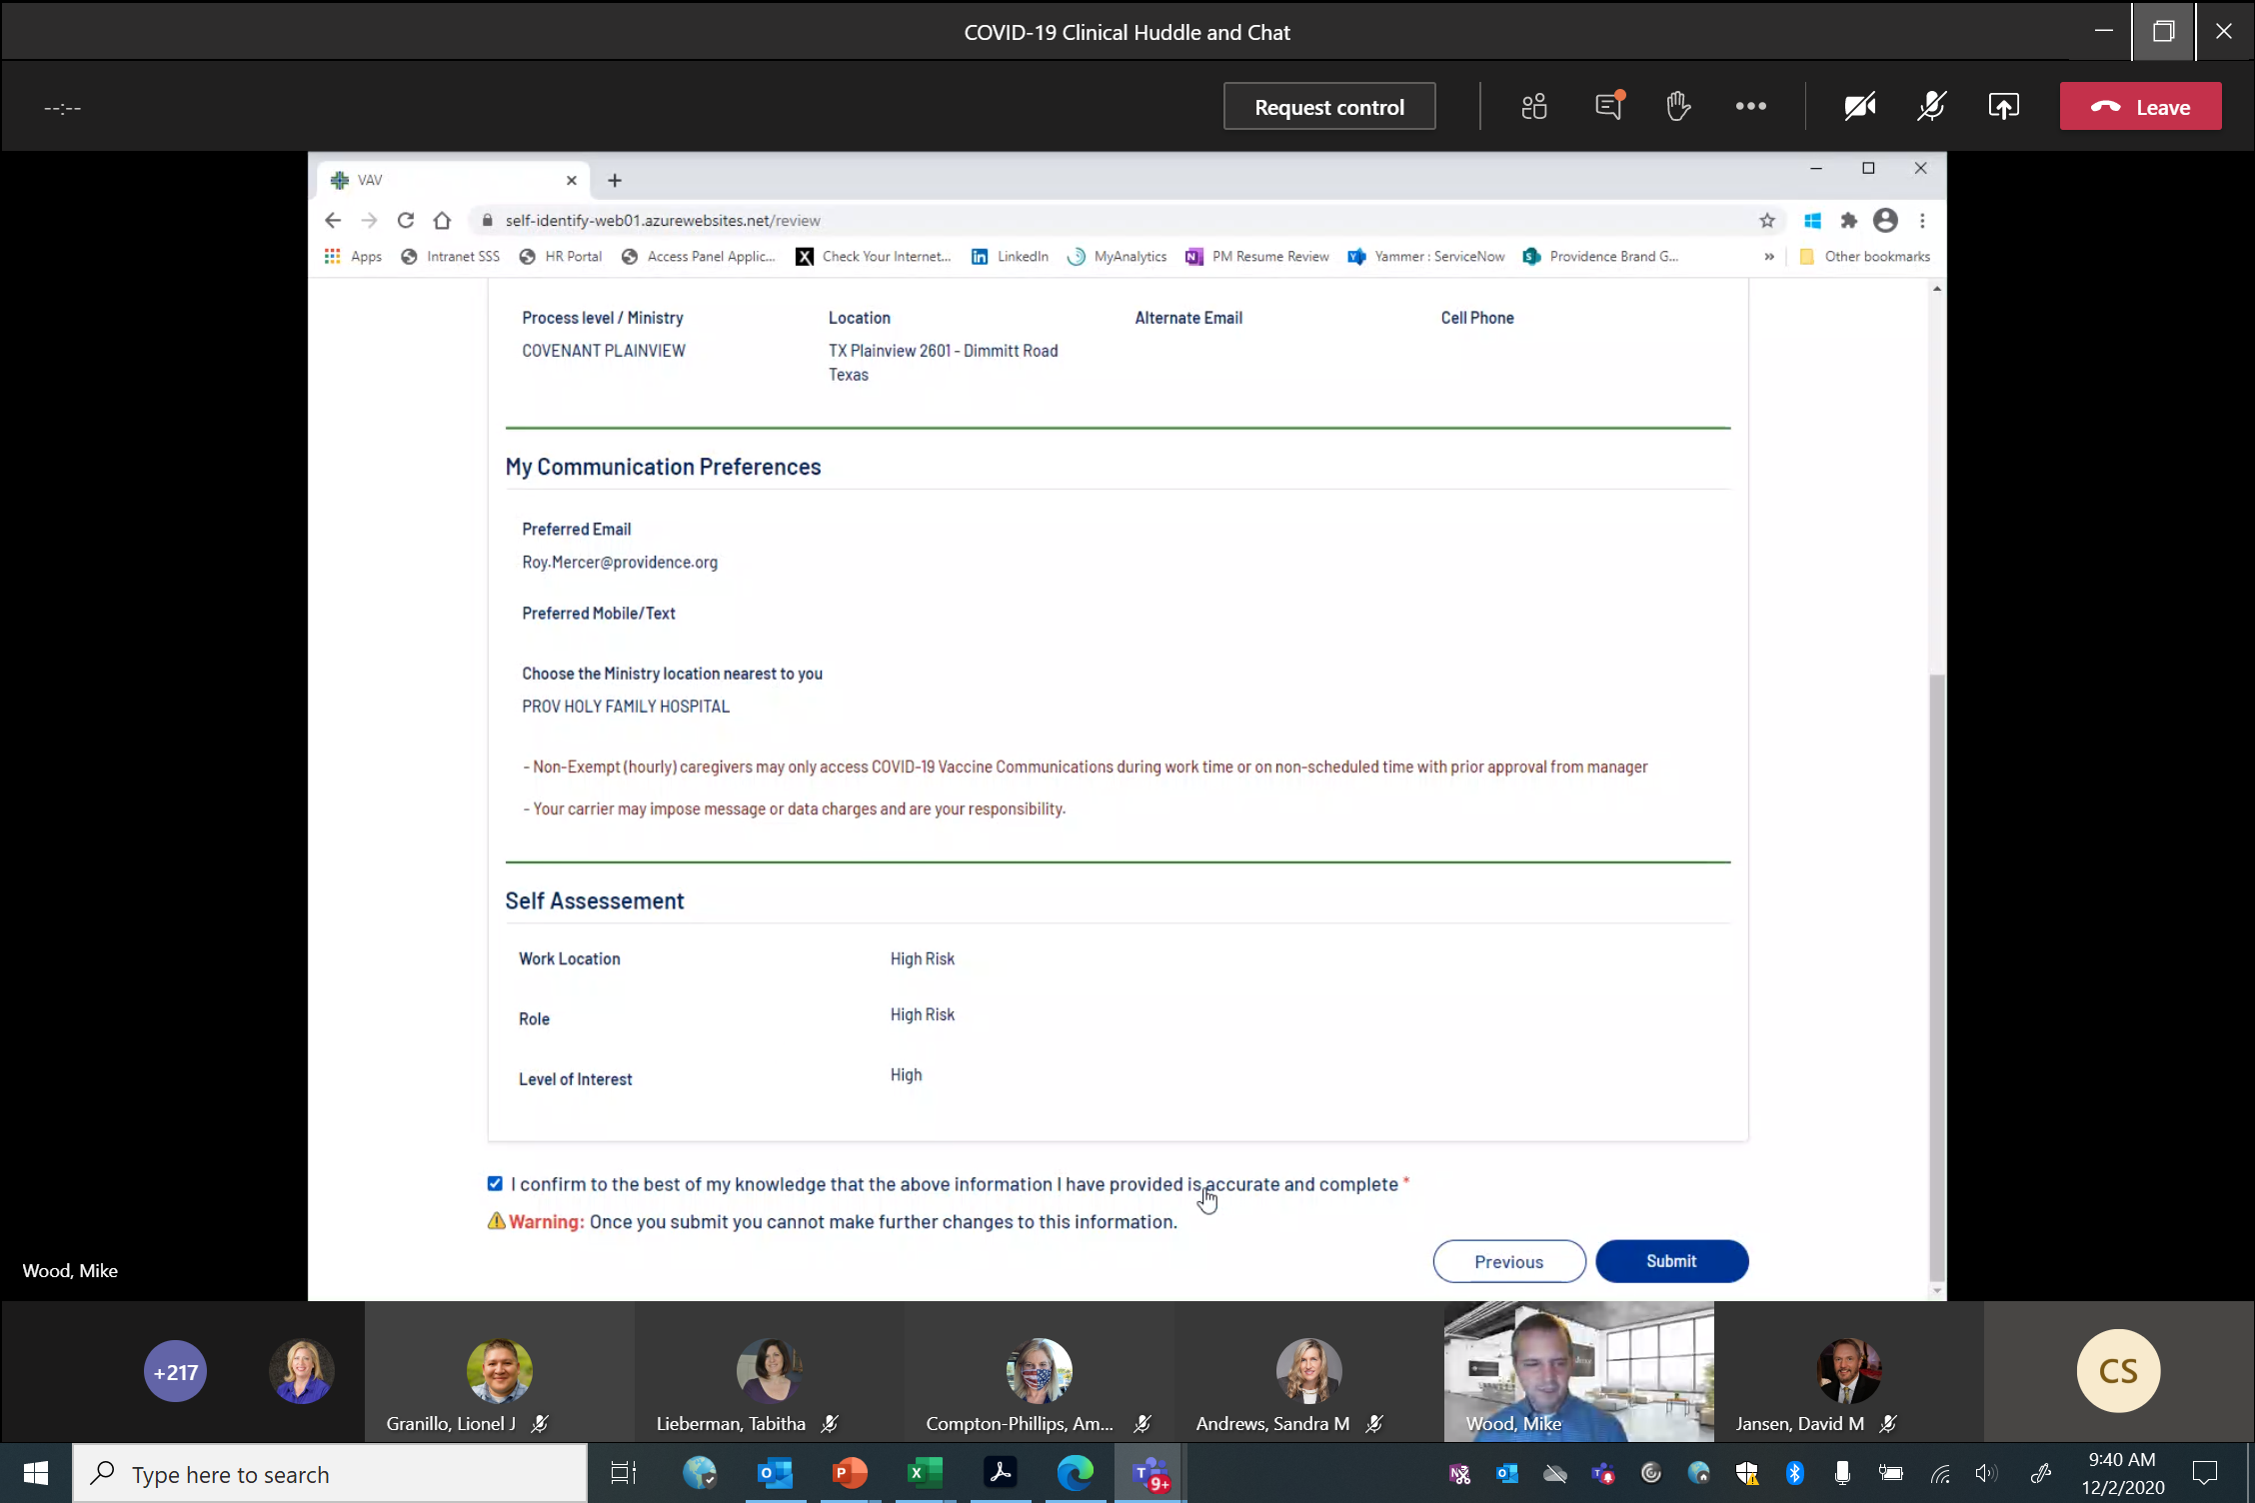

Slide 51
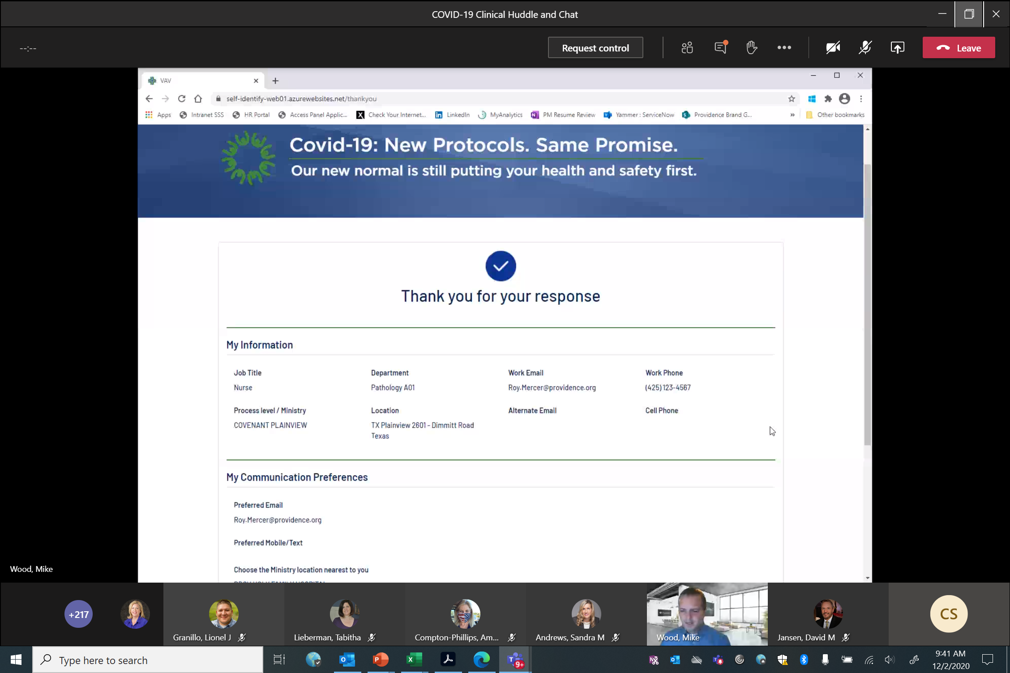

Slide 52

Planning and Prioritization
(Caregiver Identification)
Caregivers notified to complete
VAV tool
VAV Tool
Assigns priority to each caregiver
VAV Tool
Collects communication preference (email/text or both)
Collects interest level
VAV TOOL COHORTS
List of top priority caregivers by Vaccine GEO
Data Feed
COHORT by Geo data sent to Twistle
Twistle
Enrolls user into appropriate pathway
Email Pathway
SMS Pathway
Twistle
Communicates to caregiver vaccine eligibility.
Vaccine Sign-up or Declination
Information sent back to VAV Tool as system of record for all Covid Vaccine
Twistle Form
Vaccine is available for you, are you ready?
Twistle
Sends declination form to be signed.
Employee
Completes form
Twistle
Records Declination in Twistle & Sends Declination to Providence EDW
Twistle
Stops messaging patient & ends pathway.
No
Yes, but later
Twistle
Sends reminder email during 2nd batch of vaccines.
Yes
Twistle
Sends link to GEO based SignUp Genius link for choosing slot for vaccine
Twistle Form
Did you sign-up for appointment?
No
Twistle
Sends reminder with sign-up information on daily basis x ___ days
If caregiver doesn’t respond after 5 days,
6th day terminated.
Yes
Twistle Form
Asks “What date did you schedule your vaccine?”
Employee
Submits Vaccine Date
Employee
Receives vaccine
Nurse Administering Vaccinations or Admin Documents vaccine administration in OHM & State Registries
Follow Up Scheduling & Adverse Reactions
Twistle
1 day after submitted vaccine date
Send link to VAERS (national database) to report adverse events
(based on initial date employee submitted)
Twistle
15 days after first vaccine date – sends reminder to sign-up for 2nd dose.

Slide 53
Twistle Asks
Would like to receive vaccine?
Employee Data (from VAV)
Sent to Twistle
GEO Vaccine COHORT
Twistle
Sends welcome message & communicates vaccination eligibility
Twistle
Sends declination form to be signed.
Employee
Completes form
Twistle
Sends data to data to PSJH EDW
Twistle
Stops messaging patient & ends pathway.
No
Yes, but later
VAV
Updates with vaccine status
Yes
Twistle
Sends data to data to PSJH EDW
Twistle Asks
Did you sign-up for appointment?
Twistle
Sends ministry specific link to sign-up for appointment for vaccine
Twistle
Sends reminder with sign-up information on daily basis x ___ days
If caregiver doesn’t respond after 5 days,
6th day terminated.
No
VAV
Updates with vaccine status
Yes
Twistle
Stops messaging patient & ends pathway.
Twistle Asks
Did you sign-up for booster?
Twistle Form
Asks “What date did you schedule your vaccine?”
Employee
Submits Vaccine Date
Employee
Receives vaccine
Twistle
1 day after submitted vaccine date
Send link to VAERS (national database) to report adverse events
(based on initial date employee submitted)

Slide 54
Pre-Work: Creating Cohorts within Each Vaccine GEO
Start Here (using either pre-determined or self-assessed score):
But we can break each of these groups down further using the following:
Group title | Role | Work location | Total Score
High-High | 3 | 3 | 6
High-Medium | 3 | 2 | 5
Medium-High | 2 | 3 | 5
High-low | 3 | 1 | 4
Low-high | 1 | 3 | 4
Medium-Medium | 2 | 2 | 4
Medium – low | 2 | 1 | 3
Low-medium | 1 | 2 | 3
Low-low | 1 | 1 | 2
Other Cohort Factors
Location code
Department code/ cost center
Job code
Willingness to receive vaccine
Self-assessment
3,985 CGs
1,267 CGs
880 CGs
8,499 Total CGs
451 CGs
1916 CGs

Slide 55
Vaccination Event
Lubbock caregivers will need to get the vaccine at KECC
Looking at a soft start on 12/16 to work out kinks in System
Workflow
  Check-in
  Brief waiting area
  Consent signed
  Vaccine administered
  Waiting area (post) – 15 min
  Caregiver leaves
    Self monitoring for issues
    Data entry into ImmTrac2

Slide 56
Draft COVID-19 Vaccination Calendar
Pending Cohort Distribution
Following VAV completion

Slide 57
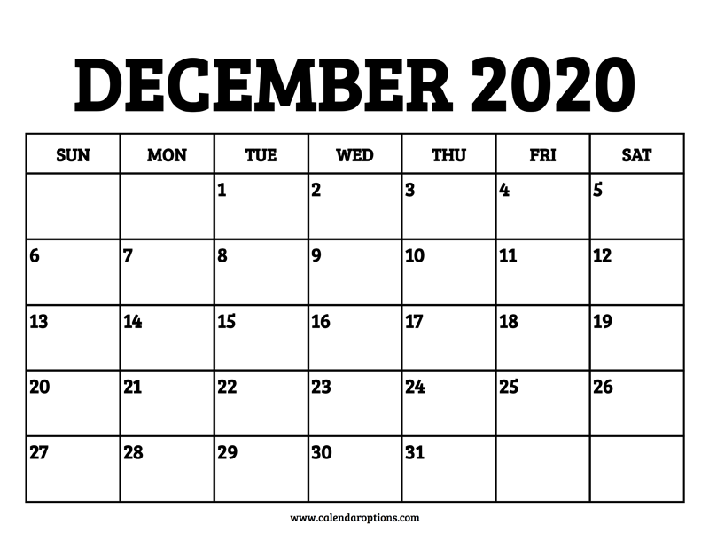
6,000-6,500 Vaccinations in December
Group A
Vac 1
Group A
Vac 1
SOFTSTART Vac 1
Group A
Vac 1
Group B (Risk 5)
Vac 1
Group C (Risk 4)
Vac 1

Slide 58
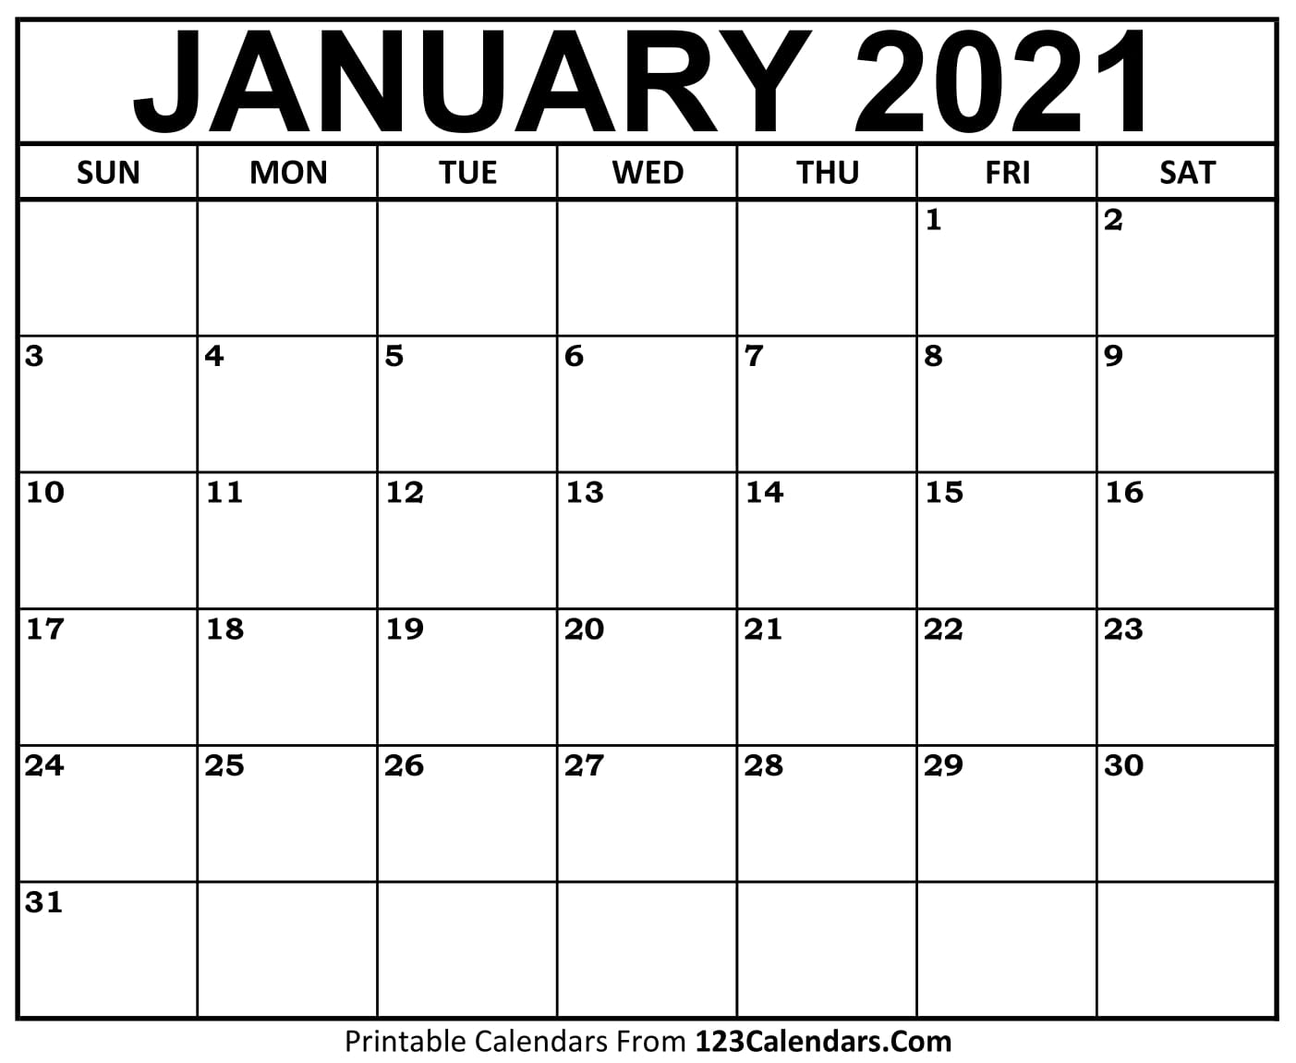
Group D (Risk 3)
Vac 1
Group E (Risk 2 - LL)
Vac 1
Group A
Vac 2
SOFTSTART Vac2
Group A
Vac 2
Group B (Risk 5)
Vac 2
Group C (Risk 4)
Vac 2
Group D (Risk 3)
Vac 2
Group E (Risk 2 - LL)
Vac 2
8,499 Caregivers fully vaccinated by January 27th

Slide 59
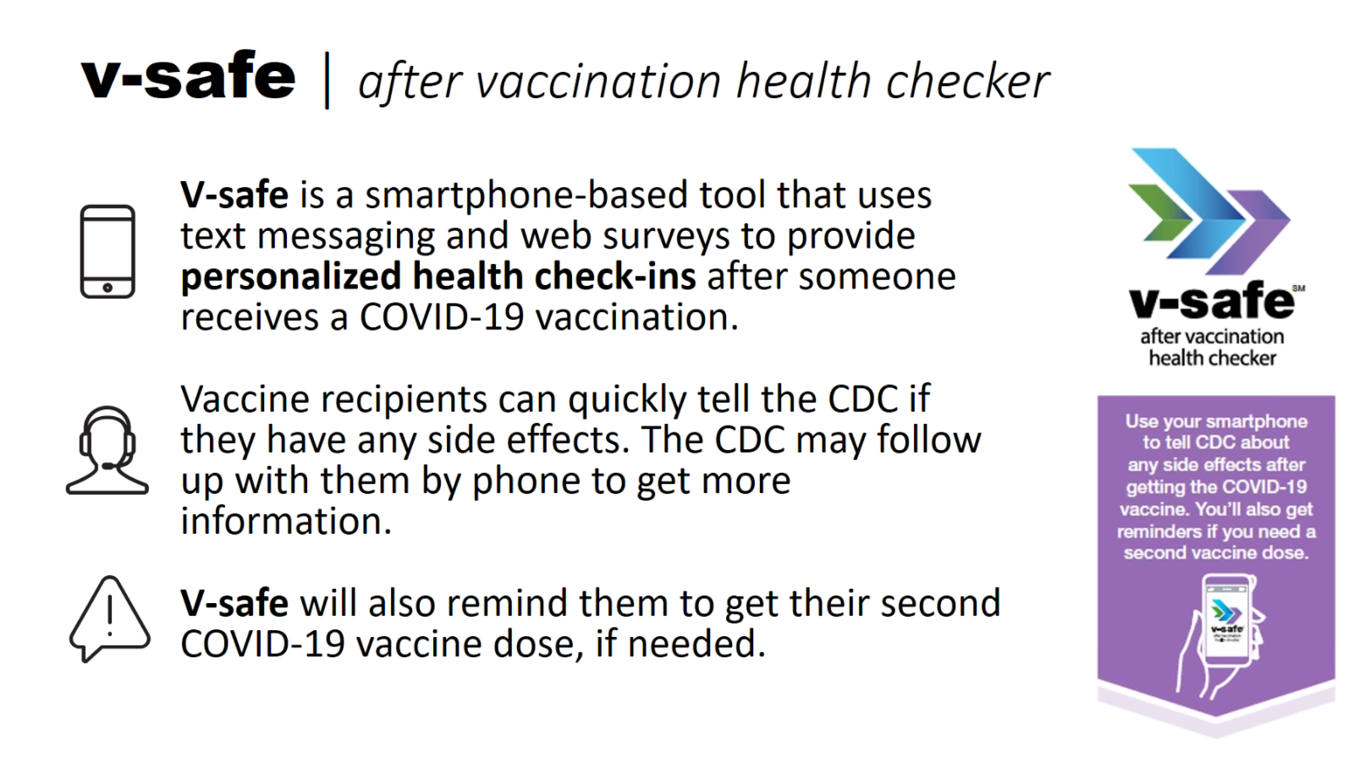
V-safe Reporting Tool

Slide 60

Texas Demographics

Slide 61
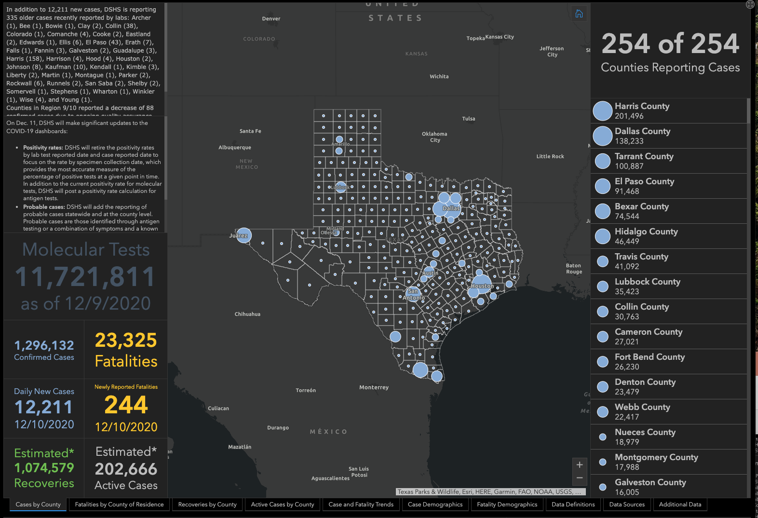

Slide 62
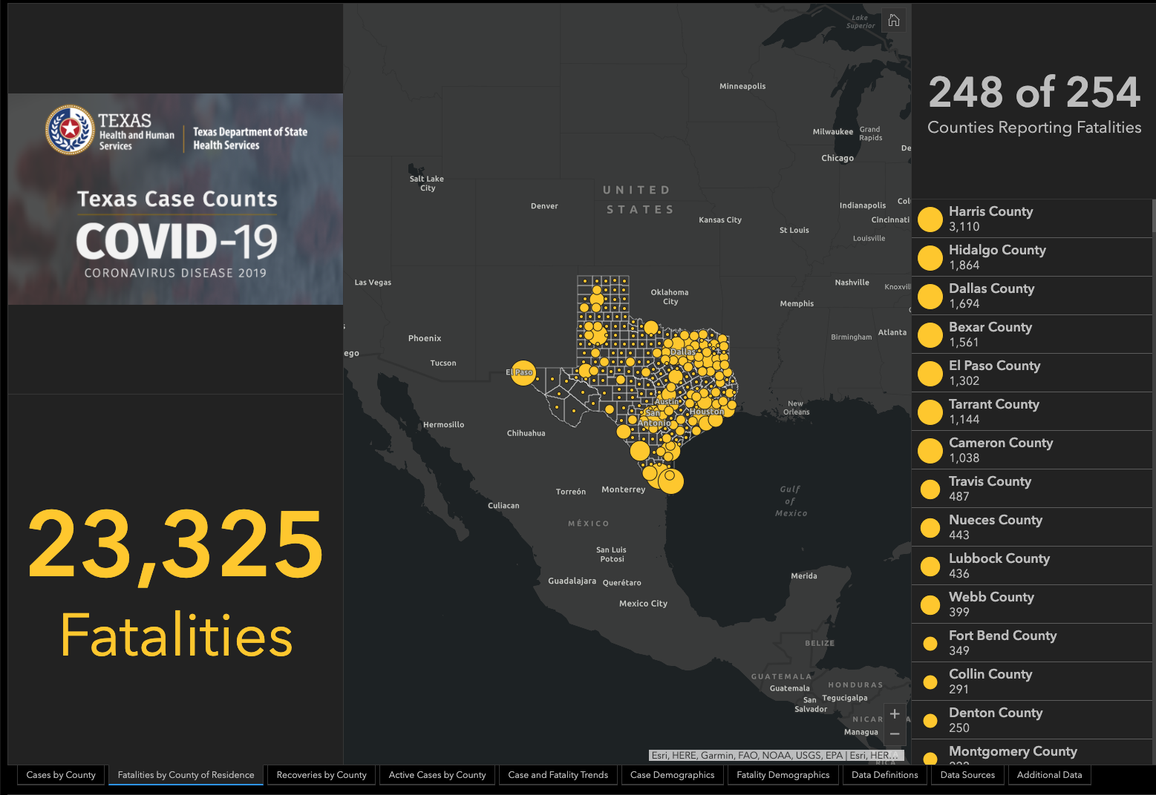

Slide 63
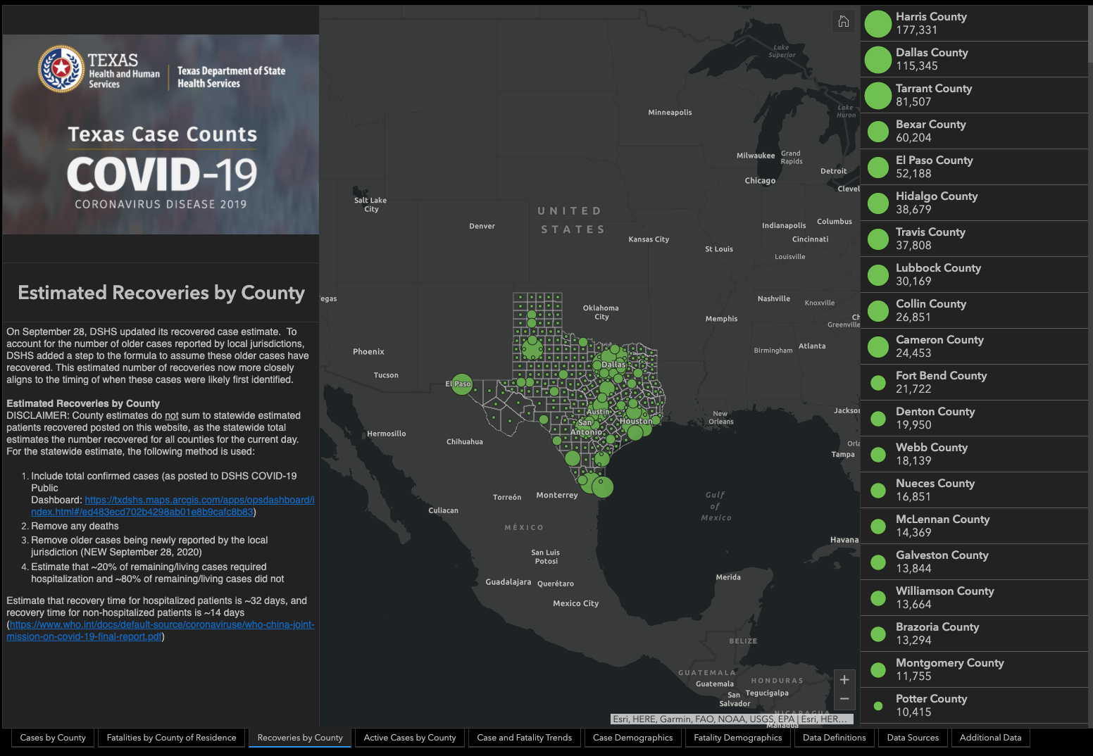

Slide 64
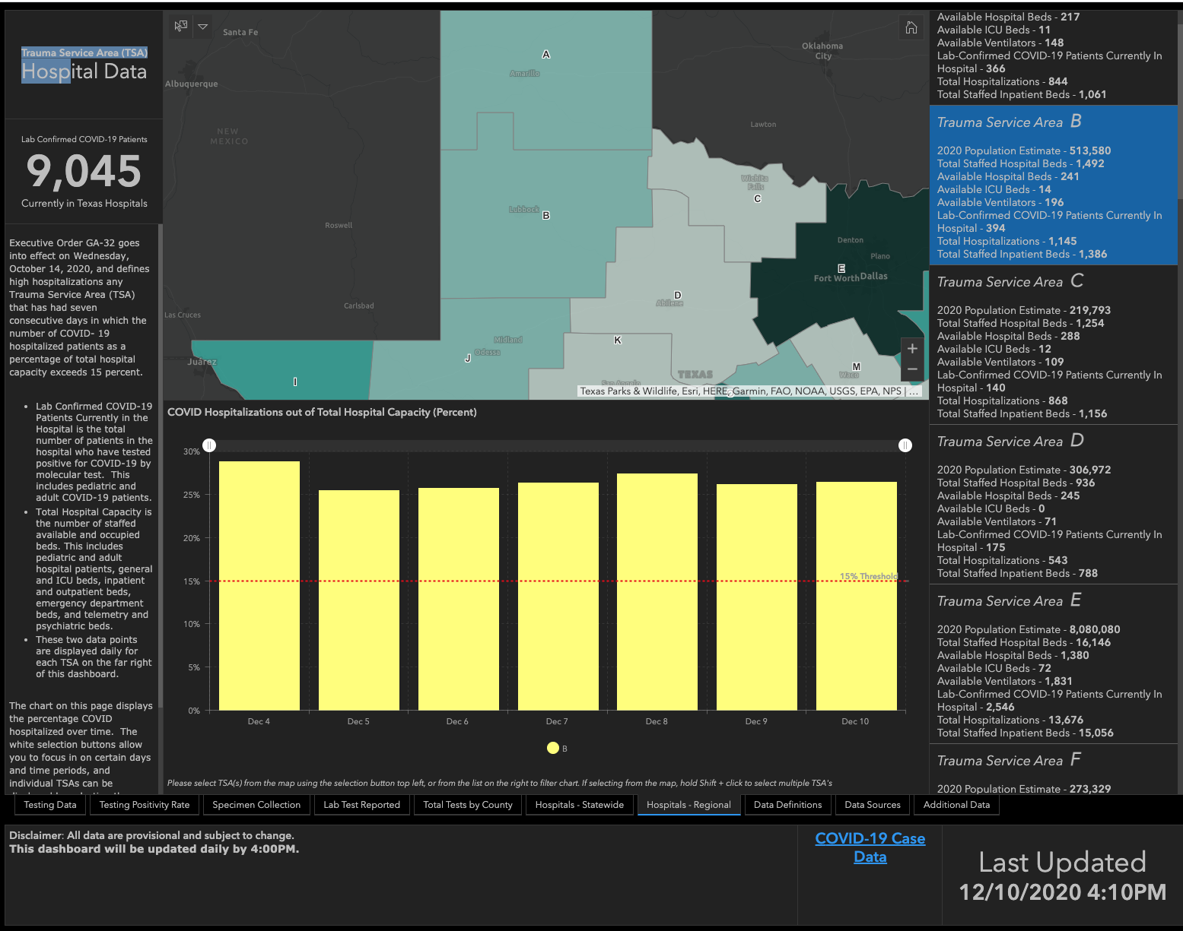
28.8%
25.7%
26.3%
27.3%
26.1%
26.4%
25.4%

Slide 65
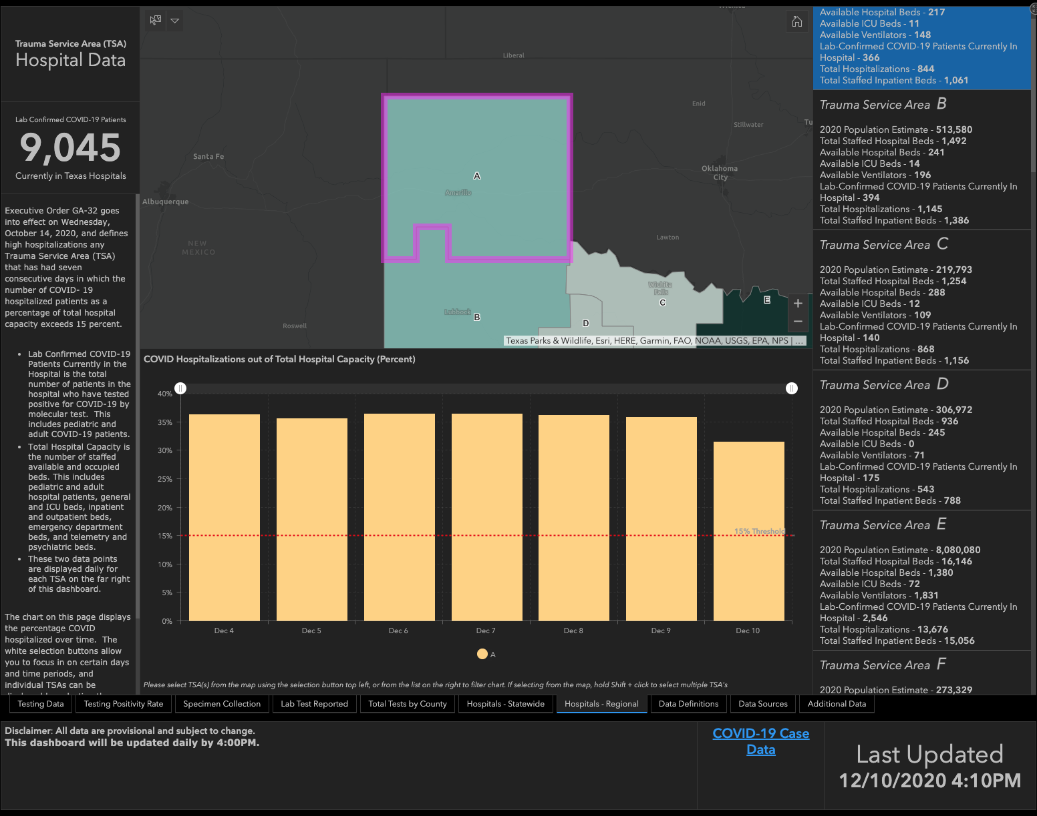
36.2%
35.5%
36.4%
36.4%
36.1%
35.8%
31.9%

Slide 66
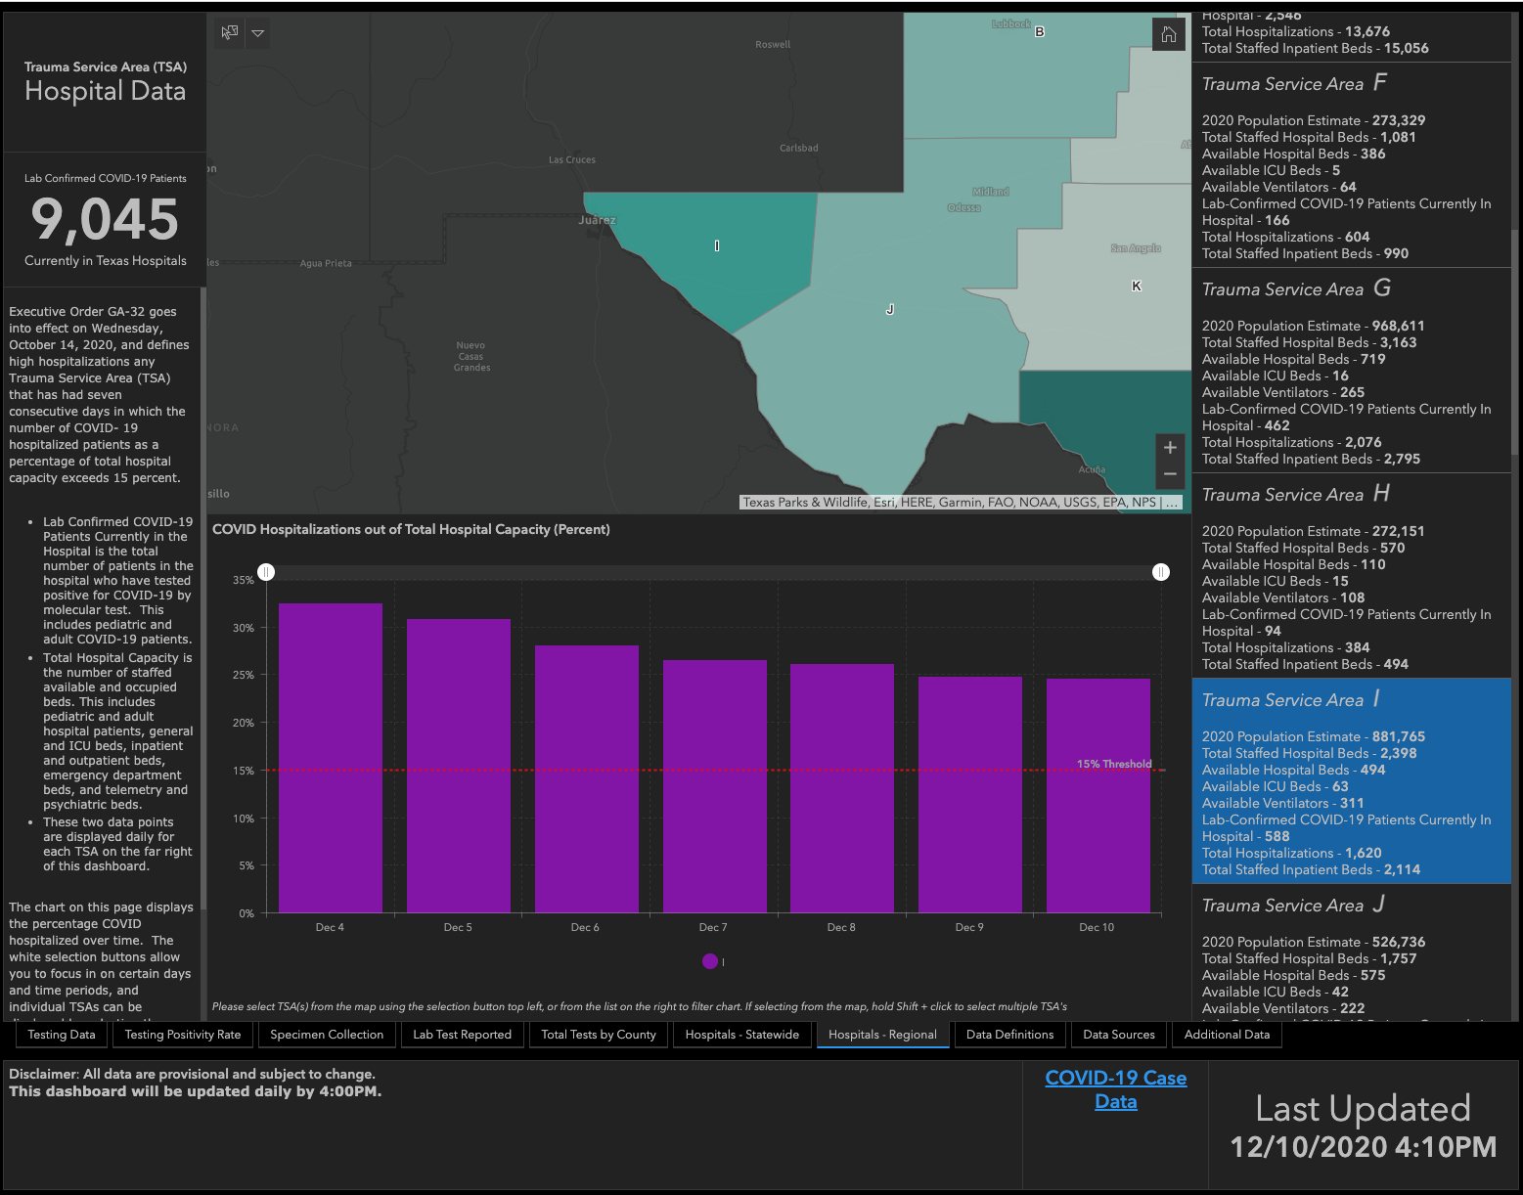
32.4%
30.8%
28%
26.4%
26.1%
24.7%
24.5%

Slide 67
Q & A

Slide 68
CME Credit was only approved for the Live Teams meeting
To receive credit for this continuing education activity, the participant must:
  Make sure you are logged into your Teams account, if you are signed in with a group provide attendee’s First and Last name(s) in the comments section.
  If you are calling into the Teams meeting you MUST text your First & Last Name to (806) 252-4735. This will ensure you are added to the sign in sheet to receive CME Credit.
  You will receive an email by the following Wednesday from the CME department with further instructions on claiming your certificate.

