Slide 1
Covenant Health
Presents
Critical Communications: A Weekly Physician Update
December 18, 2020

Slide 2
PHYSICIANS
Accreditation Statement:
The Covenant Health is accredited by the Texas Medical Association (TMA) to provide continuing medical education for physicians.
Credit Designation Statement:
The Covenant Health designates this live CME activity for a maximum of 1.0 AMA PRA Category 1 Credit(s)™. Physicians should claim only the credit commensurate with the extent of their participation in the activity.

Slide 3
Disclosures of Commercial Interest
The speakers and planners of this activity
have no relevant financial interests

Slide 4
Disclosures
This activity is provided by
Covenant Health
No commercial support has been received.
No products will be endorsed.
Speakers will notify the audience if off label drug use will be discussed.

Slide 5
CME Credit was only approved for the Live Teams meeting
To receive credit for this continuing education activity, the participant must:
  Make sure you are logged into your Teams account, if you are signed in with a group provide attendee’s First and Last name(s) in the comments section.
  If you are calling into the Teams meeting you MUST text your First & Last Name to (806) 252-4735. This will ensure you are added to the sign in sheet to receive CME Credit.
  You will receive an email by Wednesday following the call from the CME department with further instructions on claiming your certificate.

Slide 6

Reflection
Meredith Avery Cunningham
MEDIA & COMMUNITY RELATIONS MANAGER
Covenant Health

Slide 7
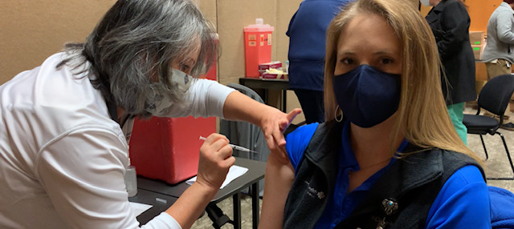

Slide 8
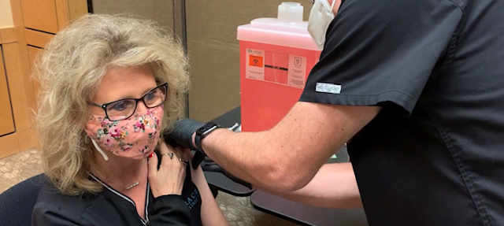

Slide 9
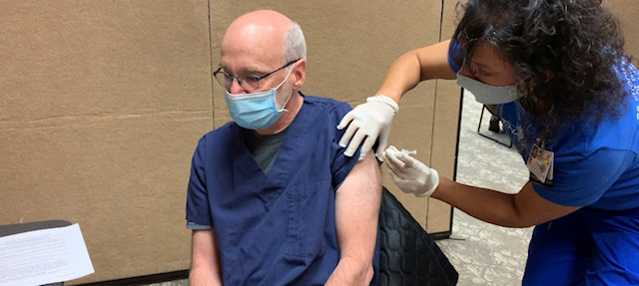

Slide 10
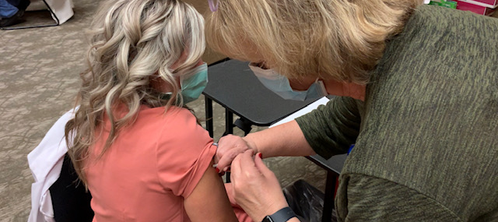

Slide 11
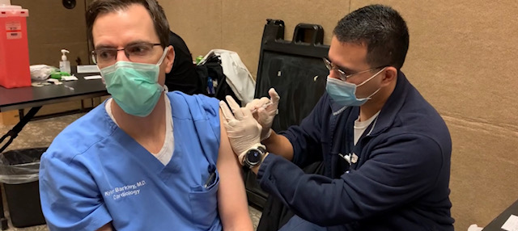

Slide 12
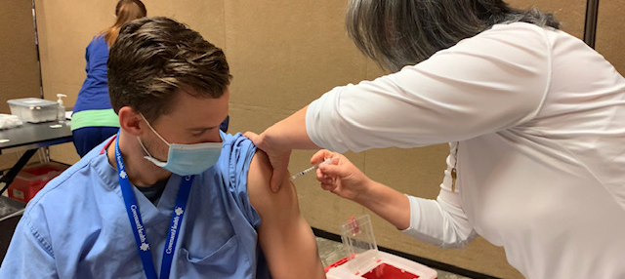

Slide 13
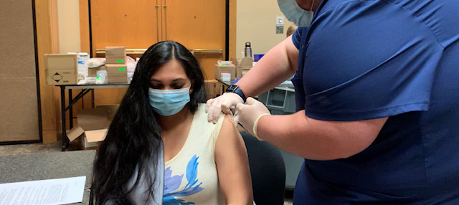

Slide 14
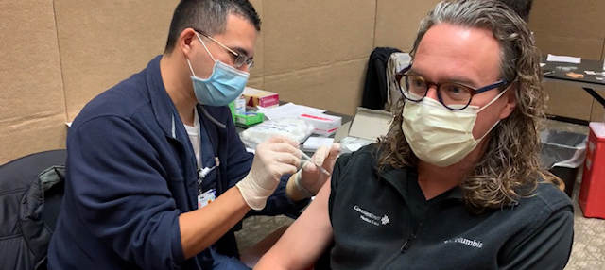

Slide 15
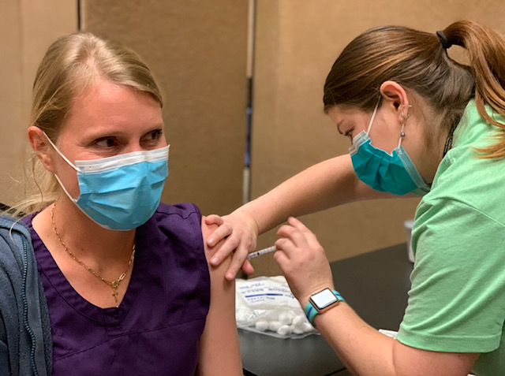

Slide 16
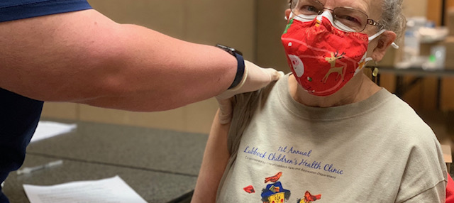

Slide 17
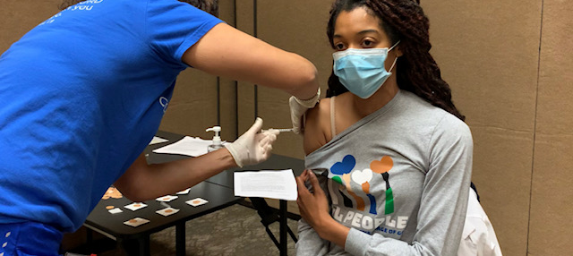

Slide 18
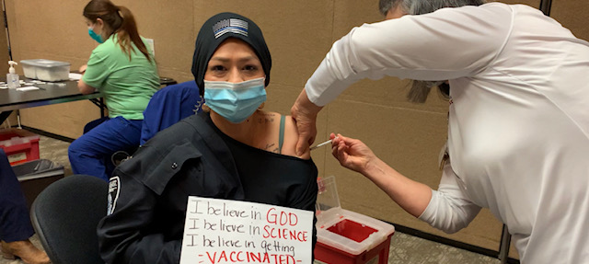

Slide 19
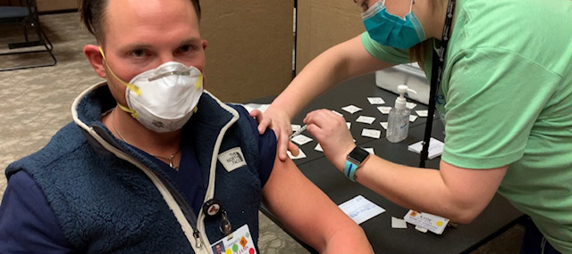

Slide 20
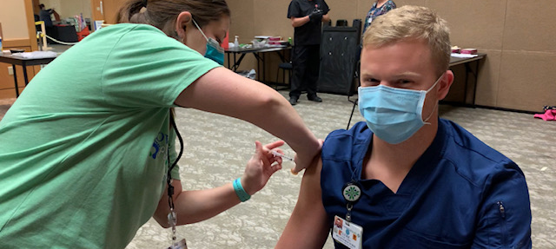

Slide 21
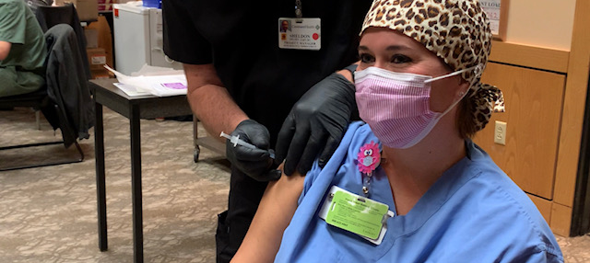

Slide 22
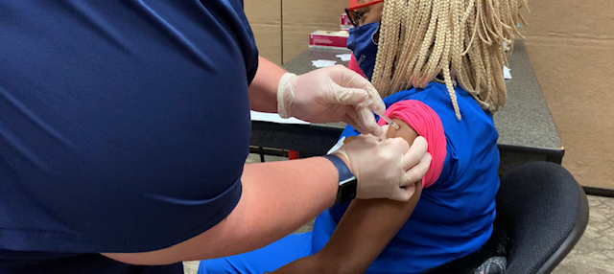

Slide 23
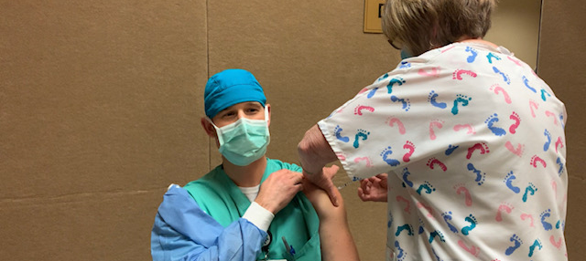

Slide 24
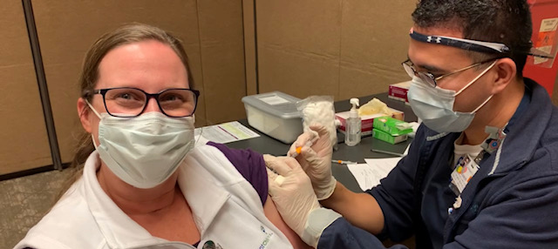

Slide 25
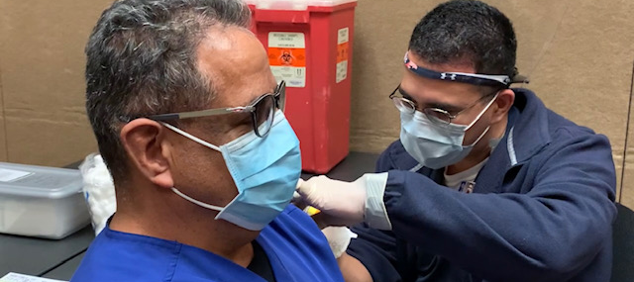

Slide 26
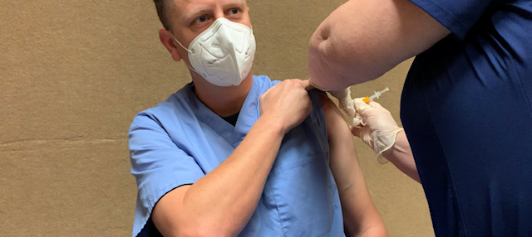

Slide 27
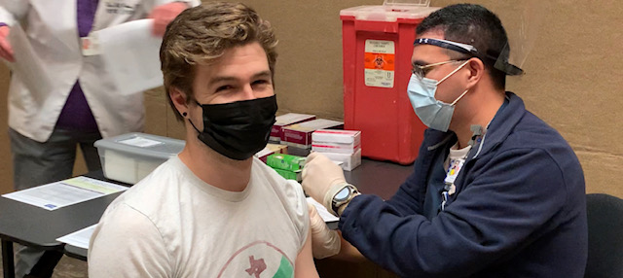

Slide 28
Timelines of Covid-19 Updated

Slide 29
Timelines of Covid-19
Exposure
Incubation Period 2-14 days)
Contagious (2.3 Days before sx,
Almost 0 at 7 days after onset of symptoms
Symptoms (Range from 2 to 14 days in duration)*
60%
Positive Viral RNA Test
No reported cases of transmission greater than 3 days after RESOLUTION of symptoms, AND 9 days after onset of symptoms despite continuing to “Test Positive”
Quarantine Duration after Exposure
Quarantine can end after Day 10 without testing and if no symptoms have been reported during daily monitoring.
  With this strategy, residual post-quarantine transmission risk is estimated to be about 1% with an upper limit of about 10%.
Patients no longer contagious may require placement in NON-COVID Units. Repeated testing of these patients is meaningless.
-3
-2
-1
0
1
2
3
4
5
6
7
8
9
10
11
12
13
14
15
16
17
18
19
20
21
Day
* Symptoms have occasionally been reported months after initial infection begins
15

Slide 30
Current Regional Covid-19 Census

Slide 31
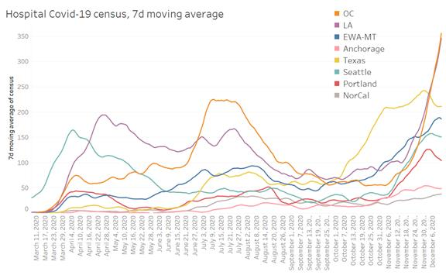
Providence

Slide 32
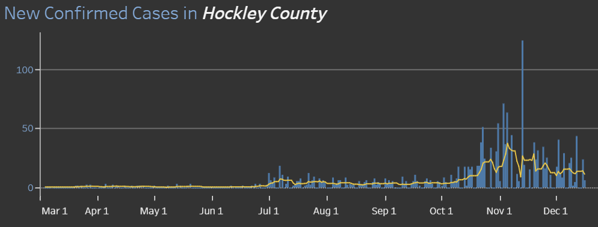
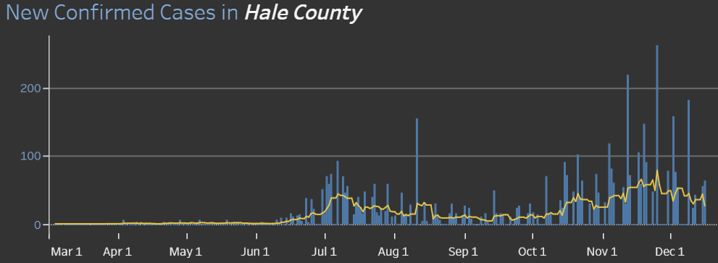
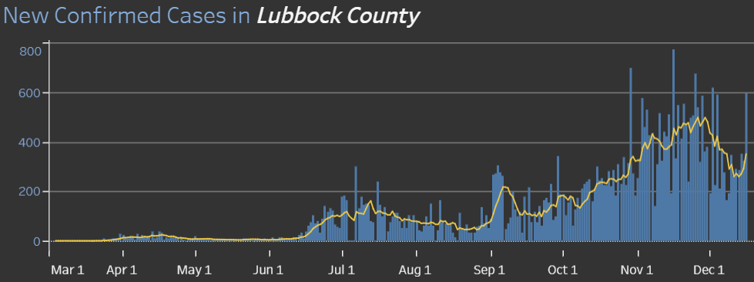
COUNTY
40 new 12/1
64 new 12/15
595 new 12/15
14.3 %
Positivity Rate

Slide 33
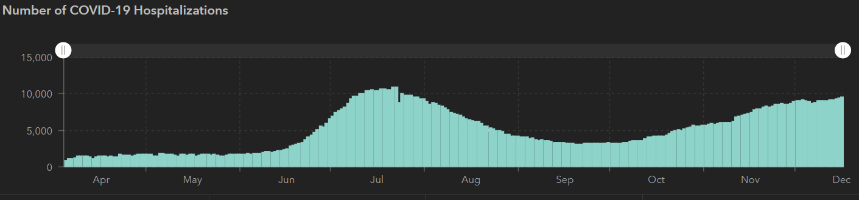
STATE
12/2 | 12/7 | 12/10 | 12/14 | 12/16
1,200,674 | 1,258,214 | 1,283,674 | 1,337,096 | 1,367,965
21,756 | 22,627 | 23,081 | 23,937 | 24,394
9,109 | 8,790 | 9,053 | 9,230 | 9,528
10,893
7/22
9528
12/16
 | 11/30 | 11/16 | 11/04 | 10/21 | 10/5 | 9/23 | 9/9 | 8/26 | 8/12 | 7/29 | 7/15 | 7/1
Cases | 1,168,111 | 1,027,889 | 926,400 | 838,809 | 769,303 | 719,599 | 645,791 | 592,137 | 506,820 | 403,307 | 282,365 | 168,062
Deaths | 21,379 | 19,579 | 18,320 | 17,210 | 16,033 | 15,129 | 13,692 | 11,805 | 9034 | 6190 | 3432 | 2481
Hospitalized | 8900 | 7468 | 5,872 | 4,319 | 3,318 | 3,195 | 3604 | 4806 | 7028 | 9595 | 10,471 | 6904

Slide 34
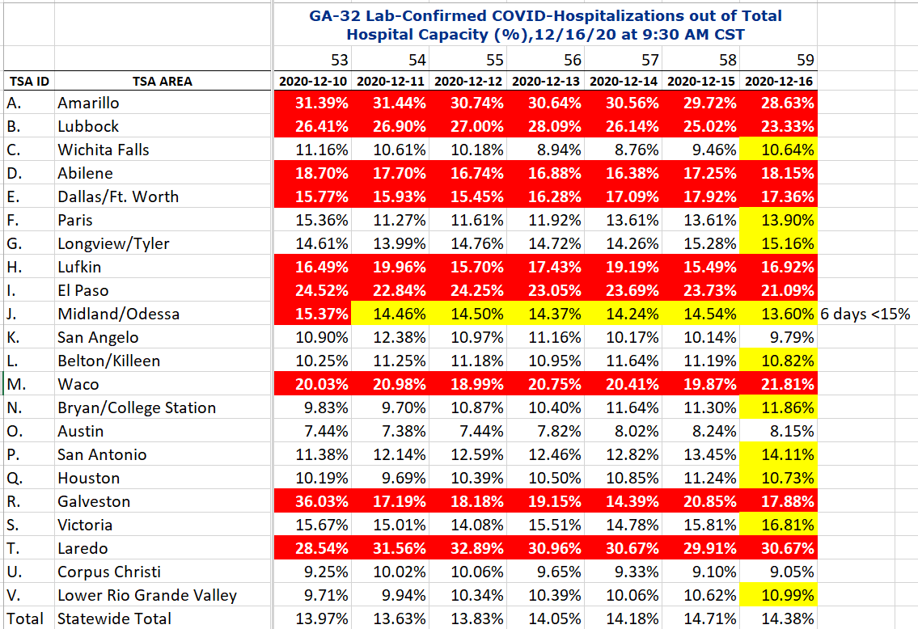
COVID+ HOSPITALIZATIONS BY TSA ID
CONFIRMED COVID+ HOSPITALIZATIONS /HOSPITAL CAPACITY

Slide 35
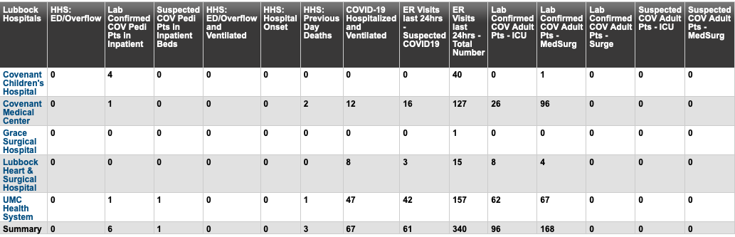
Lubbock This Morning
12/18: 270 Hospitalized in Lubbock – 67 on vents

Slide 36
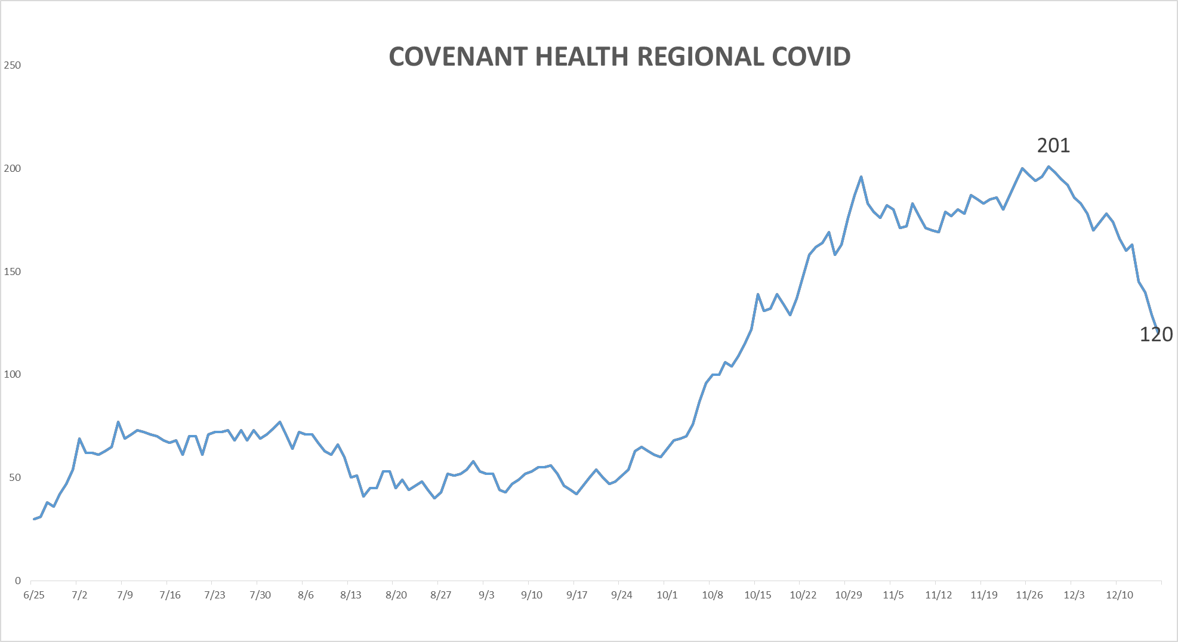
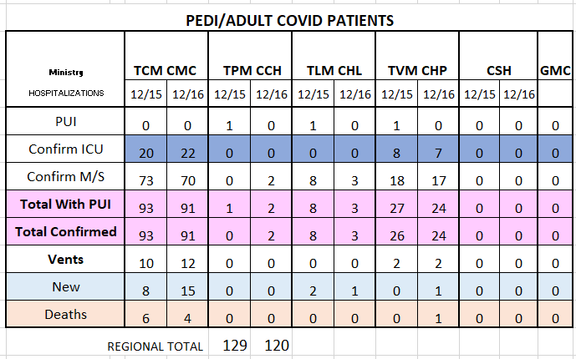
PUI/Confirmed cases-hospitalized COVID UNITS
12/16/2020

Slide 37
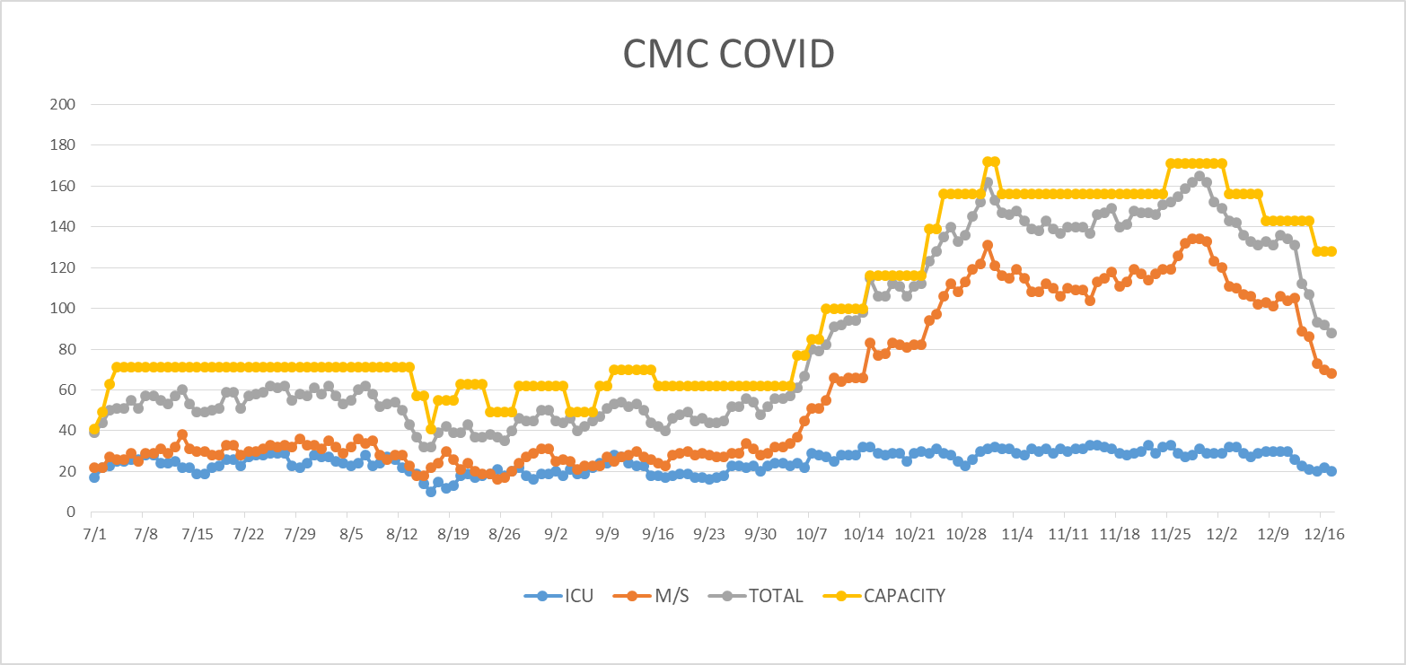
COVID Units - CMC
12/17/2020

Slide 38
Surge Plans

Slide 39
Surge Plan
Covenant Medical Center
 | ICU | Med Surg | Total
Phase 1 | 10-CICU |  | 10
Phase 2 | 17-CICU | 10-HC4 | 27
Phase 3 | 17-CICU | 24-HC4 | 41
Phase 4 | 17-CICU 8-MICU | 24-HC4 14-Pal Med | 63
Phase 5 | 17-CICU 16-MICU | 24-HC4 14-Pal Med | 71
Phase 6 | 17-CICU 16-MICU 15-S 4 | 24-HC4 13-HC6 15 – S 9 (East) | 100
Phase 7 | 17-CICU 16-MICU 15-S 4 | 24-HC4 13-HC6 31 – S 9 (all) | 116
Phase 8 | 8-E4 17-CICU 16-MICU 15-S 4 | 15-S 10(East) 24-HC4 13-HC6 31 – S 9 (all) | 139
Phase 9 | 16-E4 (all) 17-CICU 16-MICU 15-S 4 | 30 S10 (all) 24-HC4 13-HC6 31 – S 9 (all) | 162
Currently
Last Week

Slide 40
1 South Overflow at Children’s
Operational Phase
Opened Thursday 12/10
Beds- 24 beds
Patient type: Observation and Med-Surg acuity
Staff requested: RN, Respiratory Therapy
Will add Telemetry once VISI is installed
  Will accept tele patients from 7AM – 7PM
  Tuesday 12-15 VISI will be installed
Telehealth Coverage will be implemented within 2 weeks
Staff has been requested from the state to supplement our staff
Standing Down Utilization Due to Decreased Census

Slide 41
Statistics
Cristian Requenez, MS
Clinical Data Analyst
Clinical Excellence
Covenant Health

Slide 42
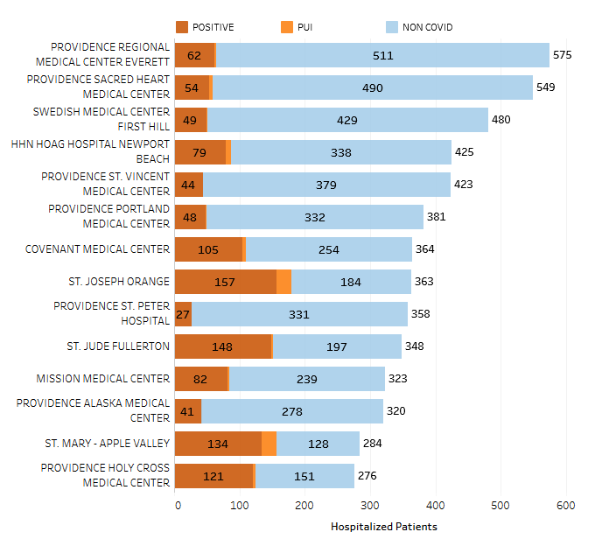
Providence System Hospitalized COVID-19 Cases

Slide 43
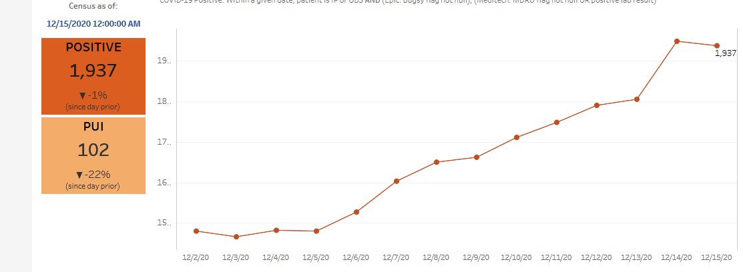
Providence Inpatient COVID-19 Volume

Slide 44
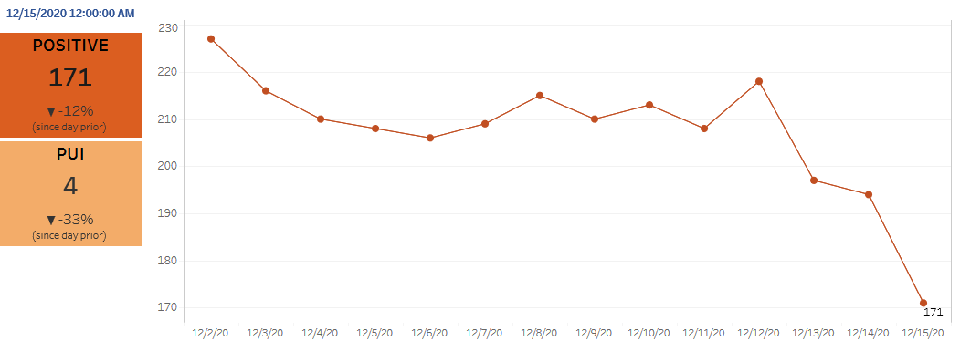
Texas Inpatient COVID-19 Volume

Slide 45
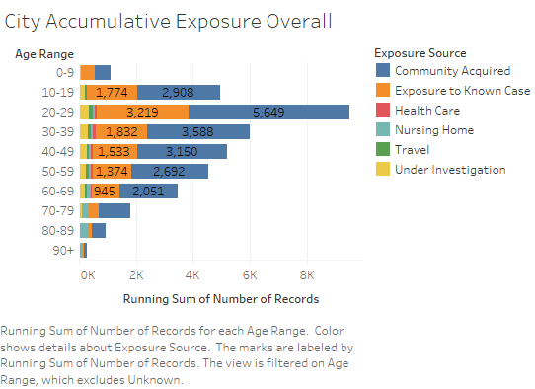
City Accumulative Exposure Overall

Slide 46
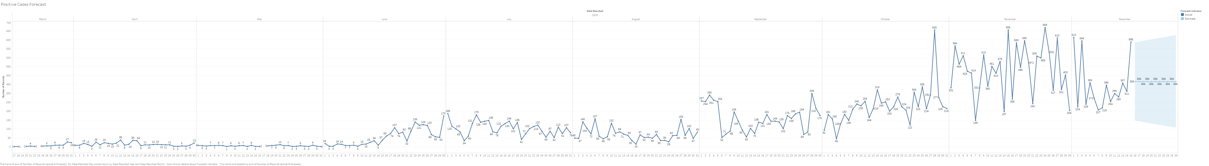
New Covid-19 POSITIVES by Day Forecast (City)

Slide 47
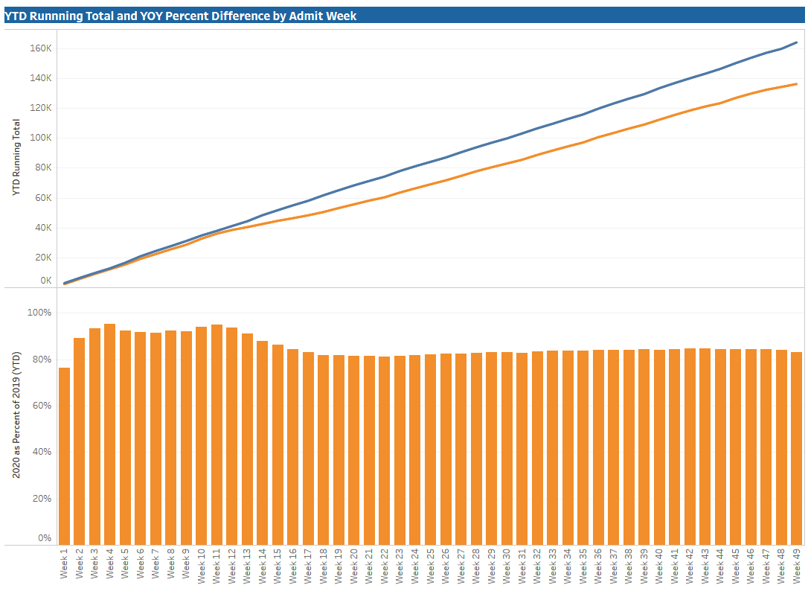
TX/NM Region Weekly Procedures (YOY)

Slide 48
Caregiver Update

Slide 49
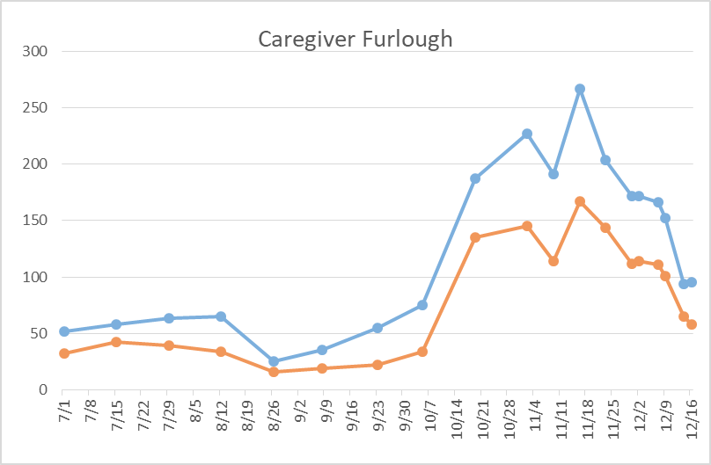
Caregivers
COVID Related Furloughs
61% are positive
Count reflects # furlough (exposed and positive)
Good
Moderate
Critical

Slide 50
Caregivers
Caregiver Testing
Tested to Date: 200 with 32.2 positivity rate
Week to date: 17% positivity rate

Slide 51
Covenant Outpatient Infusion Center Update

Slide 52
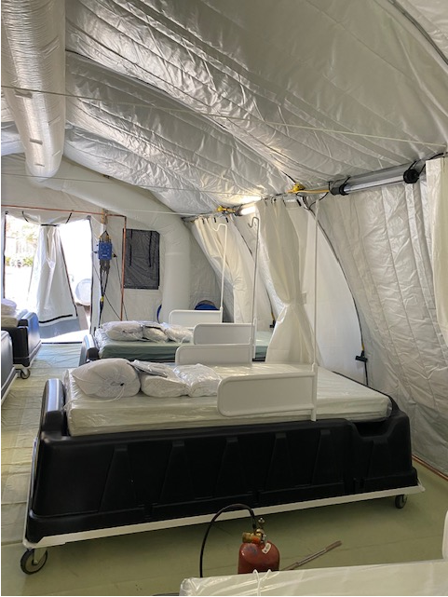
COVID Infusion Center
Status Update
20-23 per day for monoclonal antibodies and remdesivir
Starting work with city on referrals

Slide 53
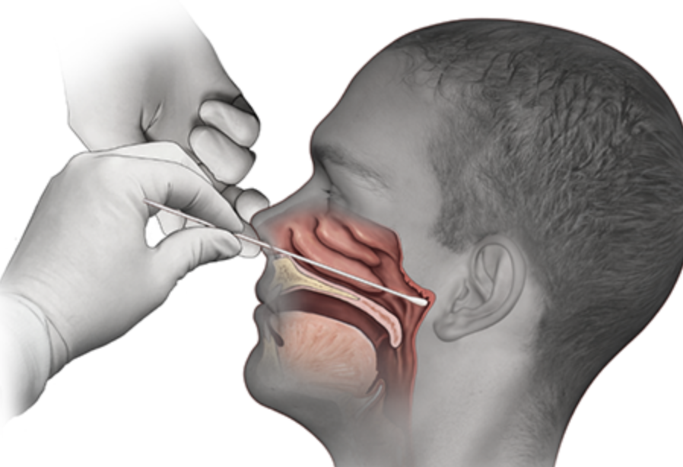
Covid-19 Testing
Jason T. Loos, MD
Ameripath

Slide 54
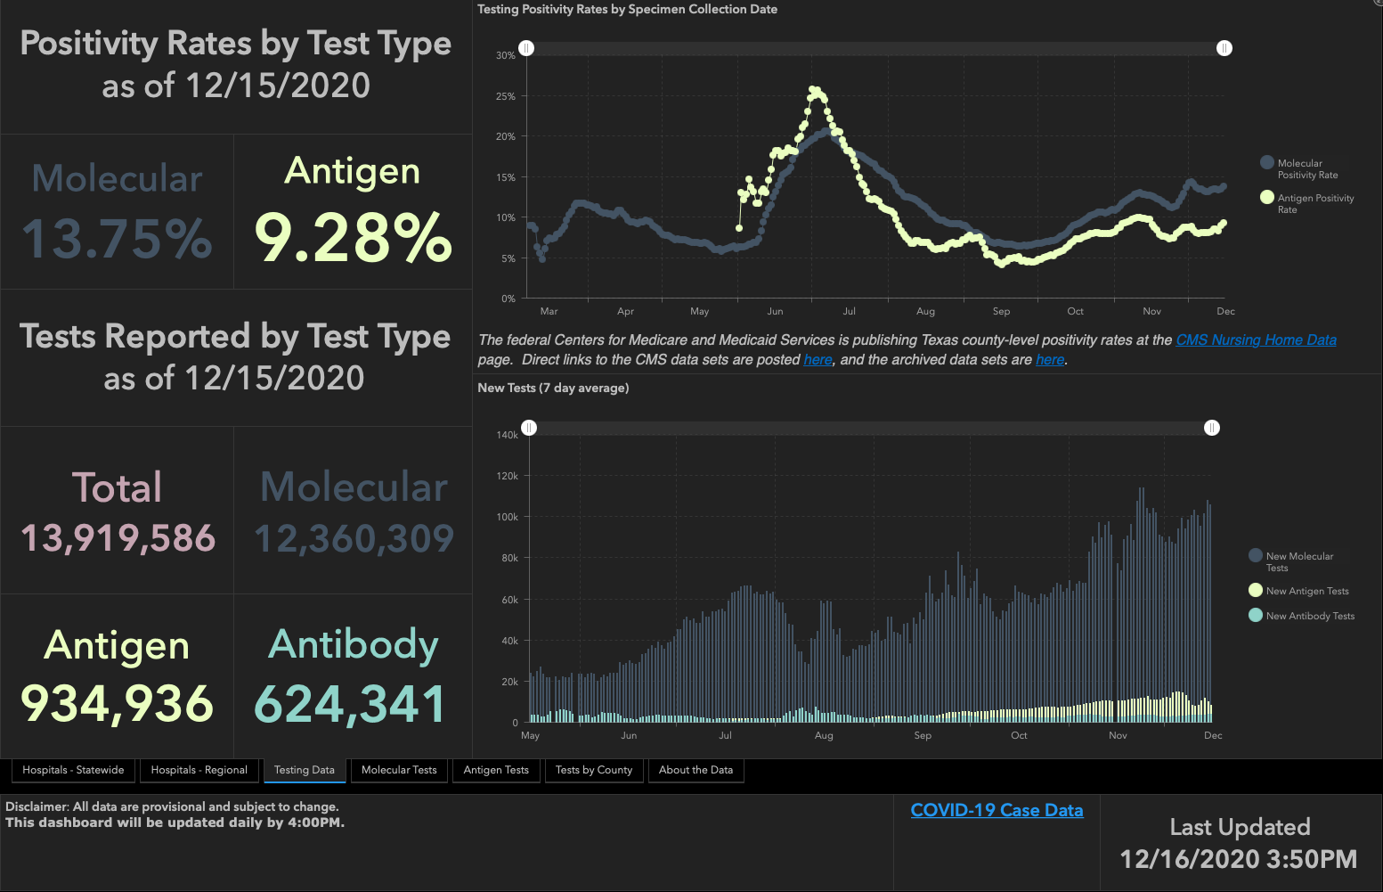

Slide 55
TESTING
 | CMC |  | GMC |  | CMG
 | Rapid | PCR | Rapid | PCR | Rapid
Test Kits
Swabs
VTM
 | CMC |  | GMG/CMG
 | Tests | + | Tests | +
12/14 | 50 | 10 | 58 | 12
12/15 | 180 | 13 | 201 | 46
12/16 | 172 | 6 | 102 | 28
PCR
Rapids
>2000 >750
<2000 <750
<1600 <500
CMC- Alinity off line, continuing to work with vendor
GMG- no issues
CMG- no issues

Slide 56
Inter-facility IC Transfer Form
City HD has requested that we complete this form for COVID patients that are transferred out from our hospitals.
Will start this next week.

Slide 57
Pharmacy Update
Wesley Wells, PharmD
Regional Pharmacy Director
Covenant Health
Larry Pineda, PharmD
Antimicrobial Stewardship Pharmacist
Covenant Health

Slide 58
Monoclonals
Bamlanimvimab
  Doses given = 97
  Inventory = 344
Casirivimab/Imdevimab
  Doses given = 21
  Inventory = 321
Updated screening form to qualify as an order
  Will treat under referring physicians
City is still ironing out the kinks of the
  Weighting patients

Slide 59
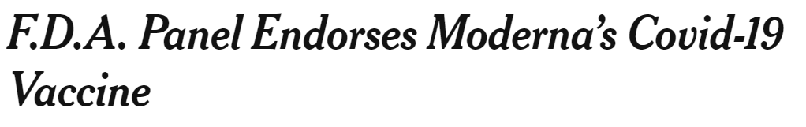
Moderna COVID Vaccine
FDA panel reviewed the Moderna vaccine for EUA approval yesterday
Expect official EUA approval soon with shipments going out next week

Slide 60
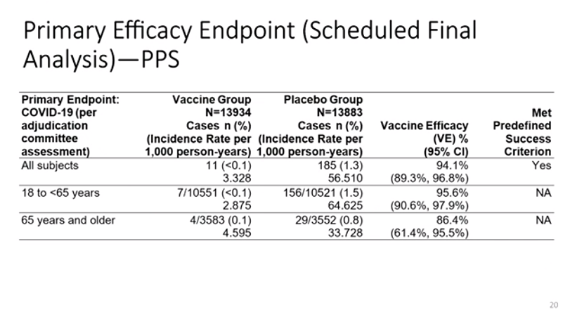
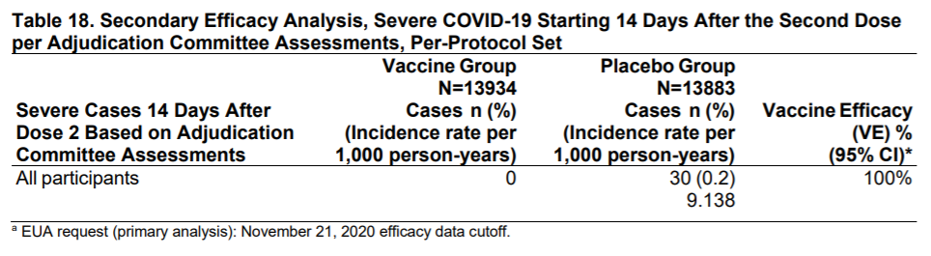
FDA Advisory Committee – Moderna
Similar efficacy as Pfizer BioNTech
Median 9 week follow up in this analysis
Small case numbers in 65 years and older limit interpretation
Wide confidence interval
Secondary outcome
No severe cases of COVID-19 in vaccine group
Notes:
Small case numbers and sample in the 65 year and older group limits interpretation of the lower, 86.4% efficacy.
Keep in mind powered for primary outcome, multiplicity adjustments not made for subgroup analysis.
The wide CI 61.4 to 95.5 supports this.

Slide 61
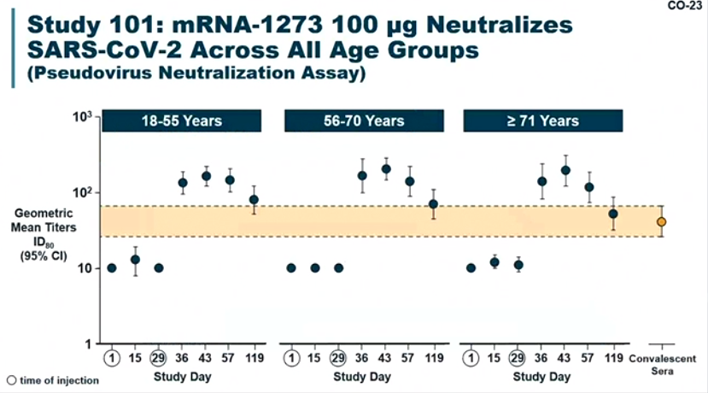
Immunogenicity – Moderna

Slide 62
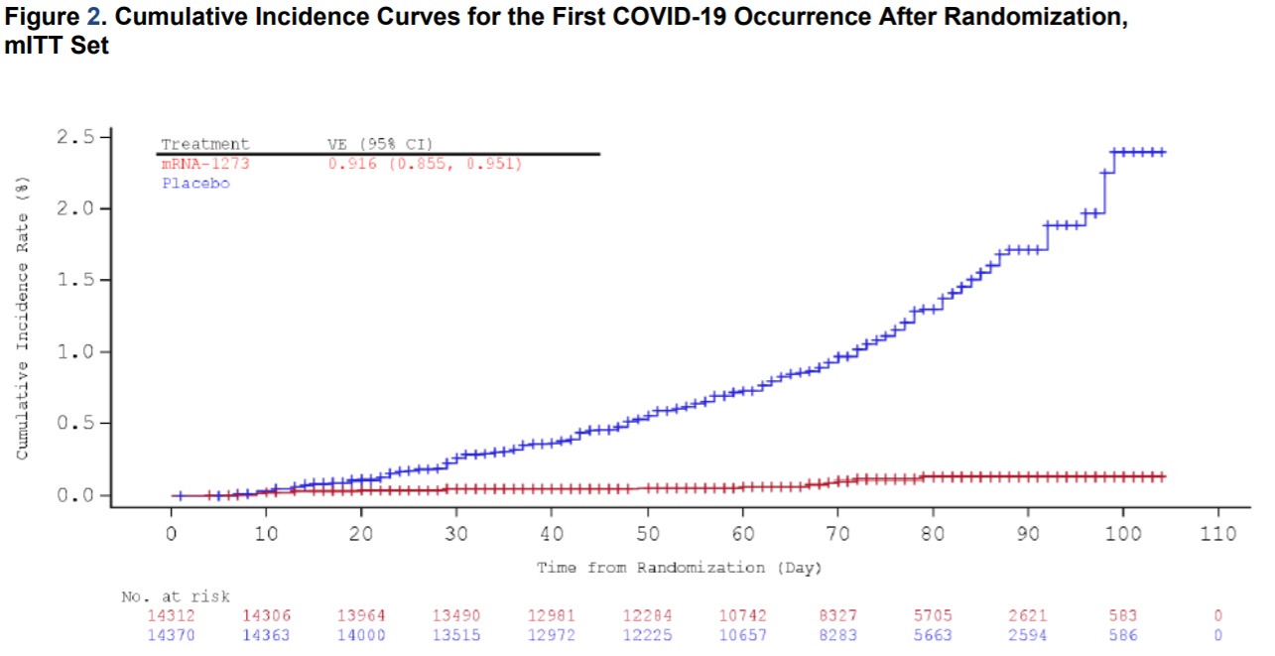
FDA Advisory Committee – Moderna
Dose 2
Dose 1

Slide 63
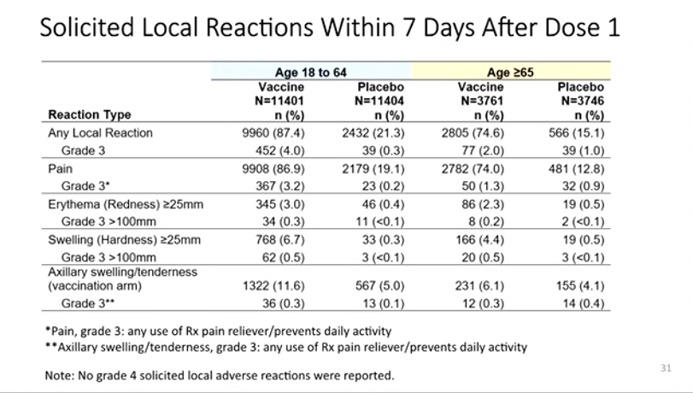
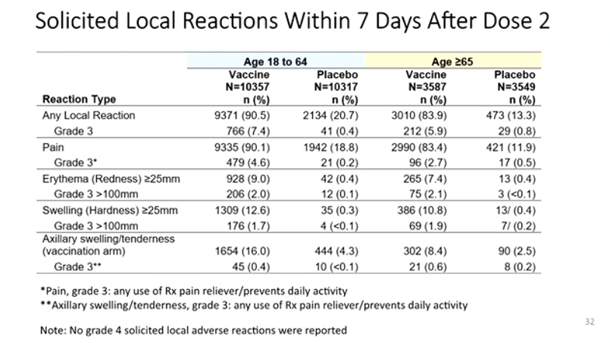
FDA Advisory Committee – Moderna
Notes:
Pain – Pfizer: 83,14 / 78,12
The majority of vaccine recipients (57.6%) reported onset of local AR on Day 1 while at home, and the median duration was 2 days after dose and 3 days after dose 2.

Slide 64
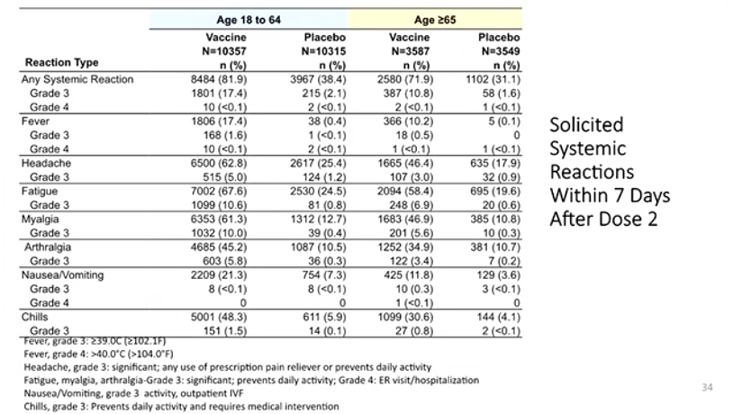
FDA Advisory Committee – Moderna
Onset 1-2 days, duration ~2 days
For comparison (Pfizer, dose 2 vs placebo%)
Fever 16%, 0%
Headache 52%, 24%
Fatigue 59%, 23%
Myalgia 37%, 8%
Arthralgia 22%, 5%
Chills 35%, 4%
More grade 4 fever reported with Moderna (significance?)
Notes:
Recall from last week, same thing with Pfizer is seen here with Moderna:
Younger more than older group (more immunogenicity)
More common with 2nd dose
One thing that is different is more grade 4s w Moderna
The majority of vaccine recipients reported onset of systemic AR while at home either on Day 1 (33.7%) or on Day 2 (37.0%), and the median duration after any dose was 2 days. Interestingly ~10% duration around 7 days!
Fever persisted beyond 7 days in 7 vaccine recipients and 4 placebo recipients, all of whom were in the younger age cohort. There were 2 vaccine recipients who reported grade 3 fever that persisted, and none in the placebo group.
No deaths attributed to vaccine

Slide 65
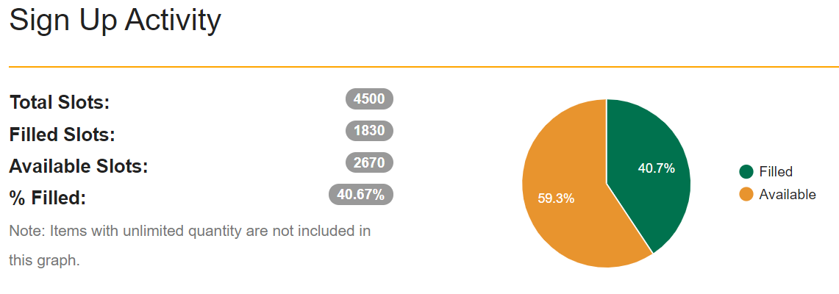
Vaccination Event
Date | 12/15 | 12/16 | 12/17 | 12/18 | 12/21 | 12/23
Doses/ Scheduled | 30 | 696 | 559 | 381 | 17 | 14
End of Day Inventory | 2895 | 2225 | 1800

Slide 66
Vaccine Update
No reports of zombie conversion
May get more than 5 doses out of a vial (6-7 doses)
1 patient had a severe allergic reaction
  Reported via V-safe tool
Sent out to 2 risk levels to help fill spots
Concerns with registration
  Julie Barclay can help add providers if they have access issues
UMC is expected to receive doses and kits on Thursday AM
  Full vaccination event starts Friday
Notified late Thursday that allocations are coming to Plainview and Levelland

Slide 67
We have been asked to do a video presentation on Vaccine FAQs that will be produced and distributed next week.

Slide 68
COVID-19 Vaccination Calendar and Update
Pending Cohort Distribution
Following VAV completion
Cynthia Salisbury RN, MSN, CPHQ, CPPS
CHIEF QUALITY OFFICER
COVENANT HEALTH

Slide 69

6,000-6,500 Vaccinations in December
Daily Schedule:
17th,18th,21st,22nd,23rd,28th,29th,30th
Set-up: 0700-0730
Vaccine Administration:
0730-1830
Wipe-down: 1840-1850
Lock-up: 1900
Group A
Vac 1
Daily Schedule: Dec. 31st
Set-up: 0700-0730
Vaccine Administration:
0730-1030
Wipe-down: 1040-1050
Lock-up: 1100
SOFTSTART Vac 1 - PM
Group A
Vac 1
Group A/B Vac 1 – Hold pending allotment receipt
Group B/C (Risk 5)
Vac 1
Group C/D (Risk 4)
Vac 1

Slide 70

Daily Schedule:
Set-up: 0700-0730
Vaccine Administration:
0730-1830
Wipe-down: 1840-1850
Lock-up: 1900
Group C/D (Risk 3 – Risk 2)
Vac 1
Group A
Vac 2
SOFTSTART Vac2
Group A
Vac 2
Group A / B
Vac 2 – HOLD, if needed
Group B / C (Risk 5)
Vac 2
Group C / D (Risk 4)
Vac 2
Group C/D (Risk 3 – Risk 2)
Vac 2
8,499 Caregivers fully vaccinated by January 27th

Slide 71

V-safe Reporting Tool

Slide 72

Texas Demographics

Slide 73


Slide 74


Slide 75


Slide 76
Q & A

Slide 77
CME Credit was only approved for the Live Teams meeting
To receive credit for this continuing education activity, the participant must:
  Make sure you are logged into your Teams account, if you are signed in with a group provide attendee’s First and Last name(s) in the comments section.
  If you are calling into the Teams meeting you MUST text your First & Last Name to (806) 252-4735. This will ensure you are added to the sign in sheet to receive CME Credit.
  You will receive an email by the following Wednesday from the CME department with further instructions on claiming your certificate.

