Slide 1
Covenant Health Presents Critical Communications: A Weekly Physician Update December 28, 2020

Slide 2
PHYSICIANS
Accreditation Statement:
The Covenant Health is accredited by the Texas Medical Association (TMA) to provide continuing medical education for physicians.
Credit Designation Statement:
The Covenant Health designates this live CME activity for a maximum of 1.0 AMA PRA Category 1 Credit(s)™. Physicians should claim only the credit commensurate with the extent of their participation in the activity.

Slide 3
Disclosures of Commercial Interest
The speakers and planners of this activity
have no relevant financial interests

Slide 4
Disclosures
This activity is provided by
Covenant Health
No commercial support has been received.
No products will be endorsed.
Speakers will notify the audience if off label drug use will be discussed.

Slide 5
CME Credit was only approved for the Live Teams meeting
To receive credit for this continuing education activity, the participant must:
Make sure you are logged into your Teams account, if you are signed in with a group provide attendee’s First and Last name(s) in the comments section.
If you are calling into the Teams meeting you MUST text your First & Last Name to (806) 252-4735. This will ensure you are added to the sign in sheet to receive CME Credit.
You will receive an email by Wednesday following the call from the CME department with further instructions on claiming your certificate.

Slide 6
Reflection
Craig D. Rhyne, MD FACS

Slide 7
The Premise
“Most important innovations –in modern times at least–arrive in clusters of simultaneous discovery”
He defines this as the
“Adjacent Possible”

Slide 8
The Adjacent Possible, and the things we take for granted
Natural “glass” was cloudy and tinted in color
Experimentation created “transparent” glass…light went right through
Without the discovery of GLASS
We wouldn’t have
transparent window panes
drinking “glasses”
Light refraction, color spectrums
Curved glass, created even more possibilities
Magnification

Slide 9
Magnification
Without magnification…
We would not be able to read beyond the age of about 40
We would not have any real knowledge of the solar system, the milky way (other than mythology), and the universe as a whole
We would not have microscopes
No knowledge of microbes
No knowledge of cell structures
No understanding of the germ theory of disease

Slide 10
The Adjacent Possible
Germ theory
Bacteria
Prions
Viruses
Without the discovery and refinement of glass, the world as we know it would not exist. One discovery has led to another, then another, then another…..and on and on!

Slide 11
The Adjacent Possible and Vaccine Development
These things had to “BE” before we could react as quickly as we have:
Watson and Crick’s discovery of DNA
Understanding of RNA as a product of ”signal” from DNA
Understanding of protein synthesis from mRNA
Knowledge of cell membranes
Mapping of genomes
Creation of the “INTERNET”
All of these led to the ADJACENT POSSIBLE for mRNA Vaccine production

Slide 12
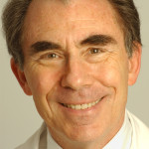
Covid-19 Vaccine
Anthony Komaroff, MD Editor in Chief, Harvard Health Letter
The Back Story
A Safety Message

Slide 13
Early steps toward mRNA vaccines
About 30 years ago, a handful of scientists began exploring whether vaccines could be made more simply. What if you knew the exact structure of the mRNA that made the critical piece of a virus’s protein coat, such as the spike protein of the COVID-19 virus?
It is relatively easy to make that mRNA in the laboratory, in large amounts. What if you injected that mRNA into someone, and the mRNA then traveled through the bloodstream to be gobbled up by immune system cells, and then those cells started to make the spike protein? Would that educate the immune system?

Slide 14
Overcoming obstacles in creating mRNA vaccines
While the concept seems simple, it required decades of work for mRNA vaccines to overcome a series of hurdles. First, scientists learned how to modify mRNA so that it did not produce violent immune system reactions. Second, they learned how to encourage immune system cells to gobble up the mRNA as it passed by in the blood. Third, they learned how to coax those cells to make large amounts of the critical piece of protein. Finally, they learned how to enclose the mRNA inside microscopically small capsules to protect it from being destroyed by chemicals in our blood.
Along the way, they also learned that, compared to traditional vaccines, mRNA vaccines can actually generate a stronger type of immunity: they stimulate the immune system to make antibodies and immune system killer cells — a double strike at the virus.

Slide 15
Then along came COVID-19
So, 30 years of painstaking research allowed several groups of scientists — including a group at Pfizer working with a German company called BioNTech, and a young company in Massachusetts called Moderna — to bring mRNA vaccine technology to the threshold of actually working. The companies had built platforms that, theoretically, could be used to create a vaccine for any infectious disease simply by inserting the right mRNA sequence for that disease.
Then along came COVID-19. Within weeks of identifying the responsible virus, scientists in China had determined the structure of all of its genes, including the genes that make the spike protein, and published this information on the Internet.

Slide 16
Within minutes, scientists 10,000 miles away began working on the design of an mRNA vaccine. Within weeks, they had made enough vaccine to test it in animals, and then in people. Just 11 months after the discovery of the SARS-CoV-2 virus, regulators in the United Kingdom and the US confirmed that an mRNA vaccine for COVID-19 is effective and safely tolerated, paving the path to widespread immunization. Previously, no new vaccine had been developed in less than four years.

Slide 17
No scientific breakthrough stands alone
Already, mRNA vaccines are being tested for other infectious agents, such as Ebola, Zika virus, and influenza. Cancer cells make proteins that also can be targeted by mRNA vaccines: indeed, recent progress was reported with melanoma. And theoretically, mRNA technology could produce proteins missing in certain diseases, like cystic fibrosis.

Slide 18
Like every breakthrough, the science behind the mRNA vaccine builds on many previous breakthroughs, including:
understanding the structure of DNA and mRNA, and how they work to produce a protein
inventing technology to determine the genetic sequence of a virus
inventing technology to build an mRNA that would make a particular protein
overcoming all of the obstacles that could keep mRNA injected into the muscle of a person’s arm from finding its way to immune system cells deep within the body, and coaxing those cells to make the critical protein
and information technology to transmit knowledge around the world at light-speed.

Slide 19
Covid-19 Vaccine

Slide 20
A NEW DAY HAS DAWNED

Slide 22
What is it, exactly?

Slide 23
What Type of Vaccine?

Slide 24
Will it become part of my DNA permanently ?
X

Slide 25
How is it given?

Slide 26
Does it matter which vaccine I get now and later?
≠

Slide 27
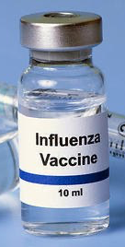
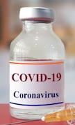
Can I get the Flu Shot and Coronavirus vaccines at the same time?

Slide 29
What if I have already had Covid-19?

Slide 30
What if I have it NOW?

Slide 31
What if I received Antibody Therapy? (B-MAB or Regeneron)

Slide 32
Can I take the Vaccine if I have a recent exposure?

Slide 34
What if I have a chronic medical condition?

Slide 35
I am immunocompromised…Does that exclude me?

Slide 36
Is it safe in Pregnancy?

Slide 37
I am currently breastfeeding…..can I still take the vaccine?

Slide 38
What are the side effects?

Slide 39
Does this vaccine really work?

Slide 40
What should I do AFTER I receive the vaccine?

Slide 41
What about the new strain identified in Great Britain?

Slide 42
SARS-CoV-2 VOC 202012/01 or B.1.1.7

Slide 43
Other Mutations in this Variant

Slide 44
Implications

Slide 46
Contraindications

Slide 47
It will take time for us to climb out of this hole

Slide 48
Current Regional Covid-19 Census

Slide 49
STATE
12/2 | 12/10 | 12/16 | 12/21 | 12/24
1,200,674 | 1,283,674 | 1,367,965 | 1,413,684 | 1,451,256
21,756 | 23,081 | 24,394 | 25,415 | 25,900
9,109 | 9,053 | 9,528 | 10,009
10,886
12/27
10,893
7/22
10,009
12/21
 | 11/30 | 11/16 | 11/04 | 10/21 | 10/5 | 9/23 | 9/9 | 8/26 | 8/12 | 7/29 | 7/15 | 7/1
Cases | 1,168,111 | 1,027,889 | 926,400 | 838,809 | 769,303 | 719,599 | 645,791 | 592,137 | 506,820 | 403,307 | 282,365 | 168,062
Deaths | 21,379 | 19,579 | 18,320 | 17,210 | 16,033 | 15,129 | 13,692 | 11,805 | 9034 | 6190 | 3432 | 2481
Hospitalized | 8900 | 7468 | 5,872 | 4,319 | 3,318 | 3,195 | 3604 | 4806 | 7028 | 9595 | 10,471 | 6904

Slide 50
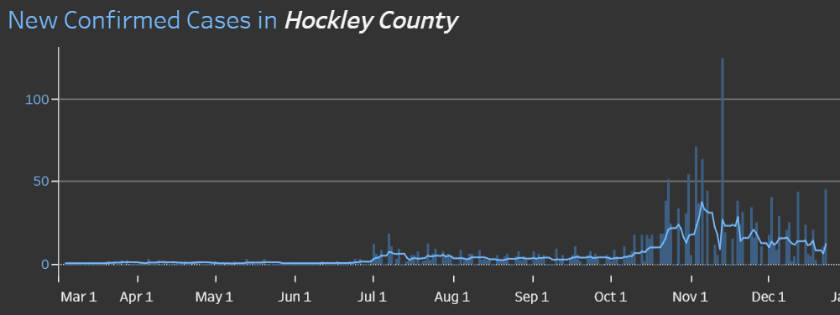
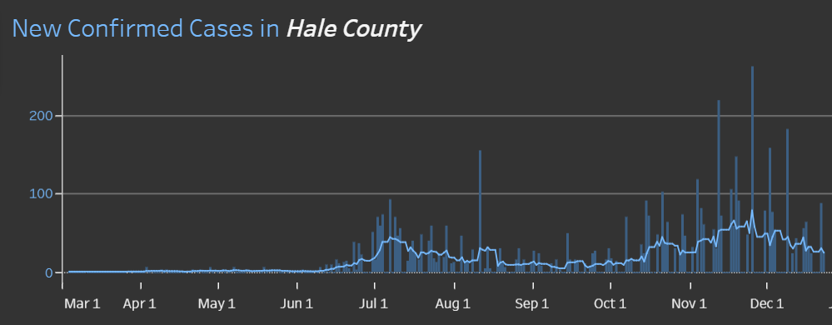
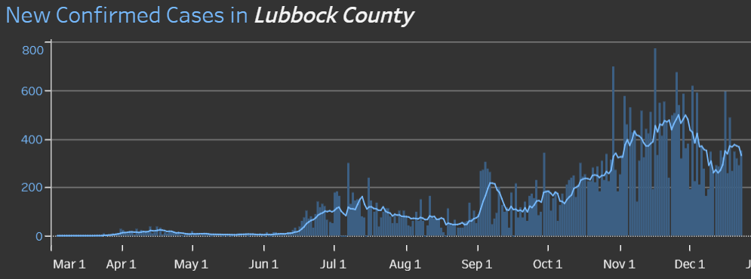
COUNTY
45 new 12/22
87 new 12/21
418 new 12/23
14.4 %
Positivity Rate

Slide 51
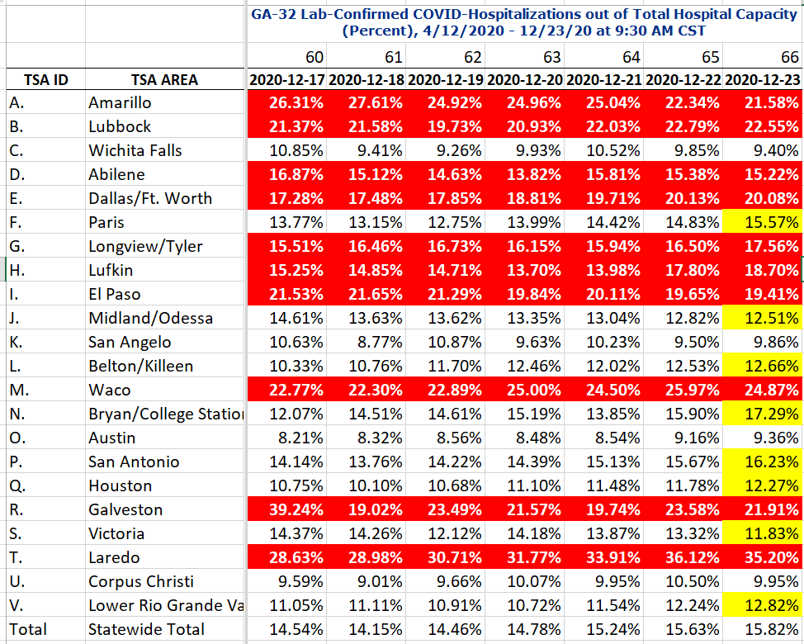
COVID+ HOSPITALIZATIONS BY TSA ID
CONFIRMED COVID+ HOSPITALIZATIONS /HOSPITAL CAPACITY

Slide 52
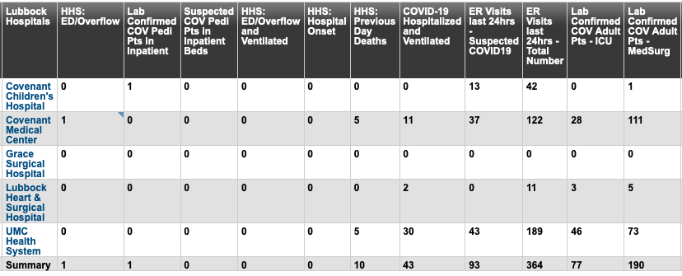
Lubbock This Morning
12/28: 268 Hospitalized in Lubbock – 43 on vents

Slide 53
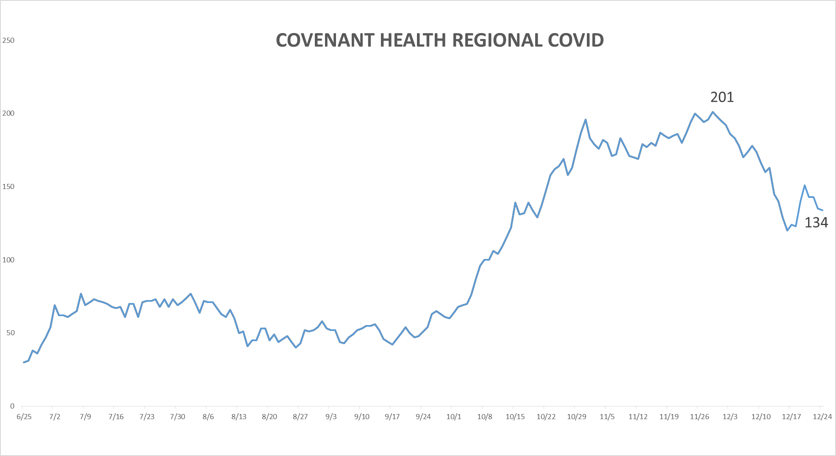
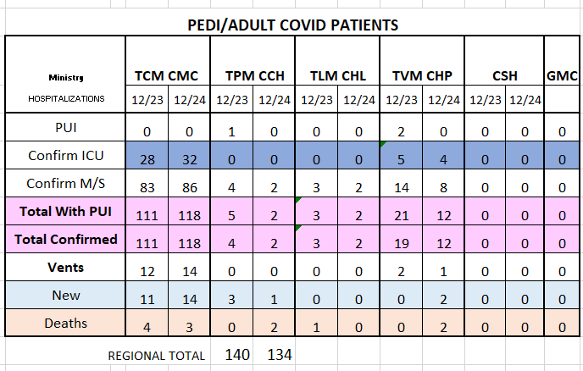
PUI/Confirmed cases-hospitalized COVID UNITS
12/24/2020

Slide 54
Surge Plans

Slide 55
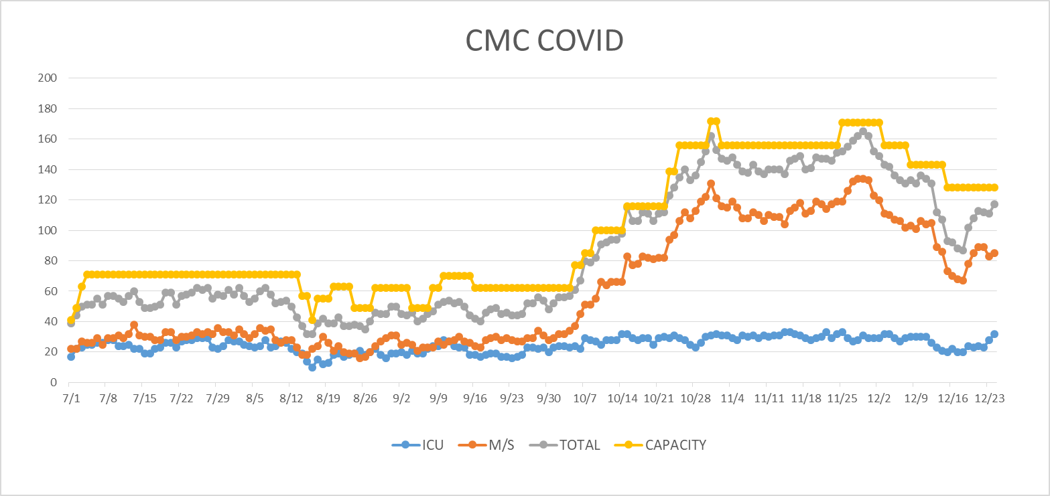
COVID Units - CMC
12/24/2020

Slide 56
Surge Plan
Covenant Medical Center
 | ICU | Med Surg | Total
Phase 1 | 10-CICU |  | 10
Phase 2 | 17-CICU | 10-HC4 | 27
Phase 3 | 17-CICU | 24-HC4 | 41
Phase 4 | 17-CICU 8-MICU | 24-HC4 14-Pal Med | 63
Phase 5 | 17-CICU 16-MICU | 24-HC4 14-Pal Med | 71
Phase 6 | 17-CICU 16-MICU 15-S 4 | 24-HC4 13-HC6 15 – S 9 (East) | 100
Phase 7 | 17-CICU 16-MICU 15-S 4 | 24-HC4 13-HC6 31 – S 9 (all) | 116
Phase 8 | 8-E4 17-CICU 16-MICU 15-S 4 | 15-S 10(East) 24-HC4 13-HC6 31 – S 9 (all) | 139
Phase 9 | 16-E4 (all) 17-CICU 16-MICU 15-S 4 | 30 S10 (all) 24-HC4 13-HC6 31 – S 9 (all) | 162
Currently
Last Week

Slide 57
Statistics
William Sommer
Clinical Data Analyst
Quality and Clinical Data Analytics
Covenant Health

Slide 58
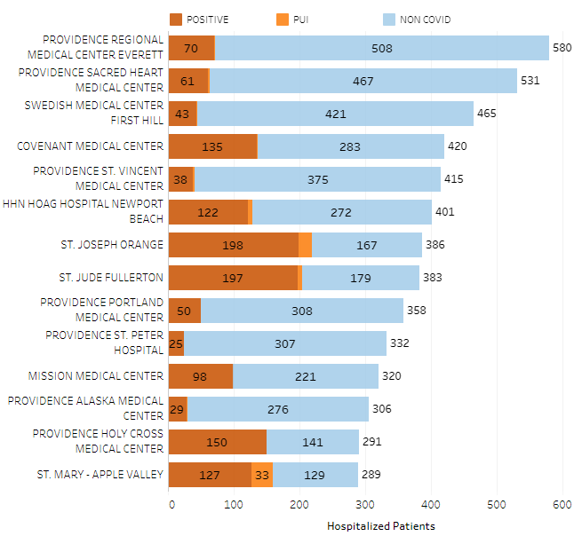
Providence System Hospitalized COVID-19 Cases

Slide 59
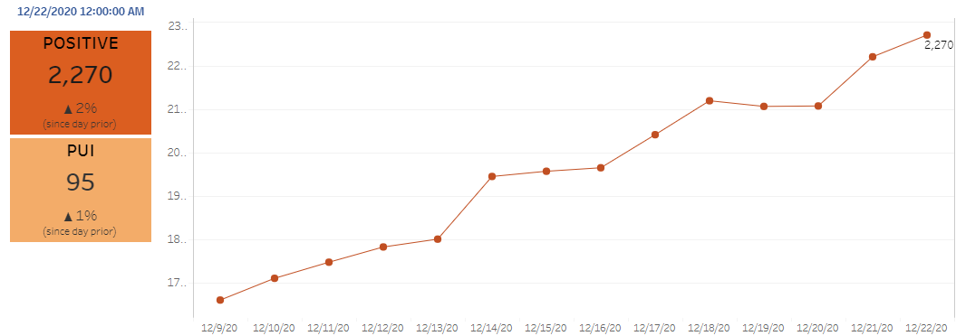
Providence Inpatient COVID-19 Volume

Slide 60
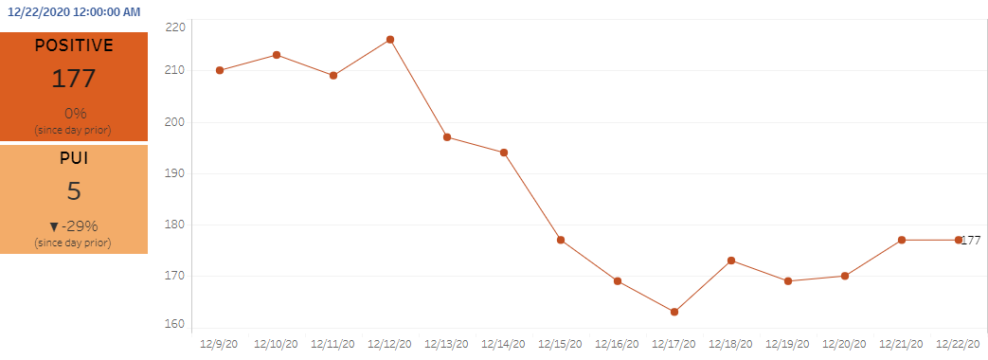
Texas Inpatient COVID-19 Volume

Slide 61
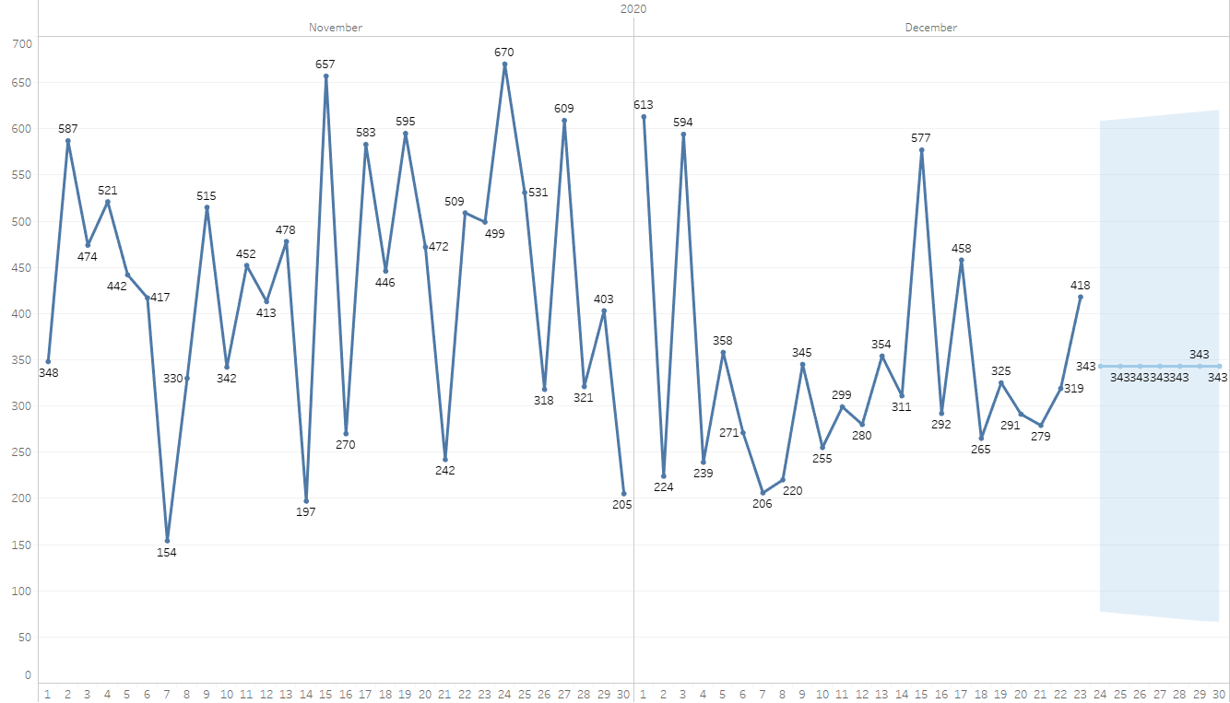
New Covid-19 POSITIVES by Day Trend

Slide 62
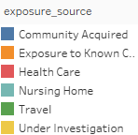
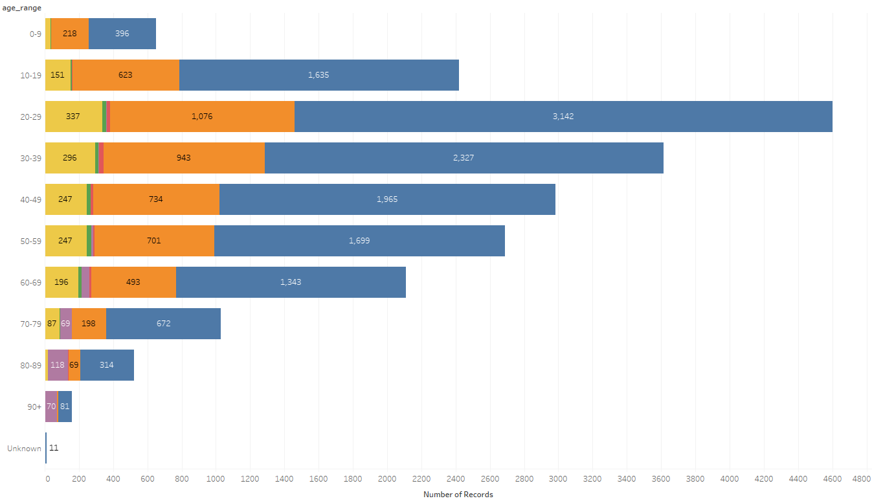
Covid-19 POSITIVES Age Distribution

Slide 63
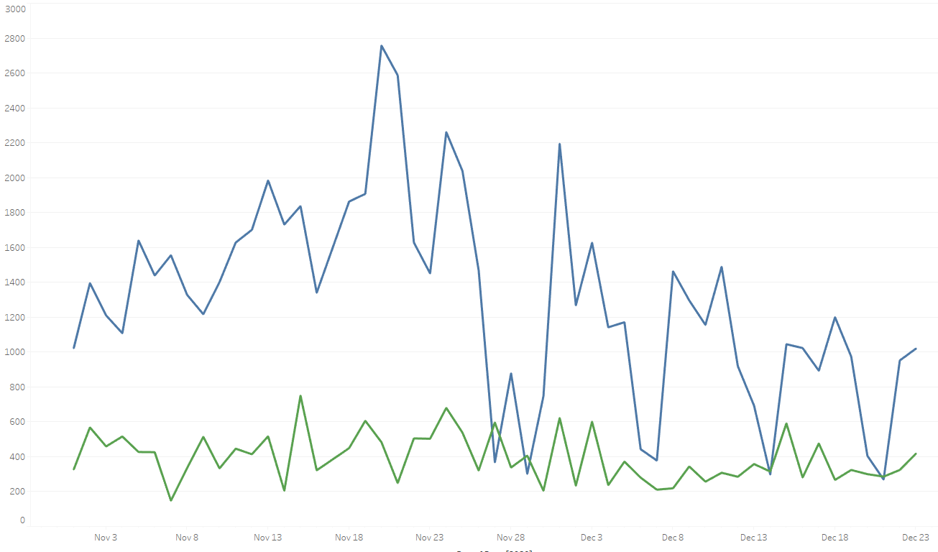
Covid-19 Daily Tests Performed

Slide 64
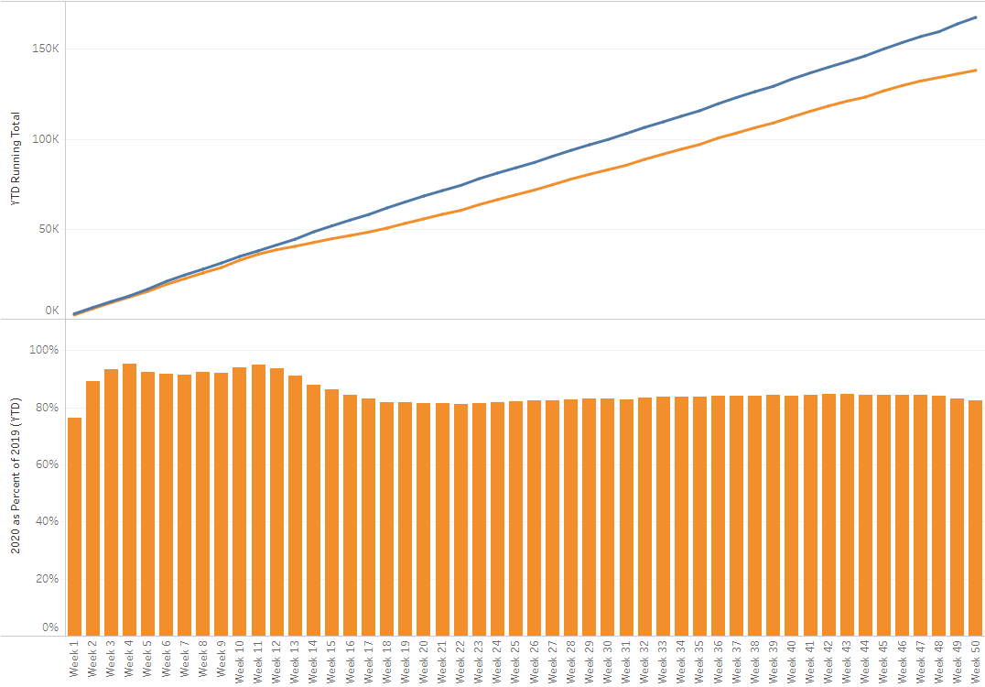
TX/NM Region Weekly Procedures (YOY)

Slide 65
Covenant Outpatient Infusion Center Update

Slide 66
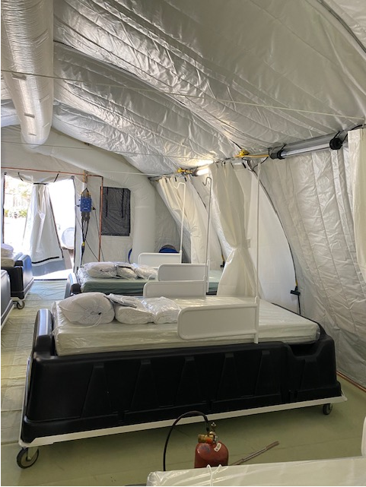
COVID Infusion Center
Status Update
Partnering with Adult Ed and have kept 3 patients from needing a hospital admission
City patients treated as well

Slide 67
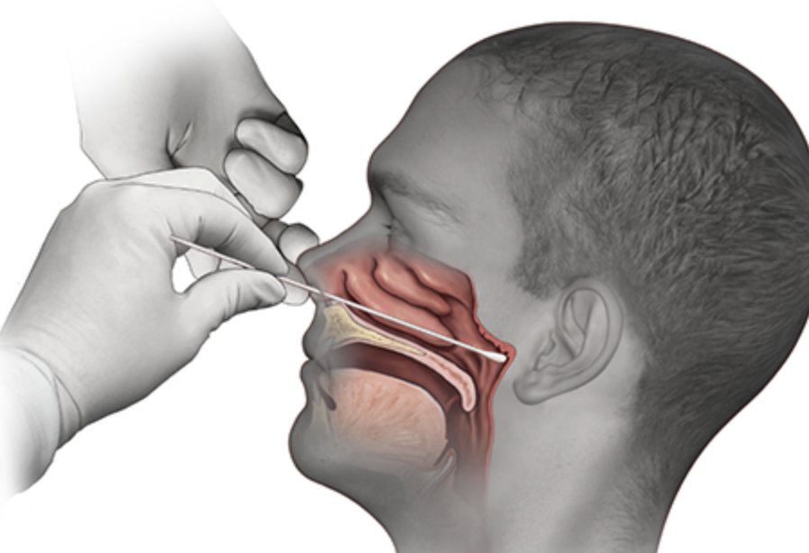
Covid-19 Testing

Slide 68
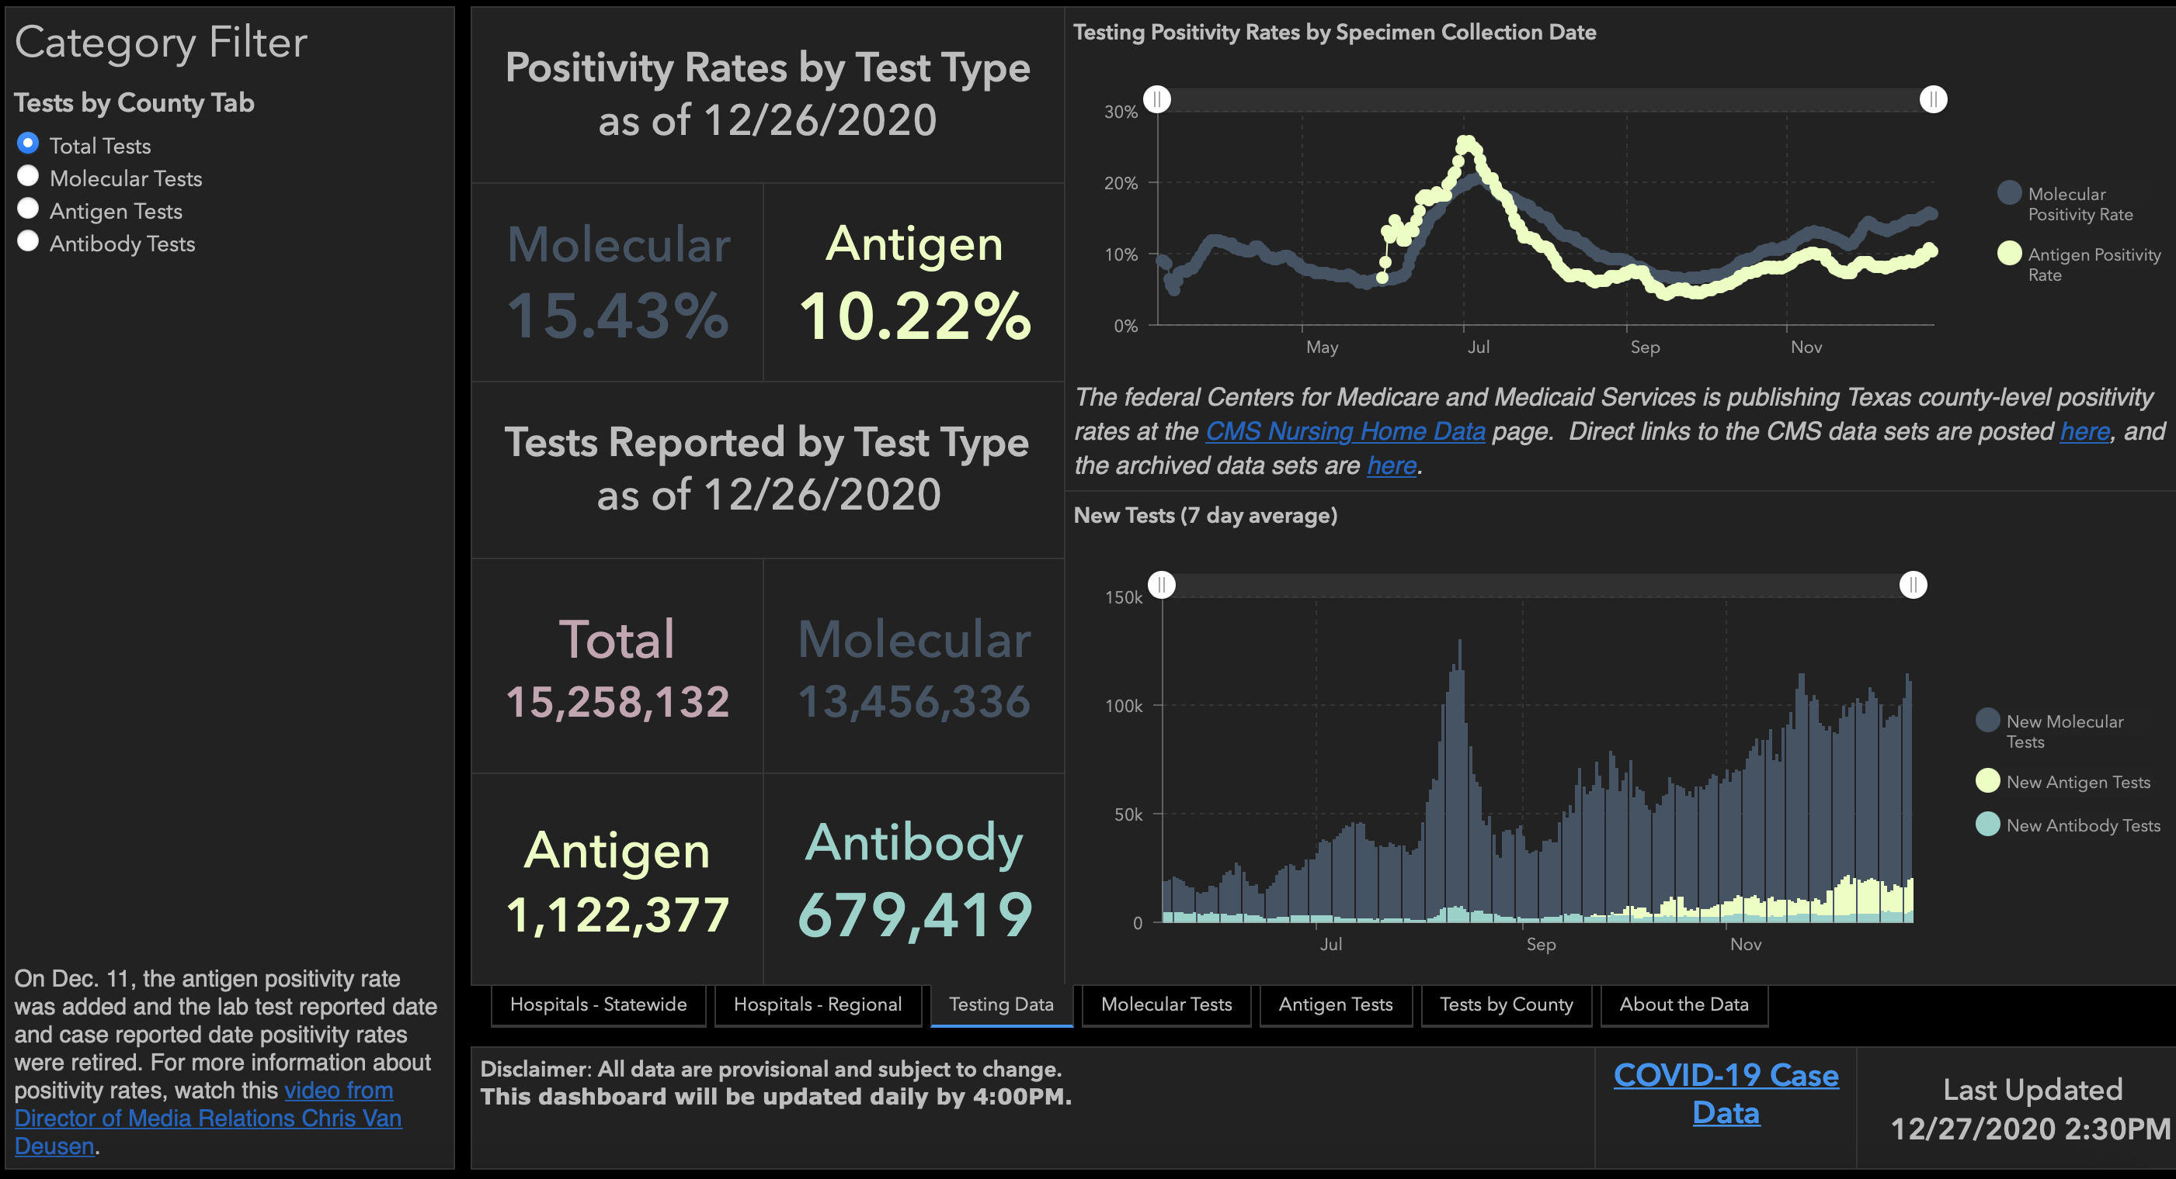

Slide 69
TESTING
 | CMC |  | GMC |  | CMG
 | Rapid | PCR | Rapid | PCR | Rapid
Test Kits
Swabs
VTM
 | CMC |  | GMG/CMG
 | Tests | + | Tests | +
12/21 | 95 | 14 | 24 | 3
12/22 | 239 | 41 | 177 | 48
12/23 | 217 | 33 | 179 | 49
PCR
Rapids
>2000 >750
<2000 <750
<1600 <500
CMC- Alinity back online
GMG- no issues
CMG- no issues

Slide 70
Pharmacy Update
Wesley Wells, PharmD
Regional Pharmacy Director
Covenant Health
Tyler Wood, PharmD
CMC Clinical Pharmacy Supervisor
Covenant Health

Slide 71
Therapeutics Update
Medication | Current State |  | Updates/Issues
Remdesivir |  |  | We have dispensed 222 vials to the COVID tent Quality team has been instrumental in ImmTrac documentation
Bamlanivimab (Lilly) |  |  | City Access: Working on weighting and centralized database
Casirivimab and Imdevimab (Regeneron) |  |  | City Access: Working on weighting and centralized database
Zanubrutinib | Patients Enrolled: 6 | Active Patients: 0 | No updates
Regeneron 2066 | Patients Enrolled: 3 (4 screened) |  | No updates
Ministry | Vials Used on 12/23 | Stock
Covenant Medical Center | 51 | 257
Covenant Children’s Hospital | 0 | 34
Covenant Plainview | 5 | 135
Covenant Levelland | 0 | 70
Home Infusion | 5 | 18
Ministry | Total Doses Infused | Stock
CMC/Home Infusion | 220 | 220
Covenant Plainview | 8 | 49
Covenant Levelland | 1 | 19
Ministry | Total Doses Infused | Stock
CMC/Home Infusion | 35 | 451
Covenant Plainview | 0 | 37

Slide 72
EXIT COVID-19 Trial
ExoFloTM Infusion Treatment for COVID-19 Associated ARDS
Multicenter, double-blinded, placebo-controlled, randomized control trial
Phase 2 trial to evaluate the safety and efficacy of IV administration of bone marrow mesenchymal stem cell (bmMSC) derived extracellular vesicles (ExoFlo™) versus placebo as treatment for moderate-to-severe Acute Respiratory Distress Syndrome (ARDS) in patients with severe COVID-19
Extracellular vesicles contain panopoly of paracrine signaling factors that promote repair and regeneration of alveolar tissue damaged by SARS-Cov-2 leading to ARDS

Slide 73
EXIT COVID-19 Trial
Enrolling 75 patients at up to 15 sites
Endpoints
Primary: Median time to recovery (SpO2 ≥ 93% on room air or pre-COVID SpO2 and O2 support2)
Secondary: Improvement in PaO2/FiO2, incidence of side effects, all-cause mortality
Three study arms
100 ml NS over 1 hr on days 1 and 4 (Placebo)
ExoFlo 10 ml + 90 ml NS over 1 hr on days 1 and 4*
ExoFlo 15 ml + 85 ml NS over 1 hr on days 1 and 4*
Notes:
Treatment doses calculated based on a per-kg analysis of Phase 1 and START trial. Re-dosing strategy developed on the observation that favorable biomarkers peaked at about 72 hours and those who recovered had a sustained response. Those who did not recover appeared to have “lost the effect” after 72-96 hours.
Pharmacokinetics studies of the IP in patients with severe COVID-19 are ill advised as it would require not only fluorescent tagging of surface proteins of the IP, but also serial MRI analysis of the biodistribution of immunofluorescence. Sending a patient with severe COVID-19 for serial MRI scans is neither practical nor safe, especially considering the progressing hypoxemia in many of these patients. Therefore, our previous proof-of-concept study focused on exploratory endpoints in order to observe a time-dependent effect—in this study, 23 out of 24 patients showed a favorable trend in biomarkers within 48-72 hours, with the peak of the favorable biomarkers and PaO2/FiO2 occurring closer to 72 hours following the first infusion of the IP. Seventeen (17) out of the 23 initial responders had a sustained response following a single dose of the IP whereas the remaining 6 appeared to have “lost the effect” after 72-96 hours, suggesting that a second dose at day = 4 may have been helpful in improving clinical outcomes.

Slide 74
Inclusion Criteria*
Male or female, aged 18-85 years
COVID-19 positive as defined by positive RT-PCR SARS-CoV-2 test
Moderate-to-severe ARDS as defined by modified Berlin definition:
Timing within 1 week of known clinical insult or new or worsening respiratory symptoms
Bilateral opacities not fully explained by effusions, or lung collapse
Respiratory failure not fully explained by cardiac failure or fluid overload
PaO2/FiO2 ≤ 200 mmHg.
Hypoxia requiring noninvasive oxygen support such as nasal cannula, nonrebreather, BIPAP, CPAP, high flow nasal cannula or mechanical ventilation despite initiating standard of care

Slide 75
Exclusion Criteria
Pregnancy
Age < 18 years
Severe physical or mental disabilities who cannot provide meaningful consent
Active malignancy requiring treatment within the last 5 years
Major physical trauma in last 5 days
Active tuberculosis or cystic fibrosis
Severe chronic respiratory disease including COPD or PF requiring home oxygen >5L/min
Use of ECMO during current admit
Pre-existing PAH
Severe pre-existing hepatic impairment
Pre-existing CKD stage IIIb or ESRD prior to onset of COVID-19
Irreversible coagulopathy
Non-COVID-19 related pneumonia
Patients who are not full code
Endotracheal intubation ≥72 hours
Moribund - expected survival less than 24 hours
Severe metabolic disturbances on presentation

Slide 76
EXIT COVID-19 – Background
COVID-induced lung injury
SARS-CoV-2 spike protein binds and gains entry in cells via ACE-2
ACE-2 normally converts (thereby inactivating) angiotensin II
Angiotensin II has vasoconstrictive, pro-inflammatory, pro-fibrotic, pro-thrombotic, and pro-oxidative properties
When SARS-CoV-2 binds ACE-2, ACE-2 is downregulated, and angiotensin II accumulates leading to in COVID-19 which leads to inflammation, oxidative stress, fibroblastic plugs, etc.
Result is diffuse alveolar damage seen with COVID-19-associated ARDS

Slide 77
EXIT COVID-19 – Background (cont.)
Mesenchymal Stem Cells (MSCs)
MSCs in bone marrow promote hospitable microenvironment enabling proliferation and maturation of hematopoeitic stem cells
MSCs downregulate inflammation and upregulate repair and regeneration
This is done via intercellular signaling which is accomplished through secretion of extracellular vesicles (exosomes) containing chemokines and other paracrine agents (not through engraftment or differentiation into target tissue)
The potential of ExoFlo™ is the ability to harness the effector mechanism of MSCs without the need to transplant stem cells which carries risks (such as GVHD)
Each mLof ExoFlo™ contains ~80 billion extracellular vesicles and is comprised of over 2000 different anti-inflammatory cytokines, anti-oxidative, pro-regenerative, tumor suppressor, and antimicrobial agents

Slide 78
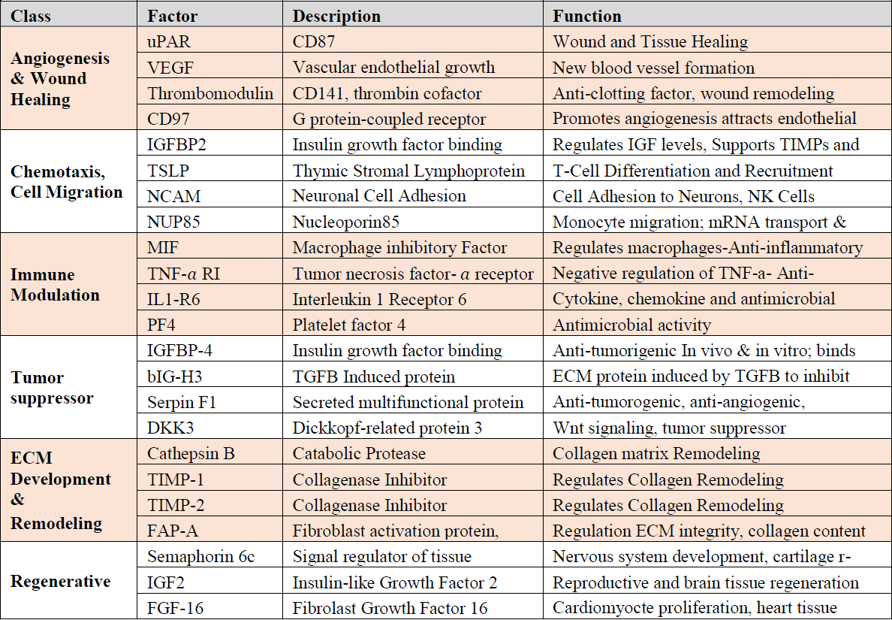
EXIT COVID-19 – Background (cont.)
Composition of vesicles
Each mL of ExoFlo™ contains ~80 billion extracellular vesicles
2000 different signaling factors

Slide 79
EXIT COVID-19 – Phase 1 Results
Phase 1 was single arm open label study involving 24 patients with moderate-to-severe COVID-associated ARDS
20 patients (83%) had type II diabetes
11 patients (46%) had pre-enrollment PaO2/FiO2ratio consistent with moderate ARDS
13 patients (54%) had severe ARDS
All patients received a single dose of 15 mL of ExoFlo™
17 of the 24 patients (71%) recovered and were discharged within a mean duration of 5.6 days
No serious ADEs noted

Slide 80
Vaccine Update
Total Administered: 3,249 doses
Inventory: 261 vials or 1,566 doses (6 doses per vial)
Pressure from State to aggressively vaccinate – even outside of organization
Need more people coming through
Date | 12/15 | 12/16 | 12/17 | 12/18 | 12/21 | 12/22 | 12/23
Doses/ Scheduled | 30 | 705 | 557 | 566 | 707 | 398 | 321
Date | 12/28 | 12/29 | 12/30
Doses/ Scheduled | 58 | 78 | 33

Slide 81
Moderna Distribution
Moderna distribution delayed this week
All orders held last Monday night to address issue with data loggers
Facility | Allocation (Doses) | Notes
Covenant Medical Center | 700 | Allocated for week 3
Covenant Children’s | 700 / 100 | 700 Received on 12/23, 100 for week 3
Covenant Health Plus | 500 | Received on 12/23
CMG Northwest Clinic | 400 | Received on 12/23
CMG Southwest Clinic | 3,000 | Received on 12/23
Covenant Plainview | 1,000 | Received on 12/23
Covenant Levelland | 200 | Delayed – possibly 12/28 or 12/29
Covenant Retail Pharmacy | 400 | Delayed – possibly 12/28 or 12/29
Family First | 400 | Unknown

Slide 82
Target Population

Slide 83
Target Population

Slide 84
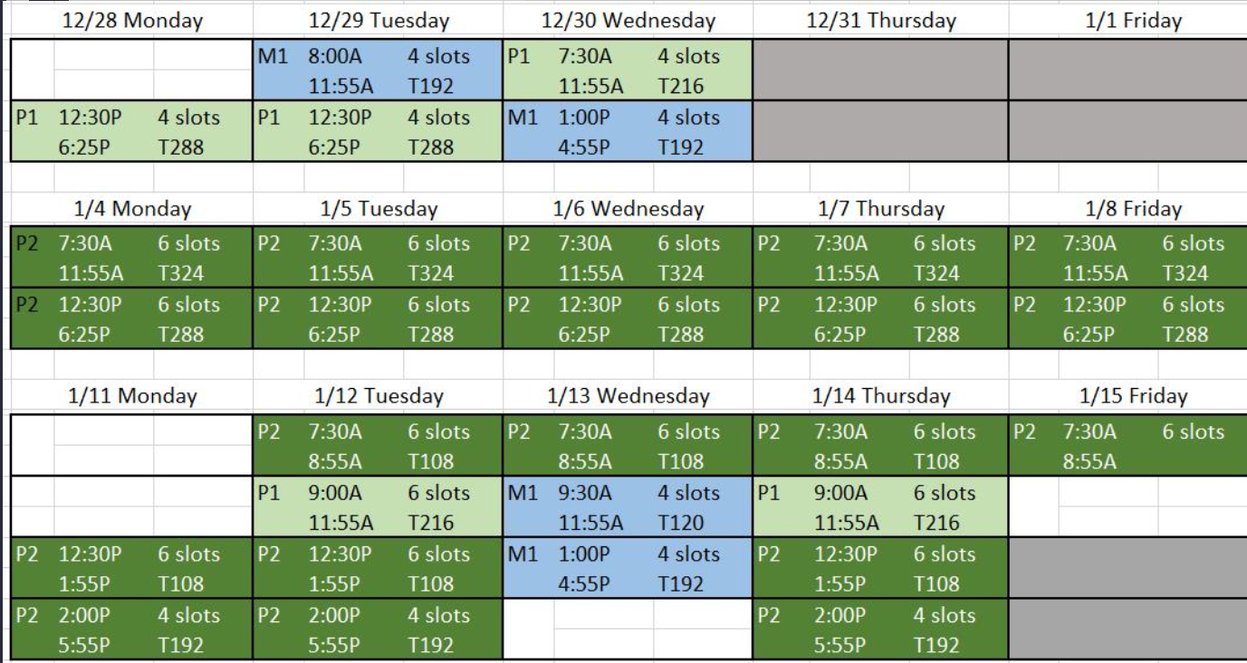
Vaccination Schedule
Notes:
[23:13] Kenady, Cynthia added this so you could show the plan. I talked with Cynthia tonight as we expect the volume of physician clinics continue to grow as the word gets around. I added more slots on 12/29 and 12/30 from 3 to 4 each 5 min. that gives us 384 and i am expanding the 1/13 to give us a total of 696. We will need more than that. Will add more as needed.

Slide 85
Vaccine Update
City Health Department
Received 1000 Moderna Doses
Planned event on 12/28
15 vaccinators performing 100 shots an hour
Target law enforcement, fire department, home health workers
Partnering with United to provide Doses
Long-term care facilities should be covered by CVS and Walgreens
We can support other healthcare workers if not covered
CMG and Grace are working on plans for phase 1b distribution

Slide 86
Target Population

Slide 87
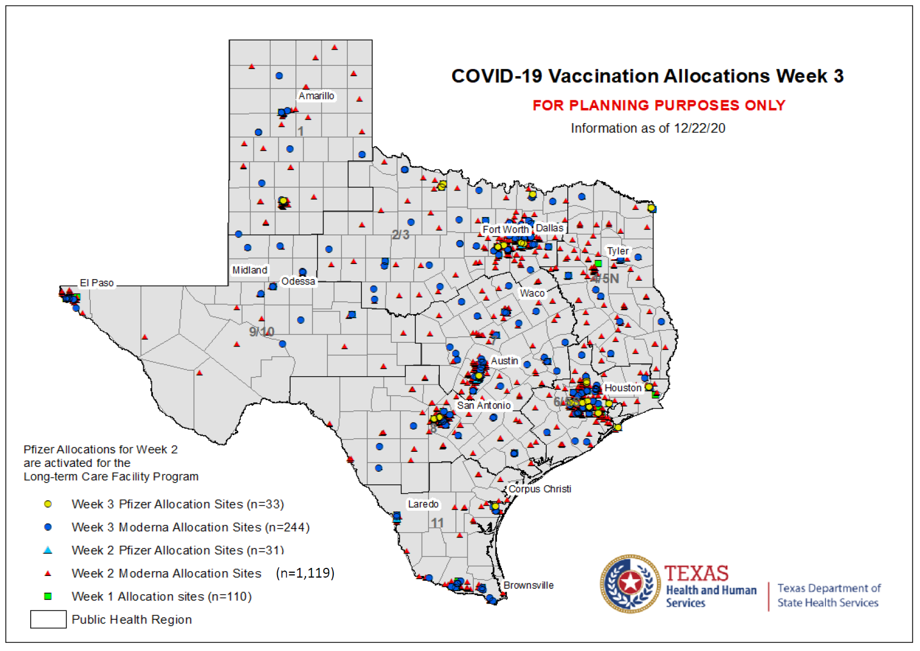
Vaccine Update
Dr. Rhyne created a video to address COVID concerns
Buttons have arrived – will send out
Working on redistribution agreements to make documentation easier
Limited by needles, syringes, and man-power
Asking assistance from community partners

Slide 88
COVID-19 Vaccination Calendar and Update
Pending Cohort Distribution
Following VAV completion
Cynthia Salisbury RN, MSN, CPHQ, CPPS
CHIEF QUALITY OFFICER
COVENANT HEALTH

Slide 89
6,000-6,500 Vaccinations in December
Daily Schedule:
17th,18th,21st,22nd,23rd,28th,29th,30th
Set-up: 0700-0730
Vaccine Administration:
0730-1830
Wipe-down: 1840-1850
Lock-up: 1900
Group A
Vac 1
Daily Schedule: Dec. 31st
Set-up: 0700-0730
Vaccine Administration:
0730-1030
Wipe-down: 1040-1050
Lock-up: 1100
SOFTSTART Vac 1 - PM
Group A
Vac 1
Group A/B Vac 1 – Hold pending allotment receipt
Group B/C (Risk 5)
Vac 1
Group C/D (Risk 4)
Vac 1

Slide 90
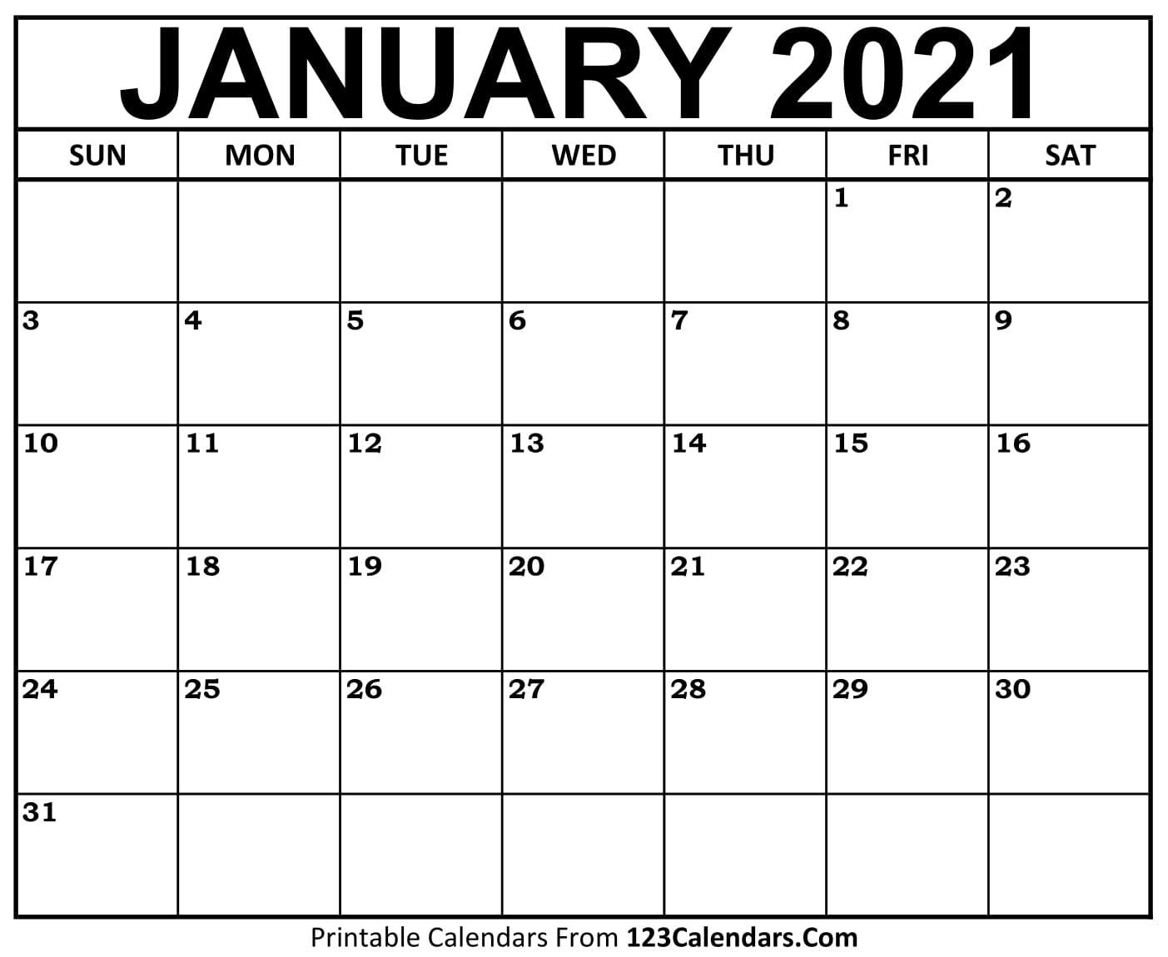
Daily Schedule:
Set-up: 0700-0730
Vaccine Administration:
0730-1830
Wipe-down: 1840-1850
Lock-up: 1900
Group C/D (Risk 3 – Risk 2)
Vac 1
Group A
Vac 2
SOFTSTART Vac2
Group A
Vac 2
Group A / B
Vac 2 – HOLD, if needed
Group B / C (Risk 5)
Vac 2
Group C / D (Risk 4)
Vac 2
Group C/D (Risk 3 – Risk 2)
Vac 2
8,499 Caregivers fully vaccinated by January 27th

Slide 91
Texas Demographics

Slide 92
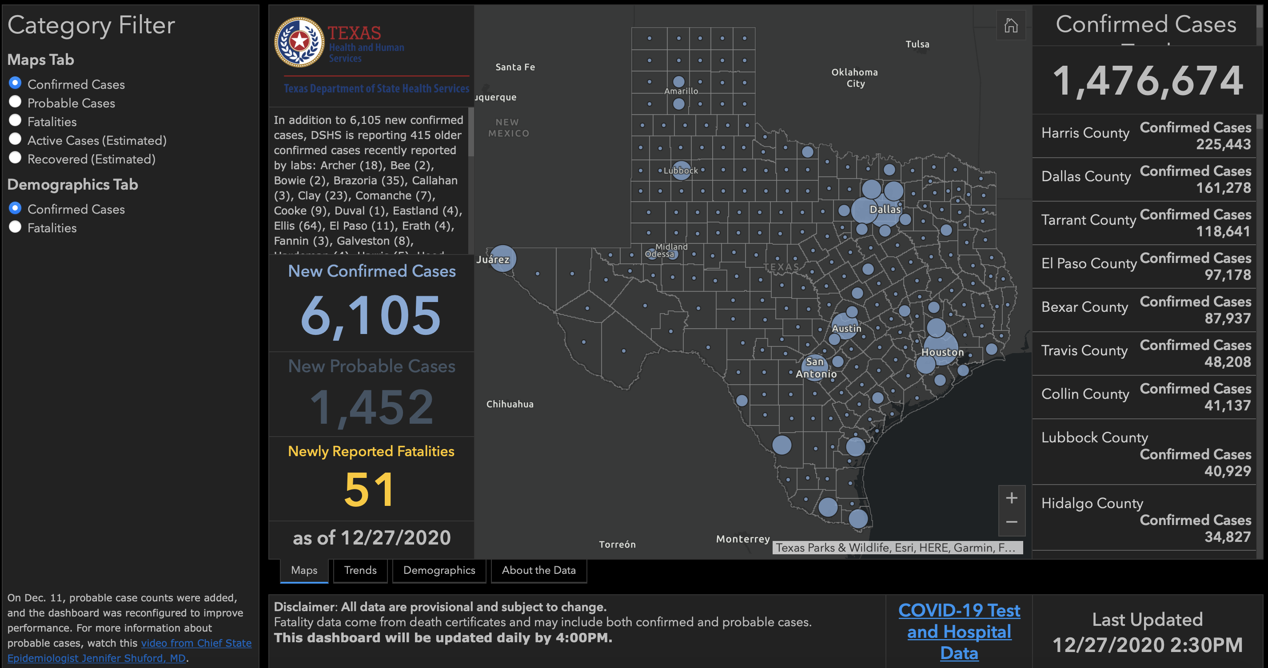

Slide 93
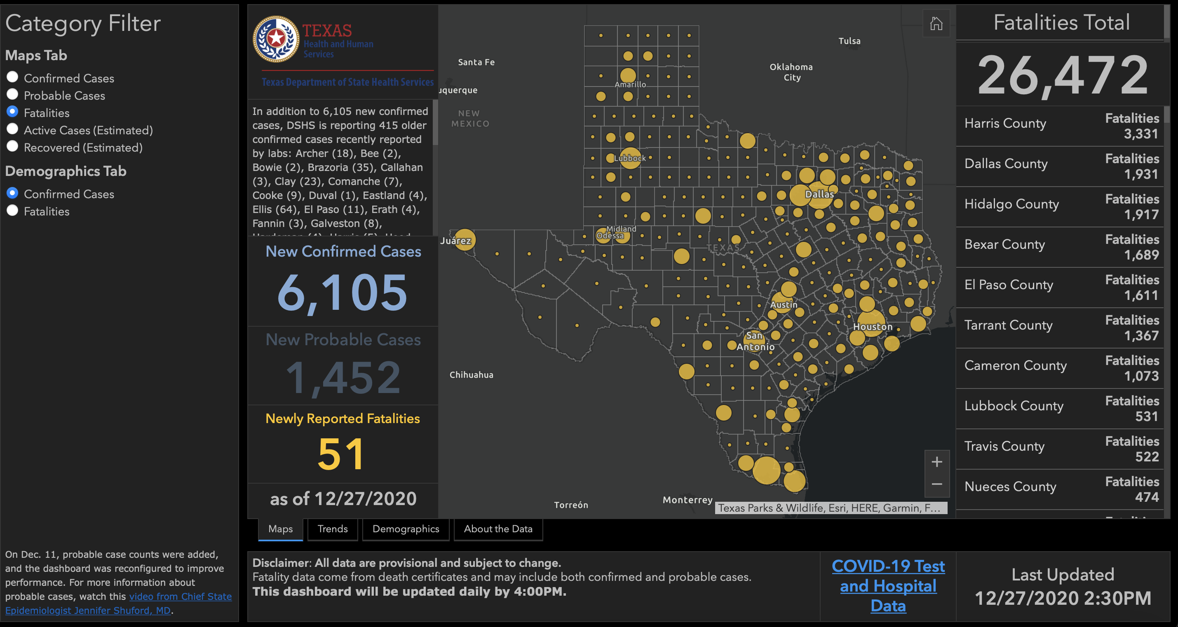

Slide 94
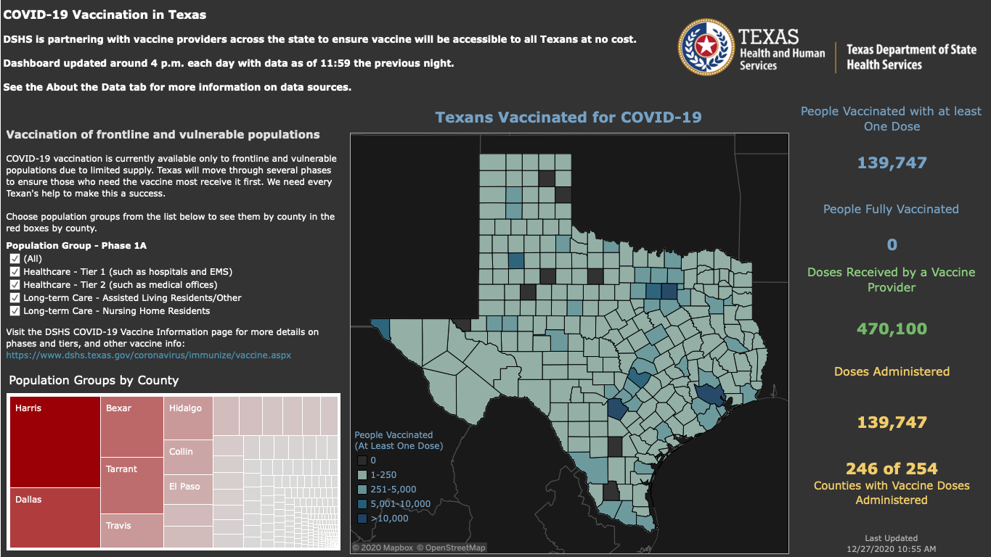

Slide 95
Q & A

Slide 96
CME Credit was only approved for the Live Teams meeting
To receive credit for this continuing education activity, the participant must:
Make sure you are logged into your Teams account, if you are signed in with a group provide attendee’s First and Last name(s) in the comments section.
If you are calling into the Teams meeting you MUST text your First & Last Name to (806) 252-4735. This will ensure you are added to the sign in sheet to receive CME Credit.
You will receive an email by the following Wednesday from the CME department with further instructions on claiming your certificate.

