Slide 1
Covenant Health
Presents
Critical Communications: A Weekly Physician Update
December 4, 2020

Slide 2
PHYSICIANS
Accreditation Statement:
The Covenant Health is accredited by the Texas Medical Association (TMA) to provide continuing medical education for physicians.
Credit Designation Statement:
The Covenant Health designates this live CME activity for a maximum of 1.0 AMA PRA Category 1 Credit(s)™. Physicians should claim only the credit commensurate with the extent of their participation in the activity.

Slide 3
Disclosures of Commercial Interest
The speakers and planners of this activity
have no relevant financial interests

Slide 4
Disclosures
This activity is provided by
Covenant Health
No commercial support has been received.
No products will be endorsed.
Speakers will notify the audience if off label drug use will be discussed.

Slide 5
CME Credit was only approved for the Live Teams meeting
To receive credit for this continuing education activity, the participant must:
  Make sure you are logged into your Teams account, if you are signed in with a group provide attendee’s First and Last name(s) in the comments section.
  If you are calling into the Teams meeting you MUST text your First & Last Name to (806) 252-4735. This will ensure you are added to the sign in sheet to receive CME Credit.
  You will receive an email by Wednesday following the call from the CME department with further instructions on claiming your certificate.

Slide 6
Reflection
Presented by
Craig D. Rhyne, MD FACS
Regional CMO – Covenant Health

Slide 7



Slide 8

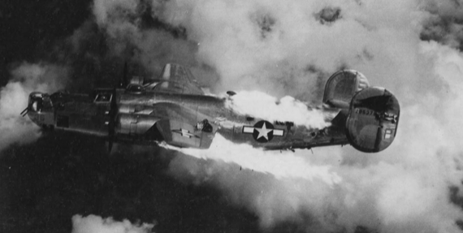

Slide 10



Slide 11
Current Regional Covid-19 Census

Slide 12
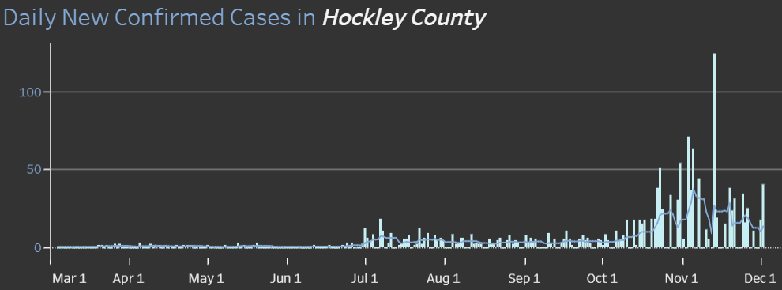
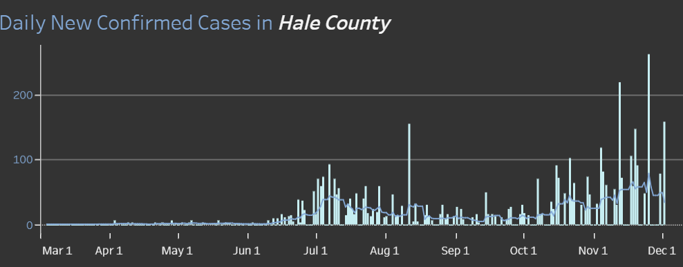
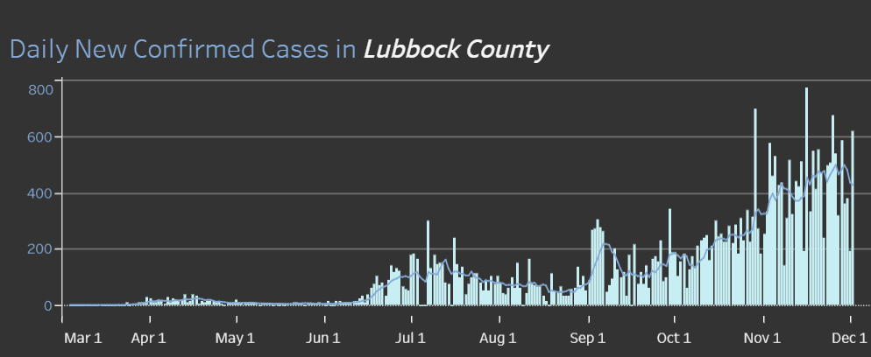
COUNTY
40 new 12/1
158 new 12/1
619 new 12/1
14.2 %
Positivity Rate

Slide 13
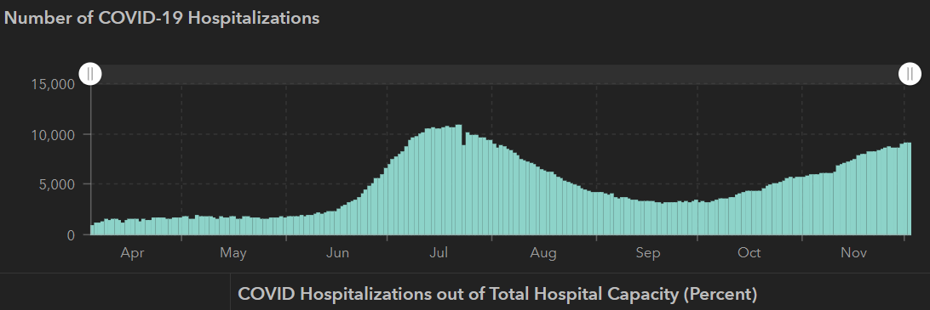
STATE
11/30 | 12/2
1,168,111 | 1,200,674
21,379 | 21,756
8900 | 9,109
10,893
7/22
 | 11/23 | 11/16 | 11/04 | 10/21 | 10/5 | 9/23 | 9/9 | 8/26 | 8/12 | 7/29 | 7/15 | 7/1
Cases | 1,100,979 | 1,027,889 | 926,400 | 838,809 | 769,303 | 719,599 | 645,791 | 592,137 | 506,820 | 403,307 | 282,365 | 168,062
Deaths | 20,588 | 19,579 | 18,320 | 17,210 | 16,033 | 15,129 | 13,692 | 11,805 | 9034 | 6190 | 3432 | 2481
Hospitalized | 8353 | 7468 | 5,872 | 4,319 | 3,318 | 3,195 | 3604 | 4806 | 7028 | 9595 | 10,471 | 6904

Slide 14
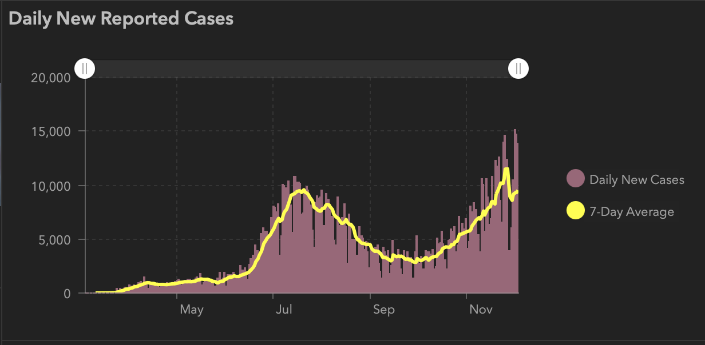

Slide 15
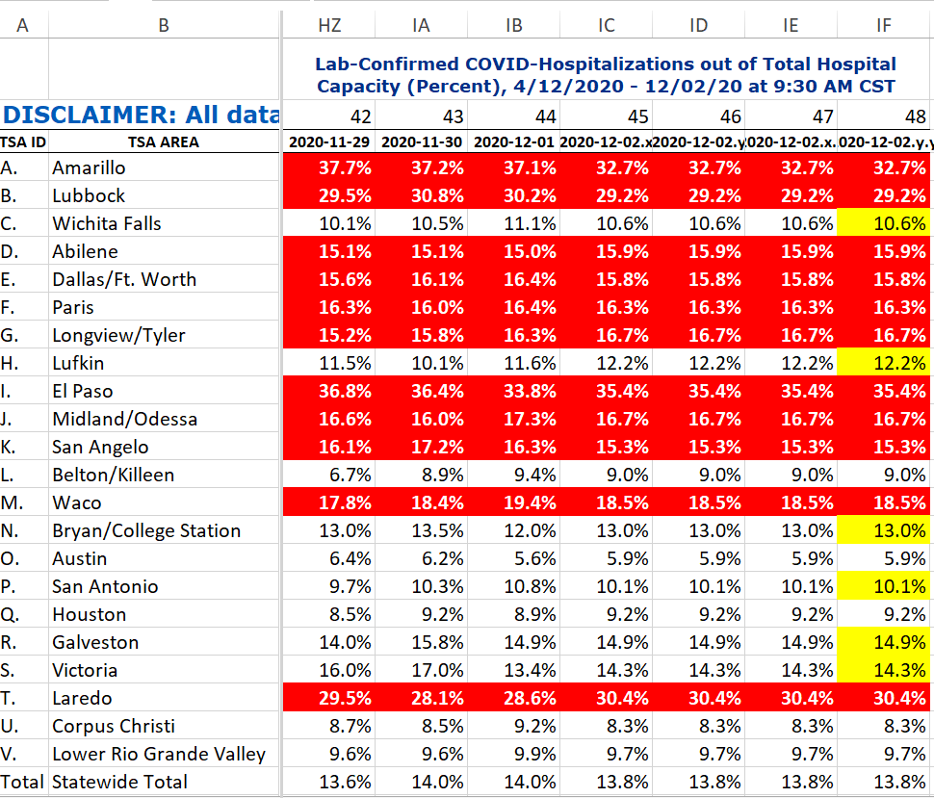
COVID+ HOSPITALIZATIONS BY TSA ID
CONFIRMED COVID+ HOSPITALIZATIONS /HOSPITAL CAPACITY

Slide 16
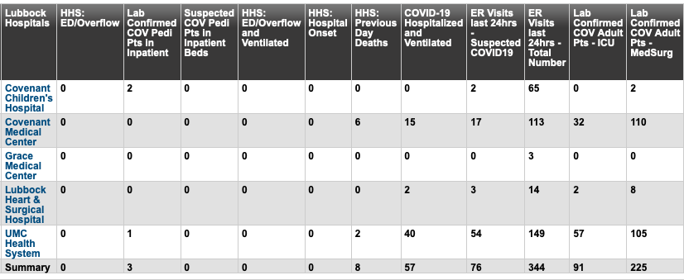
Lubbock This Morning
11/20: 319 Hospitalized in Lubbock – 57 on vents

Slide 17
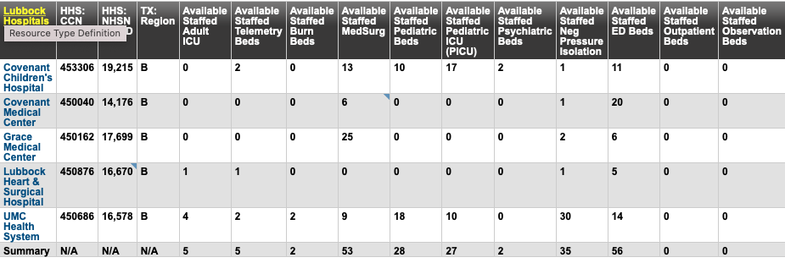
BRAC – bed availability this morning

Slide 18
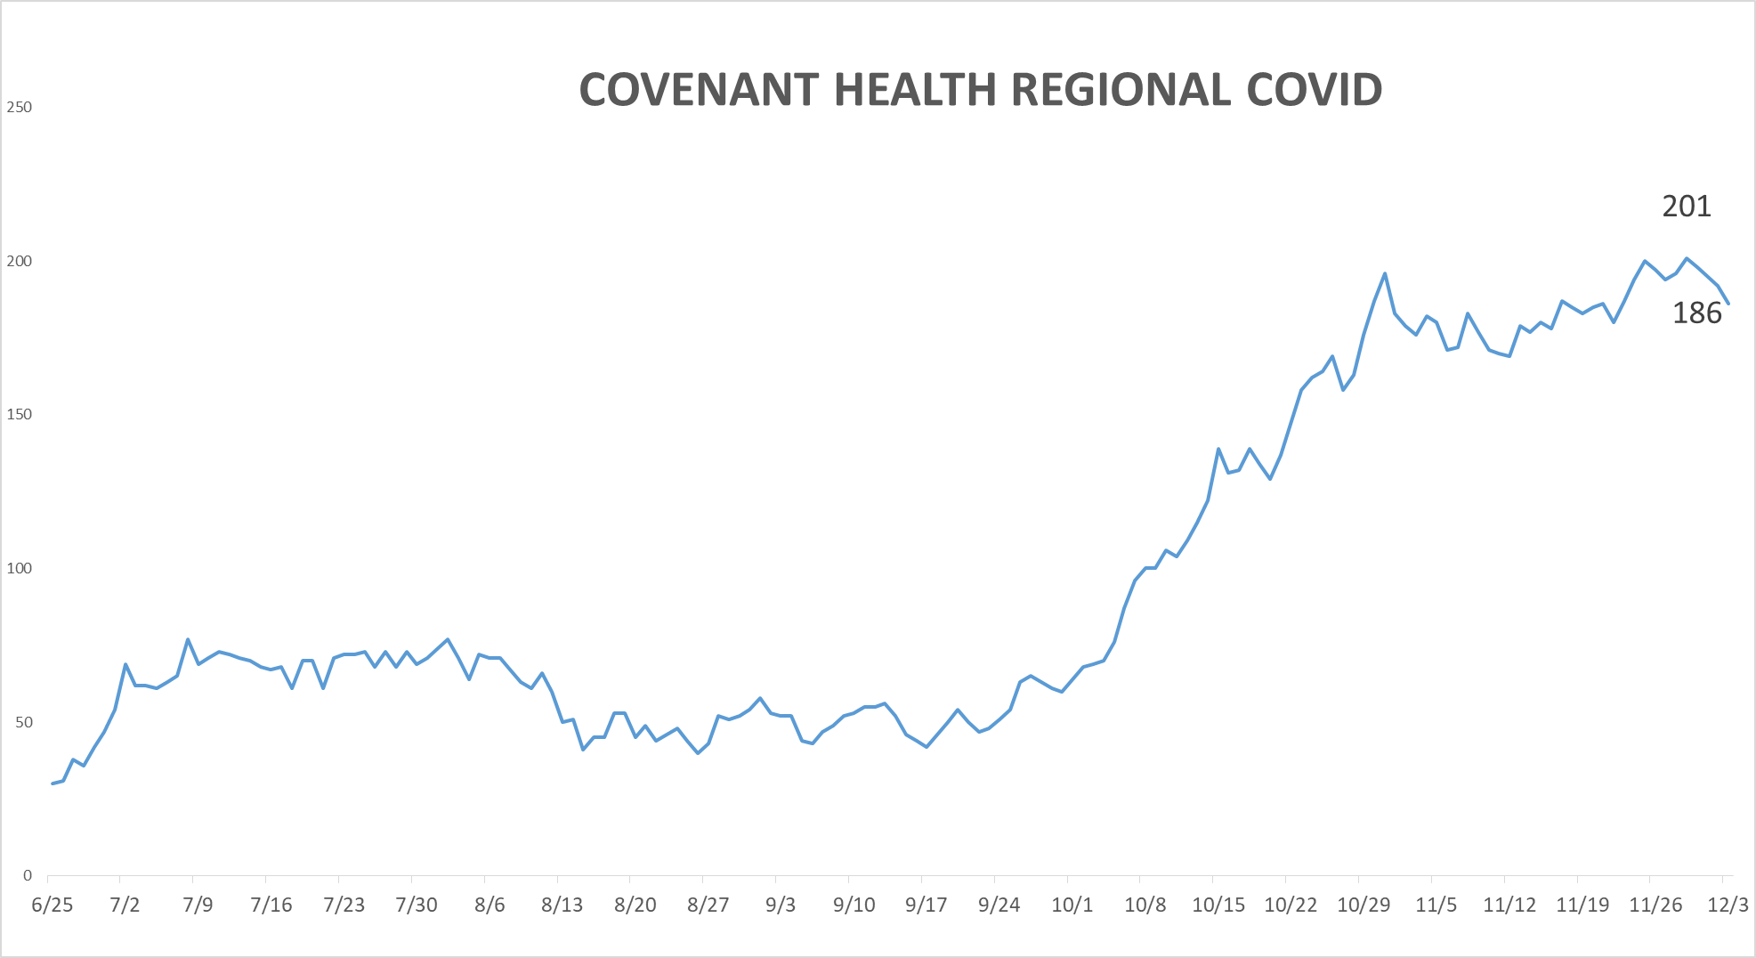
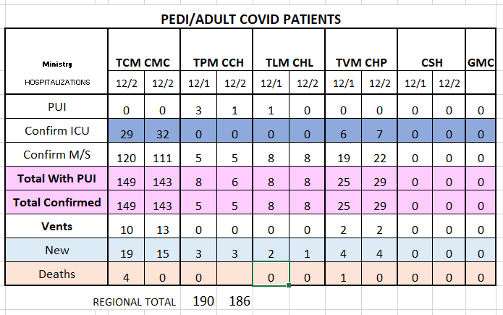
PUI/Confirmed cases-hospitalized COVID UNITS
12/3/2020

Slide 19
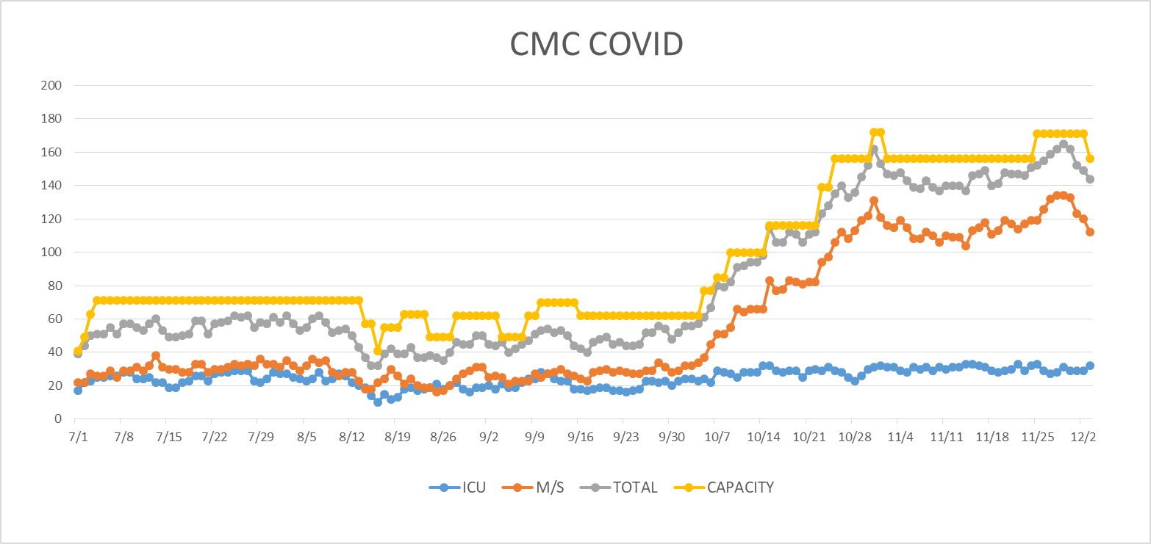
COVID Units - CMC
12/3/2020
12/2 South 6 converted back to Non-Covid, Off Diversion 12/3

Slide 20
Surge Plans

Slide 21
Surge Plan
Covenant Medical Center
 | ICU | Med Surg | Total
Phase 1 | 10-CICU |  | 10
Phase 2 | 17-CICU | 10-HC4 | 27
Phase 3 | 17-CICU | 24-HC4 | 41
Phase 4 | 17-CICU 8-MICU | 24-HC4 14-Pal Med | 63
Phase 5 | 17-CICU 16-MICU | 24-HC4 14-Pal Med | 71
Phase 6 | 17-CICU 16-MICU 15-S 4 | 24-HC4 13-HC6 15 – S 9 (East) | 100
Phase 7 | 17-CICU 16-MICU 15-S 4 | 24-HC4 13-HC6 31 – S 9 (all) | 116
Phase 8 | 8-E4 17-CICU 16-MICU 15-S 4 | 15-S 10(East) 24-HC4 13-HC6 31 – S 9 (all) | 139
Phase 9 | 16-E4 (all) 17-CICU 16-MICU 15-S 4 | 30 S10 (all) 24-HC4 13-HC6 31 – S 9 (all) | 162
Currently
Last Week

Slide 22
1 South Overflow at Children’s
Planning Phase
Beds- 24 beds
Patient type: Observation and low medical acuity
Staff requested: RN, Monitor Tech, Respiratory
Equipment: Mobile Tele system, IV modules, defibrillator, medical suction
Med Gases: RM 101-113 O2/Vacuum RM 116-128 O2/Vacuum/ Med Air
Working on Physician Coverage
Rooms to be ready: 12/8/2020
Go Live: When volume exceeds capacity at CMC (most likely 12/8)

Slide 23
Statistics
William Sommer
Clinical Data Analyst
Quality and Clinical Data Analytics
Covenant Health

Slide 24
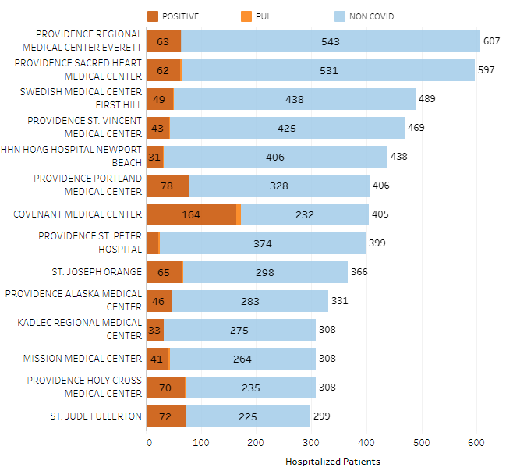
Providence System Hospitalized COVID-19 Cases

Slide 25
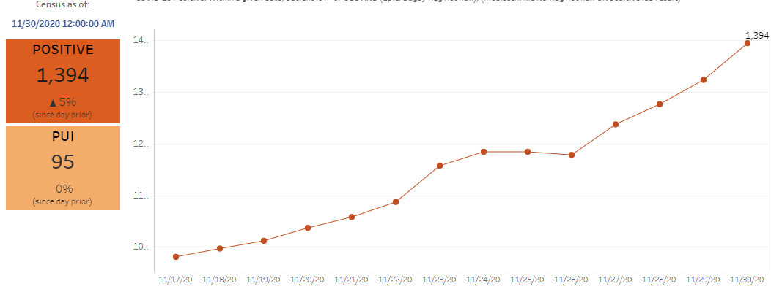
Providence Inpatient COVID-19 Volume

Slide 26
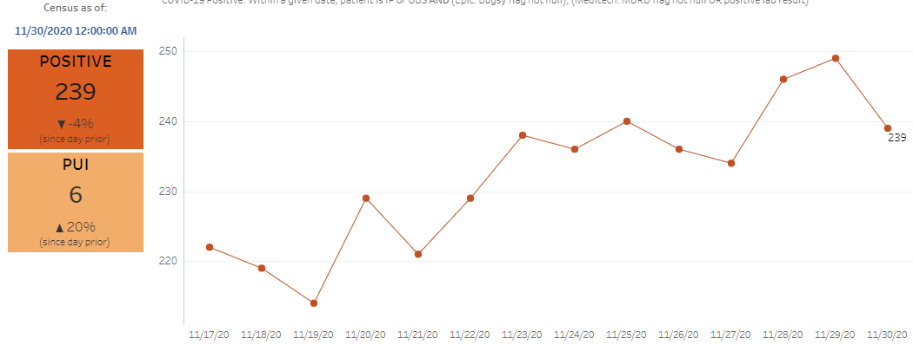
Texas Inpatient COVID-19 Volume

Slide 27
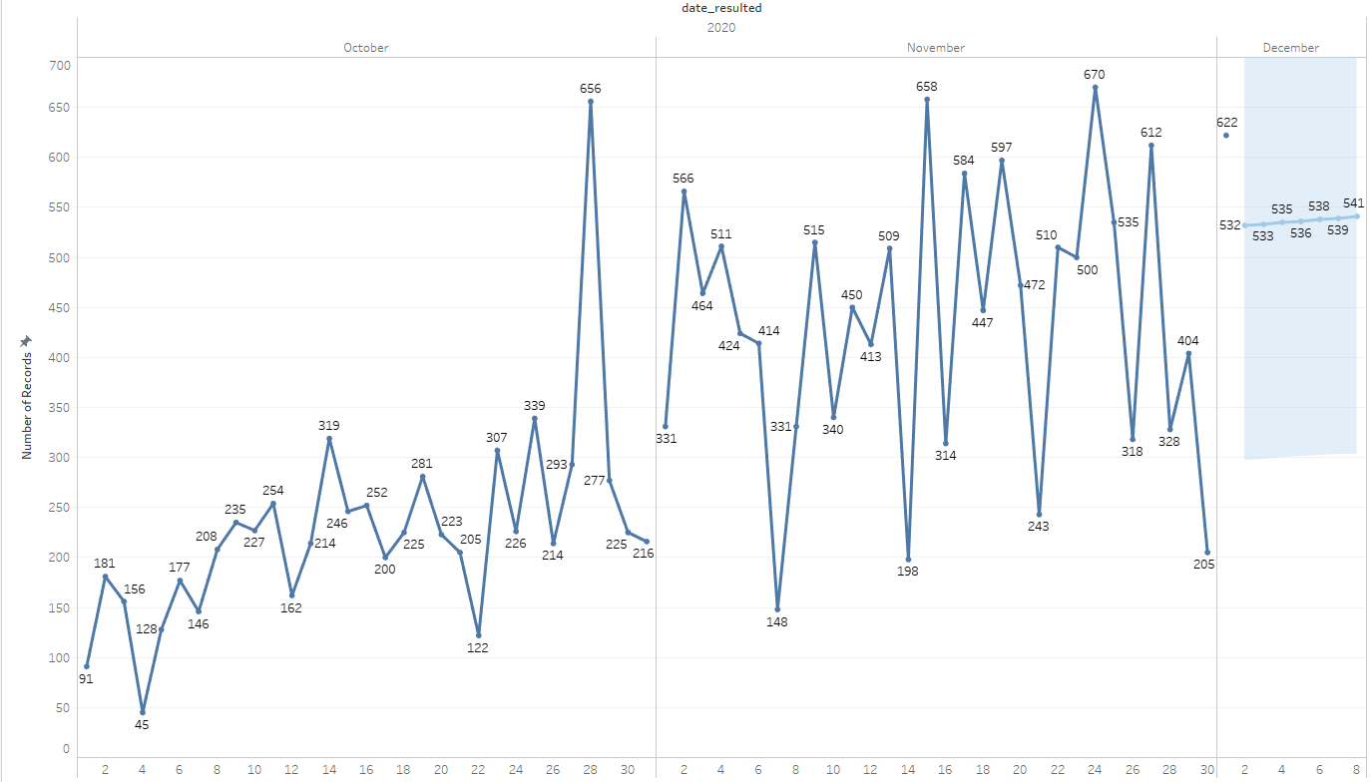

New Covid-19 POSITIVES by Day Trend

Slide 28
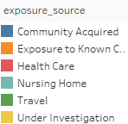
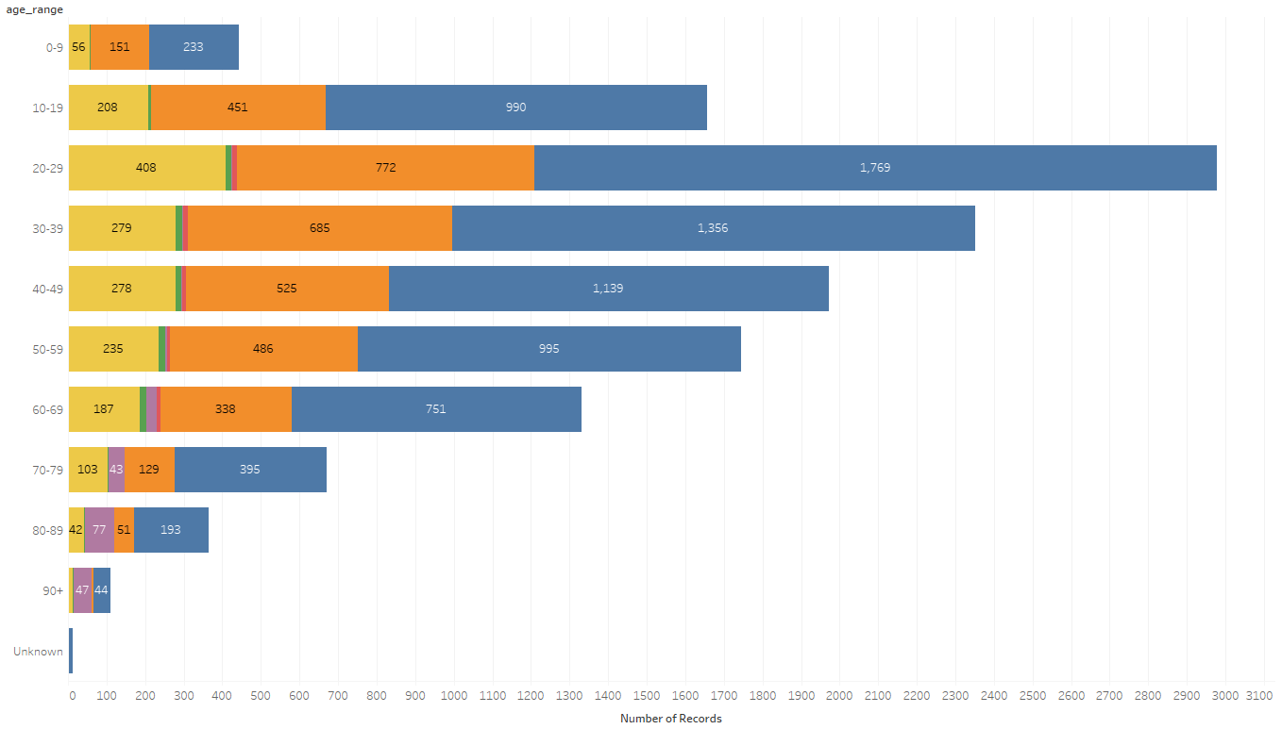
Covid-19 POSITIVES Age Distribution

Slide 29
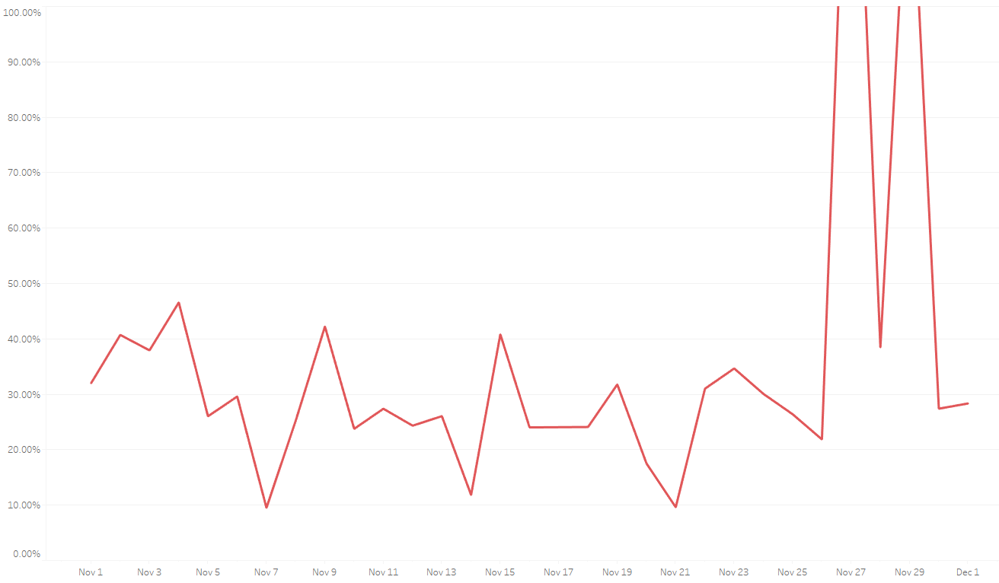

Covid-19 Daily Positive Rate

Slide 30
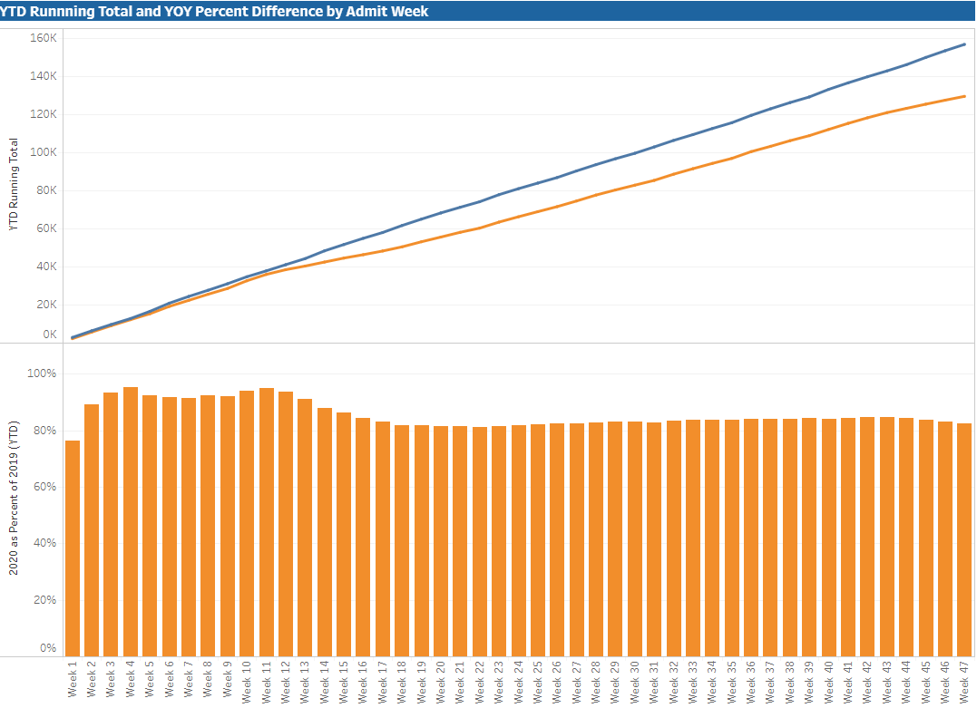

TX/NM Region Weekly Procedures (YOY)

Slide 31
Caregiver Update

Slide 32
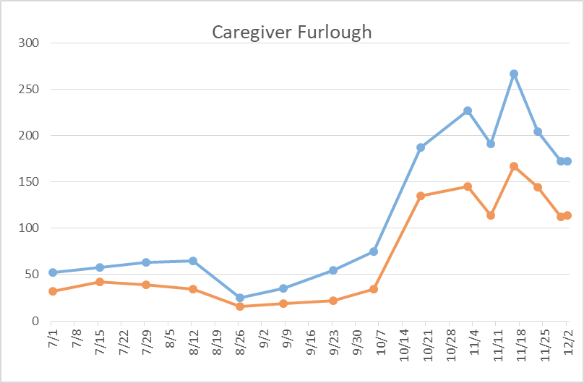
Caregivers
COVID Related Furloughs
Exposure testing at day 7 – 50% RTW 50% positive
66% are positive
Count reflects # furlough (exposed and positive)
Good
Moderate
Critical

Slide 33
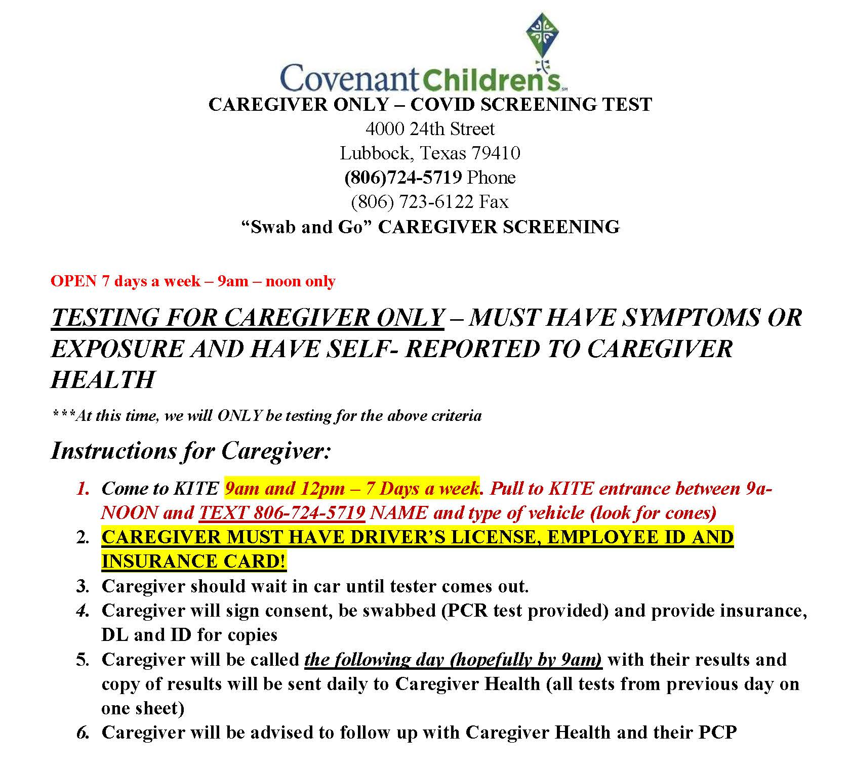
NEW
Caregiver
TESTING

Slide 34
Covenant Outpatient Infusion Center Update

Slide 35
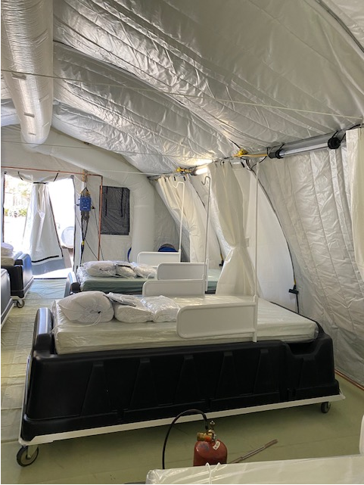
Covenant Outpatient Infusion Center
Located in the Auxillary Medical Unit (State Supplied Blue Med Tents)
COVID Infusion Center
51 Remdesivir treatments provided
5 Monoclonal Antibody
  Several do not meet criteria
  Some do not have a PCP
    City Health Dept working with the Combest Center for PCP issue

Slide 36
REMOTE PATIENT MONITORING
Home Monitoring kits
Enrolled a patient in Twistle (Smart phone APP)
Kits ordered through PMM with a patient name for inpatient and ED
Kits available for tent – setup process with Jamie Baker and Evelyn Minjarez

Slide 37
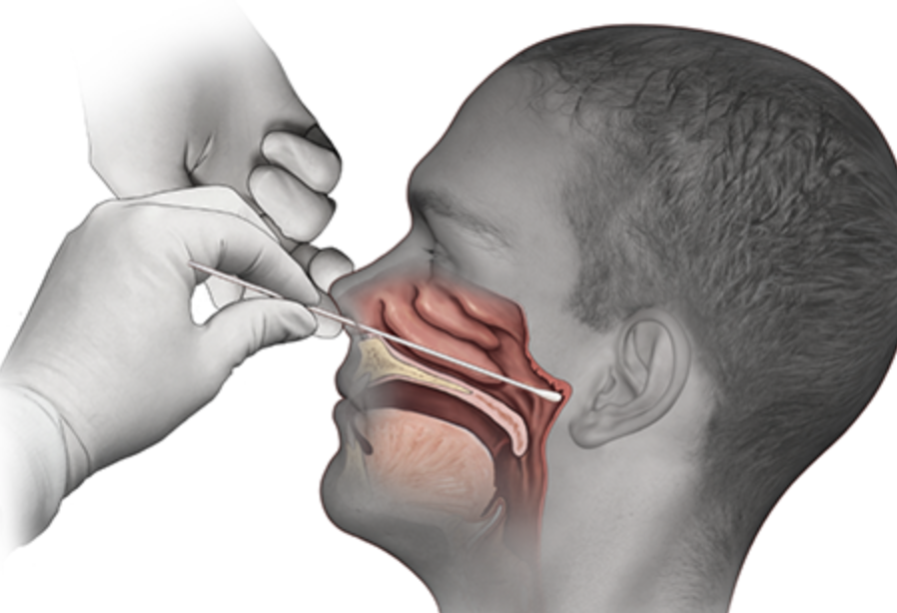
Covid-19 Testing
Jason T. Loos, MD
Ameripath

Slide 38
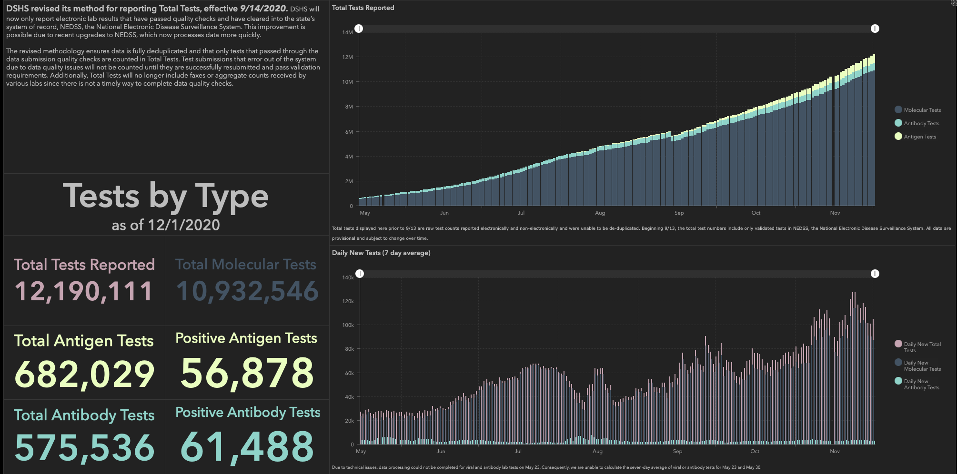

Slide 39
TESTING
 | CMC |  | GMC |  | CMG
 | Rapid | PCR | Rapid | PCR | Rapid
Test Kits
Swabs
VTM
 | CMC |  | GMG/CMG
 | Tests | + | Tests | +
12/1 | 379 | 120 | 98 | 22
12/2 | 109 | 29 | 96 | 26
PCR
Rapids
>2000 >750
<2000 <750
<1600 <500
CMC- No issues
GMG- doing well
CMG- received 1000 rapids last week

Slide 40
TESTING
CONCERNS:
Community using ED for COVID Testing, partially due to appointment availability at testing sites
Grace to expand hours and available spots
Work on communications to the public

Slide 41
What about Influenza?

Slide 42
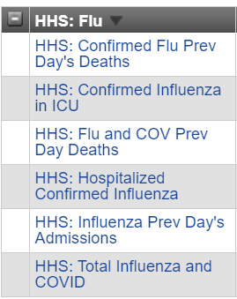
FLU Reporting to HHS
HOSPITALIZED PATIENTS TESTED – 11/30
CMC | CCH | CSH | GMC | CHP | CHL
0 | 0 | 0 | 0 | 0 | 0
0 | 0 | 0 | 0 | 0 | 0
0 | 0 | 0 | 0 | 0 | 0
0 | 0 | 0 | 0 | 0 | 0
0 | 0 | 0 | 0 | 0 | 0
0 | 0 | 0 | 0 | 0 | 0

Slide 43
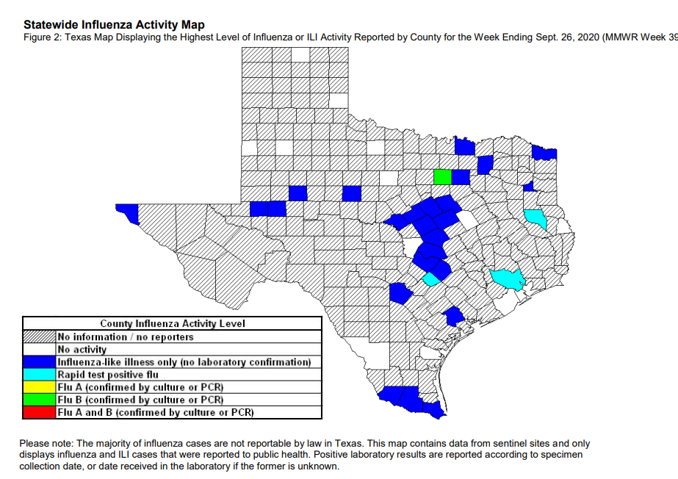
….BUT Influenza Cometh

Slide 44
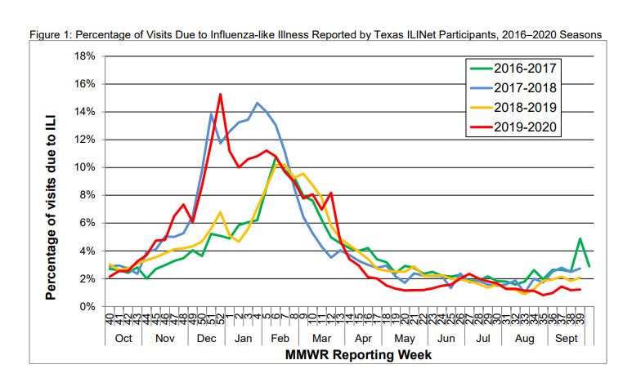
Flu reported in Texas 2016-2020

Slide 45
Repeat Testing
Unnecessary Cancellation of Procedures

Slide 46
Patients within 90 days COVID Recovery
Guideline
For patients previously diagnosed with symptomatic COVID-19 who have had no symptoms after recovery, retesting is not recommended within 90 days after the date of symptom onset for the initial COVID-19 infection.
  Treat patient as a Non-Covid patient and place on non-covid unit
  No Isolation is required
  DO NOT RETEST as PCR can remain positive for up to 90 days.
For patients developing new symptoms consistent with COVID-19 during the 90 days after the date of initial symptom onset, if an alternative etiology cannot be identified by a provider, then the patient may warrant retesting; consultation with infectious disease or infection control experts is recommended.
  Place patient in COVID isolation if no other etiology is identified
  Retesting if necessary
Serologic testing should not be used to establish the presence or absence of SARS-CoV-2 infection or reinfection.
https://www.cdc.gov/coronavirus/2019-ncov/hcp/duration-isolation.html

Slide 47
Pharmacy Update
Wesley Wells, PharmD
Regional Pharmacy Director
Covenant Health
Larry Pineda, PharmD
Antimicrobial Stewardship Pharmacist
Covenant Health

Slide 48
Update on Significant Medications
Medication | Current State | Updates/Issues
Remdesivir |  | No updates
Zanubrutinib | Patients enrolled in study: 6 Inpatients on medication: 0 | No updates
Bamlanivimab (Lilly) |  | Getting information out to providers Working on a way to identify candidates who have tested positive Continue to work on process with city Need to begin working on a process for Levelland and Plainview
Casirivimab and Imdevimab (Regeneron) |  | Receiving first round of stock Need to begin working on a process for Levelland and Plainview
Regeneron 2066 | Patients enrolled in study: 3 (4 screened) Investigational trial | No updates
Ministry | Vials Used on Previous Day | Stock (vials)
Covenant Medical Center | 52 | 814
Covenant Children’s Hospital | 0 | 0
Covenant Plainview | 15 | 153
Covenant Levelland | 5 | 40
Home Infusion | 6 | 63
Ministry | Vials Used Since Last Week | Stock (vials)
CMC/Home Infusion | 10 | 335
Covenant Plainview | 0 | 48
Ministry | Vials Used Since Last Week | Stock (vials)
CMC/Home Infusion | 0 | 81
Covenant Plainview | 0 | 9

Slide 49
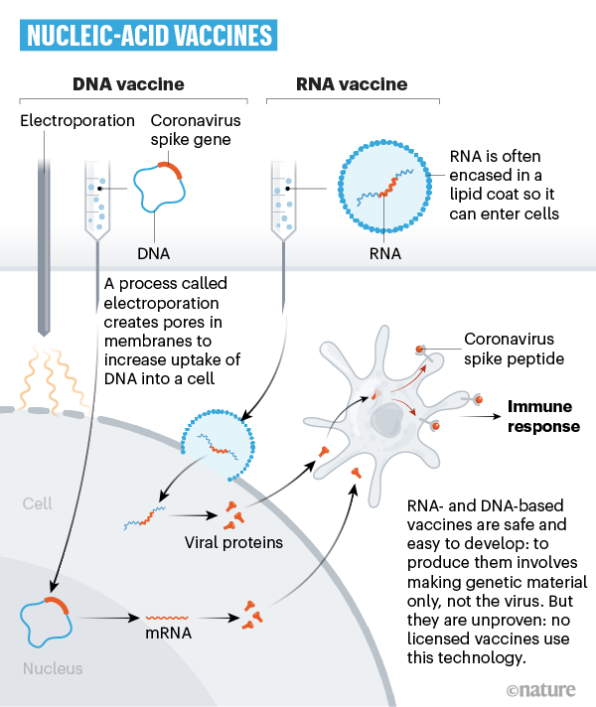
Nucleic Acid Vaccines
Genetic instructions (in the form of DNA or RNA) for a coronavirus protein that prompts an immune response
The nucleic acid is inserted into human cells, which then churn out copies of the virus protein; most of these vaccines encode the virus’s spike protein
Notes:
Slide presented in August
mRNA never enters nucleus

Slide 50
Pfizer/Biontech Phase 3 Press Release
November 18, 2020
Primary efficacy analysis
  95% effective against COVID-19 beginning 28 days after the first dose
  170 confirmed cases of COVID-19 were evaluated
  162 observed in the placebo group versus 8 in the vaccine group
    10 severe cases observed, with nine occurring in the placebo group
Safety data milestone required by FDA for EUA achieved
  Well tolerated across all populations with over 43,000 participants enrolled
  No serious safety concerns observed
  Only grade 3 adverse events greater than 2% in frequency
    Fatigue at 3.8% and headache at 2.0% following dose 2
Notes:
Most solicited adverse events resolving shortly after vaccination
FYI: Wednesday, December 02, 2020 - 02:05am
U.K. regulator, MHRA, authorizes supply of COVID-19 mRNA vaccine for emergency supply under Regulation 174; Companies are ready to deliver the first doses to the U.K. immediately

Slide 51
Moderna Phase 3 Press Release
November 30, 2020
Primary efficacy analysis
  30,000 participants included 196 cases of COVID-19 (30 cases were severe)
  Cases confirmed and adjudicated starting 2 weeks following the second dose
  Vaccine efficacy 94.1%; against severe COVID-19 was 100%
    185 cases observed in placebo group versus 11 cases observed in the mRNA-1273 group
No serious safety concerns identified to date
  No new AE information in this release
11/16/20 press release:
  Majority of adverse events were mild or moderate in severity
  Grade 3 (severe) >= 2% in frequency after the first dose included injection site pain (2.7%)
  After the second dose included fatigue (9.7%), myalgia (8.9%), arthralgia (5.2%), headache (4.5%), pain (4.1%) and erythema/redness at the injection site (2.0%)
  These solicited adverse events were generally short-lived
Notes:
Solicited adverse reactions included injection site pain, fatigue, myalgia, arthralgia, headache, and erythema/redness at the injection site. Solicited adverse reactions increased in frequency and severity in the mRNA-1273 group after the second dose.
11/16/20:
The majority of adverse events were mild or moderate in severity. Grade 3 (severe) events greater than or equal to 2% in frequency after the first dose included injection site pain (2.7%), and after the second dose included fatigue (9.7%), myalgia (8.9%), arthralgia (5.2%), headache (4.5%), pain (4.1%) and erythema/redness at the injection site (2.0%). These solicited adverse events were generally short-lived. These data are subject to change based on ongoing analysis of further Phase 3 COVE study data and final analysis.

Slide 52
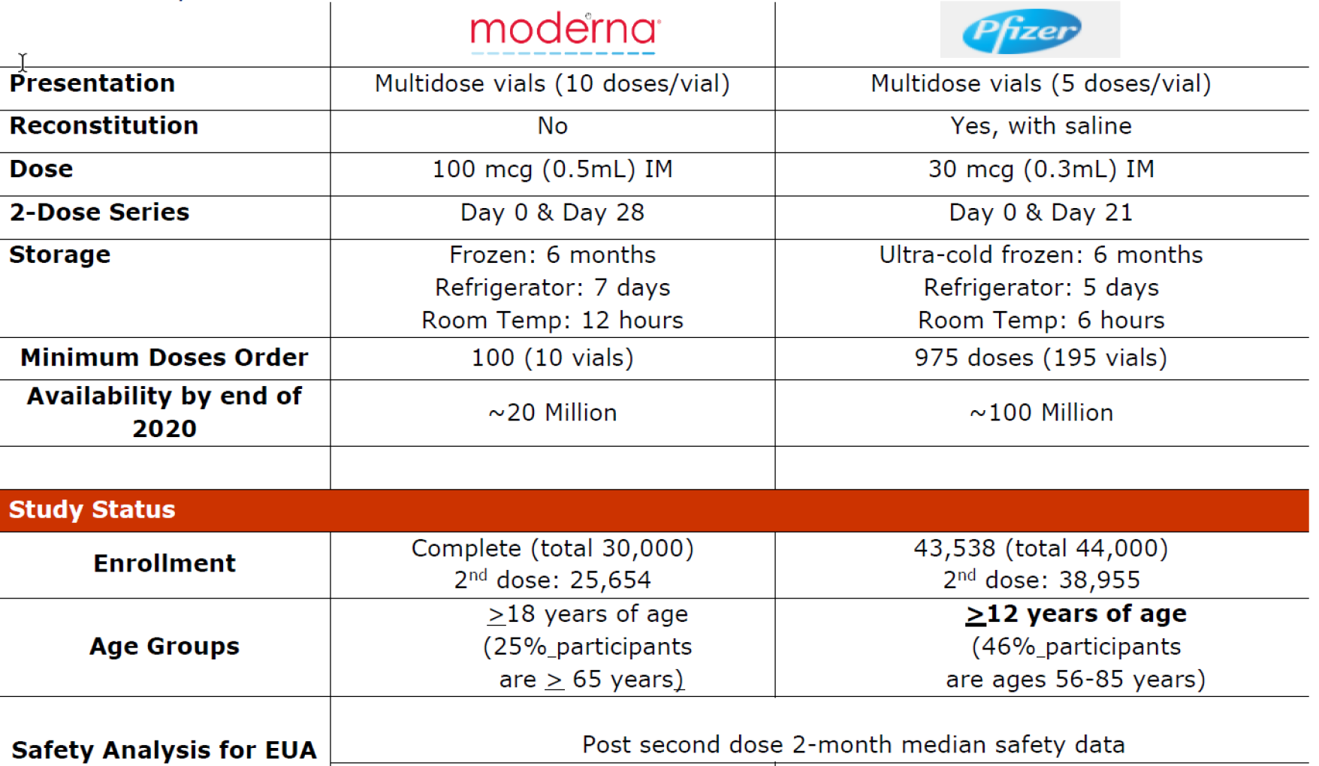
Hypothetical Vaccine Timeline
12/10
12/14
12/15
12/16
12/17
12/21
12/22
12/23
EUA Approval/
ACIP Guidelines
EUA Approval
FDA Review
Product Ships
Product Arrives
FDA Review
Product Arrives
Product Ships

Slide 53
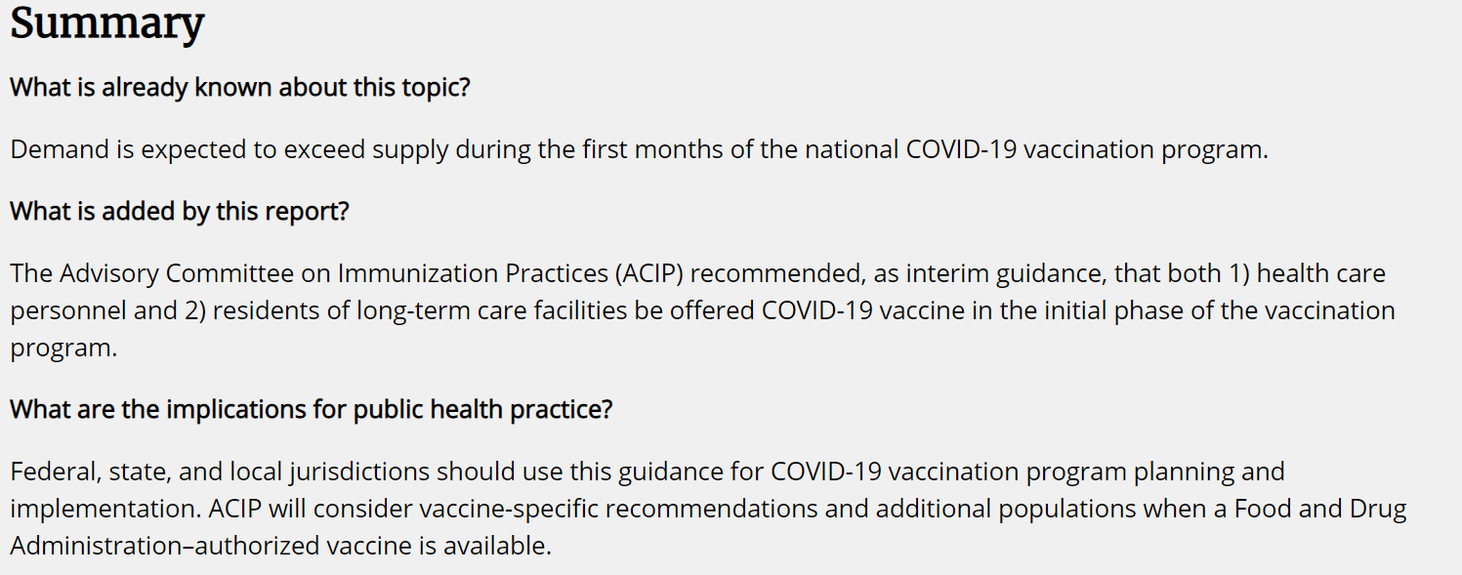
ACIP Interim Guidance
Published on December 3rd
States will make final say on population to target
  States are concerned over vaccine allotments

Slide 54
Administration/Distribution Plans
Site Registration
  CMC, CCH, LTACH, Levelland, and Plainview facilities registered
      Waiting on Grace Surgical Hospital move before registering
  CMG and Grace clinics have registered as well
Storage and Distribution
  Have been working with the State to be able to acquire the vaccine as early as possible
  Purchased a 25-cu ft ultra-low freezer for CMC to store the Pfizer vaccine at
  -70ºC
      Other facilities have freezers and refrigerators available
  Plan to be able to redistribute from CMC stock to smaller facilities
      Can move product to other sites but must bring back to CMC
      Redistribution agreements are submitted for Levelland, LTACH and Plainview
Administration
  Planning for stock to be on-site mid-December
  Working to iron out a process for caregivers to register for vaccination event
  Want to automate if possible
  Reduce the manual work of gathering demographic information

Slide 55
Administration/Distribution Plans
Administration cont.
  Quality department helping administer vaccine
  Reached out to schools of pharmacy, nursing, and medicine for additional support
  Accepting volunteers
  Will also need support documenting patient and vaccine information
Looking to use the KECC for Lubbock administrations
  Need space to monitor patients for reactions to the vaccine
Monitoring and Documentation
Doses will need to be administered into ImmTrac2 within 24 hours
Want to capture most info with registration information
Currently, a manual process
  Working with data analytics team to see if we can automate
Safety
Most common reported side effects are flu-like symptoms (soreness, aches, fever)
  Do not fully know their intensity or duration
Want to space out administration to departments incase side effects sideline caregivers

Slide 56

Texas Demographics

Slide 57
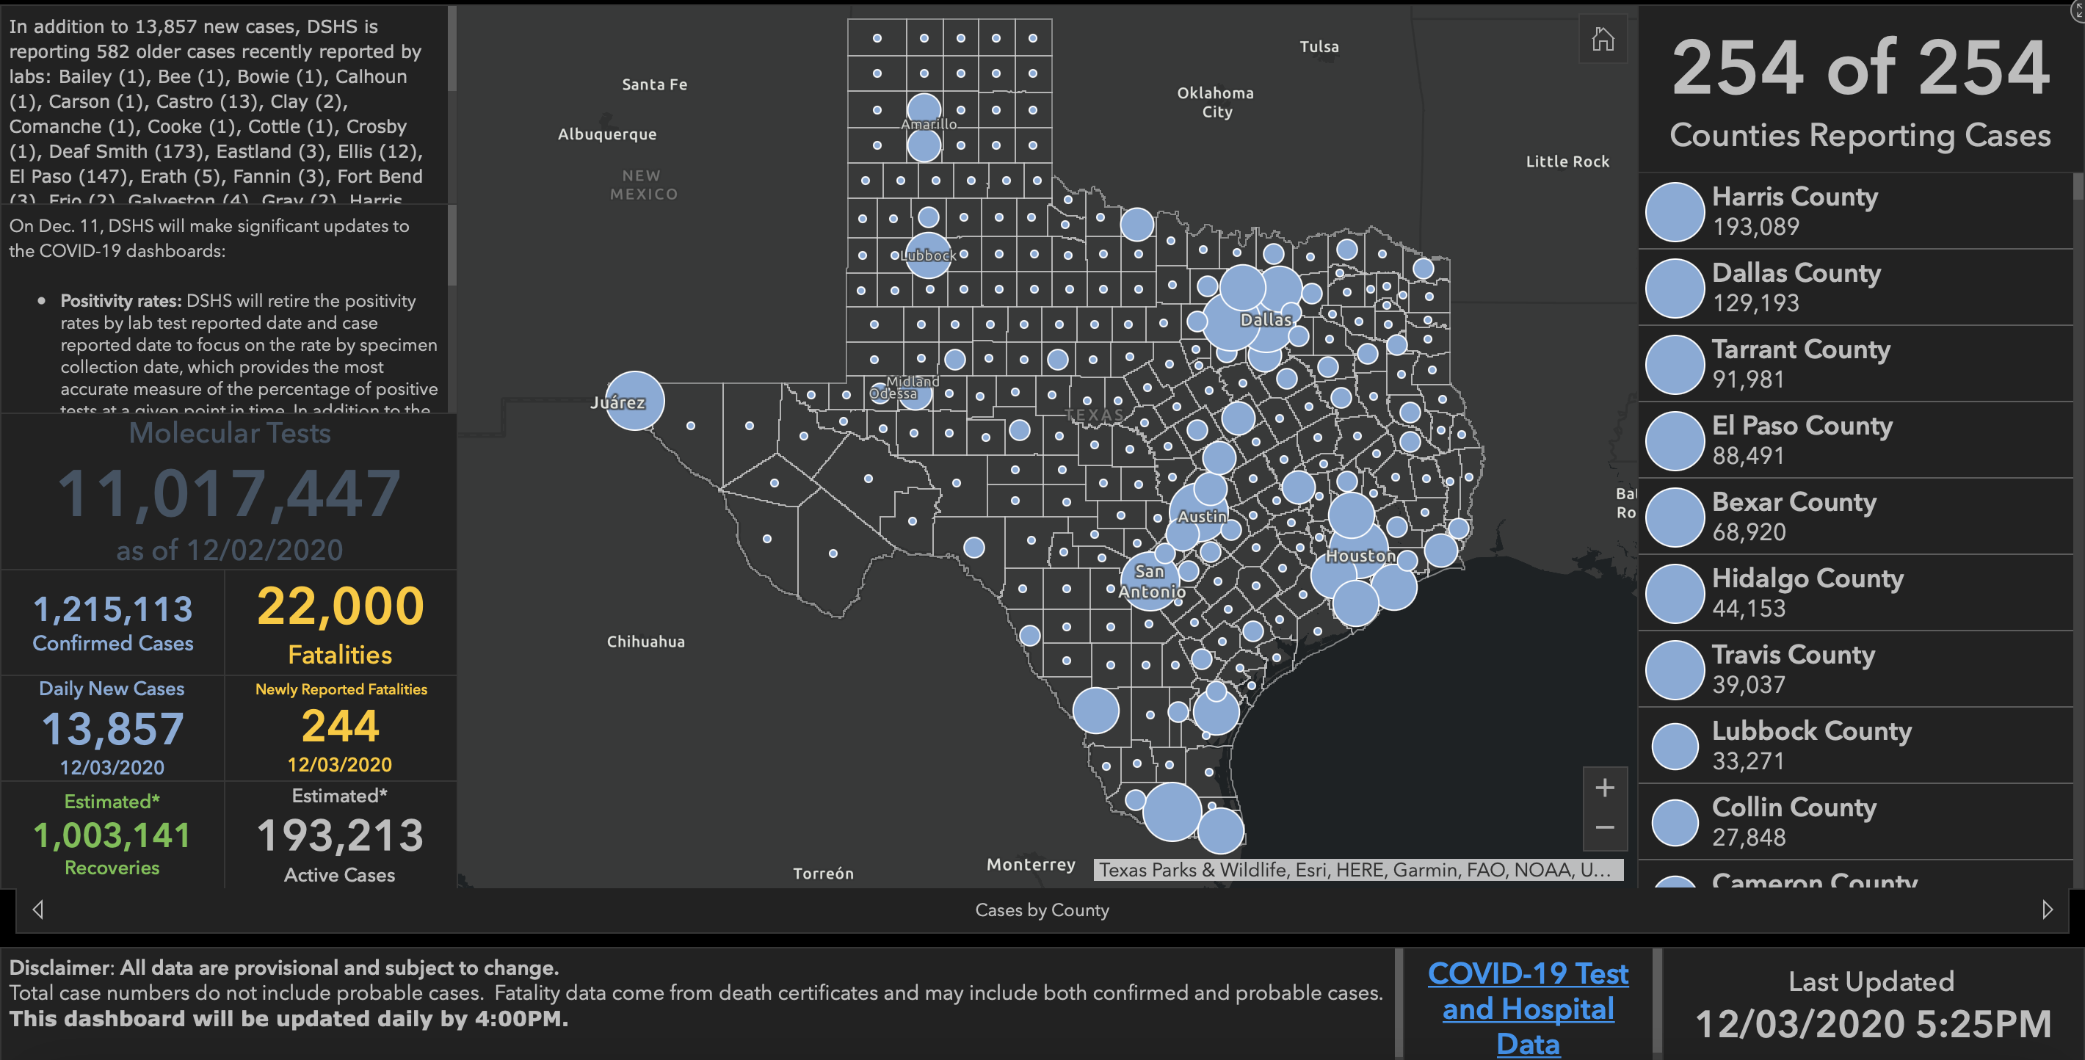

Slide 58
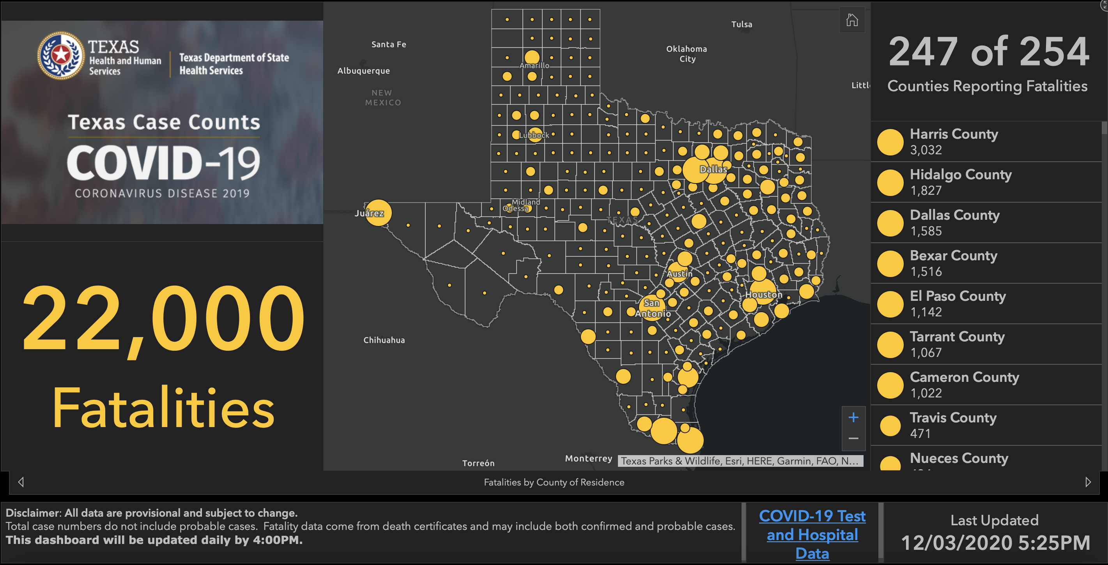

Slide 59
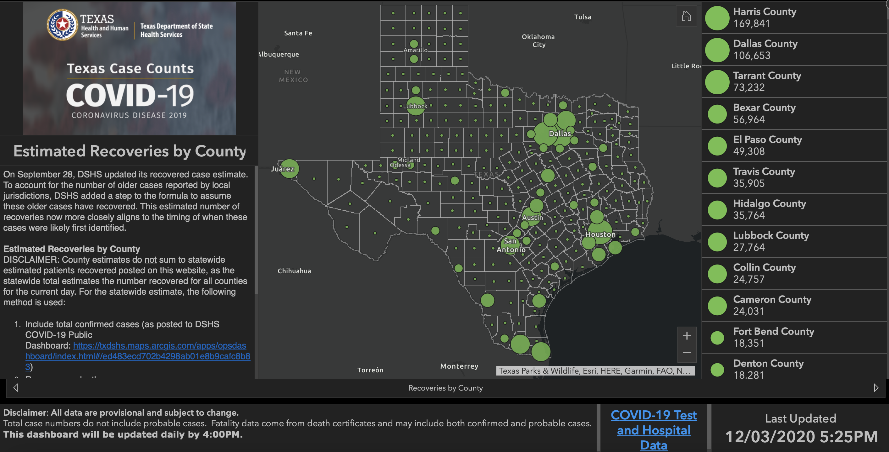

Slide 60
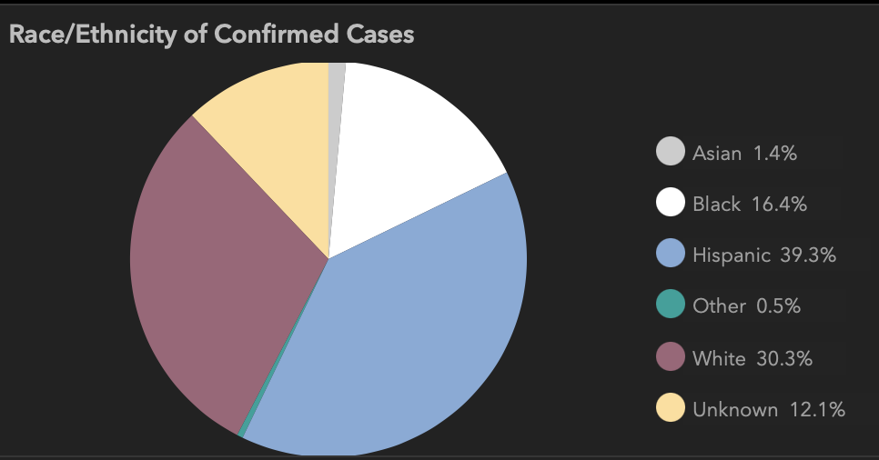
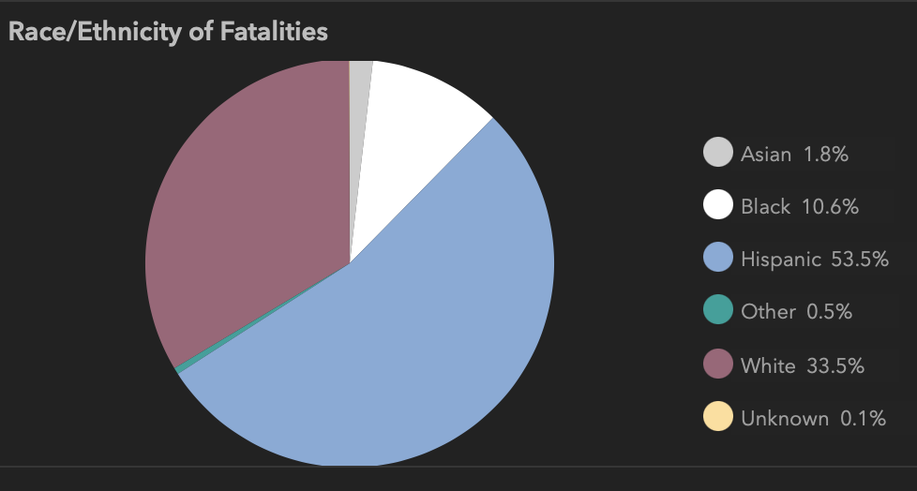
The Hispanic Population has a disproportionate mortality rate.
This has been confirmed in multiple states such as Arizona, Utah, Pennsylvania, New York, and New Jersey.
The reasons remain unclear.
Texas
New York State Department of Health. Fatalities [as of May 20, 2020]. https://covid19tracker.health.ny.gov/views/NYS-COVID19-Tracker/NYSDOHCOVID-19Tracker-Fatalities?%3Aembed=yes&%3Atoolbar=no&%3Atabs=n. Accessed May 22, 2020.
Despres C. Coronavirus case rates and death rates for Latinos in the United States. Salud America! https://salud-america.org/coronavirus-case-rates-and-death-rates-for-latinos-in-the-united-states/. Accessed May 22, 2020.
Centers for Disease Control and Prevention, National Center for Health Statistics. Weekly updates by select demographic and geographic characteristics. Provisional death counts for coronavirus disease (COVID-19). https://www.cdc.gov/nchs/nvss/vsrr/covid_weekly/. Accessed May 22, 2020.
Texas

Slide 61
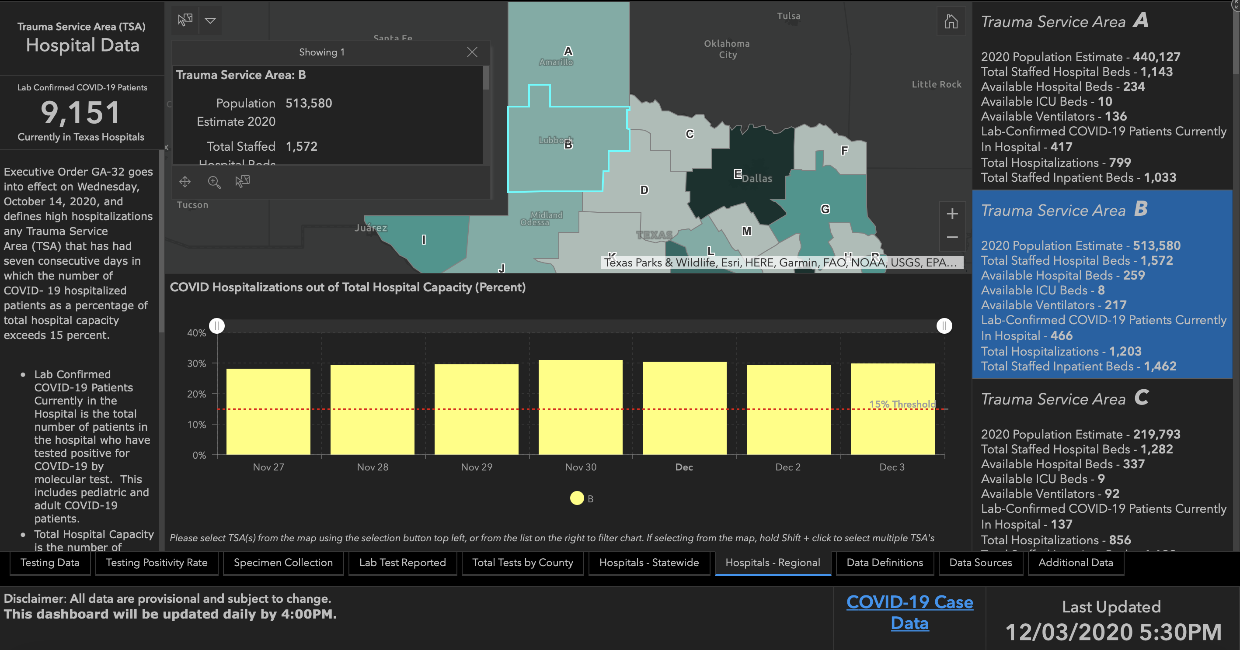
27.91%
29.01%
29.45%
30.75%
30.16%
29.22%
29.64%

Slide 62
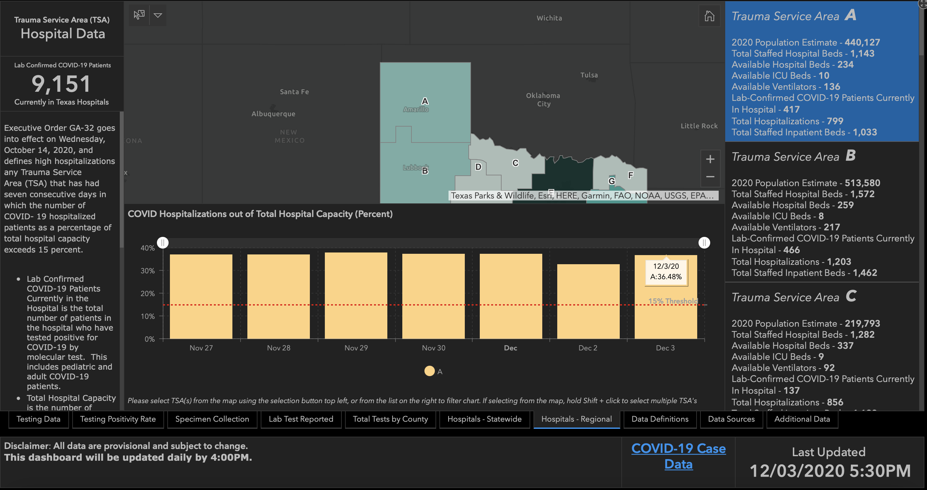

Slide 63
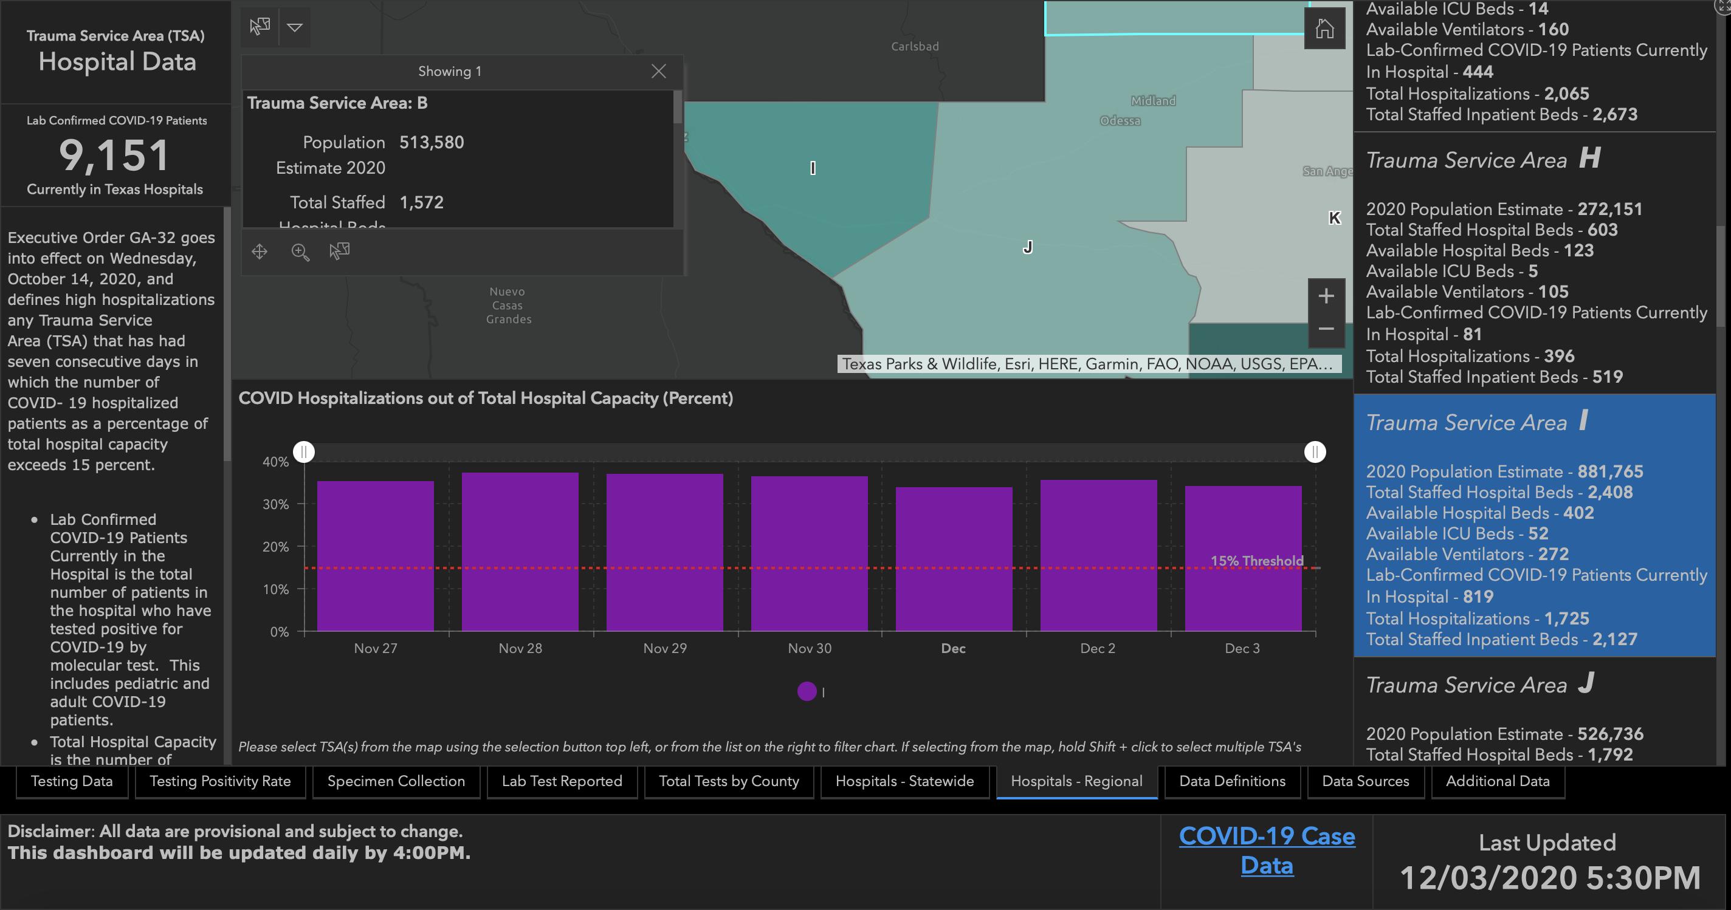

Slide 64
On Another Note….

Slide 65
Q & A

Slide 66
CME Credit was only approved for the Live Teams meeting
To receive credit for this continuing education activity, the participant must:
  Make sure you are logged into your Teams account, if you are signed in with a group provide attendee’s First and Last name(s) in the comments section.
  If you are calling into the Teams meeting you MUST text your First & Last Name to (806) 252-4735. This will ensure you are added to the sign in sheet to receive CME Credit.
  You will receive an email by the following Wednesday from the CME department with further instructions on claiming your certificate.

