Slide 1
Covenant Health
Presents
Critical Communications: A Weekly Physician Update
February 5, 2021

Slide 2
PHYSICIANS
Accreditation Statement:
The Covenant Health is accredited by the Texas Medical Association (TMA) to provide continuing medical education for physicians.
Credit Designation Statement:
The Covenant Health designates this live CME activity for a maximum of 1.0 AMA PRA Category 1 Credit(s)™. Physicians should claim only the credit commensurate with the extent of their participation in the activity.

Slide 3
Disclosures of Commercial Interest
The speakers and planners of this activity
have no relevant financial interests

Slide 4
Disclosures
This activity is provided by
Covenant Health
No commercial support has been received.
No products will be endorsed.
Speakers will notify the audience if off label drug use will be discussed.

Slide 5
CME Credit was only approved for the Live Teams meeting
To receive credit for this continuing education activity, the participant must:
  Make sure you are logged into your Teams account, if you are signed in with a group provide attendee’s First and Last name(s) in the comments section.
  If you are calling into the Teams meeting you MUST text your First & Last Name to (806) 252-4735. This will ensure you are added to the sign in sheet to receive CME Credit.
  You will receive an email by Wednesday following the call from the CME department with further instructions on claiming your certificate.

Slide 6
Reflection
Craig D. Rhyne, MD
Regional Chief Medical Officer
Covenant Health

Slide 7


Slide 8

Distinguished Guest
Joanne Roberts, MD
Chief Value Officer
Providence St. Joseph Health

Slide 9
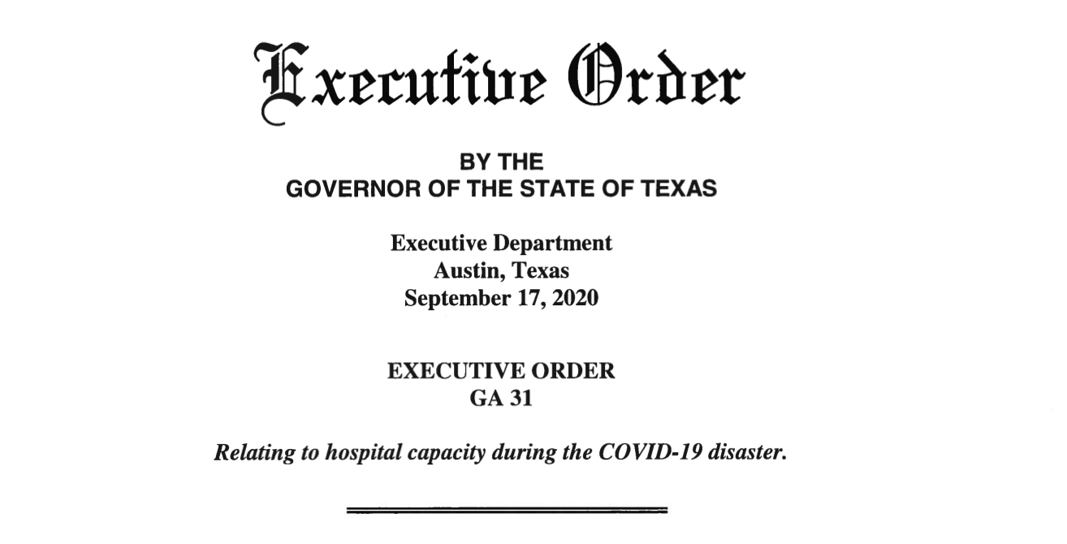
Where are We ?

Slide 10
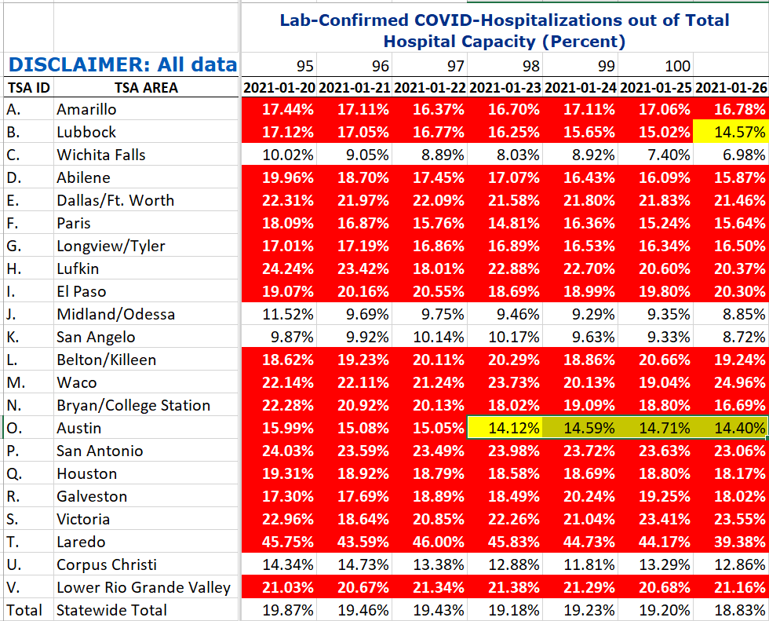
COVID+ HOSPITALIZATIONS BY TSA ID
CONFIRMED COVID+ HOSPITALIZATIONS /HOSPITAL CAPACITY
Last Week
TSA – B
100 DAYS > 15%
1/26 1st day <15%

Slide 11
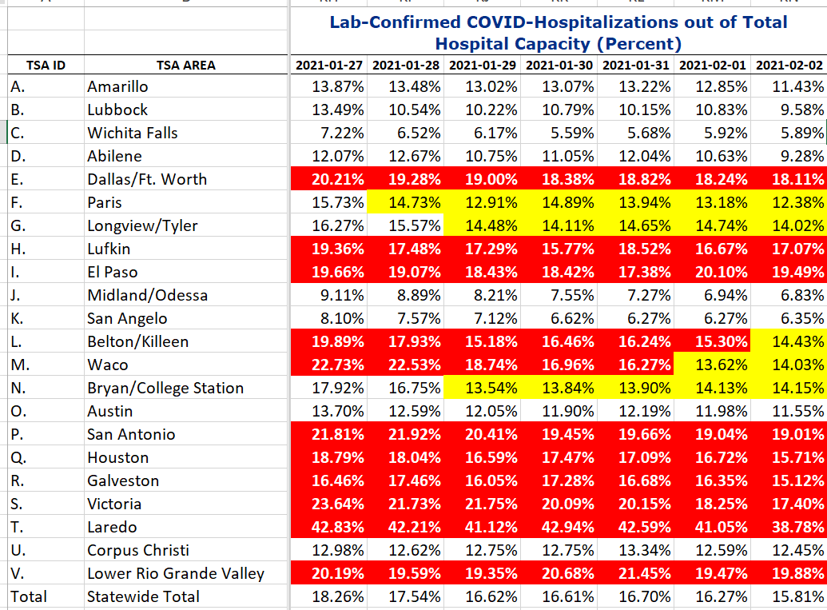
COVID+ HOSPITALIZATIONS BY TSA ID
CONFIRMED COVID+ HOSPITALIZATIONS /HOSPITAL CAPACITY
This Week
11 areas continue to be under Governors Executive Order

Slide 12
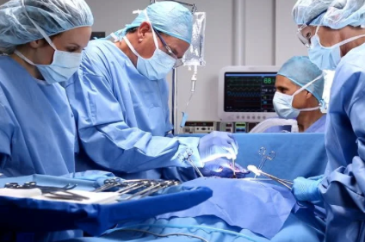
Progressive Resumption of Elective Procedures
Things we must consider:
Staff Availability
OR Crews
Blood Bank Capacity
Supply Chain
COVID Testing of Patients

Slide 13
Caregivers and the Pandemic
How are we holding up?
Charles V. Bayouth, MD
Trauma Medical Director
Covenant Medical Center
Amanda Kuhn
Principal Consultant
Integrated Talent Management

Slide 14

PHYSICIANS AND PTSD IN THE COVID ERA
The COVID-19 pandemic is classifiable as a traumatic event of exceptional magnitude that transcends the range of normal human experience with exposure to risk of death
Benfante A, Di Tella M, Romeo A and Castelli L (2020) Traumatic Stress in Healthcare Workers During COVID-19 Pandemic: A Review of the Immediate Impact. Front. Psychol. 11:569935. doi: 10.3389/fpsyg.2020.569935

Slide 15

PHYSICIANS AND PTSD IN THE COVID ERA
Frontline Medical Personnel have significantly higher levels of fear, anxiety, and depression when compared to colleagues in lower-risk areas
E.M. Huffman, D.I. Athanasiadis, N.E. Anton et al., How resilient is your team? Exploring healthcare providers’ well-being during the COVID-19 pandemic, The American Journal of Surgery, https://doi.org/10.1016/j.amjsurg.2020.09.005

Slide 16

PHYSICIANS AND PTSD IN THE COVID ERA
Increased fear and anxiety are theorized to be psychological vulnerabilities that increase the risk of PTS symptoms or development of PTSD
E.M. Huffman, D.I. Athanasiadis, N.E. Anton et al., How resilient is your team? Exploring healthcare providers’ well-being during the COVID-19 pandemic, The American Journal of Surgery, https://doi.org/10.1016/j.amjsurg.2020.09.005

Slide 17

POST TRAUMATIC STRESS DISORDER
PTSD is the development of three types of characteristic symptoms after an extreme traumatic stressor, which must involve actual or threatened death or serious injury, or a threat to the physical integrity of oneself or others
A. M. Warren, A. L. Jones, S. Shafi et al., Does caring for trauma patients lead to psychological stress in surgeons?, The Journal of Trauma and Acute Care Surgery, Vol. 75, Number 1

Slide 18
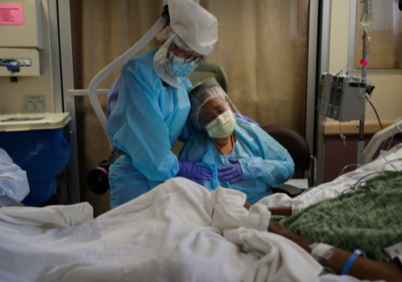
POST TRAUMATIC STRESS DISORDER
The person’s response to the trauma must involve:
  Intense fear
  Helplessness or horror
  A. M. Warren, A. L. Jones, S. Shafi et al., Does caring for trauma patients lead to psychological stress in surgeons?, The Journal of Trauma and Acute Care Surgery, Vol. 75, Number 1

Slide 19

PTSD SYMPTOM CLUSTERS
  Persistent re-experiencing of the traumatic event
  Persistent avoidance of stimuli associated with the trauma or a numbing of general responsiveness
  Persistent symptoms of increased arousal
A. M. Warren, A. L. Jones, S. Shafi et al., Does caring for trauma patients lead to psychological stress in surgeons?, The Journal of Trauma and Acute Care Surgery, Vol. 75, Number 1

Slide 20

PTSD Symptoms
Must continue for more than 1 month
Cause sufficient distress that leads to occupational or social impairment
Not be present before the traumatic event
  A. M. Warren, A. L. Jones, S. Shafi et al., Does caring for trauma patients lead to psychological stress in surgeons?, The Journal of Trauma and Acute Care Surgery, Vol. 75, Number 1

Slide 21

Classic PTSD Symptoms
Hyperarousal
  Disturbed sleep
  Irritability
  Outbursts of anger
  A. M. Warren, A. L. Jones, S. Shafi et al., Does caring for trauma patients lead to psychological stress in surgeons?, The Journal of Trauma and Acute Care Surgery, Vol. 75, Number 1
  A. M. Warren, A. L. Jones, S. Shafi et al., Does caring for trauma patients lead to psychological stress in surgeons?, The Journal of Trauma and Acute Care Surgery, Vol. 75, Number 1

Slide 22

Classic PTSD Symptoms
Avoidance of thoughts, feelings, or conversations associated with the patient’s pain and suffering
Re-experiencing of traumatic events through intrusive thoughts or dreams
Psychological or physiologic distress in response to reminders of patients
A. M. Warren, A. L. Jones, S. Shafi et al., Does caring for trauma patients lead to psychological stress in surgeons?, The Journal of Trauma and Acute Care Surgery, Vol. 75, Number 1

Slide 23

Resources for Assistance with PTSD
Peers, family, friends, communicate thoughts/feelings
Licensed Mental Health Workers
Hospital Resources
CDC.gov Website, How to Cope with Stress and Build Resilience During the COVID-19 Pandemic
Lubbock County Medical Society
  Dr. Lloyd Garland cell (806) 790-7070

Slide 24
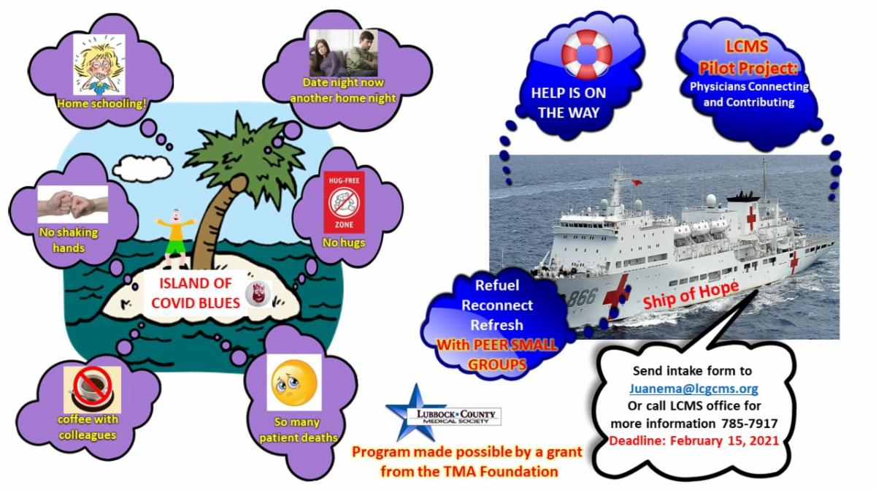
Lubbock County Medical Society

Slide 25
Navigating Stress & Burnout
Covenant Burnout Committee formed in early 2020 – in response to 2019 Caregiver Experience Survey results. The need has only grown & work continues.
Program in Development: Code Lavender
Current Practice: Schwartz Center Rounds
Upcoming Event on April 15th – “Faith in Healthcare” featuring Sheila Walsh hosted by Covenant Foundation

Slide 26
Navigating Stress & Burnout: CODE LAVENDER
Use as a peer-to-peer crisis intervention tool; not a prevention tool​
Code Lavender is a code any caregiver/physician can call for themselves or a teammate when they are being overloaded by stress and traumatic events at work beyond normal levels​
Code triggers a rapid response team to deploy to the location to provide assessment and immediate intervention
Interventions provided may provide prayer, relaxation/zen room/mindfulness practices, referrals & connection to mental health professional support
Systemizes support in cases of traumatic outcomes, communicating to caregivers (1) this work is stressful; (2) your needs are important; and (3) support can be systemized in case of traumatic outcomes​
Training begins for peer-nominated responders in Feb 2021

Slide 27
Anti-pyretic and Non-steroidal Anti-inflammatory Drug Prophylaxis Prior to Immunization
Requested Follow-up

Slide 28



Slide 29
Should acetaminophen or nonsteroidal antiinflammatory drugs be taken prior to vaccination to prevent postvaccination symptoms?
Although these drugs could decrease subjective side effects, theoretically they could also blunt immune response and make the vaccines less effective — hence they are not recommended before vaccination. They are useful, however, in diminishing side effects once they occur.
Acetaminophen is preferred for pregnant women.

Slide 30
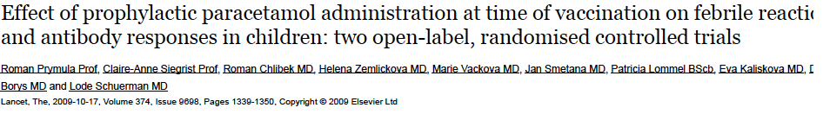
Lancet 2009
Interpretation
Although febrile reactions significantly decreased, prophylactic administration of antipyretic drugs at the time of vaccination should not be routinely recommended since antibody responses to several vaccine antigens were reduced.

Slide 31
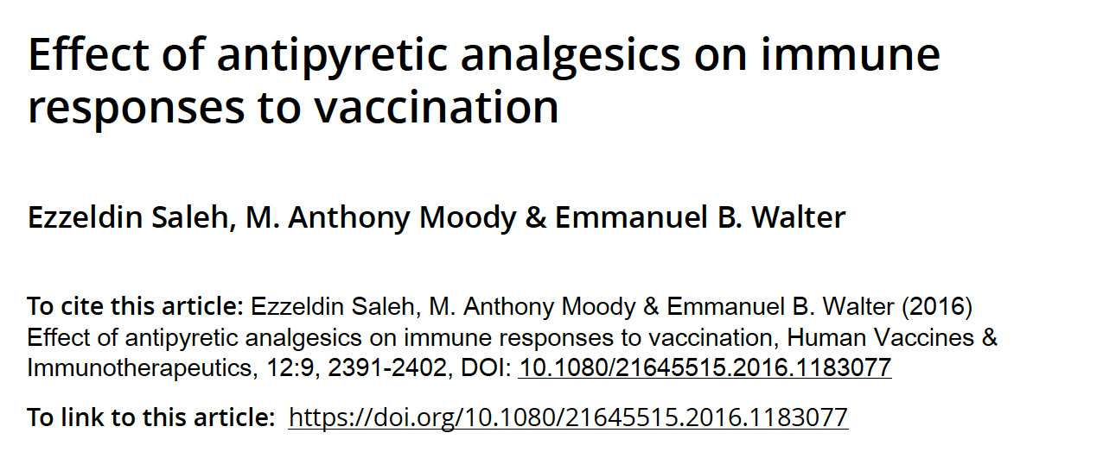
Human Vaccines & Immunotherapeutics 2016

Slide 32
Abstract
While antipyretic analgesics are widely used to ameliorate vaccine adverse reactions, their use has been
associated with blunted vaccine immune responses. Our objective was to review literature evaluating the effect of antipyretic analgesics on vaccine immune responses and to highlight potential underlying mechanisms.
Observational studies reporting on antipyretic use around the time of immunization concluded that their use did not affect antibody responses. Only few randomized clinical trials demonstrated blunted antibody response of unknown clinical significance. This effect has only been noted following primary vaccination with novel antigens and disappears following booster immunization.
The mechanism by which antipyretic analgesics reduce antibody response remains unclear and not fully explained by COX enzyme inhibition. Recent work has focused on the involvement of nuclear and subcellular signaling pathways. More detailed immunological investigations and a systems biology approach are needed to precisely define the impact and mechanism of antipyretic effects on vaccine immune responses.

Slide 33
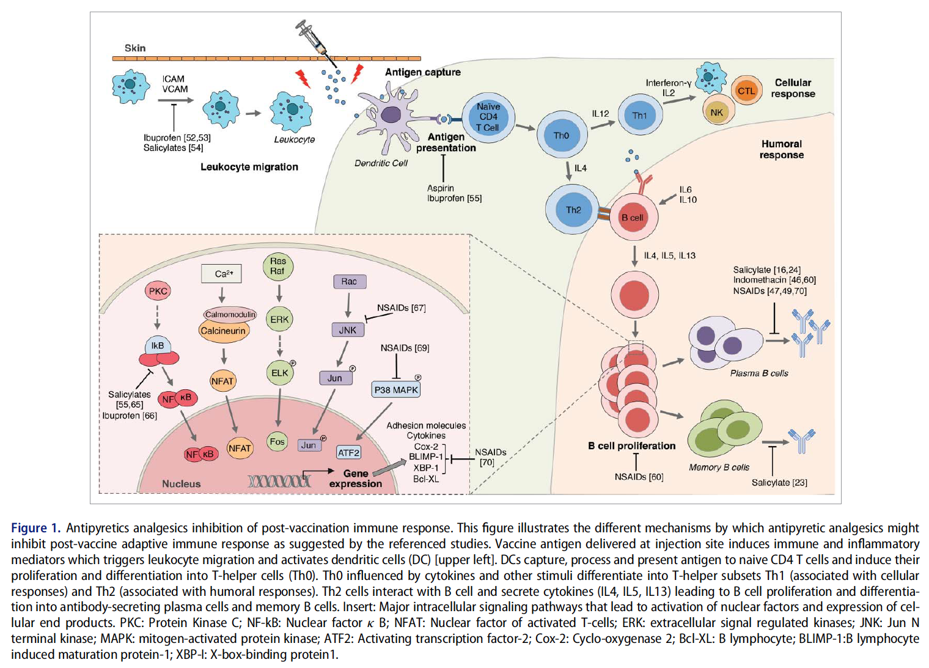

Slide 39
The relationship between novel antigen exposure, timing of antipyretic use and vaccine response
The timing of antipyretic analgesic administration, and vaccination with novel antigens appear to be important determinants of humoral immune response following vaccination. In all studies that reported decreased immunogenicity with antipyretic
prophylaxis, the significant negative impact on immune response was evident only when antipyretics were given at time of vaccination and not when they were given as a treatment thereafter.^{9,38,39}
…These laboratory data correlate with human studies, such as antibody blunting in the 2009 Prymula study that occurred only in the primary vaccine series “novel antigens” and not when booster vaccines were given

Slide 40
World Health Organization
In a recent policy statement, WHO advised against administration of prophylactic oral analgesics due to lack of evidence of effectiveness and/or the potential for affecting vaccine response.
WHO Weekly Epidemiological Record 25 September 2015; 90(39): 505-510

Slide 41
World Health Organization
In a recent policy statement, WHO advised against administration of prophylactic oral analgesics due to lack of evidence of effectiveness and/or the potential for affecting vaccine response.
WHO Weekly Epidemiological Record 25 September 2015; 90(39): 505-510

Slide 42
SUPER BOWL WEEKEND
Brian Schroeder, MD
CMO Covenant Medical Center

Slide 43
SUPER BOWL WEEKEND
SPREADER
Brian Schroeder, MD
CMO Covenant Medical Center

Slide 44
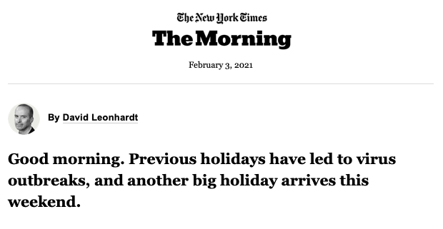


Slide 45
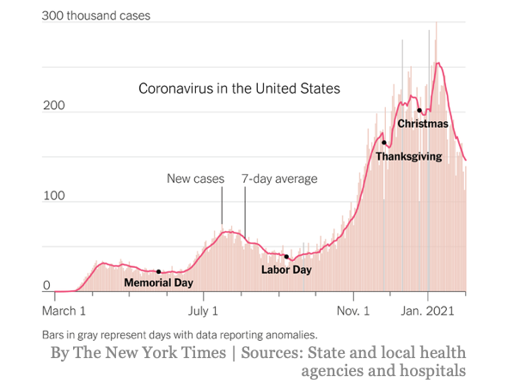

Slide 46
Current Regional Covid-19 Census

Slide 47
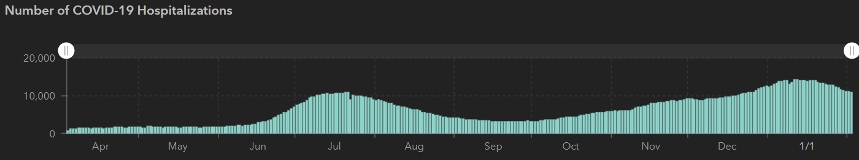
State of Texas Hospitalizations
 | 1/18 | 1/24 | 2/1 | 2/4
Cases | 1,864, 249 | 1,965,585 | 2,087,170 | 2,120,299
Deaths | 32,084 | 34,394 | 36,539 | 37,288
Hospitalizations | 13,858 | 13,564 | 11,766 | 10,827
STATE

Slide 48
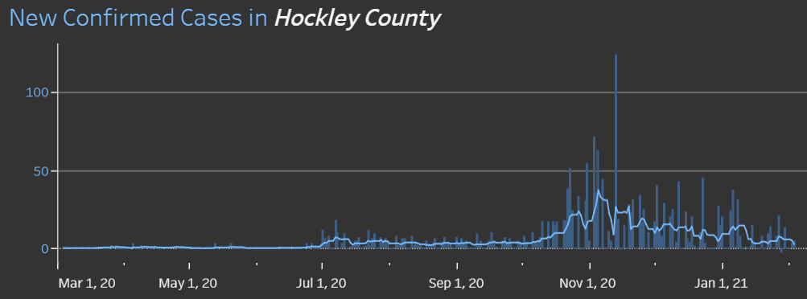
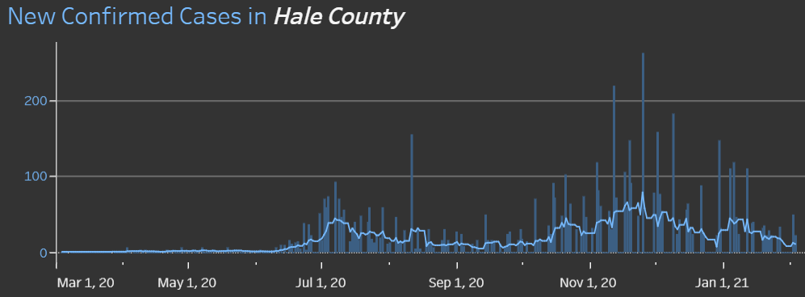
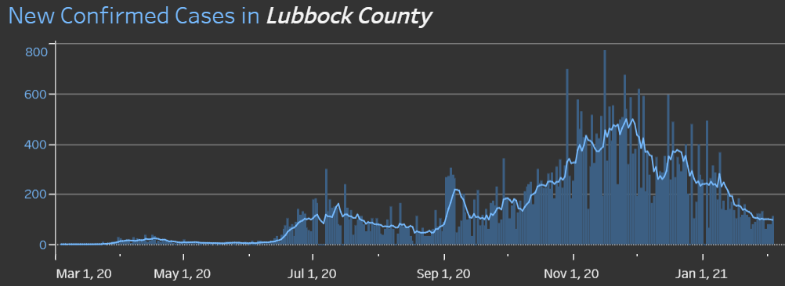
COUNTIES
1/11 110 new cases
14.5 %
Positivity Rate
1/13 144

Slide 49
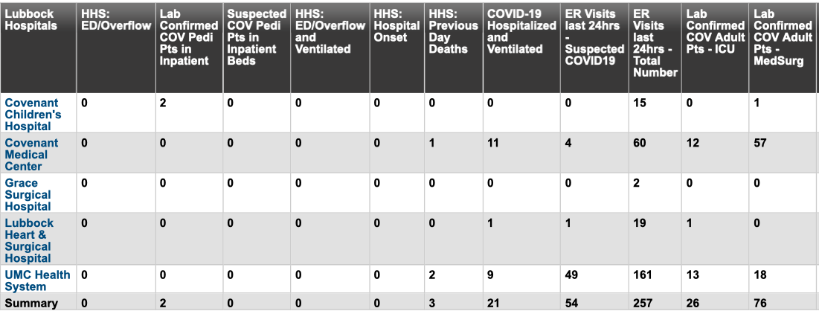
Lubbock This Morning
CMC COVID IP Census = 69 CCH IP Census = 2 UMC IP Census = 31 LHH IP Census = 1

Slide 50
Surge Plans

Slide 51
Surge Plan
Covenant Medical Center
 | ICU | Med Surg | Total
Phase 1 | 10-CICU |  | 10
Phase 2 | 17-CICU | 10-HC4 | 27
Phase 3 | 17-CICU | 24-HC4 | 41
Phase 4 | 17-CICU | 24-HC4 15-S 10(East) | 63
Phase 5 | 17-CICU | 24-HC4 15 – S 9 (East) 15-S 10(East) | 71
Phase 6 | 17-CICU 16-MICU 15-S10 | 24-HC4 13-HC6 31 – S 9 (all) | 103
Phase 7 | 17-CICU 16-MICU 15-S 4 15 S10 | 24-HC4 31 – S 9 (all) | 118
Phase 8 | 8-E4 17-CICU 16-MICU 15-S 4 | 24-HC4 13-HC6 31 – S 9 (all) 15 S10 | 139
Currently
Last Week

Slide 52
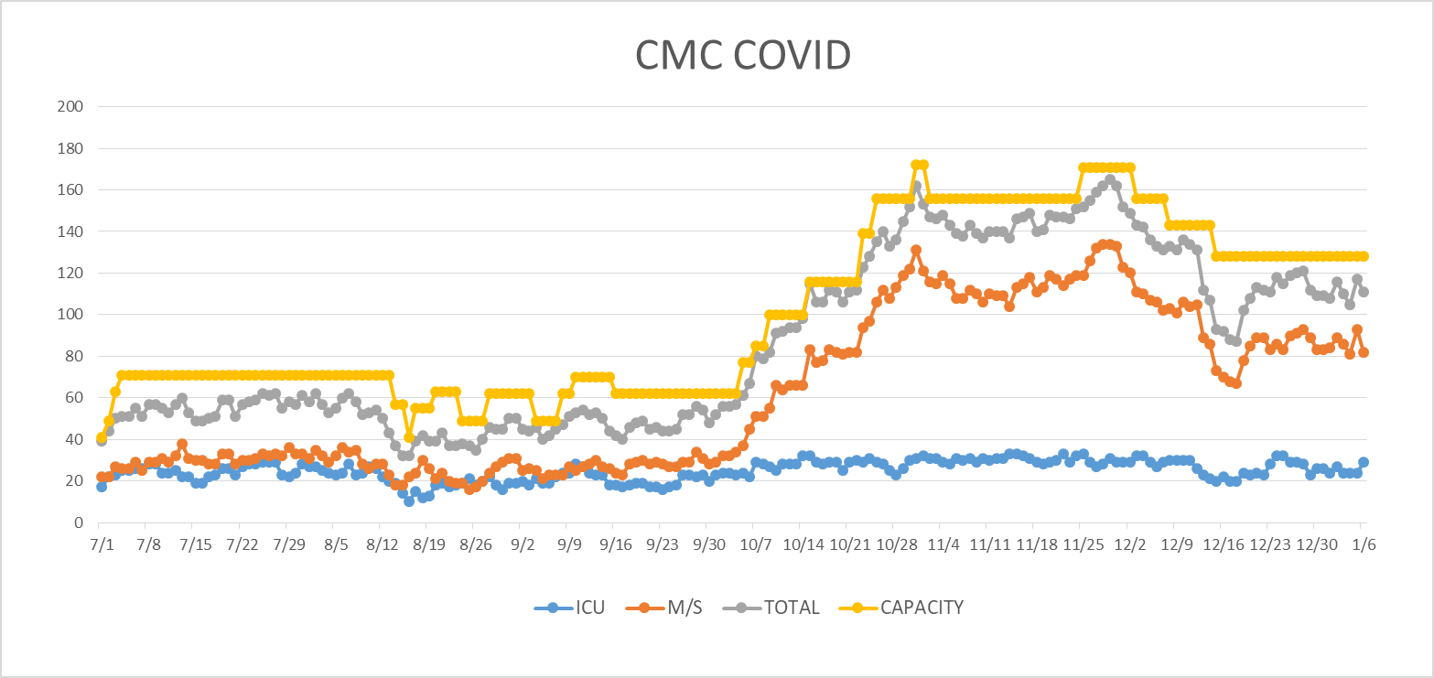
COVID Units - CMC
1/7/2020
UPDATE

Slide 53
Caregiver Update

Slide 54
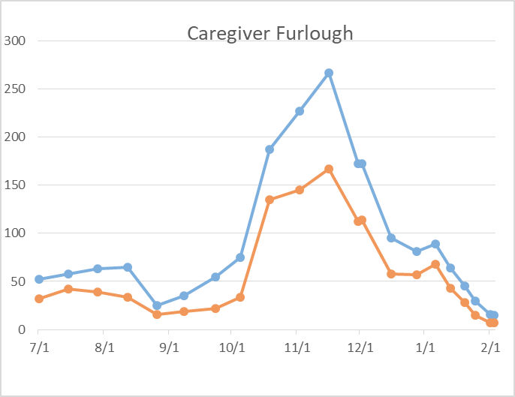
Caregivers
COVID Related Furloughs
Count reflects # furlough (exposed and positive)
Good
Moderate
Critical

Slide 55
Statistics
William Sommer
Clinical Data Analyst
Quality and Clinical Data Analytics
Covenant Health

Slide 56
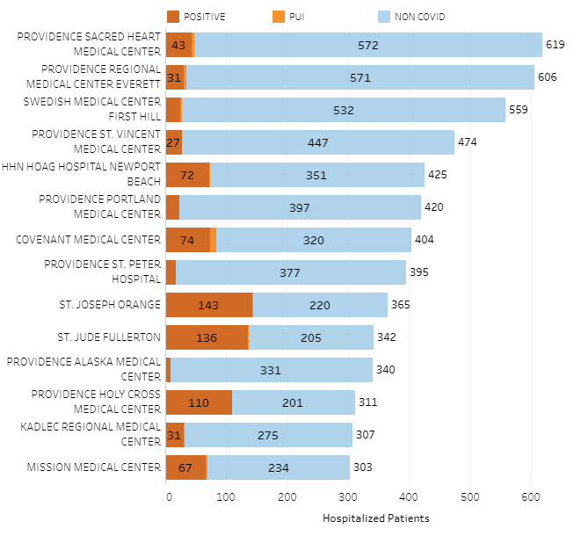
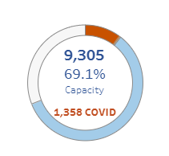
Providence System Hospitalized COVID-19 Cases

Slide 57
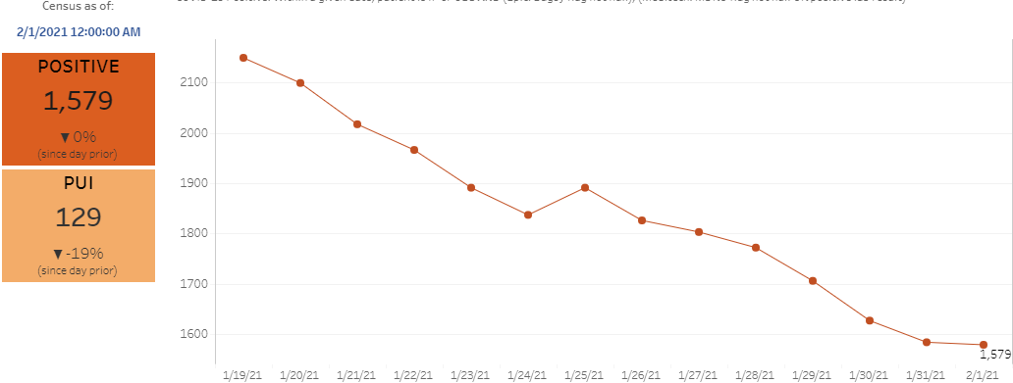
Providence Inpatient COVID-19 Volume

Slide 58
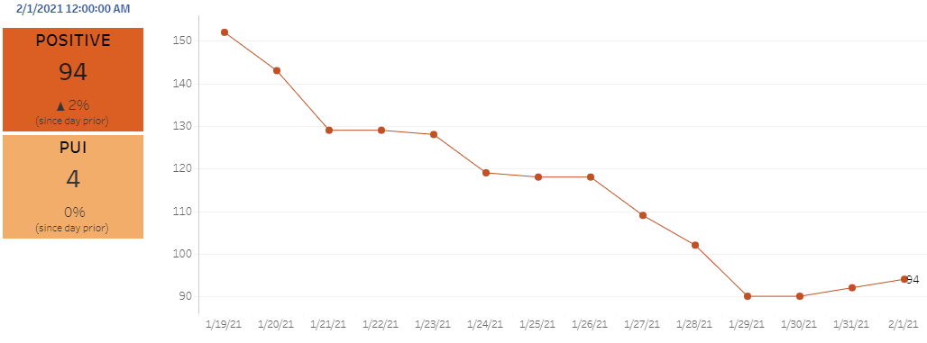
Texas Inpatient COVID-19 Volume

Slide 59
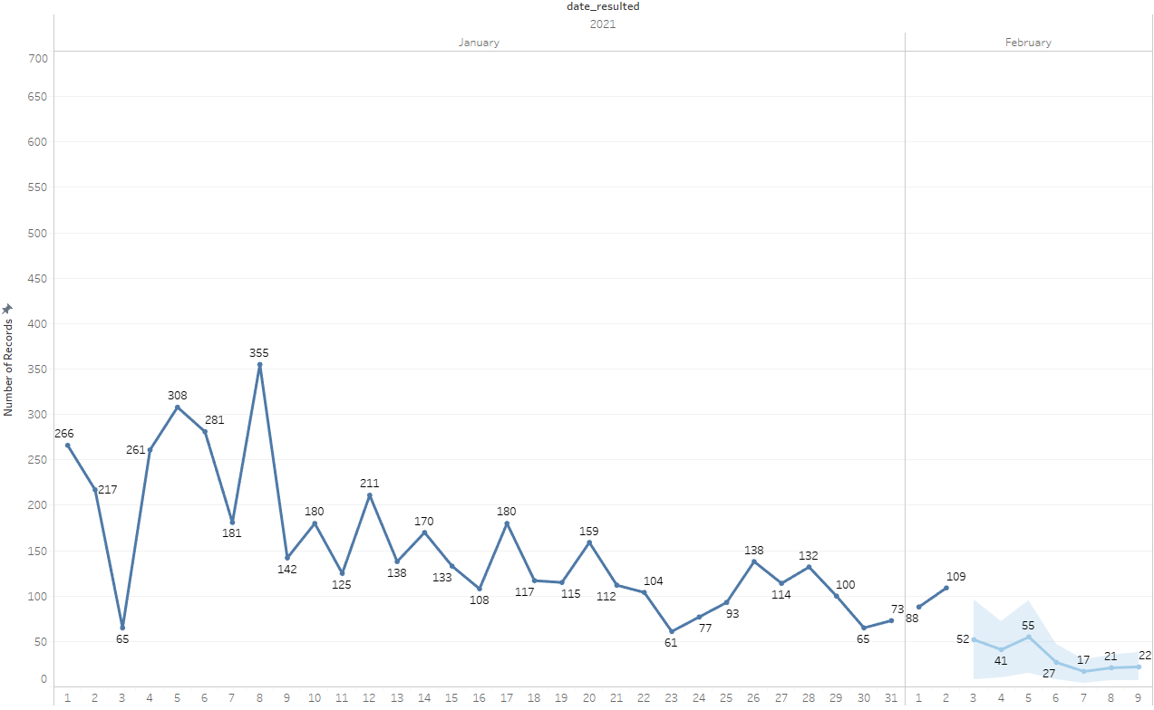

City of Lubbock COVID + Forecast

Slide 60
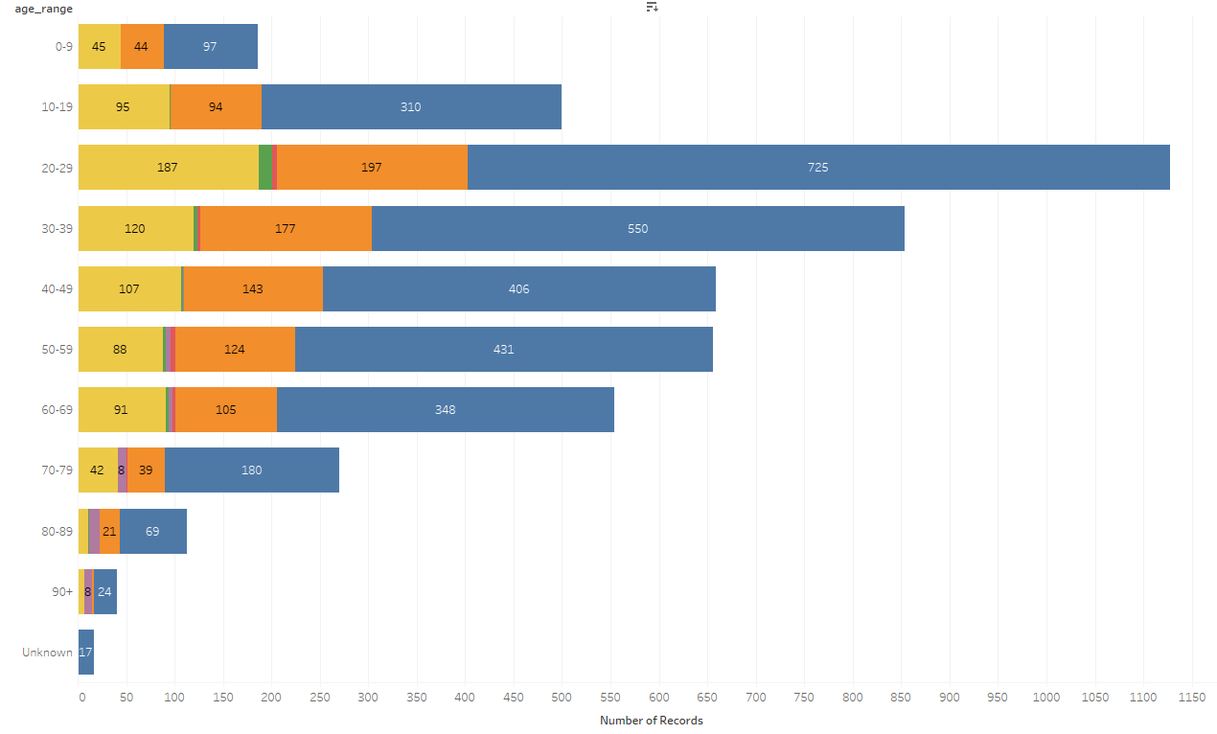
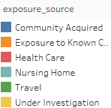
City of Lubbock COVID + Age Distribution

Slide 61
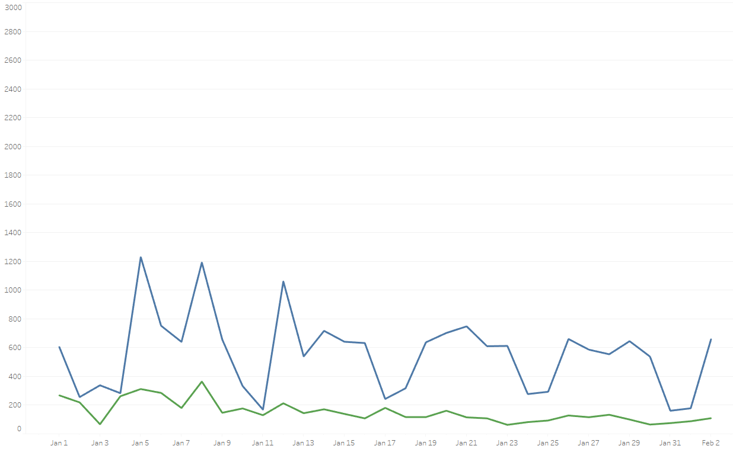

City of Lubbock Daily Tests Performed

Slide 62
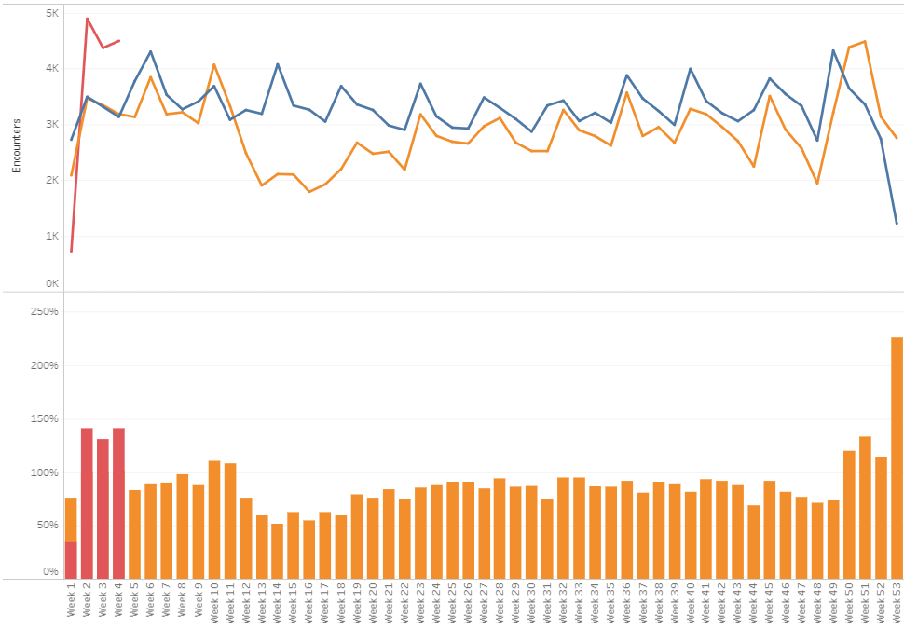

TX/NM Region Weekly Year Over Year

Slide 63
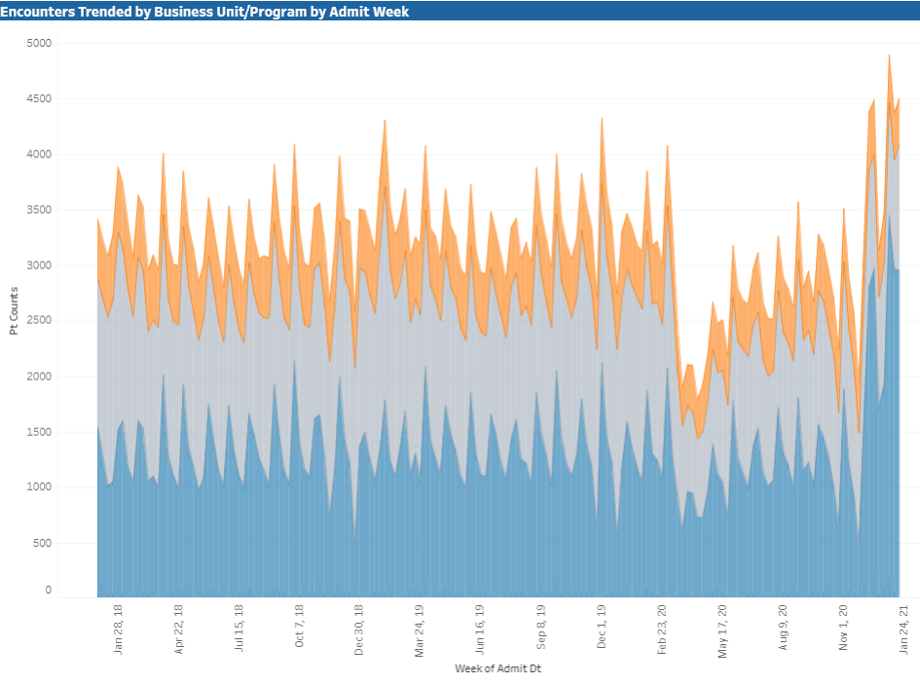

TX/NM Region Patient Encounters

Slide 64
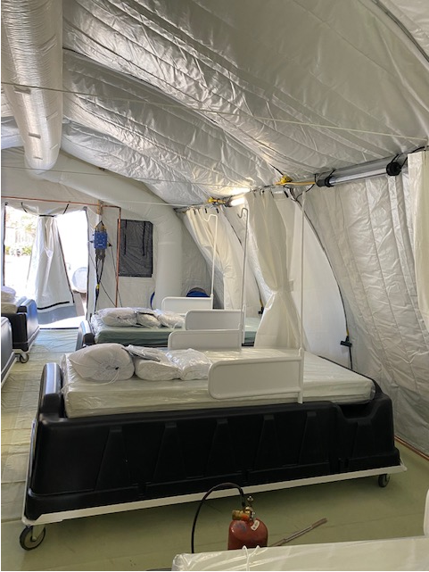
COVID Infusion Center
Status Update
Prakesh Shrestha, MD
Dennis Duriex, MD

Slide 65
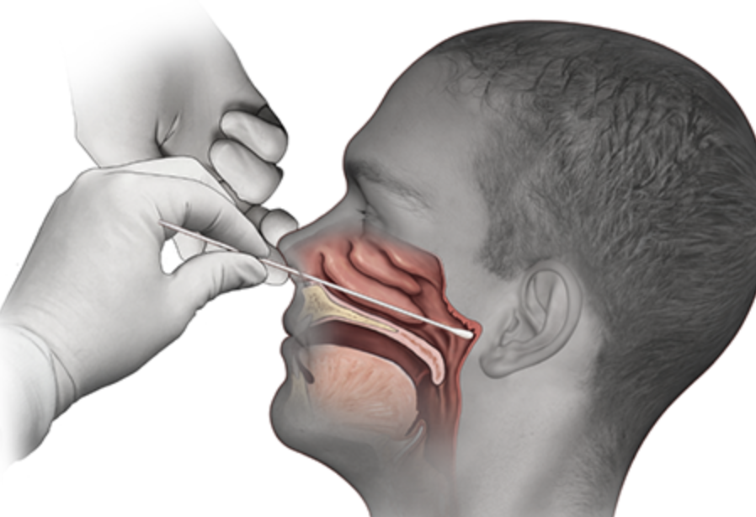
Covid-19 Testing
Jason Loos, MD
Ameripath

Slide 66
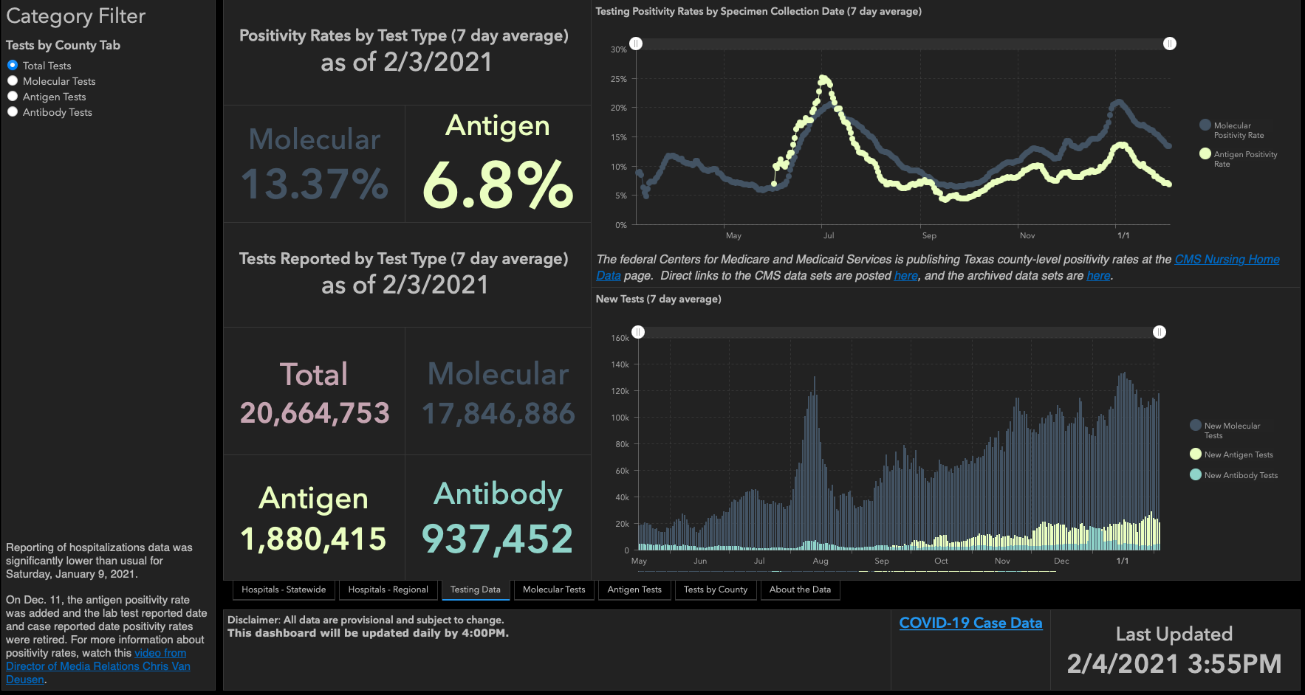

Slide 67
TESTING
 | CMC |  | GMC |  | CMG
 | Rapid | PCR | Rapid | PCR | Rapid
Test Kits
Swabs
VTM
 | CMC |  | GMG/CMG
 | Tests | + | Tests | +
2/4
2/3 | 126 | 2 | 58 | 12
2/2 | 154 | 8 | 145 | 25
PCR
Rapids
>2000 >750
<2000 <750
<1600 <500
CMC- no issues
GMG- no issues
CMG- no issues

Slide 68
Pharmacy Update
Wesley Wells, PharmD
Regional Pharmacy Director
Covenant Health

Slide 69
Therapeutics Update
Numbers are reported as of February 3 at 11:00 pm
COVID Tent numbers are as of February 2 at 11:00 pm
Medication | Current State |  | Updates/Issues
Remdesivir |  |  | We have dispensed 367 vials to the COVID tent We have treated 79 patients Preparing to close the “tent” on February 26
Bamlanivimab (Lilly) |  |  | No updates
Casirivimab and Imdevimab (Regeneron) |  |  | No updates
Zanubrutinib | Patients enrolled: 6 | Active patients: 0 | No updates
Regeneron 2066 | Patients enrolled: 3 (5 screened) | Active patients: 0 | No updates
EXIT COVID-19 Trial | Patients enrolled: 10 (11 screened) | Active patients: 0 | No updates
Ministry | 7-Day Average | Stock
Covenant Medical Center | 9 | 249
Covenant Children’s Hospital | 1 | 28
Covenant Plainview | 2 | 46
Covenant Levelland | 0 | 46
Home Infusion | 1.5 | 34
Covenant Hobbs | 5 | 18
Ministry | Total Doses Infused | Stock
CMC/Home Infusion | 610 | 78
Covenant Plainview | 30 | 63
Covenant Levelland | 17 | 56
Covenant Hobbs | 8 | 81
Ministry | Total Doses Infused | Stock
CMC/Home Infusion | 146 | 61
Covenant Plainview | 0 | 35
Covenant Hobbs | 0 | 37

Slide 70
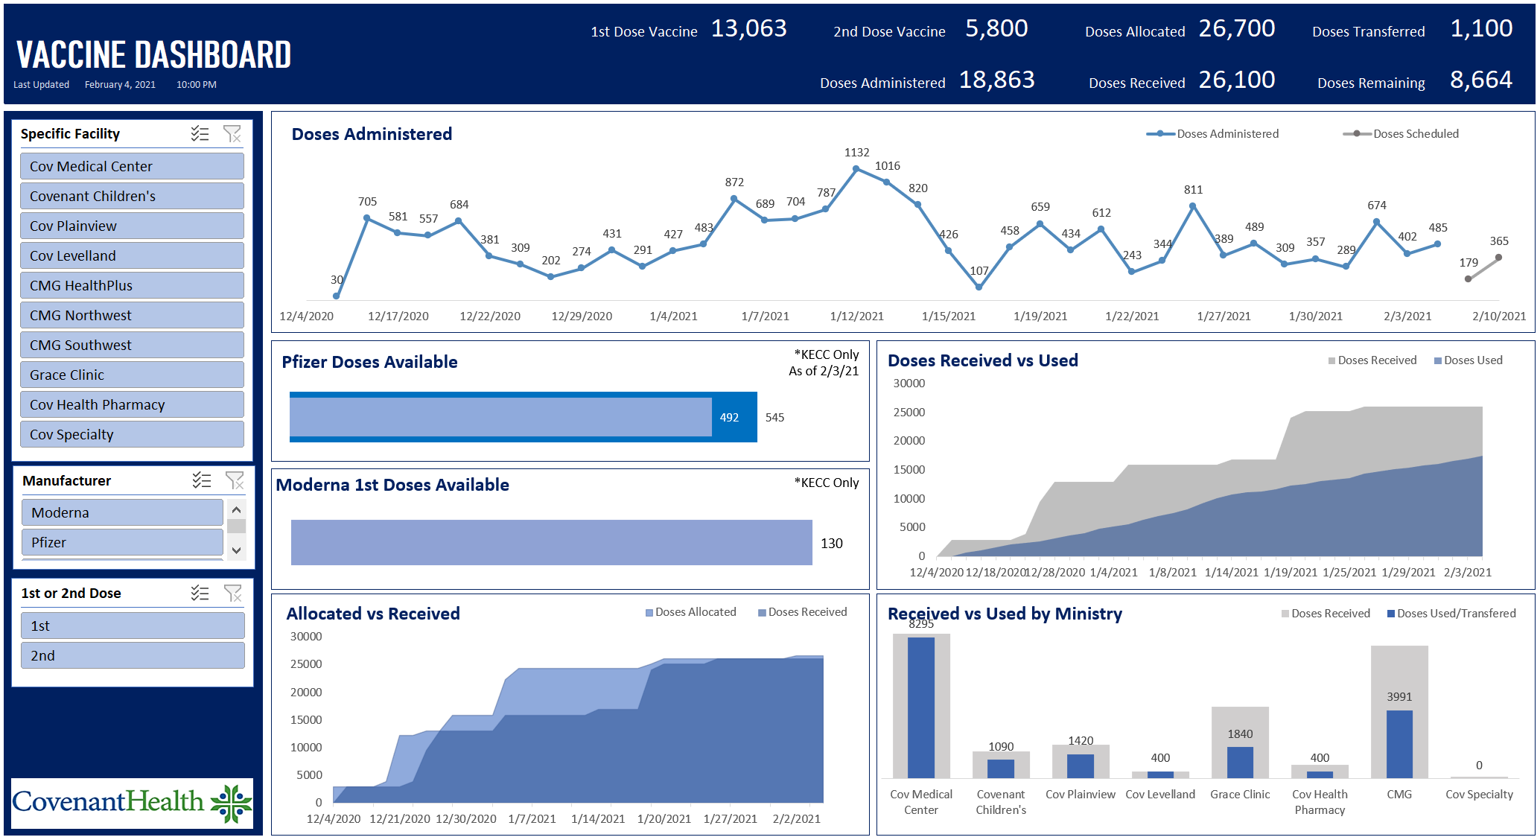
Vaccine Update

Slide 71
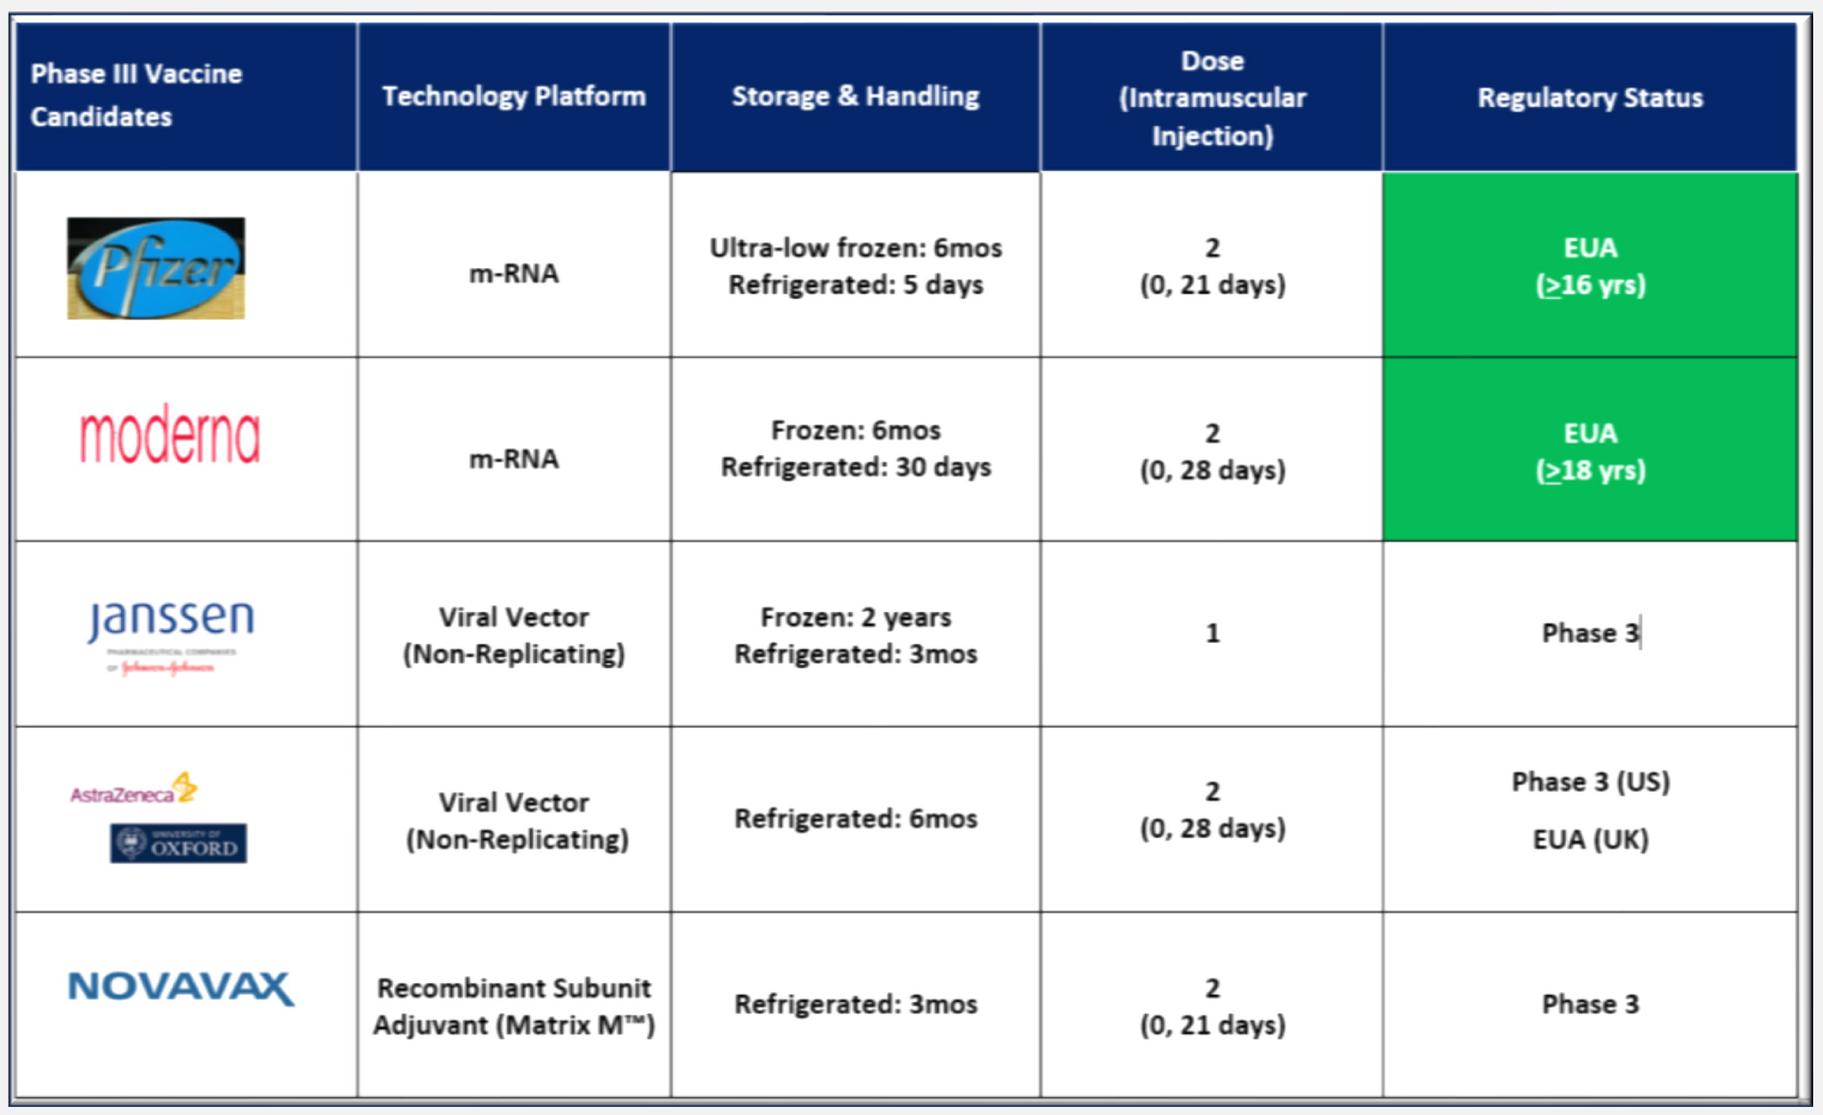
Vaccine Candidates
Notes:
Janssen single dose COVID-19 vaccine showed 72% vaccine efficacy in the US.57% efficacy noted among trial participants in South Africa, where 95% of the cases in the study were due to lineage B.1.351.
Additionally, efficacy was shown to be higher (85%) in preventing severe disease across all eight countries.
NovavaxCOVID-19 vaccine, 2-dose regiment (Day 0 & Day 21, IM) showed 89.3% vaccine efficacy in the UK study with over half of the cases were the now-predominant UK variant strain.
NovavaxCOVID-19 vaccine, 2-dose regiment (Day 0 & Day 21, IM) showed 60% vaccine efficacy in the South Africa study with majority of the cases were escape variant.
Initiated development of new constructs against the emerging strains as a booster and/or combination bivalent vaccine with plans to initiate clinical trials in 2Q21
Ongoing Phase 3 study in the US with target date to finish enrollment in February 2021
Ongoing Phase 3 study in the US with target date to finish enrollment in February 20.
Moderna will test an additional booster dose of its COVID-19 Vaccine (mRNA-1273) to study the ability to further increase neutralizing titers against emerging strains beyond the existing primary vaccination series.
Moderna is advancing an emerging variant booster candidate (mRNA-1273.351) against the B.1.351 variant first identified in the South Africa into preclinical studies and Phase 1 study in the US.
Pfizer conducted in-vitro study using the full set of UK strain spike mutations using sera of participants from a previous study. The study concluded their vaccine will prevent COVID-19 caused by the UK virus variant.
Moderna has initiated a study of its mRNA1273 in healthy adolescents 12 to < 18 years of age.
Pfizer has fully enrolled its adolescent COVID-19 vaccine trial with 2,259 participants aged 12 to 15 years.
Pfizer plans to start a new study in children aged 5 to 11 years later this year.

Slide 72
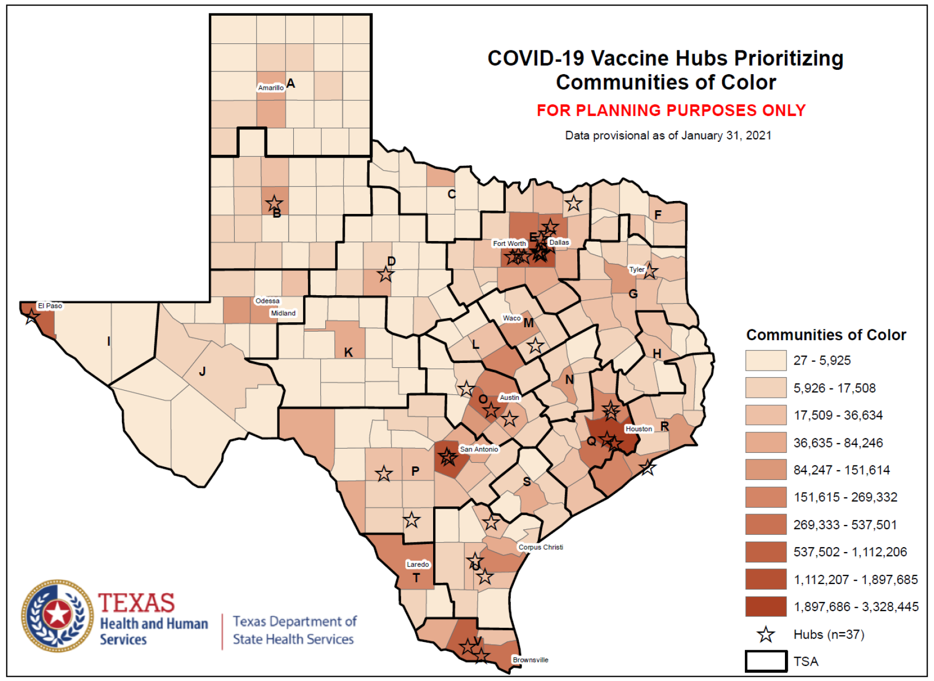
Racial Equality
State surveyed Hubs (n=82) on vaccination opportunities
  37 had plans for vaccinating communities of color
ImmTrac2 requiring documentation of race and ethnicity
Concerns over new candidates
  New technology
  Effectiveness

Slide 73
Vaccine Updates
  Levelland received 600 doses of Moderna from Muleshoe
    Muleshoe is a Texas hub
    Plan a mass vaccination event for Friday, February 5
  National push to get vaccines out to pharmacies
    Texas is focused on working with those with a large footprint
  Week 9 Texas Allocation Planning
    380,475 doses going to 407 providers in 132 counties
    Priority
      All 82 hubs, newly approved hospitals, newly approved providers in under allocated counties, legislative request, LTCF, FQHC, TDCJ request, dialysis, request

Slide 74

Texas Demographics

Slide 75
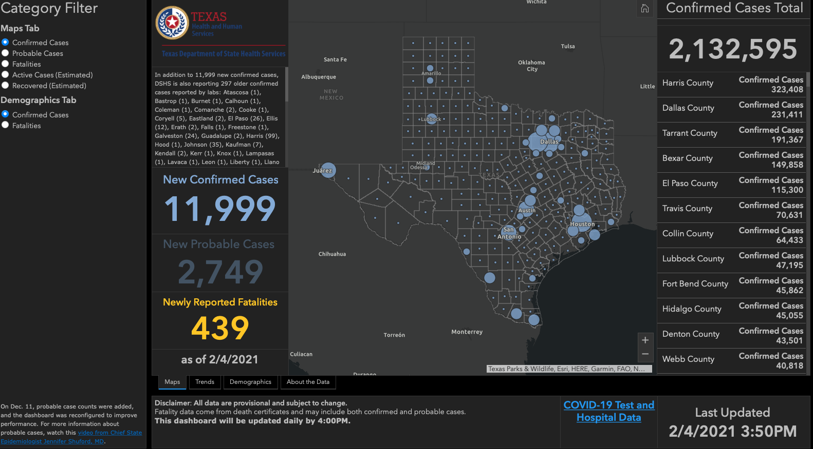

Slide 76
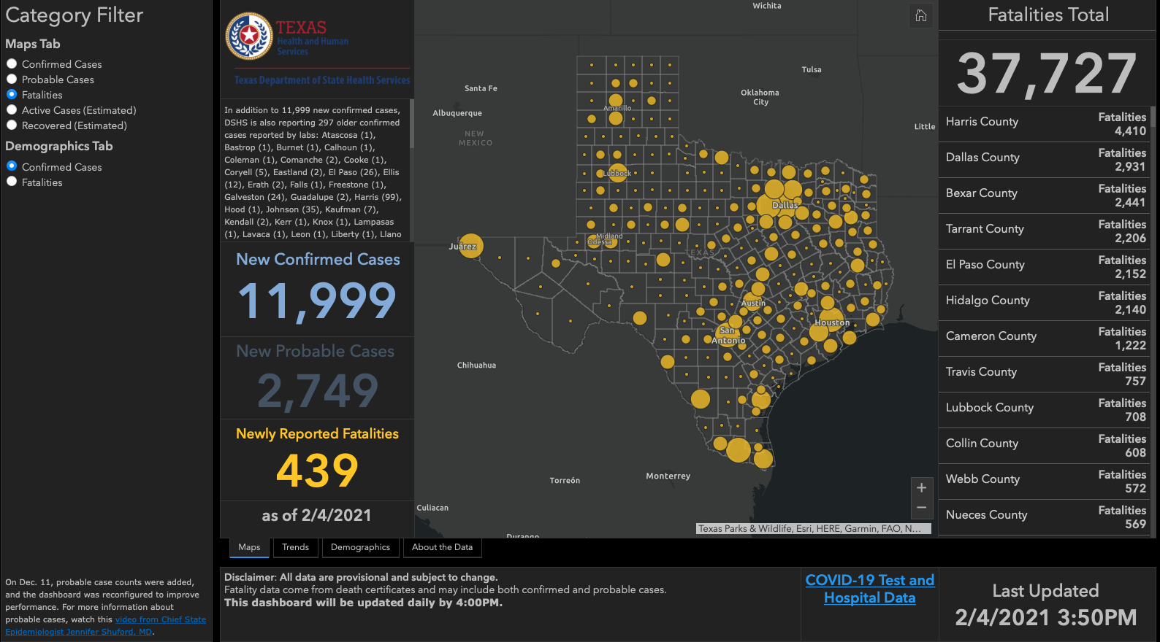

Slide 77
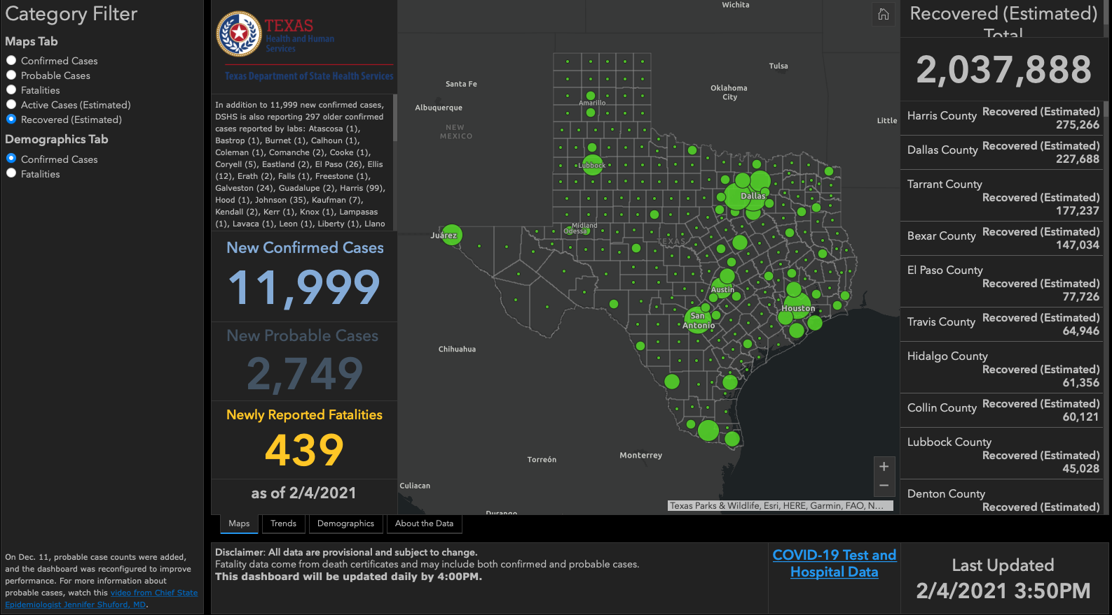

Slide 78
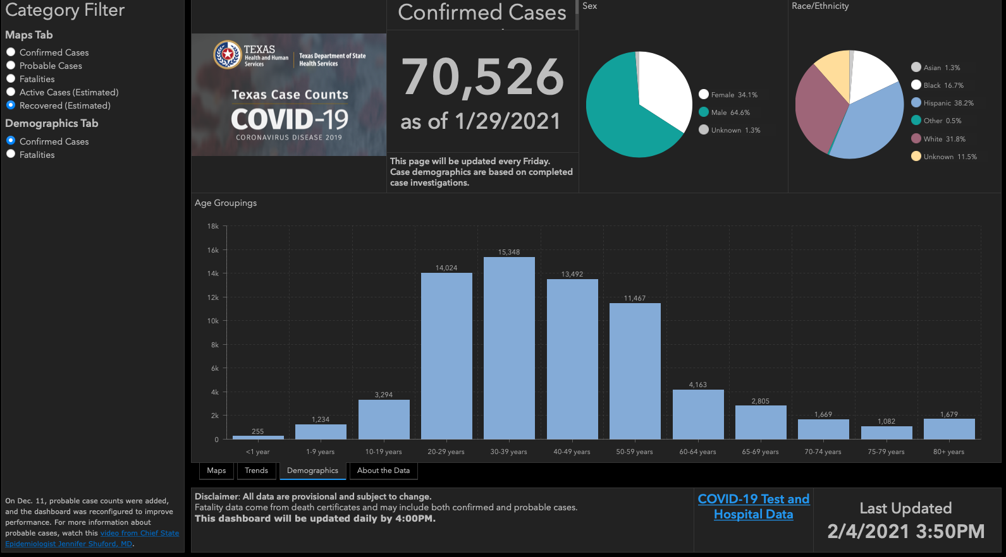

Slide 79
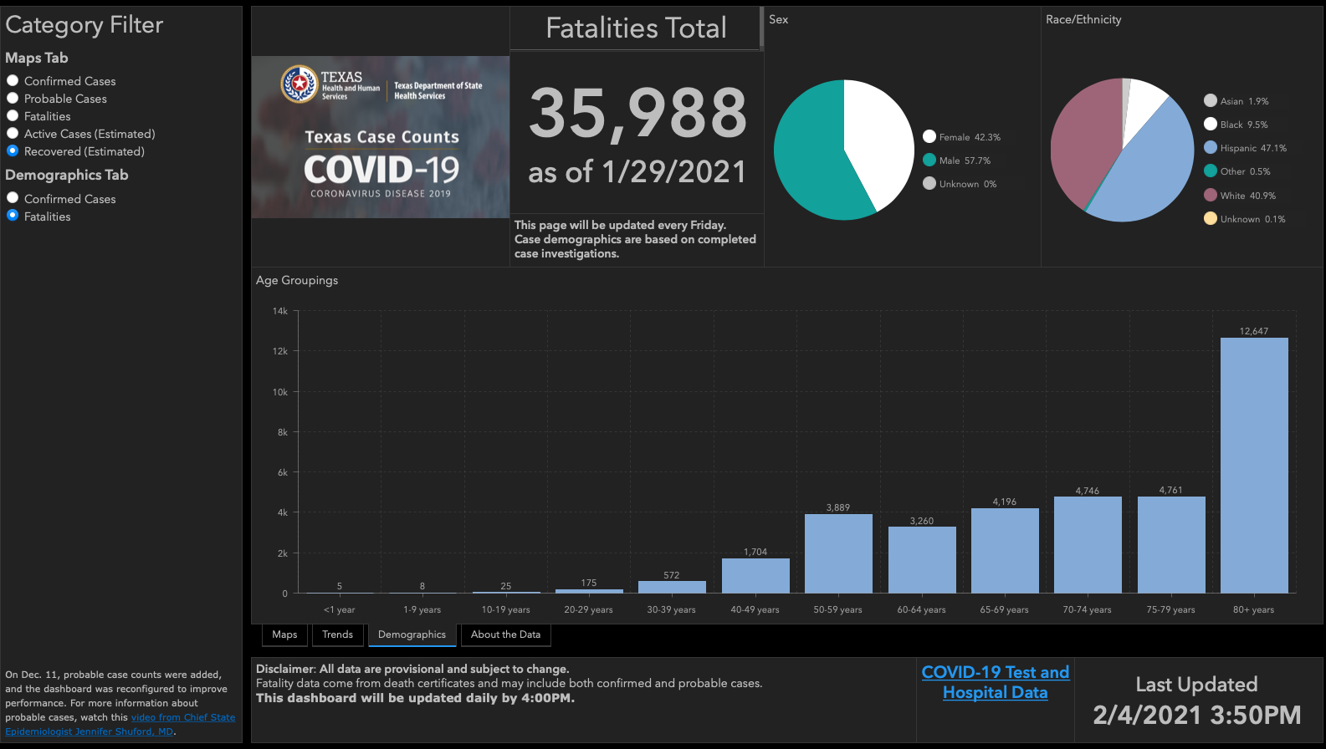

Slide 80
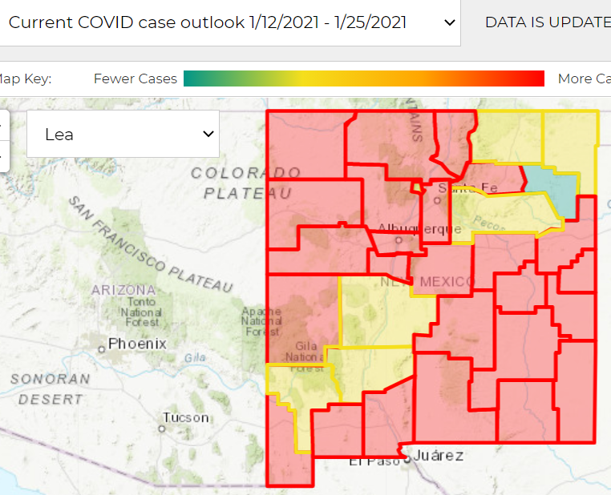
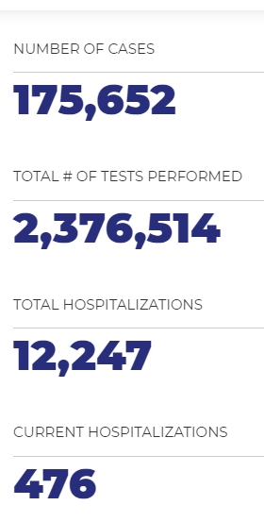
NEW MEXICO

Slide 83
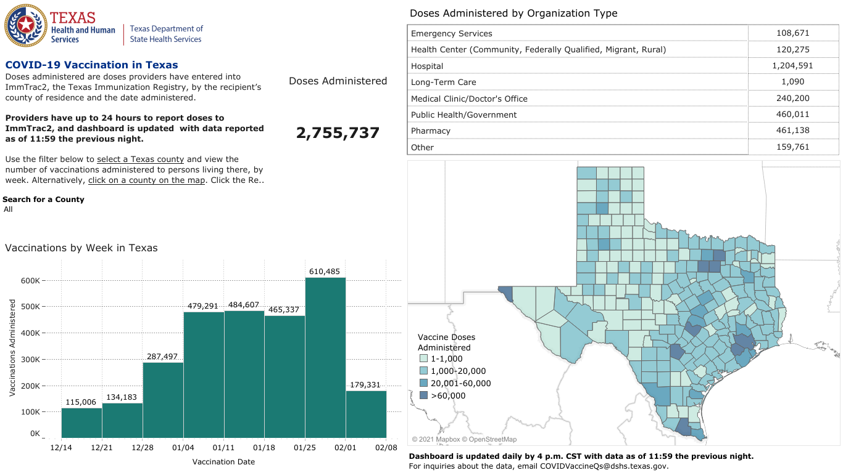

Slide 84
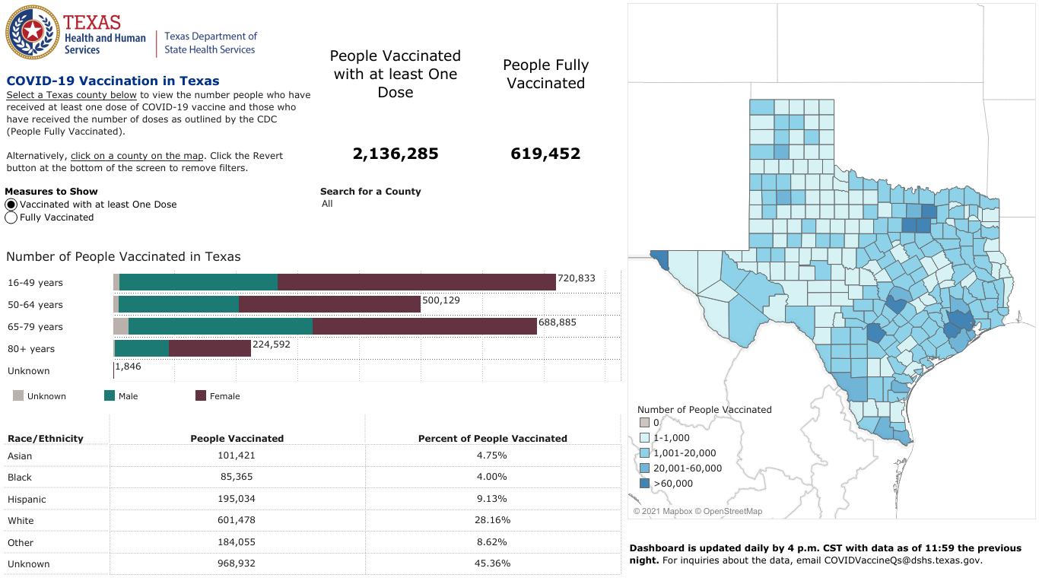

Slide 85
Q & A

Slide 86
CME Credit was only approved for the Live Teams meeting
To receive credit for this continuing education activity, the participant must:
  Make sure you are logged into your Teams account, if you are signed in with a group provide attendee’s First and Last name(s) in the comments section.
  If you are calling into the Teams meeting you MUST text your First & Last Name to (806) 252-4735. This will ensure you are added to the sign in sheet to receive CME Credit.
  You will receive an email by the following Wednesday from the CME department with further instructions on claiming your certificate.

