Slide 1
Covenant Health
Regional Update for Physicians
August 14, 2020

Slide 2

Reflection
Amy Compton-Phillips, MD
EVP, Chief Clinical Officer
Providence St. Joseph Health

Slide 4
Safety Story
Brian Schroeder, MD MBA FACP
CMO Covenant Medical Center

Slide 5
Current Regional Census

Slide 6
Regional
 | Lubbock |  | Hockley |  | Hale
 | 8/10 | 8/12 | 8/10 | 8/12 | 8/10 | 8/12
Total | 6222 | 6365 | 204 | 204 | 1285 | 1307
Active | 1749 | 1677 | 53 | 53 | 134 | 103
Deaths | 81 | 84 | 4 | 4 | 31 | 33
New | 143 |  | 0 |  | 22

Slide 7
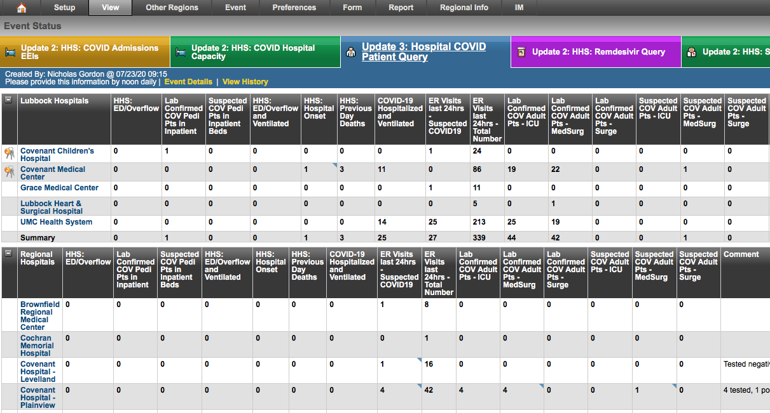
Regional - Lubbock

Slide 8
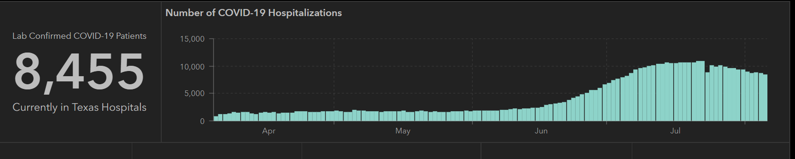
STATE
Last Week
 | 8/5 | 8/3 | 7/29 | 7/22 | 7/15 | 7/8 | 7/1
Cases | 459,887 | 442,014 | 403,307 | 351,618 | 282,365 | 210,585 | 168,062
Deaths | 7497 | 7015 | 6190 | 4348 | 3432 | 2715 | 2481
Hospitalized | 8455 | 8819 | 9595 | 10,893 | 10,471 | 9286 | 6904

Slide 9
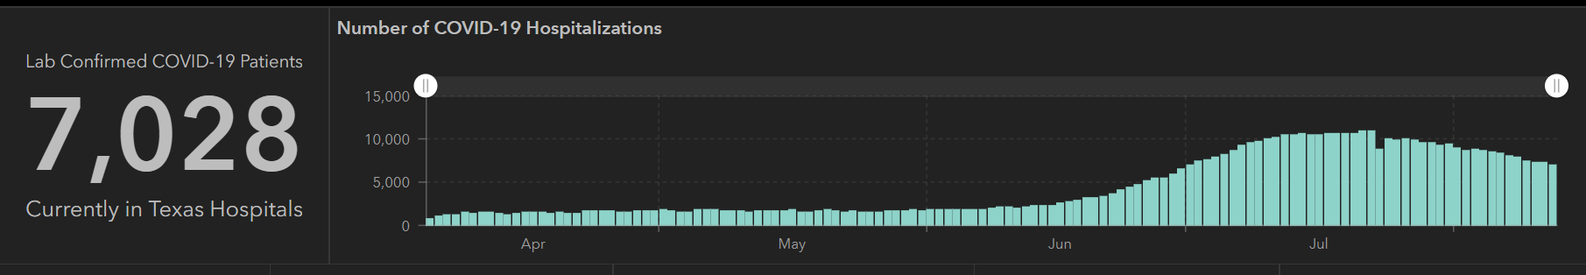
STATE
 | 8/12 | 8/10 | 8/5 | 7/29 | 7/22 | 7/15 | 7/8 | 7/1
Cases | 506,820 | 490,817 | 459,887 | 403,307 | 351,618 | 282,365 | 210,585 | 168,062
Deaths | 9034 | 8490 | 7497 | 6190 | 4348 | 3432 | 2715 | 2481
Hospitalized | 7028 | 7304 | 8455 | 9595 | 10,893 | 10,471 | 9286 | 6904

Slide 10
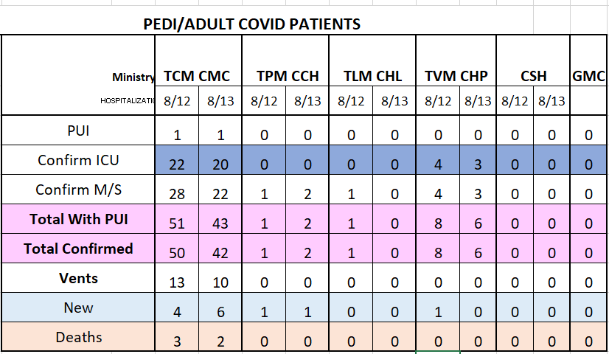
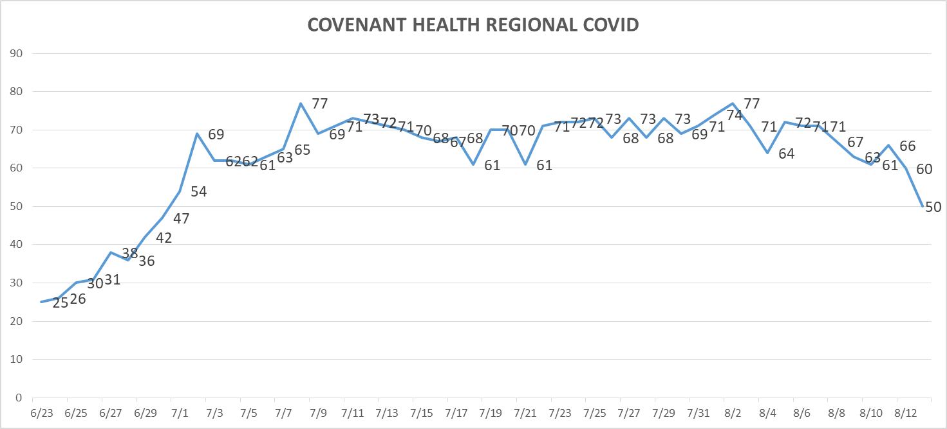
PUI/Confirmed cases-hospitalized

Slide 11
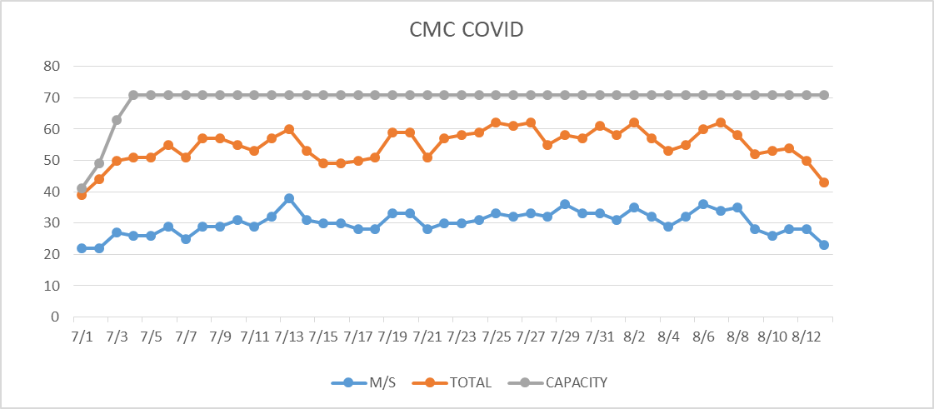
PUI/Confirmed cases-hospitalized
Transfers to COVID unit are from routine locations –
40% COVID pts are transfers

Slide 12
Surge Plan
Covenant Medical Center
 | ICU | Med Surg | Total
Phase 1 | 10-CICU |  | 10
Phase 2 | 17-CICU | 10-HC4 | 27
Phase 3 | 17-CICU | 24-HC4 | 41
Phase 4 | 17-CICU 8-MICU | 24-HC4 14-Pal Med | 63
Phase 5 | 17-CICU 16-MICU | 24-HC4 14-Pal Med | 71
Phase 6 | 17-CICU 16-MICU 8- SICU 4 (east) | 24-HC4 14-Pal Med 15 – S 9 (east) | 94
Currently
Last Week

Slide 13
Caregivers
COVID Related Furloughs
Important to wear masks in meeting areas
Count reflects # furlough (exposed and positive)
Good
Moderate
Critical

Slide 14
Release from Isolation Precautions

Slide 15
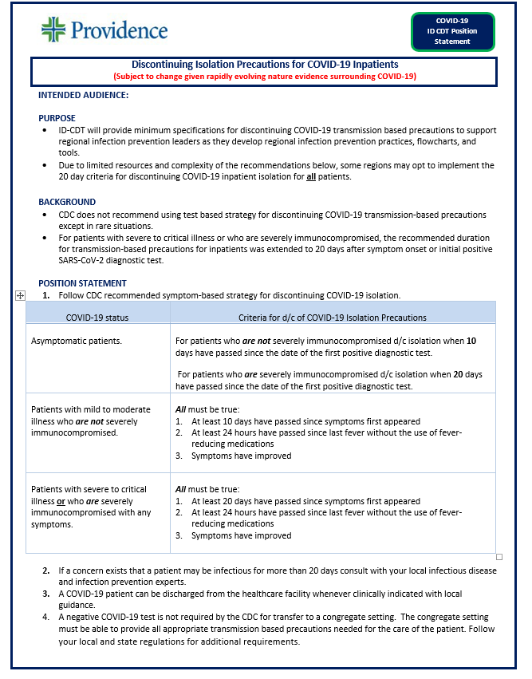
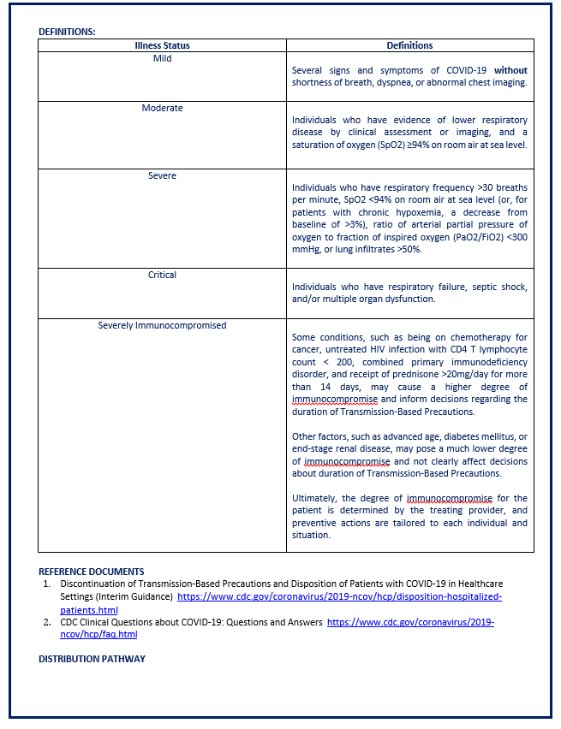
Position statement revisions
Discontinuing Isolation precautions for covid-19 inpatients
Approved

Slide 16
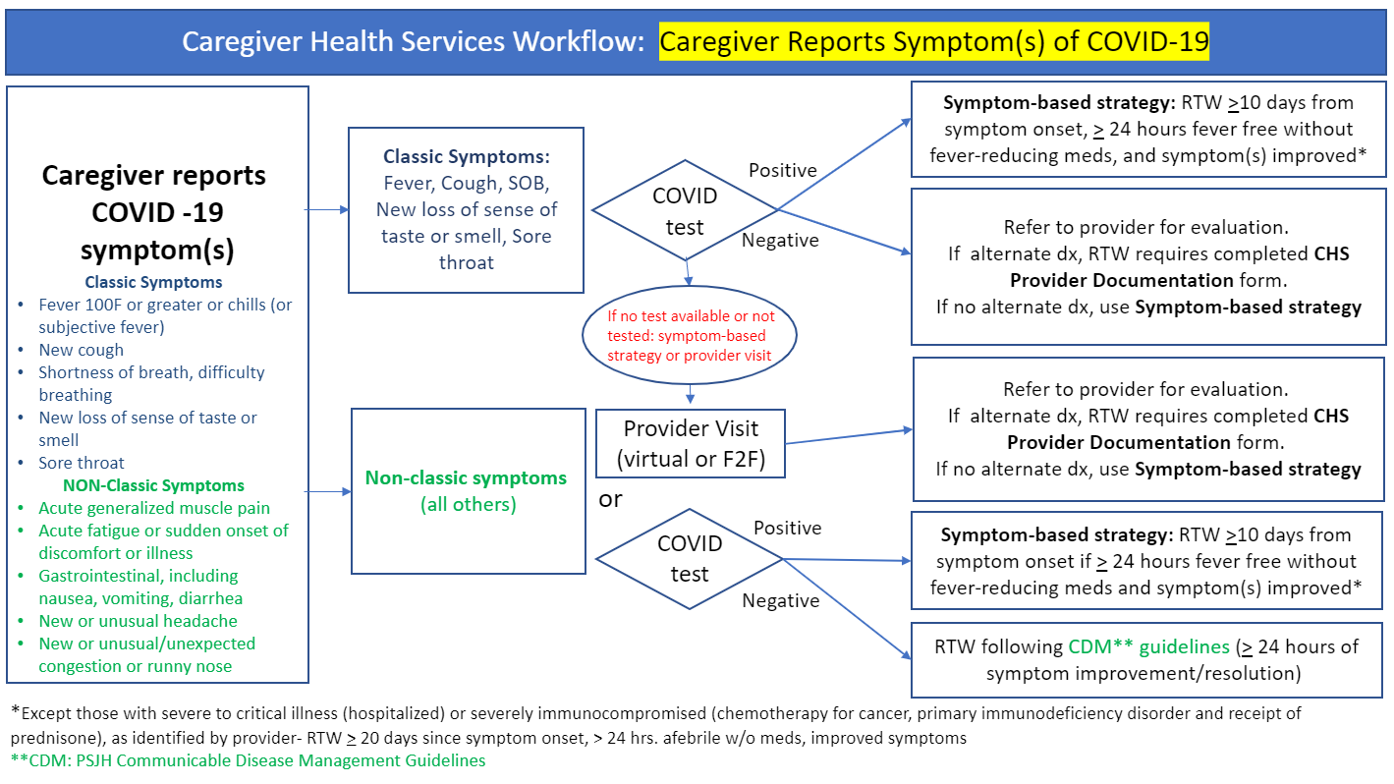
Position statement revisions
Return to work for caregivers
Approved

Slide 17
Statistics
Sean Glenn
Senior Clinical Data Analyst
Decision Support Services
Covenant Health

Slide 18
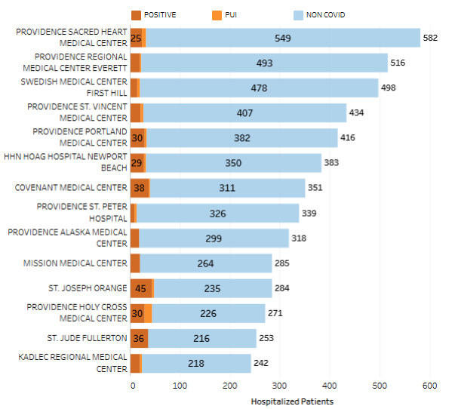
Providence System Hospitalized COVID-19 Cases

Slide 19
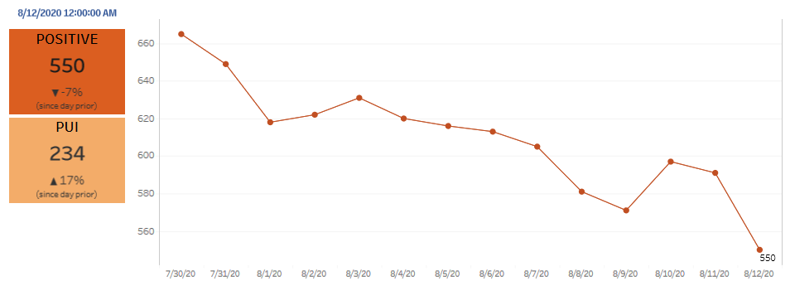
Providence Inpatient COVID-19 Volume

Slide 20
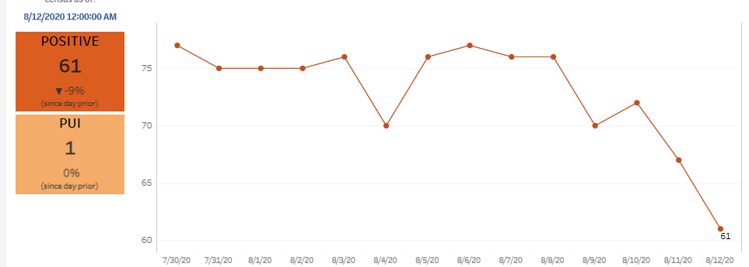
Texas Inpatient COVID-19 Volume

Slide 21
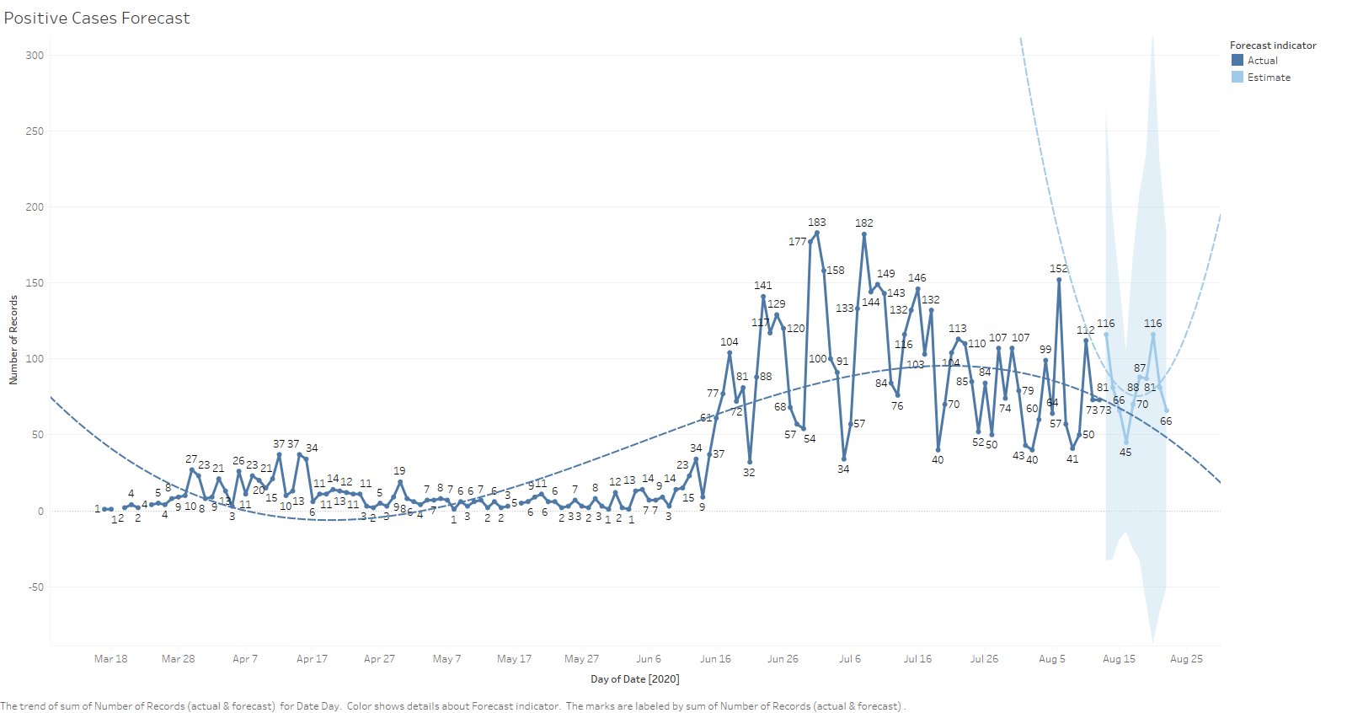
New Covid-19 POSITIVES by Day Trend

Slide 22
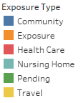
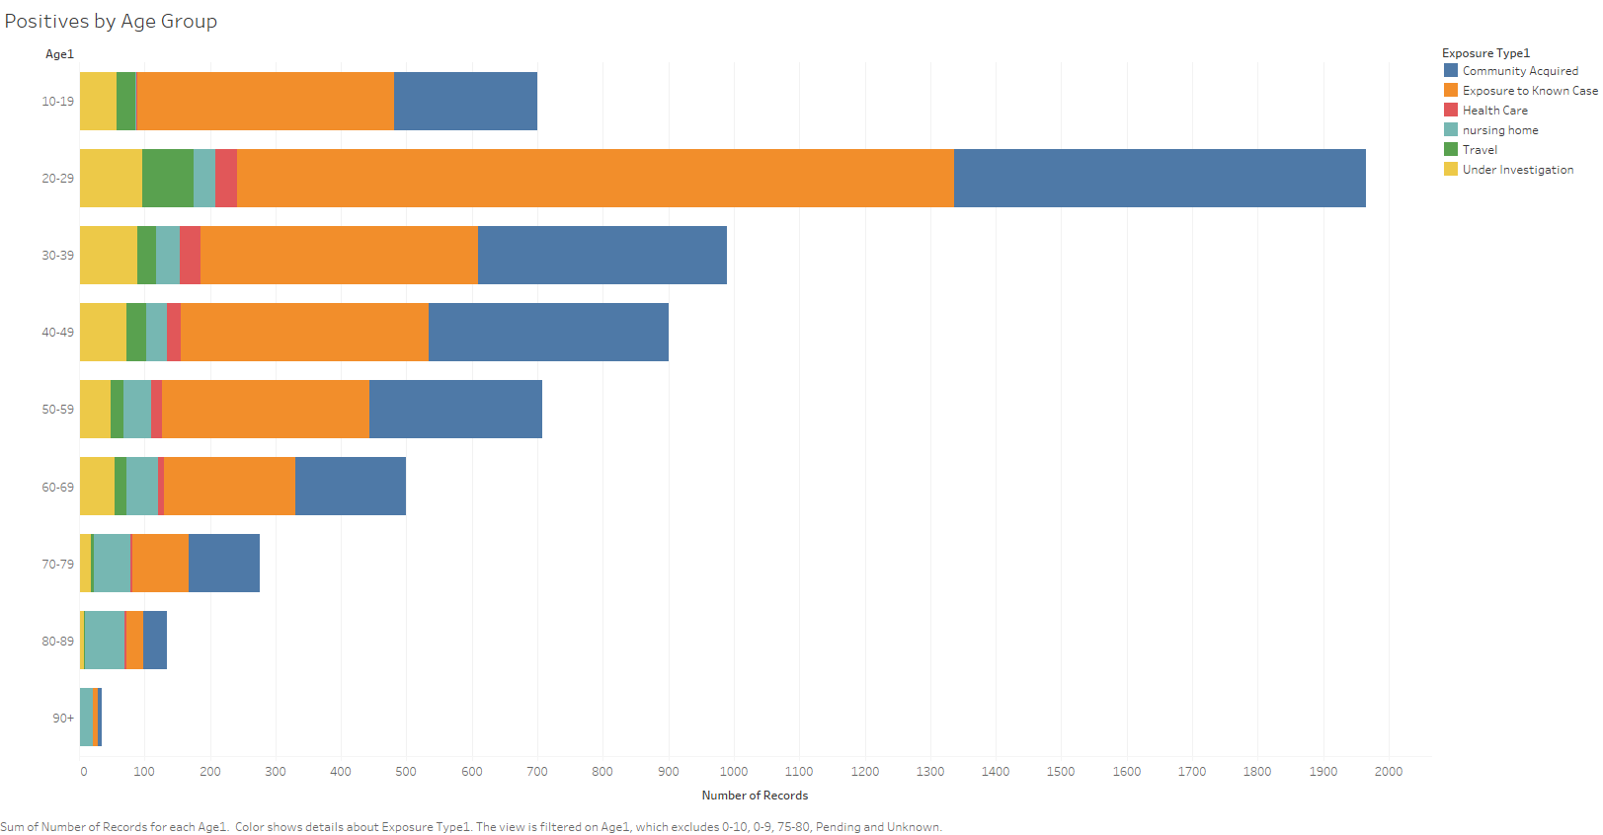
Covid-19 POSITIVES Age Distribution

Slide 23
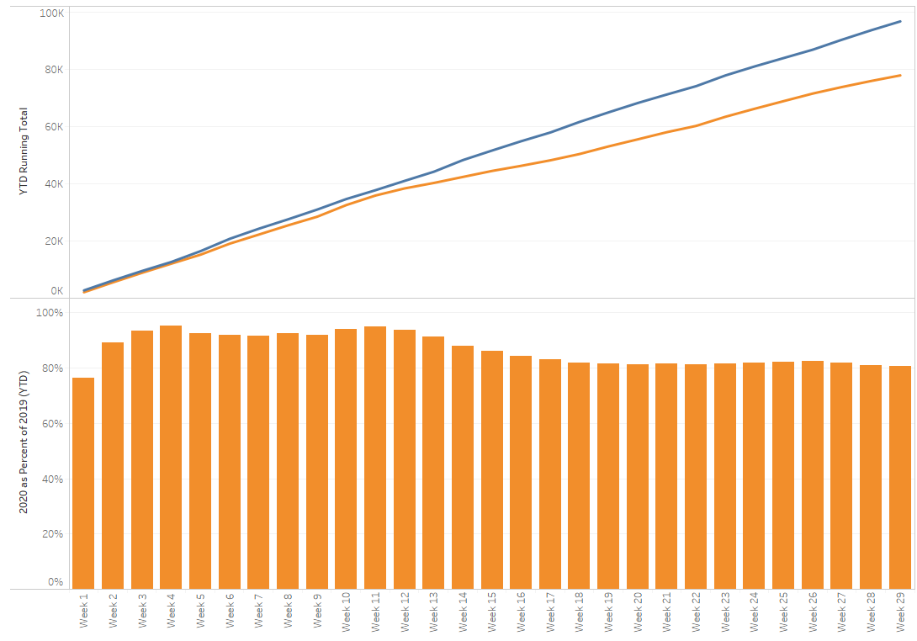
TX/NM Region Weekly Procedures (YOY)

Slide 24
Covid-19 Testing
The entire country is struggling to provide adequate testing capacity

Slide 25
TESTING
 | Availability
Abbott | 1512
Cepheid | 940
Alinity M | 4024
BD Max | -
NP Swab | >10,000
VTM | >1500
 | CMC |  | GMG/CMG
 | Tests | + | Tests | +
8/10 | 59 | 5 | 0 | 0
8/11 | 217 | 42 | 208 | 28
8/12 |  |  | 166 | 32
Cumulative Performed |  |  | 16,683 | 2150
Alinity M turn around time is about 2 hours – using this platform for asymptomatic screens
CMG received half a shipment on Friday, hoping for the other half today.
Children’s Hospital developing a testing algorithm for children

Slide 26
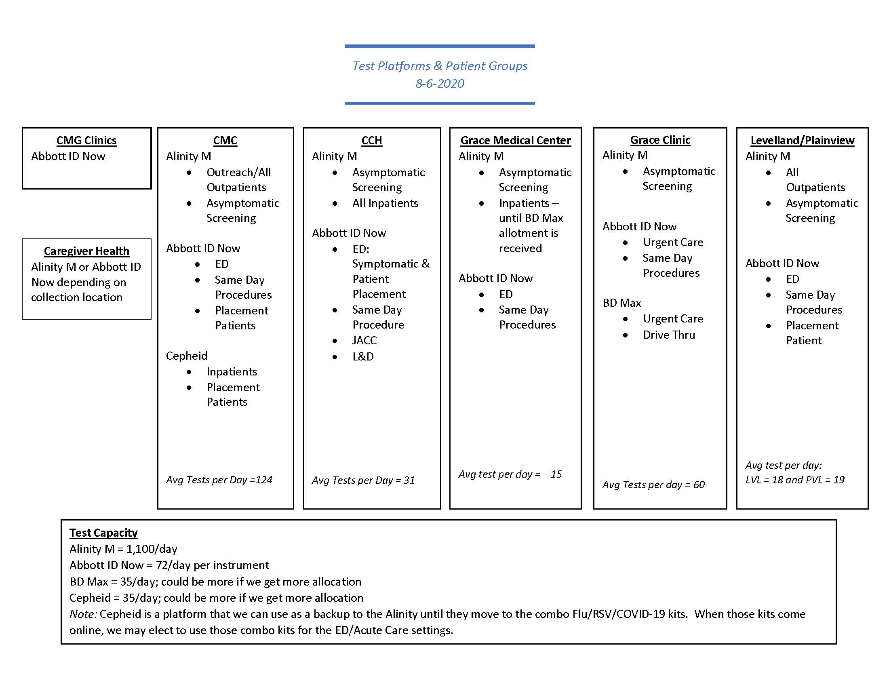
TESTING

Slide 27
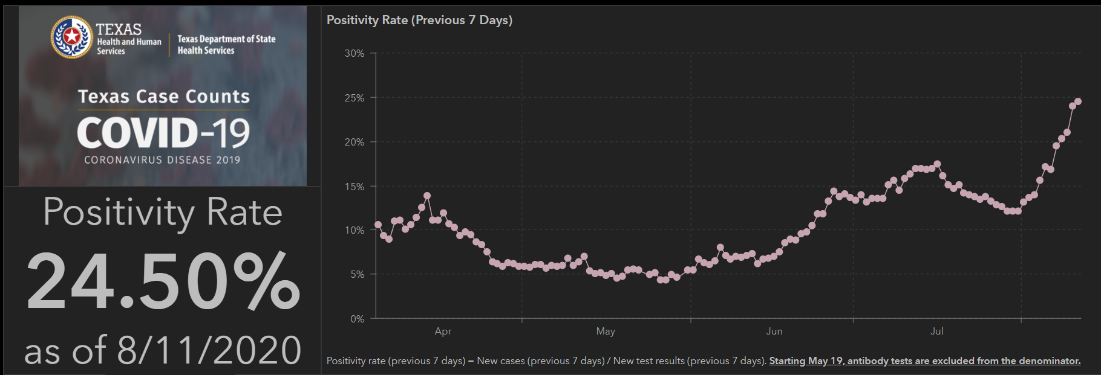
TESTING – STATEWIDE RESULTS

Slide 28
Recent Articles on COVID Transmission
Becca Bartles
August 12, 2020

Slide 29
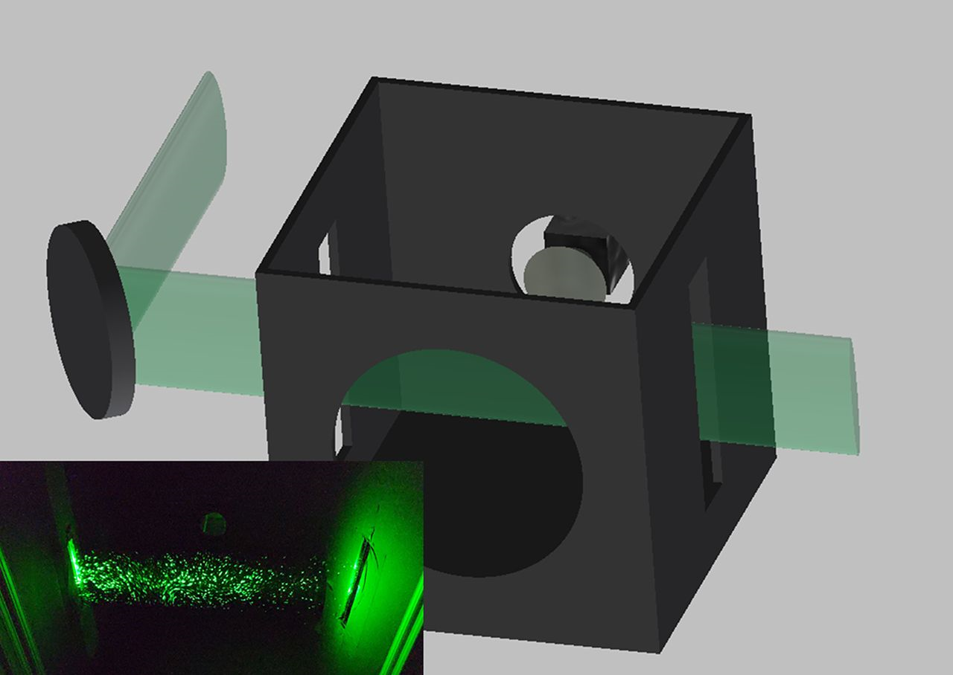
Low-cost measurement of facemask efficacy for filtering expelled droplets during speech
Optical measurement method used to evaluate mask efficacy during regular speech
A laser beam is expanded vertically by a cylindrical lens and shined through slits in the enclosure. The camera is located at the back of the box, a hole for the speaker in the front. The inset shows scattering for water particles from a spray bottle with the front of the box removed. Photo Credit: Martin Fischer, Duke University.

Slide 30
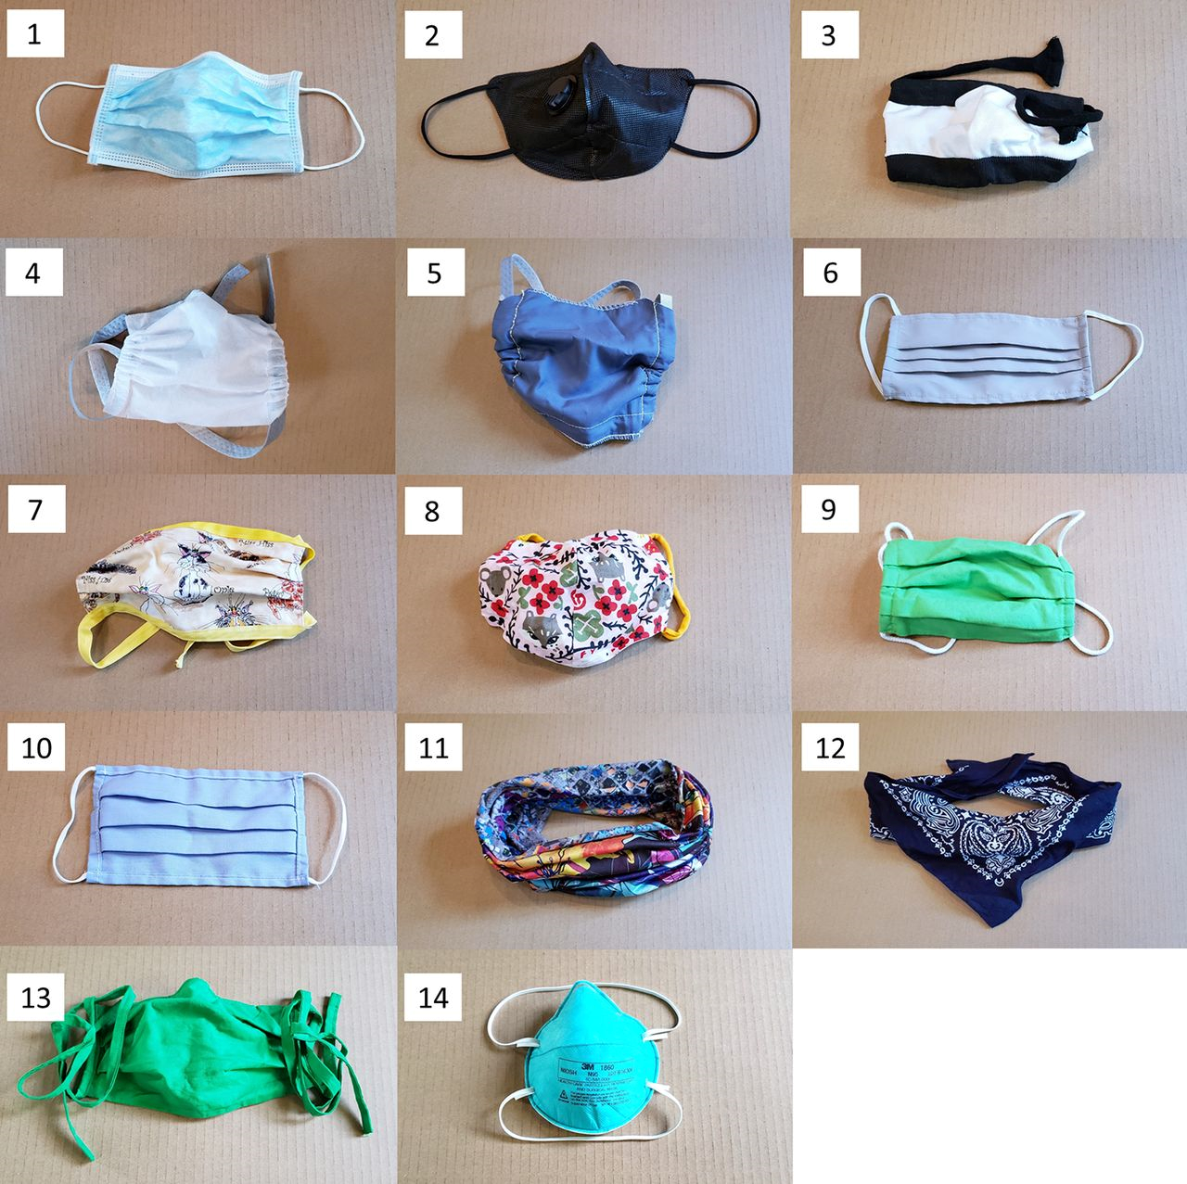
Low-cost measurement of facemask efficacy for filtering expelled droplets during speech
By Emma P. Fischer, Martin C. Fischer, David Grass, Isaac Henrion, Warren S. Warren, Eric Westman
Published Online07 Aug 2020eabd3083
DOI: 10.1126/sciadv.abd3083
https://advances.sciencemag.org/content/early/2020/08/07/sciadv.abd3083/tab-pdf

Slide 31
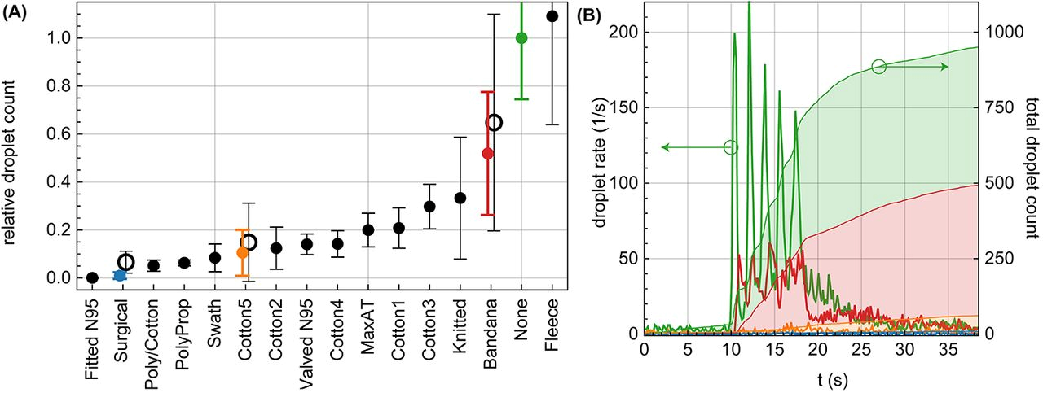
Low-cost measurement of facemask efficacy for filtering expelled droplets during speech

Slide 32
Clarification Documents

Slide 33


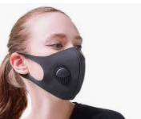
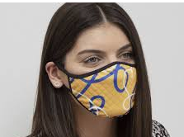
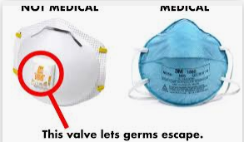
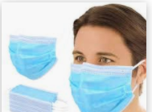
CLARIFICATION
New CDC Guidelines Advise People to wear Masks WITHOUT Vents/Valves
https://www.cdc.gov/coronavirus/2019-ncov/prevent-getting-sick/about-face-coverings.html
Masks are well documented to protect others from droplets
Masks with Valves/vents allow virus to escape from masks exposing others
Masks that are tightly woven cloth masks are best
Please discuss with caregivers to replace any valve/vented mask with appropriate hospital provided masks or personal cloth mask(no vents)

Slide 34
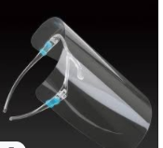


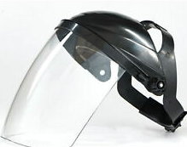
CDC Appropriate Face Shields
https://www.cdc.gov/coronavirus/2019-ncov/prevent-getting-sick/cloth-face-cover-guidance.html#:~:text=There%20is%20currently%20not%20enough,as%20a%20substitute%20for%20masks.
  Face shields are never a substitute for Masks
  Face shields are primarily used for eye protection for person wearing it.
  Wear when within patient room or within 6 feet of patient
  Face shields must meet the following criteria:
    Must wrap around the sides of the wearer’s face and extend below the chin
    Face shield which without gaps on top allowing droplets to expose eyes.
  Please use appropriate hospital provided face shields
  Personal face shield are allowed if meets the criteria above. Please contact IP for questions or clarifications.
  Examples:
Gaps at top allowing droplets to expose eyes

Slide 35
Returning to Operations

Slide 36
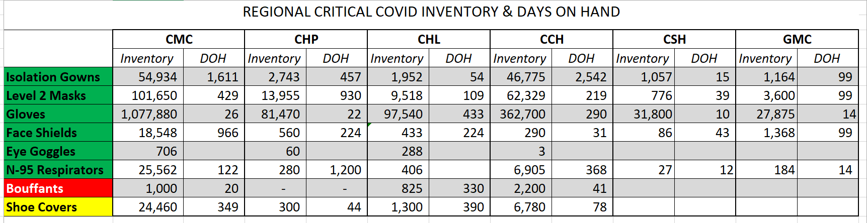
Critical Inventory

Slide 37
Pharmacy Update
Larry Pineda, PharmD
Clinical Pharmacist – AMS
Covenant Health

Slide 38
CHS COVID-19 Treatments
Agent | Dosage | Comments | Update
Remdesivir Emergency Use Authorization (EUA) 5/1/20 | 200 mg IV x 1, then 100 mg IV daily x 4 days | EUA product allocation determination: Submitting usage and inventories daily to HHS. Allocation is not based on our usage but other COVID reported metrics NIH guidelines (July 24, 2020): Because supplies are limited, recommend prioritizing for patients who require supplemental O2 but who are NOT on: high-flow oxygen noninvasive ventilation mechanical ventilation, or ECMO | Remdesivir EUA Inventory: (Thursday AM) CMC = 83 vials; Plainview = 74 vials Remdesivir EUA Patients: (Thursday AM) CMC = 10; Plainview = 0 No allocation available to purchase this week
Convalescent Plasma | 1 unit (200-400mL) | CMC enrolled in Mayo trial | Enrolled 72 patients to date
Dexamethasone | 6 mg IV/PO daily x 10 days | Alternatives if dexamethasone is unavailable: Prednisone, methylprednisolone, hydrocortisone | NIH guidelines: Recommend use in mech ventilated patients (AI) or those on supplemental oxygen (BI) Recommend against use for patients who do not require supplemental oxygen (AI)
Notes:
8/14: CMC has 10 patients on treatment and 10 rounds remaining (83 vials remaining). Plainview has 0 patients on treatment and 12 rounds remaining (74 vials)
According to the summary of the China study, remdesivir was “not associated with a difference in time to clinical improvement” compared to a standard of care control. After one month, it appeared 13.9% of the remdesivir patients had died compared to 12.8% of patients in the control arm. The difference was not statistically significant.
Hospitalized patients with advanced COVID-19 and lung involvement who received remdesivir recovered faster than similar patients who received placebo, according to a preliminary data analysis from a randomized, controlled trial involving 1063 patients, which began on February 21. The trial (known as the Adaptive COVID-19 Treatment Trial, or ACTT), sponsored by the National Institute of Allergy and Infectious Diseases (NIAID), part of the National Institutes of Health, is the first clinical trial launched in the United States to evaluate an experimental treatment for COVID-19. Preliminary results indicate that patients who received remdesivir had a 31% faster time to recovery than those who received placebo (p<0.001). Specifically, the median time to recovery was 11 days for patients treated with remdesivir compared with 15 days for those who received placebo. Results also suggested a survival benefit, with a mortality rate of 8.0% for the group receiving remdesivir versus 11.6% for the placebo group (p=0.059). Recovery in this study was defined as being well enough for hospital discharge or returning to normal activity level.
FYI Budesonide: In response to Odessa doctor, Richard Bartlett, who calls it the 'silver bullet‘. There have been no clinical trials or observational studies examining the use of ICS in COVID-19. Clinical trials would be required to establish whether these drugs may be repurposed for the treatment of this disease.

Slide 39
Pharmacy Shortages/Allocations
Covid-19 Related
  Cisatracurium
  Rocuronium
  Vecuronium
  Propofol
    Keeping close eye
  Fentanyl
  Vitamin C Liquid and Inj
  Dexamethasone Inj and Tabs
    Request override weekly
  Ivermectin
  Zinc Sulfate Tabs
    Request override weekly
Non-Covid-19 Related
  Bumetanide
  Amiodarone
  Dopamine
  Dobutamine
  Doxycycline Inj
  Nitroglycerin SDV
  Bupivacaine with epinephrine
  Lidocaine with epinephrine
  Nalbuphine Inj

Slide 40
Covenant Health
Briefing to Governor Abbott on 8-13-2020

Slide 41

Regional

Slide 42
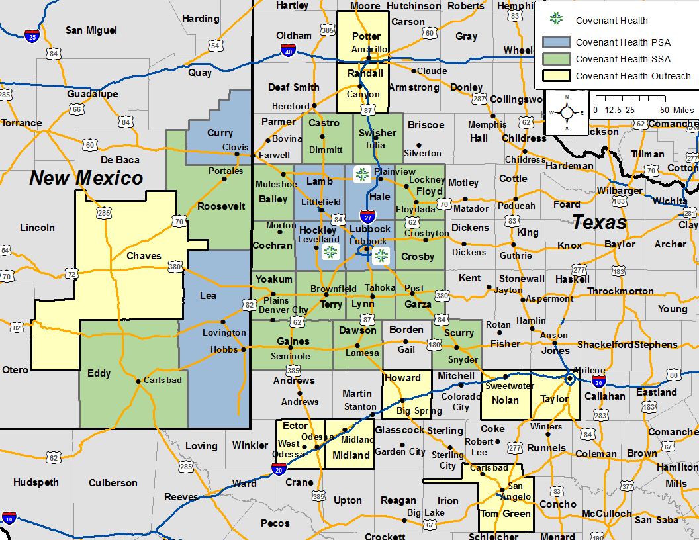
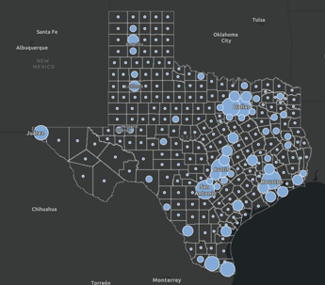
What have we accomplished?
Dedicated multiple patient care areas to treat Covid-19 victims separate from the non-infected patient population.
We have beds available at ALL seven Covenant campuses across the region.
Converted multiple “regular” hospital rooms to negative pressure rooms.
Dedicated specific nursing staff and physicians to treat the patients affected by the pandemic for PPE conservation.
Remained completely open to transfers from our region (including eastern New Mexico) and remote areas of Texas including Houston, Laredo, and even as far away as the Rio Grande Valley.
Over 40% of our hospitalized patients are from outside Lubbock County
The mortality rates have declined as we have gained experience in treatment

Slide 43

How have we adapted?
Buildup and conservation of our PPE supplies and constant evaluation of our “burn rate” to stay ahead of the need
Utilized personnel and community partnership resources to manufacture PPE “in-house” including 17,000 face shields, and 5,000 cloth masks.
Added testing capacity for inpatients and outpatients including point of care rapid tests standard laboratory equipment to ensure rapid results (hours, not days). This is being accomplished at multiple Covenant Clinics and Urgent Care Centers.
Recent addition of high volume testing platform in the clinical lab that will allow us to perform viral panels inclusive of Covid-19 as we approach the upcoming flu/RSV/pneumonia season.
Covenant Covid-19 regional inpatient census has stabilized at between 61-77 patients daily in our system which has allowed us to remain open for statewide transfers.
We are participating in Remdesivir and Convalescent Plasma Clinical Trials.

Slide 44
Surge Plan (Covenant Medical Center only)
Covenant Medical Center
 | ICU | Med Surg | Total
Phase 1 | 10-CICU |  | 10
Phase 2 | 17-CICU | 10-HC4 | 27
Phase 3 | 17-CICU | 24-HC4 | 41
Phase 4 | 17-CICU 8-MICU | 24-HC4 14-Pal Med | 63
Phase 5 | 17-CICU 16-MICU | 24-HC4 14-Pal Med | 71
Phase 6 | 17-CICU 16-MICU 8- SICU 4 (east) | 24-HC4 14-Pal Med 15 – S 9 (east) | 94
Last Week
Currently

Slide 45




What Comes Next?
Preparations for restarting schools and universities
Approximately 60,000 college students are enrolled in Lubbock, Levelland, and Plainview
The current population of Metropolitan Lubbock, Plainview, and Levelland is just over 300,000 people, making our college age population 20% the size of the resident population
We must brace for a surge when classes resume
When a vaccine becomes available, there will be more demand than supply. HHS guidance will be needed to prioritize appropriate utilization

Slide 46
Texas Demographics

Slide 47
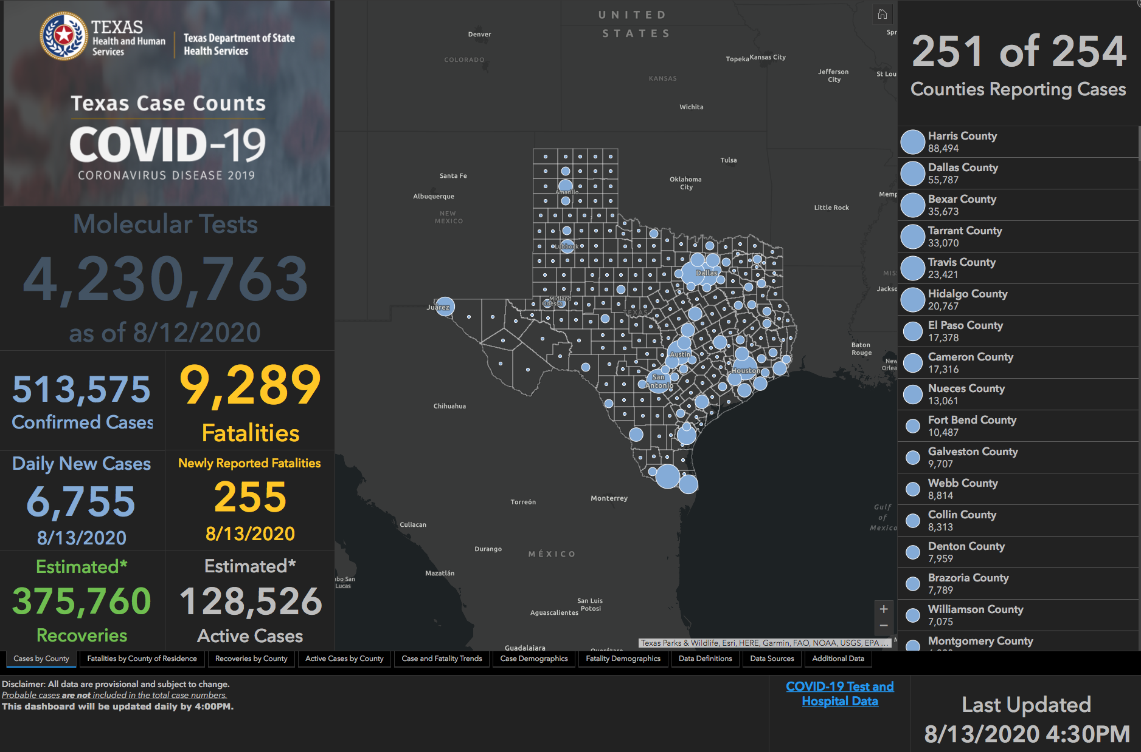

Slide 48
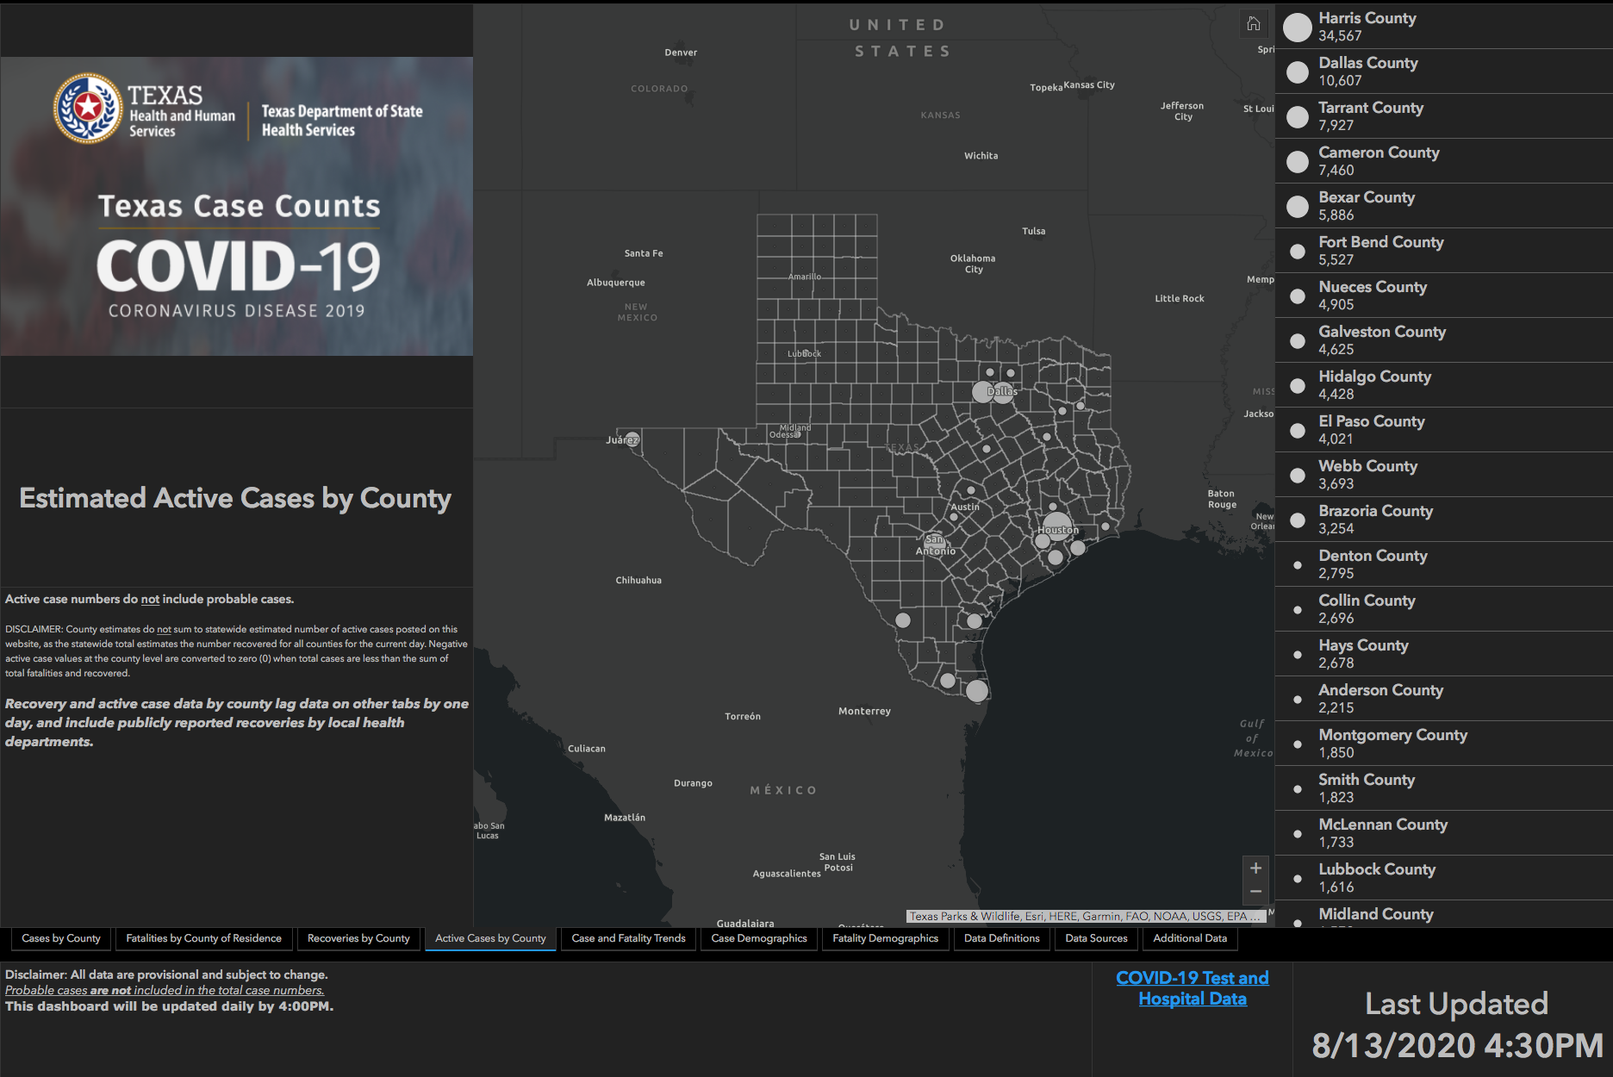

Slide 49
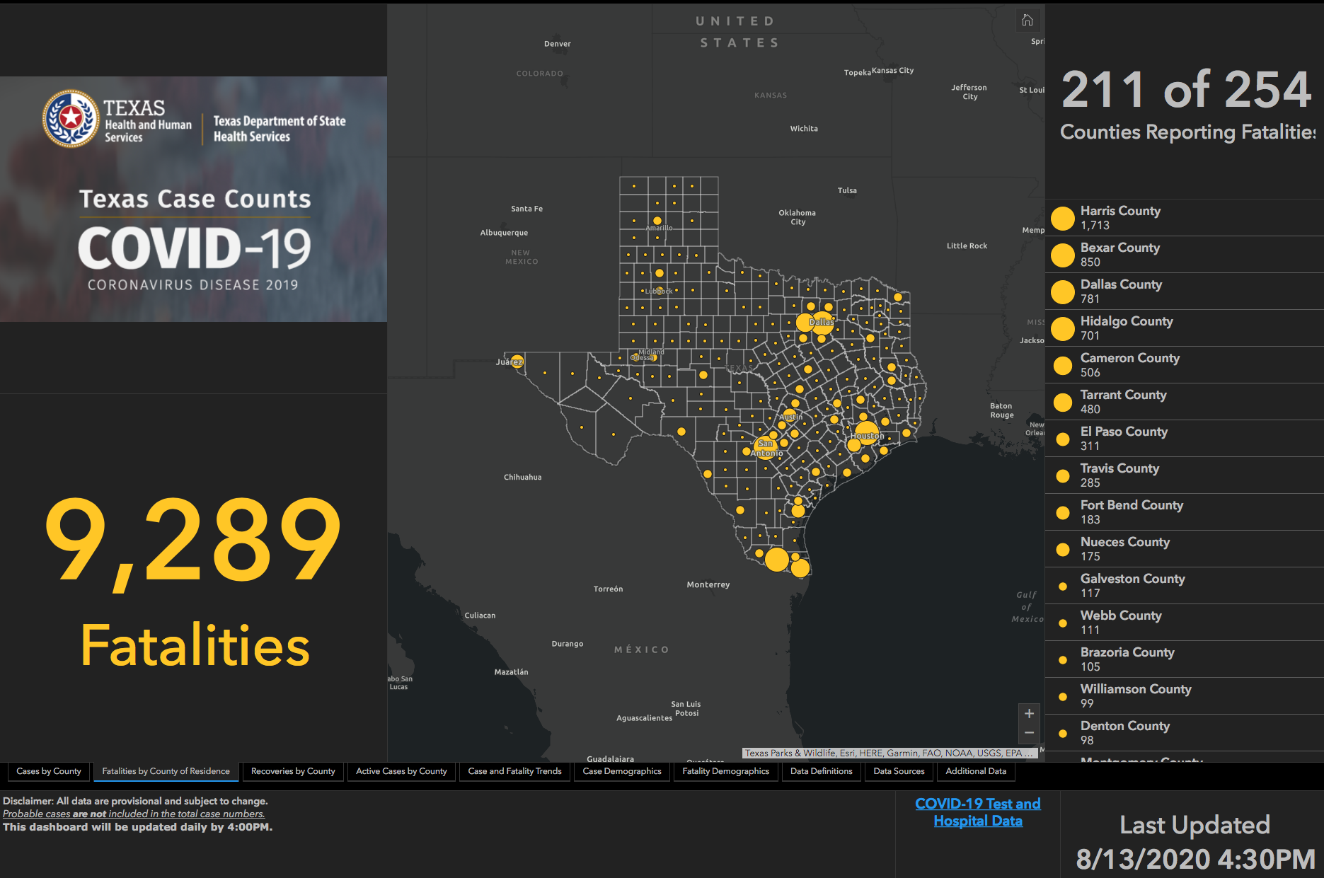

Slide 50
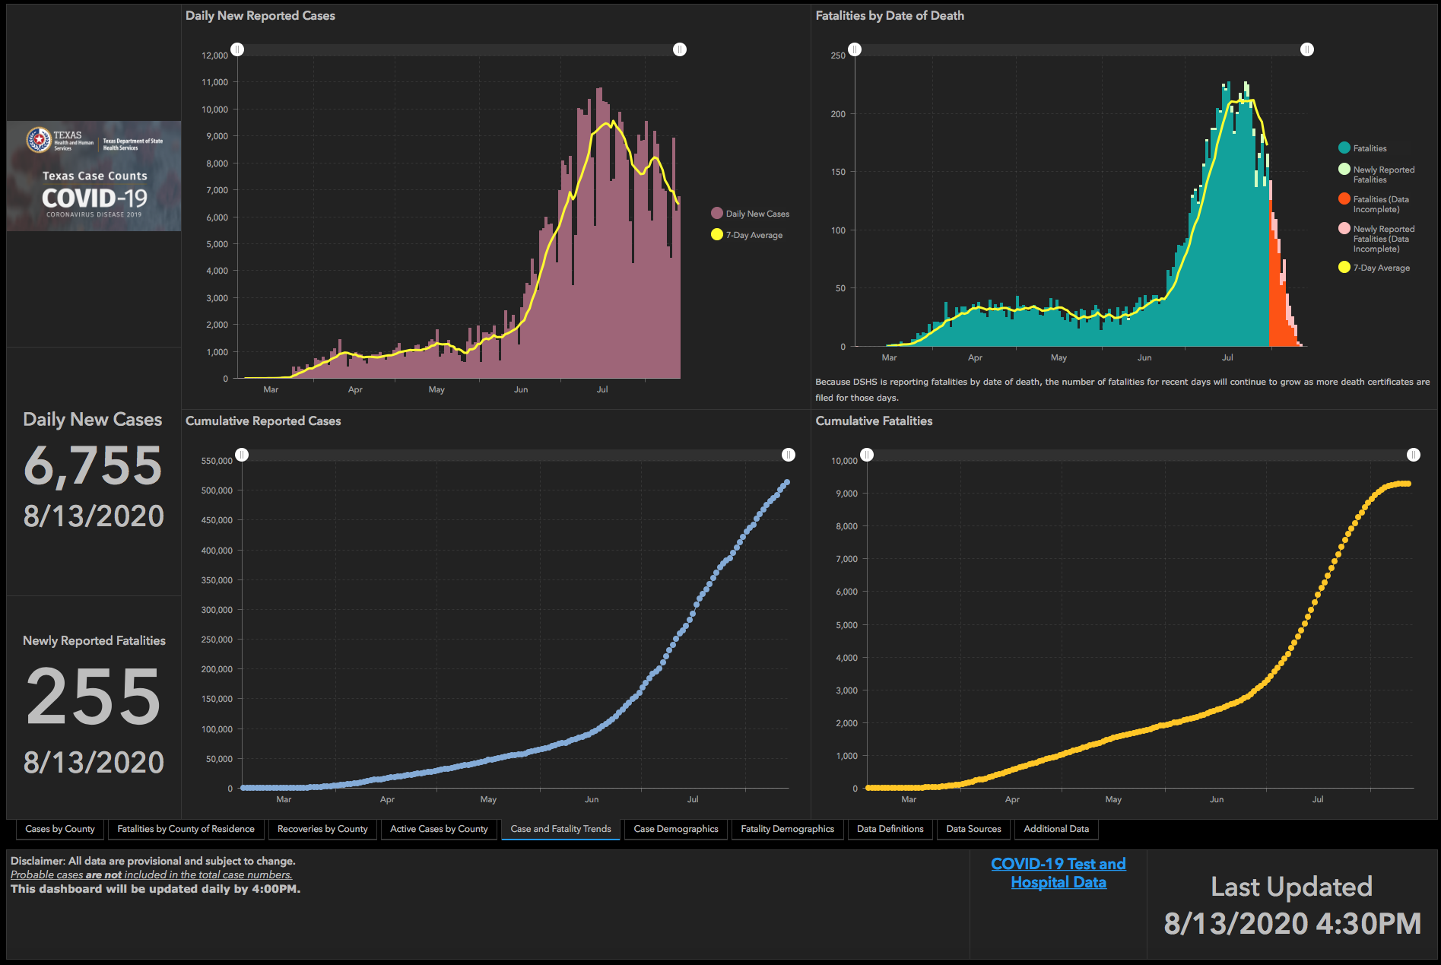

Slide 51
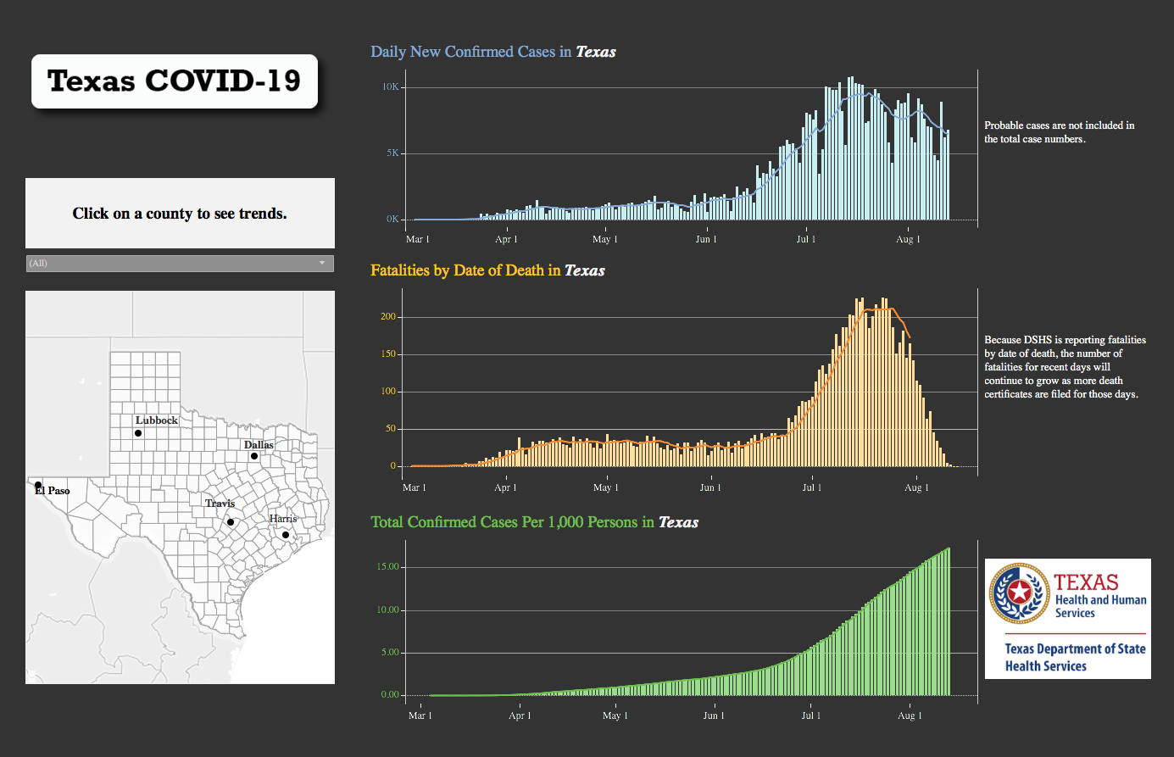

Slide 52
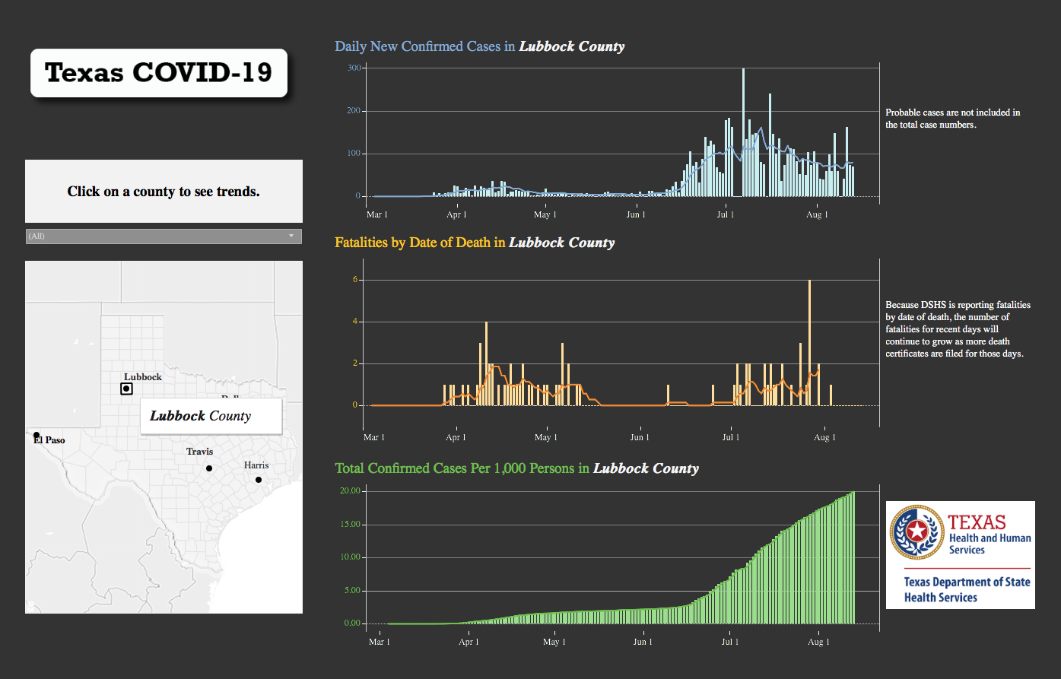

Slide 53
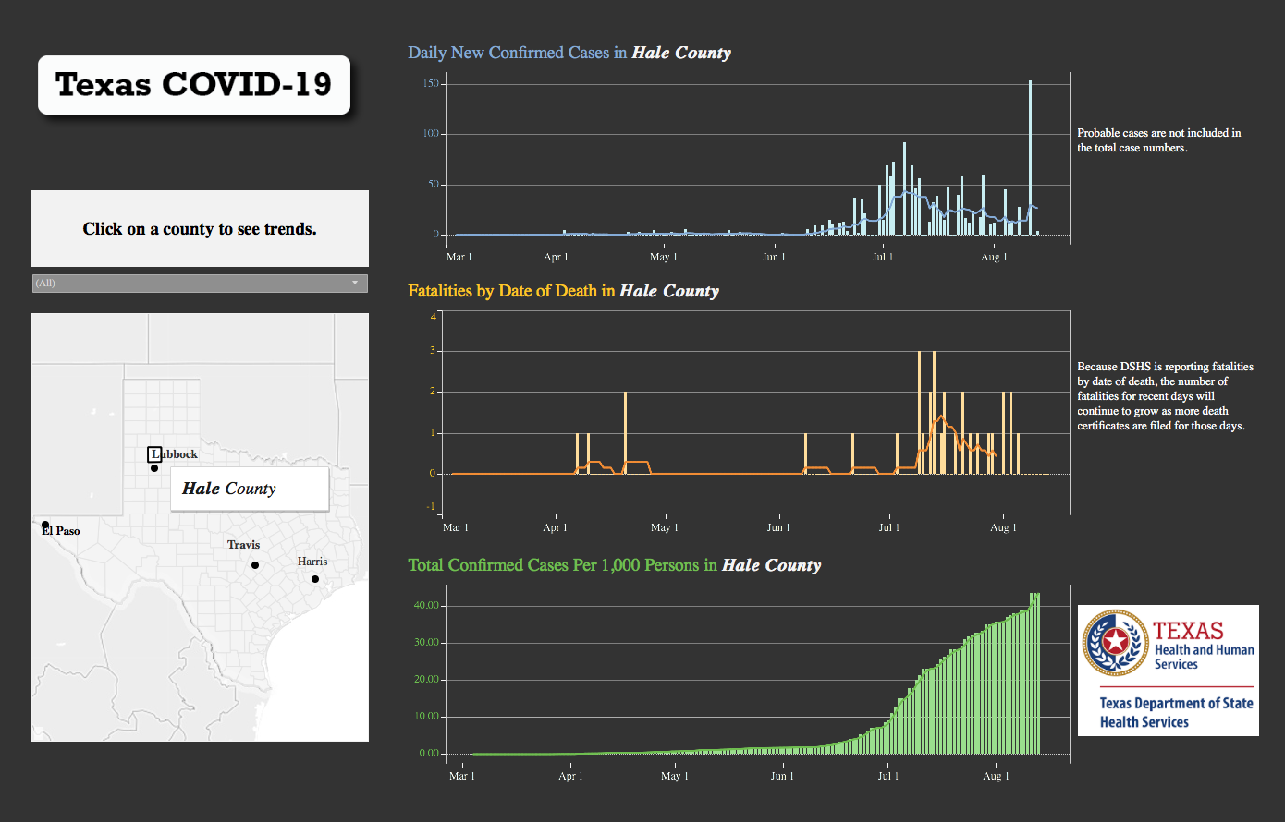

Slide 54
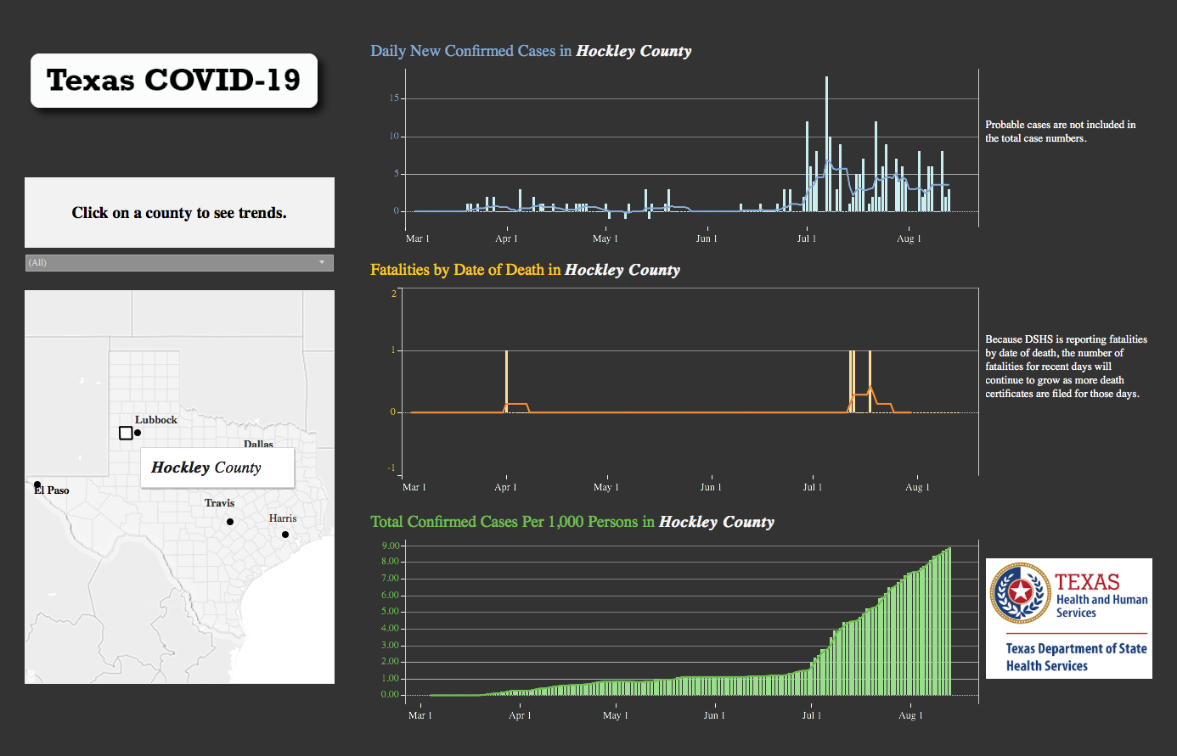

Slide 55
Restraint Education
Brian Schroeder, MD MBA FACP
CMO Covenant Medical Center

Slide 56
Restraint Orders SBAR
Situation – Orders for restraints are not compliant to CMS Conditions of Participation (CoPs)
Background – November 2019 the state investigated a complaint for restraint usage. CMC was cited for significant noncompliance by the state which led to CMS placing the organization on notice of termination.
Assesment – Audits reveal that there is still significant issues with orders and nursing documentation.
Recommendation – Provide education on requirements for proper restraint orders.

Slide 57
Restraint Orders
An order is required every calendar day.
There are 2 types of restraint orders – nonviolent and violent.
  Orders for “nonviolent” restraints are intended for patients that are removing medical devices, pulling at drains/lines/tubes, interfering with treatment, non-compliance with safety issues and to protect patient from injury.
  Orders for “violent” restraints are meant for those patients with behavioral health issues and are primarily intended in the ED.
There must be justification as to “why” restraints are applied. Intubation alone is not a justifiable reason.
No PRN orders. If a patient no longer meets justification for restraints and restraints are removed, a new order must be obtained if restraints reapplied.
An order entered as “protocol” for restraints is not acceptable.

Slide 58
Social Effects of Quarantine

Slide 59


Slide 60
Q & A

