Slide 1
Covenant Health
Regional Update for Physicians
August 14, 2020

Slide 2
Reflection
Tick, Tick, Tick
Brian Schroeder, MD MBA FACP
CMO Covenant Medical Center

Slide 3
Safety Story
Craig Rhyne, MD FACS

Slide 4
Current Regional Census

Slide 5
Regional
 | Lubbock |  | Hockley |  | Hale
 | 8/17 | 8/19 | 8/17 | 8/19 | 8/17 | 8/19
Total | 6607 | 6706 | 223 | 270 | 1491 | 1532
Active | 1645 | 1512 | 55 | 50 | 119 | 104
Deaths | 87 | 90 | 5 | 5 | 33 | 34
New | 99 |  | 47 |  | 41

Slide 6
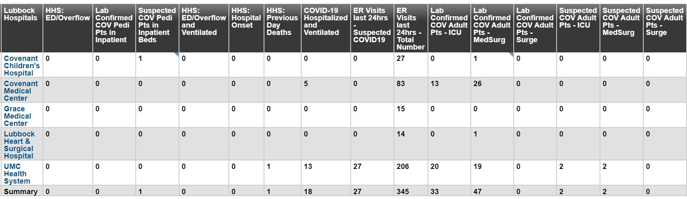
Regional - Lubbock
80 Hospitalized in Lubbock – 18 on vents

Slide 7
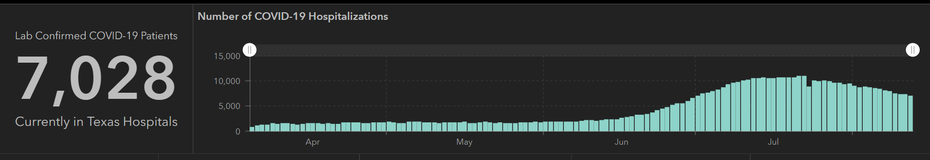
STATE
Last Week
 | 8/12 | 8/10 | 8/5 | 7/29 | 7/22 | 7/15 | 7/8 | 7/1
Cases | 506,820 | 490,817 | 459,887 | 403,307 | 351,618 | 282,365 | 210,585 | 168,062
Deaths | 9034 | 8490 | 7497 | 6190 | 4348 | 3432 | 2715 | 2481
Hospitalized | 7028 | 7304 | 8455 | 9595 | 10,893 | 10,471 | 9286 | 6904

Slide 8
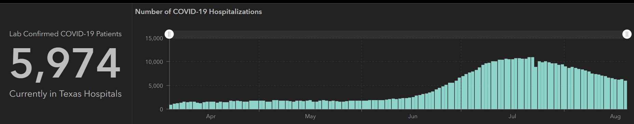
STATE
 | 8/19 | 8/17 | 8/12 | 8/5 | 7/29 | 7/22 | 7/15 | 7/8 | 7/1
Cases | 557,256 | 542,9500 | 506,820 | 459,887 | 403,307 | 351,618 | 282,365 | 210,585 | 168,062
Deaths | 10,559 | 10,034 | 9034 | 7497 | 6190 | 4348 | 3432 | 2715 | 2481
Hospitalized | 5974 | 6200 | 7028 | 8455 | 9595 | 10,893 | 10,471 | 9286 | 6904

Slide 9
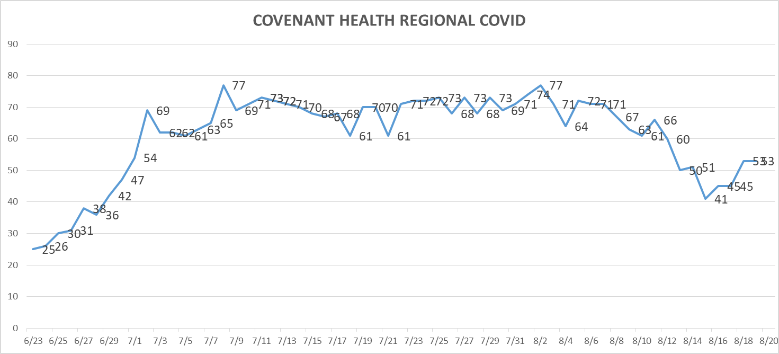
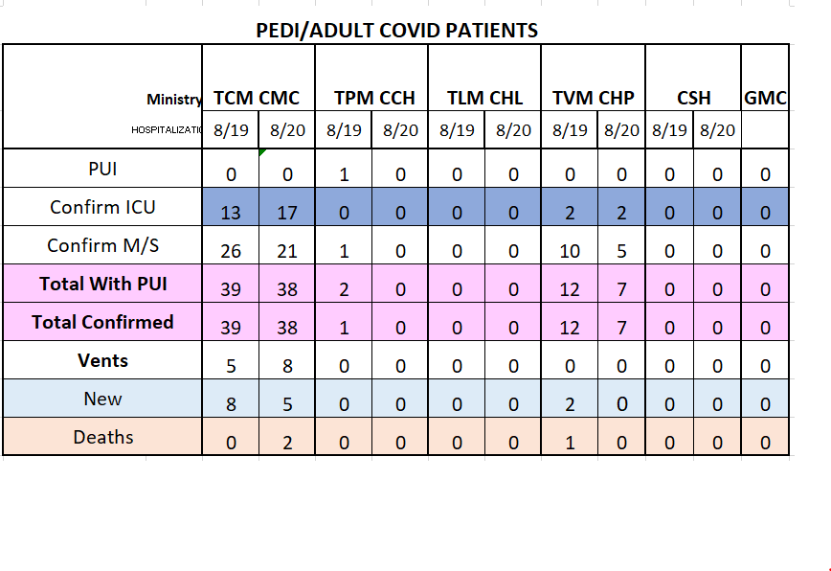
PUI/Confirmed cases-Hospitalized
MICU 8 beds opened for COVID

Slide 10
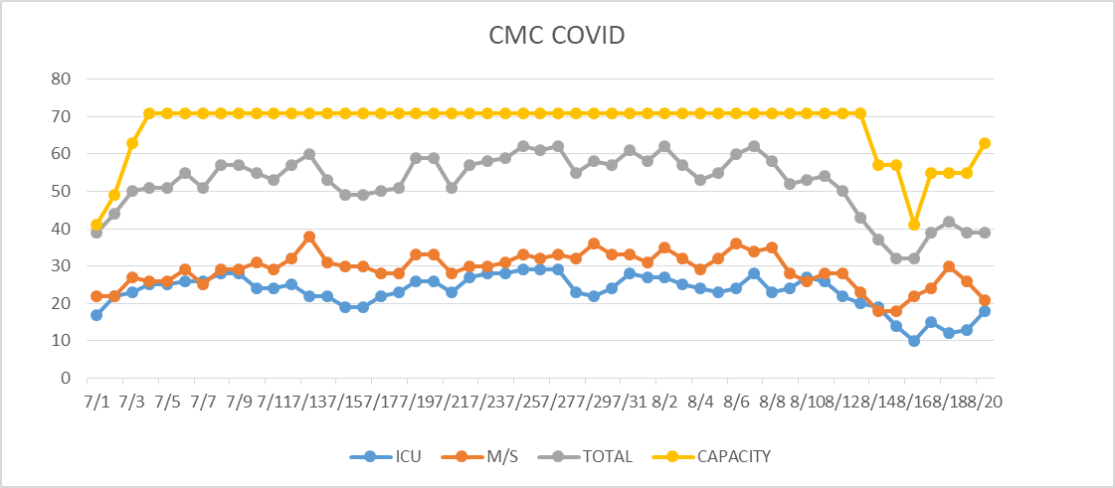
PUI/Confirmed cases-hospitalized
MICU 8 beds opened for COVID

Slide 11
Surge Plan
Covenant Medical Center
 | ICU | Med Surg | Total
Phase 1 | 10-CICU |  | 10
Phase 2 | 17-CICU | 10-HC4 | 27
Phase 3 | 17-CICU | 24-HC4 | 41
Phase 4 | 17-CICU 8-MICU | 24-HC4 14-Pal Med | 63
Phase 5 | 17-CICU 16-MICU | 24-HC4 14-Pal Med | 71
Phase 6 | 17-CICU 16-MICU 8- SICU 4 (east) | 24-HC4 14-Pal Med 15 – S 9 (east) | 94
Currently
Last Week

Slide 12
Statistics
William Sommer
Clinical Data Analyst
Decision Support Services
Covenant Health

Slide 13
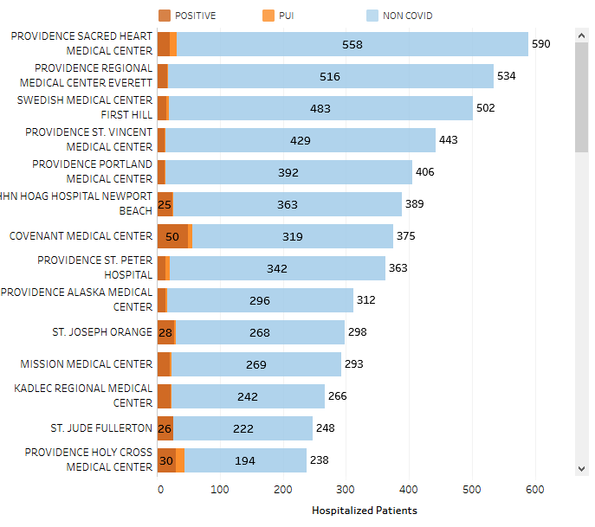
Providence System Hospitalized COVID-19 Cases
13% (Highest in PSJH)

Slide 14
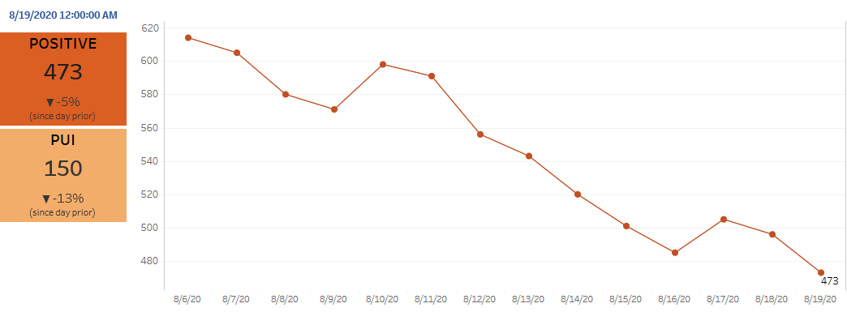
Providence Inpatient COVID-19 Volume

Slide 15
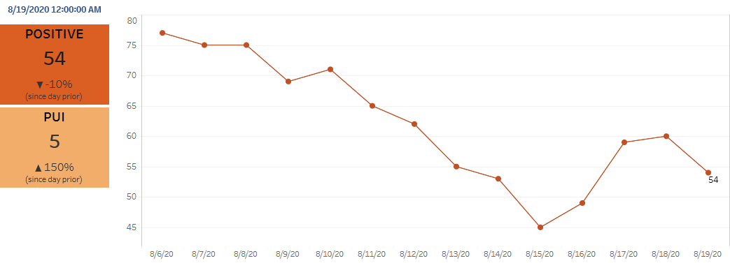
Texas Inpatient COVID-19 Volume

Slide 16
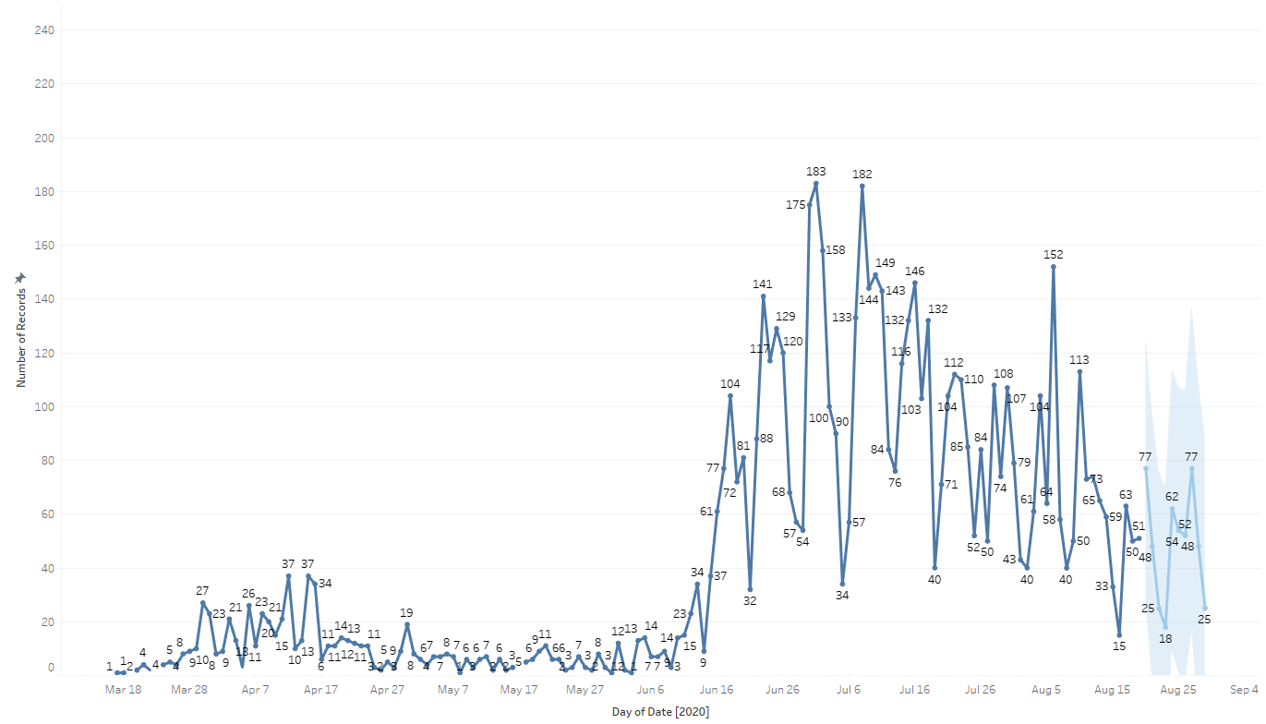

New Covid-19 POSITIVES by Day Trend

Slide 17
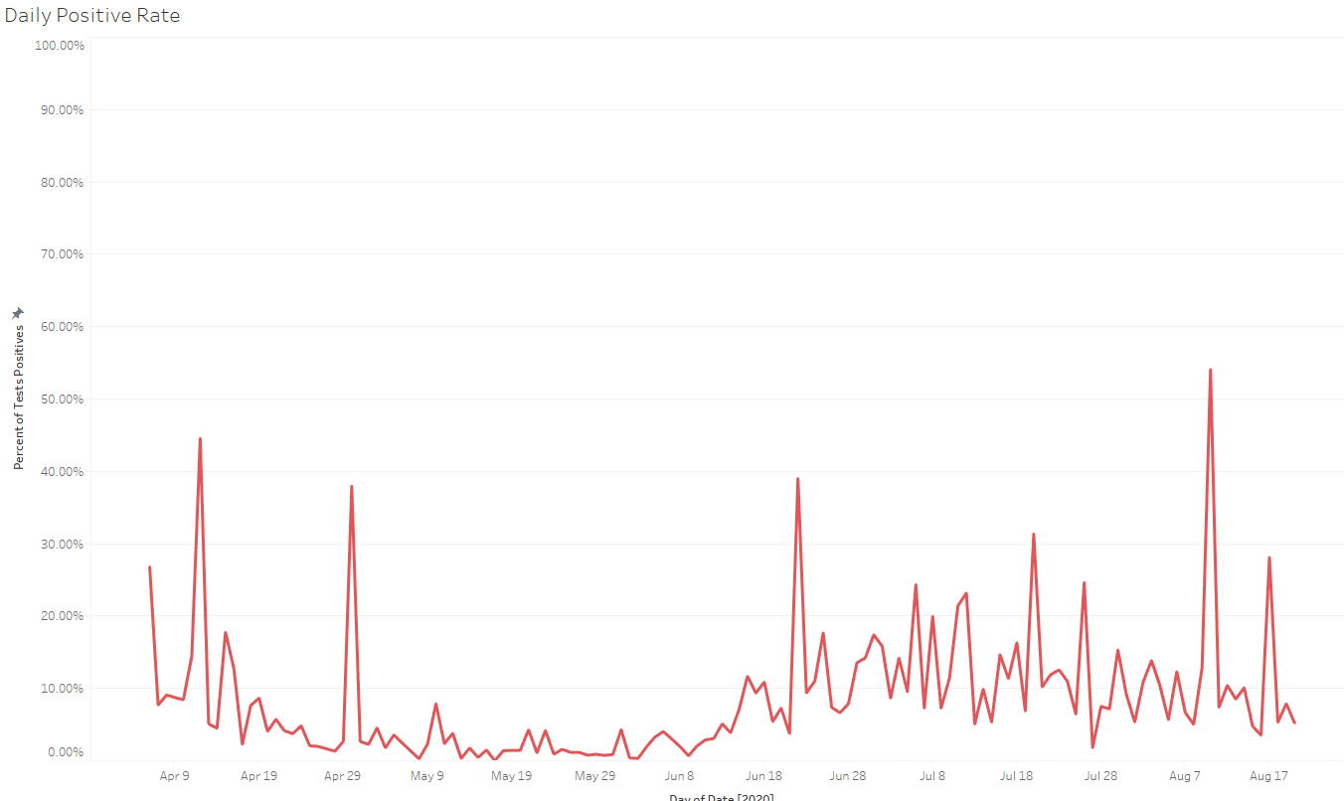
Covid-19 Daily Positive Rate

Slide 18
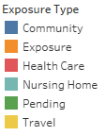
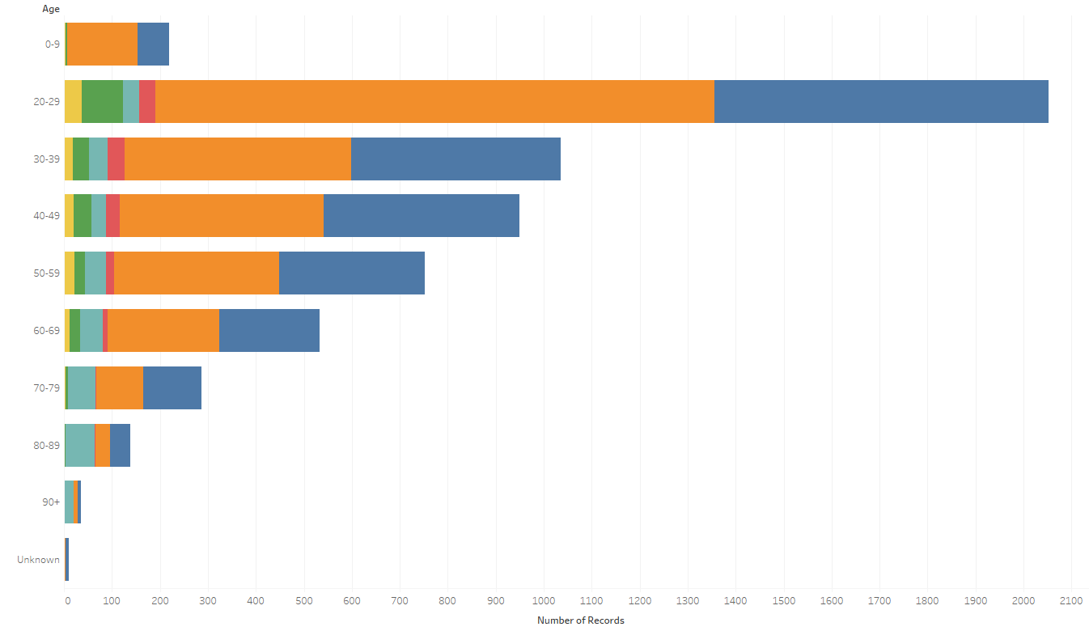
Covid-19 POSITIVES Age Distribution

Slide 19
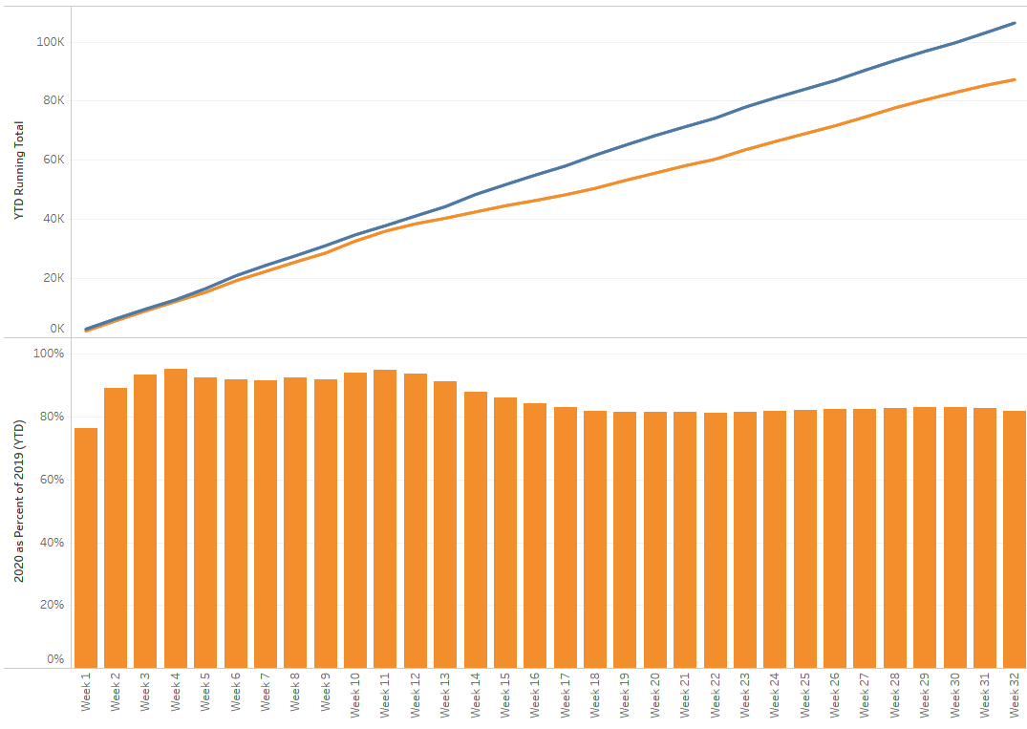

TX/NM Region Weekly Procedures (YOY)

Slide 20
Providence St. Joseph System
Covid-19 Status

Slide 21
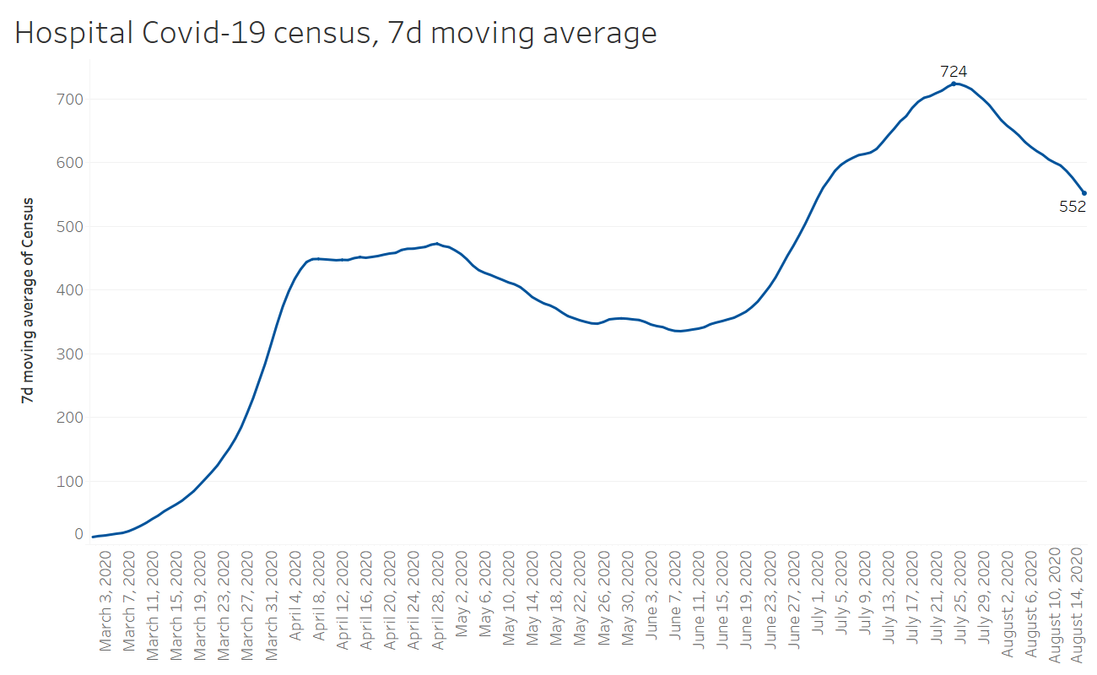

Slide 22
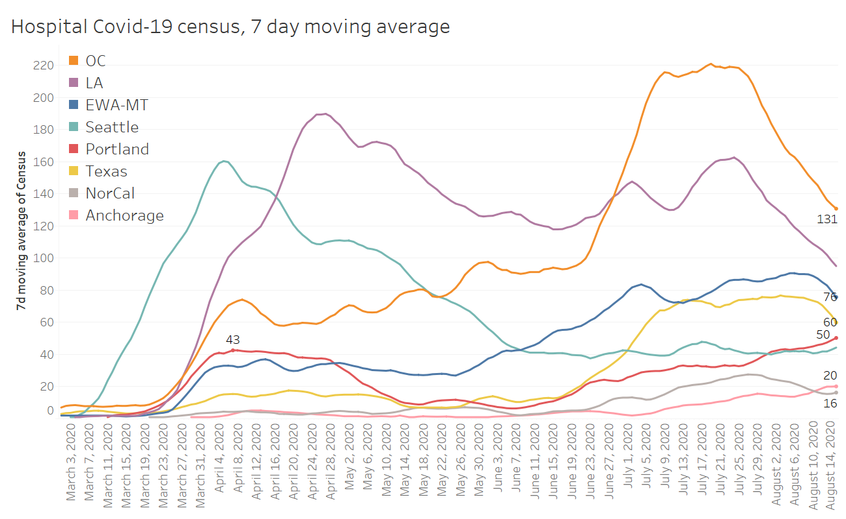

Slide 23
Covid-19 vs Flu
 |  | Total admitted
 |  | 2016 | 2017 | 2018 | 2019 | 2020
Providence Holy Cross Medical Center | FLU | 60 | 86 | 140 | 108 | 110
 | COVID |  |  |  |  | 638

Slide 24
Covid-19 vs Flu
 |  | Total admitted |  |  |  |  | Maximum admitted in a month
 |  | 2016 | 2017 | 2018 | 2019 | 2020 | 2016 | 2017 | 2018 | 2019 | 2020
Providence Holy Cross Medical Center | FLU | 60 | 86 | 140 | 108 | 110 | 17 | 31 | 68 | 26 | 56
 | COVID |  |  |  |  | 638 |  |  |  |  | 174

Slide 25
Covid-19 vs Flu
 |  | Total admitted |  |  |  |  | Maximum admitted in a month
 |  | 2016 | 2017 | 2018 | 2019 | 2020 | 2016 | 2017 | 2018 | 2019 | 2020
Providence Holy Cross Medical Center | FLU | 60 | 86 | 140 | 108 | 110 | 17 | 31 | 68 | 26 | 56
 | COVID |  |  |  |  | 638 |  |  |  |  | 174
 |  | Case characteristics
 |  | Avg Age | Avg LOS | Went to ICU | Avg ICU LOS | Vented | Avg Vent duration | Died
Providence Holy Cross Medical Center | FLU | 69 | 5.2 | 12% | 4.4 | 1% | 7.3 | 4%
 | COVID | 63 | 10.0 | 16% | 10.3 | 20% | 12.3 | 13%

Slide 26
Covid-19 Testing

Slide 27
TESTING
 | Availability
Abbott | 1512
Cepheid | 930
Alinity M | >3000
BD Max | -
NP Swab | >10,000
VTM | >1500
 | CMC |  | GMG/CMG
 | Tests | + | Tests | +
8/15 | 215 | 27 | 146 | 12
8/16 | 189 | 22 | 29 | 2
8/17 | 59 | 5 | 16 | 0
8/18 | 269 | 15 | 190 | 20
8/19 | 116 | 8 | 117 | 14
Cumulative Performed
BD Max shipment delayed until 8/21
CMG to receive full shipment today; increase weekly kits from 42 to 60
CHP Antibody testing – no report
Concerns regarding Cepheid meeting demand

Slide 28
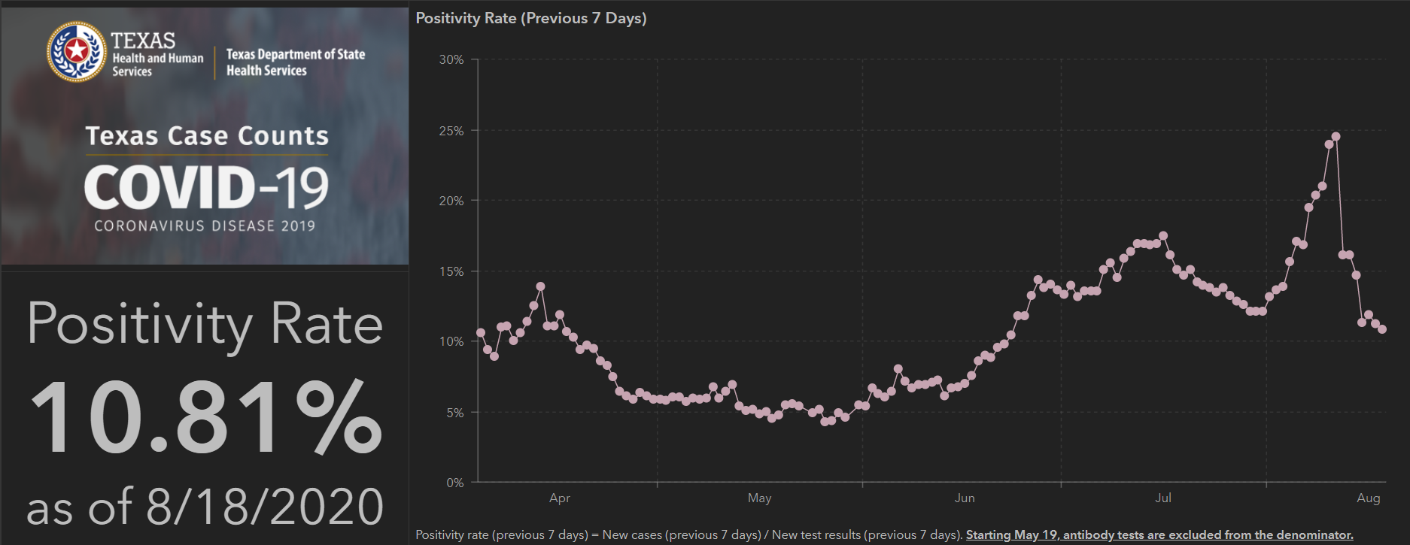
TESTING – STATEWIDE Results

Slide 29
Returning to Operations

Slide 30
Caregivers
COVID Related Furloughs
Count reflects # furlough (exposed and positive)
Good
Moderate
Critical

Slide 31
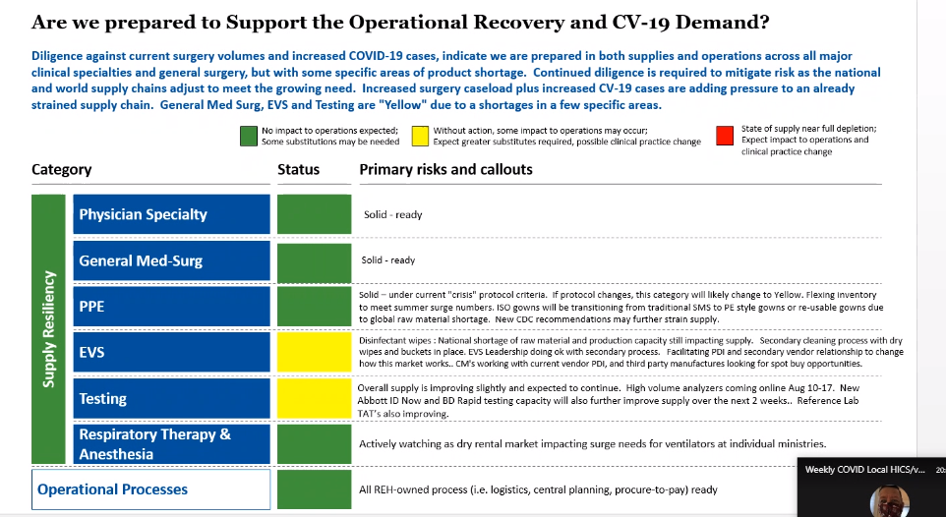
Critical Inventory - REH
REH UPDATE
N-95 Masks
500K Current
3M 1860, 1860S 1780+
1.5 M coming 10 days
Hurley Mask - China
CAPR/PAPR
8 weeks expanded
To 16 weeks for delivery

Slide 32
COVID Supplies/equipment
  State delivered supplies/equipment
  Received 10,000 gowns, 7000 bouffants and 10,000 shoe covers
  21 Negative Air Fans delivered 8/18
  City EOC has placed an order for Remdesivir
  20 Humidification systems received 8/19

Slide 33
Pharmacy Update
Larry Pineda, PharmD
Clinical Pharmacist – AMS
Covenant Health

Slide 34
CHS COVID-19 Treatments
Agent | Dosage | Comments | Update
Remdesivir Emergency Use Authorization (EUA) 5/1/20 | 200 mg IV x 1, then 100 mg IV daily x 4 days | EUA product allocation determination: Submitting usage and inventories daily to HHS. Allocation is not based on our usage but other COVID reported metrics NIH guidelines (July 24, 2020): Because supplies are limited, recommend prioritizing for patients who require supplemental O2 but who are NOT on: high-flow oxygen noninvasive ventilation mechanical ventilation, or ECMO | Remdesivir EUA Inventory: (Thursday AM) CMC = 309 vials; Plainview = 98 vials Remdesivir EUA Patients: (Thursday AM) CMC = 6; Plainview = 1
Convalescent Plasma | 1 unit (200-400mL) | CMC enrolled in Mayo trial | Enrolled 79 patients to date
Dexamethasone | 6 mg IV/PO daily x 10 days | Alternatives if dexamethasone is unavailable: Prednisone, methylprednisolone, hydrocortisone | NIH guidelines: Recommend use in mech ventilated patients (AI) or those on supplemental oxygen (BI) Recommend against use for patients who do not require supplemental oxygen (AI)
Notes:
8/14: CMC has 10 patients on treatment and 10 rounds remaining (83 vials remaining). Plainview has 0 patients on treatment and 12 rounds remaining (74 vials)
According to the summary of the China study, remdesivir was “not associated with a difference in time to clinical improvement” compared to a standard of care control. After one month, it appeared 13.9% of the remdesivir patients had died compared to 12.8% of patients in the control arm. The difference was not statistically significant.
Hospitalized patients with advanced COVID-19 and lung involvement who received remdesivir recovered faster than similar patients who received placebo, according to a preliminary data analysis from a randomized, controlled trial involving 1063 patients, which began on February 21. The trial (known as the Adaptive COVID-19 Treatment Trial, or ACTT), sponsored by the National Institute of Allergy and Infectious Diseases (NIAID), part of the National Institutes of Health, is the first clinical trial launched in the United States to evaluate an experimental treatment for COVID-19. Preliminary results indicate that patients who received remdesivir had a 31% faster time to recovery than those who received placebo (p<0.001). Specifically, the median time to recovery was 11 days for patients treated with remdesivir compared with 15 days for those who received placebo. Results also suggested a survival benefit, with a mortality rate of 8.0% for the group receiving remdesivir versus 11.6% for the placebo group (p=0.059). Recovery in this study was defined as being well enough for hospital discharge or returning to normal activity level.
FYI Budesonide: In response to Odessa doctor, Richard Bartlett, who calls it the 'silver bullet‘. There have been no clinical trials or observational studies examining the use of ICS in COVID-19. Clinical trials would be required to establish whether these drugs may be repurposed for the treatment of this disease.

Slide 35
Pharmacy Shortages/Allocations
Covid-19 Related
  Cisatracurium
  Rocuronium
  Vecuronium
  Propofol
    Keeping close eye
  Fentanyl
  Vitamin C Liquid and Inj
  Dexamethasone Inj and Tabs
    Request override weekly
  Ivermectin
  Zinc Sulfate Tabs
    Request override weekly
Non-Covid-19 Related
  Bumetanide
  Amiodarone
  Dopamine
  Dobutamine
  Doxycycline Inj
  Nitroglycerin SDV
  Bupivacaine with epinephrine
  Lidocaine with epinephrine
  Nalbuphine Inj

Slide 36
NIH Remdesivir Recommendations
Last Updated: July 24, 2020
Because remdesivir supplies are limited, the panel recommends that remdesivir be prioritized for use in hospitalized patients with COVID-19 who require supplemental oxygen but who are not on high-flow oxygen, noninvasive ventilation, mechanical ventilation, or extracorporeal membrane oxygenation (ECMO) (BI)
Notes:
Because there is uncertainty regarding whether starting remdesivir confers clinical benefit in these groups of patients, the Panel cannot make a recommendation either for or against starting remdesivir.

Slide 37
NIH Remdesivir Recommendations
Mild/Moderate
Not requiring supplemental O2
Insufficient data to recommend for or against remdesivir
Hospitalized requiring supplemental O2
Not requiring HF O2, noninvasive or invasive mech vent, ECMO
Remdesivir x 5 days or until discharge, whichever comes first (AI)
Hospitalized requiring > supplemental O2
Requiring HF O2, noninvasive or invasive mech ventilation, ECMO
Uncertain whether starting remdesivir confers clinical benefit
If a patient progresses to requiring HF O2, noninvasive or invasive mechanical ventilation, or ECMO, course should be completed
Cannot make a recommendation for or against starting remdesivir

Slide 38
Wang Y et al
Randomized, double-blind, placebo controlled trial in hospitalized adults with severe COVID-19 in China
Pts were randomized 2:1 to receive
  Remdesivir (200 mg IV on day 1, then 100 mg IV once daily on days 2-10)
  Placebo initiated within 12 days of symptom onset
Primary outcome: median time to clinical improvement was not significantly different in remdesivir group (21d) vs placebo (23d)
  28-day mortality rate was similar in both groups (14% vs 13%)
  When remdesivir was initiated within 10 days of symptom onset, median time to clinical improvement was numerically shorter (but not statistically significant) compared with placebo group (18 vs 23 days)
Limitation: underpowered
Notes:
Wang Y, Zhang D, Du G, et al. Remdesivir in adults with severe COVID-19: a randomized, double-blind, placebo-controlled, multicentre trial. Lancet. 2020; 395: 1569-78. PMID: 32423584 DOI:
10.1016/S0140-6736(20)31022-9. (https://doi.org/10.1016/S0140-6736(20)31022-9)

Slide 39
Goldman JD et al; SIMPLE-Severe
Phase 3 randomized, open-label trial in hospitalized pts with severe COVID-19
  Excluded mechanical ventilation at study entry (later modified to include)
Evaluated safety and antiviral activity of 5 and 10 day regimens
N=397 (no mech vent at study entry); 5-day (n=200), 10-day (n=197)
Primary outcome: 14 day clinical improvement
  129/200 (65%) in the 5-day group
  106/197 (54%) in the 10-day group (higher % men and severe disease category)
  After adjusting for baseline imbalances: outcomes were similar in both groups
Conclusion: treatment beyond 5 days did not appear to improve outcomes among patients who were receiving noninvasive ventilation or HF oxygen, LF oxygen, or breathing ambient air
  Can not extrapolate to critically ill, invasive mech ventilation patients
Notes:
10-day group included a higher percentage of pts in the most severe disease categories and a higher proportion of men (who are known to have worse COVID-19 outcomes than women)
Goldman JD, Lye DCB, Hui DS, et al. Remdesivir for 5 or 10 days in patients with severe covid-19. N Engl J Med. 2020 May 27. PMID: 32459919 DOI: 10.1056/NEJMoa2015301

Slide 40
Subgroup analyses from SIMPLE-Severe trial
Factors significantly associated with clinical improvement on day 14
  Black race
  Age less than 65 years
  Treatment outside of Italy
  Requirement of only low-flow oxygen support or room air at baseline
FYI: concomitant therapy with remdesivir and hydroxychloroquine vs those who received only remdesivir
  Recovery lower in combination (57% vs 69%)
  No difference in mortality
  Rate of adverse effects higher with combination
Notes:
Gilead Sciences. Gilead presents additional data on investigational remdesivir for the treatment of COVID-19. Press release. 2020 Jul 10. Available at https://www.gilead.com/news-and-press/press-room/press-releases/2020/7/gilead-presents-additional-data-on-investigational-antiviral-remdesivir-for-the-treatment-of-covid-19

Slide 41
SIMPLE-Moderate Preliminary Data
Phase 3 randomized, open-label trial in hospitalized pts with moderate COVID-19 (hospitalized with evidence of pulmonary infiltrates but without reduced oxygen levels)
Evaluated safety and antiviral activity of 5 and 10 day regimens
5-day (n=191), 10-day (n=194), or standard of care alone (n=200)
Primary outcome: clinical improvement day 11 (2 point improvement from 7 point ordinal scale)
  No difference noted: 5-day (70%), 10-day (65%), standard of care alone (61%)
Subsequent analysis of 1 point improvement:
  Statistically significant improvement in clinical status in those treated with a 5-day regimen of remdesivir (76%) compared with standard of care alone (66%)
Notes:
30. Gilead Sciences. Gilead announces results from phase 3 trial of remdesivir in patients with moderate COVID-19. Press release. 2020 Jun 1. Available at https://www.gilead.com/news-andpress/press-room/press-releases/2020/6/gilead-announces-results-from-phase-3-trial-of-remdesivir-in-patients-with-moderate-covid-19.

Slide 42
NIAID Adaptive COVID-19 Treatment Trial 1
[ACTT-1] Phase 3 adaptive, randomized, doubleblind, placebo-controlled trial in hospitalized adults with COVID-19
1063 pts randomized 1:1 to receive remdesivir up to 10 days (or until hospital discharge or death) or placebo
  88.7% of pts had severe disease at enrollment and median time from symptom onset to randomization was 9 days (range: 6-13 days)
Results:
  Median time to recovery in remdesivir group (11 days) vs placebo (15 days)
  Mortality by day 14: 7.1% in the remdesivir group vs 11.9% in the placebo
Preliminary subgroup analyses: the benefit of remdesivir was most apparent in the 421 pts who required supplemental oxygen but were not on mechanical ventilation or ECMO at baseline
Notes:
31. Adaptive COVID-19 treatment trial 2 (ACTT-II). NCT04401579. (https://www.clinicaltrials.gov/ct2/show/NCT04401579).

Slide 43
Research on Covid-19 across the Providence St. Joseph System

Slide 44
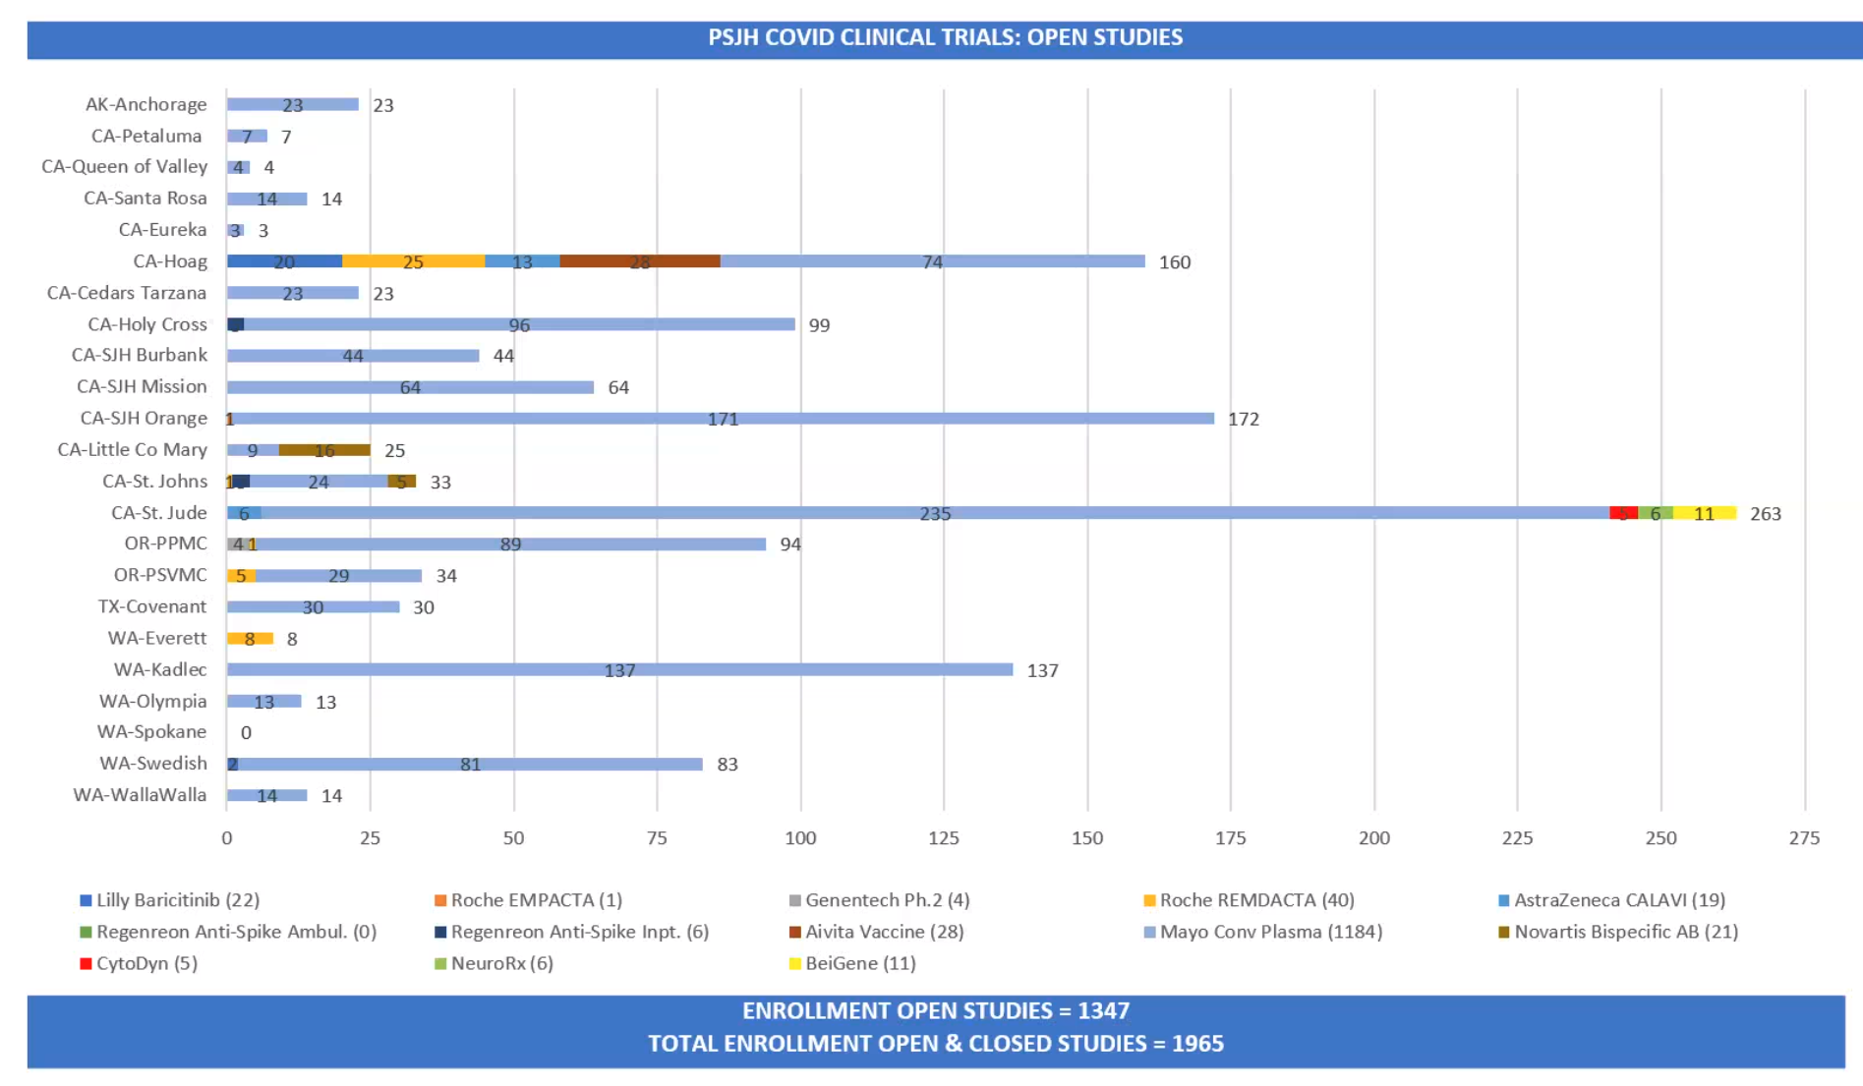

Slide 45
Regeneron Anti-Spike Ambulatory and Inpatient
CytoDyn
Baricitinib
Roche EMPACTA
NeuroRx
Genentech
Avita
BeiGene
Roche REMDACTA
Mayo Convalescent Plasma
AstraZeneca CALAVI
Novartis Bispecific AB
Monoclonal AB
2 Monclonal AB (non-competitive)
patient-specific dendritic cell vaccine
zanubrutinib
selective BTK inhibitor
Actemra/
RoActrema (Anti-IL-6) plus remdesivir
Vasoactive Intestinal Peptide (cytokine blocker)
Anti-Inflammatory JAK inhibitor
Remdacta/Covacta + Remdesivir

Slide 46
Restarting Schools
Amy Thompson
David Gray

Slide 47
Texas Demographics

Slide 48
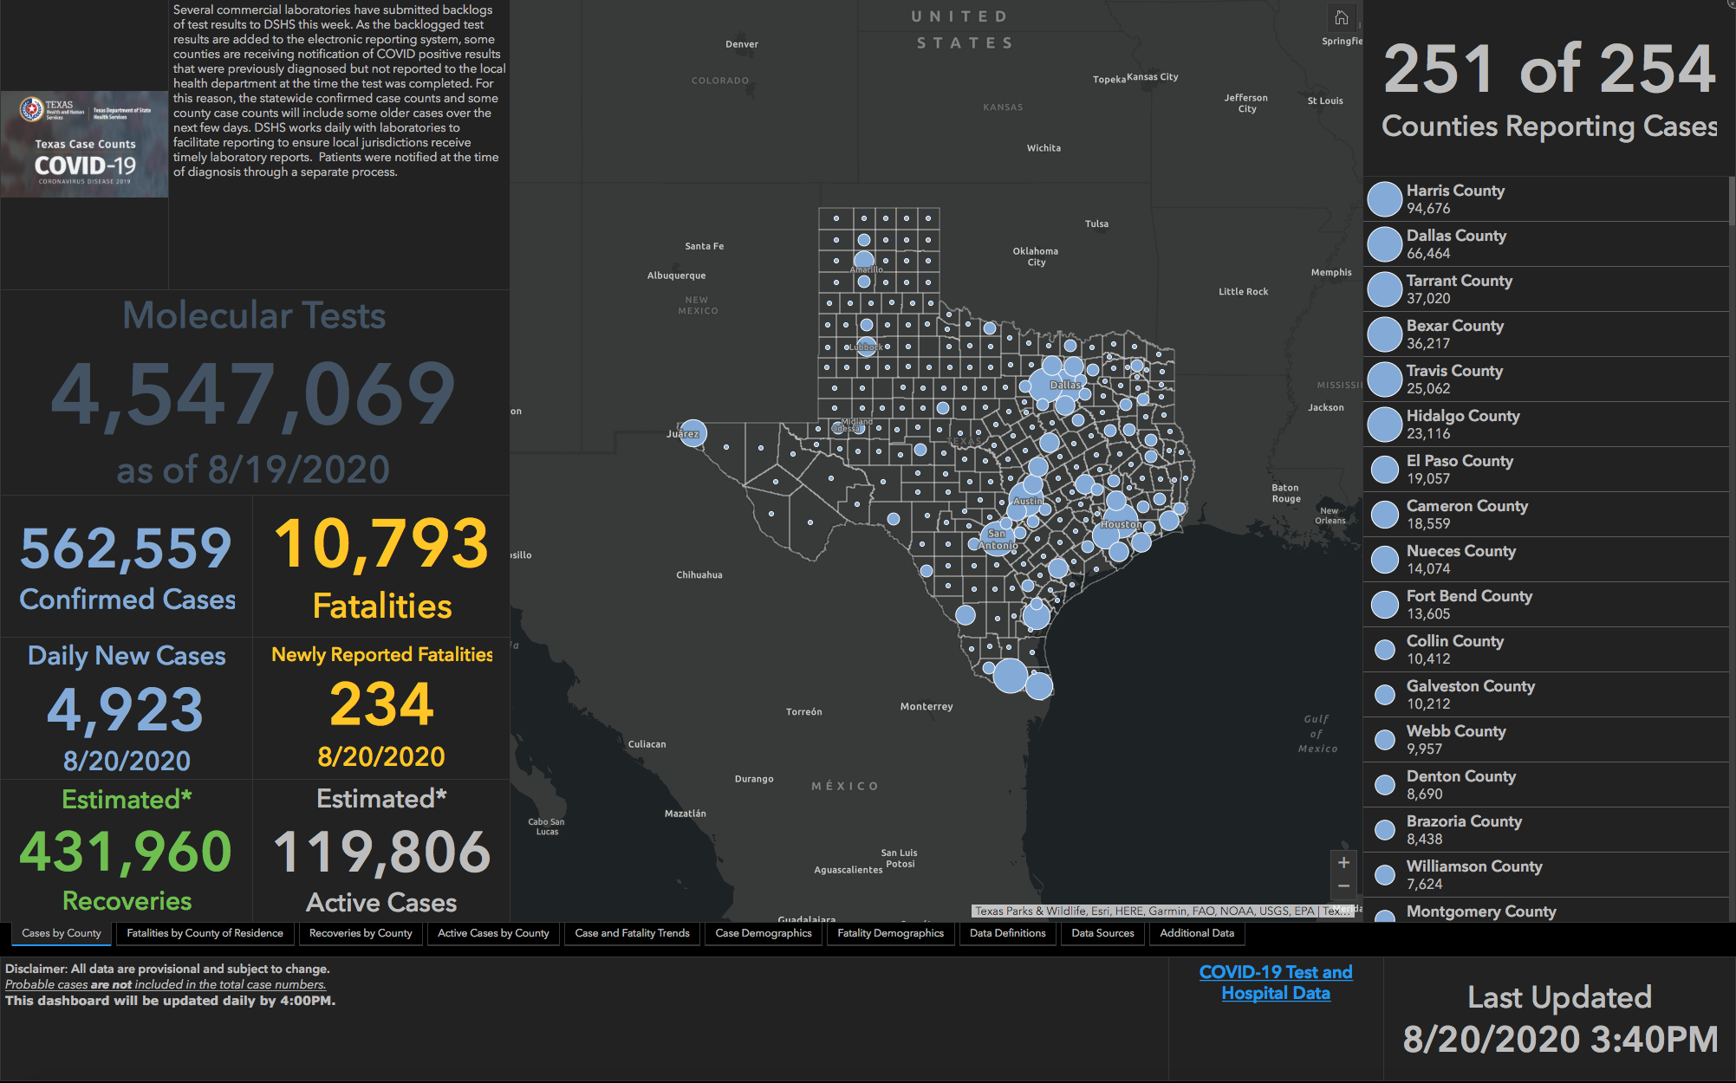

Slide 49
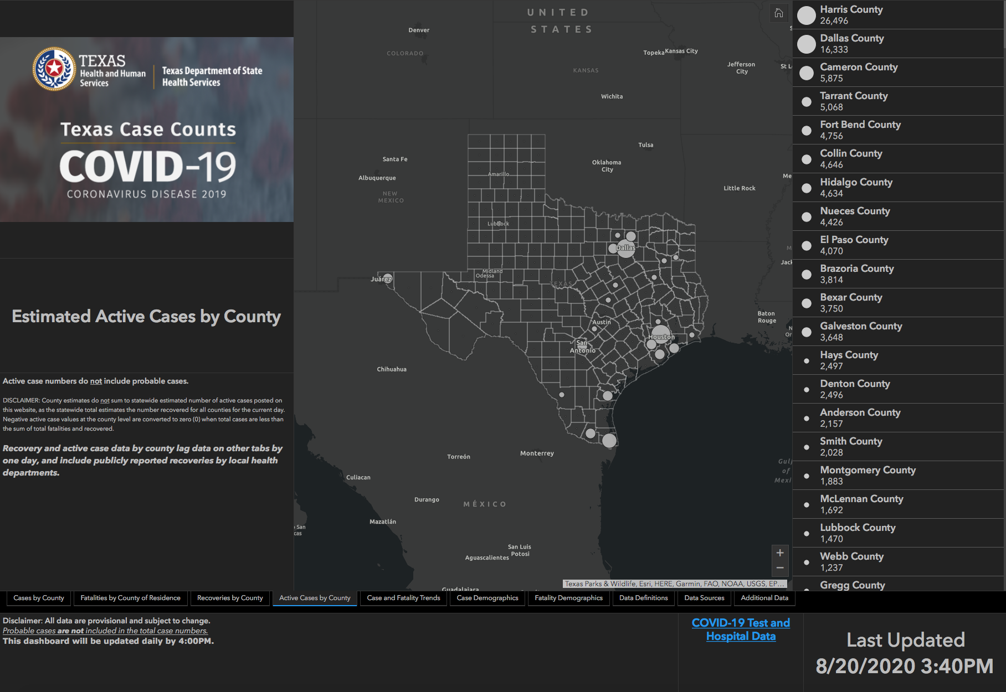

Slide 50
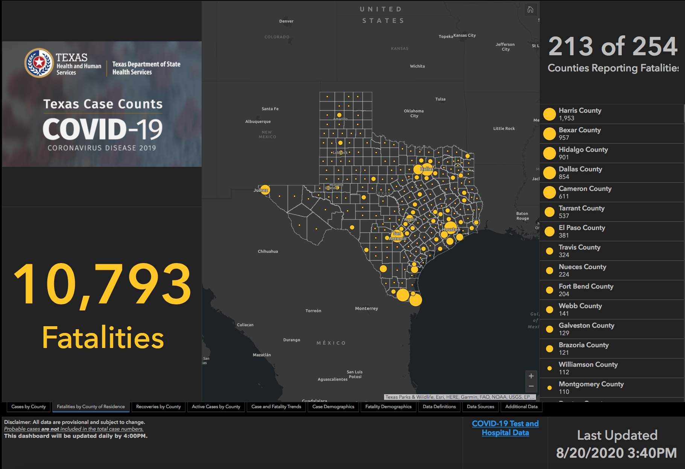

Slide 51
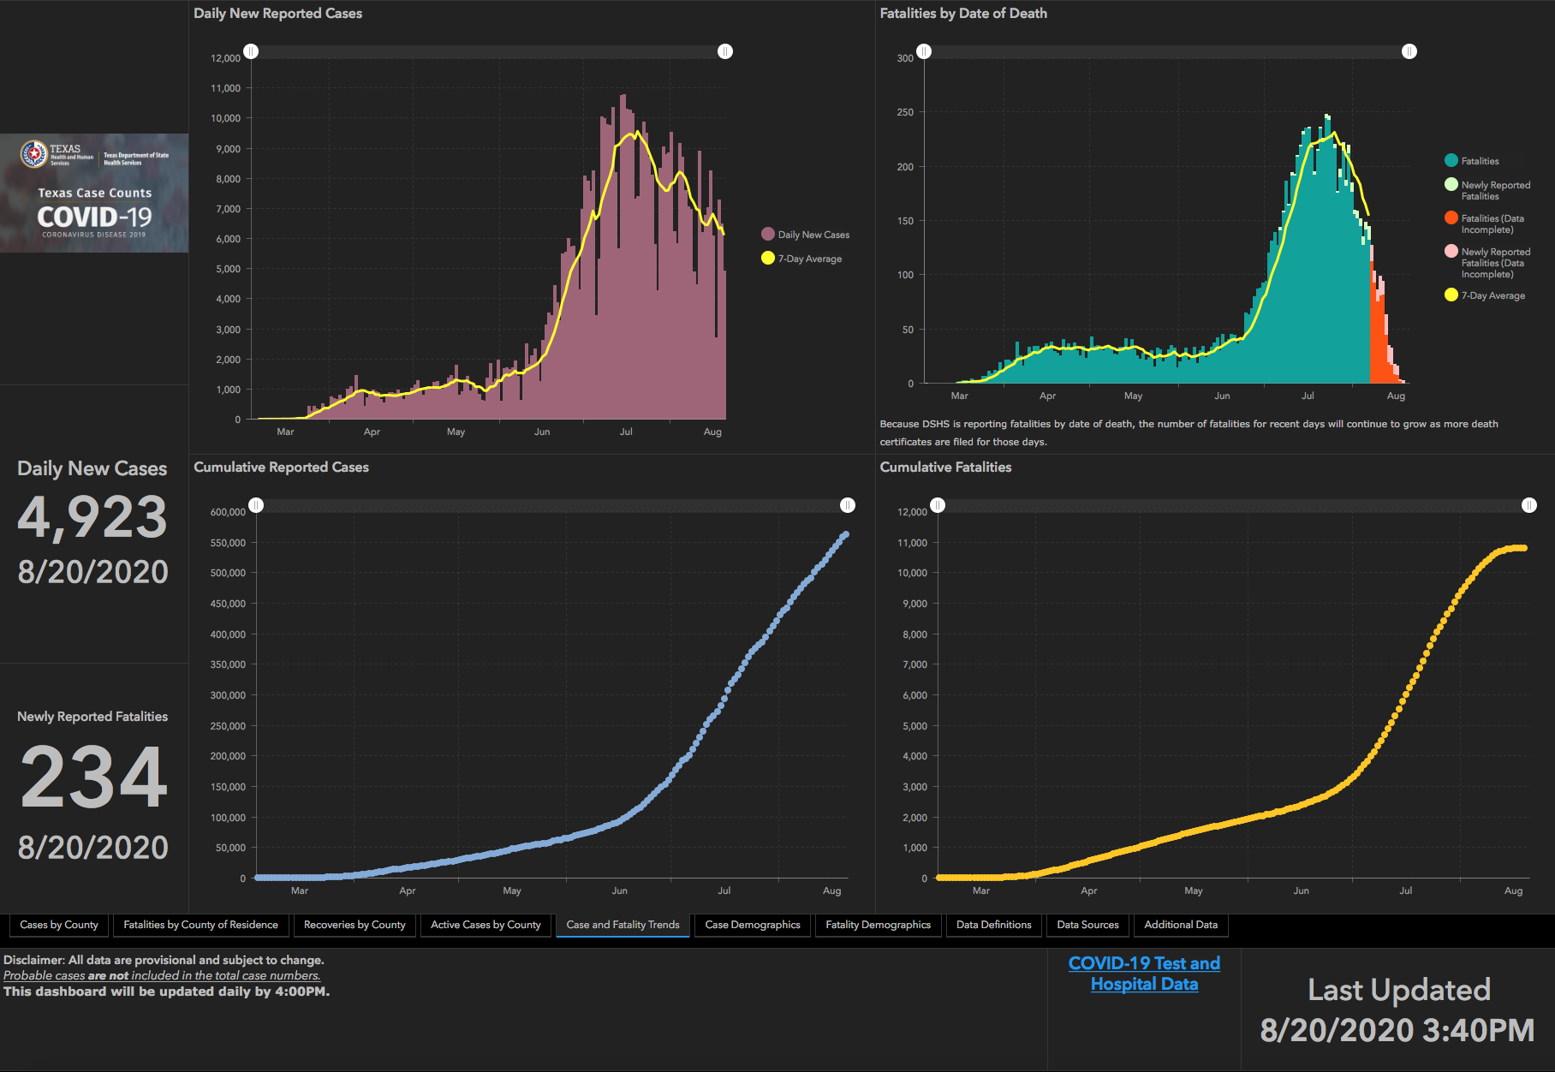

Slide 52
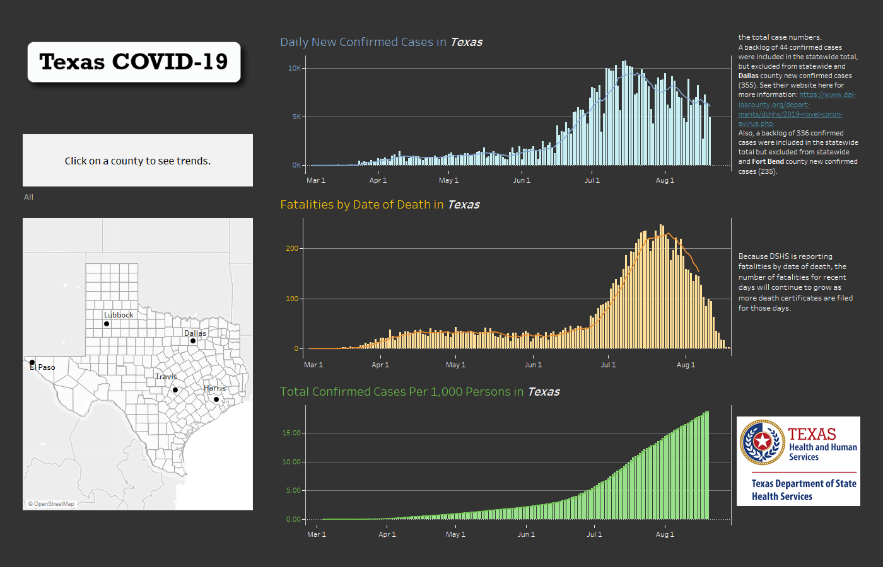

Slide 53
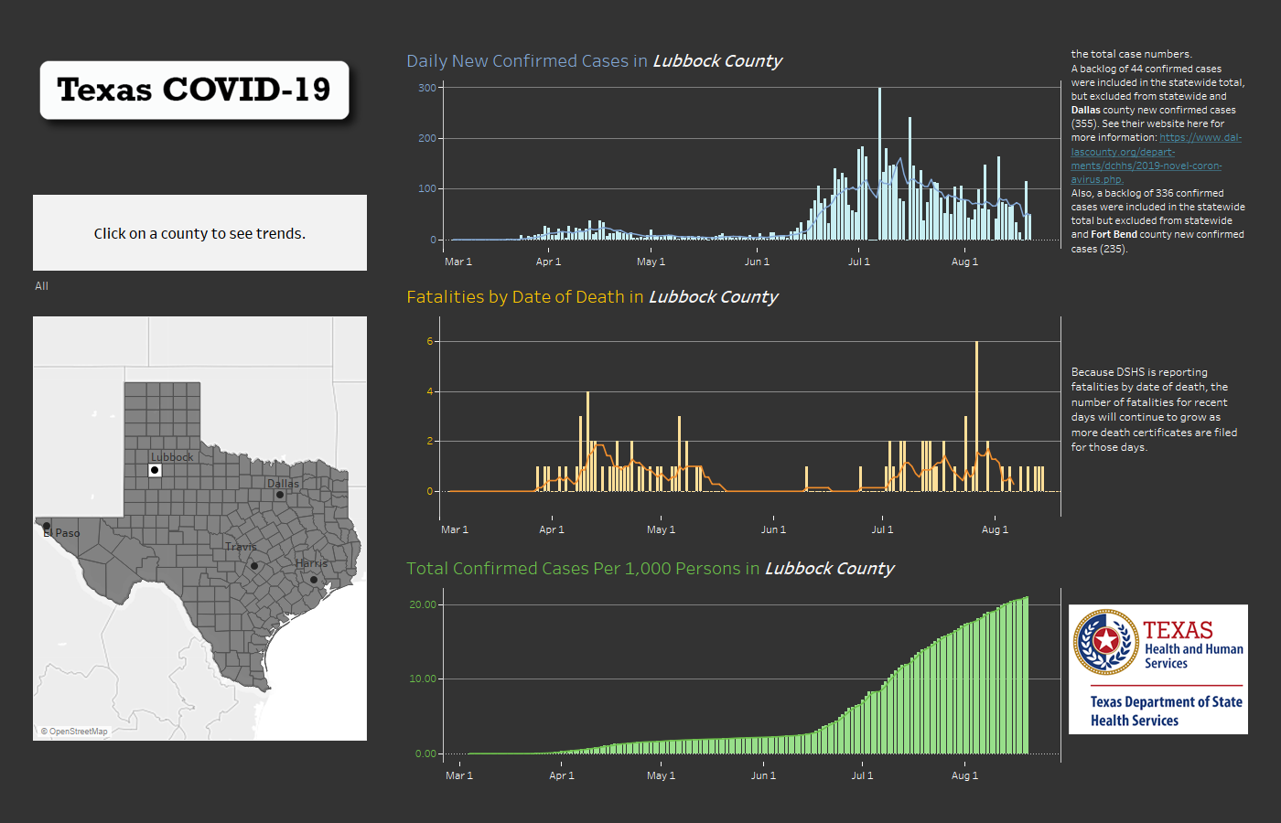

Slide 54
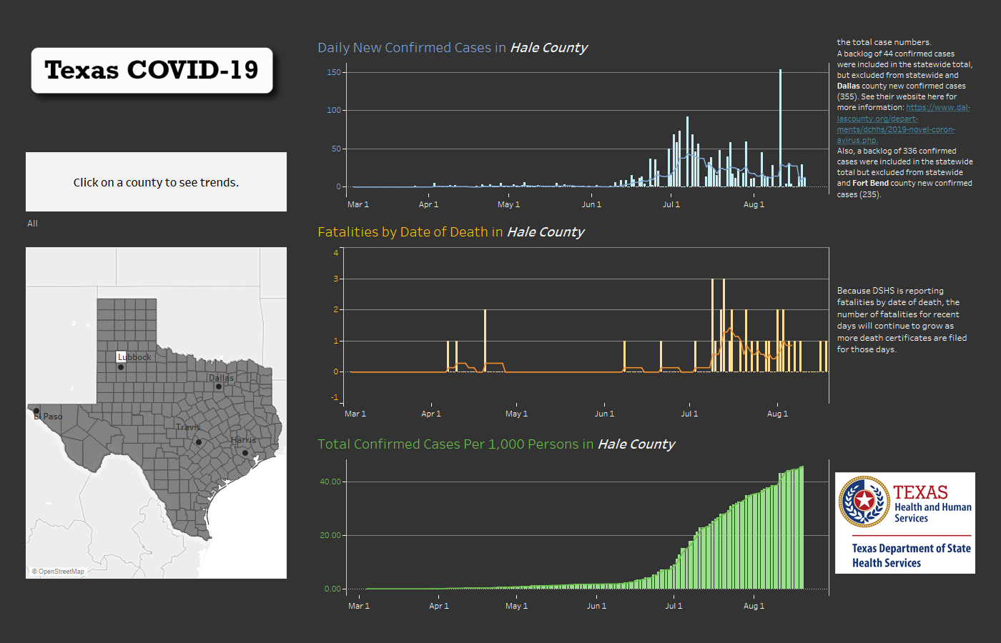

Slide 55
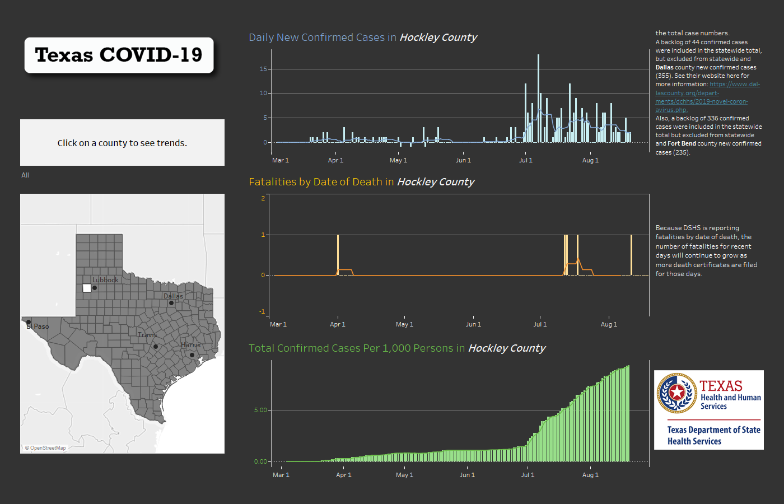

Slide 56
Social Effects of Quarantine

Slide 57


Slide 58
Q & A

