Slide 1

Reflection
Brian Schroeder in Drag—
Amazing isn’t he?
Smize: smiling with your eyes.
-Tyra Banks
Think of someone you love...someone that fills your heart with joy. Now imagine they are standing in front of you. Begin to smile, and not a blank smile that only involves the mouth. Smile with your entire soul. Even though your mouth is covered by a mask, that person on the receiving end will truly feel your kindness through your eyes...and they just might smize right back at you.
WSJ: Aug, 26, 2020
Brian Schroeder, MD MBA FACP
CMO Covenant Medical Center

Slide 2
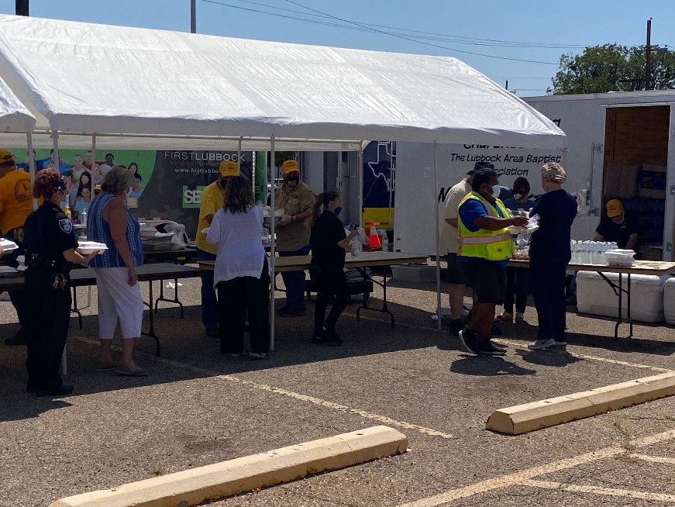

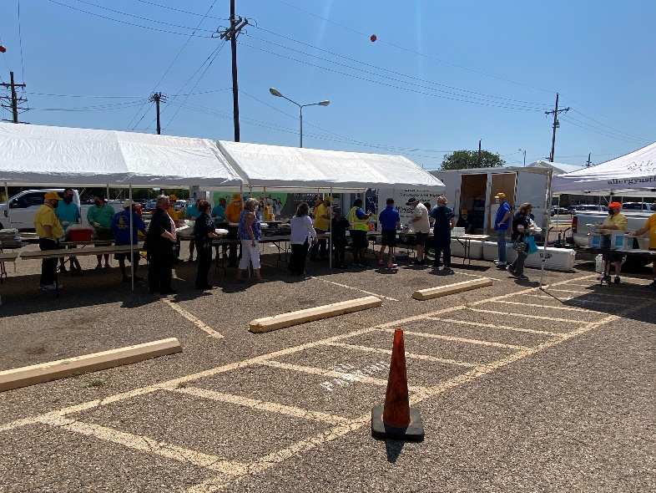
A Special Thanks – Lubbock Area Baptist Association

Slide 3

Safety Story
Brian Schroeder, MD FACS

Slide 4
Current Regional Census

Slide 5
Regional
 | Lubbock |  | Hockley |  | Hale
 | 8/24 | 8/24 | 8/24 | 8/24 | 8/24 | 8/24
Total | 6918 | 7035 | 242 | 247 | 1554 | 1591
Active | 1475 | 1472 | 55 | 34 | 80 | 74
Deaths | 94 | 95 | 5 | 5 | 35 | 39
New | 117 |  | 5 |  | 37

Slide 6
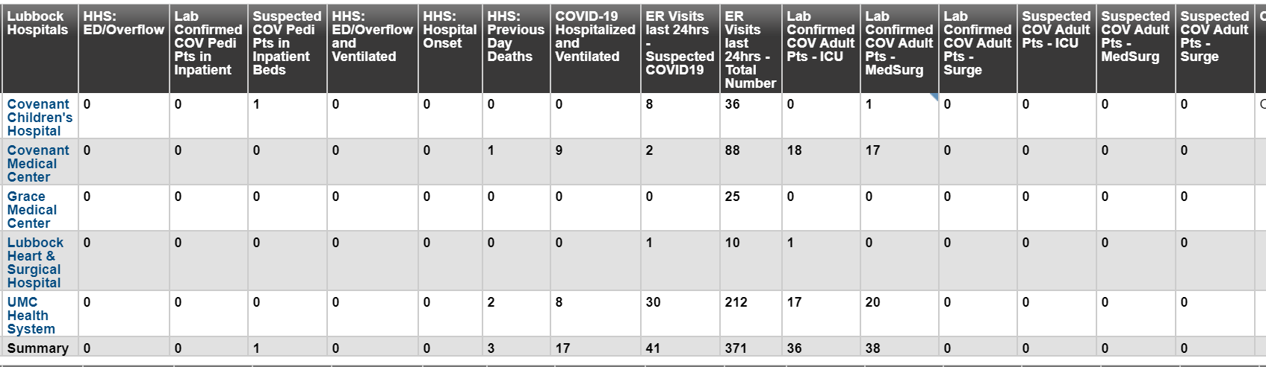
Regional - Lubbock
80 Hospitalized in Lubbock – 17 on vents

Slide 7
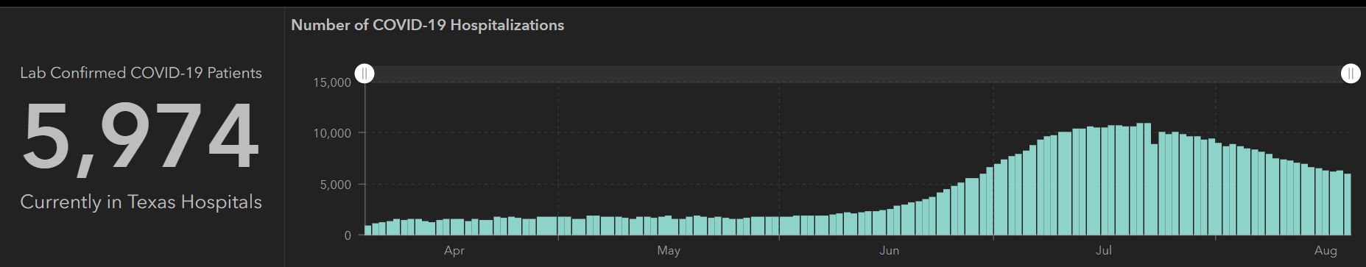
STATE
Last Week
 | 8/19 | 8/17 | 8/12 | 8/5 | 7/29 | 7/22 | 7/15 | 7/8 | 7/1
Cases | 557,256 | 542,9500 | 506,820 | 459,887 | 403,307 | 351,618 | 282,365 | 210,585 | 168,062
Deaths | 10,559 | 10,034 | 9034 | 7497 | 6190 | 4348 | 3432 | 2715 | 2481
Hospitalized | 5974 | 6200 | 7028 | 8455 | 9595 | 10,893 | 10,471 | 9286 | 6904

Slide 8
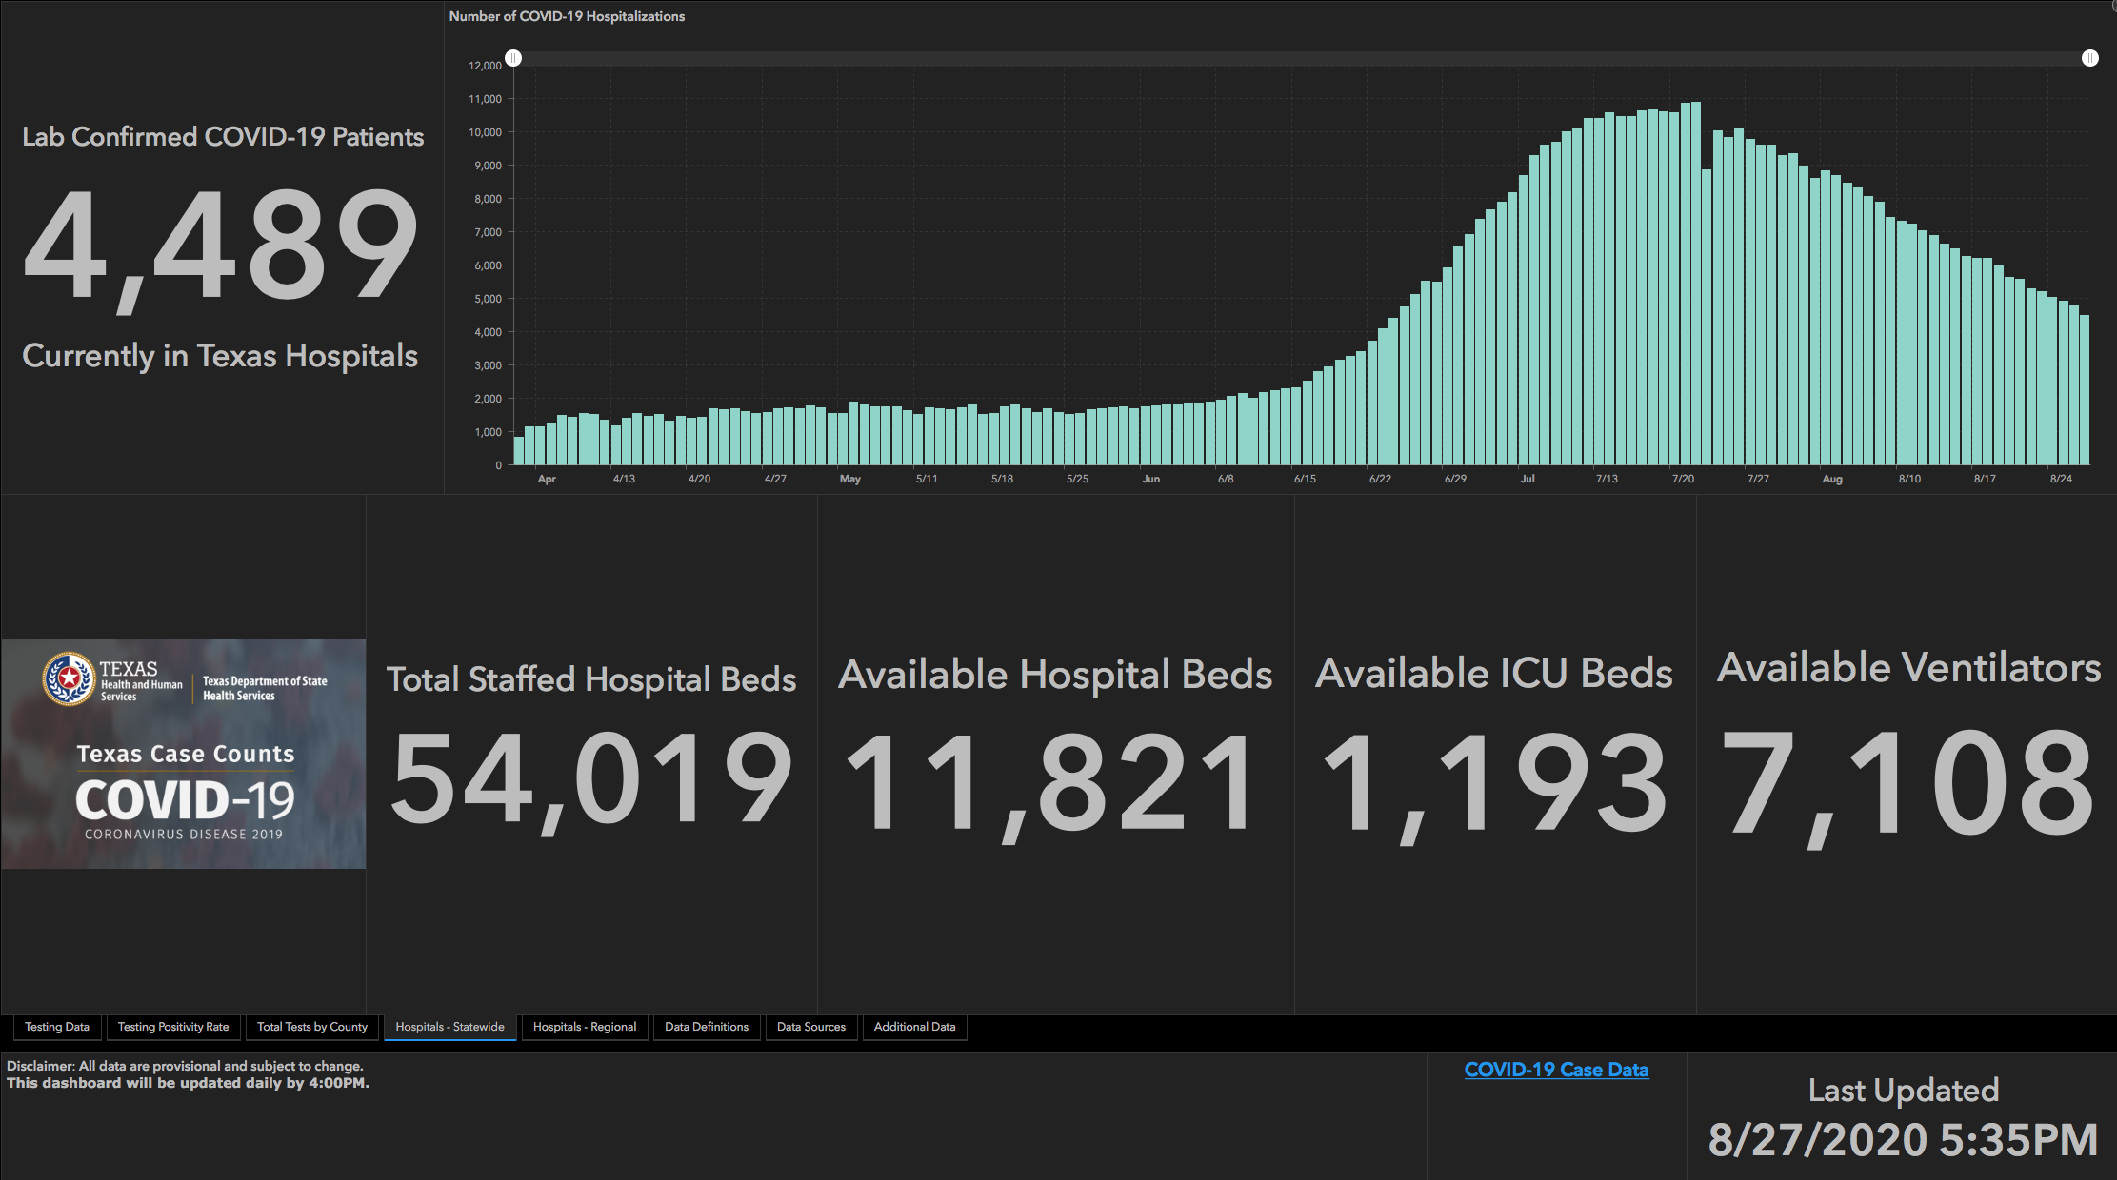
This Week
 | 8/26 | 8/19 | 8/12 | 8/5 | 7/29 | 7/22 | 7/15 | 7/8 | 7/1
Cases | 592,137 | 557,256 | 506,820 | 459,887 | 403,307 | 351,618 | 282,365 | 210,585 | 168,062
Deaths | 11,805 | 10,559 | 9034 | 7497 | 6190 | 4348 | 3432 | 2715 | 2481
Hospitalized | 4806 | 5974 | 7028 | 8455 | 9595 | 10,893 | 10,471 | 9286 | 6904

Slide 9
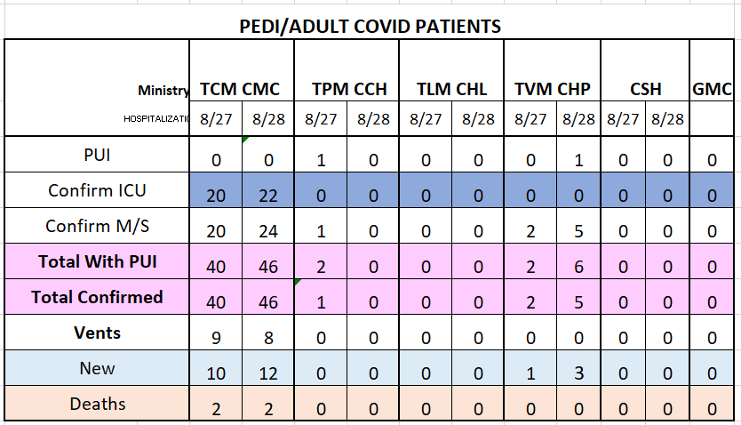
Covenant PUI/Confirmed cases-hospitalized

Slide 10
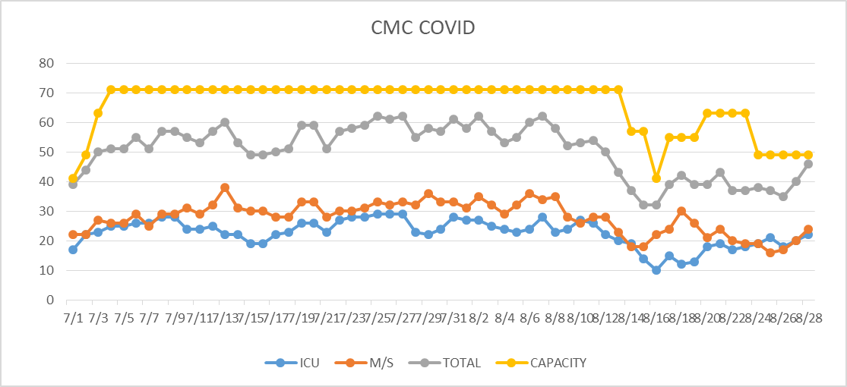
PUI/Confirmed cases-hospitalized
HC6 Closed for COVID 8/24

Slide 11
Surge Plan
Covenant Medical Center
 | ICU | Med Surg | Total
Phase 1 | 10-CICU |  | 10
Phase 2 | 17-CICU | 10-HC4 | 27
Phase 3 | 17-CICU | 24-HC4 | 41
Phase 4 | 17-CICU 8-MICU | 24-HC4 14-Pal Med | 63
Phase 5 | 17-CICU 16-MICU | 24-HC4 14-Pal Med | 71
Phase 6 | 17-CICU 16-MICU 8- SICU 4 (east) | 24-HC4 14-Pal Med 15 – S 9 (east) | 94
Currently
Last Week

Slide 12
Statistics
Cristian Requenez, MS
Clinical Data Analyst
Performance Improvement and Decision Support Services
Covenant Health

Slide 13
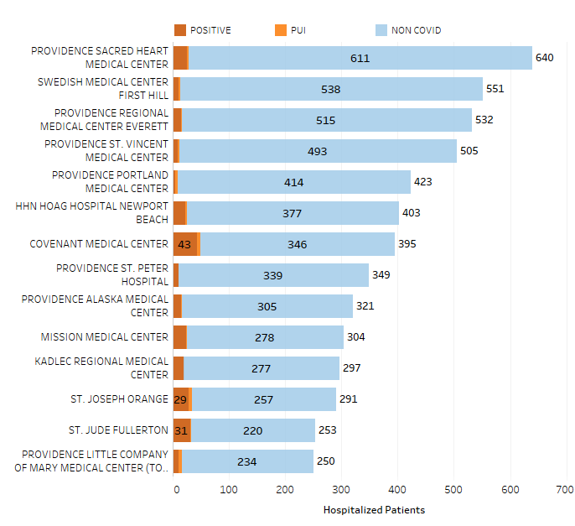
Providence System Hospitalized COVID-19 Cases
11%

Slide 14
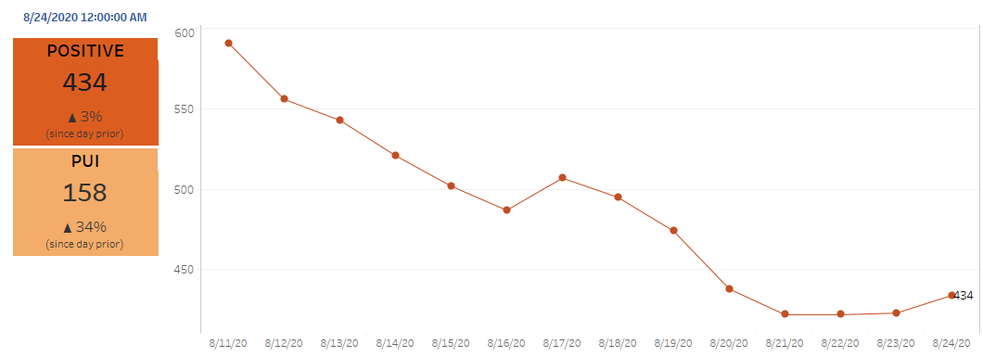
Providence Inpatient COVID-19 Volume

Slide 15
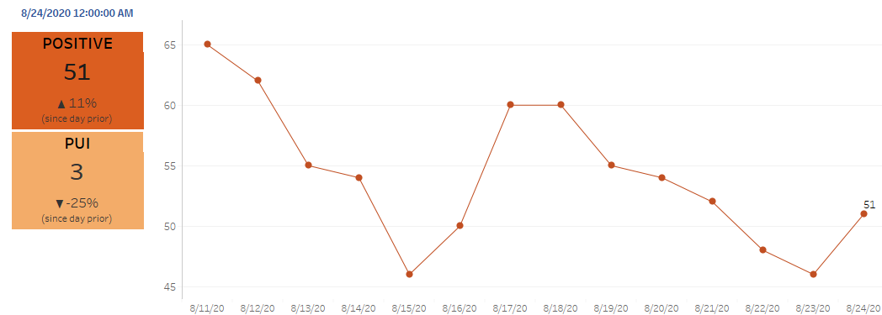
Texas Inpatient COVID-19 Volume

Slide 16
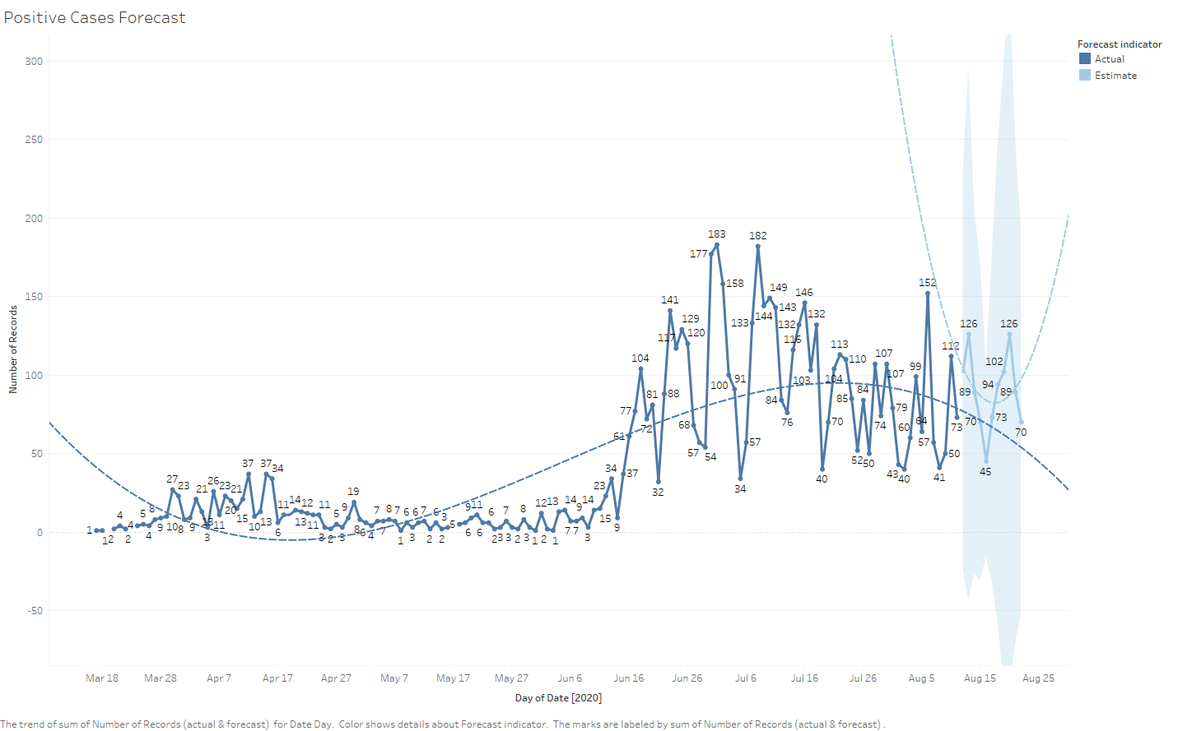
New Covid-19 POSITIVES by Day Trend

Slide 17
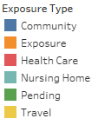
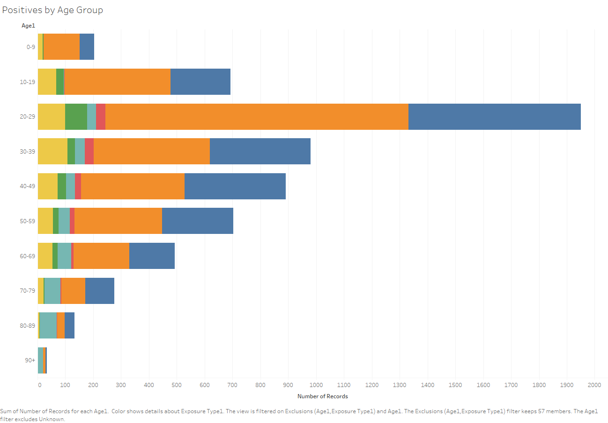
Covid-19 POSITIVES Age Distribution

Slide 18
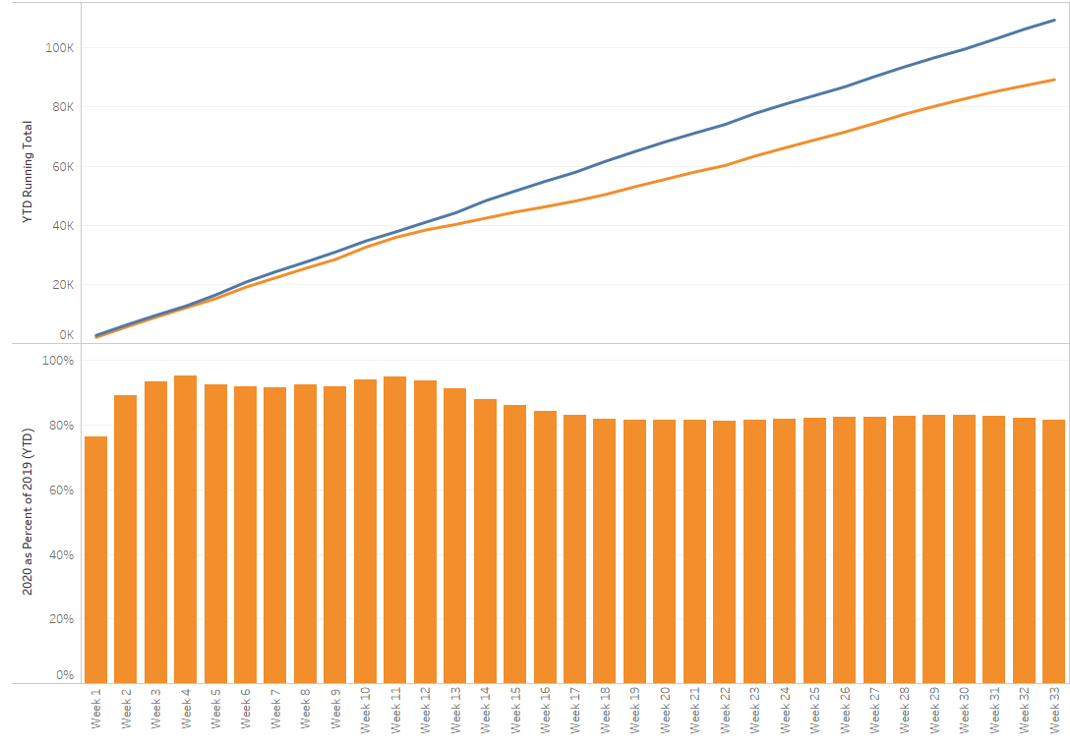
TX/NM Region Weekly Procedures (YOY)

Slide 19
Covid-19 Testing

Slide 20
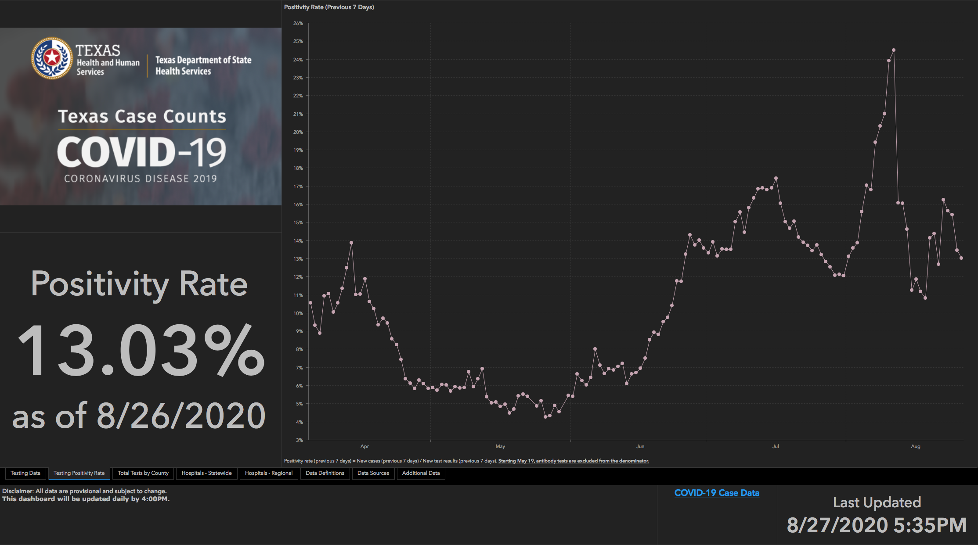
TESTING – STATEWIDE Results

Slide 21
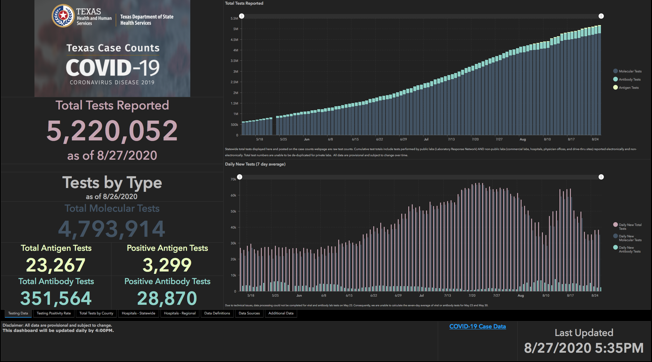

Slide 22
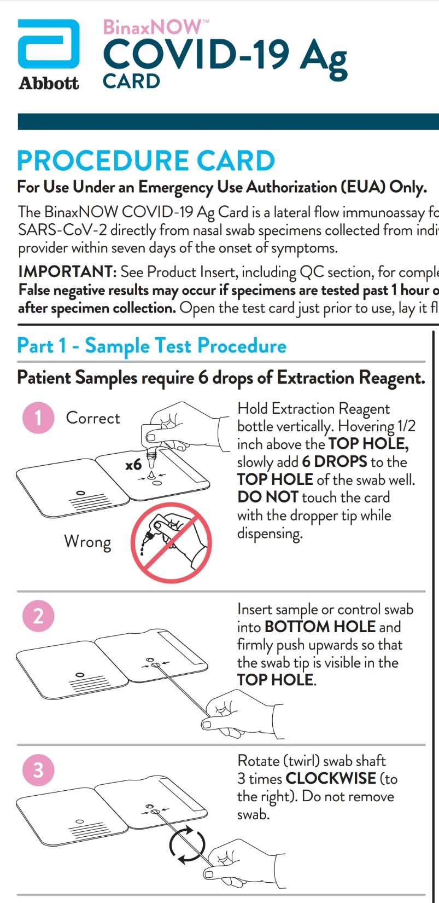
COVID-19 ANTIGEN TESTING
CLIA Waived, Point of Care test
Limit of Detection slightly less than IDNow point of care
False Positives? Confirmation of Positives by PCR
More studies needed for Clinical sensitivity and specificity.

Slide 23
Covid-19 ANTIGEN Testing
This is the “new kid” on the block
Cheap
Fast
Highly specific
Low sensitivity
Negative results are unreliable- If Covid-19 suspected, a negative test must be confirmed with a PCR test

Slide 24
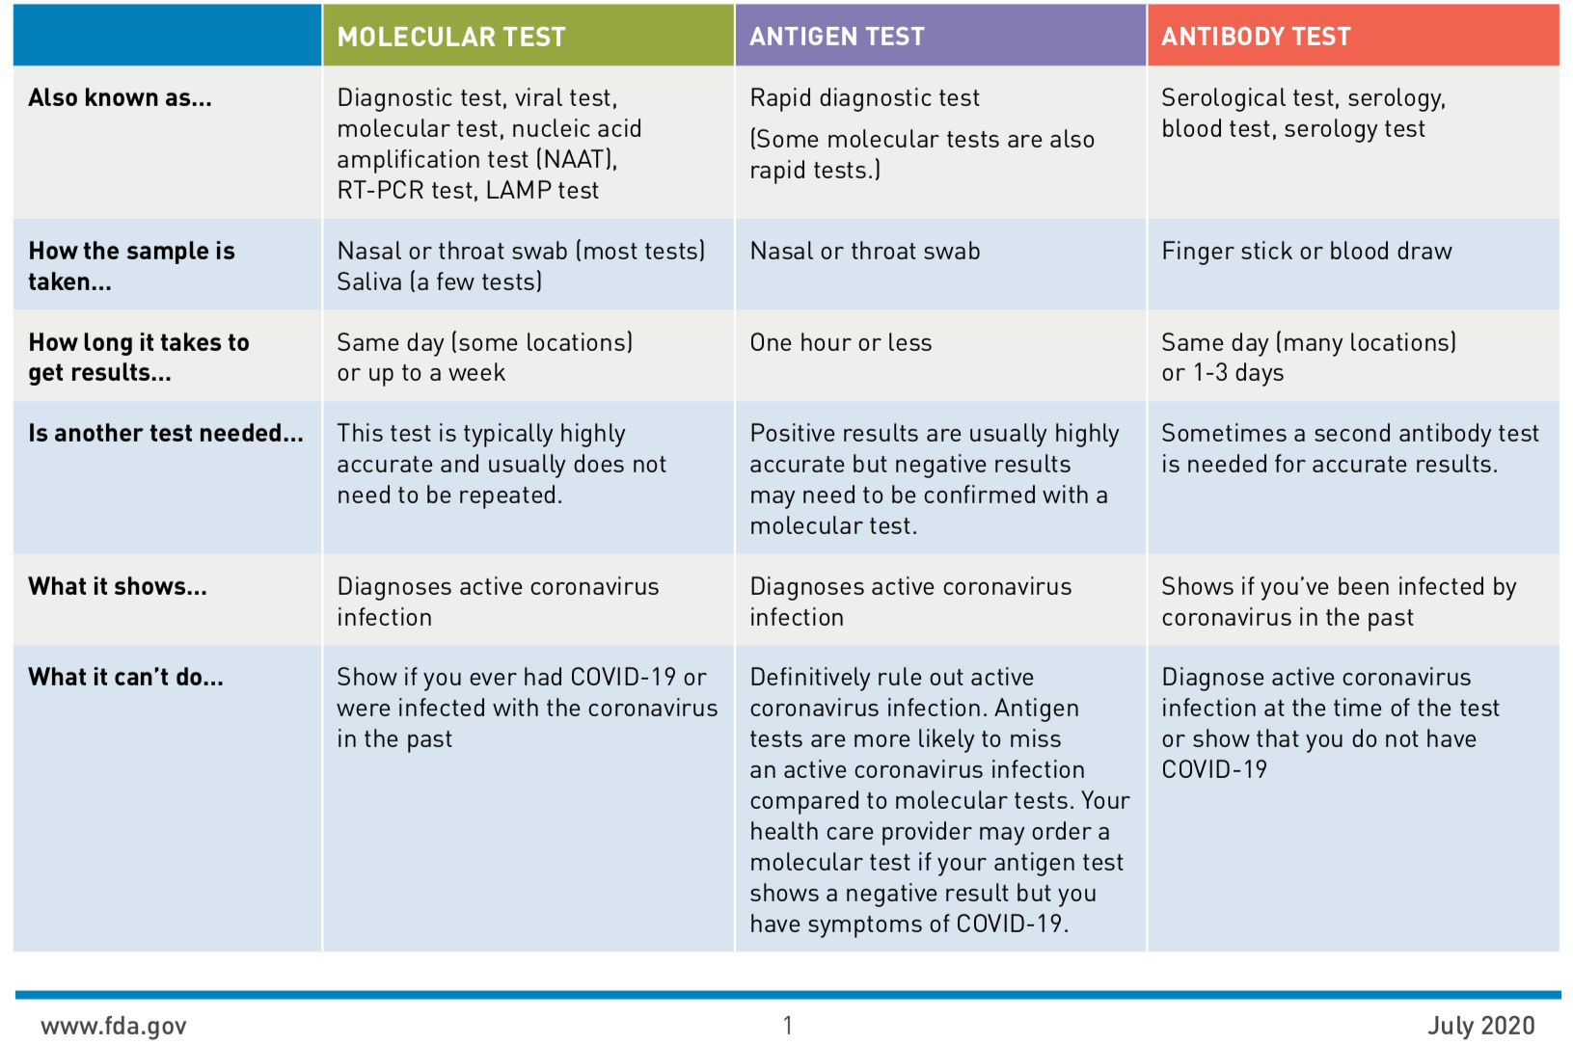
Comparison of Covid -19 Tests

Slide 25
TESTING
 | CMC | GMC | CMG
Test Kits
Swabs
VTM
 | CMC |  | GMG/CMG
 | Tests | + | Tests | +
8/22 | 117 | 9 | 7 | 0
8/23 | 49 | 4 | 12 | 0
8/24 | 152 | 15 | 201 | 28
8/25 | 209 | 16 | 188 | 20
8/26
>2000 >750
<2000 <750
<1600 <500
Alinity-currently 100-150/day Hard to tell if it will reach 800/day
BD Max shipment delayed – expect it 8/28
CMG to receive full shipment today; increase weekly kits from 42 to 60
CHP Antibody testing – 30 in Olton on 8/20

Slide 26
TESTING – preparing for children
Working with School systems
  Pedi Testing Algorithm WIP
  Plainview ISD – Dr. Rhyne assisted in guidelines
  Levelland-Return to school documentation – clarifying with LISD

Slide 27
Returning to Operations

Slide 28
Caregivers
COVID Related Furloughs
7 new work
Count reflects # furlough (exposed and positive)
Good
Moderate
Critical

Slide 29
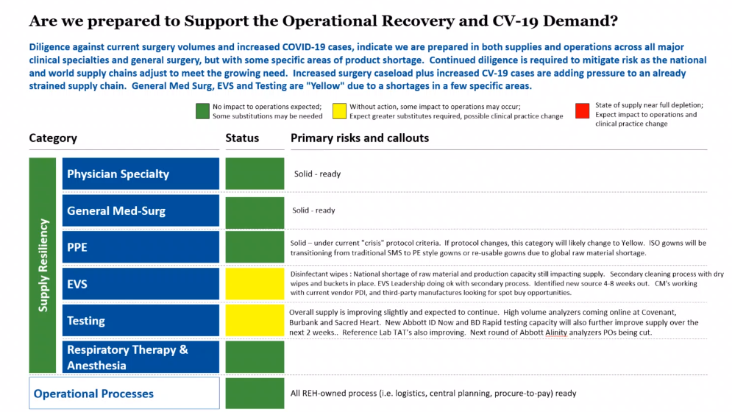
Critical Inventory - REH
REH UPDATE
PSJH Expecting
a large shipment of PDI wipes.

Slide 30
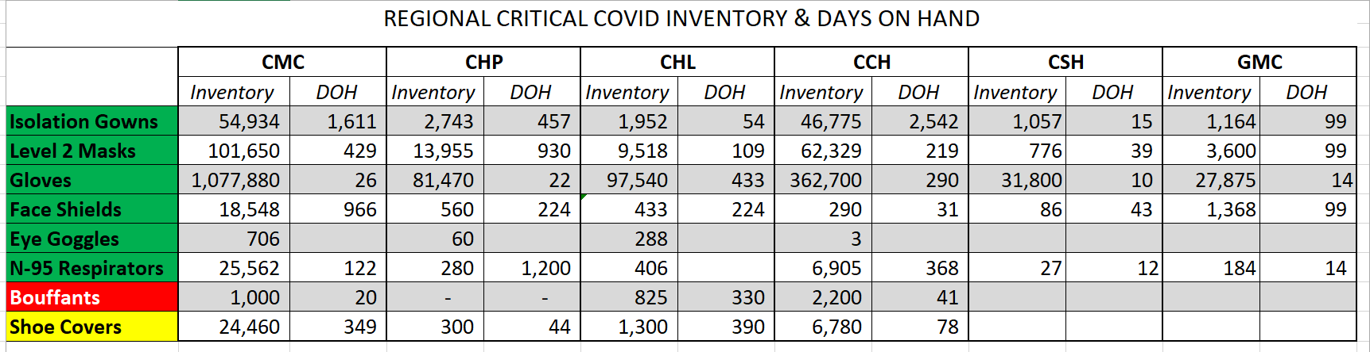
Critical Inventory

Slide 31
Critical Inventory
  Caregiver Masks
  Starting Monday 8/31, Level 2 masks – 1 per day per caregiver
  Will reassess inventory in 30 days
  N-95 Masks
  Starting Monday 8/31, n-95 masks – 1 per day per caregivers that have identified as needing to use an n-95 mask.
  Adding PICU and SICU
  IMPORTANT- Reprocessing of n-95 masks must be stressed

Slide 32
And now a few words about vented N-95 masks

Slide 33
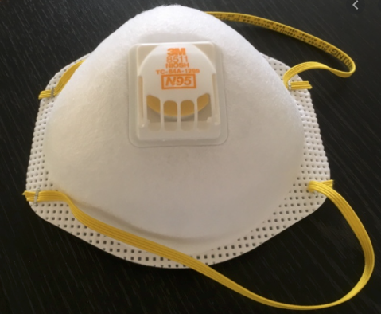
No, No, No!

Slide 34
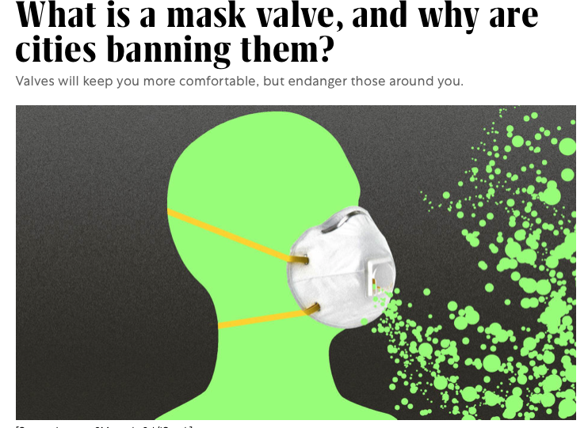

Slide 35
Pharmacy Update
Larry Pineda, PharmD
Clinical Pharmacist – AMS
Covenant Health

Slide 36
CHS COVID-19 Treatments
Agent | Dosage | Comments | Update
Remdesivir Emergency Use Authorization (EUA) 5/1/20 | 200 mg IV x 1, then 100 mg IV daily x 4 days | EUA product on allocation, cost ~$520/vial NIH guidelines (July 24, 2020): Because supplies are limited, recommend prioritizing for patients who require supplemental O2 but who are NOT on HF O2, noninvasive or mech ventilation, or ECMO | Remdesivir EUA Inventory: (Thursday AM) CMC = 247 vials; Plainview = 92 vials Remdesivir EUA Patients: (Thursday AM) CMC = 9; Plainview = 0
Convalescent Plasma | 1 unit (200-400mL) | CMC enrolled in Mayo trial | Emergency Use Authorization on 8/23/20 Mayo Trial: Enrolled 86 patients at CMC (1 OB at CCH) End date 8/28/20
Dexamethasone | 6 mg IV/PO daily x 10 days | NIH guidelines: Recommend use in mech ventilated patients (AI) or those on supplemental oxygen (BI) Recommend against use for patients who do not require supplemental oxygen (AI) Alternatives if dexamethasone is unavailable: Prednisone, methylprednisolone, hydrocortisone
Notes:
8/21: CMC received 7 cases of RDV this week, 280 vials = $145K
8/14: CMC has 10 patients on treatment and 10 rounds remaining (83 vials remaining). Plainview has 0 patients on treatment and 12 rounds remaining (74 vials)
Optimal timing of donor plasma collection in relation to recovery from COVID19, most appropriate methods of antibody testing, and minimum titers of SARS-CoV-2 antibody in convalescent plasma that may be associated with clinical benefits in pts with COVID-19 not determined.
FYI Budesonide: In response to Odessa doctor, Richard Bartlett, who calls it the 'silver bullet‘. There have been no clinical trials or observational studies examining the use of ICS in COVID-19. Clinical trials would be required to establish whether these drugs may be repurposed for the treatment of this disease.

Slide 37
Covid-19 Vaccine Update

Slide 38
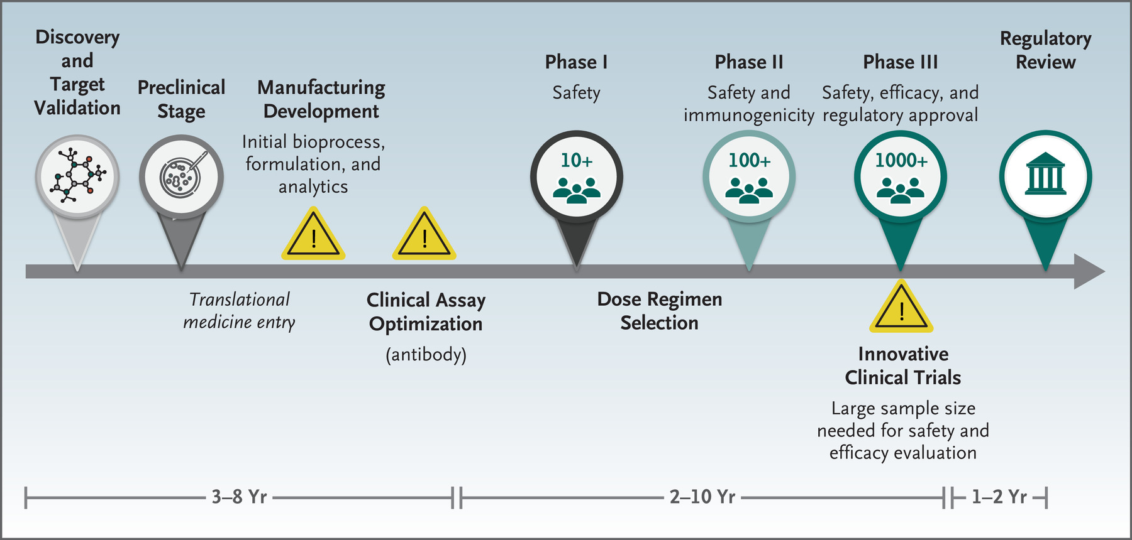
Traditional Vaccine Development Pathway
Notes:
EDITORIAL July 14, 2020 DOI: 10.1056/NEJMe2025111
The Covid-19 Vaccine-Development Multiverse by Penny M. Heaton, M.D.
Historical context:
Measles - In 1912, measles became a nationally notifiable disease, 1963 a vaccine became available = 51 years
Polio - In 1840, poliomyelitis was recognized, but first recognized as an infectious disease in 1905, formalin-inactivated vaccine 1953 = 48 years

Slide 39
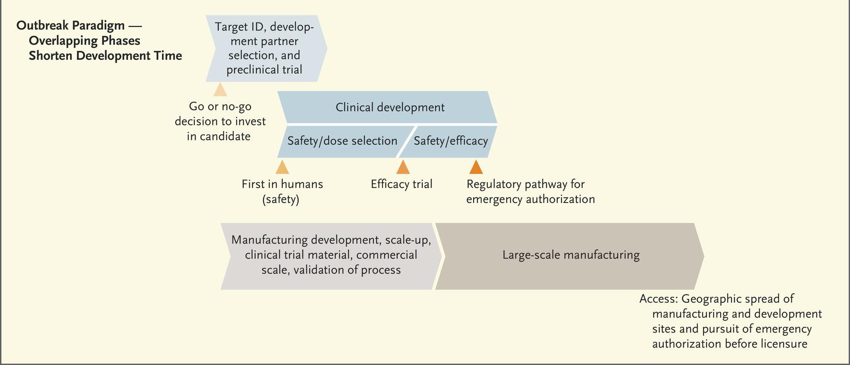
Lurie N et al. NEJM 2020; 382:1969-1973

Slide 40

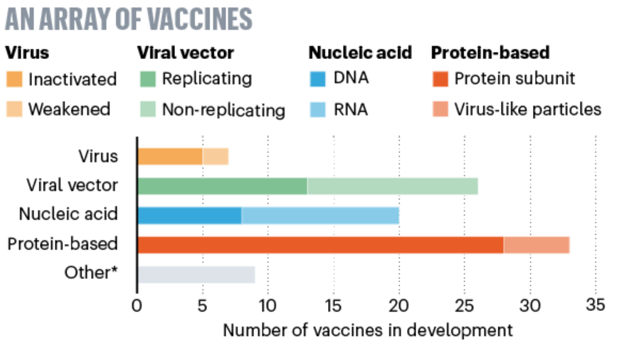
Vaccine Platforms
Links:
  https://www.nature.com/articles/d41586-020-01221-y
  https://media.nature.com/original/magazine-assets/d41586-020-01221-y/d41586-020-01221-y.pdf
Notes:
AE, CI, Warp

Slide 41
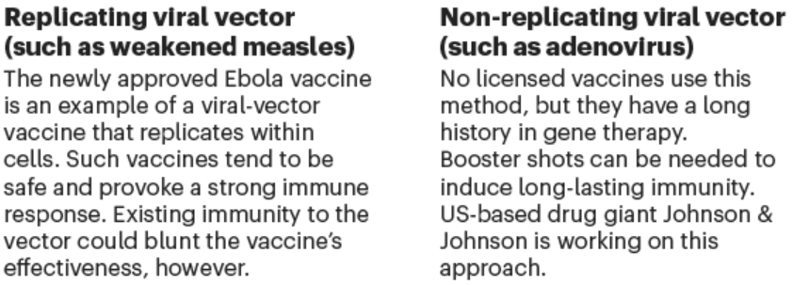
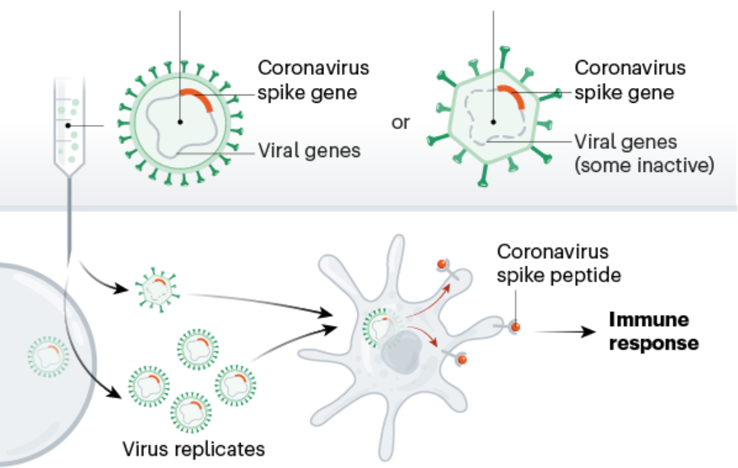
Viral Vector Vaccines

Slide 42
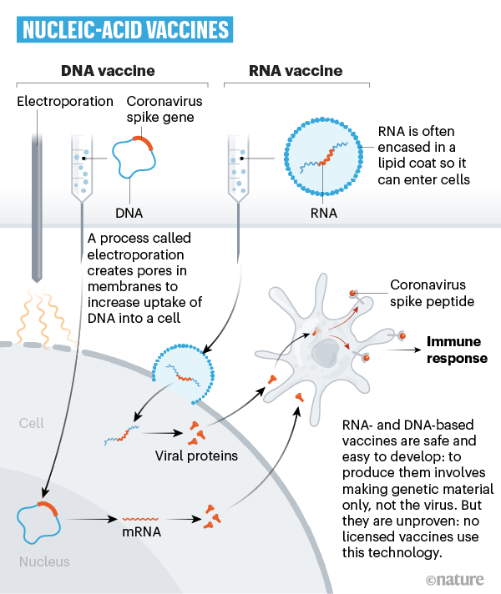
Nucleic Acid Vaccines
Genetic instructions (in the form of DNA or RNA) for a coronavirus protein that prompts an immune response.
The nucleic acid is inserted into human cells, which then churn out copies of the virus protein; most of these vaccines encode the virus’s spike protein.

Slide 43
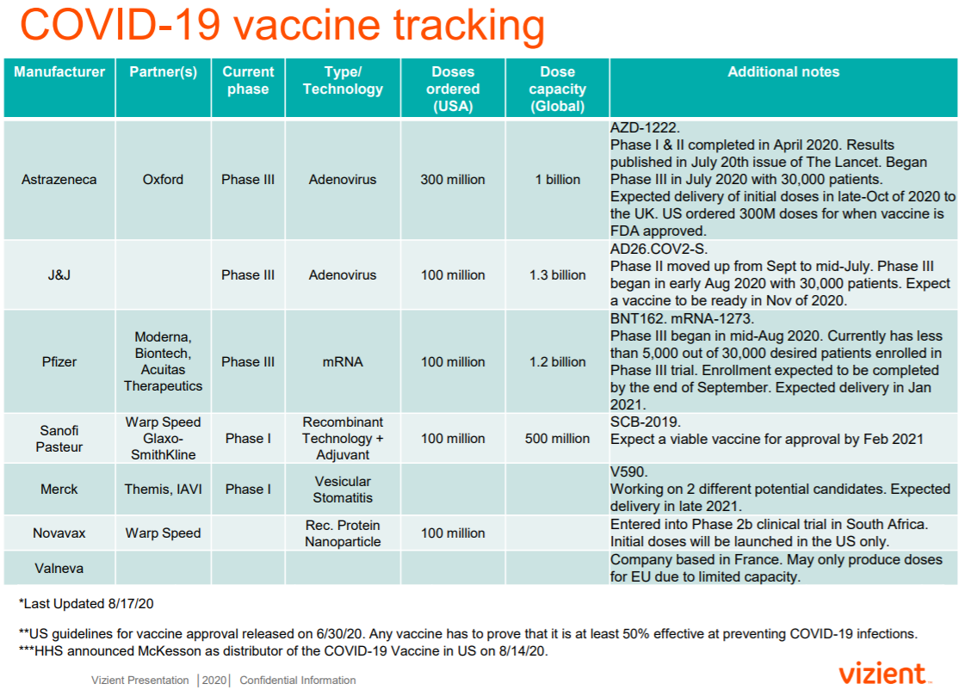
Notes:
Astrazeneca: nonreplicating viral vector, adenovirus
JJ: nonreplicating viral vector, adenovirus
Pfizer: RNA
Sanofi Pasteur: protein subunit, adjuvant to boost immune response
Merck: engineered vesicular stomatitis virus (VSV) to shuttle a gene (replicating viral vector)
Novavax: protein subunit, adjuvant to boost immune response
Valneva: inactivated whole virus vaccine

Slide 44
The million dollar question
If you have had Covid-19, can you catch it again?

Slide 45
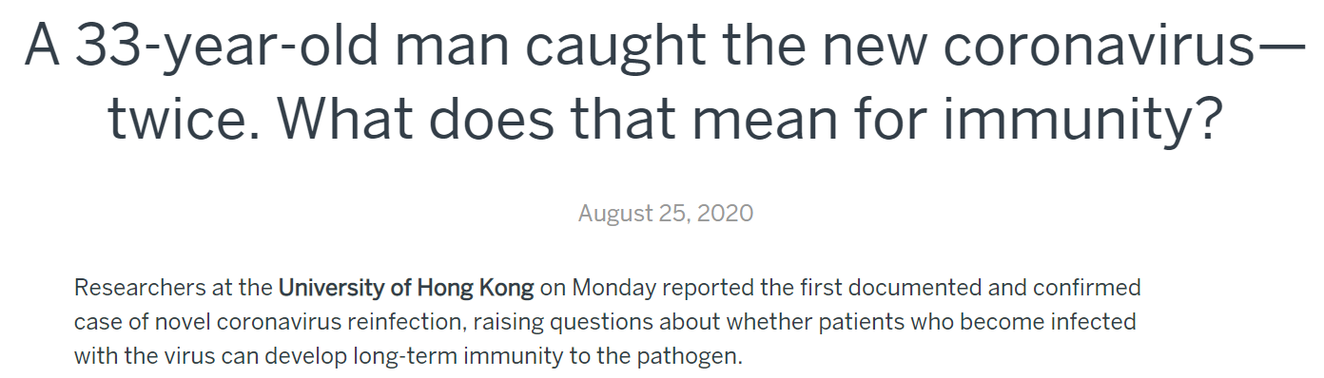
COVID19-Hot Topics
  Clinical Infectious Disease
    Cannot exempt people who have had COVID from wearing PPE

Slide 46
Changes in the
Convalescent Plasma Program

Slide 47
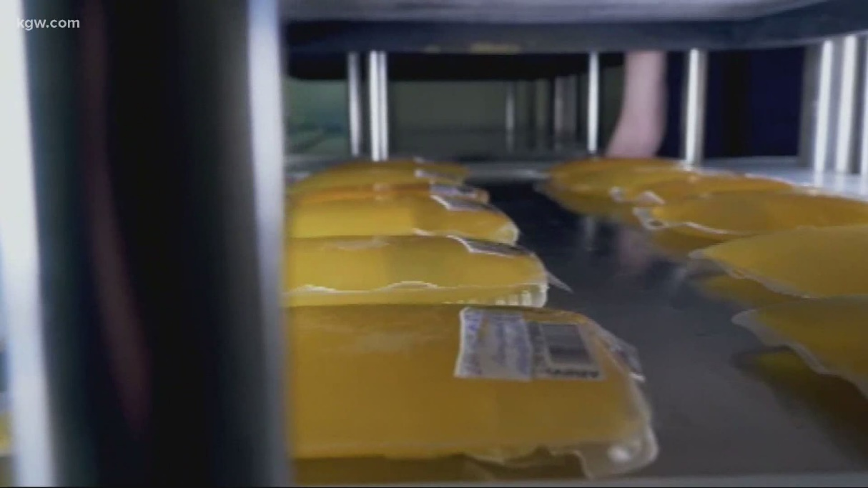
Convalescent Plasma
FDA Issues Emergency Use Authorization for Convalescent Plasma for COVID–19 Treatment
Fact sheet required for informed consent
High Titer COVID-19 Convalescent Plasma (IgG Antibodies tested on Ortho Vitros platform with S/C ratio of 12 or greater)
Low Titer COVID-19 Convalescent Plasma (all others)
https://www.fda.gov/media/141480/download

Slide 48
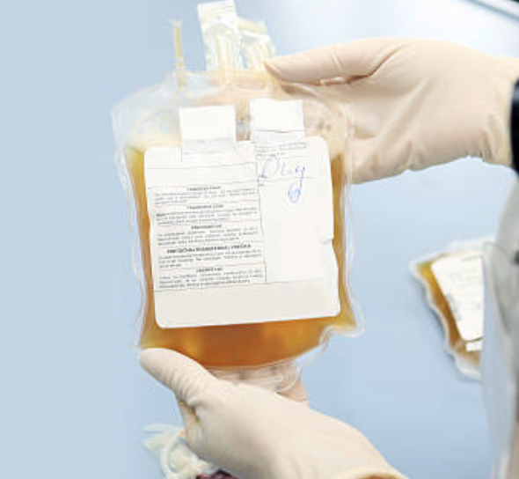
Convalescent Plasma
The Mayo Convalescent Plasma Program is ending
Convalescent Plasma has been approved OFF TRIAL for
Emergency Use Authorization (EUA)
We are rapidly working to create an appropriate consent form for patients to sign if they are candidates for Convalescent Plasma
New regulations from the FDA may require us to identify if the plasma has HIGH or LOW Titers of anti-SARS-Cov-2 antibodies.
Currently we only have a qualitative assay for the antibodies that does not give us that information
We have produced a FACT SHEET for informed consent and one for Physicians.

Slide 49
Texas Demographics

Slide 50
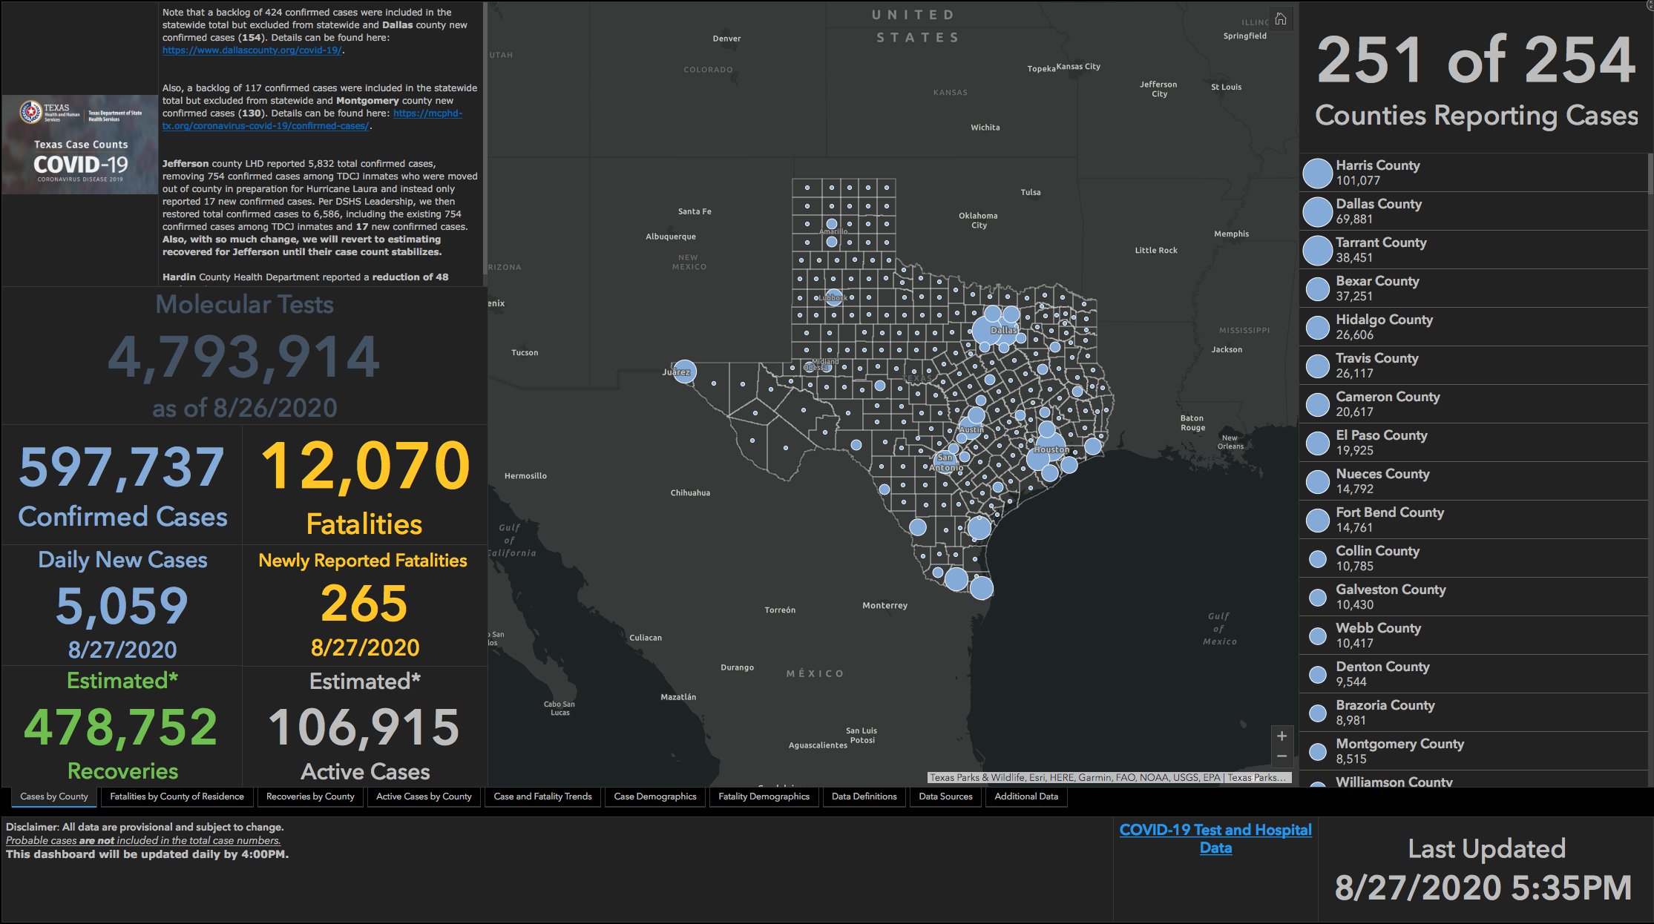

Slide 51
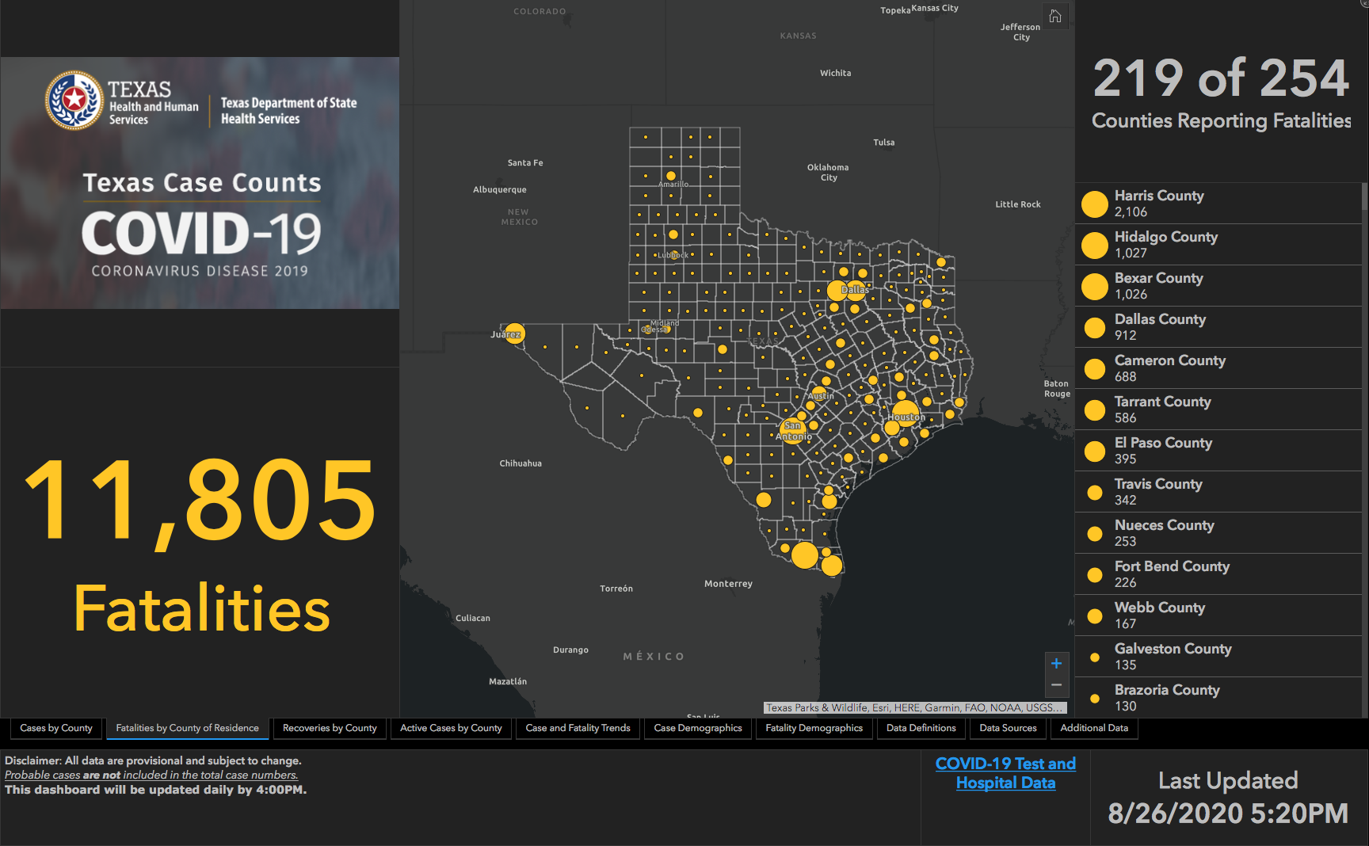

Slide 52
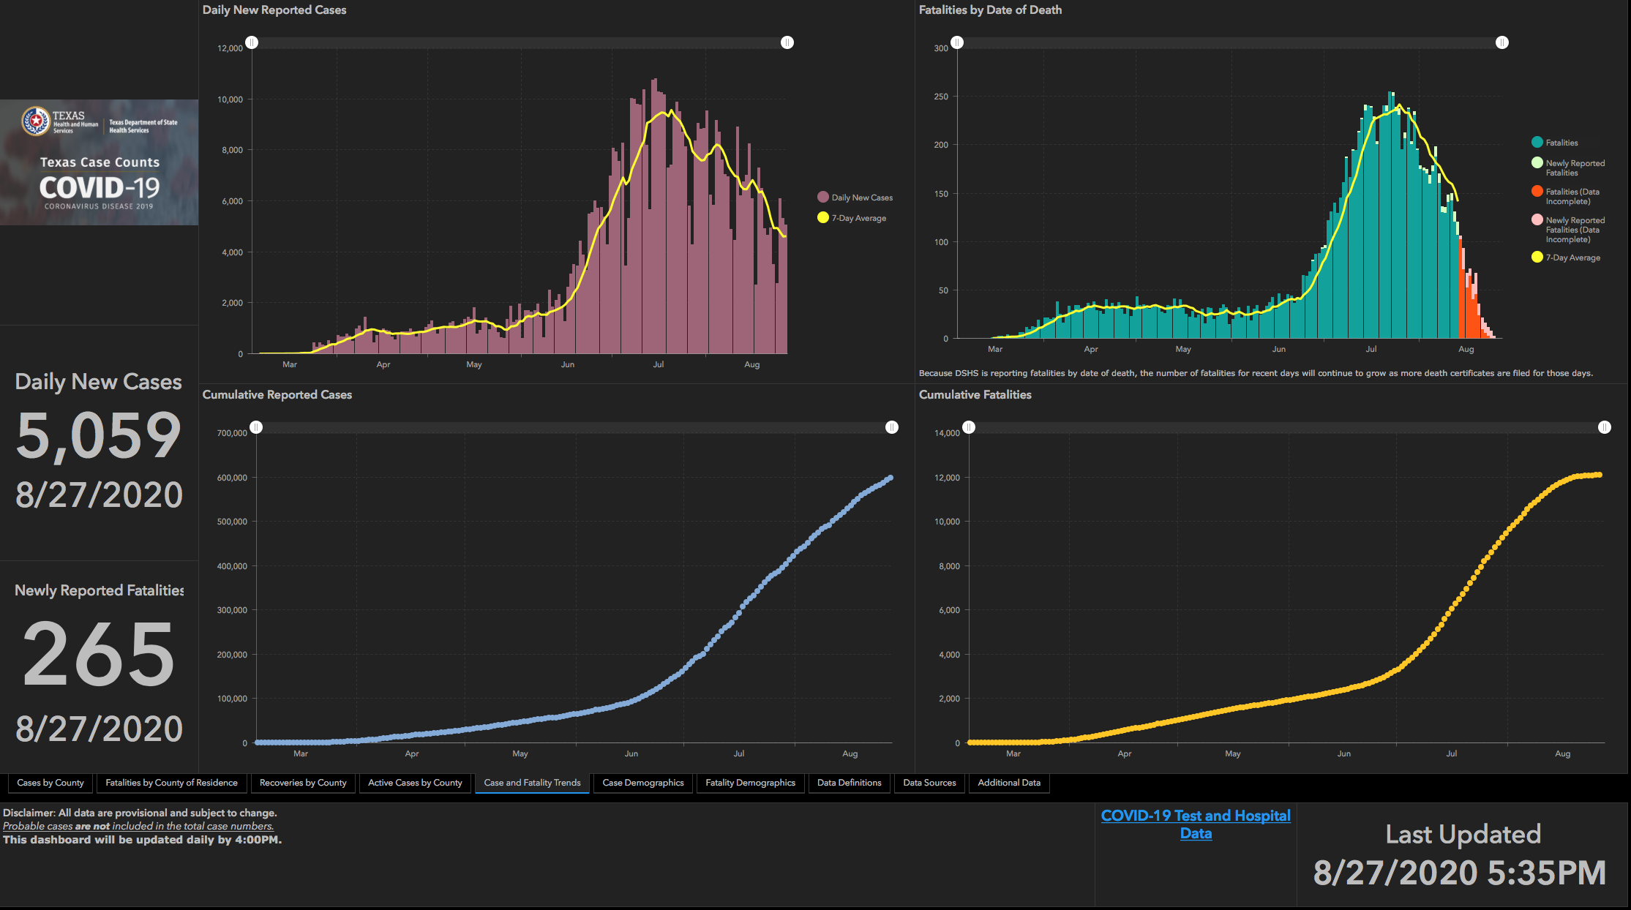

Slide 53
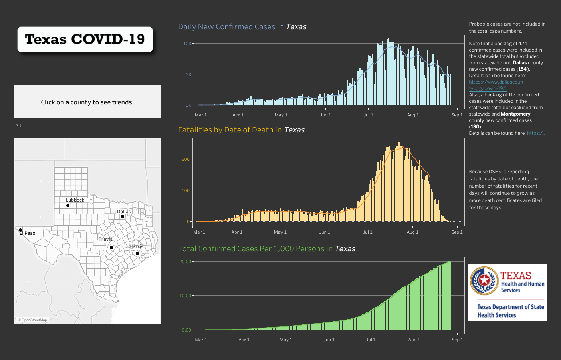

Slide 54
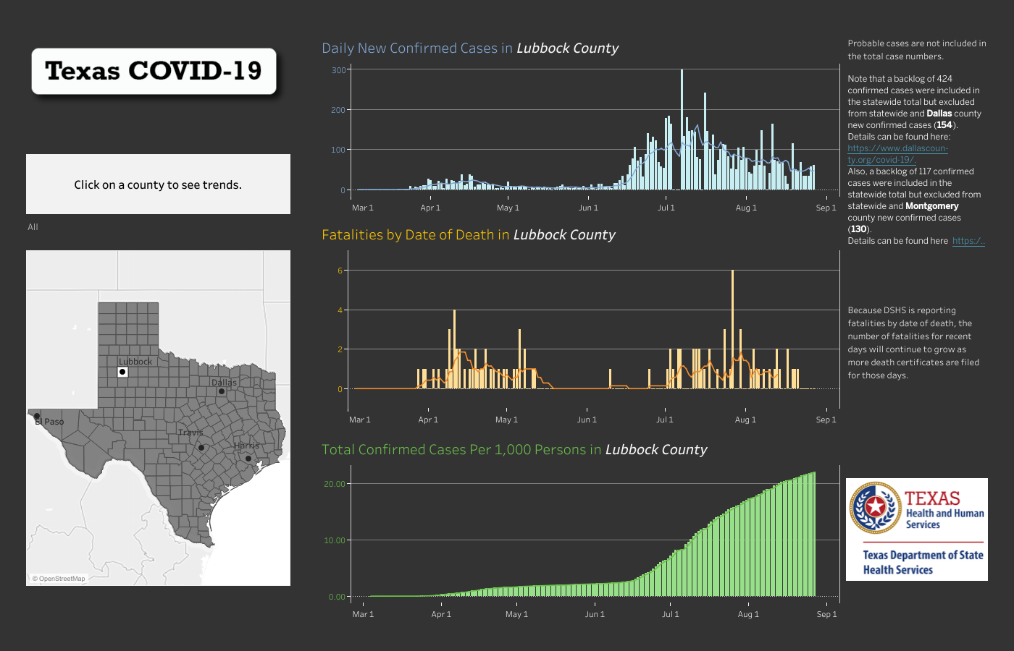

Slide 55
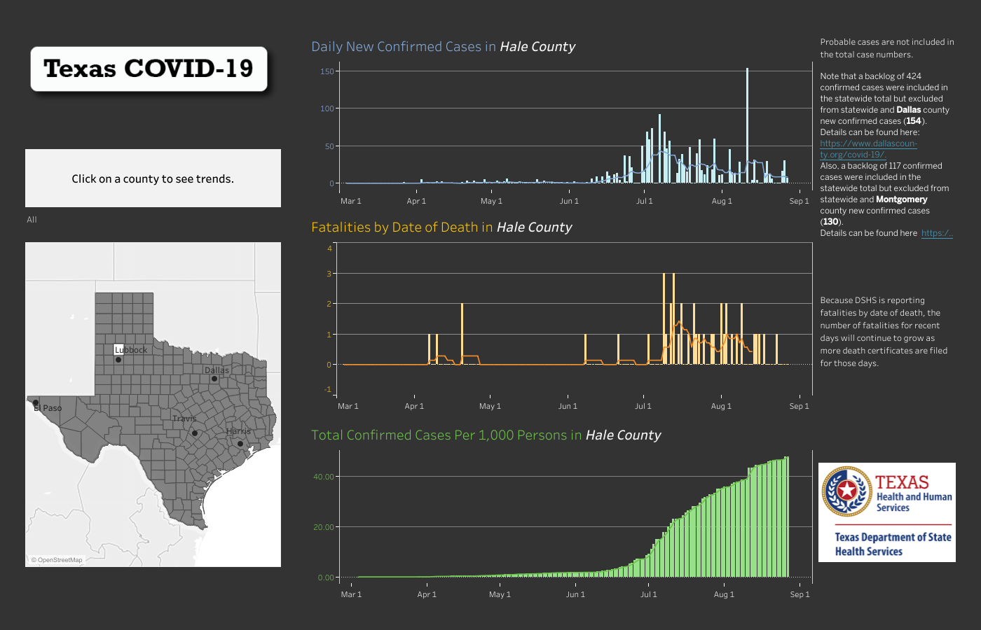

Slide 56
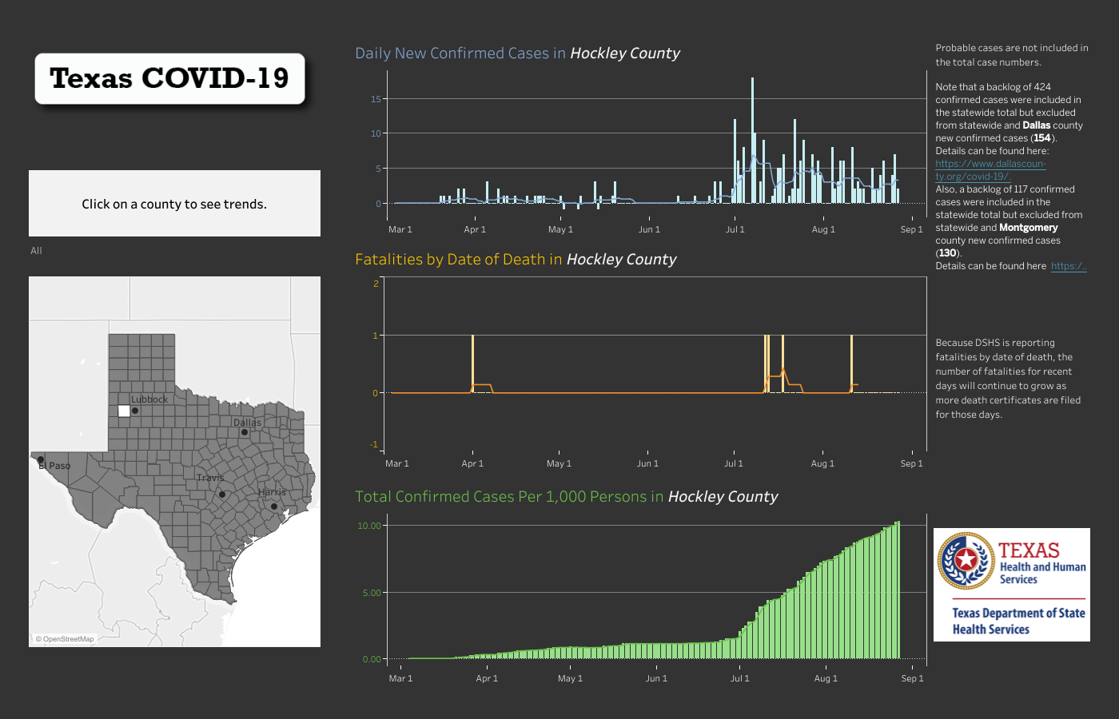

Slide 57
And if that wasn’t bad enough….

Slide 58
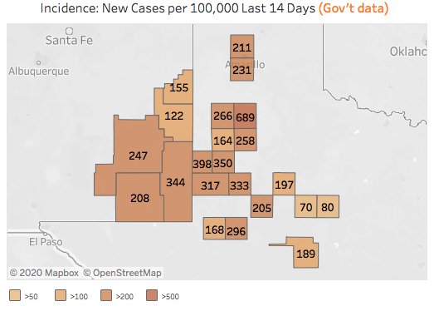

Slide 59
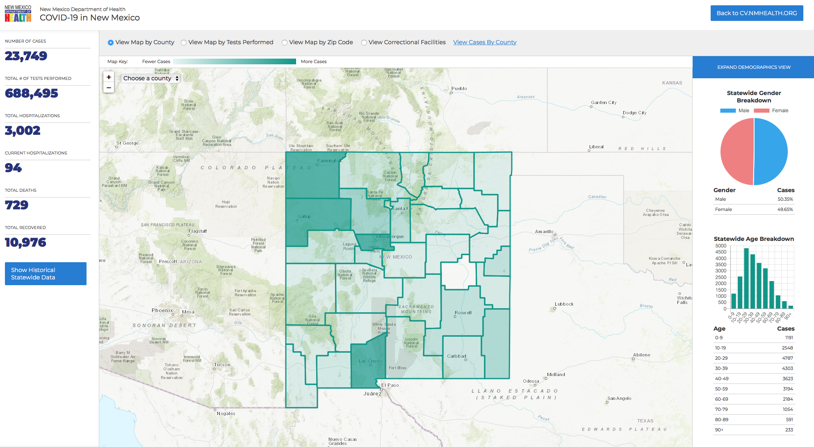

Slide 60
Medical History Trivia

Slide 61


Slide 62
Q & A

