Slide 1
Covenant Health
Presents
Critical Communications: A Weekly Physician Update
September 11, 2020

Slide 2
PHYSICIANS
Accreditation Statement:
The Covenant Health is accredited by the Texas Medical Association (TMA) to provide continuing medical education for physicians.
Credit Designation Statement:
The Covenant Health designates this live CME activity for a maximum of 1.0 AMA PRA Category 1 Credit(s)™. Physicians should claim only the credit commensurate with the extent of their participation in the activity.

Slide 3
Disclosures of Commercial Interest
The speakers and planners of this activity
have no relevant financial interests

Slide 4
Disclosures
This activity is provided by
Covenant Health
No commercial support has been received.
No products will be endorsed.
Speakers will notify the audience if off label drug use will be discussed.

Slide 5
CME Credit was only approved for the Live Teams meeting
To receive credit for this continuing education activity, the participant must:
  Make sure you are logged into your Teams account, if you are signed in with a group provide attendee’s First and Last name(s) in the comments section.
  If you are calling into the Teams meeting you MUST text your First & Last Name to (806) 252-4735. This will ensure you are added to the sign in sheet to receive CME Credit.
  You will receive an email within 3 business days from the CME department with further instructions on claiming your certificate.

Slide 6

Reflection on 9-11

Slide 7
Safety Story
2,977 INNOCENT people
were killed in the 9/11 Attacks on New York, Washingon, and in Airplanes

Slide 8




America’s Response

Slide 9
It is estimated from MULTIPLE Healthcare and Safety agencies that we lose between 98,000 and 165,000 patients every year to medical mistakes, missed diagnoses, poor communication, drug errors, etc.
It is time to take our Teamwork efforts, High Reliability Training and Safety initiatives as seriously as we did our response to 9/11.

Slide 10
Current Regional Covid-19 Census

Slide 11
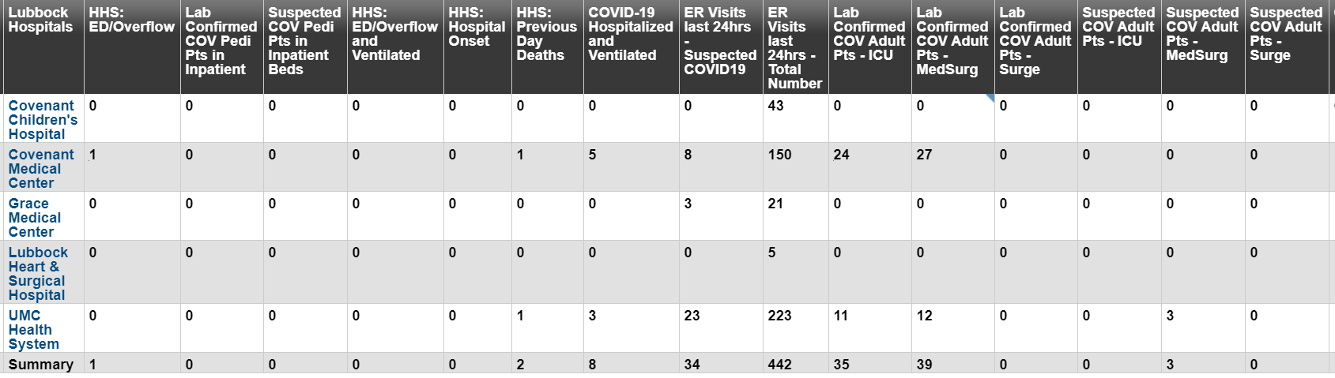
Regional
 | Lubbock |  | TTU |  | Hockley |  | Hale
 | 9/7 | 9/9 |  | 9/9 | 9/2 |  | 9/4 | 9/9
Total | 8983 | 9277 |  | 1020 | 269 |  | 1675 | 1702
Active | 2563 | 2609 |  | 650 | 48 |  | 100 | 76
Deaths | 105 | 105 |  | 0 | 5 |  | 48 | 51
New | 956 |  | >75 |  |  |  | 24
9/7: 55 Hospitalized in Lubbock – 7 on vents 9/9: 74 Hospitalized in Lubbock – 8 on vents

Slide 12
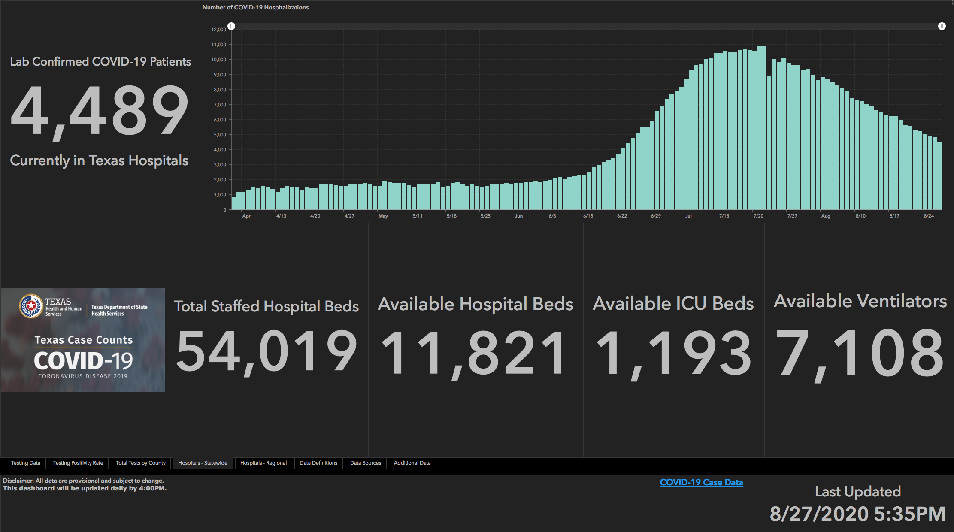
Two Weeks Ago
 | 8/26 | 8/19 | 8/12 | 8/5 | 7/29 | 7/22 | 7/15 | 7/8 | 7/1
Cases | 592,137 | 557,256 | 506,820 | 459,887 | 403,307 | 351,618 | 282,365 | 210,585 | 168,062
Deaths | 11,805 | 10,559 | 9034 | 7497 | 6190 | 4348 | 3432 | 2715 | 2481
Hospitalized | 4806 | 5974 | 7028 | 8455 | 9595 | 10,893 | 10,471 | 9286 | 6904

Slide 13
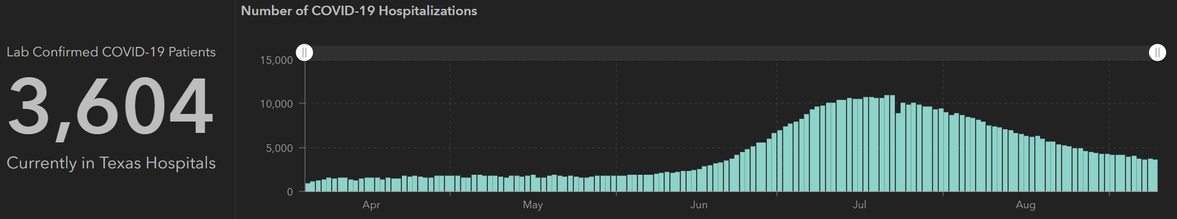
STATE
Now
 | 9/9 | 9/2 | 8/26 | 8/12 | 7/29 | 7/15 | 7/1
Cases | 645,791 | 621,667 | 592,137 | 506,820 | 403,307 | 282,365 | 168,062
Deaths | 13,692 | 12,870 | 11,805 | 9034 | 6190 | 3432 | 2481
Hospitalized | 3604 | 4149 | 4806 | 7028 | 9595 | 10,471 | 6904

Slide 14
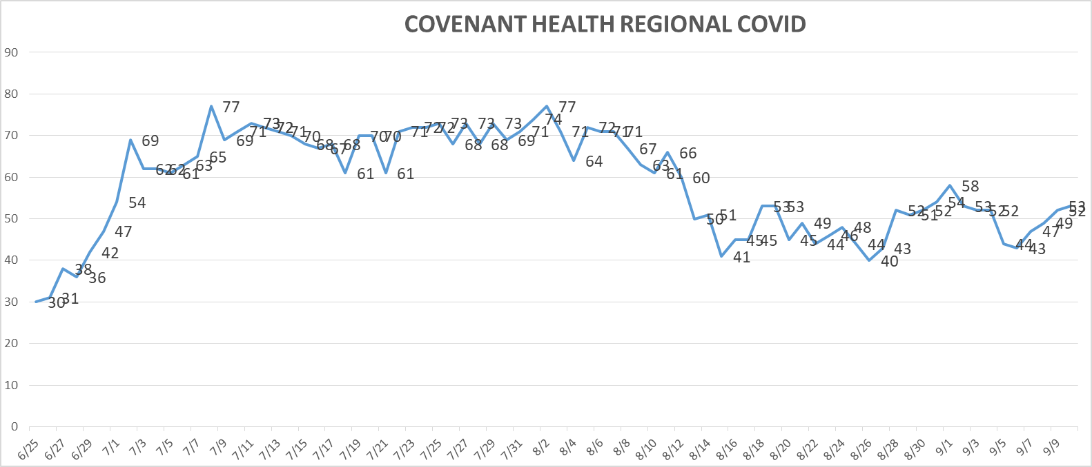
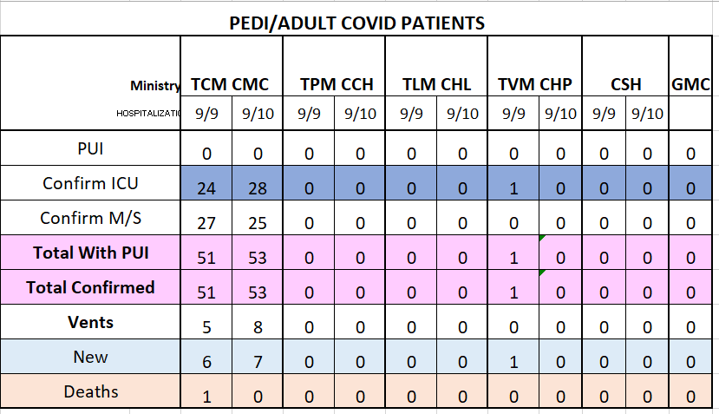
PUI/Confirmed cases-hospitalized

Slide 15
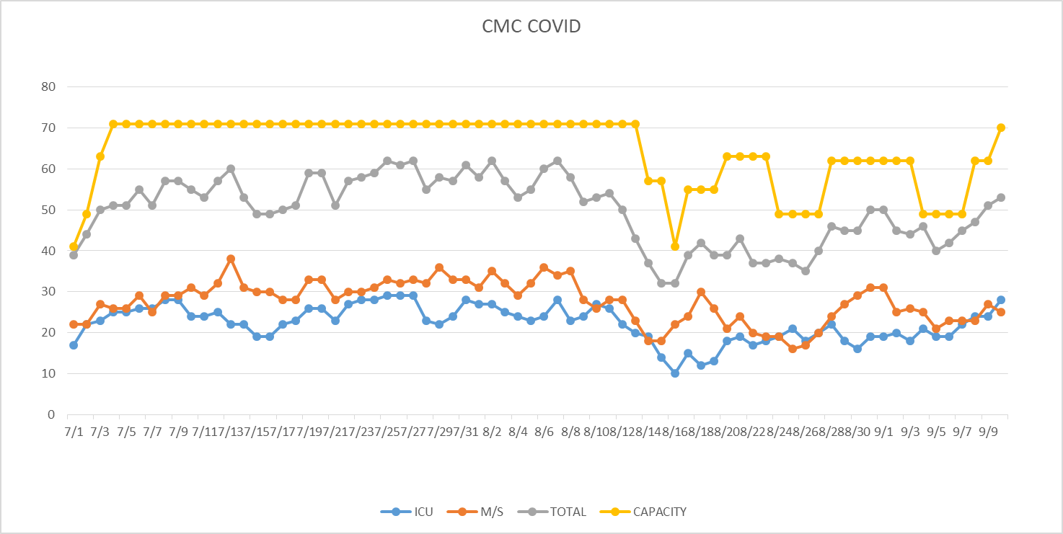
PUI/Confirmed cases-hospitalized
MICU ALL COVID 9.9.2020

Slide 16
Surge Plan
Covenant Medical Center
 | ICU | Med Surg | Total
Phase 1 | 10-CICU |  | 10
Phase 2 | 17-CICU | 10-HC4 | 27
Phase 3 | 17-CICU | 24-HC4 | 41
Phase 4 | 17-CICU 8-MICU | 24-HC4 14-Pal Med | 63
Phase 5 | 17-CICU 16-MICU | 24-HC4 14-Pal Med | 71
Phase 6 | 17-CICU 16-MICU 8- SICU 4 (east) | 24-HC4 14-Pal Med 15 – S 9 (east) | 94
Last Week
Currently

Slide 17
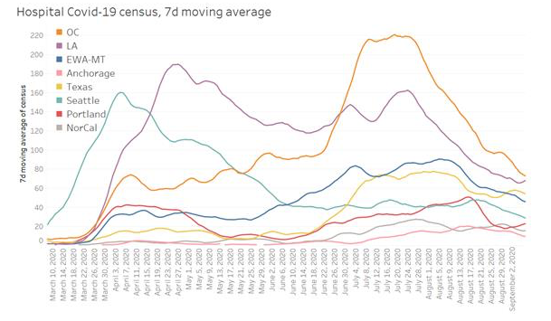
PSJH System Trends

Slide 18
Statistics
Sean Glenn
Senior Clinical Data Analyst
Decision Support Services
Covenant Health

Slide 19
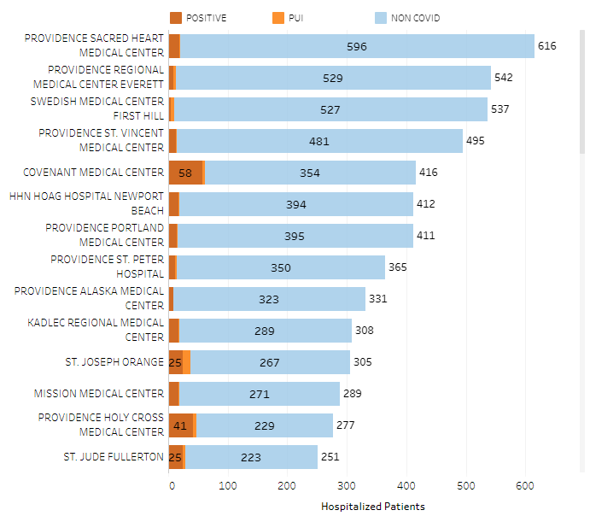
Providence System Hospitalized COVID-19 Cases

Slide 20
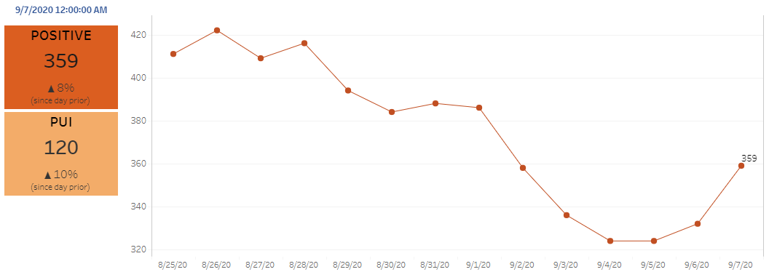
Providence Inpatient COVID-19 Volume

Slide 21
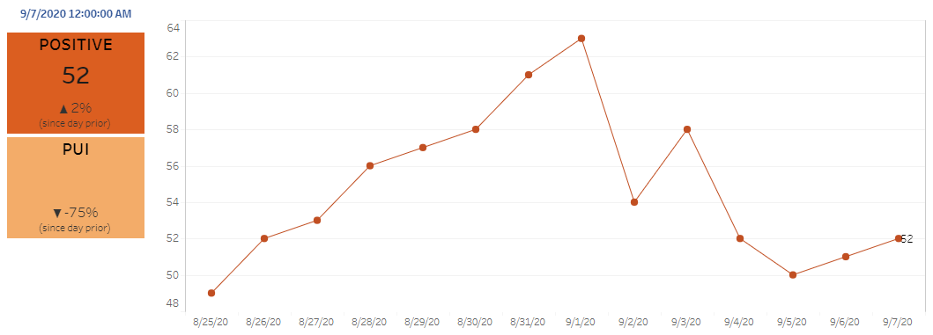
Texas Inpatient COVID-19 Volume

Slide 22
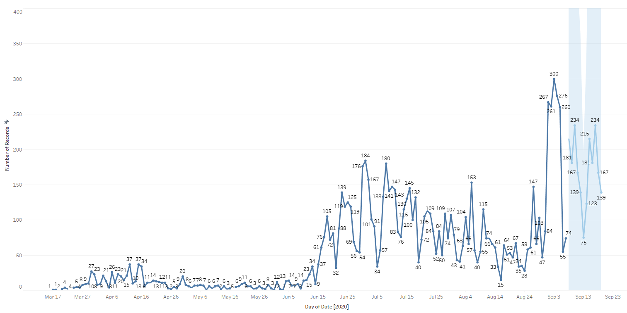

New Covid-19 POSITIVES by Day Trend

Slide 23
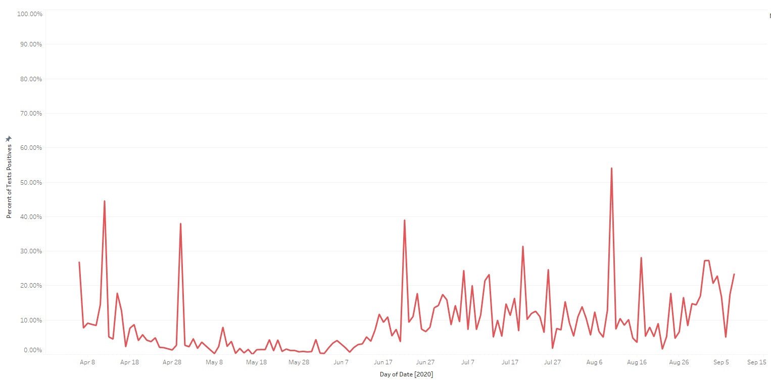
Covid-19 Daily Positive Rate

Slide 24
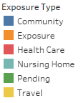
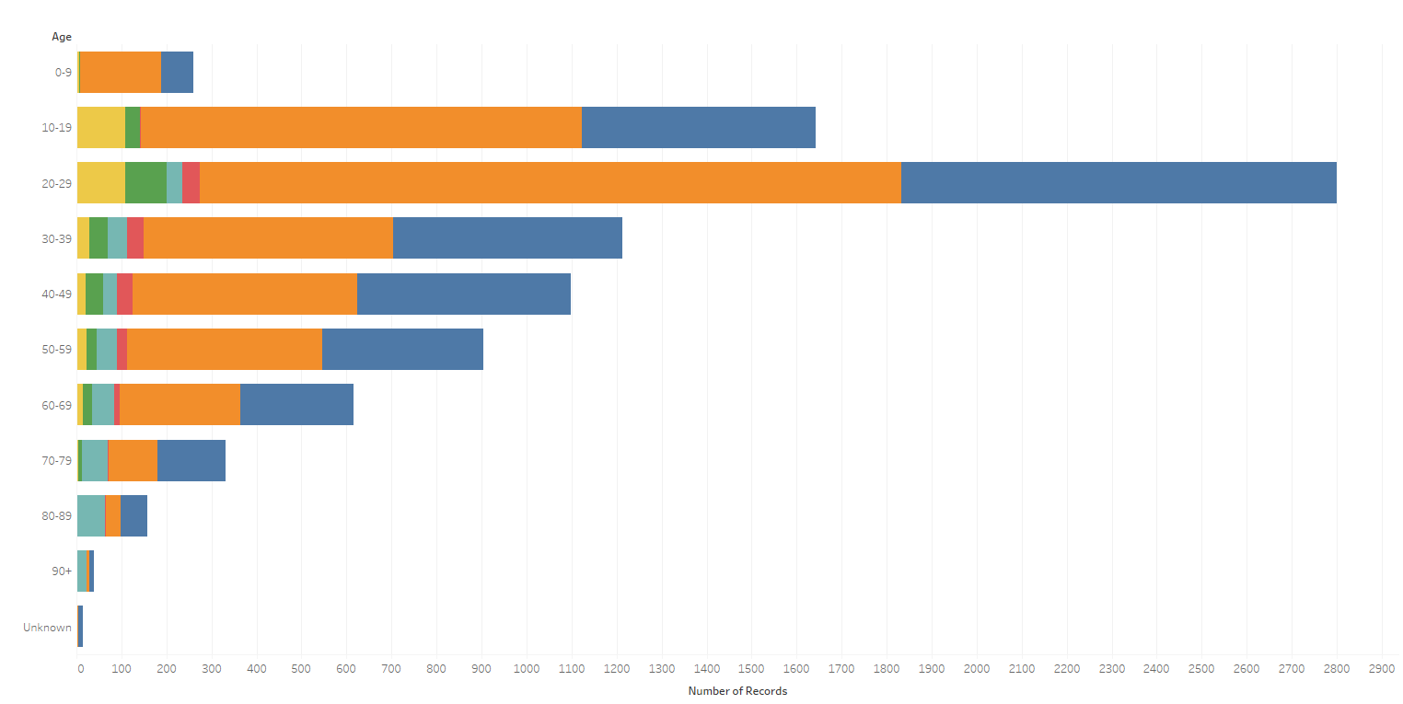
Covid-19 POSITIVES Age Distribution

Slide 25
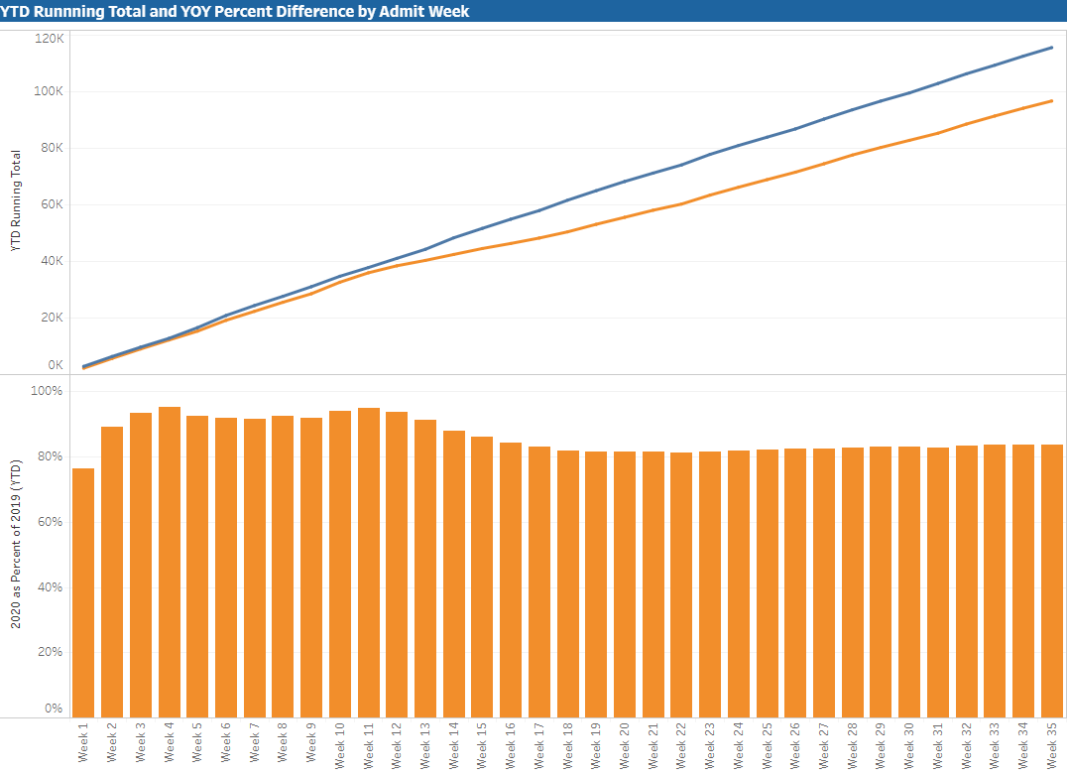

TX/NM Region Weekly Procedures (YOY)

Slide 26
Covid-19 Testing

Slide 27
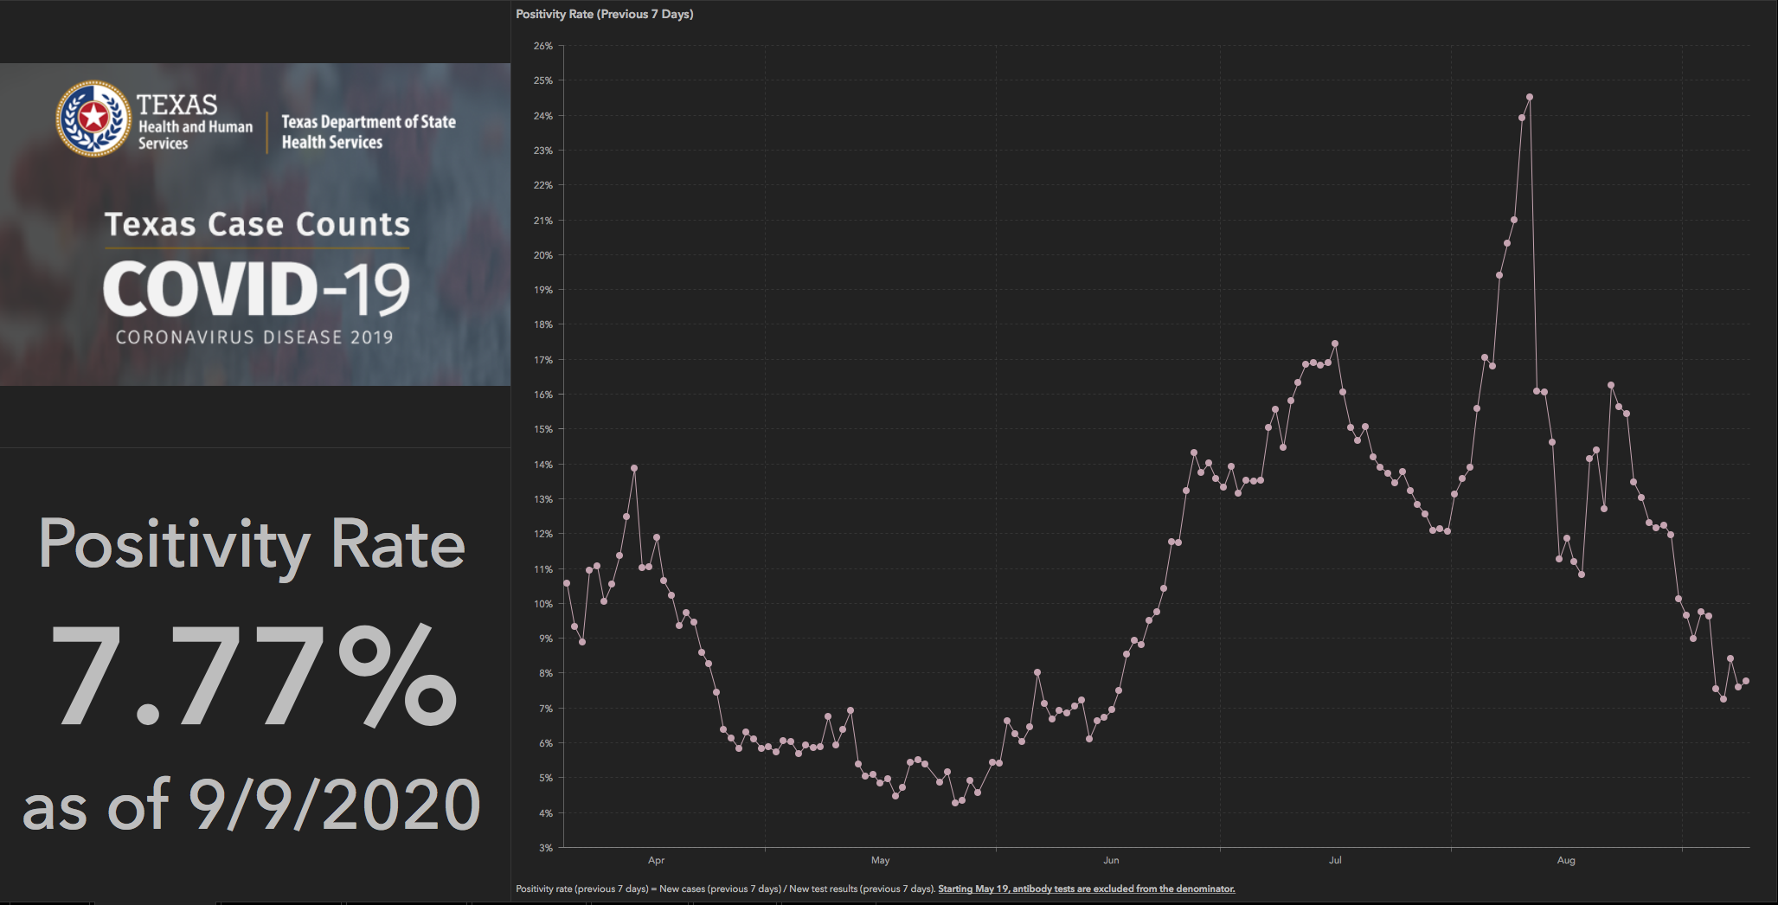
TESTING – STATEWIDE Results

Slide 28
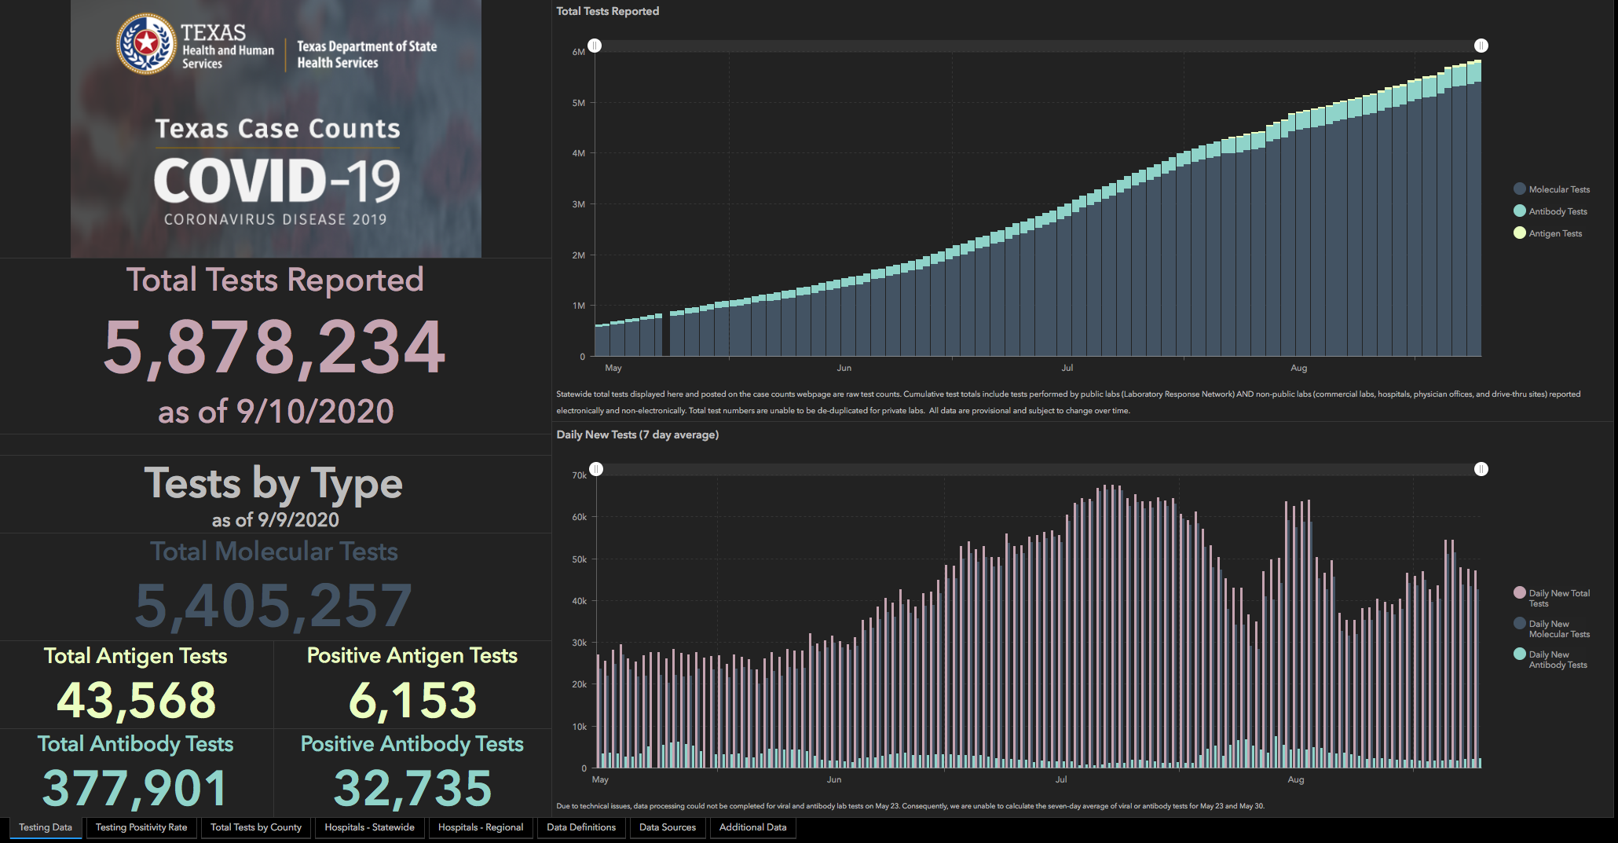

Slide 29
TESTING
 | CMC | GMC | CMG
Test Kits
Swabs
VTM
 | CMC |  | GMG/CMG
 | Tests | + | Tests | +
9/8 | 162 | 10 | 30 | 6
9/9 | 267 | 15 | 187 | 28
9/10
9/11
9/12
>2000 >750
<2000 <750
<1600 <500
BD Max- did not receive shipment last week

Slide 30
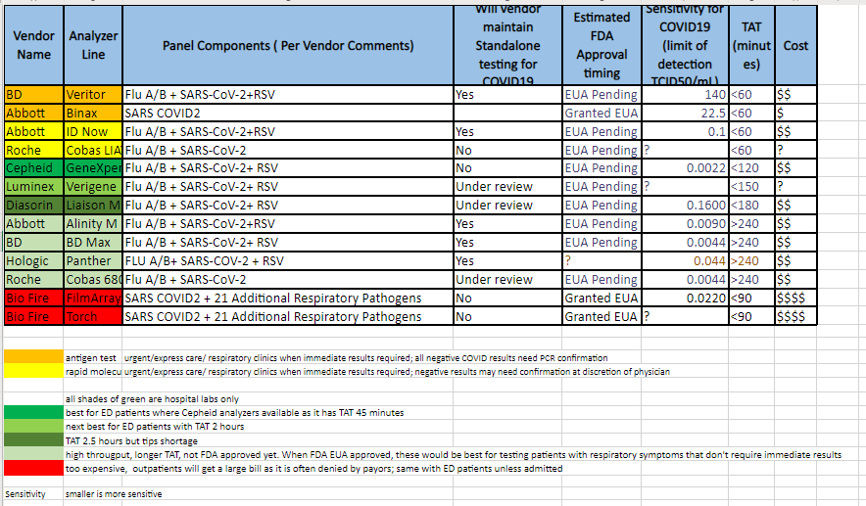
TESTING Platforms

Slide 31
TESTING – preparing for children
Testing Algorithm for Children
  Need to be able to perform multiple tests
  90-120 days for delivery for new platform
  Working on ways to utilize current platforms efficiently

Slide 32
TESTING – CMS Interim final rule
QSO-20-37-CLIA,NH (Supply and Lab Reporting to CMS)
Data submitted for CHP, CHL, CCH, and CMC
Working on GMG and CMG
HOL being asked to have HOL staff tested by area LTC facilities. Lubbock County is now at 13.9%, Hockley 15.4%, Hale is 9.8%, Floyd 8% positivity rate (CMS Data)
red-2/week testing yellow-1/week testing

Slide 33
Returning to Operations

Slide 34
Caregivers
COVID Related Furloughs
Cluster on HC5
Count reflects # furlough (exposed and positive)
Good
Moderate
Critical

Slide 35
Pharmacy Update
Larry Pineda, PharmD
Clinical Pharmacist – AMS
Covenant Health

Slide 36
CHS COVID-19 Treatments
Agent | Dosage | Comments | Update
Remdesivir Emergency Use Authorization (EUA) 5/1/20, updated 8/28/20 | 200 mg IV x 1, then 100 mg IV daily x 4 days | EUA broadened to include ‘all hospitalized adult and pediatric patients with suspected or laboratory-confirmed COVID-19, irrespective of their severity of disease’ NIH guidelines: Because supplies are limited, recommend prioritizing for patients who require supplemental O2 but who are NOT on HF O2, noninvasive or mech ventilation, or ECMO | Remdesivir EUA Inventory: (Thursday AM) # vials: CMC = 509, CCH = 80, PLV = 274, LVL = 6 Remdesivir EUA Patients: (Thursday AM) CMC = 15, CCH = 0, PLV = 0, LVL = 0
Convalescent Plasma | 1 unit (200-400mL) | Emergency Use Authorization on 8/23/20 9/1/20 NIH guidelines: Insufficient data to recommend for or against Should not be considered the standard of care Prospective, well-controlled, adequately powered randomized trials are needed to determine whether CP is effective and safe for the treatment of COVID-19. Members of the public and health care providers are encouraged to participate in these prospective clinical trials
Notes:
8/21: CMC received 7 cases of RDV this week, 280 vials = $145K
8/14: CMC has 10 patients on treatment and 10 rounds remaining (83 vials remaining). Plainview has 0 patients on treatment and 12 rounds remaining (74 vials)
Optimal timing of donor plasma collection in relation to recovery from COVID19, most appropriate methods of antibody testing, and minimum titers of SARS-CoV-2 antibody in convalescent plasma that may be associated with clinical benefits in pts with COVID-19 not determined.
FYI Budesonide: In response to Odessa doctor, Richard Bartlett, who calls it the 'silver bullet‘. There have been no clinical trials or observational studies examining the use of ICS in COVID-19. Clinical trials would be required to establish whether these drugs may be repurposed for the treatment of this disease.

Slide 37
Hydroxychloroquine
Clinical Trial Data

Slide 38
NIH Guidelines
To reflect the results of large randomized controlled trials that enrolled hospitalized patients, the following recommendations have been updated to differentiate between hospitalized and nonhospitalized patients:
  The Panel recommends against the use of chloroquine or hydroxychloroquine for the treatment of COVID-19 in hospitalized patients (AI)
  In nonhospitalized patients, the Panel recommends against the use of chloroquine or hydroxychloroquine for the treatment of COVID-19, except in a clinical trial (AI)

Slide 39
Early Data from China
Study | Type | Size | Results
Chen J et al. PMID: 32391667 | Pilot (moderate) HCQ 400mg + SOC vs SOC | 30 | Negative pharyngeal PCR at day 7 in 13 pts (86.7%) treated with HCQ; and 14 pts (93.3%) not treated with HCQ (data unclear for 3 pts) No difference in temperature normalization, radiologic progression on CT, or improvement at follow up
Chen Z et al. medRxiv preprint (not peer Reviewed) | Randomized (mild/moderate) HCQ 400mg + SOC vs SOC | 62 | Time to fever normalization was shorter in HCQ group (2.2 days) vs control (3.2 days), time to cough remission was shorter in HCQ group, and pneumonia improved in 25/31 (80.6%) in HCQ group vs 17/31 (54.8%) in control group 2 AEs in HCQ arm
Tang W et al. PMID: 32409561 | Randomized, open-label (mild/moderate) HCQ (1200mg/800mg) + SOC vs SOC | 150 | Negative PCR x 2 at day 28 in 73% of pts (53 treated with HCQ and 56 treated with SOC alone). Probability of negative conversion and median time to negative seroconversion also similar in both groups AEs reported in 30% of those treated with HCQ; 9% SOC alone

Slide 40
Early Data from France
Study | Type | Size | Results
Gautret et al. PMID: 32205204; preliminary data | Nonrandomized, open (no data on severity) HCQ 600mg x 10 d + AZ vs SOC | 36 | Negative nasopharyngeal PCR at day 6, 8/14 (57%) HCQ group, 6/6 (100%) HCQ + AZ, 2/16 (12.5%) in the control group HCQ or HCQ + AZ pts: 1 tested positive at day 8, 1 pt died and not included, 3 pt transferred to ICU and not included
Molina et al. PMID: 32240719 | Open label, uncontrolled (severe) HCQ 600mg x 10 d + AZ | 11 | 8/11 pts had significant comorbidities associated with poor outcomes and 10/11 had fever and supplemental O2; nasopharyngeal PCR positive at days 5 and 6 in 8/10 pts tested Within 5 days, 1 pt died and 2 transferred to ICU; dc’d in 1 pt after 4 days – QT
Gautret et al. PMID: 32289548 | Retrospective, observational (mild) HCQ 600mg x 10 d + AZ | 80 | Negative PCR at day 8 in 93% of those tested, mean LOS of 5 days
Million et al. PMID:32387409 | Retrospective, observational (mild) | 1061 | Virologic cure w/n 10 days: 973 pts (91.7%); poor clinical outcome in 46 pts (4.3%), 8 died (0.75%) (74-95 years old) Mild AEs in 2.3%, poor outcomes associated with beta blocker or ARBs
Notes:
Gautret et al. 92% were considered low risk for clinical deterioration
Million et al. 95% had relatively mild disease and were considered low risk for clinical deterioration; defined poor clinical outcome by either death or transfer to ICU or hospitalization for 10 days or more

Slide 41
US Retrospective Data
Study | Type | Size | Results
Magagnoli et al. medRxiv preprint (not peer Reviewed) | Observational VA patients (elderly males 59-75 years of age, many with significant comorbidities) | 368 | Mortality 27.8% (27/97) HCQ; 22.1% (25/113) HCQ + AZ; 11.4% (18/158) no HCQ; rate of ventilation 13.3, 6.9, and 14.1%, respectively HCQ alone (but not w/ AZ) associated with increased mortality compared with no HCQ; HCQ with or without AZ did not reduce the risk of mechanical ventilation
Rosenberg et al. PMID: 32392282 | Observational multicenter NY | 1438 | 735 HCQ + AZ; 271 HCQ alone; 211 AZ alone, 221 neither In-hospital mortality 20.3%; HCQ + AZ 25.7%, HCQ 19.9%, AZ 10%, neither 12.7% Cardiac arrest significantly more likely in HCQ + AZ, no difference in abnormal EKG
Geleris et al. PMID: 32379955 | Observational single-center NY | 1376 | 811 HCQ (486 also received AZ] and 565 did not receive HCQ (127 received AZ) Time to intubation or death (overall, 346 pts, 25.1%); not affected by HCQ treatment (32.3% of pts treated with HCQ, 14.9% no HCQ)
Arshad et al. PMID: 32623082 | Observational multicenter MI (protocol driven, not randomized) | 2541 | Overall mortality rate 18.1%; HCQ/AZ associated with reduction in mortality (13.5% HCQ, 20.1% HCQ + AZ, 22.4% AZ, 26.4% no HCQ) No HCQ group 61.4% >65 yr; p<0.001; no HCQ group corticosteroid treatment 35.7%; p<0.001 [Propensity score matching applied, still significant] No major cardiac arrhythmias, but only selected pts with minimal cardiac risk factors received HCQ + AZ, all pts treated with HCQ were monitored closely (EKG)
Notes:
Arshad: neither arm had ~61.4% >65 yr; whereas HCQ 48.9%, AZ 46.3, H+A 45.5%
Steroids: 146 (35.7), 948 (78.9), 57 (38.8), 582 (74.3)

Slide 42
Randomized Control Trials
Tune in next week…
Notes:
From NIH Rationale section:
In a large randomized controlled trial of hospitalized patients in the United Kingdom, hydroxychloroquine did not decrease 28-day mortality when compared to the usual standard of care. Participants who were randomized to receive hydroxychloroquine had a longer median hospital stay than those who received the standard of care. In addition, among patients who were not on invasive mechanical ventilation at the time of randomization, those who received hydroxychloroquine were more likely to subsequently require intubation or die during hospitalization than those who received the standard of care.⁵
In another randomized controlled trial that was conducted in Brazil, neither hydroxychloroquine alone nor hydroxychloroquine plus azithromycin improved clinical outcomes among hospitalized patients with mild to moderate COVID-19. More adverse events occurred among patients who received hydroxychloroquine or hydroxychloroquine plus azithromycin than among those who received the standard of care.⁶
In addition to these randomized trials, data from large retrospective observational studies do not consistently show evidence of benefit for hydroxychloroquine with or without azithromycin in hospitalized patients with COVID-19.

Slide 43
Universal Masking Mandate

Slide 44
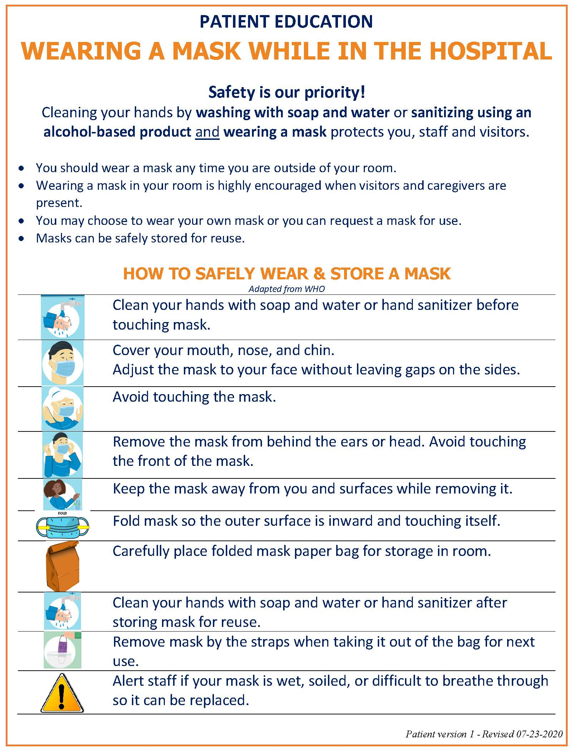
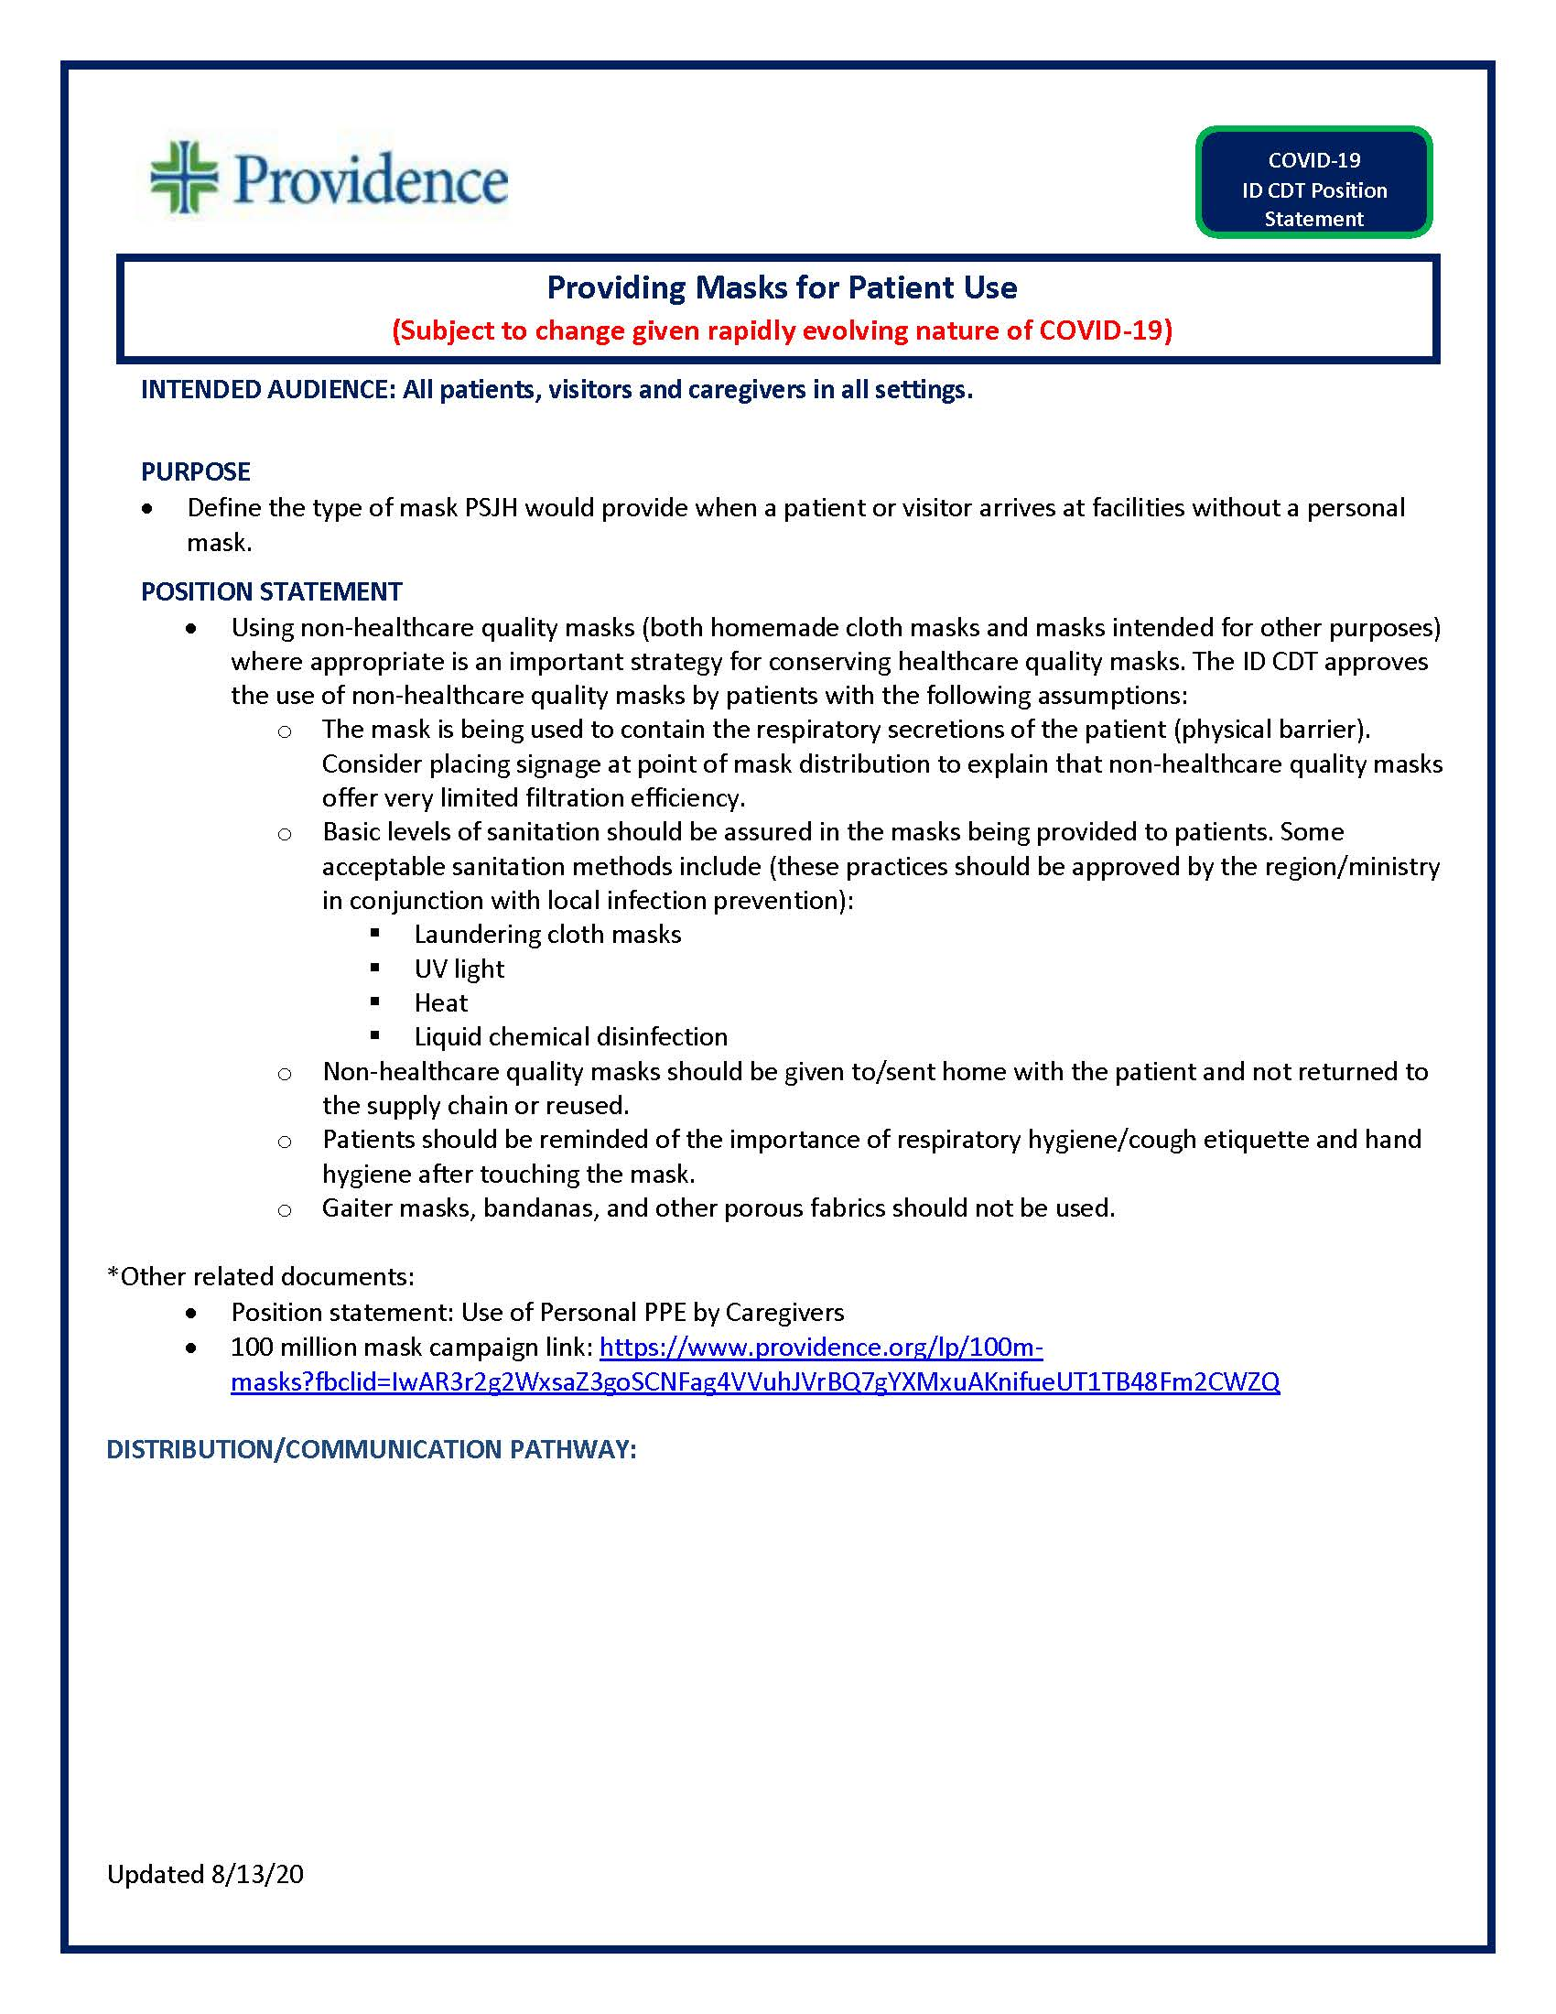
Position Statement- Patient Masking
-Need scripting information
”because of COVID you will be asked to wear a mask in the room”

Slide 45
Gaiter / Vented Mask - Screener Messaging
We are requesting that everyone entering a Covenant facility wear a mask.
Evidence has shown that masks decrease transmission and spread of COVID-19.
Thank you for wearing a mask. Unfortunately, studies have shown that vented masks and gaiters are significantly less protective than masks, at preventing virus transmission and spread.
Covenant Health is a healthcare ministry, and as such we are committed to protecting the health of our patients, visitors and caregivers.
We have masks available for your use when visiting a Covenant facility.
Masks can be worn alone, or may be placed over or under your vented mask or gaiter.
Thank you for your cooperation and helping us keep everyone safer.
https://www.cdc.gov/coronavirus/2019-ncov/prevent-getting-sick/cloth-face-cover-guidance.html
https://nypost.com/2020/08/13/cdc-warns-masks-with-valves-vents-dont-prevent-spread-of-covid-19/
https://www.washingtonpost.com/lifestyle/wellness/mask-test-duke-covid/2020/08/10/4f2bb888-db18-11ea-b205-ff838e15a9a6_story.html

Slide 46
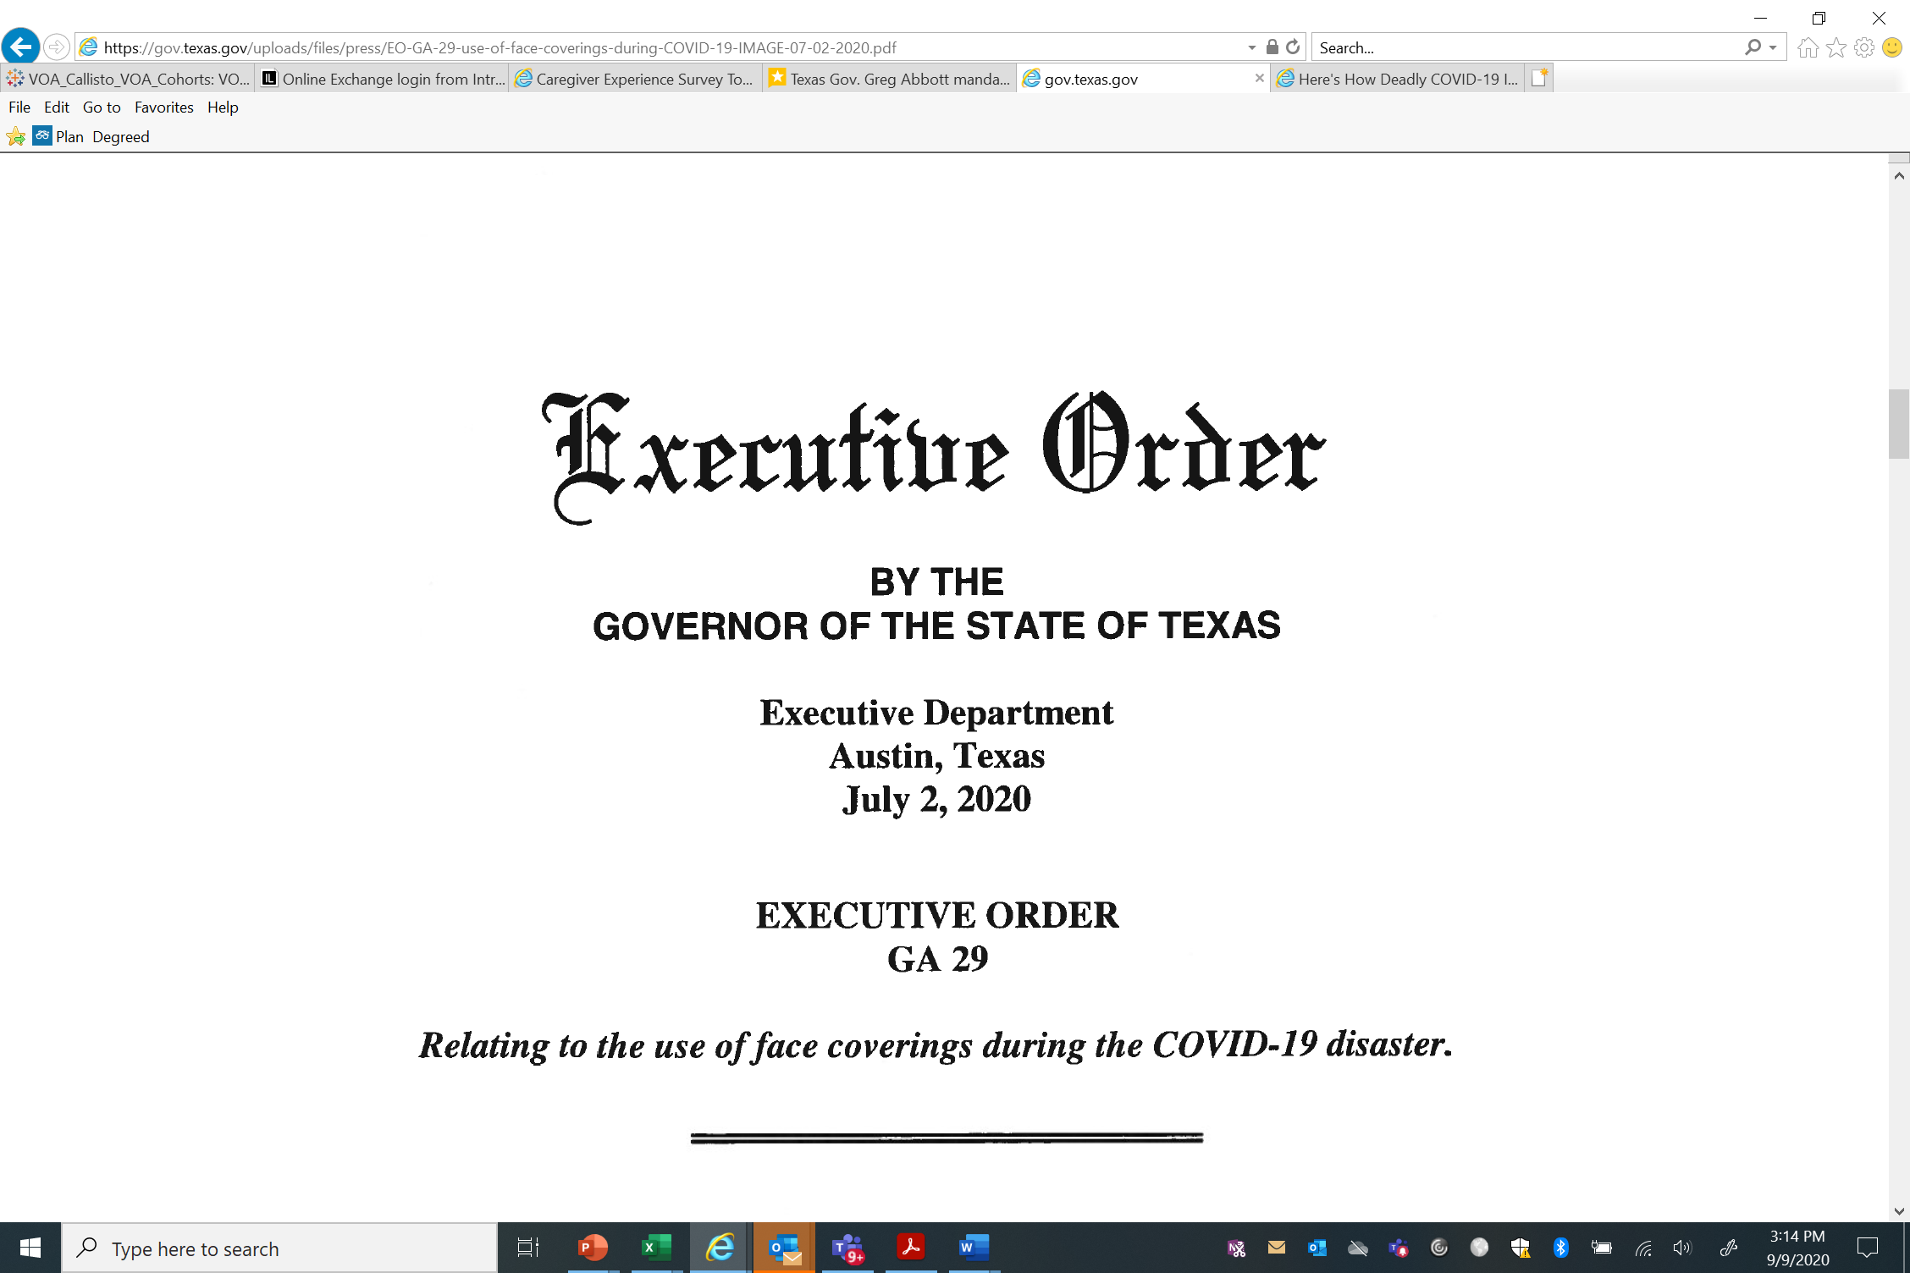
https://gov.texas.gov/uploads/files/press/EO-GA-29-use-of-face-coverings-during-COVID-19-IMAGE-07-02-2020.pdf

Slide 47
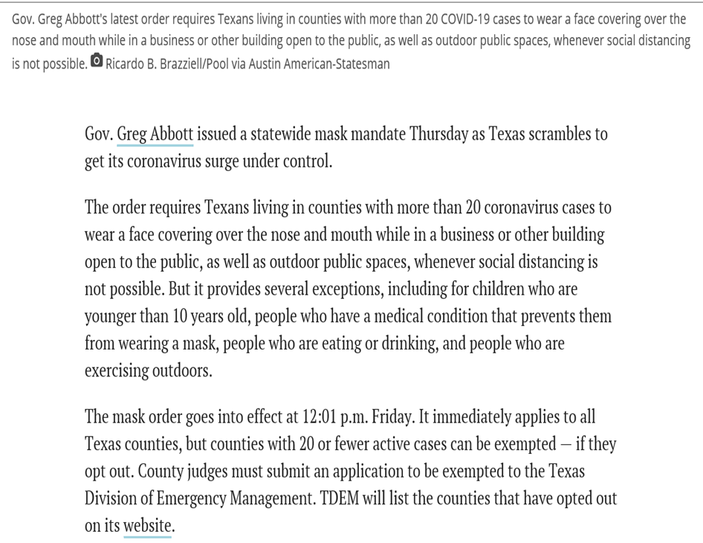

https://www.texastribune.org/2020/07/02/texas-mask-order-greg-abbott-coronavirus/

Slide 48
Mask Mandate – Visitor Refusal to wear a mask
In addition to protection of our patients, visitors and caregivers, we are under an Executive Order in the state of Texas that requires that masks be worn in public places, including healthcare facilities like Covenant.
If you are not able to wear a mask, can we assist you with ideas for virtual visitation with your loved one?
I know these are such hard times, and it is especially difficult to have a loved one in the hospital at this time. We have masks that we can provide so you can go and visit your loved one in person, or we are happy to assist with ideas for virtual visitation with your loved one.
This will help to protect the safety of everyone, including you and your loved one.
We look forward to the day when we no longer have to worry about these extra protective measures due to COVID-19.
How can we assist further?

Slide 49
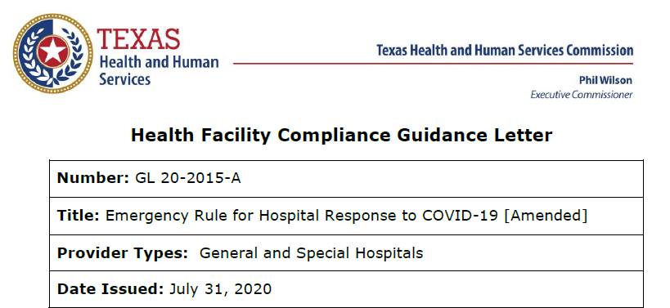
COVID19-Hot Topics
  Visitation Complaints
  Some hospitals experiencing an uptick in complaints with the visitor limitations
  Texas is under an Executive Order with an extension to September 29

Slide 50
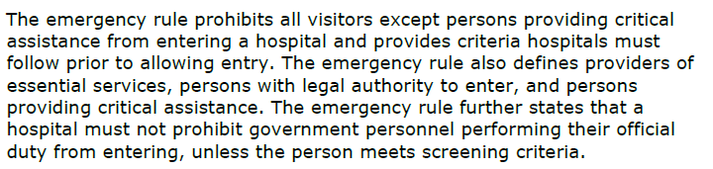
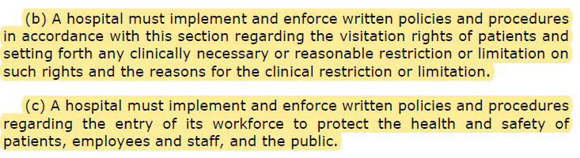
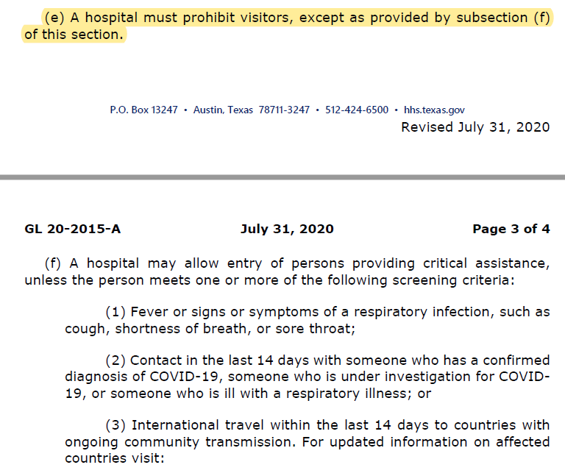
COVID19-Hot Topics
  GL 20-2015-A

Slide 51
“Universal Masking”
A Mask AND Face Shield are to be used with EVERY patient encounter!

Slide 52

And now a few words about…
“Universal Masking”
It’s inconceivable…

Slide 53

Texas Demographics

Slide 54
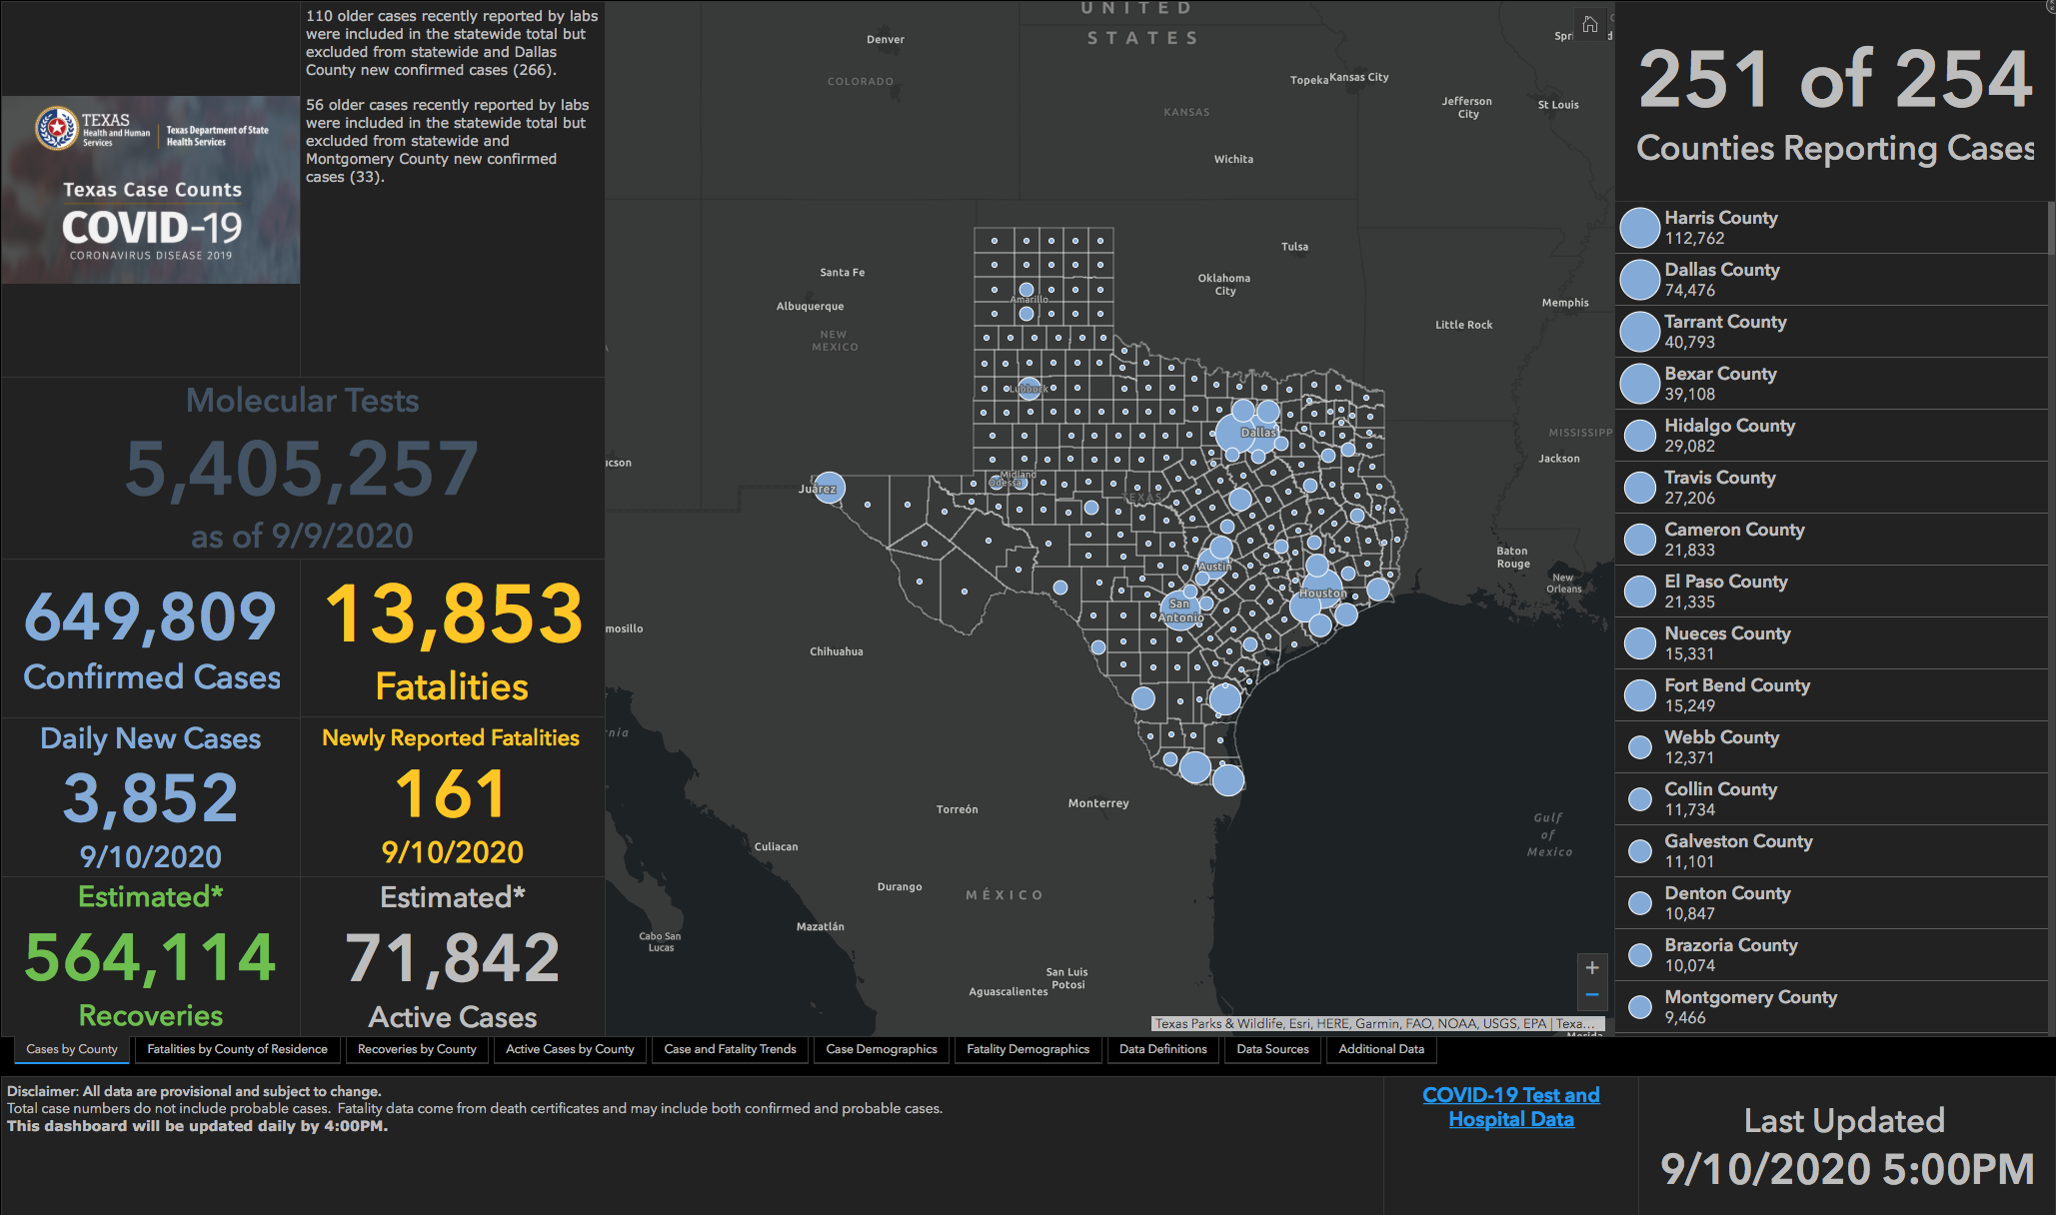

Slide 55
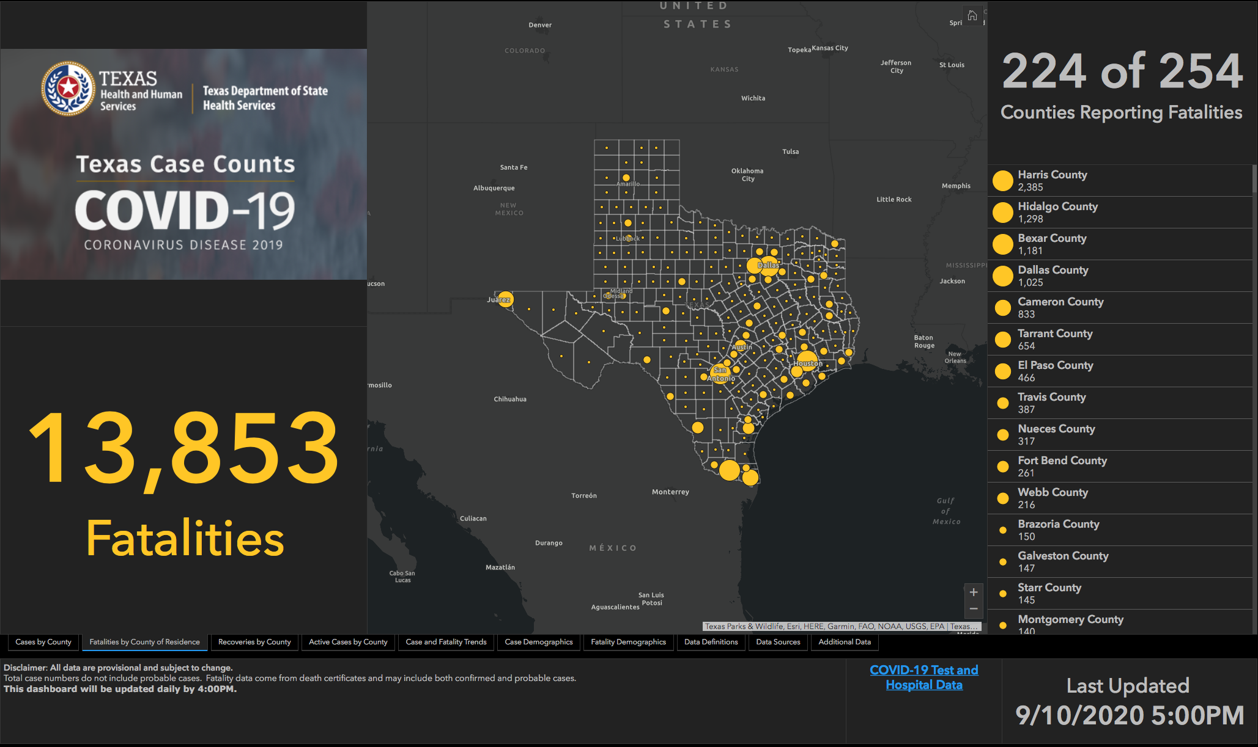

Slide 56
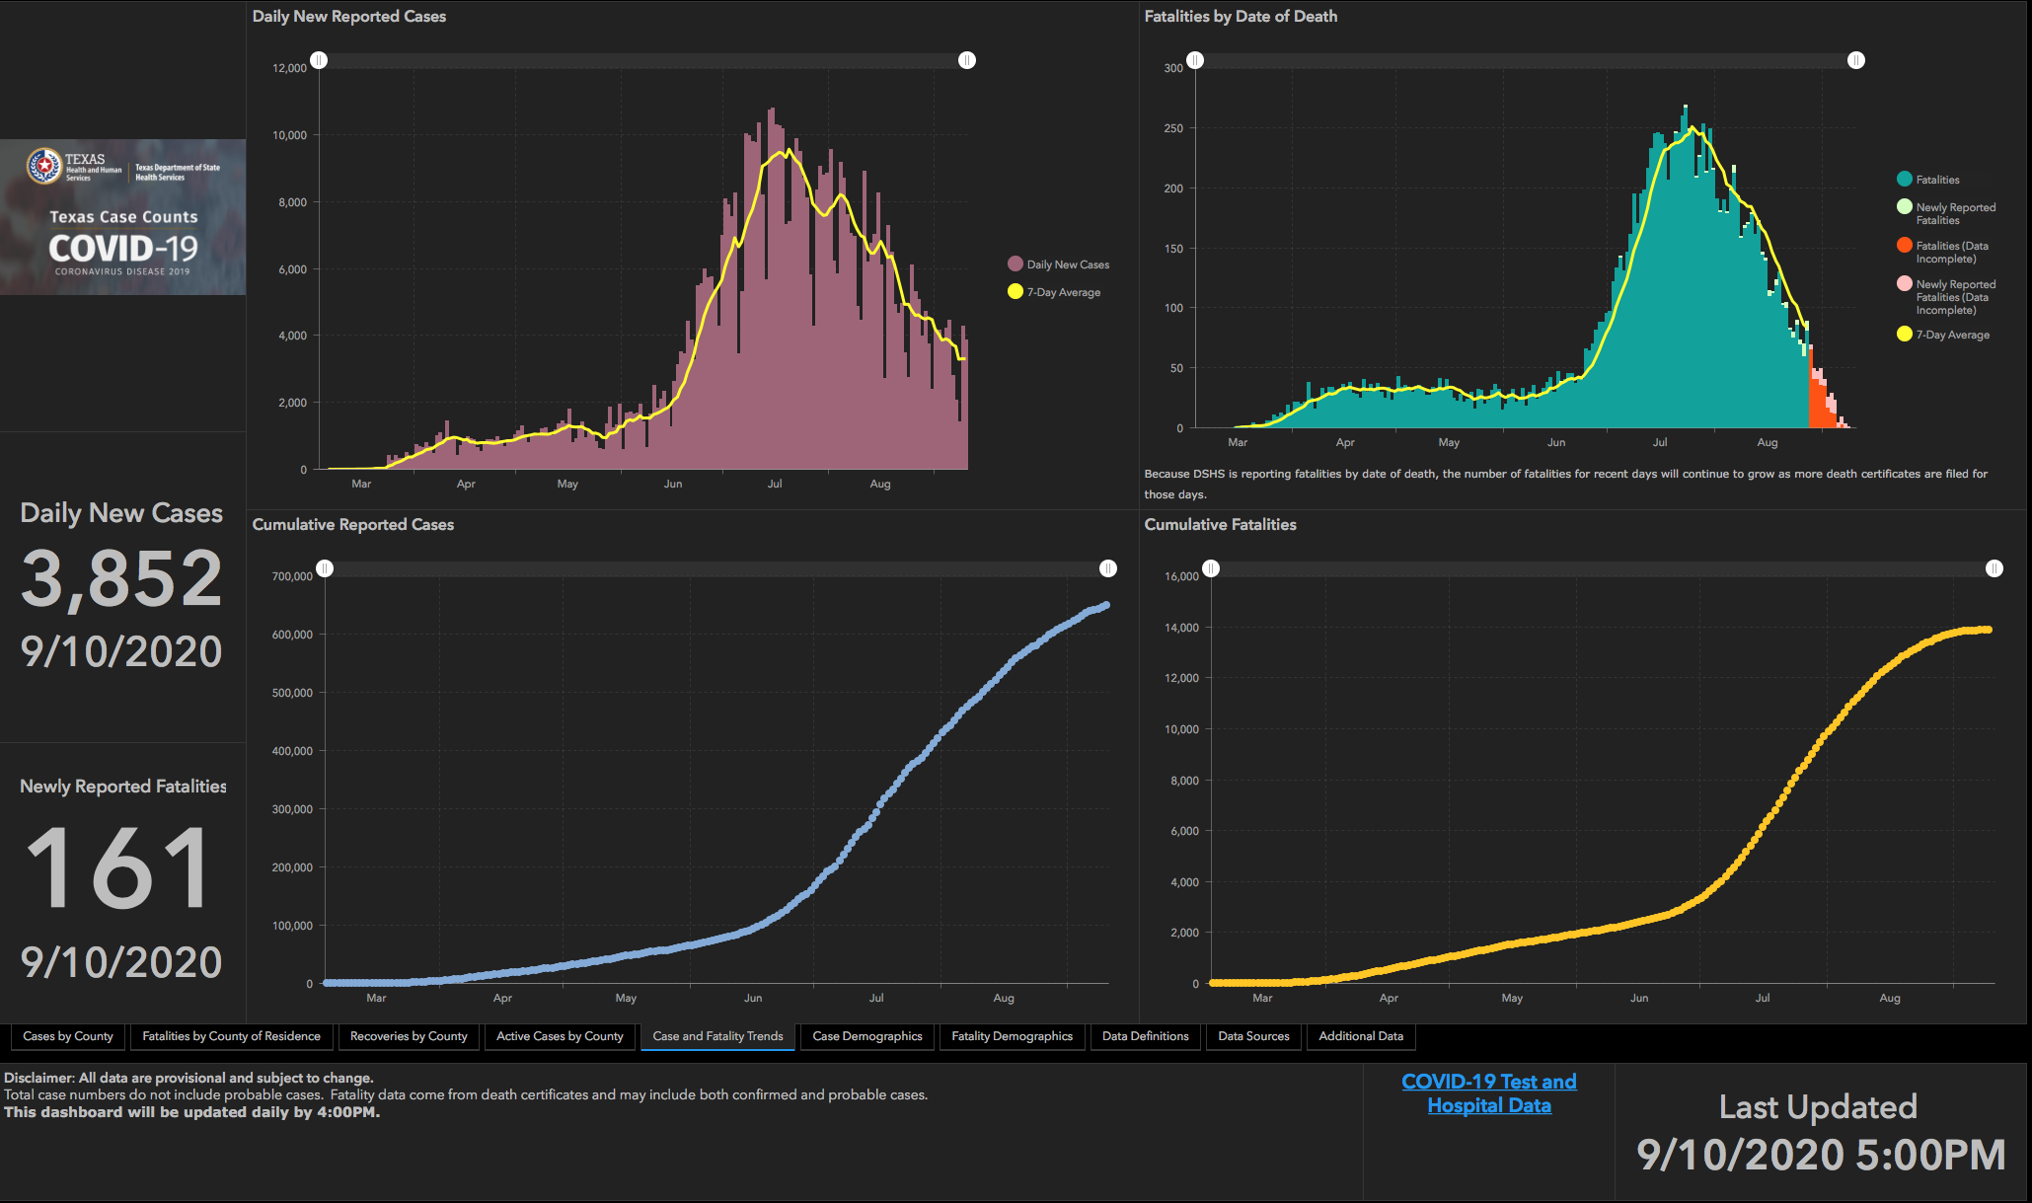

Slide 57
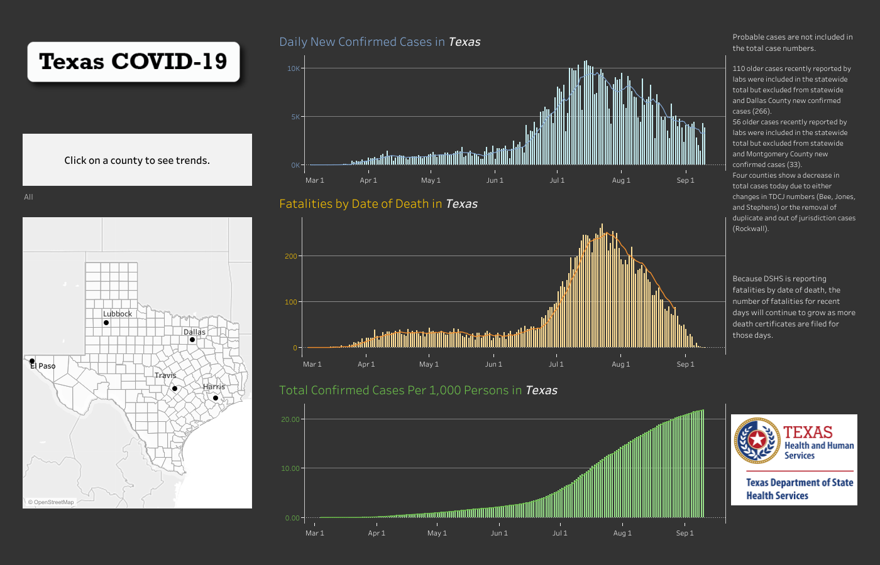

Slide 59
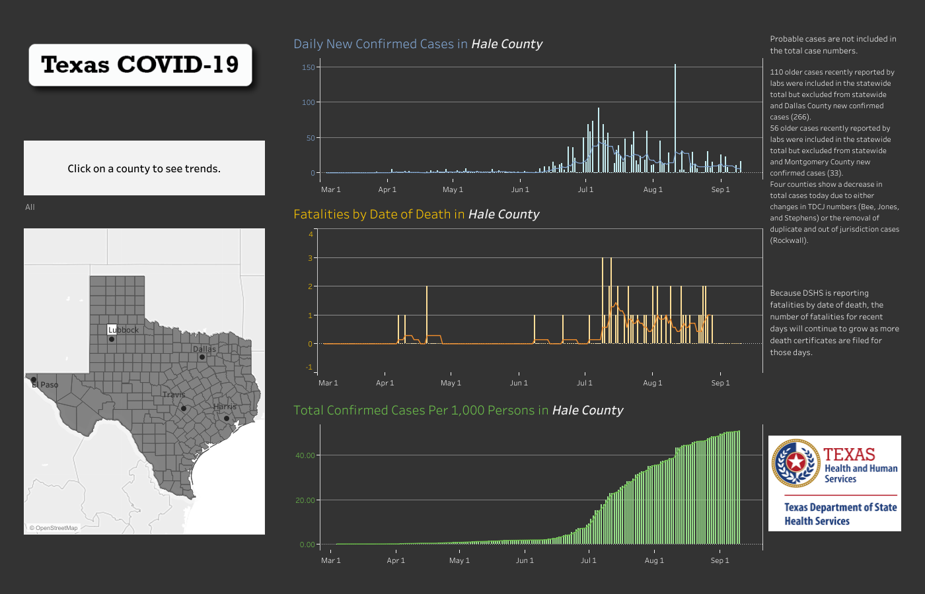

Slide 60
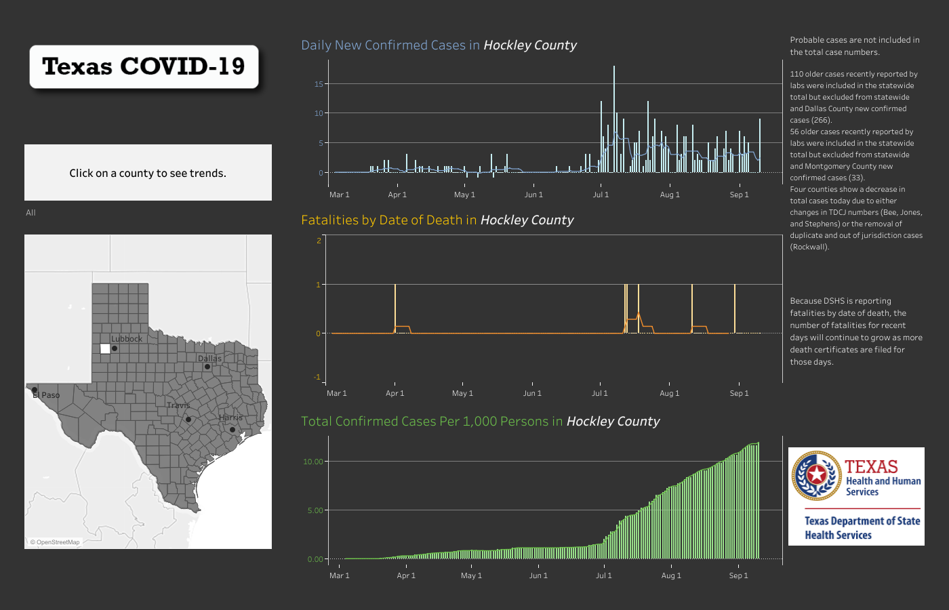

Slide 61
And New Mexico

Slide 62
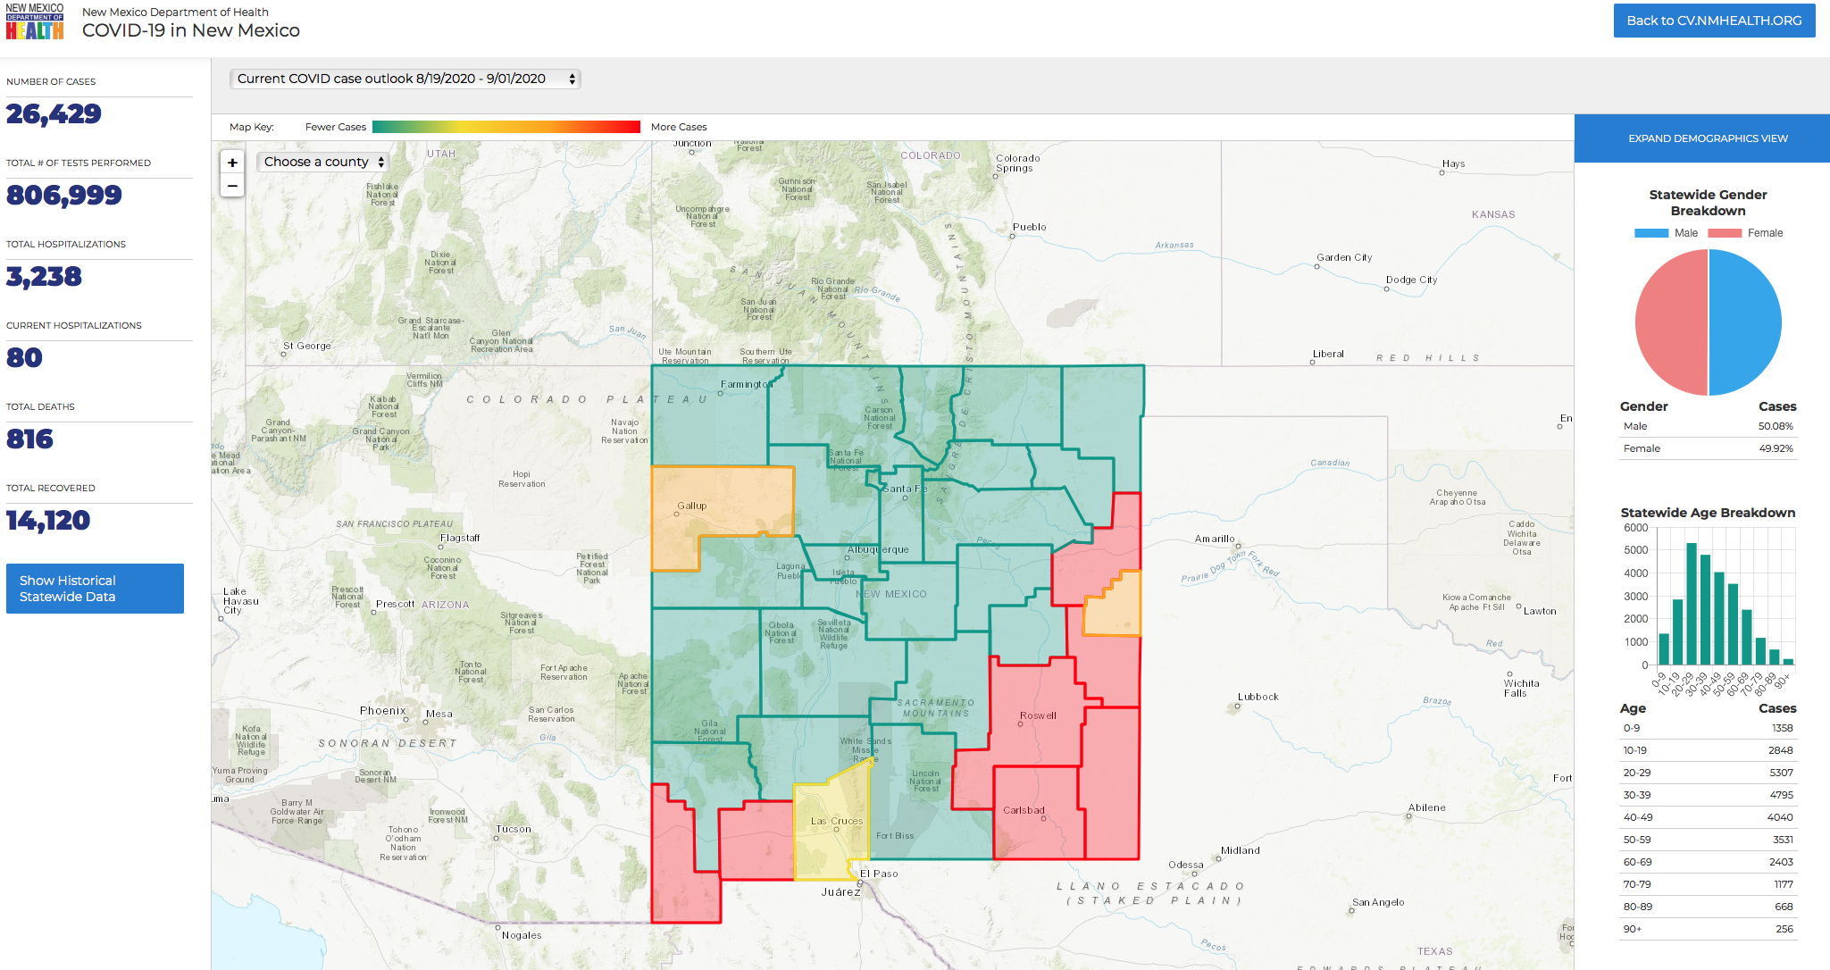

Slide 63
United States Demographics

Slide 64
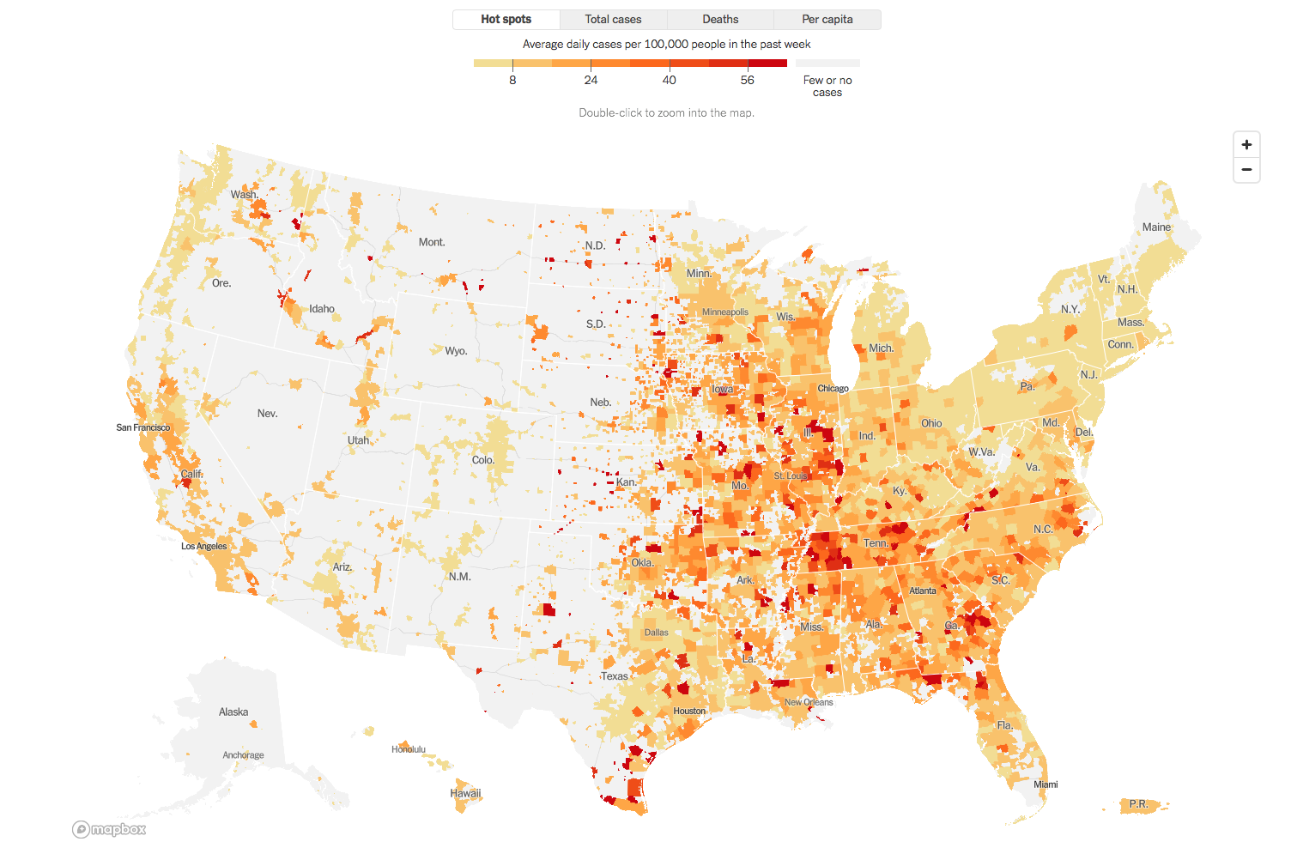

Slide 65
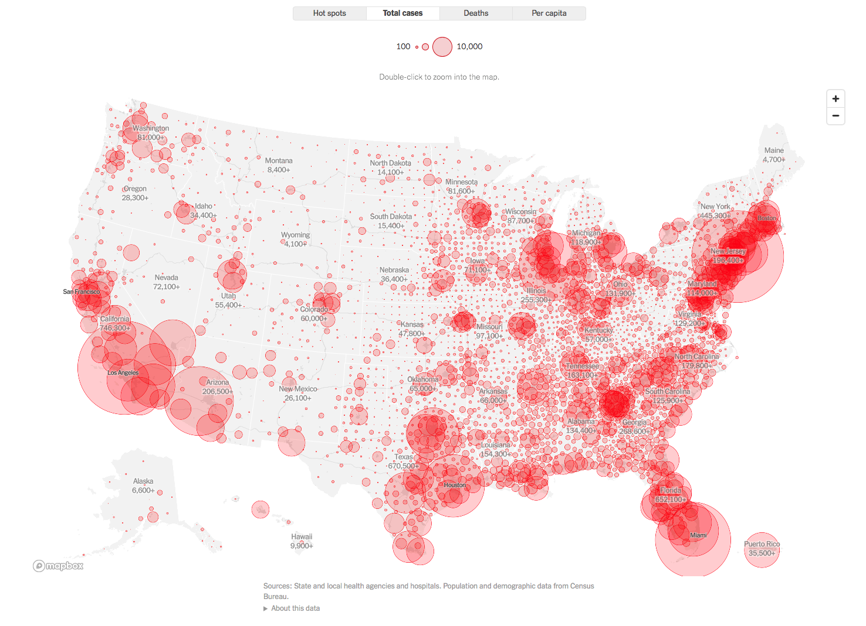

Slide 66
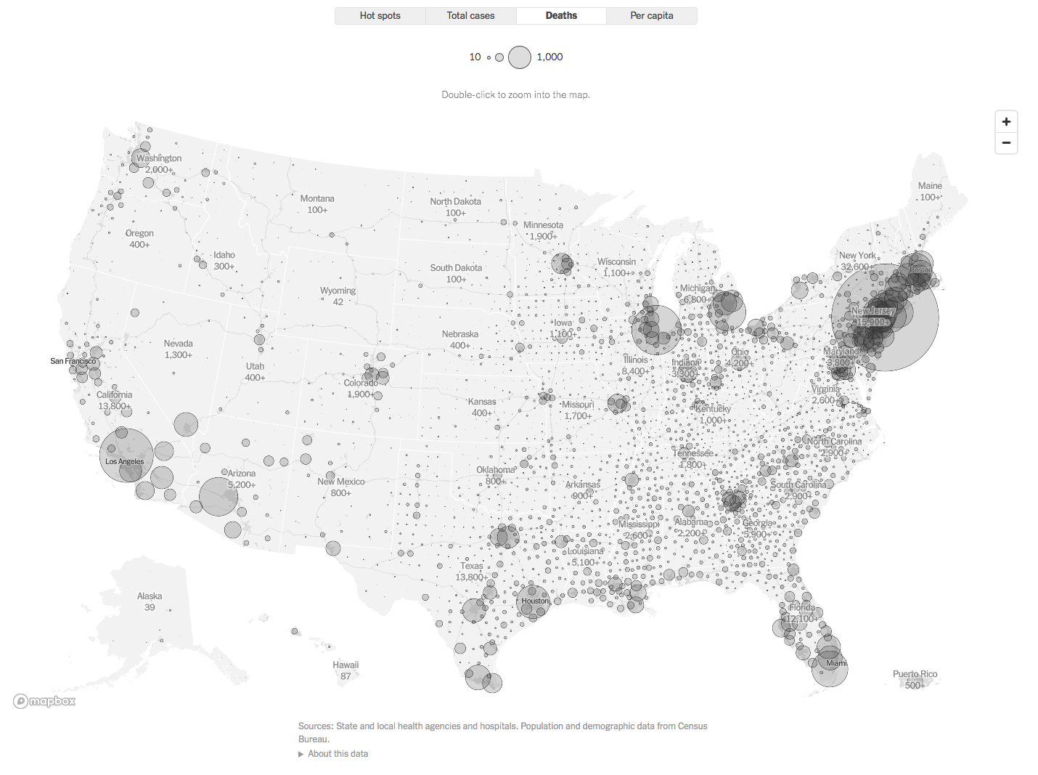

Slide 67
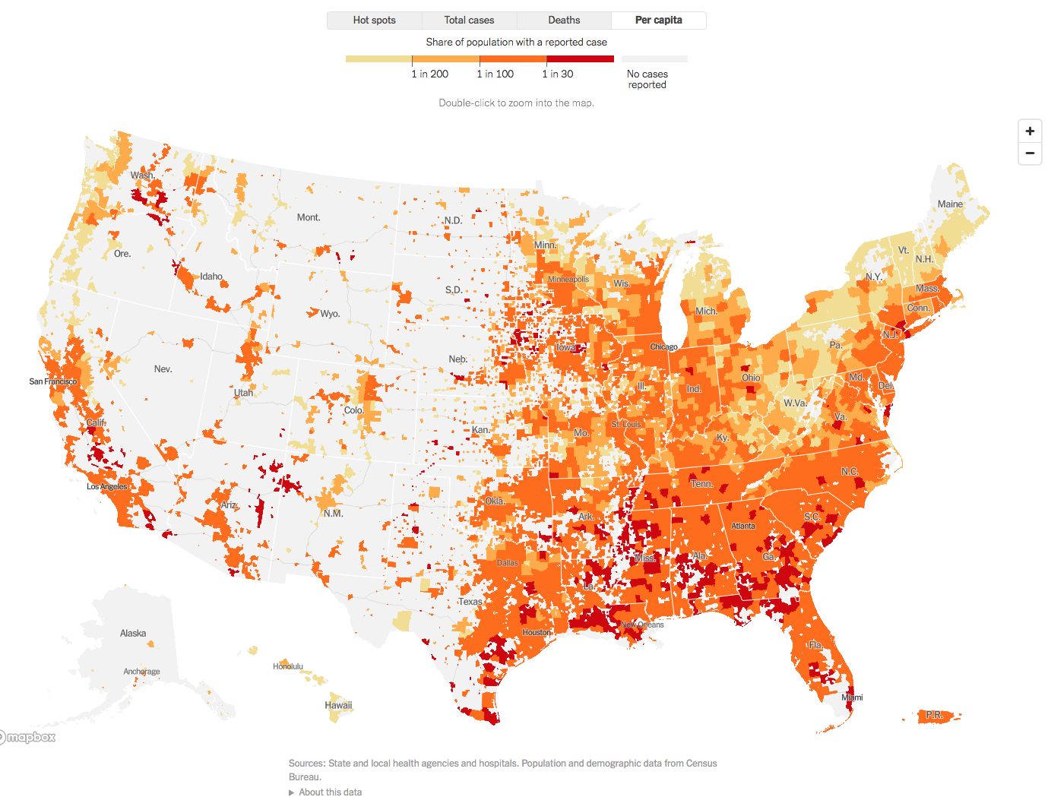

Slide 68

Worldwide Demographics

Slide 69
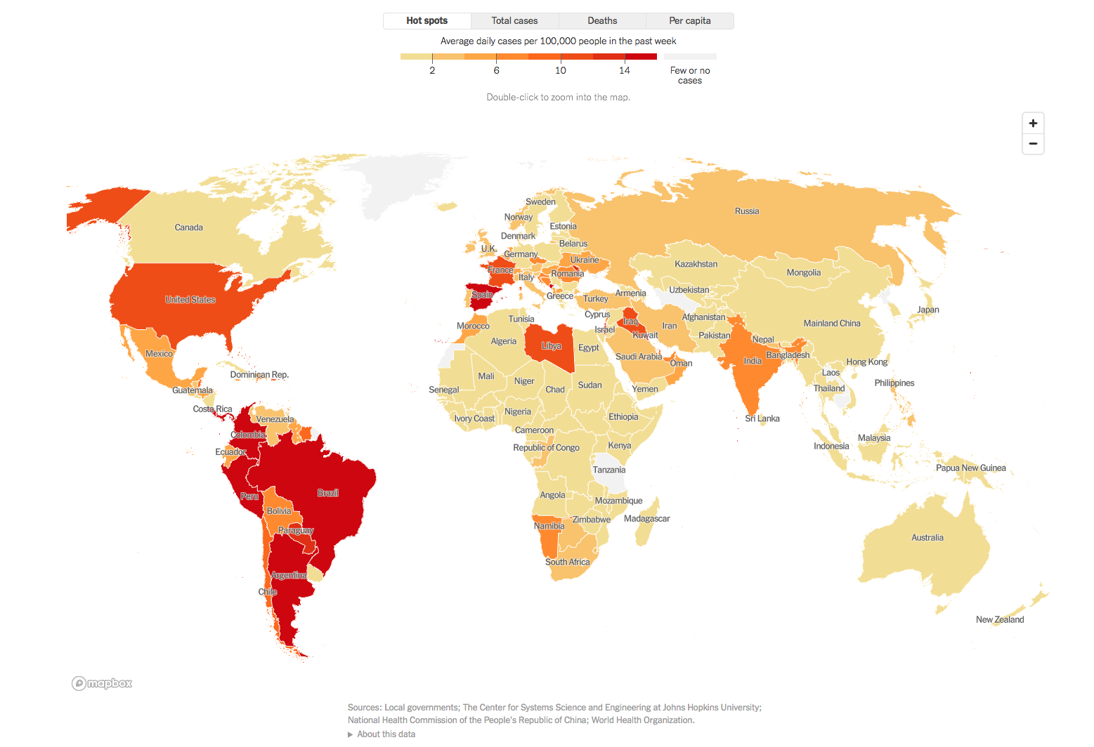

Slide 70
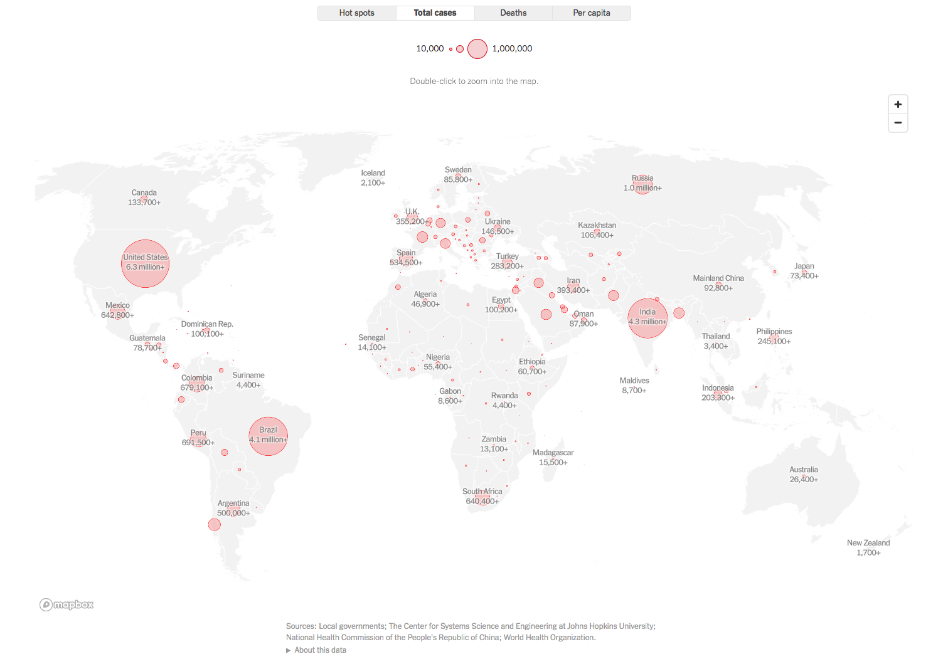

Slide 71
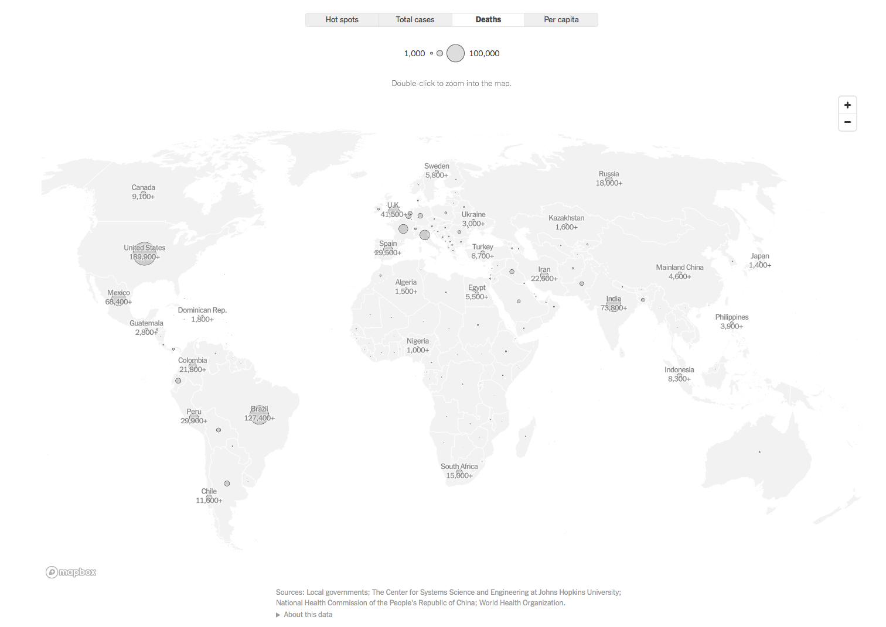

Slide 72
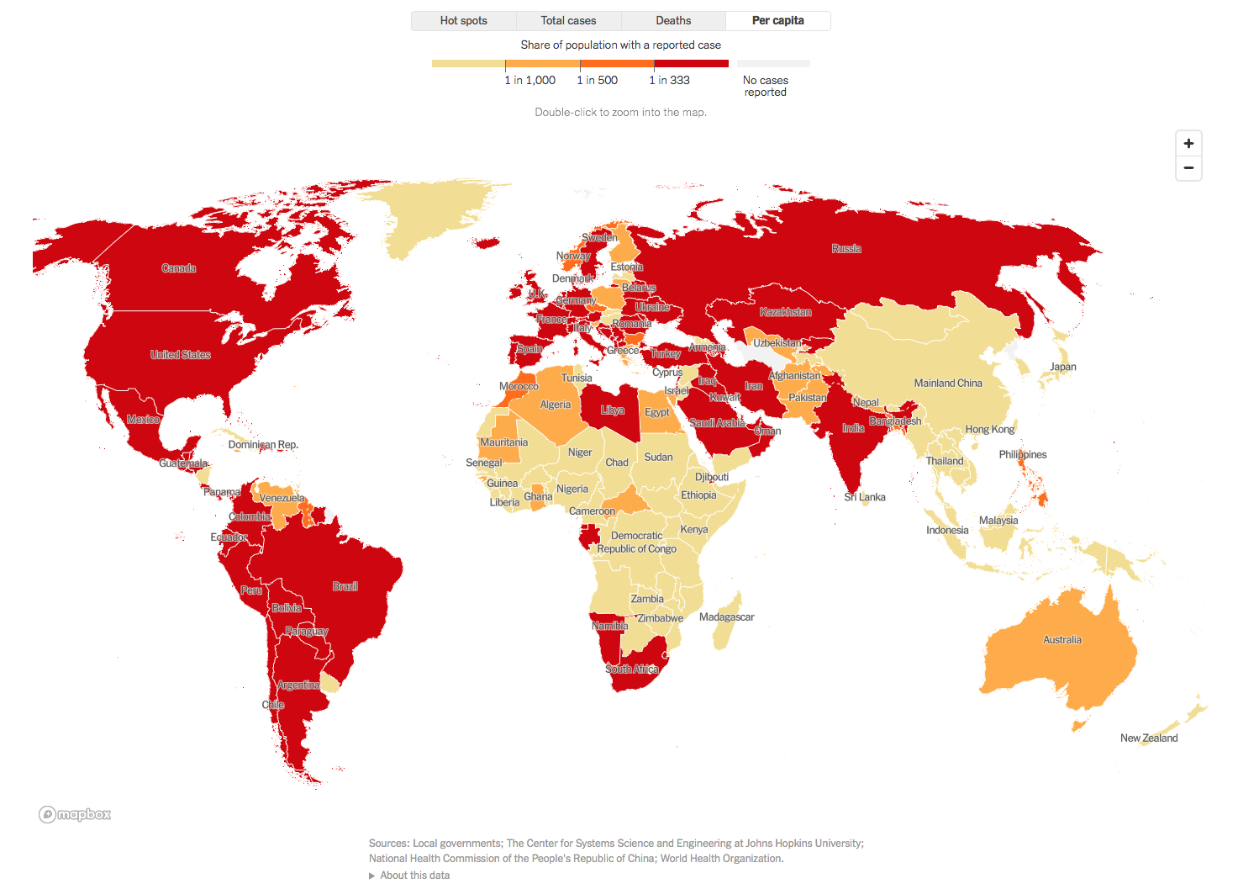

Slide 73

Governmental affairs
Governor Abbott has extended the Disaster Declaration for COVID-19 for all counties in Texas

Slide 74
Q & A

Slide 75
CME Credit was only approved for the Live Teams meeting
To receive credit for this continuing education activity, the participant must:
  Make sure you are logged into your Teams account, if you are signed in with a group provide attendee’s First and Last name(s) in the comments section.
  If you are calling into the Teams meeting you MUST text your First & Last Name to (806) 252-4735. This will ensure you are added to the sign in sheet to receive CME Credit.
  You will receive an email within 3 business days from the CME department with further instructions on claiming your certificate.

