Slide 1
Covenant Health Presents Critical Communications: A Weekly Physician Update September 11, 2020

Slide 2
PHYSICIANS
Accreditation Statement:
The Covenant Health is accredited by the Texas Medical Association (TMA) to provide continuing medical education for physicians.
Credit Designation Statement:
The Covenant Health designates this live CME activity for a maximum of 1.0 AMA PRA Category 1 Credit(s)™. Physicians should claim only the credit commensurate with the extent of their participation in the activity.

Slide 3
Disclosures of Commercial Interest
The speakers and planners of this activity
have no relevant financial interests

Slide 4
Disclosures
This activity is provided by
Covenant Health
No commercial support has been received.
No products will be endorsed.
Speakers will notify the audience if off label drug use will be discussed.

Slide 5
CME Credit was only approved for the Live Teams meeting
To receive credit for this continuing education activity, the participant must:
Make sure you are logged into your Teams account, if you are signed in with a group provide attendee’s First and Last name(s) in the comments section.
If you are calling into the Teams meeting you MUST text your First & Last Name to (806) 252-4735. This will ensure you are added to the sign in sheet to receive CME Credit.
You will receive an email within 3 business days from the CME department with further instructions on claiming your certificate.

Slide 6
Reflection and Safety Story
Nicki Colbert, DO
Sound Physicians

Slide 7
Current Regional Covid-19 Census

Slide 8
Regional
 | Lubbock |  | TTU |  | Hockley |  | Hale
 | 9/14 | 9/16 | 9/14 | 9/16 | 9/10 |  | 9/14 | 9/15
Total | 9936 | 10,044 | 1293 | 1343 | 282 |  | 1769 | 1776
Active | 2830 | 2523 | 357 | 50 | 44 |  | 87 | 86
Deaths | 113 | 113 | 0 | 0 | 7 |  | 57 | 57
New | 108 |  | 50 |  |  |  | 7
9/14: 81 Hospitalized in Lubbock – 13 on vents 9/16: 71 Hospitalized in Lubbock – 11 on vents

Slide 9
STATE
 | 9/16 | 9/14 | 9/9 | 8/26 | 8/12 | 7/29 | 7/15 | 7/1
Cases | 674,772 | 663,445 | 645,791 | 592,137 | 506,820 | 403,307 | 282,365 | 168,062
Deaths | 14,478 | 14,211 | 13,692 | 11,805 | 9034 | 6190 | 3432 | 2481
Hospitalized | 3249 | 3325 | 3604 | 4806 | 7028 | 9595 | 10,471 | 6904

Slide 10
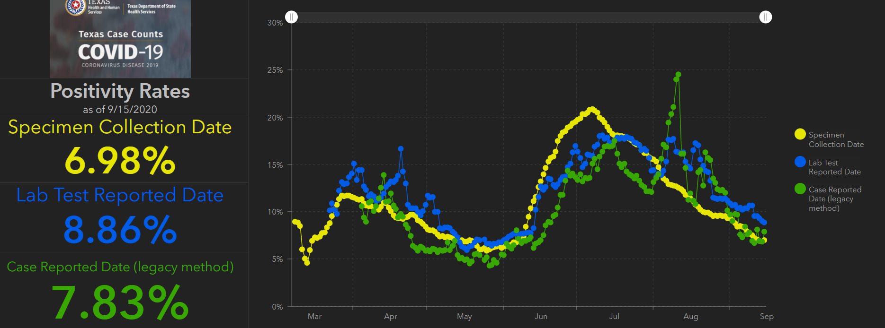
STATE
Lubbock Rate = 10.9%

Slide 11
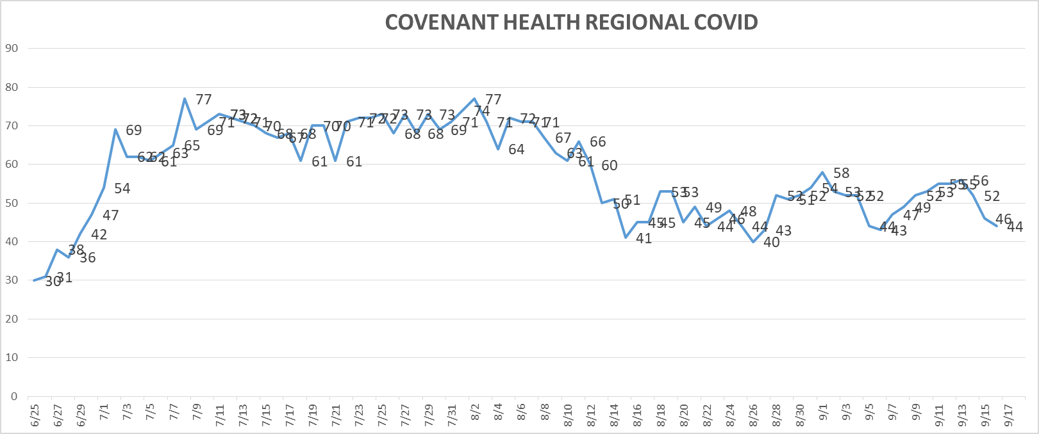
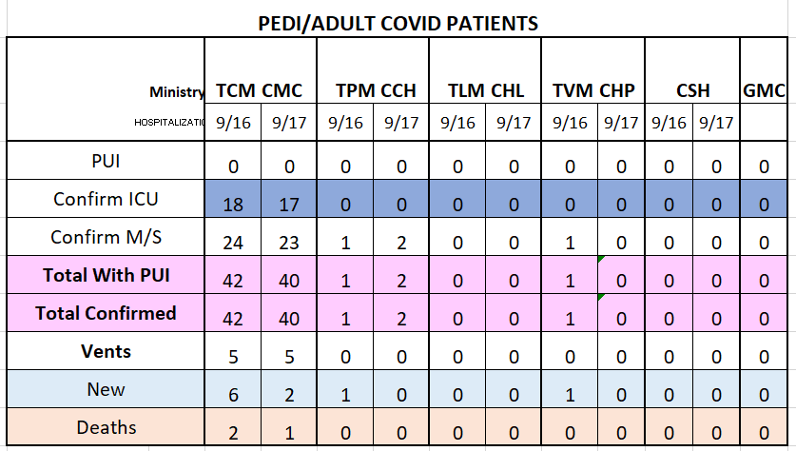
PUI/Confirmed cases-hospitalized

Slide 12
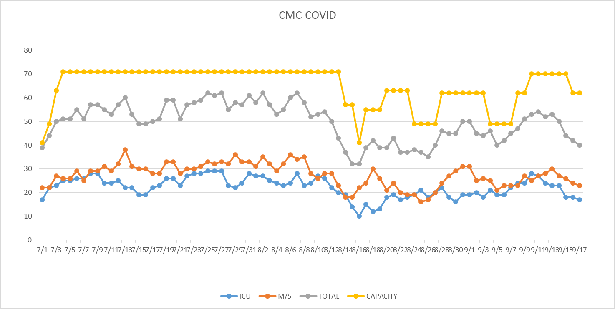
PUI/Confirmed cases-hospitalized
MICU 8 beds for COVID – Closed 8 on 9/15

Slide 13
Surge Plan
Covenant Medical Center
 | ICU | Med Surg | Total
Phase 1 | 10-CICU |  | 10
Phase 2 | 17-CICU | 10-HC4 | 27
Phase 3 | 17-CICU | 24-HC4 | 41
Phase 4 | 17-CICU 8-MICU | 24-HC4 14-Pal Med | 63
Phase 5 | 17-CICU 16-MICU | 24-HC4 14-Pal Med | 71
Phase 6 | 17-CICU 16-MICU 8- SICU 4 (east) | 24-HC4 14-Pal Med 15 – S 9 (east) | 94
Currently
Last Week

Slide 14
PSJH System Trends

Slide 15
Statistics
Cristian Requenez, MS
Clinical Data Analyst
Clinical Excellence
Covenant Health

Slide 16
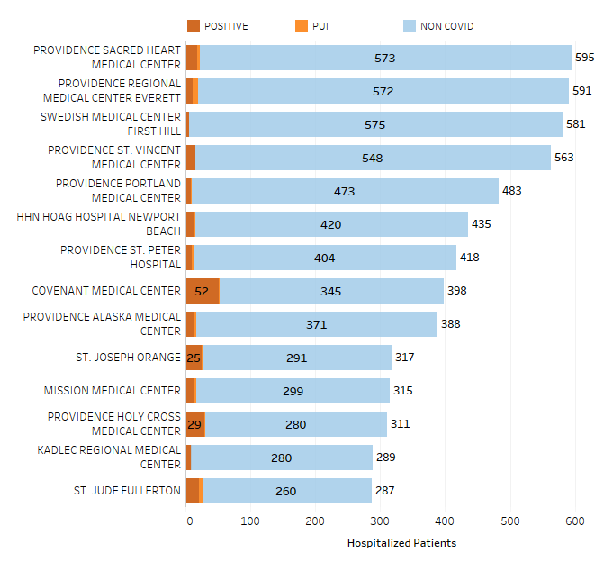
Providence System Hospitalized COVID-19 Cases
13%

Slide 17
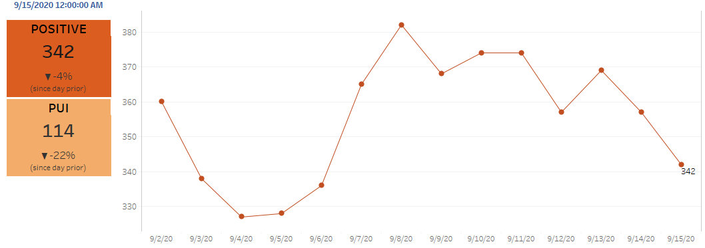
Providence Inpatient COVID-19 Volume

Slide 18
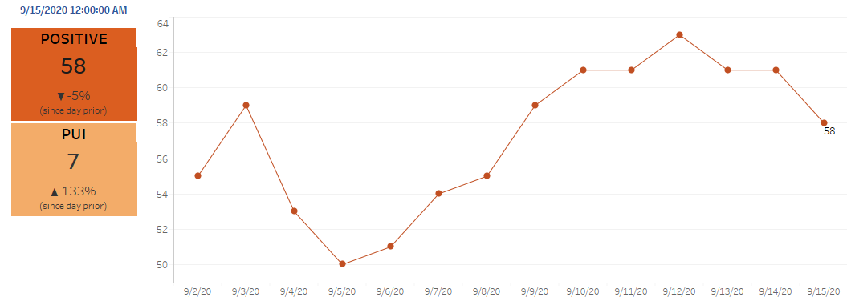
Texas Inpatient COVID-19 Volume

Slide 19
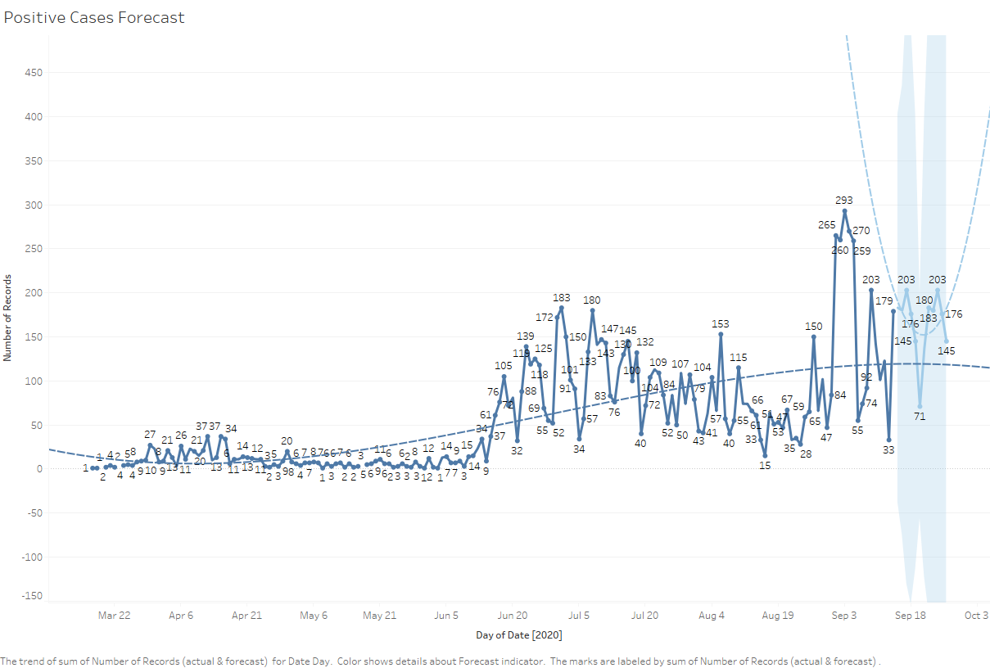
New Covid-19 POSITIVES by Day Trend

Slide 20
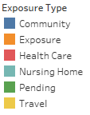
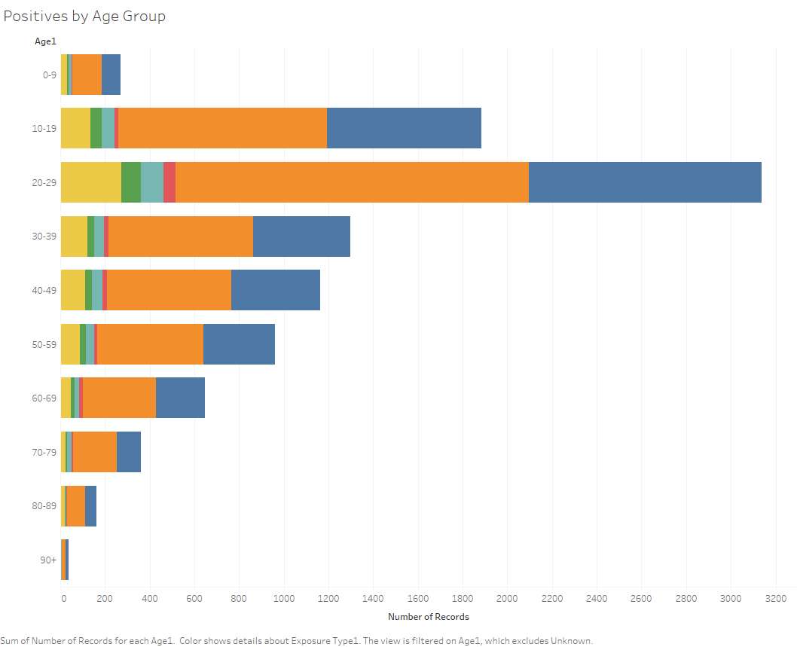
Covid-19 POSITIVES Age Distribution

Slide 21
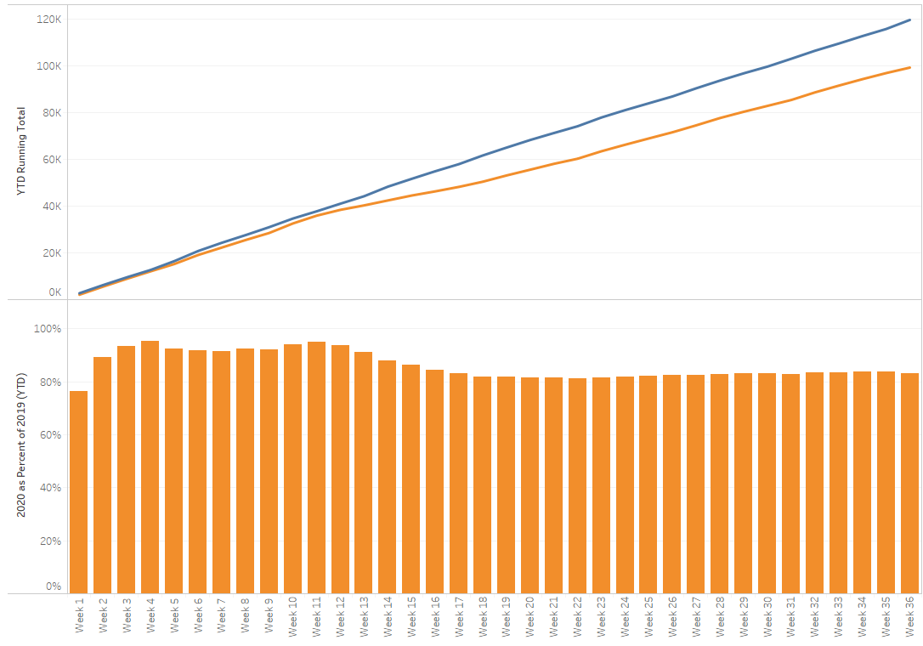
TX/NM Region Weekly Procedures (YOY)

Slide 22
Covid-19 Testing

Slide 23
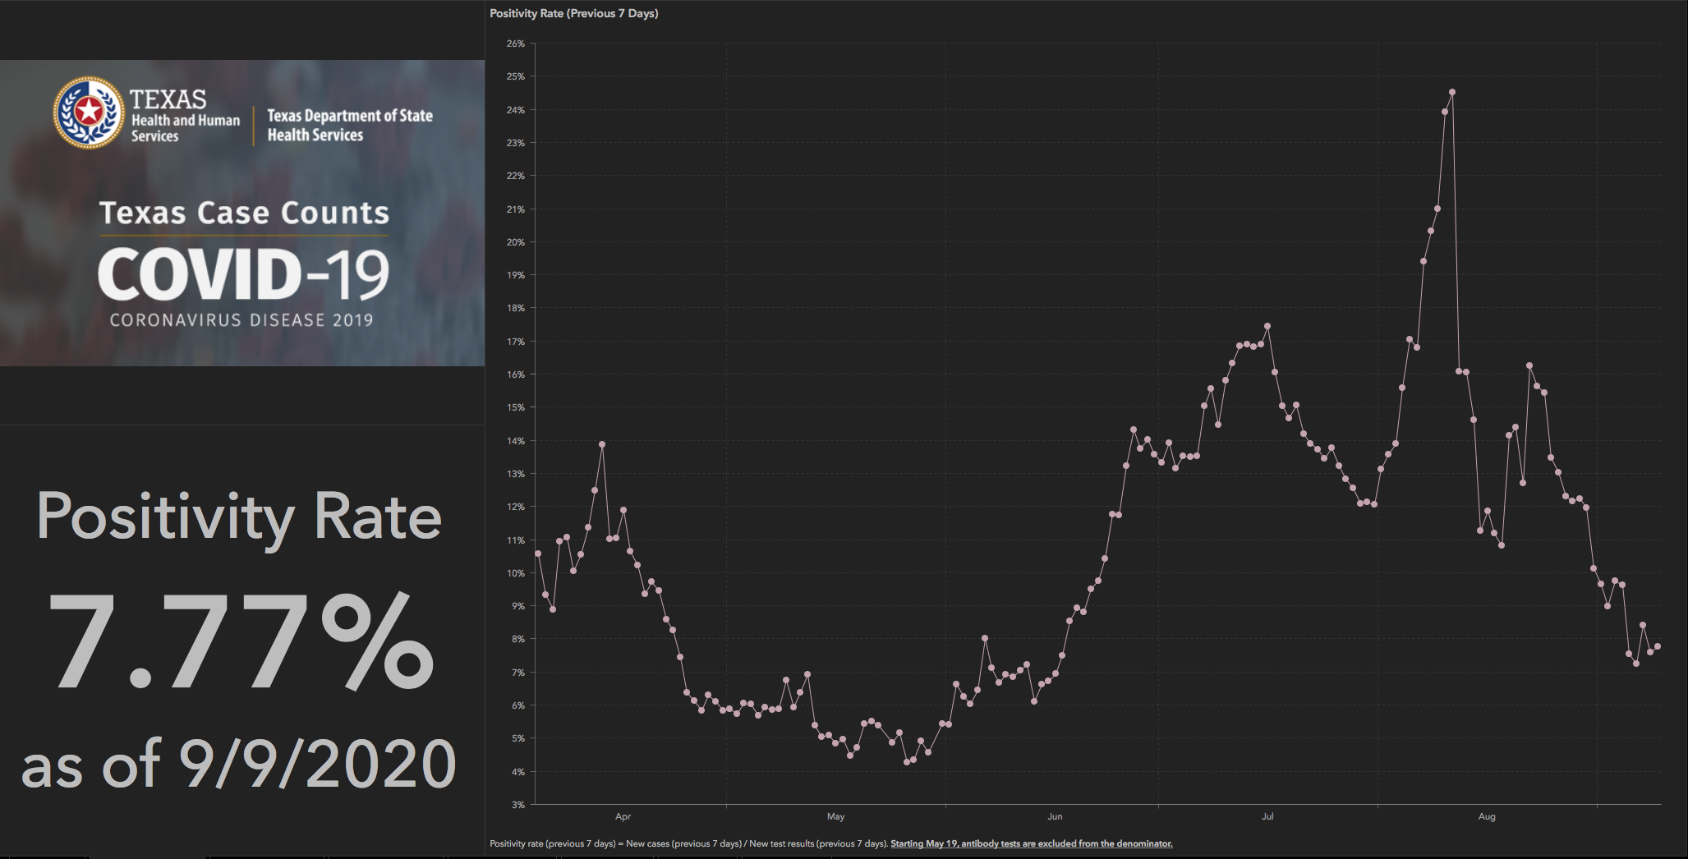
TESTING – STATEWIDE Results

Slide 25
TESTING
 | CMC | GMC | CMG
Test Kits
Swabs
VTM
 | CMC |  | GMG/CMG
 | Tests | + | Tests | +
9/15 | 284 | 20 | 237 | 56
9/16 | 236 | 17 | 201 | 29
9/17
9/18
9/19
>2000 >750
<2000 <750
<1600 <500
CMG received expecting shipment of the Abbott rapids today and supplementing with Alinity swabs from CMC
Grace notes that BD is having difficulty with keeping up with allocations on test strips, reagents are fine.

Slide 26
Pharmacy Update
Larry Pineda, PharmD
Clinical Pharmacist – AMS
Covenant Health

Slide 27
CHS Remdesivir Inventory
Ministry | Stock | On Treatment | Min PAR | Max PAR
Covenant Medical Center | 608 | 8 | 480 | 640
Children’s Hospital | 0 | 0 | 0 | 6
Covenant Plainview | 268 | 0 | 80 | 120
Covenant Levelland | 6 | 0 | 0 | 6
Notes:
Last updated: 9/17/20 at 0800
Shortages: non-covid meds, periodic shipment of hydralazine and valproate sodium. Hydralazine back order, as of right now we are out
FYI, next week: Vaccines
Operation Warp Speed (OWS)
HHS released several documents yesterday
Strategy document
Vaccine Playbook

Slide 28
Hydroxychloroquine
RCT Data

Slide 29
NIH Guidelines
To reflect the results of large randomized controlled trials that enrolled hospitalized patients, the following recommendations have been updated to differentiate between hospitalized and nonhospitalized patients:
The Panel recommends against the use of chloroquine or hydroxychloroquine for the treatment of COVID-19 in hospitalized patients (AI)
In nonhospitalized patients, the Panel recommends against the use of chloroquine or hydroxychloroquine for the treatment of COVID-19, except in a clinical trial (AI)

Slide 30
RECOVERY Trial
UK adaptive COVID-19 treatment trial with independent data monitoring committee reviewing data every two weeks
Chief investigators on hydroxychloroquine (June 5, 2020)
“We have concluded that there is no beneficial effect of hydroxychloroquine in patients hospitalized with COVID-19. We have therefore decided to stop enrolling participants to the hydroxychloroquine arm of the RECOVERY Trial with immediate effect. We are now releasing the preliminary results as they have important implications for patient care and public health.”
Notes:
Horby P, Landray M. Statement from the chief investigators of the randomised evalution of COVID-19 therapy (RECOVERY) trial on hydroxychloroquine. 2020 Jun 5. (https://www.recoverytrial.net/news/statement-from-the-chief-investigators-of-the-randomised-evaluation-of-covid-19-therapy-recovery-trial-on-hydroxychloroquine-5-june-2020-no-clinical-benefit-from-use-of-hydroxychloroquine-in-hospitalised-patients-with-covid-19).
RECOVERY Central Coordinating Office. Study protocol for randomized evaluation of Covid-19 therapy (RECOVERY). (https://www.recoverytrial.net/files/recovery-protocol-v6-0-2020-05-
14.pdf).
One month later, WHO announces stopping HCQ arm in SOLIDARITY trial

Slide 31
RECOVERY Press Release
Hydroxychloroquine, 1542 patients; compared with 3132 patients randomized to usual care alone
Regimen: day 1, 800mg x 2 doses 6 hours apart, 400mg x 2 doses 12 and 24 hours after the initial dose, then 400 mg BID x 9 days
Primary endpoint: 28 day mortality
25.7% hydroxychloroquine vs 23.5% usual care; HR 1.11 [95% CI 0.98-1.26]; p=0.10)
No evidence of beneficial effects on LOS or other outcomes

Slide 32
Horby PW et al. medRxiv. July 15, 2020
Mixed, but mostly moderate severity
1561 received hydroxychloroquine; 3155 received usual care
Primary endpoint: 28 day mortality
418 (26.8%) hydroxychloroquine and 788 (25.0%) usual care died within 28 days (rate ratio 1.09; 95% CI 0.96 to 1.23; p=0.18)
Sub analysis of respiratory support at randomization (no difference)
Secondary endpoints:
Discharged (alive) within 28 days; HCQ 60.3% vs UC 62.8% (rate ratio 0.92; 95% CI 0.85-0.99)
Median time until discharge from hospital (HCQ 16 days vs UC 13 days)
Composite endpoint of invasive mech ventilation or death; HCQ 29.8% vs UC 26.5% (risk ratio 1.12; 95% CI 1.01-1.25)
Adverse events
No significant differences (avoided HCQ if QTc prolonged)
One case of torsades linked to HCQ, patient recovered
Conclusion: no benefit in hospitalized patients
Notes:
Patients with known prolonged electrocardiograph QTc interval were ineligible for 97 the hydroxychloroquine arm
At randomization, 17% were receiving invasive mechanical ventilation or extracorporeal membrane oxygenation, 60% were receiving oxygen only (with or without non-invasive ventilation), and 24% were receiving neither
Sub analysis: Respiratory support at randomization (no difference)
No oxygen received 57/362 (15.7%) 99/750 (13.2%) 1.22 (0.87−1.70)
Oxygen only 251/938 (26.8%) 473/1873 (25.3%) 1.08 (0.92−1.26)
Invasive mechanical ventilation 110/261 (42.1%) 216/532 (40.6%) 1.03 (0.81−1.30)
Use of azithromycin or other macrolide drug during the follow-up period was similar in both arms (17% vs. 19%) as was use of dexamethasone (8% vs. 9%)
Among these patients, there were no 233 significant differences in the frequency of supraventricular tachycardia (6.9% vs. 5.9%), 234 ventricular tachycardia or fibrillation (0.9% vs. 0.7%) or atrioventricular block requiring 235 intervention (0.1% vs. 0.1%) (Table S3). Analyses of cause-specific mortality, receipt of renal 236 dialysis or hemofiltration, and duration of ventilation will be presented once all relevant 237 information (including certified cause of death) is available. There was one report of a serious 238 adverse reaction believed related to hydroxychloroquine; a case of torsades de pointes from 239 which the patient recovered without the need for intervention.

Slide 33
Cavalcanti et al. NEJM. July 23, 2020
Multicenter, randomized, open-label trial in Brazil
Enrolled 504 patients not requiring supplemental O2 (55%) or max of 4L at baseline (mild/moderate)
Excluded history of severe ventricular tachycardia or QTc > 480 at baseline
Randomized 1:1:1
173, standard care (control group)
159, hydroxychloroquine 400mg BID x 7 days with standard care
172, hydroxychloroquine 400mg BID x 7 days + azithromycin 500mg daily x 7 days with standard care
Median time from onset of symptoms to randomization was 7 days
Notes:
July 23, 2020
Modified ITT – C19 PCR positive, if not available those were excluded in mITT

Slide 34
Cavalcanti et al. Results
Primary outcome: clinical status day 15 on a 7 point ordinal scale
Proportional odds of having a higher (worse) score:
HCQ alone (OR, 1.21; 95% CI, 0.69 to 2.11; p=1.00)
HCQ + AZ (OR, 0.99; 95% CI, 0.57 to 1.73; p=1.00)
Adverse events:
HCQ + AZ (39.3%), HCQ alone (33.7%), no trial drugs (22.6%)
QTc>480 w/n 7 days: HCQ + AZ (16.5%); HCQ (14.3%); control (1.7%), p=0.009
Conclusion: No significant difference in those treated with HCQ with or without azithromycin compared with the control group
Limitations: not blinded, previous use of study medication allowed (~8% HCQ, ~36% AZ), ordinal scale outcome
Notes:
Scores on the scale were defined as follows: a score of 1 indicated not hospitalized with no limitations on activities; 2, not hospitalized but with limitations on activities; 3, hospitalized and not receiving supplemental oxygen; 4, hospitalized and receiving supplemental oxygen; 5, hospitalized and receiving oxygen supplementation administered by a high-flow nasal cannula or noninvasive ventilation; 6, hospitalized and receiving mechanical ventilation; and 7, death
There also were no significant differences in secondary outcomes: Need for mechanical ventilation, duration of hospitalization, in-hospital death
Previous use of study medication Hydroxychloroquine H/A (7.6), H (8.2), C (6.9), All (7.5)
Previous use of study medication Azithromycin H/A (33.1), H (34.6), C (39.5), All (35.8)

Slide 35
Skipper CP et al. July 16, 2020
Randomized, double-blind, placebo-controlled trial conducted from 22 March through 20 May 2020
Internet-based trial across the United States and Canada
Symptomatic, non-hospitalized adults with laboratory-confirmed COVID-19 or probable COVID-19 and high-risk exposure within 4 days of symptom onset
HCQ 800mg once, 600mg in 6 to 8 hours, then 600 mg daily x 4 more days OR masked placebo
Primary end point: change in overall symptom severity over 14 days (10-point visual analogue scale)
Notes:
Collected self-reported survey data using the Research Electronic Data Capture (REDCap) system

Slide 36
Skipper CP et al. Results
423 patients, 341 (81%) laboratory-confirmed infection or exposure
34% participants had positive PCR
56% (236 of 423) were enrolled within 1 day of symptoms starting
Primary endpoint (change in symptom severity)
HCQ and placebo groups (difference in symptom severity: relative, 12%; absolute, −0.27 points [95% CI, −0.61 to 0.07 points]; P=0.117)
Other findings
At 14 days, 24% (49 of 201) of HCQ group had ongoing symptoms compared with 30% (59 of 194) receiving placebo (P = 0.21)
Hospitalizations/deaths
HCQ, 4 hospitalizations occurred plus 1 non-hospitalized death (P = 0.29)
Placebo, 10 hospitalizations occurred (2 non–C19 related), including 1 hospitalized death
Adverse events:
HCQ 43% (92 of 212); placebo 22% (46 of 211) (P < 0.001)
Notes:
19% suspected COVID
Limitations: Only 58% of participants received SARS-CoV-2 testing because of severe U.S. testing shortages
United States during March and April 2020, SARS-CoV-2 diagnostic testing was extremely limited, nonhospitalized persons were often ineligible for testing, and turnaround time for results was multiple days
Interesting observation: change in primary endpoint from hospitalization or death. Had to change: change was necessary because the low event rate of hospitalizations or deaths in the trial would have required increasing the sample size to 6000 participants, which was not attainable. Among the enrolled participants, the incidence of hospitalization was only 3% and incidence of death only 0.4%.
With hydroxychloroquine, gastrointestinal symptoms were the most commonly reported adverse effect: 31% (66 of 212) of participants reported upset stomach or nausea, and 24% (50 of 212) reported abdominal pain, diarrhea, or vomiting. No serious adverse events.

Slide 37
Take Away
Observational data is inconsistent and low quality
Limited RCT data available
However, no significant benefit for HCQ has been shown
Adverse effects significantly greater for HCQ
Very large RCT would be needed to evaluate if administering HCQ in mild/asymptomatic outpatients can prevent hospitalization/death

Slide 38
Covid-19 Trivia

Slide 39
Viral Binding to Human Cells
SARS-CoV-2 binds tightly
In 2003, SARS, or severe acute respiratory syndrome, spread from Asia throughout the world, sickening more than 8,000 people and killing more than 700 over a six-month period. The virus that caused SARS (SARS-CoV) is similar to the one that causes COVID-19—both are types of coronaviruses—but researchers have recently discovered an important difference that may explain why the new coronavirus is so hard to stop: SARS-CoV-2 (the virus that causes COVID-19) binds 10 to 20 times more tightly to human cells than SARS-CoV (the virus responsible for SARS).

Slide 40
What about the babies?
Coronavirus can make babies seriously ill.
Compared to adults, children appear much less likely to get sick if they contract the novel coronavirus. However, a report from China suggests that the very young may be more vulnerable to serious illness than older children. Researchers reviewed the records of 2,143 Chinese children and found that nearly 11% of sick infants were seriously or critically ill, compared to 7% of children ages 1 to 5 years, 4% of children ages 6 to 15 and 3% of teenagers aged 16 and older. In the United States, from February 12 to April 2, less than 2% of cases were in children younger than 18 years. Of these pediatric cases, 15% were in children under 12 months.
A multisystem inflammatory syndrome (MIS) is affecting some children positive for current or recent SARS-CoV-2 infection. MIS is rare but very serious. MIS is characterized by gastrointestinal symptoms and cardiac (or other system) inflammation. The syndrome is similar to Kawasaki disease, an illness that could lead to enlarged coronary arteries or even coronary artery aneurysms. Contact your doctor right away if your child has fever, abdominal pain, vomiting, diarrhea, neck pain, rash, bloodshot eyes, and/or is much more tired than usual. (Not all children will experience all MIS symptoms.)

Slide 41
Can you get Covid-19 from doorknobs?
The COVID-19 virus can live on surfaces for days.
COVID-19 is spread primarily through respiratory droplets. When an infected person sneezes or coughs, the virus can travel from one person to another, either directly (which is why the CDC recommends maintaining at least a 6-foot distance from other people) or via an intermediate surface. Researchers have found that the virus can live up to 24 hours on cardboard and 2 to 3 days on plastic and stainless steel. The CDC reports that the virus was detected on surfaces of the Diamond Princess cruise ship up to 17 days after passengers disembarked. However, only pieces of the virus were detectable, not viruses capable of infecting a person.

Slide 42
I cant be contagious if I don’t have symptoms….can I ?
People who don’t have symptoms can spread the virus.
One-third of 565 Japanese citizens who were evacuated from Wuhan, China in February that tested positive for coronavirus infection never developed COVID-19 symptoms; and a study out of China reports more than half of infected children had no symptoms or only mild symptoms. That’s good news for the affected individuals, but bad news for public health

Slide 43
Does my Blood Type matter?
People with type A blood may be more susceptible to infection.
A Chinese study of 2,173 individuals who were hospitalized with COVID-19 found that the proportion of sick people with type A blood was significantly greater than researchers would expect based upon the percentage of people with type A blood in the general population. The study also found that there were fewer sick people with type O blood than would be expected. Genomic studies of patient from Italy and Spain have supported these findings, showing a higher risk of developing COVID-19 respiratory failure in patients with type A blood.

Slide 44
Covid-19 always involves the respiratory symptoms?
Some people with COVID-19 have digestive symptoms.
Cough, fever and shortness of breath are the most common symptoms of novel coronavirus infection, but many people also experience digestive symptoms, including lack of appetite, diarrhea, vomiting and abdominal pain. According to study published in The American Journal of Gastroenterology, 48.5% of 204 people admitted to the hospital with COVID-19 had digestive symptoms. A small percentage (7 people) only had digestive symptoms; these individuals did not have a cough, fever or shortness of breath.

Slide 45
I had Covid-19. I cannot get it again, can I?
Reinfection may be possible.
If a person gets COVID-19, are they immune to future infection from SARS-CoV-2? And how long will immunity last? Ten to 30% of our common colds are caused by four different coronaviruses, and we all know that having a cold doesn’t keep you from catching another cold. But animal research suggests the novel coronavirus may be different: Macaque monkeys who were exposed to SARS-CoV-2 after recovering from COVID-19 did not develop another infection. In humans, doctors have scientifically confirmed only one case of SARS-CoV-2 reinfection (there have been numerous unconfirmed cases)

Slide 46
What about Influenza AND Covid-19?
Do we need to worry about it this year?

Slide 47
HRO Toolbox
Know Why and Comply

Slide 48
Influenza Vaccination Rates
How did we do?

Slide 50
Faces of Influenza
https://www.familiesfightingflu.org/family-stories/

Slide 51
Faces of Influenza
https://www.familiesfightingflu.org/family-stories/

Slide 52
Faces of Influenza
https://www.familiesfightingflu.org/family-stories/

Slide 53
Still think you don’t need a flu shot?
You are Vulnerable – Yes, even YOU
65 and older – higher risk of complications
172 American Children and Teens (under 18 yrs old) died from flu in 2017
80% had not received a flu shot
50% were healthy children – no underlying illness
Flu can increase the risk of having a Heart Attack
It is your Civic Duty -- Don’t be the dreaded SPREADER
Everybody who gets the flu got it from someone else
Contagious at least one day before you start to feel sick and up to seven days after
You can still get the flu, but
You won’t get as sick (cushions the blow)
Flu shot reduces risk of getting flu by 40-60%
Less likely to get pneumonia
Less likely to be hospitalized and 82% less risk of being admitted to ICU
Pregnant women who get the flu shot protect their babies from the flu
Protection across the placenta – baby protected for first 6 months of life, until old enough to be vaccinated
You cannot get the flu from the vaccine
60% of College students believe the flu vaccine can cause flu – this is untrue
Most common side effects
Sore Arm
Swelling
1-2% get a degree of fever – this is not the flu, but rather the body reacting to the vaccine
https://www.mprnews.org/story/2018/10/01/npr-think-you-dont-need-flu-shot-here-are-5-reasons-to-change-your-mind
https://www.usatoday.com/story/news/health/2020/08/21/flu-shot-during-covid-what-know-2020-2021-season

Slide 54
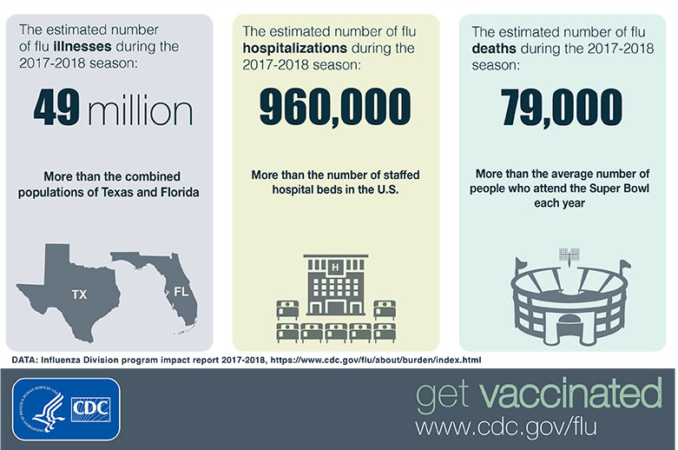
The burden of Flu Disease 2018

Slide 55
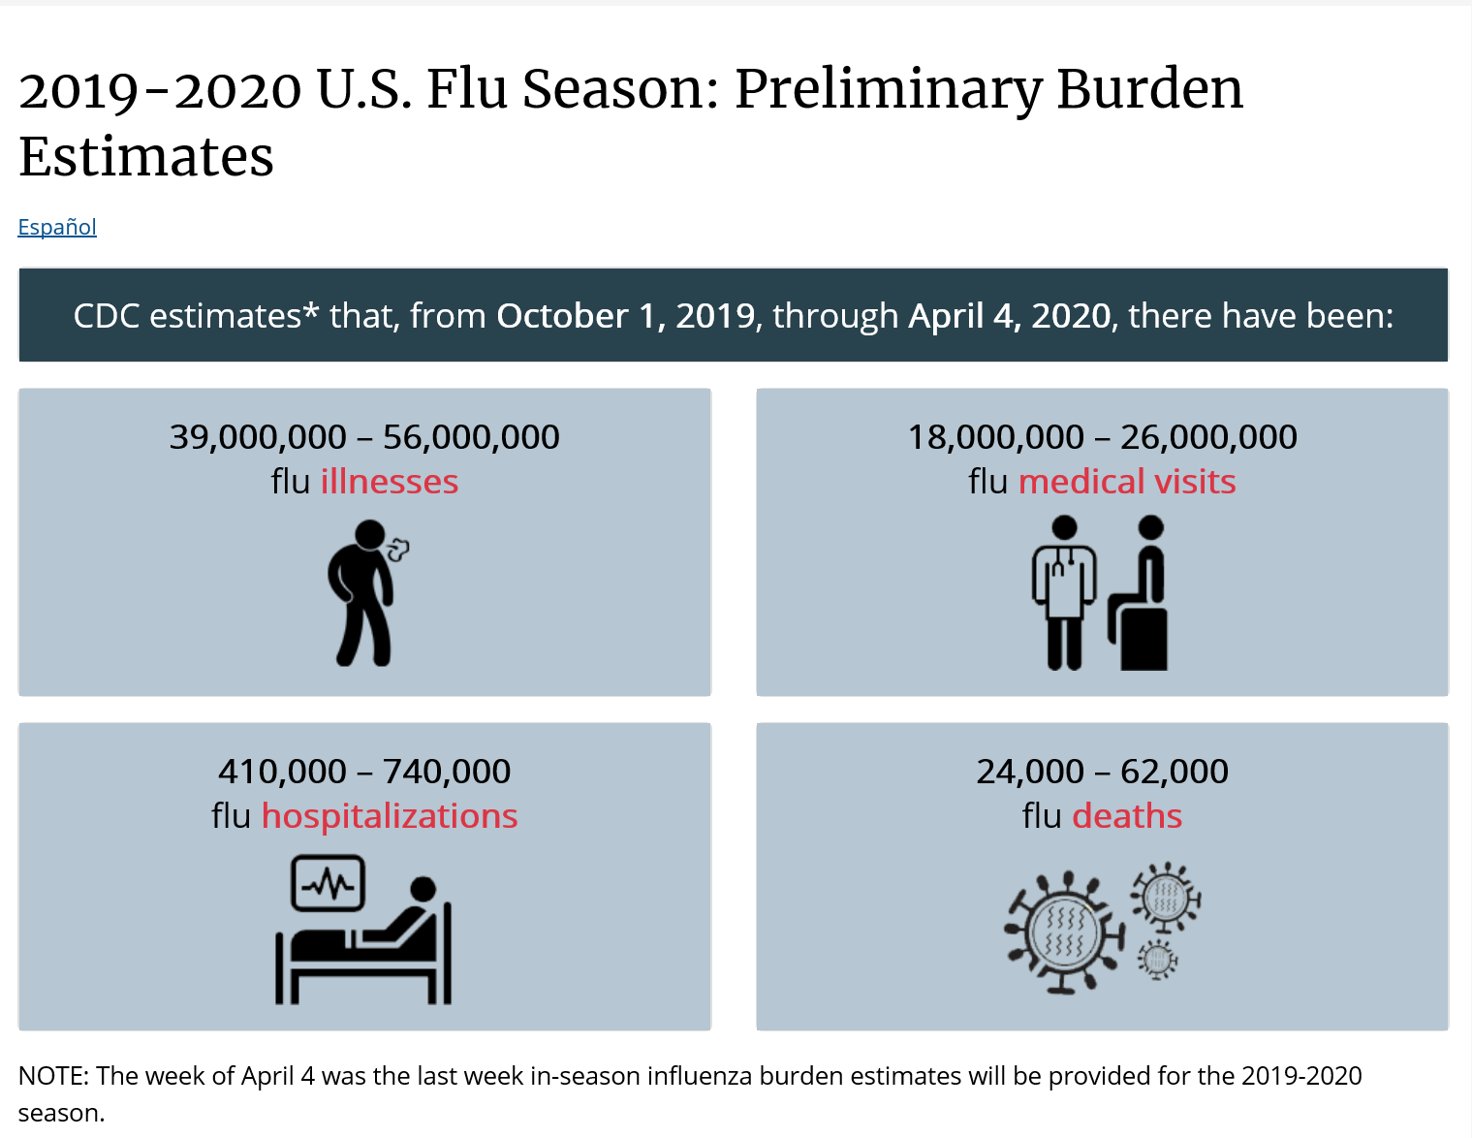
The burden of Flu Disease 2019
COVID-19
>190,000 Deaths
September 2020 YTD

Slide 56
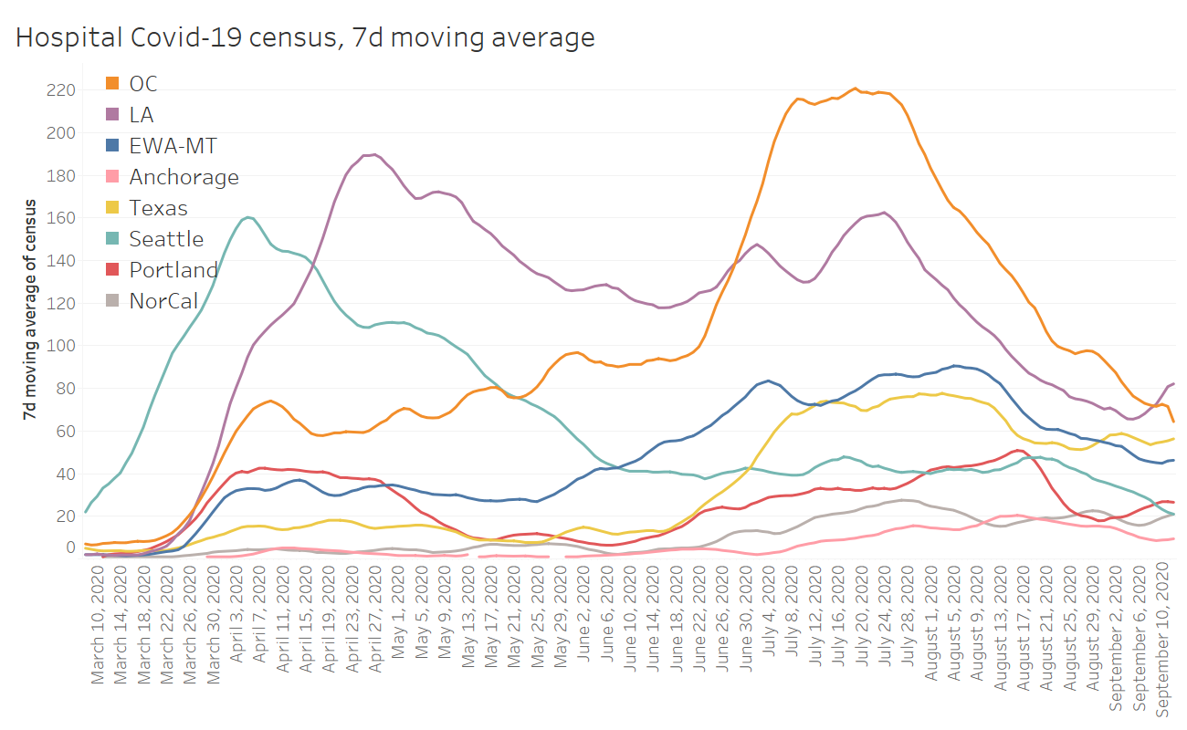

Slide 57
Covid-19 and Flu

Slide 58
Hospitalizations (inpatient and observation)

Slide 61
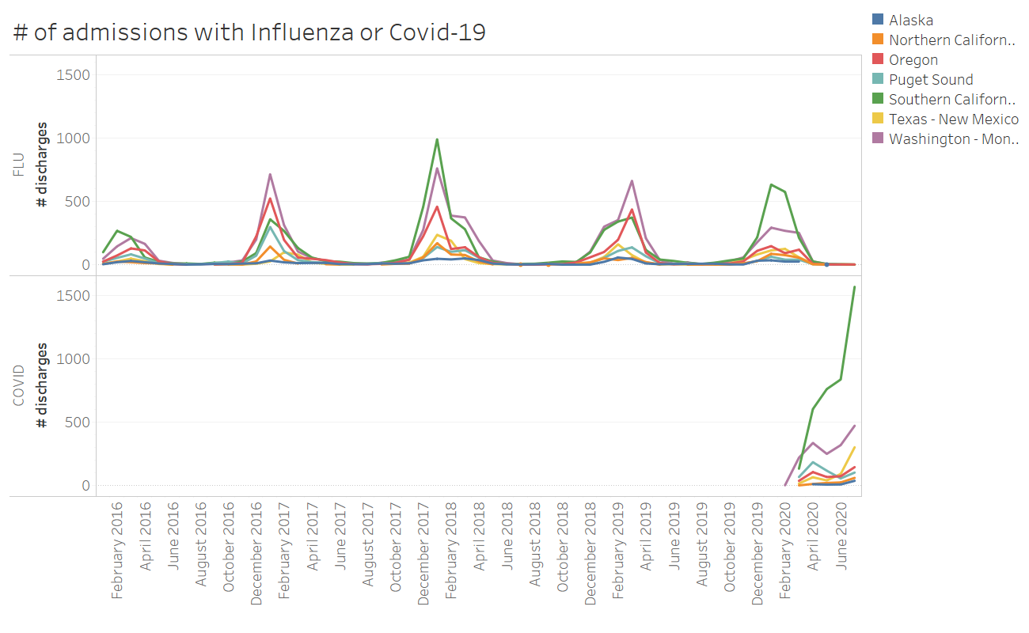

Slide 62
Minorities = Majority Impact for COVID-19
Compared to White Population:
BLACK
More than DOUBLE the death rate
More than DOUBLE infection rate
More than 3X as likely to be hospitalized
HISPANIC / LATINX
More than DOUBLE the death rate
More than TRIPLE infection rate
More than 4X as likely to be hospitalized
https://www.kff.org/coronavirus-covid-19/issue-brief/covid-19-racial-disparities-testing-infection-hospitalization-death-analysis-epic-patient-data/

Slide 63
Lubbock Population Census – 2020,2019

Slide 64
Minority Children – COVID-19 Death Rates
Compared to White Children (<21 yrs old)
Black Children – Double the death rate
Hispanic Children – Triple the death rate
https://us.cnn.com/2020/09/15/health/coronavirus-children-deaths-wellness/index.html

Slide 65
The Perfect Storm – Good Timing?
“The flu is on a collision course with the worst infectious disease outbreak we’ve experienced since the 1918 pandemic.”
Dr. Lipi Roy, Internal Medicine – NBC News and MSNBC medical contributor and Dr. L. Brett Jaggers, infectious disease
As Flu Season is Approaching, we are seeing:
Fatigue with mask wearing, social distancing, hand hygiene
More inside gatherings
The return of School and Fall Sporting Events
Influenza infection could decrease the body’s immune system – increasing susceptibility to COVID-19
A surge in both, would devastate our health system. There would be a tremendous strain on ventilators, beds, staffing – This could easily lead to another shut-down of elective cases … or worse.
https://abcnews.go.com/Health/hospitals-brace-flu-season-coronavirus-double-threat/story?id=

Slide 66
TWINDEMIC – 2020 – Expert Consensus The collision of COVID-19 and Influenza
“Getting a flu vaccine is more important than ever during 2020-2021 to protect yourself and the people around you from flu and to help reduce the strain on health care systems responding to the COVID-19 pandemic.” – CDC
“It’s important this year because we’re probably going to have a convergence of both flu and coronavirus this fall. So, anything we can do to reduce flu I think is going to be really important.” – Dr. Sanjay Gupta
Vaccination Production increased by nearly 30 million – CDC purchased 9.3 million adult doses and 2 million pedi doses – huge increase from typical purchase of 500,000 doses
“You can certainly get both the flu and COVID-19 at the same time, which could be catastrophic to your immune system.” – Dr. Adrian Burrowes
In fact, getting infected with one can make you more vulnerable to getting sick with the other… Your defenses go down, and it makes you vulnerable to getting a second infection on top of that.” – epidemiologist, Dr. Seema Yasmin
“US is in for a difficult time if COVID-19, flu outbreaks converge…” Dr. Anthony Fauci
“…the convergence could create one of the most difficult times that we’ve experienced in American public health.” Dr. Robert Redfield, Director, CDC
https://www.msn.com/en-us/health/medical/flu-shot-getting-your-annual-vaccine-is-more-essential-than-ever
https://abcnews.go.com/US/fauci-David-muir-us-difficult-time-covid-19/story?id=72294432

Slide 67
Impact to your body – The Double Whammy
COVID-19
Pneumonia
Fluid in the Lungs / Respiratory Failure
Sepsis
Cardiac Injury
Inflammation of the heart, brain, or muscle tissues
Multi-organ Failure
Influenza
Pneumonia
Fluid in the Lungs / Respiratory Failure
Sepsis
Cardiac Injury
Inflammation of the heart, brain, or muscle tissues
Multi-organ Failure
“Having both illnesses simultaneously, would increase the risk of longer-term effects on any of those body systems.
The potential for pneumonia would be greater if the body is infected with both the flu and coronavirus.
The two together definitely could be more injurious to the lungs and cause more respiratory failure.”
Dr. Michael Matthay Professor of Medicine and Critical Care Specialist University of California, SF.
“There have been cases of coinfection and the result is far worse than the impact of either of the viruses alone.”
Dr. John Brownstein, epidemiologist, ABC News
https://www.msn.com/en-us/health/medical/what-having-covid-19-and-flu-together-could-do-to-your-body
https://abcnews.go.com/Health/covid-19-flu-time-risks/story?id=72520950

Slide 68
Good News from Down Under
Australia
Last 2 weeks of June 2019 – 20,000 Influenza cases
Last 2 weeks of June 2020 – 85 Influenza cases
August 2019 – 61,000 influenza cases
August 2020 -- 107
What did our Auzzie Mates do Right?
Strict Social Distancing
Diligent Hand Hygiene
Consistent and Effective Masking
THEY GOT THEIR FLU SHOT!! – Record number of flu vaccines given in Australia this year.
Between March 1st – April 19, 2020 – 2.1 Million
Between March 1st – April 19, 2019 -- 625,000
Between March 1st – April 19, 2018 -- 235,000
https://www1.health.gov.au/internet/main/publishing.ns/Content/cda-surveil-ozflu-flucurr.htm/%24File/flu-09-2020.pdf

Slide 69
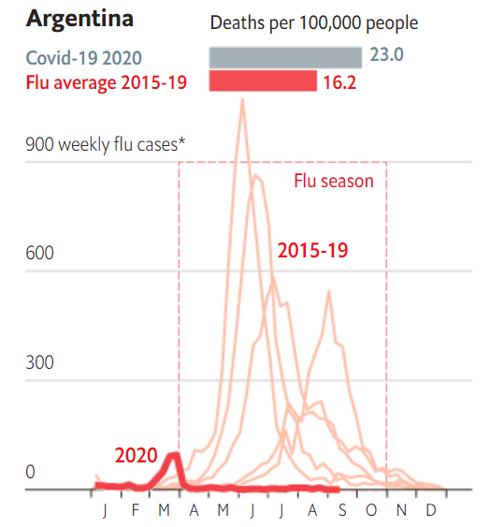
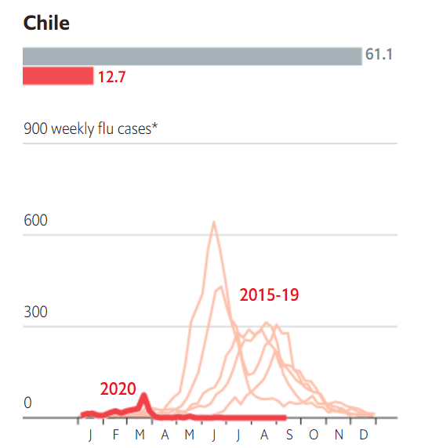
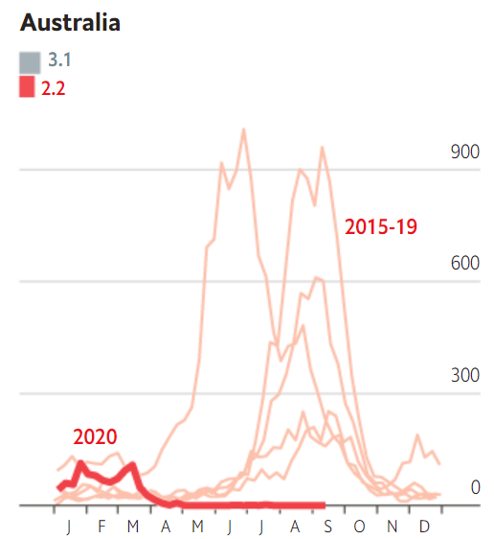
https://www.economist.com/graphic-detail/2020/09/12/the-southern-hemisphere-skipped-flu-season-in-2020

Slide 70
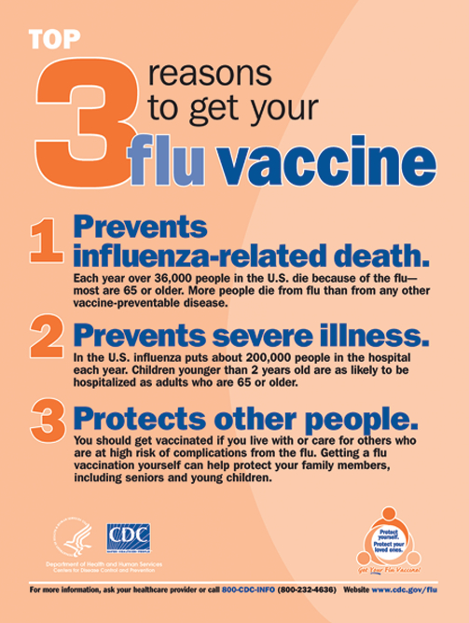
#4. PROTECTS OUR CAREGIVERS AND HEALTHCARE SYSTEM
While COVID-19 precautions such as Social Distancing, Hand Hygiene, and Mask Wearing will no doubt have a Positive impact on flu rates, none of these will actually help you to fight the infection, if you do become infected with the flu. The only thing that Will is vaccination. Equip yourself fully– GET YOUR SHOT!

Slide 71
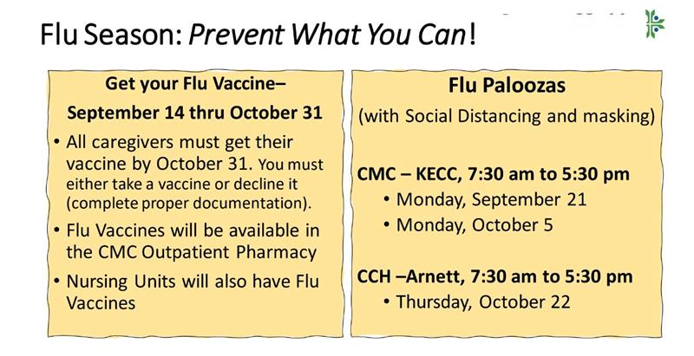
“This might be your most important flu vaccine ever.”

Slide 72
Texas Demographics

Slide 74
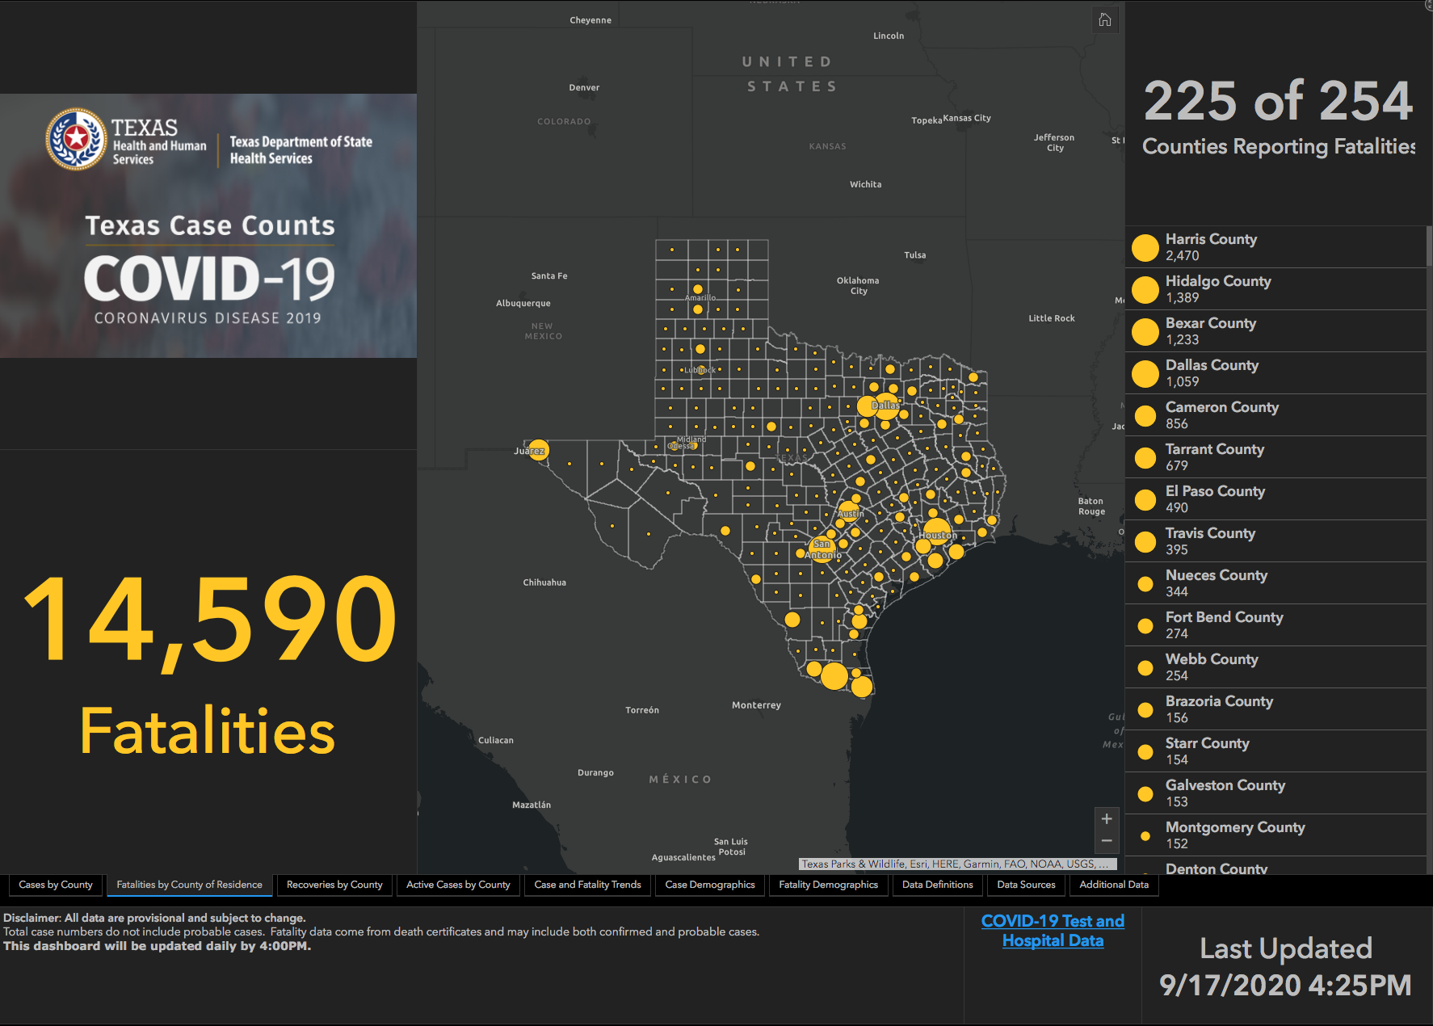

Slide 75
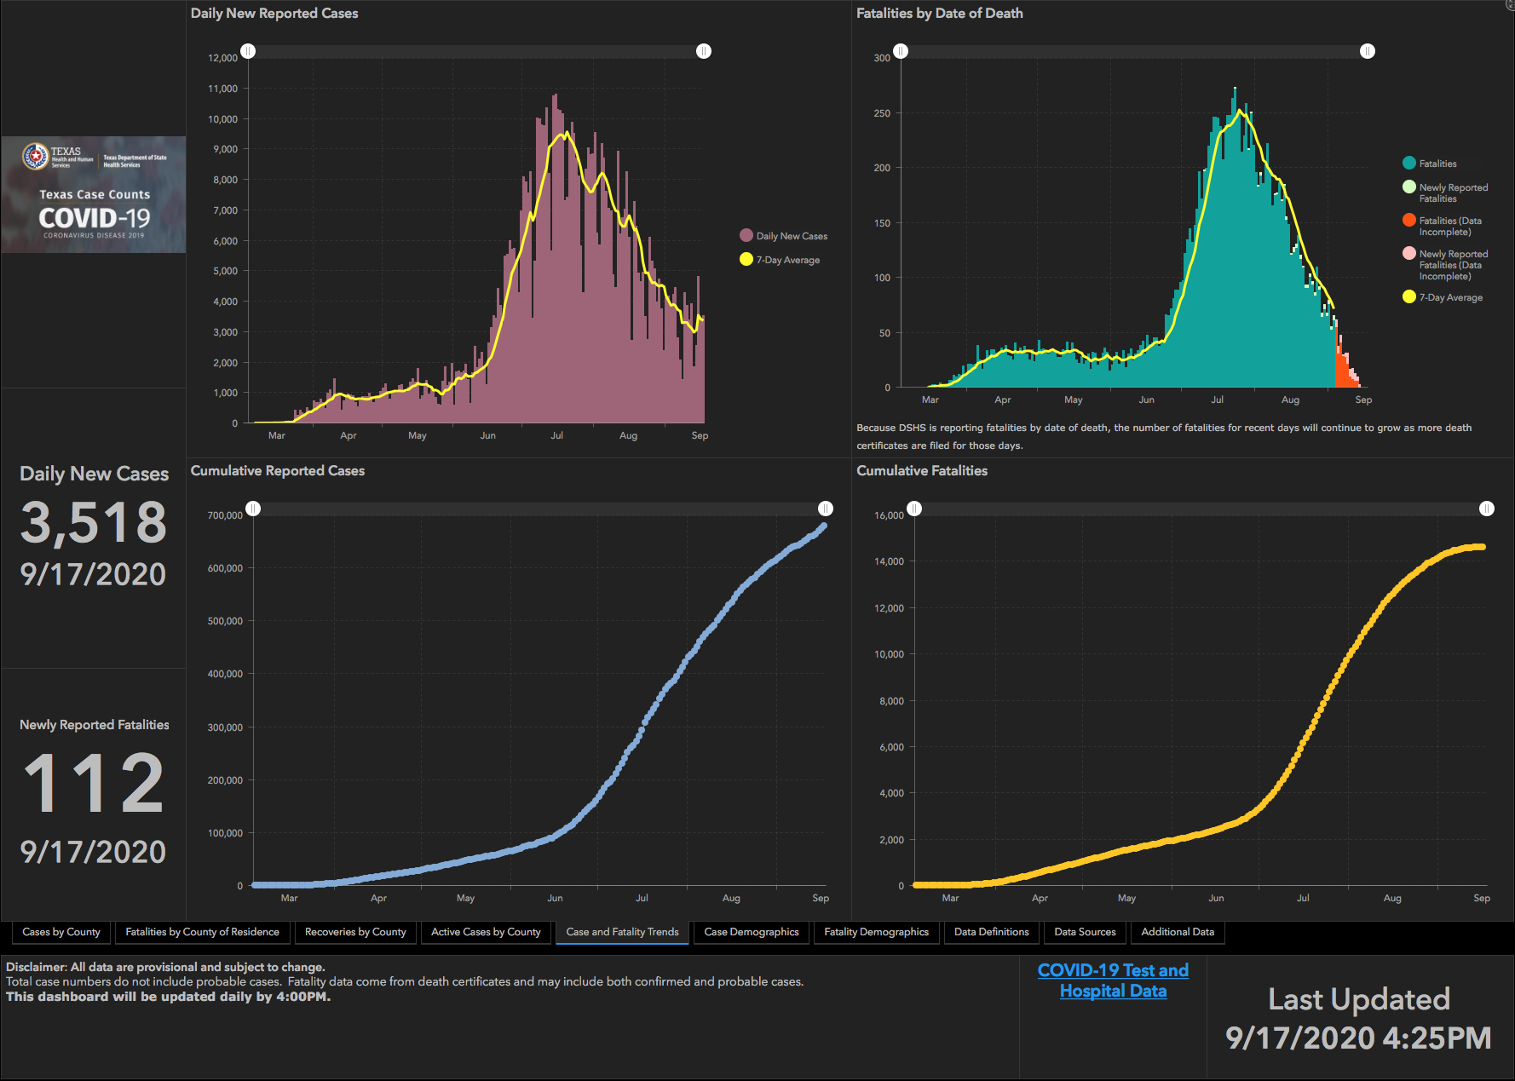

Slide 76
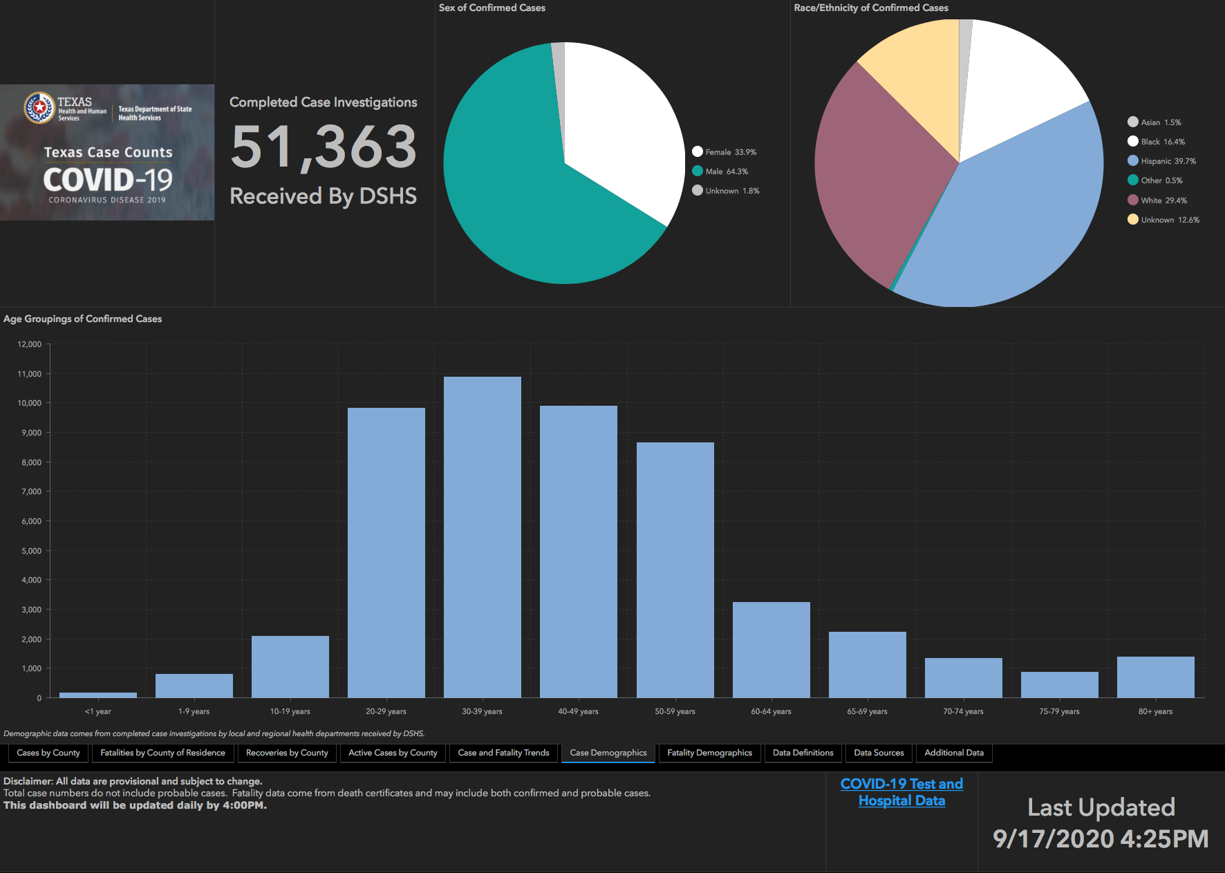

Slide 77
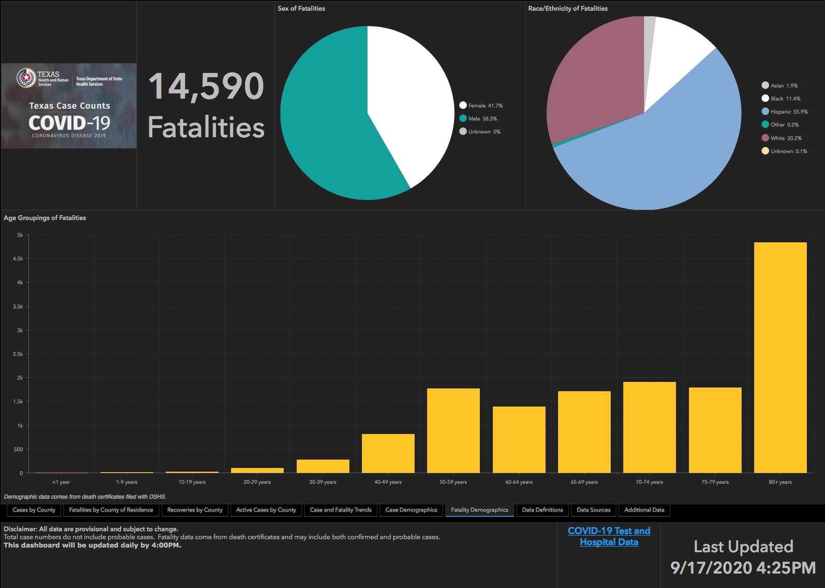

Slide 78
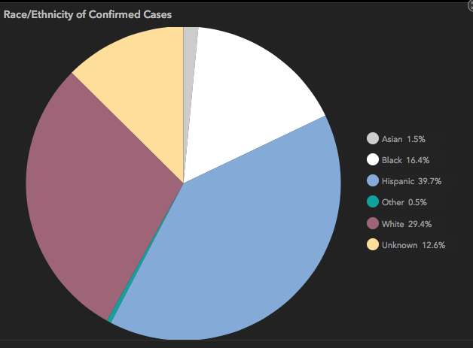
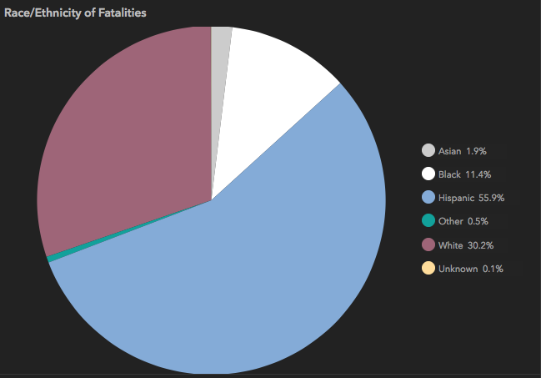
Ethnic Disparities

Slide 79
And New Mexico

Slide 80
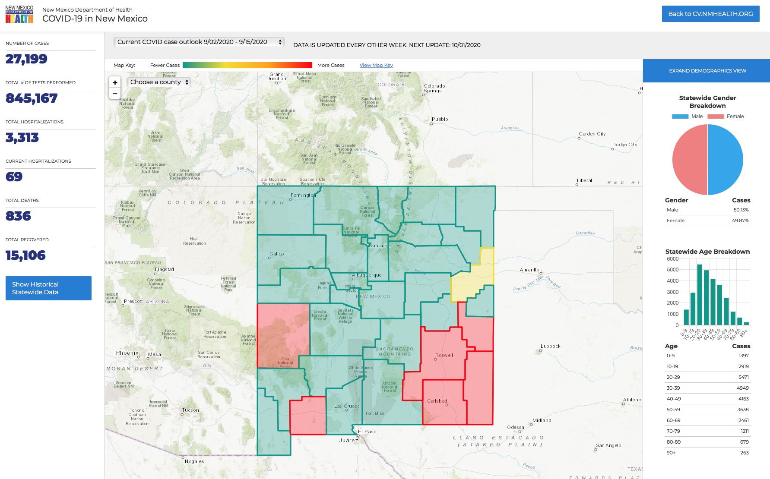

Slide 81
Governor’s Executive Order
Sept. 17, 2020

Slide 82
New Executive Orders, Expanded Openings
In his news conference (9-17-2020), Gov. Abbott announced expanded business reopenings for Texas. Among them:
Effective immediately, most Texas hospitals can provide essential services and procedures without restrictions.
Existing restrictions on elective services continue if the COVID-19 hospitalizations in their Trauma Service Area exceed 15% of all the hospitalizations in their TSA for seven consecutive days. This currently applies to TSAs S, T and V.
Hospitals now only have to reserve 10%, instead of 15%, of their total capacity for COVID-19 patients.
Hospital systems can reserve a cumulative 10% capacity for their system facilities that are in the same TSA.
Restaurants, retailers, gyms and other businesses operating in a TSA where hospitals can provide elective surgeries can increase their capacity from 50% to 75%.
Certain individuals can visit residents of nursing homes and facilities beginning Sept. 24.
There are still too many COVID-19 hospitalizations in the Rio Grande Valley, Laredo and Victoria areas for widespread reopenings. Bars across the state will remain closed for the time being. Gov. Abbott emphasized that COVID-19 hospitalizations are the key to regional reopenings of business.

Slide 83
Electronic Prescribing of Controlled Substances

Slide 84
e-Prescribing of Controlled Substances (EPCS)
State of Texas requirement to use EPCS for all DEA Scheduled drugs (II-V, controlled substances) beginning January 1st, 2021
Outpatient pharmacies will no longer accept written prescriptions for controlled substances starting on 1/1/21
Meditech allows EPCS via DrFirst
You must be enrolled in DrFirst to use EPCS
To enroll in DrFirst contact Clinical Informatics at 806-725-4189

Slide 85
Q & A

Slide 86
CME Credit was only approved for the Live Teams meeting
To receive credit for this continuing education activity, the participant must:
Make sure you are logged into your Teams account, if you are signed in with a group provide attendee’s First and Last name(s) in the comments section.
If you are calling into the Teams meeting you MUST text your First & Last Name to (806) 252-4735. This will ensure you are added to the sign in sheet to receive CME Credit.
You will receive an email within 3 business days from the CME department with further instructions on claiming your certificate.

