Slide 1
Covenant Health
Presents
Critical Communications: A Weekly Physician Update
September 25, 2020

Slide 2
PHYSICIANS
Accreditation Statement:
The Covenant Health is accredited by the Texas Medical Association (TMA) to provide continuing medical education for physicians.
Credit Designation Statement:
The Covenant Health designates this live CME activity for a maximum of 1.0 AMA PRA Category 1 Credit(s)™. Physicians should claim only the credit commensurate with the extent of their participation in the activity.

Slide 3
Disclosures of Commercial Interest
The speakers and planners of this activity
have no relevant financial interests

Slide 4
Disclosures
This activity is provided by
Covenant Health
No commercial support has been received.
No products will be endorsed.
Speakers will notify the audience if off label drug use will be discussed.

Slide 5
CME Credit was only approved for the Live Teams meeting
To receive credit for this continuing education activity, the participant must:
  Make sure you are logged into your Teams account, if you are signed in with a group provide attendee’s First and Last name(s) in the comments section.
  If you are calling into the Teams meeting you MUST text your First & Last Name to (806) 252-4735. This will ensure you are added to the sign in sheet to receive CME Credit.
  You will receive an email within 3 business days from the CME department with further instructions on claiming your certificate.

Slide 6


Reflection

Slide 7
While we may not all agree with some or many of her viewpoints, RBG should be remembered for her tireless advocacy for equal rights.
She paved the way for so many women on this leadership team and we are better organization because of those individuals.
Many of the changes she fought so tirelessly to achieve will inspire generations to come. May we all find value and inspiration in her grit, grace and resilience and apply that to how we work towards better care for our patients.

Slide 8

The right to have a job without being discriminated based on gender.
The right for women to be pregnant/have kids and work.
The right to a pension equal to male counterparts.
The right to sign a mortgage without a man.
The right to have a bank acct without a male co-signer.
The right for men to receive widowers Social Security benefits.

Slide 9

Leader Reflection 09/24/2020
Fight for the things that you care about, but do it in a way that will lead others to join you.
Ruth Bader Ginsburg
1933-2020

Slide 10
Safety Story
Power Differential
and
Deference to Expertise

Slide 11
Current Regional Covid-19 Census

Slide 12
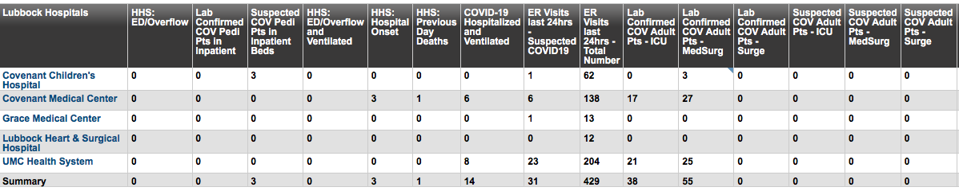
Regional
 | Lubbock |  | TTU |  | Hockley |  | Hale
 | 9/21 | 9/23 | 9/21 | 9/23 | 9/10 | 9/15 | 9/18 | 9/23
Total | 10,515 | 10,855 | 1481 | 1530 | 282 | 307 | 1807 | 1838
Active | 2307 | 2405 | 222 | 244 | 44 | 54 | 104 | 73
Deaths | 119 | 121 | 0 | 0 | 7 | 7 | 57 | 57
New | 340 |  | 49 |  | 25 |  | 31
9/21: 87 Hospitalized in Lubbock – 14 on vents 9/23: 90 Hospitalized in Lubbock – 16 on vents

Slide 13
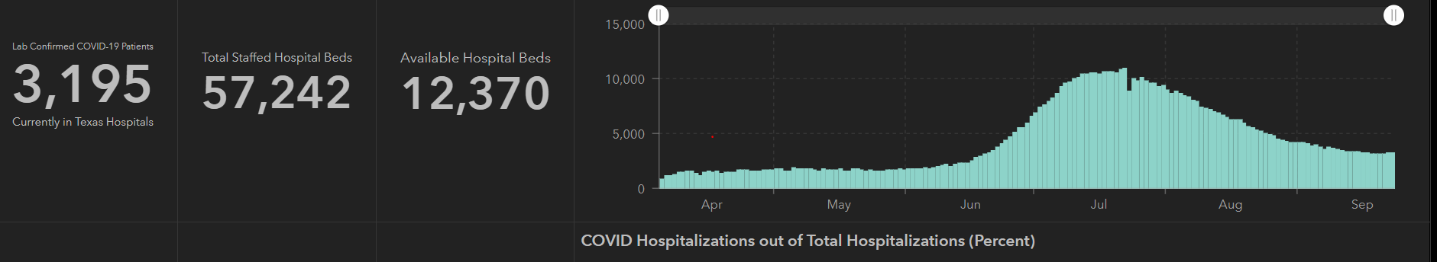
STATE
 | 9/23 | 9/21 | 9/16 | 9/9 | 8/26 | 8/12 | 7/29 | 7/15 | 7/1
Cases | 719,599 | 698,387 | 674,772 | 645,791 | 592,137 | 506,820 | 403,307 | 282,365 | 168,062
Deaths | 15,129 | 14,917 | 14,478 | 13,692 | 11,805 | 9034 | 6190 | 3432 | 2481
Hospitalized | 3,195 | 3,132 | 3249 | 3604 | 4806 | 7028 | 9595 | 10,471 | 6904

Slide 14
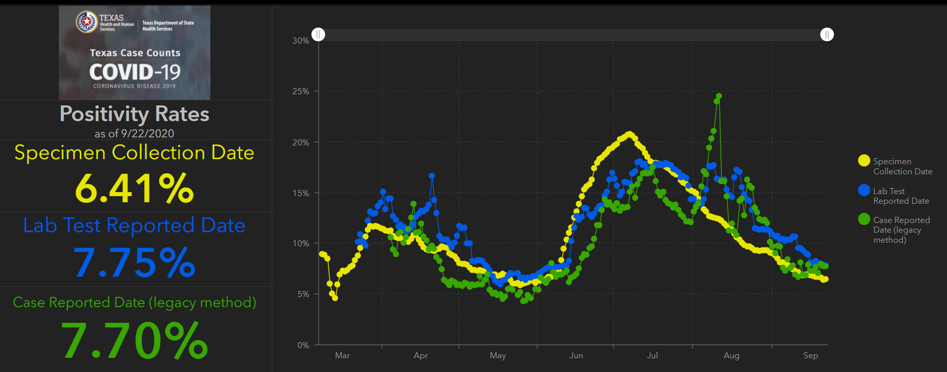
STATE
Lubbock Rate = 10.9%
County | CMS | Local HDept
Lubbock | 16.9% | 10.9%
Hockley (Levelland) | 16.0% | NA
Hale (Plainview) | 21% | NA

Slide 15
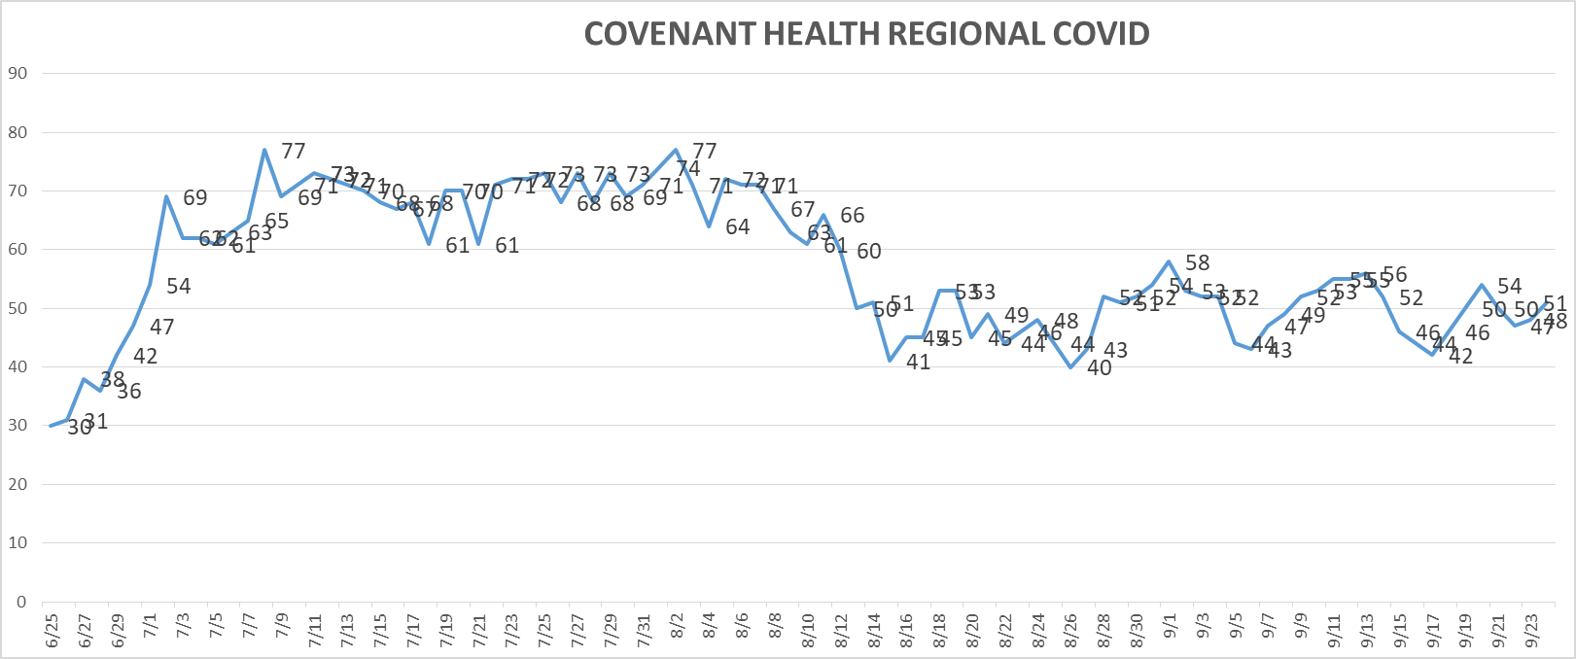
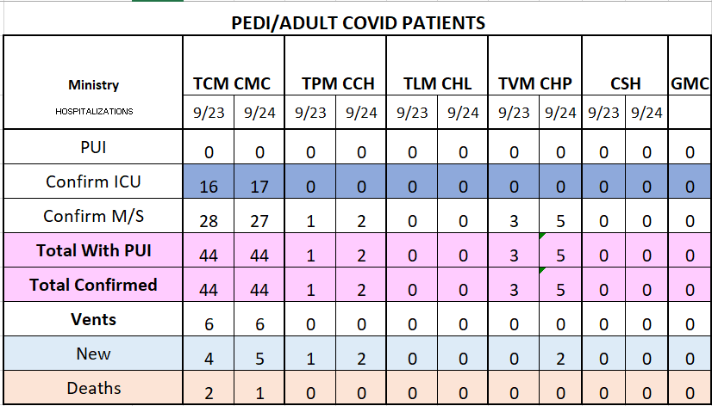
PUI/Confirmed cases-hospitalized
9/24/2020

Slide 16
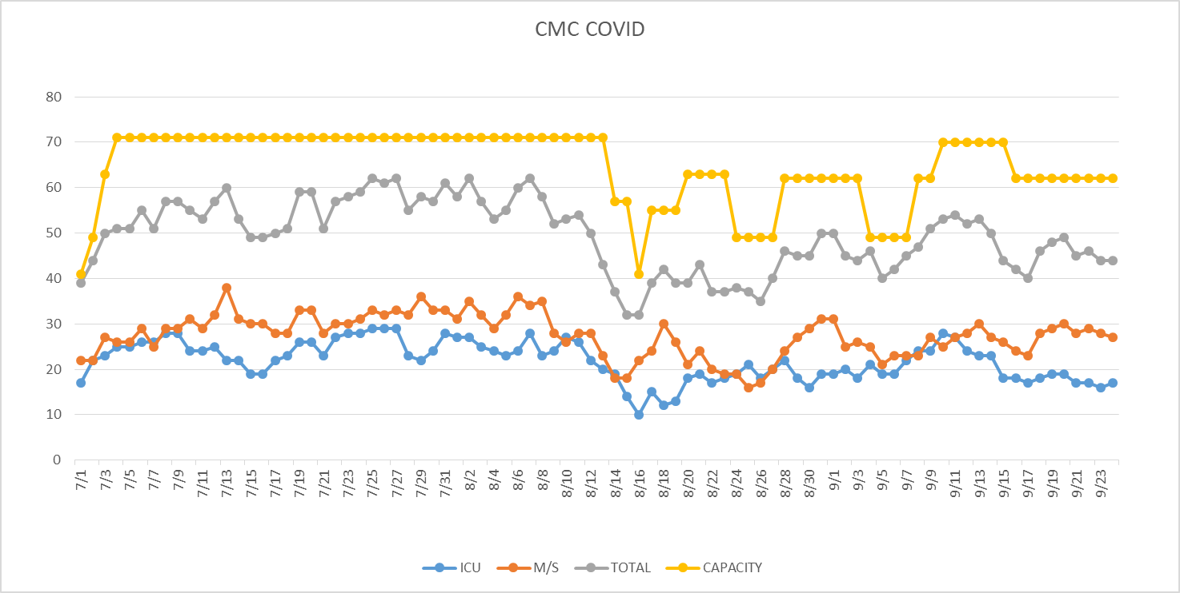
PUI/Confirmed cases-hospitalized
9/24/2020

Slide 17
Surge Plan
Covenant Medical Center
 | ICU | Med Surg | Total
Phase 1 | 10-CICU |  | 10
Phase 2 | 17-CICU | 10-HC4 | 27
Phase 3 | 17-CICU | 24-HC4 | 41
Phase 4 | 17-CICU 8-MICU | 24-HC4 14-Pal Med | 63
Phase 5 | 17-CICU 16-MICU | 24-HC4 14-Pal Med | 71
Phase 6 | 17-CICU 16-MICU 8- SICU 4 (east) | 24-HC4 14-Pal Med 15 – S 9 (east) | 94
Last Week
Currently

Slide 18
Statistics
William Sommer
Clinical Data Analyst
Decision Support Services
Clinical Excellence
Covenant Health

Slide 19
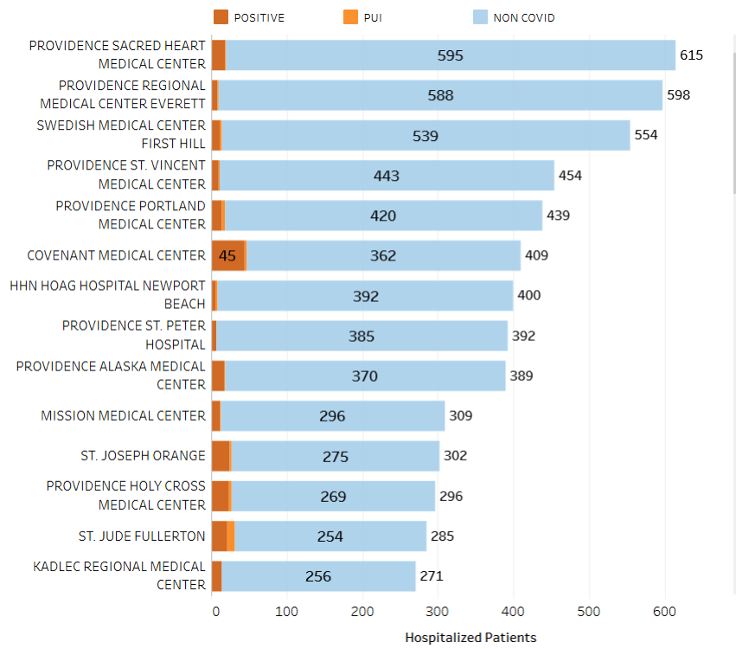
Providence System Hospitalized COVID-19 Cases

Slide 20
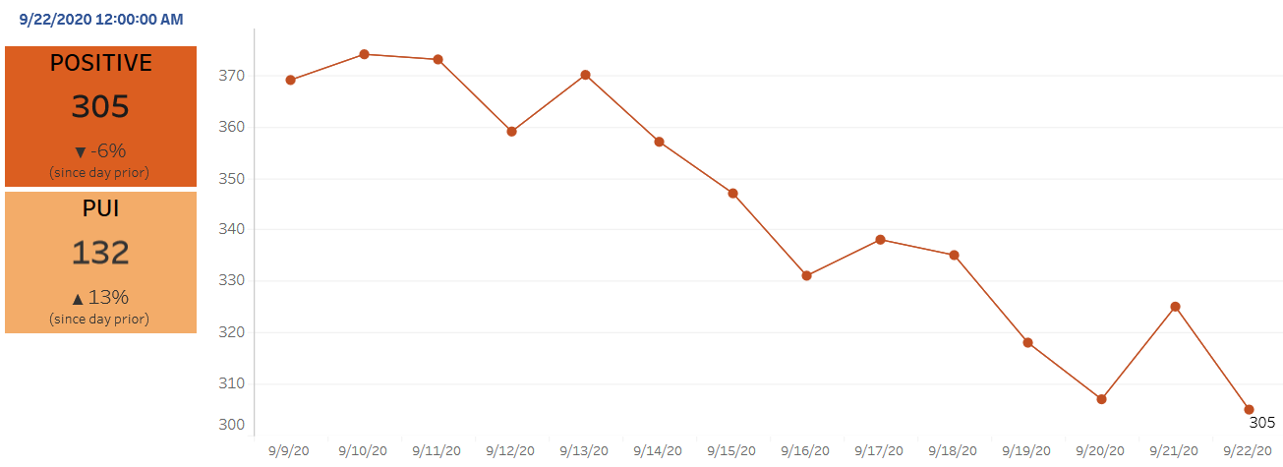
Providence Inpatient COVID-19 Volume

Slide 21
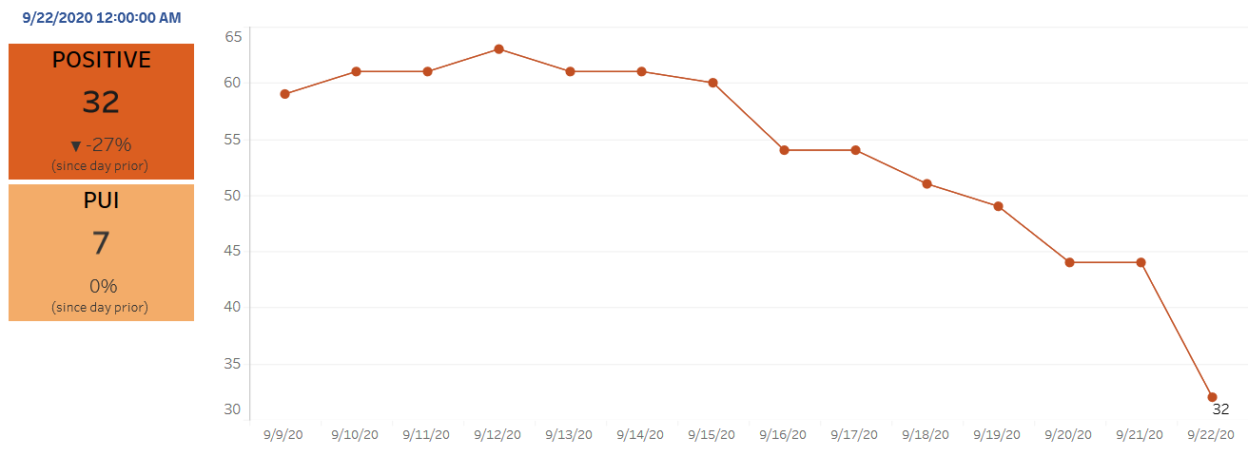
Texas Inpatient COVID-19 Volume

Slide 22
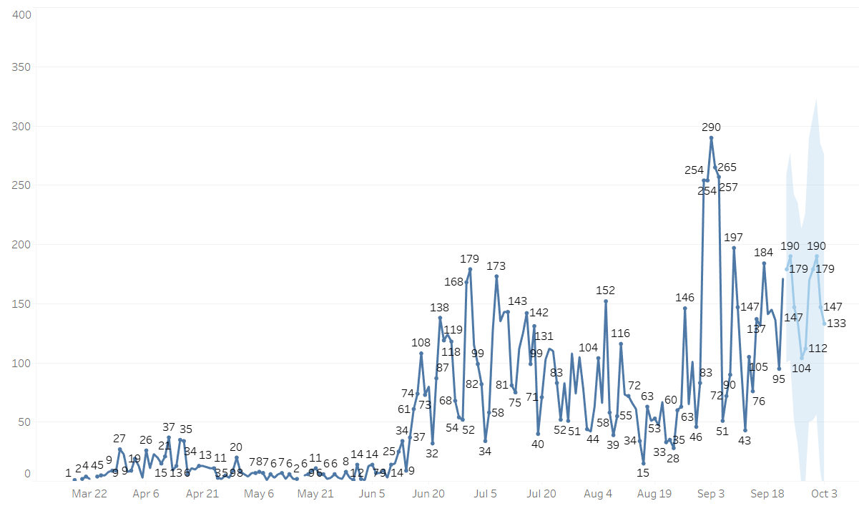

New Covid-19 POSITIVES by Day Trend

Slide 23
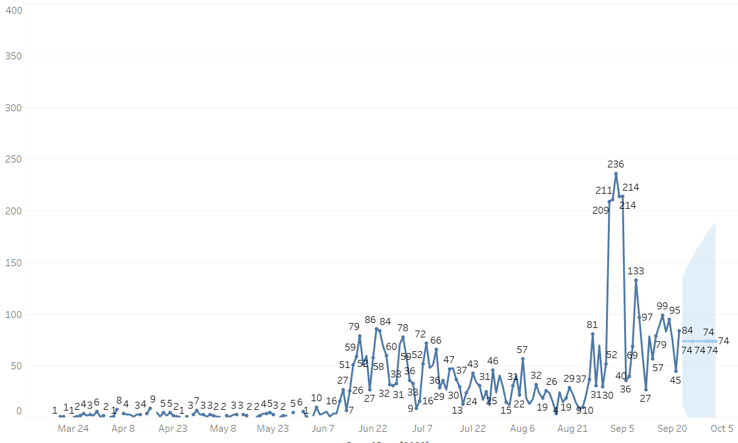
New Covid-19 POSITIVES by Day Trend 10-29

Slide 24
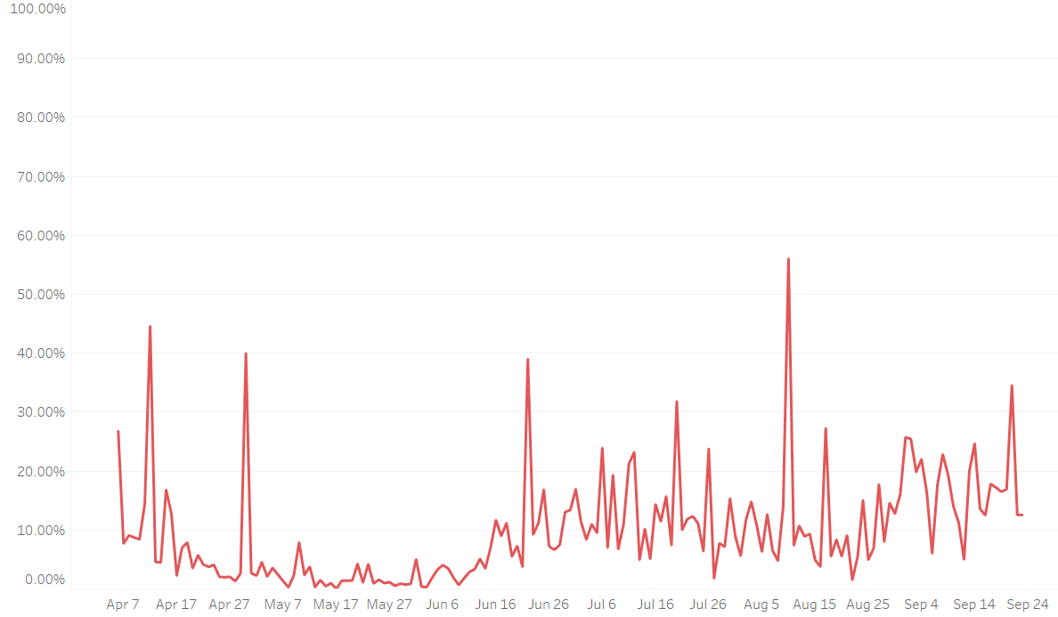
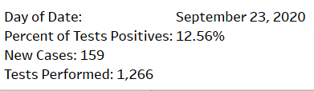
Covid-19 Daily Positive Rate

Slide 25
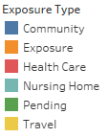
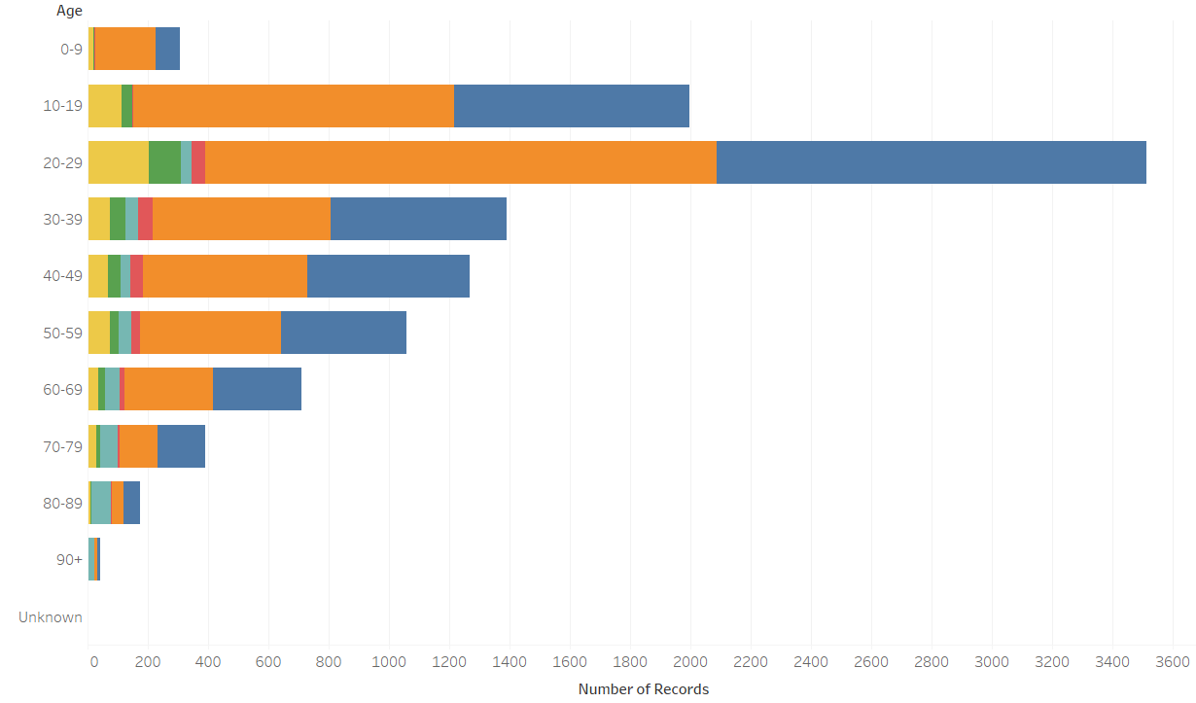
Covid-19 POSITIVES Age Distribution

Slide 26
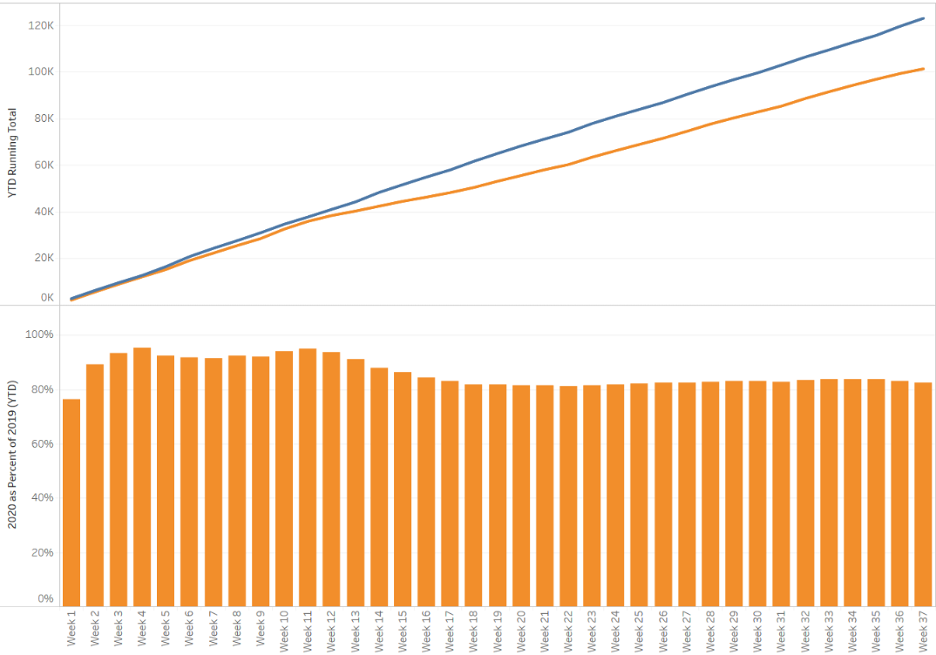

TX/NM Region Weekly Procedures (YOY)

Slide 27
Caregivers

Slide 28
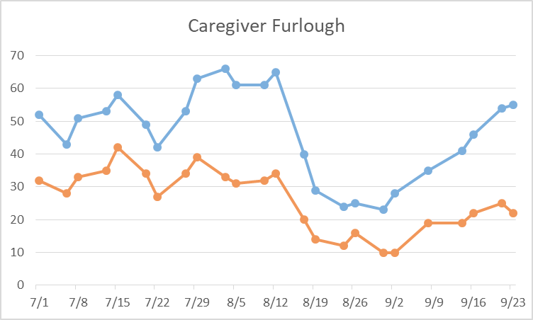
Caregivers
COVID Related Furloughs
Count reflects # furlough (exposed and positive)
Good
Moderate
Critical

Slide 29
Caregivers
FLU Vaccine
  Shipment to arrive this week
Antibody Testing for COVID for all caregivers
  Last 2 weeks of October, Team working on plans – will report next week
Respiratory Therapists
  Approved per diem rate
  14 positions without success on getting applicants
Moral Distress
  Schwartz Rounds set for Sept 29 noon

Slide 30
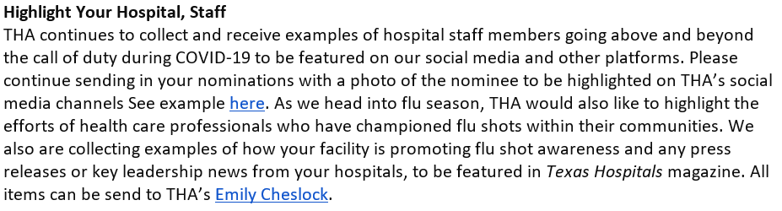
Caregivers

Slide 31
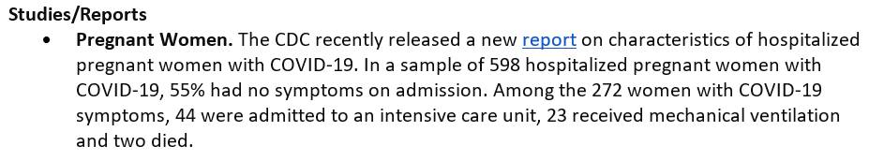
Study-pregnant women

Slide 32
Covid-19 Testing

Slide 33
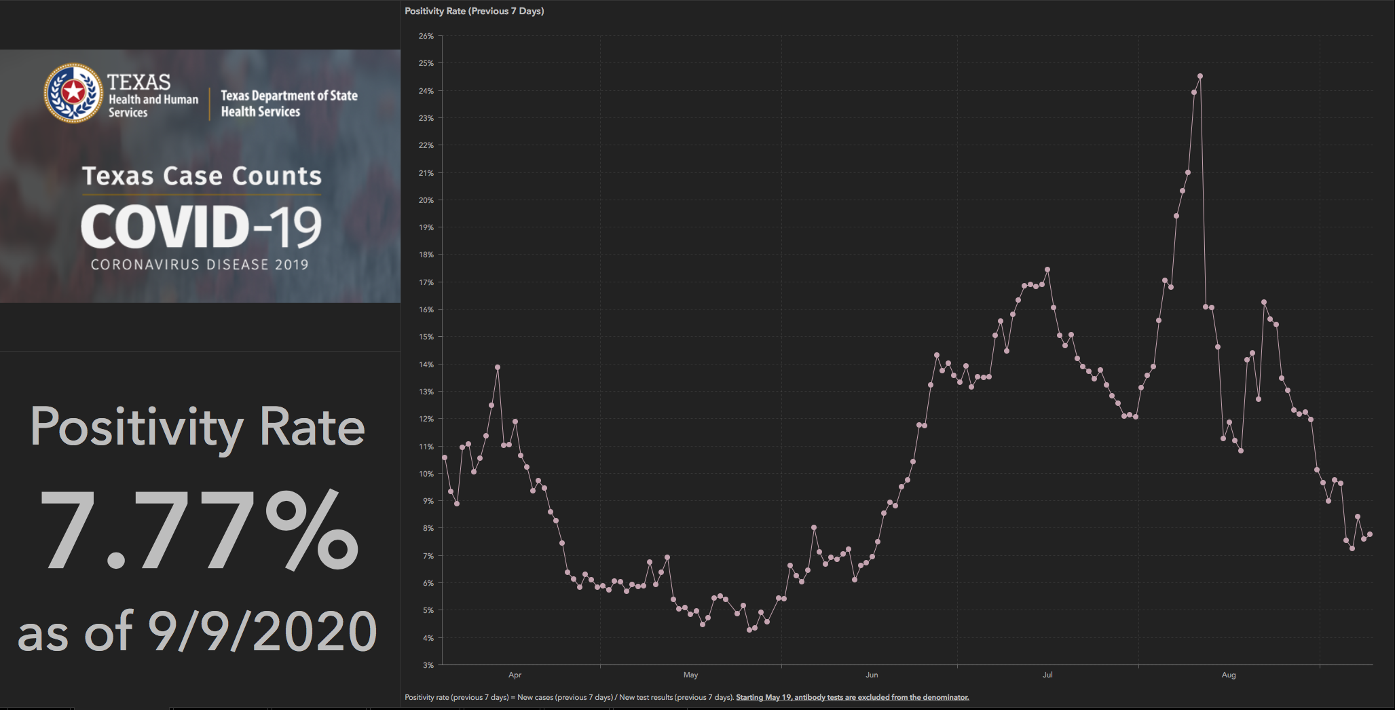
TESTING – STATEWIDE Results

Slide 34
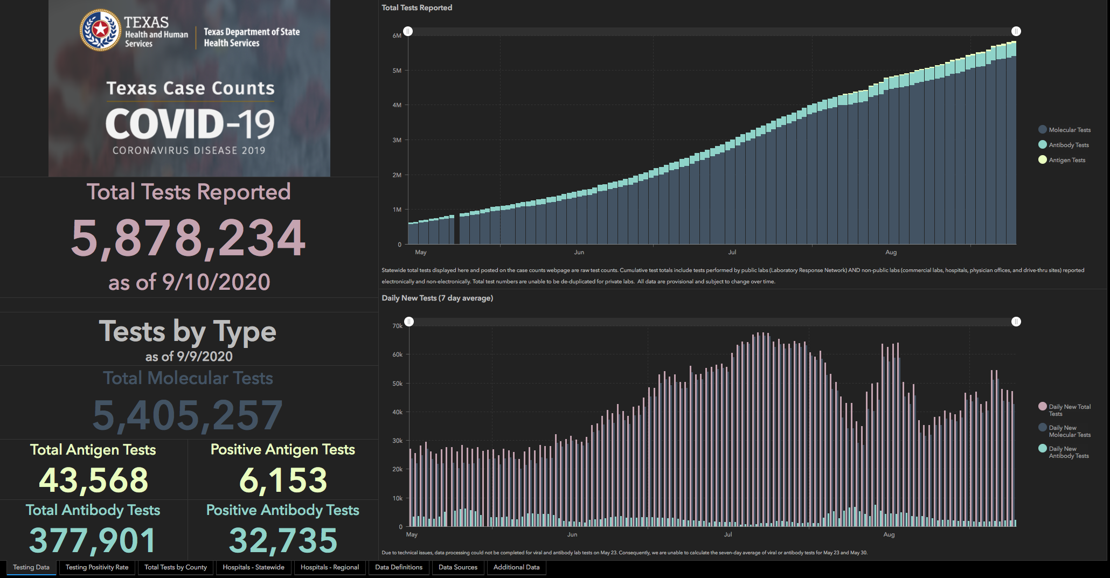

Slide 35
TESTING
 | CMC | GMC | CMG
Test Kits
Swabs
VTM
 | CMC |  | GMG/CMG
 | Tests | + | Tests | +
9/19 | 242 | 15 | 134 | 23
9/20 | 261 | 33 | 5 | 0
9/21 | 110 | 7 | 1 | 0
9/22 | 342 | 26 | 185 | 39
9/23 | 323 | 16 | 138 | 18
>2000 >750
<2000 <750
<1600 <500
Grace- out of BD kits
CMG- receiving smaller amounts

Slide 36
TESTING – preparing for children
Testing Algorithm for Children
  Have good plan for testing
  Worked with CMG PCP’s

Slide 37
TESTING – CMS Interim final rule
QSO-20-37-CLIA,NH (Supply and Lab Reporting to CMS)
Looking at a 3rd party vendor to collect and report data

Slide 38
TESTING – CMS Interim final rule
Nursing Home Surveillance
Received information from BRAC
  LRN will perform the testing for NH, LTC facilities, etc, who are required to test on a regular basis at NO COST

Slide 39
Masking Update

Slide 40
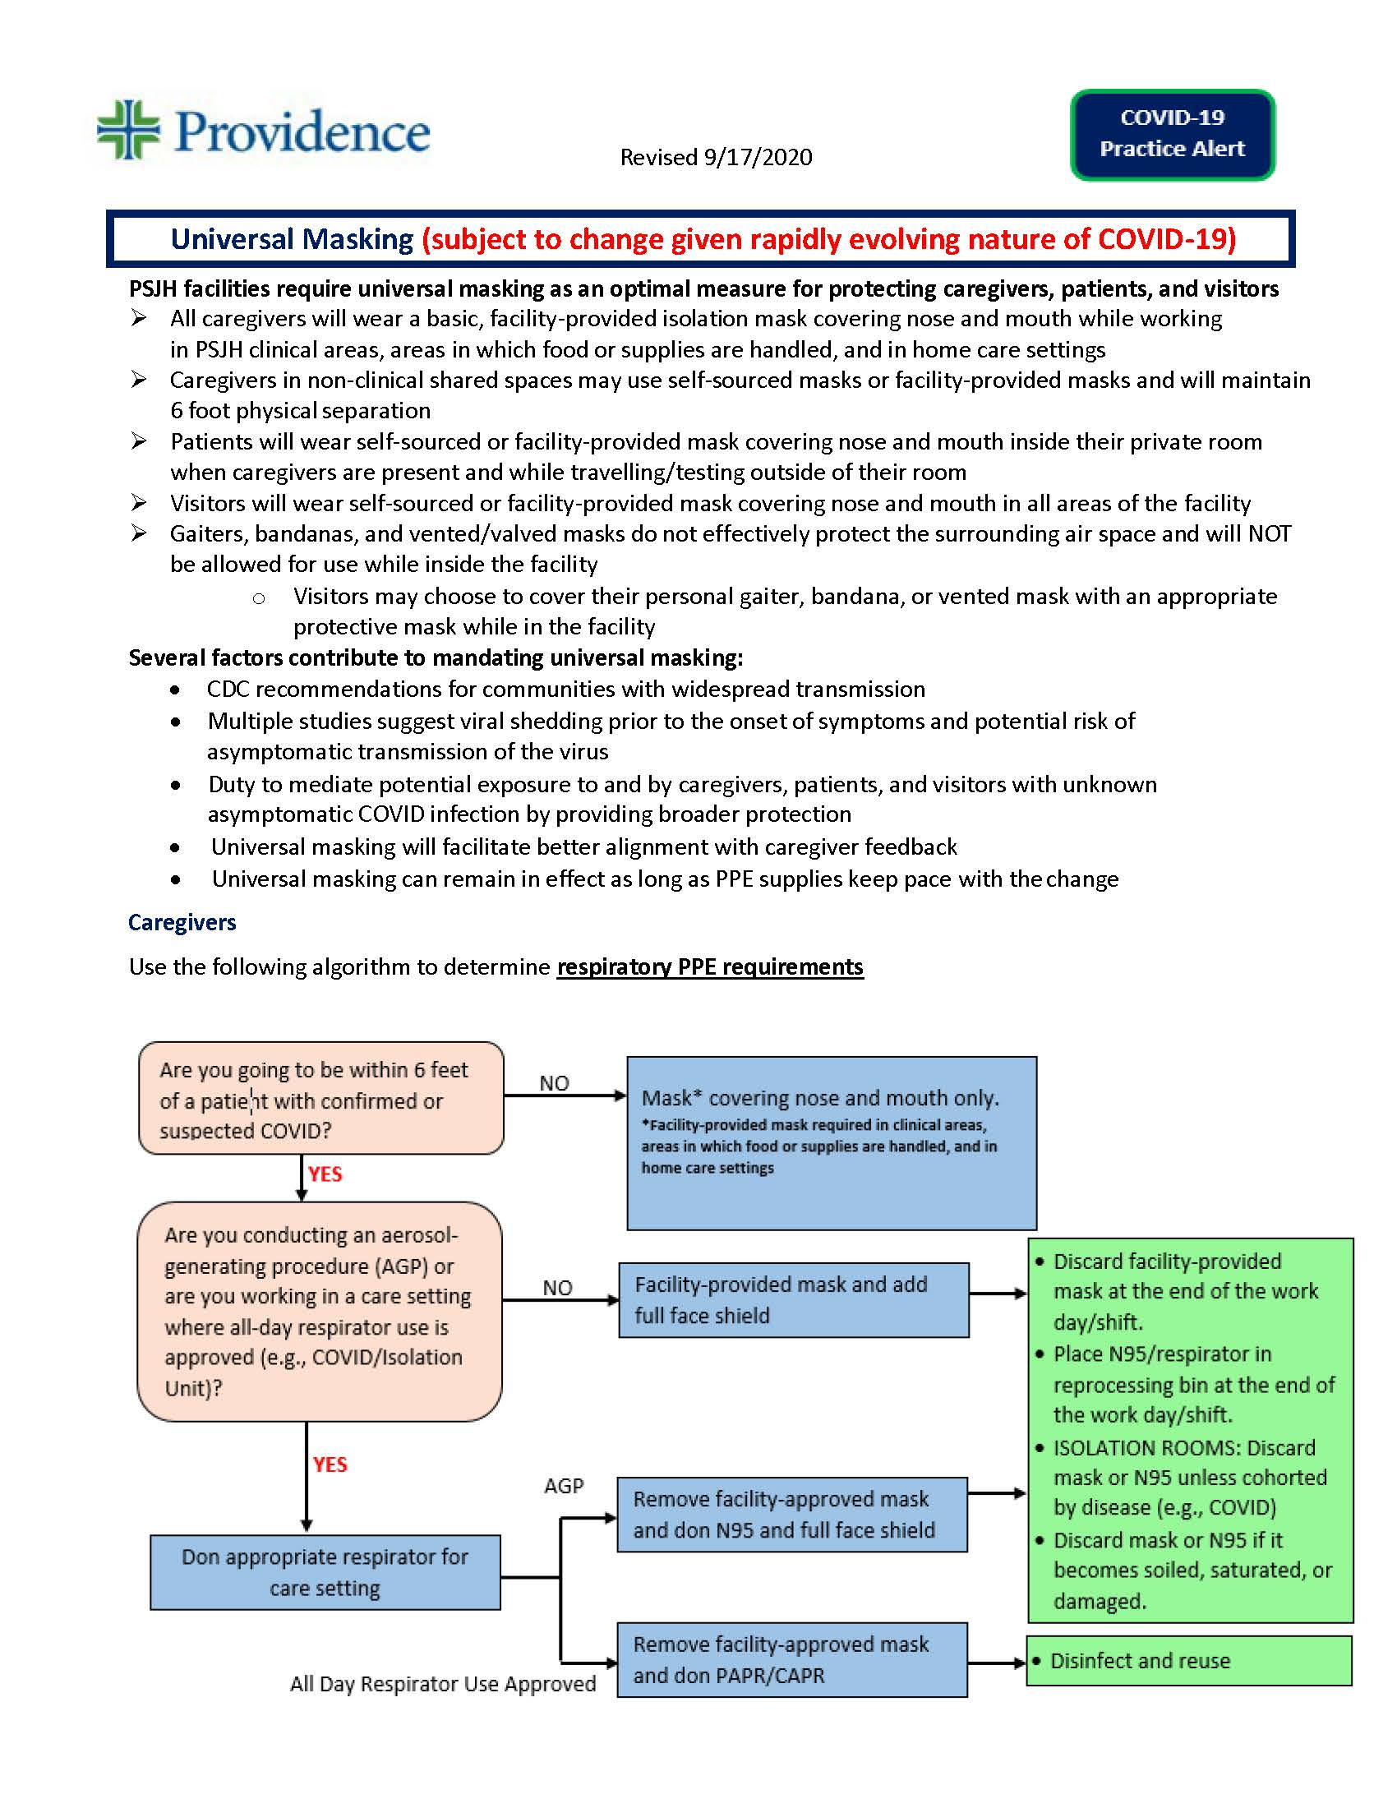
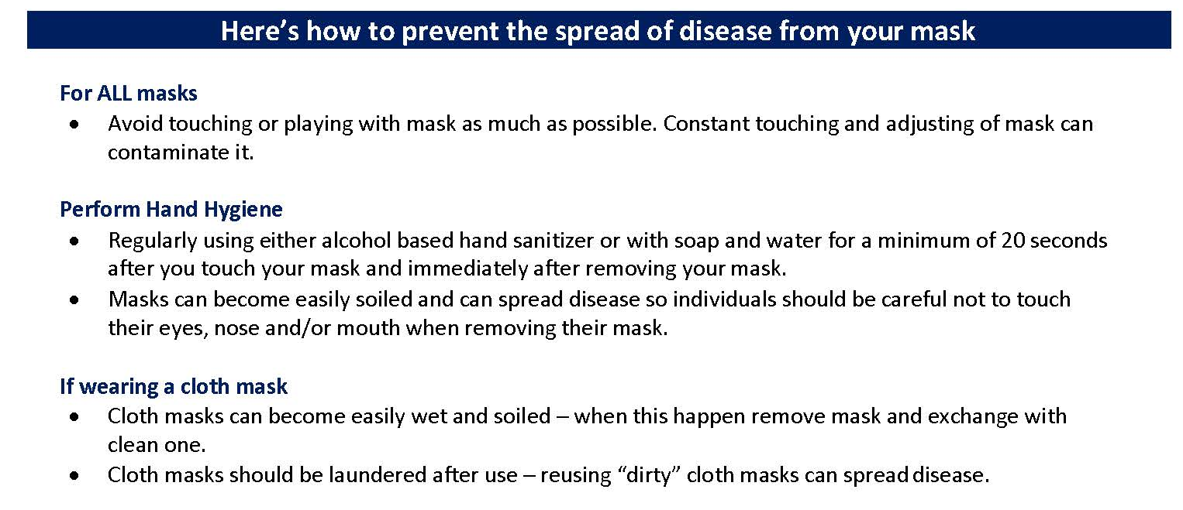
COVID19-Hot Topics
APPROVED

Slide 41

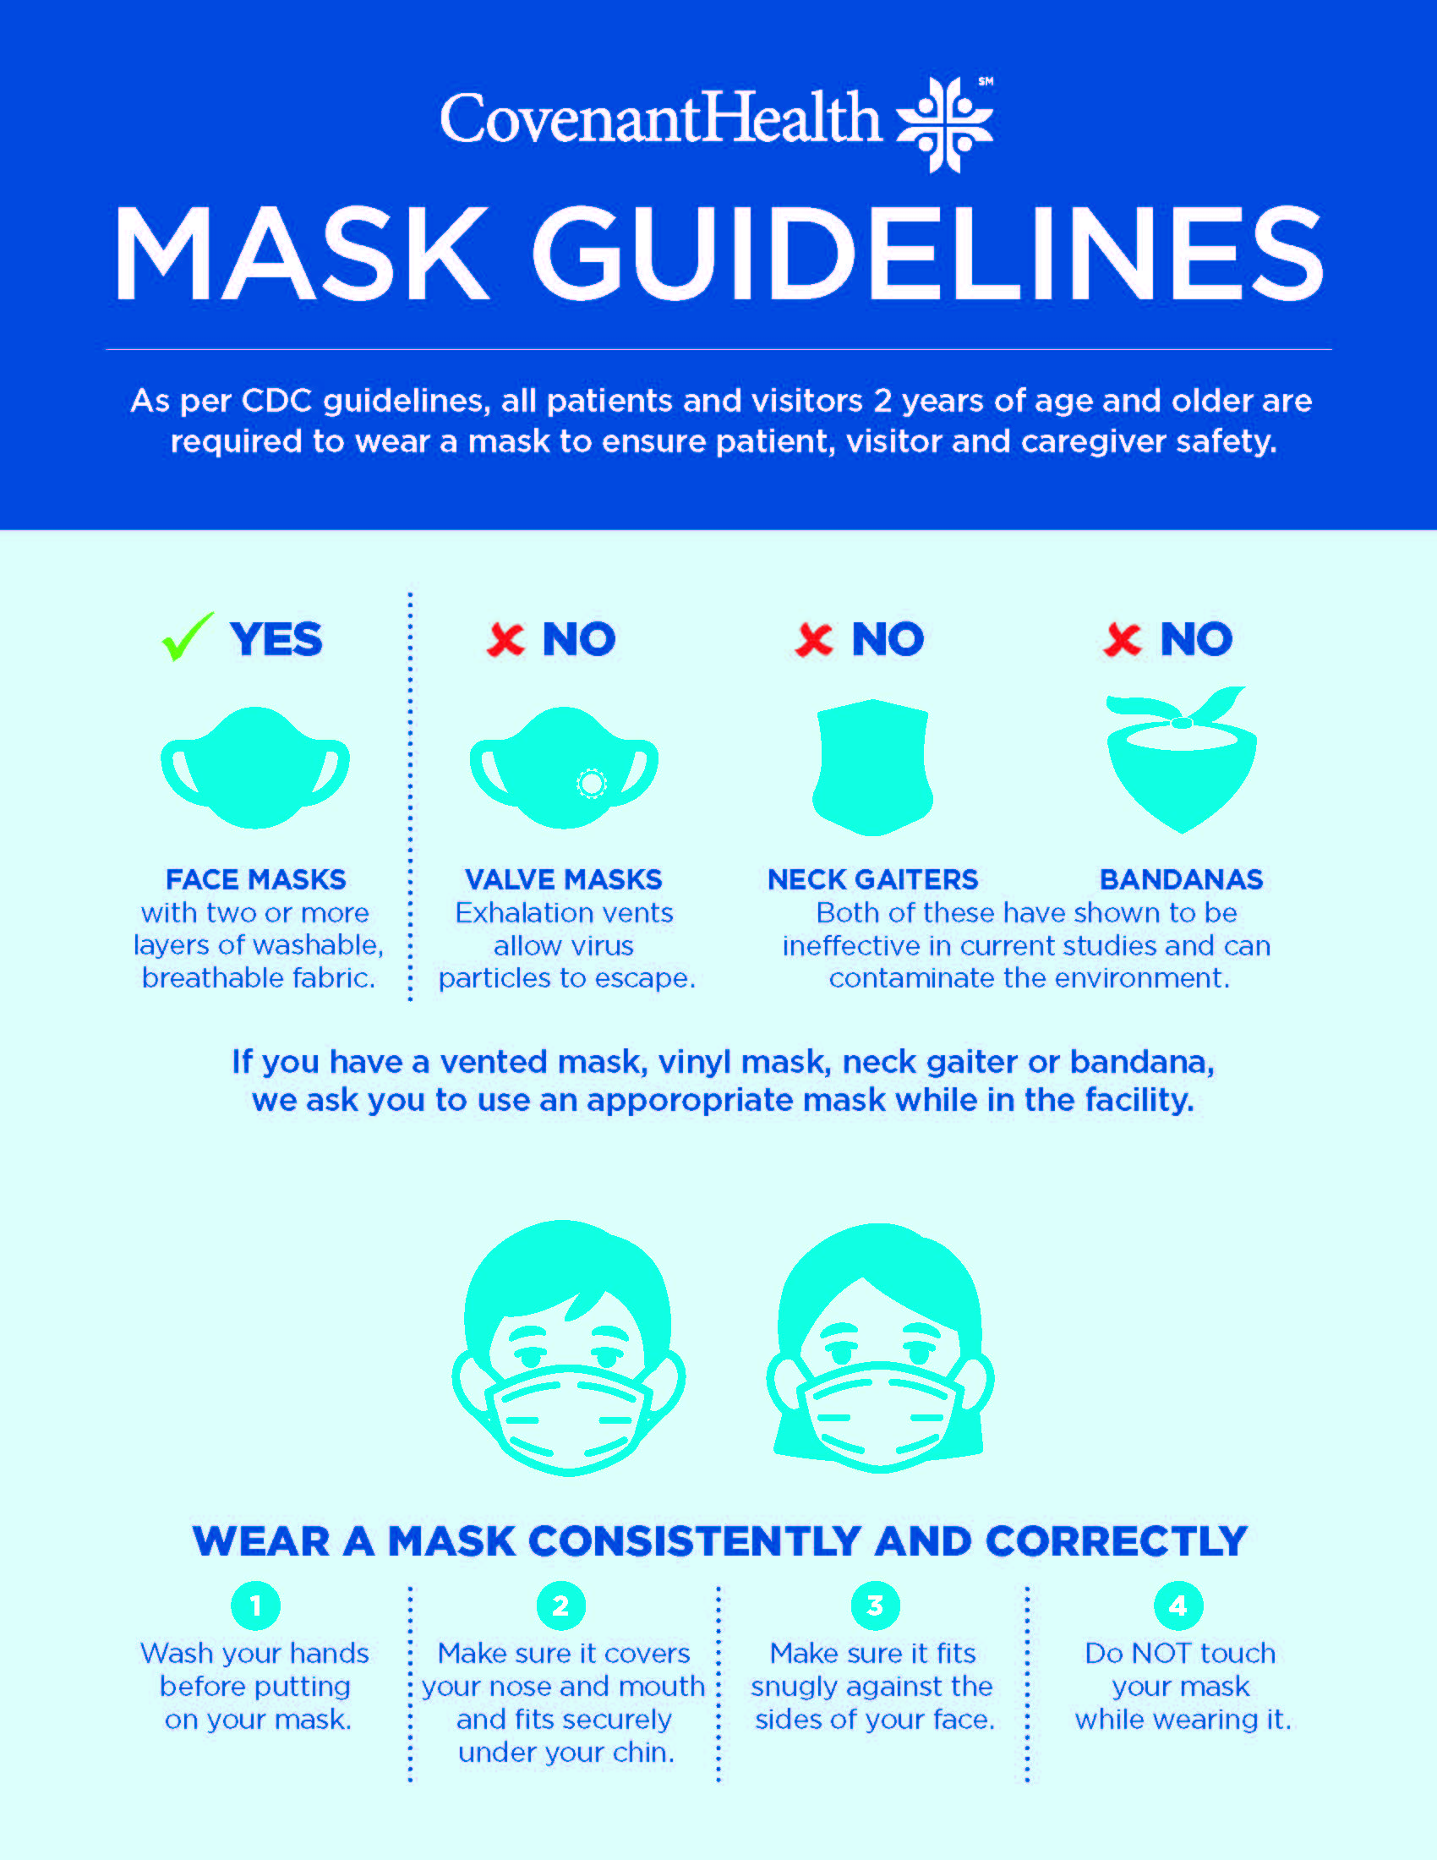

SIGNAGE ordered
Ordered for Plainview, CMG, Grace Medical and clinics, Specialty

Slide 42
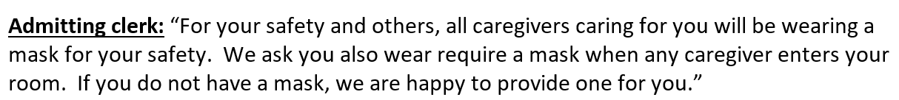
SIGNAGE – patient and visitors
Education starts with Admitting
Nursing and procedure areas to continue with education
Scripting provided by IP
OCTOBER 1, Start Date

Slide 43
Pharmacy Update
Wesley Wells, PharmD
Regional Pharmacy Director
Covenant Health

Slide 44
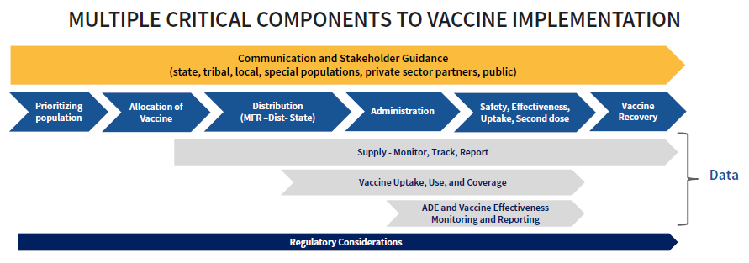

Operation Warp Speed (OWS)
Ensuring that every American who wants to receive a COVID-19 vaccine can receive one, by delivering safe and effective vaccine doses to the American people beginning January 2021
Four essential components to strategy
  Distribution
  Administration
  Monitoring
  Education
Notes:
 Distribute vaccines immediately upon granting of Emergency Use Authorization/ Biologics License Application, using a transparently developed, phased allocation methodology.
 Partnerships with state, local and tribal health departments, territories, Tribes, and federal entities to allocate and distribute vaccines, augmented by direct distribution to commercial partners.
Five pilot jurisdictions—California, Florida, Minnesota, North Dakota, and Philadelphia—to utilize a basic plan for administration and adapt it to create jurisdiction-specific plans that will serve as models for other jurisdictions
 A centralized distributor contract with potential for back-up distributors for additional storage and handling requirements.
 A flexible, scalable, secure web-based IT vaccine tracking system for ongoing vaccine allocation, ordering, uptake, and management.
Will utilize HHS’s Vaccine Tracking System (VTrckS), which is a secure, web-based IT system
 Ensure safe administration of the vaccine and availability of administration supplies.
 Delivery of vaccine to sites, with the goal of no upfront costs to providers and no out-of-pocket cost to the vaccine recipient.
 Ensuring administration sites, as covered in the jurisdiction’s microplans, have the capabilities for storing, handling, and administering vaccine products with specific distribution and administration requirements.
 Supporting reliable distribution of ancillary supplies that may be necessary for vaccine administration.
 Engagement of traditional and non-traditional administration sites and approaches in vaccination planning to allow for flexibility to accommodate vaccine requirements.
 Monitor necessary data from the vaccination program through an information technology (IT) system capable of supporting and tracking distribution, administration, and other necessary data.
 Continue engaging with state, tribal, territorial, and local partners, other stakeholders, and the public to communicate public health information, before and after distribution begins, around the vaccine and promote vaccine confidence and uptake.

Slide 45
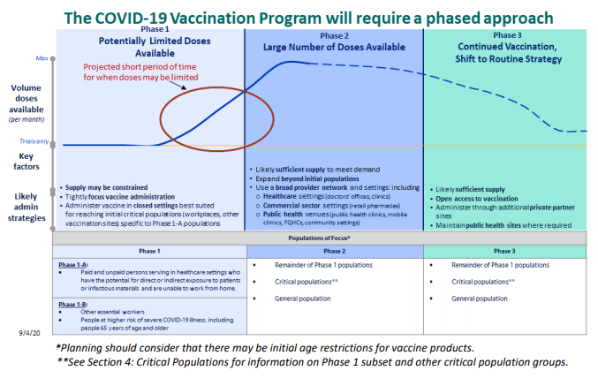
COVID Vaccination Planning
Notes:
Phase 1a:
Paid and unpaid persons serving in healthcare settings who have the potential for direct or indirect exposure to patients or infectious materials and are unable to work from home
Phase 1b:
People who play a key role in keeping essential functions of society running and cannot socially distance in the workplace (e.g., healthcare personnel not included in Phase I-A, emergency and law enforcement personnel not included in Phase 1-A, food packaging and distribution workers, teachers/school staff, childcare providers)
People at increased risk for severe COVID-19 illness, including people 65 years of age or older.
Phase 2/3:
Remainder of Phase 1 populations
Critical populations
General populations

Slide 46

Vaccinate with Confidence

Slide 47
What Is PSJH Doing?
 | Logistics & Storage | Access & Administration | Acquisition & Regional Implementation
Lead | Mike Skafi, Pharmacy
Participants | Caregiver Health Services REH Pharmacy Nursing Physician Enterprise Home and Community Care | Nursing Pharmacy Caregiver Health Services Epic/Meditech Population Health Communications Physician Enterprise Home and Community Care | Regional Ops Leaders Population Health Government Affairs Physician Enterprise Home and Community Care
Scope | Calculate anticipated need for caregivers and patients Ensure all sites have McKesson accounts Develop structures for safe, appropriate vaccination storage Ensure appropriate supply of ancillary supplies | Determine methods for reaching priority group 1 to ensure high up-take of vaccine Create screening criteria to ensure priority group 1 is targeted Determine when/where/how to offer vaccination in each care setting | Ensure early notification for all vaccine access opportunities Identify all vaccination provider locations and ensure they are registered with local jurisdiction Develop methods for reporting inventory and administration to health authority

Slide 48
Vaccine Front Runners
Likely Candidates
COVID-19 Vaccine | Pfizer | Moderna | AstraZeneca
Type | mRNA | mRNA | Typical vaccine
Manipulation | Pfizer’s vaccine will have to be mixed with a diluent (shipped separately) to dilute it. Once it’s mixed it must be used within six hours or discarded. Comes in a 5-dose vial | No dilution required. Comes in a 10- dose vial (so we still need to prepare in individual doses) | No dilution
Long term storage temp | -70c for 6 months but testing is being conducted to see if –20C is also OK | -20 C (best to use -30 freezer) | Fridge (2-8C)
Short Term Storage | The individual vaccine vials can be refrigerated for up to 5 days but can be held at room temperature for only six hours | The Moderna vaccine comes as a frozen liquid in a 10-dose vial and contains no preservatives. It can be stored for up to two weeks at normal refrigerator temperatures (2-8C degrees) according to data provided by the Immunization Action Coalition. Once at room temperature it must be used within six hours. Once vial is punctured it's good for 6 hours only. Clinical sites will need to schedule patients, so none is wasted | Fridge (2-8C)
How many doses and frequency | 2 doses 21 days apart | 2 doses 28 days apart | 2 doses 30 days apart
Most Likely Method of Distribution | Most likely will ship directly from manufacturer to large hospitals and some large pharmacies due to the ultra-freezer need. Each of Pfizer's specially designed transportation containers, contains 195 vials, equal to 975 doses. One container can hold five of those boxes, or as many as 4,875 doses. Because it’s being shipped only in large volumes, the Pfizer vaccine likely would be distributed at larger medical centers or public health departments that have the capacity to vaccinate large numbers of people and have the proper storage facilities on site | Most likely will be stored either at the manufacturing plant or at a McKesson distribution center. When an order comes in, McKesson will ship it directly to the facility that ordered it | Most likely through McKesson distribution

Slide 49

Covid-19

Slide 50
Can pregnant women pass coronavirus onto their unborn baby?
The French study reports that a woman 35 weeks’ pregnant was admitted to hospital with breathing difficulties and tested positive for SARS-CoV-2. The baby boy was delivered by caesarean, and doctors took samples from the placenta and amniotic fluid surrounding the baby. They also tested the baby’s blood and fluid from his lungs when his breathing tube was removed. All samples tested positive for SARS-CoV-2 infection.
Although the baby did not seem unwell at first, three days after birth he developed symptoms of irritability, poor feeding and muscle spasms. A brain scan showed possible signs of inflammation, but samples of the fluid that surrounds the brain and spinal cord were negative for SARS-CoV-2 or other infective microorganisms. The baby received no specific treatment and recovered over the next few days.

Slide 51
In another US report, a pregnant woman positive for COVID-19 delivered prematurely at 34 weeks due to pregnancy complications of her diabetes. The placenta tested positive for SARS-CoV-2, though the baby girl was healthy. She did not test positive until 1-2 days after birth when she also developed mild breathing problems. She received oxygen but didn’t need ventilation, and made a full recovery.
Case studies only tell us about single incidents, which may be rare. We do not know how many pregnant women, globally, have tested positive for COVID-19 at the time of delivery. Of them, we do not know what proportion of their newborns have also tested positive. These results show that the infection can be transferred across the placenta, though in other cases it has been difficult to know whether the infection was transferred in the womb or passed from mother to baby after birth. Regardless of the route of transmission, the main point is that all babies infected with COVID have made a full recovery.

Slide 52
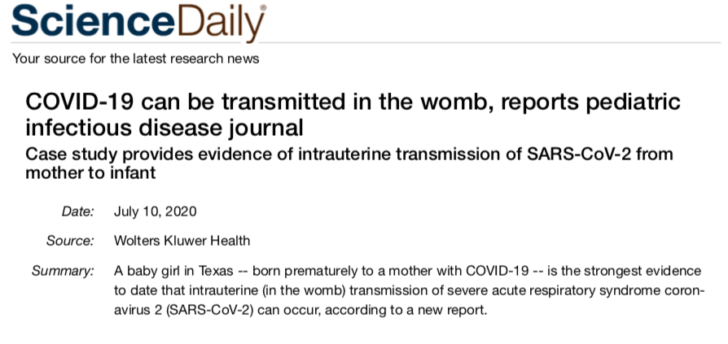
The researchers examined the placenta, which showed signs of tissue inflammation. In addition, specialized tests documented the presence of coronavirus particles as well as a protein (SARS-CoV-2 nucleocapsid protein) specific for the COVID-19 virus in fetal cells of the placenta. Together, these findings confirmed that the infection was transmitted in the womb, rather than during or after birth.

Slide 53

Texas Demographics

Slide 54
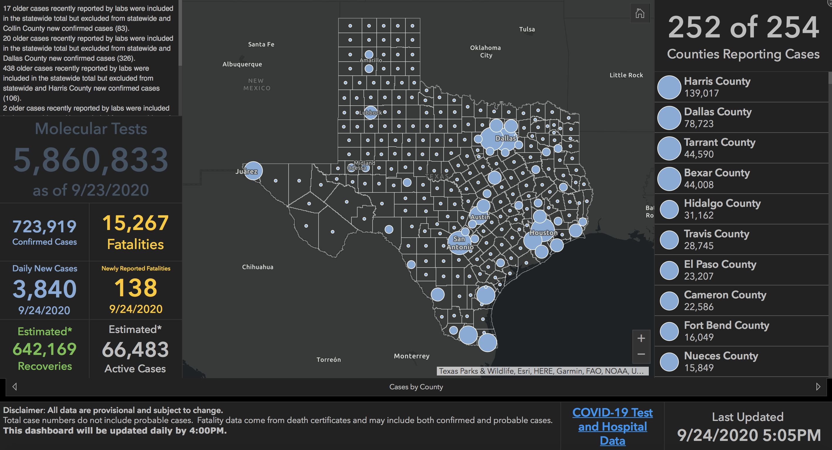

Slide 55
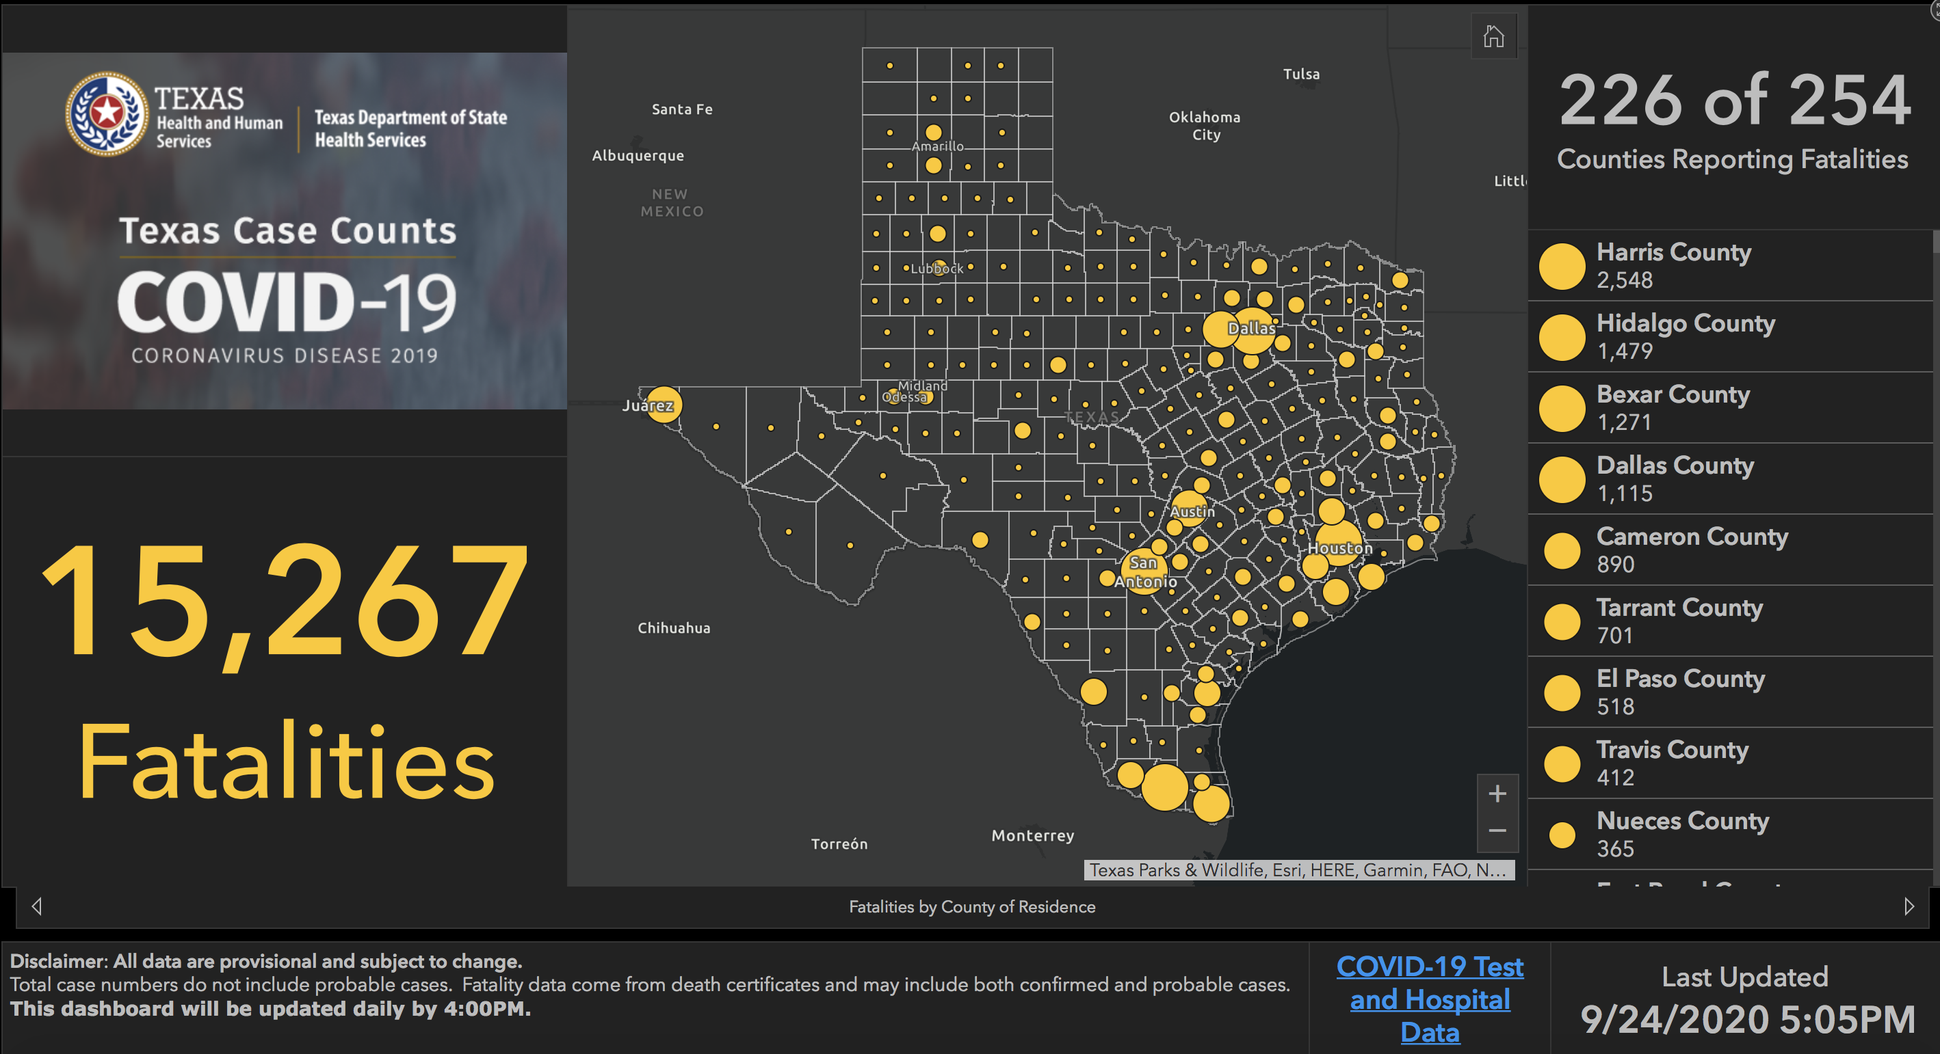

Slide 56
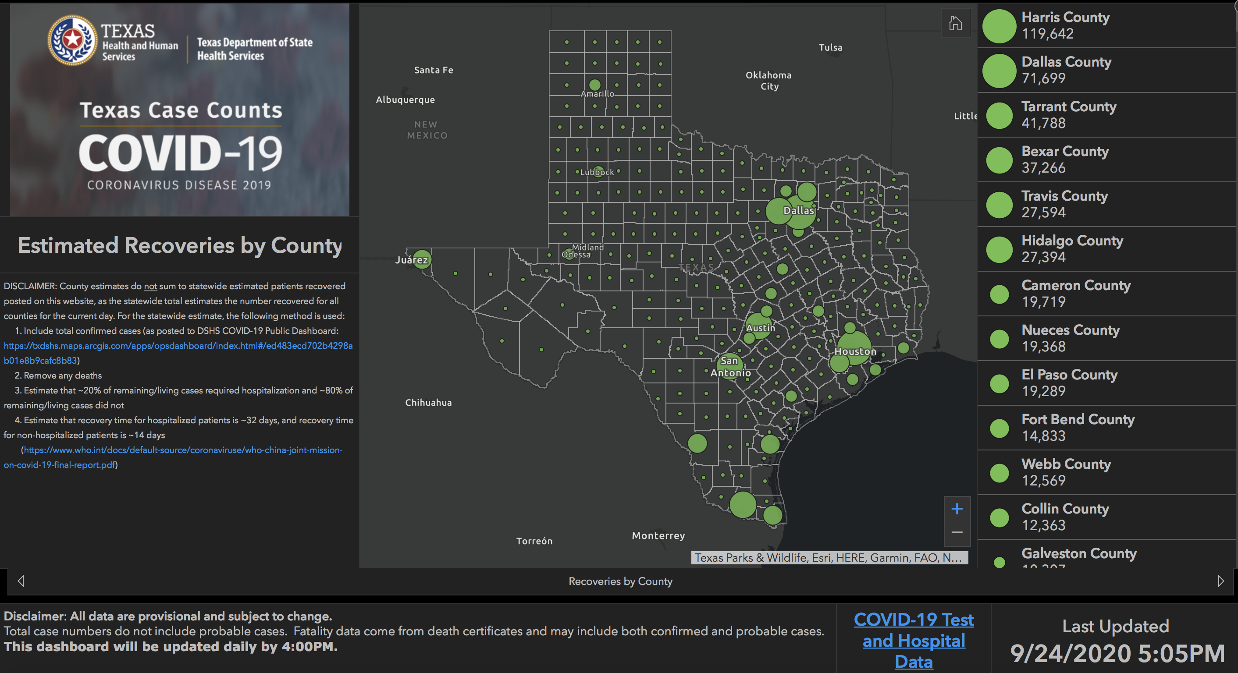

Slide 57
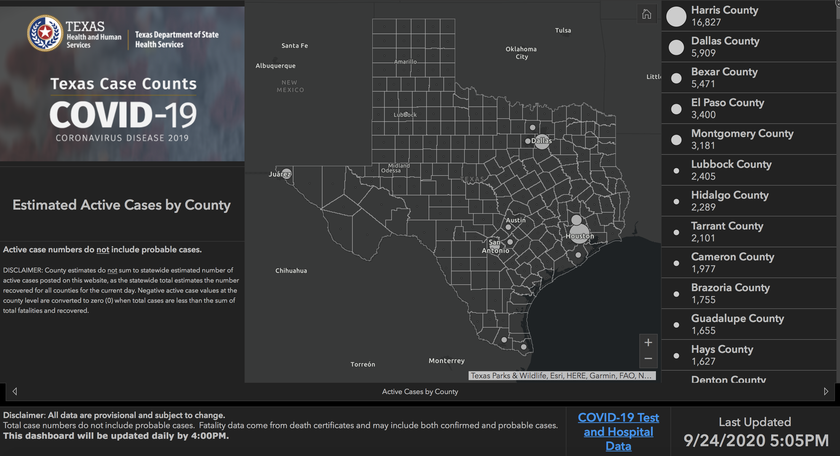

Slide 58
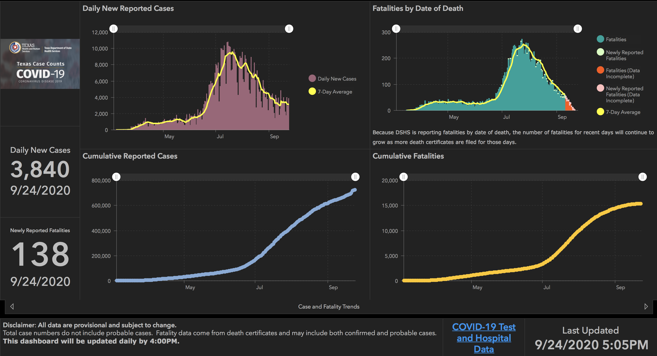

Slide 59
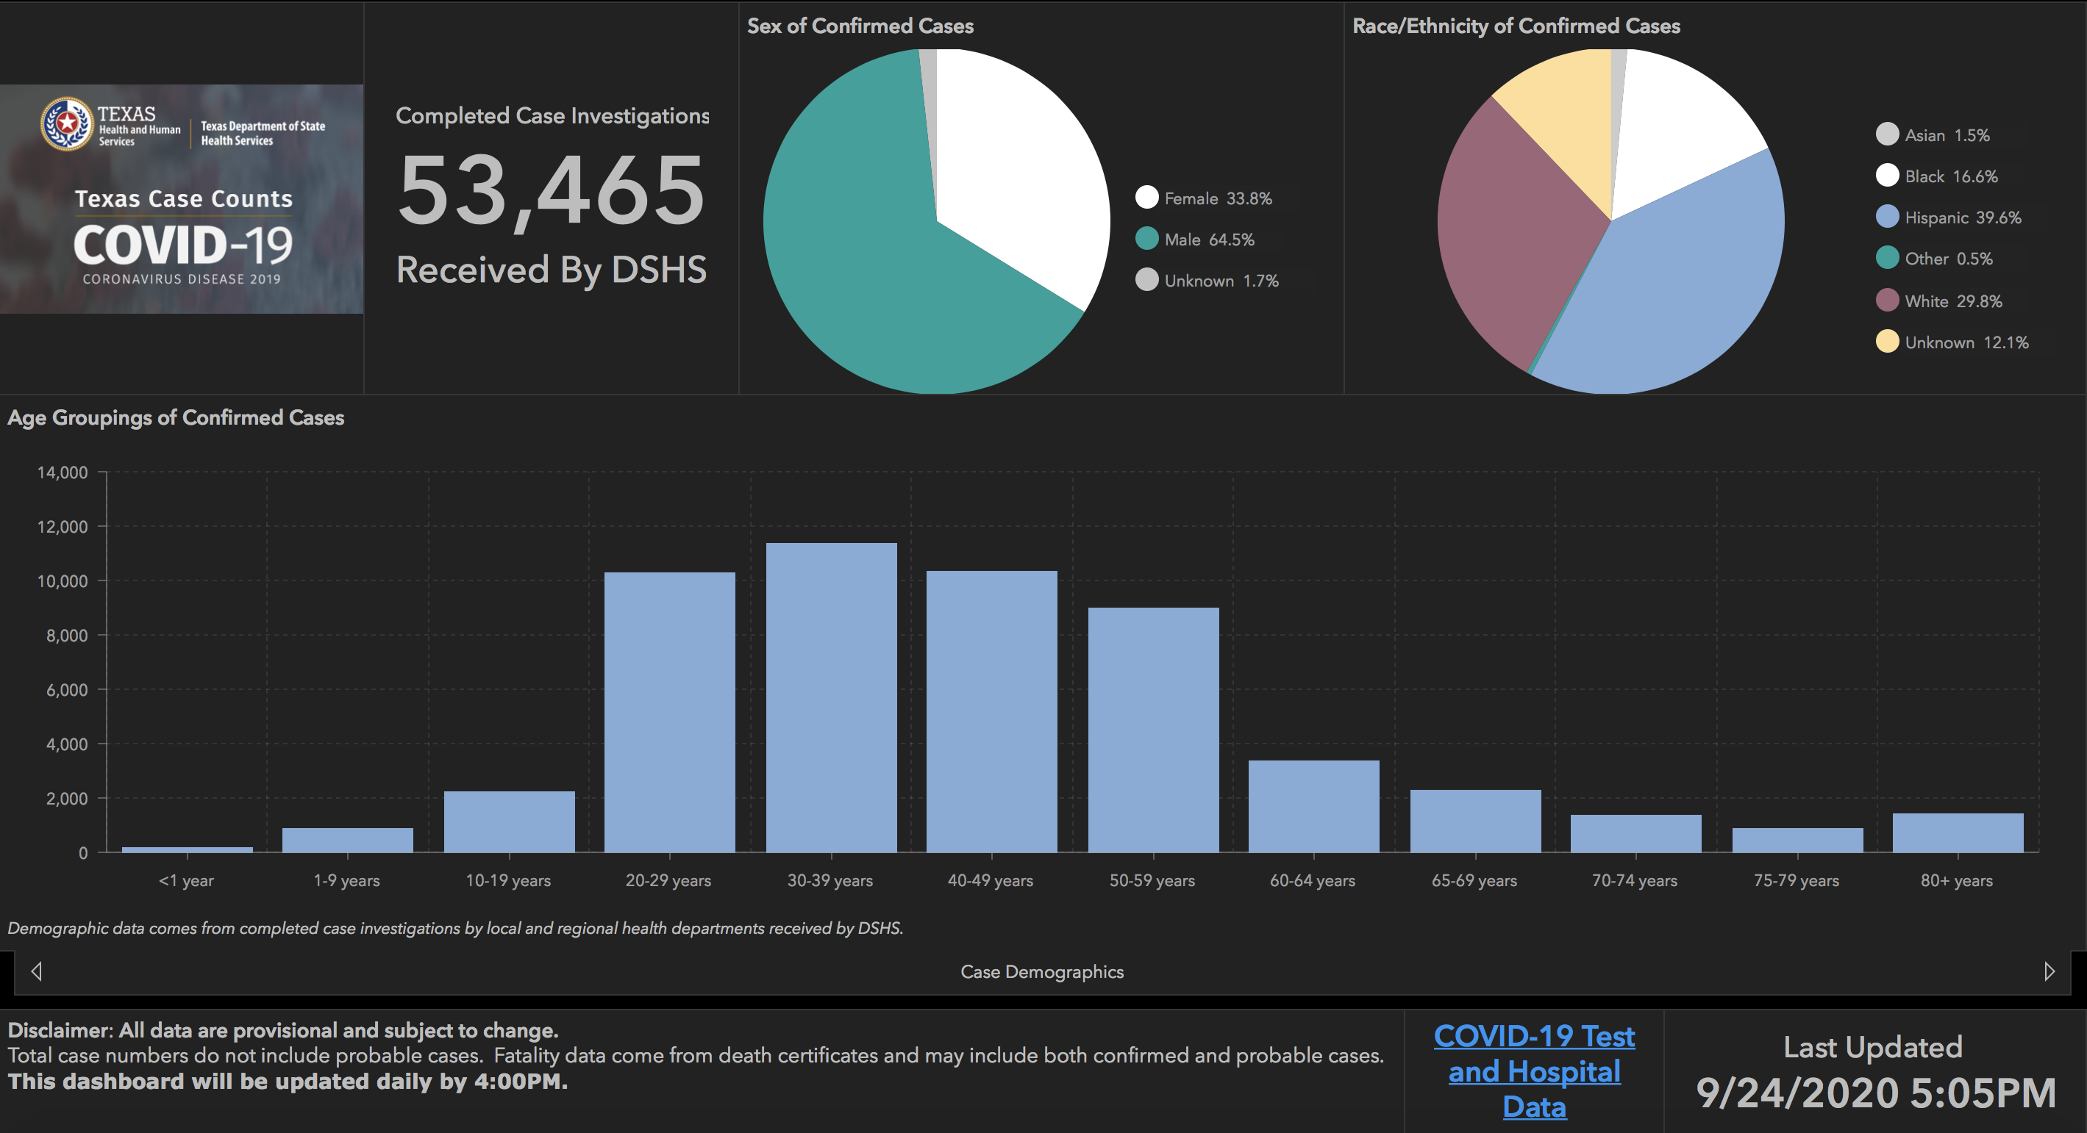

Slide 60
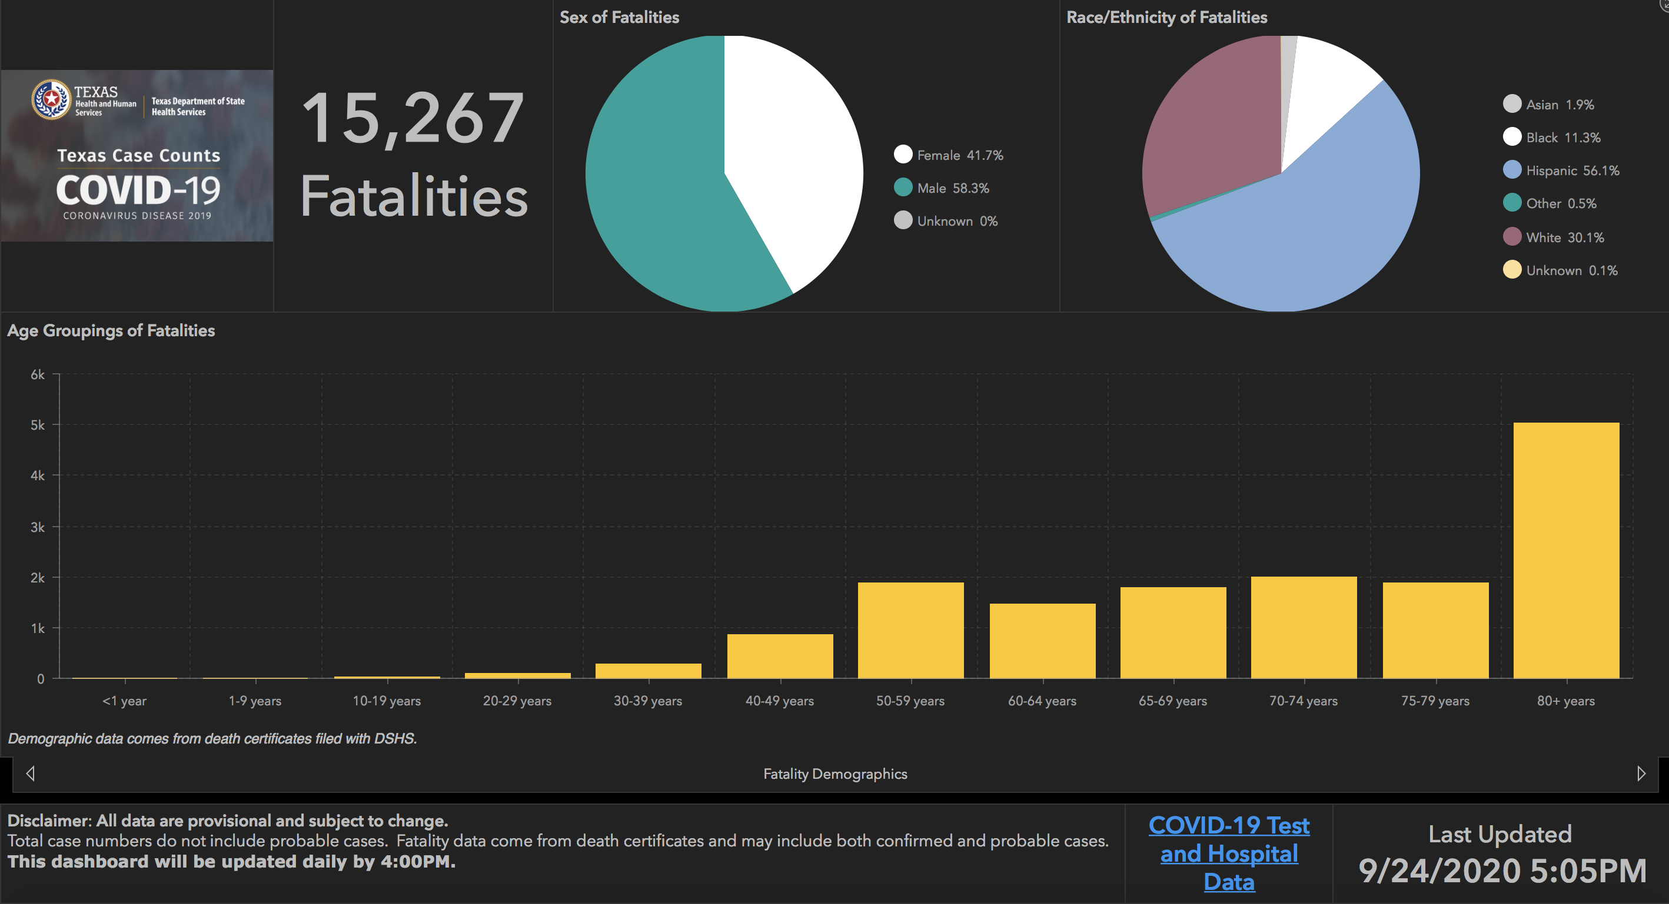

Slide 61
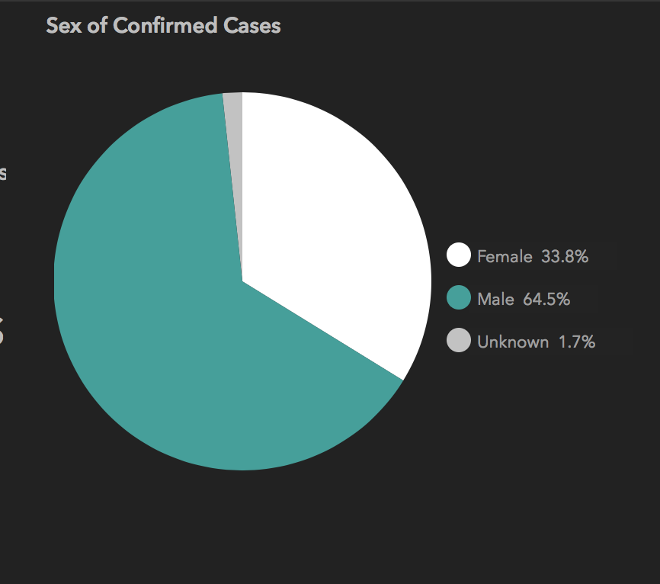
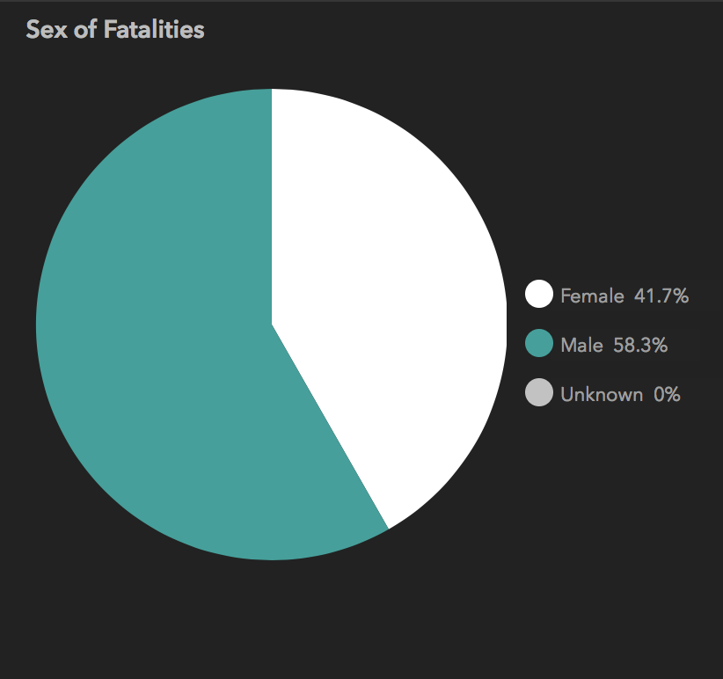
Differences in Gender

Slide 62
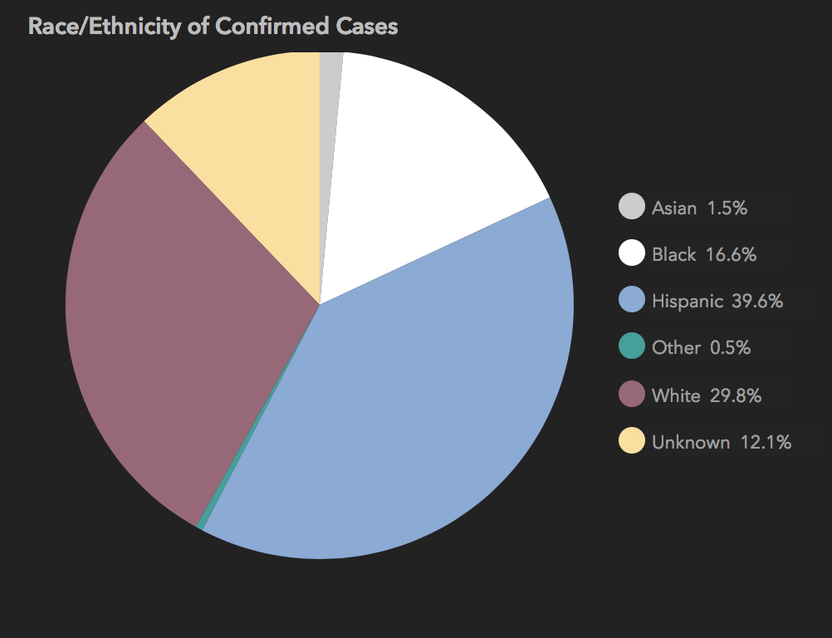
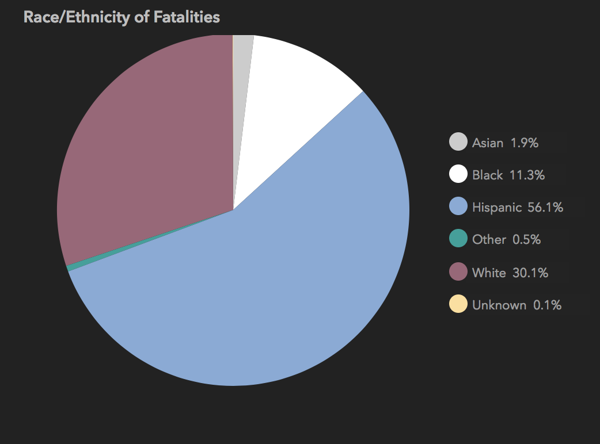
Differences in Race

Slide 63
And New Mexico

Slide 64
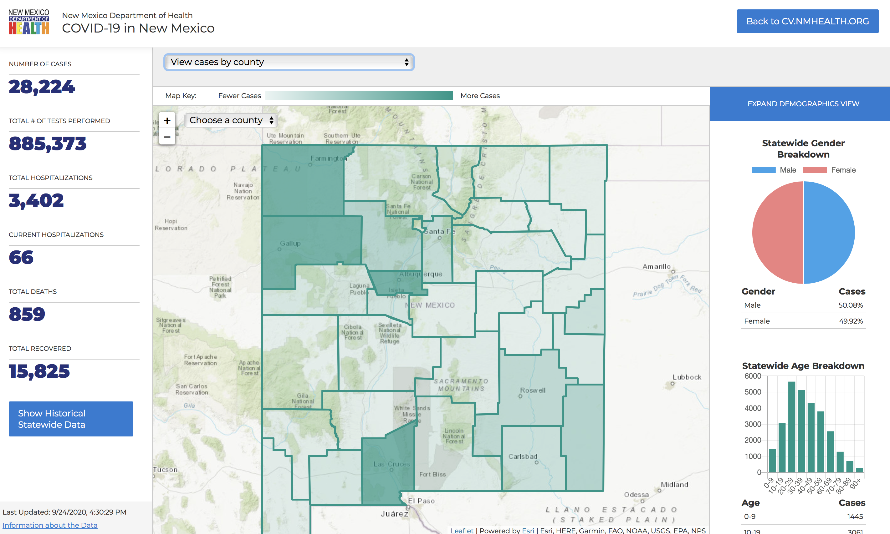

Slide 65
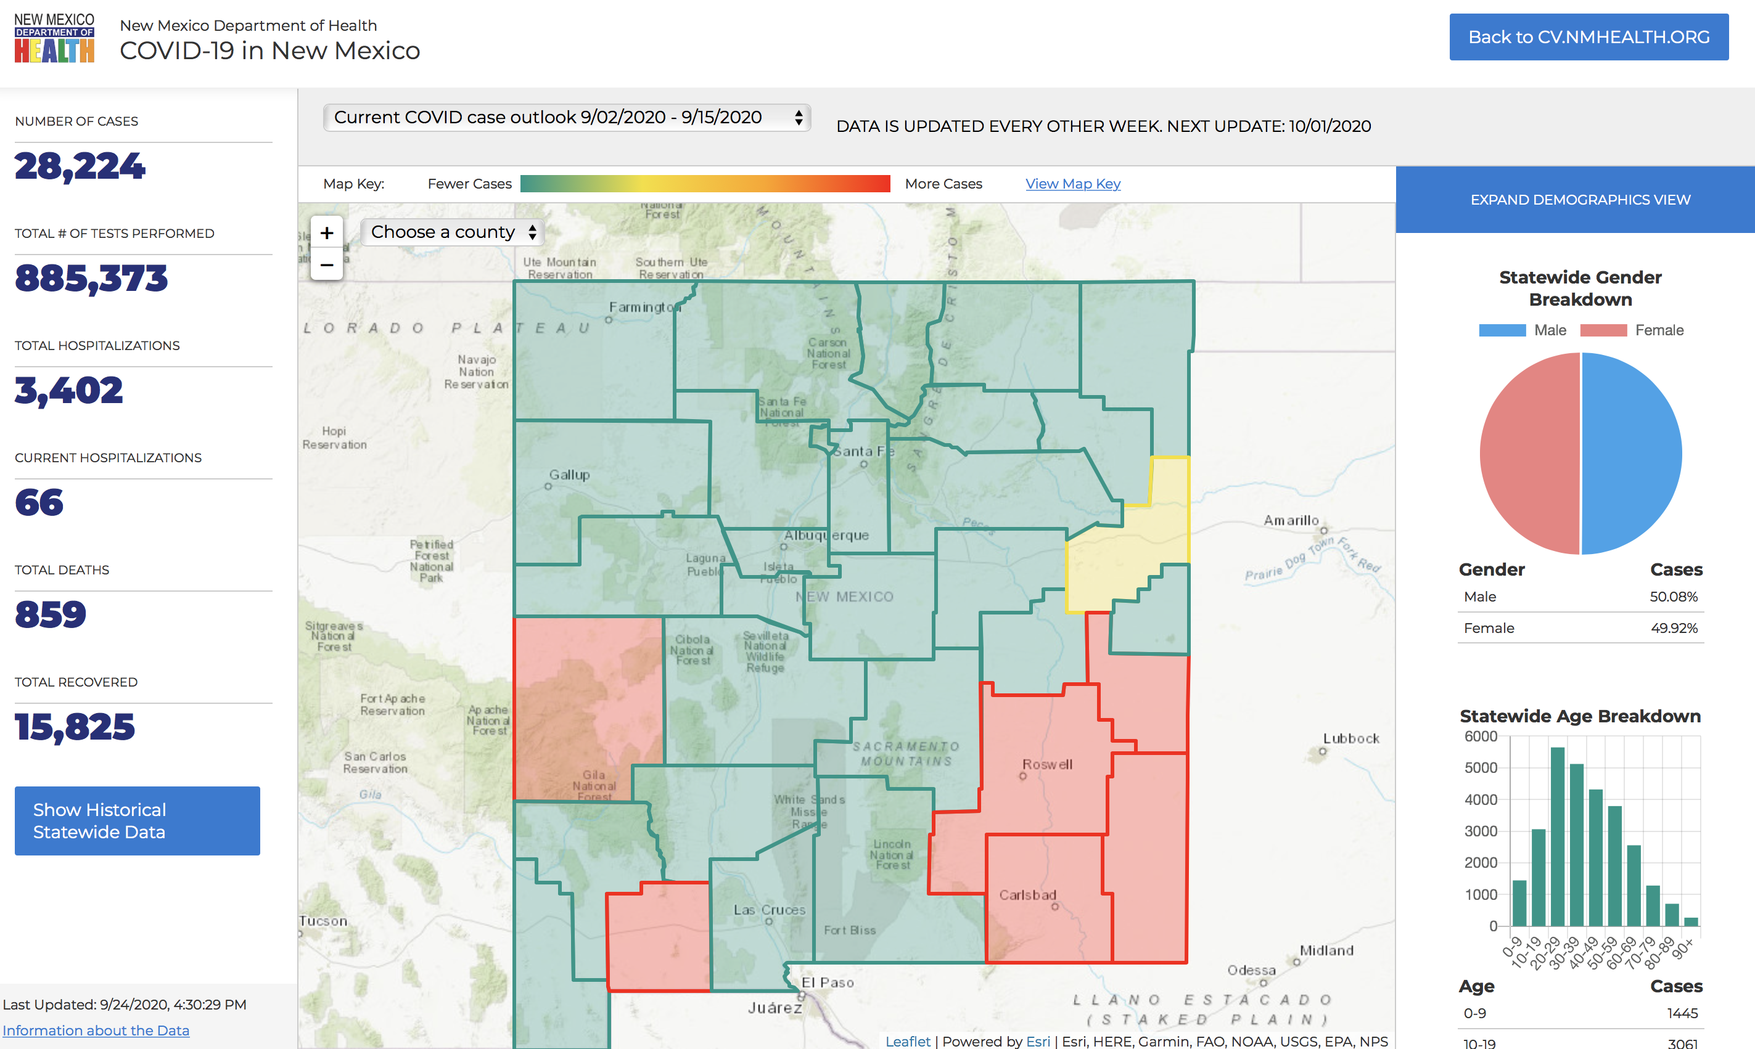

Slide 66
Governmental Affairs

Slide 67
Visitation Policy Update
HHSC Expected to Issue New Emergency Rule on Hospital Visitor Policies
  THA expects new emergency rules by Monday, which are expected to require ongoing screening of each person entering the facility, based on state, local and federal guidance. The new rules will also require hospitals to limit visitors as needed to prevent or control COVID-19-related health and safety risk, without mandating a statewide limit. All other aspects of the new rule will mirror with the current visitation rules and THA believes that a hospital’s visitation policies may continue or be adapted to allow additional flexibilities dependent on the regional level of COVID-19 activity. THA will forward the new rules and related guidance as soon as they are received or posted.

Slide 68
New Executive Orders, Expanded Openings
In his news conference (9-17-2020), Gov. Abbott announced expanded business reopenings for Texas. Among them:
Effective immediately, most Texas hospitals can provide essential services and procedures without restrictions.
Existing restrictions on elective services continue if the COVID-19 hospitalizations in their Trauma Service Area exceed 15% of all the hospitalizations in their TSA for seven consecutive days. This currently applies to TSAs S, T and V.
Hospitals now only have to reserve 10%, instead of 15%, of their total capacity for COVID-19 patients.
Hospital systems can reserve a cumulative 10% capacity for their system facilities that are in the same TSA.
Restaurants, retailers, gyms and other businesses operating in a TSA where hospitals can provide elective surgeries can increase their capacity from 50% to 75%.
Certain individuals can visit residents of nursing homes and facilities beginning Sept. 24.
There are still too many COVID-19 hospitalizations in the Rio Grande Valley, Laredo and Victoria areas for widespread reopenings. Bars across the state will remain closed for the time being. Gov. Abbott emphasized that COVID-19 hospitalizations are the key to regional reopenings of business.

Slide 69
Q & A

Slide 70
CME Credit was only approved for the Live Teams meeting
To receive credit for this continuing education activity, the participant must:
  Make sure you are logged into your Teams account, if you are signed in with a group provide attendee’s First and Last name(s) in the comments section.
  If you are calling into the Teams meeting you MUST text your First & Last Name to (806) 252-4735. This will ensure you are added to the sign in sheet to receive CME Credit.
  You will receive an email within 3 business days from the CME department with further instructions on claiming your certificate.

