Slide 1
Covenant Health Presents Critical Communications: A Weekly Physician Update Sept. 4, 2020

Slide 2
PHYSICIANS
Accreditation Statement:
The Covenant Health is accredited by the Texas Medical Association (TMA) to provide continuing medical education for physicians.
Credit Designation Statement:
The Covenant Health designates this live CME activity for a maximum of 1.0 AMA PRA Category 1 Credit(s)™. Physicians should claim only the credit commensurate with the extent of their participation in the activity.

Slide 3
Disclosures of Commercial Interest
The speakers and planners of this activity
have no relevant financial interests

Slide 4
Disclosures
This activity is provided by
Covenant Health
No commercial support has been received.
No products will be endorsed.
Speakers will notify the audience if off label drug use will be discussed.

Slide 5
CME Credit was only approved for the Live Teams meeting
To receive credit for this continuing education activity, the participant must:
Make sure you are logged into your Teams account, if you are signed in with a group provide attendee’s First and Last name(s) in the comments section.
If you are calling into the Teams meeting you MUST text your First & Last Name to (806) 252-4735. This will ensure you are added to the sign in sheet to receive CME Credit.
You will receive an email within 3 business days from the CME department with further instructions on claiming your certificate.

Slide 6
Reflection
Wesley Wells, PharmD, BCPS, BCPPS
TX-NM Regional Pharmacy Director

Slide 7
Albert Tate – Global Leadership Summit
https://youtu.be/9aeKOa8dj00?t=312
Notes:
Play Time: 5:12 - 7:52

Slide 8
Safety Story
Wesley Wells, PharmD, BCPS, BCPPS
TX-NM Regional Pharmacy Director

Slide 9
Until further notice…

Slide 10
Current Regional Census

Slide 11
Regional
 | Lubbock |  | Hockley |  | Hale
 | 8/31 | 9/2 | 8/31 | 9/2 | 8/31 | 9/2
Total | 7485 | 8027 | 247 | 269 | 1618 | 1651
Active | 1750 | 2112 | 34 | 48 | 76 | 80
Deaths | 100 | 102 | 5 | 5 | 45 | 47
New | 542 |  | 22 |  | 33
8/31: 75 Hospitalized in Lubbock – 12 on vents 9/2: 71 Hospitalized in Lubbock – 8 on vents

Slide 12
STATE
 | 9/2 | 8/31 | 8/26 | 8/12 | 7/29 | 7/15 | 7/1
Cases | 621,667 | 612,696 | 592,137 | 506,820 | 403,307 | 282,365 | 168,062
Deaths | 12,870 | 12,563 | 11,805 | 9034 | 6190 | 3432 | 2481
Hospitalized | 4149 | 4203 | 4806 | 7028 | 9595 | 10,471 | 6904
Lubbock Rate = 10.2%

Slide 13
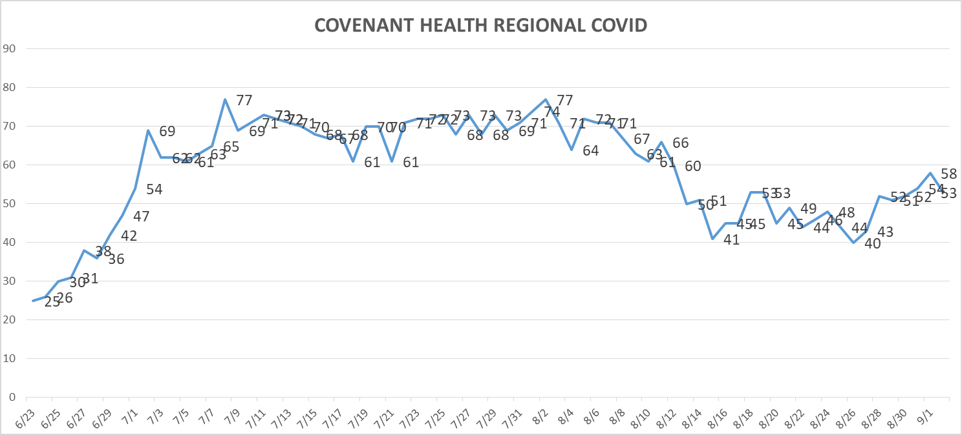
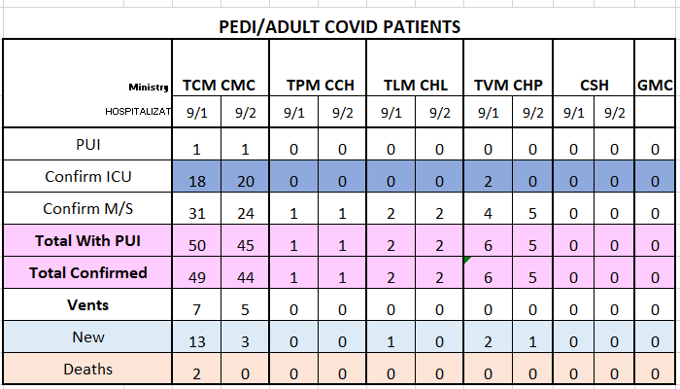
PUI/Confirmed cases-hospitalized

Slide 14
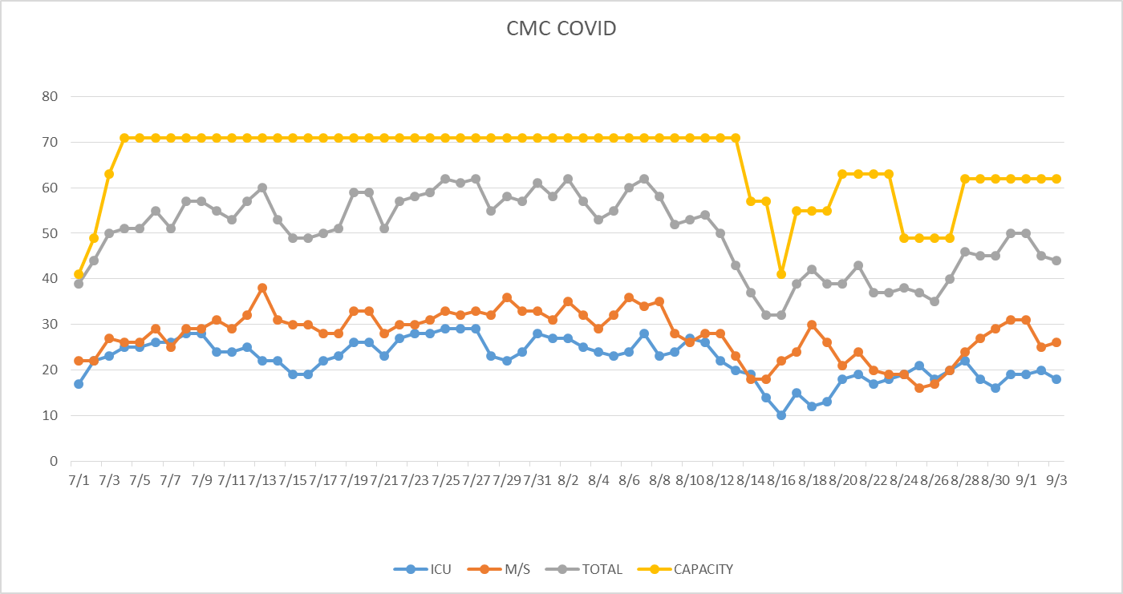
PUI/Confirmed cases-hospitalized

Slide 15
Surge Plan
Covenant Medical Center
 | ICU | Med Surg | Total
Phase 1 | 10-CICU |  | 10
Phase 2 | 17-CICU | 10-HC4 | 27
Phase 3 | 17-CICU | 24-HC4 | 41
Phase 4 | 17-CICU 8-MICU | 24-HC4 14-Pal Med | 63
Phase 5 | 17-CICU 16-MICU | 24-HC4 14-Pal Med | 71
Phase 6 | 17-CICU 16-MICU 8- SICU 4 (east) | 24-HC4 14-Pal Med 15 – S 9 (east) | 94
Last Week
Currently

Slide 16
Statistics
William Sommer, MS
Clinical Data Analyst
Decision Support Services
Covenant Health

Slide 17
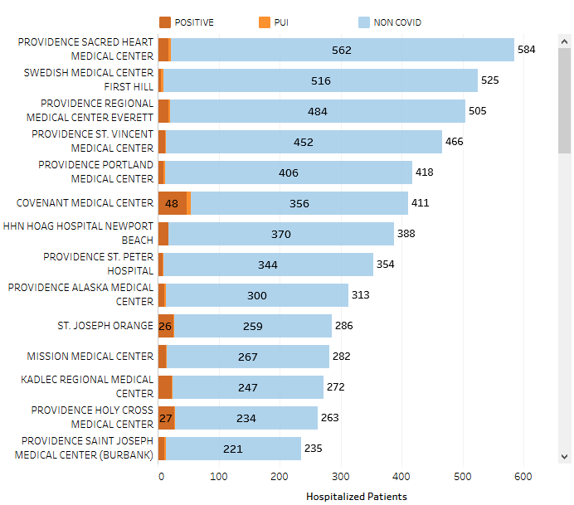
Providence System Hospitalized COVID-19 Cases

Slide 18
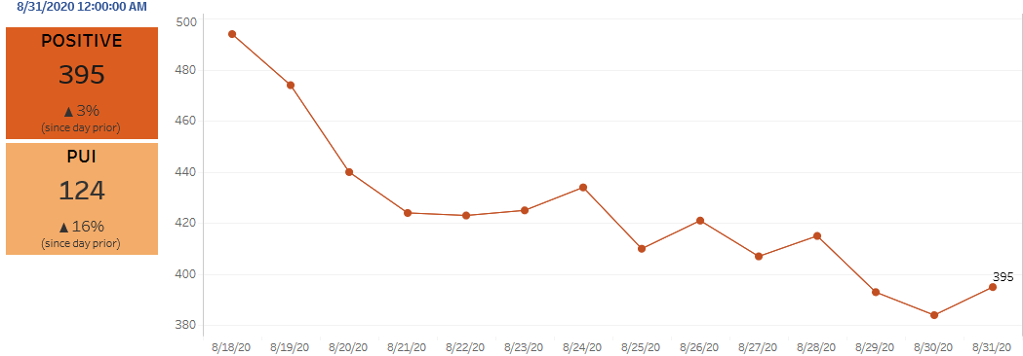
Providence Inpatient COVID-19 Volume

Slide 19
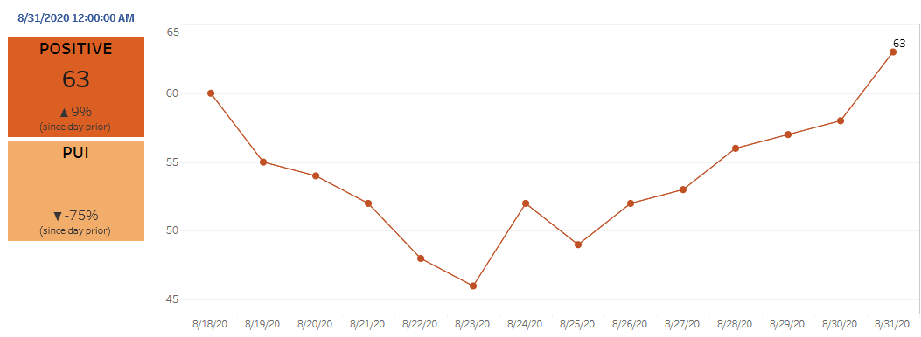
Texas Inpatient COVID-19 Volume

Slide 20
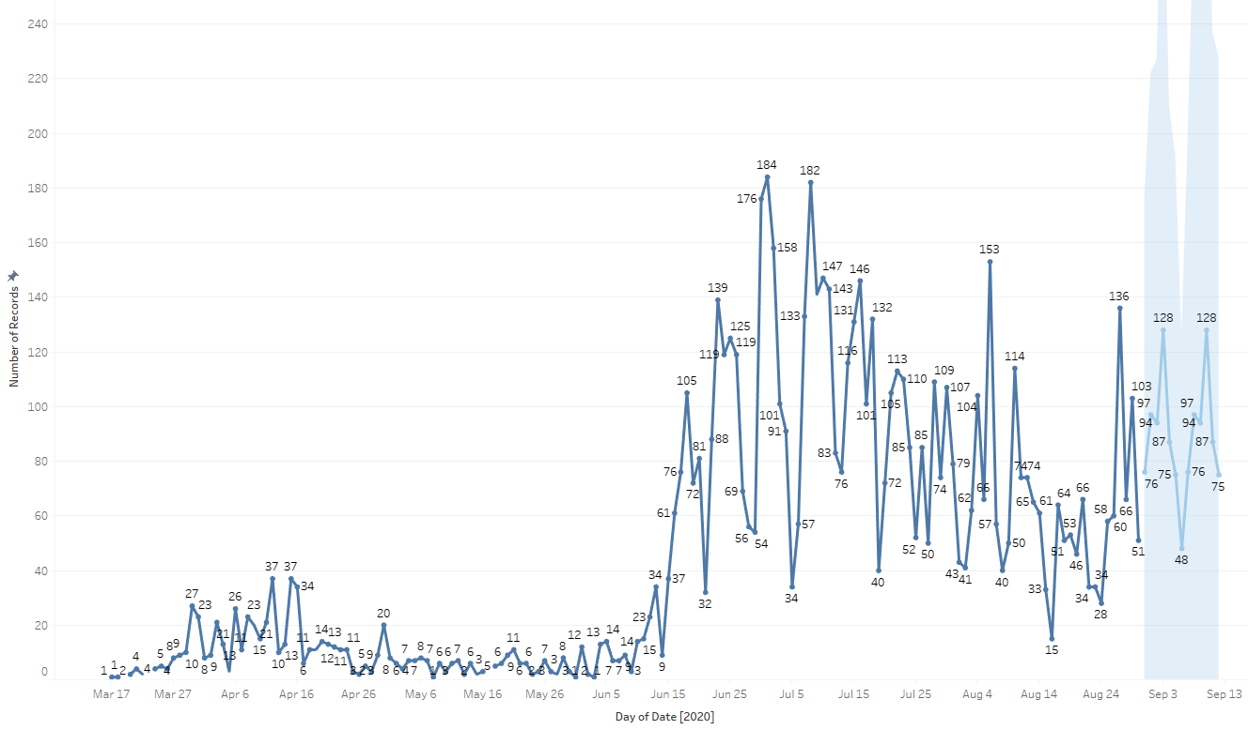
New Covid-19 POSITIVES by Day Trend

Slide 21
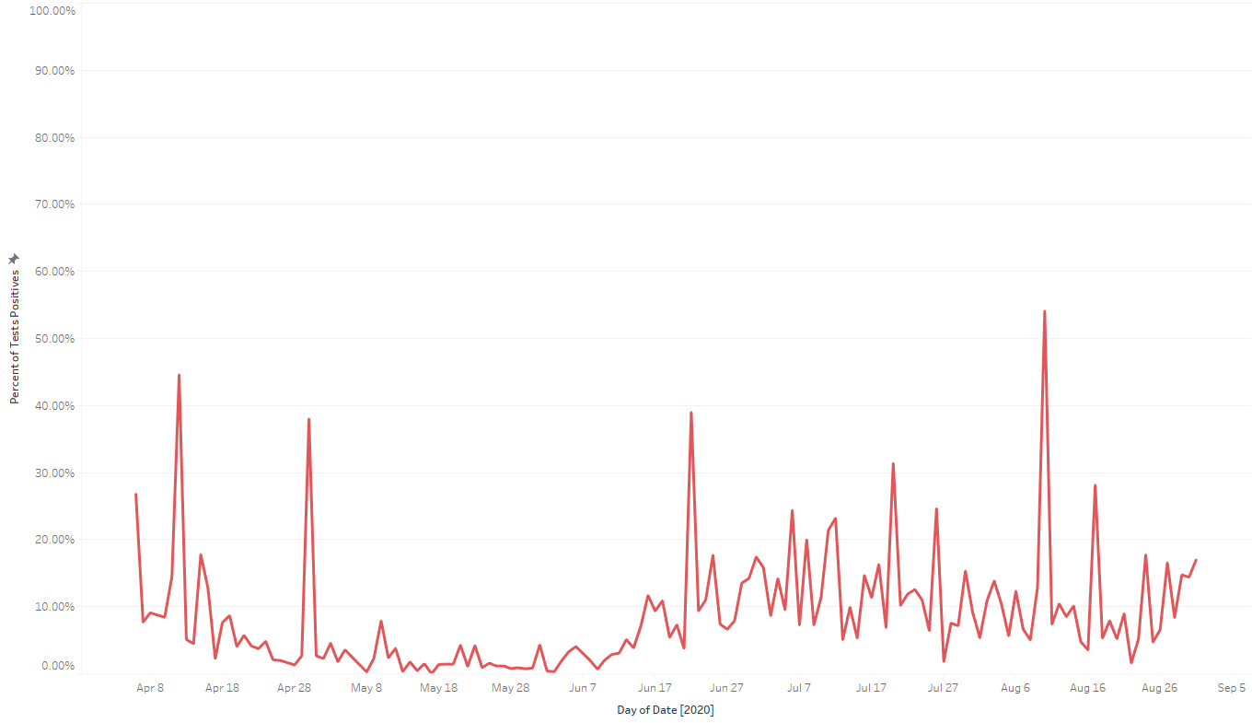
Covid-19 Daily Positive Rate

Slide 22
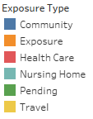
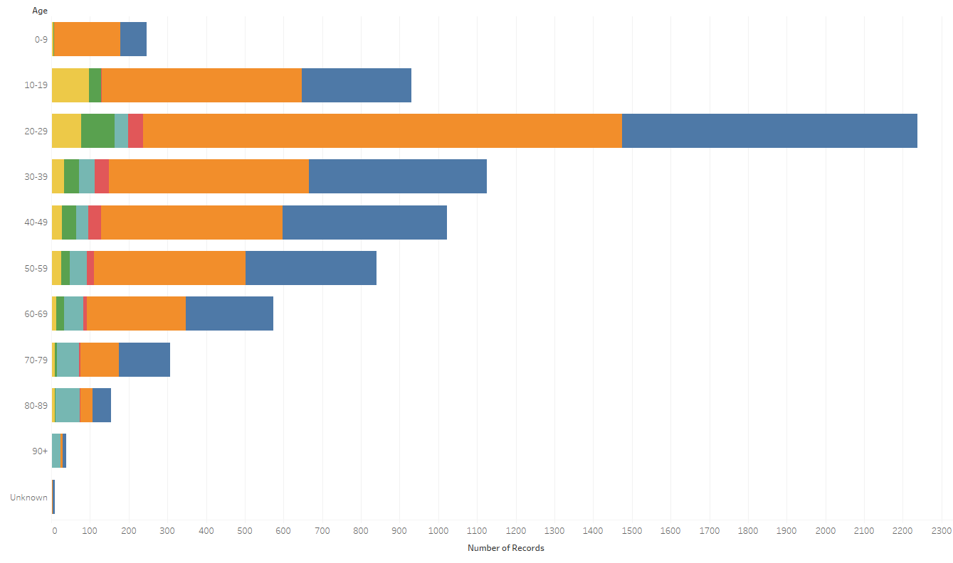
Covid-19 POSITIVES Age Distribution

Slide 23
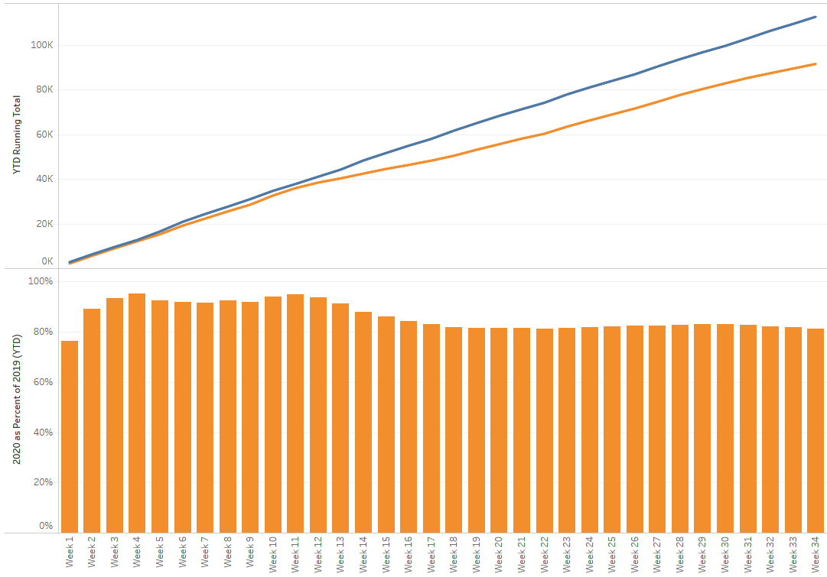
TX/NM Region Weekly Procedures (YOY)

Slide 24
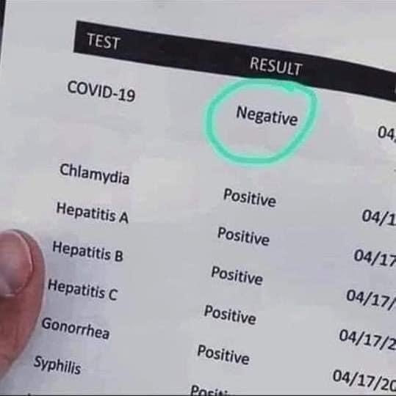
Testing

Slide 25
TESTING – STATEWIDE Results
Notes:
13.05% last week

Slide 26
Texas—State Wide Testing

Slide 27
TESTING
 | CMC | GMC | CMG
Test Kits
Swabs
VTM
 | CMC |  | GMG/CMG
 | Tests | + | Tests | +
8/30 | 142 | 33 | 4 | 0
8/31 | 65 | 7 | 8 | 0
9/1 | 217 | 17 | 231 | 51
9/2 | 232 | 12 | 227 | 67
>2000 >750
<2000 <750
<1600 <500
BD Max shipment received but not full allotment

Slide 28
Returning to Operations

Slide 29
Caregivers
COVID Related Furloughs
Count reflects # furlough (exposed and positive)
Good
Moderate
Critical

Slide 30
Caregivers
Respiratory Therapists
RT, HR and hospitals met to work on recruitment.
Trying to avoid outsourcing
Looking at RT staffing and model
Moral Distress
Schwartz Rounds
FLU Vaccinations
CMG and CHP developing plans for flu shot clinics

Slide 31
Critical Inventory
Caregiver Masks
Level 2 masks – 1 per day per caregiver
Will reassess inventory in 30 days
N-95 Masks
1 per day per caregivers for those needing an N-95 mask.
IMPORTANT- Reprocessing of N-95 masks must be stressed
You MUST label your mask with your name and campu, otherwise it will be thrown away!

Slide 32
And now a few words about…
“Universal Masking”
It’s inconceivable…

Slide 33
“Universal Masking”
A Mask AND Face Shield are to be used with EVERY patient encounter!

Slide 34
Pharmacy Update
Larry Pineda, PharmD
Clinical Pharmacist – AMS
Covenant Health

Slide 35
CHS COVID-19 Treatments
Agent | Dosage | Comments | Update
Remdesivir Emergency Use Authorization (EUA) 5/1/20, updated 8/28/20 | 200 mg IV x 1, then 100 mg IV daily x 4 days | EUA product on allocation, cost ~$520/vial NIH guidelines: Because supplies are limited, recommend prioritizing for patients who require supplemental O2 but who are NOT on HF O2, noninvasive or mech ventilation, or ECMO | Remdesivir EUA Inventory: (Thursday AM) CMC = 371 vials, CCH = 40, PLV = 157, LVL = 6 Remdesivir EUA Patients: (Thursday AM) CMC = 11, CCH = 0, PLV = 1, LVL = 0 8/28/20 FDA updates EUA: Where previously limited to severe patients, now broadened to include ‘all hospitalized adult and pediatric patients with suspected or laboratory-confirmed COVID-19, irrespective of their severity of disease’
Convalescent Plasma | 1 unit (200-400mL) | Emergency Use Authorization on 8/23/20 | 9/1/20 NIH guidelines: Insufficient data to recommend for or against Should not be considered the standard of care Prospective, well-controlled, adequately powered randomized trials are needed to determine whether CP is effective and safe for the treatment of COVID-19. Members of the public and health care providers are encouraged to participate in these prospective clinical trials
Notes:
8/21: CMC received 7 cases of RDV this week, 280 vials = $145K
8/14: CMC has 10 patients on treatment and 10 rounds remaining (83 vials remaining). Plainview has 0 patients on treatment and 12 rounds remaining (74 vials)
Optimal timing of donor plasma collection in relation to recovery from COVID19, most appropriate methods of antibody testing, and minimum titers of SARS-CoV-2 antibody in convalescent plasma that may be associated with clinical benefits in pts with COVID-19 not determined.
FYI Budesonide: In response to Odessa doctor, Richard Bartlett, who calls it the 'silver bullet‘. There have been no clinical trials or observational studies examining the use of ICS in COVID-19. Clinical trials would be required to establish whether these drugs may be repurposed for the treatment of this disease.

Slide 36
SIMPLE-Moderate Preliminary Data
Phase 3 randomized, open-label trial in hospitalized pts with moderate COVID-19 (hospitalized with evidence of pulmonary infiltrates but without reduced oxygen levels)
Evaluated safety and antiviral activity of 5 and 10 day regimens
5-day (n=191), 10-day (n=194), or standard of care alone (n=200)
Primary outcome: clinical improvement day 11 (2 point improvement from 7 point ordinal scale)
No difference noted: 5-day (70%), 10-day (65%), standard of care alone (61%)
Subsequent analysis of 1 point improvement:
Statistically significant improvement in clinical status in those treated with a 5-day regimen of remdesivir (76%) compared with standard of care alone (66%)
Notes:
I previously presented this slide on 8/21/20, same day that JAMA released publication
30. Gilead Sciences. Gilead announces results from phase 3 trial of remdesivir in patients with moderate COVID-19. Press release. 2020 Jun 1. Available at https://www.gilead.com/news-andpress/press-room/press-releases/2020/6/gilead-announces-results-from-phase-3-trial-of-remdesivir-in-patients-with-moderate-covid-19.

Slide 38
Notable Observations and Limitations
Open label, can not eliminate provider bias
Cohort had a 1% (6/584) mortality rate; 15% had deteriorated to the point that oxygen was required between enrollment and study initiation
5 day, 76% completed therapy; 10 day, 38% completed, median 6 days
Clinically relevant endpoint (clinical status distribution)?
There were no significant differences between groups in the exploratory endpoints of time to recovery, time to improvement in clinical status, or death at 28 days
Notes:
IV administration, 10 days, delay in discharge?

Slide 39
Journal Reviews
Editorial published same day in JAMA by Erin Mcreary, PharmD
“The [study] reported benefit with a 5-day course but, like the study by Wang and colleagues, reported no benefit with the 10-day course that had been shown to be beneficial in ACTT-1. Thus, there are now 3 RCTs of remdesivir in hospitalized patients with differing results, raising the question of whether the discrepancies are artifacts of study design choices, including patient populations, or whether the drug is less efficacious than hoped.”
Editorial published in NEJM 8/31/20 by Hana M. El Sahly, MD
“The authors indicate that the significant difference in the distribution of clinical scores between the 5-day RDV and SC groups may be of limited clinical benefit, which in a nonpandemic setting may be true. However, in a pandemic setting, incremental improvements can translate into substantial overall benefits for high-utilization healthcare systems. This study was conducted in March and April 2020, and it is possible that many of the patients admitted to the hospital then would be followed as outpatients now, as the majority of the patients in all groups (80%–84%) did not require supplemental oxygen. Hence, these data do not support changing the current practice of treating hospitalized COVID-19 patients with remdesivir.”

Slide 40
NIH Guidelines Update

Slide 41
Hydroxychloroquine
To reflect the results of large randomized controlled trials that enrolled hospitalized patients, the following recommendations have been updated to differentiate between hospitalized and nonhospitalized patients:
The Panel recommends against the use of chloroquine or hydroxychloroquine for the treatment of COVID-19 in hospitalized patients (AI)
In nonhospitalized patients, the Panel recommends against the use of chloroquine or hydroxychloroquine for the treatment of COVID-19, except in a clinical trial (AI)
Notes:
From NIH Rationale section:
In a large randomized controlled trial of hospitalized patients in the United Kingdom, hydroxychloroquine did not decrease 28-day mortality when compared to the usual standard of care. Participants who were randomized to receive hydroxychloroquine had a longer median hospital stay than those who received the standard of care. In addition, among patients who were not on invasive mechanical ventilation at the time of randomization, those who received hydroxychloroquine were more likely to subsequently require intubation or die during hospitalization than those who received the standard of care.⁵
In another randomized controlled trial that was conducted in Brazil, neither hydroxychloroquine alone nor hydroxychloroquine plus azithromycin improved clinical outcomes among hospitalized patients with mild to moderate COVID-19. More adverse events occurred among patients who received hydroxychloroquine or hydroxychloroquine plus azithromycin than among those who received the standard of care.⁶
In addition to these randomized trials, data from large retrospective observational studies do not consistently show evidence of benefit for hydroxychloroquine with or without azithromycin in hospitalized patients with COVID-19.

Slide 42
Interleukin-6 (IL-6) Inhibitors
Preliminary, unpublished data from randomized controlled trials have not demonstrated the efficacy of sarilumab or tocilizumab in patients with COVID-19. The data on the efficacy of siltuximab in patients with COVID-19 are limited and come from unpublished studies. The Panel’s recommendation on using interleukin (IL)-6 inhibitors for the treatment of COVID-19 has been revised:
The Panel recommends against the use of anti-IL-6 receptor monoclonal antibodies (e.g., sarilumab, tocilizumab) or an anti-IL-6 monoclonal antibody (siltuximab) for the treatment of COVID-19, except in a clinical trial (BI)

Slide 43
Ivermectin
A new subsection was added to Potential Antiviral Drugs Under Evaluation for the Treatment of COVID-19 to address the use of ivermectin for the treatment of COVID-19.
The Panel recommends against the use of ivermectin for the treatment of COVID-19, except in a clinical trial (AIII)
Rationale:
Ivermectin has been shown to inhibit the replication of severe acute respiratory syndrome coronavirus 2 (SARS-CoV-2) in cell cultures
FYI: same activity in vitro against other viruses (i.e. dengue, Zika, HIV, yellow fever)
PK/PD studies suggest that achieving the plasma concentrations necessary for the antiviral efficacy detected in vitro would require administration of doses up to 100-fold higher than those approved for use in humans
Notes:
Broad-spectrum activity in vitro against the viruses that cause dengue, Zika, HIV, and yellow fever
Ivermectin is not approved for the treatment of any viral infection, including SARS-CoV-2 infection

Slide 44
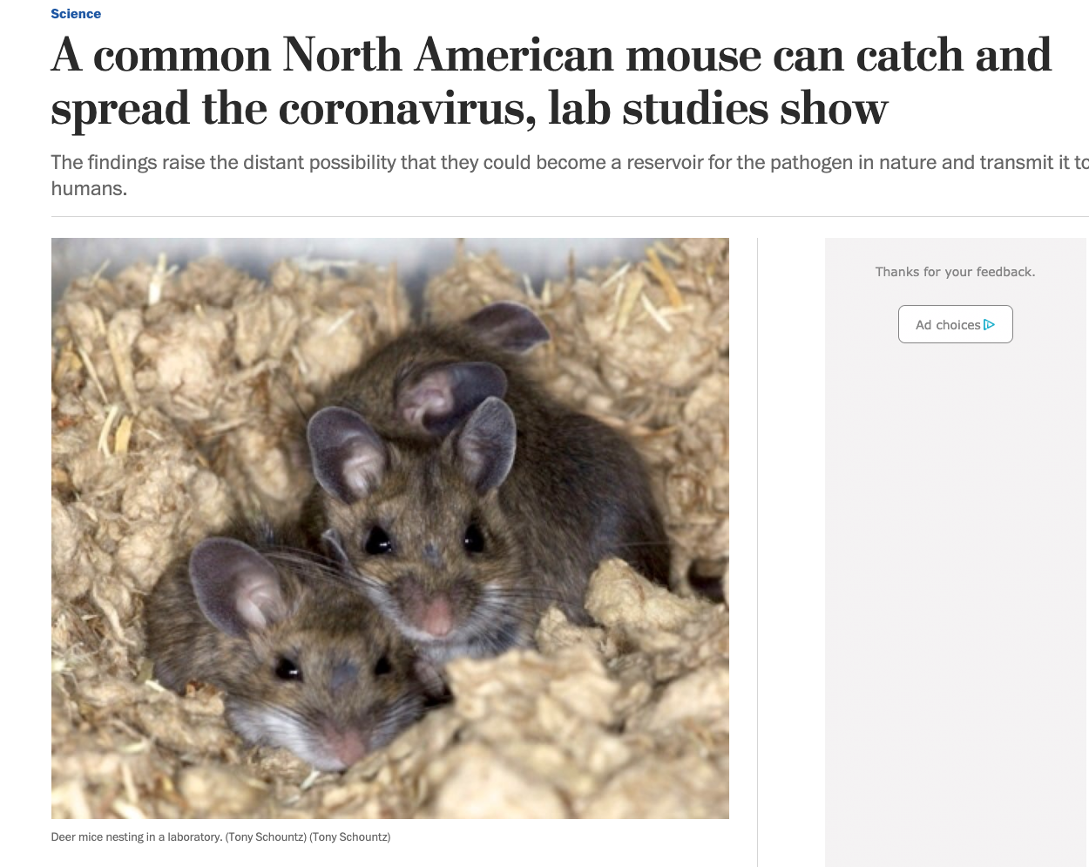
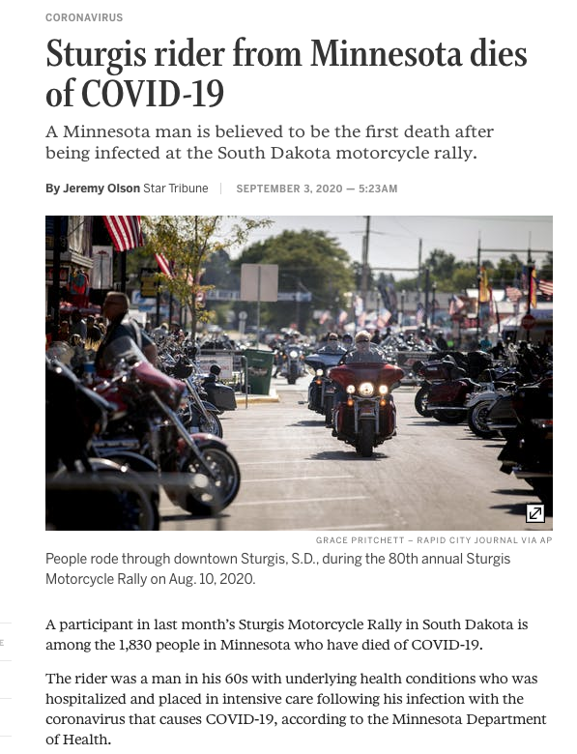
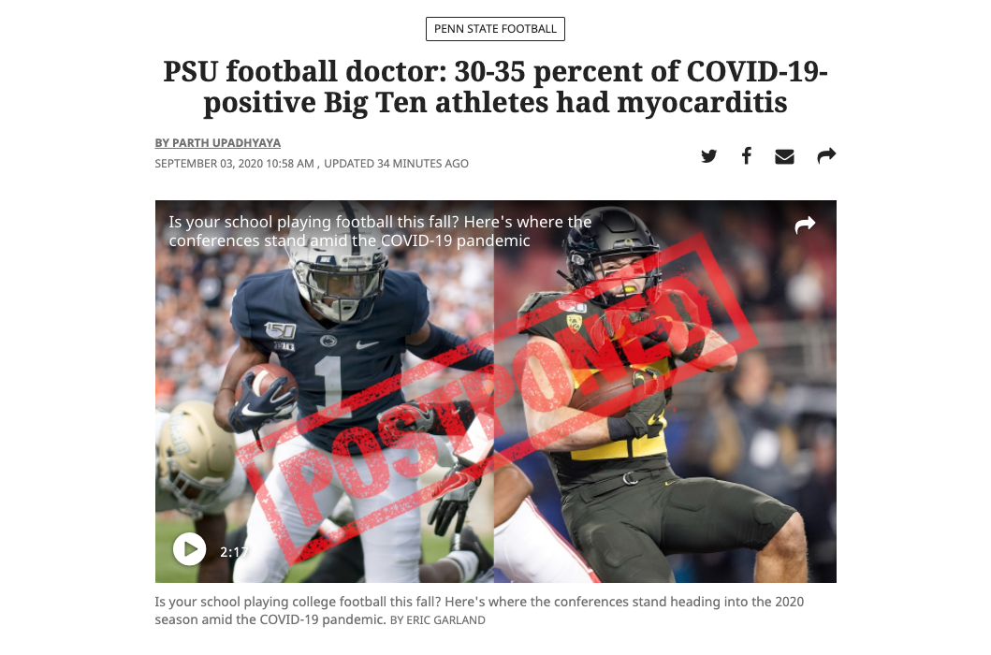
Headlines from 3 Sept 2020

Slide 45
How about a little “good news”?

Slide 46
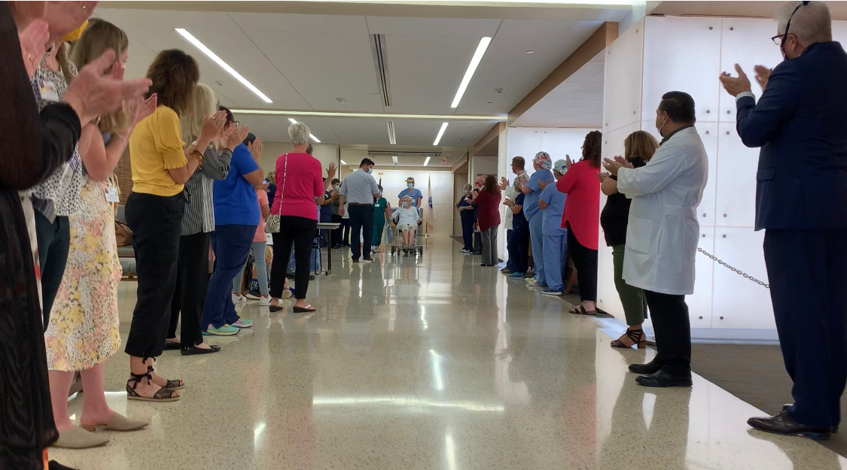
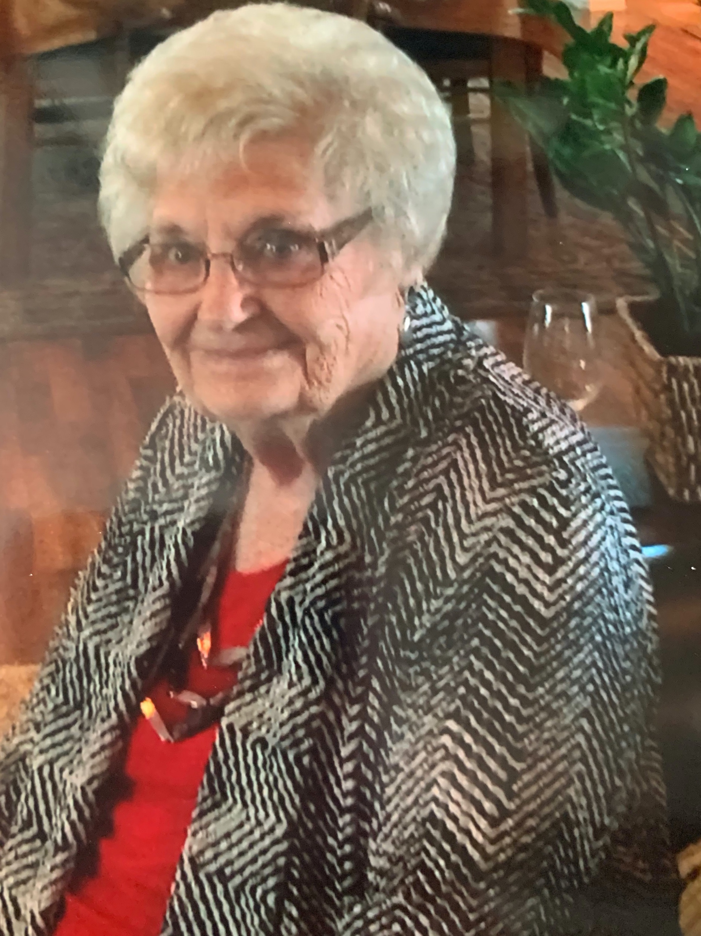
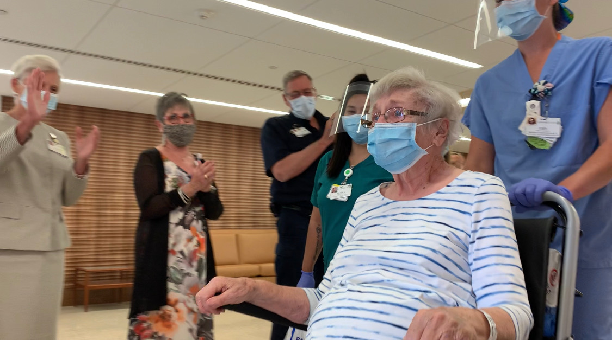
99 year old COVID survivor Anna Jo Thomas
Discharged 8/2/2020
Turns 100 years old 9/19/2020!
Notes:
Anna Jo Thomas. She is 99-years-old. Will turn 100 on September 19th.
She likes to play bridge, and garden, and can make the best darn pecan pies, says her daughter.
The only thing she can't do anymore is drive. She has a driver, that's who she got COVID from.
She was at home sick for 14 days before she ended up at the hospital. She spent a week with us.
Dr. Shrestha said that chronologically she might be 99 but physiologically she seems much younger than that.
Her daughter, Marilyn Dixson, was there along with some of her grandchildren, and great grandchildren.

Slide 47
Speaking of patients who’ve recovered…
How DO we handle these pts when they no longer need specialized critical care coverage?

Slide 48
How to handle the Post -COVID patients
NO NEED to retest
recovered pts!
They are not infectious!
Will test positive for up
to 6 weeks!

Slide 49
CLARIFICATION
COVID Death Rates on Social Media – COVID HOAX
Numerous sources suggesting conspiracy theory CDC cooking the numbers
Misinterpretation of the CDC report
Most deaths have more than one contributing factor

Slide 50
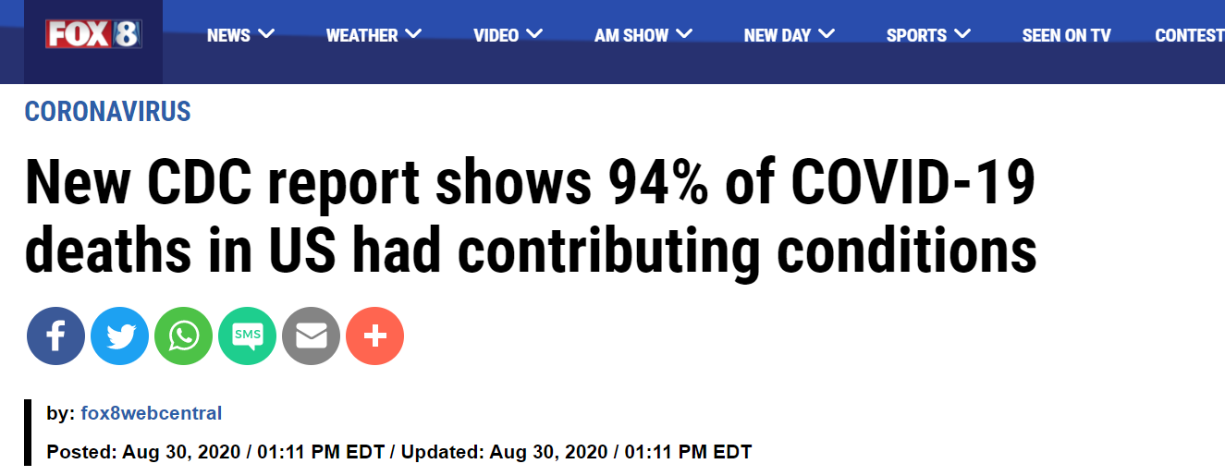

Slide 51
Texas Demographics

Slide 52
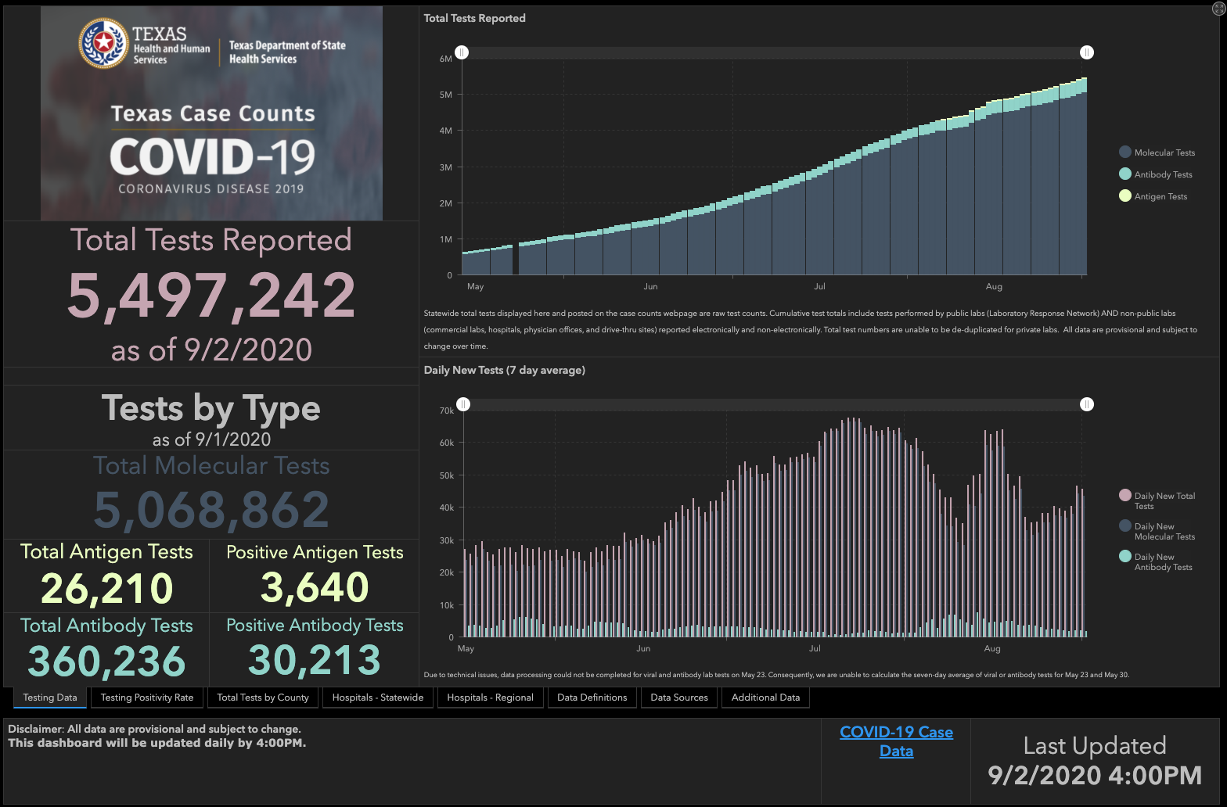

Slide 53
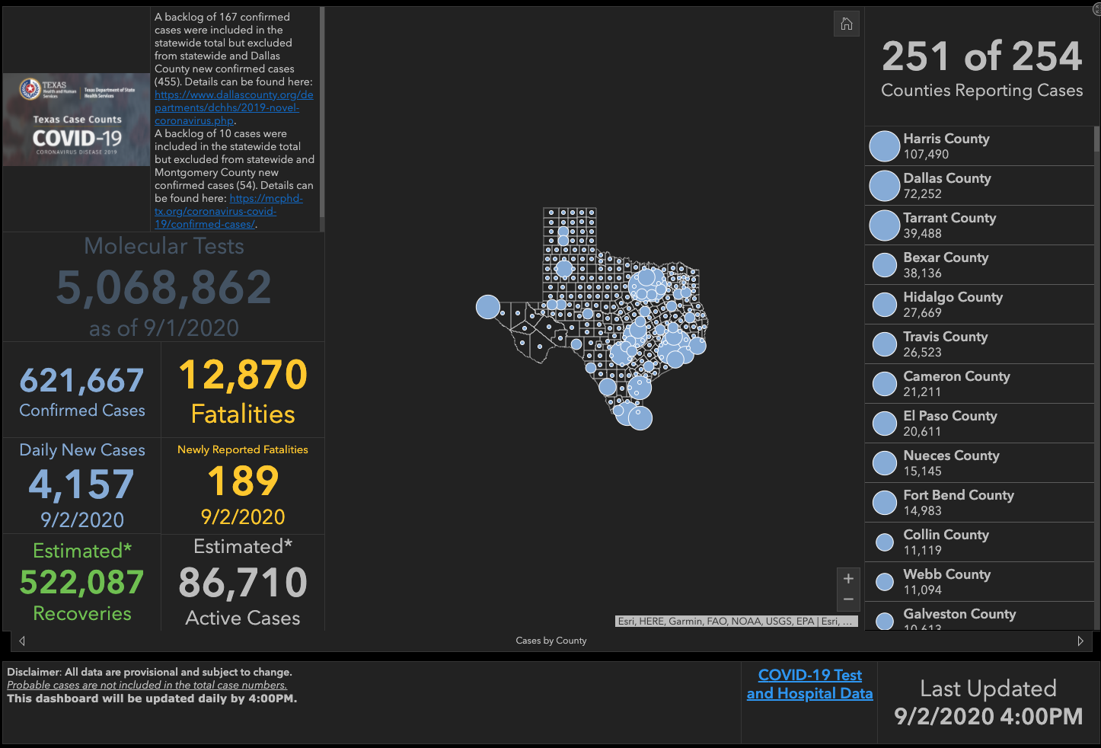

Slide 55
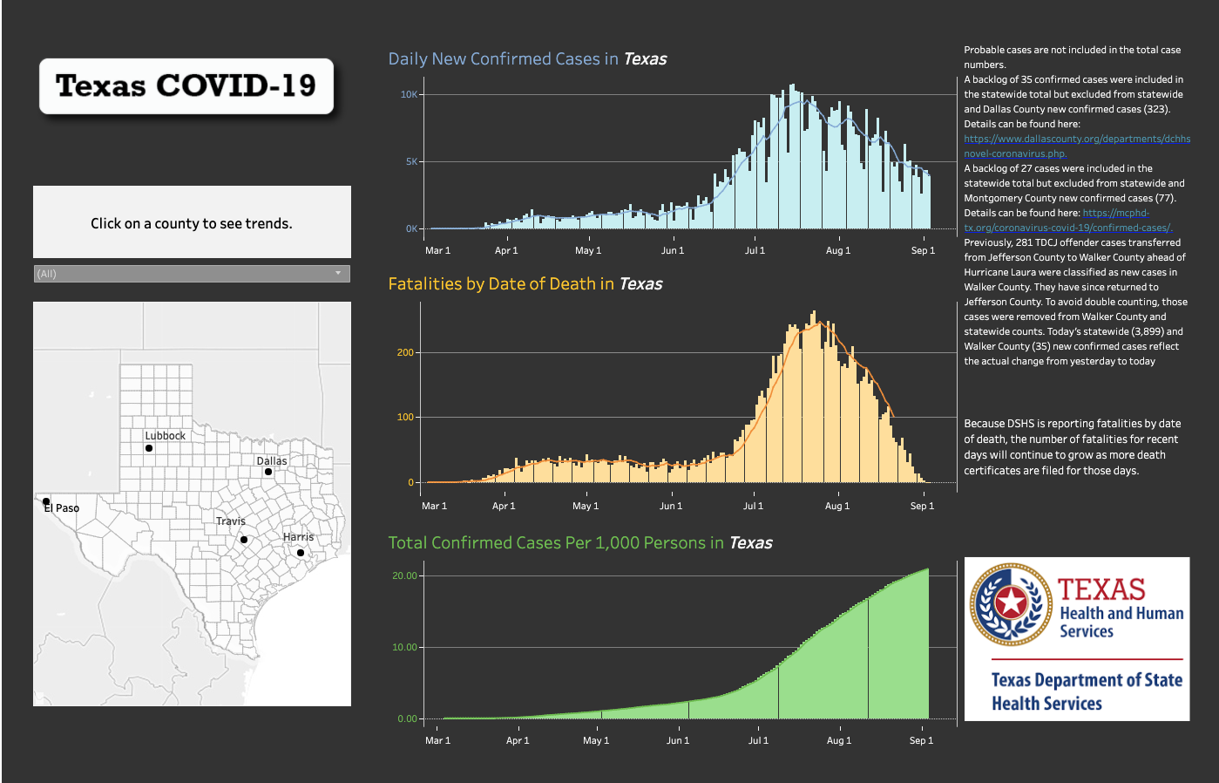

Slide 56
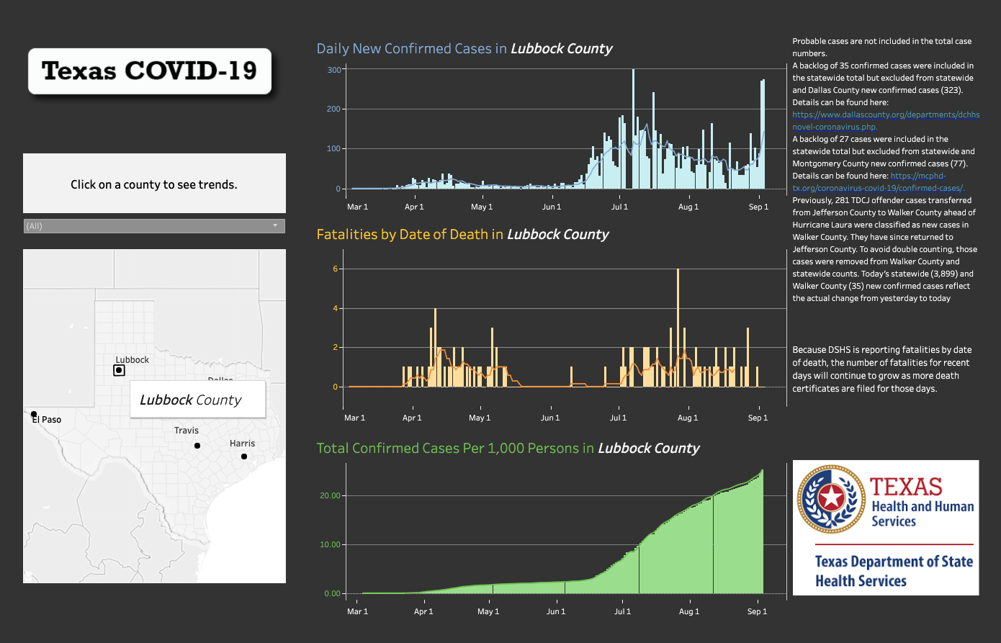

Slide 57
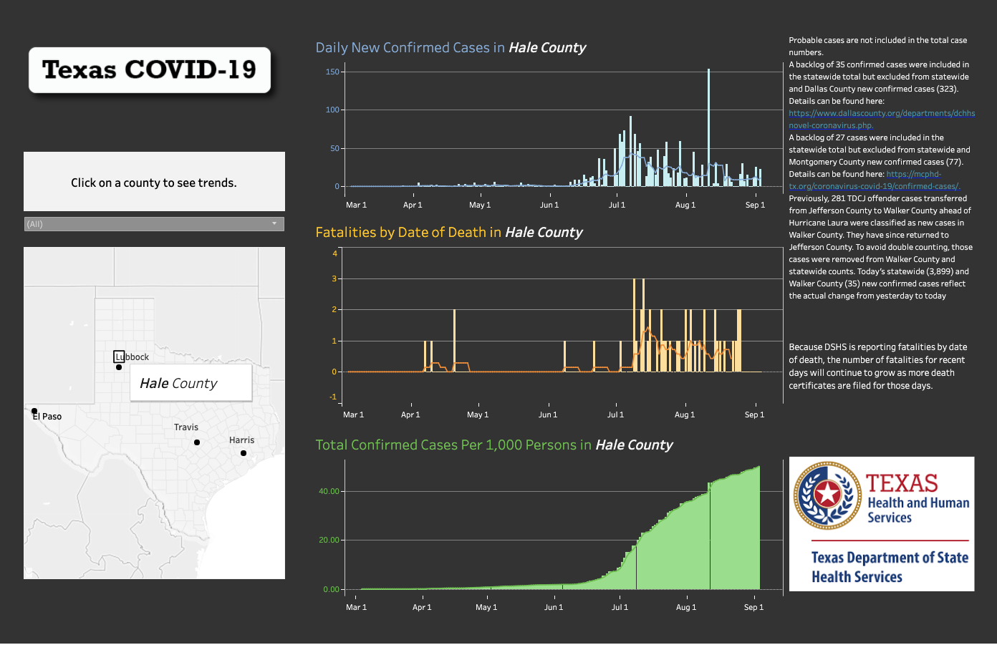

Slide 58
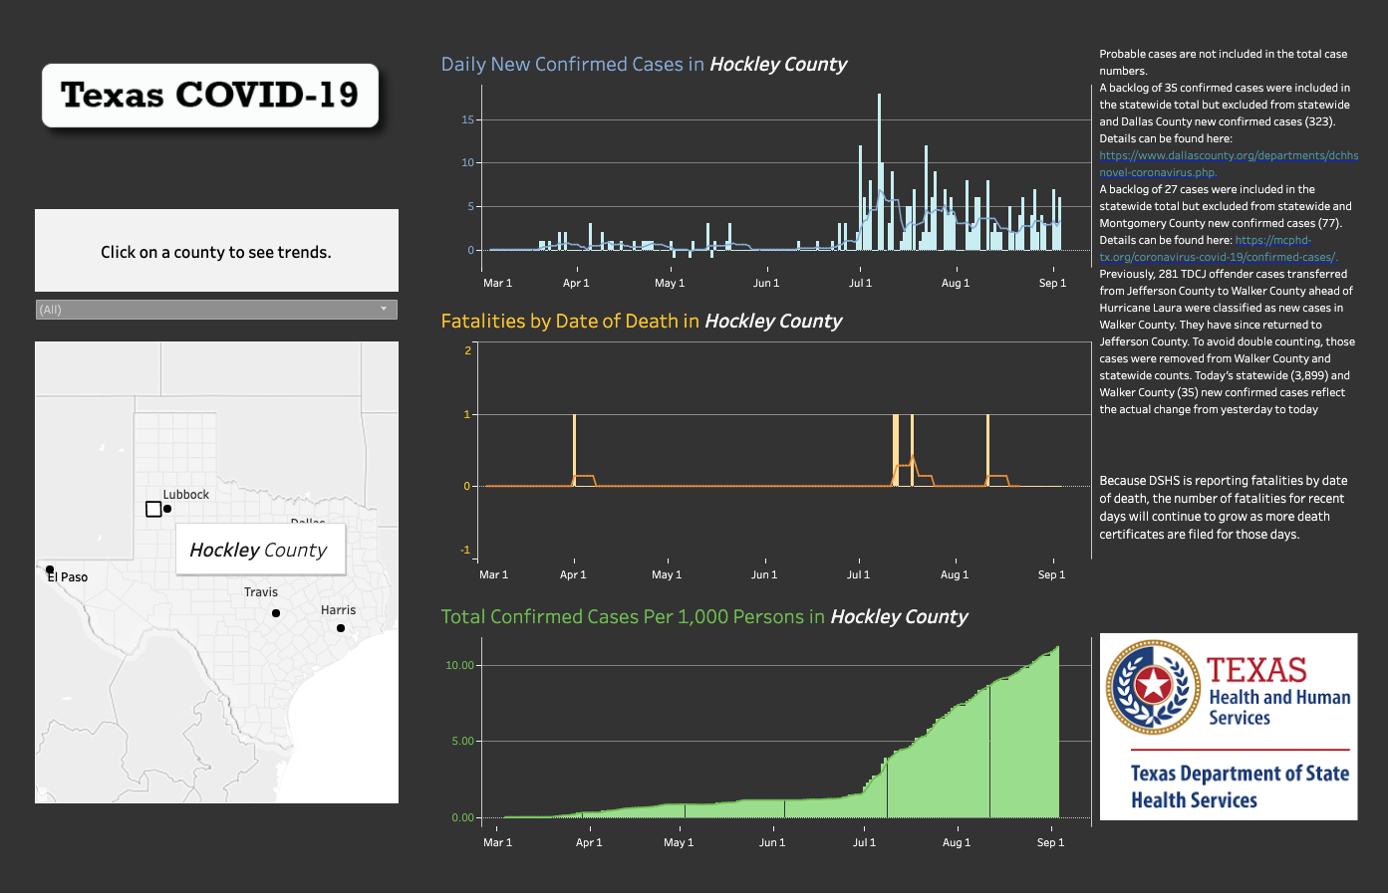

Slide 59
And if that wasn’t bad enough….

Slide 60
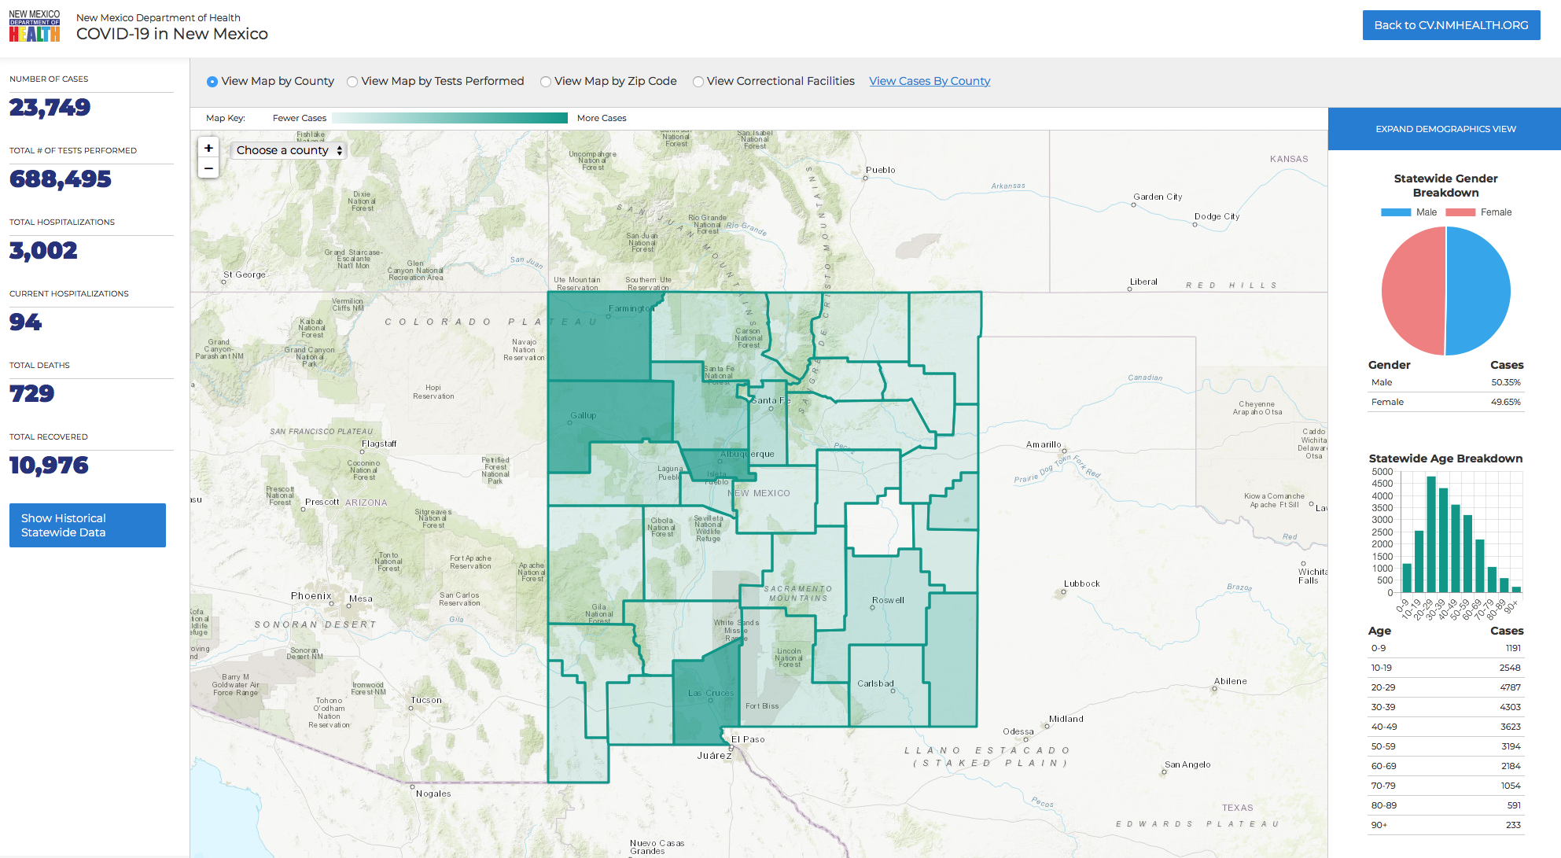
Last Week…

Slide 61
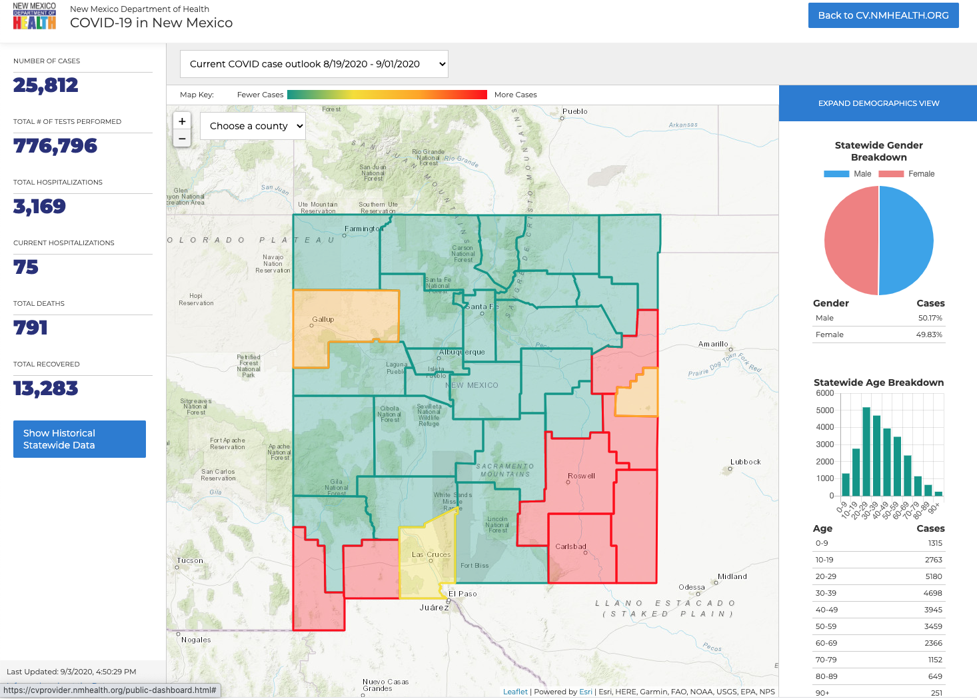

Slide 62
In other news…

Slide 63
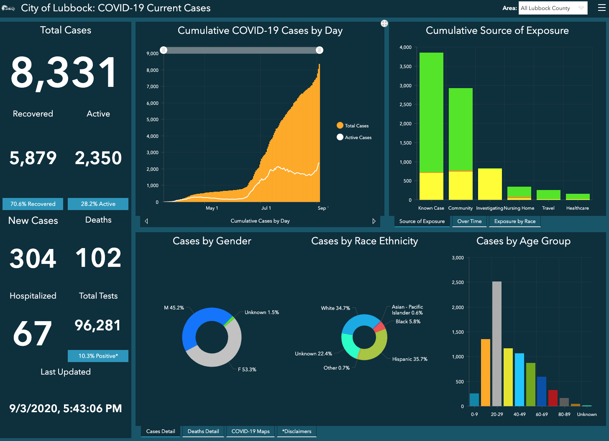
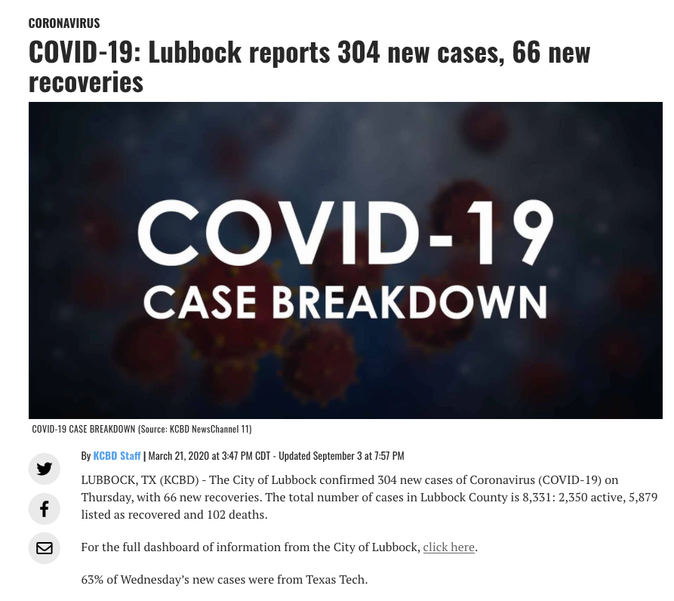

Slide 64
Lifestyles Is expanding Hours: Beginning Tuesday, Sept 8th , 2020 Mon-Thurs: 5:30am-7:30 pm Friday: 5:3—6:00 pm No weekends (for now)

Slide 65
One more thing…
“Observers” are still not allowed; will revisit issue Nov 1
An effort to conserve PPE, decrease risk of spread
This does not apply to medical students on clinical rotations!
Observers may be:
Physicians trained elsewhere, seeking residency positions
HS students thinking about medical school
College students seeking hours for clinical careers (PT, OT, etc.)

Slide 66
Got any questions or suggestions??
Please submit them in the chat box!

Slide 67
CME Credit was only approved for the Live Teams meeting
To receive credit for this continuing education activity, the participant must:
Make sure you are logged into your Teams account, if you are signed in with a group provide attendee’s First and Last name(s) in the comments section.
If you are calling into the Teams meeting you MUST text your First & Last Name to (806) 252-4735. This will ensure you are added to the sign in sheet to receive CME Credit.
You will receive an email within 3 business days from the CME department with further instructions on claiming your certificate.

