Slide 1
Covenant Health
COVID-19 Update for Physicians
April 24, 2020

Slide 2
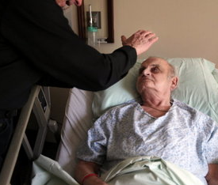
Reflection

Slide 3
CMC Surge Plan
COVENANT MEDICAL CENTER
Currently

Slide 4
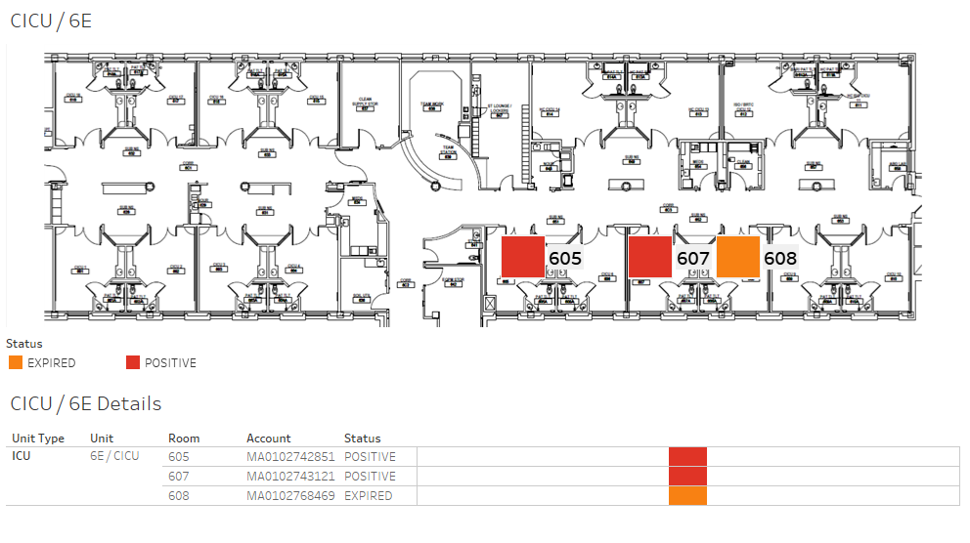
COVID-19 Cases ICU (6E)

Slide 5
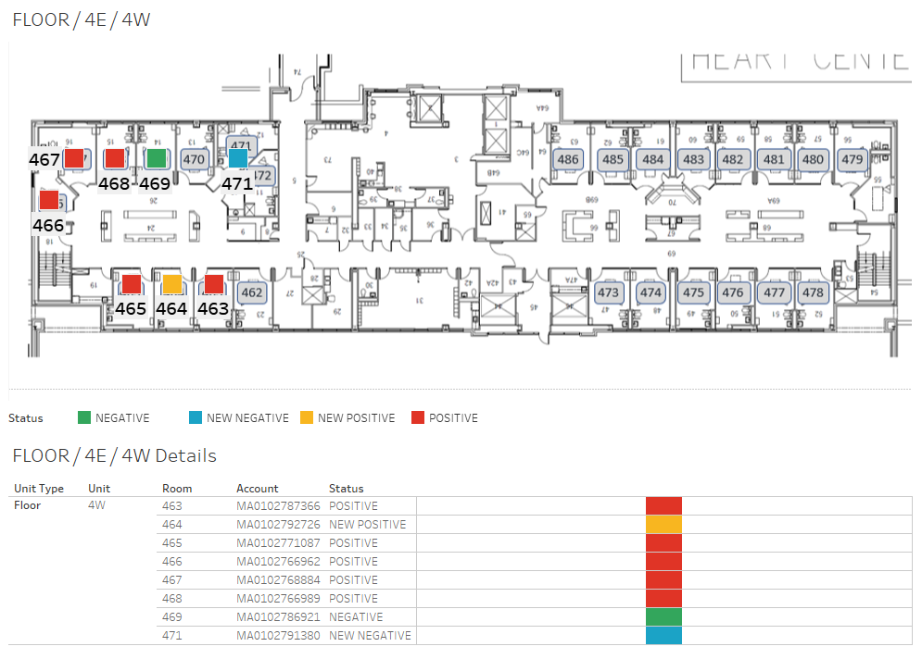
COVID-19 Cases Non-ICU (HC4)

Slide 6
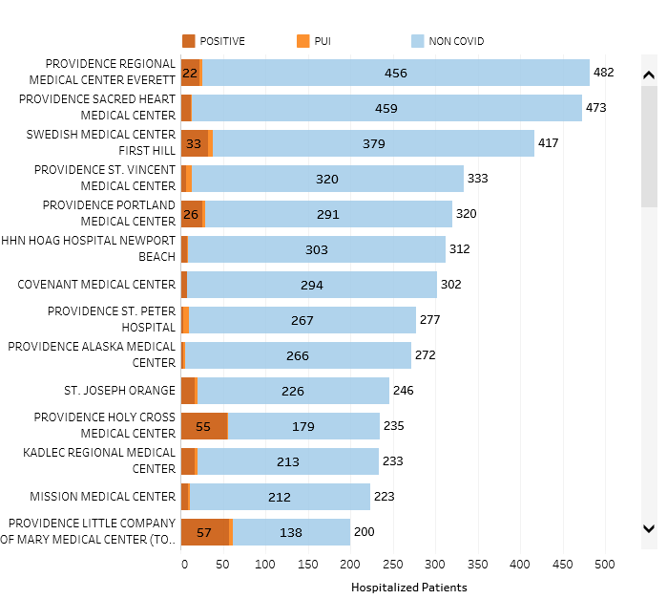
Providence System Hospitalized COVID-19 Cases
Updates Every 4Hrs

Slide 7
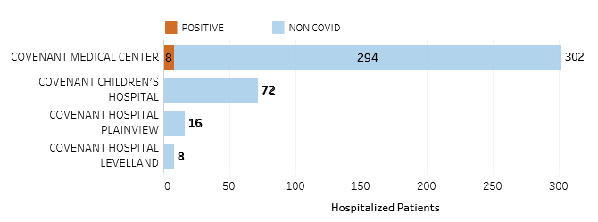
Hospitalized Covenant Region Patients
4-24-2020 at 0500
7
9

Slide 8
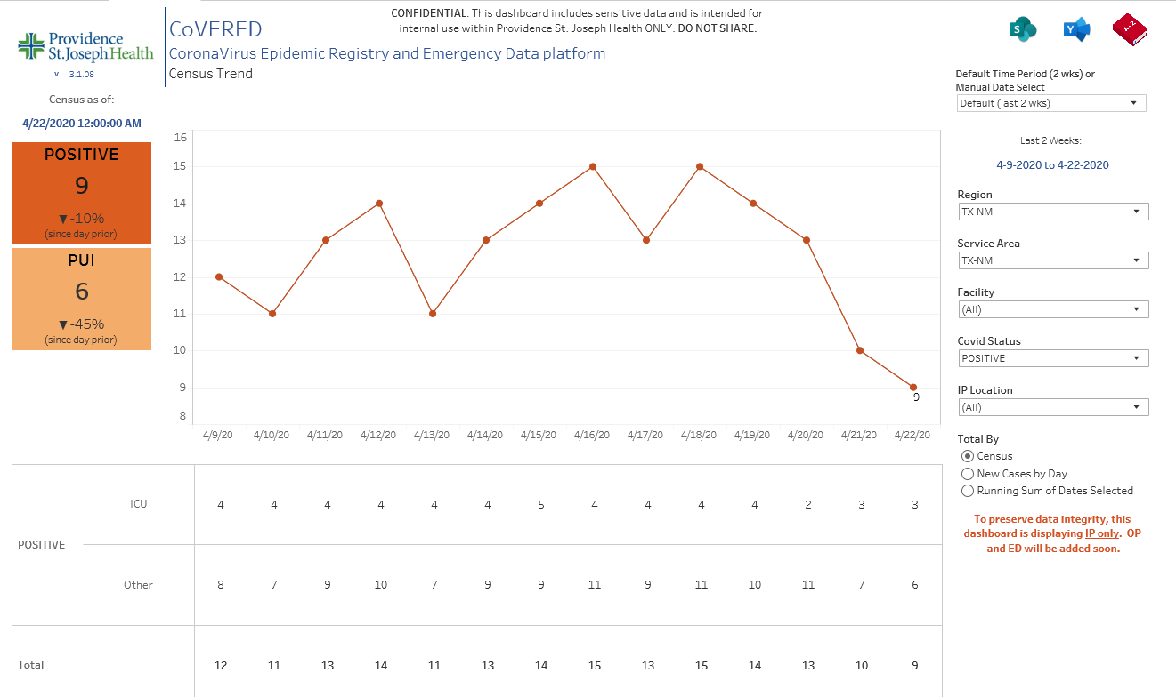
Texas Inpatient COVID-19 Volume

Slide 9
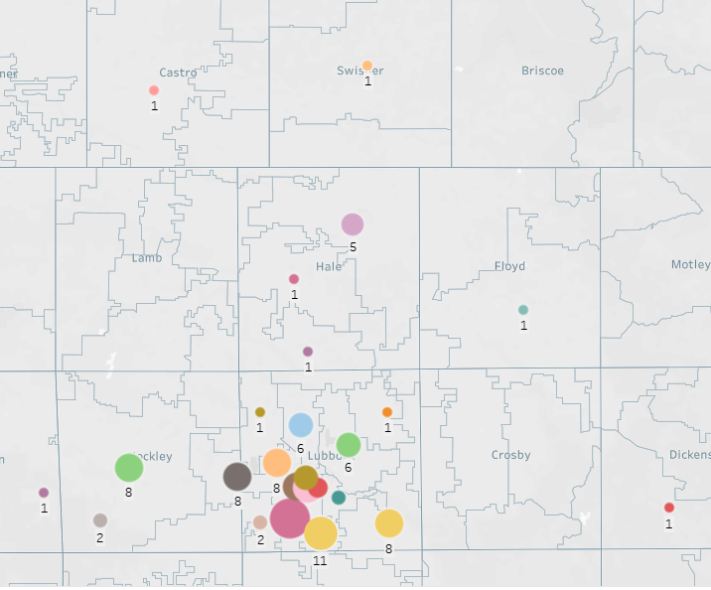
Testing COVID-19 Geographic Distribution of Positives

Slide 10
Mask renewal program
 | Medline | Sterrad | TTU
Cost | $3/mask | <$1/mask | 0
TAT | 10-14 days | 29 min | 4 days
Recovery Rate | 40% | 100% | 100%
Collection Process | Collection bin | Personal Package | Collection bin
Return Process | Bulk Return | Back to original user | Back to original user
N-95 | Green Stripe & Halyard | Halyard | Green Stripe & Halyard
Recommendation | Collect Green Stripe and wait to process until inventory warrants | After trials, begin reprocessing | Good back up
Suggest reprocessing 10 times - Trial this week
Trials with Sterrad
3M 1860
Halyard Duck Bill
Green Stripe (PFL)
Safety Zone RS900
3M 8210*
Not used in procedure areas
More coming from System
3M 8000
Not used in procedure areas
Physicians can receive one fabric mask

Slide 11
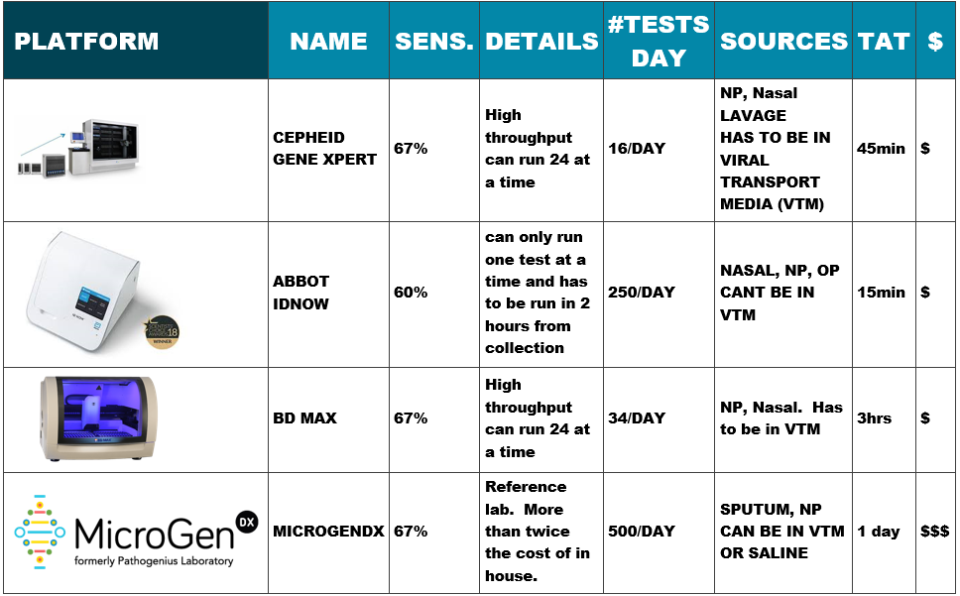
Current Covid-19 Molecular Testing Platforms

Slide 12
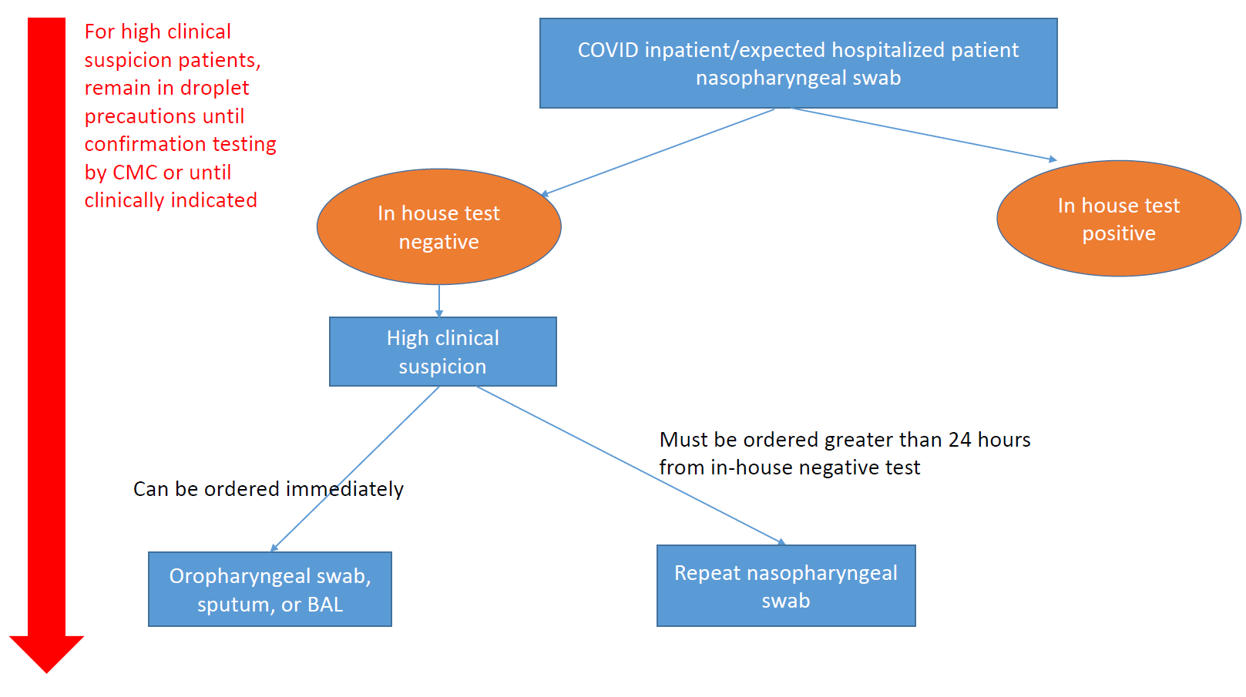
Repeat Testing

Slide 13
Antibody/Serologic Testing
Currently available through reference lab testing
Can not be used as a sole method to diagnose COVID-19
Seroconversion at 11-14 days in as low as 67%
Currently limited utility: Convalescent Plasma Donation

Slide 14
Covid-19 Research Protocols
Expanded Access Treatment Protocol: Remdesivir
(RDV;GS-5734) for the Treatment of SARS-CoV2 (CoV) Infection (Gilead Sciences)
  Activated at Covenant Friday, April 17, 2020
  First patient enrolled and treatment started Sunday, April 19th
  Second patient enrolled and treatment started Tuesday, April 21st

Slide 15
Covid-19 Research Protocols
Expanded Access to Convalescent Plasma for the Treatment of Patients with COVID-19 (MAYO)
  Facility and ID physicians registered for participation Monday, April 20th
  We will be ready to treat patients as soon as convalescent plasma is available through our local Vitalant Blood Services
  Covenant lab has been working with Vitalant to identify potential plasma donors
  One patient has been screened and deemed ineligible

Slide 16
Antibody Screening in Convalescent Serum
Vitalant is seeking convalescent plasma donors to help patients. Eligibility criteria are:
Prior diagnosis of COVID-19, documented by a laboratory test
Complete resolution of symptoms for at least 14 days
Meet all other current FDA donor eligibility requirements to donate plasma

Slide 17
Covid-19 Research Protocols
SARS-CoV-2 Serosurveillance Protocol for PSJH Health Care Workers
  Ongoing discussions regarding feasibility of conducting trial locally
  Have not moved forward on this trial

Slide 18
Pharmacy Update on Covid-19
AT PRESENT, NO DRUG HAS BEEN PROVEN TO BE SAFE AND EFFECTIVE FOR TREATING COVID-19
Hydroxychloroquine 400 mg PO BID x 1 day, then 200 mg PO BID x 4 days
  Most commonly used medication based on early data from China and France
  Conflicting study reports
  Most recent studies reveal no evidence of clinical efficacy in hospitalized patients and ~10% rate of adverse events
Adding Azithromycin 500 mg PO x 1, then 250 mg PO daily x 4 days
  Non-randomized reports showed potential benefit for mild disease, no in-vitro activity, associated with QT prolongation
  NIH COVID-19 Treatment Guidelines recommends against use except in the context of a clinical trial
Tocilizumab 4-8 mg/kg (max 800mg) IV x 1, may repeat once in 8-12 hours
  Encouraging reports from experience in China but no data from clinical trials
  Indicated in those with a possible good outcome in cytokine storm with severe disease
    IL-6 lab is a send out
  Use in the absence of acute bacterial or fungal co-infection
  Extremely expensive ($2.13K-4.25K per dose)

Slide 19
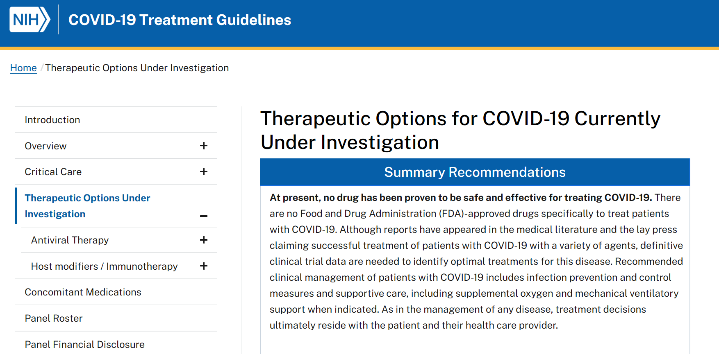
Pharmacy Update on Covid-19
Zinc, Ascorbic Acid, Vitamin B
  There is no literature that supports the use of these agents in the treatment of COVID-19
Remdesivir 200 mg IV x 1, then 100 mg IV daily x 9 days
  Covenant is enrolled in expanded access program for patients on a vent with adequate renal and hepatic function
  Early data shows promise, waiting on conclusions from all of the trials
Convalescent Plasma
  Limited data on its use but the information is very promising
  Covenant is enrolling in a the trial through the Mayo clinic
NIH Coronavirus Treatment Guidelines are available
online.
  https://covid19treatmentguidelines.nih.gov/

Slide 20
Restarting Essential (not “elective”) Procedures
Each Ministry has a slightly different plan in place
  Discuss with your ministry team for specifics
Many Steps are still in development
  There are requirements on provision for caring for Covid-19 patients, and the maintenance of adequate PPE.
There will still be a prioritization process by physician committees in place to approve cases.
The first step in restarting is Pre-Operative Testing of patients

Slide 21
Pre-Operative Testing
Surgical Assessment Services (SAS) is critical for scheduling
  This has been underutilized in the past
  Should now be considered a vital part of the scheduling process.
All procedural patients for CMC, & HPSC will be COVID screened at CMC SAS within 48 Hours of Procedure
  If patient is located out of town and can’t be screened prior to surgery, we will provide morning of procedure COVID screening through hospital admitting process
Screening will be completed by appointment only (No Walk-Ins)

Slide 22
Pre-Operative Testing (Cont.)
If General Pre-Op Assessments, EKG, or Chest X-Ray is required of SAS, the attached Reservation form must be completed and submit no later than 72 hours from the procedure date
  This is required by Admitting team to ensure patients are pre-registered prior to their SAS visit
  Reservation form is NOT required if the patient only needs COVID screening and/or Labs
CMC SAS will now be open Monday through Saturday (8 AM – 5 PM)
  This will accommodate the 48 hour COVID screening window for Monday cases

Slide 23
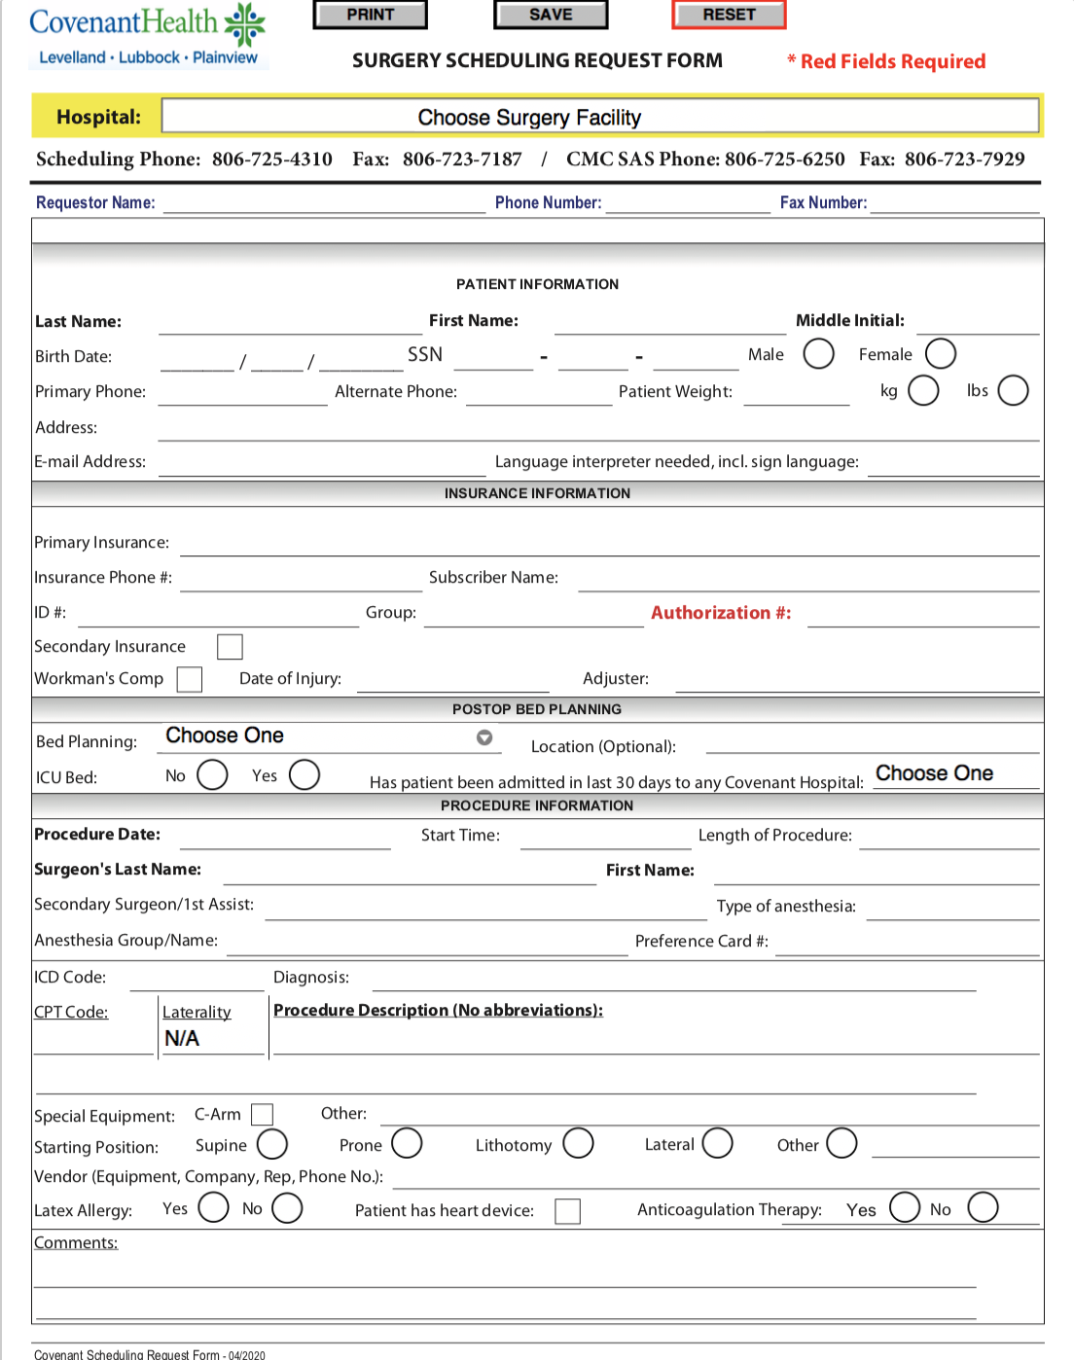
Surgery Scheduling Request Form

Slide 24
Children’s Hospital Pre-Operative Procedures
Pediatric cases can be screened at 82nd and Slide (Pedi-Urgent Care one day prior to admission
Expectant Moms will be screened at the Frenship Stadium Drive-Thru (includes Sunday testing for Monday deliveries)

Slide 25
Grace Pre-Operative Procedures
Testing will be done ON-SITE with the Abbott technology.
They currently have availability of 100 tests per week
The testing will be done 48 hours prior to admission (the exception is that for Monday morning cases, the testing can be done on the Friday before.

Slide 26
Plainview Pre-Operative Procedures
Pre-Op Covid-19 testing will be accomplished 48 hours prior to the case
For Monday cases, the testing will be accomplished on Friday before the weekend starts.

Slide 27
Levelland Pre-Operative Procedures
Pre-Op Covid-19 testing will be accomplished prior to the case in the regional clinics
If not previously done, testing will be done when the patient arrives.
(The lower volume of patients will make this possible at that location)

Slide 28
Scrubs
Over the last 90 days, approximately 400 sets of hospital scrubs have gone missing from our inventory at CMC and CCH. Because of the Covid-19 Pandemic, there is currently a nationwide shortage of hospital scrubs. Covenant has been notified by its scrub provider that additional inventory will not be available for several months.
If you have any hospital owned scrubs in your possession; at home, in your locker, in your car, etc. please return them to the Environmental Services Department.

Slide 29
Ventilator Inventory / In Use*
99 vents –24% in use
4 out of service
44 contingency – 34% in use
Discussing with anesthesiologists a plan for use of anesthesia machines as vents on NON-Covid patients. (last resort would be to use on COVID+ patients)
* As of 4-23-2020

Slide 30
Q & A

