Slide 1
Covenant Health
COVID-19 Update for Physicians
May 1, 2020

Slide 2
Reflection

Slide 3

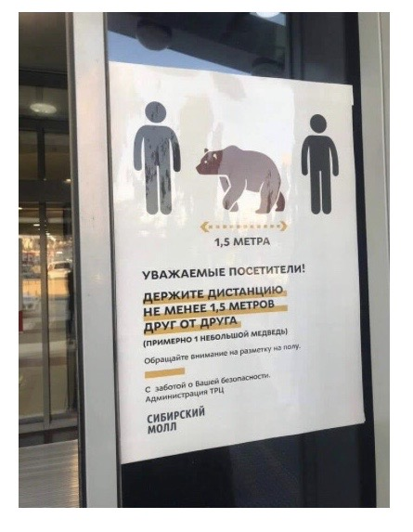
"This is actually an act of kindness, an act of compassion toward ourselves and toward others. If we can reframe our behavior, if we can reframe the instruction that we’re being given, and reflect on how, when we make a commitment to engage in physical distancing, we’re actually engaging in an act of generosity toward others. It can really help to change our relationship to the predicament in which we find ourselves.”
-Dr. Richard Davidson

Slide 4
CMC Surge Plan
COVENANT MEDICAL CENTER
Currently
Last Week

Slide 5
Statistics

Slide 6
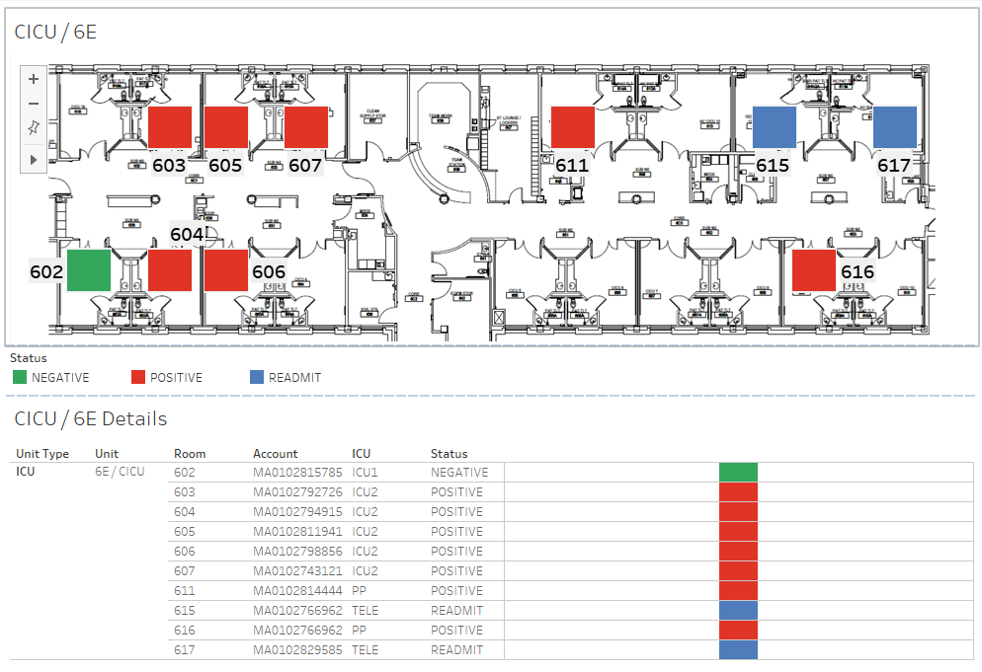
COVID-19 Cases 6E MIXED USE

Slide 7
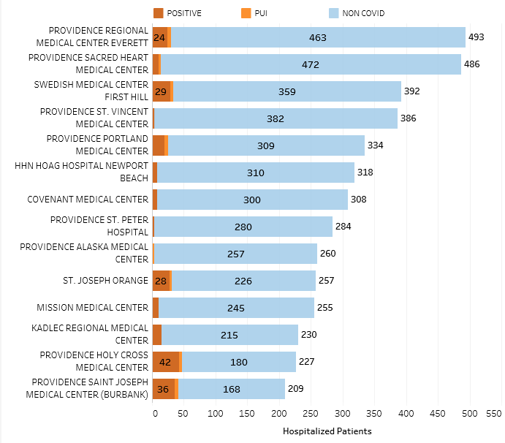
Providence System Hospitalized COVID-19 Cases

Slide 8
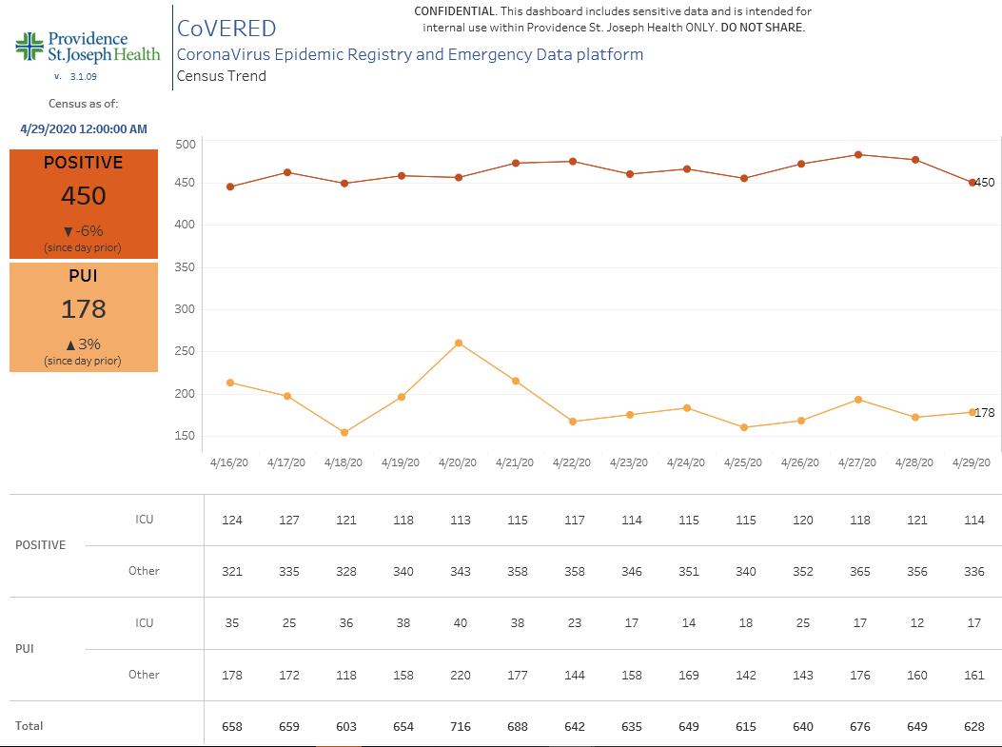
Providence Inpatient COVID-19 Volume

Slide 9
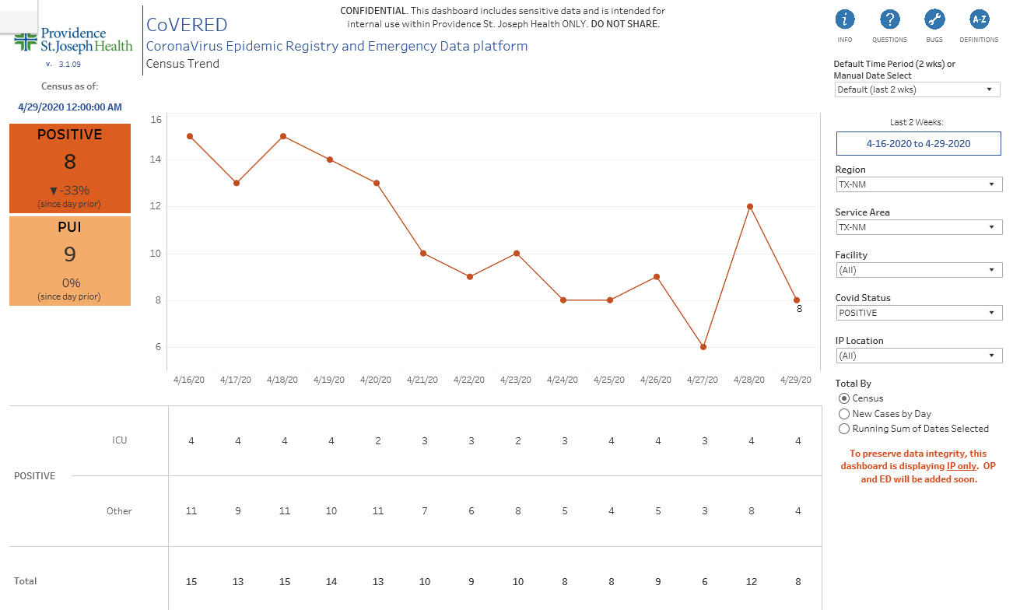
Texas Inpatient COVID-19 Volume

Slide 10
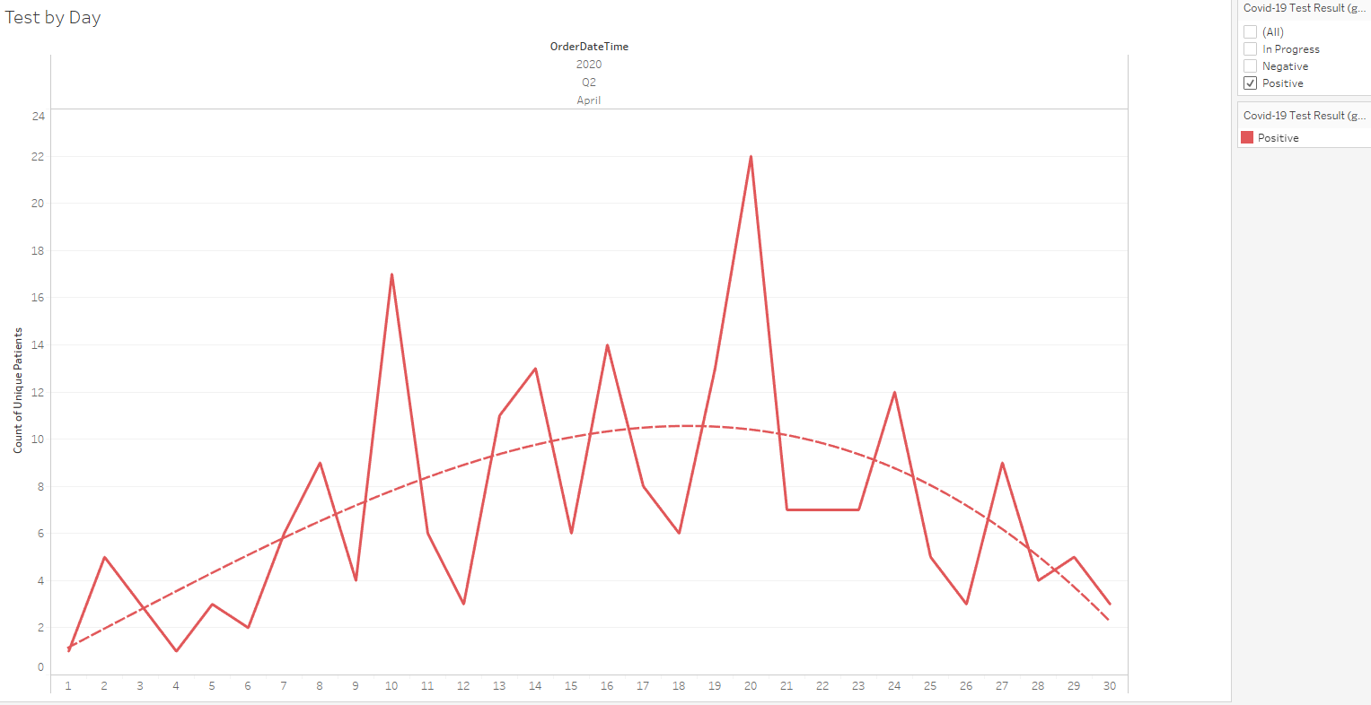
New Covid-19 POSITIVES by Day

Slide 11
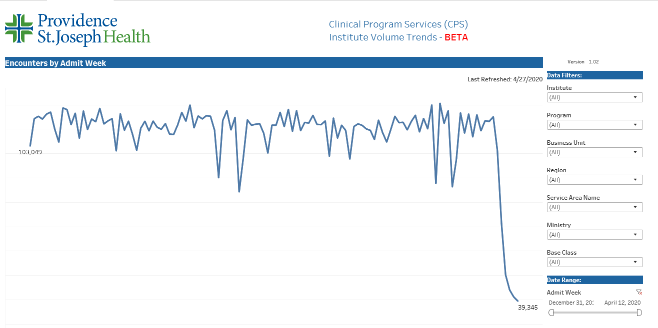
Providence System Weekly Admissions
March 1
115,029
66% Reduction
April 12
39,345

Slide 12
Texas Medical Board
Notification April 30, 2020

Slide 13
Texas Medical Board Press Release
FOR IMMEDIATE RELEASE
April 30, 2020
Media contact: Jarrett Schneider, 512-305-7018
Customer service: 512-305-7030 or 800-248-4062
TMB Adopts Emergency Rule Related to Gov. Abbott's Executive Order GA-19
Following Governor Greg Abbott's issuance of Executive Order GA-19, the Texas Medical Board's Executive Committee today adopted rules on an emergency basis.
The adopted rule amends 22 TAC Chapter 190.8 Violation Guidelines, and adds to the definition of "Unprofessional and Dishonorable Conduct" under 22 TAC §190.8(2)(U).
The adopted emergency rule goes into effect May 1, 2020 at 12:00 a.m.

Slide 14
The rule adds the following required minimum standards for safe practice related to COVID-19, and certain posting notice of those minimum standards:
(U) Notice and Compliance Requirements Concerning COVID-19 Minimum Standards of Safe Practice
(i) All physicians providing patient care or engaging in an in-person patient encounter, must implement the following minimum COVID-19 standards of safe practice.
(I) a mask must be worn by both the patient and physician or the physician's delegate when in proximity of the patient (meaning less than a 6-foot distance between the patient and the physician or the physician's delegate);
(II) follow policies the physician, medical and healthcare practice, or facility has in place regarding COVID-19 screening and testing and/or screening patients;

Slide 15
(III) that, before any encounter, patients must be screened for potential symptoms of COVID-19 or verified previously screened within last 20 days; and
(IV) that prior to care involving a medical procedure or surgery on the mucous membranes, including the respiratory tract, with a high risk of aerosol transmission, the minimum safety equipment used by a physician or physician's delegate should include N95 masks, or an equivalent protection from aerosolized particles, and face shields.
(ii) All physicians providing patient care or engaging in an in-person patient encounter in medical and healthcare practices, offices, and facilities, other than hospitals as defined under Chapter 241 of the Texas Health & Safety Code, shall post a COVID-19 Minimum Standards of Safe Practice Notice (COVID-19 Notice), delineating the minimum standards of safe practice described in this subsection, in each public area and treatment room or area of the office, practice, or facility.
The Executive Committee also withdrew emergency rules related to Executive Order GA-15 effective May 1, 2020 at 12:00 a.m.

Slide 16
Covid Testing

Slide 17
Antibody/Serologic Testing
Currently available through reference lab testing
Can not be used as a sole method to diagnose COVID-19
Seroconversion at 11-14 days in as low as 67%
Currently limited utility: Convalescent Plasma Donation

Slide 18
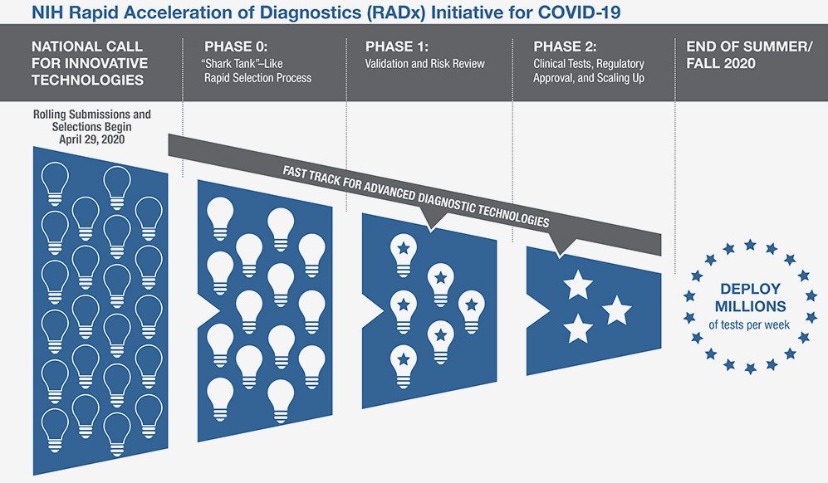
NIH Plan for Rapidly Expanding Testing

Slide 19
Pharmacy Update

Slide 20
Pharmacy Update on COVID-19
AT PRESENT, NO DRUG HAS BEEN PROVEN TO BE SAFE AND EFFECTIVE FOR TREATING COVID-19
Hydroxychloroquine 400 mg PO BID x 1 day, then 200 mg PO BID x 4 days
  Most commonly used medication based on early data from China and France
  Most recent studies reveal no evidence of clinical efficacy in hospitalized patients and ~10% rate of adverse events
Adding Azithromycin 500 mg PO x 1, then 250 mg PO daily x 4 days
  NIH COVID-19 Treatment Guidelines recommends against use except in the context of a clinical trial
Tocilizumab 4-8 mg/kg (max 800mg) IV x 1, may repeat once in 8-12 hours
  Indicated in those with a possible good outcome in cytokine storm with severe disease
  Use in the absence of acute bacterial or fungal co-infection
  Extremely expensive ($2.13K-4.25K per dose)
  Working on criteria for use
Notes:
The FDA says that neither drug has been proven safe and effective in treating COVID-19. In fact, a study published on April 23 involving 368 COVID-19 patients at U.S. Veterans Health Administration hospitals found that taking hydroxychloroquine alone, or in combination with azithromycin, did not reduce the need for a ventilator compared to those not taking the drugs. Further, people taking hydroxychloroquine alone had a higher risk of dying during the study than those not taking the drug. Researchers in China came to a similar conclusion in a study of 150 COVID-19 patients randomly assigned to receive hydroxychloroquine or the current standard of care: after a month, both groups had similar symptom profiles, and showed similar levels of the virus, suggesting that the drug wasn’t clearing the COVID-19 virus in a significant way. The National Institutes of Health is conducting an ongoing study of hydroxychloroquine among hospitalized patients, as is Novartis, whose Sandoz division makes a generic version of the drug.

Slide 21
Pharmacy Update on COVID-19
Remdesivir 200 mg IV x 1, then 100 mg IV daily x 9 days
  Covenant is enrolled in expanded access program for patients on a vent with adequate renal and hepatic function
    Have enrolled three patients to date
    Two who completed course are extubated
  4/10: NEJM reported clinical improvement in 36 of 53 patients
  4/22: Leaked China study showed no clinical improvement with remdesivir
  4/25: NIH reported preliminary results showing quicker time to recovery (11 days vs 15 days, p < 0.001)
    Nonsignificant improvement in mortality (11.6% vs 8%, p = 0.059)
Convalescent Plasma
  Covenant is enrolling in a the trial through the Mayo clinic
Zinc, Ascorbic Acid, Vitamin B
  There is no literature that supports the use of these agents in the treatment of COVID-19
Notes:
According to the summary of the China study, remdesivir was “not associated with a difference in time to clinical improvement” compared to a standard of care control. After one month, it appeared 13.9% of the remdesivir patients had died compared to 12.8% of patients in the control arm. The difference was not statistically significant.
Hospitalized patients with advanced COVID-19 and lung involvement who received remdesivir recovered faster than similar patients who received placebo, according to a preliminary data analysis from a randomized, controlled trial involving 1063 patients, which began on February 21. The trial (known as the Adaptive COVID-19 Treatment Trial, or ACTT), sponsored by the National Institute of Allergy and Infectious Diseases (NIAID), part of the National Institutes of Health, is the first clinical trial launched in the United States to evaluate an experimental treatment for COVID-19. Preliminary results indicate that patients who received remdesivir had a 31% faster time to recovery than those who received placebo (p<0.001). Specifically, the median time to recovery was 11 days for patients treated with remdesivir compared with 15 days for those who received placebo. Results also suggested a survival benefit, with a mortality rate of 8.0% for the group receiving remdesivir versus 11.6% for the placebo group (p=0.059). Recovery in this study was defined as being well enough for hospital discharge or returning to normal activity level.

Slide 22
Pre-Procedure Testing for Covid-19

Slide 23
Pre-Procedure Testing Protocol
The laboratory will notify the physician who scheduled the procedure of COVID-19 test results. If the test is positive, the ordering physician should notify:
Patient
Patient’s PCP
Hospital Admitting Office
Intended procedural area (OR, Cath Lab, Endoscopy, etc)

Slide 24
Response to Covid-19 Test Results
For patients undergoing testing 48-72 hours before a planned procedure, if the test results for COVID-19 are:
Negative, continue with the procedure as planned. Encourage patient to maintain physical distancing to prevent potential exposure and infection.
Positive, evaluate if the procedure can be delayed:
  If the procedure CANNOT be delayed, continue with the procedure as planned, knowing the patient may yet still be infected. You should exercise extreme caution and wear appropriate Level 3 PPE.
    Notification should be made to the patient, the ordering physician, admitting, the procedural unit, and the patient’s PCP. The patient must understand the need for social distancing to prevent exposure prior to the procedure date;
or
  If the procedure CAN be delayed, postpone the procedure for 10-14 days and then continue with the procedure, as planned WITHOUT retesting the patient.
Utilize appropriate PPE. Notification should be made to the patient, the ordering physician, admitting, the procedural unit, and the patient’s PCP that the patient has tested positive, and that they need to inform family members and other close contacts.

Slide 25
Impact to Caregivers

Slide 26
Caregivers Impacted by Exposure and Test Positive
CDC Guidance
Testing Based Strategy: Exclude from work until
  Resolution of fever without the use of fever-reducing medications and
  Improvement in respiratory symptoms (e.g., cough, shortness of breath), and
  Negative results of an FDA Emergency Use Authorized molecular assay for COVID-19 from at least two consecutive nasopharyngeal swab specimens collected ≥24 hours apart (total of two negative specimens)
  Time Protocol

Slide 27
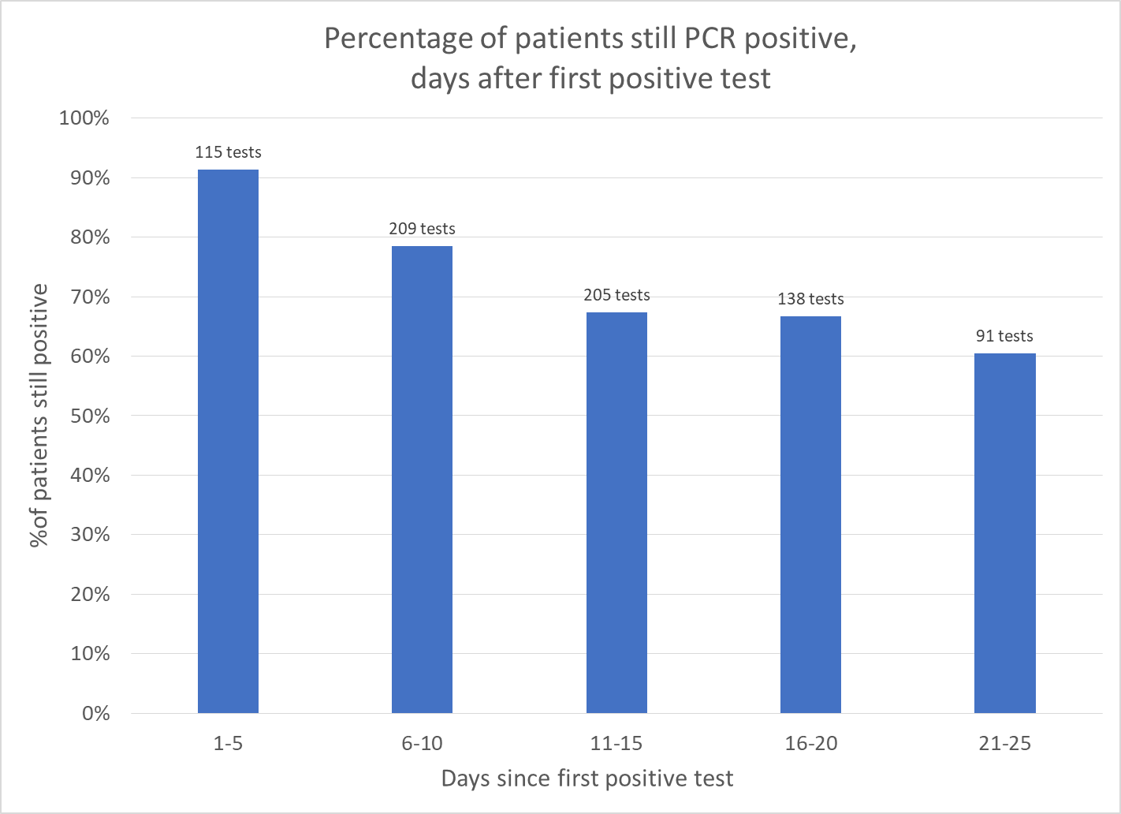
758 repeat PCR tests in 405 patients

Slide 28
Caregivers Impacted by Exposure and Test Positive
CDC Guidance:
Symptom Based Strategy: Exclude from work until
  At least 3 days (72 hours) have passed since recovery defined as resolution of fever without the use of fever-reducing medications and improvement in respiratory symptoms (e.g., cough, shortness of breath);
  and
  At least 10 days have passed since symptoms first appeared

Slide 29
Caregivers Impacted by Exposure and Test Positive
After returning to work, HCP should:
Wear a facemask for source control at all times while in the healthcare facility until all symptoms are completely resolved or until 14 days after illness onset, whichever is longer. A facemask instead of a cloth face covering should be used by these HCP for source control during this time period while in the facility. After this time period, these HCP should revert to their facility policy regarding universal source control during the pandemic.
  A facemask for source control does not replace the need to wear an N95 or higher-level respirator (or other recommended PPE) when indicated, including when caring for patients with suspected or confirmed COVID-19.
  Of note, N95 or other respirators with an exhaust valve might not provide source control.
Be restricted from contact with severely immunocompromised patients (e.g., transplant, hematology-oncology) until 14 days after illness onset
Self-monitor for symptoms, and seek re-evaluation from occupational health if respiratory symptoms recur or worsen

Slide 30
Caregivers Impacted by Exposure and Test Positive
Important Guidance:
Healthcare workers that HAVE BEEN SYMPTOMATIC are NOT REQUIRED to return to work if they are still short of breath with routine activity, if wearing of a mask exacerbates their work of breathing, or if other symptoms interfere with their ability to perform their routine functions. These guidelines should be used only to ALLOW a caregiver to return to work if they are asymptomatic and can perform their job function comfortably under the above conditions.

Slide 31
Research

Slide 32
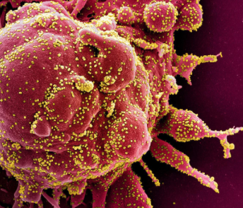
Remdesivir
  Activated at Covenant Friday, April 17, 2020
  First patient enrolled and treatment started Sunday, April 19th
  Second patient enrolled and treatment started Tuesday, April 21st
  Two patients have been successfully extubated
  A third patient has been started on the medication 4-29 (did not improve on convalescent plasma)
  NIH clinical trial shows Remdesivir accelerates recovery from advanced COVID-19 (Preliminary results)

Slide 33
Covid-19 Research Protocols
Expanded Access to Convalescent Plasma for the Treatment of Patients with COVID-19 (MAYO)
  Facility and ID physicians registered for participation Monday, April 20th
  We will be ready to treat patients as soon as convalescent plasma is available through our local Vitalant Blood Services
  Covenant lab has been working with Vitalant to identify potential plasma donors
  One donor was able to give four units of plasma.

Slide 34
Covid-19 Research Protocols
SARS-CoV-2 Serosurveillance Protocol for PSJH Health Care Workers
  Ongoing discussions regarding feasibility of conducting trial locally
  Have not moved forward on this trial
  Only about 2/3 of patients are manifesting a demonstrable immunoglobulin response
  Appearance of IgG may precede IgM
  Presence of antibodies does not necessarily confer lifetime immunity

Slide 35
Texas Demographics

Slide 36
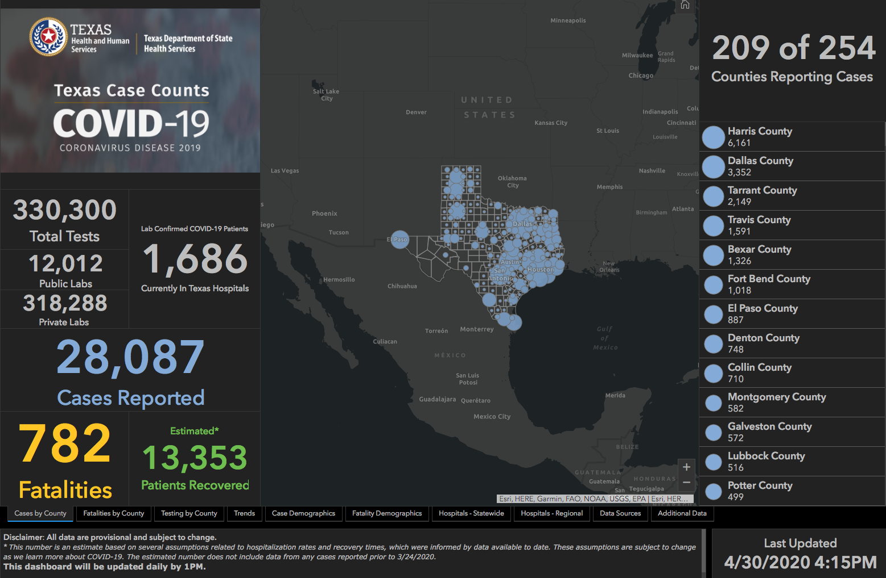

Slide 37
Q & A

