Slide 1
Covenant Health
COVID-19 Update for Physicians
May 15, 2020

Slide 2

Reflection

Slide 3
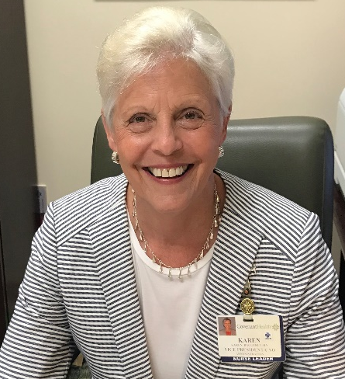
I have read some amazing recollections from Covenant nurses as they either cared for a COVID positive patient or were displaced from their workplace as their unit closed due to declining census. It made me think, I can’t imagine a world without nurses. Margretta Styles, founder of National Nurses Certification Day, once said: “Imagine a world without persons who know what nurses know, who believe as nurses believe, who do what nurses do, who have the effect that nurses have upon the health of individuals and families, who enjoy the trust that nurses enjoy.” I don’t want to ever imagine a world without nurses.
This year, I want to personally thank you for dedicating your lives to caring for others, especially during this critical time. Your skill, passion, optimism, and dedication to patient care is making a difference in the lives of many. So, instead of wishing you a Happy Nurses Week, I’m reminding you that:
Nurses are Strong.
Nurses are Amazing.
Nurses are Indispensable.
Nurses are Heroes.
And I consider myself extremely honored to serve alongside each of you.
Karen

Slide 4
CMC Surge Plan
COVENANT MEDICAL CENTER
Currently
Last Week

Slide 5
Statistics

Slide 6
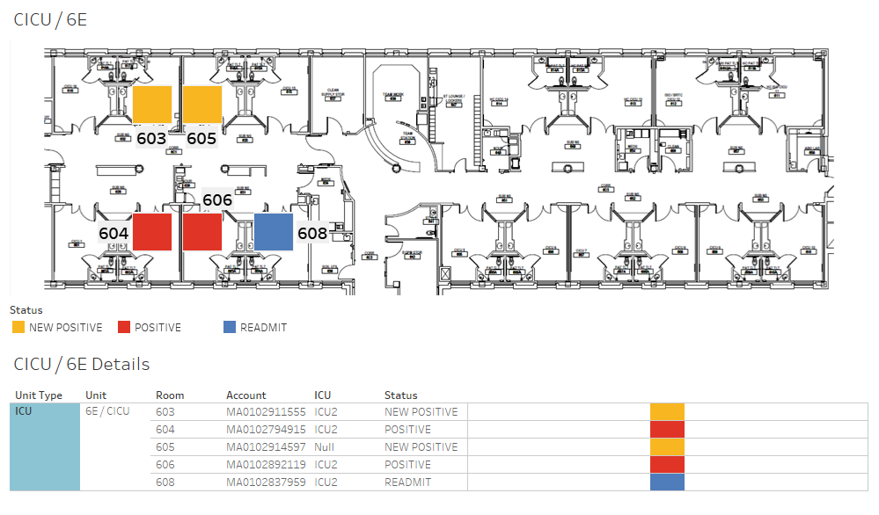
COVID-19 Cases 6E MIXED USE

Slide 7
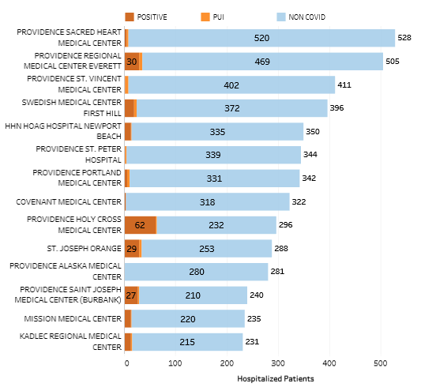
Providence System Hospitalized COVID-19 Cases

Slide 8
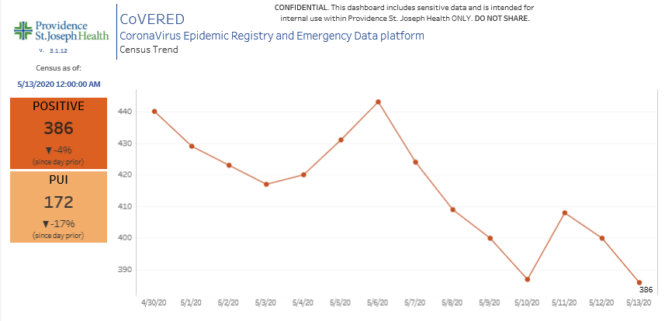
Providence Inpatient COVID-19 Volume

Slide 9
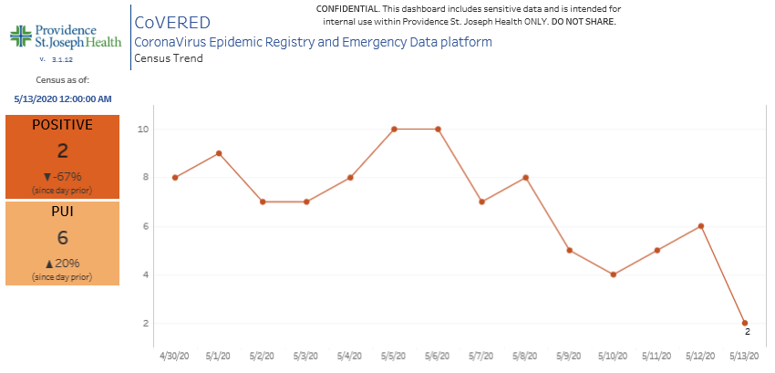
Texas Inpatient COVID-19 Volume
As of 6:00AM on 5/15, we are UP to 5 Positive Inpatients in the Region

Slide 10
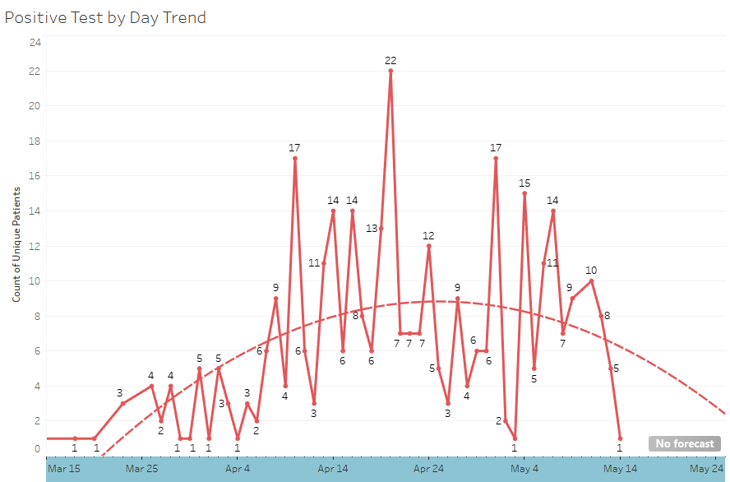
New Covid-19 POSITIVES by Day Trend

Slide 11
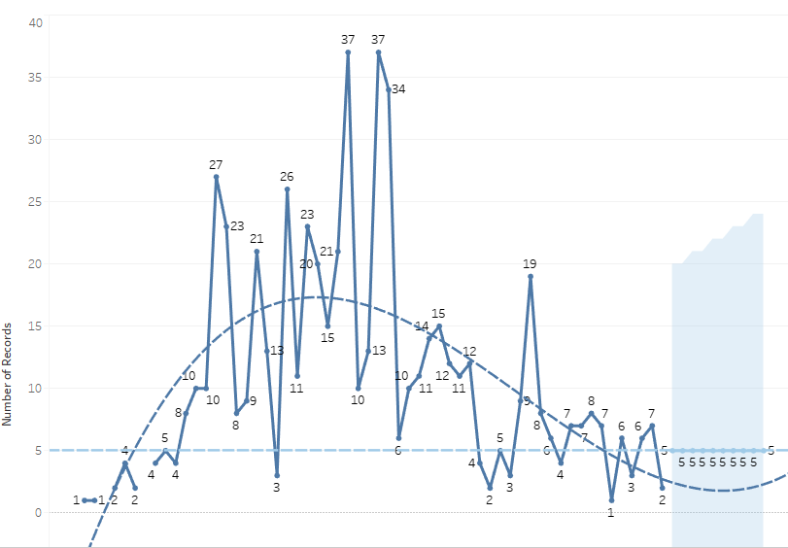
New Covid-19 POSITIVES by Day Forecast (City)

Slide 12
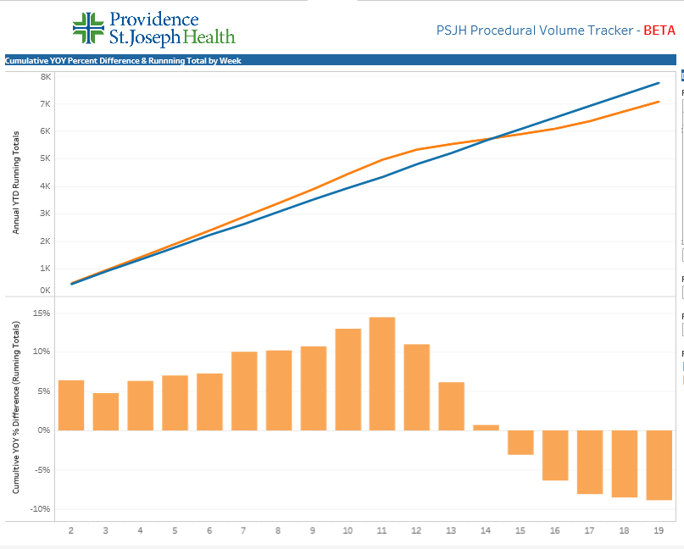
TX/NM Region Weekly Procedures (YOY)

Slide 13
Covid-19 Testing

Slide 14
Antibody/Serologic Testing
Currently available through CHP (Quest Diagnostics)
Lots of demand from employers as we “OPEN” back up
Covenant Clinical Lab will be able to provide in late May
Cannot be used as a sole method to diagnose COVID-19
Seroconversion at 11-14 days in as low as 67%
Currently limited utility: Convalescent Plasma Donation and/or Epidemiology data
The presence of antibodies does NOT mean an individual is “Immune”
Negative Results do NOT rule our Covid-19 Infection
Equivocal results may represent an early infection, detection of an IgG generated from a past infection (different strain of Coronavirus) or an underlying immune disorder….

Slide 15
Pharmacy Update
Allen Cunningham, PharmD

Slide 16
CHS COVID-19 Treatments
Agent | Dosage | Comments | Update
Hydroxychloroquine | 400 mg PO BID x 1 day, then 200 mg PO BID x 4 days | Most commonly used medication based on early data from China and France Recent data suggests no benefit with potential harm Caution advised in patients at risk for QT prolongation/arrhythmias | NIH updated guidelines (5/12/20): insufficient data to recommend either for or against using chloroquine or hydroxychloroquine for the treatment of COVID-19 recommends AGAINST using high-dose chloroquine (600 mg twice daily for 10 days) PSJH AMS COVID-19 subgroup lists HCQ as an alternative management strategy for high risk patients only
Hydroxychloroquine + azithromycin | Azithromycin 500 mg PO x 1, then 250 mg PO daily x 4 days | High risk for adverse events (QTc prolongation); guidelines recommend AGAINST use except in the context of a clinical trial | No change from 5/8/20 PSJH AMS COVID-19 subgroup recommends AGAINST use of this combination
Tocilizumab | 400 mg IVPB x 1 dose May repeat x 1 in 8-12 hours if clinical symptoms worsen or do not demonstrate improvement | IL-6 receptor antagonist used to treat CRS ($2.13K - $4.25K per dose) CHS criteria for use: Proven COVID-19 infection Early treatment of severe or critically ill patients who are clinically deteriorating Restricted to intensivists or ID AST/ALT <5xULN, ANC >500, Plt >50K | NIH updated guidelines (5/12/20): insufficient data to recommend either for or against the use of IL-6 inhibitors for the treatment of COVID-19
Notes:
The FDA says that neither drug has been proven safe and effective in treating COVID-19. In fact, a study published on April 23 involving 368 COVID-19 patients at U.S. Veterans Health Administration hospitals found that taking hydroxychloroquine alone, or in combination with azithromycin, did not reduce the need for a ventilator compared to those not taking the drugs. Further, people taking hydroxychloroquine alone had a higher risk of dying during the study than those not taking the drug. Researchers in China came to a similar conclusion in a study of 150 COVID-19 patients randomly assigned to receive hydroxychloroquine or the current standard of care: after a month, both groups had similar symptom profiles, and showed similar levels of the virus, suggesting that the drug wasn’t clearing the COVID-19 virus in a significant way. The National Institutes of Health is conducting an ongoing study of hydroxychloroquine among hospitalized patients, as is Novartis, whose Sandoz division makes a generic version of the drug.
HCQ:
PSJH high risk patients (age > 60, pulmonary disease, CV disease, CKD, DM, immune compromised, HTN present on admission or receiving anti-hypertensives prior to admission)
Toci:
Proven COVID-19 infection based on laboratory testing AND radiographic evidence of pneumonia
Severely ill definition: SpO2 ≤ 93% on room air or FiO2/PaO2 ≤ 300 mmHg or respiratory rate ≥ 30 breaths/min
Critically ill definition: Mechanical ventilation OR multi organ failure OR ICU admission

Slide 17
CHS COVID-19 Treatments
Agent | Dosage | Comments | Update
Remdesivir | 200 mg IV x 1, then 100 mg IV daily x 9 days FDA issued an Emergency Use Authorization (EUA) 5/1/20 Duration recommendation changed to 5 days for patients who are not on mechanical ventilation and/or ECMO (can receive an additional 5 days if no clinical improvement) No restriction for timing from symptom onset | Covenant is enrolled in expanded access program for patients on a vent with adequate renal and hepatic function Enrolled 3 patients to date 2 completed course and extubated | 6 clinical trial treatment courses remaining as of 5/14/20 Distribution for EUA: TX Department of State Health Services distributed 30 cases (1,200 vials) to 14 hospitals UMC and Odessa Medical Center received 1 case each NWTHS in Amarillo, 2 cases
Convalescent Plasma | 1 unit (200-400mL) x 1 | Covenant is enrolled in Mayo clinic clinical trial | Enrolled 5 patients to date
Zinc, Ascorbic Acid, Vitamin B | No established dose for COVID-19 | No literature to support use in the treatment of COVID-19
Notes:
According to the summary of the China study, remdesivir was “not associated with a difference in time to clinical improvement” compared to a standard of care control. After one month, it appeared 13.9% of the remdesivir patients had died compared to 12.8% of patients in the control arm. The difference was not statistically significant.
Hospitalized patients with advanced COVID-19 and lung involvement who received remdesivir recovered faster than similar patients who received placebo, according to a preliminary data analysis from a randomized, controlled trial involving 1063 patients, which began on February 21. The trial (known as the Adaptive COVID-19 Treatment Trial, or ACTT), sponsored by the National Institute of Allergy and Infectious Diseases (NIAID), part of the National Institutes of Health, is the first clinical trial launched in the United States to evaluate an experimental treatment for COVID-19. Preliminary results indicate that patients who received remdesivir had a 31% faster time to recovery than those who received placebo (p<0.001). Specifically, the median time to recovery was 11 days for patients treated with remdesivir compared with 15 days for those who received placebo. Results also suggested a survival benefit, with a mortality rate of 8.0% for the group receiving remdesivir versus 11.6% for the placebo group (p=0.059). Recovery in this study was defined as being well enough for hospital discharge or returning to normal activity level.

Slide 18
Pharmacy Shortages/Allocations
Covid-19 Related
  Cisatracurium
  Rocuronium
  Vecuronium
  Dexmedetomidine
  Diprivan
  Fentanyl
  Etomidate
  Vitamin C Liquid
  Vitamin C Injection
Non-Covid-19 Related
  Bumetanide
  Amiodarone
  Dopamine
  Dobutamine
  Famotidine
  Furosemide Inj
  Doxycycline Inj
  Nitroglycerin SDV
  IV solutions
  Bupivicaine with epinephrine

Slide 19
Pre-Procedure Testing for Covid-19

Slide 20
Surgical Assessment Services
A reminder that to avoid large groups of people congregating in a small clinical area, we are scheduling patients to have appointed times to arrive for their pre-admission testing.
Encourage your patients to utilize their appointment times appropriately.

Slide 21
Pre-Procedure Testing Protocol
The laboratory will notify the physician who scheduled the procedure of COVID-19 test results. If the test is positive, the ordering physician should notify:
Patient
Patient’s PCP
Hospital Admitting Office
Intended procedural area (OR, Cath Lab, Endoscopy, etc)

Slide 22
Medical Students, APRNs, Pas, and Observers

Slide 23
Clinical Rotation Students – Medical Students, APRNs and PAs
TTUHSC Medical Students are currently scheduled to start back June 8.
Other schools will be dependent on the following:
  School’s decision to allow students to return
  Hospital/Clinic decision to allow students to return
    This will be a new portion of the application requiring a clinic or hospital administrator to sign off allowing them to return and address if they are requiring the school to provide PPE or if it will be provided by the clinic or hospital.
  Application process will still be handled by the Regional Medical Staff Office and a contract with the school must be in place for the student to rotate.
  Students will not be allowed to work in the COVID unit or participate in COVID testing.
www.covenantmss.org
Observers
Program is on hold and will be re-assessed on September 1.

Slide 24
Texas Demographics

Slide 25
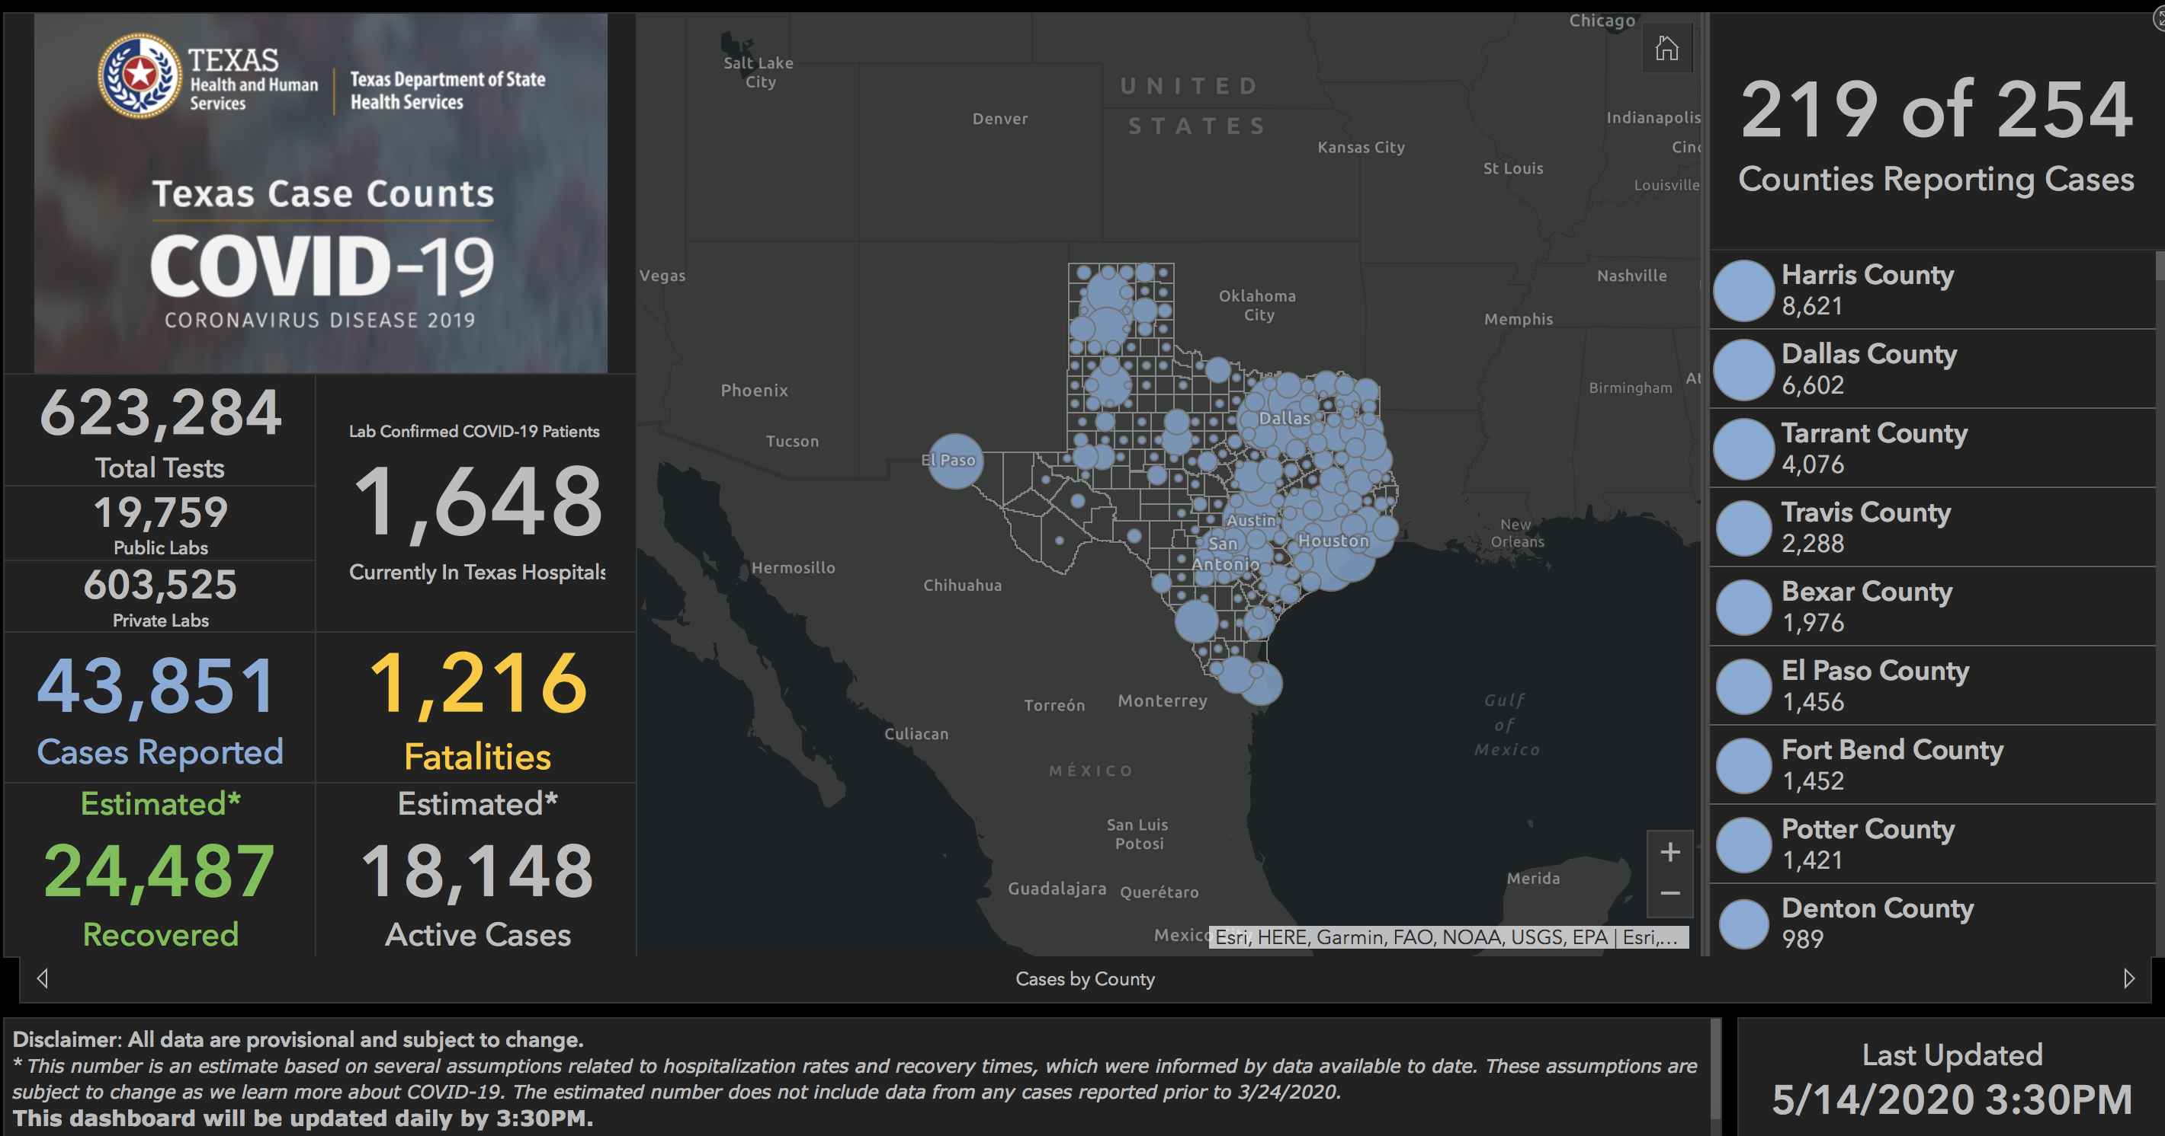

Slide 26
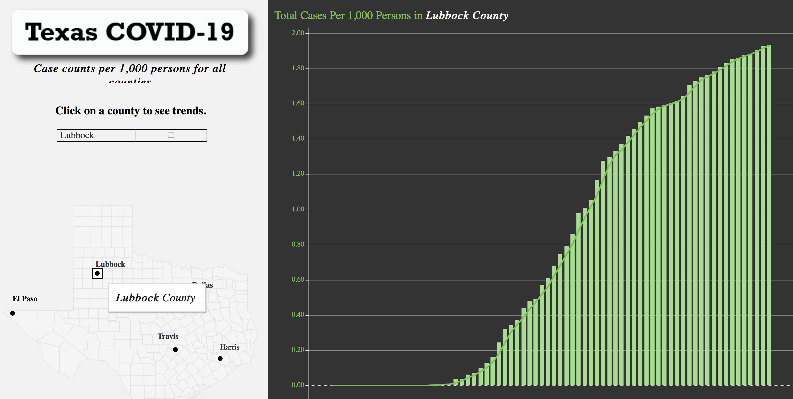
Current Lubbock County Statistics

Slide 27
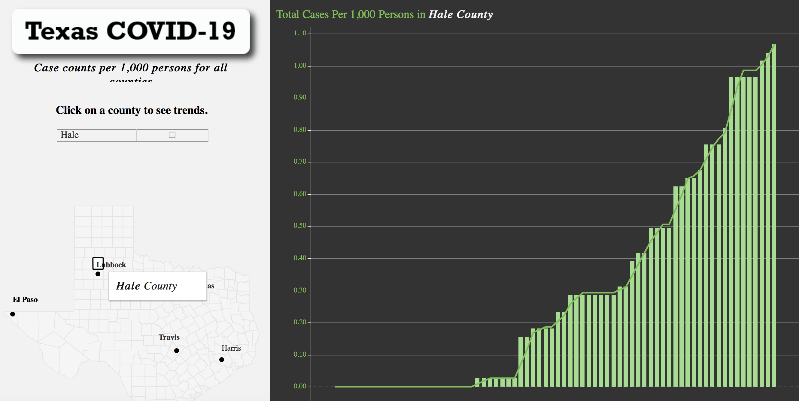
Current Hale County Statistics

Slide 28
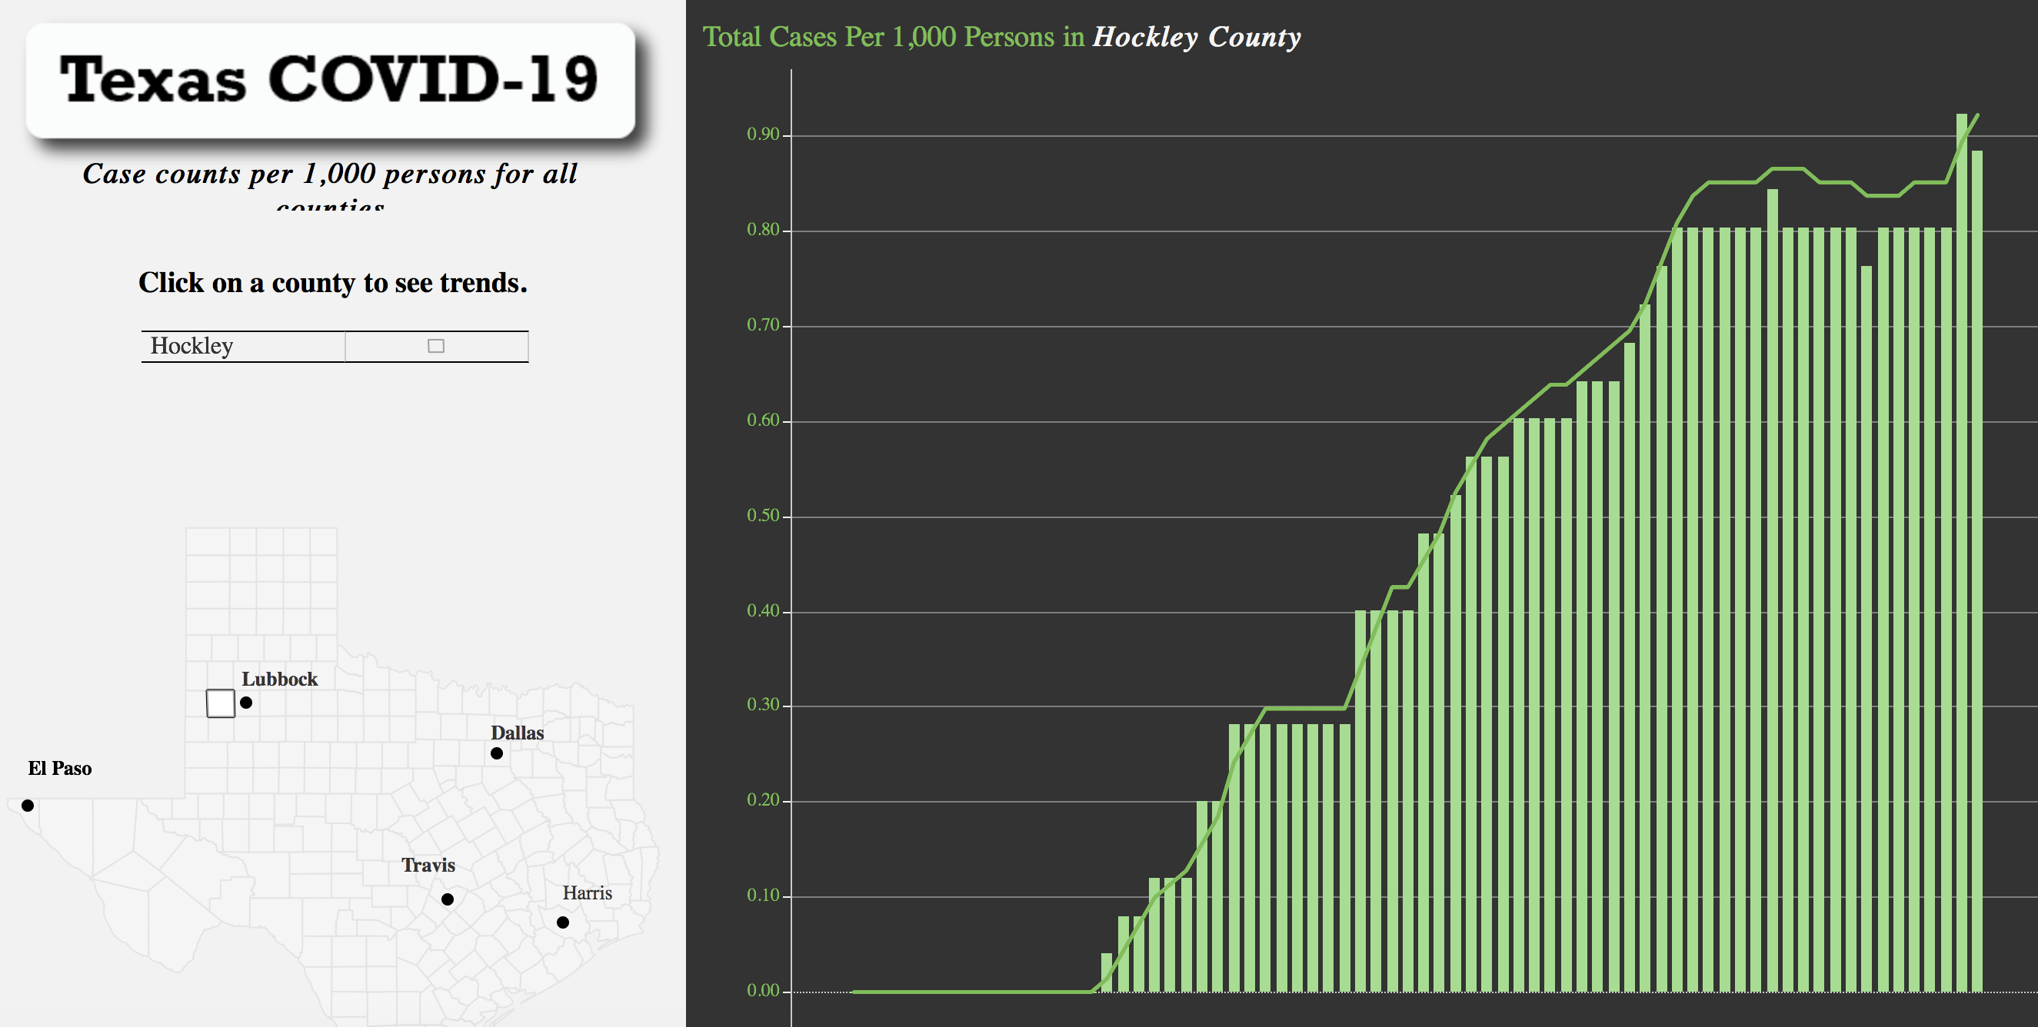
Current Hockley County Statistics

Slide 29
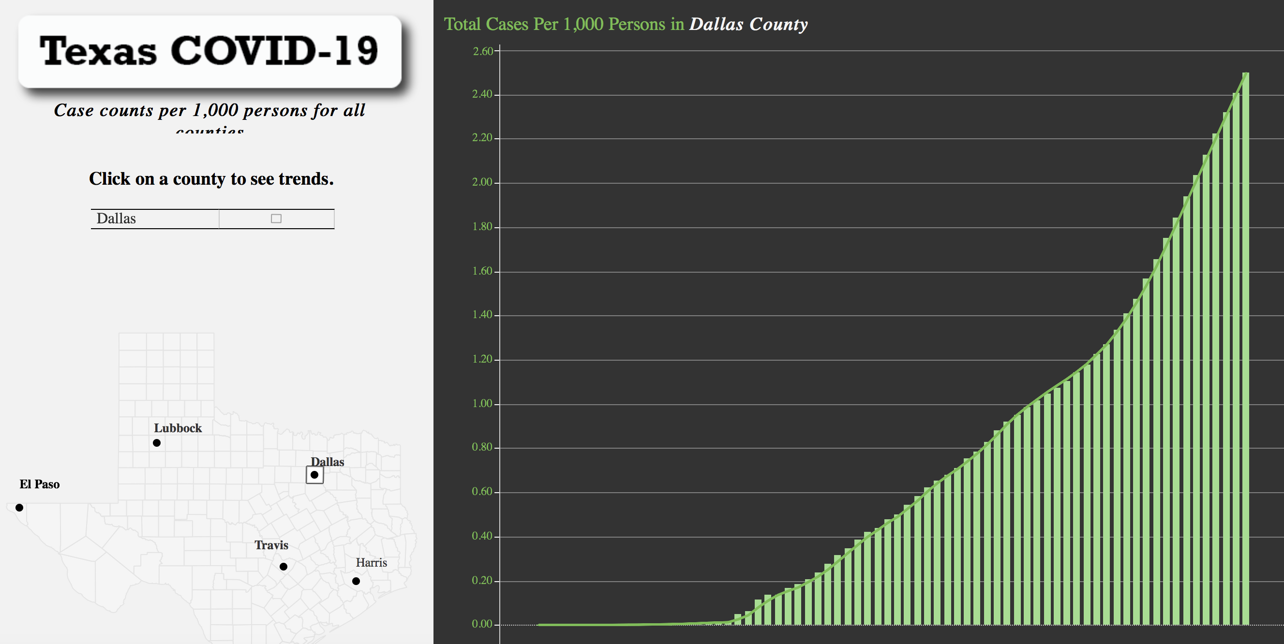
Current Dallas County Statistics

Slide 30
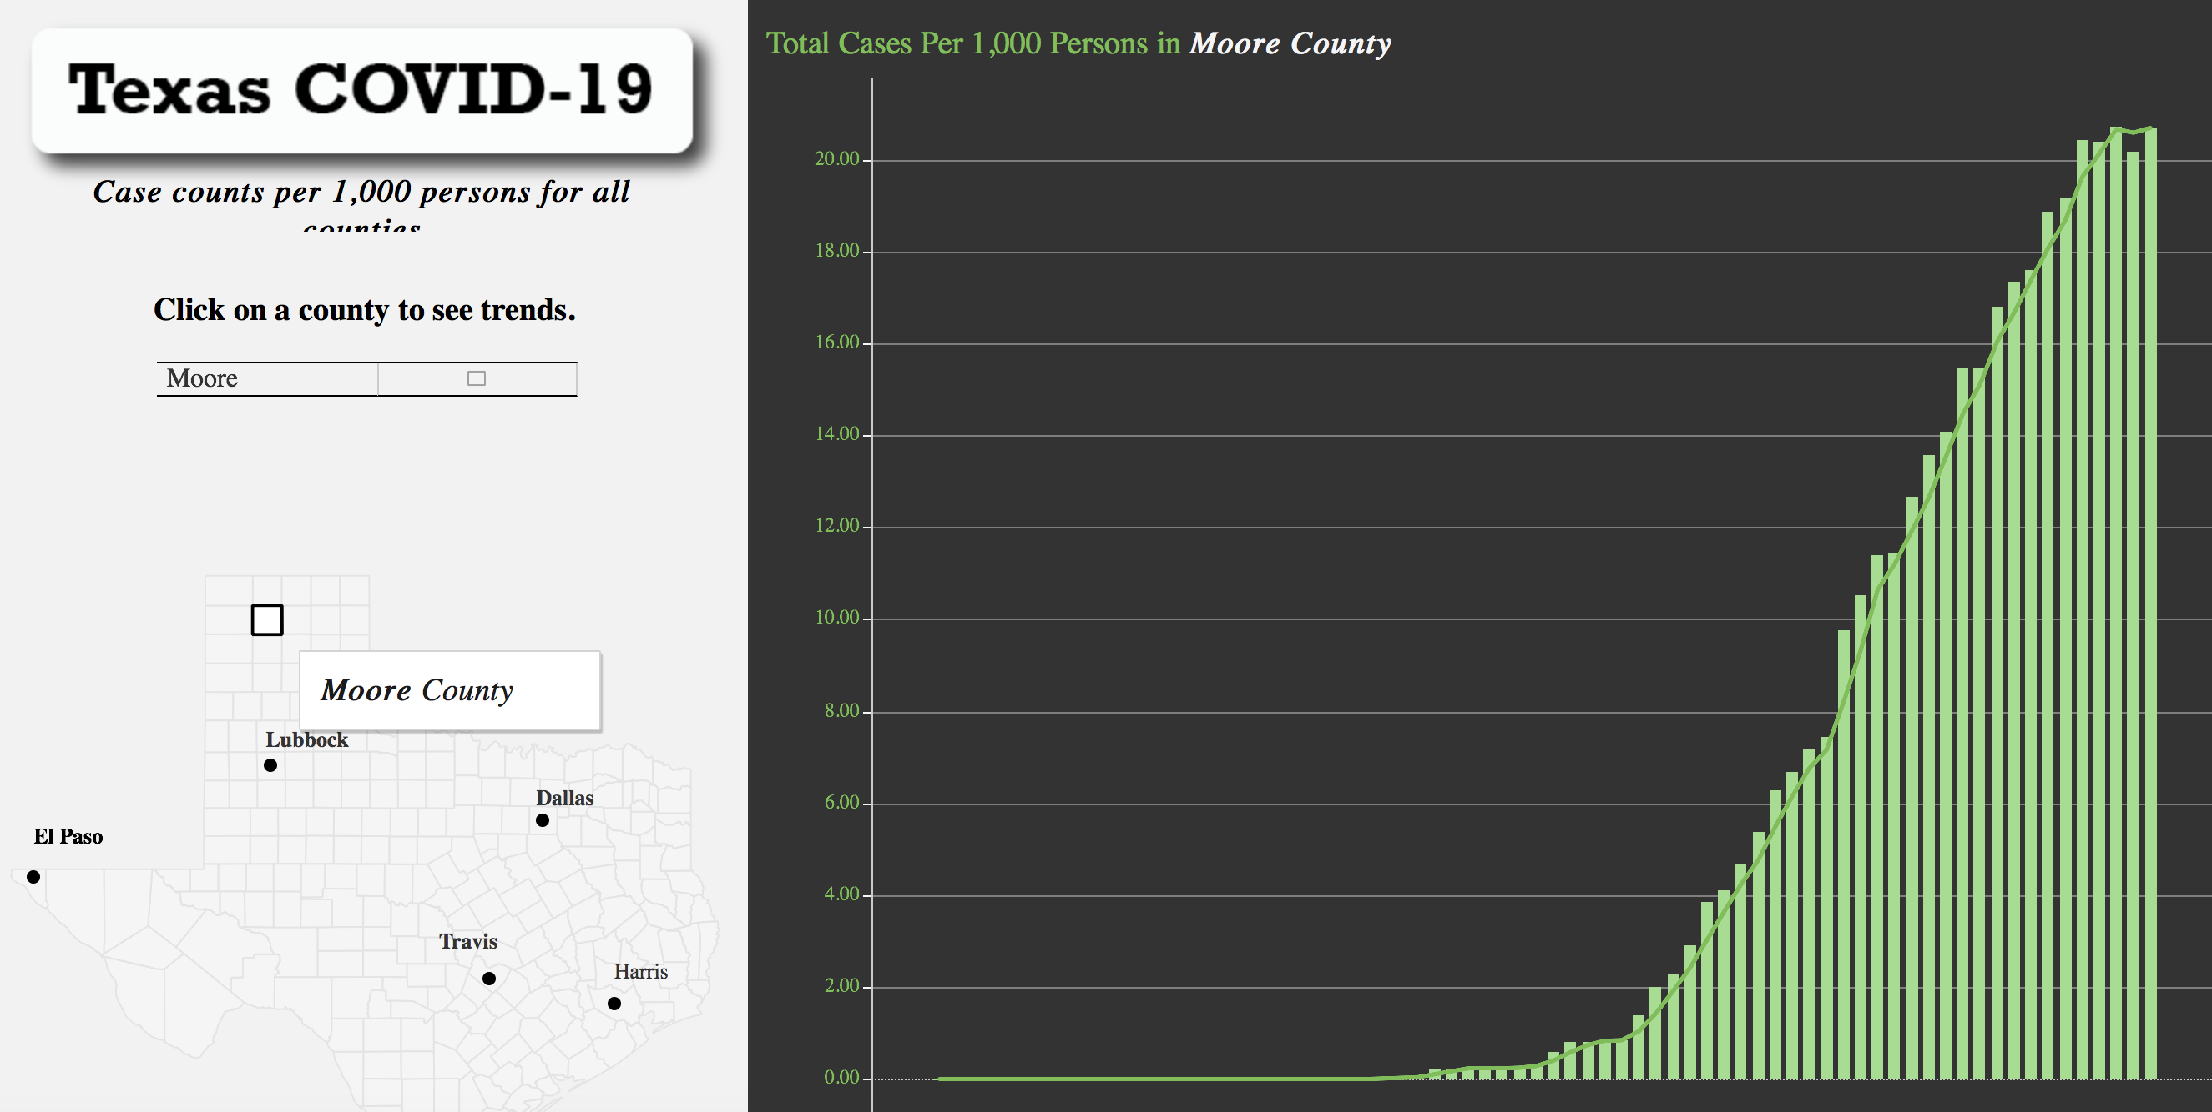
Current Moore County Statistics

Slide 31
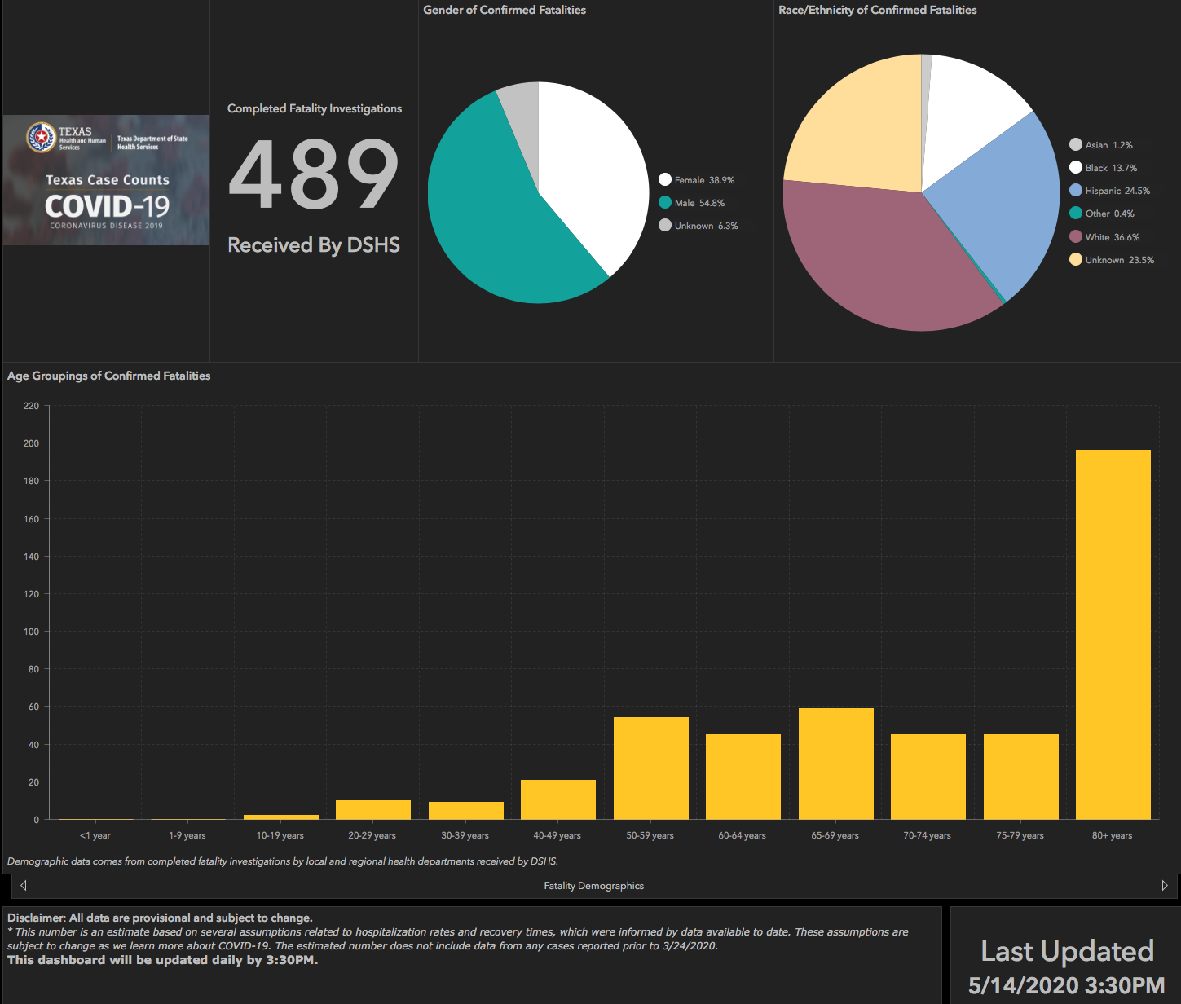

Slide 32


Slide 33
Visitation Policy

Slide 34
Visitation policy will remain at one visitor per 24 hours at this time.
Exceptions: Imminent death
  This does NOT include admission to palliative care unless death is felt to be imminent

Slide 35
Financial Recovery

Slide 36


Slide 37
All Covenant Campuses will be impacted financially by Covid-19
All executives will have reduced pay for at least the remainder of the year
There will be no merit incentives for VPs and above this year
Capital investments will be suspended until at least the 3rd quarter where feasible (i.e. Hope Tower construction)
Employees have been asked to participate in reduced work hours through a program from Texas Workforce Commission (TWC)
Voluntary Furloughs have been offered to some staff (Should NOT do both voluntary furlough and participate in TWC program)
We need your help to reduce costs – Let leadership know if you identify any areas for savings.

Slide 38
Q & A

