Slide 1
Covenant Health
COVID-19 Update for Physicians
May 29, 2020

Slide 2
Reflection
Julie Barclay

Slide 3


Slide 4
CMC Surge Plan
COVENANT MEDICAL CENTER
Currently
Last Week

Slide 5
Statistics

Slide 6
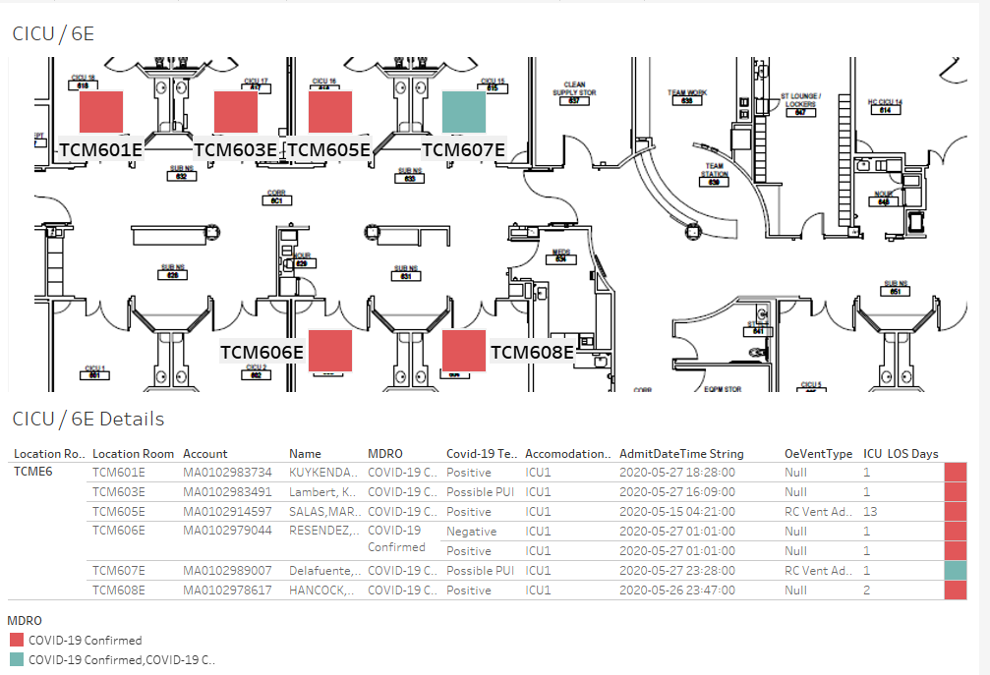
COVID-19 Cases 6E MIXED USE
New case not on floor map:

Slide 7
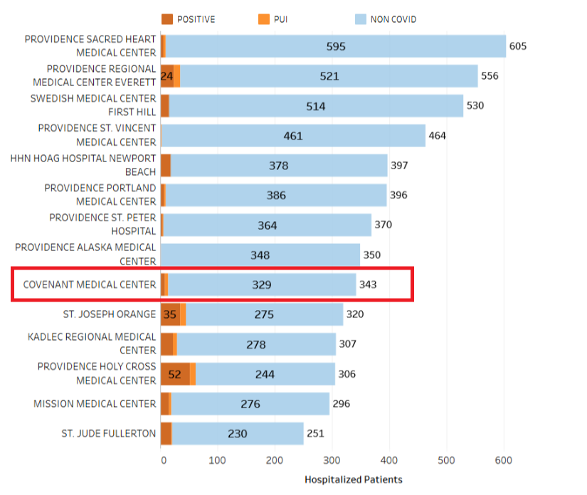
Providence System Hospitalized COVID-19 Cases

Slide 8
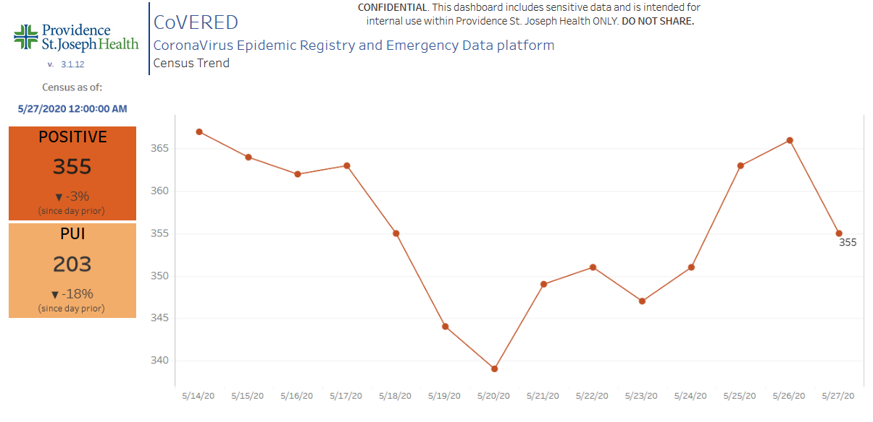
Providence Inpatient COVID-19 Volume

Slide 9
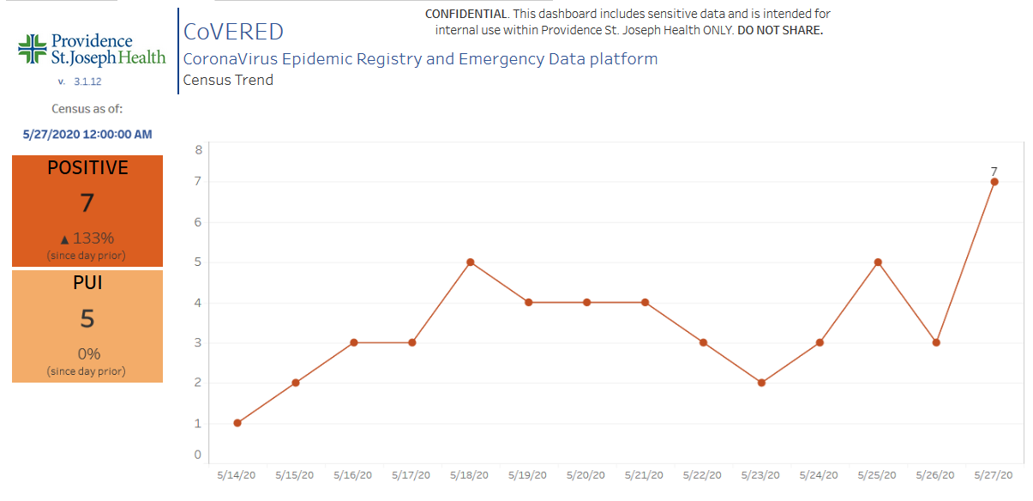
Texas Inpatient COVID-19 Volume

Slide 10
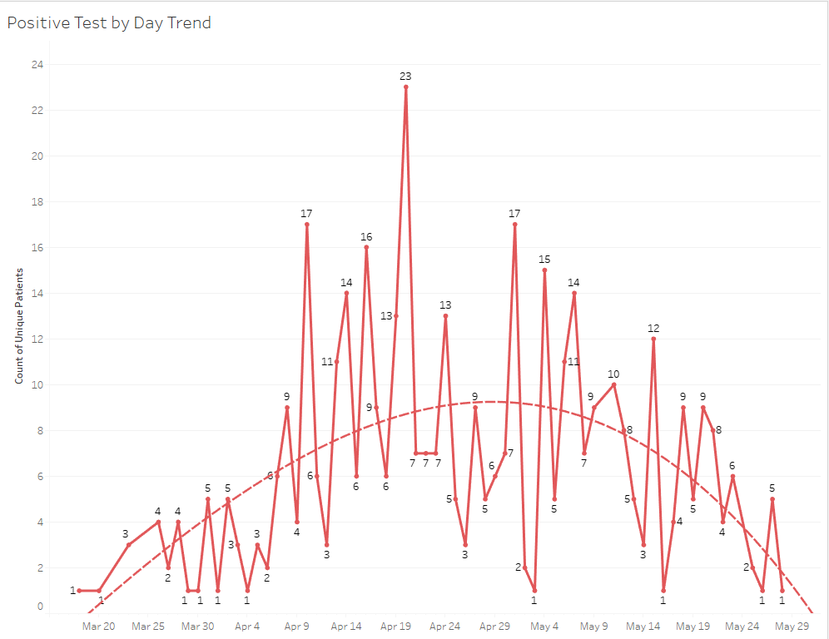
New Covid-19 POSITIVE Patients by Day Trend

Slide 11
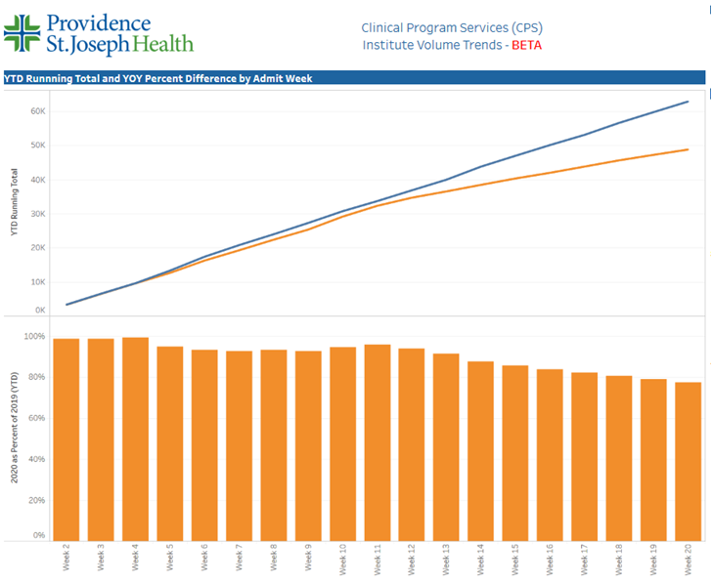
TX/NM Region Weekly Procedures (YOY)

Slide 12
Covid-19 Testing

Slide 13
TESTING
 | CMC | CCH | CHP | Grace | Total Tests
Abbott | 1152 | - | - | - | 295
Cepheid | 842 | - | - | -
BD Max | - | - | - | 1152
NP Swab | 5280 | - | - | -
VTM | >1600 | - | - | -

Slide 14
Physician Screening

Slide 15
Physician Screening
At CMC, beginning Monday June 1, Physician Dining Room Screening will be open ONLY from 0600 until 1000 M-F.
After that time or on weekends, you can be screened at the first unit you visit.
Level II PPE is available at all nursing stations
N-95 Masks (Level III PPE) will be available in all procedural areas, ICUs and in the ED.

Slide 16
Pharmacy Update
Allen Cunningham, PharmD

Slide 17
CHS COVID-19 Treatments
Agent | Dosage | Comments | Update
Hydroxychloroquine | 400 mg PO BID x 1 day, then 200 mg PO BID x 4 days Caution: QT prolongation, arrhythmias EUA = mandatory AE reporting to FDA MedWatch | Commonly prescribed based on early observational data; recent data suggests no benefit with potential harm NIH guidelines (5/12/20): insufficient data to recommend for or against use; do not recommend for PrEP or PEP PSJH AMS COVID-19 subgroup: alternative therapy for high risk patients only | 5/22/20: Lancet observational study reports HCQ associated with increased risk of in-hospital mortality 96,032 registry analysis (671 hospitals, 6 continents) Control group mortality = 9.3% HCQ 18%, HCQ+AZ 23.8%, CQ 16.4%, CQ+AZ 22.2% Control group arrhythmia = 0.3% HCQ 6.1%, HCQ+AZ 8.1%, CQ 4.3%, CQ+AZ 6.5% 5/25/20: WHO suspends HCQ arm of Solidarity trial, other 3 arms will continue (remdesivir, Kaletra, interferon)
Hydroxychloroquine + azithromycin | Azithromycin 500 mg PO x 1, then 250 mg PO daily x 4 days | High risk for AEs (QTc prolongation); guidelines recommend AGAINST use except in context of clinical trial | See above
Tocilizumab | 400 mg IVPB x 1 dose May repeat x 1 in 8-12 hours if clinical symptoms worsen or do not demonstrate improvement | IL-6 receptor antagonist used to treat CRS ($2.13K - $4.25K per dose) CHS criteria for use: Proven COVID-19 infection Early treatment of severe/critically ill patients who are clinically deteriorating Restricted to intensivists or ID AST/ALT <5xULN, ANC >500, Plt >50K | No change from 5/22/20 NIH guidelines state insufficient data to recommend either for or against the use of IL-6 inhibitors for the treatment of COVID-19
Notes:
The FDA says that neither drug has been proven safe and effective in treating COVID-19. In fact, a study published on April 23 involving 368 COVID-19 patients at U.S. Veterans Health Administration hospitals found that taking hydroxychloroquine alone, or in combination with azithromycin, did not reduce the need for a ventilator compared to those not taking the drugs. Further, people taking hydroxychloroquine alone had a higher risk of dying during the study than those not taking the drug. Researchers in China came to a similar conclusion in a study of 150 COVID-19 patients randomly assigned to receive hydroxychloroquine or the current standard of care: after a month, both groups had similar symptom profiles, and showed similar levels of the virus, suggesting that the drug wasn’t clearing the COVID-19 virus in a significant way. The National Institutes of Health is conducting an ongoing study of hydroxychloroquine among hospitalized patients, as is Novartis, whose Sandoz division makes a generic version of the drug.
HCQ:
PSJH high risk patients (age > 60, pulmonary disease, CV disease, CKD, DM, immune compromised, HTN present on admission or receiving anti-hypertensives prior to admission)
Toci:
Proven COVID-19 infection based on laboratory testing AND radiographic evidence of pneumonia
Severely ill definition: SpO2 ≤ 93% on room air or FiO2/PaO2 ≤ 300 mmHg or respiratory rate ≥ 30 breaths/min
Critically ill definition: Mechanical ventilation OR multi organ failure OR ICU admission

Slide 18
CHS COVID-19 Treatments
Agent | Dosage | Comments | Update
Remdesivir | 200 mg IV x 1, then 100 mg IV daily x 9 days Emergency Use Authorization (EUA) 5/1/20 Duration = 5 days for patients not on mech vent and/or ECMO (can receive an additional 5 days if no clinical improvement) No restriction for timing from symptom onset | Covenant is enrolled in expanded access program Enrolled 5 patients to date 1 active – ON HOLD due to AKI 2 completed course and extubated 2 stopped due to renal function PSJH criteria for EUA: 1. Adults or pediatrics with confirmed SARS-CoV-2 2. Pneumonia per chest imaging 3. Patient with SpO2 ≤ 94% or requiring supplemental O2, mech vent, and/or ECMO 4. AST/ALT < 5 x ULN 5. eGFR > 30 ml/min | Expanded access end date 5/29/20 Inventory = 83 vials Can be rolled over to EUA after 5/29 Emergency Use Authorization Inventory = 80 vials 5/28 – 4 pts initiated 5 day treatment = 6 vials 10 day treatment = 11 vials Mandatory AE reporting to FDA MedWatch for EUA
Convalescent Plasma | 1 unit (200-400mL) x 1 | CMC enrolled in Mayo trial | Enrolled 7 patients to date
Zinc, Ascorbic Acid, Vitamin B | No established dose for COVID-19 | No literature to support use in the treatment of COVID-19 | No change
Notes:
According to the summary of the China study, remdesivir was “not associated with a difference in time to clinical improvement” compared to a standard of care control. After one month, it appeared 13.9% of the remdesivir patients had died compared to 12.8% of patients in the control arm. The difference was not statistically significant.
Hospitalized patients with advanced COVID-19 and lung involvement who received remdesivir recovered faster than similar patients who received placebo, according to a preliminary data analysis from a randomized, controlled trial involving 1063 patients, which began on February 21. The trial (known as the Adaptive COVID-19 Treatment Trial, or ACTT), sponsored by the National Institute of Allergy and Infectious Diseases (NIAID), part of the National Institutes of Health, is the first clinical trial launched in the United States to evaluate an experimental treatment for COVID-19. Preliminary results indicate that patients who received remdesivir had a 31% faster time to recovery than those who received placebo (p<0.001). Specifically, the median time to recovery was 11 days for patients treated with remdesivir compared with 15 days for those who received placebo. Results also suggested a survival benefit, with a mortality rate of 8.0% for the group receiving remdesivir versus 11.6% for the placebo group (p=0.059). Recovery in this study was defined as being well enough for hospital discharge or returning to normal activity level.

Slide 19
Pharmacy Shortages/Allocations
Covid-19 Related
  Cisatracurium
  Rocuronium
  Vecuronium
  Dexmedetomidine
  Diprivan
  Fentanyl
  Etomidate
  Vitamin C Liquid
  Vitamin C Injection
Non-Covid-19 Related
  Bumetanide
  Amiodarone
  Dopamine
  Dobutamine
  Famotidine
  Furosemide Inj
  Doxycycline Inj
  Nitroglycerin SDV
  IV solutions
  Bupivicaine with epinephrine

Slide 20
Pre-Procedure Testing for Covid-19

Slide 21
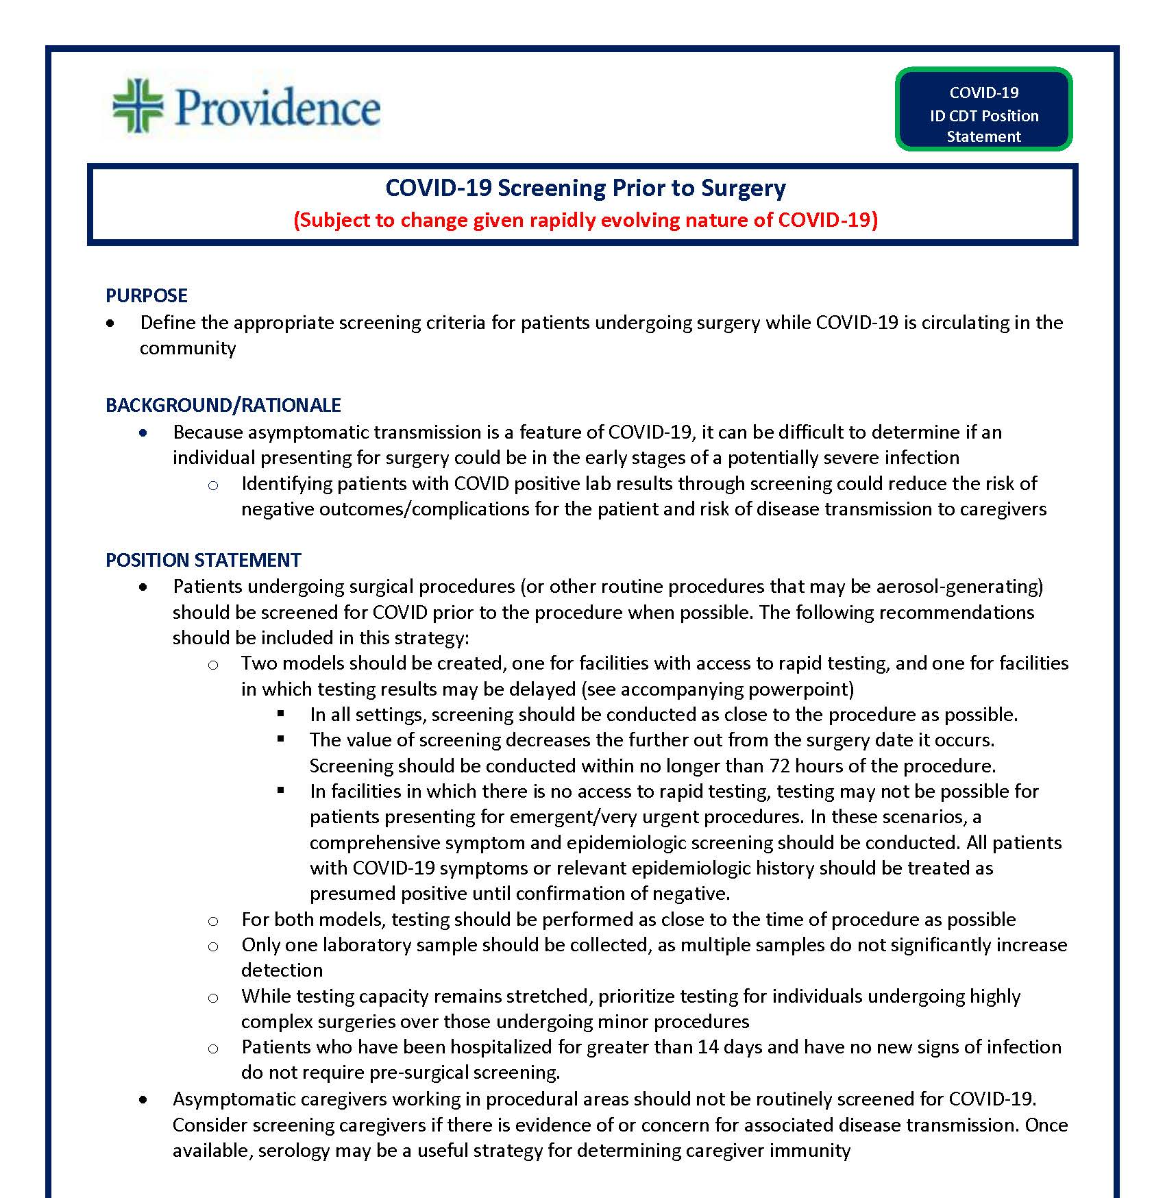

POSITION STATEMENT
  Surgery Pre-Screening
  Wear a mask and shield at all times when within 6 ft of a patient

Slide 22
Addition of INPATIENTS tested before procedures
Physicians requested that all inpatients undergoing procedures be tested just as all outpatients were.
Starting Monday June 1, there will be a new nurse driven protocol to ensure all inpatients have a Covid-19 test prior to procedures (similar to DVT protocol, pneumonia protocol, etc.)
CMC was the only ministry NOT doing testing on inpatients going for procedures, and this will make our policy uniform.

Slide 23
Marketing Update

Slide 24

Delivering Care Safely
https://www.youtube.com/watch?v=Bc2x8AgSQ38&t=3s

Slide 25

New York Times Article

Slide 26

Orest Holubec
EVP, Chief Communication Officer
You may have seen a story in the New York Times regarding large health systems receiving CARES Act funding. As you can imagine, we are extremely disappointed by the coverage. The article is written with a clear bias without regard to the facts.
Providence was significantly impacted by COVID-19 with more than 1,200 positive cases to date. We have also been dealing with the crisis longer than other U.S. health systems having received the first confirmed patient in the country.
In Q1 of 2020, Providence lost $276M as a result of our COVID-19 response. Then in April alone, we lost $179M even with support from CARES. This was driven by the increased costs associated with caring for COVID-19 patients along with $503M in lost net services revenue due to suspending non-emergent surgeries per government orders and declines in other patient volumes.
Providence received $509M in CARES Act funding. This represents 0.8 percent of total CARES dollars distributed. [Providence treats 1.4% of all US patients]. When spread across our 51 hospitals, the funding is $10M per hospital, which puts us on par with what was received by the rural hospitals mentioned in the article. Additionally, the Providence system includes several rural and critical access hospitals.

Slide 27
We continued to pay our caregivers as normal through the end of April even if their programs or services were closed, which cost more than $500M. In addition, we offered temporary benefits, such as 80 hours of emergency PTO and $100/day for childcare.
Providence is deeply committed to caring for those who are poor and vulnerable. In some parts of Washington state, for example, more than 70 percent of our patients depend on government programs for health insurance or are uninsured. Each year, we invest more than $1.5 billion in community benefit. In Q1 of this year alone, we provided $450M in community benefit, including $281M in unpaid Medicaid costs.
Providence operates on very narrow margins of 0 to 1 percent, so we can’t count on operating income for viability. Unrestricted cash, which includes assets that are not easily liquidated, is our financial foundation. If we had to sustain our operations on this, it would only last six months due to the cost of operating our ministries 24/7, 365 days a year.

Slide 28
The pandemic isn’t over, and we need to be financially stable to handle the next potential wave. With uncertainty in the economy and unemployment, we anticipate more patients will be uninsured.
Our investment losses in March were $763M. We are seeing some of this return but it’s still uncertain what will happen with the markets through the rest of the year.
Regarding the Providence Venture Fund, we made a strategic decision to invest in innovation because traditional health care providers are ripe for disruption, and we need to stay ahead of the curve to ensure our future. This is critical to needed health care transformation. While we have set aside $300M, we have only invested $100M to date.
Providence executives are taking reduced pay this year. Our CEO as well as our president of operations both volunteered to take 50 percent pay cuts, while other executives are taking 10 to 20 percent reductions. Because IRS Form 990 reporting requires that we report data that isn't received as take-home pay, Rod’s salary as reported in the article is not accurate.

Slide 30
Covid-19 Impact in
Texas

Slide 31
Facts related to Covid-19 care for Covenant Health in Texas:
  Emergency Department visits dropped 40%
  Surgeries and procedures dropped 66% across our hospitals and ambulatory settings.
  In total, gross revenue dropped by 40%.
Examples of Texas expenses related to Covid-19:
  Continuation of pay for all caregivers through April was over $500,000.
  We saw a significant increase in PPE spend on gowns, N95s, face shields, and surgical masks. Through April 2020, our spend on PPE was $336,000.
  We have spent $2.4 million on our response related to emergency department triage tents, drive-through testing and Covid-19 response clinics.

Slide 32
Covenant Health revenue related to Covid-19:
Through April, revenue is down 32% ($21 million in March and $31 million in April), compared to budget.
We anticipate 33%, equating to $203 million in net revenue loss through July due to ongoing Covid-19 care and lower volumes.
Government funding from the CARES Act to Covenant Health:
We have received $30.6 million in CARES ACT funding.
We received $100 million in advanced payment loans from Medicare; these must be repaid through provision of services to patients covered by Medicare.
Community benefit from Covenant Health:
In 2019, the Texas/New Mexico community benefit totaled $75 million. More information is available in our annual report.

Slide 33
Net impact on Covenant Health for 2020:
It is too early to tell what impact Covid-19 care may have for the rest of 2020. We anticipate an additional surge of cases in the fall.
Given the Texas unemployment that is approaching 12% (up from 2.6% in Lubbock, pre-Covid-19), we anticipate a significant increase in people who are uninsured, under-insured, or Medicaid patients whose expense are either not reimbursed at all or at a reduced amount that doesn’t cover costs. Our Mission calls us to provide care to people in our community.
We are estimating the total net operating revenue impact conservatively at 20%, reflecting a negative $230 million.

Slide 34
The Importance of a Strong Balance Sheet
Providence’s Approach to Stewardship
· Like many other not-for-profit hospitals and health systems, Providence makes very little money on patient care operations. Our current and recent operating margin has been between 0 to 1 percent.
· We operate 51 hospitals, more than 1,000 clinics and hundreds of programs and services across seven states. In addition, we employ about 120,000 caregivers.
· The cost of maintaining capital-intensive facilities that need constant upgrade is tremendous. We also face continually rising costs of pharmaceuticals, medical equipment and highly skilled labor.
· While we brought in $25B in operating revenue last year, we also had $24.6B in expenses. That left us with $373M, which is barely a 1 percent margin. In other words, we essentially broke even on our operations. Without investment income from our portfolio, we would have to make more painful sacrifices around capital and operating costs.
· Breaking even is a precarious balancing act in a normal year. But add a pandemic and a weakened economy to the mix, and it creates an even more serious cash flow situation.

Slide 35
· As stewards of a 165-year legacy, we have a responsibility to maintain an adequate savings account. Our reserves protect us from insolvency, bankruptcy or unplanned scenarios, such as a pandemic.
· Providence has $11.8B in consolidated cash and investments. While it includes some unrestricted cash, it also includes investments and other assets that are not easily liquidated or are intended for a specific purpose, such as foundation assets or reserves for our insurance funds.
· In addition, we carry about $7B in debt. Like mortgages on a home, we borrow money to pay for our hospitals and other facilities. With our operations only producing enough cash to cover expenses and capital, in order to maintain a good credit rating, we are required to have a certain amount of money in reserve. Even a small increase on our interest rates could wipe out our already thin operating margin.
· We’re proud that we manage our resources responsibly. Adequate reserves ensure we can continue to serve all in our communities especially the most poor and vulnerable. In fact, in 2019, we provided $1.5 billion in community benefit, which includes free and low-cost care and the cost of caring for those on Medicaid. To learn more, read our annual report to the community.

Slide 36
Financial Recovery

Slide 37
Partial Unemployment Program (TWC)
Texas Workforce Commission (TWC) program for Healthcare Workers
  Allows us to offer a 32 hour workweek in June and July (our traditionally lower volume months)
  Replaces some or all of the lost pay with partial unemployment benefits plus a $600 CARES Act Covid unemployment benefit through 7-31-2020
  For every five caregivers that participates in the program, we save enough in salaries to avoid one potential layoff.
  We are encouraging caregivers to rest and rejuvenate during their time off

Slide 38
Unpaid Voluntary Furloughs
Some caregivers have opted to take a two week (or longer) unpaid furlough to contribute to our recovery efforts.
This will save even more than the reduced hours program.
This is entirely voluntary at this point in time

Slide 39
Texas Demographics

Slide 40
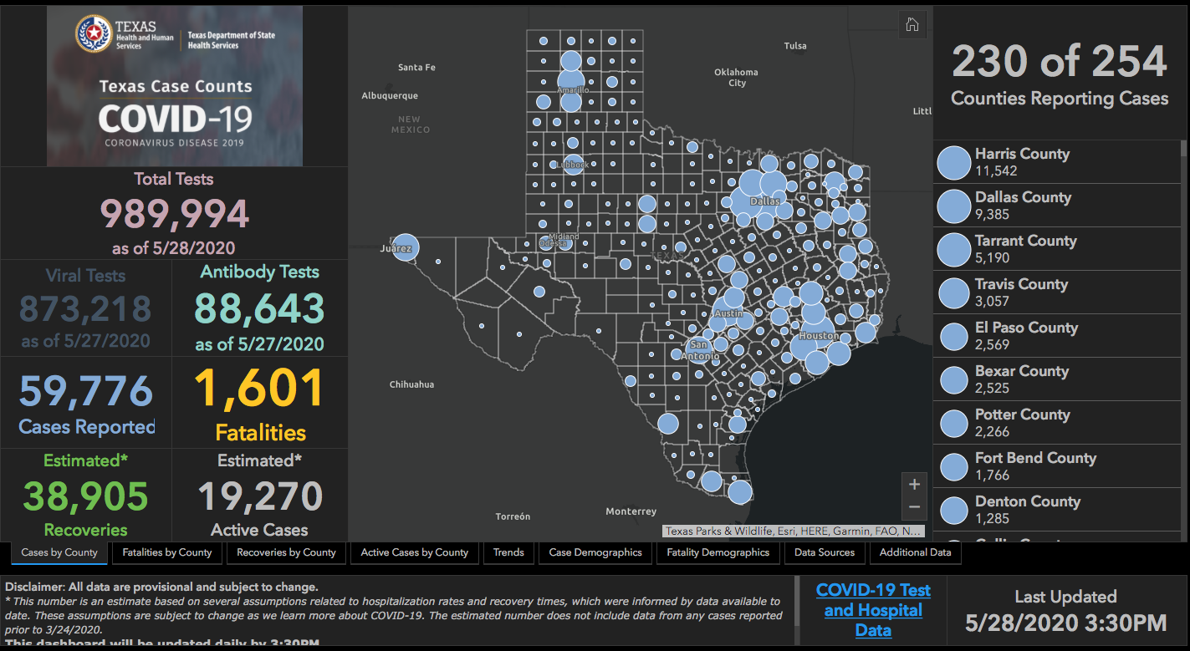

Slide 41
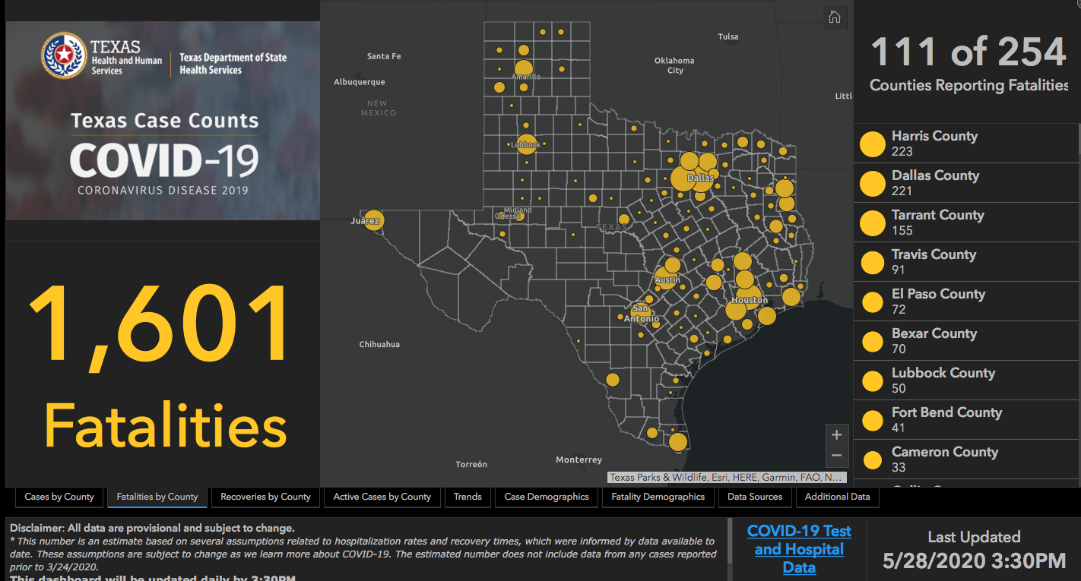

Slide 42
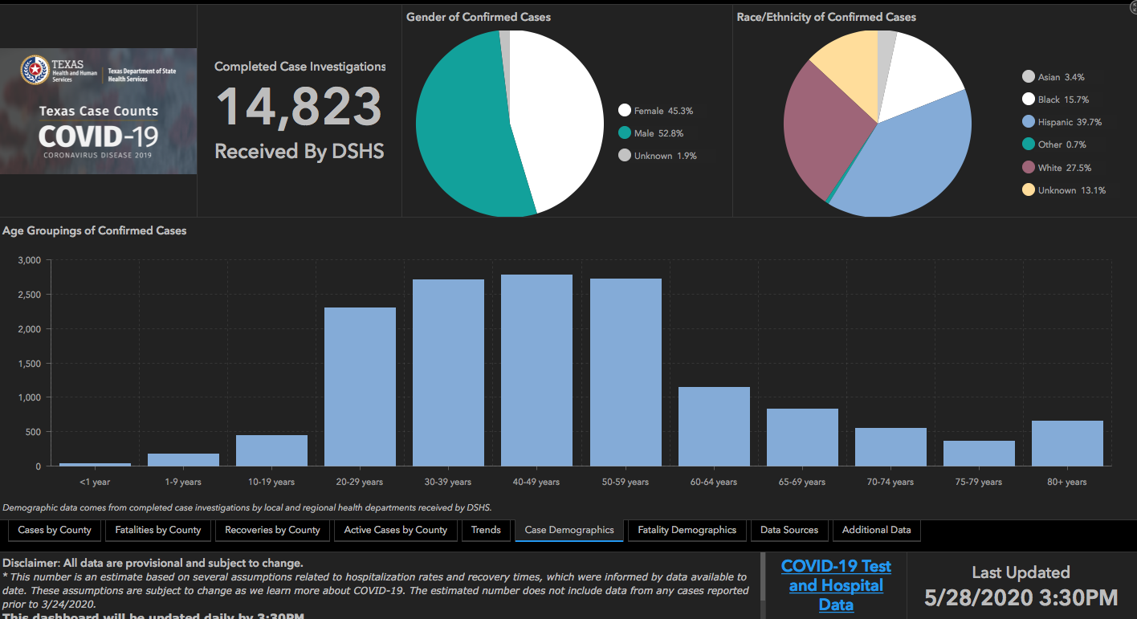

Slide 43
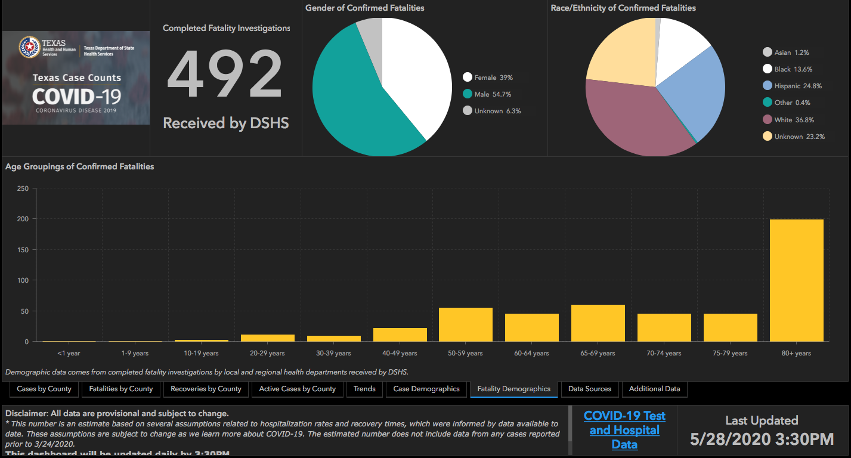

Slide 44
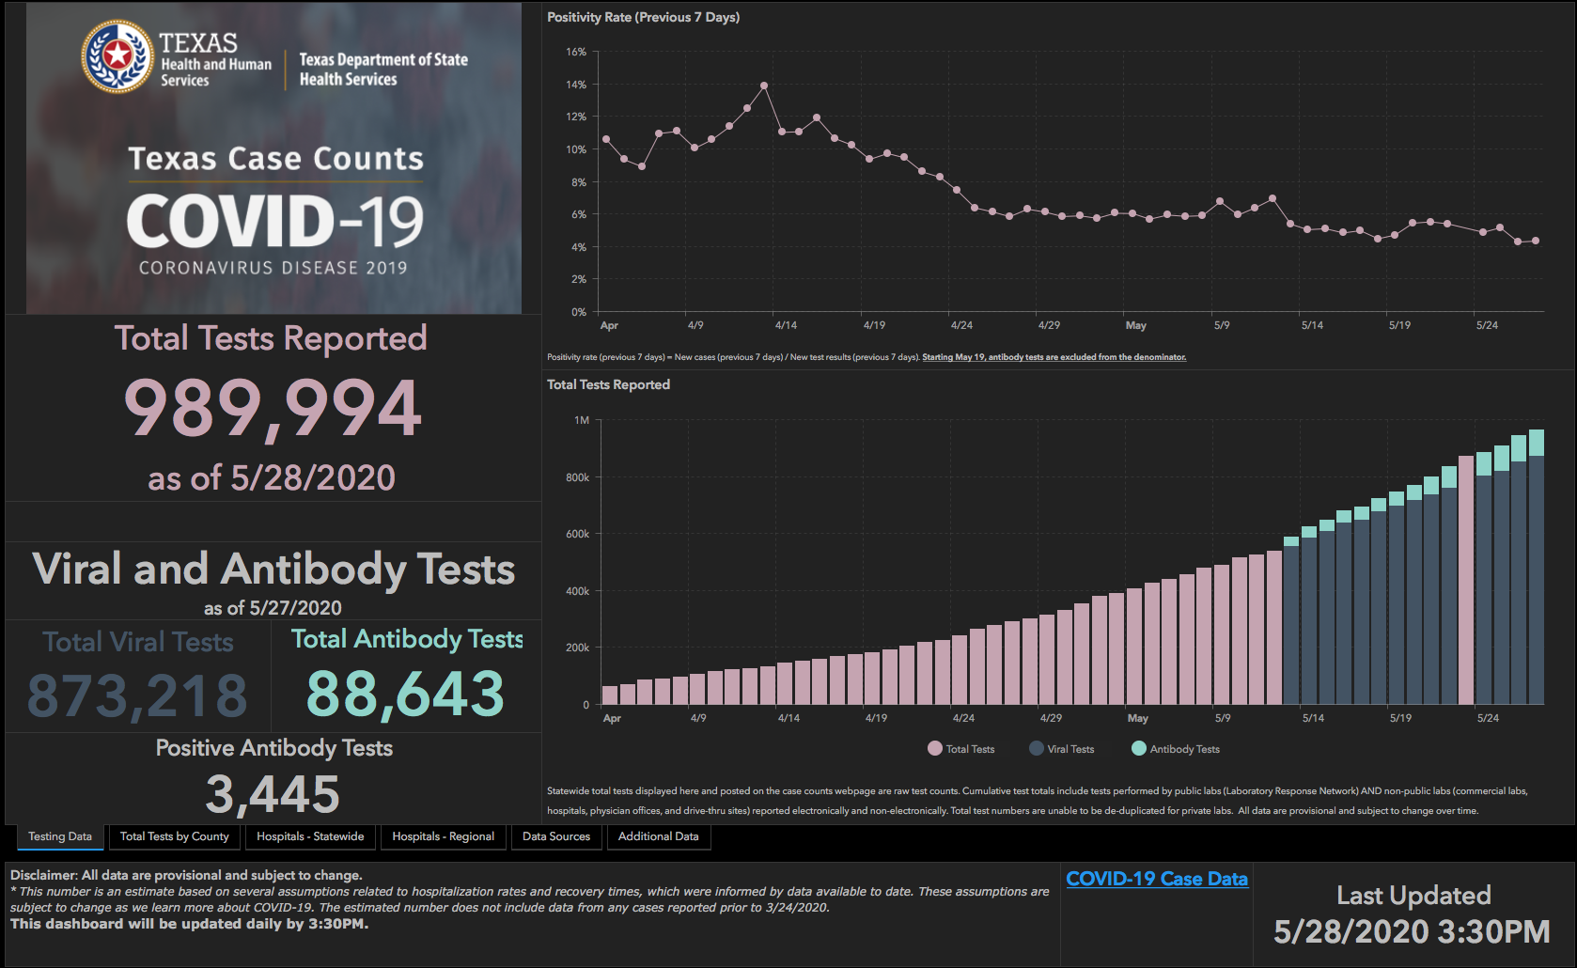

Slide 45
Q & A

