Slide 1
Covenant Health
COVID-19 Update for Physicians
May 8, 2020

Slide 2

Reflection
An old Cherokee told his grandson, “My son, there is a battle between two wolves inside us all.
One is Evil. It is anger, jealousy, greed, resentment, inferiority, lies, and ego. The other is Good. It is Joy, peace, love, hope, humility, kindness, empathy and truth.”
The boy thought about it, and asked, “Grandfather, which wolf wins?
The old man quietly replied, “The one you feed.”

Slide 3
CMC Surge Plan
COVENANT MEDICAL CENTER
Currently
Last Week

Slide 4
Statistics

Slide 5
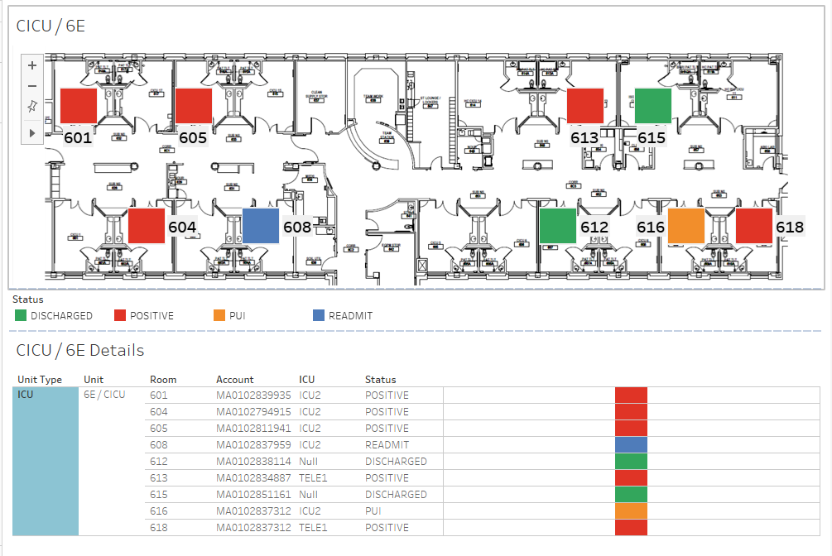
COVID-19 Cases 6E MIXED USE

Slide 6
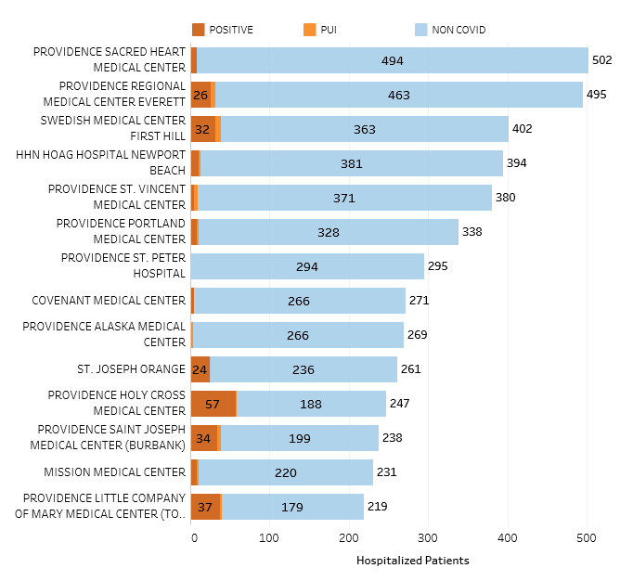
Providence System Hospitalized COVID-19 Cases

Slide 7
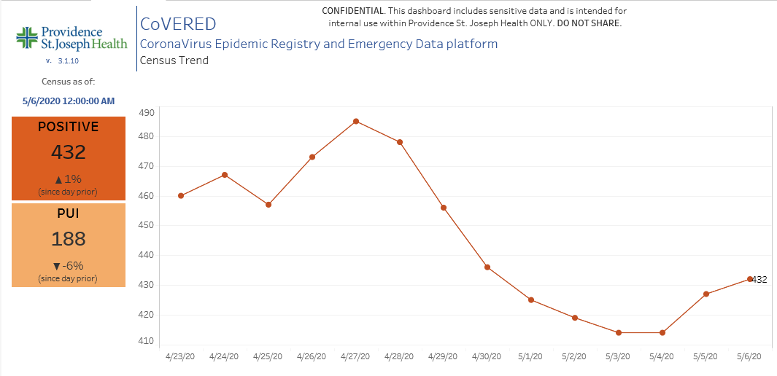
Providence Inpatient COVID-19 Volume

Slide 8
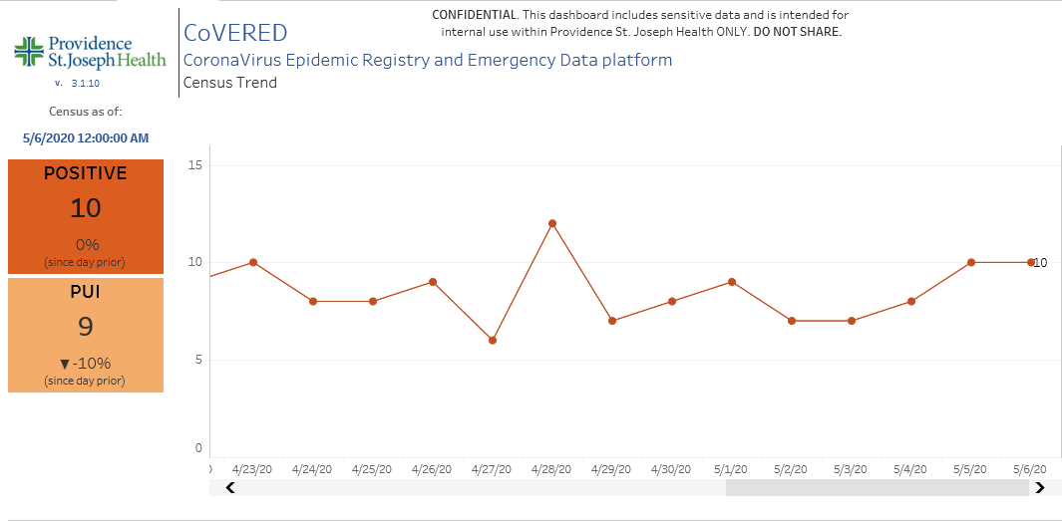
Texas Inpatient COVID-19 Volume
As of 6:00AM on 5/8, we are Down to 7 Positive Inpatients in the Region

Slide 9
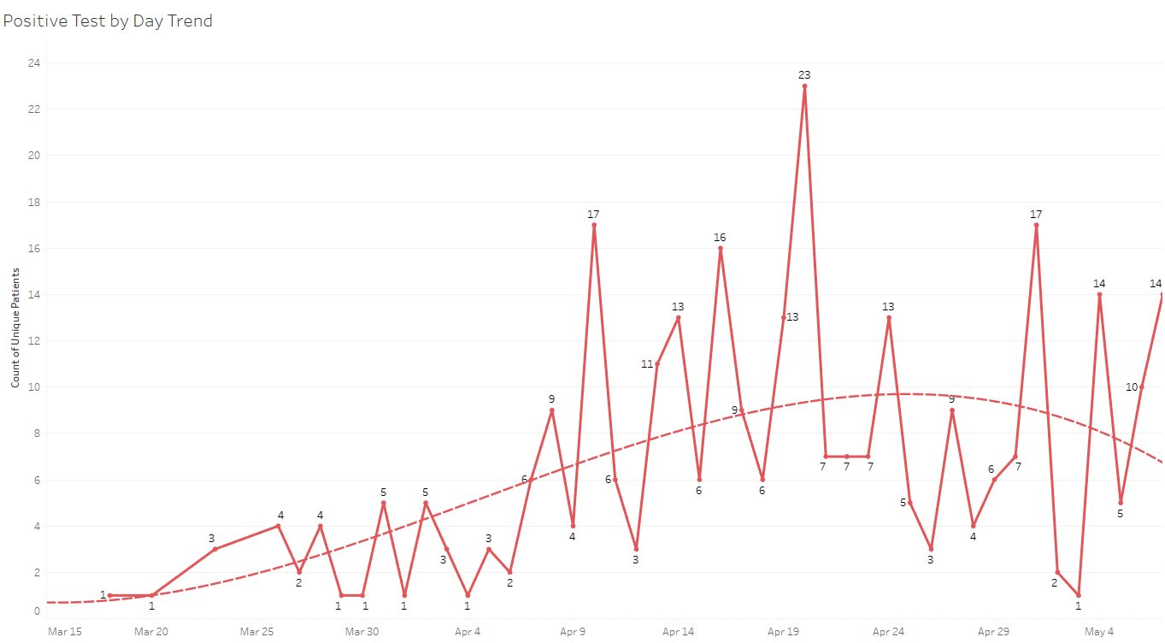
New Covid-19 POSITIVES by Day Trend

Slide 10
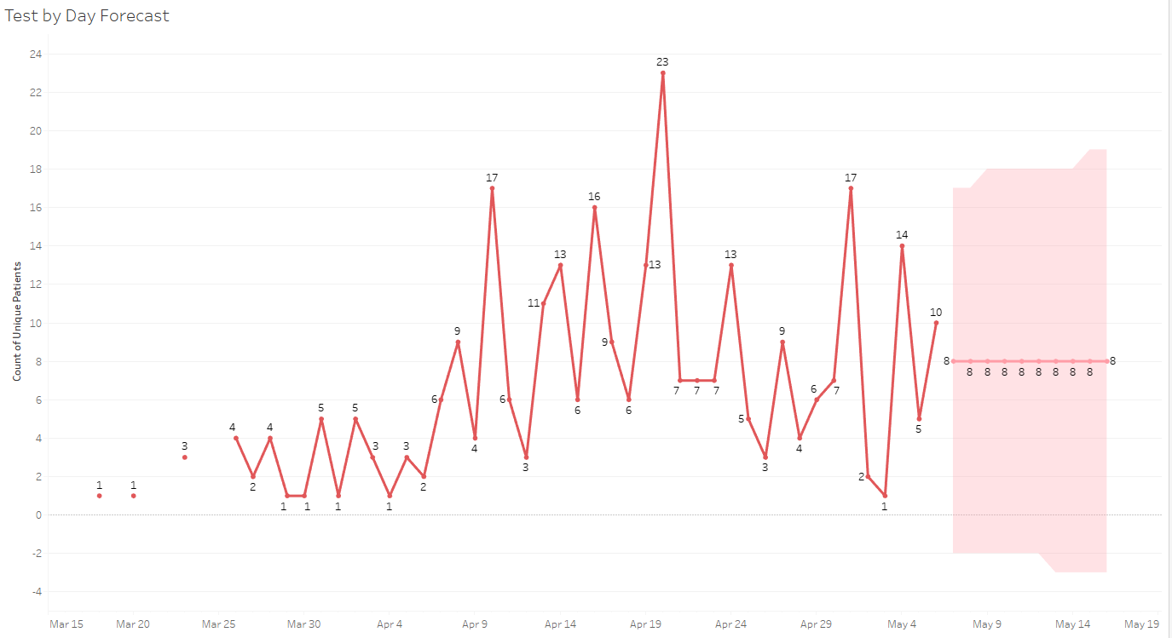
New Covid-19 POSITIVES by Day Forecast

Slide 11
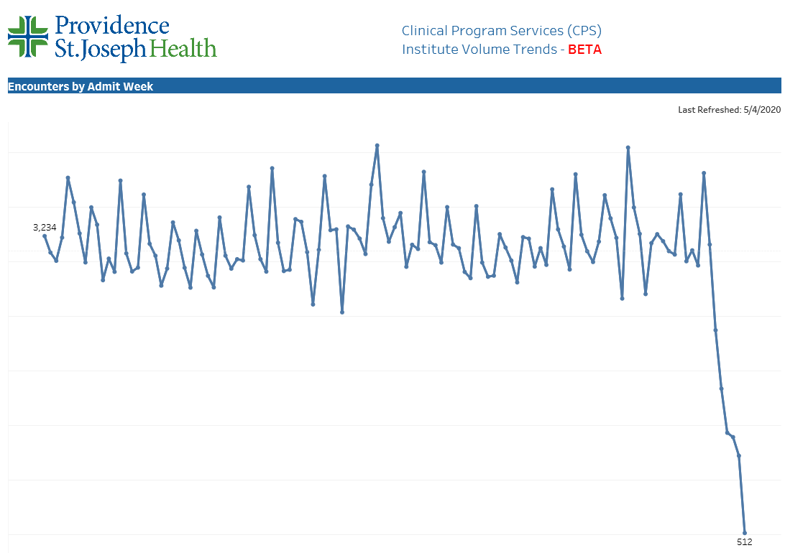
TX/NM Region Weekly Admissions
March 1
3,811
87% Reduction
April 19
512

Slide 12
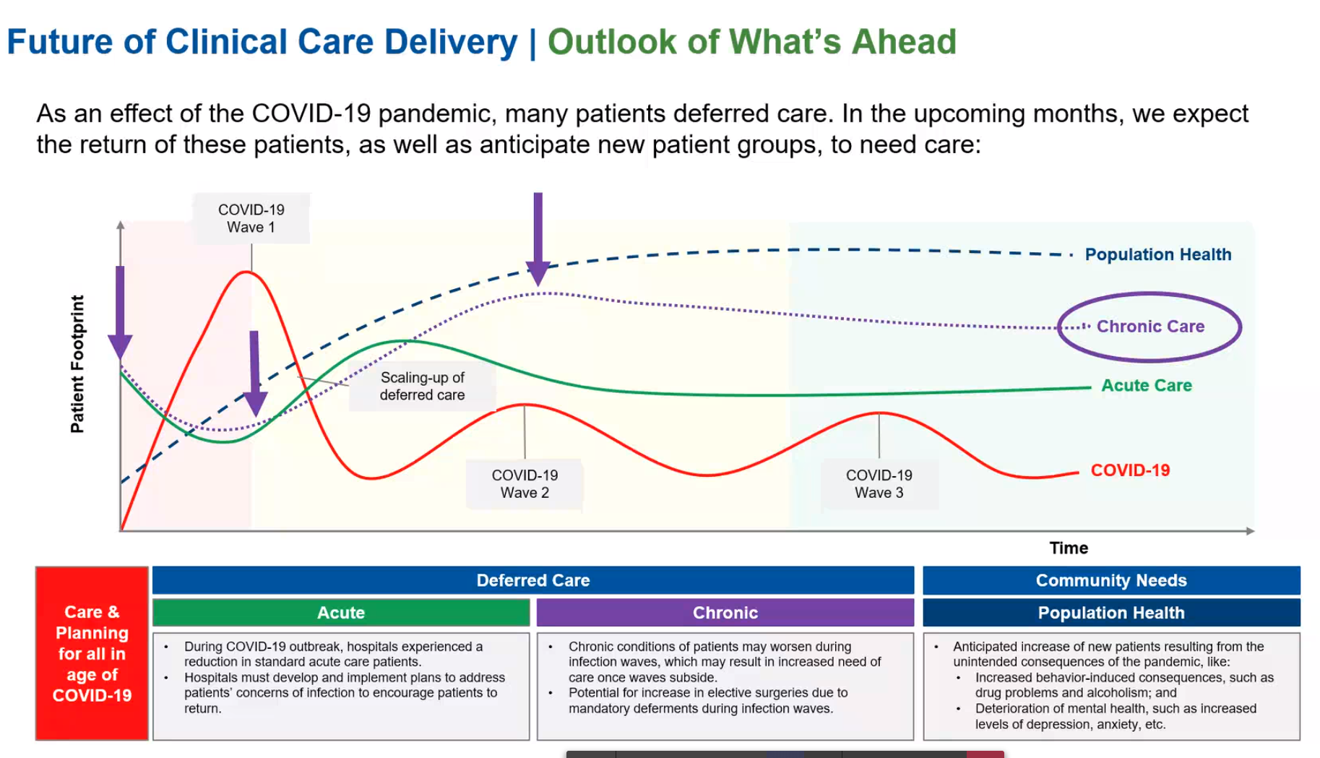

Slide 13
Resources, Engineering, and Hospitality (REH) Return to Operations Plan
Overview of Work Streams, Owners, Objectives and Status
May 1 2020

Slide 14
REH Return to Operations Framework General Approach
  To be prepared to support our ramp up in urgent and elective cases, REH must focus on three key areas:
  Supply Resiliency
  Engage with vendors and identify potential upstream supply category disruptions
  Create solutions for impacted supply categories (i.e. identifying new vendors/products to address supply gaps)
  REH Operational Resiliency
  Ensure all REH Caregivers are healthy and running operations efficiently
  Optimize REH-owned processes, namely procure-to-pay, to ensure reliable operations to support ramp up
  System Integration
  Increase monitoring and engagement with key enterprise partners (i.e. Medline, Accenture, Vizient)
  Partner with other key Shared Services teams (i.e. Pharmacy, RESO, Risk, Comms) to coordinate return to operations
  Prepare materials and reports to inform key stakeholders – namely clinical operators in the field and system leaders

Slide 15
Are we prepared to ramp up operations?
  Early diligence against initial ramp up projections, indicate we are prepared in both supplies and operations for a metered return across all major clinical specialties and general surgery. Continued diligence is required to mitigate risk as the national and world supply chains adjust to meet the growing need.
No impact to operations expected;
Some substitutions may be needed
Without action, some impact to operations may occur;
Expect greater substitutes required, possible clinical practice change
State of supply near full depletion;
Expect impact to operations and
clinical practice change
Category
Status
Primary risks and callouts
Physician Specialty
Solid - ready
General Med-Surg
Trending toward green, breadth of supplies requires continued diligence.
PPE
Solid - ready
Supply Resiliency
EVS
Trending toward Green, but with spot concerns to mitigate such as disinfectant wipes.
Testing
Overall supply is sufficient with use of commercial labs. Capacity does not match Regional demand in all cases. Continued diligence needed to expand capacity.
Respiratory Therapy & Anesthesia
Solid - ready
Operational Processes
All REH-owned process (i.e. logistics, central planning, procure-to-pay) ready

Slide 16
Key Milestones Accomplished Week of 4/27
  Complete qualitative (surveys) and quantitative (data) assessments of vendor readiness …… Complete
  Secure Regional plans and ensure alignment ……………………………………………………………. Outstanding
  Build out readiness status reporting by major specialty areas …………………………………………… Complete
  Continue growing PPE and Testing supply…………………………………………………………………………… Complete
Key Milestones for Week of 5/4
  Secure detailed ministry plans volume and ramp up rate assumptions by EOD 5.5
  Revalidate REH assumptions against detailed ministry plans – identify gaps
  Secure EVS disinfectant products pipeline
  Communication of updated REH support plan to Key stakeholders in all Regions

Slide 17
Disinfectant Wipes

Slide 18
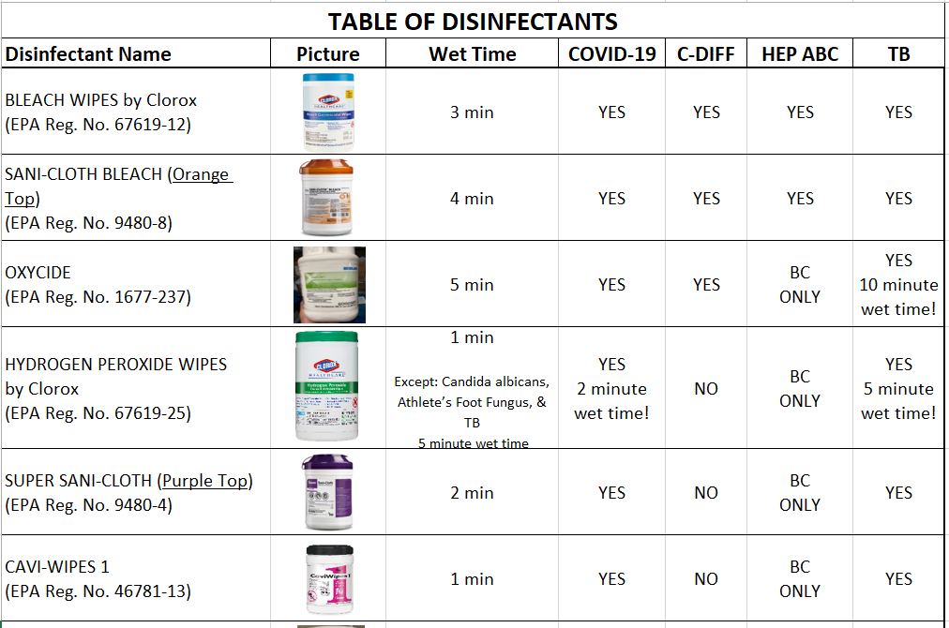
COVID19-Hot Topics
  Disinfectant Wipes

Slide 19
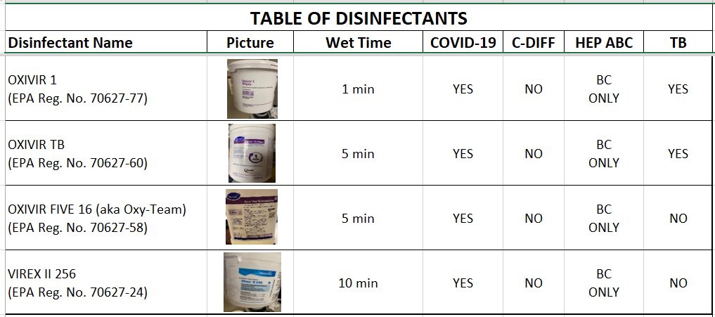
  Disinfectant Wipes

Slide 20
Covid Testing

Slide 21
Antibody/Serologic Testing
Currently available through CHP (Quest Diagnostics)
Lots of demand from employers as we “OPEN” back up
Covenant Clinical Lab will be able to provide in late May
Cannot be used as a sole method to diagnose COVID-19
Seroconversion at 11-14 days in as low as 67%
Currently limited utility: Convalescent Plasma Donation and/or Epidemiology data
The presence of antibodies does NOT mean an individual is “Immune”
Negative Results do NOT rule our Covid-19 Infection
Equivocal results may represent an early infection, detection of an IgG generated from a past infection (different strain of Coronavirus) or an underlying immune disorder….

Slide 22
Pharmacy Update
Allen Cunningham, PharmD

Slide 23
CHS COVID-19 Treatments
Agent | Dosage | Comments | Update
Hydroxychloroquine | 400 mg PO BID x 1 day, then 200 mg PO BID x 4 days | Most commonly used medication based on early data from China and France Most recent studies reveal no evidence of clinical efficacy in hospitalized patients and ~10% rate of adverse events | PSJH AMS COVID-19 subgroup no longer recommending use largely due to limited clinical trial data, some data suggestion it may be harmful, and risk of AE Caution advised in patients at risk for QT prolongation or receiving other drugs associated with arrhythmias
Hydroxychloroquine + azithromycin | 400 mg PO BID x 1 day, then 200 mg PO BID x 4 days + 500 mg PO x 1, then 250 mg PO daily x 4 days | High risk for adverse events (QTc prolongation) Guidelines recommend AGAINST use of this combination except in the context of a clinical trial | PSJH AMS COVID-19 subgroup recommends AGAINST use of this combination
Tocilizumab | 400 mg IVPB x 1 dose May repeat x 1 in 8-12 hours if clinical symptoms worsen or do not demonstrate improvement | IL-6 receptor antagonist used to treat cytokine release syndrome $2.13K - $4.25K per dose | CHS criteria for use: Proven COVID-19 infection Early treatment of severe or critically ill patients who are clinically deteriorating despite receiving other treatment and/or supportive care Restrict to intensivists or infectious diseases AST/ALT < 5 x ULN, ANC > 500, Plt > 50,000
Notes:
The FDA says that neither drug has been proven safe and effective in treating COVID-19. In fact, a study published on April 23 involving 368 COVID-19 patients at U.S. Veterans Health Administration hospitals found that taking hydroxychloroquine alone, or in combination with azithromycin, did not reduce the need for a ventilator compared to those not taking the drugs. Further, people taking hydroxychloroquine alone had a higher risk of dying during the study than those not taking the drug. Researchers in China came to a similar conclusion in a study of 150 COVID-19 patients randomly assigned to receive hydroxychloroquine or the current standard of care: after a month, both groups had similar symptom profiles, and showed similar levels of the virus, suggesting that the drug wasn’t clearing the COVID-19 virus in a significant way. The National Institutes of Health is conducting an ongoing study of hydroxychloroquine among hospitalized patients, as is Novartis, whose Sandoz division makes a generic version of the drug.
Toci:
Proven COVID-19 infection based on laboratory testing AND radiographic evidence of pneumonia
Severely ill definition: SpO2 ≤ 93% on room air or FiO2/PaO2 ≤ 300 mmHg or respiratory rate ≥ 30 breaths/min
Critically ill definition: Mechanical ventilation OR multi organ failure OR ICU admission

Slide 24
CHS COVID-19 Treatments
Agent | Dosage | Comments | Update
Remdesivir | 200 mg IV x 1, then 100 mg IV daily x 9 days | Covenant is enrolled in expanded access program for patients on a vent with adequate renal and hepatic function Enrolled 3 patients to date 2 completed course and extubated 6 clinical trial treatment courses remaining as of 5/6/20 | FDA issued an Emergency Use Authorization (EUA) 5/1/20 Duration recommendation changed to 5 days for patients who are not on mechanical ventilation and/or ECMO (can receive an additional 5 days if no clinical improvement) No restriction for timing from symptom onset Distribution Gilead has donated all supply to federal government for allocation No PSJH facility has been designated to receive product
Convalescent Plasma | 1 unit (200-400mL) x 1 | Covenant is enrolled in Mayo clinic clinical trial | Enrolled 3 patients to date
Zinc, Ascorbic Acid, Vitamin B | No established dose for COVID-19 | No literature to support use in the treatment of COVID-19
Notes:
According to the summary of the China study, remdesivir was “not associated with a difference in time to clinical improvement” compared to a standard of care control. After one month, it appeared 13.9% of the remdesivir patients had died compared to 12.8% of patients in the control arm. The difference was not statistically significant.
Hospitalized patients with advanced COVID-19 and lung involvement who received remdesivir recovered faster than similar patients who received placebo, according to a preliminary data analysis from a randomized, controlled trial involving 1063 patients, which began on February 21. The trial (known as the Adaptive COVID-19 Treatment Trial, or ACTT), sponsored by the National Institute of Allergy and Infectious Diseases (NIAID), part of the National Institutes of Health, is the first clinical trial launched in the United States to evaluate an experimental treatment for COVID-19. Preliminary results indicate that patients who received remdesivir had a 31% faster time to recovery than those who received placebo (p<0.001). Specifically, the median time to recovery was 11 days for patients treated with remdesivir compared with 15 days for those who received placebo. Results also suggested a survival benefit, with a mortality rate of 8.0% for the group receiving remdesivir versus 11.6% for the placebo group (p=0.059). Recovery in this study was defined as being well enough for hospital discharge or returning to normal activity level.

Slide 25
Pharmacy Shortages/Allocations
Covid-19 Related
  Cisatracurium
  Rocuronium
  Vecuronium
  Dexmedetomidine
  Diprivan
  Fentanyl
  Etomidate
  Vitamin C Liquid
  Vitamin C Injection
Non-Covid-19 Related
  Bumetanide
  Amiodarone
  Dopamine
  Dobutamine
  Famotidine
  Furosemide Inj
  Doxycycline Inj
  Nitroglycerin SDV
  IV solutions
  Bupivicaine with epinephrine

Slide 26
Pre-Procedure Testing for Covid-19

Slide 27
Pre-Procedure Testing Protocol
The laboratory will notify the physician who scheduled the procedure of COVID-19 test results. If the test is positive, the ordering physician should notify:
Patient
Patient’s PCP
Hospital Admitting Office
Intended procedural area (OR, Cath Lab, Endoscopy, etc)

Slide 28
Impact to Caregivers

Slide 29
Returning Warriors
Should we quarantine those doctors and nurses who have travelled to endemic areas to assist with medical relief?
There is no real qualitative difference in those returning from “mission-driven” trips from those caregivers who have been manning our “front lines” against Covid-19
For that reason, we have changed our policy and only require those high risk caregivers to monitor symptoms and temperature at least daily

Slide 30
Caregivers Impacted by Exposure and Test Positive
CDC Guidance:
Symptom Based Strategy: Exclude from work until
  At least 3 days (72 hours) have passed since recovery defined as resolution of fever without the use of fever-reducing medications and improvement in respiratory symptoms (e.g., cough, shortness of breath);
  and
  At least 10 days have passed since symptoms first appeared

Slide 31
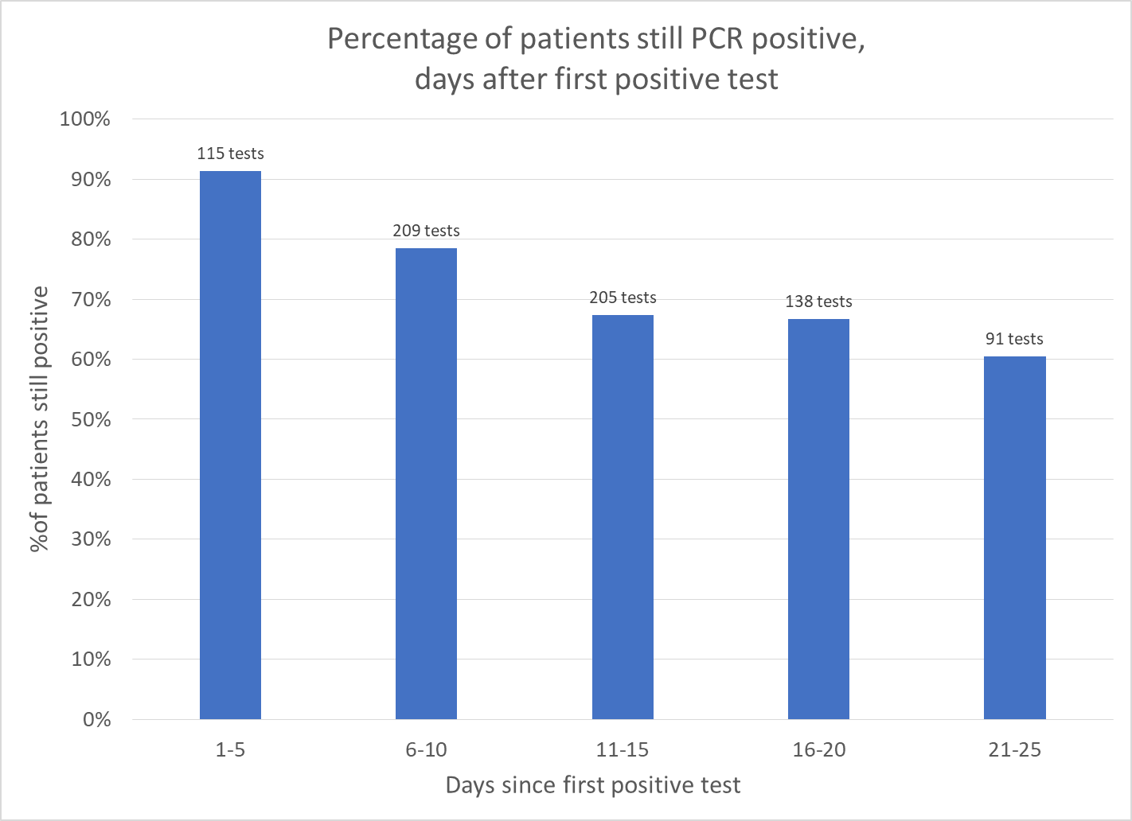
758 repeat PCR tests in 405 patients

Slide 32
Medical Students, APRNs, Pas, and Observers

Slide 33
Clinical Rotation Students – Medical Students, APRNs and PAs
TTUHSC Medical Students are currently scheduled to start back June 1.
Other schools will be dependent on the following:
  School’s decision to allow students to return
  Hospital/Clinic decision to allow students to return
    This will be a new portion of the application requiring a clinic or hospital administrator to sign off allowing them to return and address if they are requiring the school to provide PPE or if it will be provided by the clinic or hospital.
  Application process will still be handled by the Regional Medical Staff Office and a contract with the school must be in place for the student to rotate.
  Students will not be allowed to work in the COVID unit or participate in COVID testing.
www.covenantmss.org
Observers
Program is on hold and will be re-assessed on September 1.

Slide 34
Texas Demographics

Slide 35

Craig to UPDATE

Slide 36
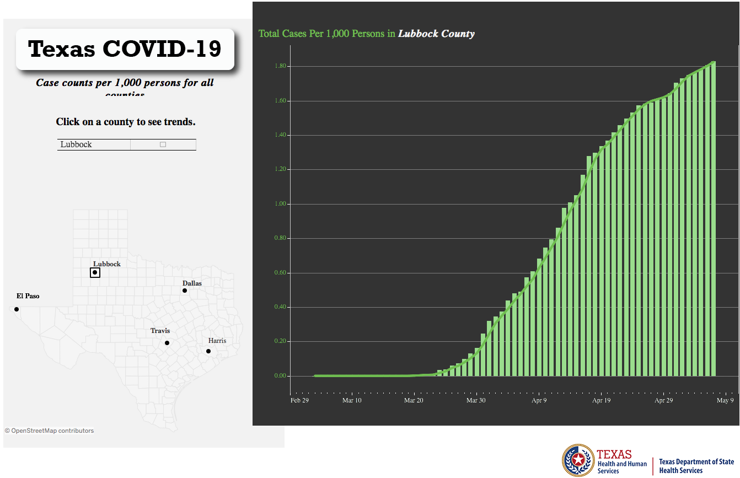

Slide 37
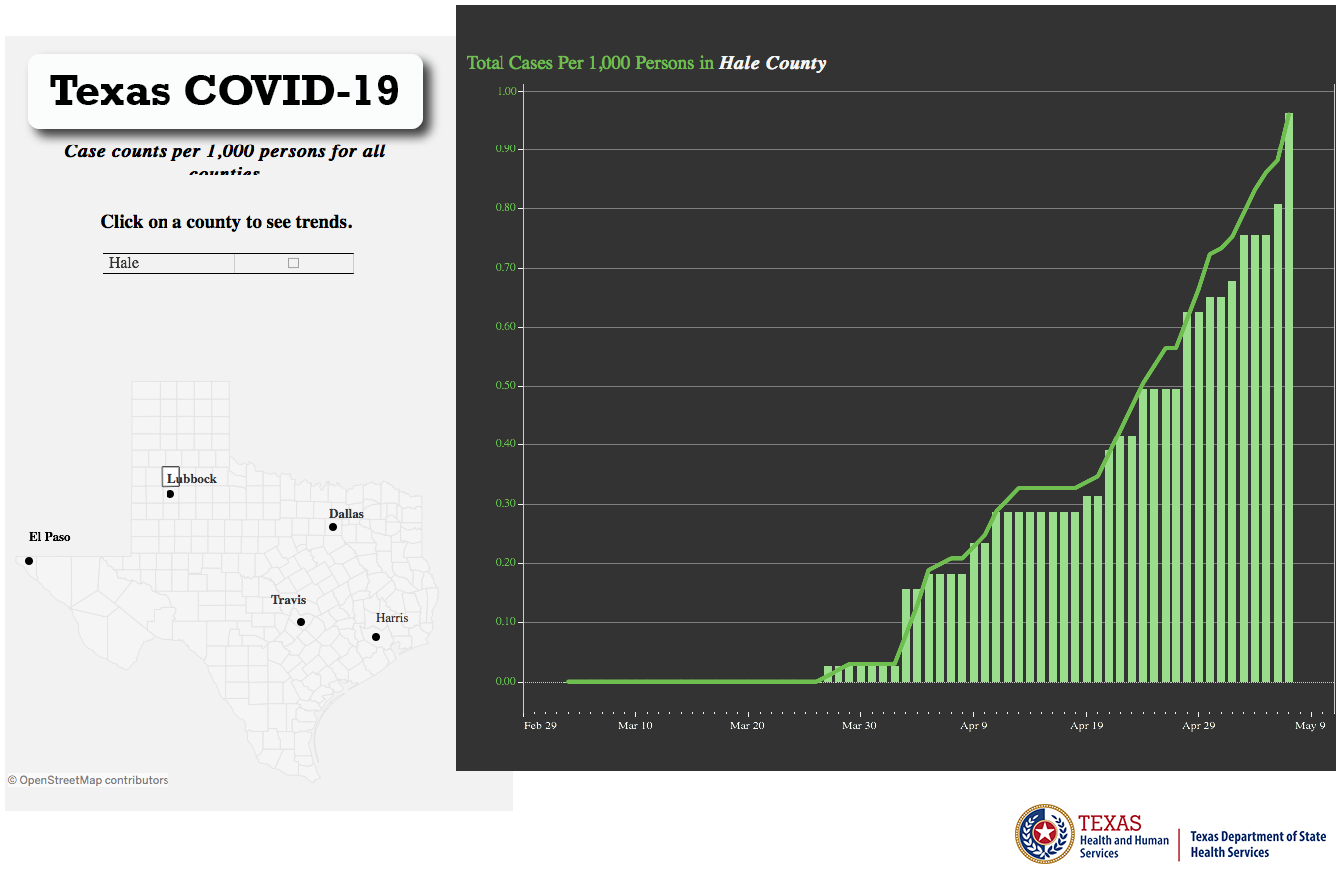

Slide 38
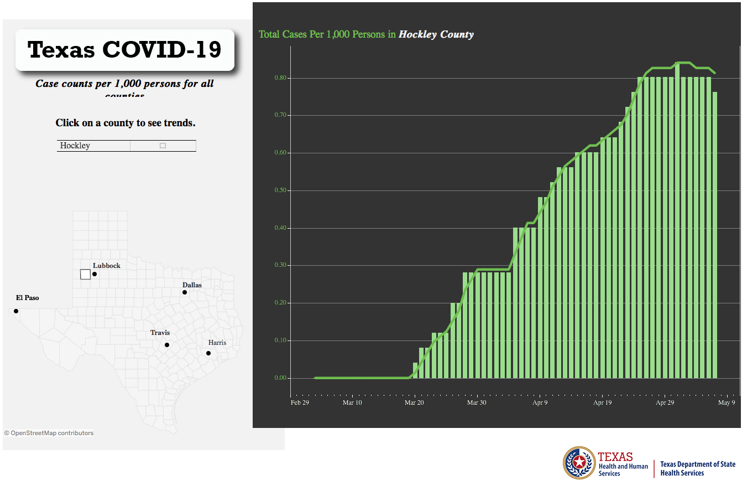

Slide 39
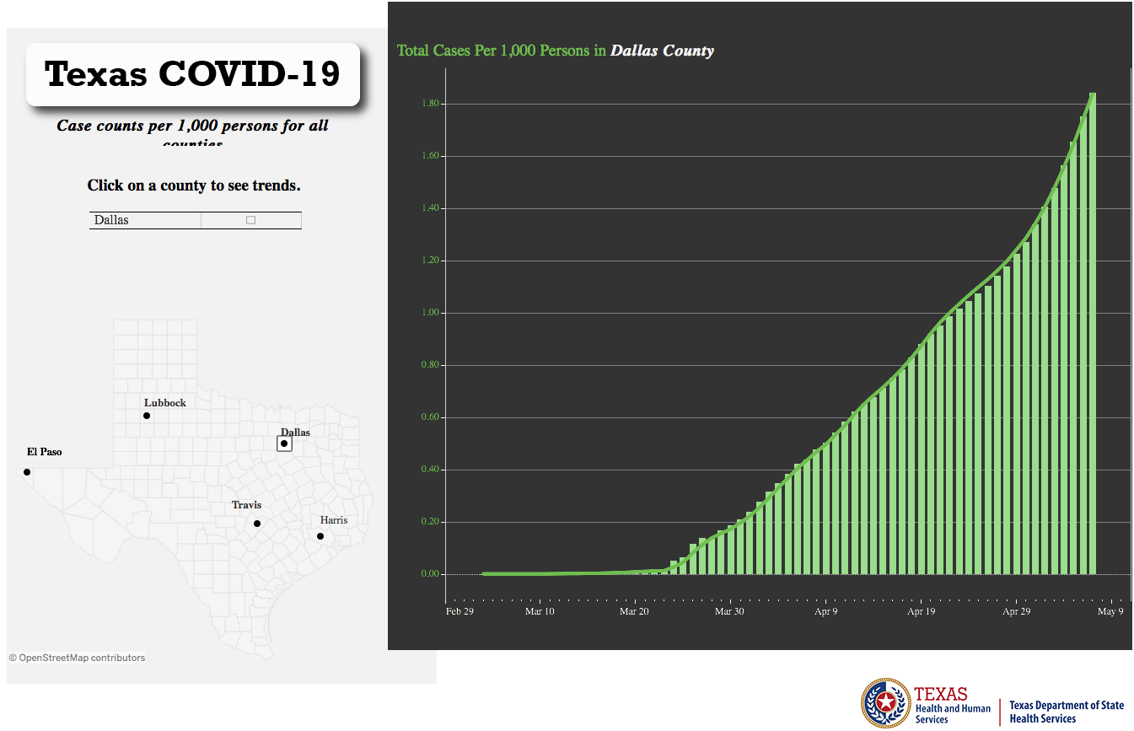

Slide 40
Q & A

