Slide 1
Covenant Health Update for Physicians
June 12, 2020

Slide 2
Reflection
Brian Schroeder, MD

Slide 4
Current Regional Census

Slide 5
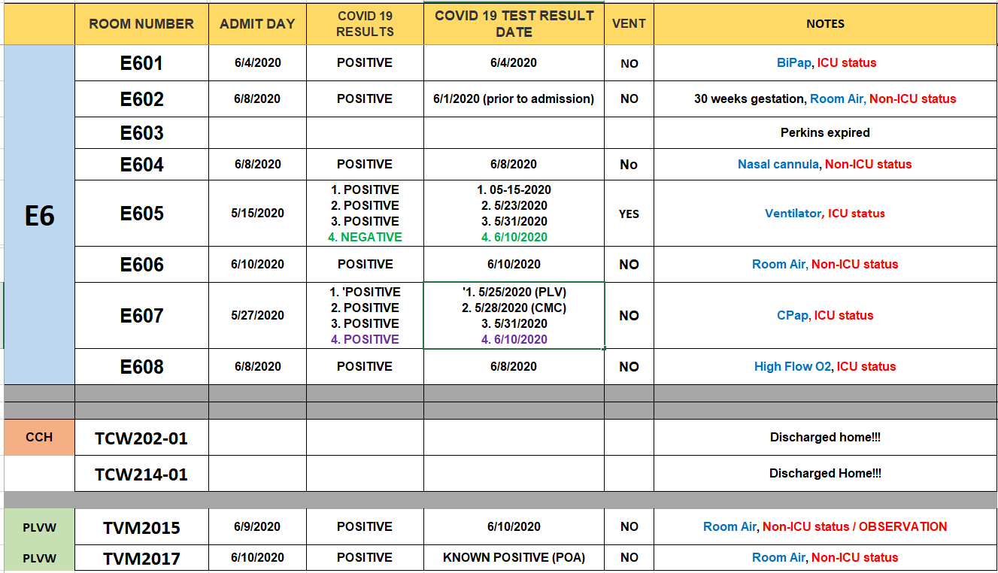
PUI/Confirmed cases-hospitalized

Slide 6
Statistics

Slide 7
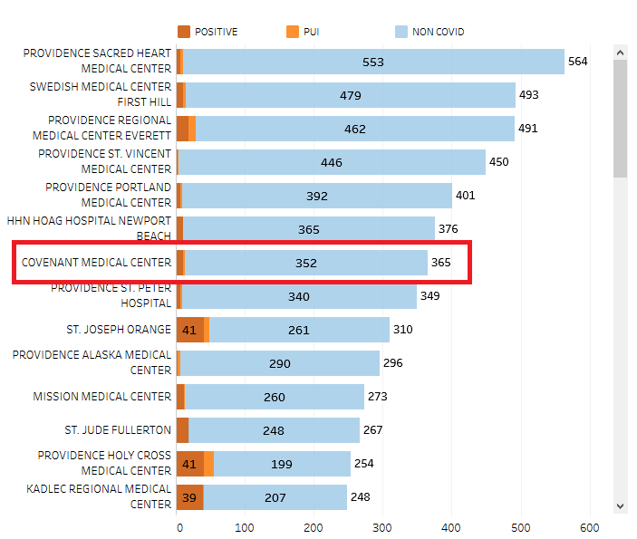
Providence System Hospitalized COVID-19 Cases

Slide 8
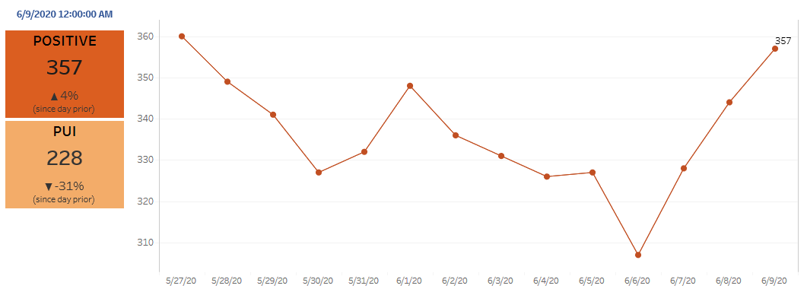
Providence Inpatient COVID-19 Volume

Slide 9
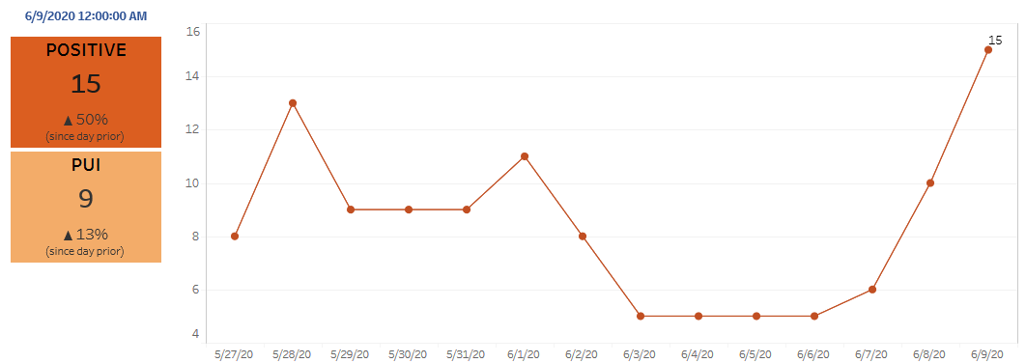
Texas Inpatient COVID-19 Volume

Slide 10
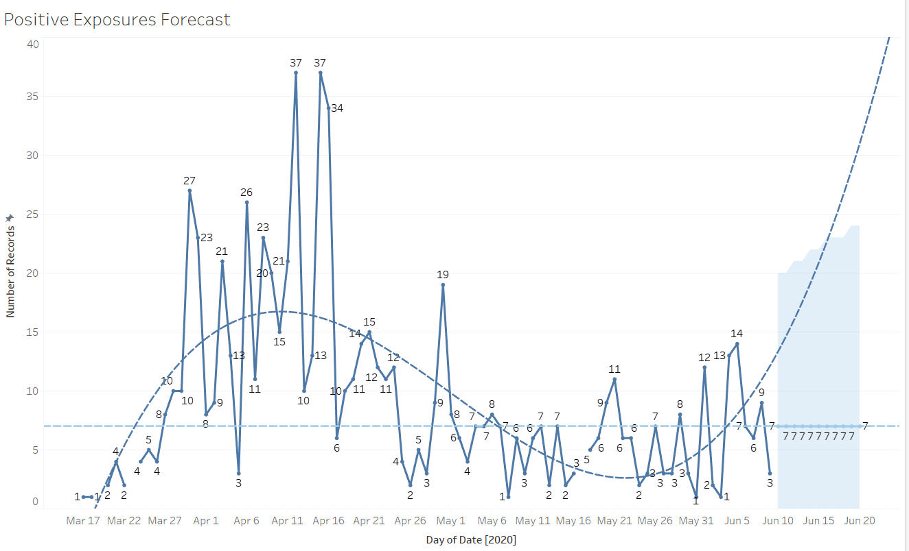
New Covid-19 POSITIVES by Day Trend

Slide 11
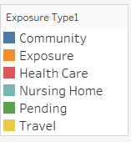
Covid-19 POSITIVES Age Distribution

Slide 12
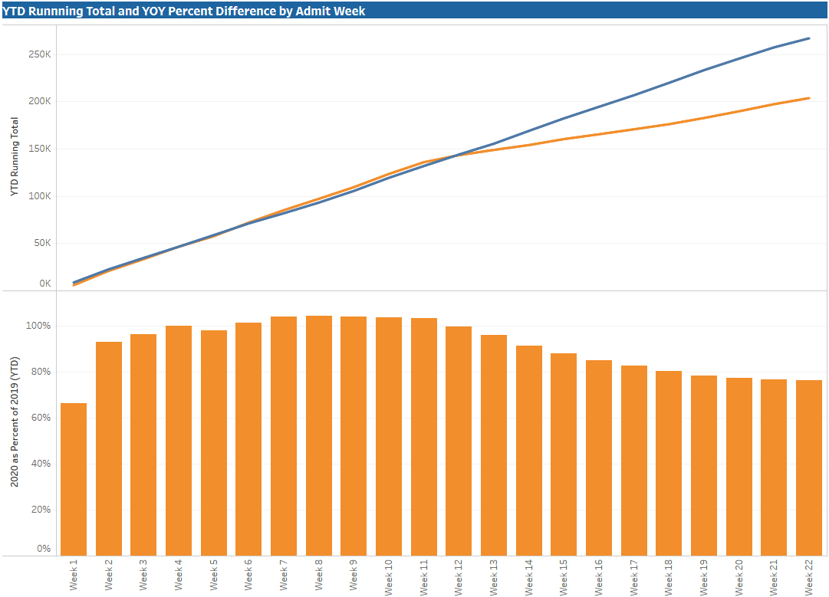
TX/NM Region Weekly Procedures (YOY)

Slide 13
Covid-19 Testing

Slide 14
TESTING
 | CMC | CCH | CHP | Grace | Total Tests
Abbott | 2784 | - | - | - | 247
Cepheid | 770 | - | - | -
BD Max | - | - | - | 1542
NP Swab | >5000 | - | - | -
VTM | >1300 | - | - | -
PSJH receiving 3 large platforms – 1 for Texas
PSJH discussing testing to underserved populations
Mfg shortages – Abbott and Cepheid

Slide 15
TESTING - Antibody
 | 5/6 – 5/9 | 5/11-5/15 | 5/18 – 5/22 | 5/26-5/29 | 6/1 | 6/2 | 6/3 | 6/4
Testing Totals | 785 | 1006 | 693 | 168 | 0 | 15 | 134 | 73
3706 total tests – 63 positive; 1.7%

Slide 16
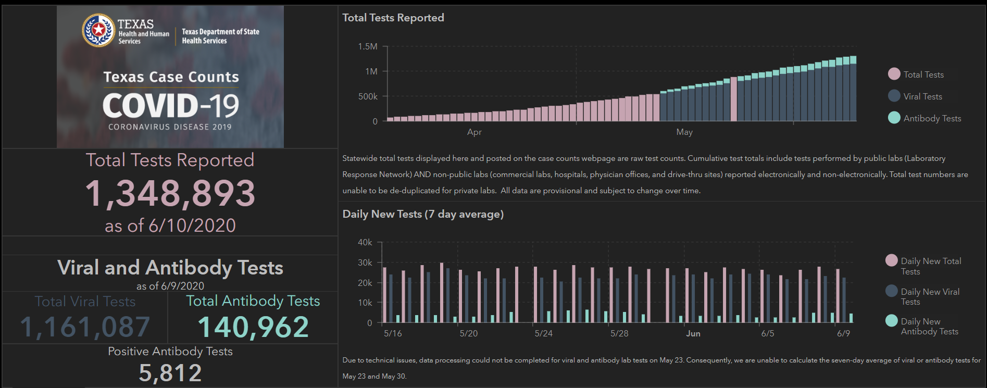
TESTING – STATEWIDE REsults
198,025 tests since 6/3
1417 new positives

Slide 17
Physician Screening

Slide 18
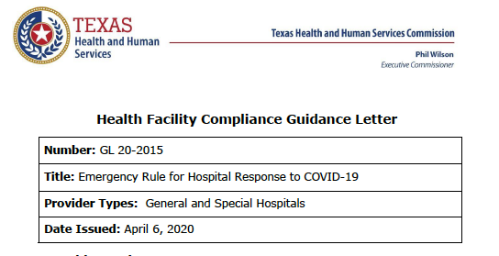
(c) A hospital must implement and enforce written policies and procedures regarding the entry of its workforce to protect the health and safety of patients, employees and staff, and the public.

Slide 19
Pharmacy Update
Wesley Wells
Regional Pharmacy Director

Slide 20
CHS COVID-19 Treatments
Agent | Dosage | Comments | Update
Hydroxychloroquine | 400 mg PO BID x 1 day, then 200 mg PO BID x 4 days Caution: QT prolongation, arrhythmias EUA = mandatory AE reporting to FDA MedWatch | Commonly prescribed based on early observational data; recent data suggests no benefit with potential harm NIH guidelines (5/12/20): insufficient data to recommend for or against use; do not recommend for PrEP or PEP PSJH AMS COVID-19 subgroup: alternative therapy for high risk patients only | 5/22/20: Lancet observational study reports HCQ associated with increased risk of in-hospital mortality -This study has now been retracted (6/5/20) by Lancet at the request of 3 of the original authors -Concerns were raised with respect to the veracity of the data and analyses conducted by a global healthcare data collaborative Awaiting results from RCT sponsored by NIAID
Hydroxychloroquine + azithromycin | Azithromycin 500 mg PO x 1, then 250 mg PO daily x 4 days | High risk for AEs (QTc prolongation); guidelines recommend AGAINST use except in context of clinical trial
Tocilizumab | 400 mg IVPB x 1 dose May repeat x 1 in 8-12 hours if clinical symptoms worsen or do not demonstrate improvement | IL-6 receptor antagonist used to treat CRS ($2.13K - $4.25K per dose) CHS criteria for use: Proven COVID-19 infection Early treatment of severe/critically ill patients who are clinically deteriorating Restricted to intensivists or ID AST/ALT <5xULN, ANC >500, Plt >50K | NIH guidelines state insufficient data to recommend either for or against the use of IL-6 inhibitors for the treatment of COVID-19
Notes:
The FDA says that neither drug has been proven safe and effective in treating COVID-19. In fact, a study published on April 23 involving 368 COVID-19 patients at U.S. Veterans Health Administration hospitals found that taking hydroxychloroquine alone, or in combination with azithromycin, did not reduce the need for a ventilator compared to those not taking the drugs. Further, people taking hydroxychloroquine alone had a higher risk of dying during the study than those not taking the drug. Researchers in China came to a similar conclusion in a study of 150 COVID-19 patients randomly assigned to receive hydroxychloroquine or the current standard of care: after a month, both groups had similar symptom profiles, and showed similar levels of the virus, suggesting that the drug wasn’t clearing the COVID-19 virus in a significant way. The National Institutes of Health is conducting an ongoing study of hydroxychloroquine among hospitalized patients, as is Novartis, whose Sandoz division makes a generic version of the drug.
HCQ:
PSJH high risk patients (age > 60, pulmonary disease, CV disease, CKD, DM, immune compromised, HTN present on admission or receiving anti-hypertensives prior to admission)
Toci:
Proven COVID-19 infection based on laboratory testing AND radiographic evidence of pneumonia
Severely ill definition: SpO2 ≤ 93% on room air or FiO2/PaO2 ≤ 300 mmHg or respiratory rate ≥ 30 breaths/min
Critically ill definition: Mechanical ventilation OR multi organ failure OR ICU admission
After publication of our Lancet Article,¹
several concerns were raised with respect to the veracity of the data and analyses conducted by Surgisphere Corporation and its founder and our co-author, Sapan Desai, in our publication. We launched an independent third-party peer review of Surgisphere with the consent of Sapan Desai to evaluate the origination of the database elements, to confirm the completeness of the database, and to replicate the analyses presented in the paper.
Our independent peer reviewers informed us that Surgisphere would not transfer the full dataset, client contracts, and the full ISO audit report to their servers for analysis as such transfer would violate client agreements and confidentiality requirements. As such, our reviewers were not able to conduct an independent and private peer review and therefore notified us of their withdrawal from the peer-review process.

Slide 21
CHS COVID-19 Treatments
Agent | Dosage | Comments | Update
Remdesivir | 200 mg IV x 1, then 100 mg IV daily x 9 days Emergency Use Authorization (EUA) 5/1/20 5 day treatment = 6 vials 10 day treatment = 11 vials | Covenant was enrolled in expanded access program, which ended 5/29/20 PSJH criteria for EUA: 1. Adults or pediatrics with confirmed SARS-CoV-2 2. Pneumonia per chest imaging 3. Patient with SpO2 ≤ 94% or requiring supplemental O2, mech vent, and/or ECMO 4. AST/ALT < 5 x ULN 5. eGFR > 30 ml/min Mandatory AE reporting to FDA MedWatch | Emergency Use Authorization Inventory = 180 vials EUA to date: 10 patients (2 patients on therapy as of Thursday AM) Per EUA, patients must be provided “Fact Sheet for Patients” and we must document that we communicated EUA info to patient in chart -Tasked to ID provider -System compliance will also be monitoring documentation TX requires patients to be entered in ImmTrac2 registry -Tasked to ASP/Quality
Convalescent Plasma | 1 unit (200-400mL) x 1 | CMC enrolled in Mayo trial | Enrolled X patients to date
Zanubrutinib | 320 mg PO once daily for up to a maximum of 28 days | CMC will be participating in this phase 2, randomized, double blind, placebo-controlled | Looking to enroll 46-52 patients (enrollment date TBD)
Notes:
According to the summary of the China study, remdesivir was “not associated with a difference in time to clinical improvement” compared to a standard of care control. After one month, it appeared 13.9% of the remdesivir patients had died compared to 12.8% of patients in the control arm. The difference was not statistically significant.
Hospitalized patients with advanced COVID-19 and lung involvement who received remdesivir recovered faster than similar patients who received placebo, according to a preliminary data analysis from a randomized, controlled trial involving 1063 patients, which began on February 21. The trial (known as the Adaptive COVID-19 Treatment Trial, or ACTT), sponsored by the National Institute of Allergy and Infectious Diseases (NIAID), part of the National Institutes of Health, is the first clinical trial launched in the United States to evaluate an experimental treatment for COVID-19. Preliminary results indicate that patients who received remdesivir had a 31% faster time to recovery than those who received placebo (p<0.001). Specifically, the median time to recovery was 11 days for patients treated with remdesivir compared with 15 days for those who received placebo. Results also suggested a survival benefit, with a mortality rate of 8.0% for the group receiving remdesivir versus 11.6% for the placebo group (p=0.059). Recovery in this study was defined as being well enough for hospital discharge or returning to normal activity level.

Slide 22
Pharmacy Shortages/Allocations
Covid-19 Related
Cisatracurium
Rocuronium
Vecuronium
Dexmedetomidine
Propofol
Fentanyl
Etomidate
Vitamin C Liquid
Vitamin C Injection
Ivermectin
Non-Covid-19 Related
Bumetanide
Amiodarone
Dopamine
Dobutamine
Famotidine
Furosemide Inj
Doxycycline Inj
Nitroglycerin SDV
Bupivacaine with epinephrine
Lidocaine with epinephrine
Methadone inj

Slide 23
Financial Recovery

Slide 24
Partial Unemployment Program (TWC)
Texas Workforce Commission (TWC) program for Healthcare Workers
Allows us to offer a 32 hour workweek in June and July (our traditionally lower volume months)
Replaces some or all of the lost pay with partial unemployment benefits plus a $600 CARES Act Covid unemployment benefit through 7-31-2020
For every five caregivers that participates in the program, we save enough in salaries to avoid one potential layoff.
We are encouraging caregivers to rest and rejuvenate during their time off

Slide 25
Health Care Industry Representatives (HCIR)
As we re-open elective services, we will be facing allowing some vendors (HCIR) to return to our facilities. Be aware that this comes at a price and with Federal regulations (OSHA):
We are obligated to provide appropriate PPE to the Vendors
The PPE provided must be the same level of protection that the procedural team is using
The PPE must be FIT TESTED as appropriate
For the purpose of limiting the Burn Rate of PPE, we are asking our doctors to help us by limiting the number of vendors that are attending procedures to essential vendors only.

Slide 26
Texas Demographics

Slide 27
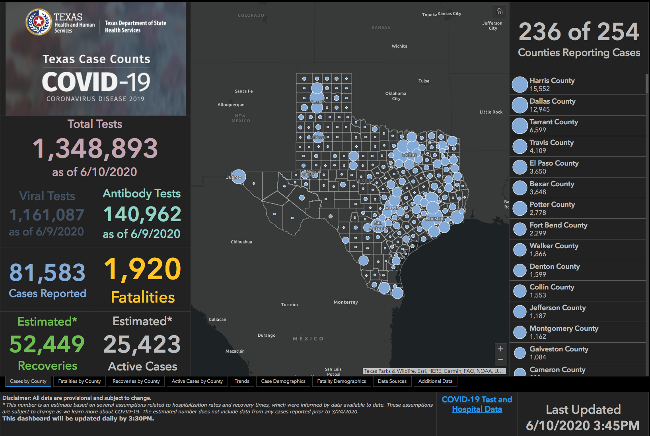

Slide 28
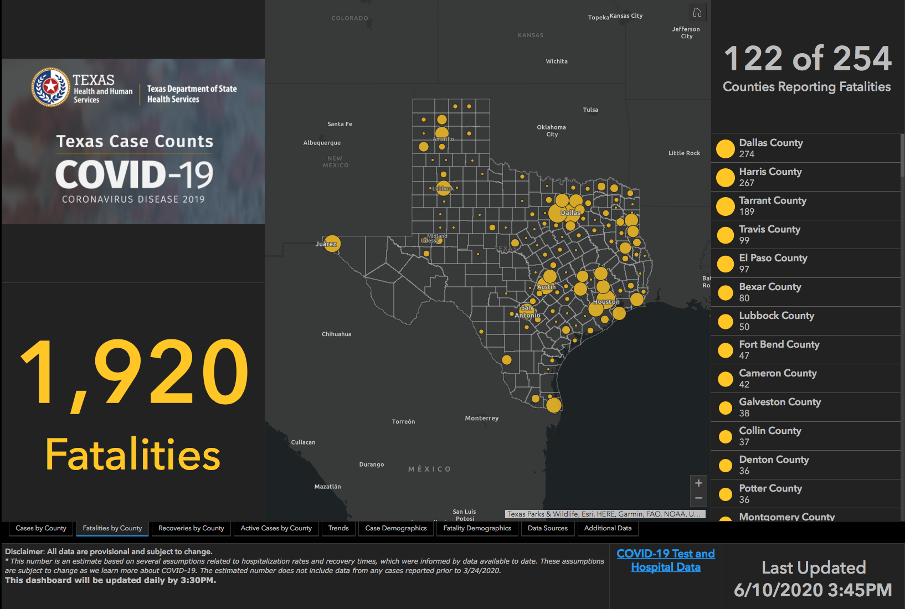

Slide 29
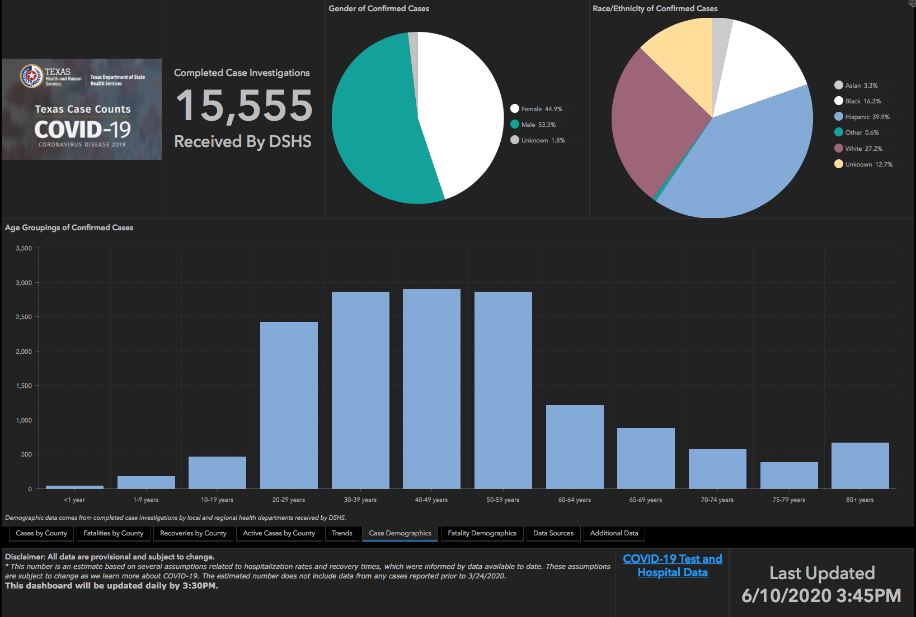

Slide 30
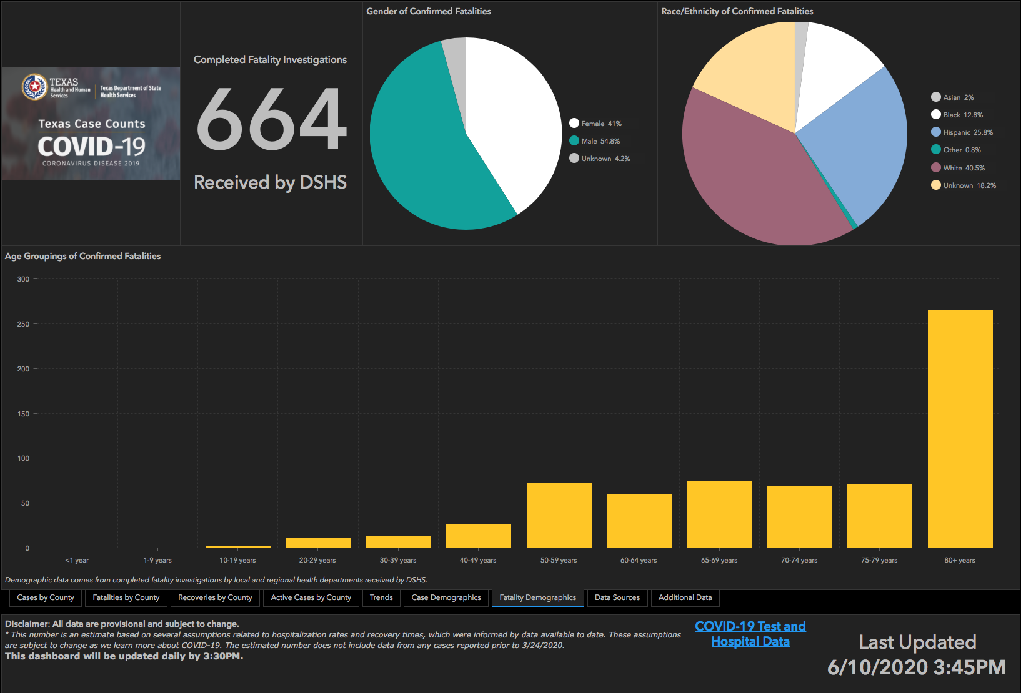

Slide 31
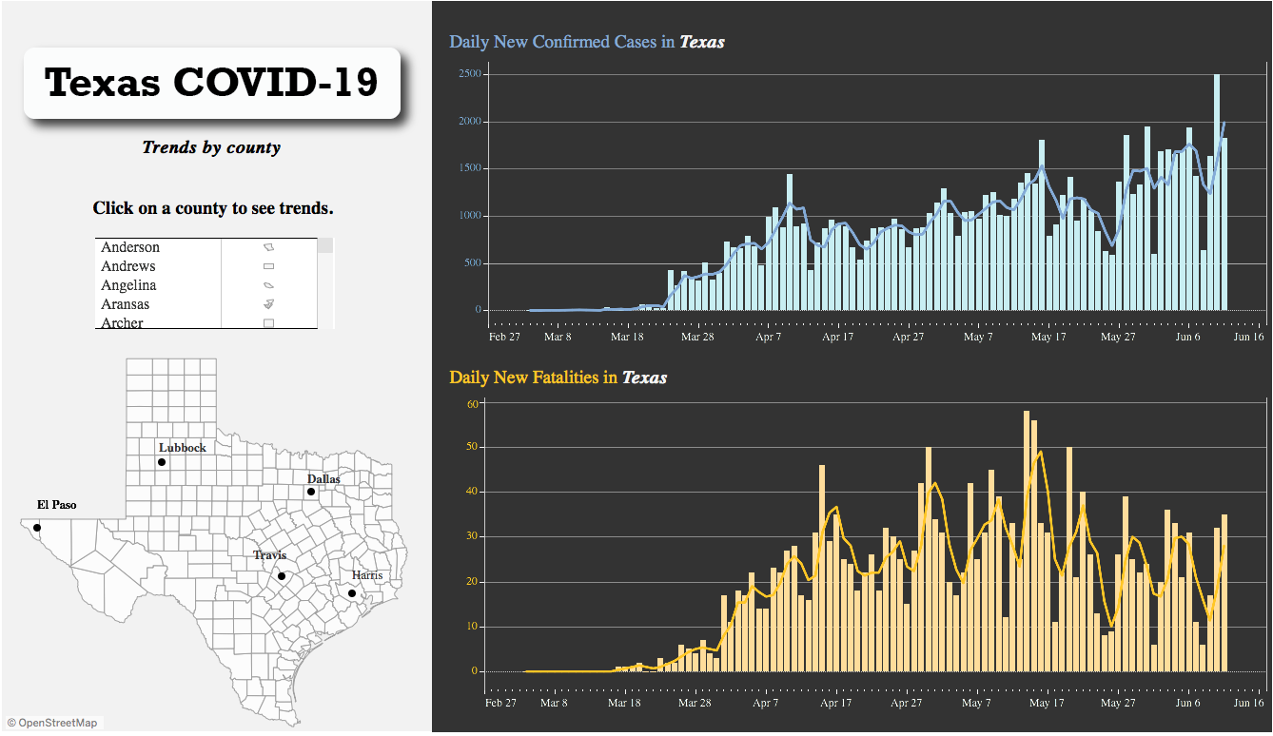

Slide 33
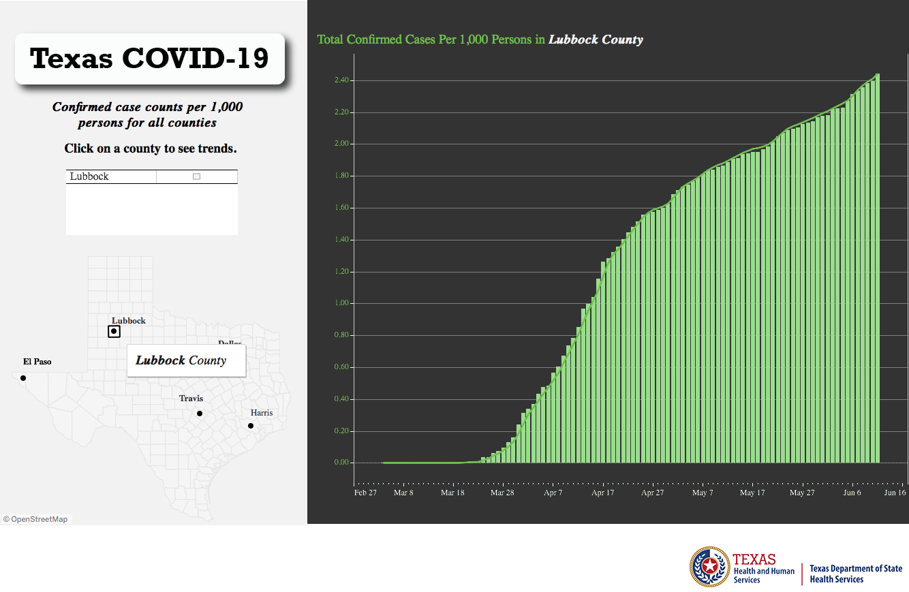

Slide 35
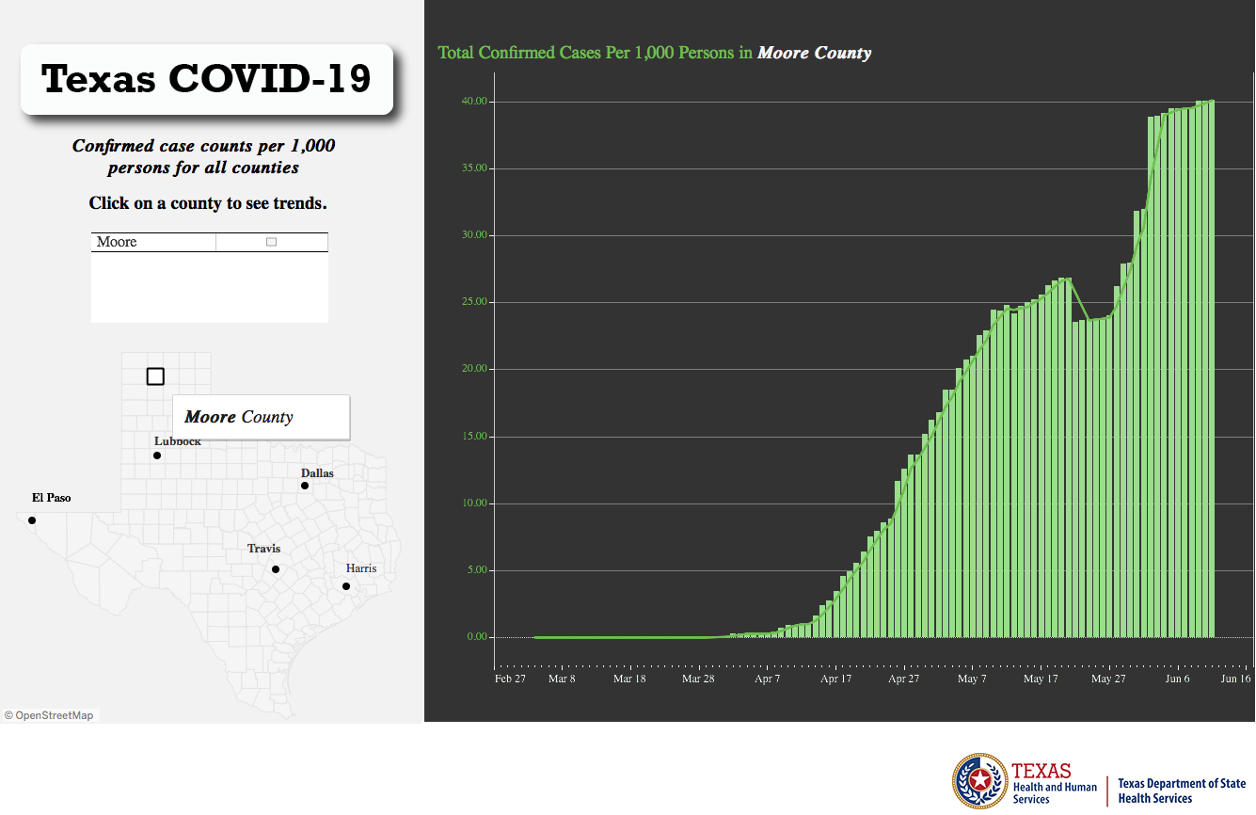

Slide 36
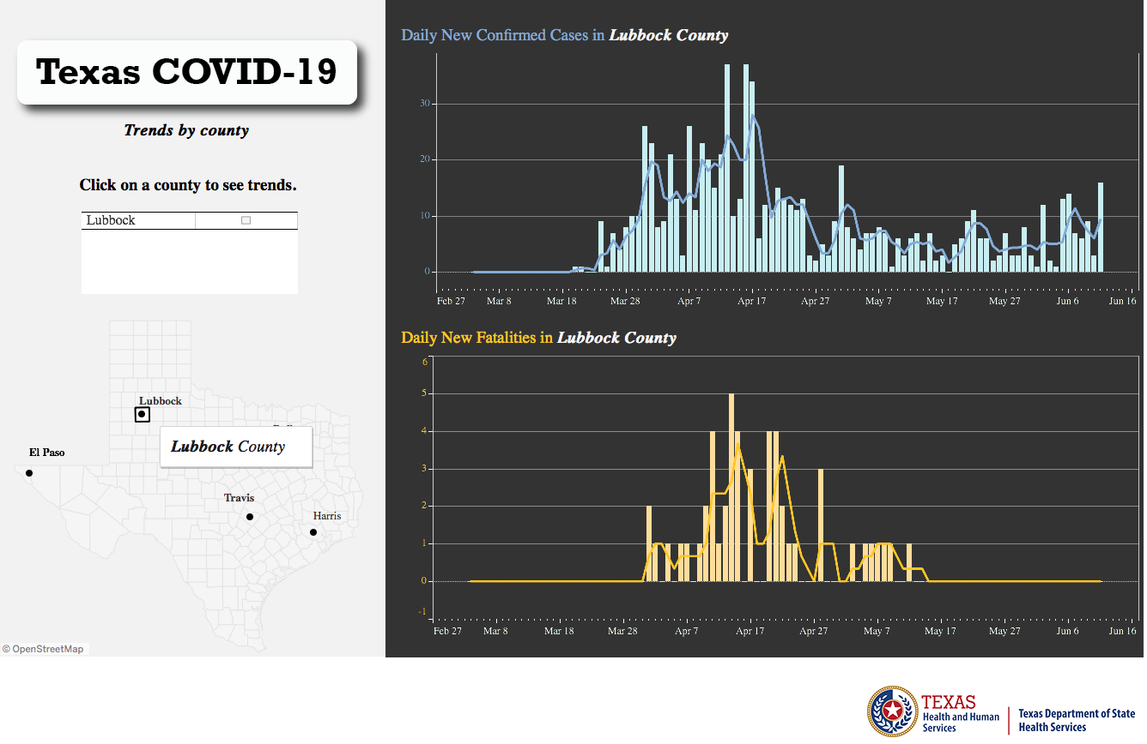

Slide 37
Q & A

