Slide 1
Covenant Health
Update for Physicians
June 26, 2020

Slide 2
Reflection

Slide 3

Our loving God hiddenly but surely works for our good even in the places we do not expect, including amid the evil of deadly epidemics. The fear of bodily illness and death should drive us to pray and to care for our souls, remembering that this world is not our lasting home.
An epidemic is one of many evils that beset us, and we have to take that seriously; but the greater evil is the evil within.
Matthew 10:28, Luke 12:4

Slide 4
Current Regional Census

Slide 5
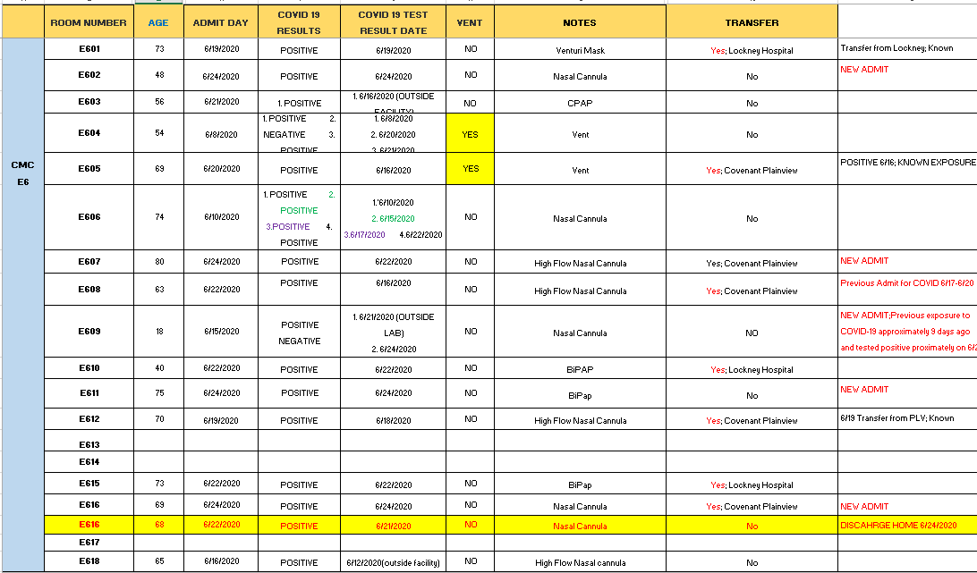
PUI/Confirmed cases-hospitalized

Slide 6
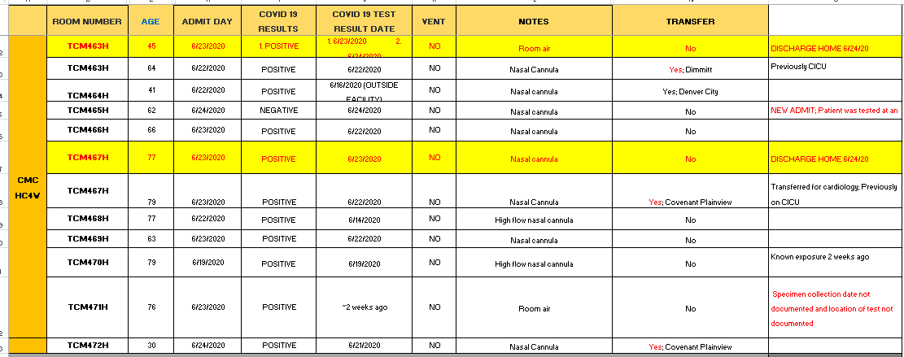
PUI/Confirmed cases-hospitalized

Slide 7
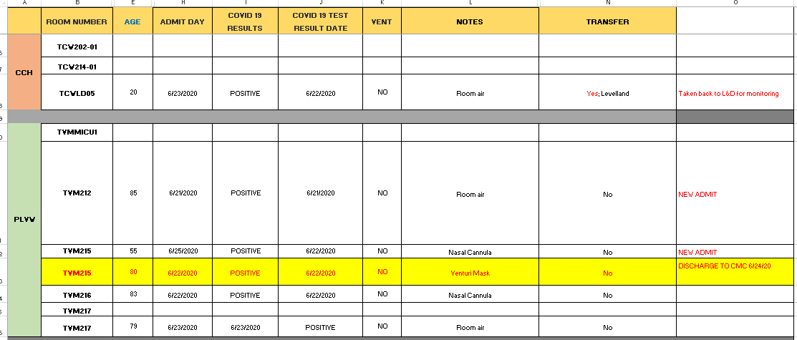
PUI/Confirmed cases-hospitalized

Slide 8
CMC Surge Plan
COVENANT MEDICAL CENTER
Last Week
Currently

Slide 9
Statistics

Slide 10
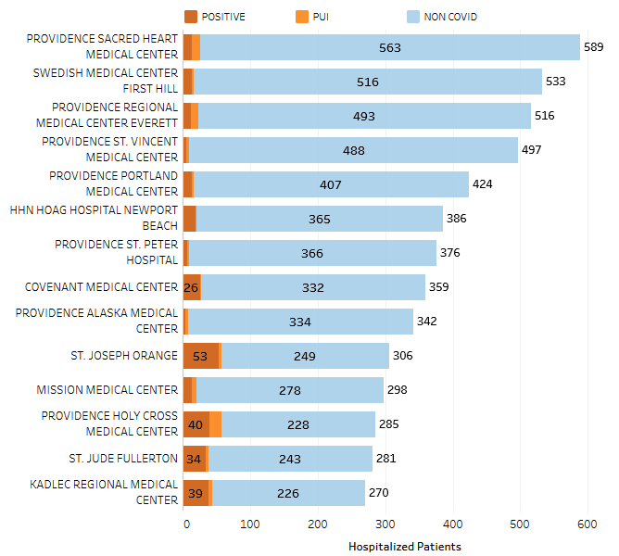
Providence System Hospitalized COVID-19 Cases

Slide 11
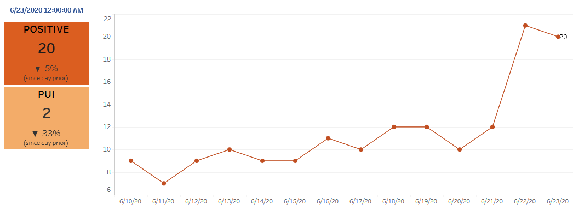
Texas Inpatient COVID-19 Volume

Slide 12
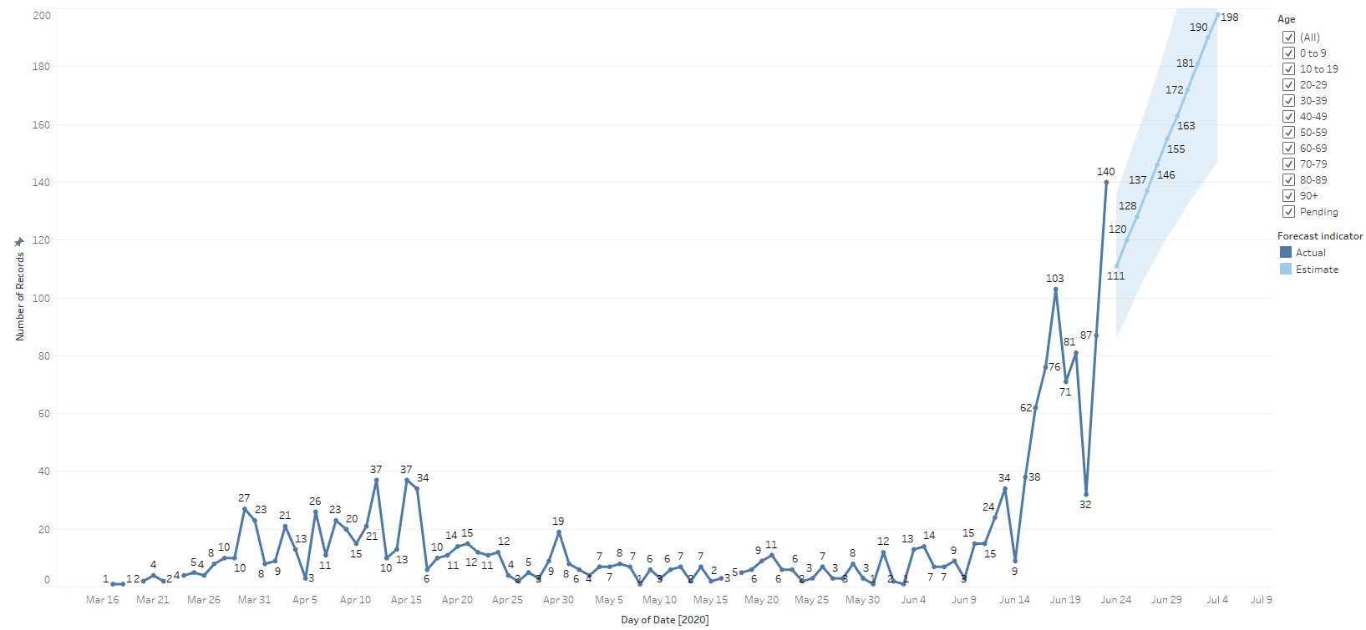
New Covid-19 POSITIVES by Day Trend

Slide 13
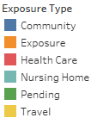
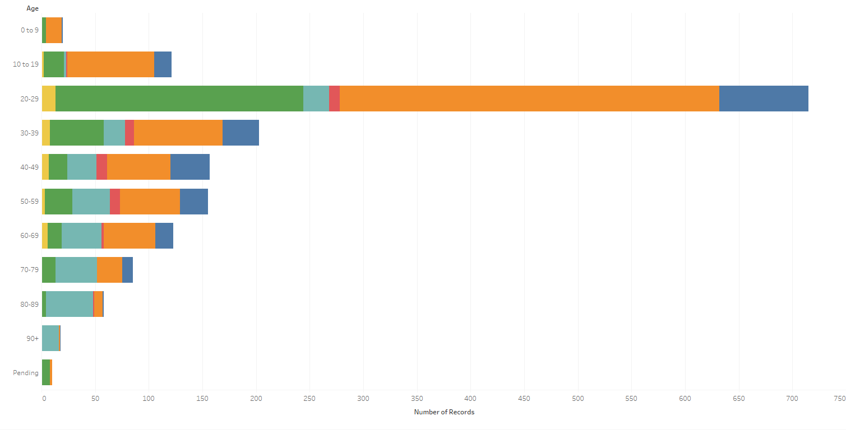
Covid-19 POSITIVES Age Distribution

Slide 14
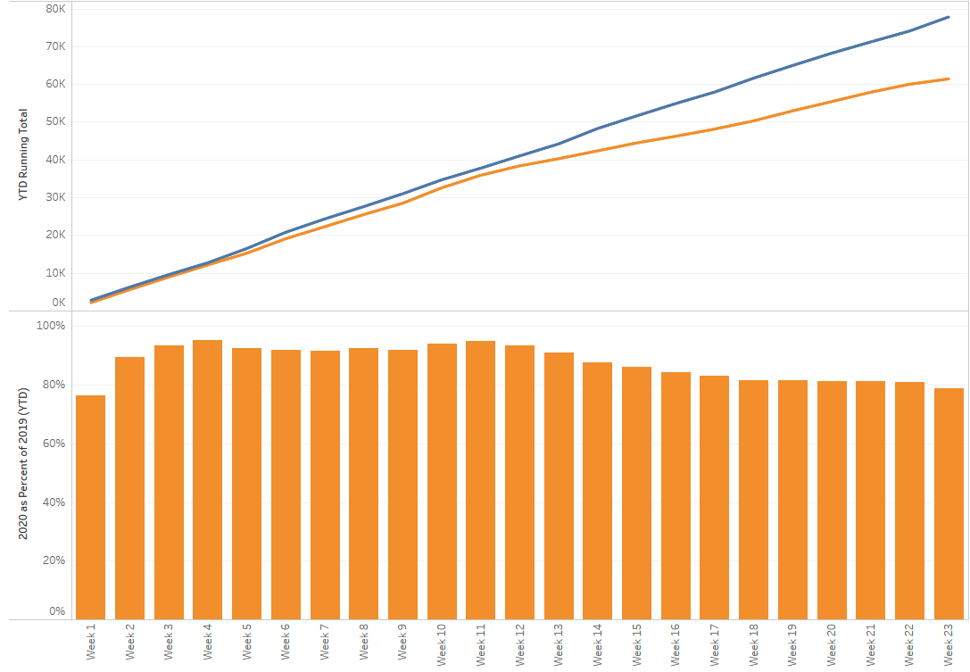
TX/NM Region Weekly Procedures (YOY)

Slide 15
Returning to Operations

Slide 16
COVID19-HOT TOPICS
  PPE Inventory
System taking count for additional CAPR’s (Maxair 710) to purchase

Slide 17
REH Return to Operations Plan
Overview of Work Streams, Owners, Objectives and Status
Updated 6.18.2020

Slide 18
Are we prepared to ramp up operations?
  Early diligence against revised ramp up projections, indicate we are prepared in both supplies and operations for a metered return across all major clinical specialties and general surgery. Continued diligence is required to mitigate risk as the national and world supply chains adjust to meet the growing need. Increased surgery caseload plus increased CV-19 cases are adding pressure to an already strained supply chain. General Med Surg category moving to "Yellow" due to a shortages in a few specific areas.
No impact to operations expected;
Some substitutions may be needed
Without action, some impact to operations may occur;
Expect greater substitutes required, possible clinical practice change
State of supply near full depletion;
Expect impact to operations and
clinical practice change
Category
Status
Primary risks and callouts
Physician Specialty
Solid - ready
General Med-Surg
Moving to yellow because of declining inventory and allocation on shoe covers/bouffant caps with increasing usage. Managing inbound spot buys to resolve this concern. Also balancing inventory to maximize inventories.
PPE
Solid – under current clinical use criteria
Supply Resiliency
Medline self-manufactured wipes now on-line. Third party mfr. now on-line for both wipes and hand sanitizer. Changing this back to yellow due to delay in getting 3rd party EPA approval. Should have this resolved in the coming week.
EVS
Testing
Overall supply is sufficient with use of commercial labs. Capacity does not match Regional demand in all cases. Additional capacity strategies under way.
Respiratory Therapy & Anesthesia
Actively watching as dry rental market impacting surge needs for ventilators at individual Ministries.
Operational Processes
All REH-owned process (i.e. logistics, central planning, procure-to-pay) ready

Slide 19
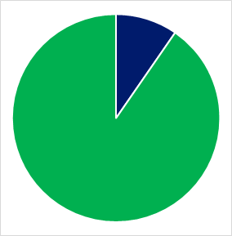
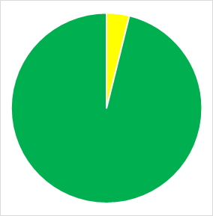
Return to Operations Management Framework
Workstream identified
Ready for Return
Workstream in progress
Some Issues
Workstream complete or active
Major Issues
Function
Owner(s)
Objective
System Integration
  David Carlson
  Understand and communicate system operations ramp up strategies through engaging with clinical, system and peer division leaders
Physician Specialty
  Cheryl Saxby
  Identify at-risk supply categories through increased vendor engagement, launch mitigation strategies
General MedSurg
  Cole Ercanbrack
  Identify at-risk supply categories through increased vendor engagement, launch mitigation strategies
PPE
  Cole Ercanbrack
  Forecast PPE use by system policy, increase allocations with current suppliers and identify alternative sources
Supply Resiliency
EVS
  Gerry Slingsby
  Forecast EVS need, increase allocations with current vendors and identify alternative sources
Testing
  Andy Maze
  Understand system testing strategy and ensure proper inflow and distribution of testing supplies
Respiratory Therapy & Anesthesia
  Tran Nguyen
  Ensure adequate supply of consumables and disposables associated with respiratory and anesthesiologic care
Central Planning
  Pat Donovan
  Ensure accurate data and information on inventory planning (i.e. manage LUM to general storage, optimize reorder points)
Operations & Logistics
  Rick Miltimore
  Promote accurate physical inventory and documenting operations
Procurement
  Sean Thornton
  Identify critical processes that may roadblock surgery ramp up, determine solutions to address
CTM & Maintenance
  Steve Ellithorpe
  Ensure continued and uninterrupted maintenance, prioritize schedule by most necessary equipment
Operations Resiliency
Non-Acute Support
  Karla Butts
  Ensure Ambulatory concerns and requirements communicated and met through Return to Operations management project plan
Projections & Reporting
  Brad Alexander
  Develop simple reports to inform clinical operators and system leaders on supply standing
Capital Equipment
  Tamar Katz
  Hyper local need of Vents was met this week. Watching this closely as cases rise.
Project management and communications lead by Kevin Klauer
REH Executive Team concurrently reviewing work from home protocols

Slide 20
Supply Readiness by Clinical Specialty (1/2)
No impact to operations expected;
Some substitutions may be needed
Without action, some impact to operations may occur;
Expect greater substitutes required, possible clinical practice change
State of supply near full depletion;
Expect impact to operations
Category
At-risk supply categories
Risk Level
What is REH doing?
What support do we need?
Common Medical Surgical Supply
Cole Ercanbrack
  Surgical Disposables
  Increasing allocation and spot buys for shoe covers
  Item specific follow up with manufacture on high risk items
  Process critical items to increase inventory or determine subs.
  Specific ramp up scheduled, identifying critical need supplies
  Align with system IP’s usage, practices and conservations efforts
  Surgical Devices
  Sterility Assurance Disposables
  Nursing Supplies
Cath/CV OR
Cheryl Saxby
  Implants
  Surveying key vendors on supply availability and services needed for ramp up
  Review of scheduled cases at facilities and ramp up %
  Mapping
  Rep service
  Perfusion services
Neurosciences
Cheryl Saxby
  Implants
  Surveying key vendors on supply availability and services needed for ramp up
  Review of scheduled cases at facilities and ramp up %
  Instrument sets
  Rep service
  Engage with SPD departments to review turnaround times on Instrument sets if we exceed 100% over normal procedures expectation.
Clinical specialties
  Neuromonitoring services
  SPD turn around on Instrument sets
Ortho/Trauma
Cheryl Saxby
  Implants
  Surveying key vendors on supply availability and services needed for ramp up
  Review of scheduled cases at facilities and ramp up %
  Instrument sets
  Rep service
  Engage with SPD departments to review turnaround times on Instrument sets if we exceed 100% over normal procedures expectation.
  SPD turn around on Instrument sets
  Review of scheduled cases at facilities and ramp up %
Gen/Robotics
Cheryl Saxby
  Disposables
  Surveying key vendors on supply availability and services needed for ramp up
  Rep service is good. Supplies, as we ramp up to our 26 new robots will be slow moving
  Rep Service
Digestive Health
Cole Ercanbrack
  Disposables
  Surveying supplier’s direct inventory status & rep support
  Utilizing reporting tools for earlier detection of supply shortages
  Specific ramp up scheduled, identifying critical need supplies
  Align with system IP’s PPE usage, practices and conservations efforts
  Devices
  Rep service

Slide 21
Supply Readiness by Clinical Specialty (2/2)
No impact to operations expected;
Some substitutions may be needed
Without action, some impact to operations may occur;
Expect greater substitutes required, possible clinical practice change
State of supply near full depletion;
Expect impact to operations
Category
At-risk supply categories
Risk Level
What is REH doing?
What support do we need?
Women & Children
Lionel Granillo
  OBGYN Disposables
  Partnering with Medline to continually manage distributed inventory
  Surveying supplier’s direct inventory status
  Connecting with W&C System leadership to identify ramp-up trends
  Specific ramp up scheduled, identifying critical need supplies
  Align with system IP’s PPE usage, practices and conservations efforts
  Labor & Delivery
  Surgical Devices
Clinical specialties
Respiratory Therapy
& Anesthesia
Tran Nguyen
  Proprietary disposable & consumables
  Core list of critical items completed & maintained with possible subs for RT, currently in process for Anesthesia
  Weekly connect of key RT stakeholders and continued communication with RT Resource Council
  Shifting inventory as needed throughout the system
  Utilizing reporting tools for earlier detection of supply shortages
  Continued monitoring of department level inventory, identifying items in critical need
  Maximizing ministry level ordering ability, maintaining higher than normal stock levels as appropriate for ministry
  Hepa Filters
  ASA recommended circuits
PPE
Cole Ercanbrack
  N95 Respirator Masks
  Maximizing allocation from contracted suppliers
  Managing non-traditional supply channels
  Monitoring & aligning with system IP’s PPE strategies and Nations changes.
  Increasing owned inventory levels for flexibility
  Implementing PAPR/CAPR stockpile program
  Align with system IP’s PPE usage, practices and conservations efforts
  Facial Protection
  Gowns
EVS
Gerry Slingsby
  Disinfectant Liquid
  Reviewing on-hand and backorder reports
  Reviewing backorder reports/Identifying 3rd party vendors
  Establishing 3rd part supply lines
  Working with Laundries. In-house/outsourced & COOP. obtaining linen scrubs, gowns as necessary
  Maintaining clear lines of communication between facilities and contract teams
  Flexibility in product selection
  Disinfectant Wipes
General categories
  Laundry/Linen/Scrubs/Iso Gowns
Testing
Andy Maze
  In-house COVID reagents
  Sourcing more in-house high-complexity reagents
  Driving efficiency with reference labs
  Synchronizing swab and reagent supply
  Alignment on serological, PCR testing
  Labs confirm alternative specimen types
  System blood donation strategy
  Blood products and services
  In-house swabs, transport media
  Commercial reference lab testing

Slide 22
Covid-19 Testing

Slide 23
TESTING
 | CMC | CCH | CHP | Grace | Total Tests
Abbott | >2448 | - | - | - | 214
Cepheid | 690 | - | - | -
BD Max | - | - | - | 1473
NP Swab | >5000 | - | - | -
VTM | >1500 | - | - | -
    CMC will have antibody testing capability mid July
    New COVID testing platform ready 1st week of August

Slide 24
TESTING - Antibody
 | 5/6 – 5/9 | 5/11-5/15 | 5/18 – 5/22 | 5/26-5/29 | 6/1 – 6/5 | 6/15-6/19
Testing Totals | 785 | 1006 | 693 | 168 | 162 | 117
    Cov Health Partners
        Levelland this week
    CMG starts today
      Need a physician order for this test

Slide 25
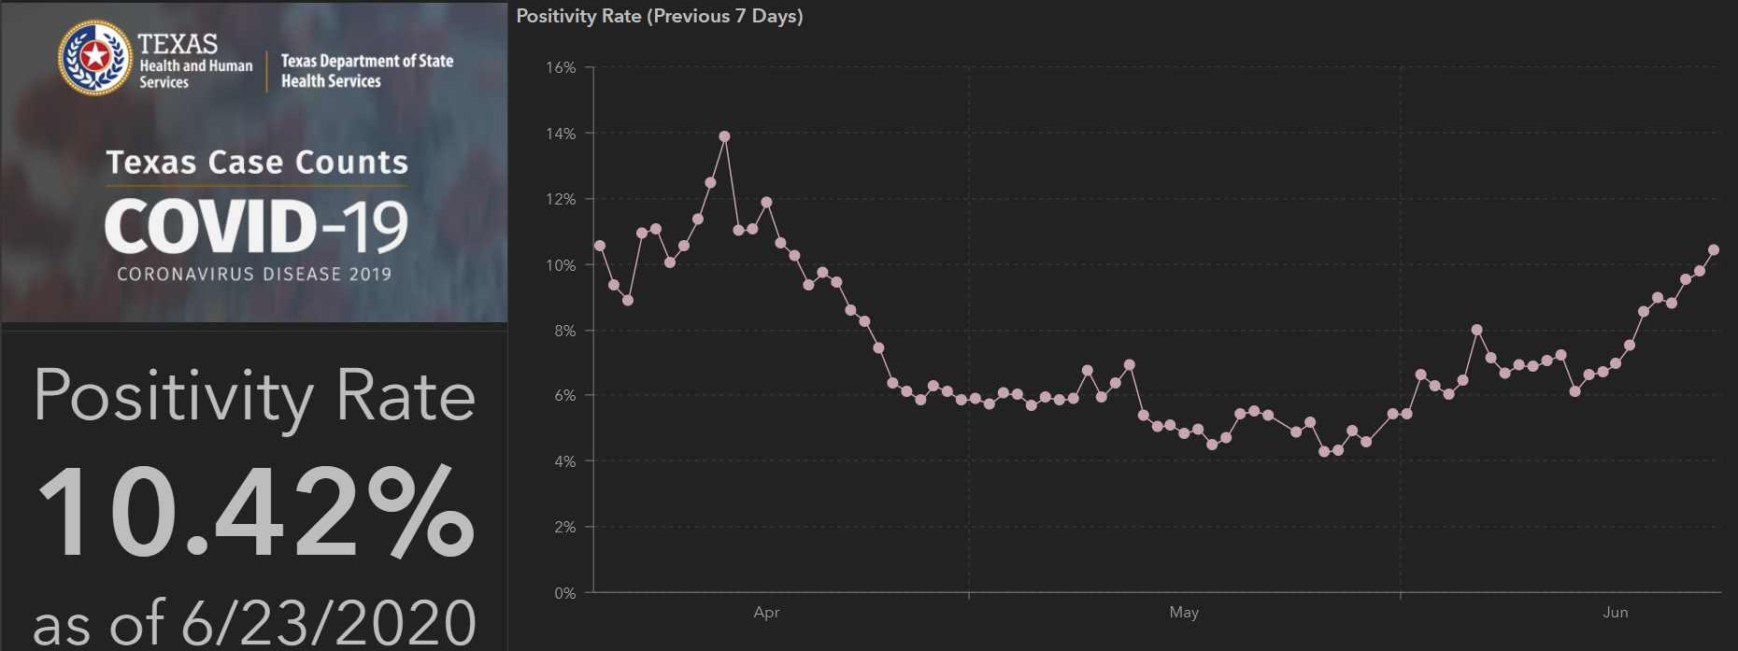
TESTING – STATEWIDE Results

Slide 26
Physician Screening

Slide 27
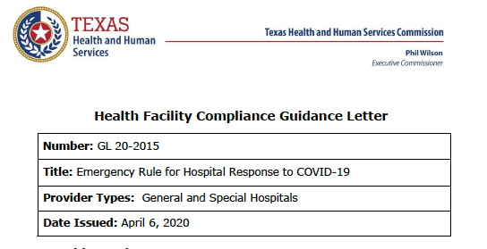
(c) A hospital must implement and enforce written policies and procedures regarding the entry of its workforce to protect the health and safety of patients, employees and staff, and the public.

Slide 28
Recently, a physician developed symptoms of COVID-19 Infection and proceeded to perform cases and make rounds while neglecting to wear a mask
This resulted in unnecessary exposures of patients, nurses and doctors who routinely work with this physician.
To date, we have found no evidence that this physician ever complied with the screening efforts.

Slide 29
Texas governor issues exec order suspending elective surgeries in 4 counties
Texas Gov. Greg Abbott issued an executive order June 25 to ensure beds are available for patients with COVID-19 as cases continue to spike in the state.
The executive order suspends elective procedures in four Texas counties: Bexar, Dallas, Harris and Travis. The order directs all hospitals in those areas to postpone all nonemergent procedures.
The order allows Mr. Abbott to add or subtract from the list of counties to address surges in hospitalizations that may arise in other parts of the state.
"As Texas faces a rise in COVID-19 cases, we are focused on both slowing the spread of this virus and maintaining sufficient hospital capacity for COVID-19 patients," Mr. Abbott said. "These four counties have experienced significant increases in people being hospitalized due to COVID-19 and today's action is a precautionary step to help ensure that the hospitals in these counties continue to have ample supply of available beds to treat COVID-19 patients."

Slide 30
Why use a Mask?

Slide 31
Caregivers
COVID Related Furloughs
 | 6/22 | 6/24 | 6/25
CMC | 11 | 16
CCH | 6 | 7
GMC | 2 | 2
CSH | 0 | 0
CHPLV | 1 | 2
CHL | 0 | 1
CMG | 3 | 3
GMG | 5 | 6
HOL | 0 | 0
CHP | 1 | 2
Total | 29 | 39
Count reflects # furlough (exposed and positive)
Good
Moderate
Critical

Slide 32
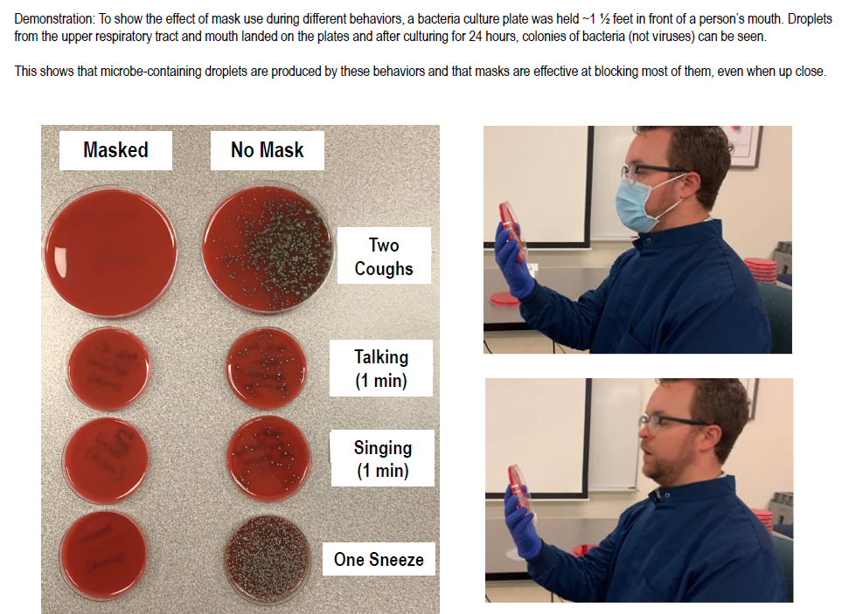

Slide 33
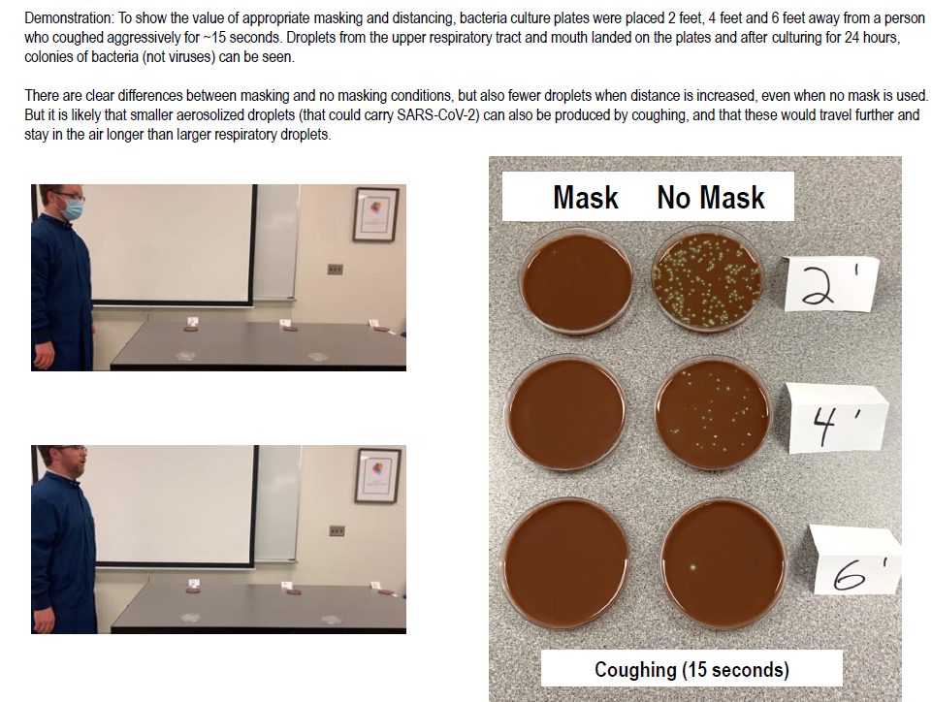

Slide 34
Caregivers
Reducing Exposures
Wear the M A S K
  not just in a patient room
  Nurses stations, hallways, elevators
  Areas where there are other people
Social distance
  “Mask-free zones”
  Elevators, Dining locations, standing in line
  Areas where there are other people
BE SMART when you are away from work

Slide 35
Masking – Preventing the Spread
With the rapid increase of positive COVID cases in our community, we are documenting additional caregivers working unknowingly with asymptomatic COVID.
Lubbock is reporting an additional 100+ positive individuals daily, with the large number of these between the ages of 20-29 years of age.
In the past week, we have followed up with 4 asymptomatic caregivers who were working, while unknowingly exposing patients and their fellow caregivers. They began feeling symptomatic hours after their shift and were tested positive.
At Covenant Health, we are following the CDC guidelines for follow-up to exposures and have had the following for the week of June 19 – Jun 25:
Infection prevention has followed up on 46 patients with disclosure and testing.
Caregiver health has followed up and interviewed 75 caregivers, providing instructions and, if needed, quarantine due to a positive test.

Slide 36
Preventing the Spread - Continued
Proper use of a mask has proven to decrease the transmission of COVID and will protect others, including your fellow caregivers and patients, from unnecessary exposure.
As a medical staff, we are asking every provider to wear a mask while in any Covenant Health public areas. This includes cafeteria, unit hallways, skybridge, nursing stations, elevators, etc.
For your patient’s safety, we are asking you to wear a level 2 mask when caring for any patient.
For your safety, we ask you to protect your eyes and mask by wearing a face shield in every patient room.
Not every patient is tested before admission to CMC and we know the COVID test has a high ( 20-36%) false negative rate, so we encourage you to use an abundance of caution while in our ministries.
Thank you for partnering with us to protect our patients at Covenant Health.

Slide 37
Pharmacy Update
Wesley Wells
Regional Pharmacy Director

Slide 38
CHS COVID-19 Treatments
Agent | Dosage | Comments | Update
Hydroxychloroquine | 400 mg PO BID x 1 day, then 200 mg PO BID x 4 days | Recent data suggests no benefit with potential harm Caution: QT prolongation, arrhythmias | NIH guidelines recommend against its use in the treatment of COVID-19 patients FDA revoked EUA
Tocilizumab | 400 mg IVPB x 1 dose May repeat x 1 in 8-12 hours if clinical symptoms worsen or do not demonstrate improvement | IL-6 receptor antagonist used to treat CRS ($2.13K - $4.25K per dose) CHS criteria for use: Proven COVID-19 infection Early treatment of severe/critically ill patients who are clinically deteriorating Restricted to intensivists or ID AST/ALT <5xULN, ANC >500, Plt >50K | NIH guidelines state insufficient data to recommend either for or against the use of IL-6 inhibitors for the treatment of COVID-19
Zanubrutinib | 320 mg PO once daily for up to a maximum of 28 days | CMC will be participating in this phase 2, randomized, double blind, placebo-controlled Looking to enroll 46-52 patients | Completed initial training. Hope to enroll patients in the next few weeks.
Convalescent Plasma | 1 unit (200-400mL) x 1 | CMC enrolled in Mayo trial | Enrolled __ patients to date
Notes:
The FDA says that neither drug has been proven safe and effective in treating COVID-19. In fact, a study published on April 23 involving 368 COVID-19 patients at U.S. Veterans Health Administration hospitals found that taking hydroxychloroquine alone, or in combination with azithromycin, did not reduce the need for a ventilator compared to those not taking the drugs. Further, people taking hydroxychloroquine alone had a higher risk of dying during the study than those not taking the drug. Researchers in China came to a similar conclusion in a study of 150 COVID-19 patients randomly assigned to receive hydroxychloroquine or the current standard of care: after a month, both groups had similar symptom profiles, and showed similar levels of the virus, suggesting that the drug wasn’t clearing the COVID-19 virus in a significant way. The National Institutes of Health is conducting an ongoing study of hydroxychloroquine among hospitalized patients, as is Novartis, whose Sandoz division makes a generic version of the drug.
HCQ:
PSJH high risk patients (age > 60, pulmonary disease, CV disease, CKD, DM, immune compromised, HTN present on admission or receiving anti-hypertensives prior to admission)
Toci:
Proven COVID-19 infection based on laboratory testing AND radiographic evidence of pneumonia
Severely ill definition: SpO2 ≤ 93% on room air or FiO2/PaO2 ≤ 300 mmHg or respiratory rate ≥ 30 breaths/min
Critically ill definition: Mechanical ventilation OR multi organ failure OR ICU admission
After publication of our Lancet Article,¹
several concerns were raised with respect to the veracity of the data and analyses conducted by Surgisphere Corporation and its founder and our co-author, Sapan Desai, in our publication. We launched an independent third-party peer review of Surgisphere with the consent of Sapan Desai to evaluate the origination of the database elements, to confirm the completeness of the database, and to replicate the analyses presented in the paper.
Our independent peer reviewers informed us that Surgisphere would not transfer the full dataset, client contracts, and the full ISO audit report to their servers for analysis as such transfer would violate client agreements and confidentiality requirements. As such, our reviewers were not able to conduct an independent and private peer review and therefore notified us of their withdrawal from the peer-review process.

Slide 39
CHS COVID-19 Treatments
Agent | Dosage | Comments | Update
Remdesivir | 200 mg IV x 1, then 100 mg IV daily x 4-9 days Emergency Use Authorization (EUA) 5/1/20 5 day treatment = 6 vials 10 day treatment = 11 vials | Covenant was enrolled in expanded access program, which ended 5/29/20 PSJH criteria for EUA: 1. Adults or pediatrics with confirmed SARS-CoV-2 2. Pneumonia per chest imaging 3. Patient with SpO2 ≤ 94% or requiring supplemental O2, mech vent, and/or ECMO 4. AST/ALT < 5 x ULN 5. eGFR > 30 ml/min Mandatory AE reporting to FDA MedWatch | Emergency Use Authorization Inventory = 126 vials as of Thursday AM EUA to date: 30 patients (5 patients on therapy as of Thursday AM) Per EUA, patients must be provided “Fact Sheet for Patients” and we must document that we communicated EUA info to patient in chart Interaction with Hydroxychloroquine
Dexamethasone | 6 mg IV/PO daily x 10 days | Prior NIH guidelines recommended against its use in mechanically ventilated patients without ARDS | Updated NIH guidelines recommend its use in mechanically ventilated patients or those on supplemental oxygen.
Ivermectin | 150-400 mcg/kg PO | In vitro studies show benefit at high doses | No published data supporting its safety and efficacy
Sildenafil | 20 mg PO three times a day | Current trials are ongoing | No data supporting its use at this time
Notes:
According to the summary of the China study, remdesivir was “not associated with a difference in time to clinical improvement” compared to a standard of care control. After one month, it appeared 13.9% of the remdesivir patients had died compared to 12.8% of patients in the control arm. The difference was not statistically significant.
Hospitalized patients with advanced COVID-19 and lung involvement who received remdesivir recovered faster than similar patients who received placebo, according to a preliminary data analysis from a randomized, controlled trial involving 1063 patients, which began on February 21. The trial (known as the Adaptive COVID-19 Treatment Trial, or ACTT), sponsored by the National Institute of Allergy and Infectious Diseases (NIAID), part of the National Institutes of Health, is the first clinical trial launched in the United States to evaluate an experimental treatment for COVID-19. Preliminary results indicate that patients who received remdesivir had a 31% faster time to recovery than those who received placebo (p<0.001). Specifically, the median time to recovery was 11 days for patients treated with remdesivir compared with 15 days for those who received placebo. Results also suggested a survival benefit, with a mortality rate of 8.0% for the group receiving remdesivir versus 11.6% for the placebo group (p=0.059). Recovery in this study was defined as being well enough for hospital discharge or returning to normal activity level.

Slide 40
Pharmacy Shortages/Allocations
Covid-19 Related
  Cisatracurium
  Rocuronium
  Vecuronium
  Dexmedetomidine
  Propofol
  Fentanyl
  Etomidate
  Vitamin C Liquid
  Vitamin C Injection
  Ivermectin
  Dexamethasone
Non-Covid-19 Related
  Bumetanide
  Amiodarone
  Dopamine
  Dobutamine
  Famotidine
  Furosemide Inj
  Doxycycline Inj
  Nitroglycerin SDV
  Bupivacaine with epinephrine
  Lidocaine with epinephrine
  Methadone inj

Slide 41
Preservation of PPE

Slide 42
Health Care Industry Representatives (HCIR)
As we re-open elective services, we will be facing allowing some vendors (HCIR) to return to our facilities. Be aware that this comes at a price and with Federal regulations (OSHA):
  We are obligated to provide appropriate PPE to the Vendors
  The PPE provided must be the same level of protection that the procedural team is using
  The PPE must be FIT TESTED as appropriate
  For the purpose of limiting the Burn Rate of PPE, we are asking our doctors to help us by limiting the number of vendors that are attending procedures to essential vendors only.

Slide 43
Texas Demographics

Slide 44
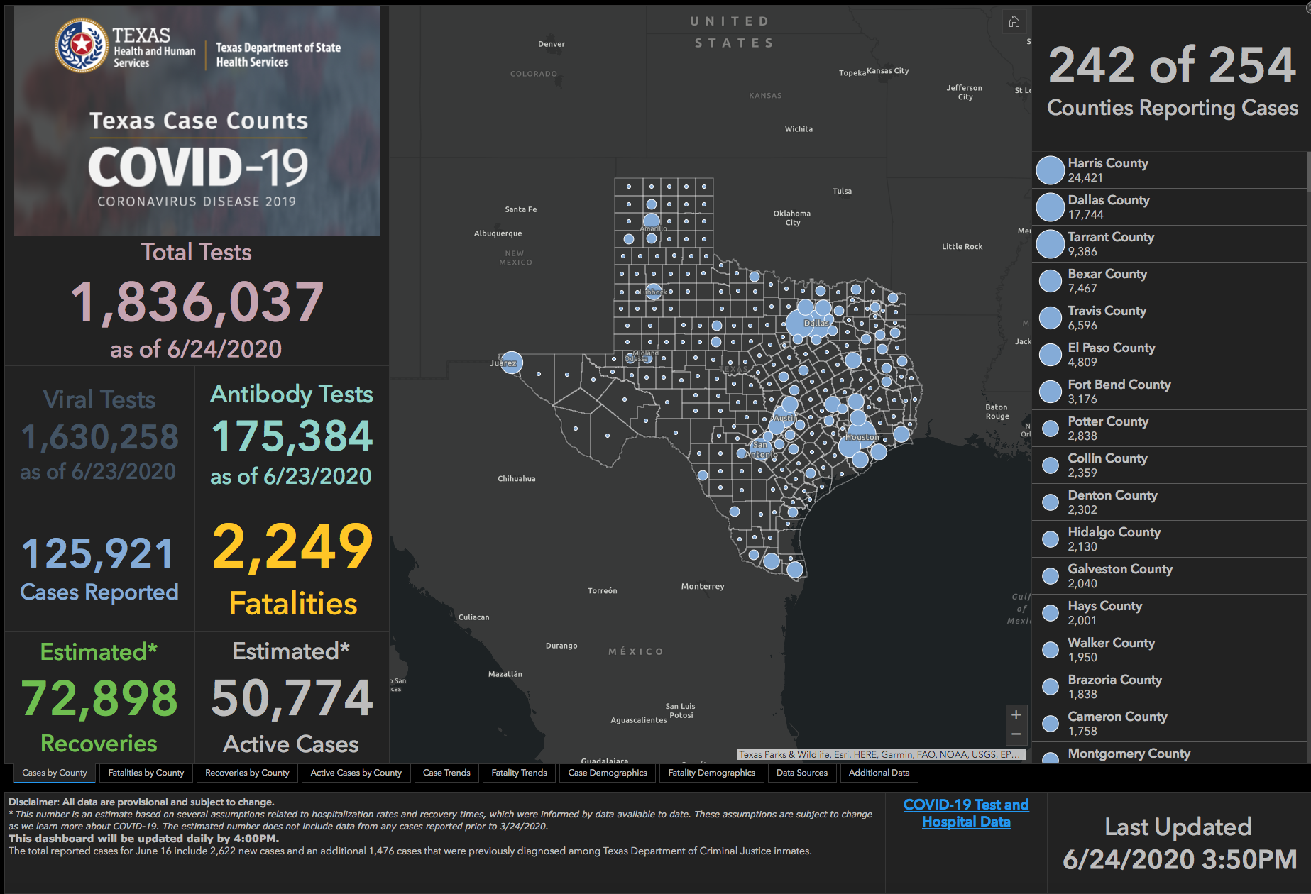

Slide 45
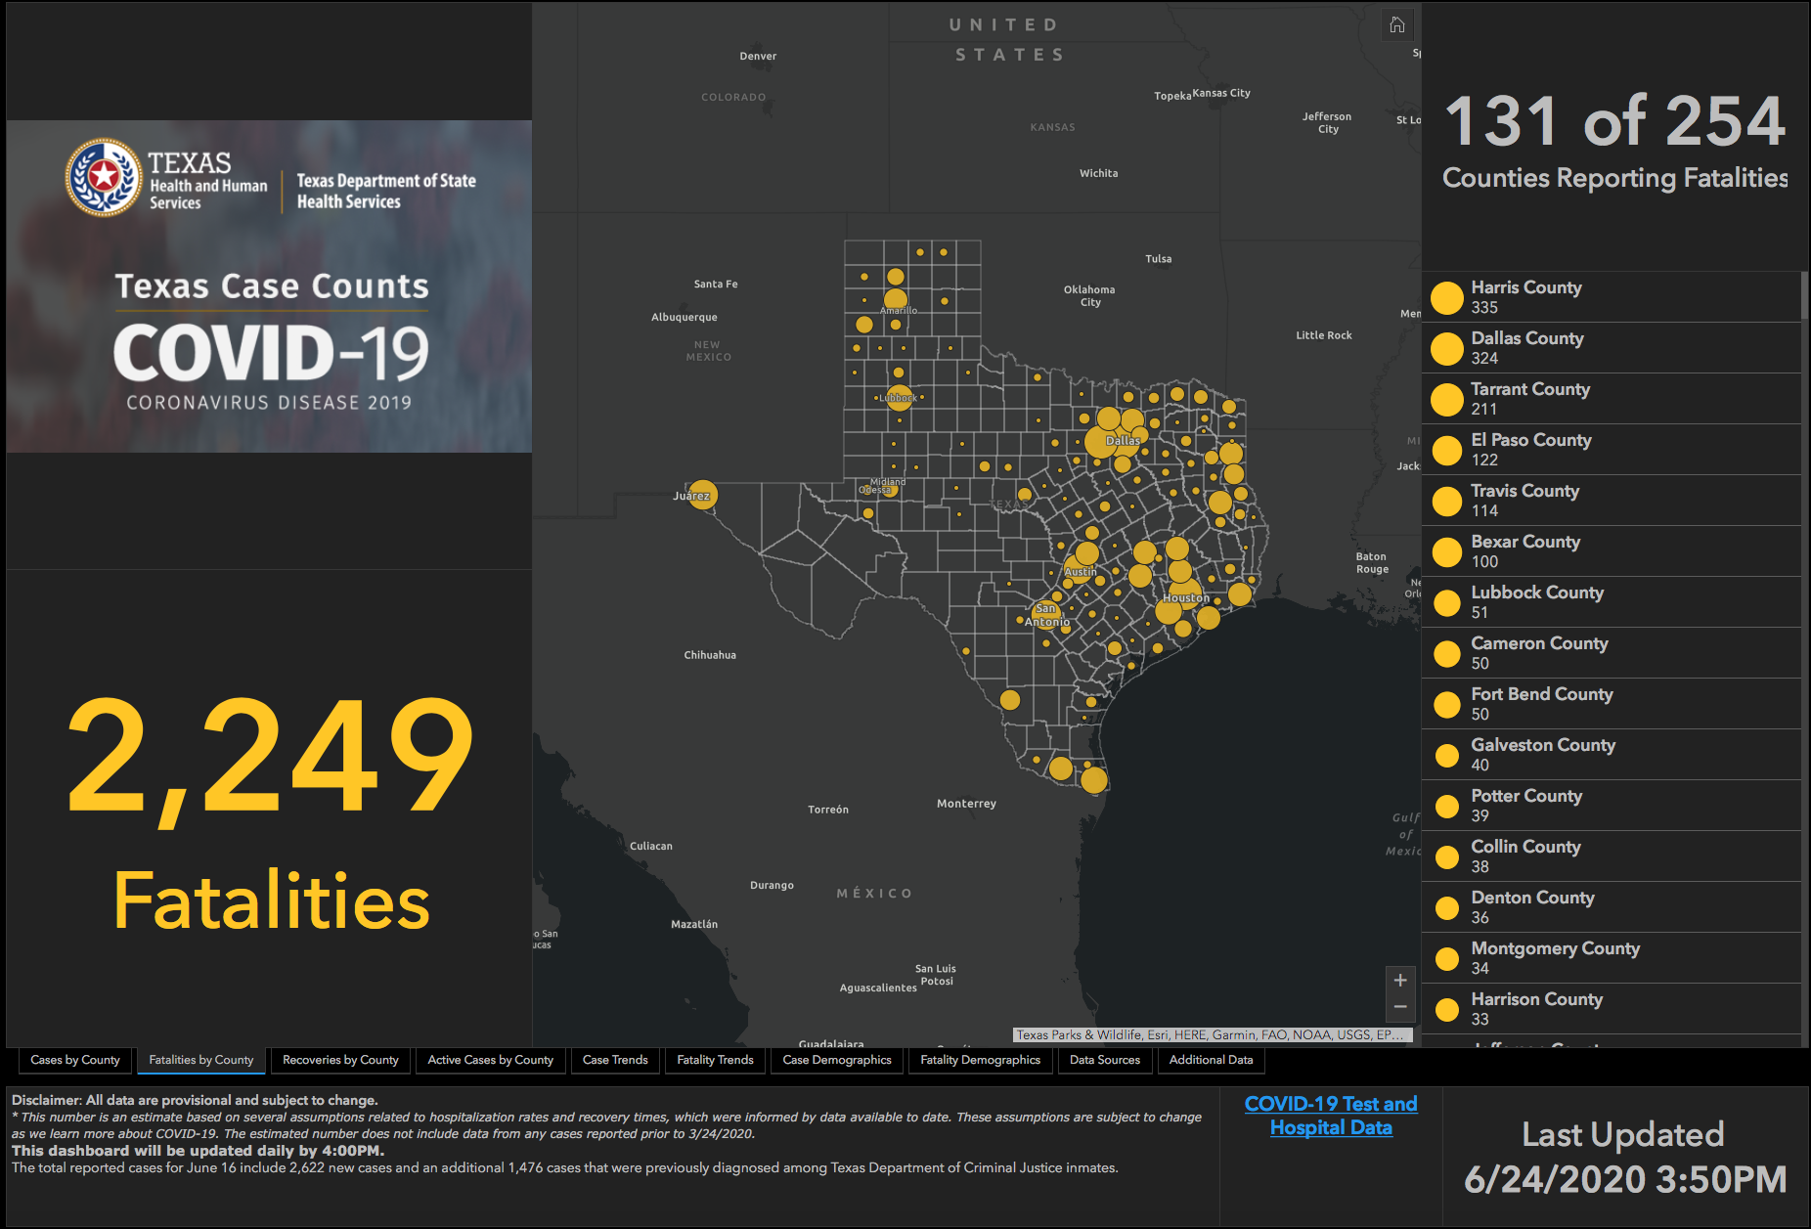

Slide 46
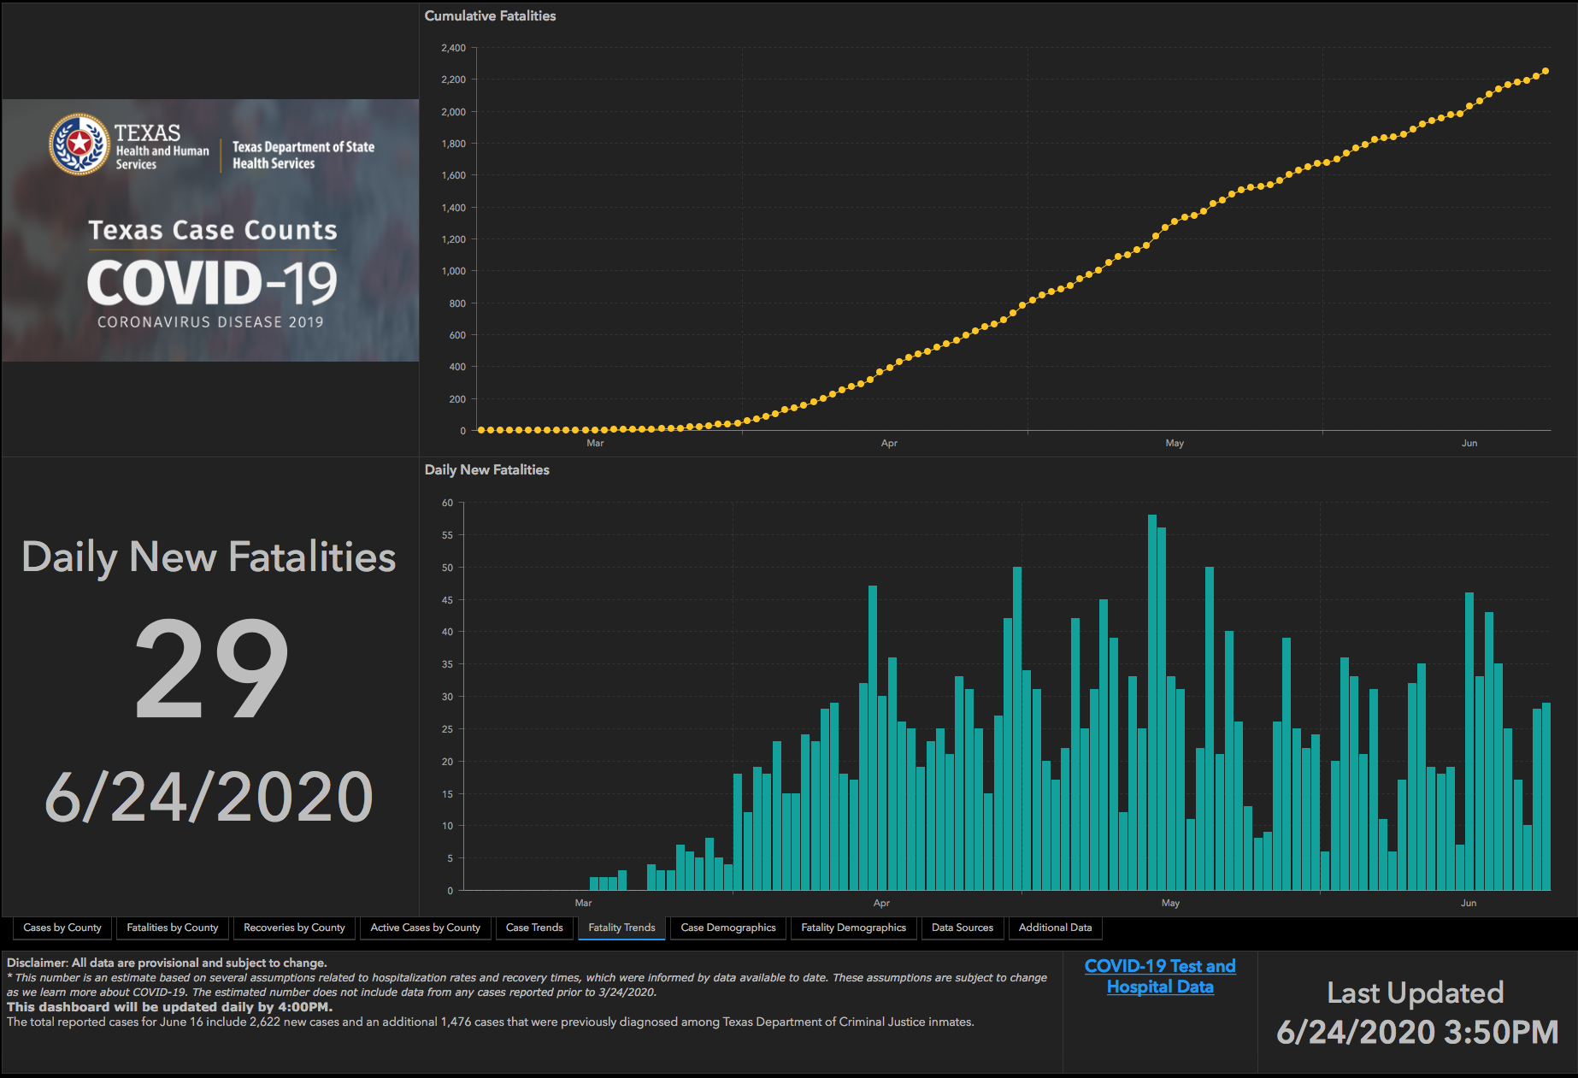

Slide 47
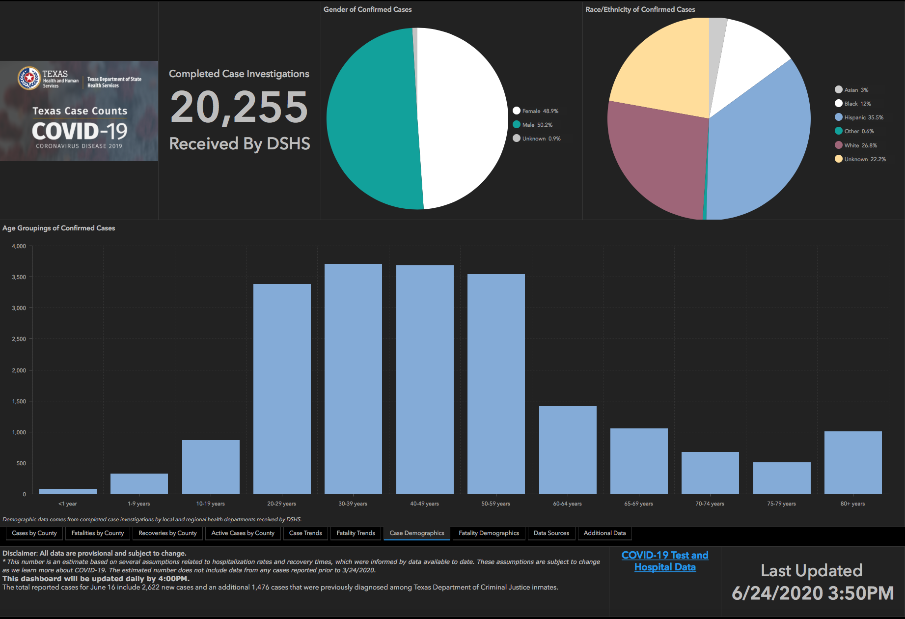

Slide 48
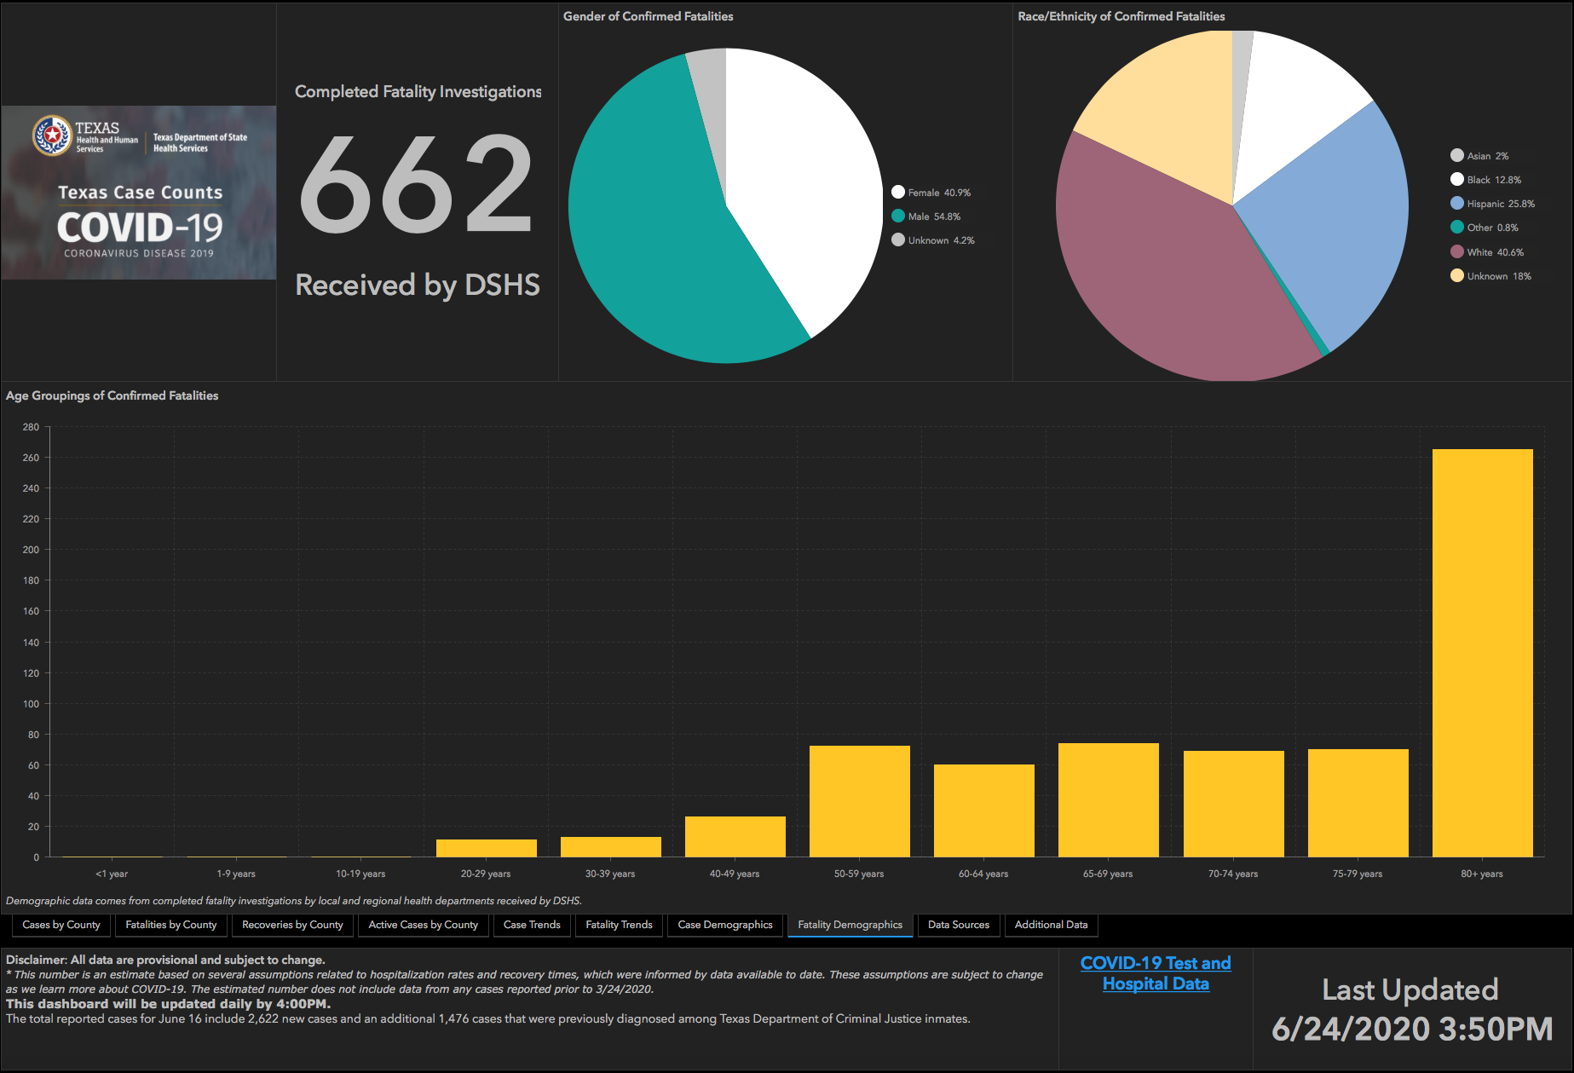

Slide 49
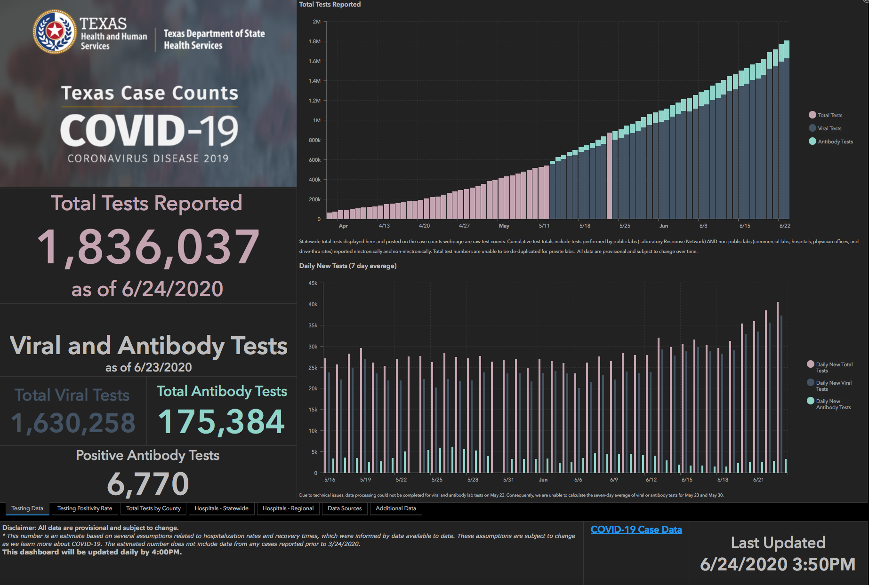

Slide 50
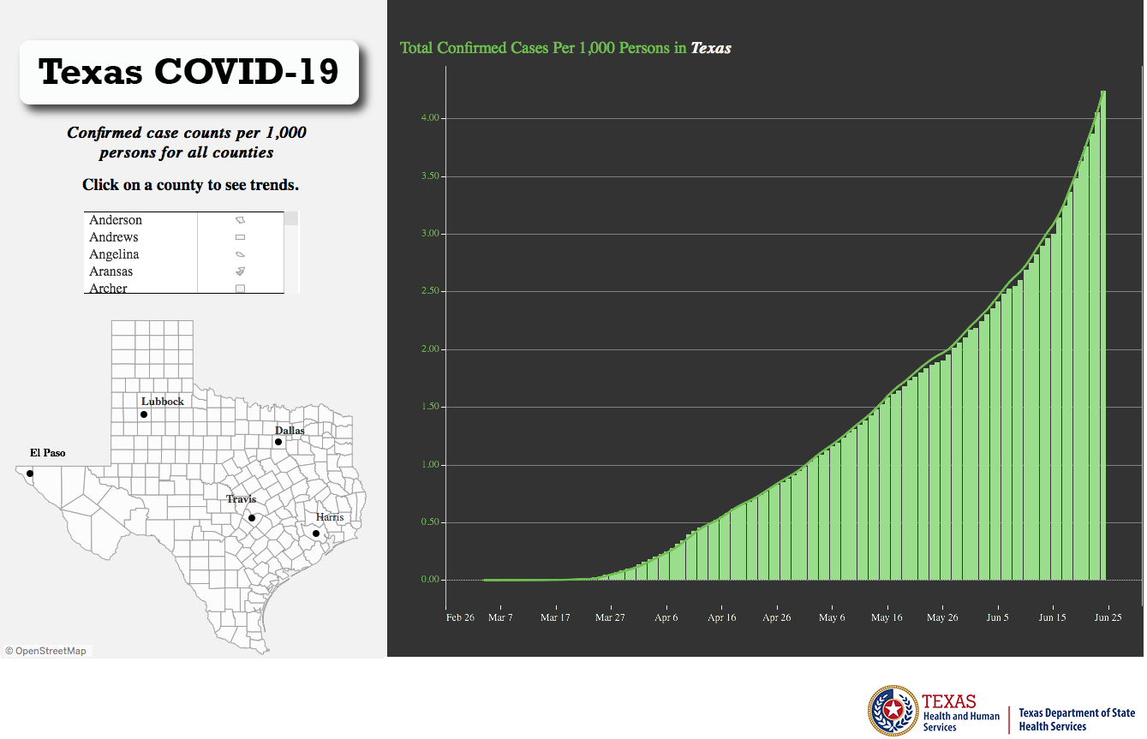
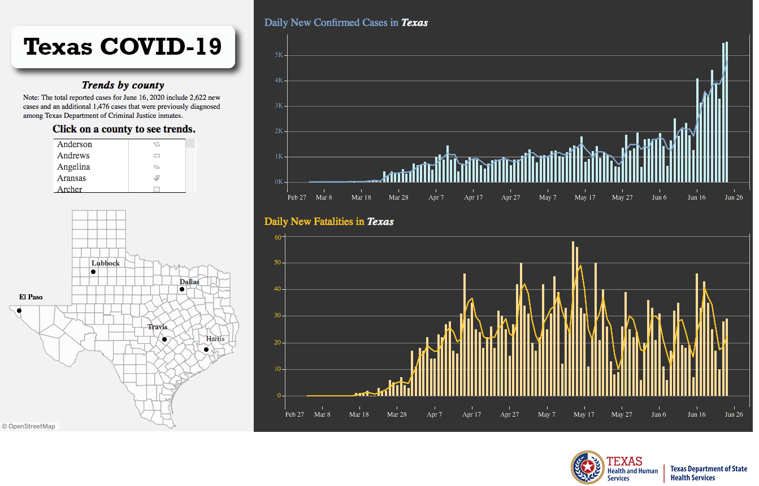
State of Texas
Orange bar represents ONE Case per 1000 Persons
(The Higher on the graph, the better)

Slide 51
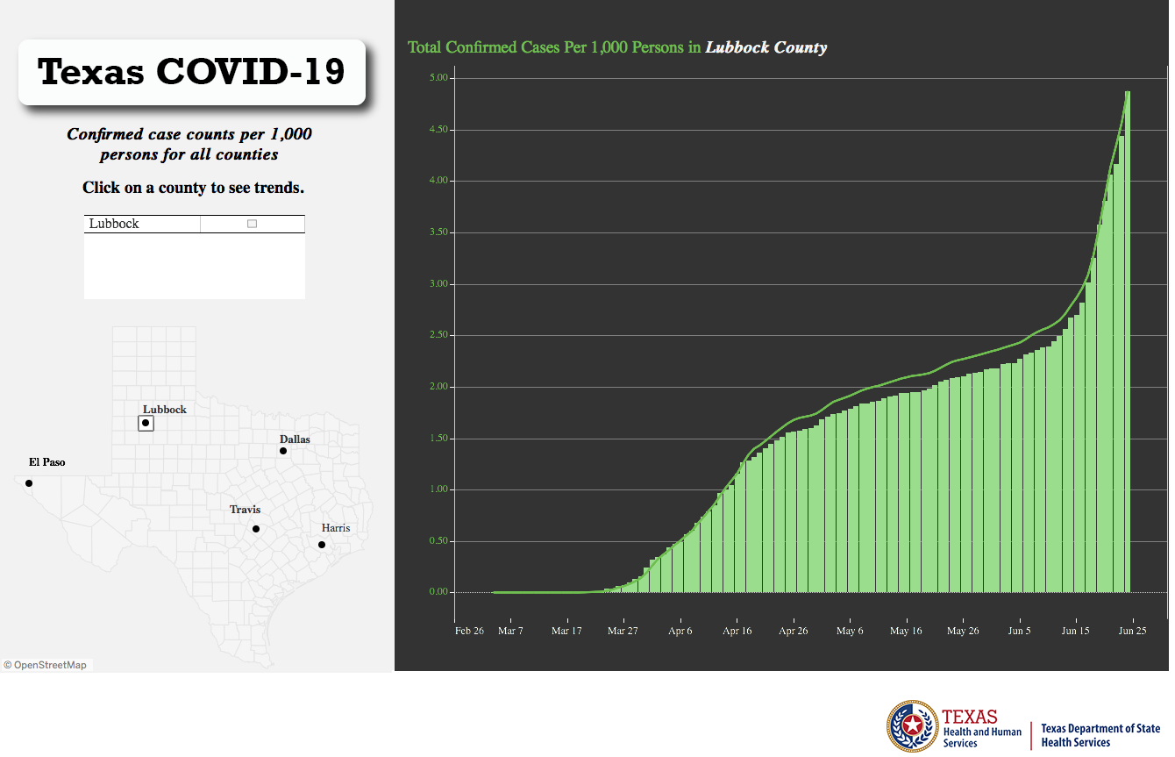
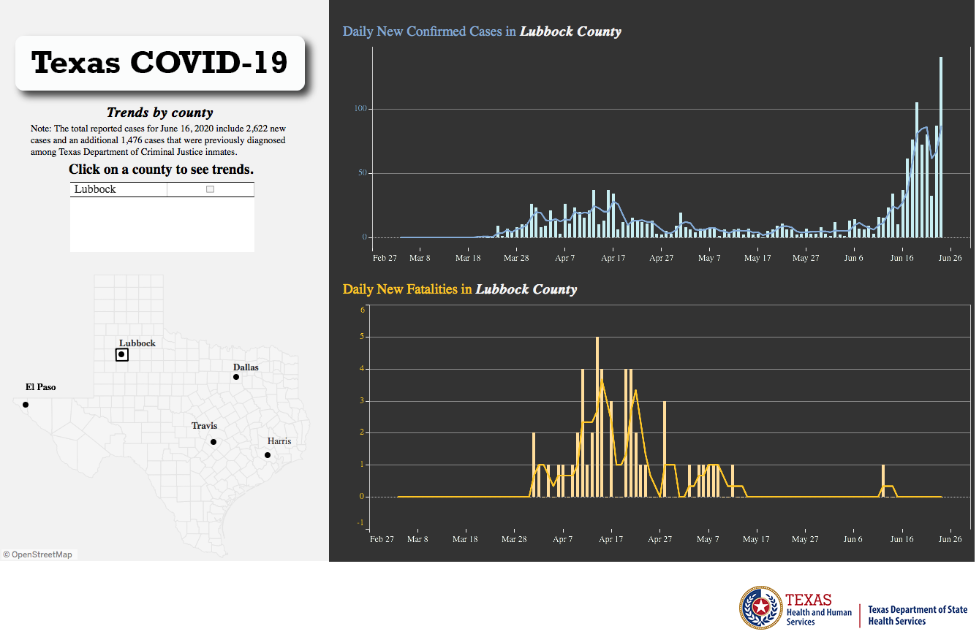
Lubbock County Trends
Orange bar represents ONE Case per 1000 Persons
(The Higher on the graph, the better)

Slide 52
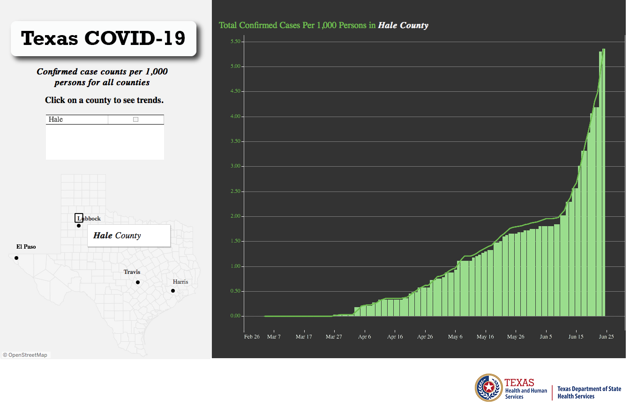
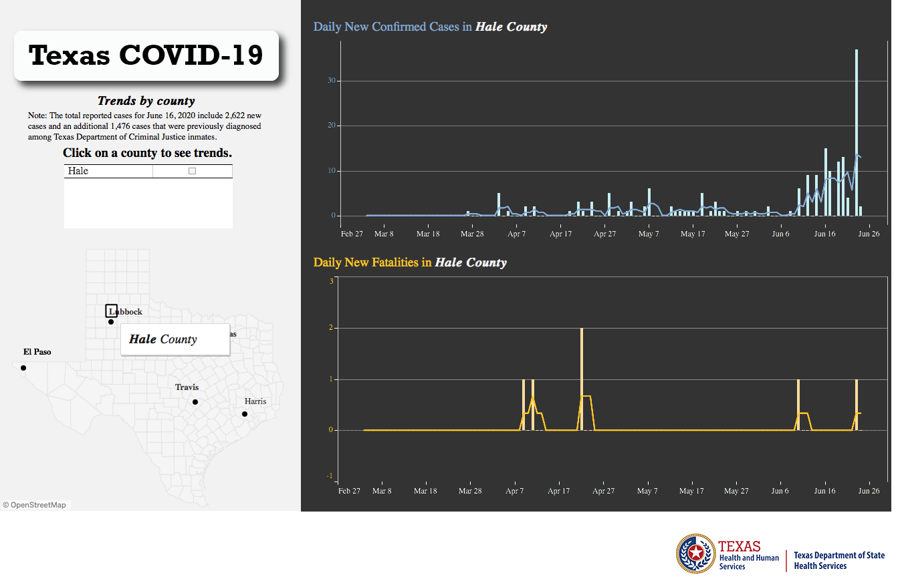
Hale County Trends
Orange bar represents ONE Case per 1000 Persons
(The Higher on the graph, the better)

Slide 53
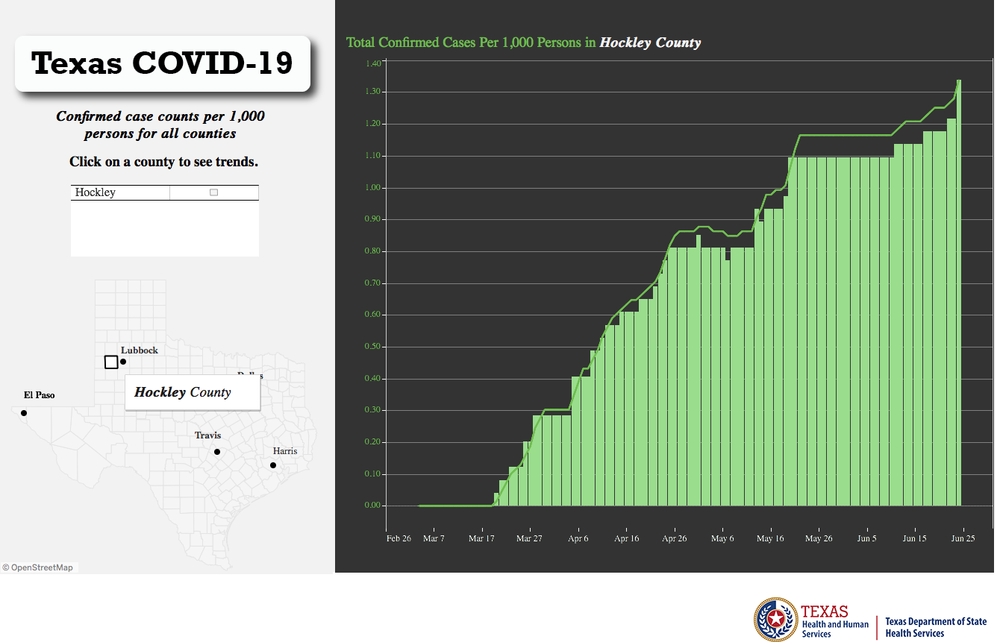
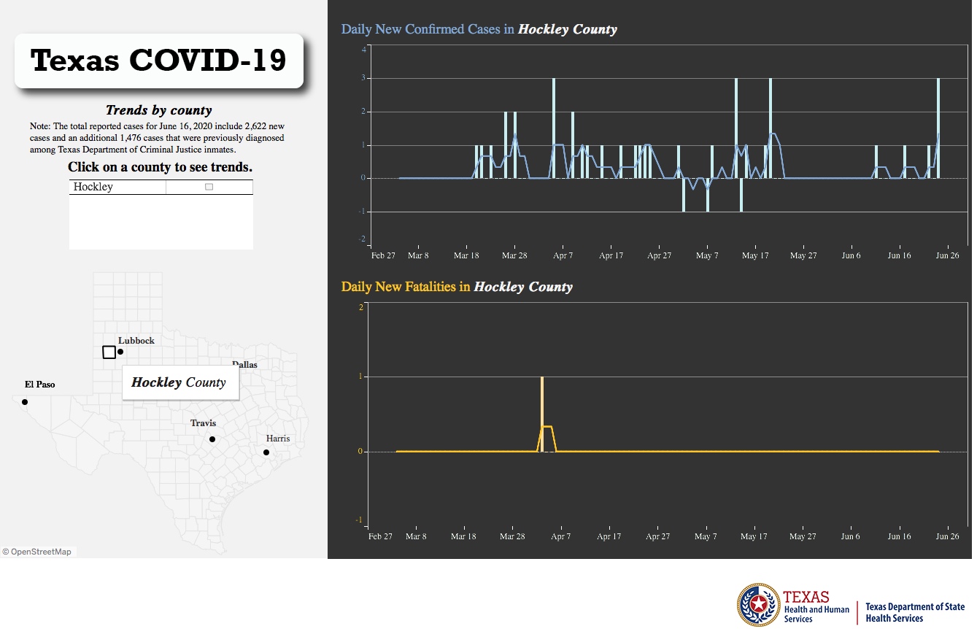
Hockley County Trends
Orange bar represents ONE Case per 1000 Persons
(The Higher on the graph, the better)

Slide 54
Q & A

