Slide 1
Covenant Health
Regional Update for Physicians
July 10, 2020

Slide 2
Reflection

Slide 3

The Bridge Builder
An old man going a lone highway,
Came at the evening, cold and gray,
To a chasm, vast, and deep and wide,
Through which was flowing a sullen tide.
The old man crossed in the twilight dim;
The sullen stream had no fear for him;
But he turned, when safe on the other side,
And built a bridge to span the tide.
"Old man," said a fellow pilgrim, near,
"You are wasting strength with building here;
Your journey will end with the ending day;
You never again will pass this way;
You've crossed the chasm, deep and wide-
Why build you this bridge at the evening tide?"
The builder lifted his old gray head:
"Good friend, in the path I have come," he said,
"There followeth after me today,
A youth, whose feet must pass this way.
This chasm, that has been naught to me,
To that fair-haired youth may a pitfall be.
He, too, must cross in the twilight dim;
Good friend, I am building this bridge for him."
Will Allen Dromgoole

Slide 4
Safety Story
Ordering Convalescent Plasma
Karin Whitten, MT(ASCP)SBB, CPPS
Transfusion Safety Coordinator

Slide 5
CCP order/issue printouts

Slide 6
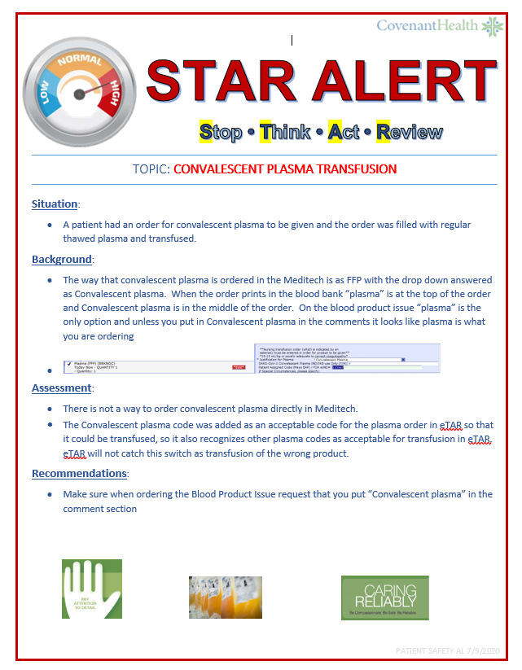

Slide 7
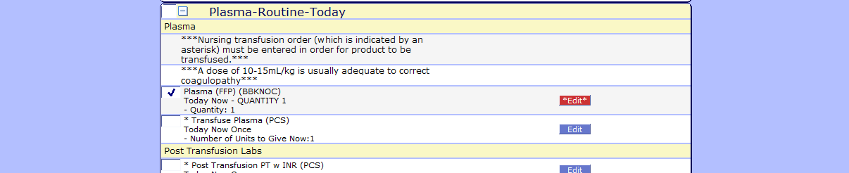
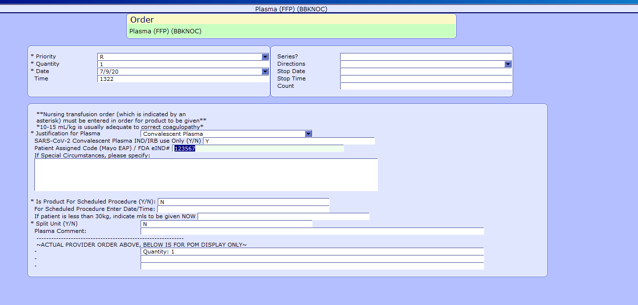

Slide 8
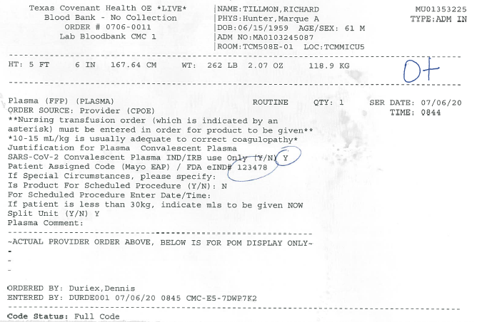

Slide 9
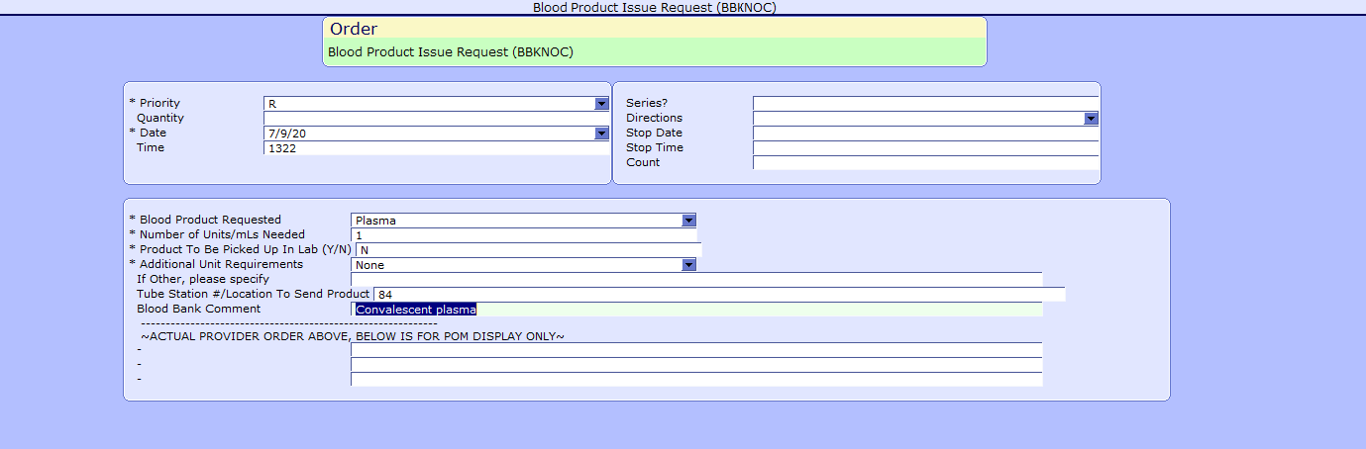
If the convalescent plasma comment is not entered then the blood issue request is for regular plasma (see next slide)

Slide 10
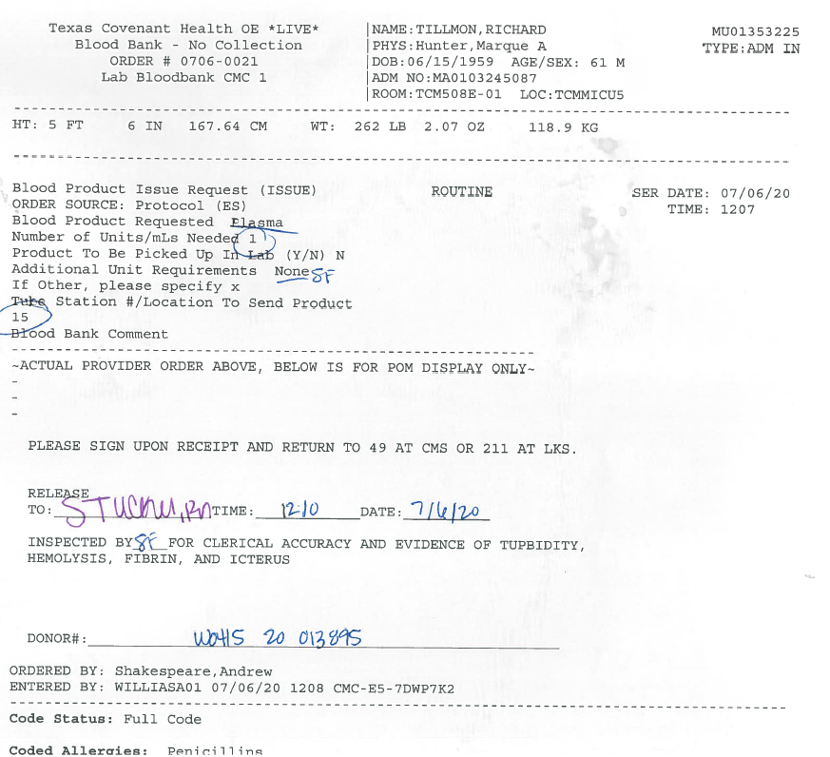

Slide 11
Pharmacy Update
Wesley Wells
Regional Pharmacy Director

Slide 12
CHS COVID-19 Treatments
Agent | Dosage | Comments | Update
Remdesivir Emergency Use Authorization (EUA) 5/1/20 | 200 mg IV x 1, then 100 mg IV daily x 4 days Can consider an additional 5 days of therapy in the following patients: Clinically worsening Continues on high-flow nasal cannula, non-rebreather, ventimask, mech ventilation, or ECMO w/o improvement Immunosuppressed | CMC expanded access program ended 5/29/20 PSJH criteria for EUA: 1. Adults or pediatrics with confirmed SARS-CoV-2 2. Pneumonia per chest imaging 3. Patient with SpO2 ≤ 94% or requiring supplemental O2, mech vent, and/or ECMO 4. AST/ALT < 5 x ULN 5. eGFR > 30 ml/min Must provide “Fact Sheet for Patients” and document that we communicated information to patient Mandatory AE reporting to FDA MedWatch | Emergency Use Authorization Inventory = 72 vials as of Thursday AM EUA to date: 30 patients (7 patients on therapy as of Thursday AM) NEW: purchased through ASB, allocation based on COVID-19 hospitalizations 7/8/20: ID-CDT update Durations to be limited to 5 days Form committee for remdesivir decisions System currently working on Meditech process for ordering RDV
Dexamethasone | 6 mg IV/PO daily x 10 days | Not recommended in patients who do not require supplemental oxygen | NIH guidelines recommend use in mechanically ventilated patients or those on supplemental oxygen Supported by PSJH ID-CDT
Notes:
According to the summary of the China study, remdesivir was “not associated with a difference in time to clinical improvement” compared to a standard of care control. After one month, it appeared 13.9% of the remdesivir patients had died compared to 12.8% of patients in the control arm. The difference was not statistically significant.
Hospitalized patients with advanced COVID-19 and lung involvement who received remdesivir recovered faster than similar patients who received placebo, according to a preliminary data analysis from a randomized, controlled trial involving 1063 patients, which began on February 21. The trial (known as the Adaptive COVID-19 Treatment Trial, or ACTT), sponsored by the National Institute of Allergy and Infectious Diseases (NIAID), part of the National Institutes of Health, is the first clinical trial launched in the United States to evaluate an experimental treatment for COVID-19. Preliminary results indicate that patients who received remdesivir had a 31% faster time to recovery than those who received placebo (p<0.001). Specifically, the median time to recovery was 11 days for patients treated with remdesivir compared with 15 days for those who received placebo. Results also suggested a survival benefit, with a mortality rate of 8.0% for the group receiving remdesivir versus 11.6% for the placebo group (p=0.059). Recovery in this study was defined as being well enough for hospital discharge or returning to normal activity level.
FYI Budesonide: In response to Odessa doctor, Richard Bartlett, who calls it the 'silver bullet‘. There have been no clinical trials or observational studies examining the use of ICS in COVID-19. Clinical trials would be required to establish whether these drugs may be repurposed for the treatment of this disease.

Slide 13
CHS COVID-19 Treatments
Agent | Dosage | Comments | Update
Hydroxychloroquine | 400 mg PO BID x 1 day, then 200 mg PO BID x 4 days FDA has revoked HCQ EUA | RCT data shows no benefit with potential harm (caution: QT prolongation, arrhythmias) Observational data suggested some benefit | PSJH ID-CDT does not recommend use with rationale that all COVID-19 guidelines recommend against its use Coadministration with remdesivir is not recommended as it may result in reduced antiviral activity of remdesivir
Tocilizumab | 400 mg IVPB x 1 dose May repeat x 1 in 8-12 hours if clinical symptoms worsen or do not demonstrate improvement | IL-6 receptor antagonist used to treat CRS ($2.13K - $4.25K per dose) CHS criteria for use: Proven COVID-19 infection Early treatment of severe/critically ill patients who are clinically deteriorating Restricted to intensivists or ID AST/ALT <5xULN, ANC >500, Plt >50K PSJH compliance: signed informed consent is recommended prior to dispensing this agent | NIH guidelines state insufficient data to recommend for or against the use of IL-6 inhibitors for treatment of COVID-19 7/2/20: Sarilumab trials stopped, no efficacy at any dose 7/8/20: PSJH ID-CDT approval of new criteria for use: Severe/critically ill patients who are clinically deteriorating despite other treatment and/or supportive care Require at least 6 L suppl O2 to maintain a SpO2 ≥ 93% Mechanical vent OR multi organ failure OR ICU admission
Convalescent Plasma | 1 unit (200-400mL) x 1 | CMC enrolled in Mayo trial | Enrolled 29 patients to date
Notes:
The FDA says that neither drug has been proven safe and effective in treating COVID-19. In fact, a study published on April 23 involving 368 COVID-19 patients at U.S. Veterans Health Administration hospitals found that taking hydroxychloroquine alone, or in combination with azithromycin, did not reduce the need for a ventilator compared to those not taking the drugs. Further, people taking hydroxychloroquine alone had a higher risk of dying during the study than those not taking the drug. Researchers in China came to a similar conclusion in a study of 150 COVID-19 patients randomly assigned to receive hydroxychloroquine or the current standard of care: after a month, both groups had similar symptom profiles, and showed similar levels of the virus, suggesting that the drug wasn’t clearing the COVID-19 virus in a significant way. The National Institutes of Health is conducting an ongoing study of hydroxychloroquine among hospitalized patients, as is Novartis, whose Sandoz division makes a generic version of the drug.
HCQ:
PSJH high risk patients (age > 60, pulmonary disease, CV disease, CKD, DM, immune compromised, HTN present on admission or receiving anti-hypertensives prior to admission)
Toci:
Proven COVID-19 infection based on laboratory testing AND radiographic evidence of pneumonia
Severely ill definition: SpO2 ≤ 93% on room air or FiO2/PaO2 ≤ 300 mmHg or respiratory rate ≥ 30 breaths/min
Critically ill definition: Mechanical ventilation OR multi organ failure OR ICU admission
After publication of our Lancet Article,¹
several concerns were raised with respect to the veracity of the data and analyses conducted by Surgisphere Corporation and its founder and our co-author, Sapan Desai, in our publication. We launched an independent third-party peer review of Surgisphere with the consent of Sapan Desai to evaluate the origination of the database elements, to confirm the completeness of the database, and to replicate the analyses presented in the paper.
Our independent peer reviewers informed us that Surgisphere would not transfer the full dataset, client contracts, and the full ISO audit report to their servers for analysis as such transfer would violate client agreements and confidentiality requirements. As such, our reviewers were not able to conduct an independent and private peer review and therefore notified us of their withdrawal from the peer-review process.

Slide 14
CHS COVID-19 Treatments
Agent | Dosage | Comments | Update
Ivermectin | 150-400 mcg/kg PO | In vitro studies show benefit at high doses No RCT data | No published peer reviewed data supporting its safety and efficacy Caution with small pilot, phase 2, or retrospective study info available on pre-print servers
Sildenafil | 20 mg PO three times a day | Current trials are ongoing | No data supporting its use at this time
Zanubrutinib | 320 mg PO once daily for up to a maximum of 28 days | CMC will be participating in this phase 2, randomized, double blind, placebo-controlled (N~46-52) | Completed initial training. Hope to enroll patients in the next few weeks. Current enrollment: 0 patients
Notes:
According to the summary of the China study, remdesivir was “not associated with a difference in time to clinical improvement” compared to a standard of care control. After one month, it appeared 13.9% of the remdesivir patients had died compared to 12.8% of patients in the control arm. The difference was not statistically significant.
Hospitalized patients with advanced COVID-19 and lung involvement who received remdesivir recovered faster than similar patients who received placebo, according to a preliminary data analysis from a randomized, controlled trial involving 1063 patients, which began on February 21. The trial (known as the Adaptive COVID-19 Treatment Trial, or ACTT), sponsored by the National Institute of Allergy and Infectious Diseases (NIAID), part of the National Institutes of Health, is the first clinical trial launched in the United States to evaluate an experimental treatment for COVID-19. Preliminary results indicate that patients who received remdesivir had a 31% faster time to recovery than those who received placebo (p<0.001). Specifically, the median time to recovery was 11 days for patients treated with remdesivir compared with 15 days for those who received placebo. Results also suggested a survival benefit, with a mortality rate of 8.0% for the group receiving remdesivir versus 11.6% for the placebo group (p=0.059). Recovery in this study was defined as being well enough for hospital discharge or returning to normal activity level.

Slide 15
Pharmacy Shortages/Allocations
Covid-19 Related
  CISATRACURIUM
  Rocuronium
  Vecuronium
  Propofol
  Fentanyl
  Vitamin C Liquid and Inj
  Dexamethasone Inj and Tabs
  Ivermectin
  Dexamethasone
  Zinc Sulfate Tabs
  Sildenafil Tabs
  Budesonide Inhalers
Non-Covid-19 Related
  Bumetanide
  Amiodarone
  Dopamine
  Dobutamine
  Famotidine
  Furosemide Inj
  Doxycycline Inj
  Nitroglycerin SDV
  Bupivacaine with epinephrine
  Lidocaine with epinephrine
  Methadone Inj
  Nalbuphine Inj
  Sertraline 20 mg/ml Soln

Slide 16
Current Regional Census

Slide 17
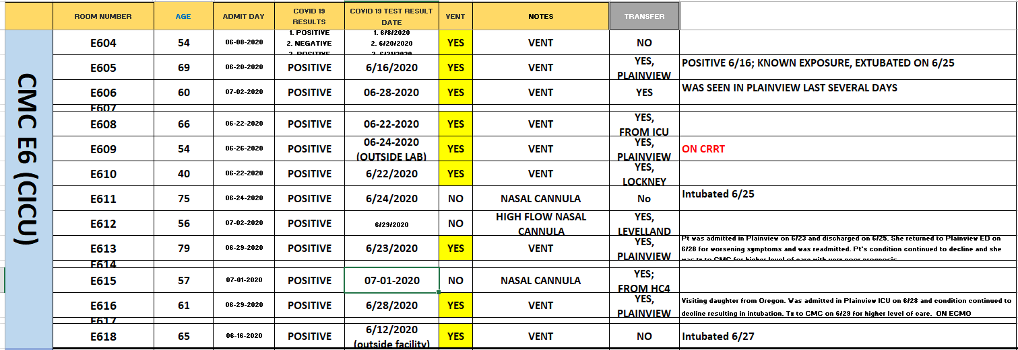
PUI/Confirmed cases-hospitalized

Slide 18
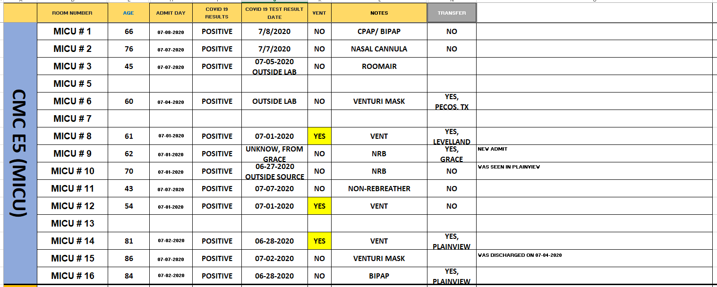
PUI/Confirmed cases-hospitalized

Slide 19
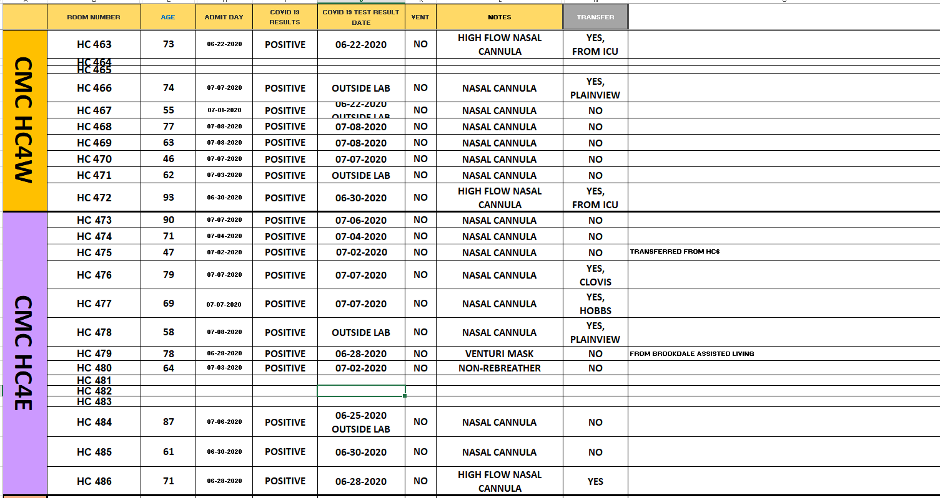
PUI/Confirmed cases-hospitalized

Slide 20
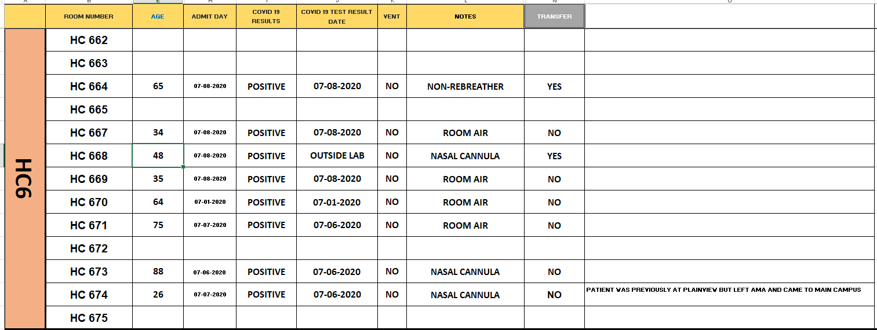
PUI/Confirmed cases-hospitalized

Slide 21
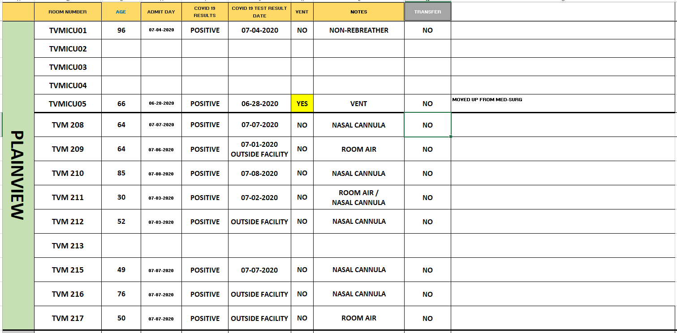
PUI/Confirmed cases-hospitalized

Slide 22
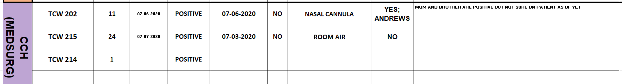
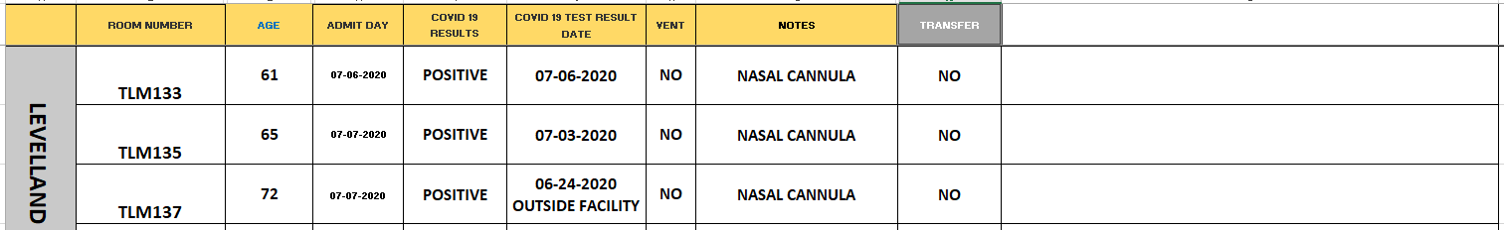
PUI/Confirmed cases-hospitalized

Slide 23
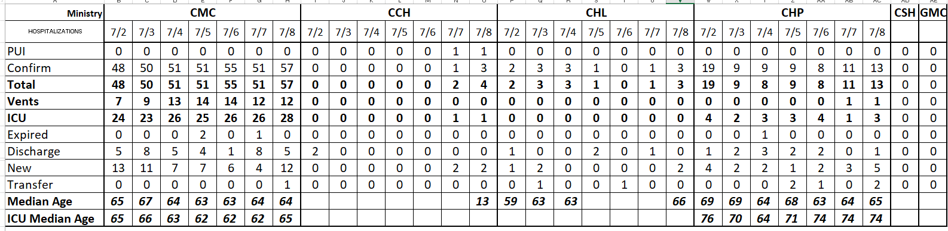
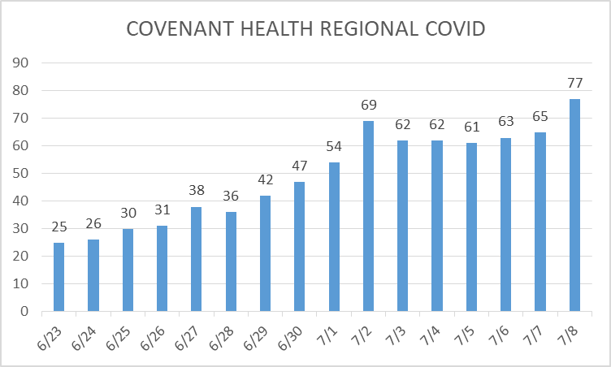
PUI/Confirmed cases-hospitalized

Slide 24
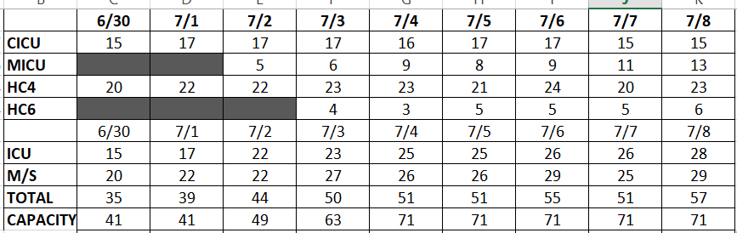
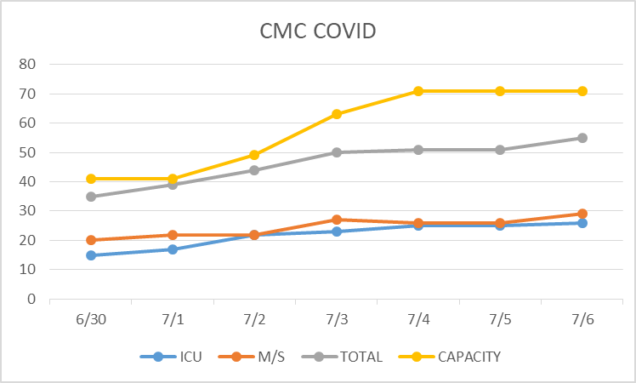
PUI/Confirmed cases-hospitalized
7/7-2 ECMO
7/8-2 ECMO

Slide 25
Surge Plan- Revised
Covenant Medical Center
 | ICU | Med Surg | Total
Phase 1 | 10-CICU |  | 10
Phase 2 | 17-CICU | 10-HC4 | 27
Phase 3 | 17-CICU | 24-HC4 | 41
Phase 4 | 17-CICU 8-MICU | 24-HC4 14-Pal Med | 63
Phase 5 | 17-CICU 16-MICU | 24-HC4 14-Pal Med | 71
Phase 6 | 17-CICU 16-MICU 8- SICU 4 (east) | 24-HC4 14-Pal Med 15 – S 9 (east) | 94
Last Week
Currently

Slide 26
Timelines of Covid-19
Exposure
Incubation Period (± 5.2 days)
Symptoms (Range from 2 to 14 days in duration)*
Contagious (2.3 Days before sx,
Almost 0 at 7 days after onset of symptoms
Positive Viral RNA Test 60%
No reported cases of transmission greater than 3 days after RESOLUTION of symptoms, AND 9 days after onset of symptoms despite continuing to “Test Positive”
For us to remain open to elective procedures, we must accept that patients no longer contagious may require placement in NON-COVID Units. Repeated testing of these patients is meaningless.
-3
-2
-1
0
1
2
3
4
5
6
7
8
9
10
11
12
13
14
15
16
17
18
19
20
21
Day
* Symptoms have occasionally been reported months after initial infection begins
15

Slide 27
Statistics

Slide 28
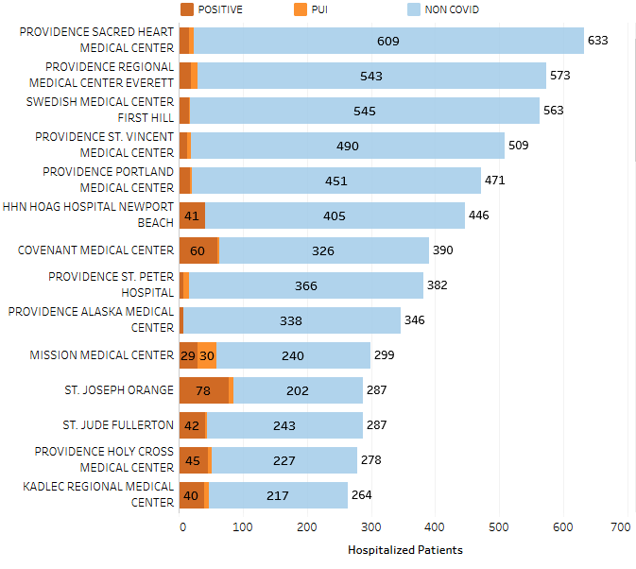
Providence System Hospitalized COVID-19 Cases

Slide 29
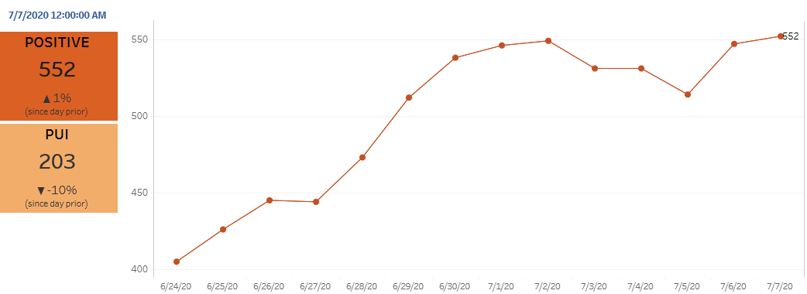
Providence Inpatient COVID-19 Volume

Slide 30
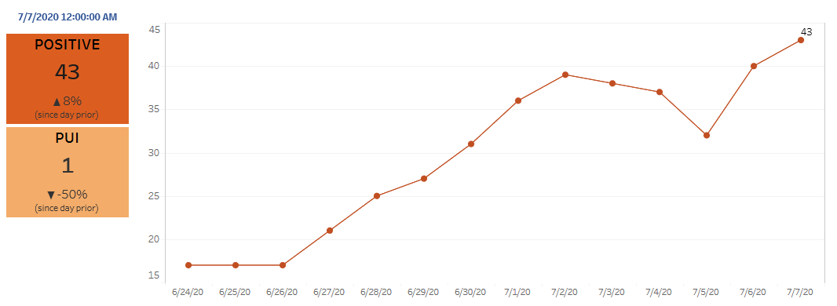
Texas Inpatient COVID-19 Volume

Slide 31
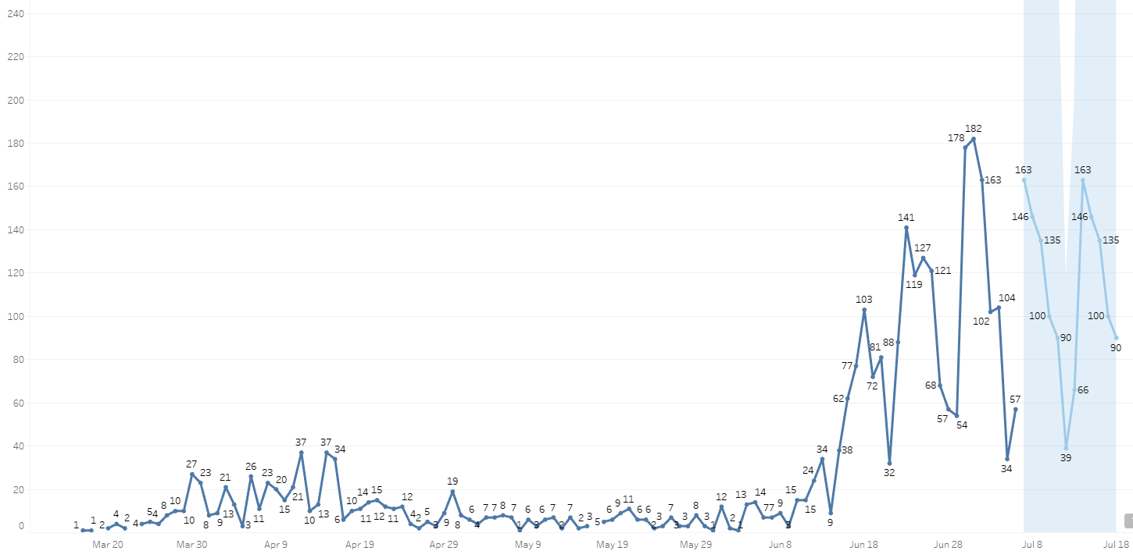

New Covid-19 POSITIVES by Day Trend

Slide 32
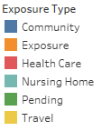
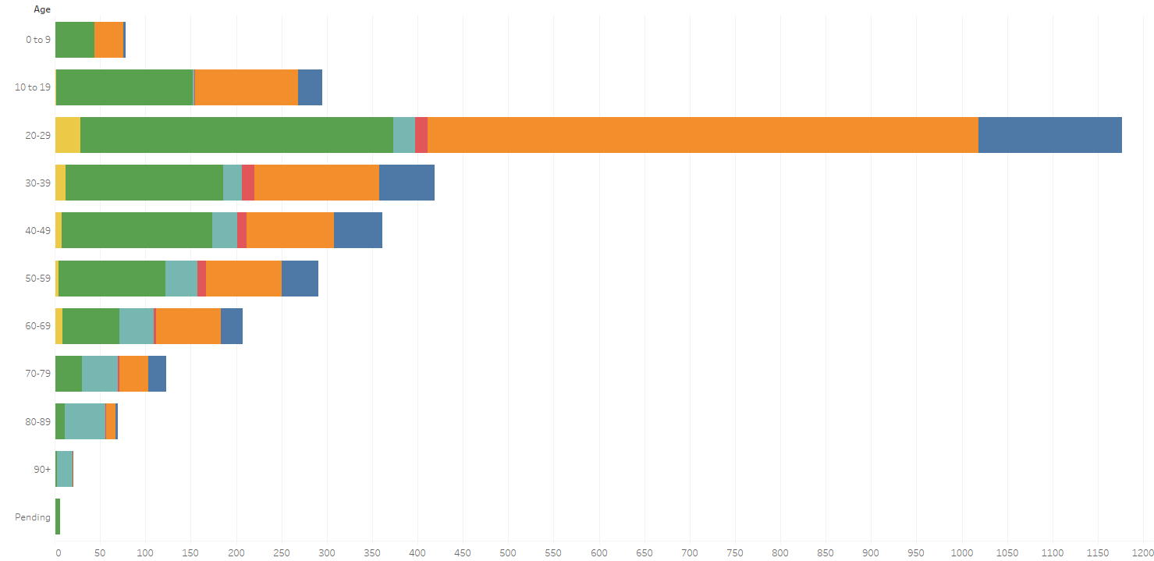
Covid-19 POSITIVES Age Distribution

Slide 33
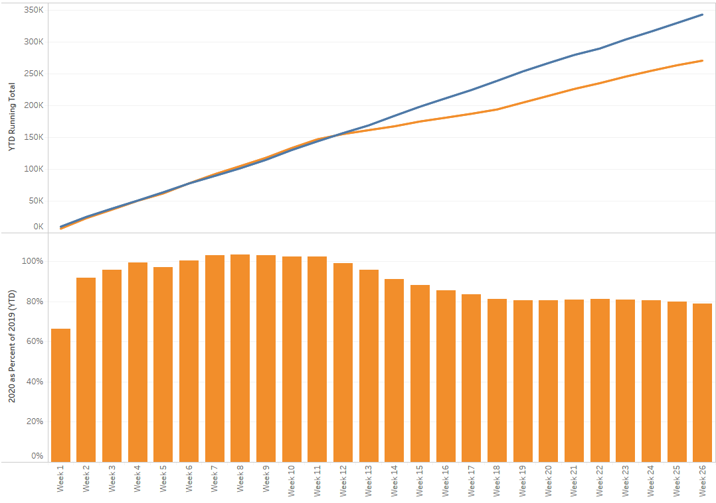

TX/NM Region Weekly Procedures (YOY)

Slide 34
Covid-19 Testing

Slide 35
Viral Testing
 | CMC | CCH | CHP | Grace | Total Tests
Abbott | 1416 | - | - | - | 266
Cepheid | 1500 | - | - | -
BD Max | - | - | - | 884
NP Swab | >5000 | - | - | -
VTM | ? | - | - | -

Slide 36
Antibody Testing
 | May | 6/1 – 6/5 | 6/15-6/19 | 6/22-6/24 | 6/28-7/4
Cov Health Partners | 2,652 | 162 | 117 | 508 | 37
CMG | NA | NA | NA
CMC validating anti-body machine – go live July 8

Slide 37
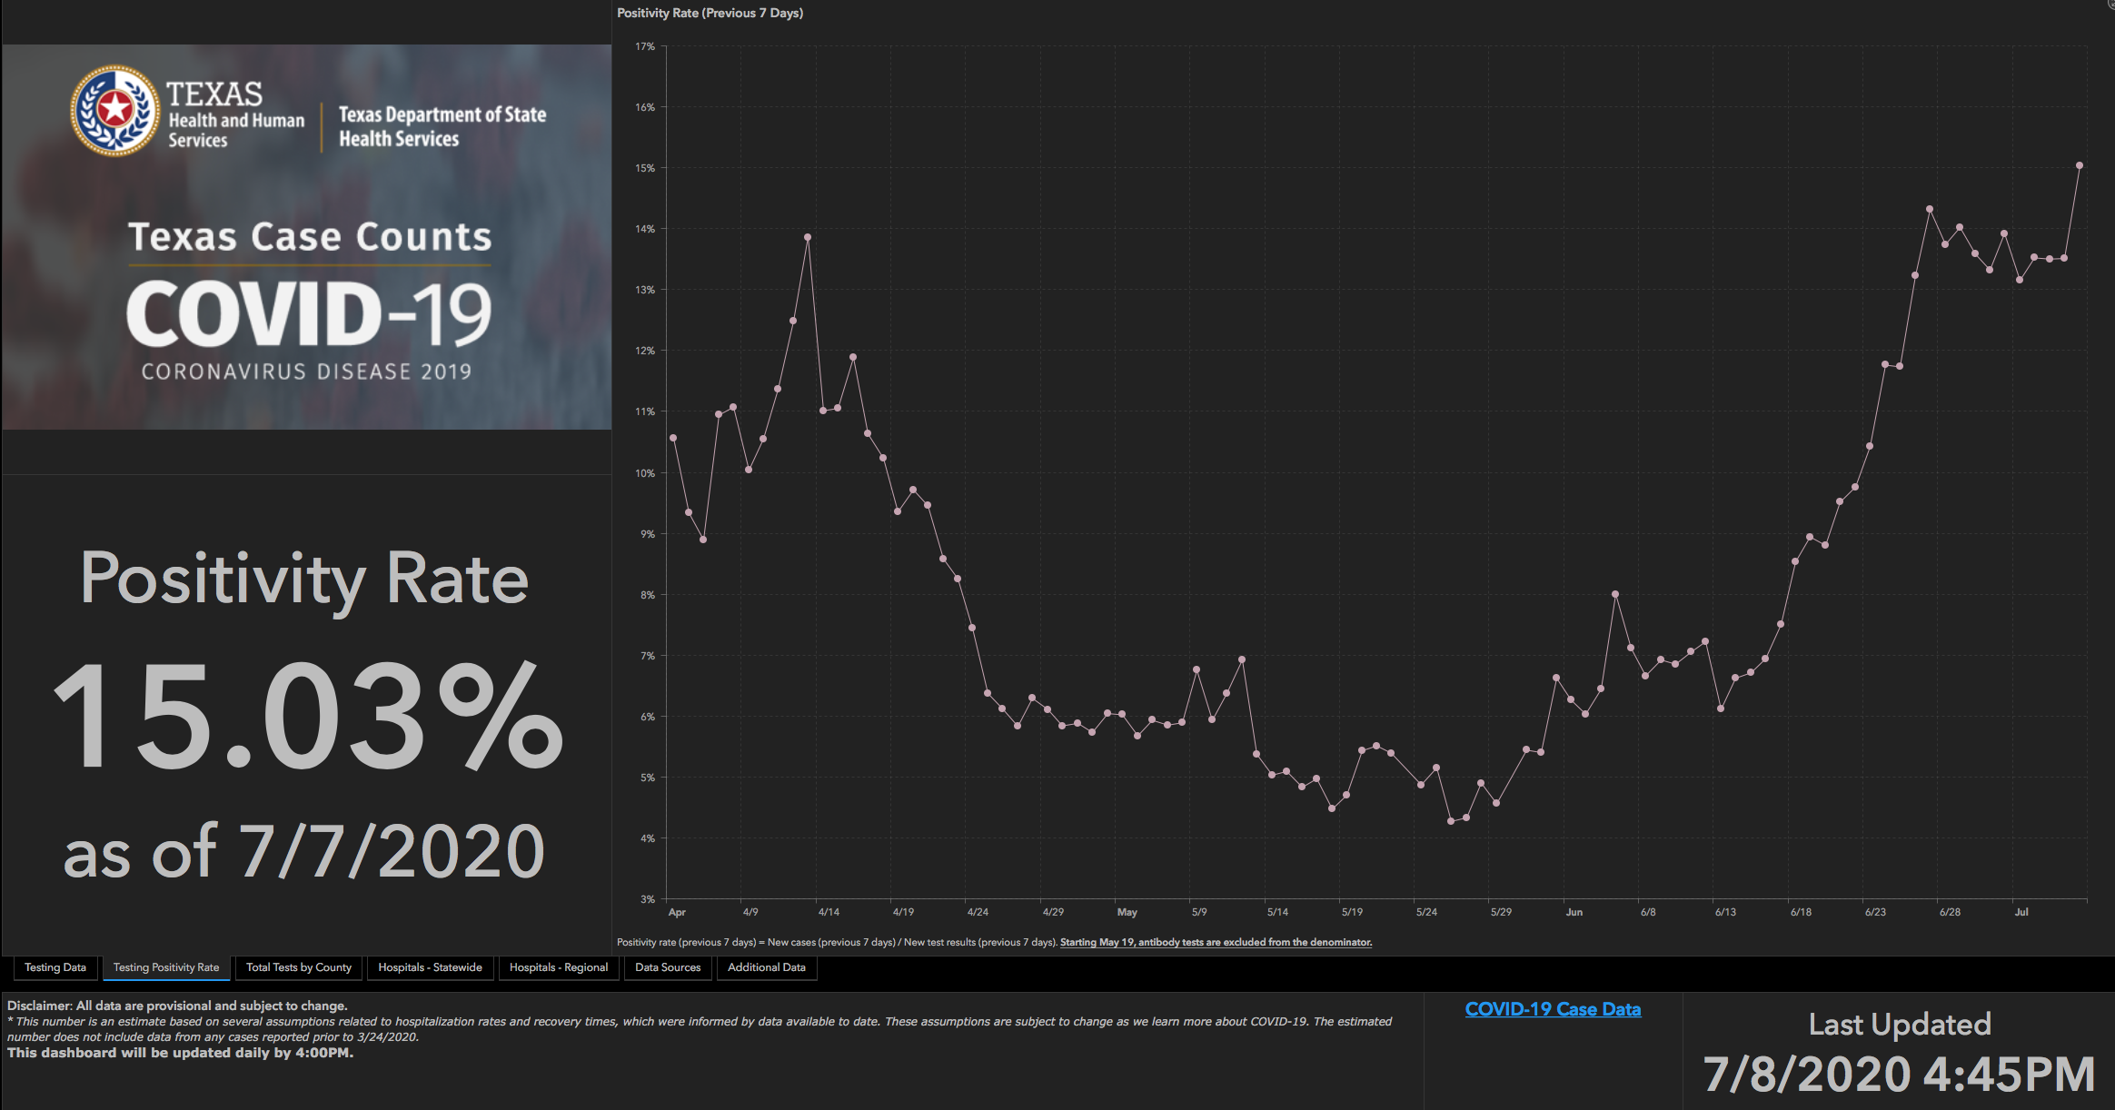
TESTING – STATEWIDE Results

Slide 38
Returning to Operations

Slide 39
COVID19-HOT TOPICS:
  PPE Inventory
Blue Gowns-June utilization reports indicates appropriate usage of blue gowns. High volume of use is due to significant increases in COVID patients.
SCRUBS-current inventory increased. Add more COVID units – need to increase inventory or purchase scrubs

Slide 40
Elective Surgical Procedures in Texas

Slide 41

NOW, THEREFORE, I, Greg Abbott, Governor of Texas, by virtue of the power and authority vested in me by the Constitution and laws of the State of Texas, do hereby order the following effective at 11:59 p.m. on Friday, June 26, 2020:
Every hospital that is licensed under Chapter 241 of the Texas Health and Safety Code, and is also located in Bexar, Dallas, Harris, or Travis counties, shall postpone all surgeries and procedures that are not medically necessary to diagnose or correct a serious medical condition of, or to preserve the life of, a patient who without timely performance of the surgery or procedure would be at risk for serious adverse medical consequences or death, as determined by the patient’s physician; provided, however, that this prohibition shall not apply to any surgery or procedure that, if performed in accordance with the commonly accepted standard of clinical practice, would not deplete any hospital capacity needed to cope with the COVID-19 disaster.
NOW, THEREFORE, I, Greg Abbott, Governor of Texas, by virtue of the power and authority vested in me by the Constitution and laws of the State of Texas, do hereby add the following counties, effective at 11:59 p.m. on Wednesday, July 1, 2020, to the list set forth in Executive Order GA-27:
Cameron County; Hidalgo County; Nueces County; and Webb County.
This proclamation shall remain in effect and in full force for as long as Executive Order GA-27 is in effect and in full force, unless otherwise modified, amended, rescinded, or superseded by the governor.

Slide 42
Additional Counties Added as of 11:59 PM Friday July 10:
Andrews | Calhoun | Ector | Irion | Kleberg | McLennan | Reeves | Val Verde
Aransas | Chambers | Edwards | Jackson | La Salle | McCulloch | Refugio | Victoria
Atascosa | Coke | Falls | Jasper | Lavaca | McMullen | Runnels | Walker
Austin | Comal | Frio | Jeff Davis | Lee | Medina | San Saba | Ward
Bandera | Colorado | Galveston | Jefferson | Liberty | Menard | San Patricio | Walker
Bastrop | Concho | Gillespie | Jim Hogg | Limestone | Midland | Schleicher | Waller
Bee | Crane | Glasscock | Jim Wells | Live Oak | Montgomery | Starr | Wharton
Blanco | Crockett | Goliad | Karnes | Llano | Newton | Sterling | Willacy
Brazoria | DeWitt | Gonzales | Kendall | Loving | Orange | Sutton | Williamson
Brooks | Dimmit | Guadalupe | Kenedy | Martin | Pecos | Terrell | Wilson
Brewster | Duval | Hardin | Kerr | Mason | Presidio | Tom Green | Winkler
Burnet | Fayette | Hays | Kimble | Matagorda | Reagan | Upton | Zapata
Caldwell | Fort Bend | Howard | Kinney | Maverick | Real | Uvalde | Zavala

Slide 43
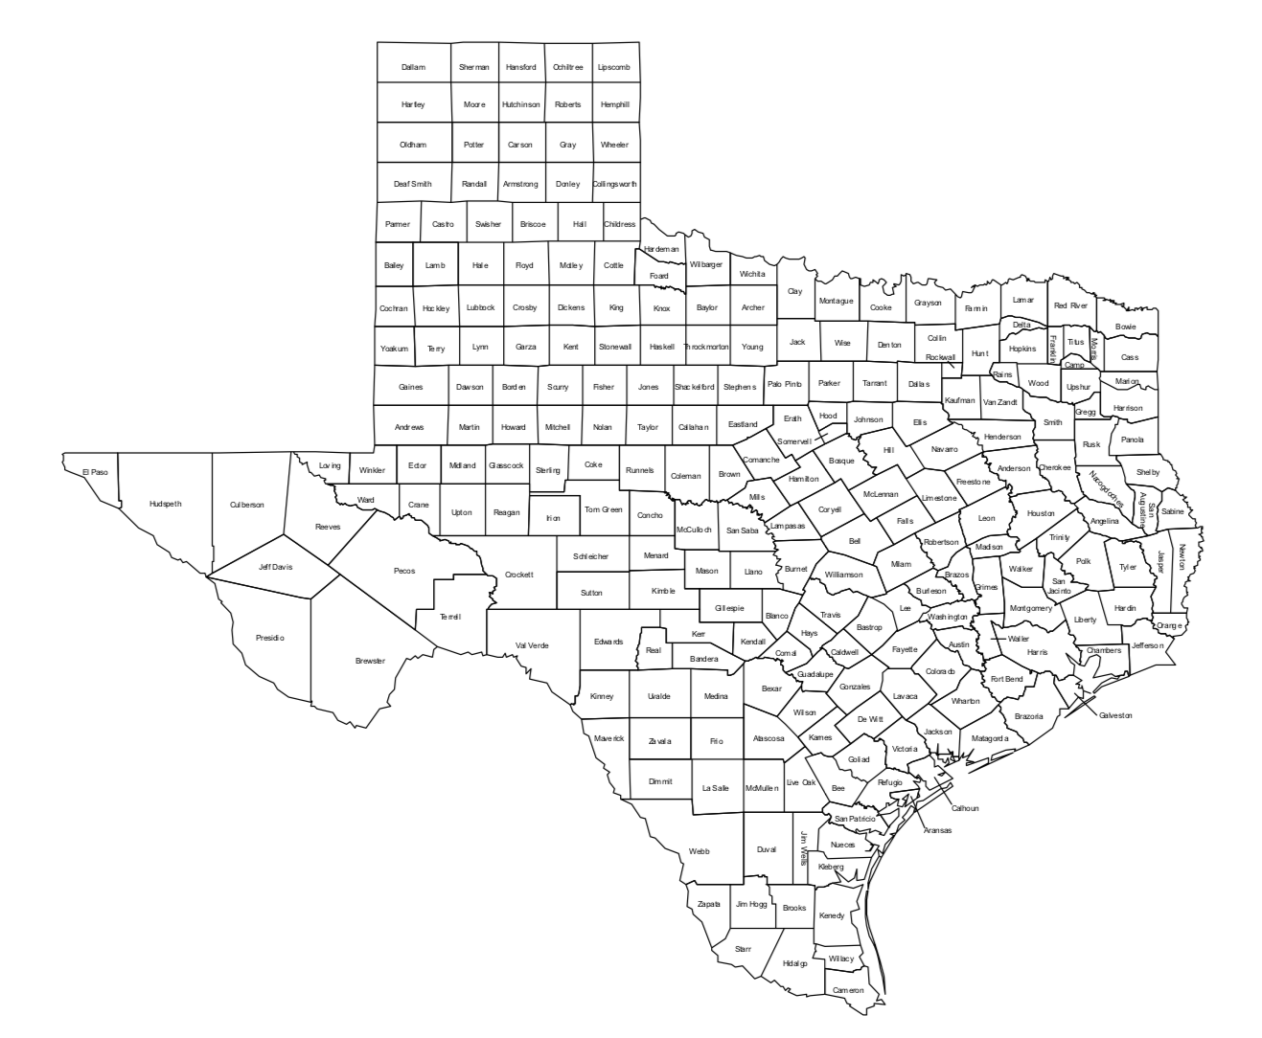
Texas Counties prohibited from performing elective procedures effective at 11:59 PM
7-10-2020

Slide 44
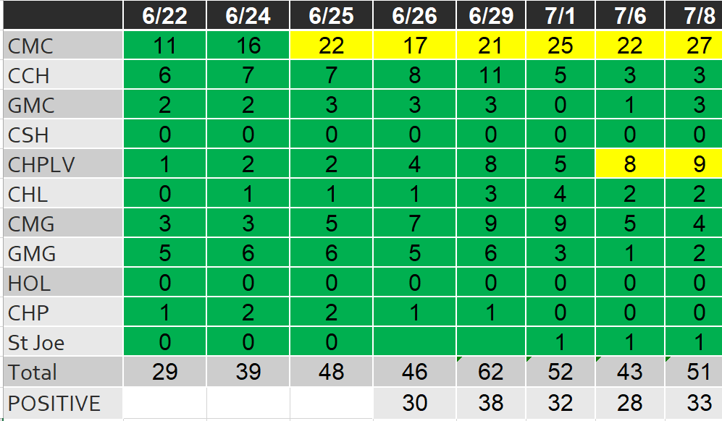
Caregivers
COVID Related Furloughs
Count reflects # furlough (exposed and positive)
Good
Moderate
Critical

Slide 45
REH Operational Recovery Plan
Overview of Work Streams, Owners, Objectives and Status
Updated 7.2.2020

Slide 46
Are we prepared to ramp up operations?
  Early diligence against revised ramp up projections, indicate we are prepared in both supplies and operations for a metered return across all major clinical specialties and general surgery. Continued diligence is required to mitigate risk as the national and world supply chains adjust to meet the growing need. Increased surgery caseload plus increased CV-19 cases are adding pressure to an already strained supply chain. General Med Surg category moving to "Yellow" due to a shortages in a few specific areas.
No impact to operations expected;
Some substitutions may be needed
Without action, some impact to operations may occur;
Expect greater substitutes required, possible clinical practice change
State of supply near full depletion;
Expect impact to operations and
clinical practice change
Category
Status
Primary risks and callouts
Physician Specialty
Solid - ready
General Med-Surg
Ongoing management of declining inventory on shoe covers/bouffant caps. We are balancing inventory to minimize disruptions and have large spot buy inventory available July 17-22nd. SBAR out 6/26 with guidance for ministries.
PPE
Solid – under current "crisis" protocol criteria. If protocol changes, this category would likely change to Yellow. Flexing inventory to meet summer surge numbers.
Supply Resiliency
Medline self-manufactured wipes now on-line but supply still lagging demand. SBAR out 6.26 with guidance for ministries.
EVS
Testing
Overall supply is sufficient with use of commercial labs. Capacity does not match regional demand in all cases. Additional capacity strategies under way.
Respiratory Therapy & Anesthesia
Actively watching as dry rental market impacting surge needs for ventilators at individual ministries.
Operational Processes
All REH-owned process (i.e. logistics, central planning, procure-to-pay) ready

Slide 47
Supply Readiness by Clinical Specialty (1/2)
No impact to operations expected;
Some substitutions may be needed
Without action, some impact to operations may occur;
Expect greater substitutes required, possible clinical practice change
State of supply near full depletion;
Expect impact to operations
Category
At-risk supply categories
Risk Level
What is REH doing?
What support do we need?
Common Medical Surgical Supply
Cole Ercanbrack
  Surgical Disposables
  Increasing allocation and spot buys for shoe covers
  Item specific follow up with manufacture on high risk items
  Process critical items to increase inventory or determine subs.
  Specific critical supply needs communication.
  Align with system IP’s usage, practices and conservations efforts
  Surgical Devices
  Sterility Assurance Disposables
  Nursing Supplies
Cath/CV OR
Cheryl Saxby
  Implants
  Surveying key vendors on supply availability and services needed for ramp up
  Review of scheduled cases at facilities and ramp up %
  Mapping
  Rep service
  Perfusion services
Neurosciences
Cheryl Saxby
  Implants
  Surveying key vendors on supply availability and services needed for ramp up
  Review of scheduled cases at facilities and ramp up %
  Instrument sets
  Rep service
  Engage with SPD departments to review turnaround times on Instrument sets if we exceed 100% over normal procedures expectation.
Clinical specialties
  Neuromonitoring services
  SPD turn around on Instrument sets
Ortho/Trauma
Cheryl Saxby
  Implants
  Surveying key vendors on supply availability and services needed for ramp up
  Review of scheduled cases at facilities and ramp up %
  Instrument sets
  Rep service
  Engage with SPD departments to review turnaround times on Instrument sets if we exceed 100% over normal procedures expectation.
  SPD turn around on Instrument sets
  Review of scheduled cases at facilities and ramp up %
Gen/Robotics
Cheryl Saxby
  Disposables
  Surveying key vendors on supply availability and services needed for ramp up
  Rep service is good. Supplies, as we ramp up to our 26 new robots will be slow moving
  Rep Service
Digestive Health
Cole Ercanbrack
  Disposables
  Surveying supplier’s direct inventory status & rep support
  Utilizing reporting tools for earlier detection of supply shortages
  Specific ramp up scheduled, identifying critical need supplies
  Align with system IP’s PPE usage, practices and conservations efforts
  Devices
  Rep service

Slide 48
Supply Readiness by Clinical Specialty (2/2)
No impact to operations expected;
Some substitutions may be needed
Without action, some impact to operations may occur;
Expect greater substitutes required, possible clinical practice change
State of supply near full depletion;
Expect impact to operations
Category
At-risk supply categories
Risk Level
What is REH doing?
What support do we need?
Women & Children
Lionel Granillo
  OBGYN Disposables
  Partnering with Medline to continually manage distributed inventory
  Surveying supplier’s direct inventory status
  Connecting with W&C System leadership to identify ramp-up trends
  Specific ramp up scheduled, identifying critical need supplies
  Align with system IP’s PPE usage, practices and conservations efforts
  Labor & Delivery
  Surgical Devices
Clinical specialties
Respiratory Therapy
& Anesthesia
Tran Nguyen
  Proprietary disposable & consumables
  Core list of critical items completed & maintained with possible subs for RT, currently in process for Anesthesia
  Weekly connect of key RT stakeholders and continued communication with RT Resource Council
  Shifting inventory as needed throughout the system
  Utilizing reporting tools for earlier detection of supply shortages
  Continued monitoring of department level inventory, identifying items in critical need
  Maximizing ministry level ordering ability, maintaining higher than normal stock levels as appropriate for ministry
  Hepa Filters
  ASA recommended circuits
PPE
Cole Ercanbrack
  N95 Respirator Masks
  Maximizing allocation from contracted suppliers
  Managing non-traditional supply channels
  Monitoring & aligning with system IP’s PPE strategies and Nations changes.
  Increasing owned inventory levels for flexibility
  Implementing PAPR/CAPR stockpile program
  Align with system IP’s PPE usage, practices and conservations efforts
  Facial Protection
  Gowns
EVS
Gerry Slingsby
  Disinfectant Liquid
  Reviewing on-hand and backorder reports
  Reviewing backorder reports/Identifying 3rd party vendors
  Establishing 3rd part supply lines
  Working with Laundries. In-house/outsourced & COOP. obtaining linen scrubs, gowns as necessary
  Maintaining clear lines of communication between facilities and contract teams
  Flexibility in product selection
  Disinfectant Wipes
General categories
  Laundry/Linen/Scrubs/Iso Gowns
Testing
Andy Maze
  In-house COVID reagents
  Sourcing more in-house high-complexity reagents
  Driving efficiency with reference labs
  Synchronizing swab and reagent supply
  Alignment on serological, PCR testing
  Labs confirm alternative specimen types
  System blood donation strategy
  Blood products and services
  In-house swabs, transport media
  Commercial reference lab testing

Slide 49
Texas Demographics

Slide 50
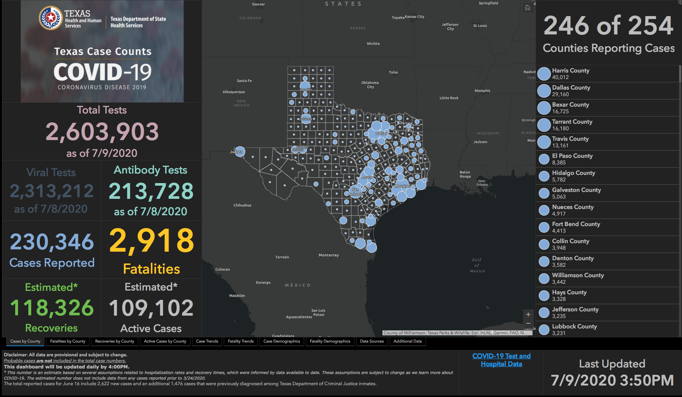

Slide 51
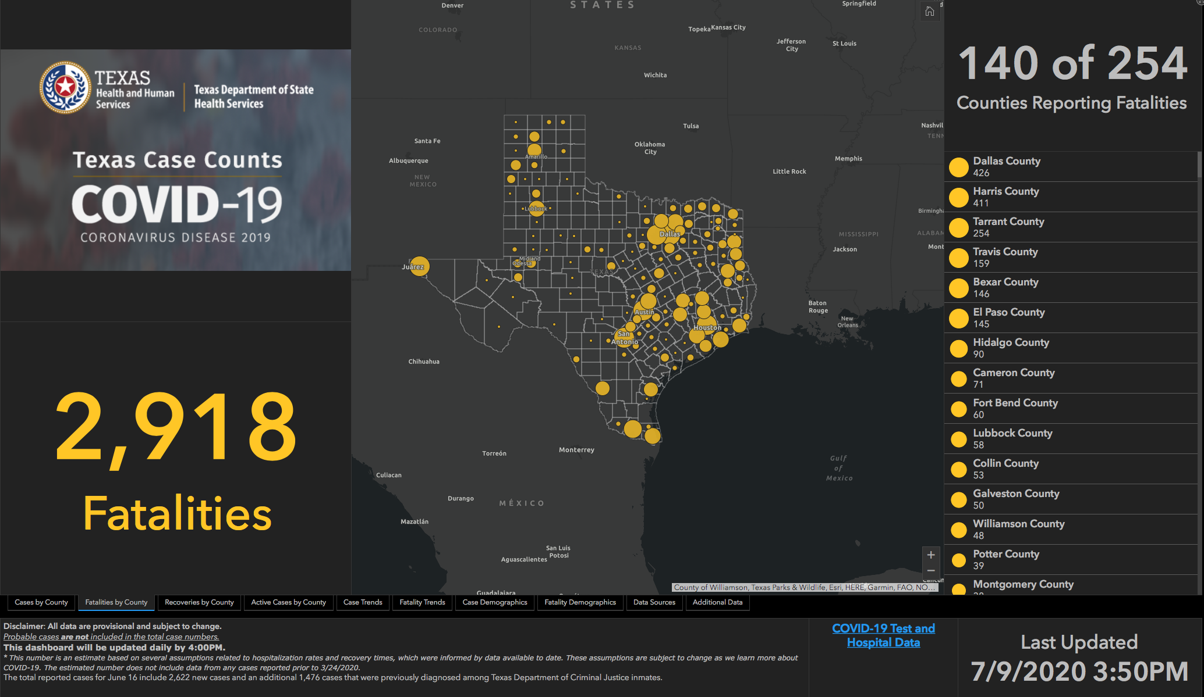

Slide 52
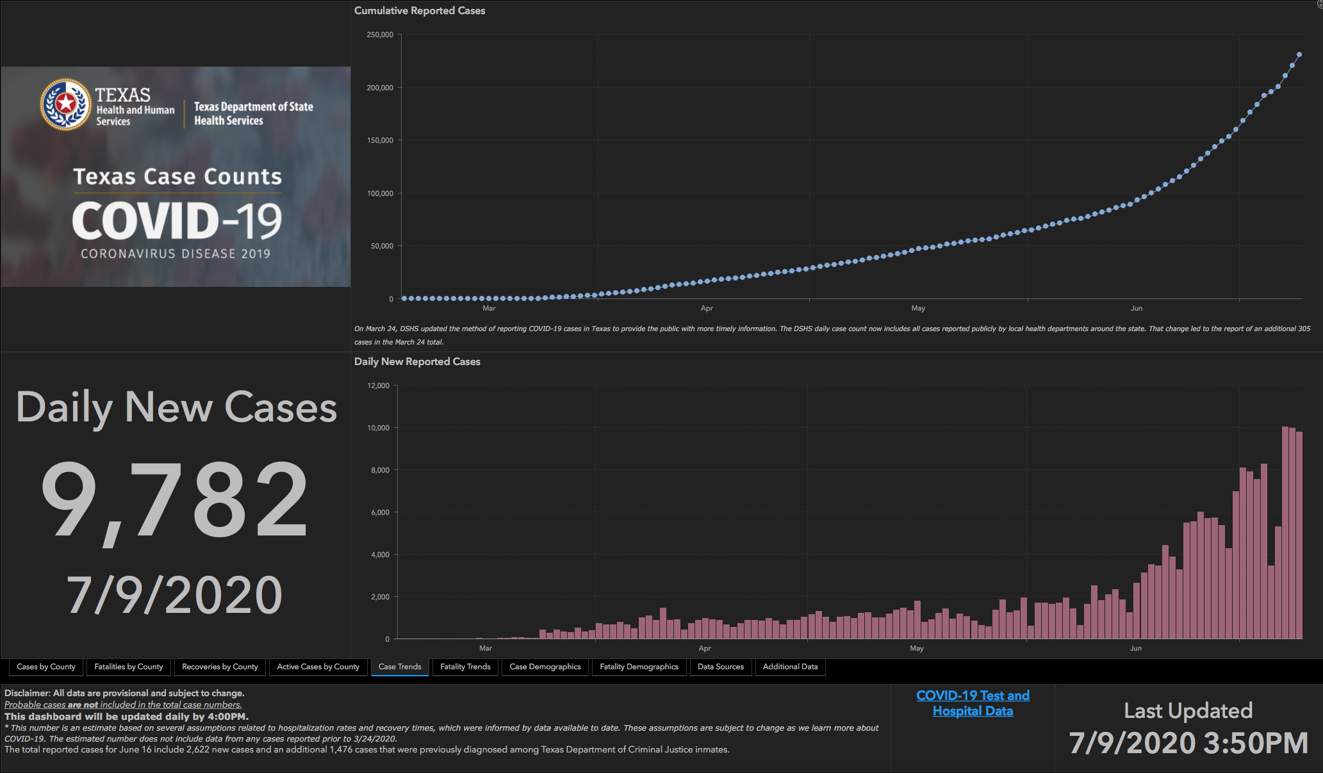

Slide 53
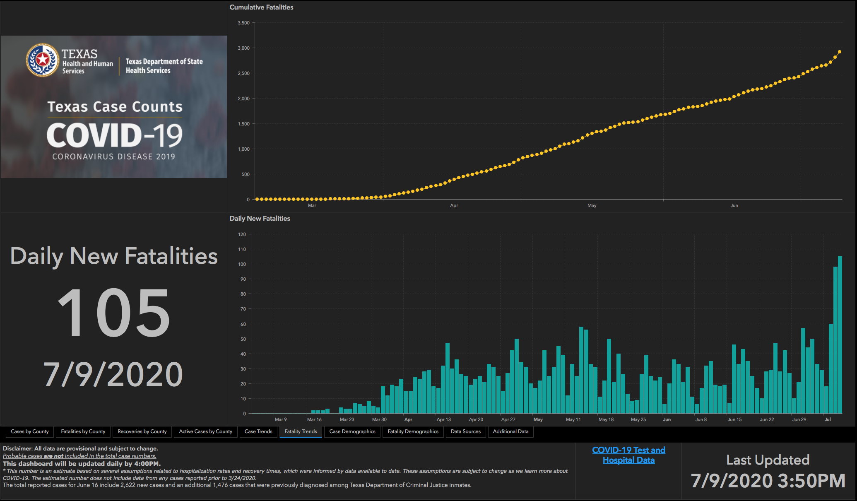

Slide 54
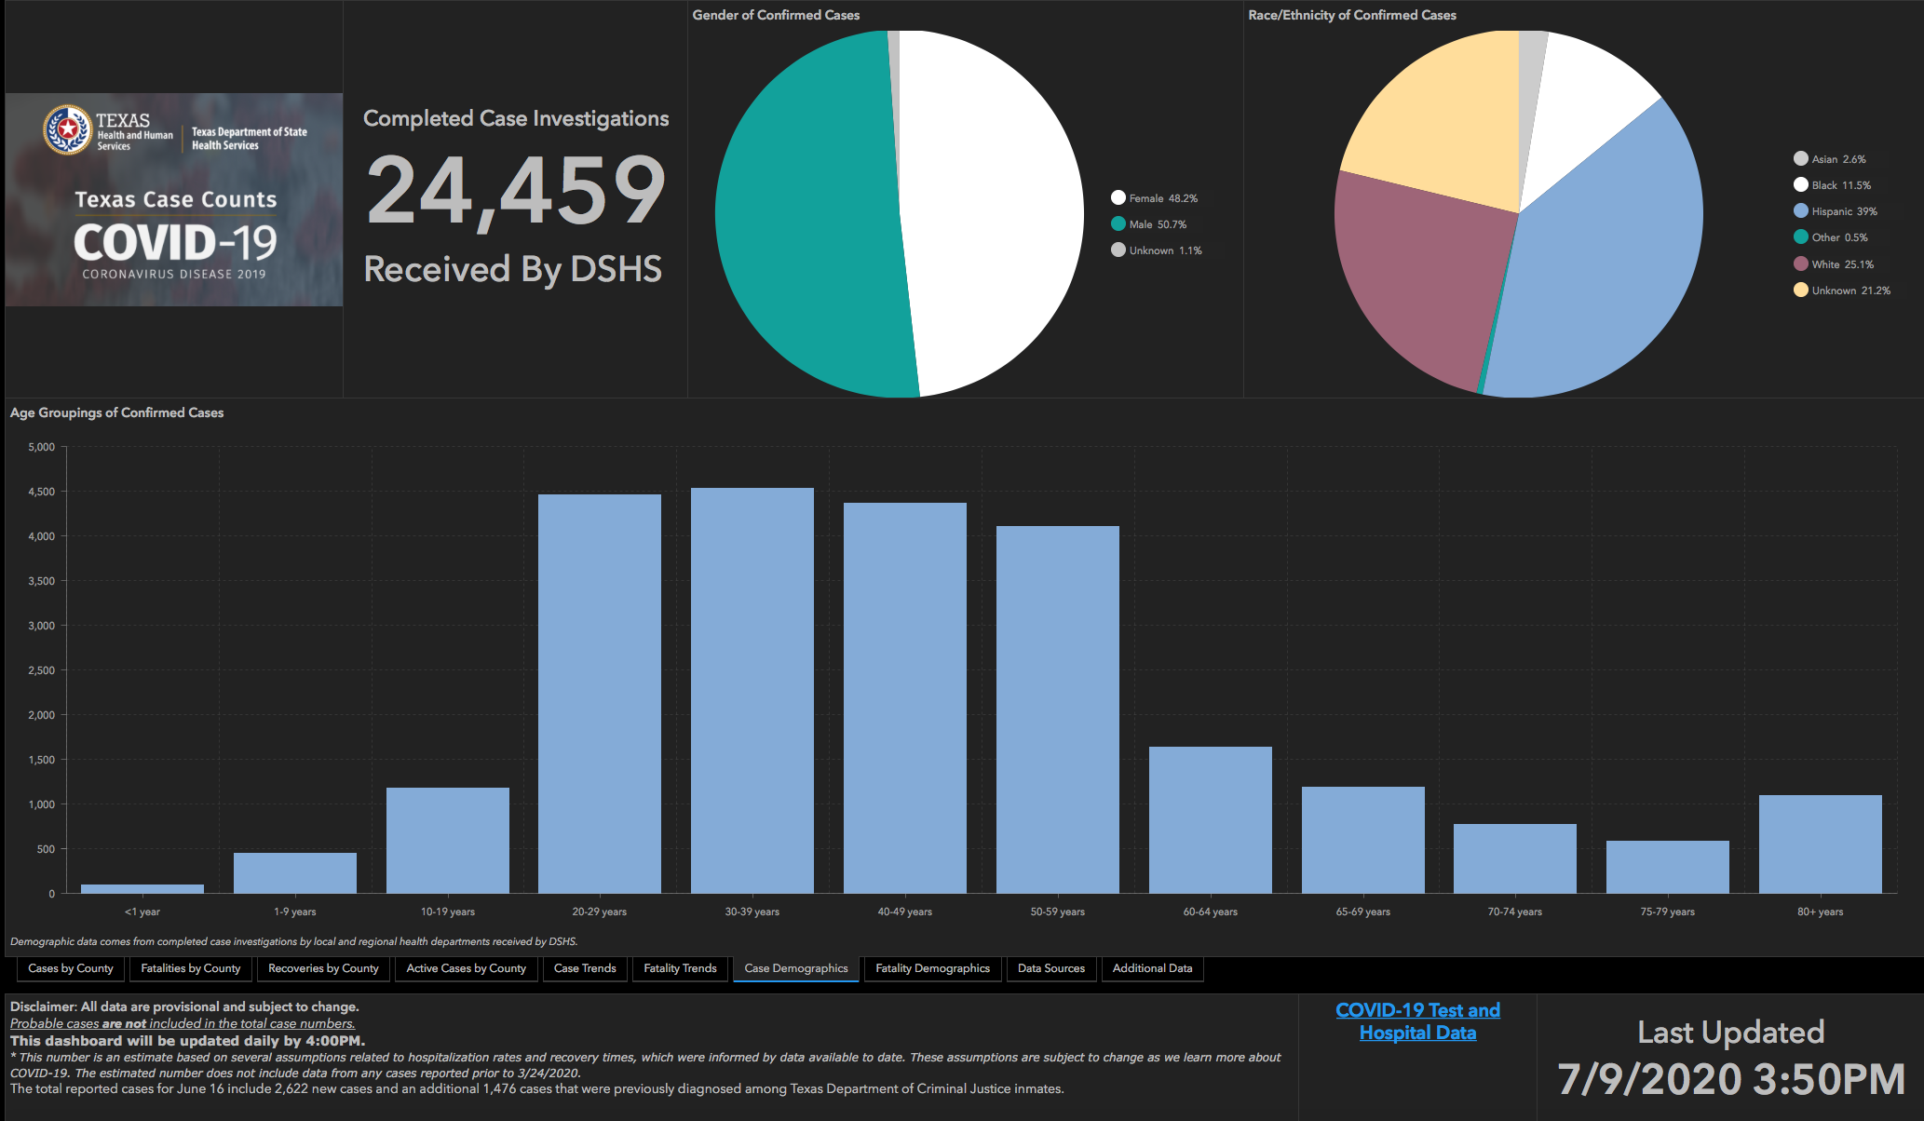

Slide 55
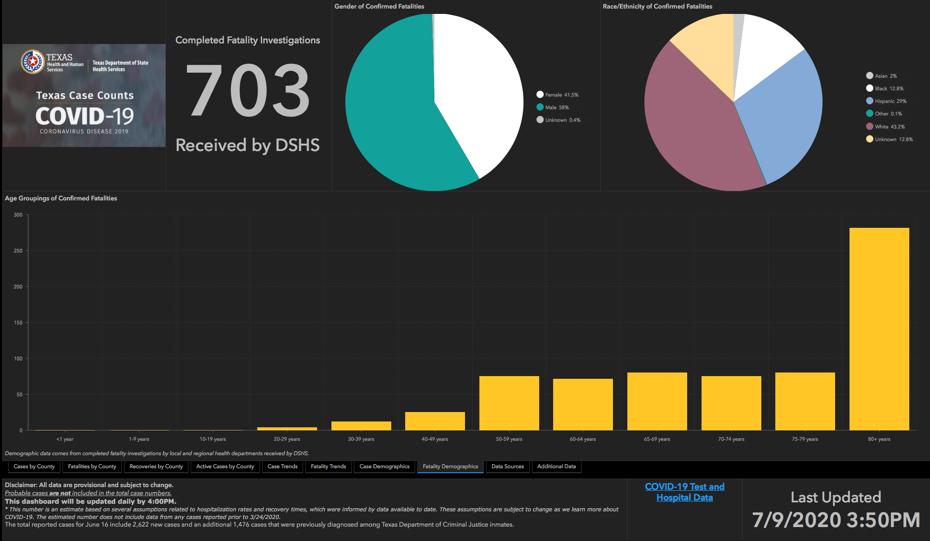

Slide 56
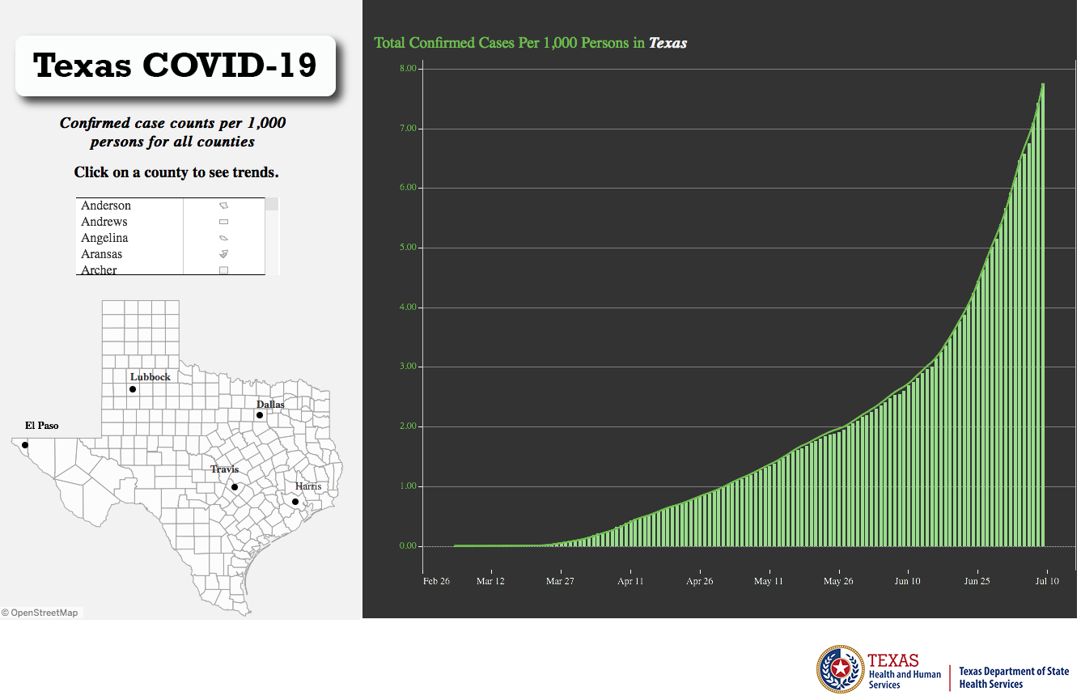
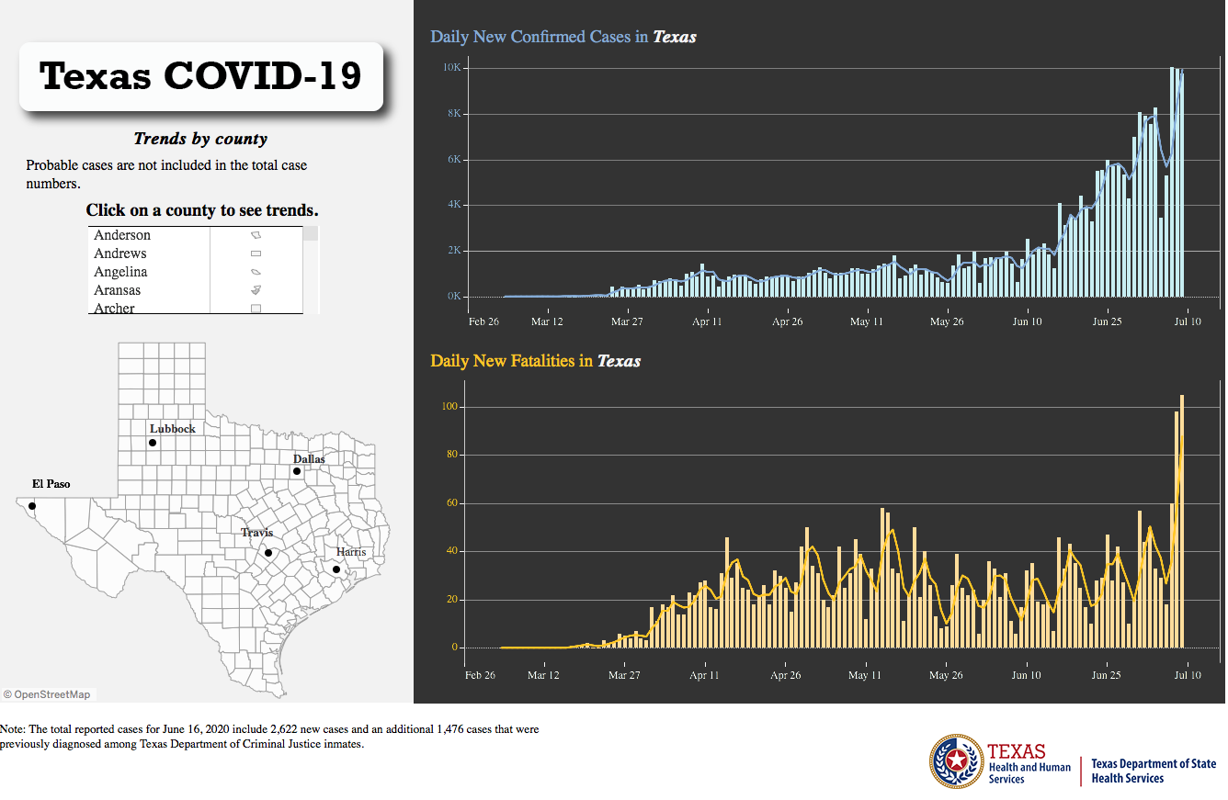
Texas Statewide Statistics
Orange bar represents ONE Case per 1000 Persons
(The Higher on the graph, the better)

Slide 57
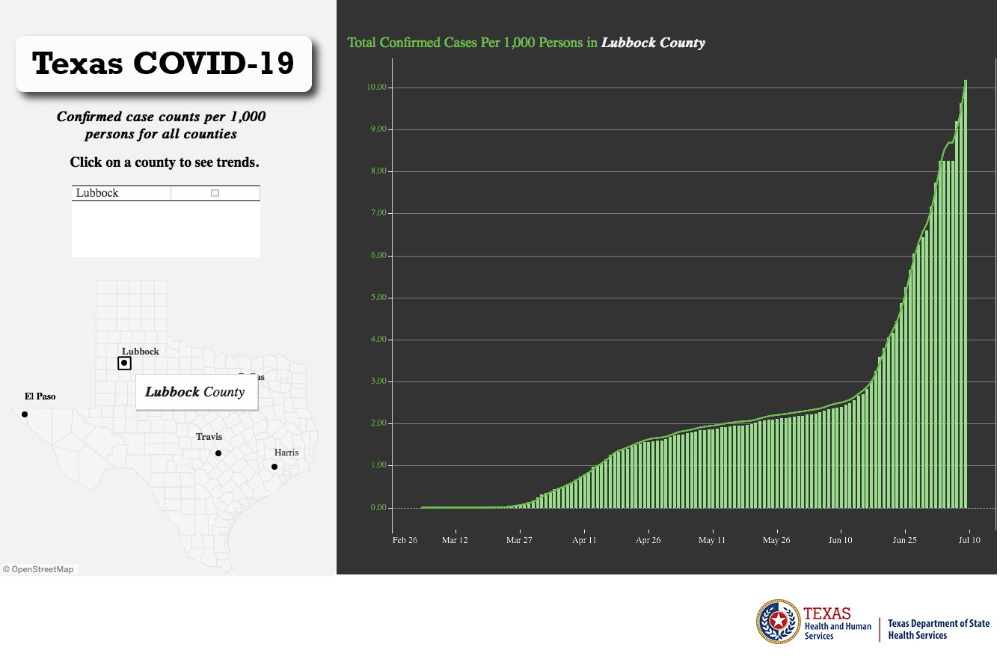
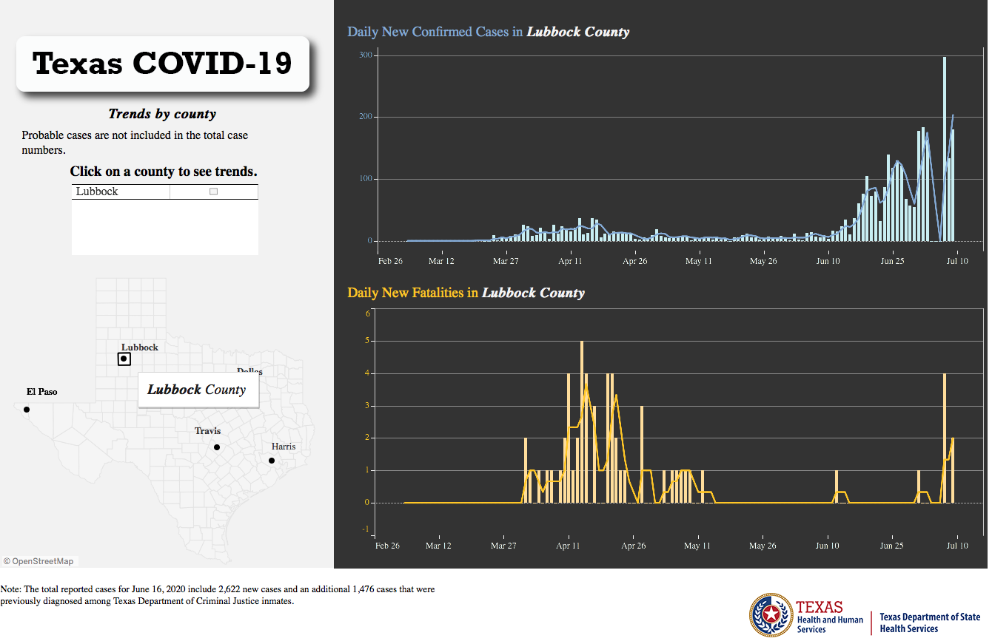
Lubbock County Statistics
Orange bar represents ONE Case per 1000 Persons
(The Higher on the graph, the better)

Slide 58
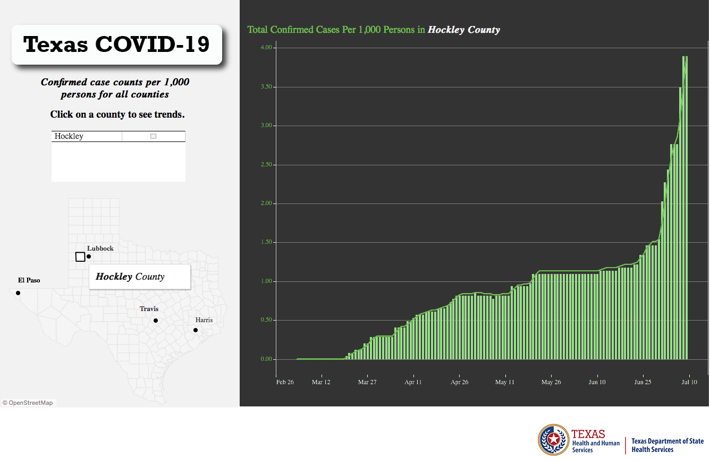
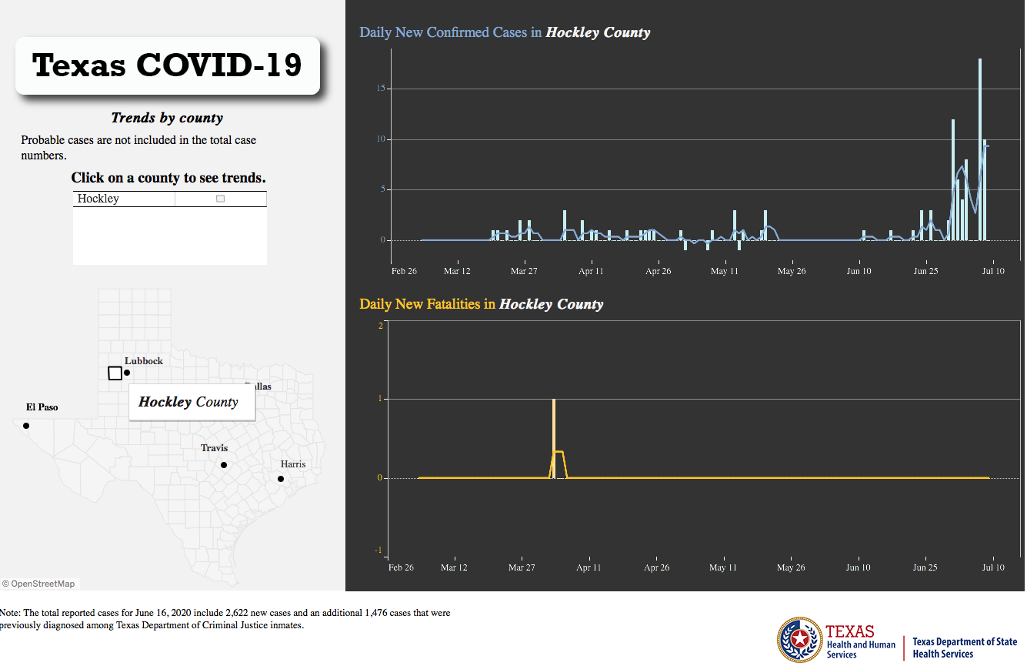
Hockley County Statistics
Orange bar represents ONE Case per 1000 Persons
(The Higher on the graph, the better)

Slide 59
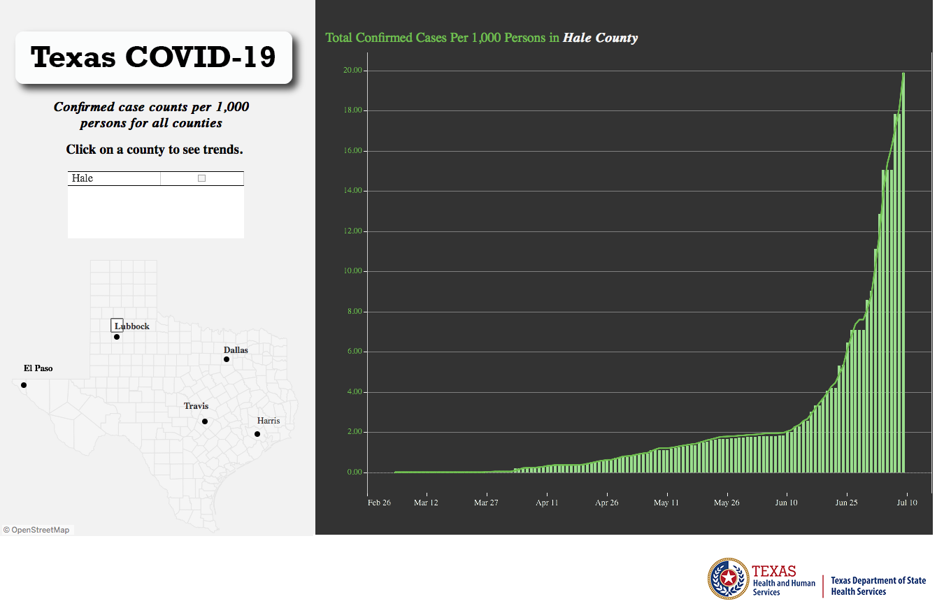
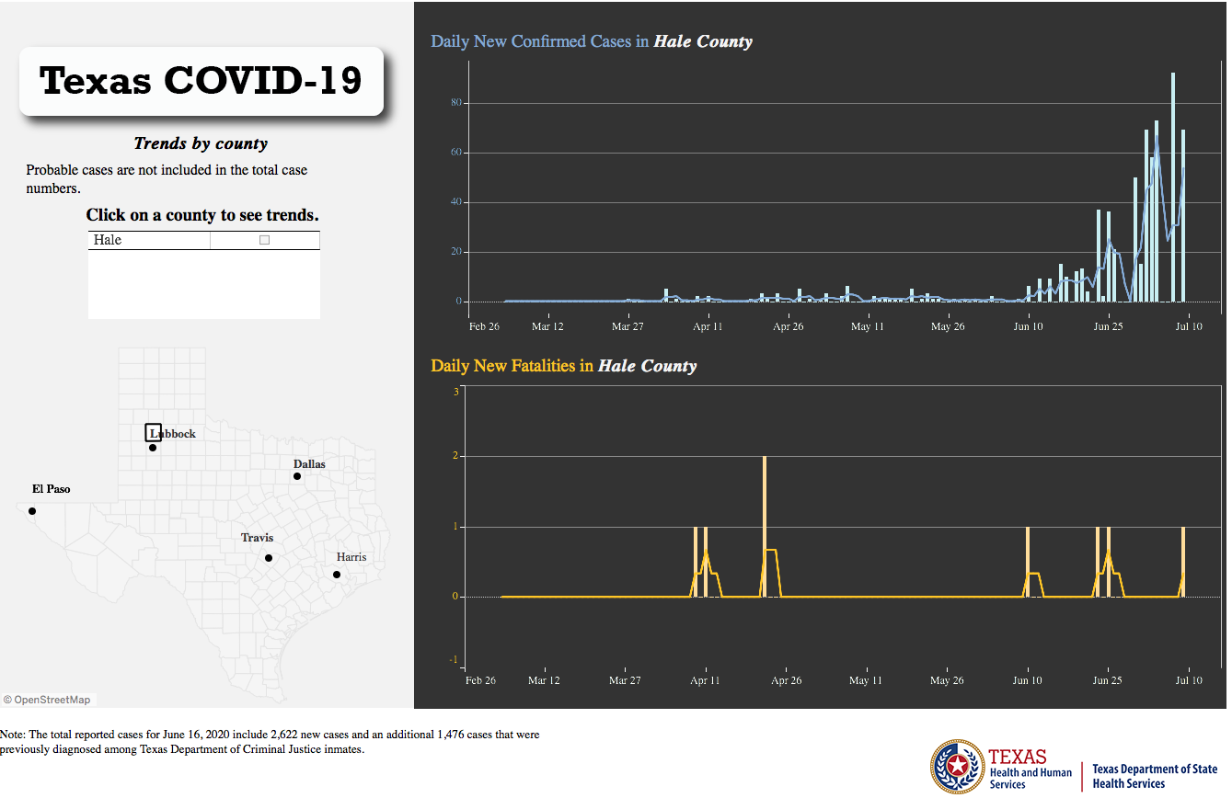
Hale County Statistics
Orange bar represents ONE Case per 1000 Persons
(The Higher on the graph, the better)

Slide 60


Slide 61
Q & A

