Slide 1
Covenant Health
Regional Update for Physicians
July 17, 2020

Slide 2
Reflection

Slide 3


Slide 4
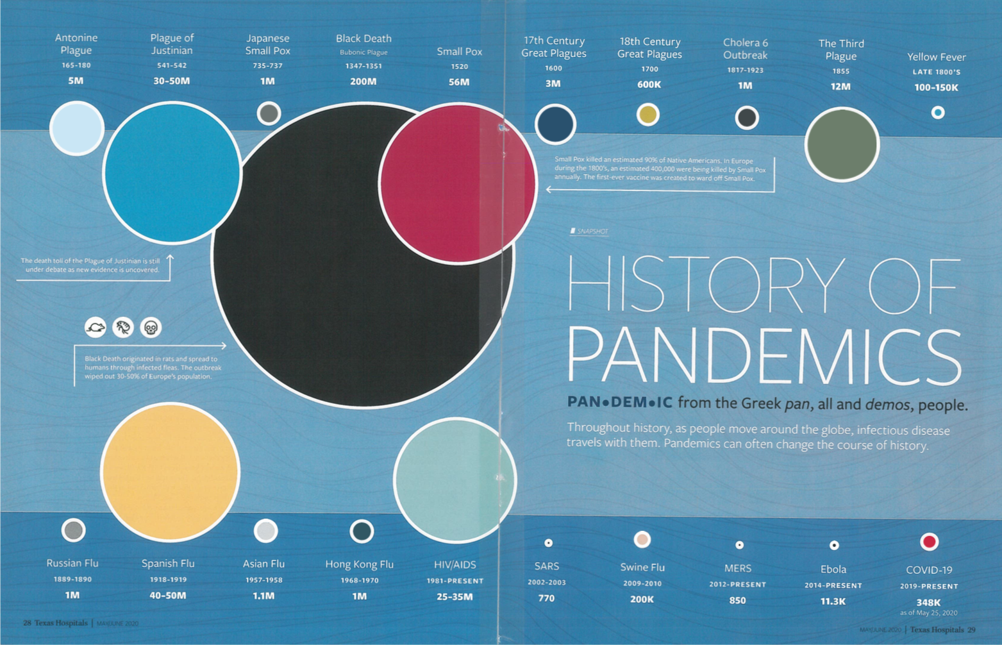

Slide 5
Current Regional Census

Slide 6
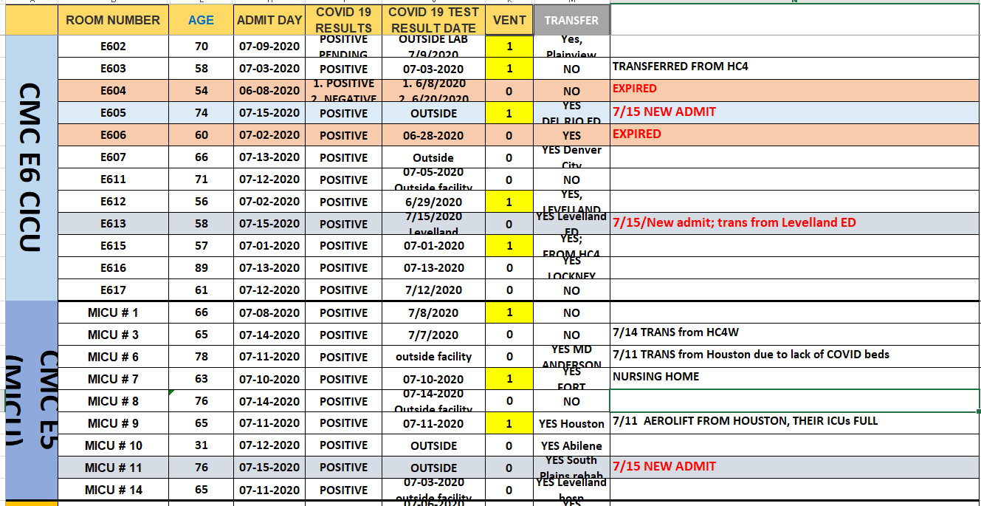
PUI/Confirmed cases-hospitalized

Slide 7
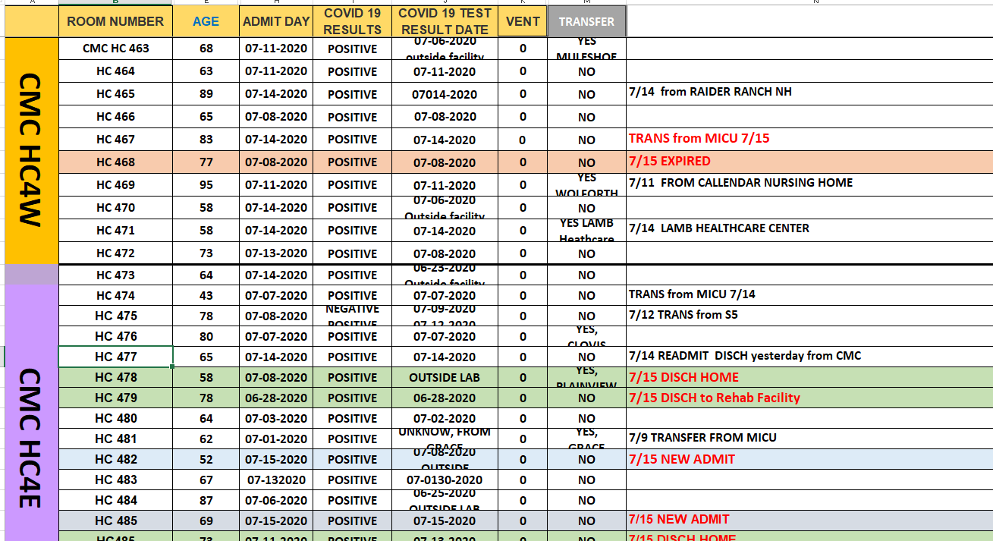
PUI/Confirmed cases-hospitalized

Slide 8
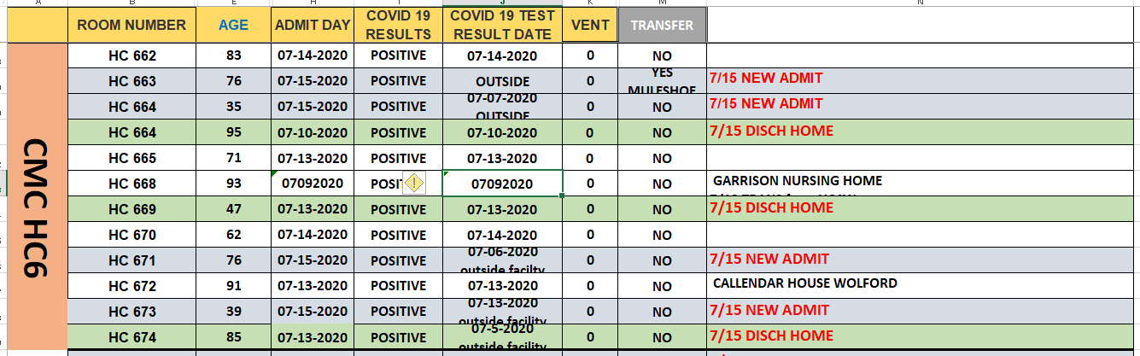
PUI/Confirmed cases-hospitalized

Slide 9
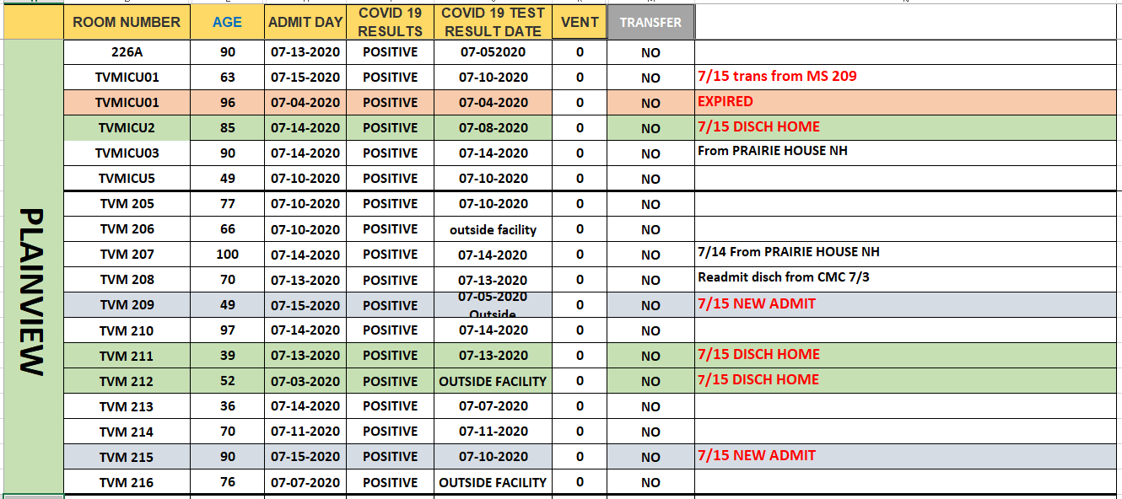
PUI/Confirmed cases-hospitalized

Slide 10
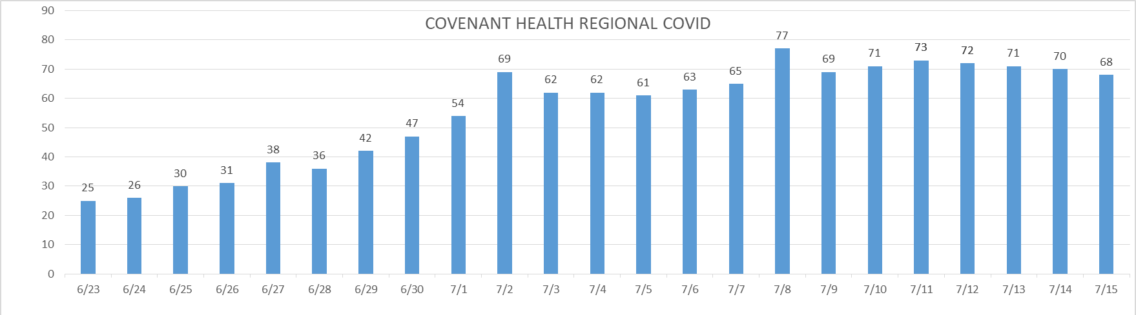
PUI/Confirmed cases-hospitalized

Slide 11
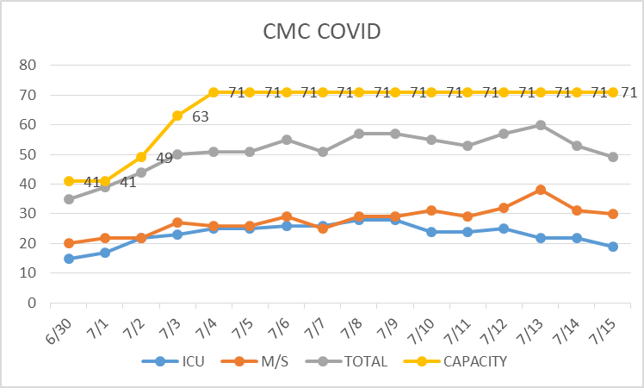
PUI/Confirmed cases-hospitalized

Slide 12
Surge Plan- Revised
Covenant Medical Center
 | ICU | Med Surg | Total
Phase 1 | 10-CICU |  | 10
Phase 2 | 17-CICU | 10-HC4 | 27
Phase 3 | 17-CICU | 24-HC4 | 41
Phase 4 | 17-CICU 8-MICU | 24-HC4 14-Pal Med | 63
Phase 5 | 17-CICU 16-MICU | 24-HC4 14-Pal Med | 71
Phase 6 | 17-CICU 16-MICU 8- SICU 4 (east) | 24-HC4 14-Pal Med 15 – S 9 (east) | 94
Last Week
Currently

Slide 13
Caregivers
COVID Related Furloughs
REMIND STAFF
Wear Face Shield when they are within 6 feet of a patient, including when they are obtaining an NP swab
Count reflects # furlough (exposed and positive)
Good
Moderate
Critical

Slide 14
Statistics
Cristian Requenez, MS
Clinical Data Analyst
Performance Improvement and Decision Support Services

Slide 15
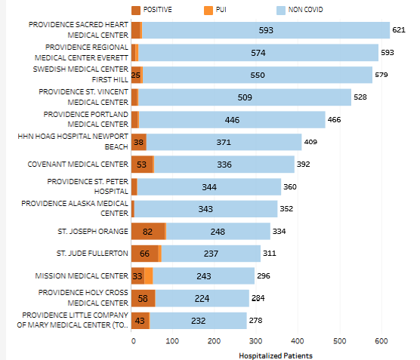
Providence System Hospitalized COVID-19 Cases

Slide 16
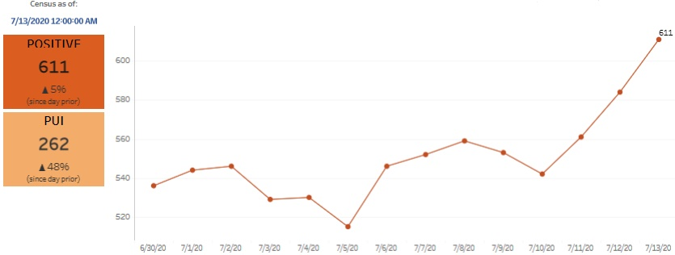
Providence Inpatient COVID-19 Volume

Slide 17
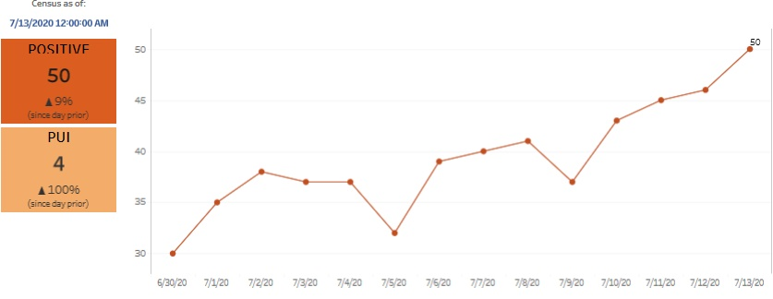
Texas Inpatient COVID-19 Volume

Slide 18
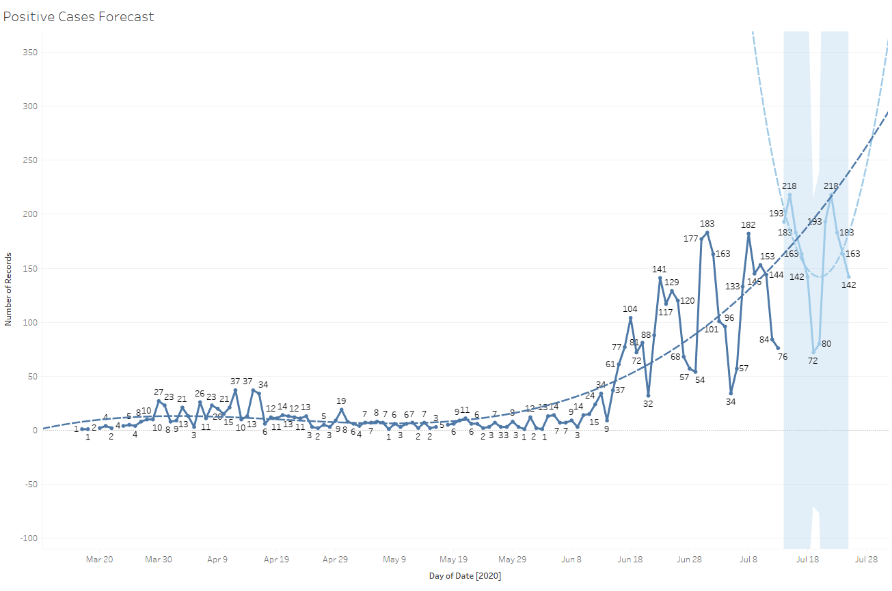
New Covid-19 POSITIVES by Day Trend

Slide 19
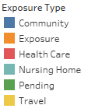
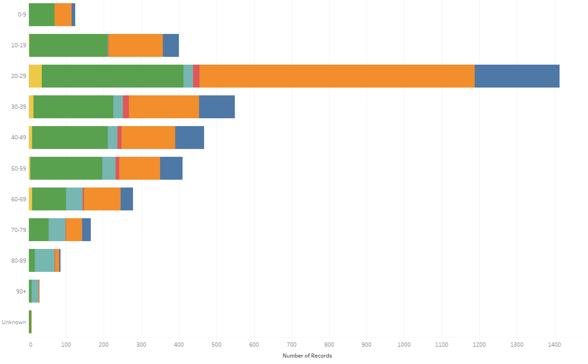
Covid-19 POSITIVES Age Distribution

Slide 20
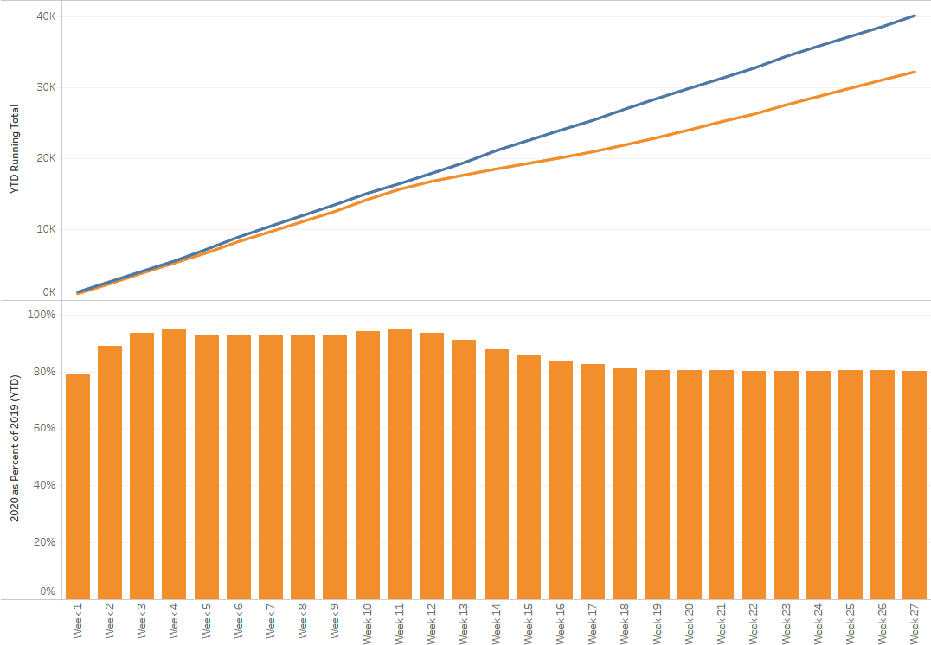
TX/NM Region Weekly Procedures (YOY)

Slide 21
Covid-19 Testing

Slide 22
TESTING
 | CMC | CCH | CHP | Grace | Total Tests
Abbott | 768 | - | - | - | 312
Cepheid | 1427 | - | - | -
BD Max | - | - | - | 280
NP Swab | >10,000 | - | - | -
VTM | >1000 | - | - | -

Slide 23
TESTING - Antibody
 | May | June | July
Cov Health Partners | 2,652 | 824 | 135
CMG | NA | NA | 7 w/ 0 +
CMC | NA | NA | 65 w/ 1+

Slide 24
Laboratory Update on Antibody Testing

Slide 25
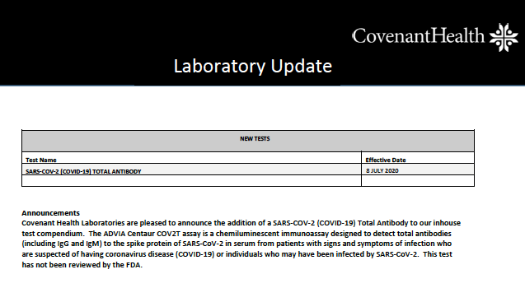

Slide 26
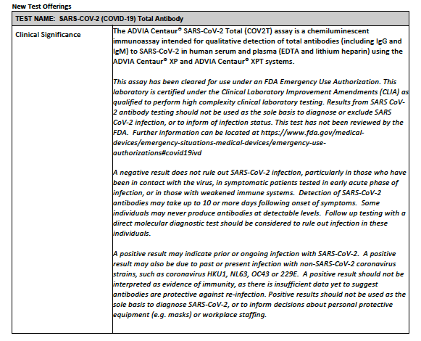

Slide 27
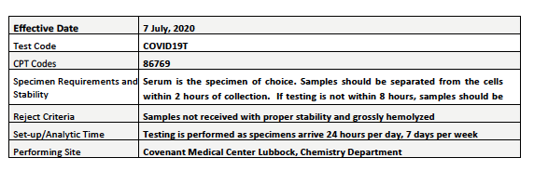

Slide 28
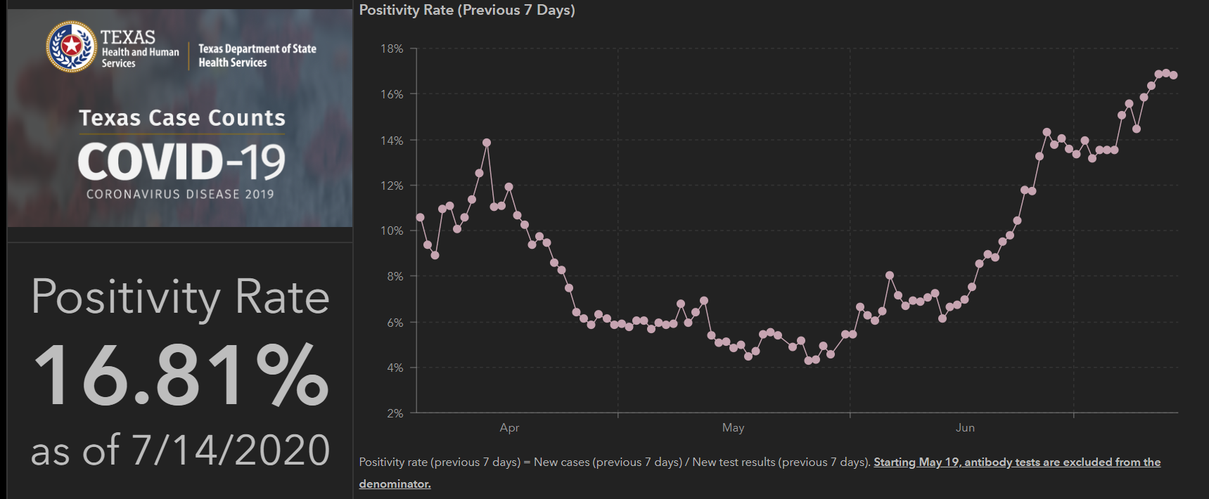
TESTING – STATEWIDE

Slide 29
Clinic Testing
 | 07/07 | 07/08 | 07/09 | 07/10 | 07/11 | 07/12 | 07/13
19TH & Quaker UC | 11 tested 0 Positive | 6 Tested 1 Positive | 2 tested 0 positive | 2 Tested 1 Positive | 1 tested 1 positive | 4 Tested 1 tested | 3 tested 1 positive
NorthWest | 50 Tested 10 Positive | 65 tested 14 positive | 43 tested 4 positive | 45 tested 5 positive | N/A | N/A | 46 tested 10 positive
Pedi UC | 22 Tested 5 Positive | 25 Tested 4 Positive | 10 Tested 0 Positive | 25 Tested 4 positive | N/A | N/A | Needing Spreadsheet updated
HP | 81 Tested 15 positive | 156 Tested 40 positive | 161 tested 35 positive | 145 tested 20 positive | 88 tested 19 positive | 67 tested 1 positive | 85 tested 19 positive
Wolfforth | 2 Tested 0 Positive | 3 Tested 1 Positive | 4 Tested 0 Positive | 2 Tested 1 positive | N/A | N/A | N/A
Roswell | 2 Tested 0 Positive | N/A | N/A | N/A | N/A | N/A | N/A
Antibody Testing | 3 Tested 1 Reactive | 6 Tested 0 Reactive | 3 Tested 0 reactive | 6 tested 2 reactive | N/A | N/A | 7 Tested 0 Reactive
 | Grace
 | 7/6 | 7/7 | 7/8 | 7/9 | 7/10 | 7/11 | 7/12 | 7/13
Count of Tested |  | 58 | 62
Positive | 25
Re-test

Slide 30
Returning to Operations

Slide 31
COVID19-HOT TOPICS
  PPE Inventory

Slide 32
Pharmacy Update
Larry Pineda, PharmD
Clinical Pharmacist – AMS/ID

Slide 33
CHS COVID-19 Treatments
Agent | Dosage | Comments | Update
Remdesivir Emergency Use Authorization (EUA) 5/1/20 | 200 mg IV x 1, then 100 mg IV daily x 4 days Can consider an additional 5 days of therapy in the following patients: Clinically worsening Continues on high-flow nasal cannula, non-rebreather, ventimask, mech ventilation, or ECMO w/o improvement Immunosuppressed | CMC expanded access program ended 5/29/20 PSJH criteria for EUA: 1. Adults or pediatrics with confirmed SARS-CoV-2 2. Pneumonia per chest imaging 3. Patient with SpO2 ≤ 94% or requiring supplemental O2, mech vent, and/or ECMO 4. AST/ALT < 5 x ULN 5. eGFR > 30 ml/min Must provide “Fact Sheet for Patients” and document that we communicated information to patient Mandatory AE reporting to FDA MedWatch | Emergency Use Authorization Inventory = 144 vials at CMC as of Thursday (32 vials at Plainview) EUA Patients: 5 patients on therapy at CMC, 1 patient at CCH, and 1 patient at Plainview as of Thursday AM 7/16/20: purchased through ASB, allocation based on COVID-19 hospitalizations
Dexamethasone | 6 mg IV/PO daily x 10 days | Not recommended in patients who do not require supplemental oxygen | NIH guidelines recommend use in mechanically ventilated patients or those on supplemental oxygen
Notes:
According to the summary of the China study, remdesivir was “not associated with a difference in time to clinical improvement” compared to a standard of care control. After one month, it appeared 13.9% of the remdesivir patients had died compared to 12.8% of patients in the control arm. The difference was not statistically significant.
Hospitalized patients with advanced COVID-19 and lung involvement who received remdesivir recovered faster than similar patients who received placebo, according to a preliminary data analysis from a randomized, controlled trial involving 1063 patients, which began on February 21. The trial (known as the Adaptive COVID-19 Treatment Trial, or ACTT), sponsored by the National Institute of Allergy and Infectious Diseases (NIAID), part of the National Institutes of Health, is the first clinical trial launched in the United States to evaluate an experimental treatment for COVID-19. Preliminary results indicate that patients who received remdesivir had a 31% faster time to recovery than those who received placebo (p<0.001). Specifically, the median time to recovery was 11 days for patients treated with remdesivir compared with 15 days for those who received placebo. Results also suggested a survival benefit, with a mortality rate of 8.0% for the group receiving remdesivir versus 11.6% for the placebo group (p=0.059). Recovery in this study was defined as being well enough for hospital discharge or returning to normal activity level.
FYI Budesonide: In response to Odessa doctor, Richard Bartlett, who calls it the 'silver bullet‘. There have been no clinical trials or observational studies examining the use of ICS in COVID-19. Clinical trials would be required to establish whether these drugs may be repurposed for the treatment of this disease.

Slide 34
CHS COVID-19 Treatments
Agent | Dosage | Comments | Update
Tocilizumab | 400 mg IVPB x 1 dose May repeat x 1 in 8-12 hours if clinical symptoms worsen or do not demonstrate improvement | IL-6 receptor antagonist used to treat CRS ($2.13K - $4.25K per dose) CHS criteria for use: Proven COVID-19 infection Early treatment of severe/critically ill patients who are clinically deteriorating Restricted to intensivists or ID AST/ALT <5xULN, ANC >500, Plt >50K PSJH compliance: signed informed consent is recommended prior to dispensing this agent | NIH guidelines state insufficient data to recommend for or against the use of IL-6 inhibitors for treatment of COVID-19 7/8/20: PSJH ID-CDT approval of new criteria for use: Severe/critically ill patients who are clinically deteriorating despite other treatment and/or supportive care Require at least 6 L suppl O2 to maintain a SpO2 ≥ 93% Mechanical vent OR multi organ failure OR ICU admission
Convalescent Plasma | 1 unit (200-400mL) x 1 | CMC enrolled in Mayo trial | Enrolled 35 patients to date
Notes:
The FDA says that neither drug has been proven safe and effective in treating COVID-19. In fact, a study published on April 23 involving 368 COVID-19 patients at U.S. Veterans Health Administration hospitals found that taking hydroxychloroquine alone, or in combination with azithromycin, did not reduce the need for a ventilator compared to those not taking the drugs. Further, people taking hydroxychloroquine alone had a higher risk of dying during the study than those not taking the drug. Researchers in China came to a similar conclusion in a study of 150 COVID-19 patients randomly assigned to receive hydroxychloroquine or the current standard of care: after a month, both groups had similar symptom profiles, and showed similar levels of the virus, suggesting that the drug wasn’t clearing the COVID-19 virus in a significant way. The National Institutes of Health is conducting an ongoing study of hydroxychloroquine among hospitalized patients, as is Novartis, whose Sandoz division makes a generic version of the drug.
HCQ:
PSJH high risk patients (age > 60, pulmonary disease, CV disease, CKD, DM, immune compromised, HTN present on admission or receiving anti-hypertensives prior to admission)
Toci:
Proven COVID-19 infection based on laboratory testing AND radiographic evidence of pneumonia
Severely ill definition: SpO2 ≤ 93% on room air or FiO2/PaO2 ≤ 300 mmHg or respiratory rate ≥ 30 breaths/min
Critically ill definition: Mechanical ventilation OR multi organ failure OR ICU admission
After publication of our Lancet Article,¹
several concerns were raised with respect to the veracity of the data and analyses conducted by Surgisphere Corporation and its founder and our co-author, Sapan Desai, in our publication. We launched an independent third-party peer review of Surgisphere with the consent of Sapan Desai to evaluate the origination of the database elements, to confirm the completeness of the database, and to replicate the analyses presented in the paper.
Our independent peer reviewers informed us that Surgisphere would not transfer the full dataset, client contracts, and the full ISO audit report to their servers for analysis as such transfer would violate client agreements and confidentiality requirements. As such, our reviewers were not able to conduct an independent and private peer review and therefore notified us of their withdrawal from the peer-review process.

Slide 35
CHS COVID-19 Treatments
Agent | Dosage | Comments | Update
Ivermectin | 150-400 mcg/kg PO | In vitro studies show activity at high doses No RCT data No published peer reviewed data supporting its safety and efficacy: caution with pilot, phase 2, or retrospective study info available on pre-print | Effective dosing strategy unknown Concentration used in-vitro showing activity is >35X higher than the max plasma concentration after oral administration of approved dose (200 mcg/kg) For 70kg patient = 14 mg x 35 = 490 mg (>160 3mg tablets)
Sildenafil | 20 mg PO three times a day | COVID-19 efficacy? | Clinical trials ongoing
Zanubrutinib | 320 mg PO once daily for up to a maximum of 28 days | CMC will be participating in this phase 2, randomized, double blind, placebo-controlled (N~46-52) | Completed initial training. Hope to enroll patients in the next few weeks. Current enrollment: 0 patients
Notes:
According to the summary of the China study, remdesivir was “not associated with a difference in time to clinical improvement” compared to a standard of care control. After one month, it appeared 13.9% of the remdesivir patients had died compared to 12.8% of patients in the control arm. The difference was not statistically significant.
Hospitalized patients with advanced COVID-19 and lung involvement who received remdesivir recovered faster than similar patients who received placebo, according to a preliminary data analysis from a randomized, controlled trial involving 1063 patients, which began on February 21. The trial (known as the Adaptive COVID-19 Treatment Trial, or ACTT), sponsored by the National Institute of Allergy and Infectious Diseases (NIAID), part of the National Institutes of Health, is the first clinical trial launched in the United States to evaluate an experimental treatment for COVID-19. Preliminary results indicate that patients who received remdesivir had a 31% faster time to recovery than those who received placebo (p<0.001). Specifically, the median time to recovery was 11 days for patients treated with remdesivir compared with 15 days for those who received placebo. Results also suggested a survival benefit, with a mortality rate of 8.0% for the group receiving remdesivir versus 11.6% for the placebo group (p=0.059). Recovery in this study was defined as being well enough for hospital discharge or returning to normal activity level.
Ivermectin: The concentration resulting in 50% inhibition (IC50; 2 µM) was > 35× higher than the maximum plasma concentration (Cmax) after oral administration of the approved dose (200 mcg/kg)

Slide 36
Pharmacy Shortages/Allocations
Covid-19 Related
  CISATRACURIUM
  Rocuronium
  Vecuronium
  Propofol
  Fentanyl
  Vitamin C Liquid and Inj
  Dexamethasone Inj and Tabs
  Ivermectin
  Dexamethasone
  Zinc Sulfate Tabs
  Sildenafil Tabs
  Budesonide Inhalers
Non-Covid-19 Related
  Bumetanide
  Amiodarone
  Dopamine
  Dobutamine
  Famotidine
  Furosemide Inj
  Doxycycline Inj
  Nitroglycerin SDV
  Bupivacaine with epinephrine
  Lidocaine with epinephrine
  Methadone Inj
  Nalbuphine Inj
  Sertraline 20 mg/ml Soln

Slide 37
Elective Surgical Procedures in Texas

Slide 38
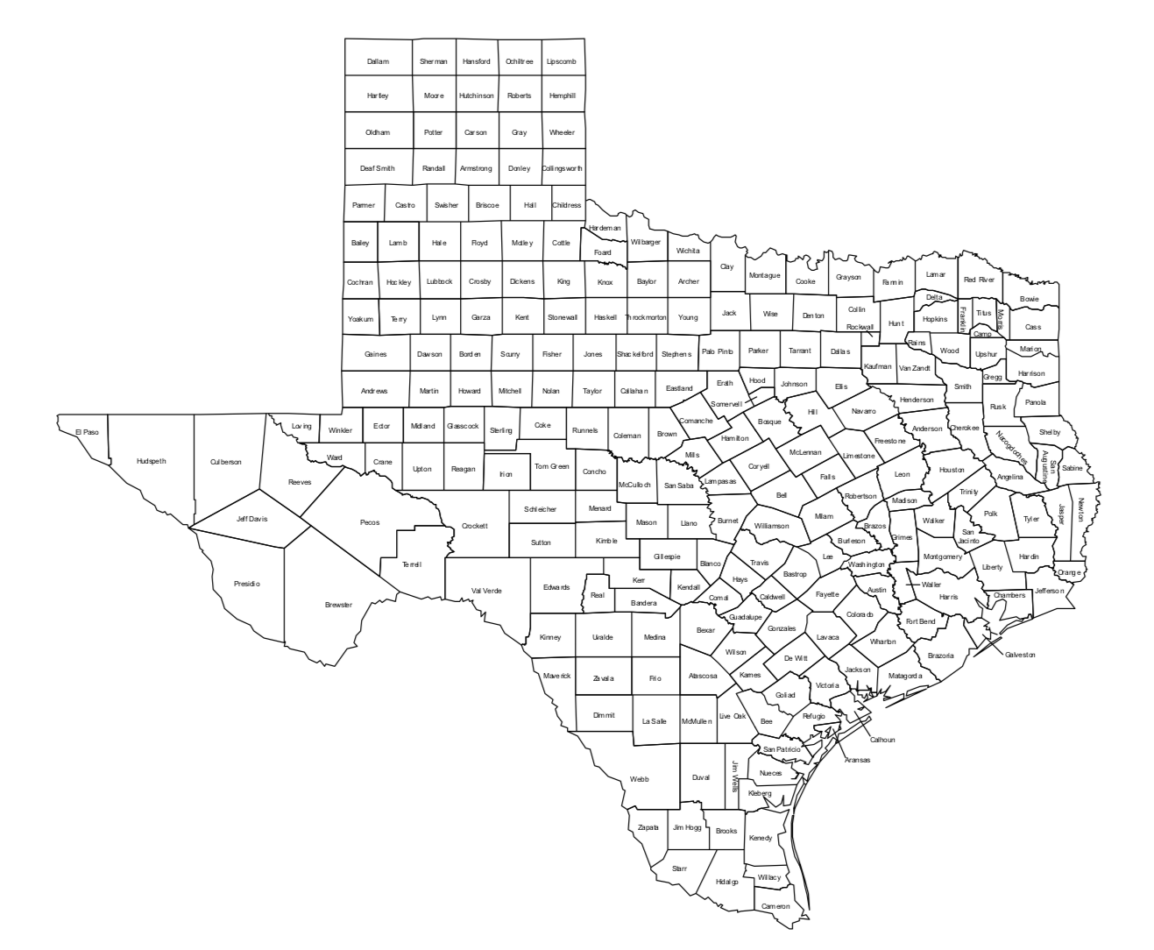
Texas Counties prohibited from performing elective procedures effective at 11:59 PM
7-10-2020

Slide 39
Aerosol Generating Procedures

Slide 40
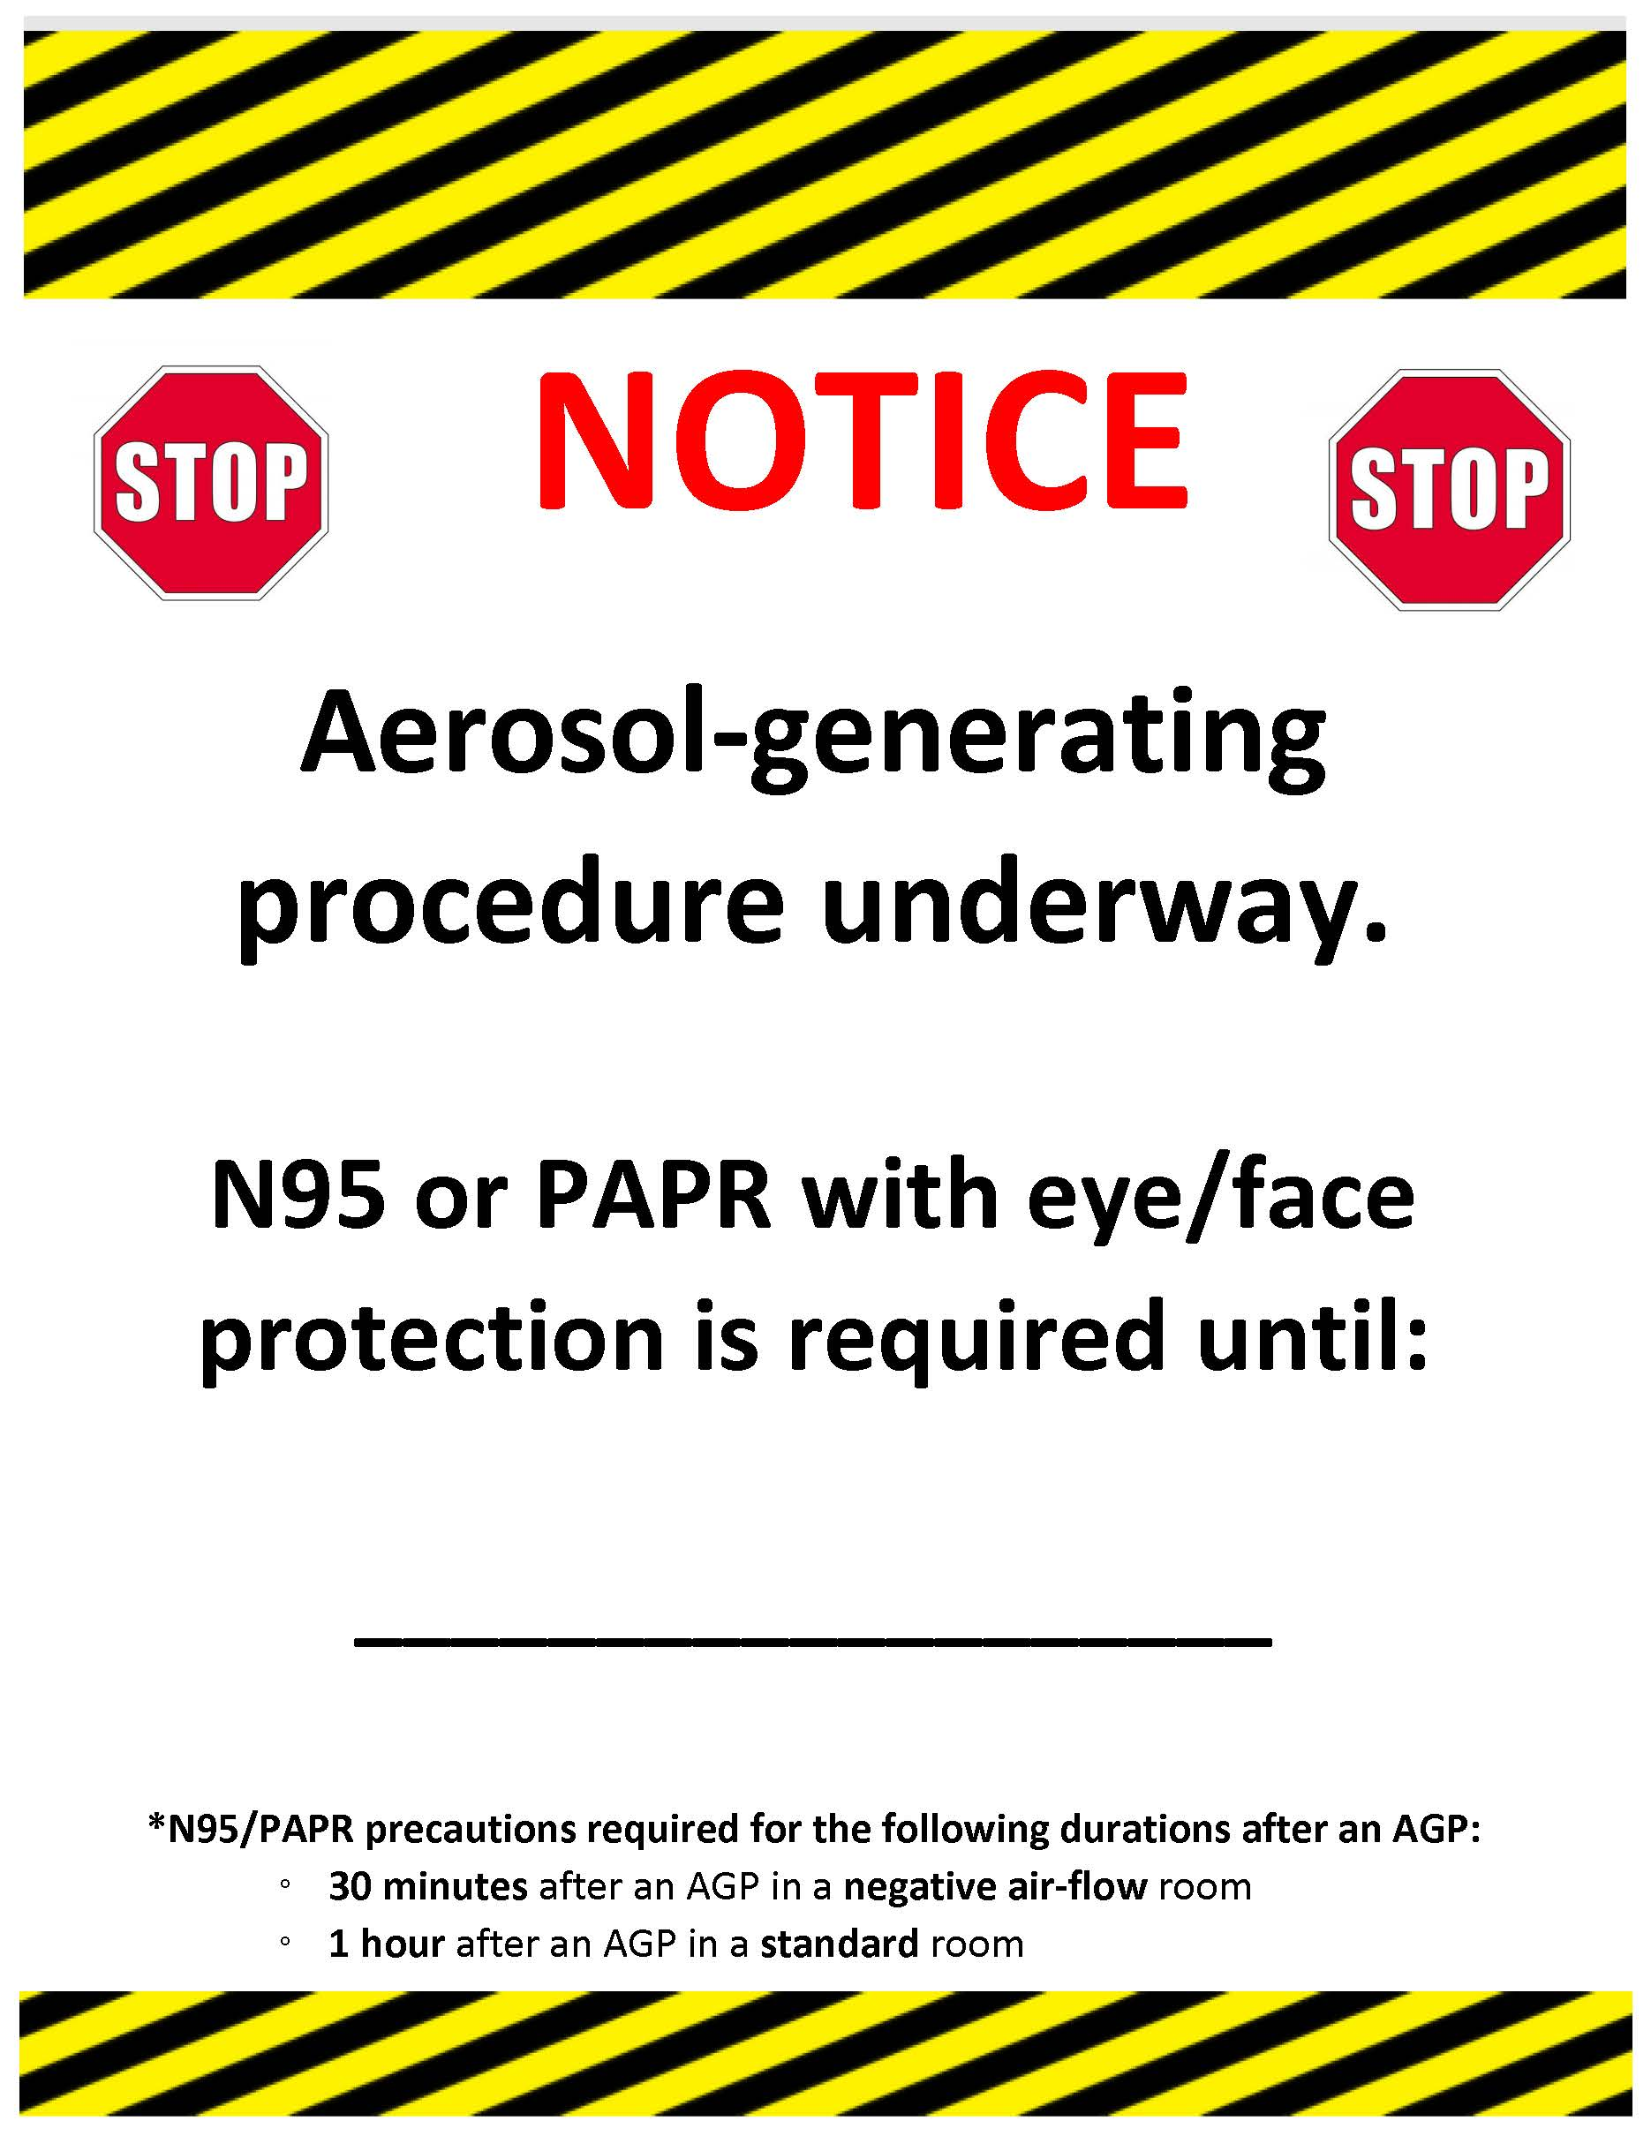
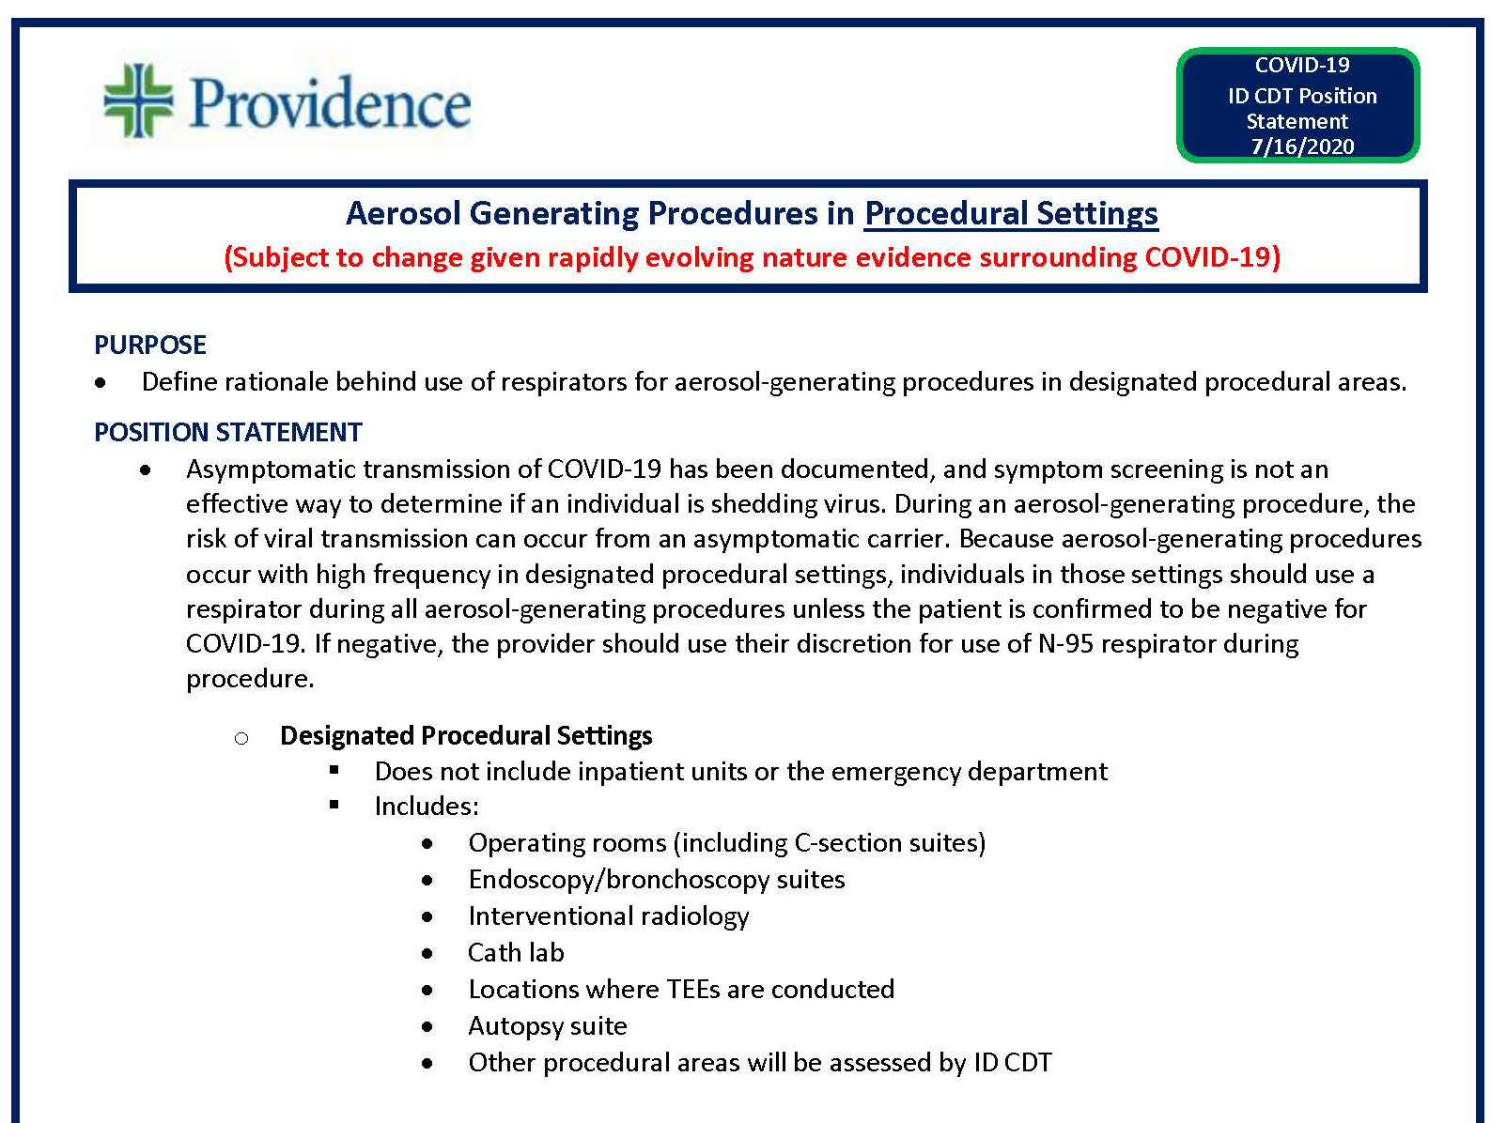
POSITION
STATEMENT
Aerosol Generating Procedures in Procedural Settings

Slide 41
Texas Demographics

Slide 42
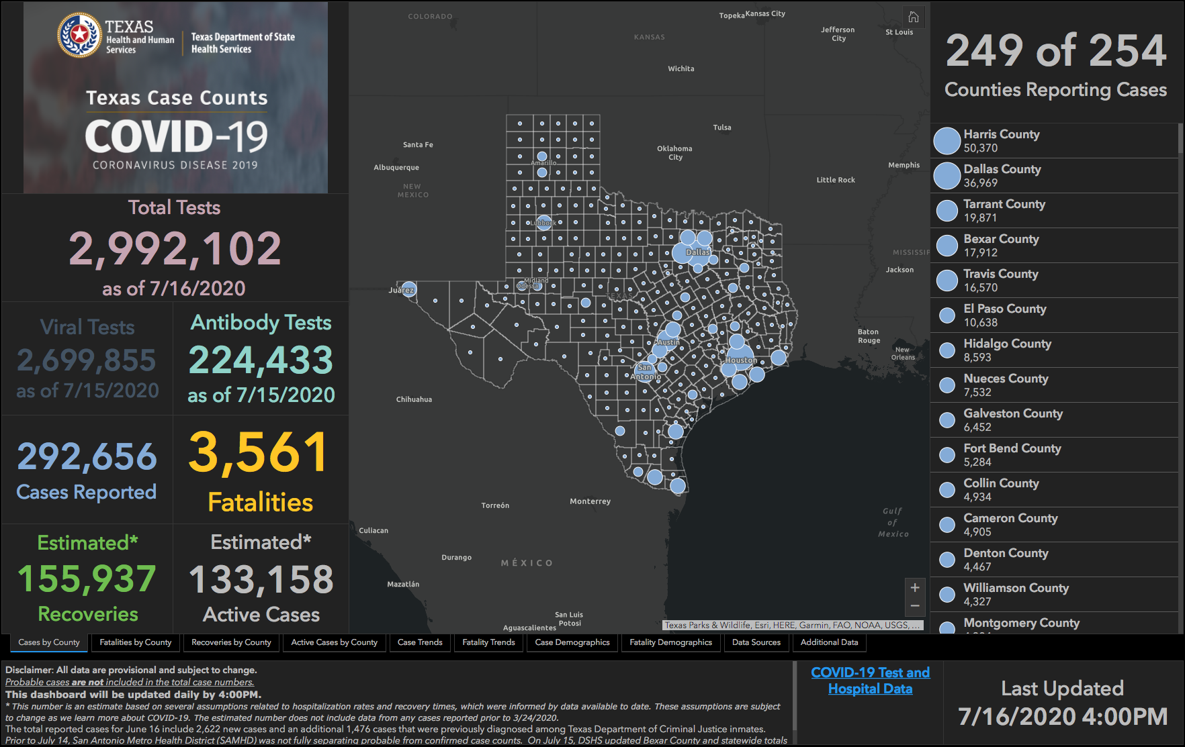

Slide 43
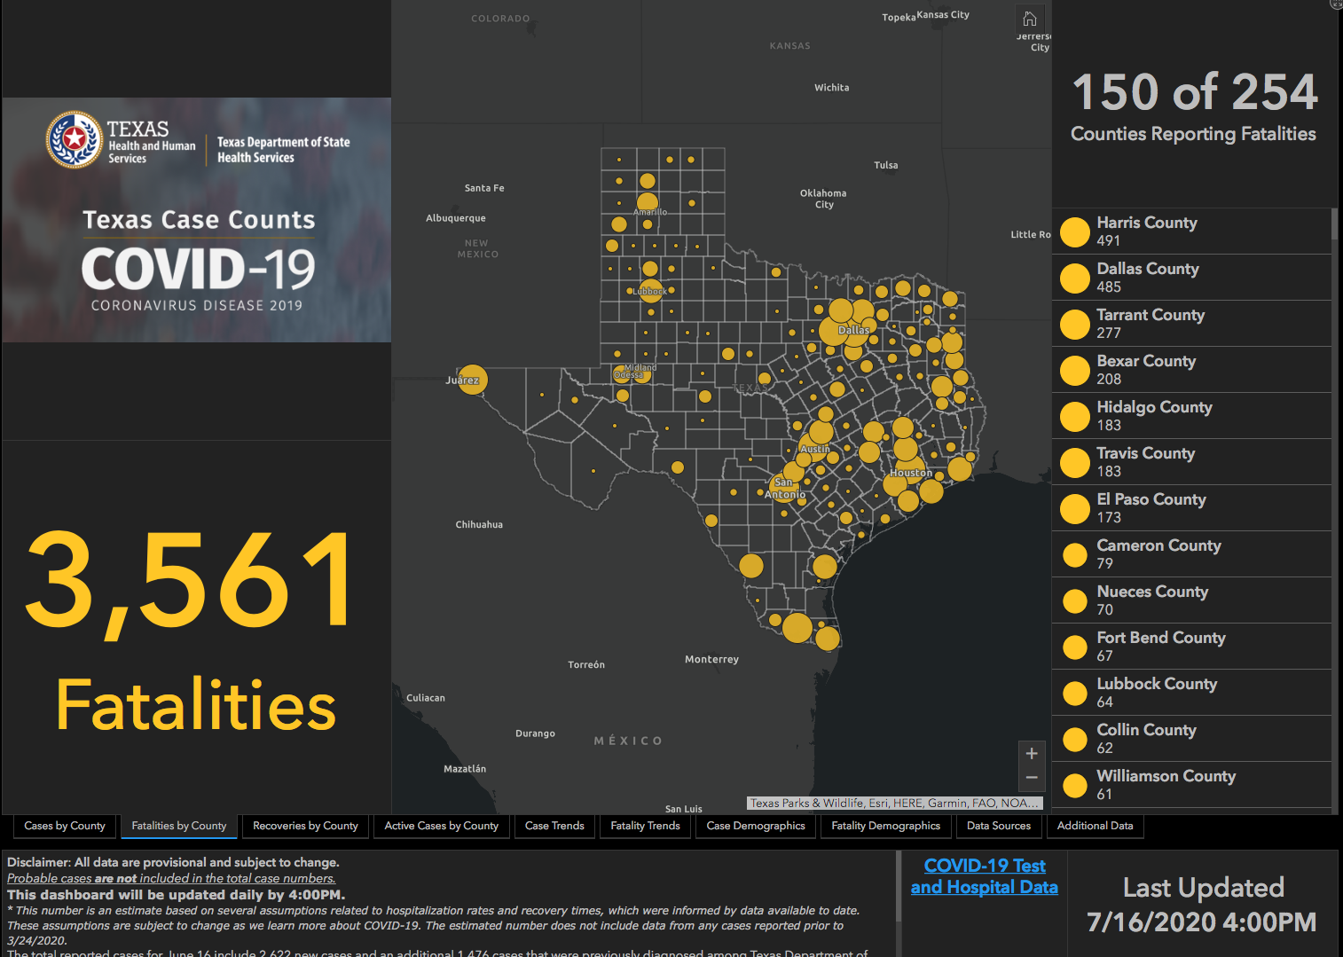

Slide 44
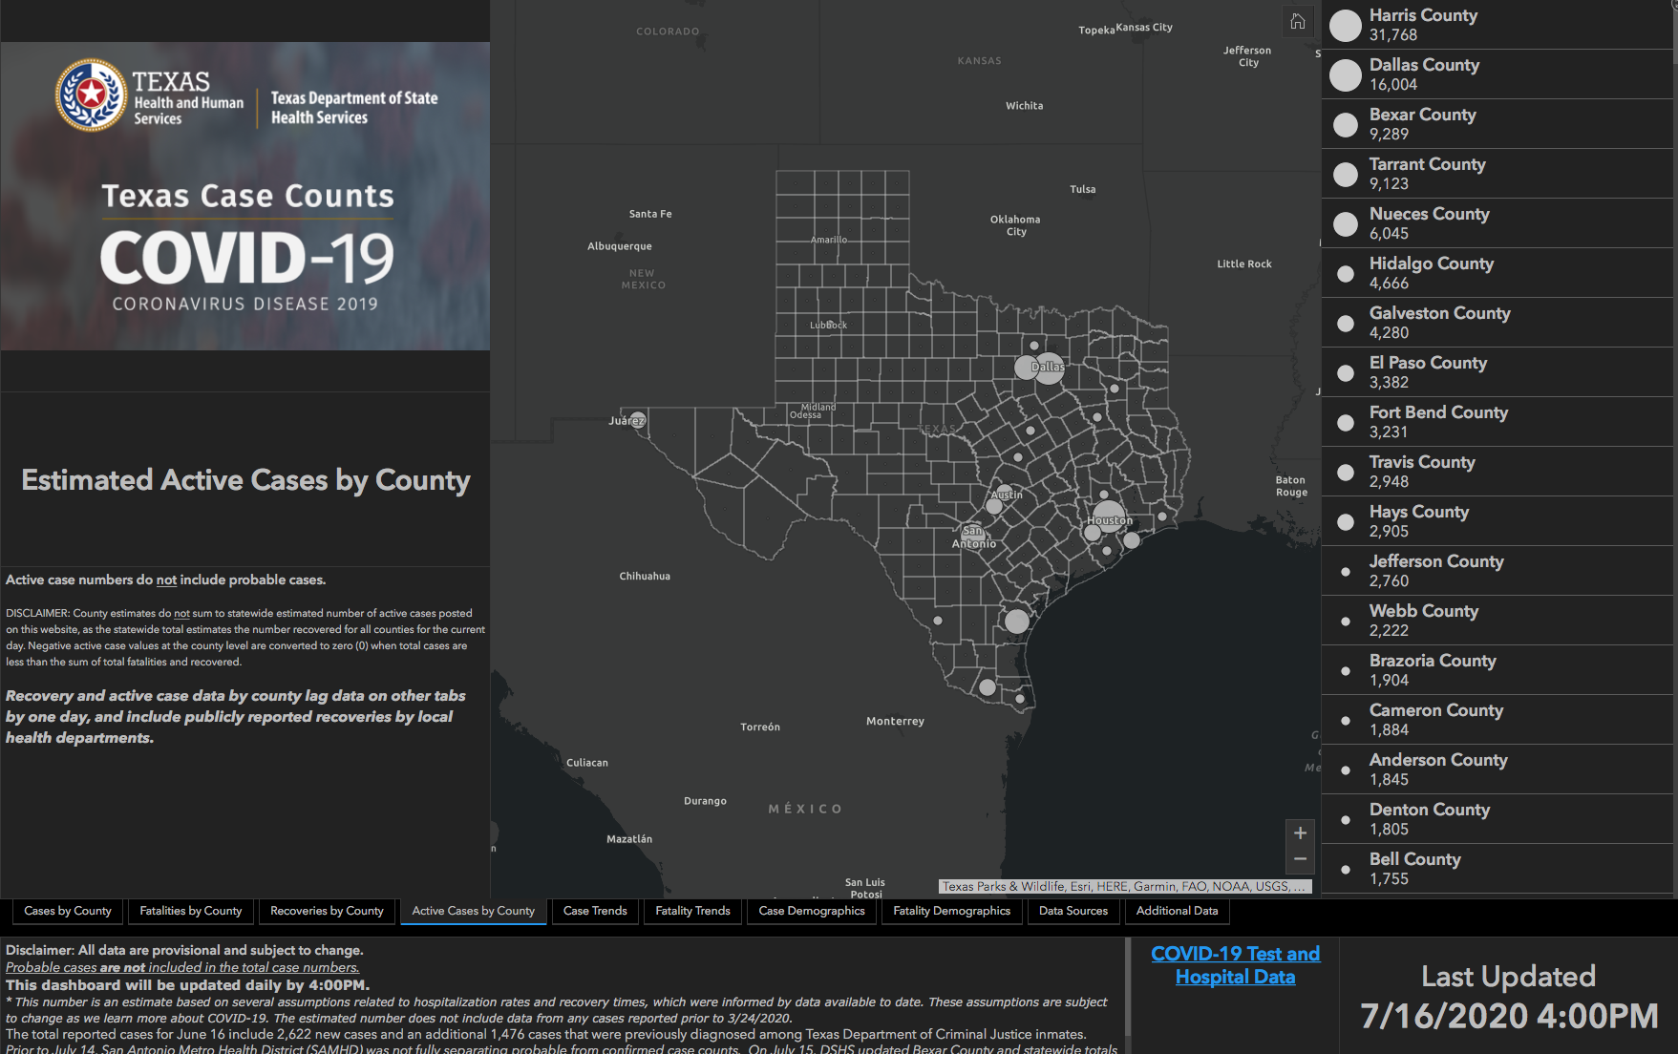

Slide 45
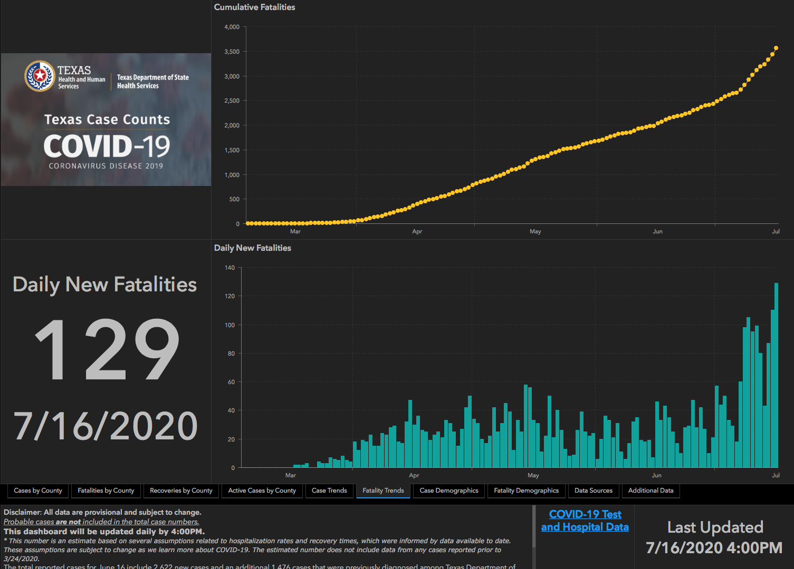

Slide 46
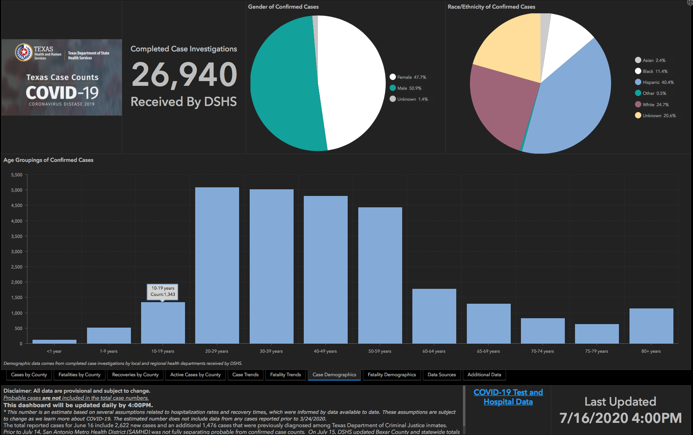

Slide 47
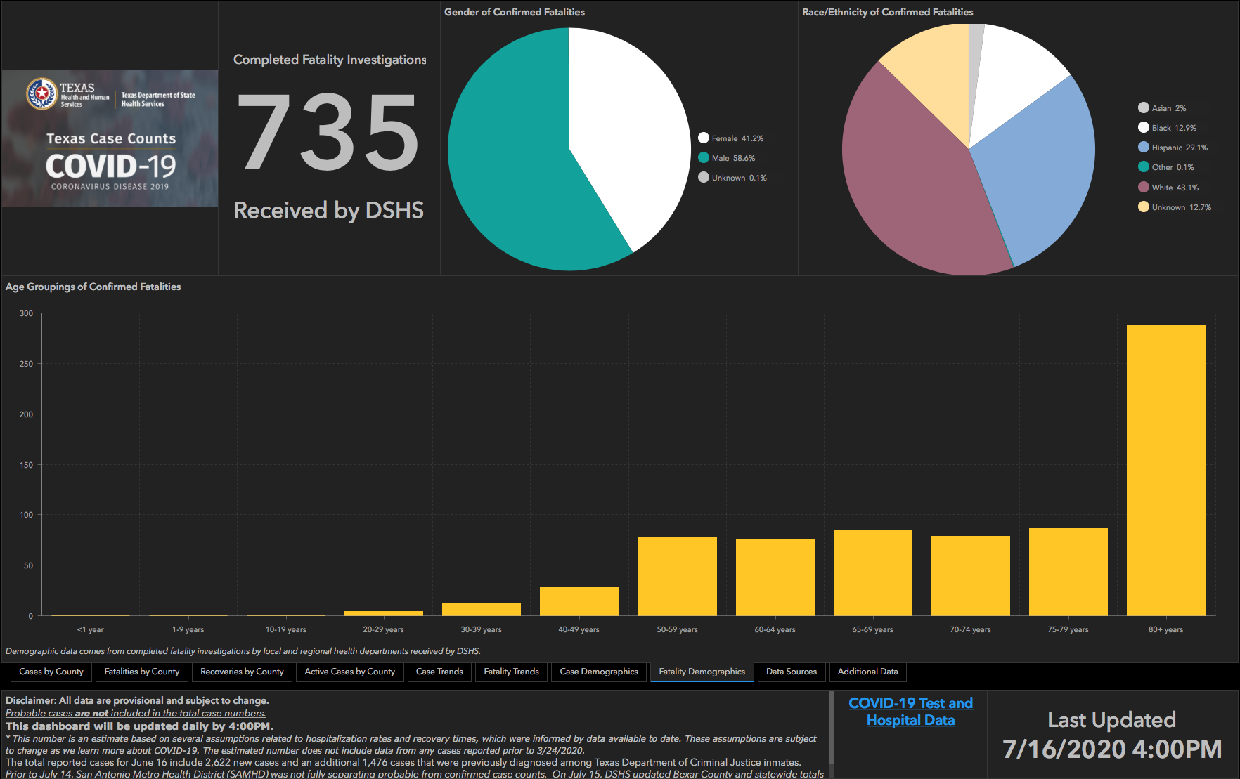

Slide 48
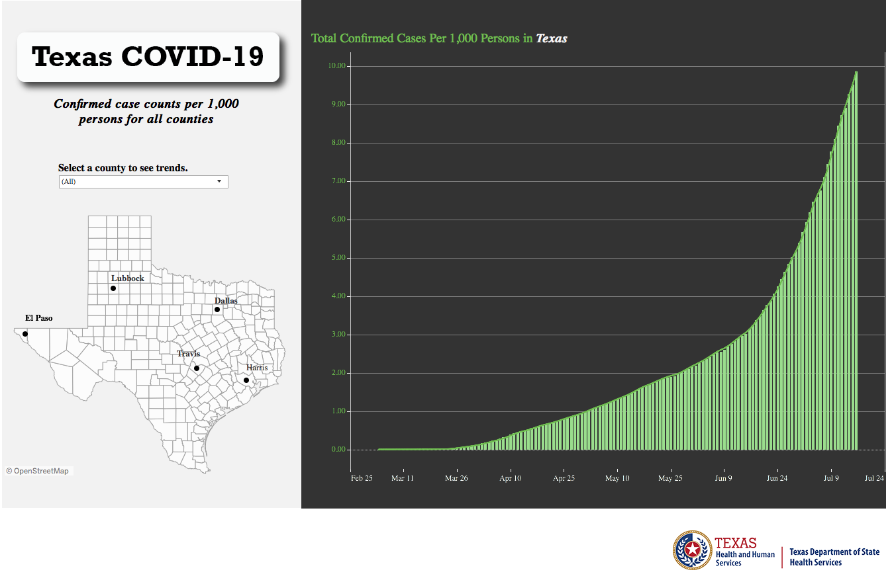
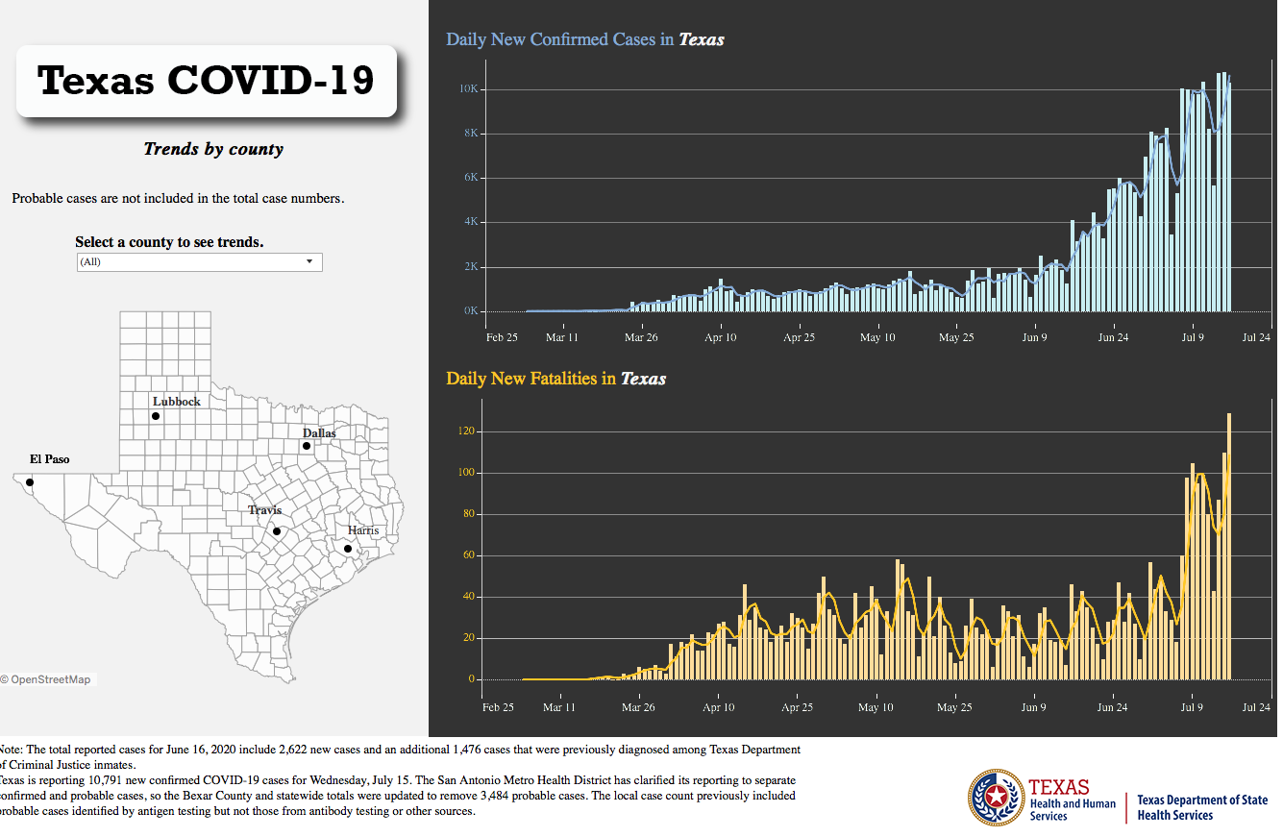
Texas Statewide Statistics
Orange bar represents ONE Case per 1000 Persons
(The Higher on the graph, the better)

Slide 49
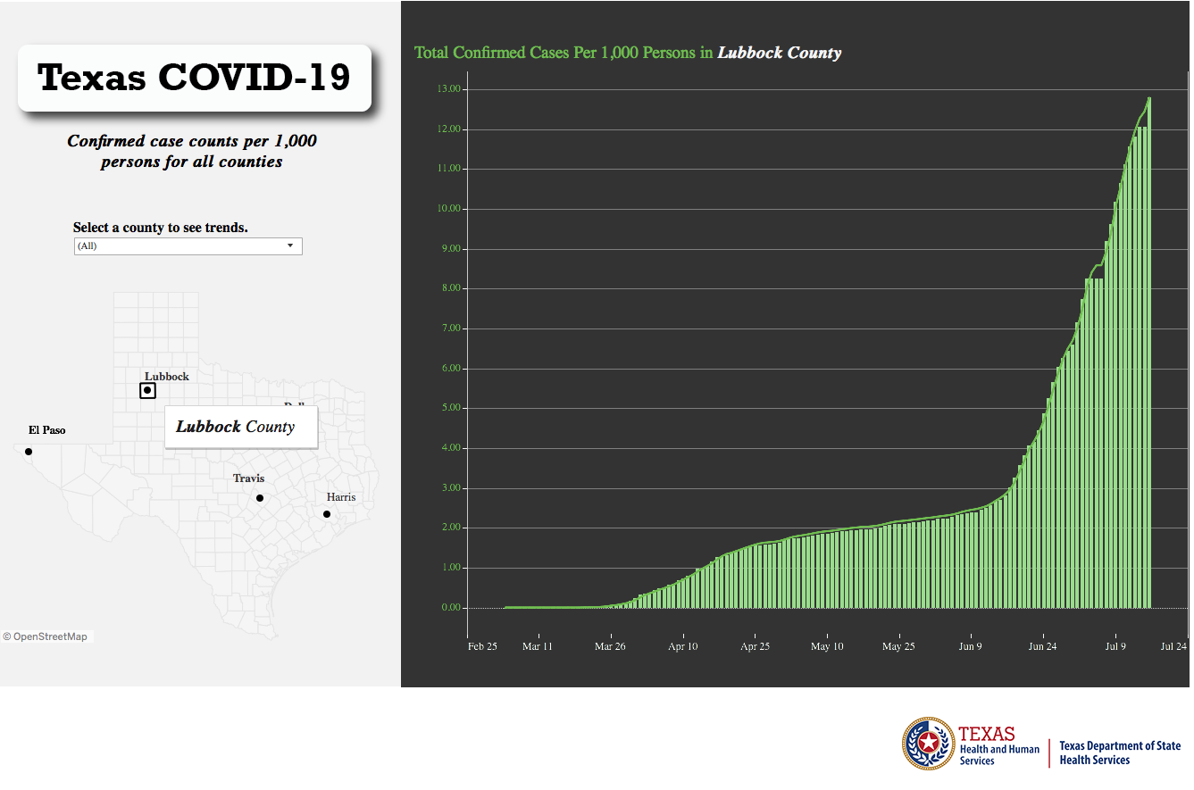
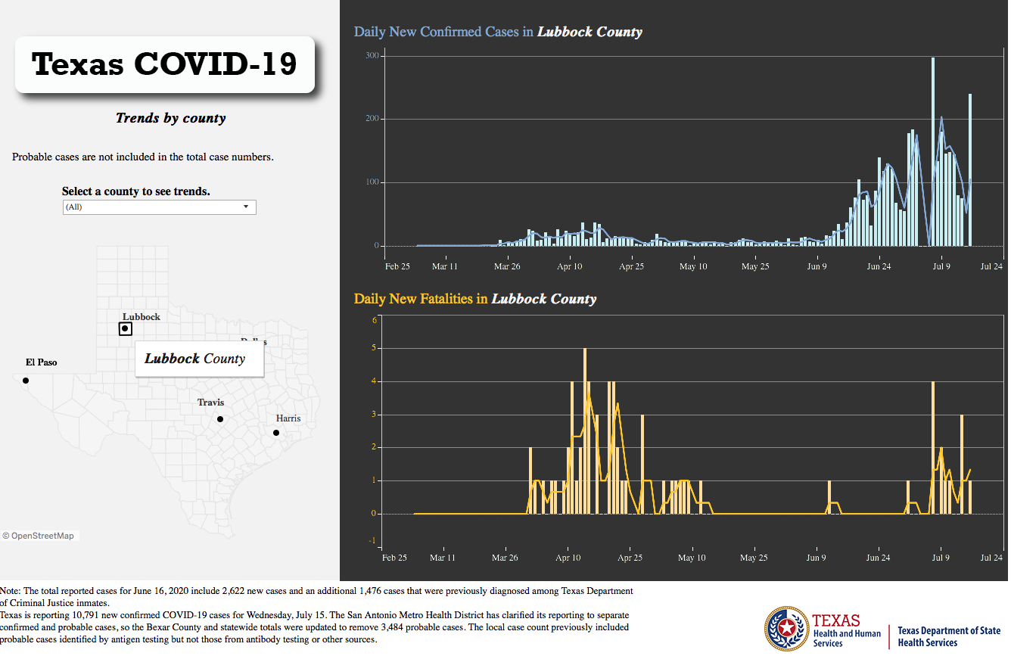
Lubbock County Statistics
Orange bar represents ONE Case per 1000 Persons
(The Higher on the graph, the better)

Slide 50
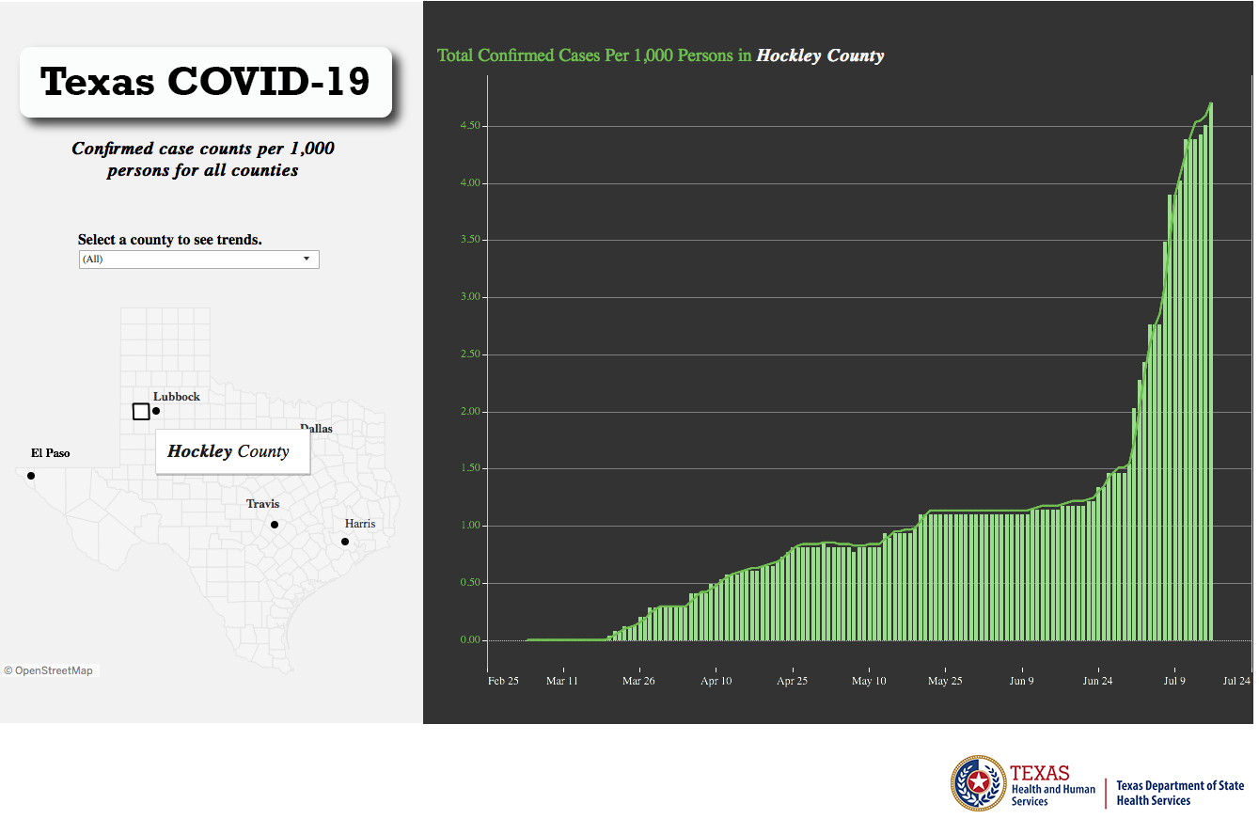
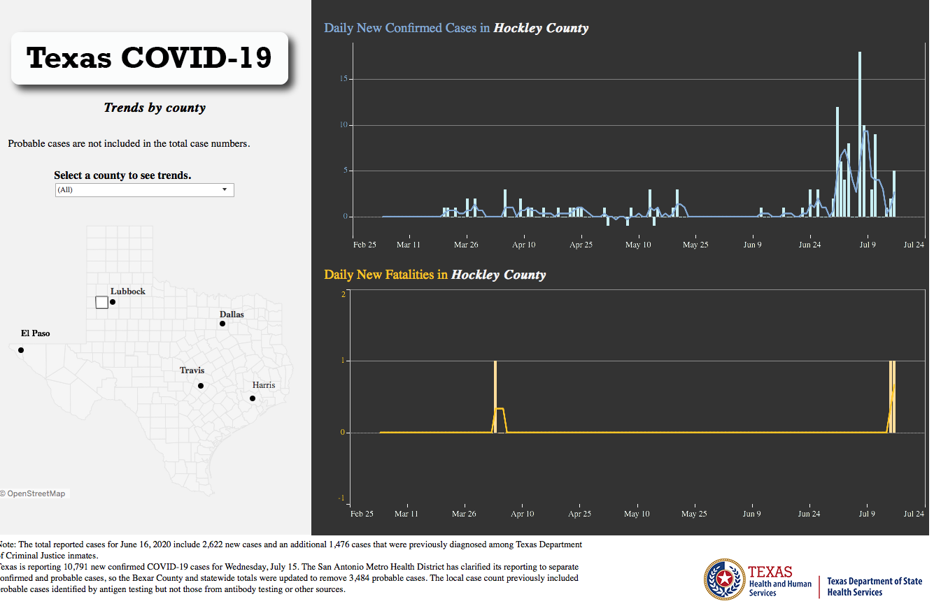
Hockley County Statistics
Orange bar represents ONE Case per 1000 Persons
(The Higher on the graph, the better)

Slide 51
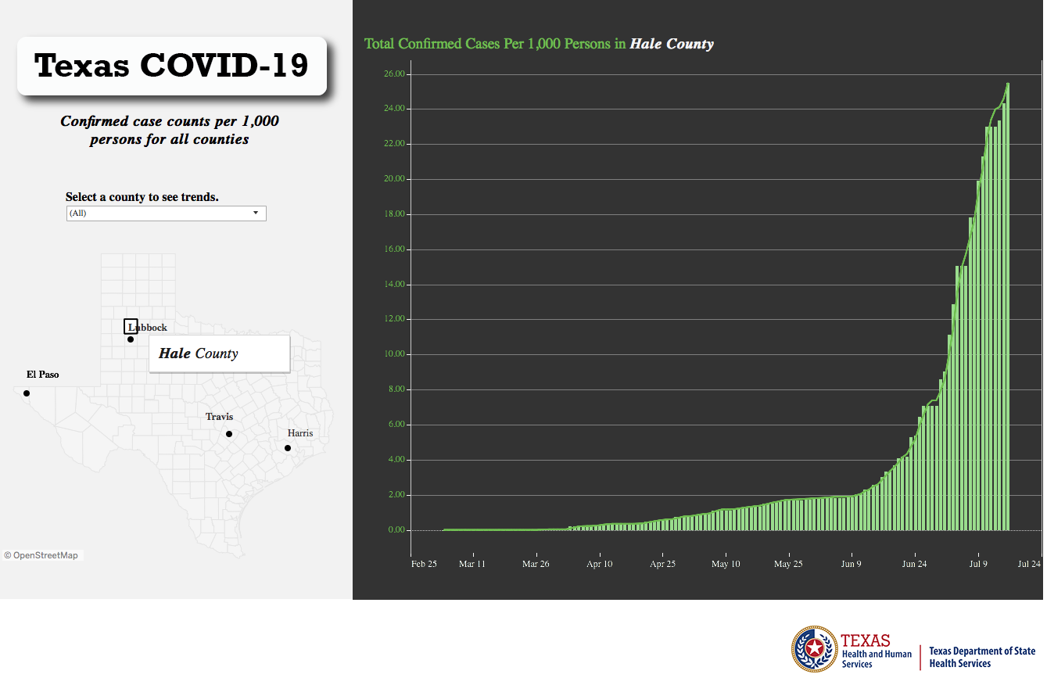
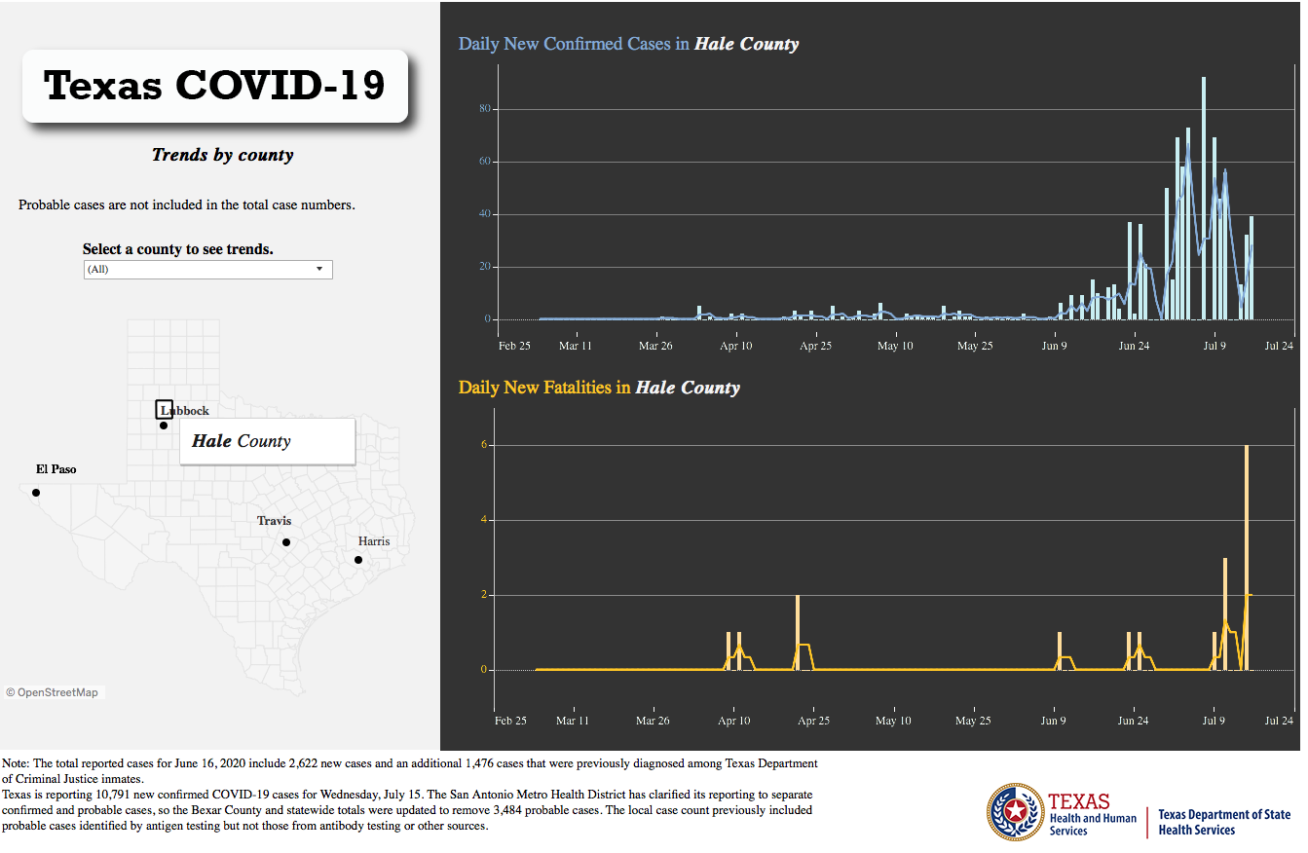
Hale County Statistics
Orange bar represents ONE Case per 1000 Persons
(The Higher on the graph, the better)

Slide 52
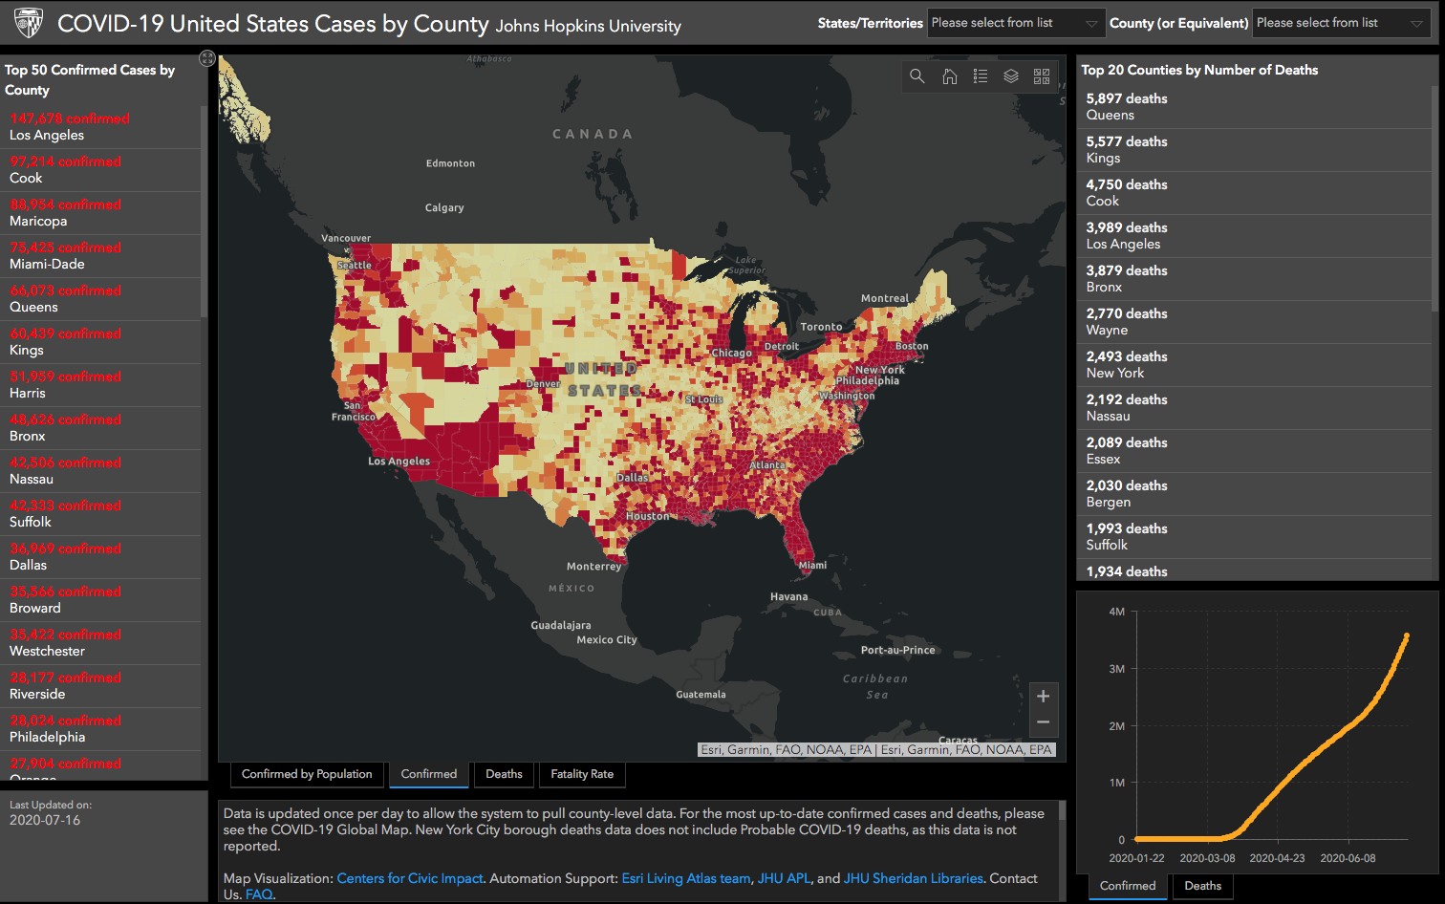

Slide 53
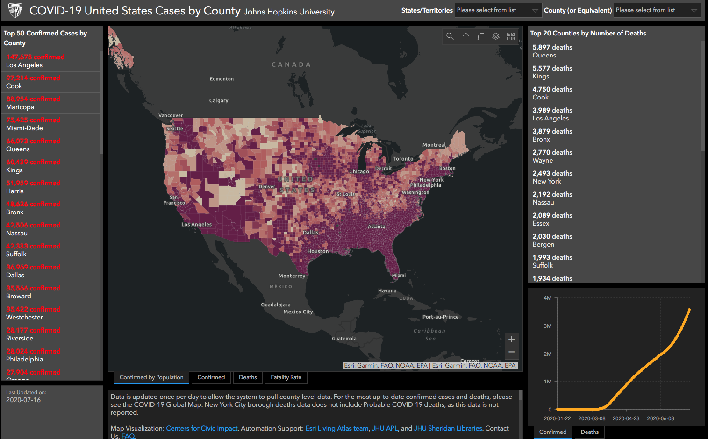

Slide 54
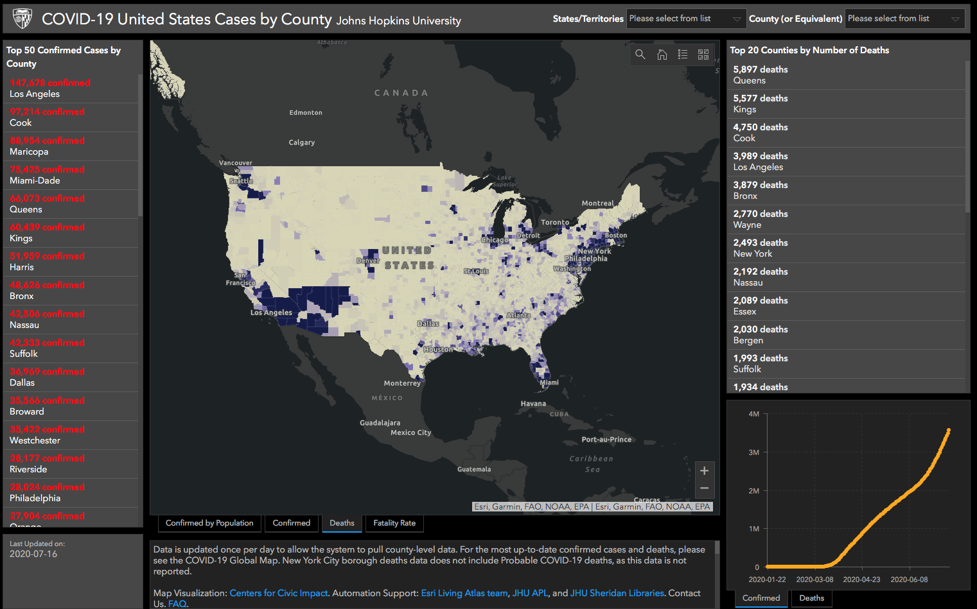

Slide 55
Q & A

