Slide 1
Covenant Health
Regional Update for Physicians
July 31, 2020

Slide 2

Reflection
“Any idiot can face a crisis; it’s this day-to-day living that wears you out.”
Anton Chekhov

Slide 3
Current Regional Census

Slide 4
Regional
 | Lubbock |  | Hockley |  | Hale
 |  | 7/29 |  | 7/29 |  | 7/29
Total |  | 5327 |  | 168 |  | 1162
Active |  | 1954 |  | 68 |  | 154
Deaths |  | 75 |  | 4 |  | 25
New | 227 |  | 18 |  | 59
Bender Terrace and Garrison under control
Crown Point – 2nd round of testing – waiting results
County Jail – 60 active cases

Slide 5
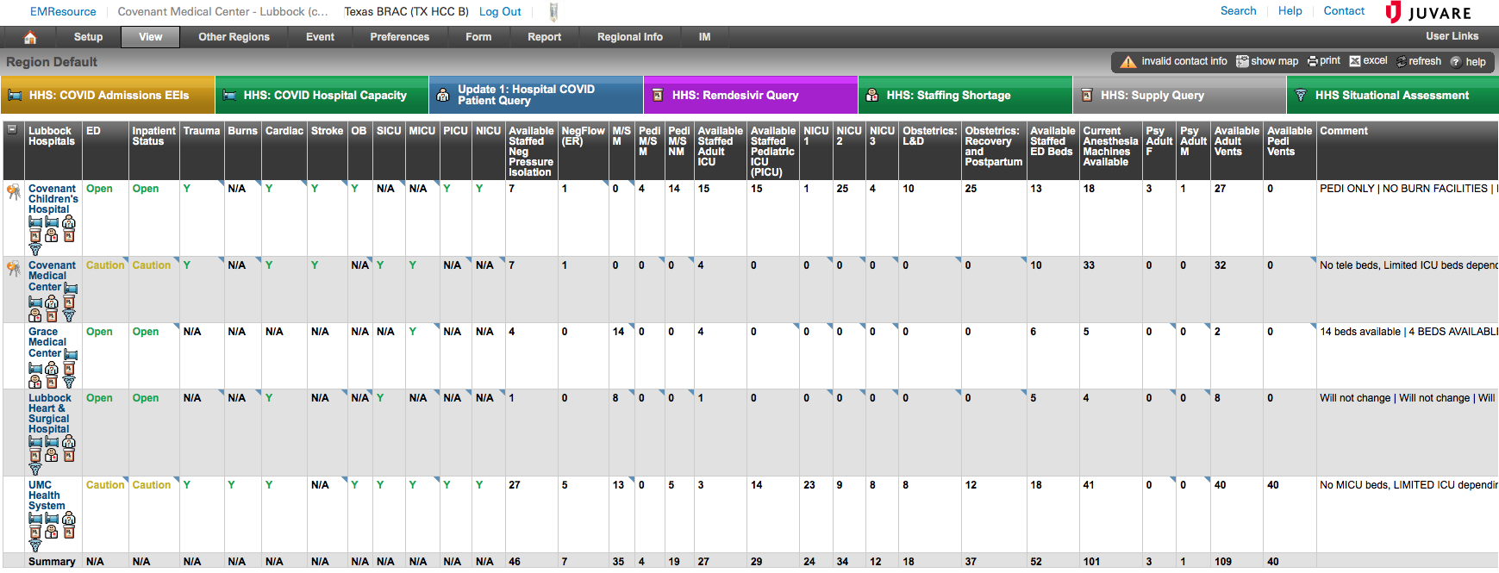
EMResources

Slide 6
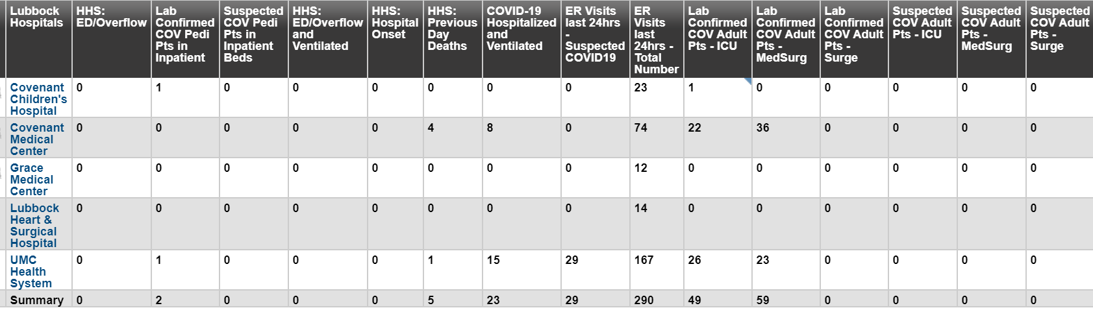
Regional: Lubbock

Slide 7
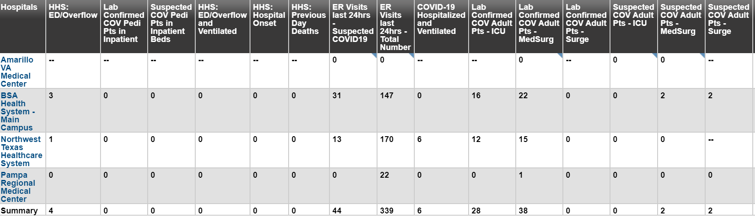
Regional: Amarillo

Slide 8
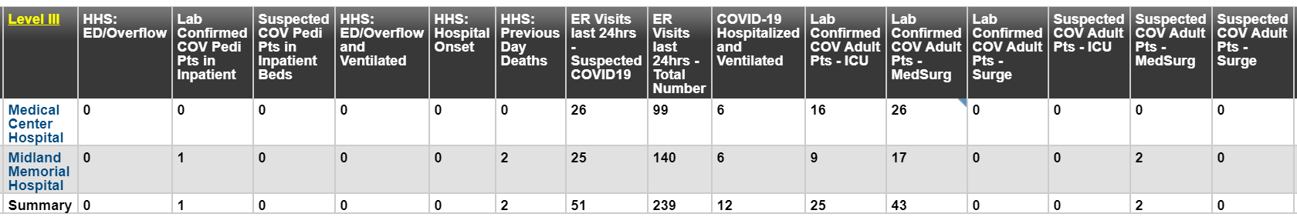
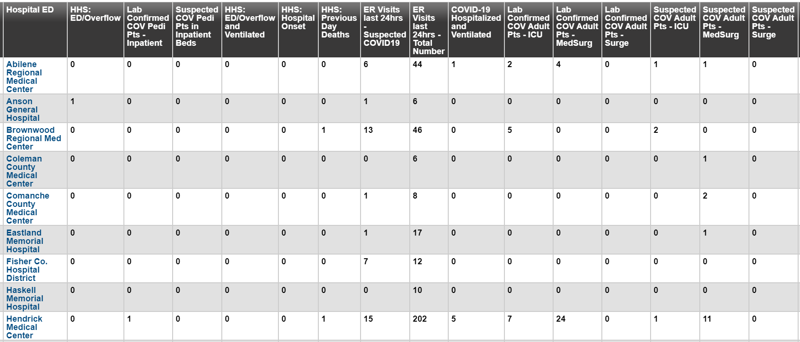
Regional: Midland / Odessa / Abilene

Slide 9
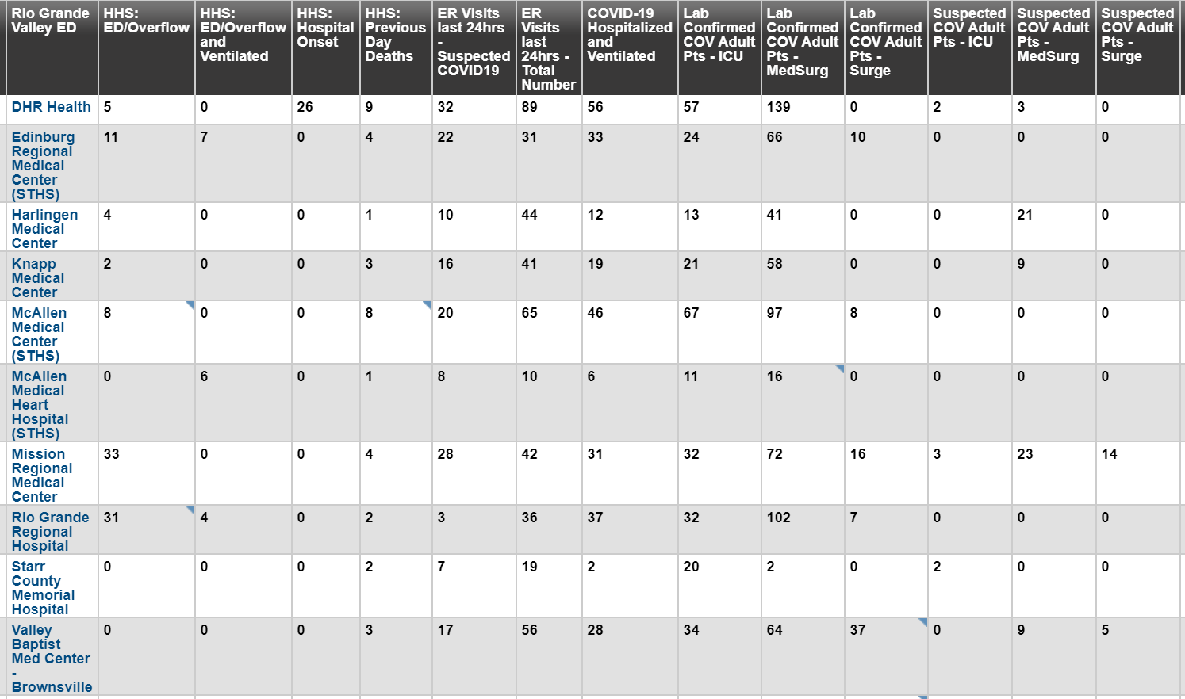
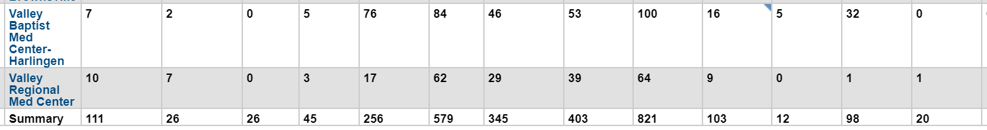
Regional

Slide 10
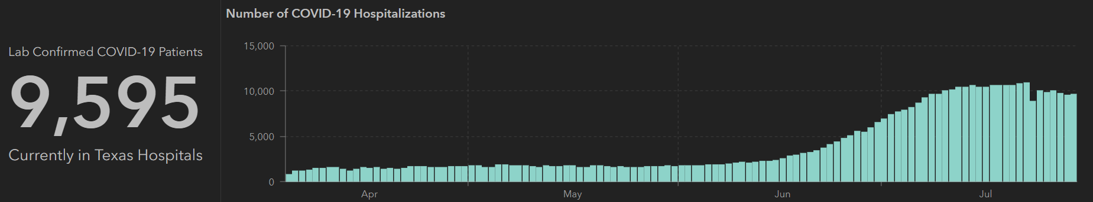
STATE
 | 7/29 | 7/27 | 7/22 | 7/20 | 7/15 | 7/13 | 7/8 | 7/6 | 7/1
Cases | 403,307 | 385,923 | 351,618 | 332,434 | 282,365 | 264,363 | 210,585 | 200,557 | 168,062
Deaths | 6190 | 5713 | 4348 | 4020 | 3432 | 3235 | 2715 | 2655 | 2481
Hospitalized | 9595 | 9781 | 10,893 | 10,569 | 10,471 | 10,405 | 9286 | 8698 | 6904

Slide 11
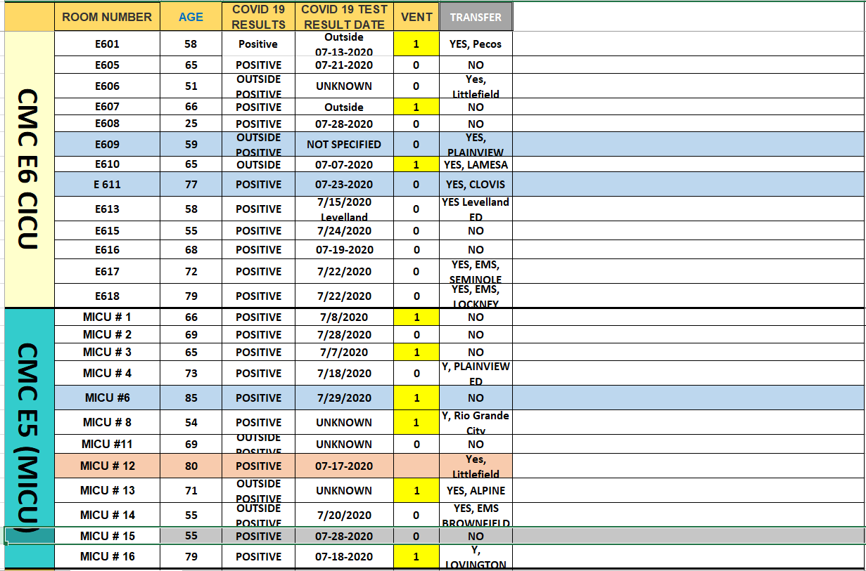
PUI/Confirmed cases-hospitalized

Slide 12
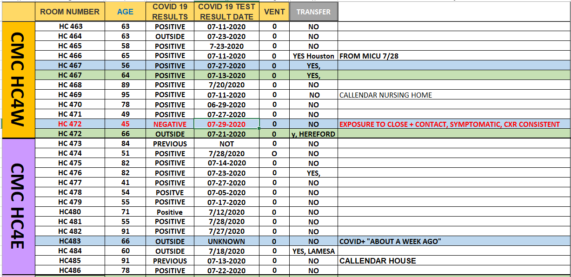
PUI/Confirmed cases-hospitalized

Slide 13
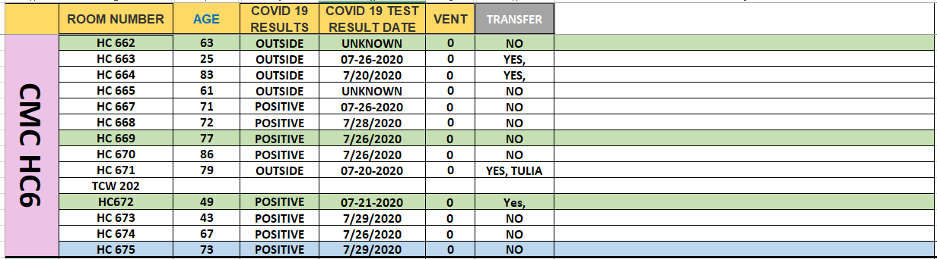
PUI/Confirmed cases-hospitalized

Slide 14
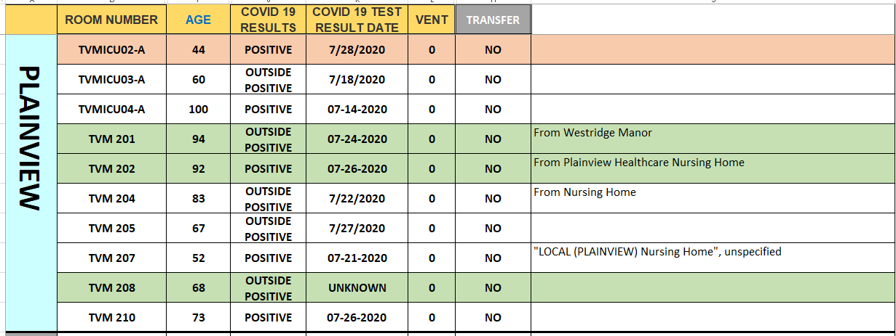
PUI/Confirmed cases-hospitalized

Slide 15
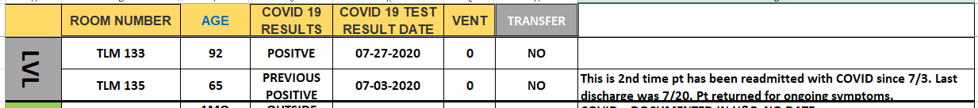
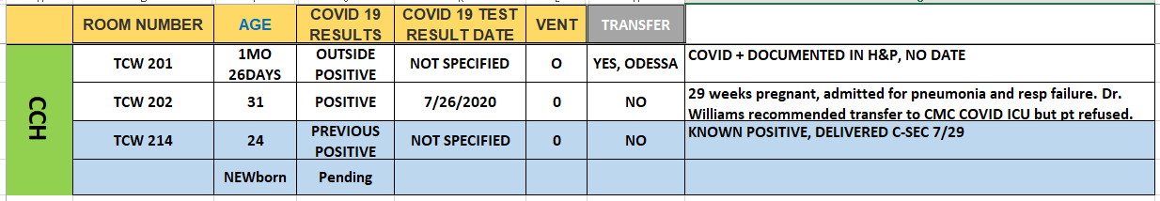
PUI/Confirmed cases-hospitalized

Slide 16
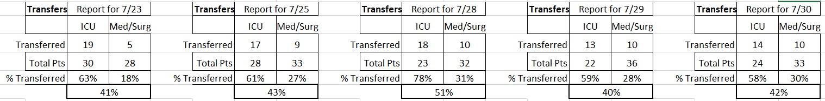
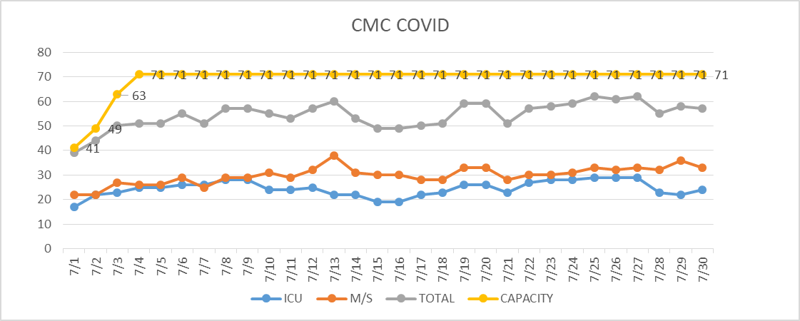
PUI/Confirmed cases-hospitalized

Slide 17
Surge Plan- Revised
Covenant Medical Center
 | ICU | Med Surg | Total
Phase 1 | 10-CICU |  | 10
Phase 2 | 17-CICU | 10-HC4 | 27
Phase 3 | 17-CICU | 24-HC4 | 41
Phase 4 | 17-CICU 8-MICU | 24-HC4 14-Pal Med | 63
Phase 5 | 17-CICU 16-MICU | 24-HC4 14-Pal Med | 71
Phase 6 | 17-CICU 16-MICU 8- SICU 4 (east) | 24-HC4 14-Pal Med 15 – S 9 (east) | 94
Last Week
Currently

Slide 18
Caregivers
COVID Related Furloughs
Count reflects # furlough (exposed and positive)
Good
Moderate
Critical

Slide 19
Statistics
Cristian Requenez, MS
Clinical Data Analyst
Performance Improvement and Decision Support Services

Slide 20
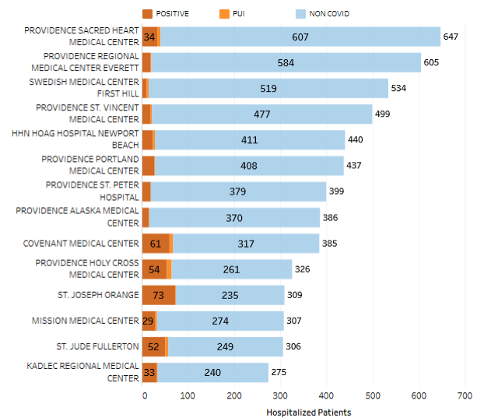
Providence System Hospitalized COVID-19 Cases
15.8%

Slide 21
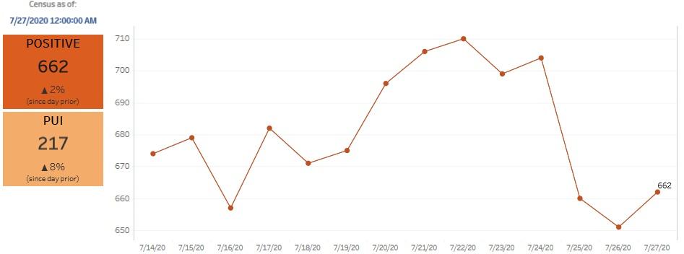
Providence Inpatient COVID-19 Volume

Slide 22
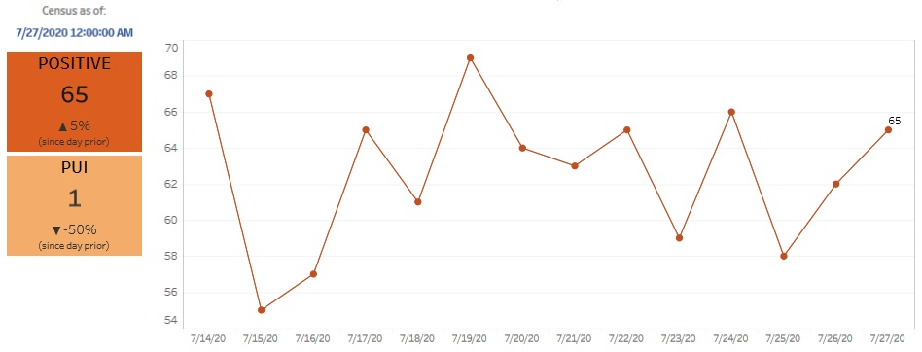
Texas Inpatient COVID-19 Volume

Slide 23
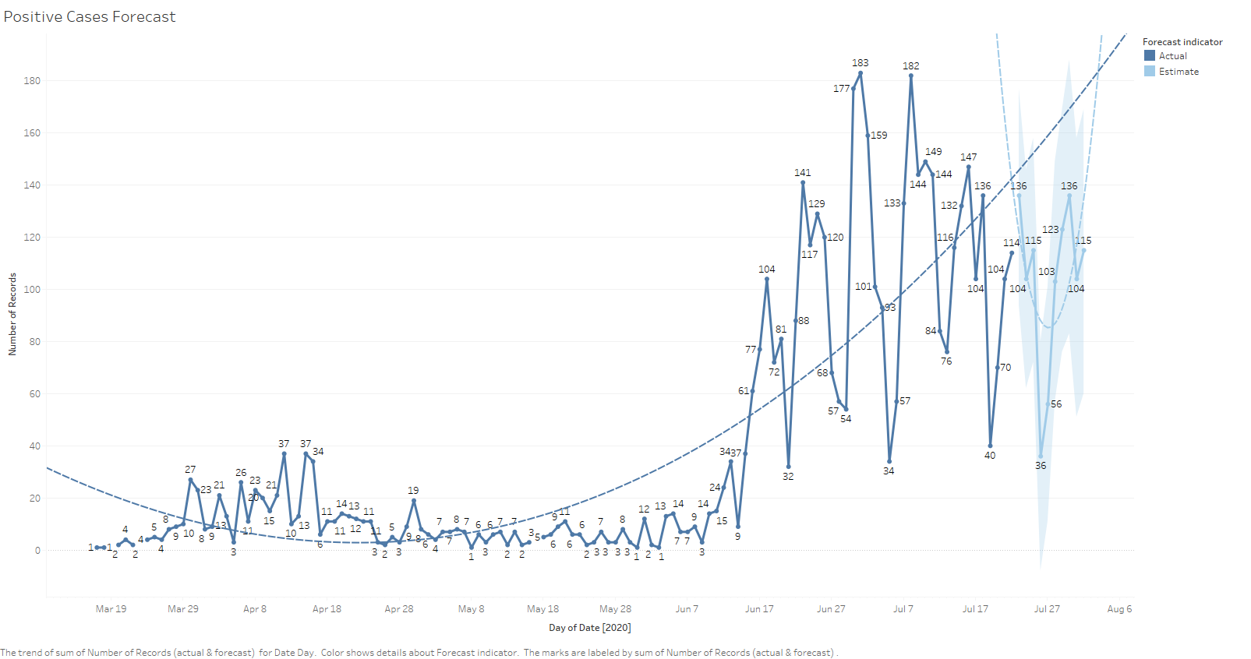
New COVID-19 POSITIVES by Day Trend

Slide 24
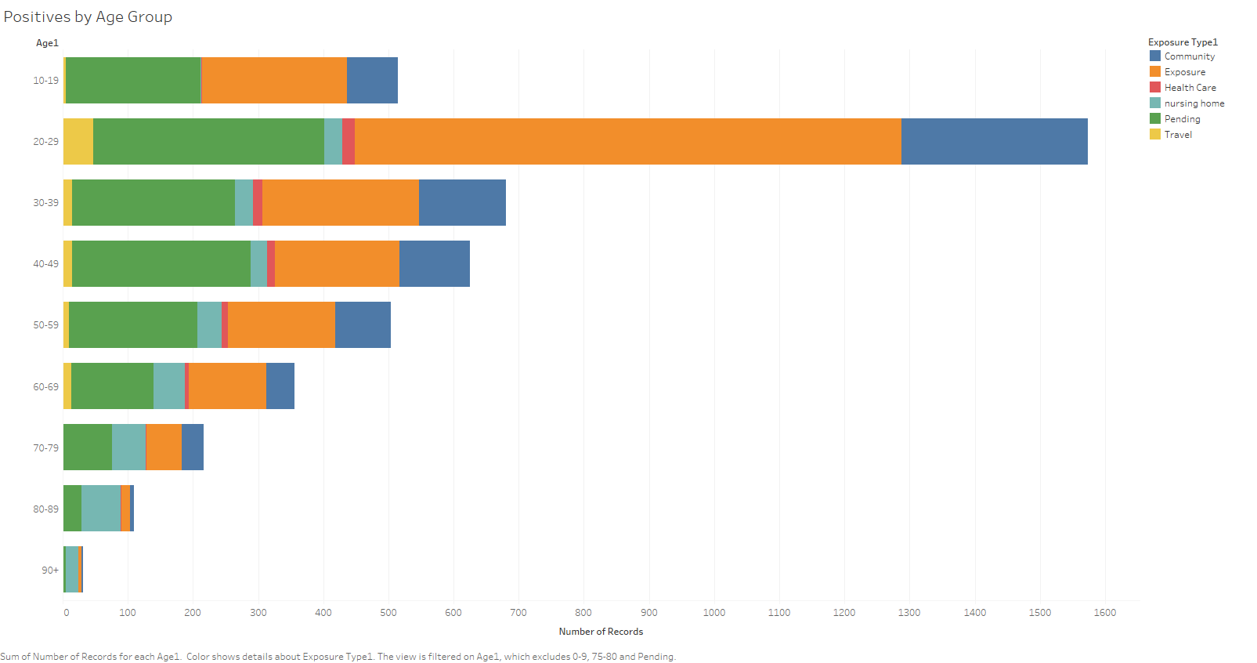
COVID-19 POSITIVES Age Distribution

Slide 25
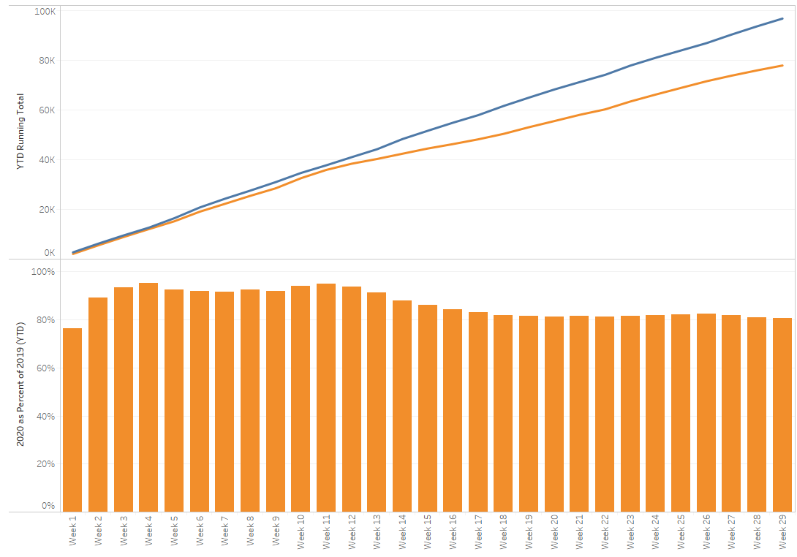
TX/NM Region Weekly Procedures (YOY)

Slide 26
Covid-19 Testing
The entire country is struggling to provide adequate testing capacity

Slide 27
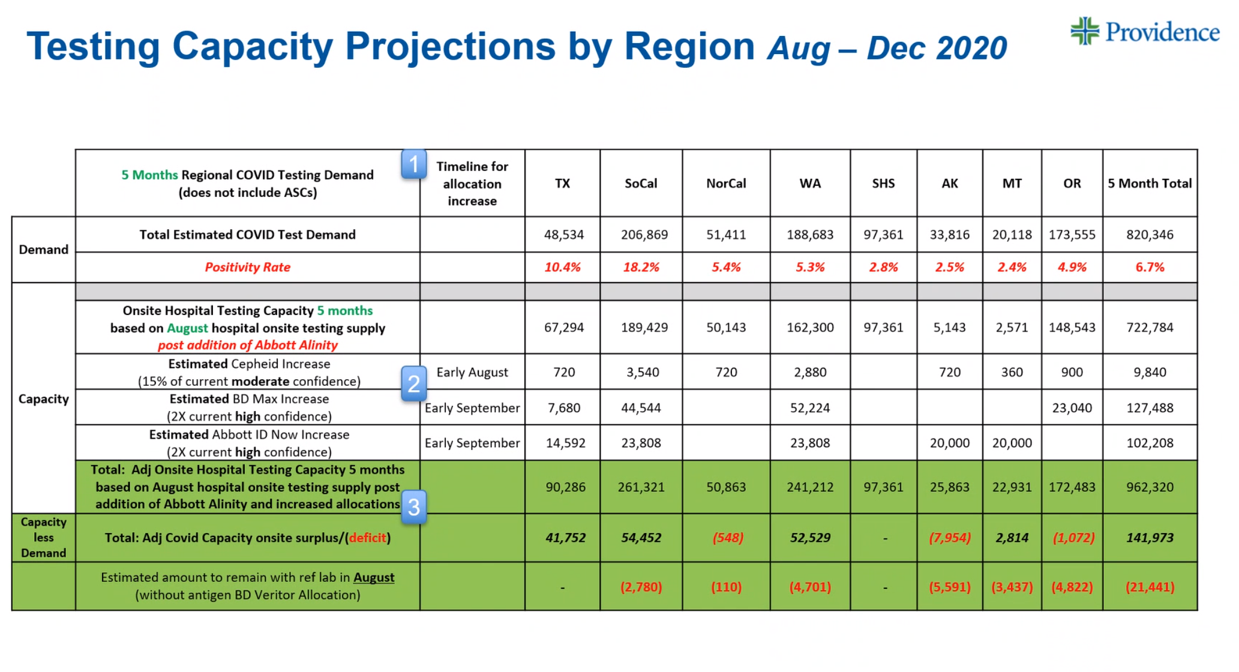
Testing Capacity

Slide 28
TESTING
 | CMC | CCH | CHP | Grace | Total Tests
Abbott | 728 | - | - | - | 286
Cepheid | 1740 | - | - | -
BD Max | - | - | - | 473
NP Swab | >10,000 | - | - | -
VTM | >2000 | - | - | -
Alinity Update

Slide 29
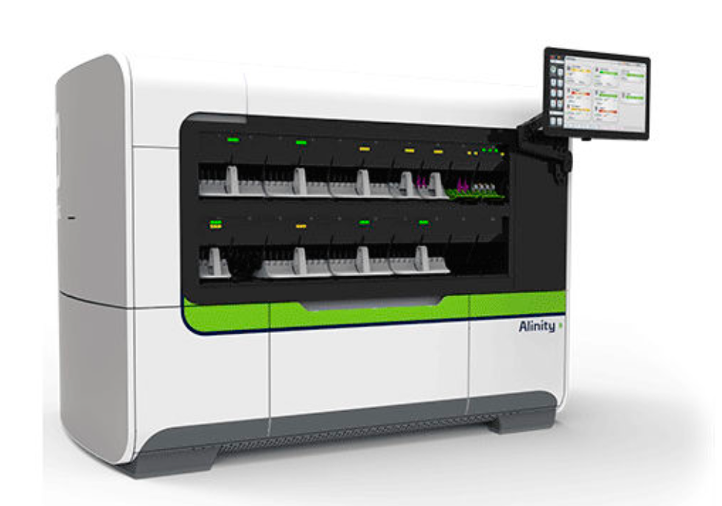
Abbott Alinity® m
The newest member of our clinical laboratory testing family

Slide 30
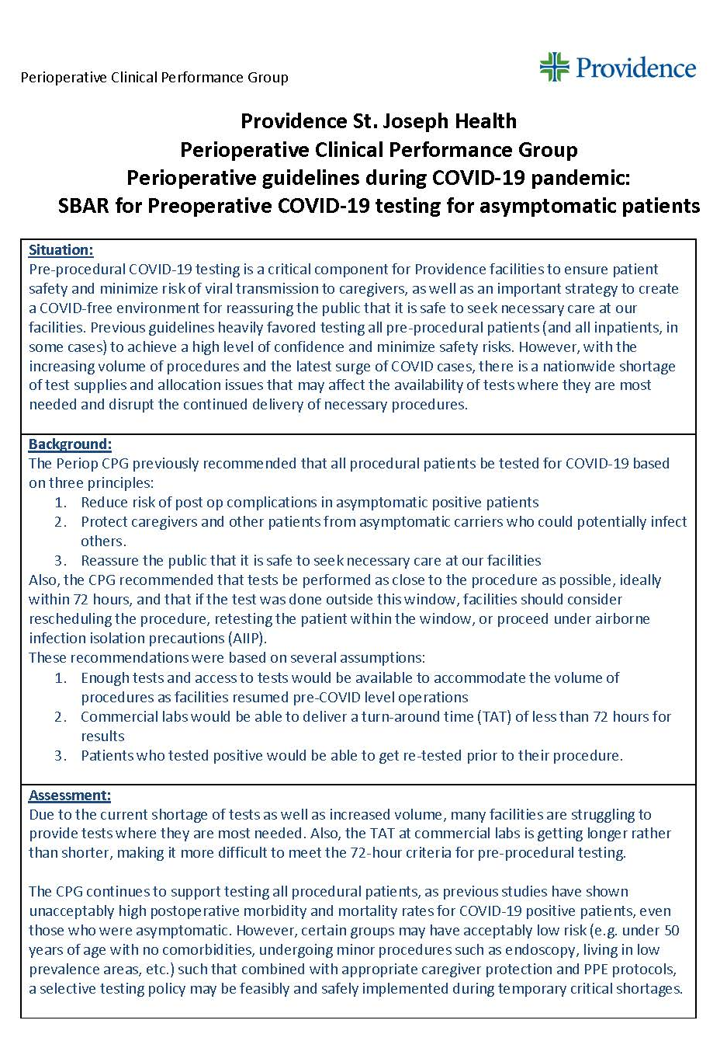
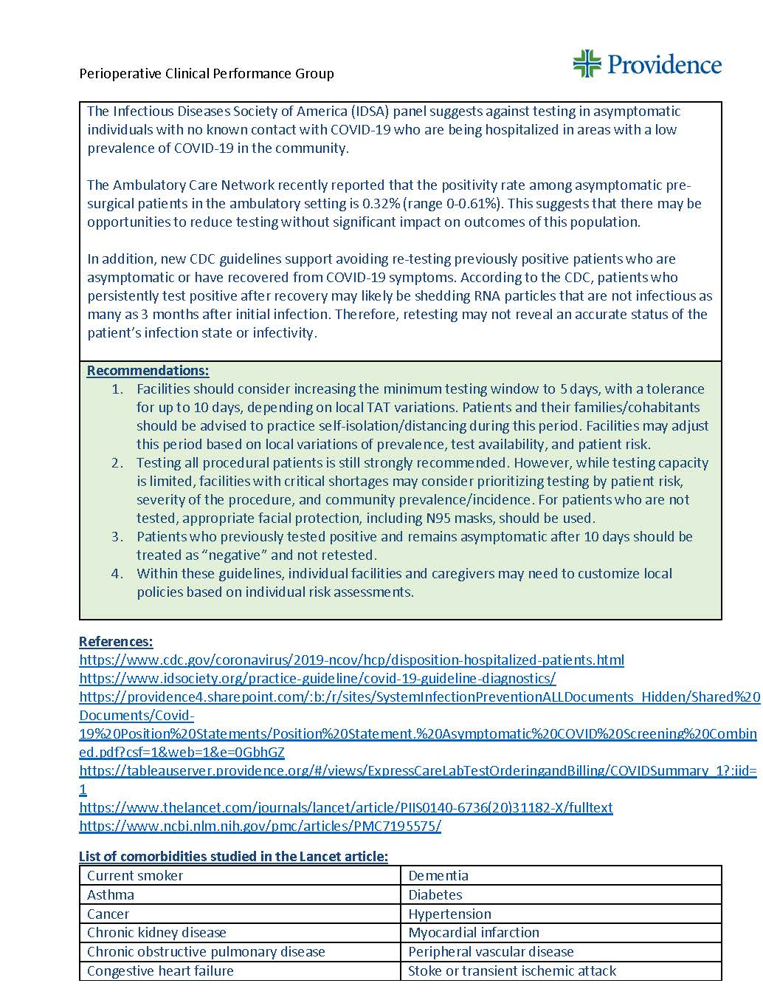
SBAR
Preoperative COVID-19 Testing for Asymptomatic Patients
Dr. Jason Loos
Daniel Hronek
Charlotte Wheeler

Slide 31
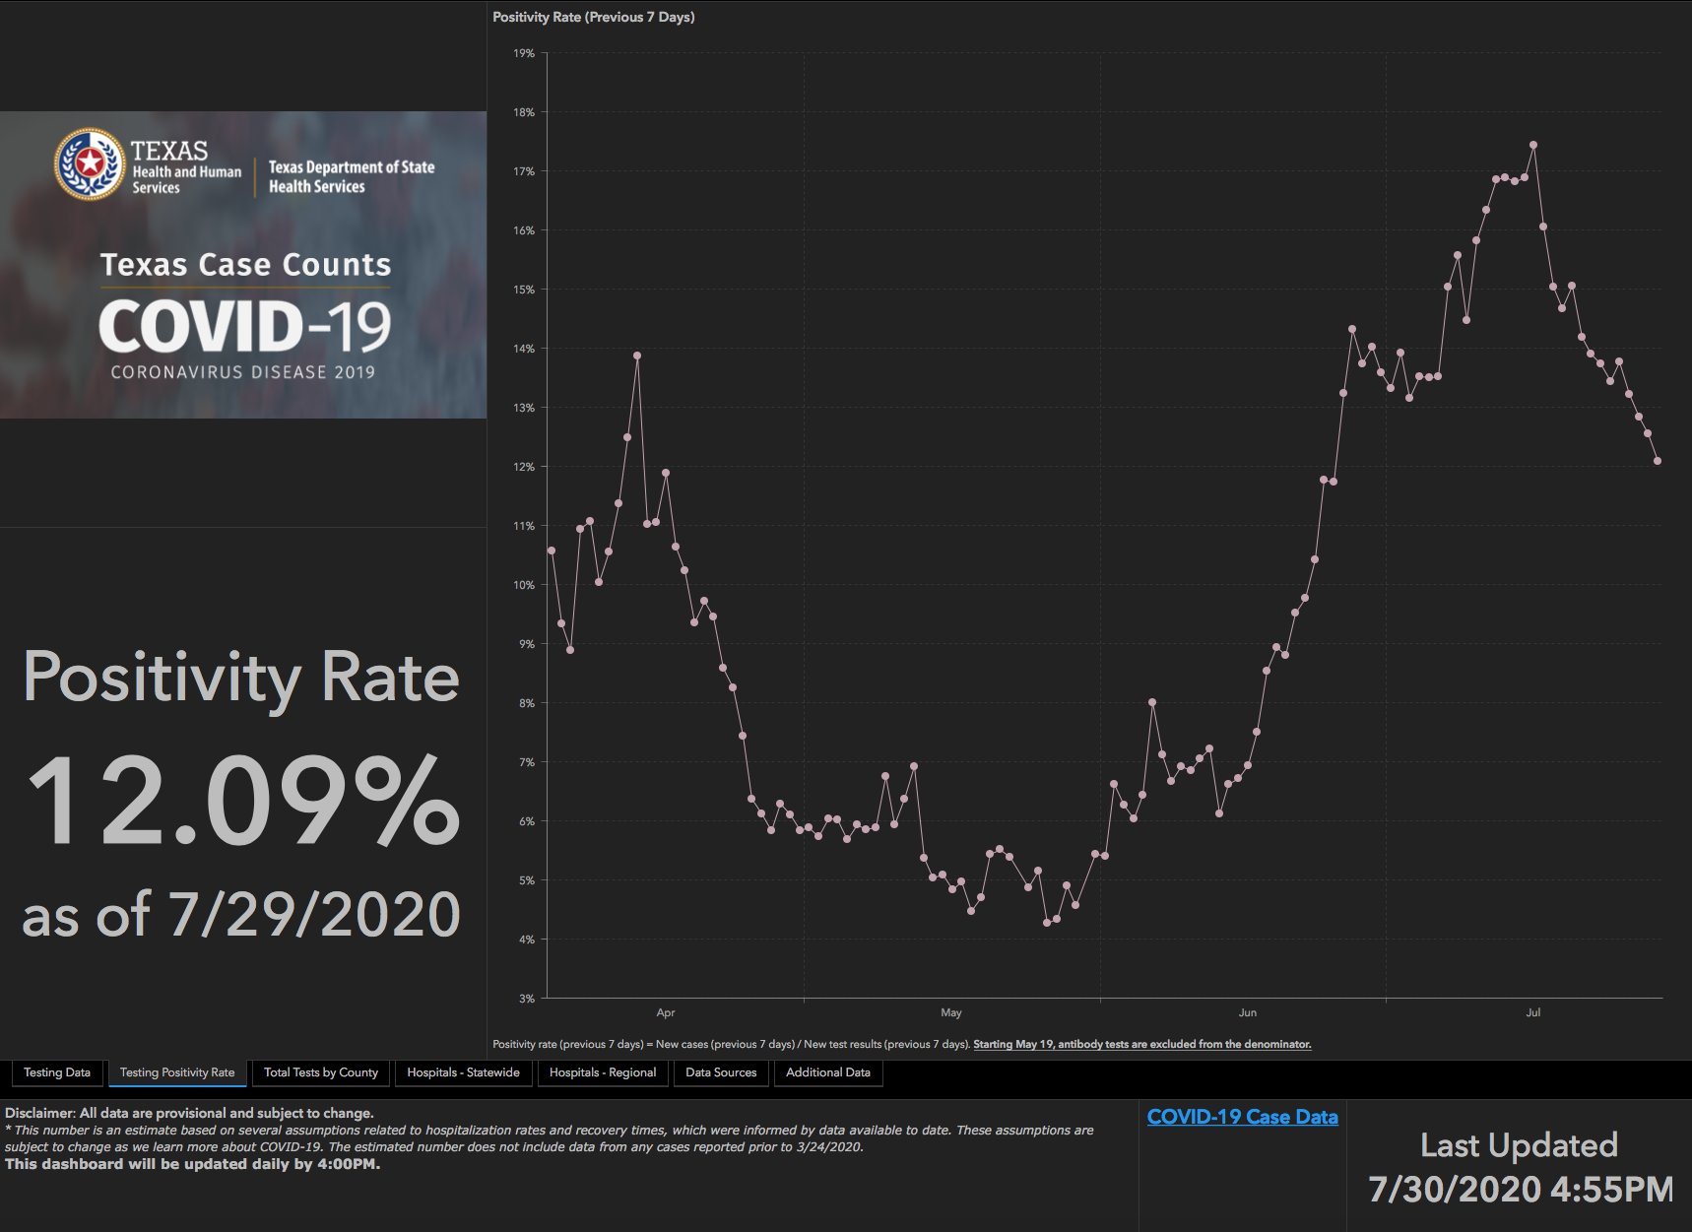
TESTING – Statewide Results

Slide 32
Returning to Operations

Slide 33
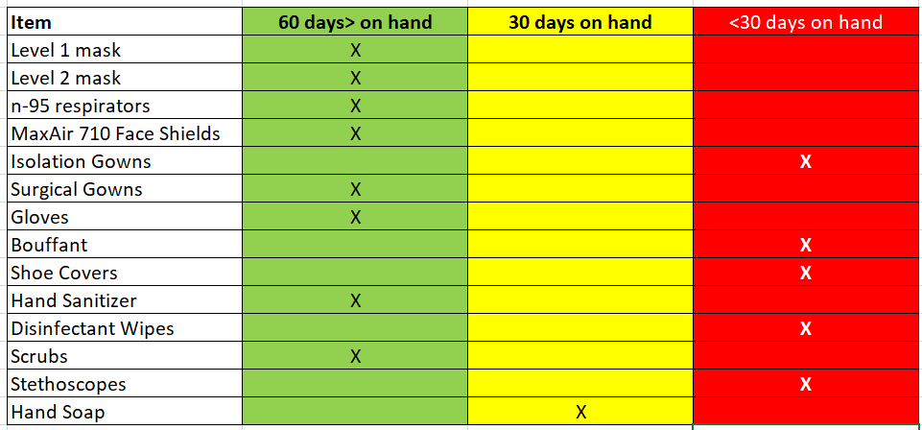
COVID19-HOT TOPICS
  PPE Inventory

Slide 34
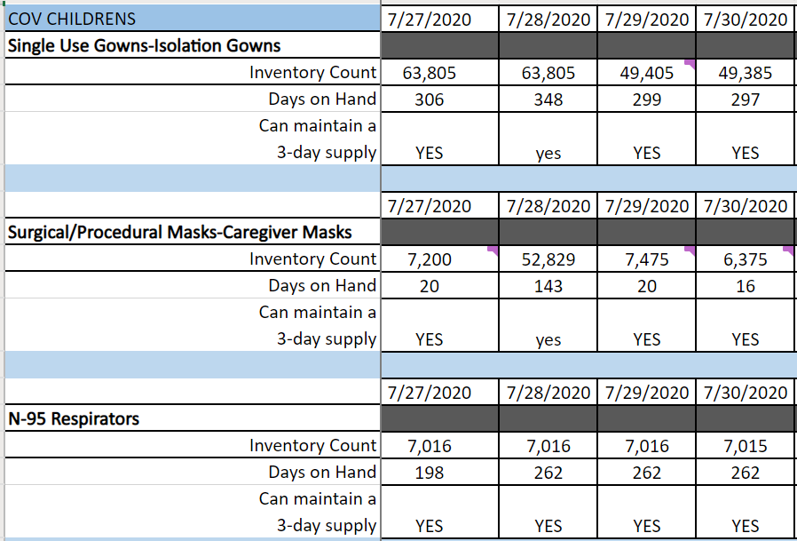
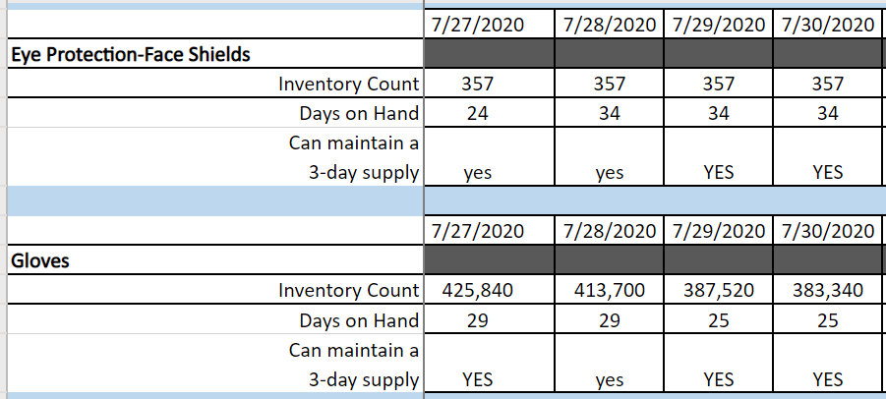

Covenant Women’s and Children’s Hospital

Slide 35
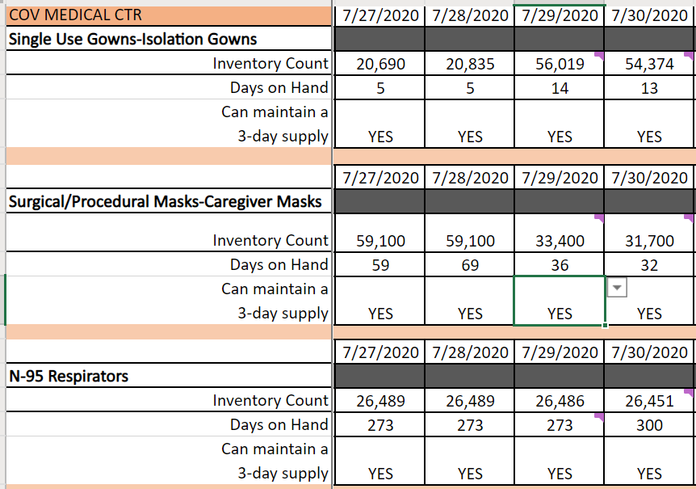
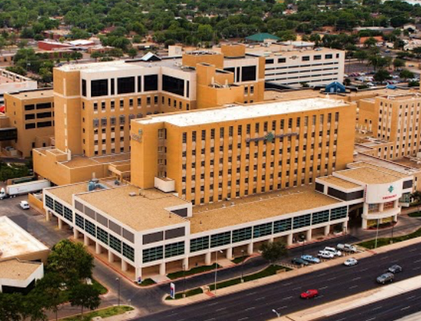
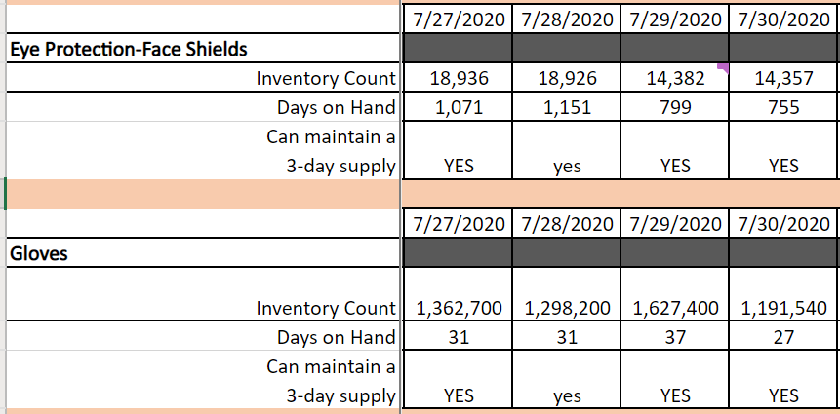
Covenant Medical Center

Slide 36
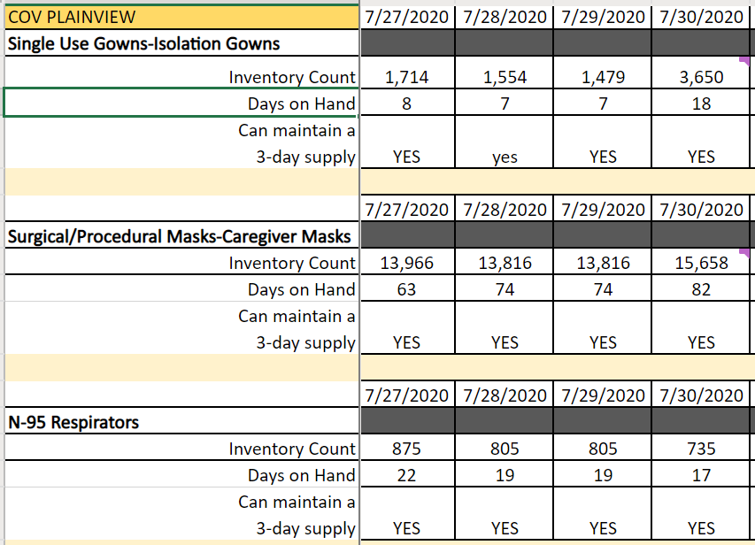

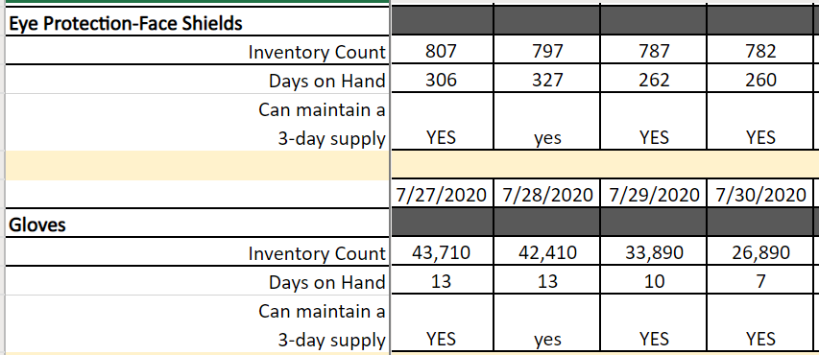
Covenant Plainview

Slide 37
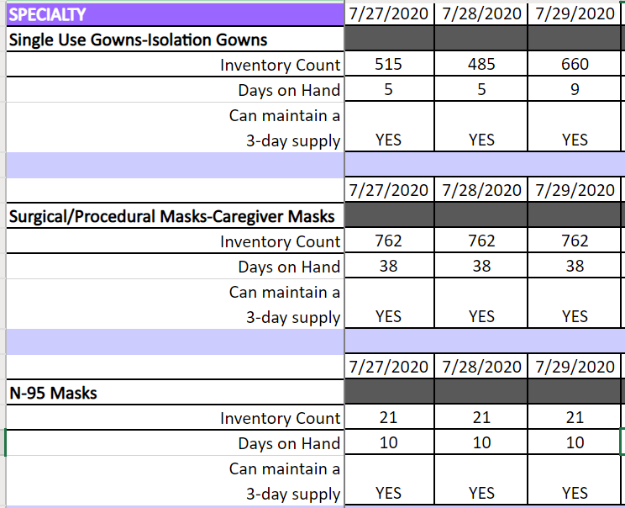

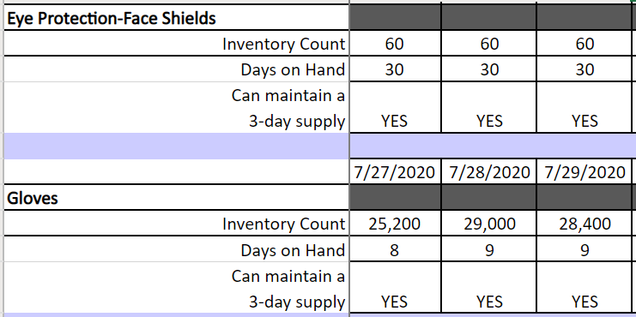
Covenant Specialty Hospital

Slide 38
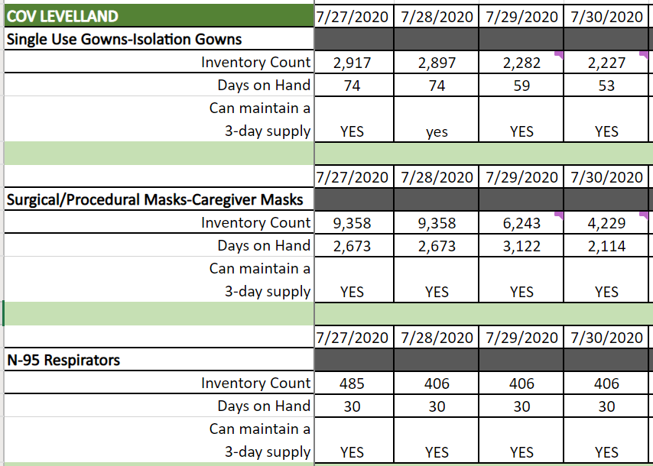

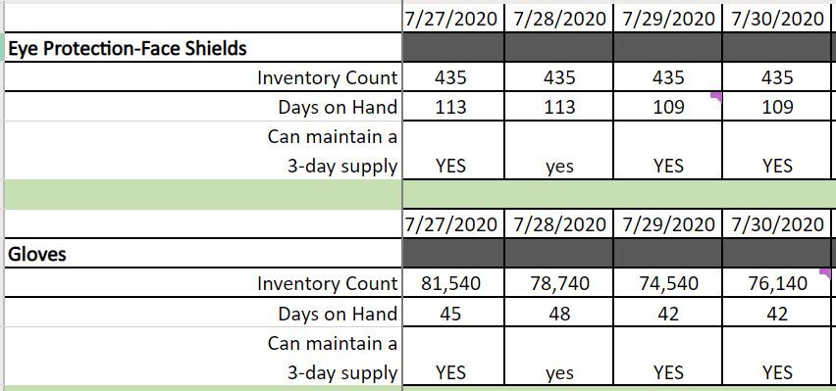
Covenant Levelland

Slide 39
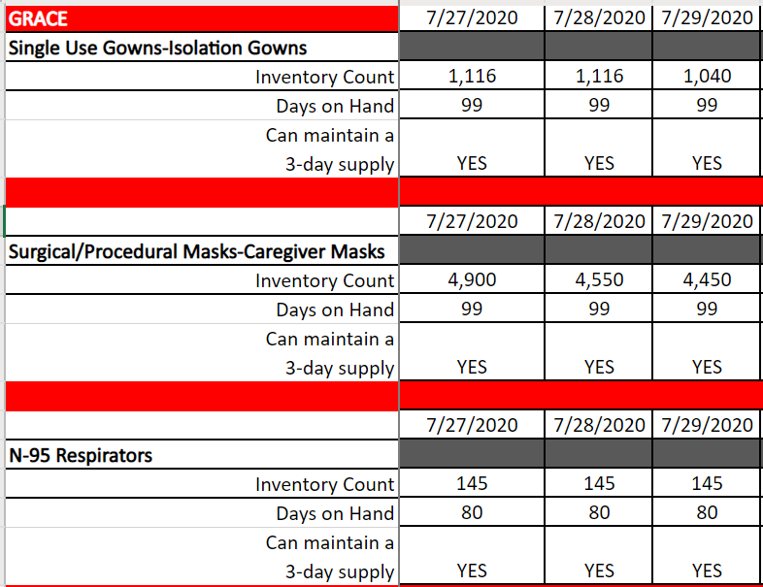

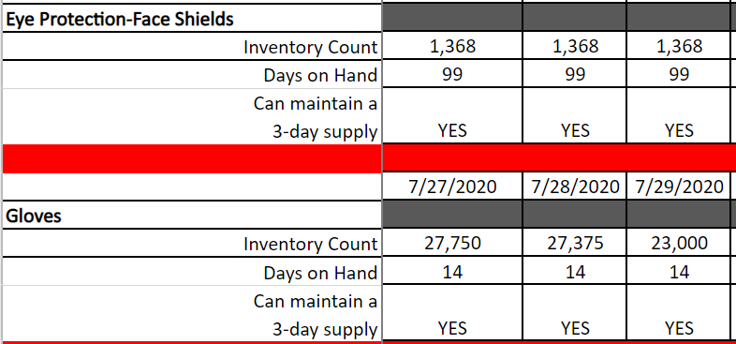

Grace

Slide 40

COVID19-Hot topics
  High Flow Nasal Cannula Machines
  10 AIRO units to be delivered for Plainview – 8 weeks from 7/10. Hopefully sooner.
  Vent Supplies
  Recert to clean Heater Wires received at CCH and CMC. Checking with Plainview
  64 Heater chambers received by CCH

Slide 41
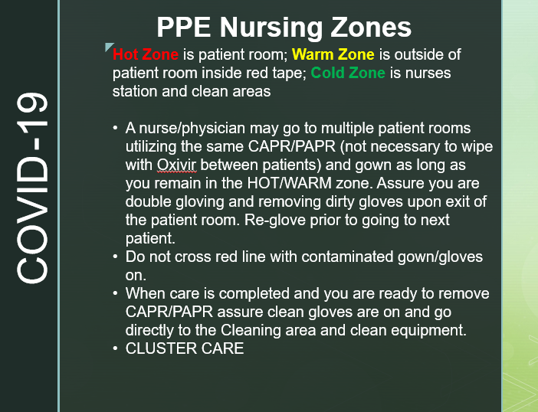
COVID19-Hot Topics
  Gown Conservation
  Bundling of tasks
  Setting up Zones
  Back up plan – Reusable Gowns,samples being sent to each hospital
  ?overgown use?

Slide 42
Pharmacy Update
Larry Pineda, PharmD
Clinical Pharmacist – AMS

Slide 43
CHS COVID-19 Treatments
Agent | Dosage | Comments | Update
Remdesivir Emergency Use Authorization (EUA) 5/1/20 | 200 mg IV x 1, then 100 mg IV daily x 4 days | EUA product purchased through ASB, allocation based on Teletracking reporting Reporting data daily RDV Utilization Team assemble to handle ethical concerns when supply becomes limited As part of EUA: Must provide “Fact Sheet for Patients” and document that we communicated information to patient Mandatory AE reporting to FDA MedWatch | Remdesivir EUA Inventory: (Thursday 12pm) CMC = 180 vials; Plainview = 98 vials Remdesivir EUA Patients: (Thursday 12pm) CMC = 11; Plainview = 1 NIH guidelines update (July 24, 2020): Because supplies are limited, recommend prioritizing for patients who require supplemental O2 but who are NOT on: high-flow oxygen noninvasive ventilation mechanical ventilation, or ECMO Rationale: uncertainty regarding whether starting remdesivir confers clinical benefit in these patients Recommended duration of treatment: 5 days or until discharge, whichever comes first
Dexamethasone | 6 mg IV/PO daily x 10 days | NIH guidelines recommend use in mechanically ventilated patients or those on supplemental oxygen
Notes:
According to the summary of the China study, remdesivir was “not associated with a difference in time to clinical improvement” compared to a standard of care control. After one month, it appeared 13.9% of the remdesivir patients had died compared to 12.8% of patients in the control arm. The difference was not statistically significant.
Hospitalized patients with advanced COVID-19 and lung involvement who received remdesivir recovered faster than similar patients who received placebo, according to a preliminary data analysis from a randomized, controlled trial involving 1063 patients, which began on February 21. The trial (known as the Adaptive COVID-19 Treatment Trial, or ACTT), sponsored by the National Institute of Allergy and Infectious Diseases (NIAID), part of the National Institutes of Health, is the first clinical trial launched in the United States to evaluate an experimental treatment for COVID-19. Preliminary results indicate that patients who received remdesivir had a 31% faster time to recovery than those who received placebo (p<0.001). Specifically, the median time to recovery was 11 days for patients treated with remdesivir compared with 15 days for those who received placebo. Results also suggested a survival benefit, with a mortality rate of 8.0% for the group receiving remdesivir versus 11.6% for the placebo group (p=0.059). Recovery in this study was defined as being well enough for hospital discharge or returning to normal activity level.
FYI Budesonide: In response to Odessa doctor, Richard Bartlett, who calls it the 'silver bullet‘. There have been no clinical trials or observational studies examining the use of ICS in COVID-19. Clinical trials would be required to establish whether these drugs may be repurposed for the treatment of this disease.

Slide 44
CHS COVID-19 Treatments
Agent | Dosage | Comments | Update
Tocilizumab | 400 mg IVPB x 1 dose May repeat x 1 in 8-12 hours if clinical symptoms worsen or do not demonstrate improvement | IL-6 receptor antagonist used to treat CRS ($2.13K - $4.25K per dose) igned informed consent is recommended prior to dispensing this agent CHS criteria for use: Proven COVID-19 infection Early treatment of severe/critically ill patients who are clinically deteriorating Restricted to intensivists or ID AST/ALT <5xULN, ANC >500, Plt >50K Additional PSJH ID-CDT criteria for use: Require at least 6 L suppl O2 to maintain a SpO2 ≥ 93% Mechanical vent OR multi organ failure OR ICU admission | NIH guidelines state insufficient data to recommend for or against the use of IL-6 inhibitors for treatment of COVID-19 Roche Media Release 7/29/20: Update on the phase III COVACTA trial – “COVACTA trial did not meet its primary endpoint of improved clinical status in patients with COVID-19 associated pneumonia, or the key secondary endpoint of reduced patient mortality” Reminder: As of 7/2, a clinical trial with sarilumab was stopped due to futility
Convalescent Plasma | 1 unit (200-400mL) x 1 | CMC enrolled in Mayo trial | Enrolled 54 patients to date Of note: 2 at CCH (pedi) via eIND
Notes:
The FDA says that neither drug has been proven safe and effective in treating COVID-19. In fact, a study published on April 23 involving 368 COVID-19 patients at U.S. Veterans Health Administration hospitals found that taking hydroxychloroquine alone, or in combination with azithromycin, did not reduce the need for a ventilator compared to those not taking the drugs. Further, people taking hydroxychloroquine alone had a higher risk of dying during the study than those not taking the drug. Researchers in China came to a similar conclusion in a study of 150 COVID-19 patients randomly assigned to receive hydroxychloroquine or the current standard of care: after a month, both groups had similar symptom profiles, and showed similar levels of the virus, suggesting that the drug wasn’t clearing the COVID-19 virus in a significant way. The National Institutes of Health is conducting an ongoing study of hydroxychloroquine among hospitalized patients, as is Novartis, whose Sandoz division makes a generic version of the drug.
HCQ:
PSJH high risk patients (age > 60, pulmonary disease, CV disease, CKD, DM, immune compromised, HTN present on admission or receiving anti-hypertensives prior to admission)
Toci:
Proven COVID-19 infection based on laboratory testing AND radiographic evidence of pneumonia
Severely ill definition: SpO2 ≤ 93% on room air or FiO2/PaO2 ≤ 300 mmHg or respiratory rate ≥ 30 breaths/min
Critically ill definition: Mechanical ventilation OR multi organ failure OR ICU admission
After publication of our Lancet Article,¹
several concerns were raised with respect to the veracity of the data and analyses conducted by Surgisphere Corporation and its founder and our co-author, Sapan Desai, in our publication. We launched an independent third-party peer review of Surgisphere with the consent of Sapan Desai to evaluate the origination of the database elements, to confirm the completeness of the database, and to replicate the analyses presented in the paper.
Our independent peer reviewers informed us that Surgisphere would not transfer the full dataset, client contracts, and the full ISO audit report to their servers for analysis as such transfer would violate client agreements and confidentiality requirements. As such, our reviewers were not able to conduct an independent and private peer review and therefore notified us of their withdrawal from the peer-review process.
Toci update 7/31:
Primary endpoint not met: The difference in clinical status between Actemra/RoActemra and placebo in patients assessed using a 7-category ordinal scale at week four was not statistically significant (p=0.36; odds ratio [95% CI] = 1.19 [0.81, 1.76], a statistically significant odds ratio greater than 1 would have favoured Actemra/RoActemra).
• There was no difference between Actemra/RoActemra and placebo in the percentage of patients that died by week four (Actemra/RoActemra = 19.7% and placebo = 19.4% with a difference [95% CI] of 0.3% [-7.6%, 8.2%], p=0.9410)

Slide 45
CHS COVID-19 Treatments
Agent | Dosage | Comments | Update
Ivermectin | 150-400 mcg/kg PO* *Effective dosing strategy unknown | In vitro studies show activity at high doses Concentration used in-vitro showing activity is >35X higher than the max plasma concentration after oral administration of approved dose (200 mcg/kg) No RCT data No published peer reviewed data supporting its safety and efficacy: caution with pilot, phase 2, or retrospective study info available on pre-print | Clinical trials ongoing
Sildenafil | 20 mg PO three times a day | COVID-19 efficacy unknown | Clinical trials ongoing
Zanubrutinib | 320 mg PO once daily for up to a maximum of 28 days | CMC will be participating in this phase 2, randomized, double blind, placebo-controlled (N~46-52) | Current enrollment: 0 patients
Notes:
According to the summary of the China study, remdesivir was “not associated with a difference in time to clinical improvement” compared to a standard of care control. After one month, it appeared 13.9% of the remdesivir patients had died compared to 12.8% of patients in the control arm. The difference was not statistically significant.
Hospitalized patients with advanced COVID-19 and lung involvement who received remdesivir recovered faster than similar patients who received placebo, according to a preliminary data analysis from a randomized, controlled trial involving 1063 patients, which began on February 21. The trial (known as the Adaptive COVID-19 Treatment Trial, or ACTT), sponsored by the National Institute of Allergy and Infectious Diseases (NIAID), part of the National Institutes of Health, is the first clinical trial launched in the United States to evaluate an experimental treatment for COVID-19. Preliminary results indicate that patients who received remdesivir had a 31% faster time to recovery than those who received placebo (p<0.001). Specifically, the median time to recovery was 11 days for patients treated with remdesivir compared with 15 days for those who received placebo. Results also suggested a survival benefit, with a mortality rate of 8.0% for the group receiving remdesivir versus 11.6% for the placebo group (p=0.059). Recovery in this study was defined as being well enough for hospital discharge or returning to normal activity level.
Ivermectin: The concentration resulting in 50% inhibition (IC50; 2 µM) was > 35× higher than the maximum plasma concentration (Cmax) after oral administration of the approved dose (200 mcg/kg)

Slide 46
Pharmacy Shortages/Allocations
Covid-19 Related
  Cisatracurium
  Rocuronium
  Vecuronium
  Propofol
  Fentanyl
  Vitamin C Liquid and Inj
  Dexamethasone Inj and Tabs
  Ivermectin
  Dexamethasone
  Zinc Sulfate Tabs
  Sildenafil Tabs
  Budesonide Inhalers
Non-Covid-19 Related
  Bumetanide
  Amiodarone
  Dopamine
  Dobutamine
  Famotidine
  Furosemide Inj
  Doxycycline Inj
  Nitroglycerin SDV
  Bupivacaine with epinephrine
  Lidocaine with epinephrine
  Methadone Inj
  Nalbuphine Inj

Slide 47
Reminders to Physicians
Oxygen and Pulse Oximetry

Slide 48
Documentation Improvement
Oxygen
Oxygen must be treated just like any other medication
An ORDER in MEDITECH is required for us to administer O₂
Pulse Oximetry
Pulse oximetry can be ordered as spot checks OR continuous
On COVID-19 patients, it should be ordered CONTINUOUSLY for the following reasons:
  Sudden deteriorations have occurred
  Continuous pulse oximetry can be monitored from outside the room, reducing the PPE requirements to care for these patients

Slide 49
Texas Demographics

Slide 50
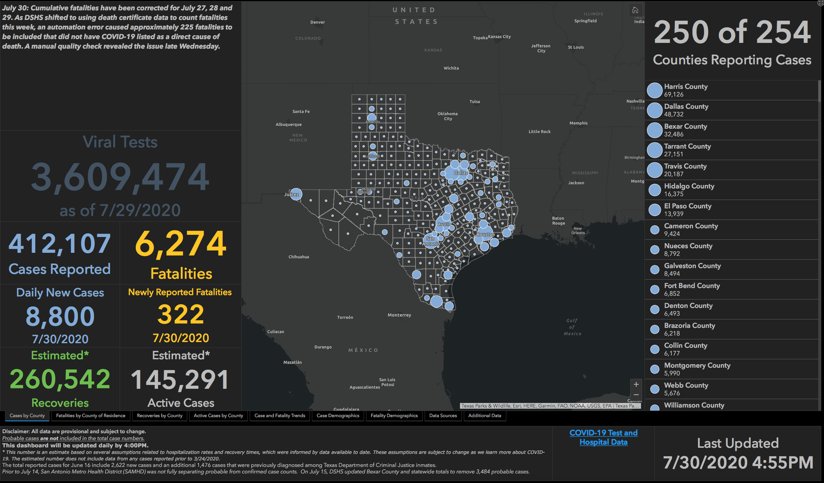

Slide 51


Slide 52
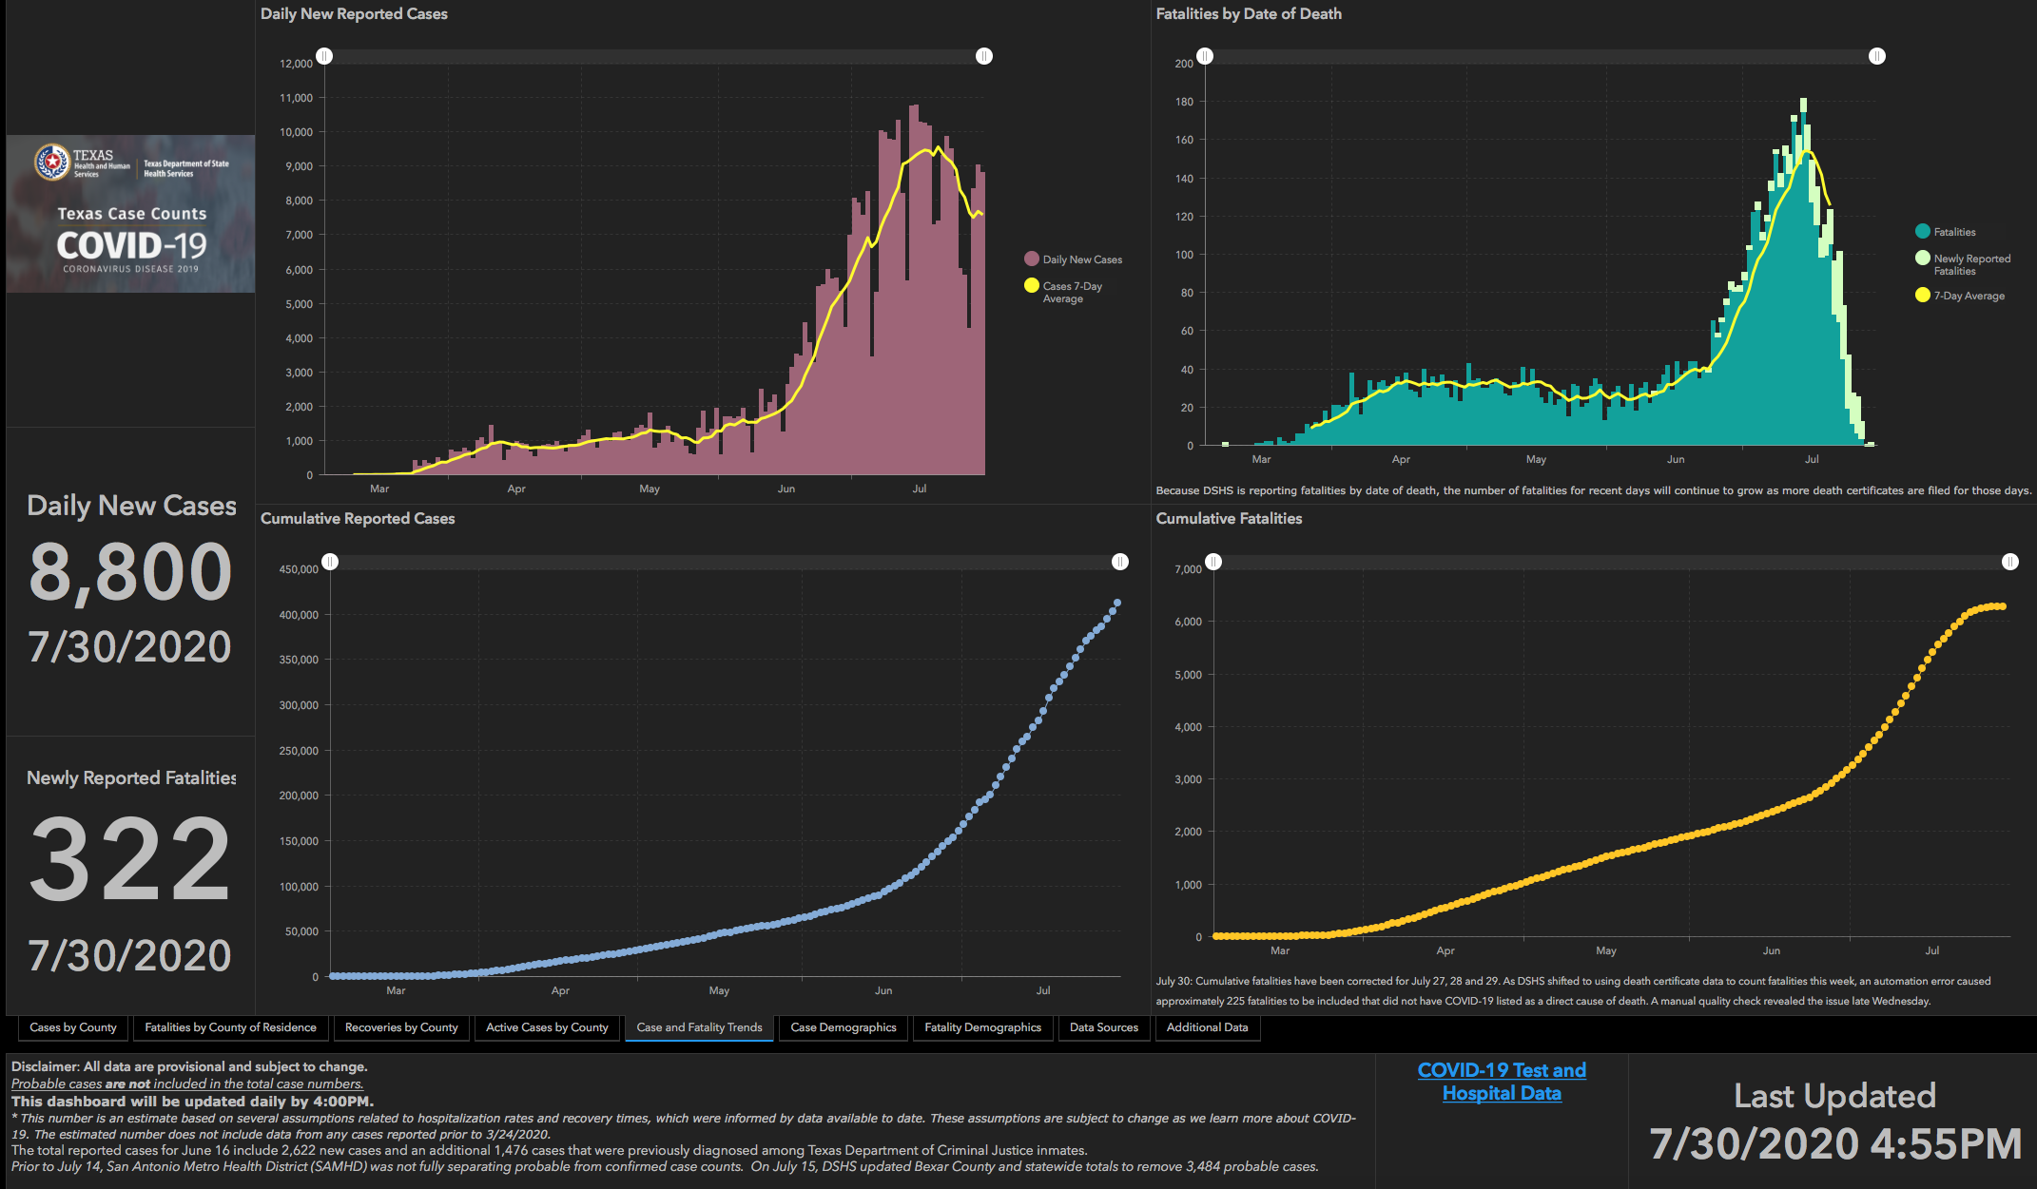

Slide 53
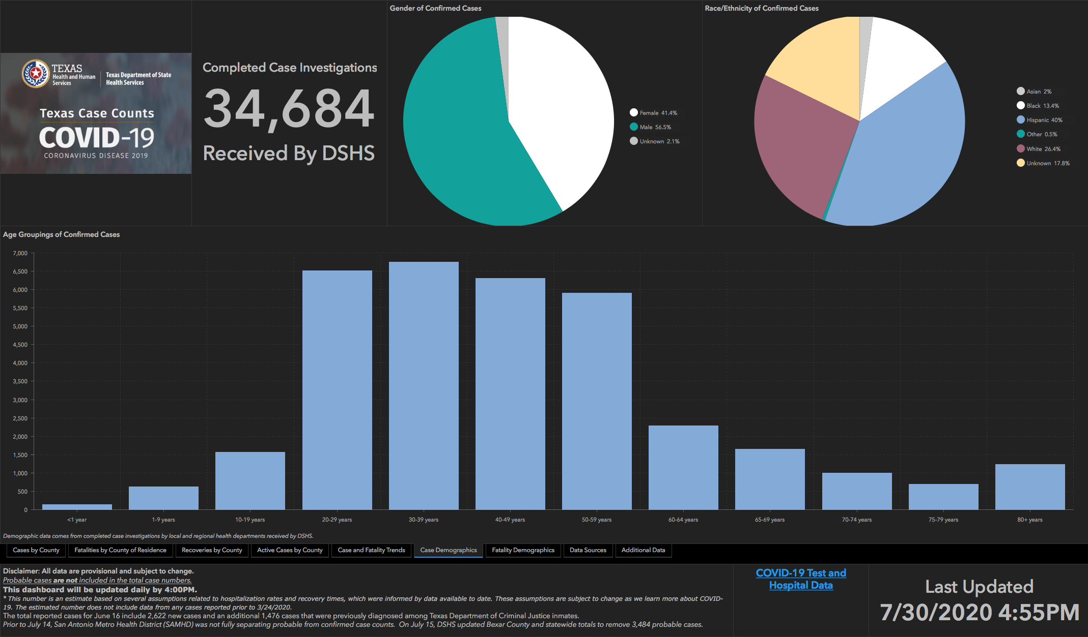

Slide 54
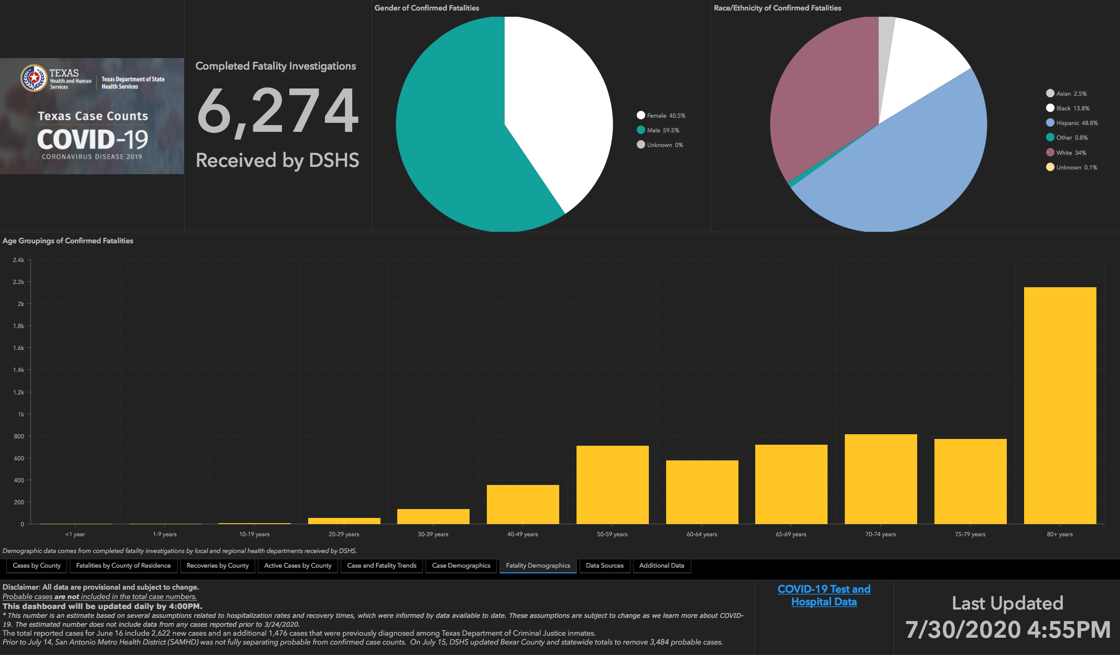

Slide 55
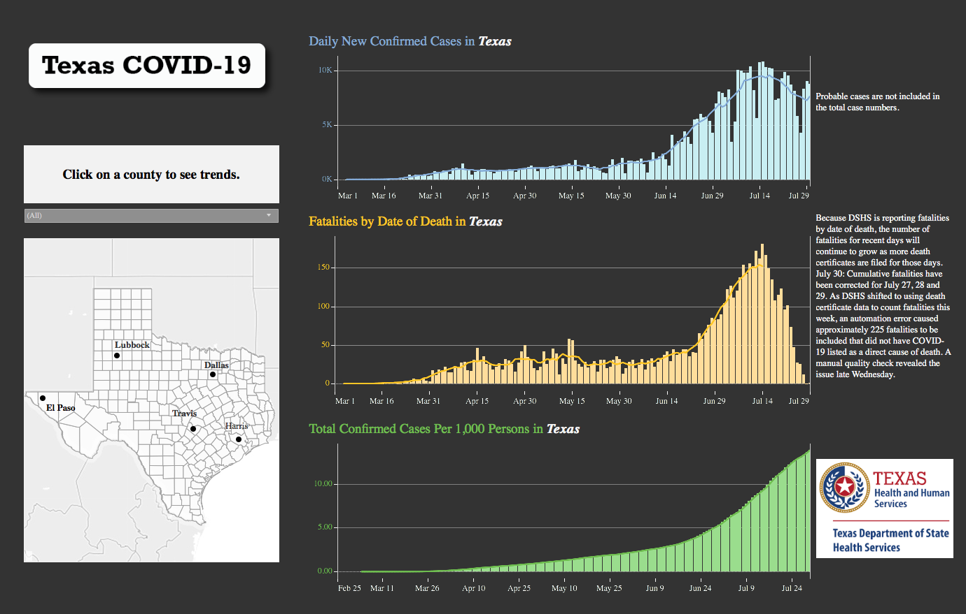

Slide 56
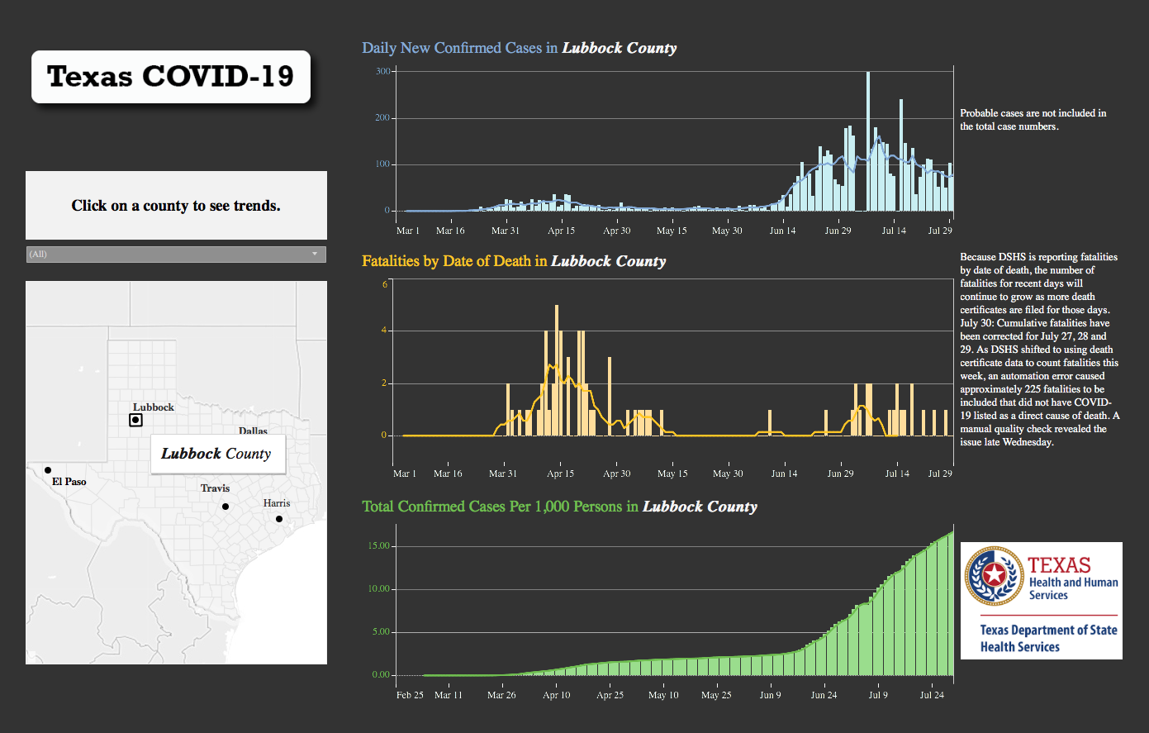

Slide 57
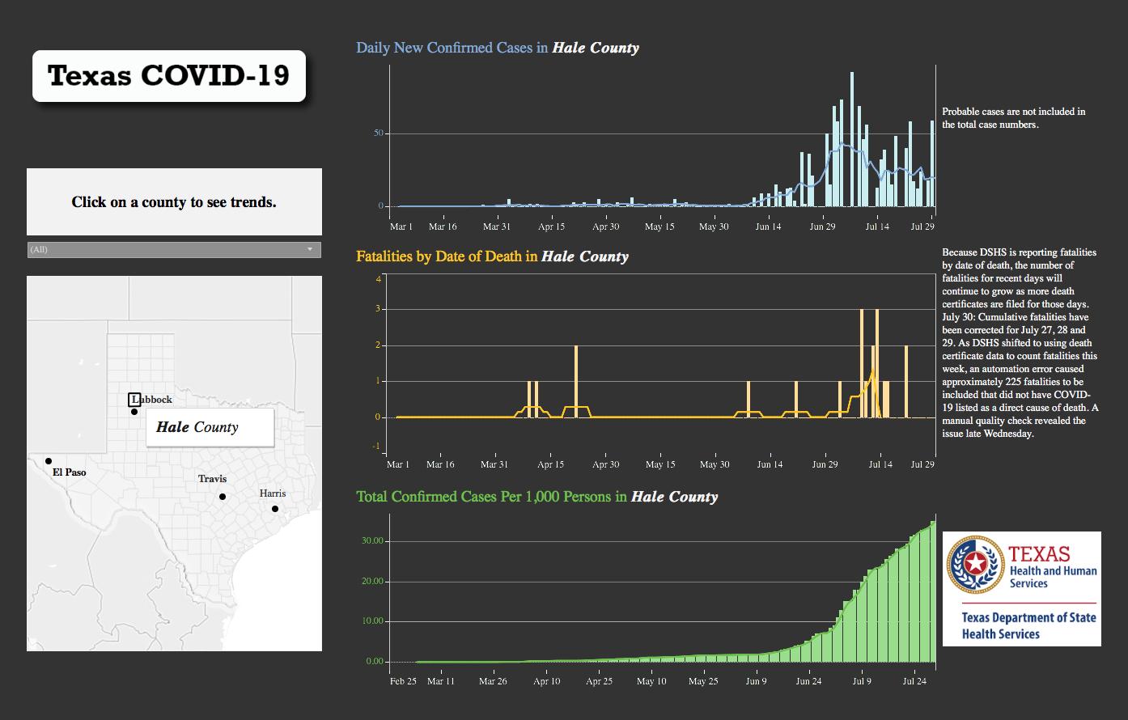

Slide 58
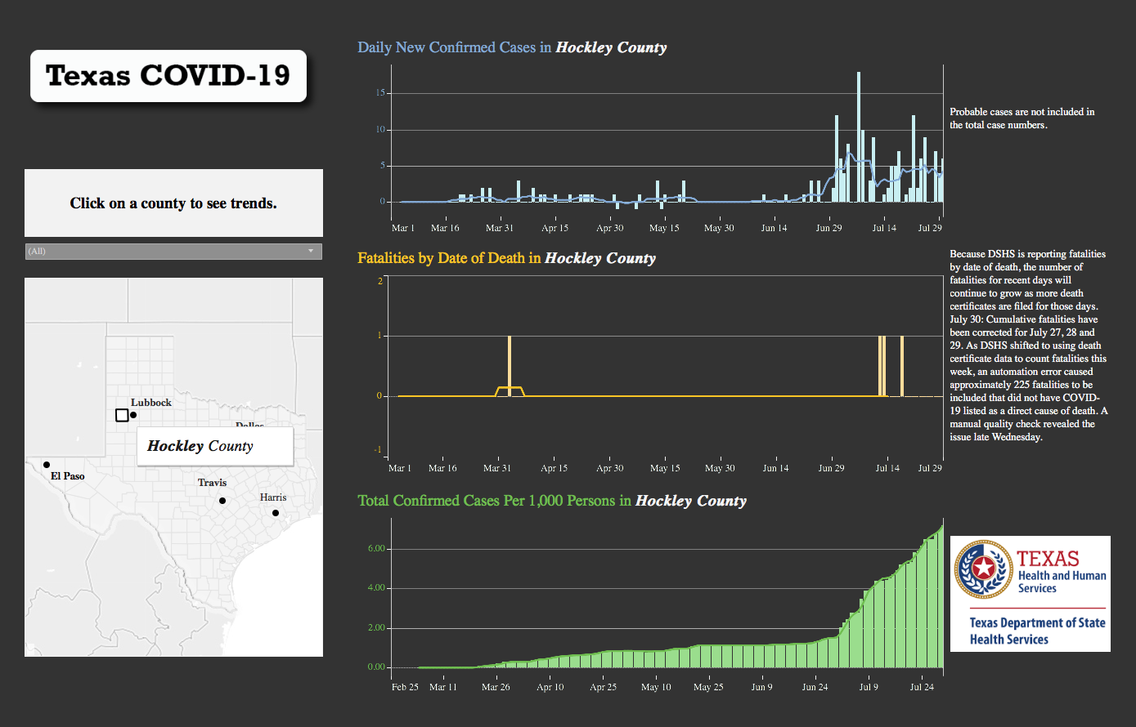

Slide 59
Center for Disease Control Statistics

Slide 60


Slide 61


Slide 62
Q & A

