Slide 1
Covenant Health
Regional Update for Physicians
August 7, 2020

Slide 2

Reflection

Slide 3
Safety Story

Slide 4
Situation
A patient was admitted for elective surgery and had a negative rapid Covid-19 test as a screen.
A minor complication arose that indicated a possible need to return to the OR five days later.
A repeat COVID-19 test was performed and was POSITIVE

Slide 5
Background
The patient was completely asymptomatic
There was no reason to suspect a COVID-19 infection
Multiple caregivers had cared for this patient without using PPE as prescribed in our current policy

Slide 6
Assessment:
  A). The patient was too early in their course to be detected by initial screen or the initial result was a false negative….
  B). The patient had acquired the infection while in the hospital…
  C). The patient had a remote earlier infection that could not be picked up by the less sensitive initial screen, but residual viral RNA was detected by the second, more sensitive testing modality…

Slide 7
Recommendations
The patient was retested to confirm the second viral RNA result and an Antibody test was performed…
The second test was still positive
The antibody test was strongly positive

Slide 8
Resolution
The patient had MOST LIKELY had a remote infection and was no longer contagious.
BUT, if either of the first two scenarios had been the case, the caregivers that had been in contact with that patient would all have been exposed
There is NO PERFECT screening. Always wear the appropriate PPE for the situation you are in.

Slide 9
Caring Reliably
Know why and comply…
Follow the policy on PPE
NOT because it is a policy…
but because in an imperfect world, not doing so could be disastrous

Slide 10
Current Regional Census

Slide 11
Regional
 | Lubbock |  | Hockley |  | Hale
 | 8/3 | 8/5 | 8/3 | 8/5 | 8/3 | 8/5
Total | 5652 | 5811 | 174 | 174 | 1185 | 1244
Active | 1871 | 1707 | 53 | 53 | 162 | 120
Deaths | 78 | 80 | 4 | 4 | 26 | 31
New | 159 |  | 0 |  | 59

Slide 12
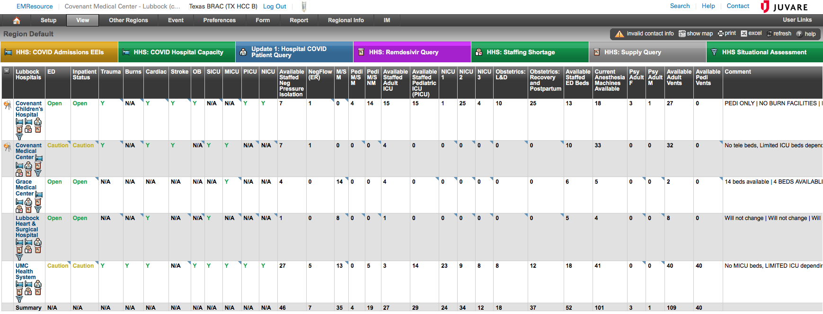
EMResources - Lubbock

Slide 13
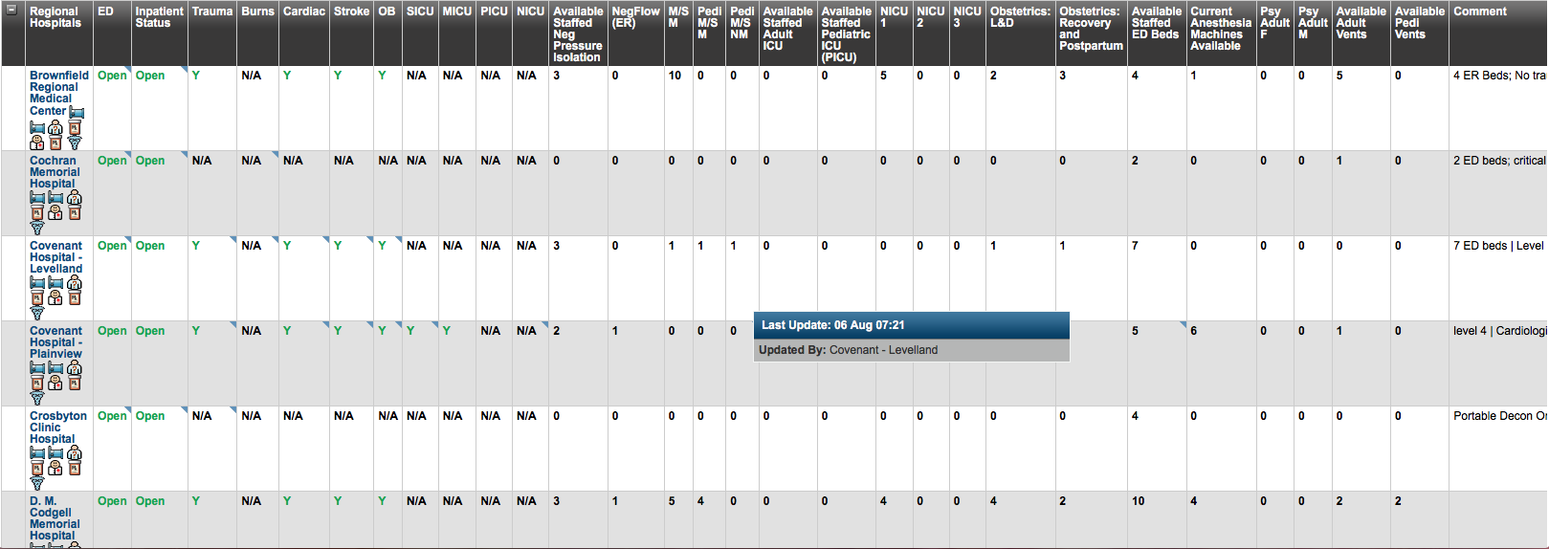
EMResources - Region

Slide 14
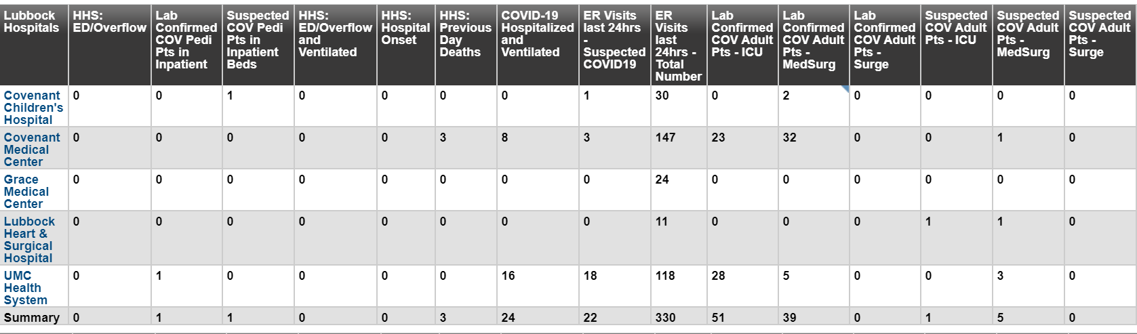
Regional - Lubbock

Slide 15
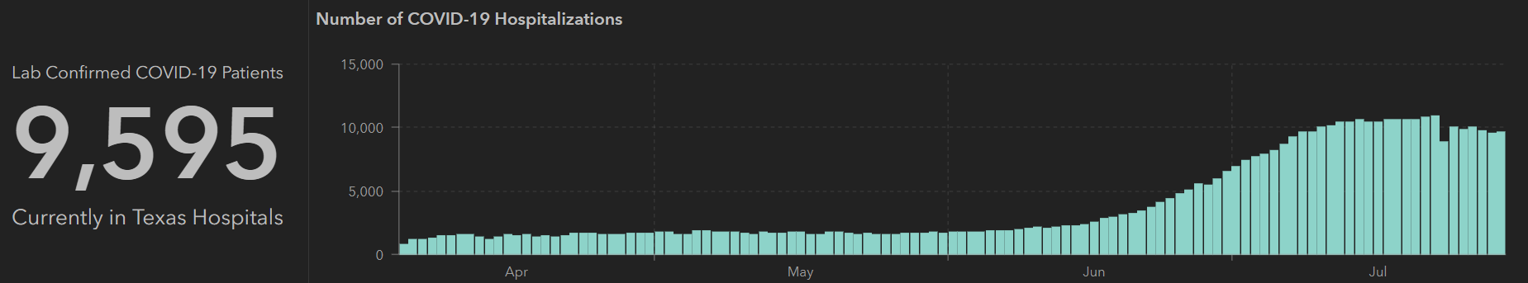
STATE
Last Week
 | 7/29 | 7/27 | 7/22 | 7/20 | 7/15 | 7/13 | 7/8 | 7/6 | 7/1
Cases | 403,307 | 385,923 | 351,618 | 332,434 | 282,365 | 264,363 | 210,585 | 200,557 | 168,062
Deaths | 6190 | 5713 | 4348 | 4020 | 3432 | 3235 | 2715 | 2655 | 2481
Hospitalized | 9595 | 9781 | 10,893 | 10,569 | 10,471 | 10,405 | 9286 | 8698 | 6904

Slide 16
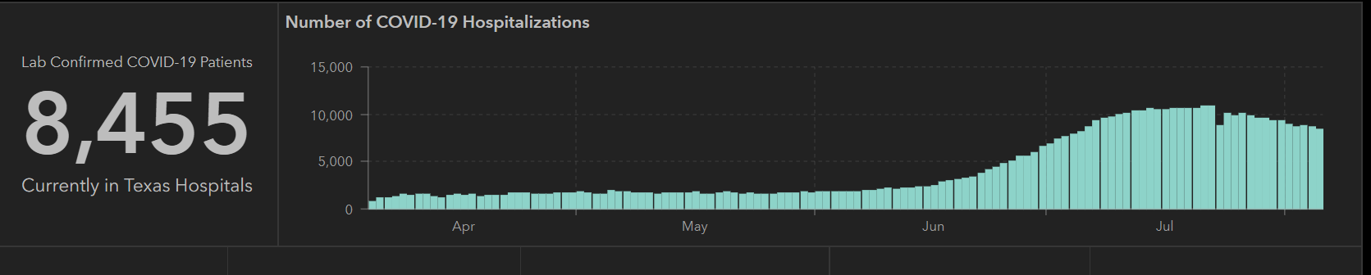
STATE
 | 8/5 | 8/3 | 7/29 | 7/22 | 7/15 | 7/8 | 7/1
Cases | 459,887 | 442,014 | 403,307 | 351,618 | 282,365 | 210,585 | 168,062
Deaths | 7497 | 7015 | 6190 | 4348 | 3432 | 2715 | 2481
Hospitalized | 8455 | 8819 | 9595 | 10,893 | 10,471 | 9286 | 6904

Slide 17
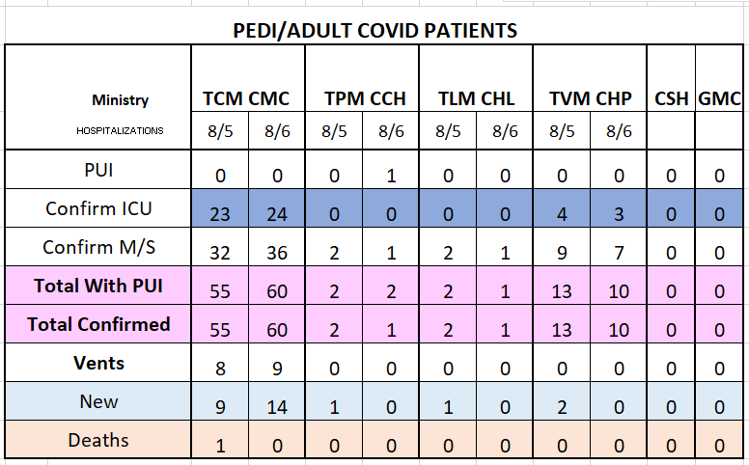
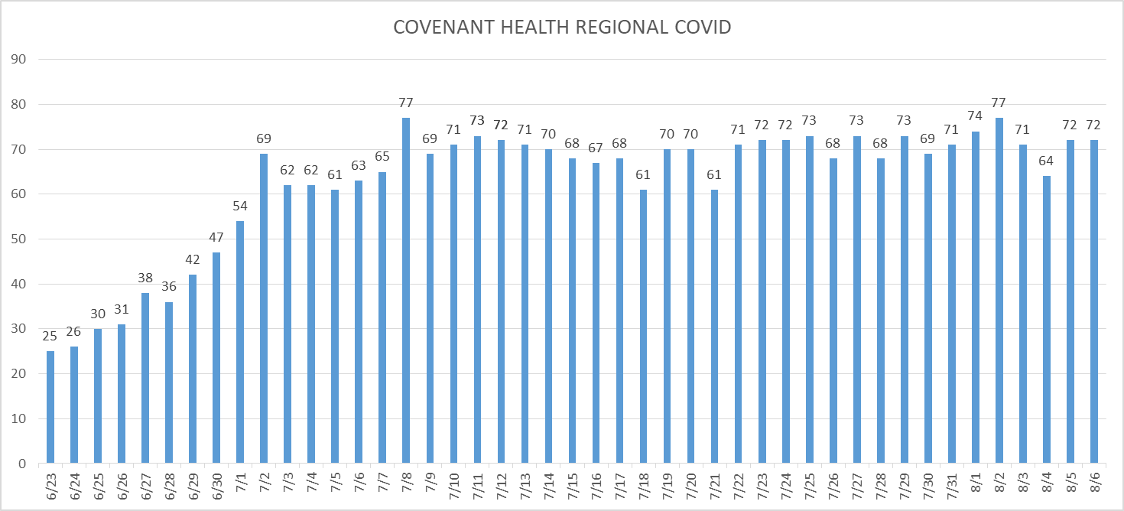
PUI/Confirmed cases-hospitalized

Slide 18
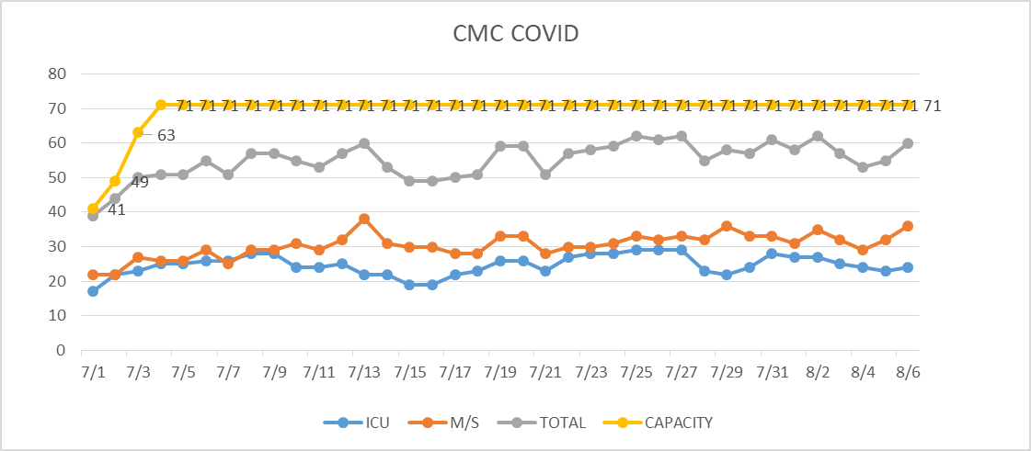
PUI/Confirmed cases-hospitalized
Transfers to COVID unit are from routine locations –
40% COVID pts are transfers

Slide 19
Surge Plan
Covenant Medical Center
 | ICU | Med Surg | Total
Phase 1 | 10-CICU |  | 10
Phase 2 | 17-CICU | 10-HC4 | 27
Phase 3 | 17-CICU | 24-HC4 | 41
Phase 4 | 17-CICU 8-MICU | 24-HC4 14-Pal Med | 63
Phase 5 | 17-CICU 16-MICU | 24-HC4 14-Pal Med | 71
Phase 6 | 17-CICU 16-MICU 8- SICU 4 (east) | 24-HC4 14-Pal Med 15 – S 9 (east) | 94
Last Week
Currently

Slide 20
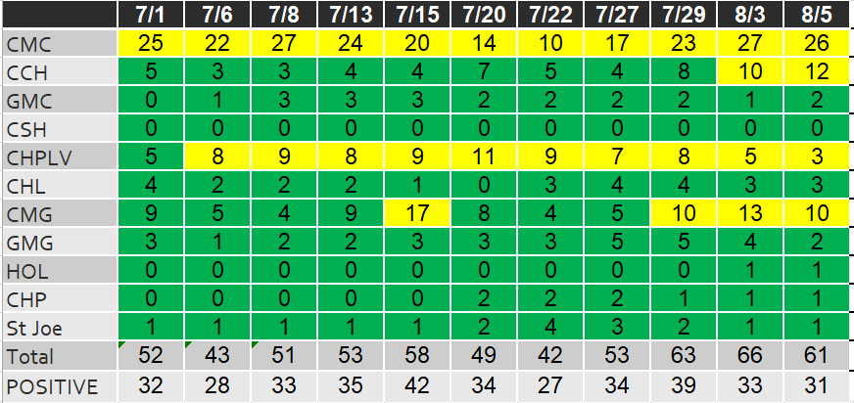
Caregivers
COVID Related Furloughs
Count reflects # furlough (exposed and positive)
Good
Moderate
Critical

Slide 21
Statistics
Cristian Requenez, MS
Clinical Data Analyst
Performance Improvement and Decision Support Services

Slide 22
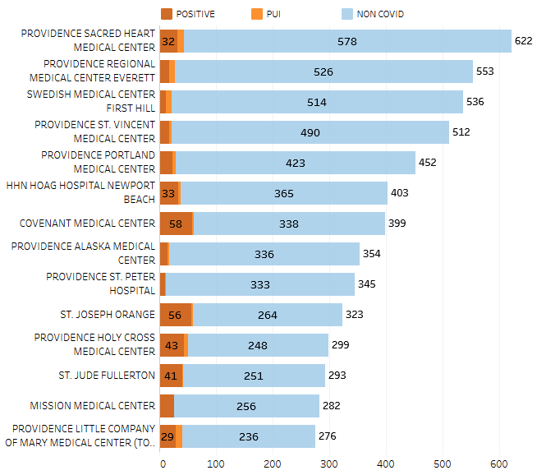
Providence System Hospitalized COVID-19 Cases

Slide 23
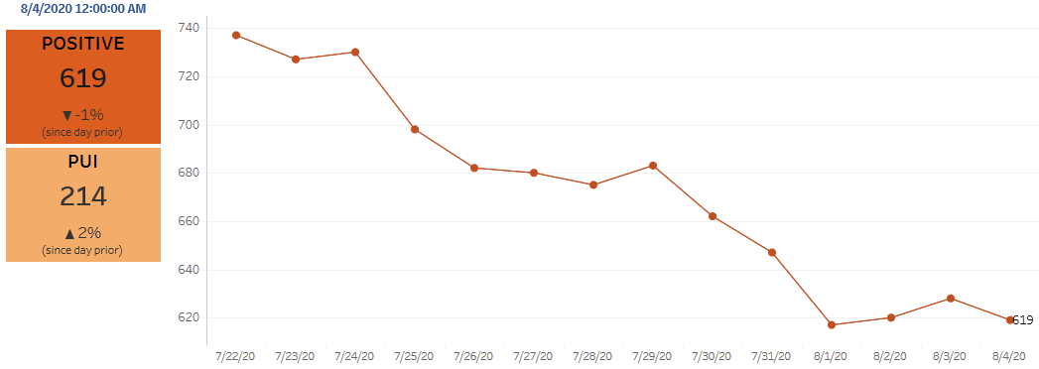
Providence Inpatient COVID-19 Volume

Slide 24
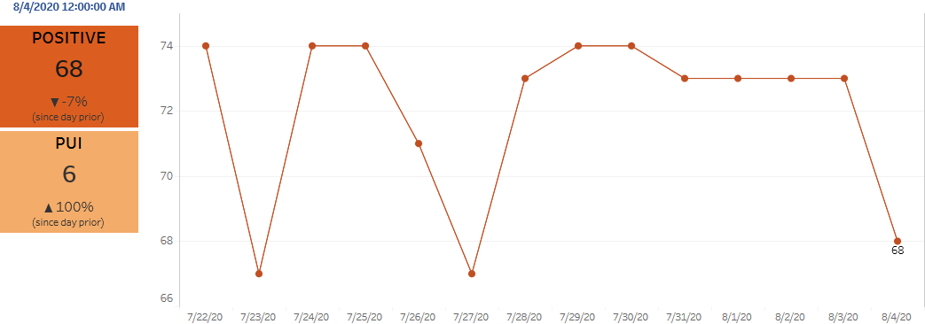
Texas Inpatient COVID-19 Volume

Slide 25
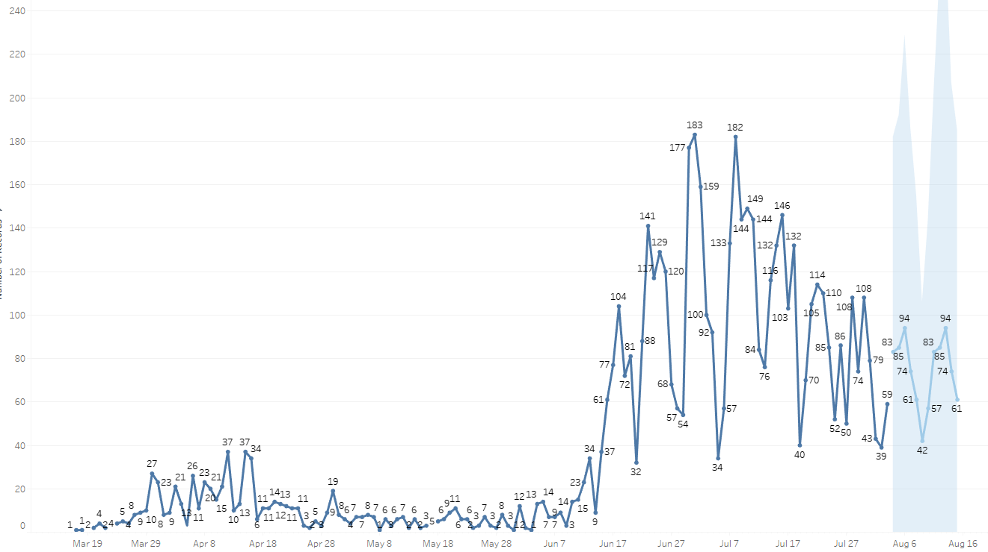

New Covid-19 POSITIVES by Day Trend

Slide 26
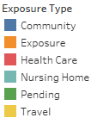
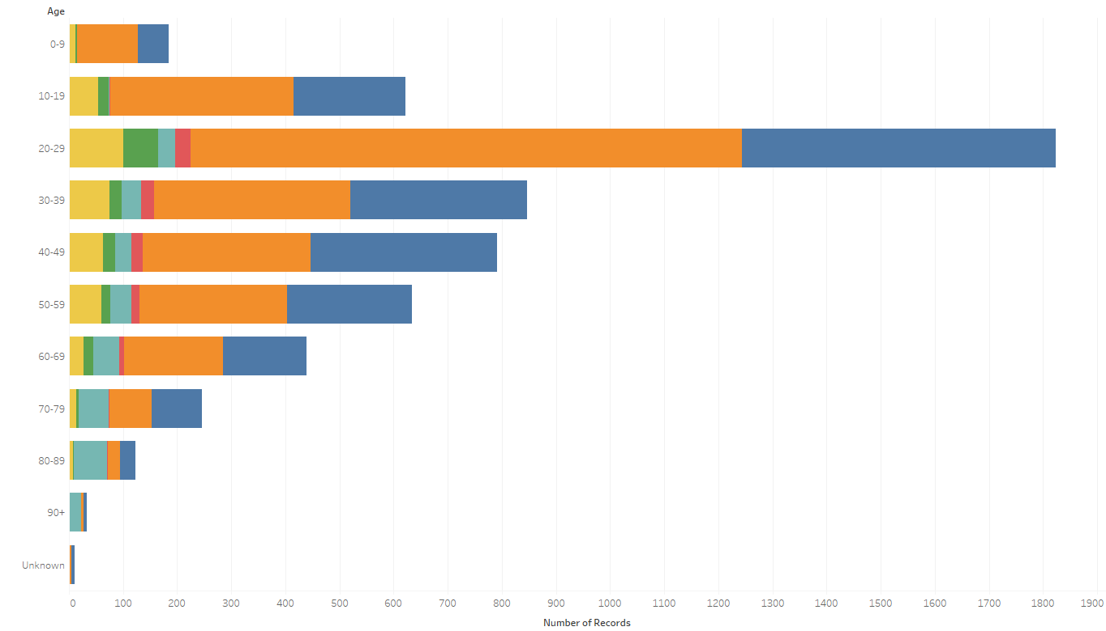
Covid-19 POSITIVES Age Distribution

Slide 27
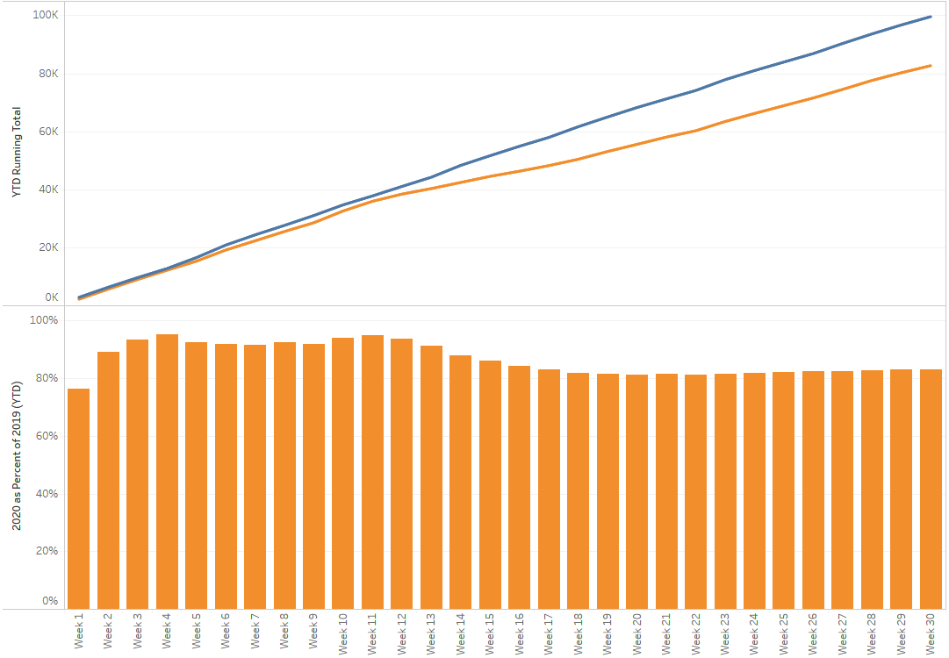

TX/NM Region Weekly Procedures (YOY)

Slide 28
Covid-19 Testing
The entire country is struggling to provide adequate testing capacity

Slide 29
TESTING
 | CMC | CCH | CMG | Grace
Abbott | 1330 | - | - | -
Cepheid | 125 | - | - | -
BD Max | - | - | - | 120
NP Swab | >10,000 | - | - | -
VTM | >1500 | - | -
Performed | 245 |  |  | 169
Positive |  |  |  | 29
Limited test kits available as mfg are preparing for strep-flu kits. CMG testing closing for the weekend. Limited on ability to provide to Roswell and Cochran.
BD Max Manufacturer moving into a larger facility – will not received test kits during this time. Expect 240 in their next allotment
Allotments at CMC are stable –
  Future: Cepheid-> FluA/B, RSV, COVID; Torch Biofire Combo test that includes COVID

Slide 30
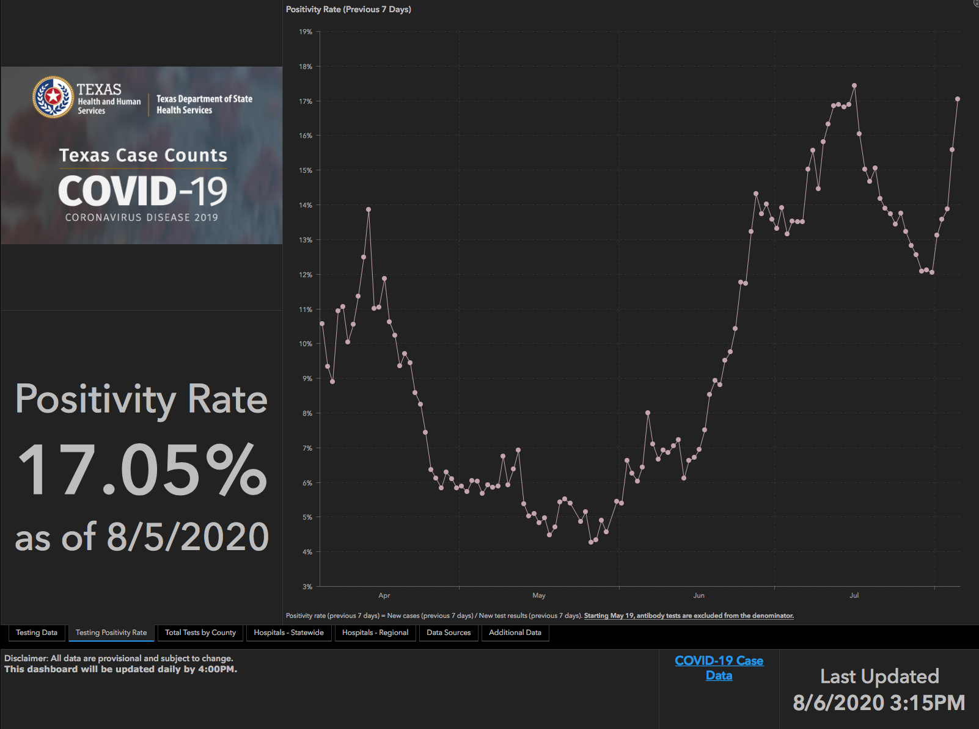
TESTING – STATEWIDE RESULTS

Slide 31
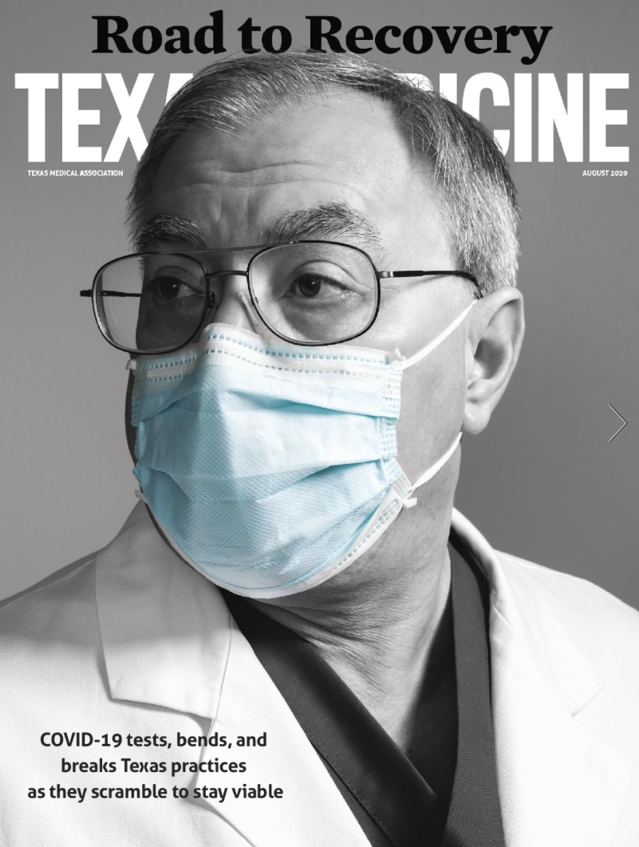
Risky Activities
Adapted from Texas Medicine
August 2020 Issue

Slide 32
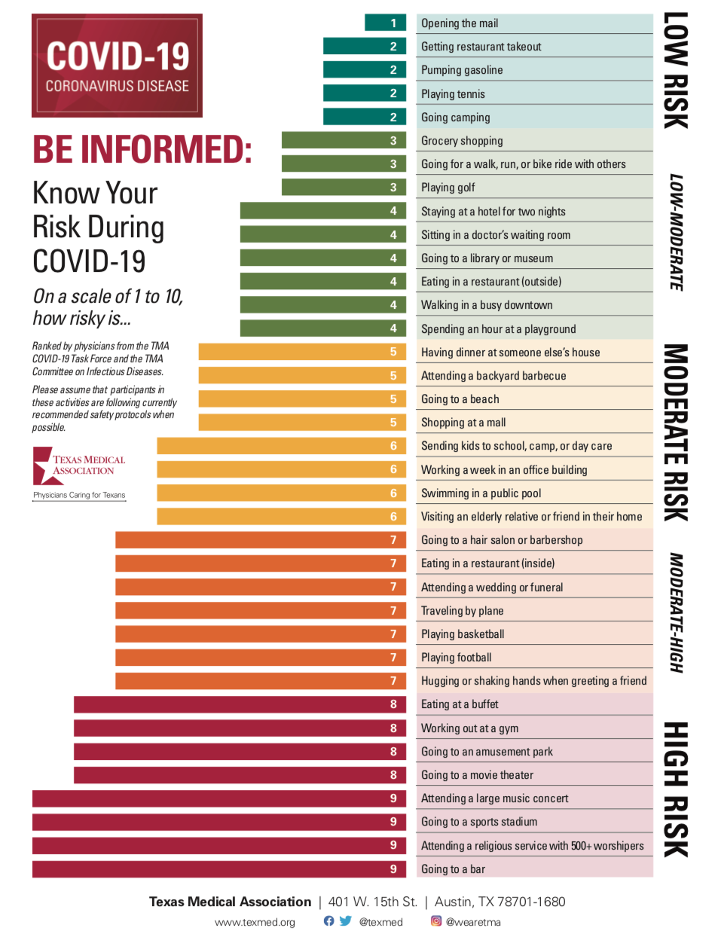

Slide 33
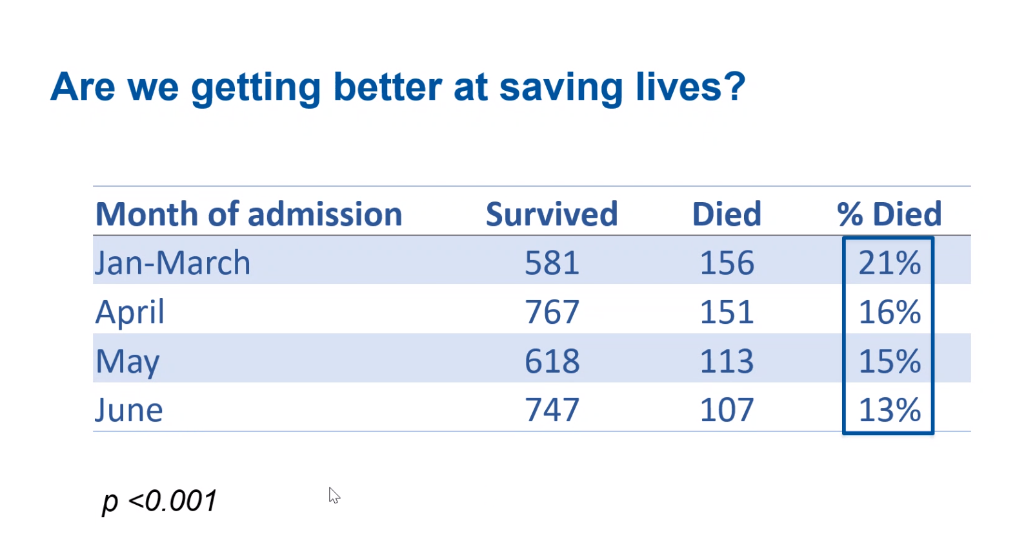
System Mortality Results

Slide 34
Returning to Operations

Slide 35
COVID19-Hot Topics
  Nursing Home
  More NH opening COVID areas to take COVID residents
  Meeting with hospitals, ICF facilities, Public Heath to discuss current barriers – August 10 2-4PM KECC
  N-95 Masks and EVS
  -Request for EVS to wear n-95 masks when cleaning COVID rooms. Contacted other hospitals. Will report next week

Slide 36

COVID19-Hot topics
  High Flow Nasal Cannula Machines
  10 AIRO units to be delivered for Plainview – 8 weeks (9/4). Hopefully sooner.
  Vent Supplies
  Recert to clean Heater Wires- Must be acquired through Steris (not Med-line) . We can reuse the wires an ulimited number of time with the appropriate cleaner.
  Disinfectant Wipes Hand Sanitizing Wipes
  Receiving 5 pallets of disinfectant wipes from STAR Request

Slide 37
COVID19-Hot Topics
  Gown Conservation
  Conservation measures are extending Days on Hand
  11 days increased to 24 days
  Received shipments of polypropylene gowns – Size L
    SBAR explaining the rating
  Switching to these gowns on COVID units
  “OLD” blue gowns will be used with endo, dialysis, wound care
  SBAR coming for chemo gowns – Will review next week

Slide 38

VISITOR SCREENING
  Revised Caregiver Screening applies to visitors and ED Screens – APPROVED 8/4
  Currently using paper screening
  Request has been made to do verbal screen
  Electronic temp check PILOT @ Swedish
    Stanley – for hospital use
    RichTech – for ambulatory areas

Slide 39
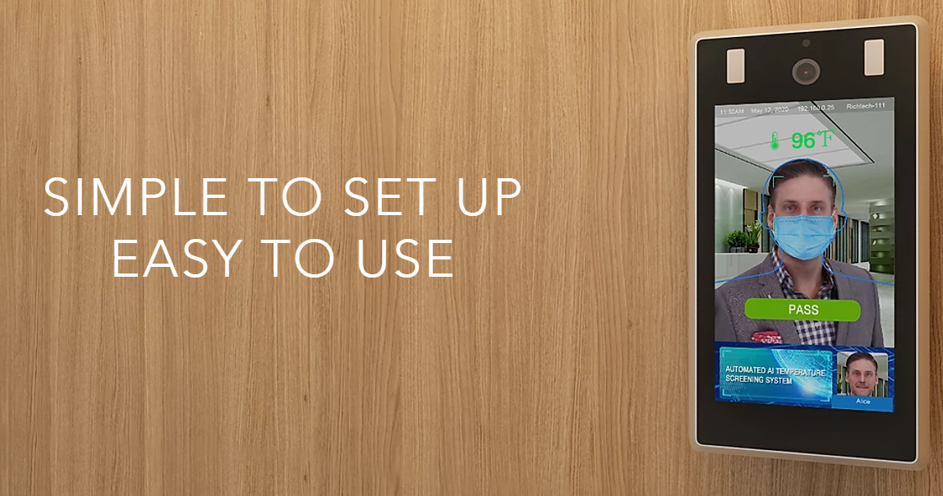
VISITOR SCREENING
  Electronic temp check PILOT @ Swedish
    Stanley – for hospital use
    RichTech – for ambulatory areas

Slide 40
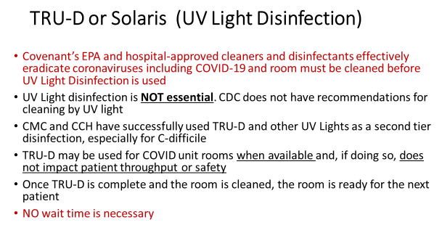
CLARIFICATION

Slide 41
Critical Inventory
HOSPITALS TO BUY THEIR ALLOCATIONS

Slide 42
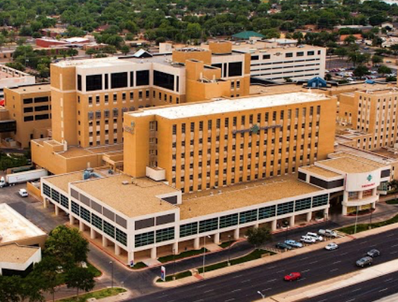
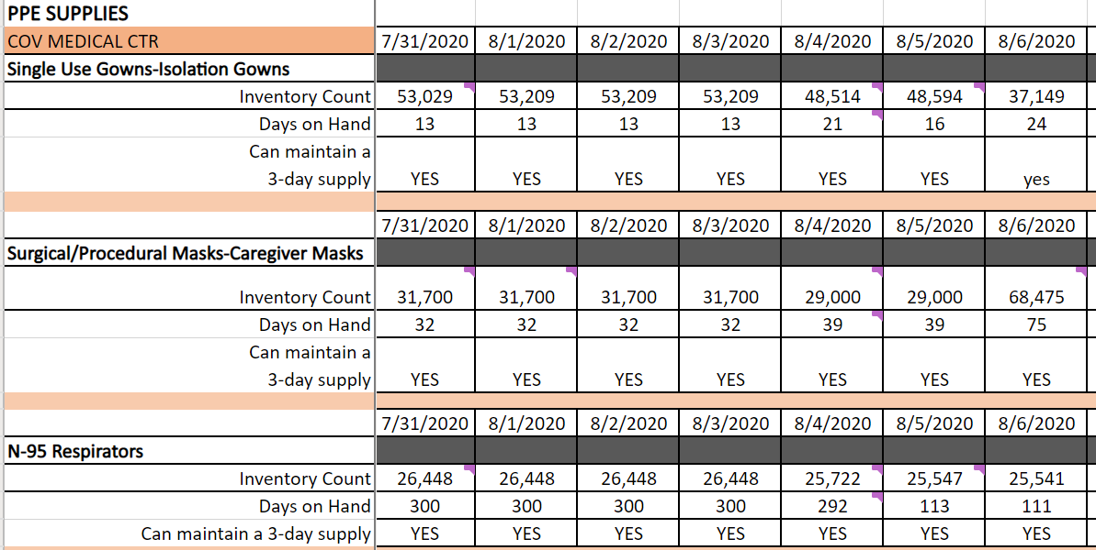
Covenant Medical Center

Slide 43
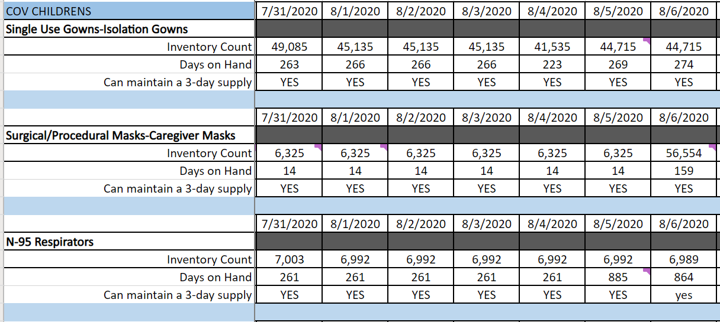

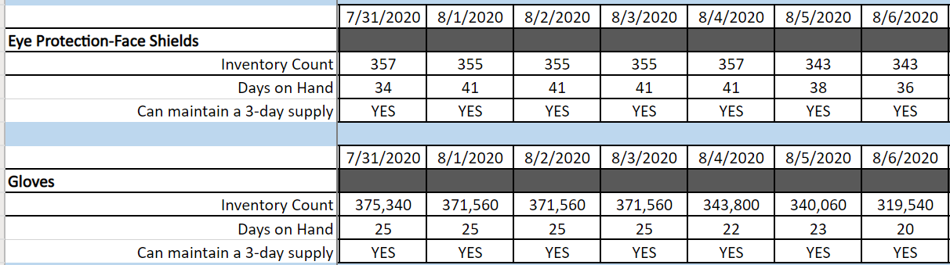
Covenant Women’s and Children’s Hospital

Slide 44
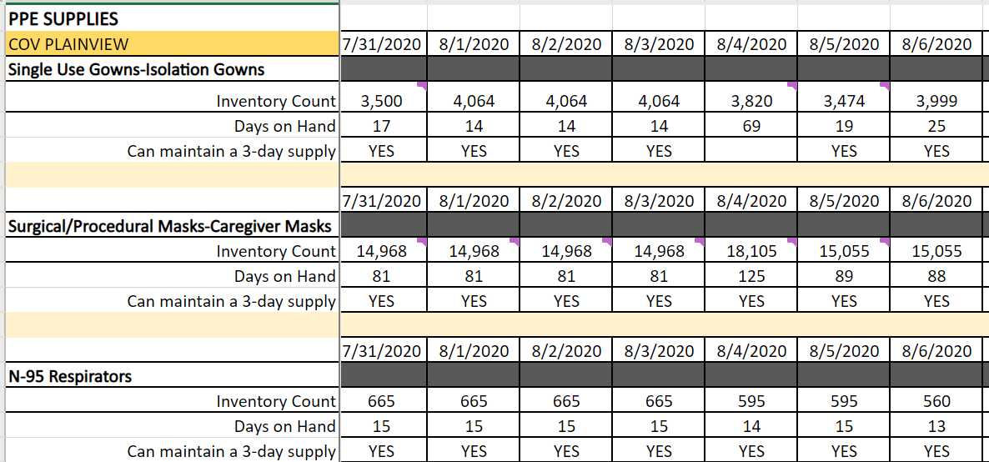

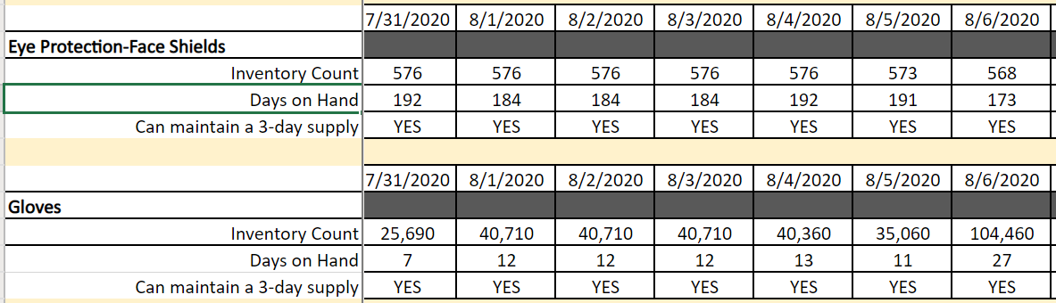
Covenant Plainview

Slide 45
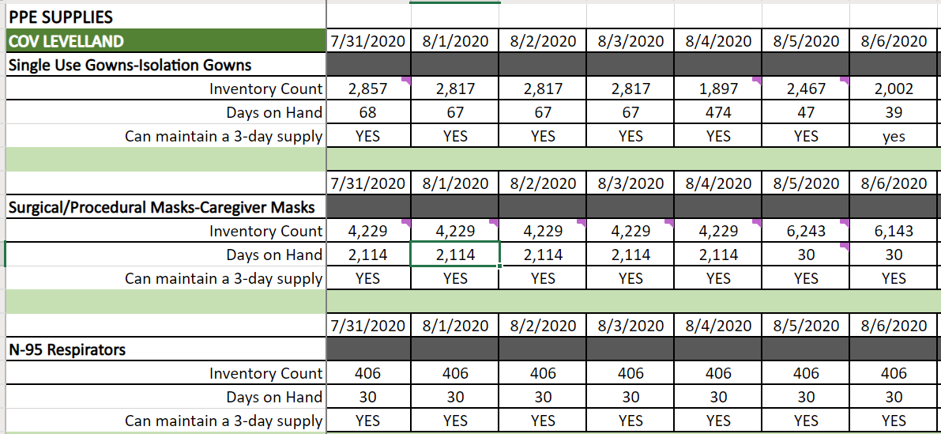

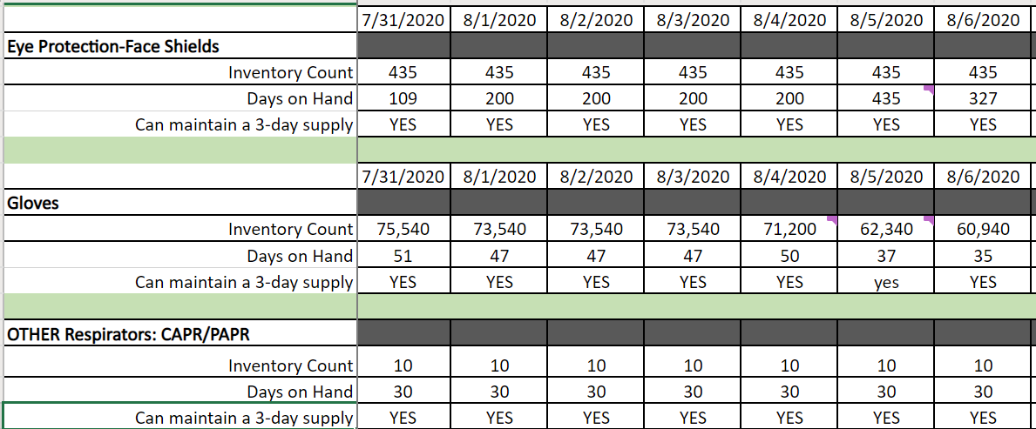
Covenant Levelland

Slide 46
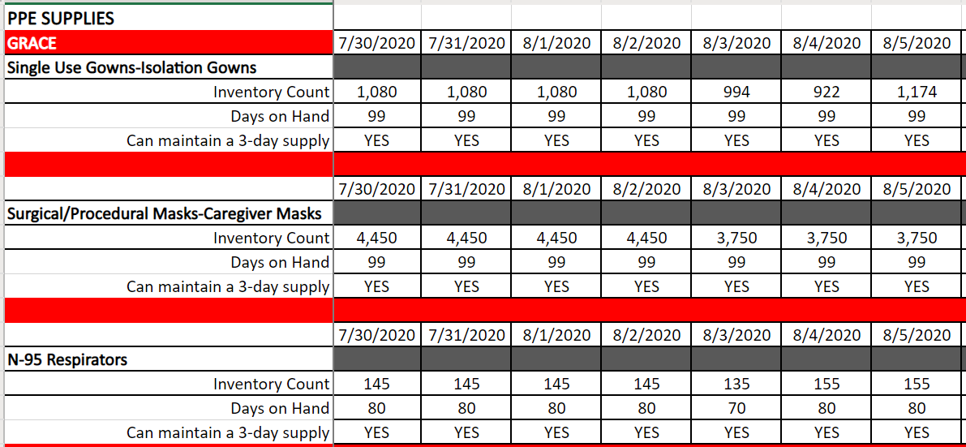

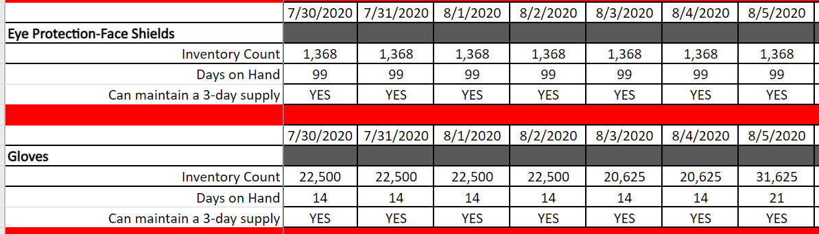

Grace

Slide 47
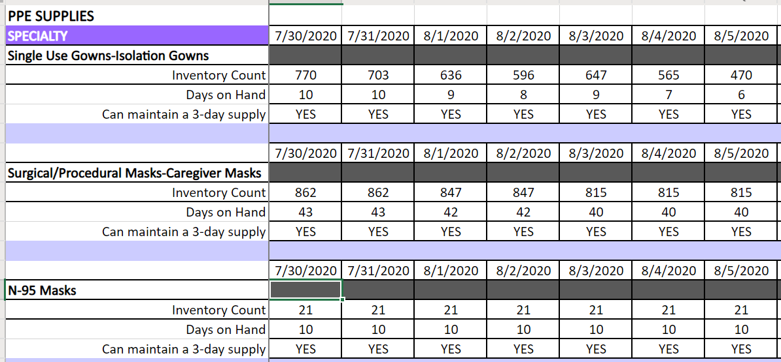

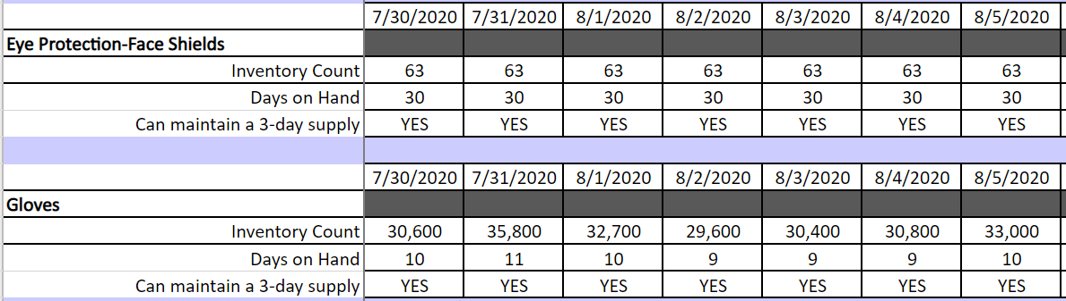
Covenant Specialty Hospital

Slide 48
Pharmacy Update
Wes Wells, PharmD
Regional Pharmacy Director
Covenant Health

Slide 49
CHS COVID-19 Treatments
Agent | Dosage | Comments | Update
Remdesivir Emergency Use Authorization (EUA) 5/1/20 | 200 mg IV x 1, then 100 mg IV daily x 4 days | EUA product purchased through ASB, allocation based on Teletracking reporting Reporting data daily RDV Utilization Team assemble to handle ethical concerns when supply becomes limited As part of EUA: Must provide “Fact Sheet for Patients” info Mandatory AE reporting to FDA MedWatch NIH guidelines update (July 24, 2020): Because supplies are limited, recommend prioritizing for patients who require supplemental O2 but who are NOT on: high-flow oxygen noninvasive ventilation mechanical ventilation, or ECMO | Remdesivir EUA Inventory: (Thursday AM) CMC = 166 vials; Plainview = 81 vials Remdesivir EUA Patients: (Thursday AM) CMC = 8; Plainview = 4 Allocation Determination: We are submitting usage and inventories daily to HHS. Allocation is not based on our usage but other COVID reported metrics. Allocations not purchased by the states will be distributed to other states.
Convalescent Plasma | 1 unit (200-400mL) x 1 | CMC enrolled in Mayo trial | Enrolled ___ patients to date Of note: 2 at CCH (pedi) via eIND
Notes:
According to the summary of the China study, remdesivir was “not associated with a difference in time to clinical improvement” compared to a standard of care control. After one month, it appeared 13.9% of the remdesivir patients had died compared to 12.8% of patients in the control arm. The difference was not statistically significant.
Hospitalized patients with advanced COVID-19 and lung involvement who received remdesivir recovered faster than similar patients who received placebo, according to a preliminary data analysis from a randomized, controlled trial involving 1063 patients, which began on February 21. The trial (known as the Adaptive COVID-19 Treatment Trial, or ACTT), sponsored by the National Institute of Allergy and Infectious Diseases (NIAID), part of the National Institutes of Health, is the first clinical trial launched in the United States to evaluate an experimental treatment for COVID-19. Preliminary results indicate that patients who received remdesivir had a 31% faster time to recovery than those who received placebo (p<0.001). Specifically, the median time to recovery was 11 days for patients treated with remdesivir compared with 15 days for those who received placebo. Results also suggested a survival benefit, with a mortality rate of 8.0% for the group receiving remdesivir versus 11.6% for the placebo group (p=0.059). Recovery in this study was defined as being well enough for hospital discharge or returning to normal activity level.
FYI Budesonide: In response to Odessa doctor, Richard Bartlett, who calls it the 'silver bullet‘. There have been no clinical trials or observational studies examining the use of ICS in COVID-19. Clinical trials would be required to establish whether these drugs may be repurposed for the treatment of this disease.

Slide 50
CHS COVID-19 Treatments
Agent | Dosage | Comments | Update
Dexamethasone | 6 mg IV/PO daily x 10 days | NIH guidelines recommend use in mechanically ventilated patients or those on supplemental oxygen | May utilize alternatives if dexamethasone is unavailable. Prednisone 40 mg/day divided Q12-24H Methylprednisolone 32 mg/day divided Q12-24H Hydrocortisone 160 mg/day divided Q6-12H
Tocilizumab | 400 mg IVPB x 1 dose May repeat x 1 in 8-12 hours if clinical symptoms worsen or do not demonstrate improvement | IL-6 receptor antagonist used to treat CRS ($2.13K - $4.25K per dose) Signed informed consent is recommended prior to dispensing this agent CHS criteria for use: Proven COVID-19 infection Early treatment of severe/critically ill patients who are clinically deteriorating Restricted to intensivists or ID AST/ALT <5xULN, ANC >500, Plt >50K | NIH guidelines state insufficient data to recommend for or against the use of IL-6 inhibitors for treatment of COVID-19 Roche Media Release 7/29/20: Update on the phase III COVACTA trial – “COVACTA trial did not meet its primary endpoint of improved clinical status in patients with COVID-19 associated pneumonia, or the key secondary endpoint of reduced patient mortality” ID CDT and AMS do not recommend using outside of clinical trials Reminder: As of 7/2, a clinical trial with sarilumab was stopped due to futility
Notes:
The FDA says that neither drug has been proven safe and effective in treating COVID-19. In fact, a study published on April 23 involving 368 COVID-19 patients at U.S. Veterans Health Administration hospitals found that taking hydroxychloroquine alone, or in combination with azithromycin, did not reduce the need for a ventilator compared to those not taking the drugs. Further, people taking hydroxychloroquine alone had a higher risk of dying during the study than those not taking the drug. Researchers in China came to a similar conclusion in a study of 150 COVID-19 patients randomly assigned to receive hydroxychloroquine or the current standard of care: after a month, both groups had similar symptom profiles, and showed similar levels of the virus, suggesting that the drug wasn’t clearing the COVID-19 virus in a significant way. The National Institutes of Health is conducting an ongoing study of hydroxychloroquine among hospitalized patients, as is Novartis, whose Sandoz division makes a generic version of the drug.
HCQ:
PSJH high risk patients (age > 60, pulmonary disease, CV disease, CKD, DM, immune compromised, HTN present on admission or receiving anti-hypertensives prior to admission)
Toci:
Proven COVID-19 infection based on laboratory testing AND radiographic evidence of pneumonia
Severely ill definition: SpO2 ≤ 93% on room air or FiO2/PaO2 ≤ 300 mmHg or respiratory rate ≥ 30 breaths/min
Critically ill definition: Mechanical ventilation OR multi organ failure OR ICU admission
After publication of our Lancet Article,¹
several concerns were raised with respect to the veracity of the data and analyses conducted by Surgisphere Corporation and its founder and our co-author, Sapan Desai, in our publication. We launched an independent third-party peer review of Surgisphere with the consent of Sapan Desai to evaluate the origination of the database elements, to confirm the completeness of the database, and to replicate the analyses presented in the paper.
Our independent peer reviewers informed us that Surgisphere would not transfer the full dataset, client contracts, and the full ISO audit report to their servers for analysis as such transfer would violate client agreements and confidentiality requirements. As such, our reviewers were not able to conduct an independent and private peer review and therefore notified us of their withdrawal from the peer-review process.
Toci update 7/31:
Primary endpoint not met: The difference in clinical status between Actemra/RoActemra and placebo in patients assessed using a 7-category ordinal scale at week four was not statistically significant (p=0.36; odds ratio [95% CI] = 1.19 [0.81, 1.76], a statistically significant odds ratio greater than 1 would have favoured Actemra/RoActemra).
• There was no difference between Actemra/RoActemra and placebo in the percentage of patients that died by week four (Actemra/RoActemra = 19.7% and placebo = 19.4% with a difference [95% CI] of 0.3% [-7.6%, 8.2%], p=0.9410)

Slide 51
CHS COVID-19 Treatments
Agent | Dosage | Comments | Update
Ivermectin | 150-400 mcg/kg PO* *Effective dosing strategy unknown | In vitro studies show activity at high doses Concentration used in-vitro showing activity is >35X higher than the max plasma concentration after oral administration of approved dose (200 mcg/kg) No RCT data No published peer reviewed data supporting its safety and efficacy: caution with pilot, phase 2, or retrospective study info available on pre-print | Clinical trials ongoing
Sildenafil | 20 mg PO three times a day | COVID-19 efficacy unknown | Clinical trials ongoing
Zanubrutinib | 320 mg PO once daily for up to a maximum of 28 days | CMC will be participating in this phase 2, randomized, double blind, placebo-controlled (N~46-52) | Current enrollment: 0 patients
Notes:
According to the summary of the China study, remdesivir was “not associated with a difference in time to clinical improvement” compared to a standard of care control. After one month, it appeared 13.9% of the remdesivir patients had died compared to 12.8% of patients in the control arm. The difference was not statistically significant.
Hospitalized patients with advanced COVID-19 and lung involvement who received remdesivir recovered faster than similar patients who received placebo, according to a preliminary data analysis from a randomized, controlled trial involving 1063 patients, which began on February 21. The trial (known as the Adaptive COVID-19 Treatment Trial, or ACTT), sponsored by the National Institute of Allergy and Infectious Diseases (NIAID), part of the National Institutes of Health, is the first clinical trial launched in the United States to evaluate an experimental treatment for COVID-19. Preliminary results indicate that patients who received remdesivir had a 31% faster time to recovery than those who received placebo (p<0.001). Specifically, the median time to recovery was 11 days for patients treated with remdesivir compared with 15 days for those who received placebo. Results also suggested a survival benefit, with a mortality rate of 8.0% for the group receiving remdesivir versus 11.6% for the placebo group (p=0.059). Recovery in this study was defined as being well enough for hospital discharge or returning to normal activity level.
Ivermectin: The concentration resulting in 50% inhibition (IC50; 2 µM) was > 35× higher than the maximum plasma concentration (Cmax) after oral administration of the approved dose (200 mcg/kg)

Slide 52
Pharmacy Shortages/Allocations
Covid-19 Related
  Cisatracurium
  Rocuronium
  Vecuronium
  Propofol
  Fentanyl
  Vitamin C Liquid and Inj
  Dexamethasone Inj and Tabs
  Ivermectin
  Zinc Sulfate Tabs
  Sildenafil Tabs
  Budesonide Inhalers
Non-Covid-19 Related
  Bumetanide
  Amiodarone
  Dopamine
  Dobutamine
  Famotidine
  Furosemide Inj
  Doxycycline Inj
  Nitroglycerin SDV
  Bupivacaine with epinephrine
  Lidocaine with epinephrine
  Methadone Inj
  Nalbuphine Inj

Slide 53
Differences in Approval Status

Slide 54
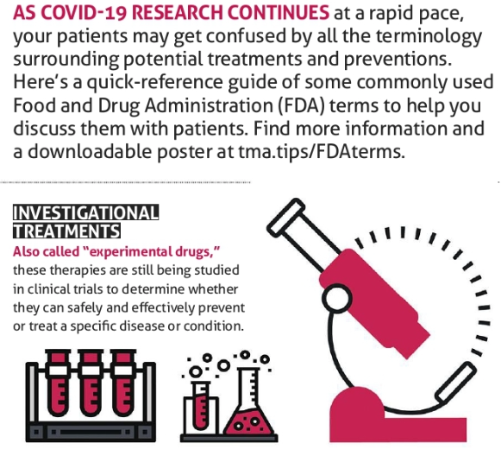
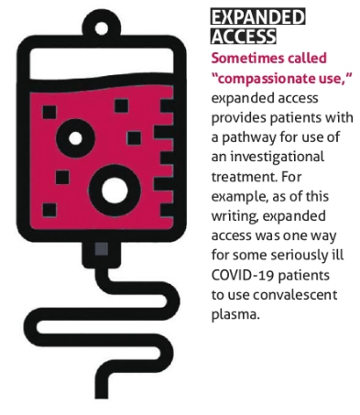
FDA “Approved” Treatment?

Slide 55
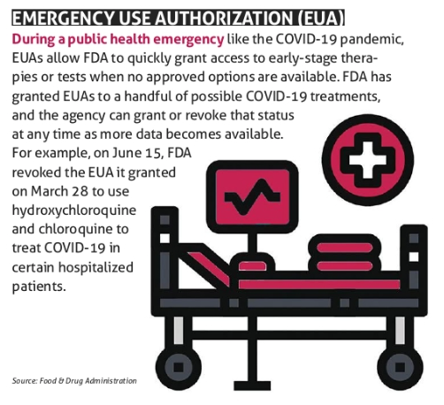
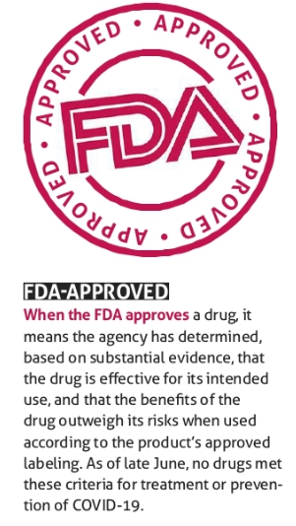
FDA “Approved” Treatment?

Slide 56
Reminders to Physicians
Code Lavender
Connie Gonzales, RN

Slide 57
Texas Demographics

Slide 58
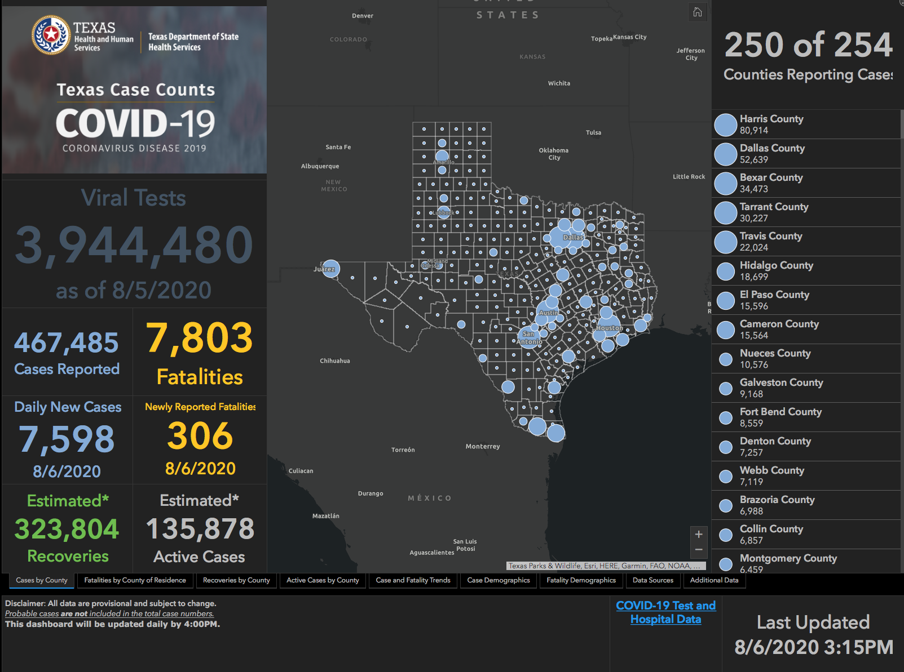

Slide 59
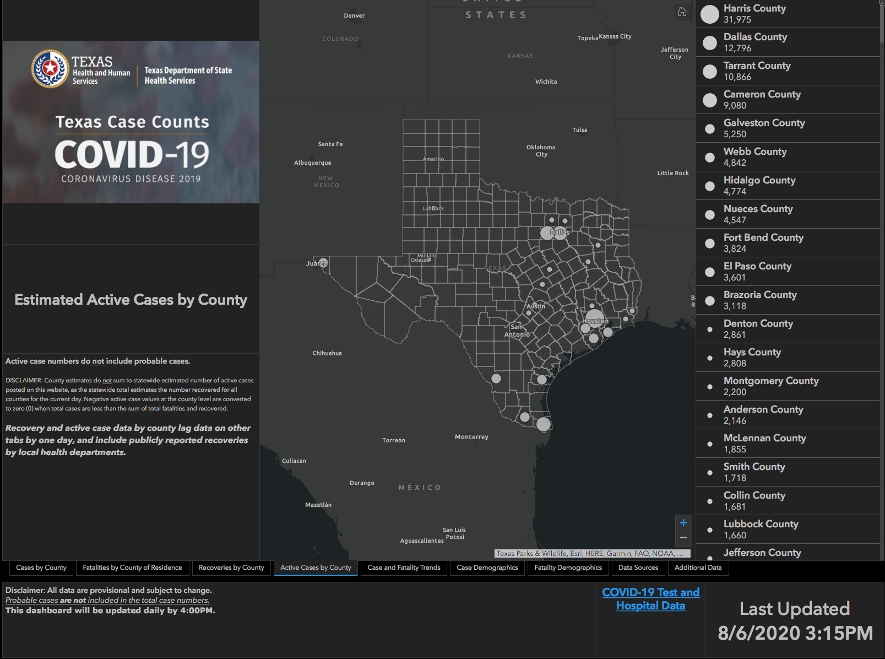

Slide 60


Slide 61
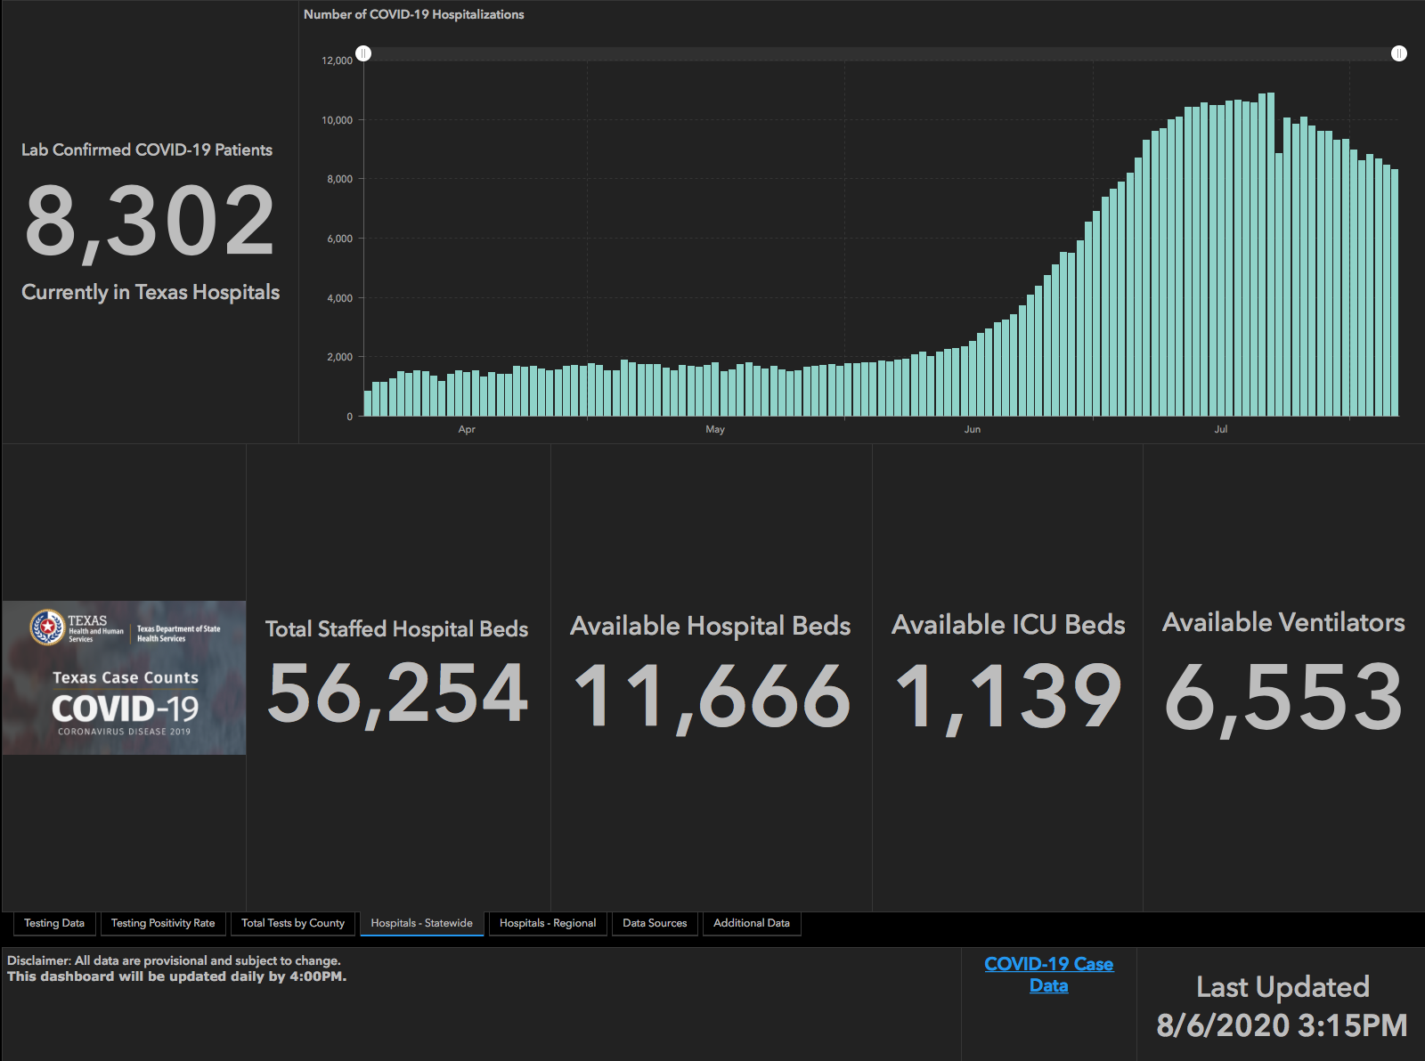

Slide 62
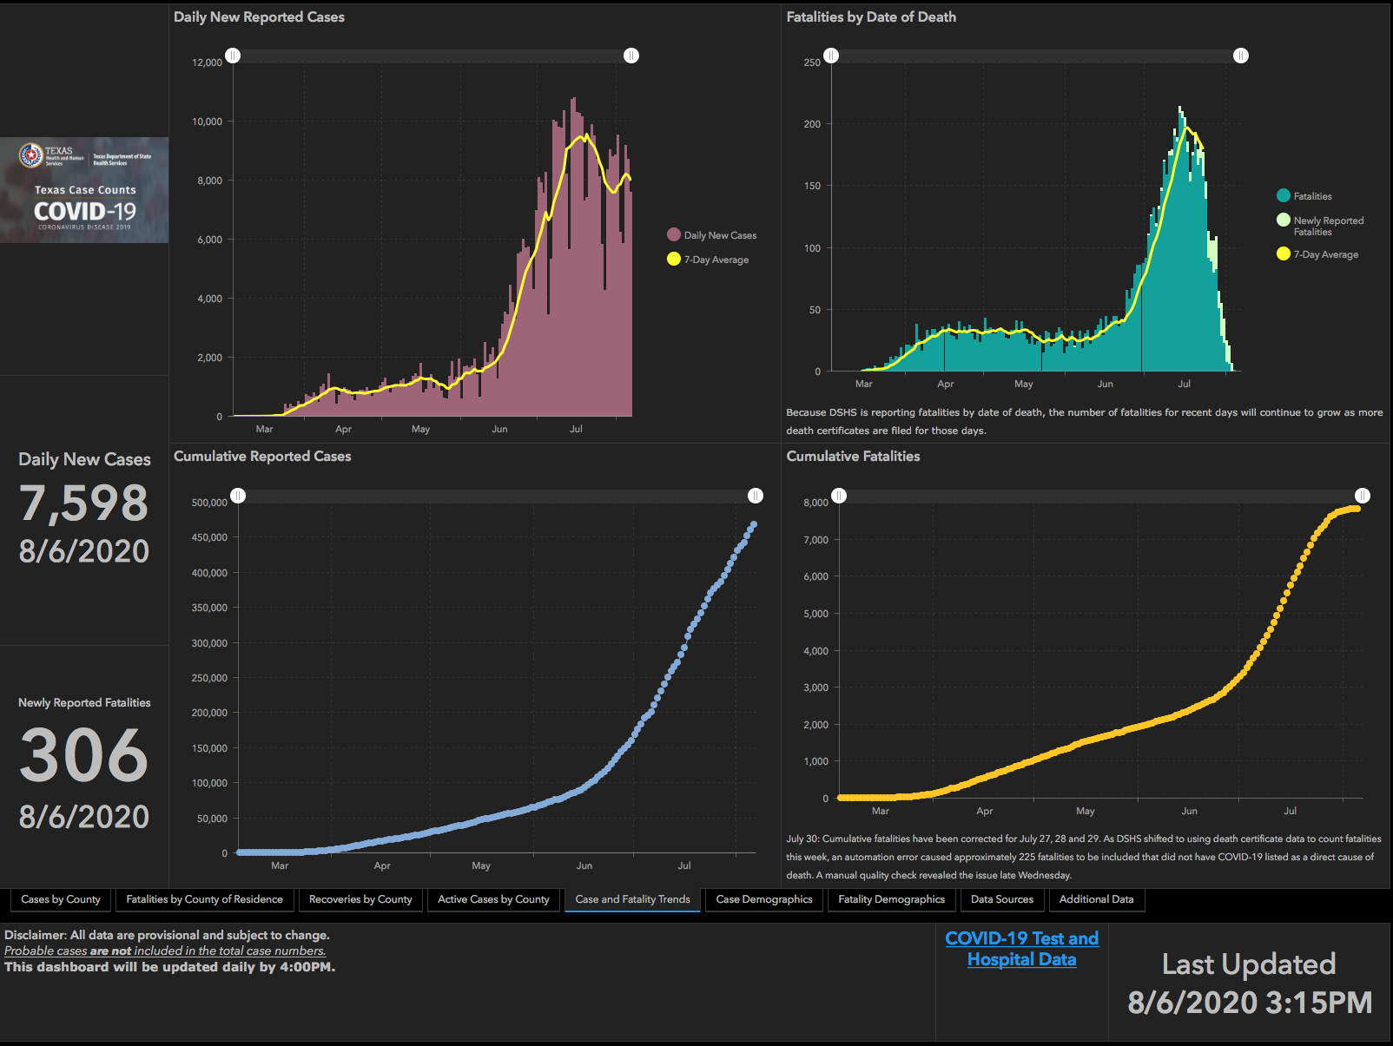

Slide 63
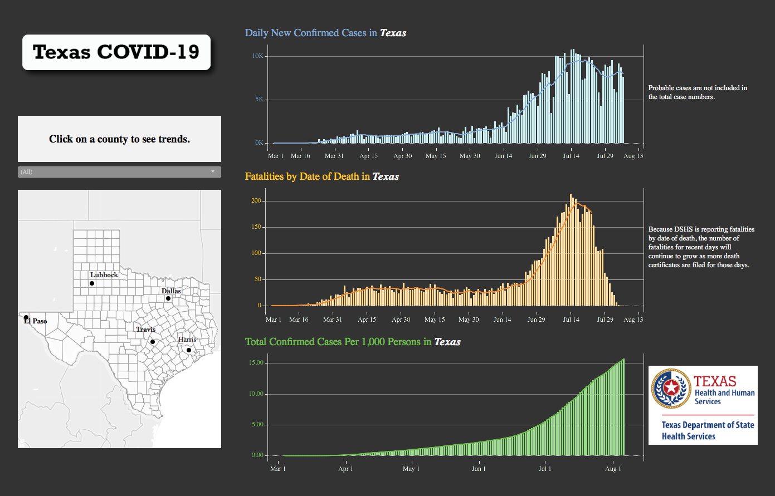

Slide 64
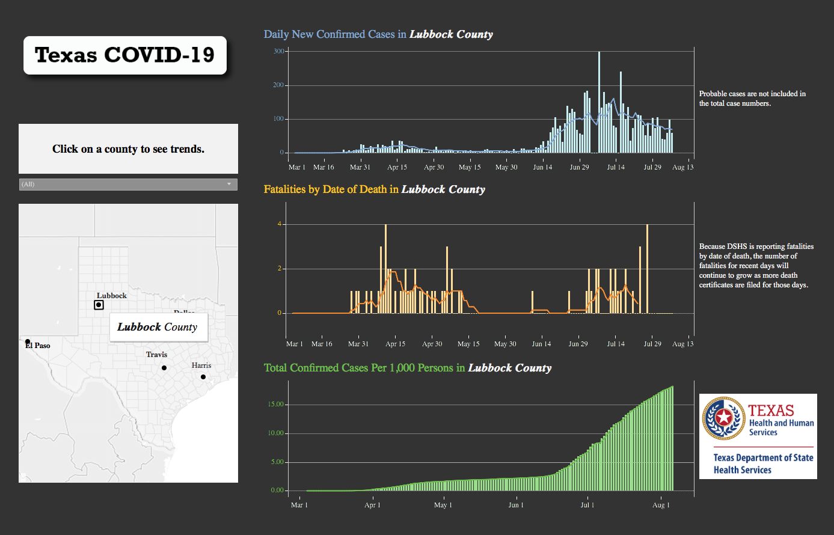

Slide 65
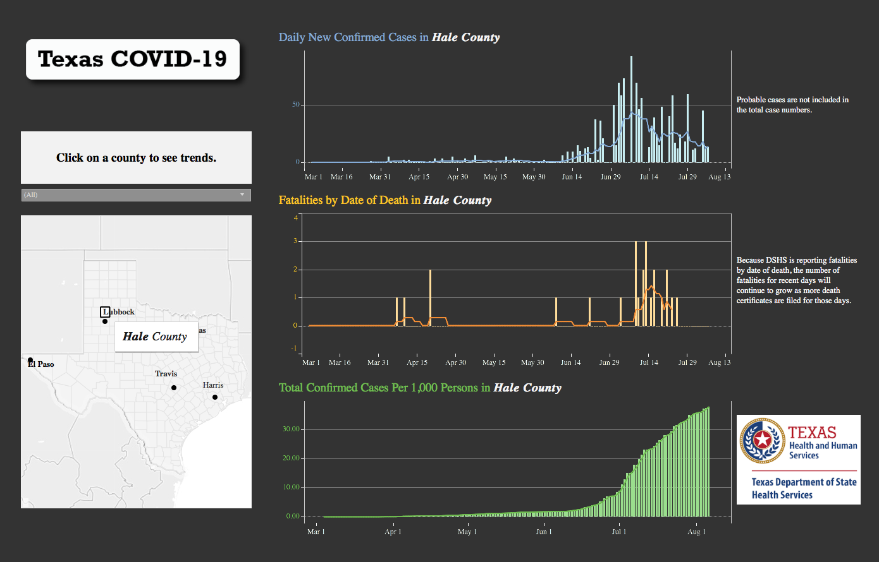

Slide 66
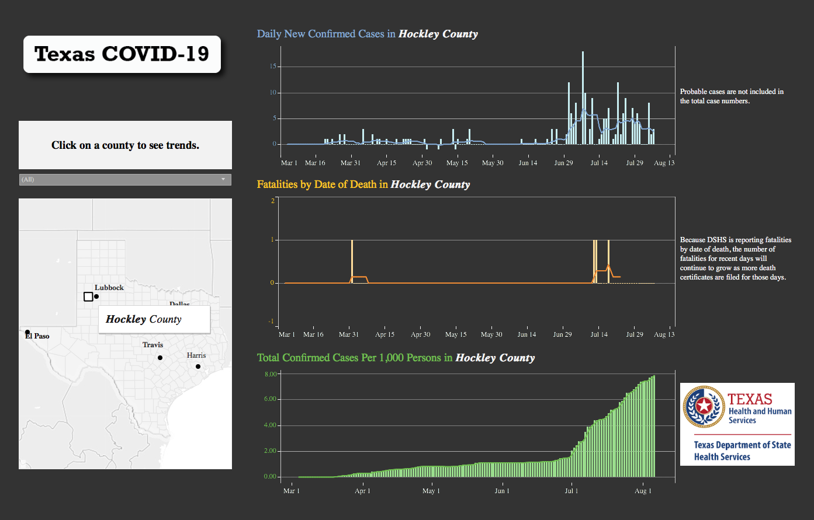

Slide 67
Q & A

