Slide 1
Inpatient DNR Orders
Lindzi Timberlake, Associate Counsel
Sandy Slaton, Risk Management Director

Slide 2
Inpatient DNR orders changed on April 1, 2018, when a new Texas law regarding Inpatient DNR orders took effect NEW: parameters set for a specific physician’s medical order for DNR reflecting informed consent for DNR Unchanged: Out-of-hospital DNR order, Medical power of attorney, Directives to Physicians and Family or Surrogates (Living Will, Advance Directive)

Slide 3
Legislative intent is to ensure that DNR orders are not placed for inpatients without a specific consent by the patient/pt’s representative that is documented Requirements: 1. Attending physician writes order and 2. Oral consent by patient with decisional capacity; witnessed or 3. Written consent (Advance Directive) from patient or 4. Direction and consent from patient’s representative and 5. Must inform patient or patient’s representative when DNR order written

Slide 4
Other provisions: 1. Physician may still issue DNR order if patient has no known Advance Directive or surrogate decision-maker and death is imminent, DNR is medically appropriate, and the order is not contrary to directions of pt conveyed when pt had decisional capacity. 2. Witnesses to oral consent for DNR order are specified in the statute: a) Two competent adult witnessed required b) Only one may be a hospital employee providing direct patient care to the patient, an employee of the attending physician, or a hospital employee who is an administrative employee c) Potential witnesses include patient’s spouse, patient’s family member, patient’s friend, attending physician, stranger

Slide 5
Statutory requirements for Inpatient DNR Order: Attending Physician: “selected by or assigned to a patient who has primary responsibility for a patient’s treatment or care” Does NOT include resident, fellow, Physician Assistant, Nurse Practitioner or any other individual to whom a physician could delegate their duties Scenario: admitting physician, hospitalist currently assigned to patient, consulting physician currently managing the care for the patient (i.e., surgeon who has just performed surgery and is managing post-op care)

Slide 6
COVENANT POLICY: “If desired by the patient (or patient’s representative) and the patient consents in writing or orally to a DNR order by the attending physician, the DNR order will be issued and dated by an attending physician and placed in the patient’s medical record as soon as practicable.” QUESTION: Does this mean a verbal order can be issued by the attending physician? Interpretation: Yes, if – 1) Informed consent discussion took place between patient/representative and physician 2) Physician not readily able to enter order in EMR or paper chart 3) Physician MUST sign the order within 24 hours. Two licensed caregivers (typically, RNs) must sign as witnesses to verbal order

Slide 7
In-Hospital DNR Order - 7 basis for this order A) Written declaration by patient with decisional capacity B) Oral declaration by patient with decisional capacity C) Declaration in “Patient’s Directive to Physician” (Advance Directive, Living Will) D) Declaration for patient without decisional capacity by patient’s legal guardian or Medical Power of Attorney (MPOA) E) Declaration for patient without decisional capacity by Qualified Adult (surrogate – usually next of kin) F) Declaration for minor patient by minor’s spouse, parents or legal guardian G) Physician order for patient without decisional capacity, without surrogate decision-maker, without directive against DNR, and death is imminent regardless of providing CPR

Slide 8
Inpatient DNR Order The new order form is simplified: 1. Designate choice of FULL RESUSCITATION or DNR 2. Obtain appropriate signature(s): - Have patient sign, if able - If verbal consent by patient, have 2 appropriate witnesses sign - Have patient’s representative sign

Slide 9
SCENARIOS: 7 basis for Inpatient DNR Order

Slide 10
Written declaration by pt with decisional capacity Mr Apple is admitted to the hospital for COVID pneumonia and hyperglycemia. He has given the nursing staff a piece of notebook paper he brought from home on which he wrote his end-of-life wishes, including the desire to be a DNR. Action: Discuss Mr Apple’s plan of care and prognosis with him and verify his DNR wishes. Ensure he’s aware of what DNR means in the hospital. Document your conversation in the medical record and write an order for Inpatient DNR. Ask Mr Apple to sign as patient. w

Slide 12
Oral declaration by pt with decisional capacity Mr Apple is admitted to the hospital for COVID pneumonia and hyperglycemia. He tells the admitting nurse he doesn’t want “any of that CPR and machines and stuff.” The nurse tells you about Mr Apple’s wishes. Action: Discuss Mr Apple’s plan of care and prognosis with him and verify his DNR wishes. Ensure he’s aware of what DNR means in the hospital. Document your conversation in the medical record and write an order for Inpatient DNR. Have one of the unit RNs or Chaplain to serve as a witness, along with Mrs Apple (2 appropriate witnesses). w

Slide 14
Declaration in “Patient’s Directive to Physician” (Advance Directive, Living Will) Mr Apple is admitted to the hospital for COVID pneumonia and hyperglycemia. He tells the admitting nurse he has an Advance Directive and doesn’t want “any of that CPR and machines and stuff.” The nurse tells you about Mr Apple’s Advance Directive. Action: Discuss Mr Apple’s plan of care and prognosis with him and verify his DNR wishes. Ensure he’s aware of what DNR means in the hospital. Document your conversation in the medical record, including that you are conforming with pt’s Advance Directive, and write an order for Inpatient DNR. Ask Mr Apple for a copy of his Advance Directive for his medical record. Ask Mr Apple to sign as patient. Note: If patient representative presents Advance Directive for patient who lacks decisional capacity, ask representative to sign. w

Slide 15
Use when patient presents an Advance Directive
Use when pt’s representative presents an Advance Directive

Slide 16
Declaration for patient without decisional capacity by Qualified Adult (surrogate – usually next of kin) Mr Apple, a widower with no children, is admitted to the hospital for COVID pneumonia and hyperglycemia. He is confused and somnolent. His nephew, Mr Banana, is with him and tells the admitting nurse that he doesn’t want CPR and life support for his uncle if he worsens. Mr Apple doesn’t have an Advance Directive or MPOA. The nurse tells you what Mr Banana said. Action: Discuss Mr Apple’s plan of care and prognosis with his nephew and verify the DNR wishes. Ensure he’s aware of what DNR means in the hospital. Document your conversation in the medical record and write an order for Inpatient DNR. Ask Mr Banana to sign on behalf of his uncle. w

Slide 17
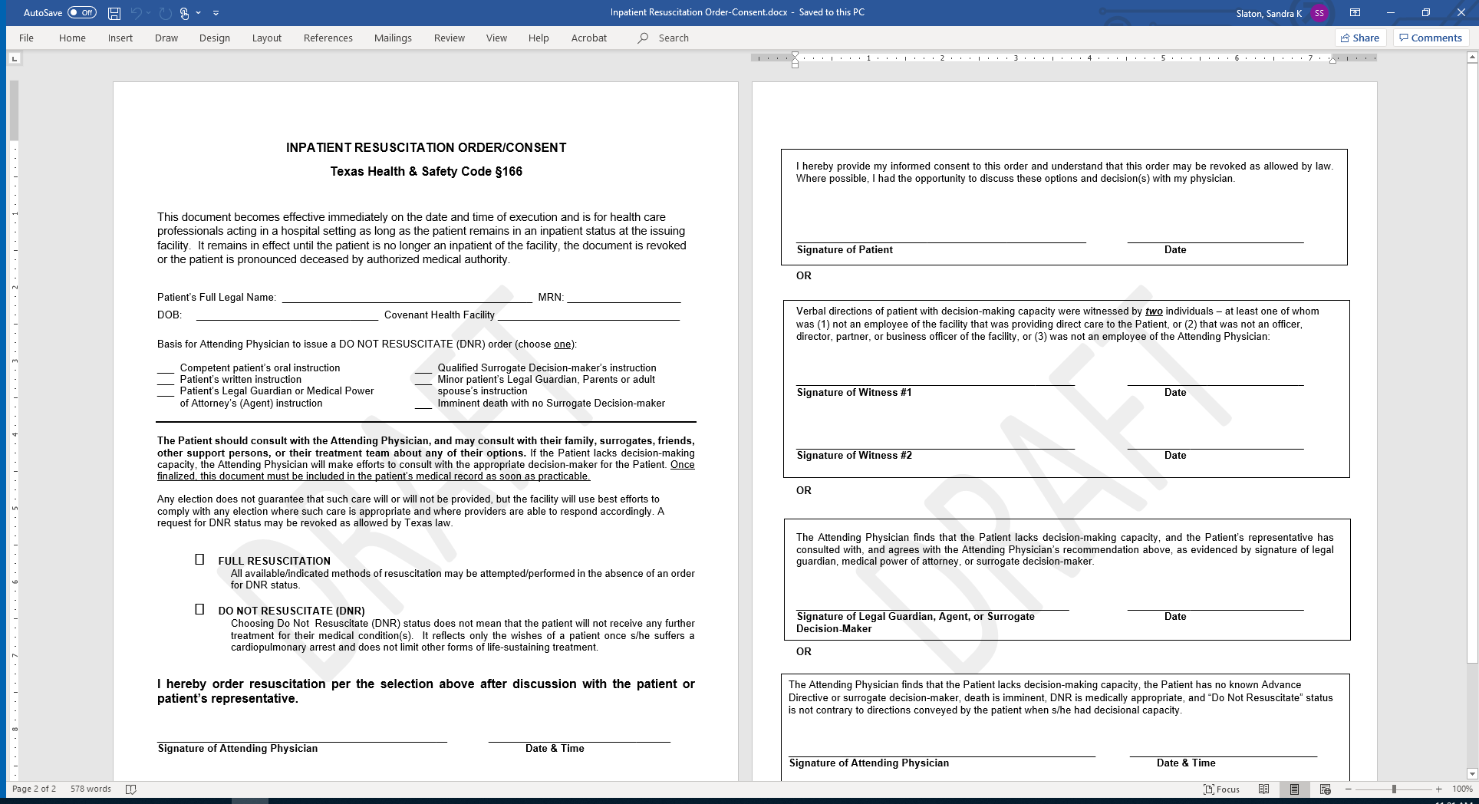
Declaration for patient without decisional capacity by patient’s legal guardian or Medical Power of Attorney (MPOA) Mr Pie is admitted to the hospital for COVID pneumonia and hyperglycemia. He is confused and somnolent. His daughter, Ms Cake, arrives and informs the staff she is her dad’s MPOA. She tells the admitting nurse that she doesn’t want CPR and life support for her dad if he worsens. The nurse tells you what Ms Cake said. Action: Discuss Mr Pie’s plan of care and prognosis with his MPOA and verify the DNR wishes. Ensure she’s aware of what DNR means in the hospital. Document your conversation in the medical record and write an order for Inpatient DNR. Ask Ms Cake to sign on behalf of her dad. w

Slide 18
Declaration for minor patient by minor’s spouse, parents or legal guardian Miss Cherry, a 16-year-old, is admitted to the hospital with a severe head and chest injuries following a MVC. After a few days in the ICU, her mom, Mrs Cherry, comes tells the nurse that she doesn’t want CPR for her daughter if she arrests. Miss Donut doesn’t have a guardian. The nurse tells you what Mrs Cherry said. Action: Discuss Miss Cherry’s plan of care and prognosis with her mom and verify the DNR wishes. Ensure she’s aware of what DNR means in the hospital. Document your conversation in the medical record and write an order for Inpatient DNR. Ask Mrs Cherry to sign as parent of the minor patient. w

Slide 19
Declaration for patient without decisional capacity by patient’s legal guardian or Medical Power of Attorney (MPOA) Mr Pie is admitted to the hospital for COVID pneumonia and hyperglycemia. He is confused and somnolent. His daughter, Ms Cake, arrives and informs the staff she is her dad’s MPOA. She tells the admitting nurse that she doesn’t want CPR and life support for her dad if he worsens. The nurse tells you what Ms Cake said. Action: Discuss Mr Pie’s plan of care and prognosis with his MPOA and verify the DNR wishes. Ensure she’s aware of what DNR means in the hospital. Document your conversation in the medical record and write an order for Inpatient DNR. Ask Ms Cake to sign on behalf of her dad. w

Slide 20
Physician order for patient without decisional capacity, without surrogate decision-maker, without directive against DNR, and death is imminent regardless of providing CPR Mrs Pear, a 77-year-old widow, is admitted to the hospital after being found down at in her driveway. Care Managers are unable to locate any family and no Advance Directive has been located. After a few days in the ICU, it’s apparent she had a devastating brain bleed with shift and she will not survive. Action: Document Mrs Pear’s condition and prognosis and the rationale for making her a DNR in the medical record, and write an order for Inpatient DNR. You may request an Ethics Consult for guidance in this situation. w

Slide 22
Questions?  Risk Management is available 24/7 to assist you with questions about Inpatient DNR Orders: (806) 392-7319  Ethics is available for consult: Order consult in Meditech  Texas Hospital Association has good information on their website: https://www.tha.org/SB11

