Slide 1


Clinical Documentation Integrity (CDI) Program

Slide 2
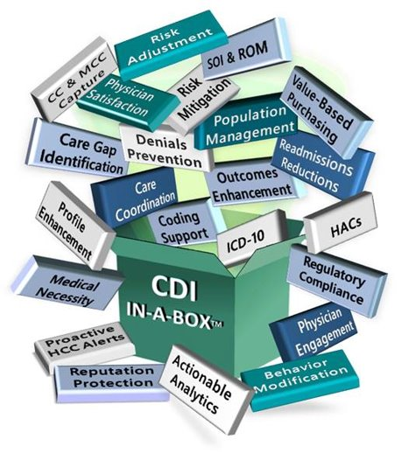
CDI FUNDAMENTAL PURPOSE
Communication
Reduce Denials
Improve your E&M billing
Accuracy in the Patients Medical Record
Quality
Efficiency

Slide 3


CDI
WHO | Staff of Registered Nurses—Clinical review​ Trained in CDI Clinical Review and Coding Guidelines​ Standardized Efficiency and Compliance Bridge the Gap Between Clinical Language and Coding​
WHAT | Concurrently Review Inpatient Medical Records​ Place Provider E-Query for Clarification in the Medical Record Support Quality Standards Improve Documentation in the Medical Record
WHY | Coders Review Only Documentation—Not Clinical Information​ Coding Compliance Guidelines​ Timely Query Response < 72 hours​ Develop and Maintain Communication with Providers
Incorporate E-Query into Your Daily Workflow

Slide 4
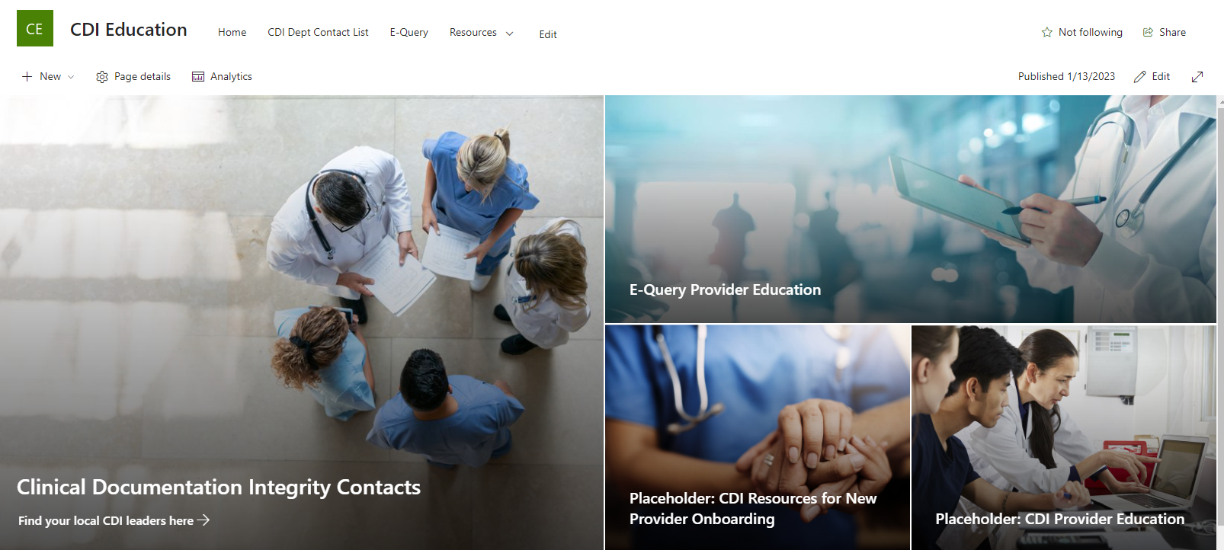
CDI Education - Home (sharepoint.com)
                Providence CDI Program

Slide 5

MEET OUR TEAM
Robert Vietri, RHIA, CCDS
CDI Manager
rvietri@r1rcm.com
Katherine McFarland
Central Division CDI Director
kmcfarland@r1rcm.com
Lesa Hansen
VP CDI Services – CDI - Providence
Clinical Documentation Integrity Contacts (sharepoint.com)
                Providence CDI Program

Slide 6
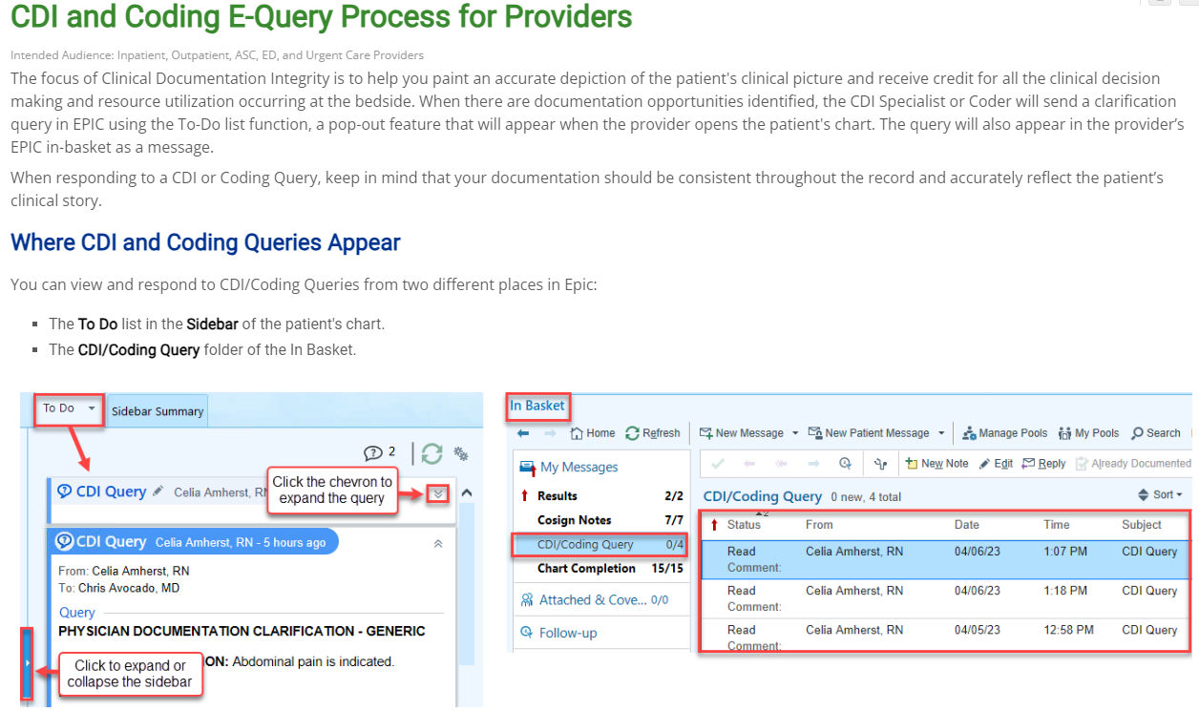
CDI and Coding Query CDI and Coding E-Query Process for Providers (providence.org)
                Providence CDI Program

Slide 7

Thank you for your Partnership
                Providence CDI Program

