Slide 1
Clinical Documentation Integrity (CDI) Program

Slide 2
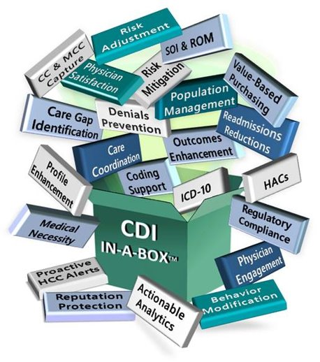
CDI FUNDAMENTAL PURPOSE
Communication
Reduce Denials
Improve your E&M billing
Accuracy in the Patients Medical Record
Quality
Efficiency

Slide 3
CDI
WHO | Staff of Registered Nurses—Clinical review​ Trained in CDI Clinical Review and Coding Guidelines​ Standardized Efficiency and Compliance Bridge the Gap Between Clinical Language and Coding​
WHAT | Concurrently Review Inpatient Medical Records​ Place Provider E-Query for Clarification in the Medical Record Support Quality Standards Improve Documentation in the Medical Record
WHY | Coders Review Only Documentation—Not Clinical Information​ Coding Compliance Guidelines​ Timely Query Response < 72 hours​ Develop and Maintain Communication with Providers
Incorporate E-Query into Your Daily Workflow

Slide 4
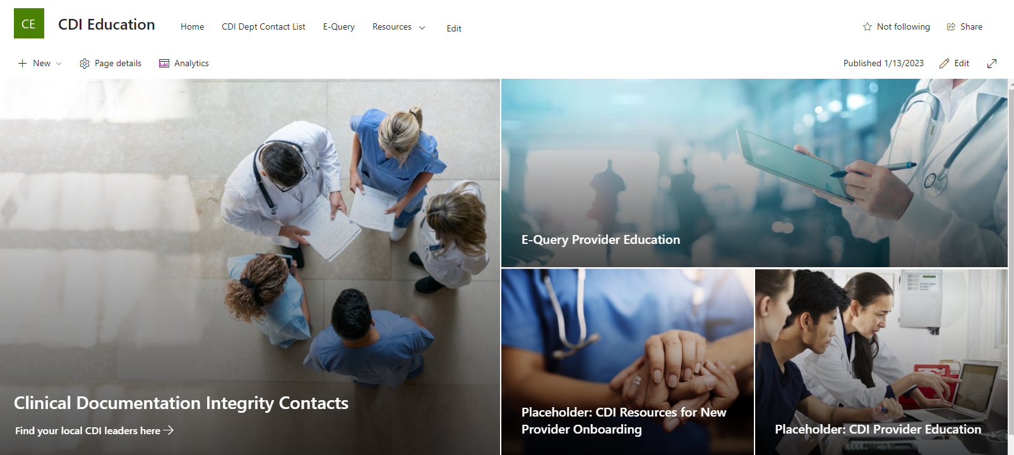
CDI Education - Home (sharepoint.com)
Providence CDI Program

Slide 5
MEET OUR TEAM
Robert Vietri, RHIA, CCDS
CDI Manager
Robert.vietri@providence.org
Katherine McFarland
Central Division CDI Director
Katherine.mcfarland@providence.org
Clinical Documentation Integrity Contacts (sharepoint.com)
Providence CDI Program

Slide 6
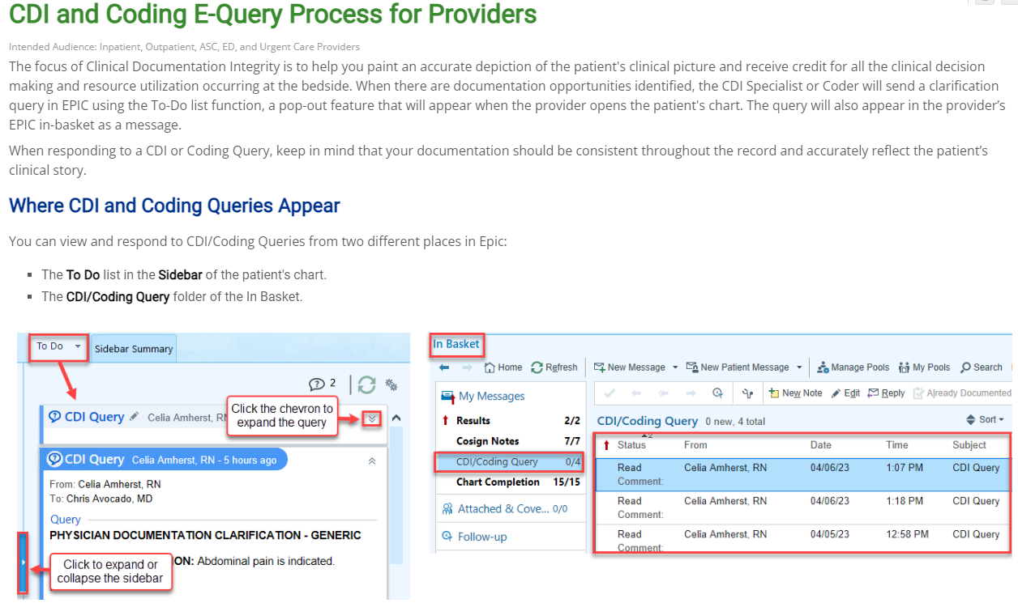
CDI and Coding Query CDI and Coding E-Query Process for Providers (providence.org)
Providence CDI Program

Slide 7
Thank you for your Partnership
Providence CDI Program

