Slide 1
Covenant Health
Presents
Critical Communications: A Weekly Physician Update
November 6th, 2020

Slide 2
PHYSICIANS
Accreditation Statement:
The Covenant Health is accredited by the Texas Medical Association (TMA) to provide continuing medical education for physicians.
Credit Designation Statement:
The Covenant Health designates this live CME activity for a maximum of 1.0 AMA PRA Category 1 Credit(s)™. Physicians should claim only the credit commensurate with the extent of their participation in the activity.

Slide 3
Disclosures of Commercial Interest
The speakers and planners of this activity
have no relevant financial interests

Slide 4
Disclosures
This activity is provided by
Covenant Health
No commercial support has been received.
No products will be endorsed.
Speakers will notify the audience if off label drug use will be discussed.

Slide 5
CME Credit was only approved for the Live Teams meeting
To receive credit for this continuing education activity, the participant must:
  Make sure you are logged into your Teams account, if you are signed in with a group provide attendee’s First and Last name(s) in the comments section.
  If you are calling into the Teams meeting you MUST text your First & Last Name to (806) 252-4735. This will ensure you are added to the sign in sheet to receive CME Credit.
  You will receive an email within 3 business days from the CME department with further instructions on claiming your certificate.

Slide 6
Reflection & Safety Story
Presented by
Michael Chamales, MD
Medical Director
Covenant Emergency Services

Slide 7
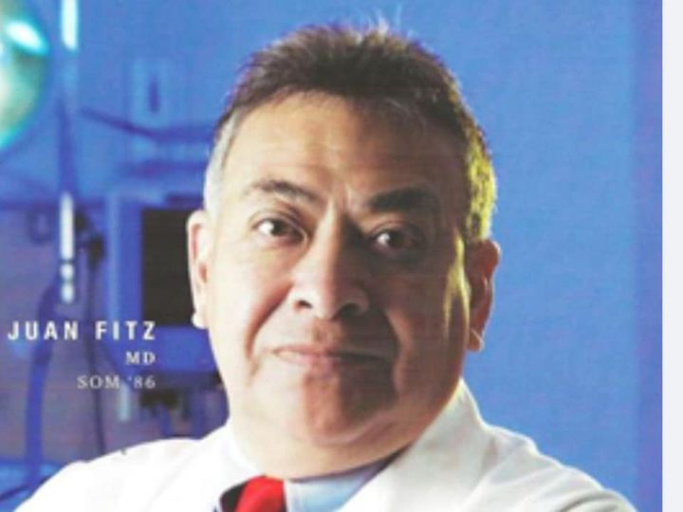


Slide 8
Visitation: Tues. Nov 10, 6-8 pm Lakewood Chapel
Services for Dr. Fitz will be live-streamed
Wed, Nov 11th, 11:00 am
Knipling Education Center
CMC Physician Dining Room

Slide 9
Dr Bodine
Yoakum County Hospital
Presented by:
Collin McLarty
Yoakum County Hospital

Slide 10
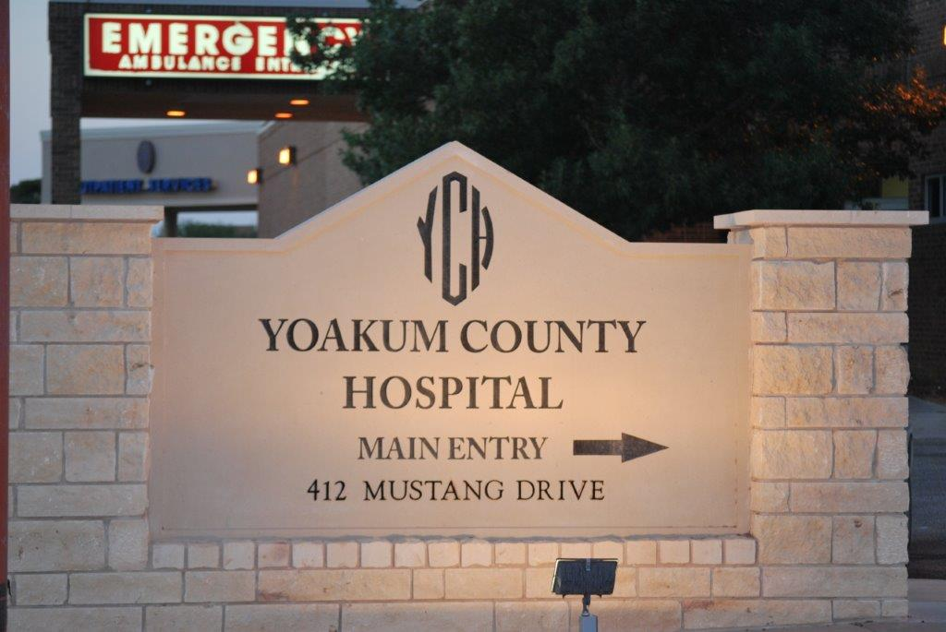
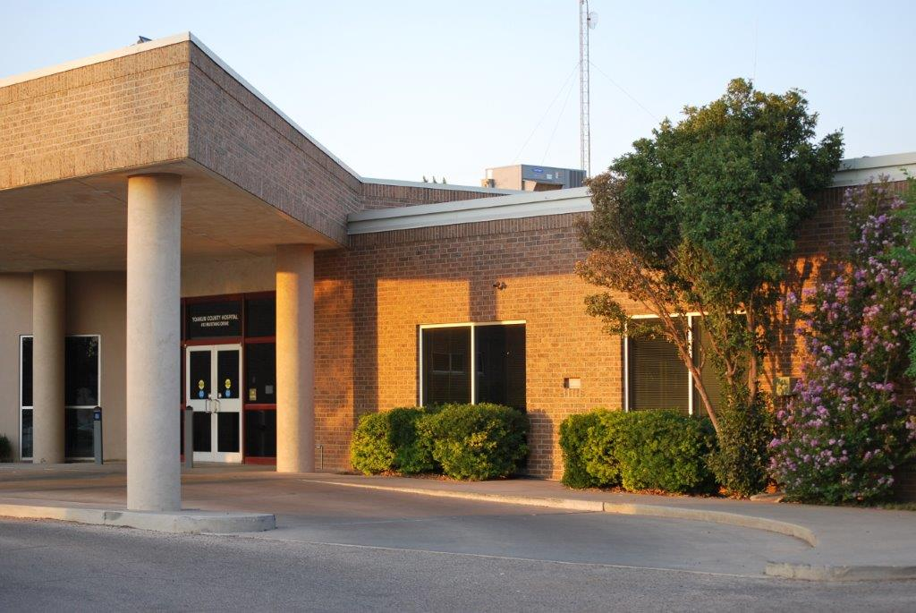
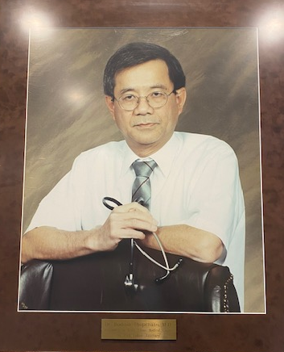
REFLECTION
Honoring
Dr. Bodindr Thepchatri
Served the Denver City and Yoakum County communities with unmatched compassion and kindness.
“Tirelessly cared for his patients, in his clinic, at Yoakum County Hospital and at Shinnery Oaks Community. His kind spirit and dedication enhanced the lives of countless patients.”

Slide 11

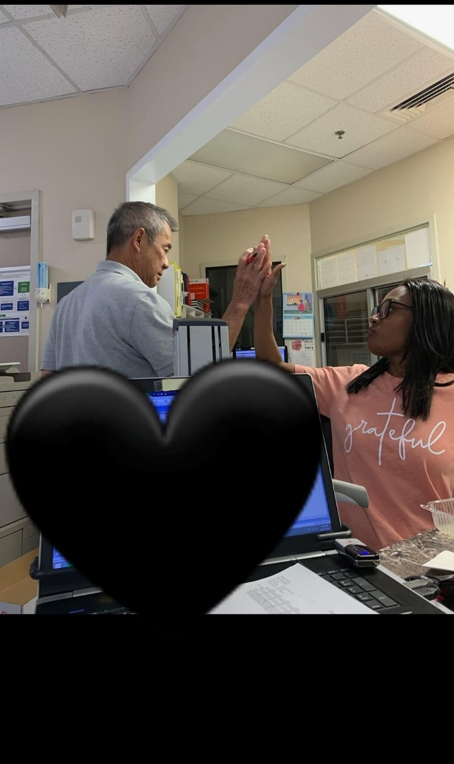
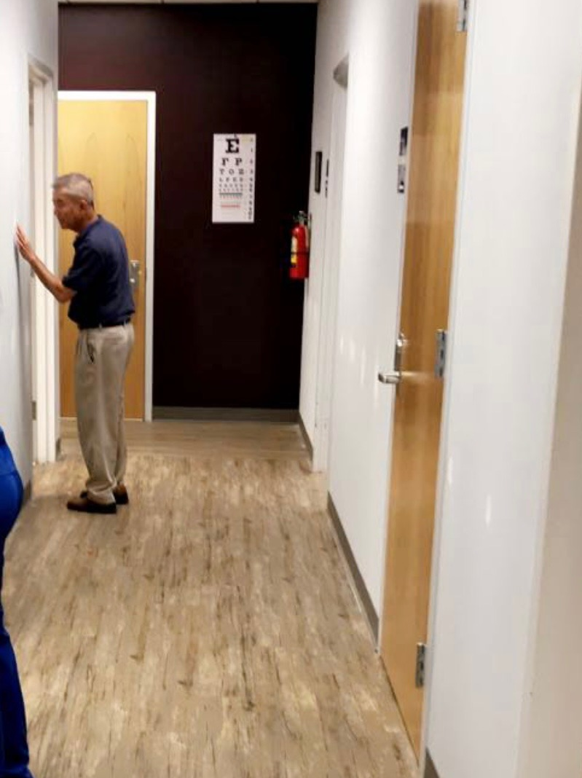

Slide 12
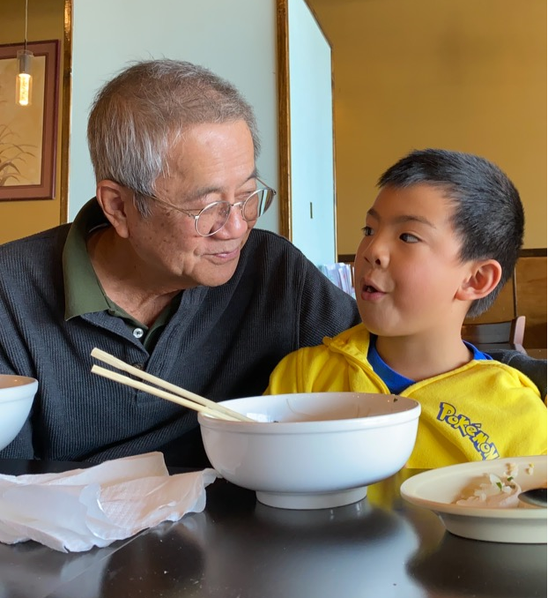
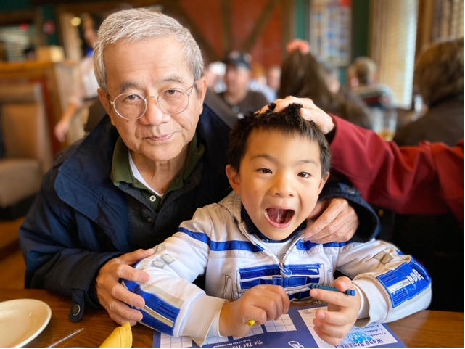
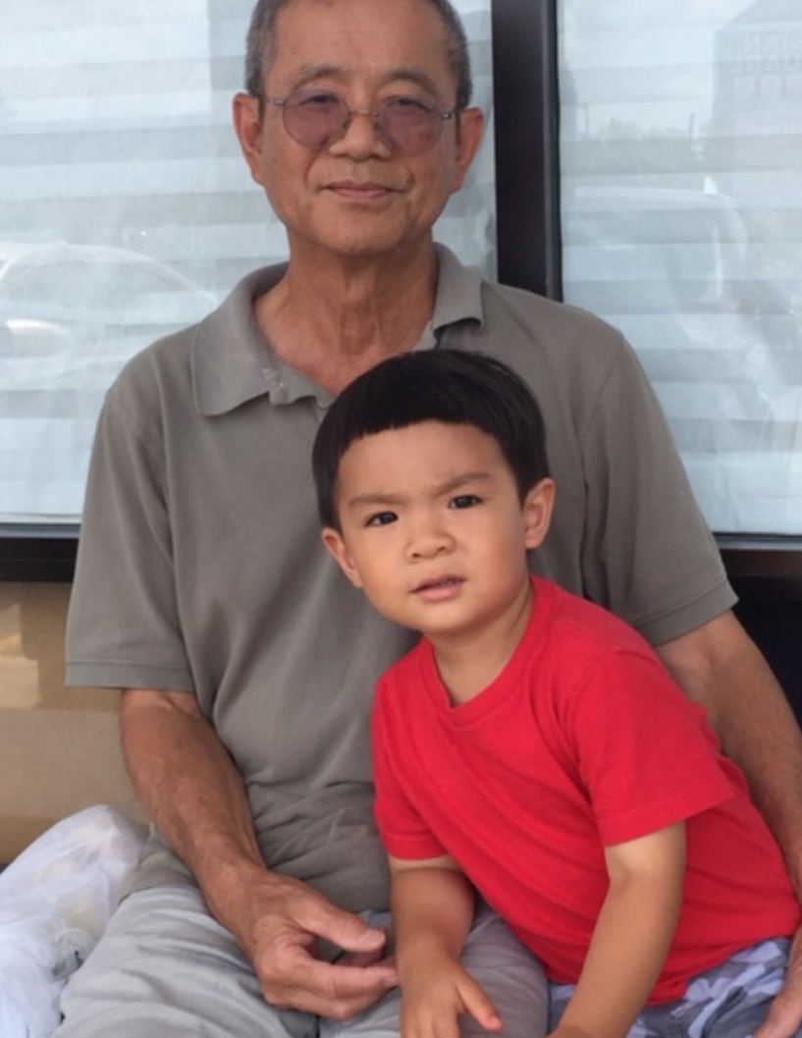
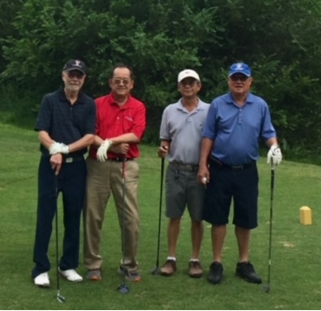
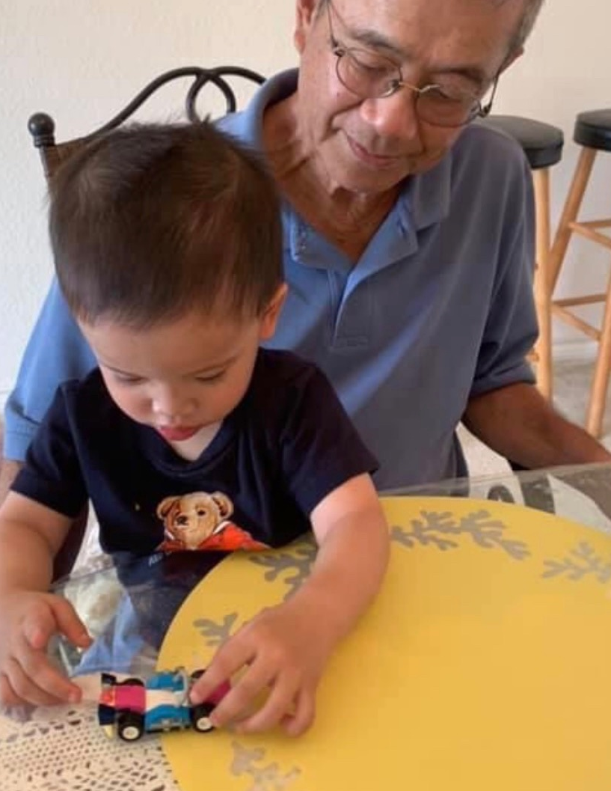
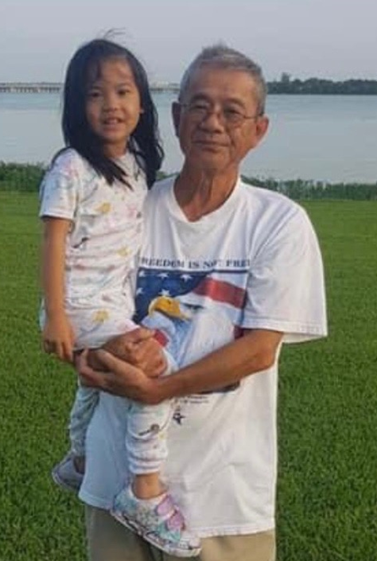

Slide 13
If you have thoughts or remembrances of these fine gentlemen, feel free to share them in the Chat Box

Slide 14
Current Regional Covid-19 Census

Slide 15
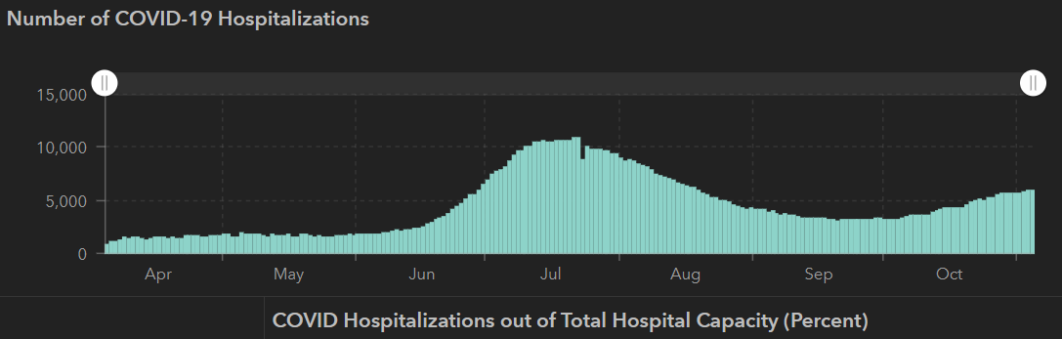
STATE
 | 11/03 | 10/28 | 10/21 | 10/14 | 10/5 | 9/23 | 9/9 | 8/26 | 8/12 | 7/29 | 7/15 | 7/1
Cases | 926,400 | 879,994 | 838,809 | 805,802 | 769,303 | 719,599 | 645,791 | 592,137 | 506,820 | 403,307 | 282,365 | 168,062
Deaths | 18,320 | 17,700 | 17,210 | 16,717 | 16,033 | 15,129 | 13,692 | 11,805 | 9034 | 6190 | 3432 | 2481
Hospitalized | 5,872 | 5,659 | 4,319 | 3,870 | 3,318 | 3,195 | 3604 | 4806 | 7028 | 9595 | 10,471 | 6904

Slide 16
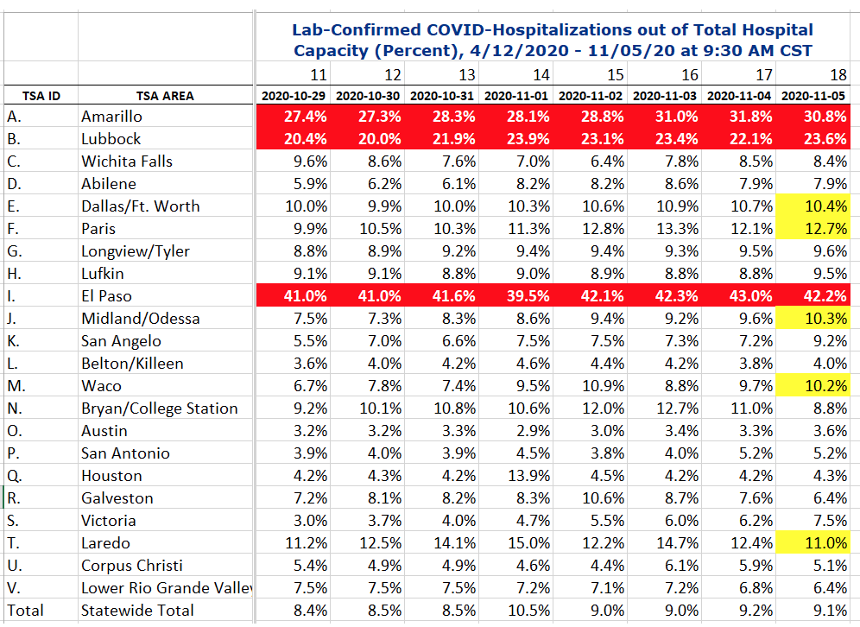
COVID+ HOSPITALIZATIONS BY TSA ID
CONFIRMED COVID+ HOSPITALIZATIONS /HOSPITAL CAPACITY
El Paso has not reached their peak yet

Slide 17
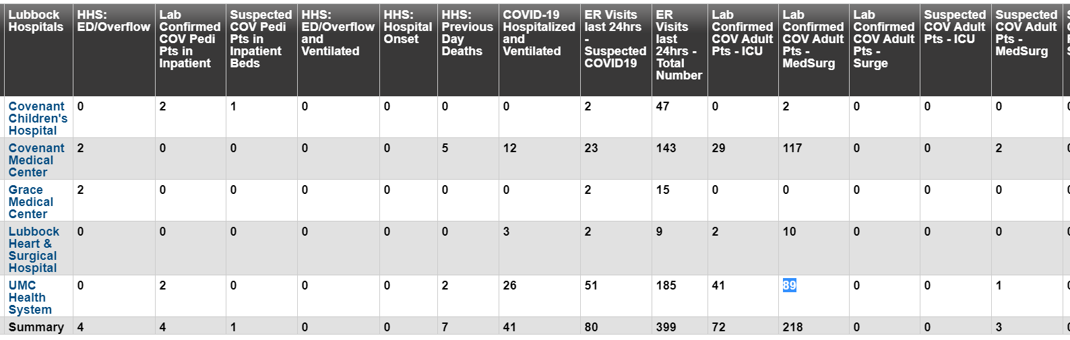
Lubbock as of Thursday AM
11/2: 292 Hospitalized in Lubbock – 36 on vents 11/4: 298 Hospitalized in Lubbock – 41 on vents

Slide 18
DSHS – RAC Meeting
Medical Incident Support Team (MIST) plans:
Virtual MIST Team
  A and B RAC areas
  Manage the transfers, monitor diversion and appropriate requests / denials
Need to log our current requests and reason for denials
Area of Origin | Number of Patients
RAC B (Lubbock Region) | 3
RAC A (Amarillo Region) | 1
RAC J (Midland/Odessa Region) | 1
New Mexico | 4
update

Slide 19
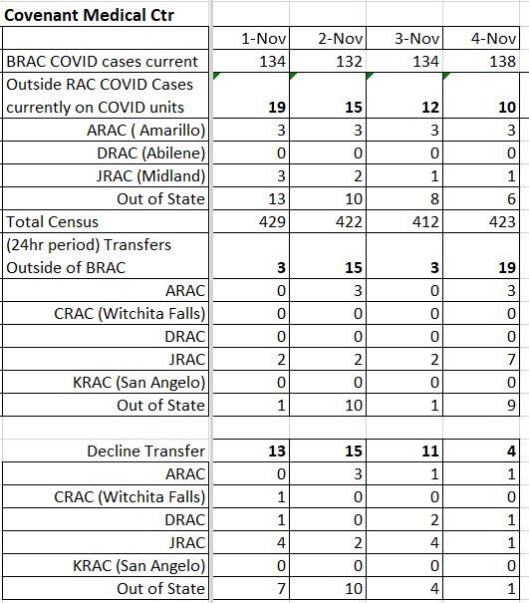
RAC-DSHS
Medical Incident Support Team (MIST)
Sending patients to Colorado, Austin and East Texas
Houston, San Antonio and Dallas not taking any patients
Amarillo VA approved to accept Non-Veteran COVID patients
Ambulance strike team in A/B RAC to transport patients from larger hospitals to smaller hospital stepdown units
Small hospitals encouraged expand beds

Slide 20
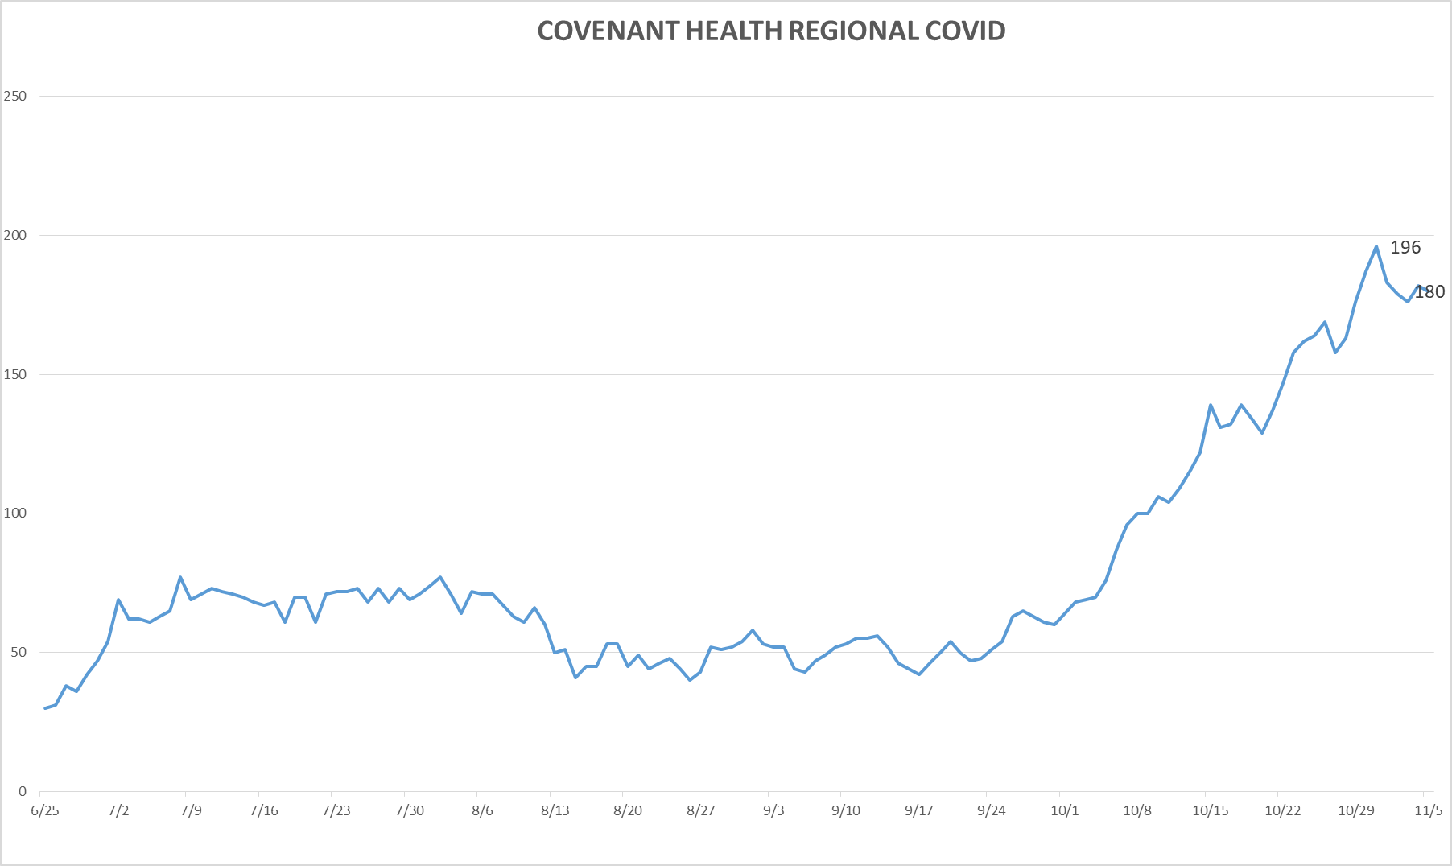
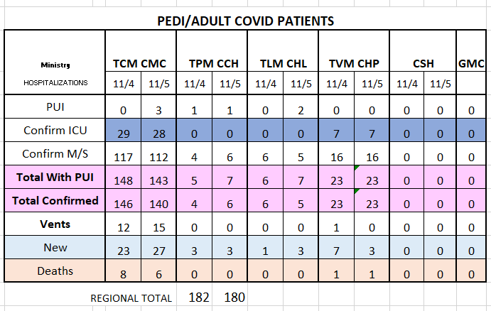
PUI/Confirmed cases-hospitalized
11/5/2020

Slide 21
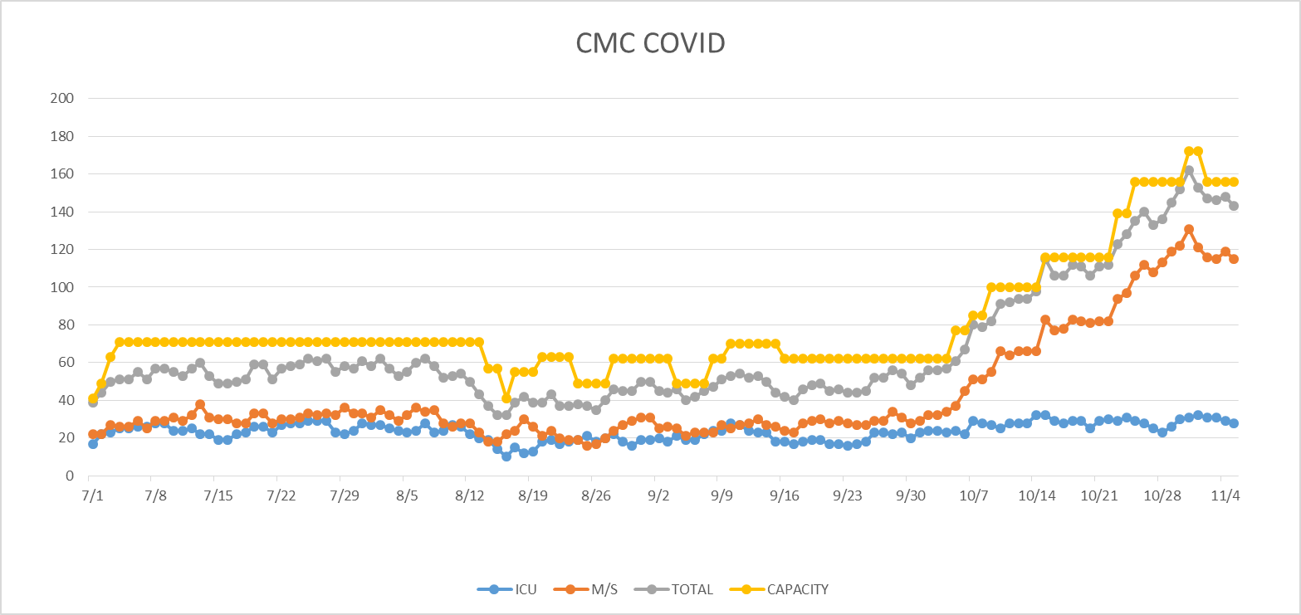
PUI/Confirmed cases-hospitalized
11/5/2020
ED HOLDS =1 Back on Diversion 11/4

Slide 22
Surge Plan
Covenant Medical Center
 | ICU | Med Surg | Total
Phase 1 | 10-CICU |  | 10
Phase 2 | 17-CICU | 10-HC4 | 27
Phase 3 | 17-CICU | 24-HC4 | 41
Phase 4 | 17-CICU 8-MICU | 24-HC4 14-Pal Med | 63
Phase 5 | 17-CICU 16-MICU | 24-HC4 14-Pal Med | 71
Phase 6 | 17-CICU 16-MICU 15-S 4 | 24-HC4 13-HC6 15 – S 9 (East) | 100
Phase 7 | 17-CICU 16-MICU 15-S 4 | 24-HC4 13-HC6 31 – S 9 (all) | 116
Phase 8 | 8-E4 17-CICU 16-MICU 15-S 4 | 15-S 10(East) 24-HC4 13-HC6 31 – S 9 (all) | 139
Phase 9 | 16-E4 (all) 17-CICU 16-MICU 15-S 4 | 30 S10 (all) 24-HC4 13-HC6 31 – S 9 (all) | 162
Last Week
Currently

Slide 23
CENSUS
 | 10/26 | 10/27 | 10/28 | 10/29 | 10/30 |  | 11/2 | 11/3 | 11/4 | 11/5 | 11/6
CMC (360) | 343 | 344 | 336 | 351 | 351 |  | 344 | 336 | 341 | 335
Cases (41) | 26 | 21 | 18 | 21 | 17 |  | 18 | 17 | 19
CCH (135) | 74 | 80 | 104 | 92 | 87 |  | 85 | 73 | 79 | 100
Cases (19) | 12 | 6 | 4 | 12 |  |  | 6 | 10 | 10
GMC (18) | 4 | 4 | 9 | 5 | 1 |  | 3 | 3 | 8
Cases (20) | 3 | 6 | 12 | 0 | 0 |  | 0 | 11 | 18
CHP (49) | 37 | 46 | 40 | 44 | 38 |  | 40 | 40 | 35 | 30
Cases (19) | 11 | 5 | 3 | 13 | 7 |  | 12 | 7 | 9 | 8
CHL (18) |  | 8 | 9 | 16 |  | 8
cases |  | 4 | 0 | 1
CSH (37) | 29 | 29 | 33 | 33 | 35 |  | 35 | 36 | 37 | 37
Capacity Status RED Square

Slide 24
Statistics
William Sommer
Clinical Data Analyst
Clinical Excellence
Covenant Health

Slide 25
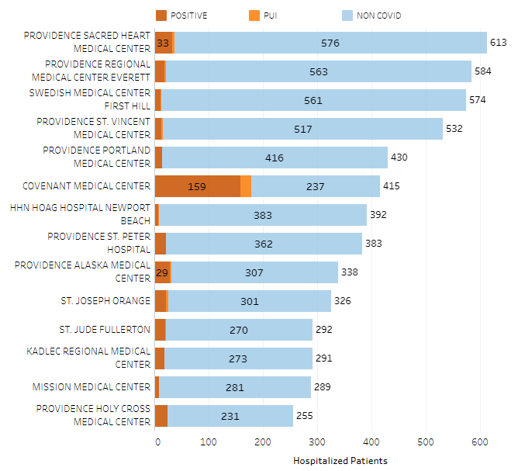
Providence System Hospitalized COVID-19 Cases

Slide 26
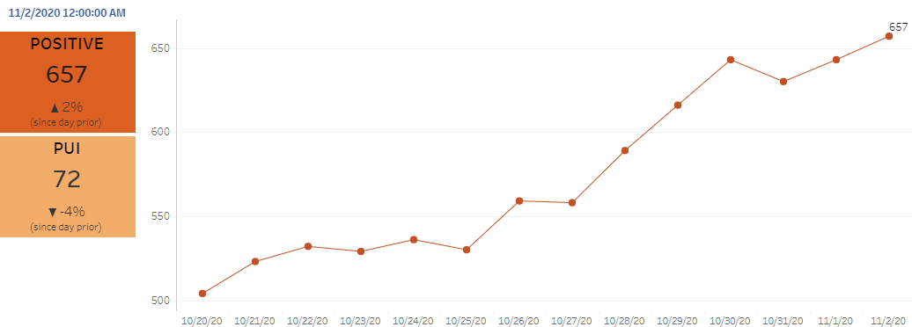
Providence Inpatient COVID-19 Volume

Slide 27
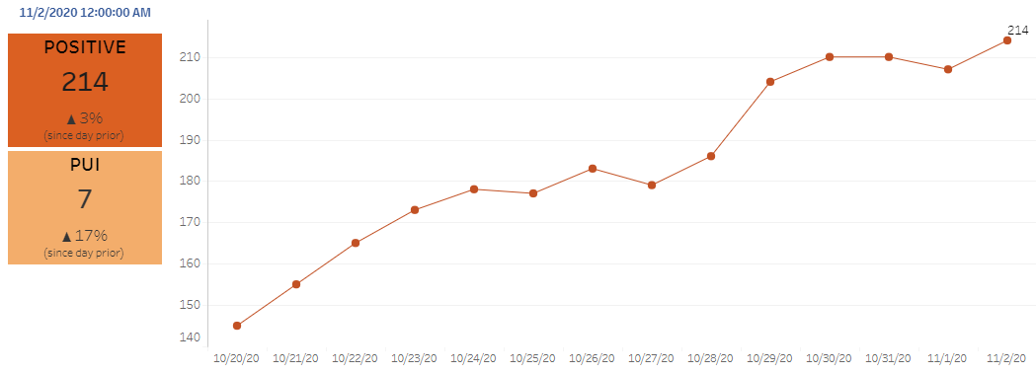
Texas Inpatient COVID-19 Volume

Slide 28
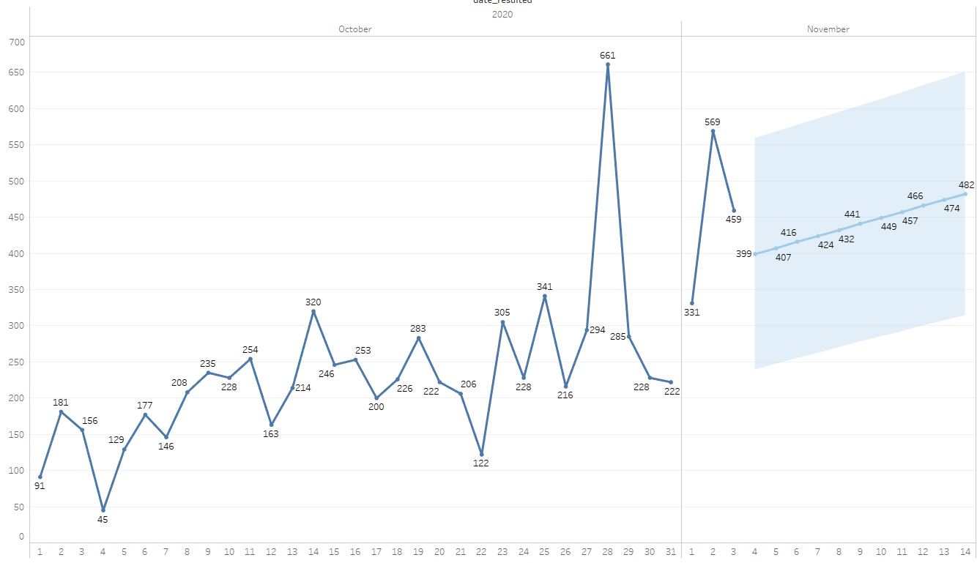

New Covid-19 POSITIVES by Day Trend

Slide 29
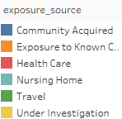
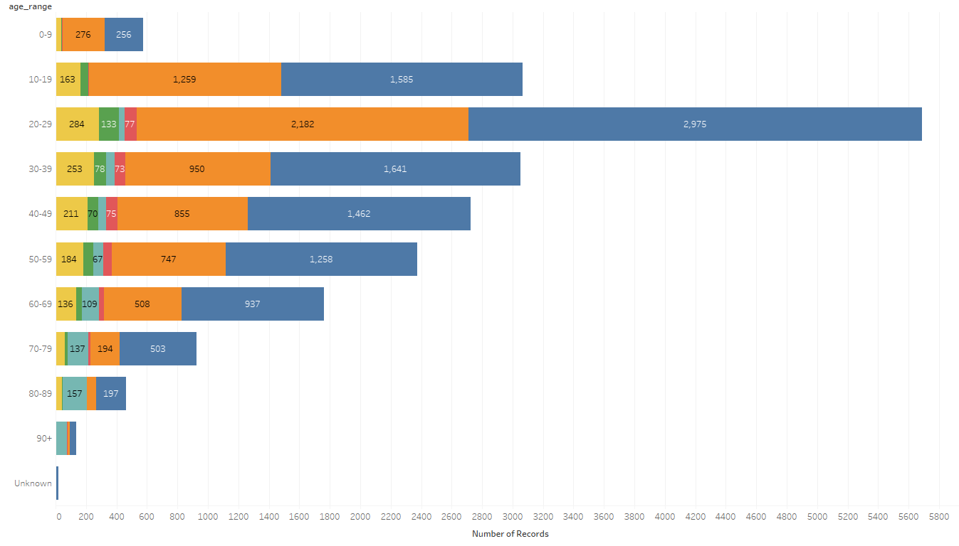
Covid-19 POSITIVES Age Distribution

Slide 30
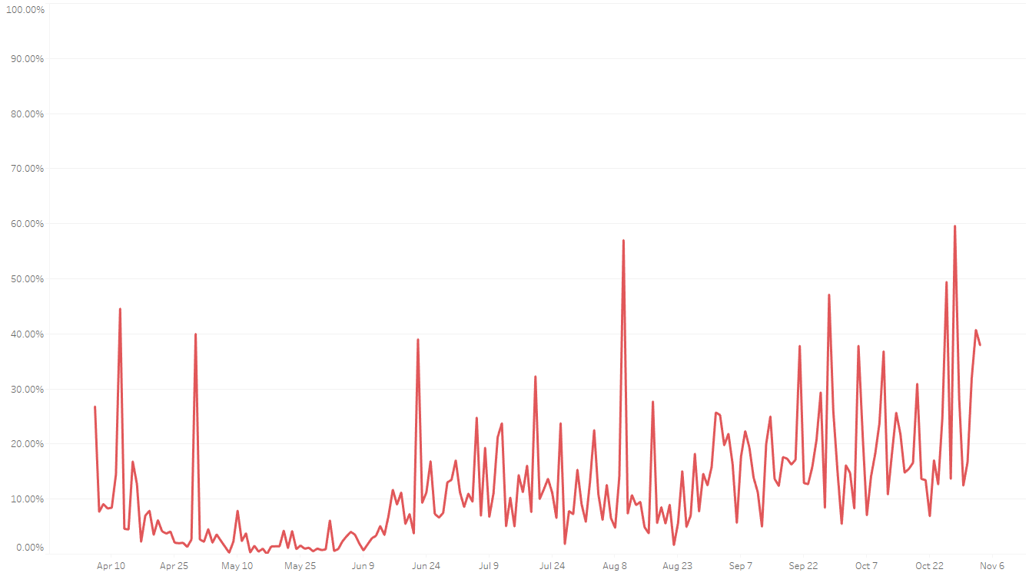

Covid-19 Daily Positive Rate

Slide 31
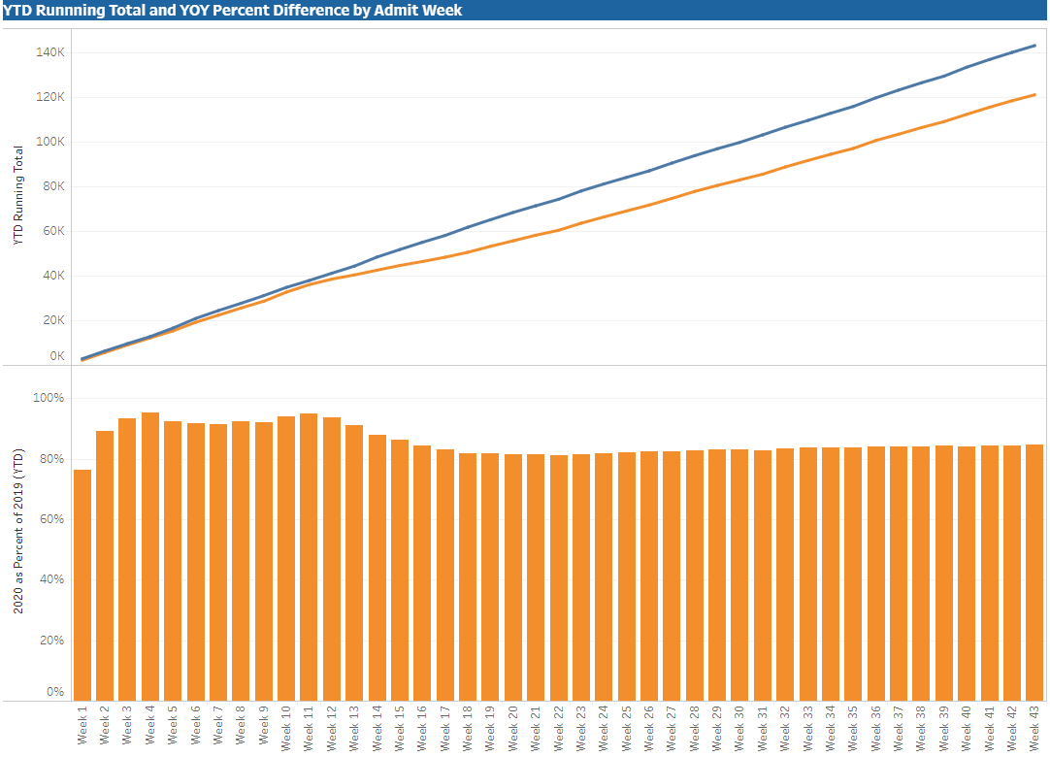

TX/NM Region Weekly Procedures (YOY)

Slide 32
Caregiver Update

Slide 33
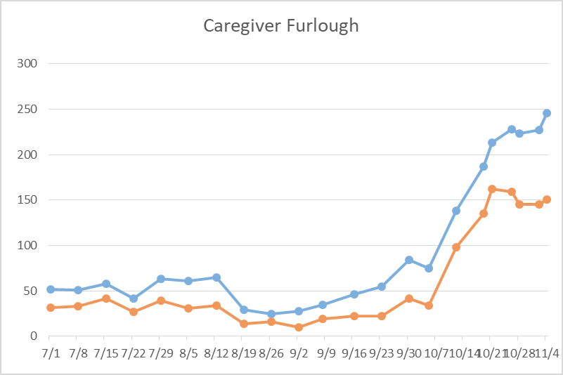
Caregivers
COVID Related Furloughs
61.4% are positive
Count reflects # furlough (exposed and positive)
Good
Moderate
Critical

Slide 34
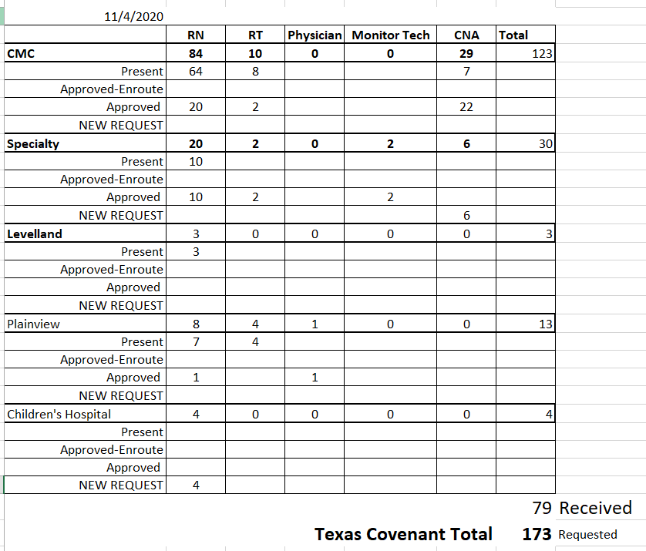
STAR Requests
If you see staff in Black Scrubs, please tell them “Thank you”!

Slide 35
VISITATION
Limiting visitors-
Visitors in isolation or Covid rooms? No
“Non-essential” visitors? No
Visitors for pts at end of life?
Up to 5
Medical students/residents? 1 may entering the room with isolation and COVID patients
Volunteers? No
Add pediatric exceptions? As per law
Please do do not grant “special permissions”! This confuses pts, families, staff!

Slide 36
HOT TOPIC n-95
 | 8210 | 9205 Large | Green Stripe | Duckbill Regular | Duckbill small
Supply | Good | New Have not received shipment | Fair Next shipment will not arrive until Jan 2021 | Poor Not available | Poor plus On order, but will need fit testing
Non-procedural areas | YES | YES | NO Exception-May fit on larger faces when 8210 does not work | NO | NO Exception-Usually fits on smaller faces when 8210 does not work
Procedural areas | NO | NO | YES | YES | YES

Slide 37
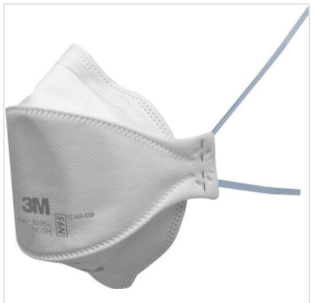
HOT TOPIC n-95
For those that need a Large n-95:
3M 9205 has been ordered
Have a dozen on hand
  1st try on a caregiver did not fit
Alternative solutions
  If you have personal N-95s, notify IP and Safety to inspect and research it
  MAY NOT work in areas that require a properly fitted N-95 until one is provided

Slide 38
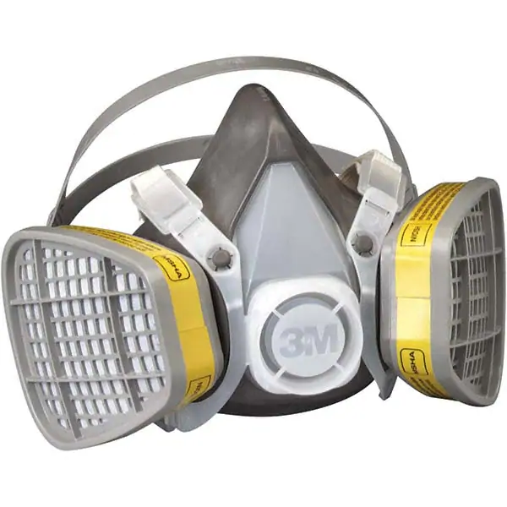
HOT TOPIC n-95
Elastomeric Respirators
Not fluid resistant, not recommended for use with patient care
Ideal for non-patient care use such as cleaning areas or non-clinical uses
Requires fit testing and medical health screen

Slide 39
HOT TOPIC isolation gowns
CMC deliveries between 11pm-5am
Change is due to staffing levels for Central Supply
Increase counts to areas last night
We have 18-20 day supply on hand
Placed another STAR request for 20,000 gowns
Disposables expected this week or next

Slide 40
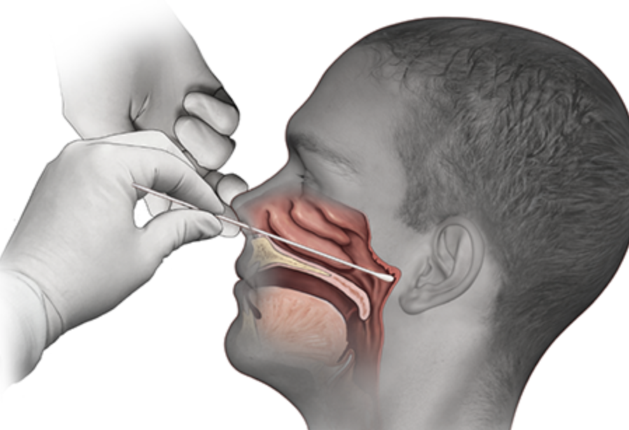
Covid-19 Testing
Jason T. Loos, MD
Ameripath

Slide 41
TESTING
 | CMC |  | GMC |  | CMG
 | Rapid | PCR | Rapid | PCR | Rapid
Test Kits
Swabs
VTM
 | CMC |  | GMG/CMG
 | Tests | + | Tests | +
11/3 | 85 | 28
11/4 | 68 | 49 | 114 | 50
PCR
Rapids
>2000 >750
<2000 <750
<1600 <500
CMC- Alinity down, will not be up before Friday
GMG-Expect shipment Friday
CMG-received shipment last week

Slide 42
Pharmacy Update
Wesley Wells, PharmD
Regional Pharmacy Director
Covenant Health

Slide 43
Pharmacy Update
Medication | Current State | Updates/Issues
Remdesivir |  | Evaluating criteria for use
Zanubrutinib | Patients enrolled in study: 6 Inpatients on medication: 0 Patients at home (discharged): 2 | No updates
COVID Vaccine | Currently in registration phase | Need to register as soon as possible EnrollTexasIZ.dshs.texas.gov
Ministry | Vials Used on Previous Day | Stock (vials)
Covenant Medical Center | 55 | 432
Covenant Children’s Hospital | 0 | 0
Covenant Plainview | 18 | 93
Covenant Levelland | 4 | 49

Slide 44
Regeneron 2066 Trial
Anti-spike SARS-COV-2 monoclonal antibodies for the treatment of hospitalized patients with covid-19
  Prevents the binding of virus to cells
Phase 3 trial, plans to enroll 1350 patients
3 treatment arms
Infusion of study drug or placebo over 1 hour
CMC PIs
  Dr. Duriex and Dr. Shrestha
  Obtain ID consult for inclusion

Slide 45
2066 Criteria for Inclusion
Adult ≥ 18 years of age who provides informed consent
SARS-CoV-2-positive test result ≤ 72 hours prior to randomization
  Outside record acceptable
Symptoms consistent w/ COVID-19, onset ≤ 10 days before randomization
Hospitalized for ≤ 72 hours AND;
  Maintains O2 saturation >93% on low-flow oxygen via nasal cannula, simple face mask, or other similar device
  -OR-
  High-intensity oxygen therapy without mechanical ventilation
    Non-rebreather mask (with SpO2 ≤96% while receiving O2 flow rate of at least 10 L/min)
    High-flow device with at least 50% FiO2
    Non-invasive ventilator, including continuous positive airway pressure
Notes:
Patients must meet the following criteria for inclusion

Slide 46
Communications Update

Slide 47
ARAC-BRAC Collaboration
MST Ambulance Strike Force teams
  Transferring lower acuity pts to smaller hospitals, making room
STAR Requests: 755
  477 physicians, nurses, APPs in place
  PPE Resources
Blue Med Tent
  SME engineer site visit pending
Mortuary capacity being monitored closely

Slide 48
Electronic Prescribing
EPCS is a STATE LAW!
Beginning Jan 1, you cannot prescribe Sched II-V narcotics with paper prescriptions.
You MUST do it electronically!
You MUST register soon!
To enroll, contact Clinical Informatics at
806-725-4189 ASAP!

Slide 49

Texas Demographics

Slide 50
19.9%
21.9%
23.8%
23.1%
23.4%
22.1%
23.6%

Slide 51
27.3%
28.3%
28.1%
28.8%
31%
31.8%
30.8%

Slide 52
41%
41.6%
39.5%
42.1%
42.2%
43%
42.2%

Slide 53
New Mexico Demographics

Slide 54
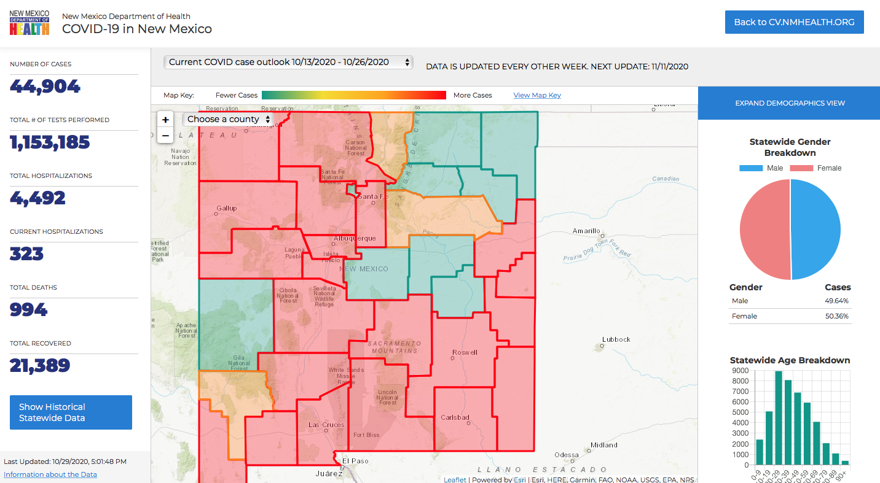
Updated every 2 Weeks; no new info

Slide 55
Q & A

Slide 56
CME Credit was only approved for the Live Teams meeting
To receive credit for this continuing education activity, the participant must:
  Make sure you are logged into your Teams account, if you are signed in with a group provide attendee’s First and Last name(s) in the comments section.
  If you are calling into the Teams meeting you MUST text your First & Last Name to (806) 252-4735. This will ensure you are added to the sign in sheet to receive CME Credit.
  You will receive an email within 3 business days from the CME department with further instructions on claiming your certificate.

