Slide 1
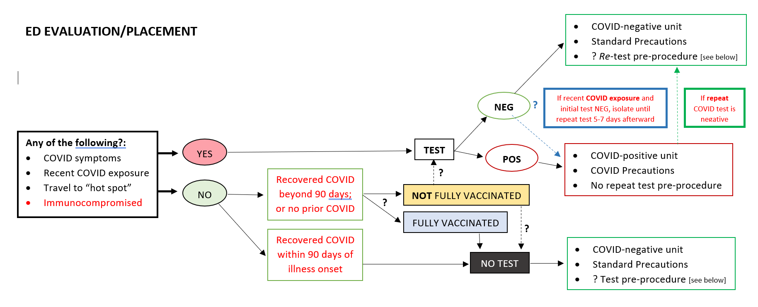
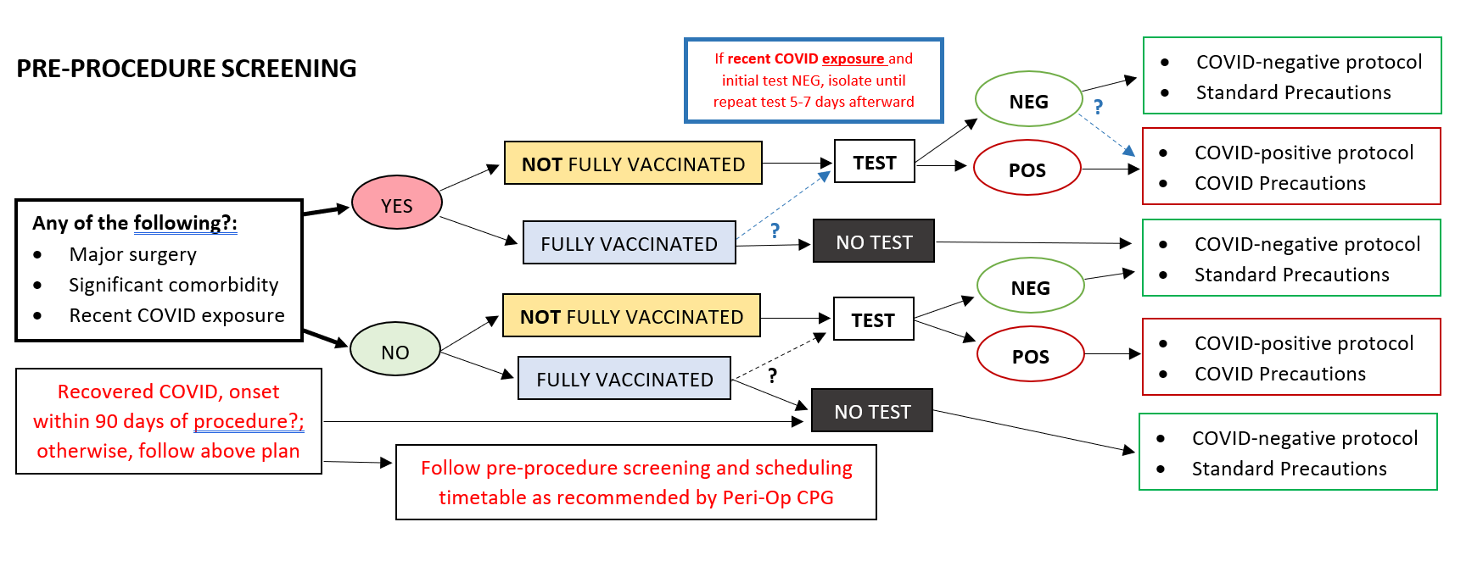
Testing Pathways
Implement in non-surgical procedures now (excluding AGPs)
Partner with Peri-op for integration in surgical procedures following additional discernment

